Slide 1
DSIB01 Autumn 2021 05 Motif Detection
Mgr. Ondřej Vaculík
437307@mail.muni.cz

Slide 2
Overview
Peak calling - brief overview
Motif representation in biology
PPM
PWM
sequence logos
Tools
Bedops
Bedtools
The MEME Suite
MEME-ChIP
Tomtom
Demo on real dataset
Homework - Individual work

Slide 3
Clip-seq analysis - peak calling
a statistical procedure, which uses coverage properties of CLIP and Input samples to find regions which are enriched due to protein binding
requires mapped reads, and outputs a set of regions, which represent the putative binding locations. Each region is usually associated with a significance score which is an indicator of enrichment
many different tools for peak calling available:
iCount
Paraclu
PureCLIP
Piranha

Slide 4
Sequence motifs
a nucleotide or amino-acid sequence pattern that is widespread and usually assumed to be related to biological function of the macromolecule
short, recurring patterns in DNA/RNA that are presumed to have a biological function. Often they indicate sequence-specific binding sites for proteins such as nucleases, transcription factors, RNA-binding proteins. Others are involved in important processes at the RNA level, including ribosome binding, mRNA processing (splicing, editing, polyadenylation) and transcription termination.

Slide 5
Sequence motif representation - PPMs
a position probability matrix
in general:
there’s one row for each symbol of the alphabet and one column for each position in the pattern
in PPM each number is a probability of nucleotide occurrence in given position (sum of each column is 1)

Slide 6
Sequence motif representation - PWMs
a position weight matrix
also known as a position-specific weight matrix (PSWM) or position-specific scoring matrix (PSSM)
the most commonly used
the elements in PWMs are calculated as log likelihoods
PWMs are often derived from a set of aligned sequences that are thought to be functionally related and have become an important part of many software tools for computational motif discovery.

Slide 7
Sequence motif representation - Sequence logos
Graphical representation of PWMs
the bigger letter the higher chance for the nucleotide to appear in the position

Slide 8
Tools - BEDOPS + bedtools
BEDOPS:
open-source command-line toolkit that performs efficient and scalable Boolean and other set operations, statistical calculations, archiving, conversion and other management of genomic data of arbitrary scale
https://bedops.readthedocs.io/en/latest/
functions for today: sort-bed, bedextract
bedtools:
a swiss-army knife of tools for a wide-range of genomics analysis tasks
allows one to intersect, merge, count, complement, and shuffle genomic intervals from multiple files and in many different formats (.bed, .bam, .gff, …)
https://bedtools.readthedocs.io/en/latest/
function for today: getfasta

Slide 9
Tools - The MEME Suite
The MEME Suite is a powerful, integrated set of web-based tools for studying sequence motifs in proteins, DNA and RNA.
MEME-ChIP
web service designed to analyze ChIP-seq ‘peak regions’ - short genomic regions surrounding declared ChIP-seq ‘peaks’
works also with CLIP-seq ‘peak regions’
Given a set of genomic regions, it performs:
ab initio motif discovery
motif enrichment analysis
motif visualization
binding affinity analysis
motif identification
https://meme-suite.org/meme/tools/meme-chip

Slide 10
Tools - The MEME Suite
The MEME Suite is a powerful, integrated set of web-based tools for studying sequence motifs in proteins, DNA and RNA.
Tomtom
web service that allows the user to compare motifs discovered by the suite, by other tools, or taken from the literature to all of the motifs in a selected database of motifs
aligns each input motif with each motif in the selected database and reports the most similar pairs, along with estimates of the statistical significance of each match
https://meme-suite.org/meme/tools/tomtom

Slide 11
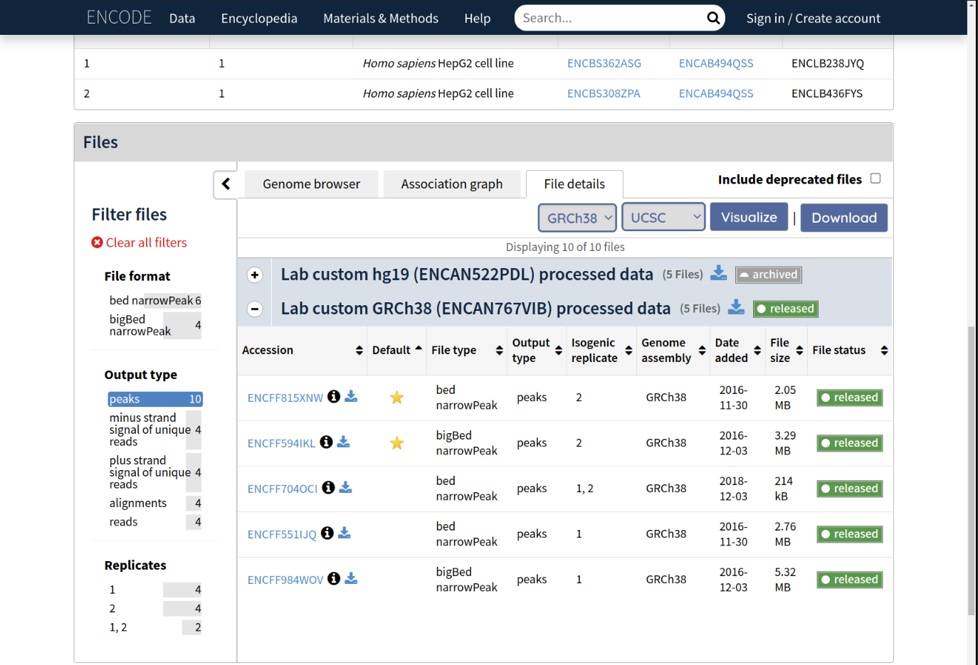
Real dataset
Download the dataset: bed file with peaks, choose isogenic replicate 1,2 https://www.encodeproject.org/experiments/ENCSR570WLM/
Download the chromosome 1 fasta reference
Unzip the files

Slide 12
Real dataset
Create and activate conda environment for today’s practicals
Open the terminal
conda create --name practicals
conda activate practicals
Installation of necessary packages:
if it turns out you’re missing a channel for installing some of the tool, you can add them by following cmd:
conda config --add channels NAME
conda install bedops
conda install –c bioconda bedtools

Slide 13
Real dataset
Sort intervals in downloaded file and then extract chromosome 1 positions
sort-bed PATH/TO/peaks.bed > PATH/TO/OUTPUT/sorted_peaks.bed
Unify intervals length to 100 nt
awk -F '\t' '{X=50; mid=(int($2)+int($3))/2;printf("%s\t%d\t%d\t%s\n",$1,(mid-X<0?0:mid-X),mid+X, $4);}' PATH/TO/chr1_peaks.bed > PATH/TO/OUTPUT/chr1_peaks_extended.bed

Slide 14
Real dataset
Extract sequences from a reference FASTA file for each of the intervals
bedtools getfasta -s -fi PATH/TO/chr1.fasta -bed PATH/TO/chr1_peaks_extended.bed -fo PATH/TO/QKI_chr1.fa

Slide 15
Real dataset
Open the MEME Suite web
Open the MEME-ChIP tool
Pick appropriate setup
Run the analysis

Slide 16
Homework
Re-do the motif analysis on the artificial dataset
4 different datasets (1 dataset per student) + 1 bonus dataset
will be sent by email
Task:
download the data
extend the intervals to 100 nt
extract sequences for the intervals
use MEME-ChIP to analyse motifs in dataset
try to identify domain/protein/protein family
(look also at the CISBP database and pfam database - by clicking through the results)
Bonus task 1:
Download the Motifs in MEME Text Format, upload the file to Tomtom tool, choose the CISBP-RNA Single Species RNA (Homo Sapiens) motif database and look at the results of the motif comparison tool
Bonus task 2:
Repeat the analysis on the bonus (voluntary) dataset
We’ll discuss the results on the practicals 3. 12. 2021

