Slide 1
Examination methods in rehabilitation, 8.11.2021
Hypermobility
Mgr. Veronika Mrkvicová, Ph.D.
Department of Physiotherapy and Rehabilitation – MF MU

Slide 2
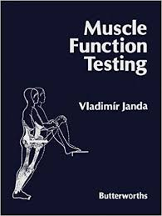
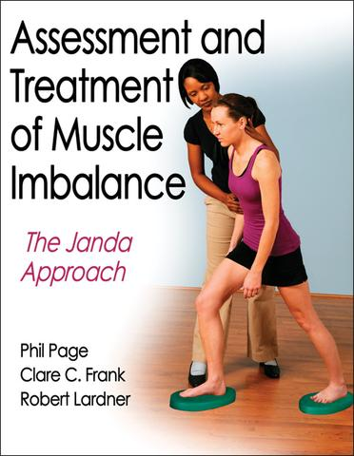
Content
Hypermobility
Examination of hypermobility

Slide 3

Hypermobility - introduction
the term used to describe the ability to move the joints beyond the normal ROM
it is not strictly a disease or a clinical entity
the syndrome is not based exclusively on muscular disorder (however, because it has been assessed in relation to muscle shortening and muscle weakness it should be examined in this context)

Slide 4
Hypermobility - introduction
It is common in general population.
It may be present in just a few joints or it may be widespread.
It is most common in childhood and adolescence, in females, and Asian and Afro-Caribbean races.
It tends to lessen with age.
In many people joint hypermobility is of no medical consequence and commonly does not give rise to symptoms.
Hypermobility can even be considered an advantage, for example athletes, gymnasts, dancers and musicians might specifically be selected because of their extra ROM.

Slide 5
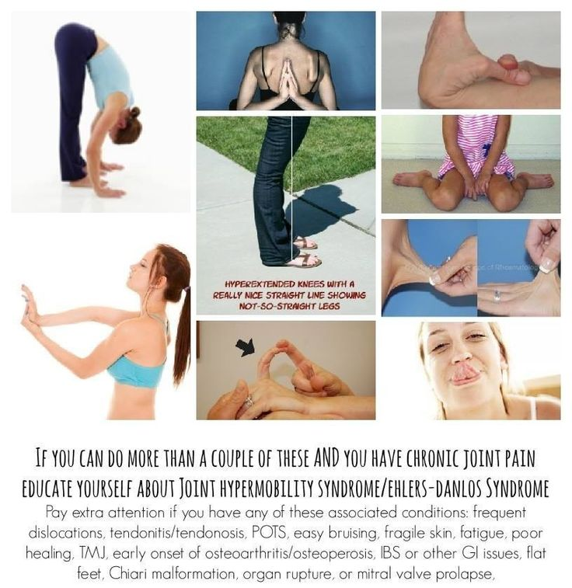
Hypermobility - symptoms
Most people have hypermobility with no other symptoms
Approximately 5 % of the healthy population have one or more hypermobile joints
However, people with "joint hypermobility syndrome" = JHS are those with many difficulties

Slide 6
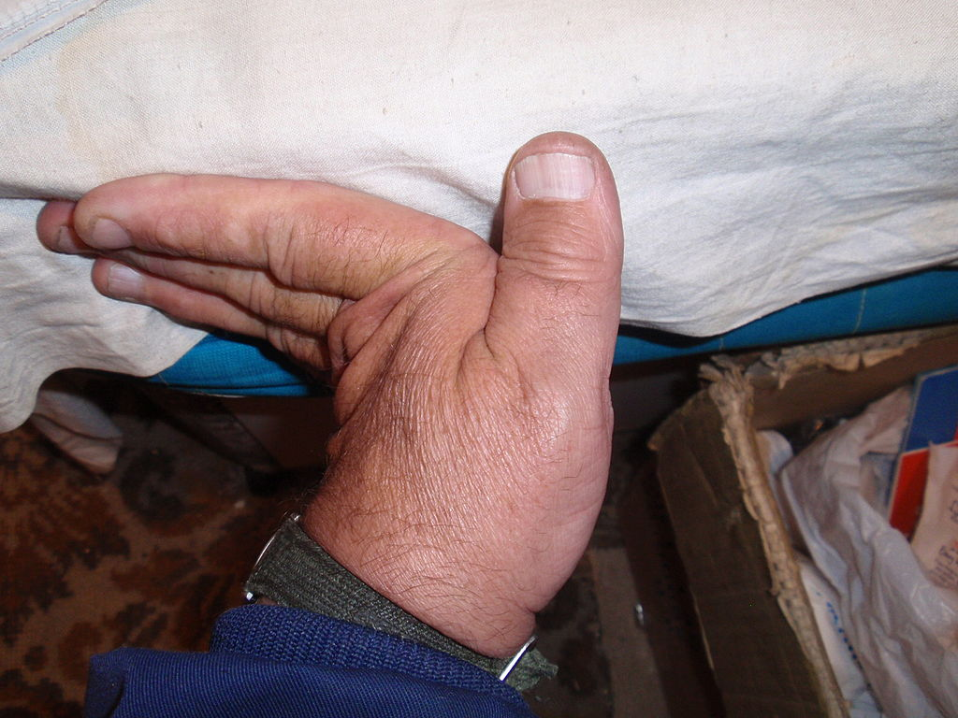
Hypermobility - symptoms
People with hypermobility syndrome may develop other conditions caused by their unstable joints. These conditions include:
Joint instability causing frequent sprains, tendinitis, or bursitis
Joint pain
Subluxations or dislocations,
especially in the shoulder
(severe types limit the ability to push,
pull, grasp, reach, etc.)
Early-onset of osteoarthritis

Slide 7
Hypermobility - symptoms
Back pain, prolapsed discs or spondylolisthesis
Joint movement may produce clicking sounds
Susceptibility to whiplash
Temporomandibular Joint Syndrome also known as TMJ
Increased nerve compression disorders (e.g. carpal tunnel syndrome)
The ability of finger locking
Poor response to anaesthetic or pain medication
"Growing pains" as described in children in late afternoon or night

Slide 8
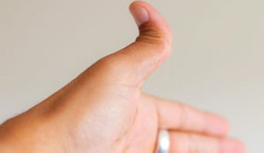
Hypermobility - symptoms
Abnormal joint proprioception (an impaired ability to locate body parts in space and/or monitor an extended joint)
These abnormalities cause abnormal joint stress, meaning that the joints can wear out, leading to osteoarthritis
The condition tends to run in families, suggesting a genetic basis for at least some forms of hypermobility

Slide 9
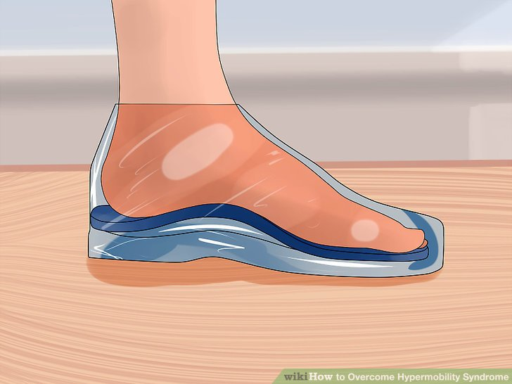
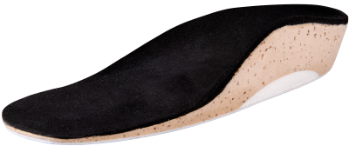
Hypermobility - symptoms
Symptoms of hypermobility include a dull but intense pain around the knee and ankle joints and the soles of the feet.
The pain and discomfort affecting these body parts can be alleviated by using custom orthoses.

Slide 10

Hypermobility - symptoms
Hypermobility syndrome can lead to chronic pain or even disability in severe cases
Musical instrumentalists with hypermobile fingers may have difficulties when fingers collapse into the finger locking position or may display superior abilities due to their increased range of motion for fingering – such as in playing a violin or cello

Slide 11
Hypermobility - symptoms
Hypermobility has been associated with chronic fatigue syndrome and fibromyalgia.
Hypermobility causes physical trauma (in the form of
joint dislocations, joint subluxations, joint instability,
sprains, etc.).
These conditions often, in turn, cause physical and/or
emotional trauma and are possible triggers for
conditions such as fibromyalgia.

Slide 12
Hypermobility
Hypermobility may be a symptom of a serious medical conditions, such as Stickler Syndrome, Ehlers-Danlos syndrome, Marfan syndrome, Loeys-Dietz syndrome,rheumatoid arthritis, osteogenesis imperfecta, lupus, polio, Down syndrome, morquio syndrome, cleidocranial dysostosis or myotonia congenita.

Slide 13
Hypermobility
Hypermobility generally results from one or more of the following:
Misaligned joints
Abnormally shaped ends of one or more bones at a joint
Weakened ligaments/ligamentous, muscles and tendons laxicity (resulting from Type 1 collagen or other connective tissues defect (as found in Ehlers-Danlos syndrome, Loeys-Dietz syndrome and Marfan syndrome)

Slide 14
Hypermobility
Current thinking suggests four causative factors:
1. The shape of the ends of the bones – if a shallow rather than a deep socket is inherited, a relatively large ROM will be possible. If the socket is particularly shallow, then the joint may dislocate easily.
2. Protein deficiency or hormone problems – ligaments are made up of several types of protein fibre. These proteins include elastin, which gives elasticity and which may be altered in some people. Female sex hormones alter collagen proteins. Women are generally more supple just before a period and even more so in the later stages of pregnancy, because of a hormone called relaxin that allows the pelvis to expand so the head of the baby can pass.

Slide 15
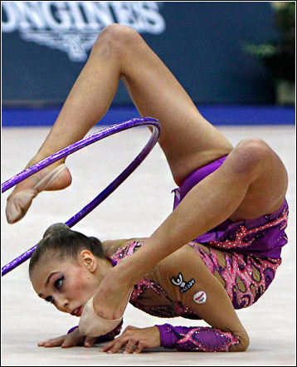
Hypermobility
3. Muscle tone – the tone of muscles is controlled by the nervous system, and influences ROM. Special techniques can change muscle tone and increase flexibility. Yoga, for example, can help to relax muscles and make the joints more supple. Gymnasts and athletes can sometimes acquire hypermobility in some joints through activity.
4. Proprioception – compromised ability to detect exact joint/body position with closed eyes, may lead to overstretching of hypermobile joints

Slide 16
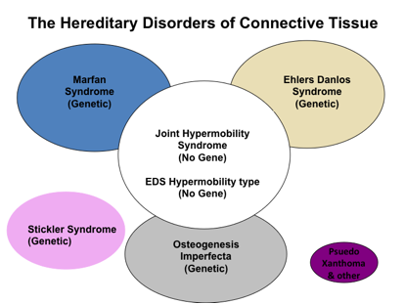
Hypermobility
Hypermobility can also be caused by connective tissue disorders, such as Ehlers-Danlos Syndrome (EDS) and Marfan syndrome
Joint hypermobility is a common symptom for both
People with EDS-HT suffer from frequent joint dislocations and subluxations (partial/incomplete dislocations), with or without trauma, sometimes spontaneously.

Slide 17
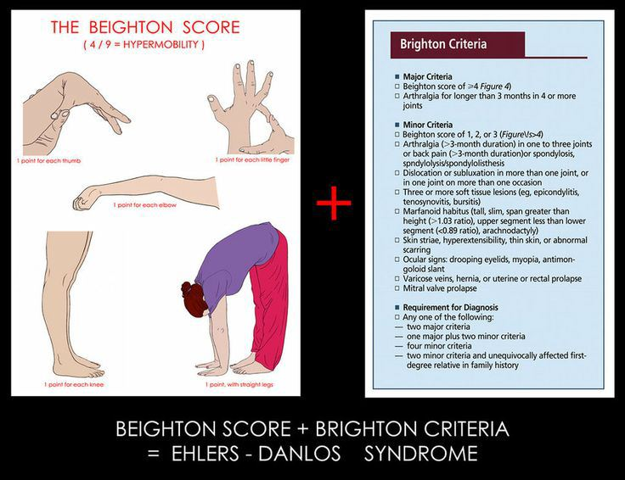
https://www.youtube.com/watch?v=31G69TZE_R4

Slide 19

Hypermobility and pregnancy
During pregnancy, the body releases certain hormones that alter ligament physiology easing the stretching needed to accommodate fetal growth as well as the birthing process.
For women with hypermobility conditions pregnancy-related pelvic girdle pain during pregnancy can be debilitating due to these two converging factors.
Pain often inhibits such women from standing up or walking during pregnancy. The pregnant patient may be forced to use a bedpan and/or a wheelchair during pregnancy (possibly associated with permanent disabilities).
The pregnant woman with hypermobile joints will often be in significant pain as muscles and joints adapt to the pregnancy.

Slide 20
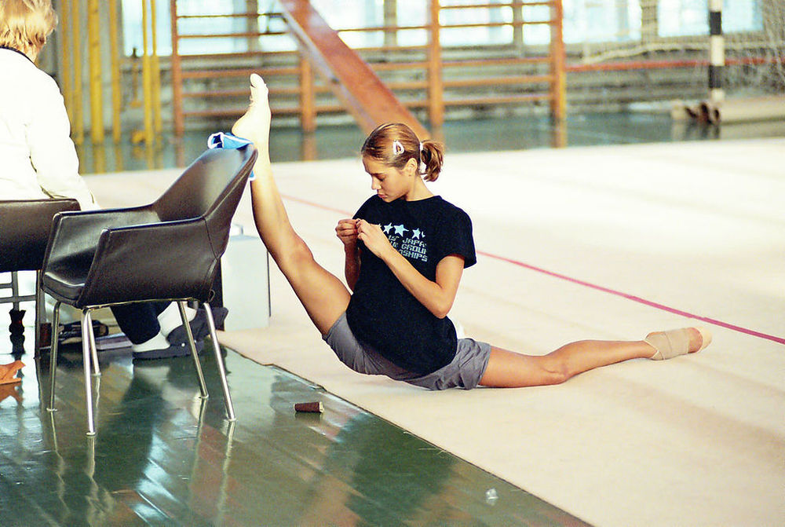
Hypermobility - types
There are four main types of hypermobility:
Compensatory
Hypermobility in the neurological disease
Constitutional
Local pathological
(post-traumatic)

Slide 21
1. Compensatory Hypermobility
This is a local pathological hypermobility, which is a consequence of compensatory mechanisms in limiting the ROM in another segment or joint
Local hypermobility can arise in one movement segment of the spine as a compensatory mechanism for another stiff segment.
Therapy for this type of hypermobility focus on hypomobile segments. After restoring movement of the hypomobile segment there occurs spontaneously normal function of the hypermobile segment.

Slide 22

2. General Hypermobility
This type of hypermobility (or rather increased passivity) belong to the clinical picture of some neurological diseases, eg. disability of cerebellum, peripheral paresis.
In this type of hypermobility with hypotonia also classified as part of the syndrome ADHD (attention deficit hyperactivity disorders), with hypermobility and cerebellar dyskinetic cerebral palsy or Down syndrome, and oligophrenia.
A general pathological hypermobility usually arises in disorders of the afferent nerve fibres, for example in tabes dorsalis, some cases of polyneuritis, and similar diseases.
It is also seen in disturbances of central muscle tonus regulation such as oligophrenia, and in some cerebellar and extrapyramidal hyperkinetic diseases.

Slide 23
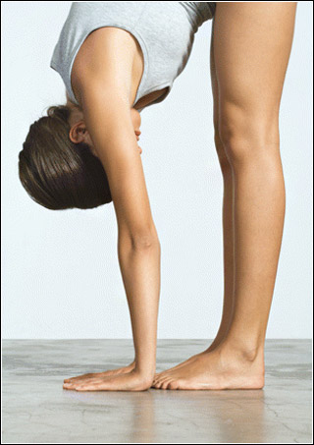
3. Constitutional Hypermobility
is a vague nonprogressive clinical syndrome that is characterized by a general laxity of connective tissues, muscles, and ligaments in particular
involves the whole body, although all parts may not be affected to the same extent or even strictly symmetrically

Slide 24
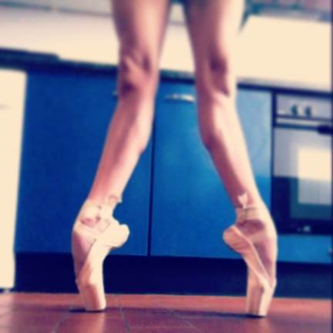
3. Constitutional Hypermobility
It is characterized by increasing joint ROM above the normal standard generalized in all joints.
Etiology is unclear, but it is assumed an insufficiency of mesenchyme manifested clinically as high ligament laxity and intramuscular supportive stroma. Hormonal changes participate on changes in the quality of mesenchymal tissue
Constitutional hypermobility is more common in women and affects up to 40 % of the female population. According to V.Janda this type of hypermobility pronounced for young girls decreases with age gradually to its decline (around 40 years).

Slide 25
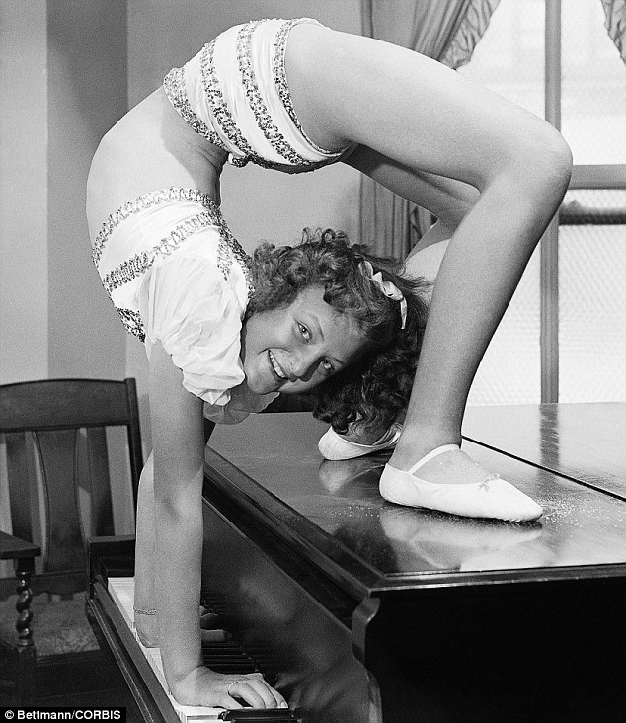
3. Constitutional Hypermobility
Patients with constitutional
hypermobility may develop muscle
tightness with increased tone as
a compensatory mechanism to
stabilize the unstable joints,
particularly the weight-bearing joints.
Its estimation is very important not only for
pathogenetical analysis in some disorders
but also for the total physiotherapy
programme.
In addition assessment is useful to judge
the optimal movement abilities, since
hypermobility leads to a decrease in the
static weight-bearing tolerance.

Slide 26
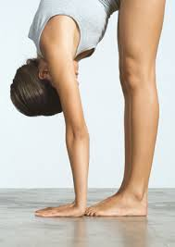
3. Constitutional Hypermobility
When a muscle is tight, gentle stretches, if necessary, should be conducted.
Muscles in constitutional hypermobility tend to have a lower muscle tone and in general are weaker. Hence, they are more prone to overuse and more likely to develop TrPs.
Inhibition and release of these TrPs are imperative.

Slide 27
4. Local pathological (post-traumatic) Hypermobility
For this type of hypermobility is more often used the term instability.
It develops as a result of former trauma in which there is a damage of static stabilizers (joint capsule and ligaments) of the motion segment.
The aim of rehabilitation therapy is to stabilize unstable segment using muscle function.

Slide 28
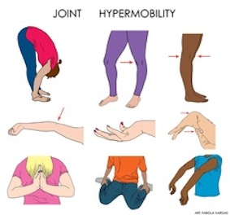
Assessment of hypermobility
https://www.youtube.com/watch?v=VqtSEV1LQ1o
https://www.youtube.com/watch?v=uKlwObVjY5k
https://www.youtube.com/watch?v=31G69TZE_R4

Slide 29
Assessment of Hypermobility
is the estimation of muscle tone via palpation and ROM. However, in the clinic, ROM tests usually are sufficient to provide information about the status of hypermobility in a patient.
Therefore the measurement of the maximal passive ROM in the joint is also an assessment of hypermobility.
No detailed tests permitting quantitative grading of hypermobility have yet been evolved.
Many different tests exist to show hypermobility. Principally one tries with these tests to assess various parts of the body and to differentiate
between the upper and the lower parts.
Quite often the hypermobility is found to be more pronounced in the upper or lower part of the body.
The differences between the two sides of the body, if present, are slight.

Slide 30
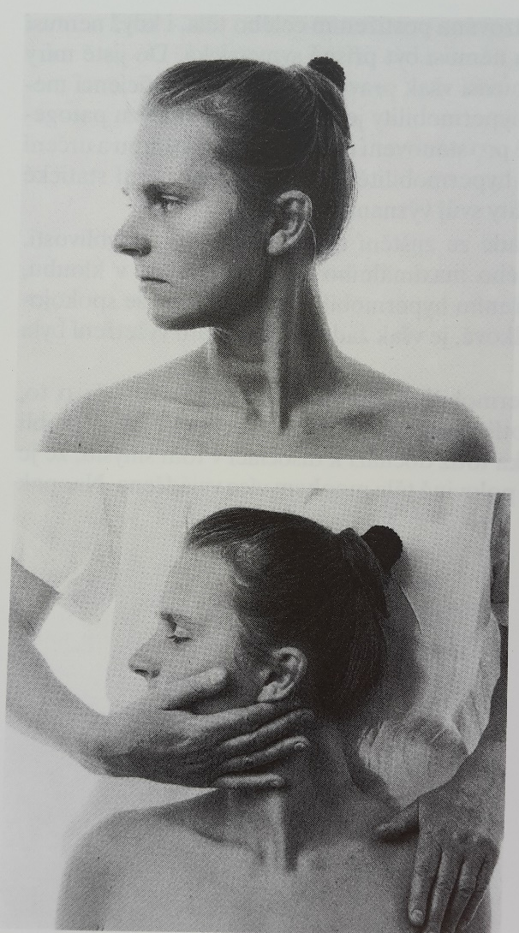
Head rotation
In standing or in sitting the patient turns the head actively first to one side and then to the other. At the end of the range the patient is tested passively in addition to find out if further movement is possible.
The normal range is about 80 degrees to each side and the active and the passive movements are almost the same.
With hypermobility the head may be rotated actively to over 90 degrees and passively to even more.
The symmetry of the rotation to each side is compared.

Slide 31
Head rotation
Possible errors
Extension and flexion are also allowed.
The increased ROM is not always looked at thoroughly to determine whether the mobility is increased mainly in the cervical cranial part or in the whole cervical spine.

Slide 32
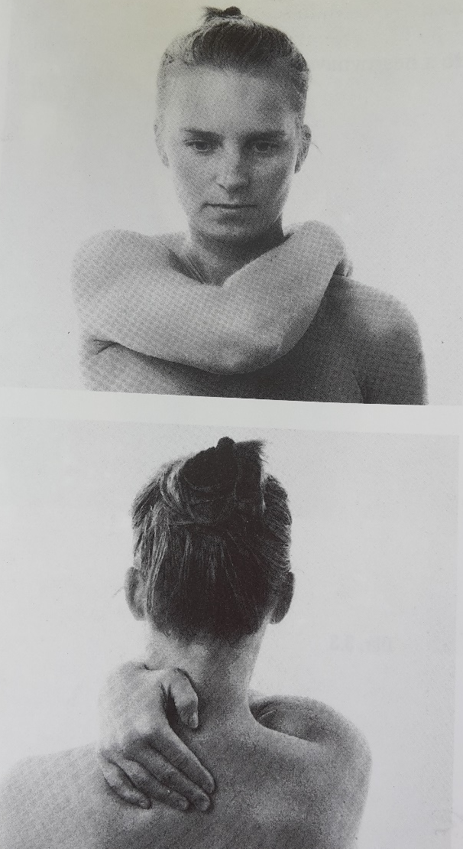
High arm cross
The patient is sitting or standing and puts her arm around the neck from the front towards the opposite side.
Normally the elbow almost reaches the median plane of the body and the fingers reach the cervical spine.
With hypermobility the ROM is much greater.
The distance the fingers can move across the median plane is measured.
The ROM of the arms must be compared to both side; the subordinate arm may have a slightly larger range of movement.

Slide 33
High arm cross
Possible errors
Errors are not very common.

Slide 34
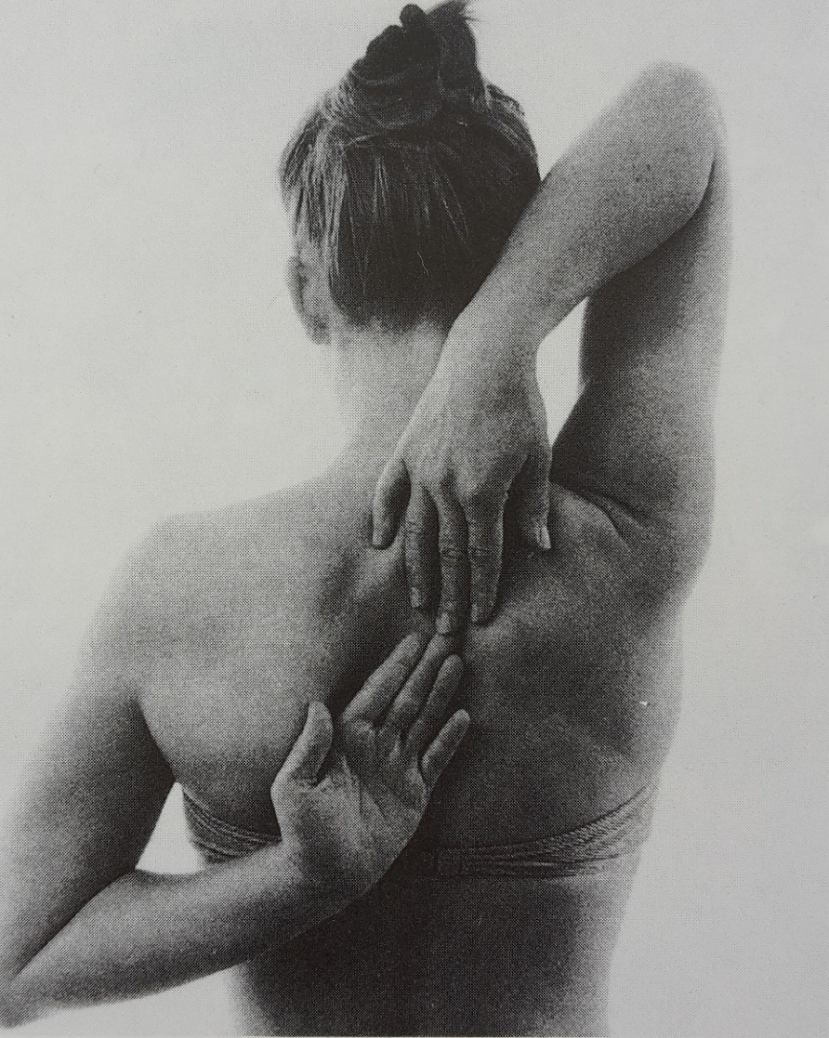
Touching the hands behind the back
In standing or in sitting the patient tries to bring both hands together behind the back, one from above the shoulder and the other from below.
Normally the tips of the fingers can touch without any increase in ThL lordosis.
According to the grade of the hypermobility the patient can put the fingers or the hands on top of each other and in some cases even the wrists.
The test is aIso performed the other way round so that each arm can be compared.

Slide 35
Touching the hands behind the back
Possible errors
A large increase in lordosis is allowed.
The sides are not compared.

Slide 36
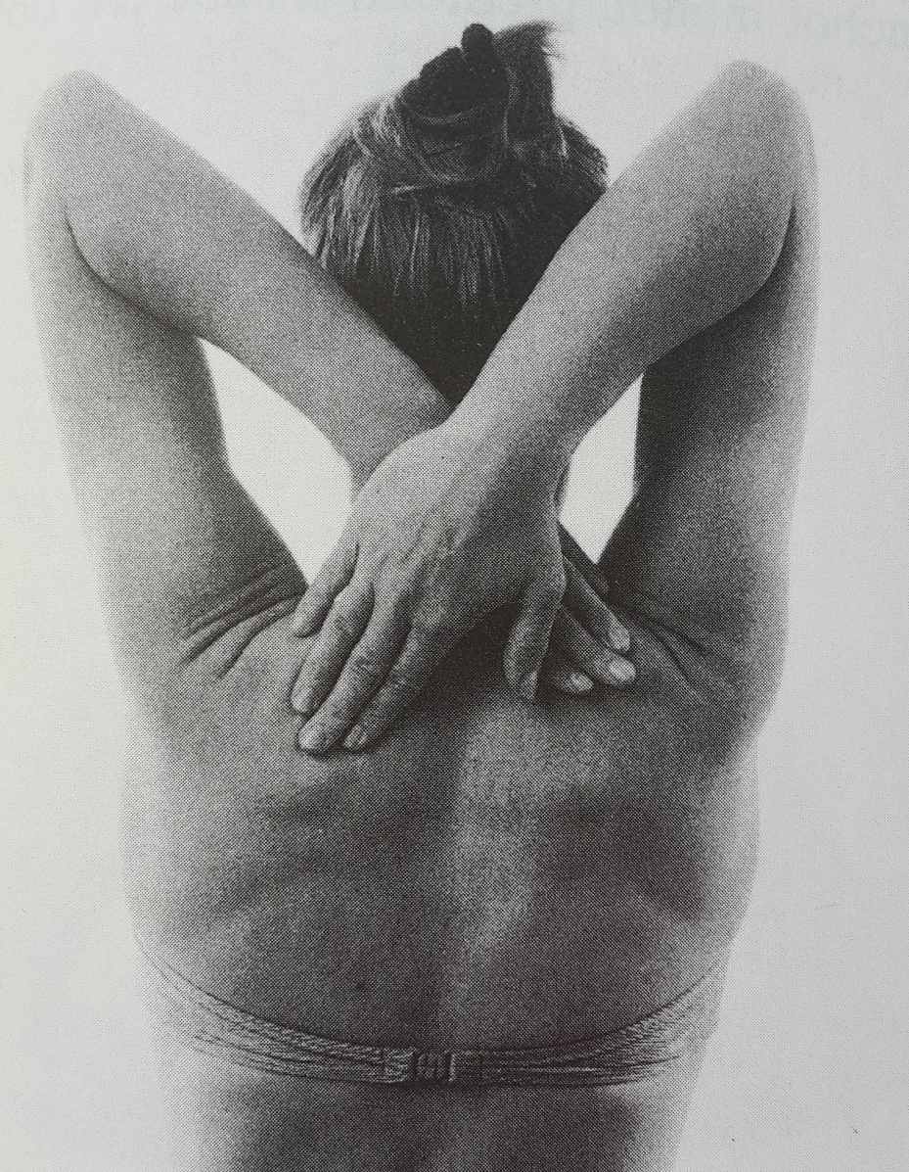
Crossing the arms behind the neck
The patient in sitting or Iying puts the arms across the neck with the fingers in the direction of the shoulder blades.
Normally the tips of the fingers can touch the opposite scapula.
With hypermobility the patient can reach part of the shoulder blade or even the whole shoulder blade with the hand or hands.

Slide 37
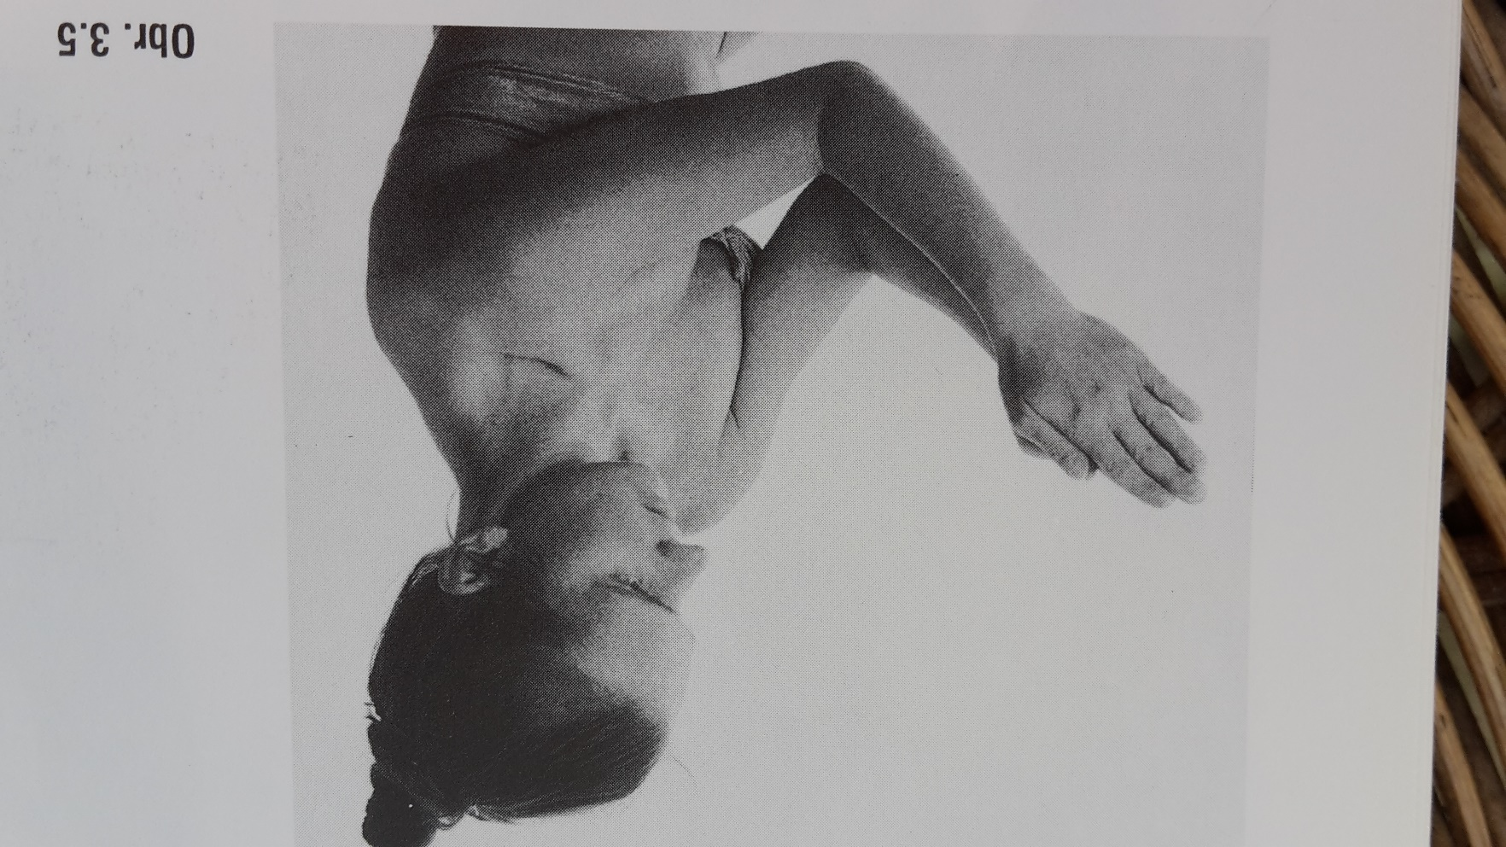
Extension of the elbow
The patient is standing or, even better, sitting. The elbows, lower arms and hands are pressed against each other with the fingers together and maximal flexion in the elbows. The patient tries to extend the elbows without separating them.
With a normal ROM the elbows can be extended to 110 degrees but
With hyperextension this angle is much greater.

Slide 38
Extension of the elbow
Possible errors
The elbows are not kept against each other, especially at the end of ROM.
Complicated with obesity.

Slide 39
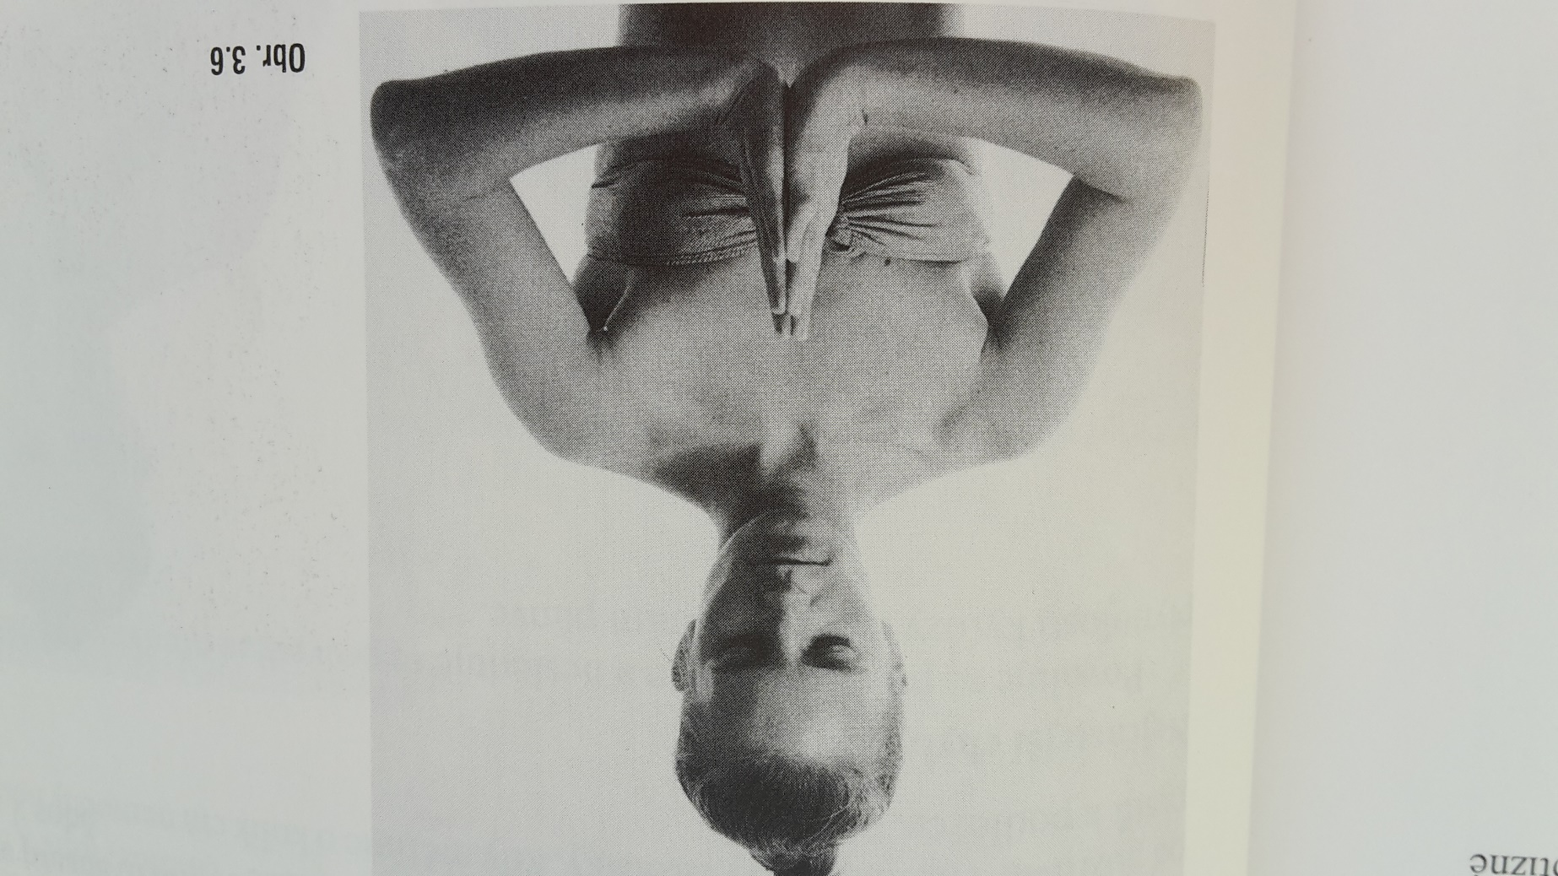
Movement of the hands
The patient presses the hands against each other in front of the body and overstretches the wrist through a downward movement without parting the hands.
Normally it is possible to achieve
a 90-degree angle between the hands and the forearms. If this is not possible, it is a sign of shortening of the wrist flexors and the ligaments of the hand.
On the other hand, an increase of the hyperextension angle means hypermobility.

Slide 40
Movement of the hands
Possible errors
The hands are not kept pressed against each other.

Slide 41
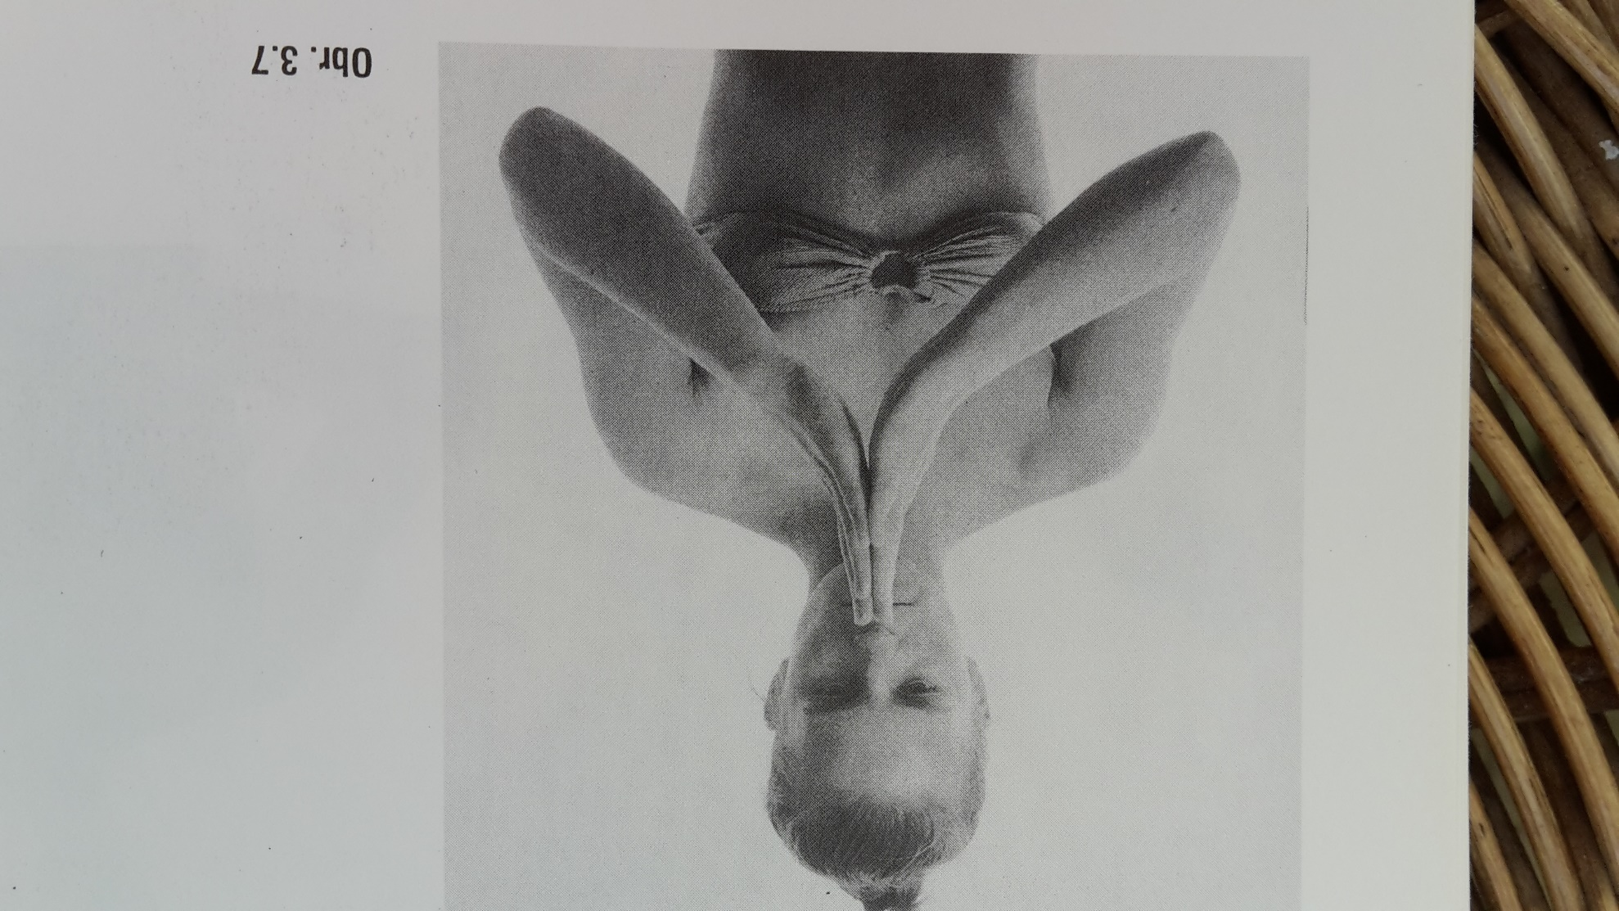
Movement of the fingers
This is in fact the second phase of the previous assessment. The patient pushes the outstretched fingers against each other and the hand is held as a continuation of the forearm. The fingers at the metacarpophalangeal joints are then hyperextended by moving the hands downwards. The hand must stay as a continuation of the forearm throughout the movement.
Normally the angle between the palms is 80 degrees.
With hypermobility this angle is much greater.

Slide 42
Movement of the fingers
Possible errors
The exact position of the hands in the axis of the forearm is not checked.
The outstretched fingers are not pressed against each other along their whole surface.

Slide 43
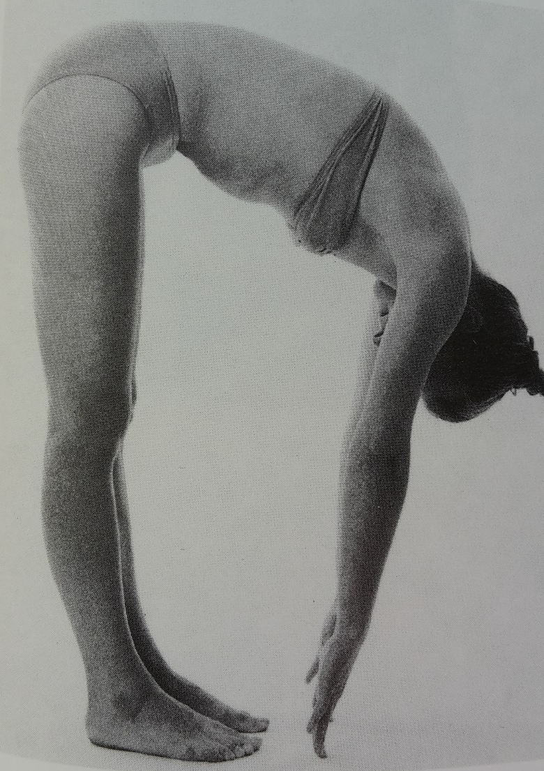
Forward flexion of the back
The patient is in standing and bends forwards with straight legs and the feet together as in the Thomayer (Neri) test. The bending of the back as a whole and the tilting of the pelvis and the curve of the spine are observed. If there is a difference of hypermobility in the upper and lower halves of the body, especially when this is due to shortened hamstrings, the pelvis is tilted just a little. When there is shortening of the paravertebral lumbar muscles, there is
a compensatory increase of kyphosis in the thoracic spine and the lumbar spine remains more or less straight.
Normally the patient can touch the floor with the fingertips.
The hypermobility is graded depending on how much of the hand touches the floor, for instance the fingertips, the fingers or the whole hand. Minus cm – Thomayer test.

Slide 44
Forward flexion of the back
Possible errors
Flexion in the knee joint and forward bending are not observed properly.
The kyphosis and the tilting of the pelvis are not differentiated.

Slide 45
Side flexion of the back
The patient in standing position with the feet together, bends sideways, at the same time moving the hand downwards against the outside of the thigh. The shoulder must not be lifted in compensation and the pelvis must not be moved sideways.
Normally a plumb line dropped from the shoulder crease should come to the intergluteal line.
With hypermobility the side flexion is increased and so the plumb line hangs from the shoulder crease towards the contralateral side.
In the case of shortening, particularly of the quadratus lumborum the plumb line does not reach the intergluteal line.
One may also register how far down below the knee joint the patient can reach.
This test is not very accurate because it also depends on the length of the arms.

Slide 46
Side flexion of the back
Possible errors
Rotation towards the backward movement of the trunk is allowed.
There is a shift forward or a backward movement of the pelvis.

Slide 47
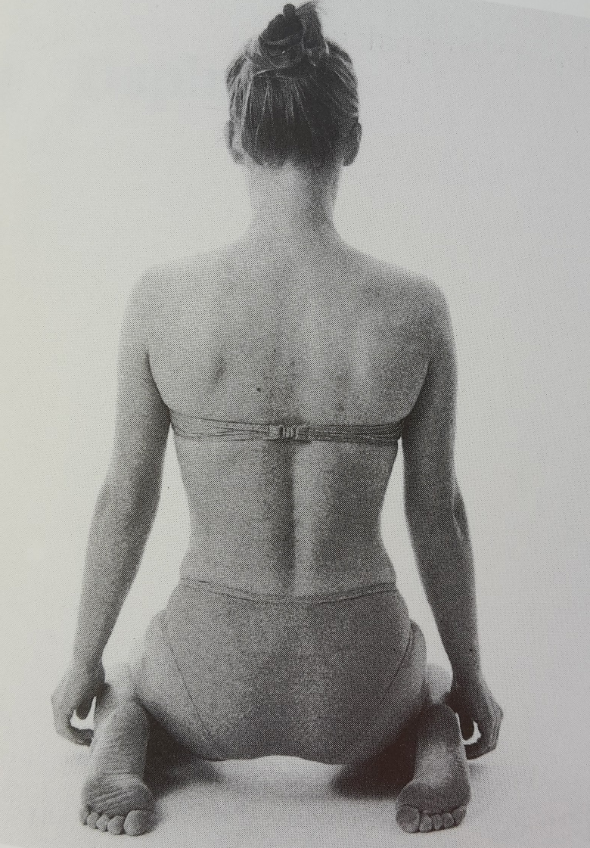
Sitting down between the heels
The patient is kneeling and attempts to sit down between the heels.
Normally the bottom reaches a line between the heels.
With hypermobility the patient can sit down on the floor.
With shortening, especially of the rectus femoris, the bottom stays above the heels.

Slide 48
Sitting down between the heels
Possible errors
Faults are not very common but the trunk must not be bent forwards.

Slide 49
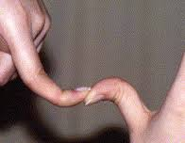
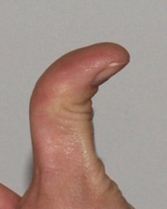
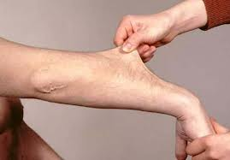
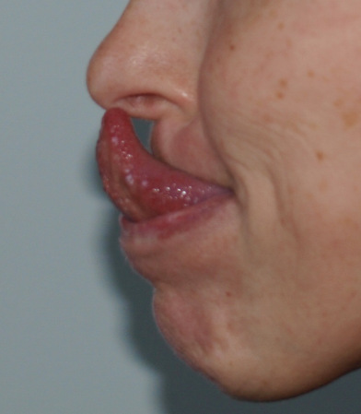
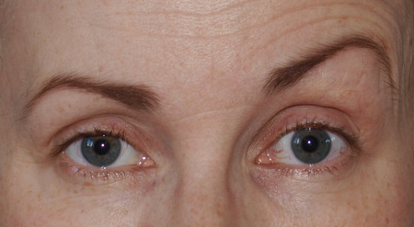
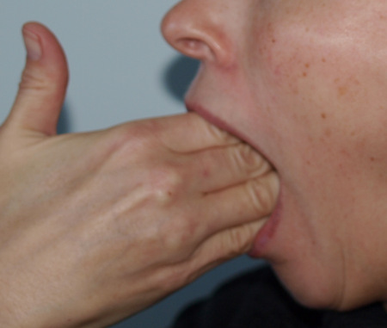
Other tests
hyperextension of the thumb
the straight-leg raise test for determining hamstring length
ankle dorsiflexion

Slide 50
e-sources, literature
Janda V. et al.: Muscle functioning test
Page P.: Assessment and Treatment of Muscle Imbalance
https://www.youtube.com/watch?v=VqtSEV1LQ1o
https://en.wikipedia.org/wiki/Hypermobility_(joints)
http://www.wikiskripta.eu/index.php/Vy%C5%A1et%C5%99en%C3%AD_hypermobility

Slide 51
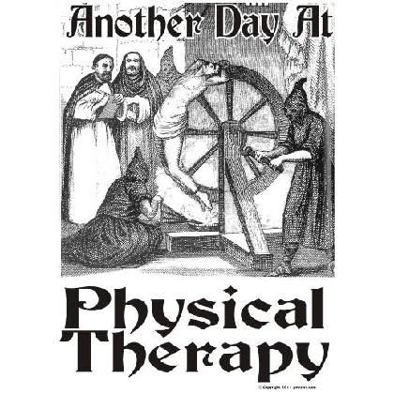
Thank you for your attention ☺

