Slide 1
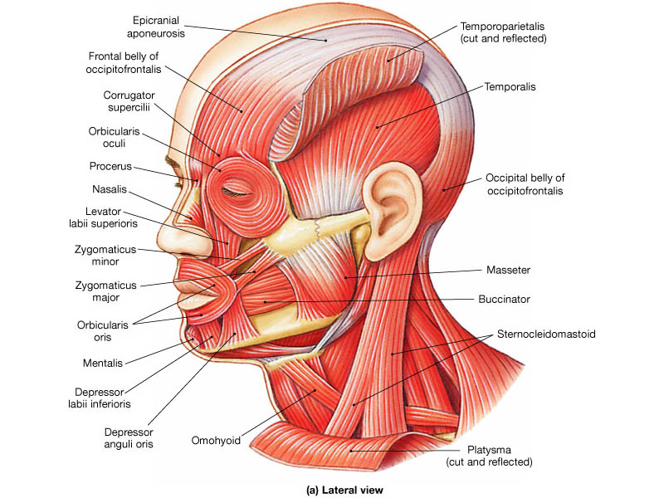
Manual muscle testing (2)
Facial muscles
Examination methods in Rehabilitation, 13.9.2021
Mgr. Veronika Mrkvicová, Ph.D. (physiotherapist)

Slide 2
Introduction
Facial muscles
MMT, grading
Facial nerve
Facial paralysis

Slide 3
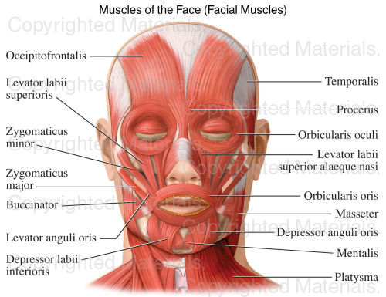

Slide 4
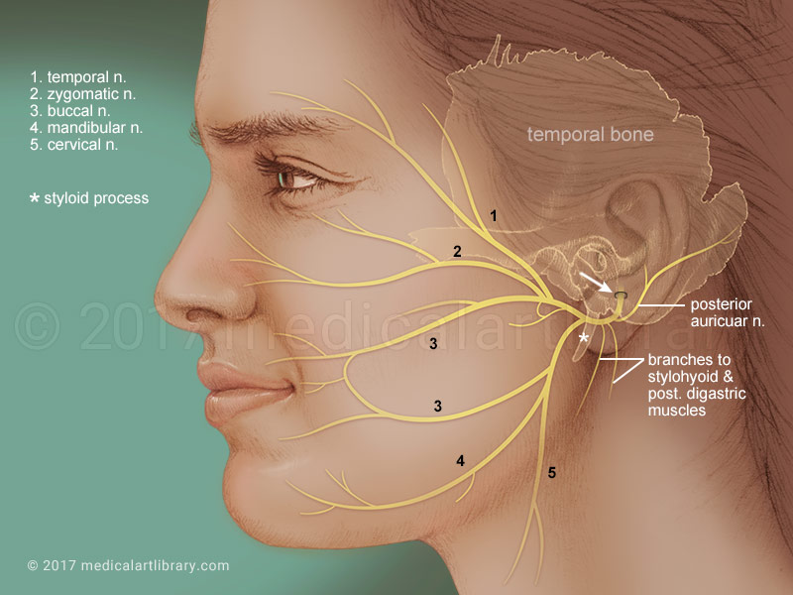
Facial Nerve
Most of the facial nerve is comprised
of motor innervation of the muscles
of facial expression
In addition, it subserves several other functions including:
taste perception from the anterior two-thirds of the tongue
perception of cutaneous stimuli in the external auditory canal and over part of the pinna and mastoid region
innervation of the stapedius muscle in the middle ear
innervation of the lacrimal gland and two of the salivary glands (the submaxillary and submandibular)

Slide 5
Facial expression
The most prominent deficit noted by patients with facial nerve damage is weakness of muscles of facial expression
Careful observation of the patient's face during conversation and at rest almost always reveals facial weakness
Additionally, the face may "droop" on the side of damage due to the effects of gravity

Slide 6
Facial nerve: test
The nerve can be further tested by functional activities:
having the patient close their eyes and lips tightly
having the patient grimace (show their teeth)
having the patient look up (elevating the eyebrows and creasing the forehead)
having the patient fill their cheeks with air with their lips tightly pursed. If one or both sides of the face are weak, s/he will have difficulty holding the air in

Slide 7
Bell´s palsy
The most common cause of facial weakness, an idiopathic condition that may result from viral infection-induced inflammatory swelling of the facial nerve in its canal
Since the canal is very long and tight, swelling can put pressure on the nerve, resulting in damage either by direct effects or by impairing blood flow in the nerve
In some cases, facial palsy is produced by a very clear viral infection with Herpes Zoster, often associated with ear pain and vesicles on the tympanic membrane
Lyme disease also has a predisposition to produce facial palsy, sometimes bilateral

Slide 8
Bell´s palsy
The characteristic of peripheral facial palsy is that it involves the entire side of the face, including weakness of the forehead muscles as well as those around the eye and mouth
This is because fibers to all of these regions of the face are packed together in the facial canal
Most cases of uncomplicated Bell's palsy recover quite well
In its most severe form, infarction of the nerve may occur with a prolonged and not infrequently incomplete process of regeneration
This is more common when a longer course of the nerve is affected, accompanied by ageusia (loss of taste) and hyperacusis

Slide 9
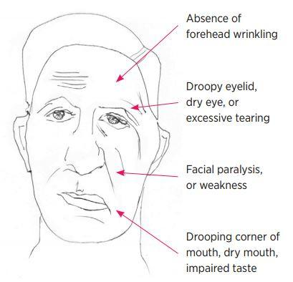
Bell´s palsy

Slide 10
Central paralysis
Corticobulbar (pyramidal) projections from the motor cortex (precentral gyrus) through the genu of the internal capsule are the major pathway for voluntary facial movement
The cerebral cortical projections to the facial motor neurons innervating the upper face are essentially bilateral (i.e., each cortical hemisphere provides innervation to both sides)
Therefore, unilateral lesions (such as a stroke affecting one hemisphere or the internal capsule) will not produce weakness of the upper face muscles

Slide 11
Central paralysis
On the other hand, facial motor neurons that innervate the muscles of the lower face receive input largely from the contralateral hemisphere (i.e., the right hemisphere activates motor neurons of the left facial nucleus, and vice-versa)
Therefore, a lesion involving the right motor cortex (e.g., carotid-middle cerebral arterial system occlusion and hemispheric infarction) causes a weakness of voluntary left lower facial movement that is especially noticeable while the patient is talking, grimacing (usually elicited by asking the patient to bare their teeth or gums), or resting

Slide 12
Central paralysis
The corner of the mouth droops and there may be some widening of the palpebral fissure (eye)
On the other hand, the forehead is normally creased when a person raises their eyebrows or looks toward the ceiling
This distinguishes the "supranuclear" weakness of the face from the weakness of the whole side of the face due to damage of the peripheral facial nerve, as seen with Bell's palsy.

Slide 13
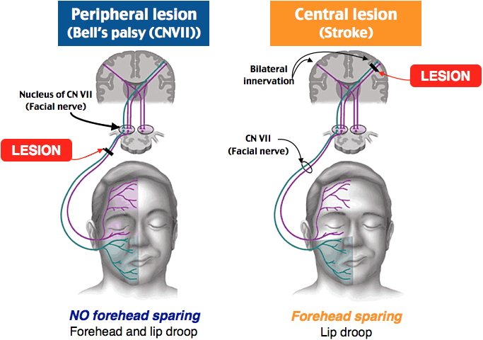
Peripheral vs. central lesion

Slide 14
Manual muscle test - grading
5 Normal contraction of the muscle, no assymetry compared to healthy side
4 Nearly normal contraction, little assymetry compared to healthy side
3 Contraction of the muscle in one half compared to healthy side
2 Contraction of the muscle in one quarter compared to healthy side
1 Trace of muscle contraction can be seen/palpated
0 The muscle demonstrates no palpable muscle contraction

Slide 15
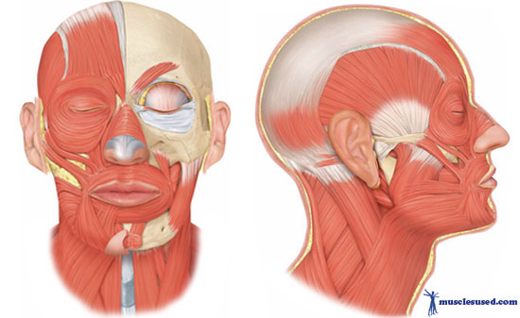
Muscles of facial expression

Slide 16
Occiptofrontalis group
The occiptofrontalis, or scalp, group consists of the frontalis and occipitalis
These muscles provide movement of the eyebrows, forehead, and scalp

Slide 17
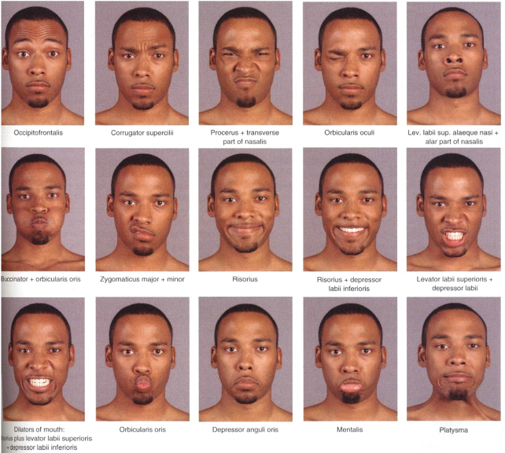
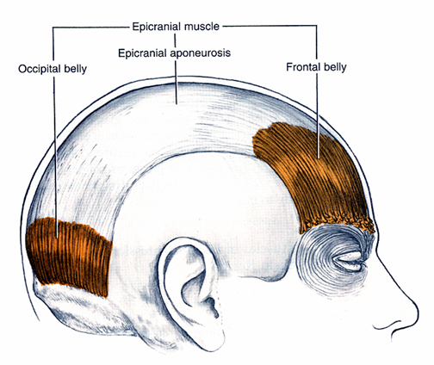
M. occipitofrontalis
Raises forehead, pulls scalp backward

Slide 18
Orbital group
The orbital group consists of:
orbicularis oculi
corrugator supercilii
These muscles provide movement of the eyelid and periorbital skin

Slide 19
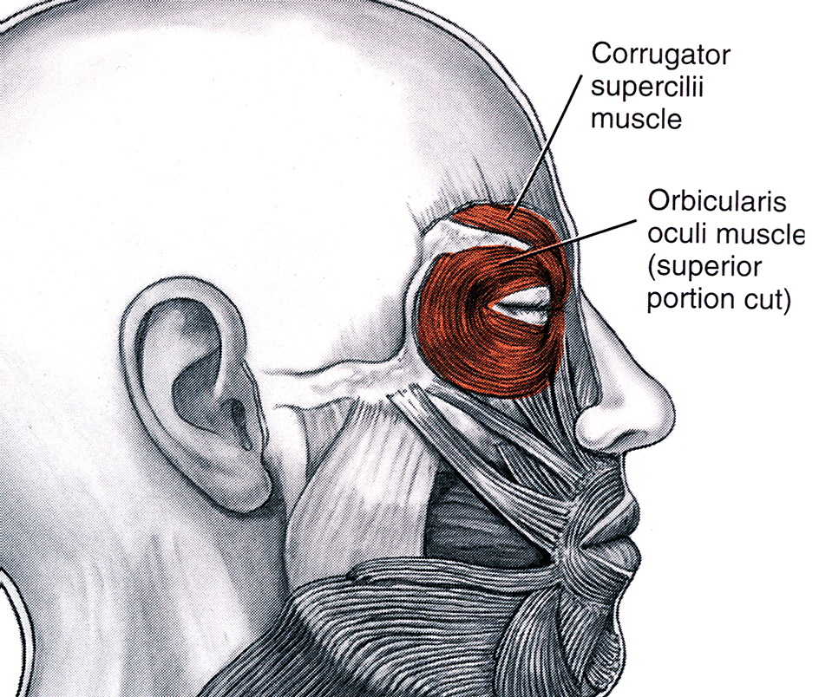
M. corrugator supercilii
Draws eyebrow medially

Slide 20
M. orbicularis oculi
Closes eyelid

Slide 21
Nasal group
The nasal group consists of:
Procerus
Nasalis
These muscles provide movement of the nose and perinasal skin

Slide 22
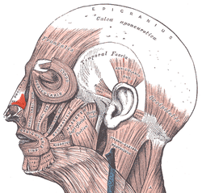
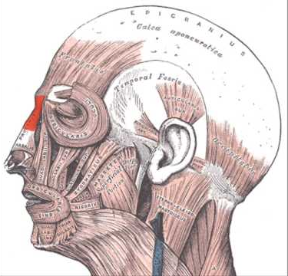
M. procerus
M. nasalis
M. nasalis
M. procerus

Slide 23
Oral Group
The oral group consists of:
obicularis oris
depressor anguli oris, levator anguli oris
zygomaticus major et minor
levator labii sup., levator labii sup. alaeque nasi
risorius
depressor labii inferioris
mentalis
buccinator
These muscles provide movement of the lips

Slide 24
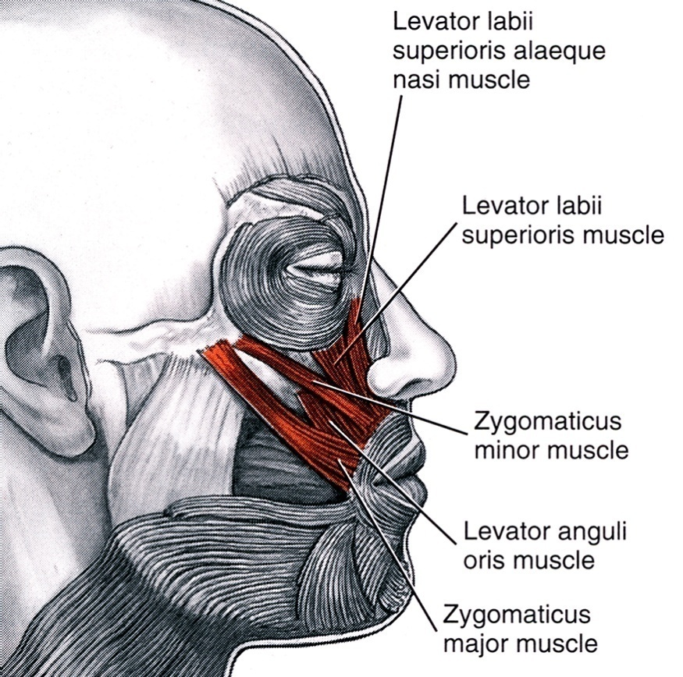
M. levator labii superioris alaeque nasi
Raises upper lip
and widens nostril

Slide 25
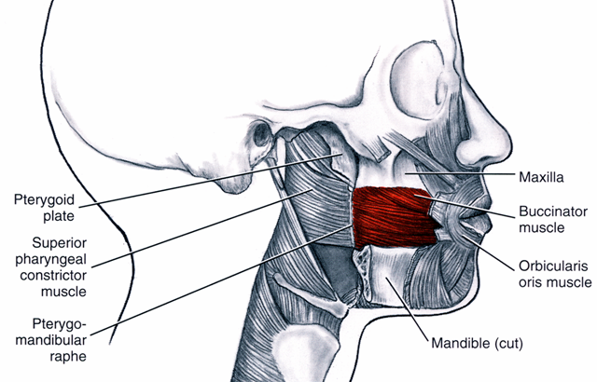
M. buccinator
Moves “bolus” of food

Slide 26
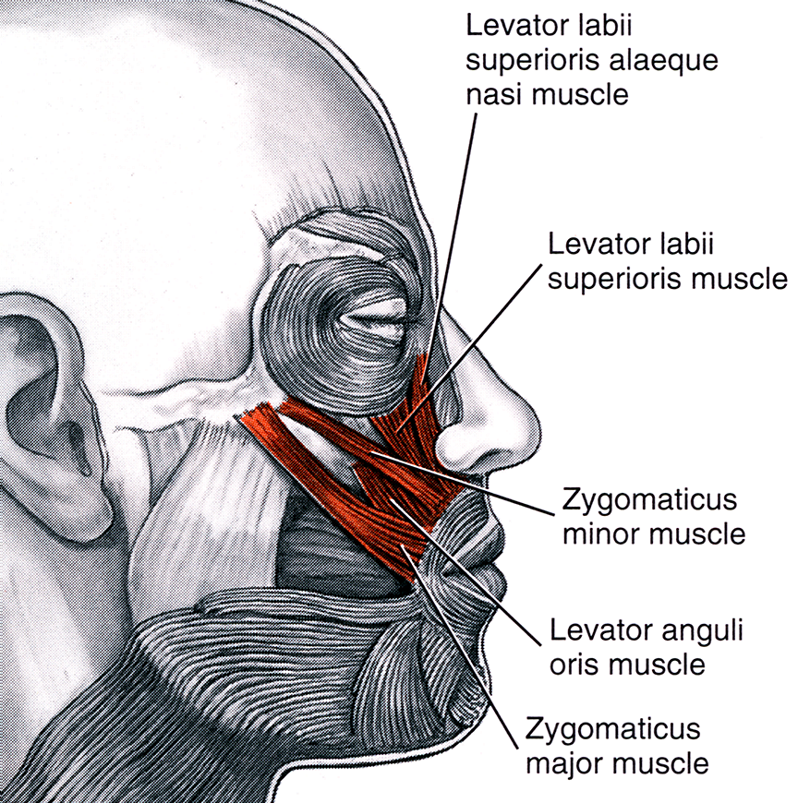
M. zygomaticus major et minor
Raises angle of mouth

Slide 27
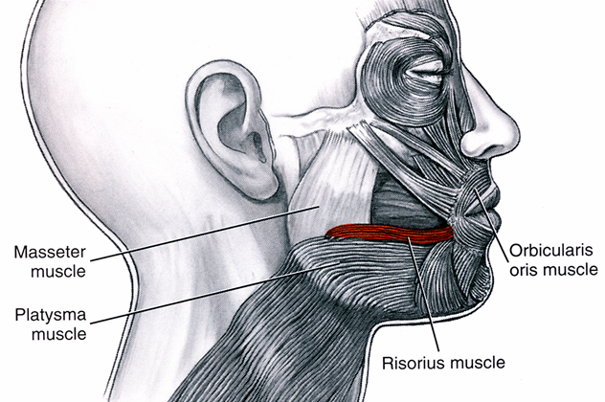
M. risorius
Smile widely

Slide 28
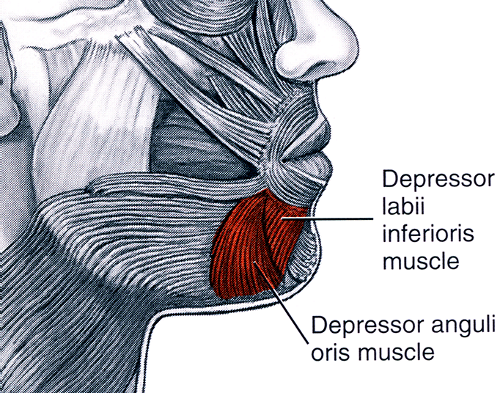
M. risorius, m. depressor labii inferioris

Slide 29
M. levator labii superioris
M. depressor labii inferioris
Lowers lower lip

Slide 30
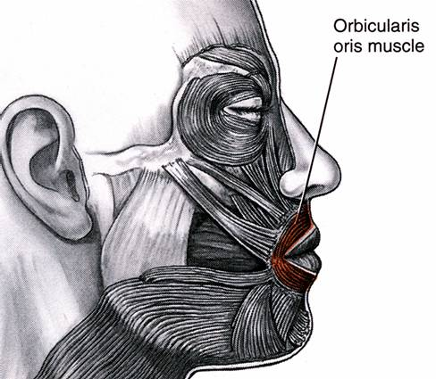
M. orbicularis oris
Closes or purses lips

Slide 31
M. depressor anguli oris

Slide 32
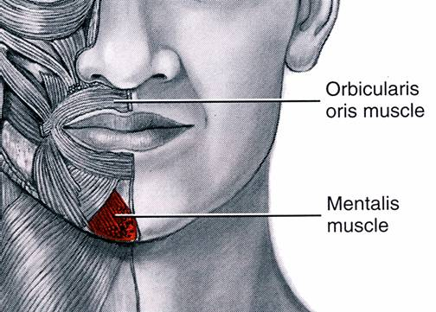
M. mentalis
Raises chin, protrudes lower lip, and decreases depth of lower vestibule

Slide 33
Neck group
The neck group consists of the platysma
It provides movement of the skin of the neck

Slide 34
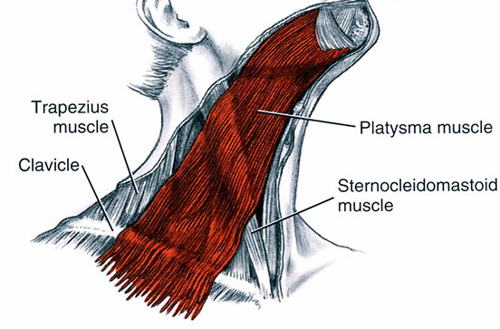
M. platysma
Raises skin of neck and
lowers corner of mouth

Slide 35
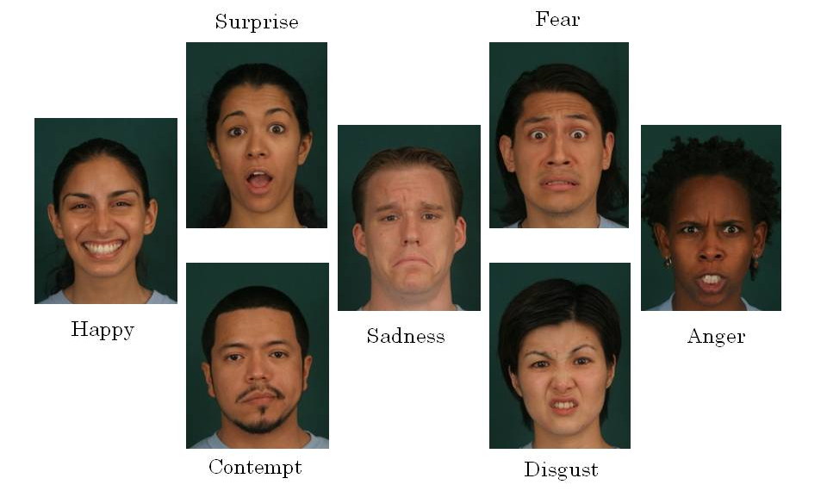
Thank you for attention ☺
The Seven Universal Facial Expressions of Emotion

