Slide 1
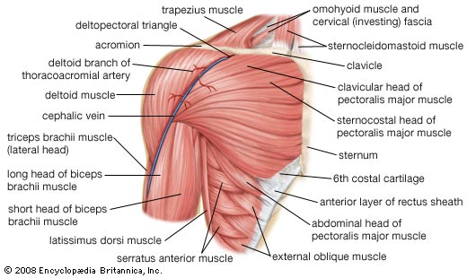
Examination Methods in Rehabilitation (27.9.2021)
Manual muscle test:
Scapula, shoulder
Mgr. Veronika Mrkvicová, Ph.D. (physiotherapist)

Slide 2
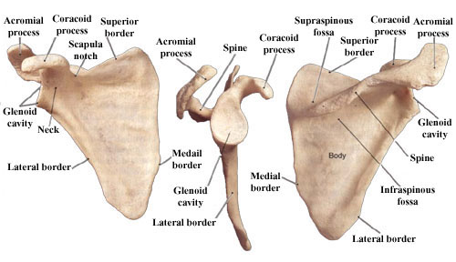
Scapula

Slide 3
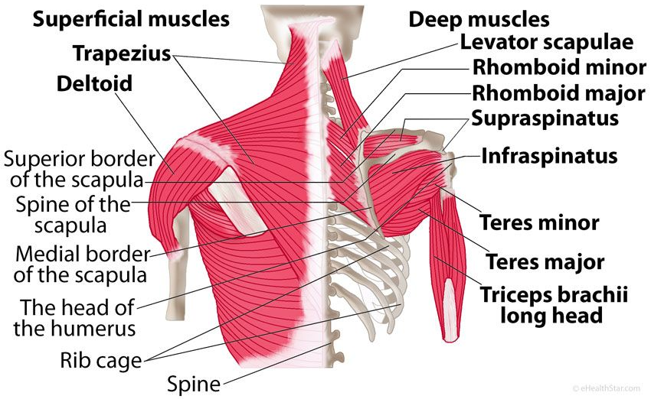
Scapular muscles (from behind)

Slide 4
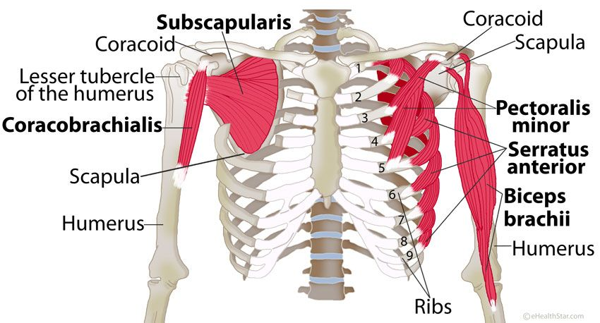
Scapular muscles (from the front)

Slide 5
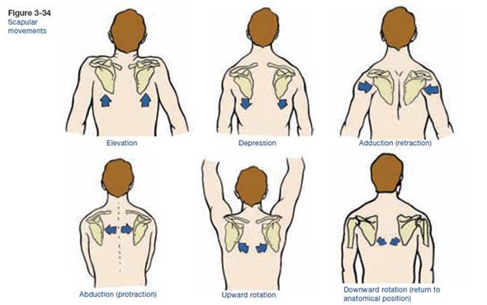
Scapular movements

Slide 6
Muscles of the shoulder girdle
Muscles distribution according their location:
Muscles going downward to the scapula
(trapezius – upper part, levator scapulae, rhomboidei, serratus anterior – upper part)
Horizontal shape
(trapezius – medial part, serratus anterior, pectoralis – partially)
Muscles going upward to the scapula
(serratus anterior – lower part, trapezius – lower part, latissimus dorsi, pectoralis minor, pectoralis maior – lower part)

Slide 7
Muscles of the shoulder girdle
Muscles distribution according muscle function:
Group of muscles connecting shoulder girdle with the trunk
(trapezius, rhomboidei, levator scapulae, serratus anterior, pectoralis minor)
Group of muscles connecting shoulder girdle with the arm (supraspinatus, infraspinatus, teres maior et minor, subscapularis, deltoideus, coracobrachialis, pectoralis maior, lattisimus dorsi)
Group of muscles connecting shoulder blade with forearm (biceps brachii et triceps brachii)

Slide 8
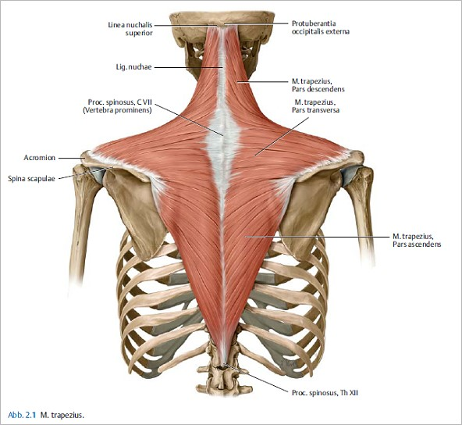
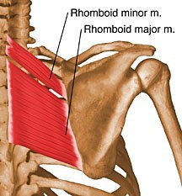
Scapular adduction
(retraction)
Trapezius muscle
Rhomboid maj. et min.

Slide 9
Trapezius
Origin
Medial third of superior nuchal line; external occipital protruberance, nuchal ligament, and spinous processes of C7 - T12 vertebrae
Insertion
Lateral third of clavicle, acromion, and spine of scapula
Action
Elevates, retracts and rotates scapula
superior fibers elevate, middle fibers retract, and inferior fibers depress scapula
superior and inferior fibers act together in superior rotation of scapula
Innervation
Spinal root of accessory nerve (CN XI) (motor) and cervical nerves (C3 and C4) (pain and proprioception) (XI, C3, C4)

Slide 10
Rhomboid Major and Minor
Origin
Minor: nuchal ligament and spinous processes of C7 and T1 vertebrae
Major: spinous processes of T2 - T5 vertebrae
Insertion
Medial border of scapula from level of spine to inferior angle
Action
Retract scapula and rotate it to depress glenoid cavity
fix scapula to thoracic wall
Innervation
Dorsal scapular nerve ( C4 and C5) (C4, C5)

Slide 11
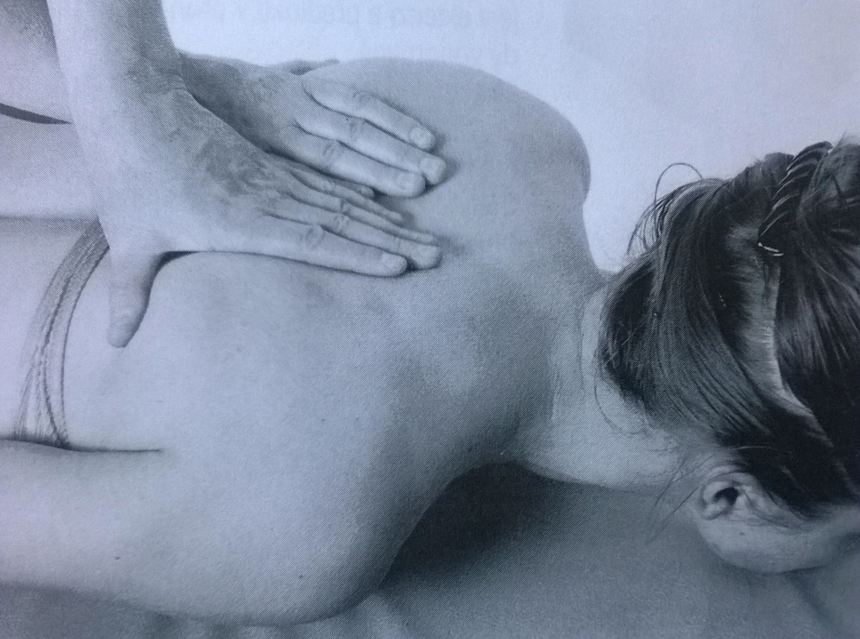
Scapular adduction – grade 5,4
Position: lying prone, head on the chin, upper limbs extended, relaxed, palms up
Movement: adduction of scapula (draw up the shoulder blades)
Resistance: PT puts the resistance against the movement of scapula using his/her palms on the patients vertebral edge of scapula

Slide 12
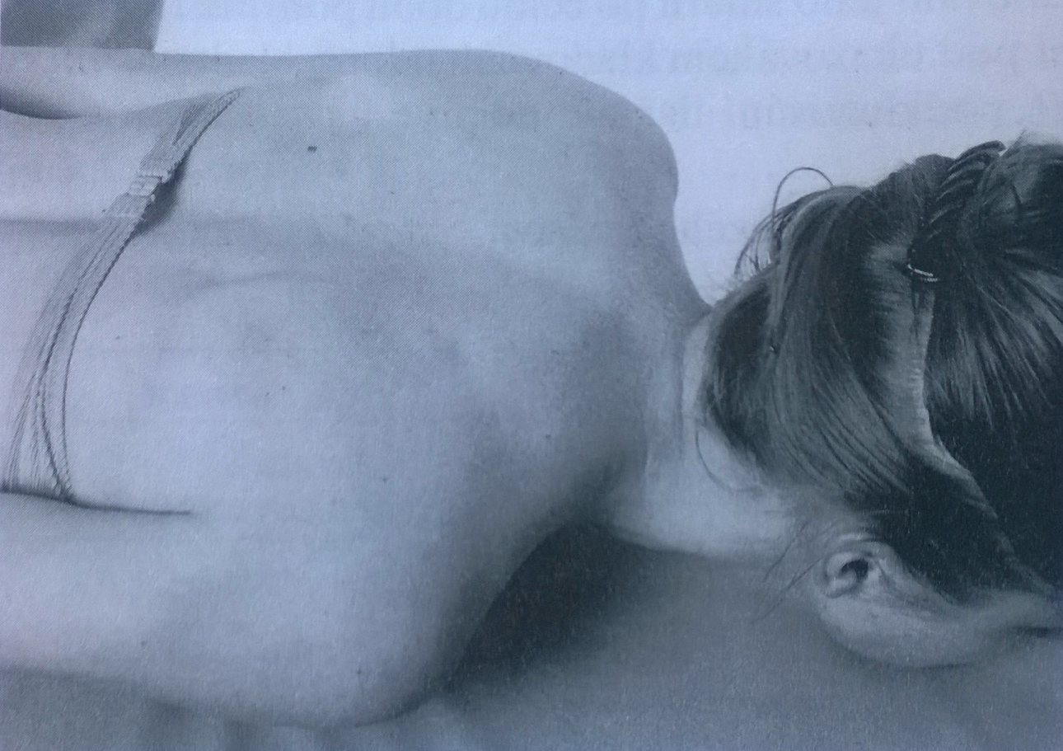
Scapular adduction – grade 3
Position: lying prone, head on the chin, upper limbs extended, relaxed, palms up
Movement: adduction of scapula (draw up the shoulder blades)

Slide 13
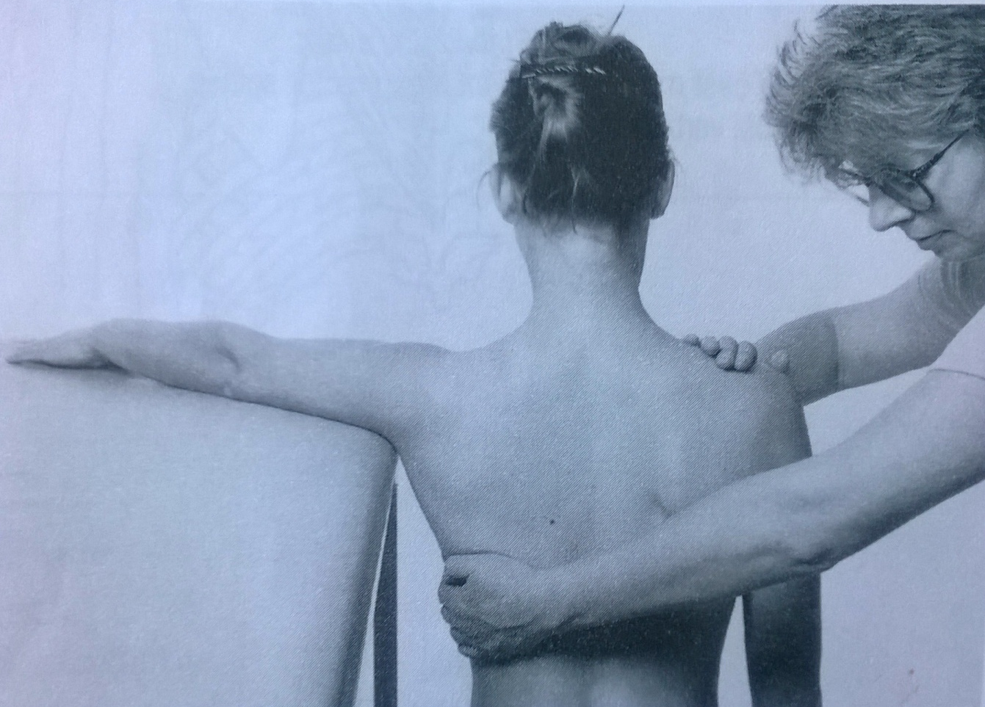
Scapular adduction – grade 2
Position: siting on the chair, the tested upper limb lying on the table (horizontal plane), elbow extended, palm down
Fixation: shoulder of the uninvolved side and the chest on the tested side
Movement: adduction of scapula by pulling the whole arm on the table

Slide 14
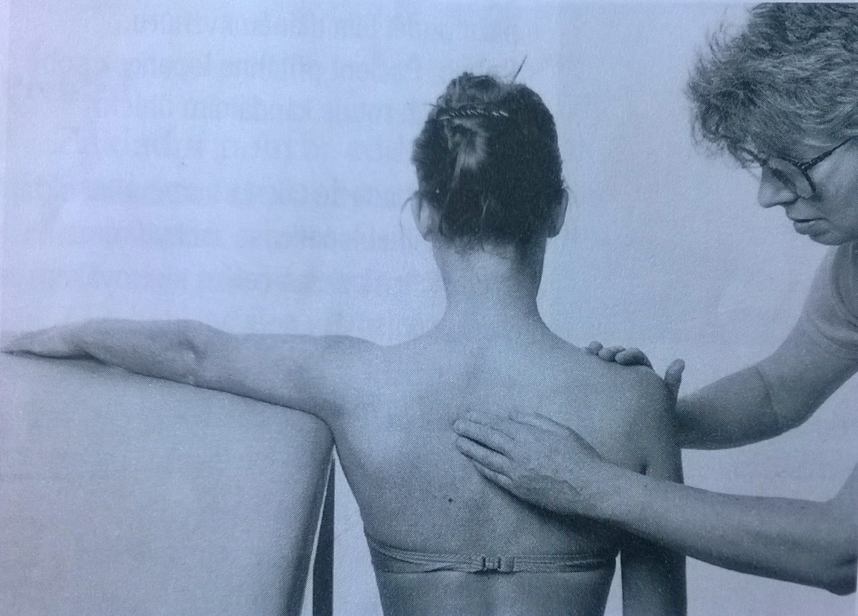
Scapular adduction – grade 1,0
Position: siting on the chair, the tested upper limb lying on the table (horizontal plane), elbow extended, palm down
Fixation: shoulder of the uninvolved side
Attempt to move: palpate the area between scapula and Th spine during patients attempt of scapula adduction

Slide 15
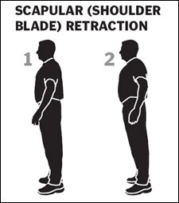
Scapular adduction – notes:
Don´t allow the patient to do a rotation of trunk, elevation of the upper limb, elevation of scapula or shoulders
Put the same level of resistance against the movement of scapula
The position of the head is important

Slide 16
Adduction with depression
Trapezius muscle (lower part)

Slide 17
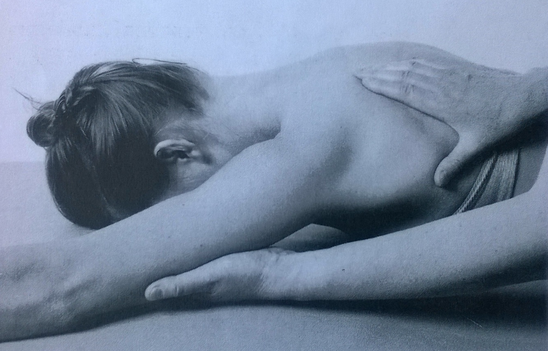
Adduction with depression – grade 5,4,3
Position: prone position, head on the forhead, uninvolved upper limb lying relaxed along the body, the tested upper limb elevated, elbow extended, ulnar part of the forearm on the table
Fixation: supporting the patients arm
Movement: adduction and depression of scapula
Resistance: PT put resistance against the lower angle of scapula and its movement down and rotation inward. The grades 5,4,3 differentiate according the amount of resistance

Slide 18
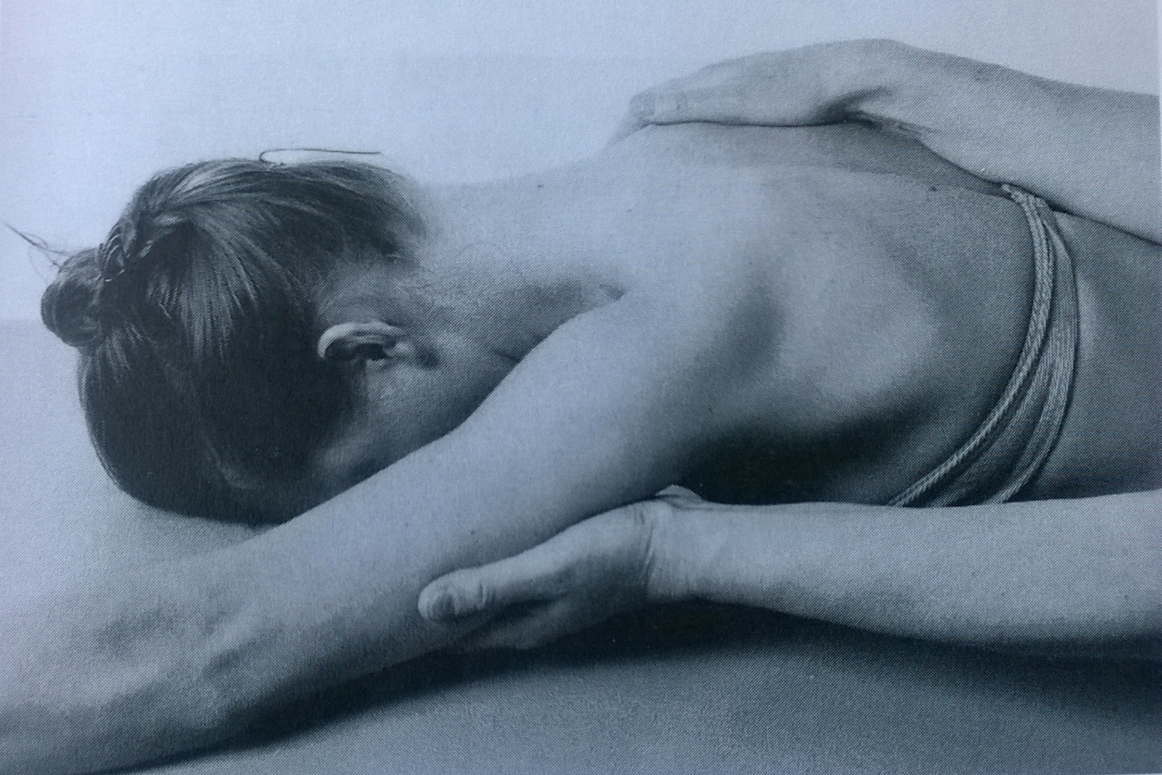
Adduction with depression – grade 2
Position: prone position, head on the forhead, uninvolved upper limb lying relaxed along the body, the tested upper limb elevated, elbow extended, ulnar part of the forearm on the table
Fixation: the trunk on the uninvolved side, support the patients arm
Movement: adduction and depression of scapula

Slide 19
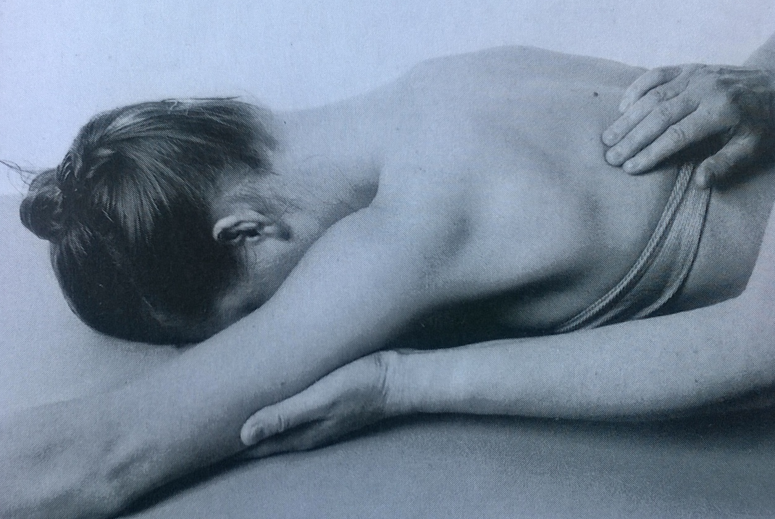
Adduction with depression – grade 1,0
Position: prone position, head on the forhead, uninvolved upper limb lying relaxed along the body, the tested upper limb elevated, elbow extended, ulnar part of the forearm on the table
Fixation: support the patients arm
Attempt to move: PT palpate a trace of contraction of lower part of trapezius muscle, in the area between lower angle of scapula and the lower Th spine

Slide 20
Adduction with depression – notes:
The correct position of the tested upper limb is important

Slide 21
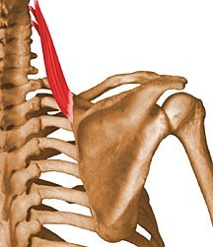
Scapular elevation
Trapezius muscle (upper part)
Levator scapulae

Slide 22
Levator scapulae
Origin
Posterior tubercles of transverse processes of C1 - C4 vertebrae
Insertion
Superior part of medial border of scapula
Action
Elevates scapula and tilts its glenoid cavity inferiorly by rotating scapula
Innervation
Dorsal scapular (C5) and cervical (C3 and C4) nerves (C3, C5, C4)

Slide 23
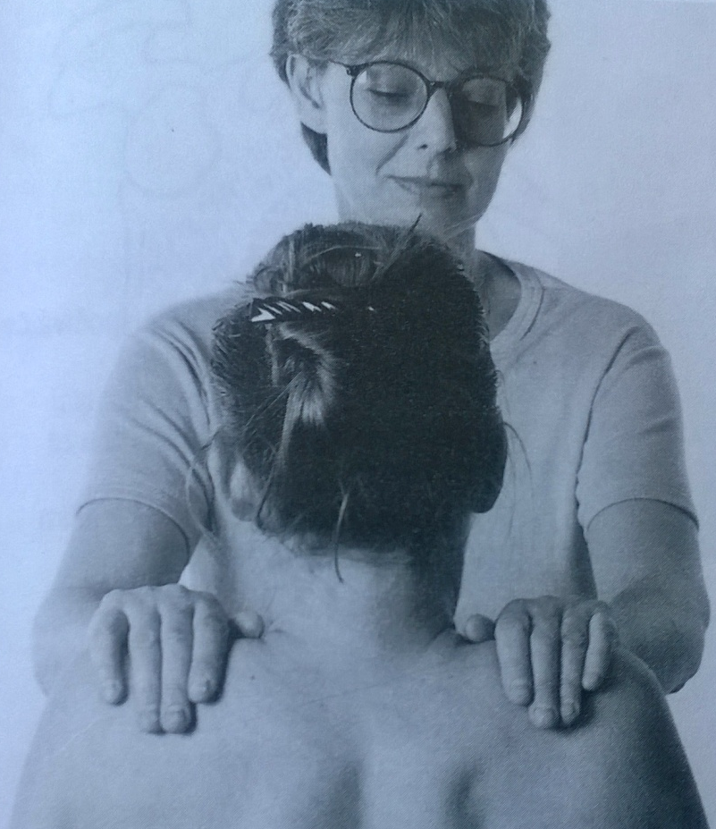
Scapular elevation – grade 5,4
Position: patient sits on the chair without backrest, upper limbs relaxed along body side
Fixation: not necessary
Movement: elevation of shoulders in full range of motion
Resistance: PT put resistance against shoulder movement

Slide 24
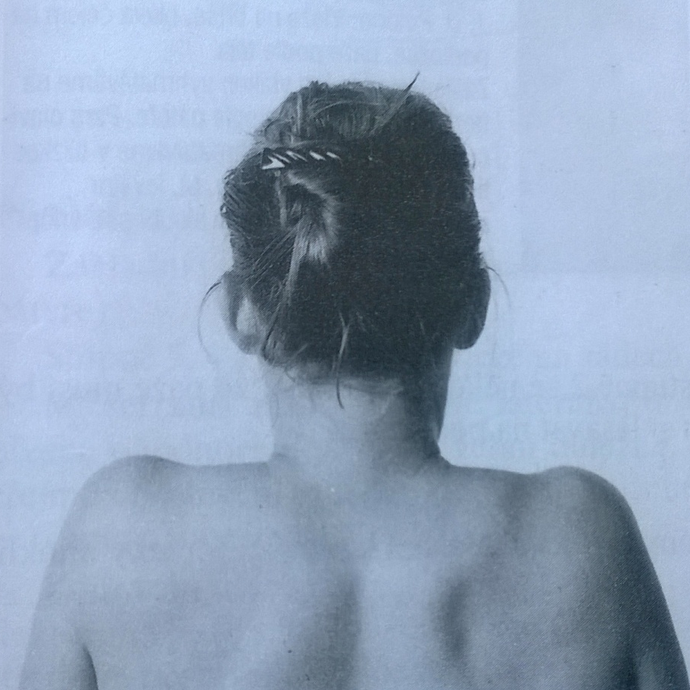
Scapular elevation – grade 3
Position: patient sits on the chair without backrest, upper limbs relaxed along body side
Movement: elevation of shoulders in full range of motion

Slide 25
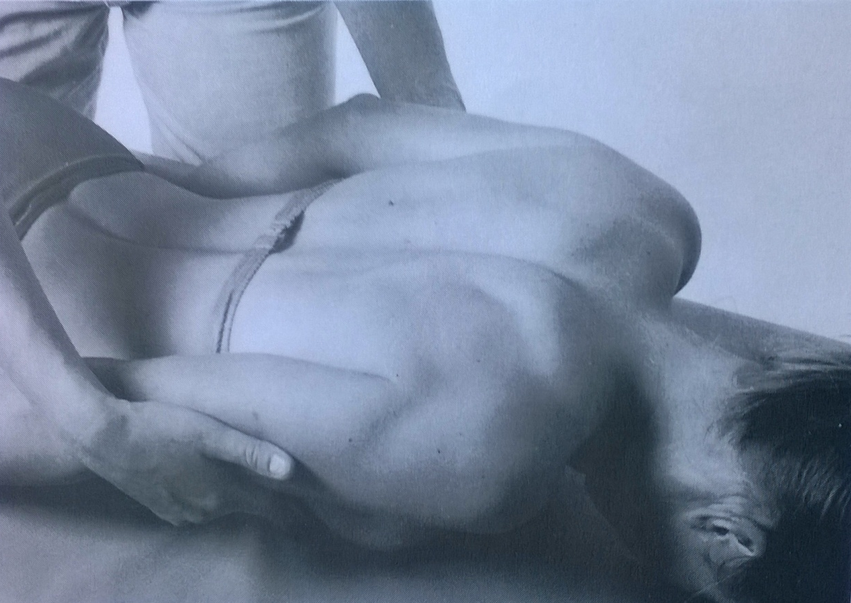
Scapular elevation – grade 2
Position: prone position, head on the table, upper limbs relaxed, lying along body side
Fixation: not necessary, PT supports patients´ arm
Movement: elevation of shoulders in full range of motion

Slide 26
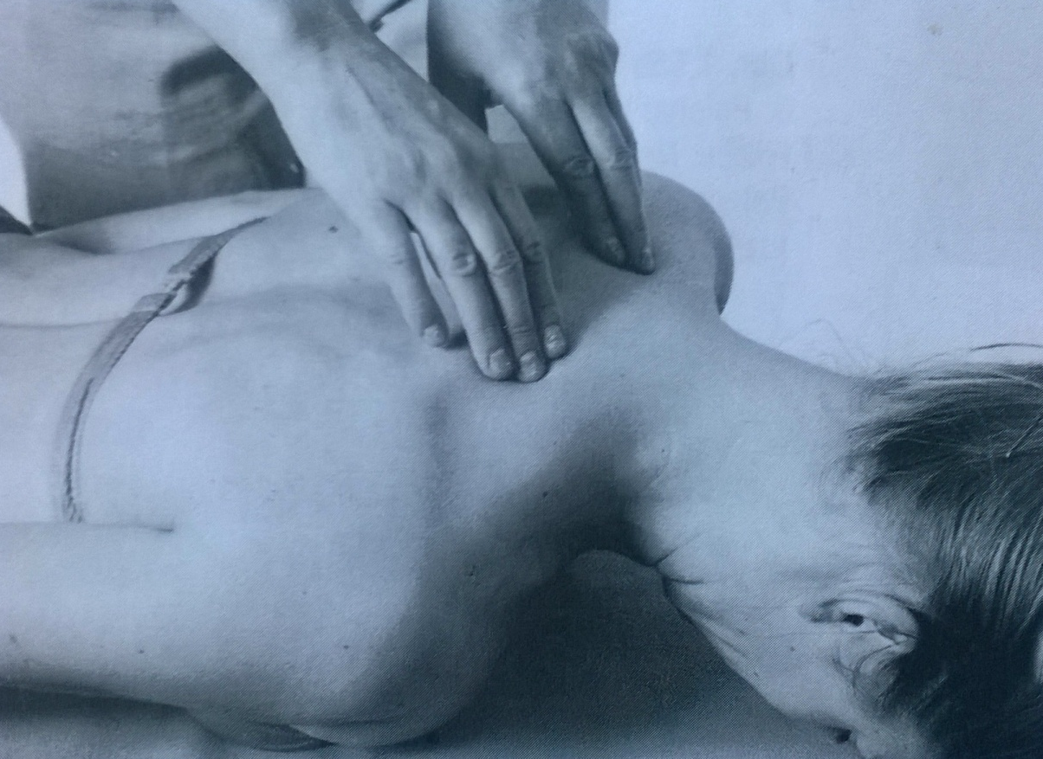
Scapular elevation – grade 1,0
Position: prone position, head on the table, upper limbs relaxed, lying along body side
Attempt to move: PT palpates the trace of levator scapulae and trapezius muscle contraction during patients´ attempt to elevate the shoulders

Slide 27
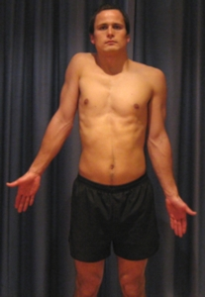
Scapular elevation – notes:
The movement is tested on both sides together
The arms should be supported during testing grade 2
The head should be in central position, no movement of the head should be allowed

Slide 28
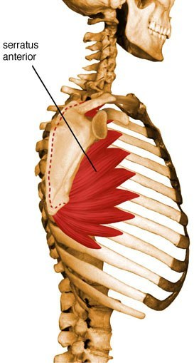
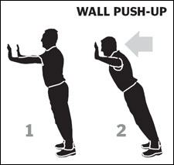
Scapular abduction with rotation
Serratus anterior

Slide 29
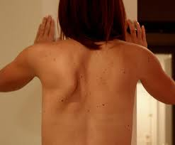
Serratus anterior
Origin
Superolateral surfaces of upper 8 or 9 ribs at the side of chest
Insertion
Vertebral border of scapula
Action
Draws scapula forward and upward
abducts scapula and rotates it
stabilizes vertebral border of scapula
Innervation
Long thoracic nerve (C5, C6, C7) (C5, C6, C7)

Slide 30
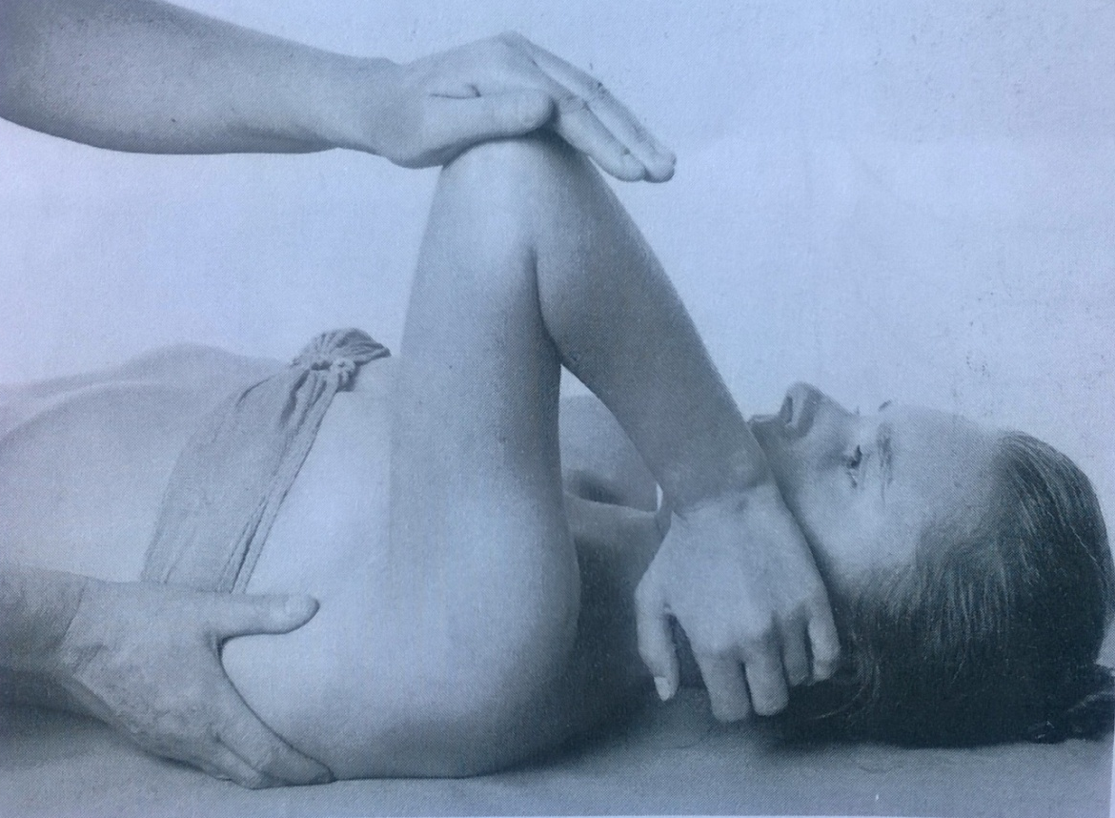
Scapular abduction with rotation – grade 5,4
Position: supine position, lower limbs flexed, tested upper limb fully flexed in elbow, 90° flexion in the shoulder, scapula on the table
Fixation: PT fix patients trunk below the lower angle of scapula
Movement: patient moves the arm up (thus the scapula abduct and rotate)
Resistance: PT put the resistance on patients´ flexed elbow, against the movement upwards

Slide 31
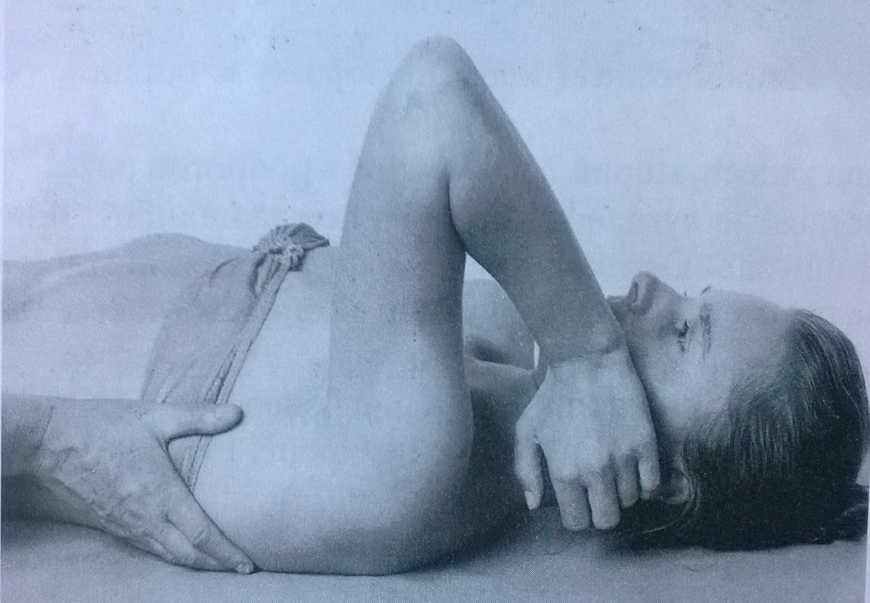
Scapular abduction with rotation – grade 3
Position: supine position, lower limbs flexed, tested upper limb fully flexed in elbow, 90° flexion in the shoulder, scapula on the table
Fixation: PT fix patients trunk below the lower angle of scapula
Movement: patient moves the arm up (thus the scapula abduct and rotate)

Slide 32
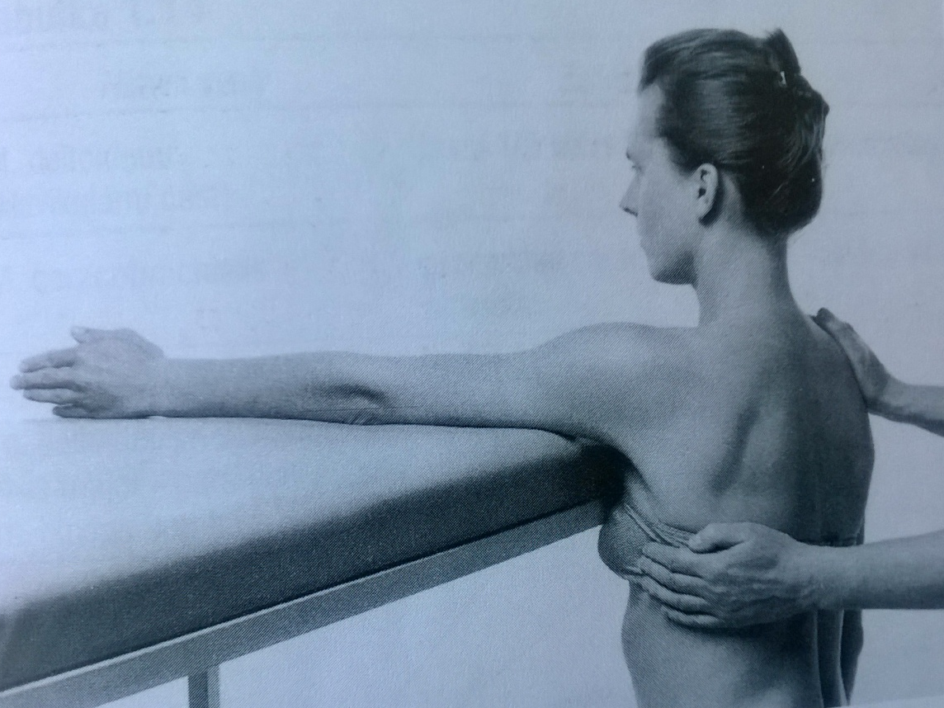
Scapular abduction with rotation – grade 2
Position: patient sits in front of the table, tested upper limb lying on the table (90° flexion in the shoulder, elbow extended, forearm on the ulnar side)
Fixation: lateral part of the trunk on the tested side, below the lower scapula angle, shoulder on the untested side
Movement: patient move the arm lying on the ulnar side forward (thus the scapula abduct and rotate)

Slide 33
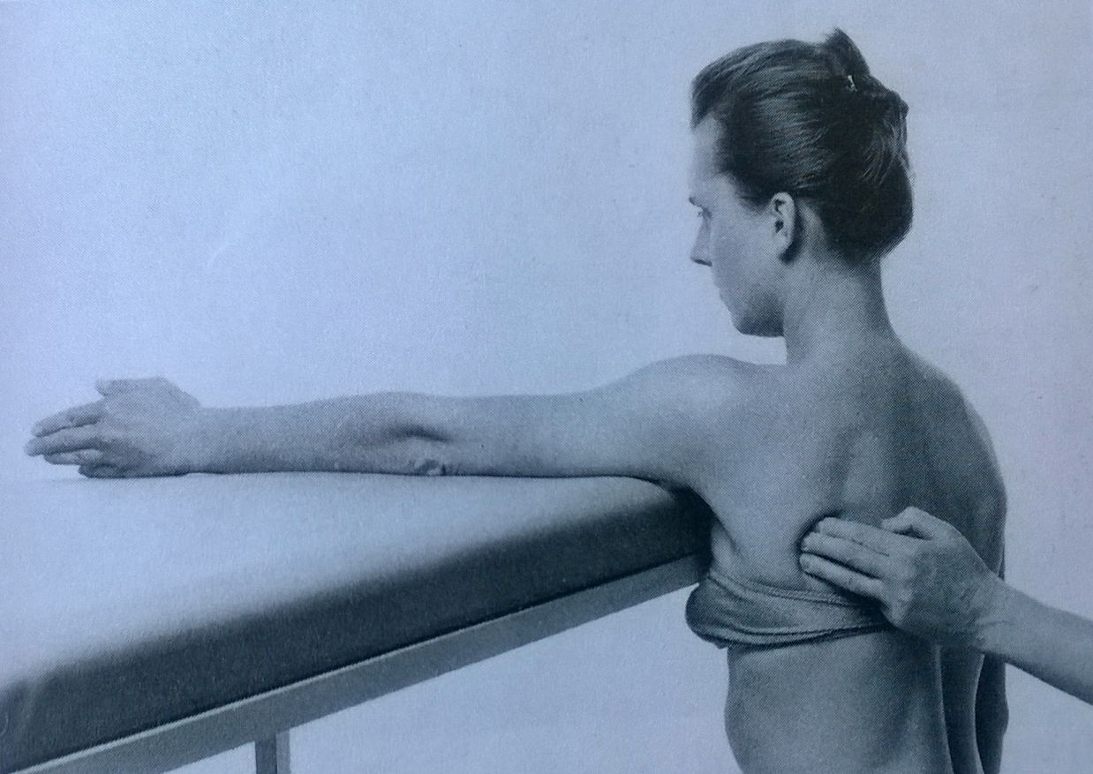
Scapular abduction with rotation – grade 1,0
Position: patient sits in front of the table, tested upper limb lying on the table (90° flexion in the shoulder, elbow extended, forearm on the ulnar side)
Fixation: if it´s need, lateral part of the trunk on the tested side, below the lower scapula angle
Attempt to move: during patients´ attempt to move the arm forward, PT palpate the serratus anterior on the vertebral edge of scapula

Slide 34
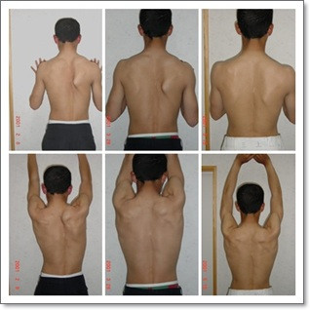
Scapular abduction with rotation – notes:
Fixation of the trunk is necessary, any attempt of rotation of the trunk should be allowed, no elevation of the shoulders
Be precise during palpation of the serratus anterior contraction, the trace can be often overlook
Weakness of serratus anterior
leads to scapula alata

Slide 35
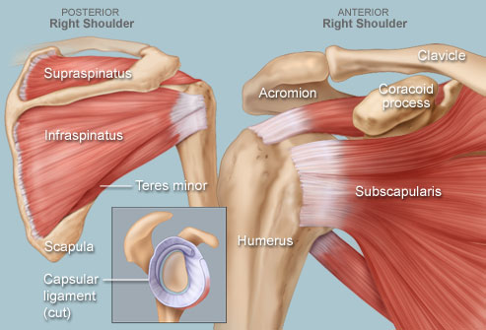
Shoulder

Slide 36
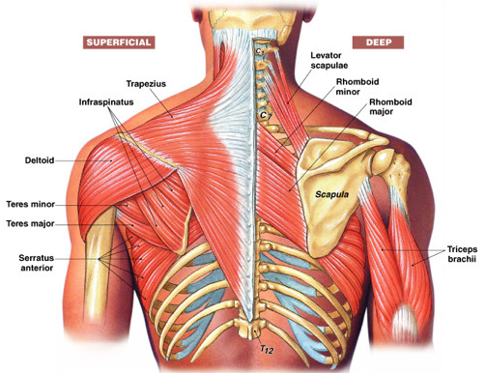

Slide 37
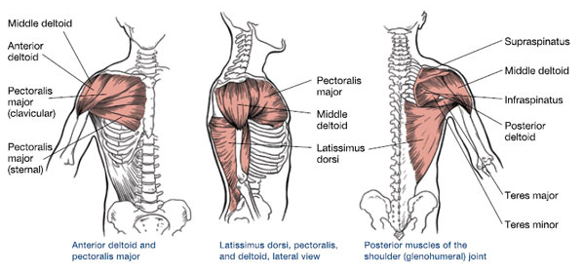
Superficial shoulder muscles

Slide 38
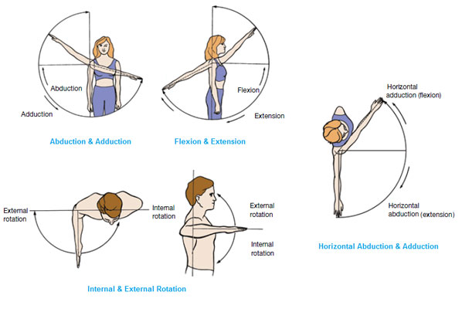
Movement of the shoulder

Slide 39
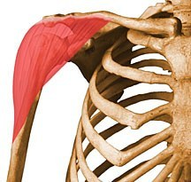
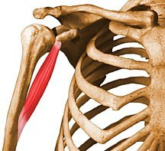
Shoulder flexion
Deltoid muscle
Coracobrachialis muscle

Slide 40
Deltoid muscle
Origin
Lateral third of clavicle, acromion, and spine of scapula
Insertion
Deltoid tuberosity of humerus
Action
Anterior part: flexes and medially rotates arm
Middle part: abducts arm
Posterior part: extends and laterally rotates arm
Innervation
Axillary nerve (C5 and C6) (C5, C6)

Slide 41
Coracobrachialis muscle
Origin
Tip of coracoid process of scapula
Insertion
Middle third of medial surface of humerus
Action
Helps to flex and adduct arm
Innervation
Musculocutaneous nerve (C5, C6 and C7) (C5, C6, C7)

Slide 42
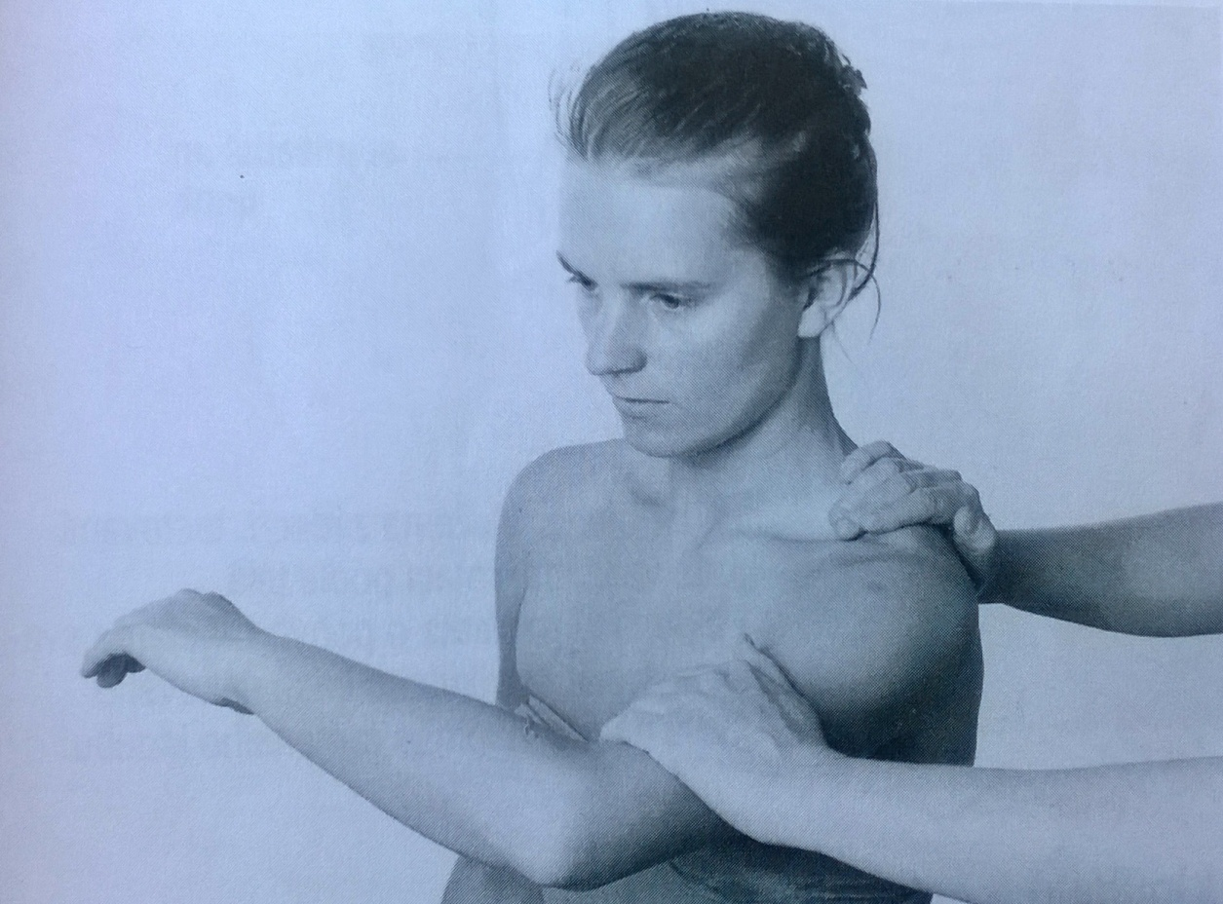
Shoulder flexion – grade 5,4
Position: patient sits, tested upper limb along body side, 90° flexion of the elbow, forearm in prone position
Fixation: upper part of the scapula
Movement: 90° flexion in the shoulder
Resistance: PT put resistance on the lower part of the arm against the movement (arched)

Slide 43
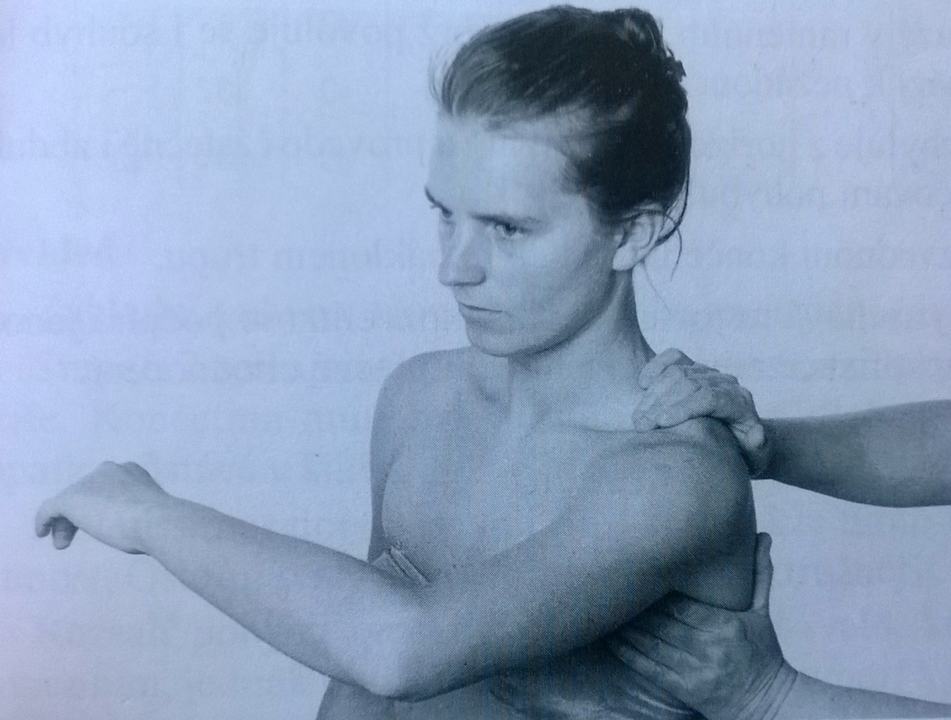
Shoulder flexion – grade 3
Position: patient sits, tested upper limb along body side, 90° flexion of the elbow, forearm in prone position
Fixation: upper part of the scapula
Movement: 90° flexion in the shoulder

Slide 44
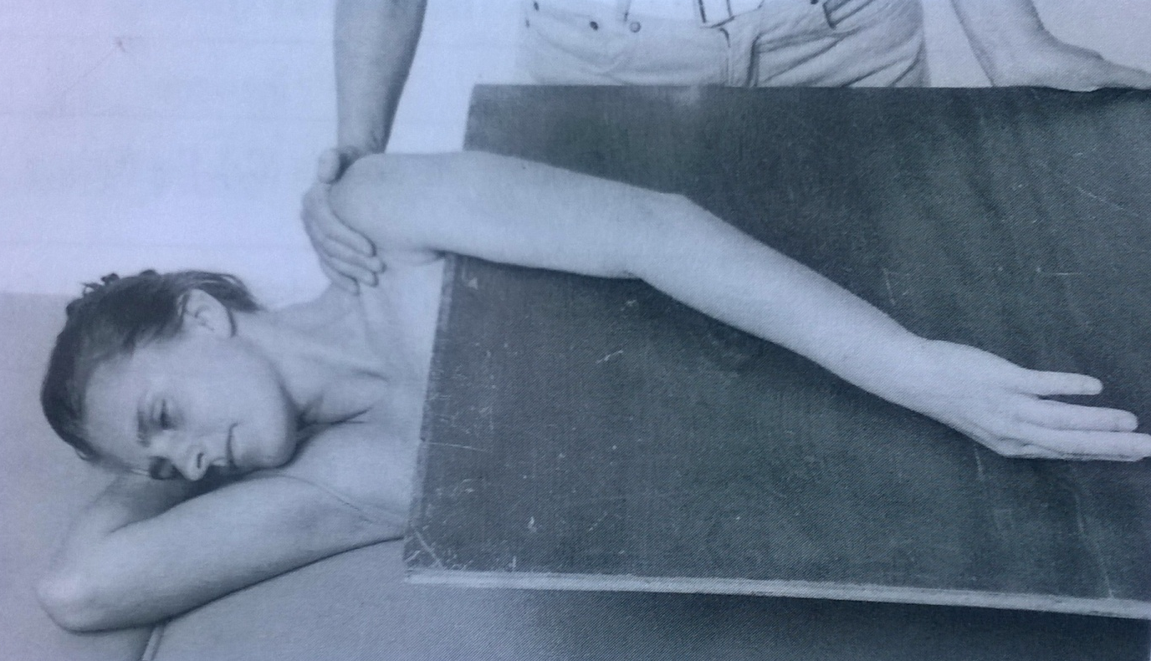
Shoulder flexion – grade 2
Position: lying on the untested side, lower limbs flexed, tested upper limb lying extended inner rotated on the desk
Fixation: upper part of the scapula
Movement: 90° flexion in the shoulder (pushing the arm along the desk)

Slide 45
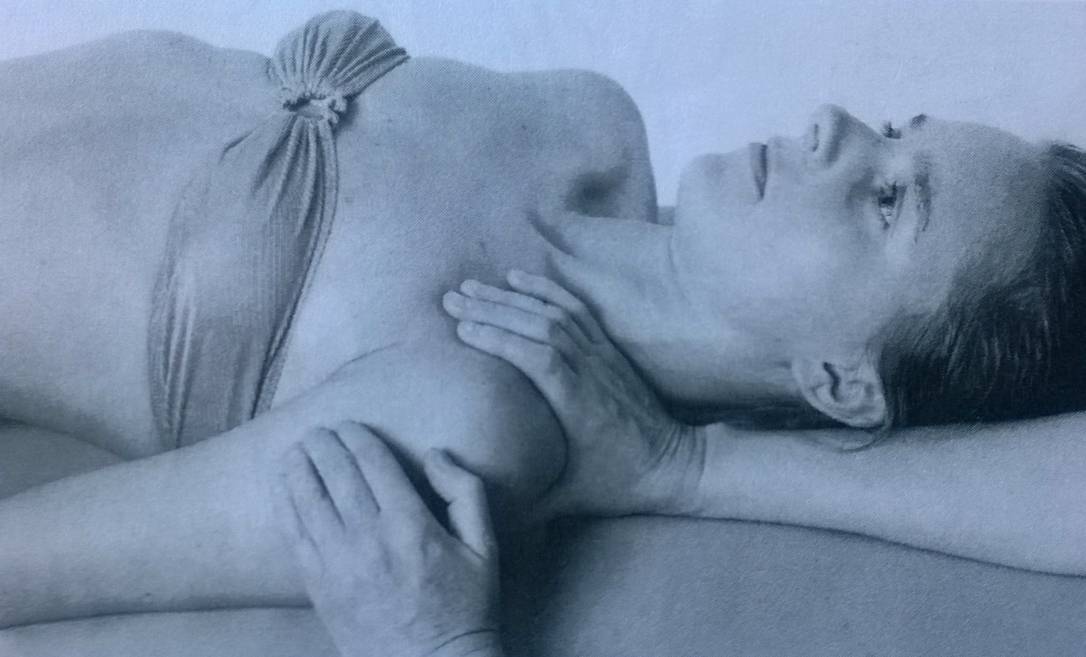
Shoulder flexion – grade 1,0
Position: supine position, tested upper limb extended, in inner rotation, lying along body side
Attempt to move: PT palpates a trace of deltoid muscle contraction on the anterior part of shoulder during patients´ attempt to move the arm forward

Slide 46
Shoulder flexion – note:
The movement has to be done with arm inner rotated. Dont´ allow the patient to do outer rotation (substitution of biceps muscle can then occur)
Dont´ allow to move the scapula (elevation or protraction) or move the trunk (usually extension)
Do the movement just in sagital plane (any abduction or rotation of the shoulder)

Slide 47
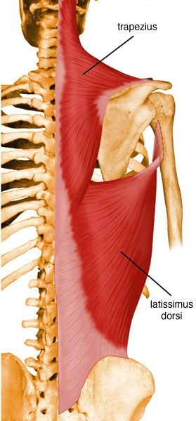
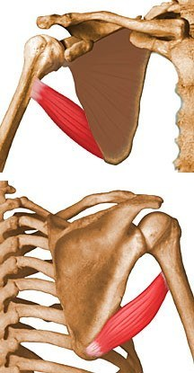
Shoulder extension
Latissimus dorsi
Teres maior
Deltoid

Slide 48
Latissimus dorsi
Origin
Spinous processes of inferior 6 thoracic vertebrae, thoracolumbar fascia, iliac crest, and inferior 3 or 4 ribs
Insertion
Floor of intertubercular groove of humerus
Action
Extends, adducts, and medially rotates humerus
raises body toward arms during climbing
Innervation
Thoracodorsal nerve (C6, C7, and C8) (C6, C7, C8)

Slide 49
Teres maior
Origin
Dorsal surface of inferior angle of scapula
Insertion
Medial lip of intertubercular groove of humerus
Action
Adducts and medially rotates arm
Innervation
Lower subscapular nerve (C6 and C7) (C6, C7)

Slide 50
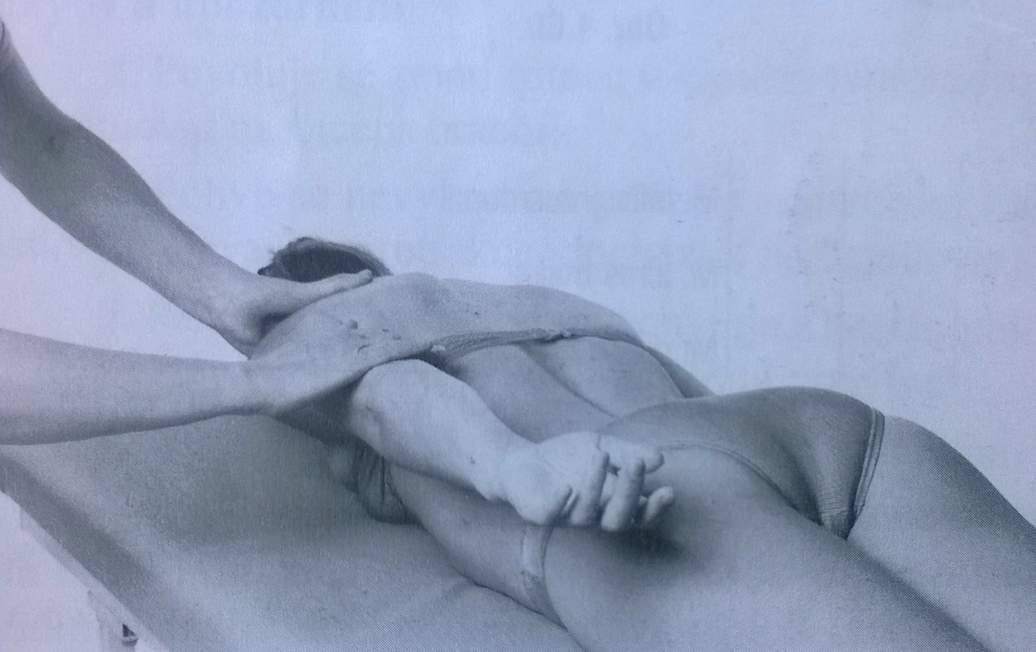
Shoulder extension – grade 5,4
Position: lying prone, head on the table, upper limbs internal rotated, lying relaxed along body side
Fixation: upper part of scapula
Movement: shoulder extension (30-40°)
Resistance: PT puts resistance on the lower part of the arm against the patients´ elevation of the arm

Slide 51
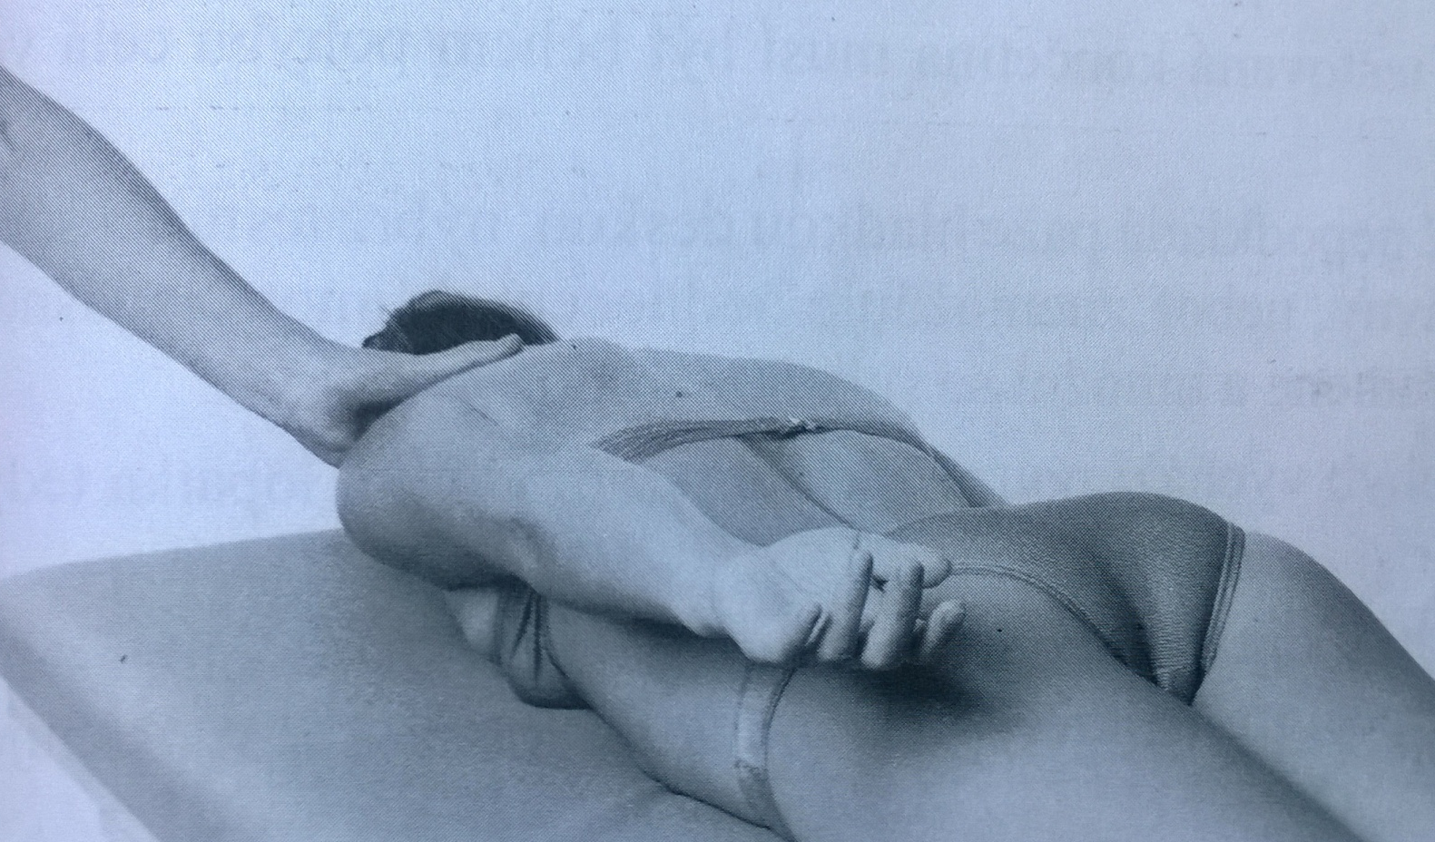
Shoulder extension – grade 3
Position: lying prone, head on the table, upper limbs internal rotated, lying relaxed along body side
Fixation: upper part of scapula
Movement: shoulder extension (30-40°)

Slide 52
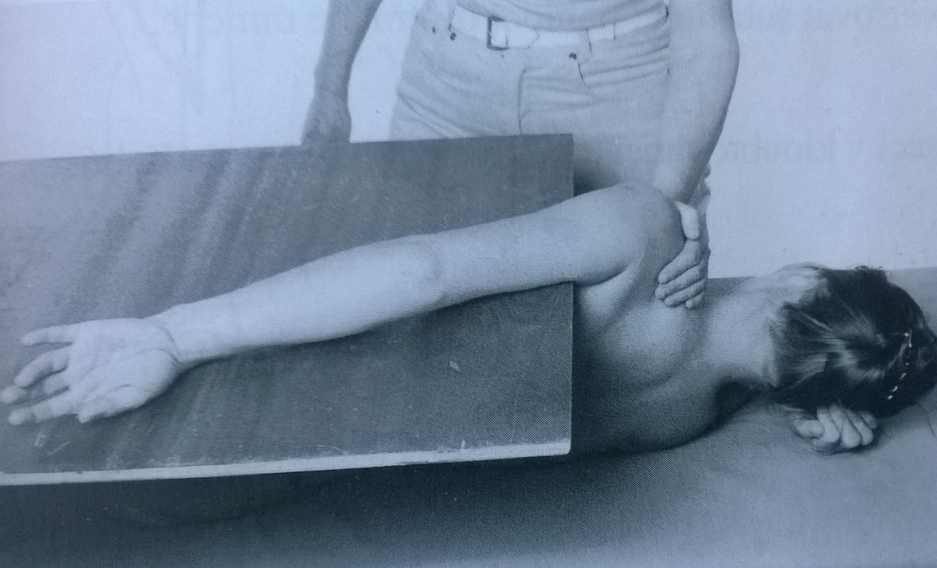
Shoulder extension – grade 2
Position: lying on the untested side, lower limbs flexed, uninvolved arm flexed, below the head, tested upper limb lying extended inner rotated on the desk
Fixation: upper part of scapula
Movement: shoulder extension (30-40°) pushing the arm along the desk

Slide 53
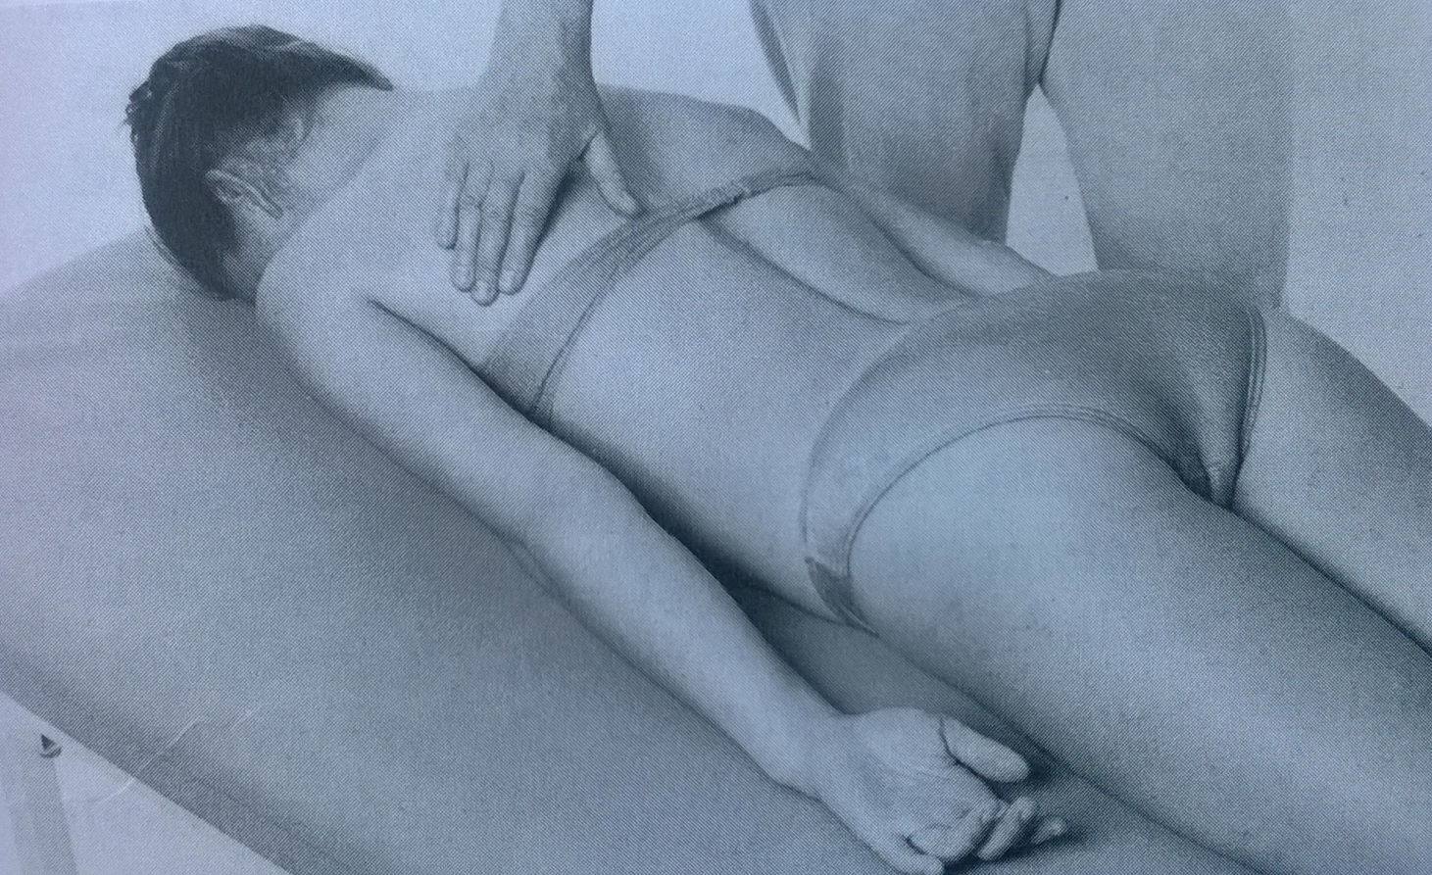
Shoulder extension – grade 1,0
Position: lying prone, head on the table, upper limbs internal rotated, lying relaxed along body side
Attempt to move: PT palpates the trace of contraction of latissimus dorsi and teres maior, during patients´ attempt to elevate the arm

Slide 54
Shoulder extension – notes:
The arm should be inner rotated during the whole movement
The trunk and scapula shouldn´t move during testing
Don´t allow the patient to adduct the scapulas or protract the shoulders

Slide 55
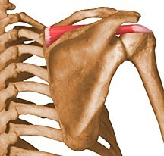
Shoulder abduction
Deltoid
Supraspinatus

Slide 56
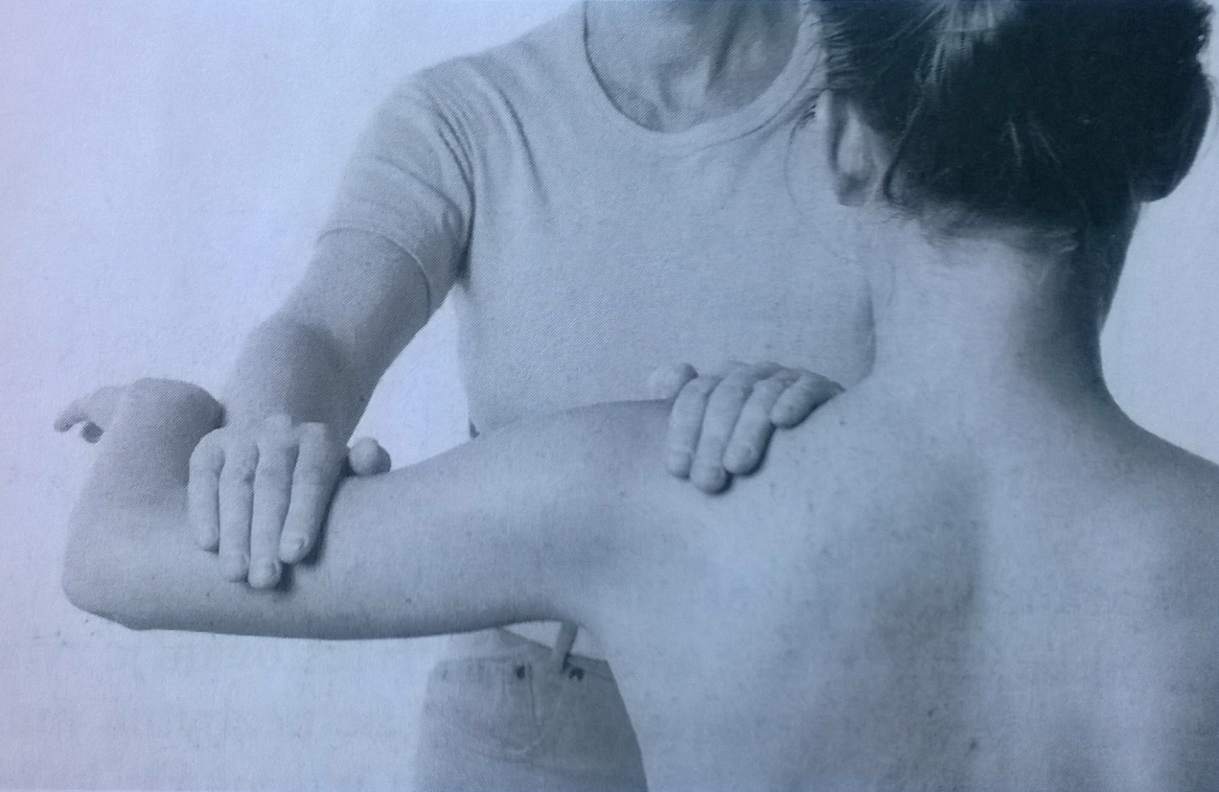
Shoulder abduction – grade 5,4
Position: sitting, elbow 90° flexed
Fixation: upper part of scapula
Movement: 90° shoulder abduction
Resistance: PT put resistance at the lower part of the arm, against the movemet (arched)

Slide 57
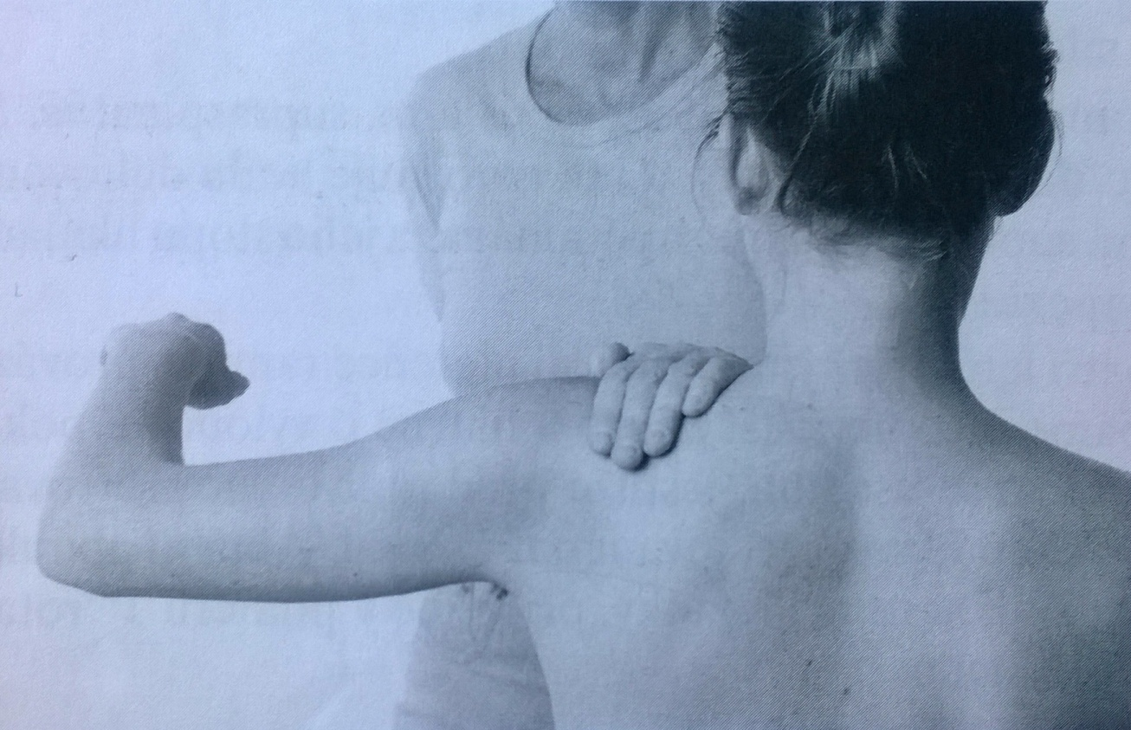
Shoulder abduction – grade 3
Position: sitting, elbow 90° flexed
Fixation: upper part of scapula
Movement: 90° shoulder abduction

Slide 58
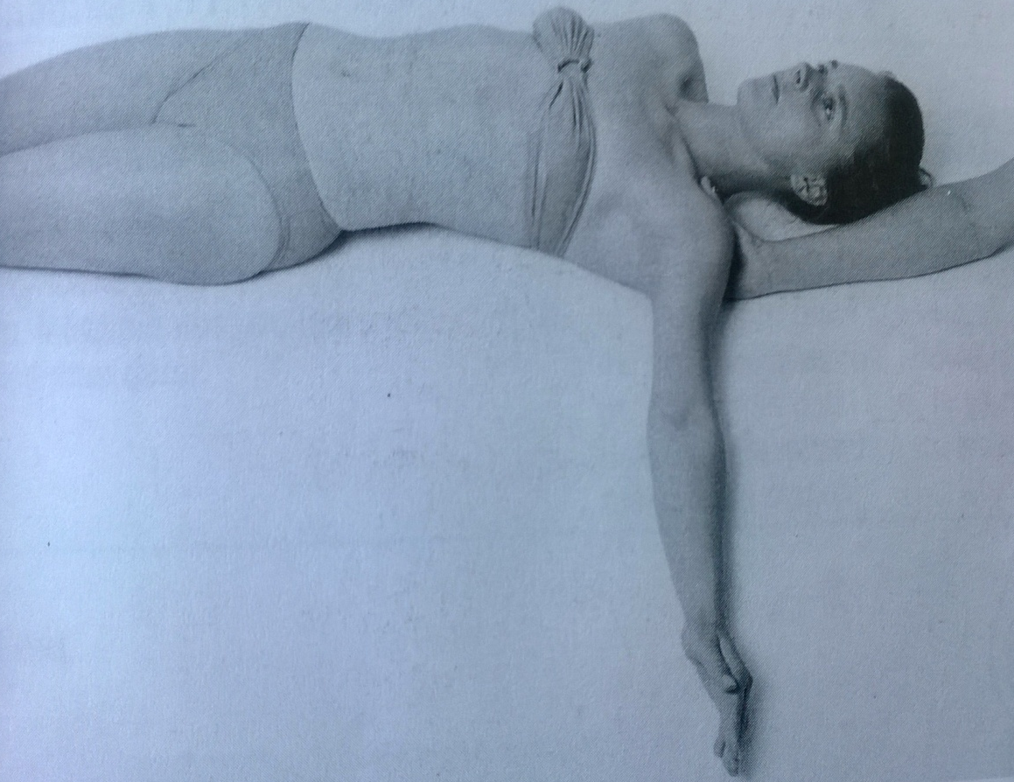
Shoulder abduction – grade 2
Position: lying supine, tested upper limb extended lying on the ulnar part of the forearm
Fixation: upper part of scapula
Movement: 90° shoulder abduction (pushing the arm along the table/desk)

Slide 59
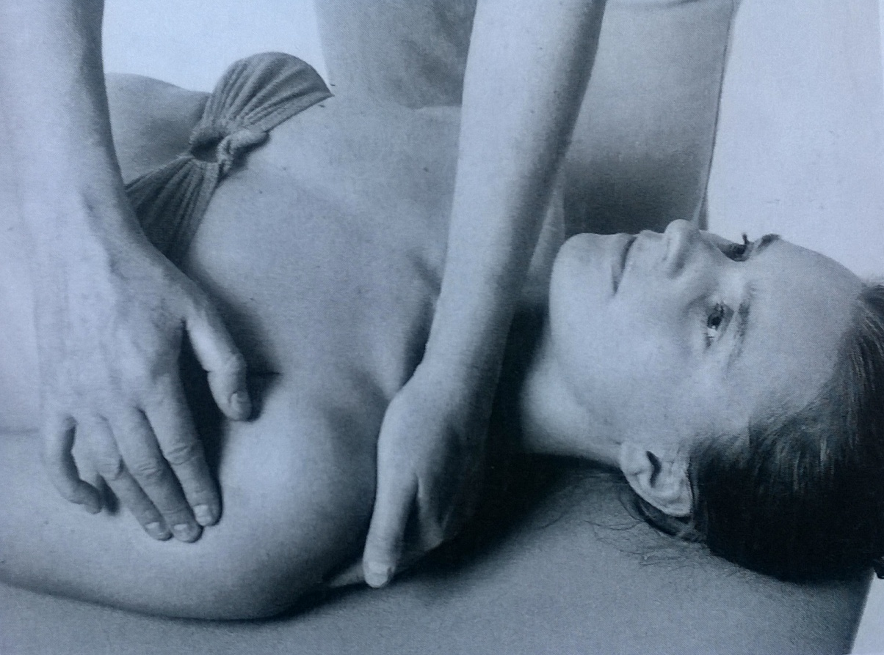
Shoulder abduction – grade 1,0
Position: lying supine, tested upper limb extended lying on the ulnar part of the forearm
Attempt to move: PT palpates the trace of contraction of deltoid and supraspinatus

Slide 60
Shoulder abduction – notes:
Don´t allow the patient to: elevate the shoulder, do the external rotation of the arm (substitution of biceps brachii or front part of deltoid can occur), move the trunk

Slide 61
Extension in abduction
(horizontal abduction)
Deltoid muscle (scapular part)

Slide 62

Extension in abduction – grade 5,4
Position: lying prone, head on the table, tested upper limb 90° abducted and inner rotated in shoulder, 90° flexion in elbow
Fixation: fix scapula over the spina scapulae
Movement: extension from the above mentioned position
Resistance: PT put resistance on the lower part of the arm against the movement

Slide 63

Extension in abduction – grade 3
Position: lying prone, head on the table, tested upper limb 90° abducted and inner rotated in shoulder, 90° flexion in elbow
Fixation: fix scapula over the spina scapulae, lower trunk if needed
Movement: extension from the above mentioned position

Slide 64

Extension in abduction – grade 2
Position: sitting next to the table, tested upper limb lying on the table – shoulder 90° abducted and inner rotated, elbow in 90° flexion
Fixation: fix scapula over the spina scapulae, lateral side of the trunk
Movement: extension from the above mentioned position

Slide 65

Extension in abduction – grade 1,0
Position: sitting next to the table, tested upper limb lying on the table – shoulder 90° abducted and inner rotated, elbow in 90° flexion
Attempt to move: PT palpates the trace of contraction of deltoid muscle during patients´ attempt of extension

Slide 66
Extension in abduction – notes:
The movement should occur just in shoulder joint – no adduction of scapula or rotation of the trunk, no elevation of the shoulder

Slide 67

Flexion in abduction
(horizontal adduction)
Pectoralis maior

Slide 68
Pectoralis maior
Origin
Clavicular head: anterior surface of medial half of clavicle
Sternocostal head: anterior surface of sternum, superior six costal cartilages, and aponeurosis of external oblique muscle
Insertion
Lateral lip of intertubercular groove of humerus
Action
Adducts and medially rotates humerus
draws scapula anteriorly and inferiorly
Acting alone: clavicular head flexes humerus and sternocostal head extends it
Innervation
Lateral and medial pectoral nerves; clavicular head (C5 and C6, sternocostal head (C7, C8, and T1) (C5, C6, C7, C8, T1)

Slide 69

Flexion in abduction – grade 5,4
Position: lying supine, lower limbs flexed, tested upper limb 90° abduct in the shoulder, 90° flexed in the elbow
Fixation: fix the shoulder from above
Movement: 90° flexion in the shoulder from the position mentioned above
Resistance: PT put resistance at the lower part of the arm (arched) against the movement

Slide 70

Flexion in abduction – grade 3
Position: lying supine, lower limbs flexed, tested upper limb 90° abduct in the shoulder, 90° flexed in the elbow
Fixation: fix the shoulder from above
Movement: 90° flexion in the shoulder from the position mentioned above

Slide 71

Flexion in abduction – grade 2
Position: sitting in front of the table, tested upper limb lying on the table, 90° abduction and inner rotation in the shoulder, 90° flexion in the elbow
Fixation: fix the shoulder from above, lateral side of the trunk on the tested side
Movement: horizontal flexion in the shoulder, pushing the arm on the table, in full range of movement

Slide 72

Flexion in abduction – grade 1,0
Position: sitting in front of the table, tested upper limb lying on the table, 90° abduction and inner rotation in the shoulder, 90° flexion in the elbow
Attempt to move: PT palpates trace of contraction of pectoralis muscle during patients´ attempt to move the arm forward

Slide 73
Flexion in abduction – notes
Don´t allow the patient to do elevation or protraction of the shoulder
Flexion of the elbow should be 90° during whole tested movement

Slide 74


External rotation
Infraspinatus
Teres minor

Slide 75
Infraspinatus
Origin
Infraspinous fossa of scapula
Insertion
Middle facet on greater tuberosity of humerus
Action
Laterally rotate arm
helps to hold humeral head in glenoid cavity of scapula
Innervation
Suprascapular nerve (C5 and C6) (C5, C6)

Slide 76
Teres minor
Origin
Superior part of lateral border of scapula
Insertion
Inferior facet on greater tuberosity of humerus
Action
Laterally rotate arm
helps to hold humeral head in glenoid cavity of scapula
Innervation
Axillary nerve (C5 and C6) (C5, C6)

Slide 77

External rotation – grade 5,4
Position: lying prone, head rotated to the tested side, tested upper limb lying on the table – shoulder 90° abducted, elbow 90° flexed (arm supported with the pillow, forearm relaxed)
Fixation: fix the lower part of the arm (lightly), scapula over the spina scapulae if needed
Movement: external rotation in full range of motion from the position mentioned above
Resistance: PT put resistance on the distal part of the forearm

Slide 78

External rotation – grade 3
Position: lying prone, head rotated to the tested side, tested upper limb lying on the table – shoulder 90° abducted, elbow 90° flexed (arm supported with the pillow, forearm relaxed)
Fixation: fix the lower part of the arm (lightly), scapula over the spina scapulae if needed
Movement: external rotation in full range of motion from the position mentioned above

Slide 79

External rotation – grade 2
Position: lying prone, head rotated to the tested side, tested upper limb in 90° flexion and inner rotation in the shoulder (hanging from the table, relaxed)
Fixation: fix the lower part of the arm (lightly), scapula over the spina scapulae if needed
Movement: external rotation in full range of motion from the position mentioned above

Slide 80

External rotation – grade 1,0
Position: lying prone, head rotated to the tested side, tested upper limb in 90° flexion and inner rotation in the shoulder (hanging from the table, relaxed)
Attempt to move: PT palpates contraction at the dorsal part of the shoulder during patients´ attempt to external rotate the arm

Slide 81

External rotation – notes:
The muscles of the forearm and the hand should be relaxed during testing
No extension of the elbow or wrist is allowed
When testing grade 2, no rotation of the forearm

Slide 82

Internal rotation
Subscapularis
Pectoralis
maior
Latissimus
dorsi
Teres
maior

Slide 83
Subscapularis
Origin
Subscapular fossa of scapula
Insertion
Lesser tuberosity of humerus
Action
Medially rotates arm and adducts it
helps to hold humeral head in glenoid cavity of scapula
Innervation
Upper and lower subscapular nerves (C5, C6 and C7) (C5, C6, C7)

Slide 84

Internal rotation – grade 5,4
Position: lying prone, head rotated to the tested side, tested upper limb lying on the table – shoulder 90° abducted, elbow 90° flexed (arm supported with the pillow, forearm relaxed)
Fixation: fix the lower part of the arm (lightly), scapula over the spina scapulae if needed
Movement: internal rotation in full range of motion from the position mentioned above
Resistance: PT put resistance on the distal part of the forearm

Slide 85

Internal rotation – grade 3
Position: lying prone, head rotated to the tested side, tested upper limb lying on the table – shoulder 90° abducted, elbow 90° flexed (arm supported with the pillow, forearm relaxed)
Fixation: fix the lower part of the arm (lightly), scapula over the spina scapulae if needed
Movement: internal rotation in full range of motion from the position mentioned above

Slide 86

Internal rotation – grade 2
Position: lying prone, head rotated to the tested side, tested upper limb in 90° flexion and external rotation in the shoulder (hanging from the table, relaxed)
Fixation: fix the lower part of the arm (lightly), scapula over the spina scapulae if needed
Movement: internal rotation in full range of motion from the position mentioned above

Slide 87

Internal rotation – grade 1,0
Position: lying prone, head rotated to the tested side, tested upper limb in 90° flexion and inner rotation in the shoulder (hanging from the table, relaxed)
Attempt to move: PT palpates contraction at the dorsal part of the shoulder during patients´ attempt to internal rotate the arm (deep palpation)

Slide 88
Internal rotation – notes:
The muscles of the forearm should be relaxed during whole tested movement
Flexion of the elbow should be 90° during whole tested movement

Slide 89
Literature, e-sources
http://www.webmd.com/pain-management/picture-of-the-shoulder
https://www.acefitness.org/blog/3535/muscles-that-move-the-arm
http://www.rad.washington.edu/academics/academic-sections/msk/muscle-atlas/upper-body

Slide 90

Thank you for your attention ☺

