Slide 1
Heart as a muscle
Dr. Amir Samadian m.d.
Department of physiology
Spring 2020

Slide 2
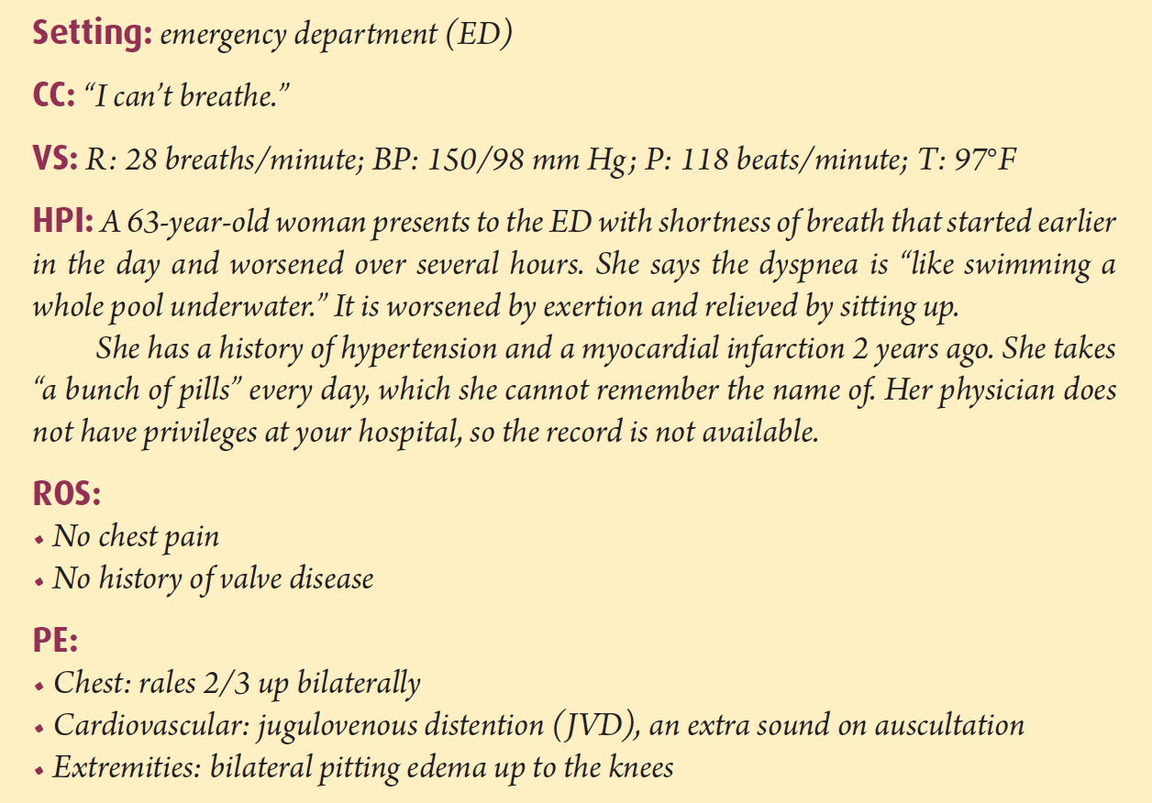
Clinical Case

Slide 3
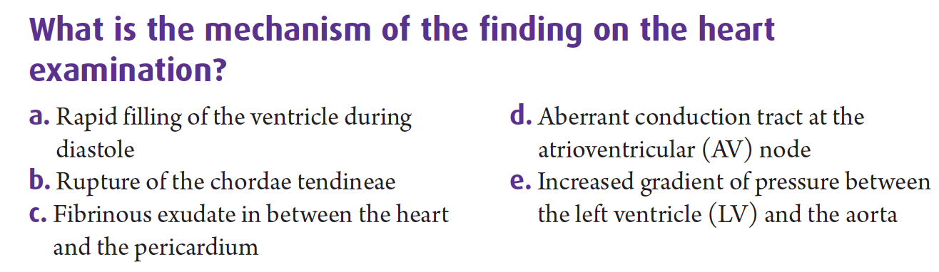
Q1

Slide 4
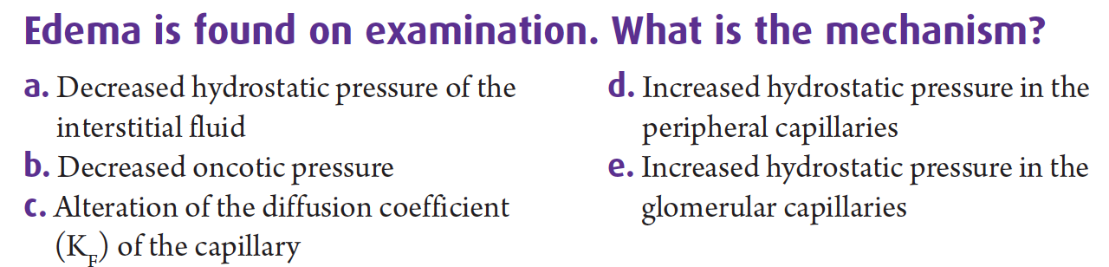
Q2

Slide 5
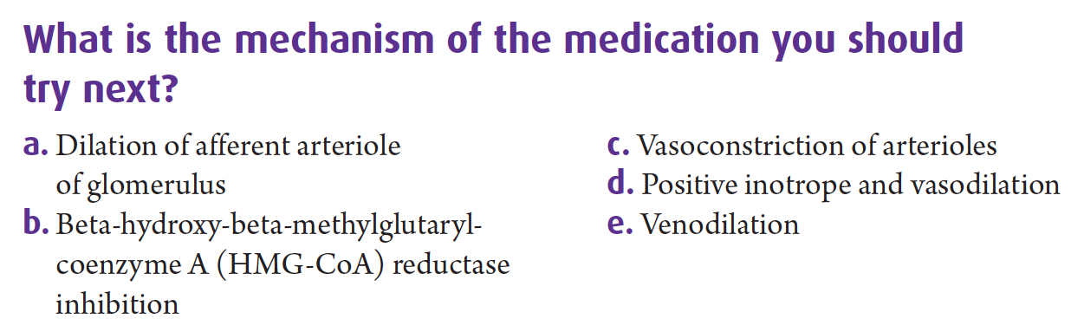
Q3

Slide 6
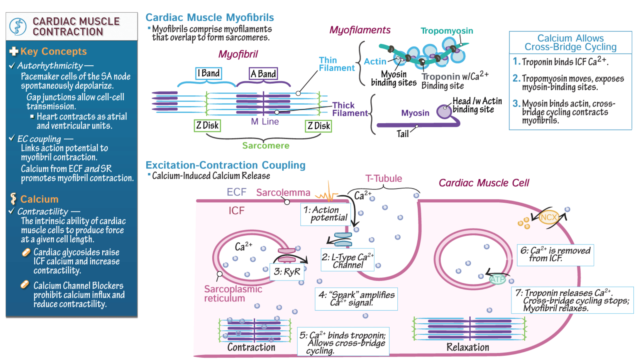

Slide 7
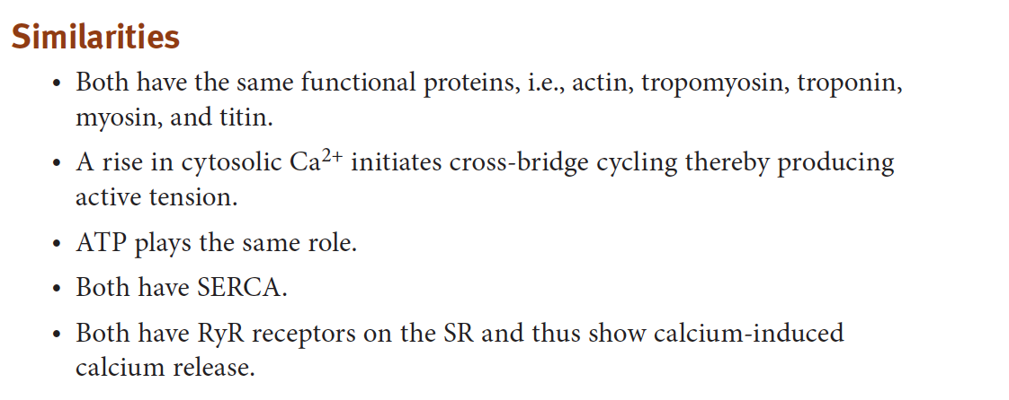
Similarities of myocardial and skeletal muscle contraction

Slide 8
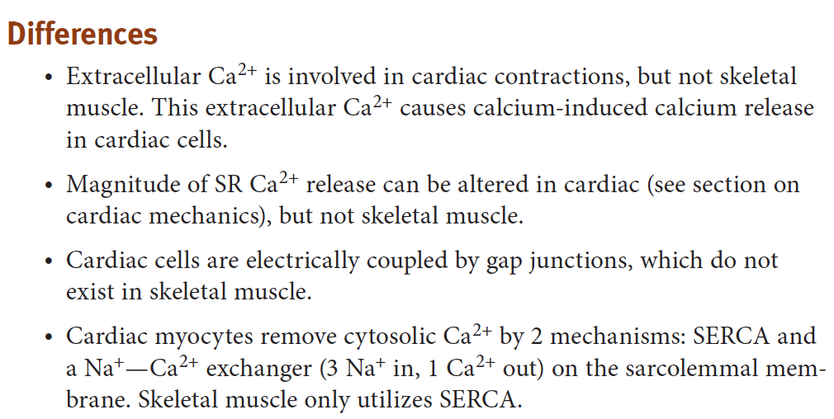
myocardial and skeletal muscle contraction

Slide 9
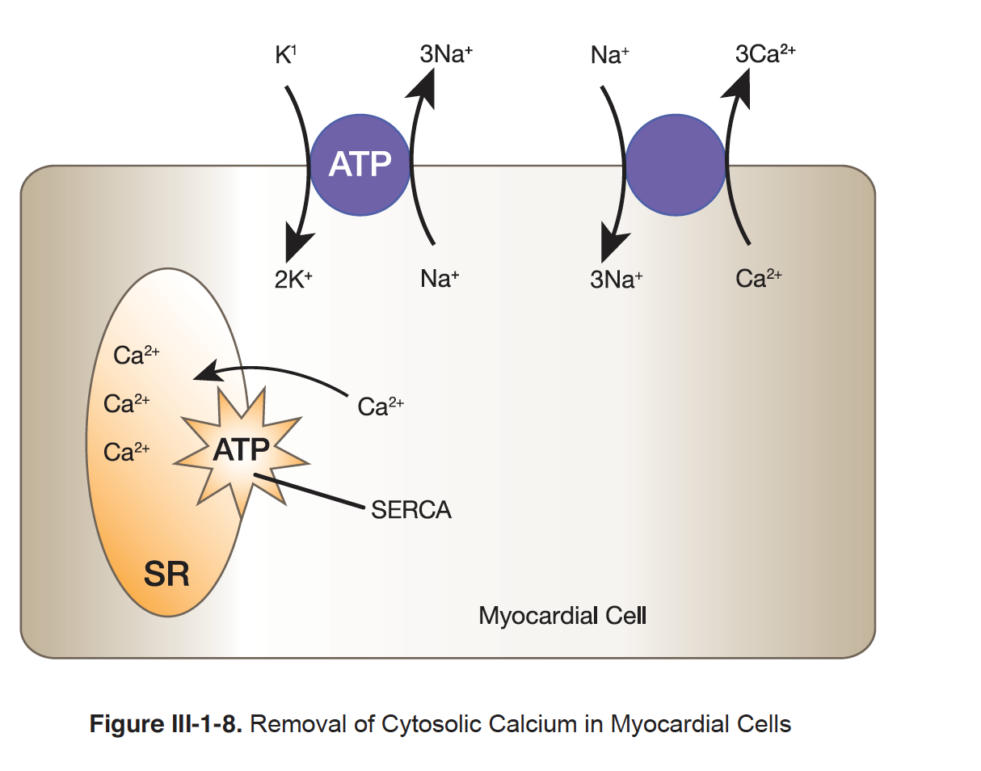
Removal of calcium in cardiomyocytes

Slide 10
Cardiac output (as a measure of cardiac performance)

Slide 11
SYSTOLIC PERFORMANCE OF THE VENTRICLE
Systolic performance actually means the overall force generated by the ventricular muscle during systole.
The heart does 2 things in systole: pressurizes and ejects blood. An important factor influencing this systolic performance is the number of cross-bridges cycling during contraction.
The greater the number of cross-bridges cycling → the greater the force of contraction.
Systolic performance is determined by 3 independent variables:
- Preload
- Contractility
- Afterload

Slide 12
PRELOAD
Preload is the load on the muscle in the relaxed state (before it contracts). More specifically, it is the load or prestretch on ventricular muscle at the end of diastole.
Applying preload to muscle does 2 things ;
Stretches the muscle (sarcomere) → greater the Preload → greater the stretch of the sarcomere
Generates passive tension in the muscle (muscle is elastic → resists the stretch like a rubber band !→ resistant is measured as passive tension)
The greater the Preload → the greater the stretch or length of sarcomere → the greater the passive tension →more cross-bridge cycles to be formed → GREATER FORCE OF CONTRACTION! → increase in SV

Slide 13
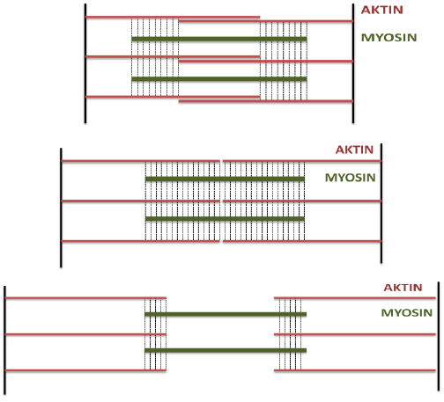
FRANK-STARLING MECHANISM

Slide 14
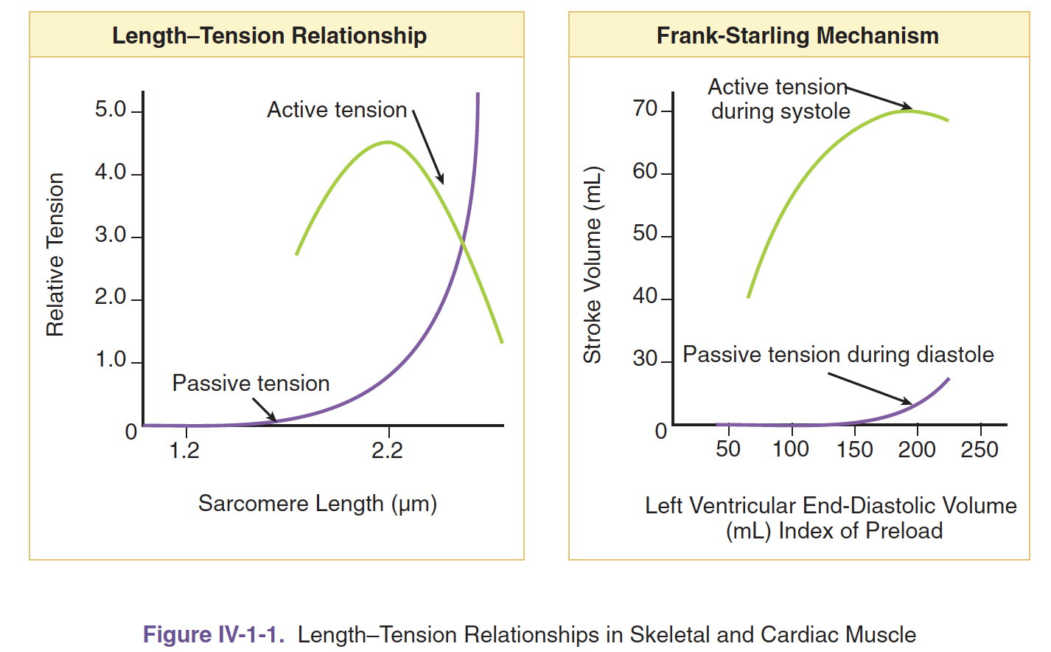
Lenght-tension relationship

Slide 15
In summary
Increased stretching (increased preload) of cardiac muscle →
increases passive tension (prior to contraction)
Increases total tention (during contraction)
Increases active tension (during contraction) until a peak response occurs

Slide 16
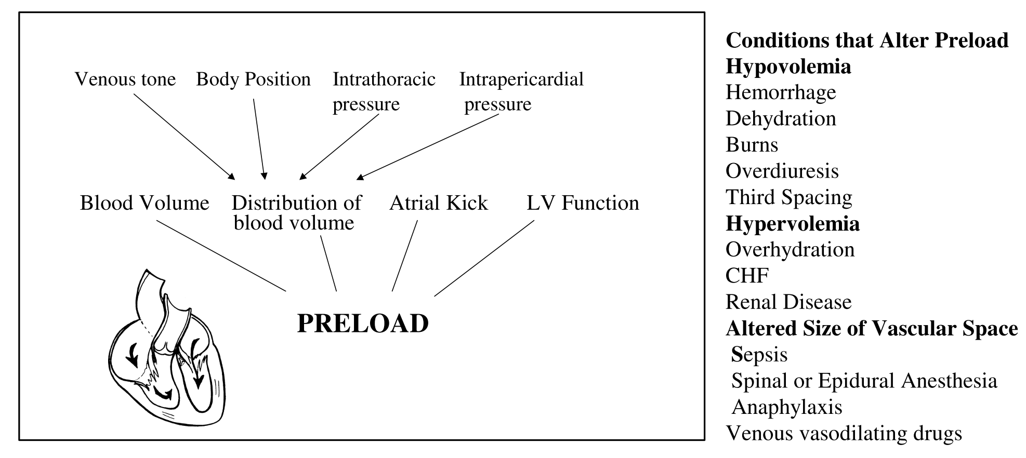
What determines the Preload ?

Slide 17
How to measure preload?
Preload on ventricular muscle is not measured directly; rather, indices are utilized.
- Left ventricular end-diastolic volume (LVEDV)
- Left ventricular end-diastolic pressure (LVEDP)
- Central venous pressure (CVP)
- Pulmonary capillary wedge pressure (PCWP)
- Right atrial pressure (RAP)

Slide 18
AFTERLOAD
Afterload is defined as the “load” that the heart must eject blood against.
Probably, the best “marker” of afterload is systemic vascular resistance (SVR), also called total peripheral resistance (TPR).
However, TPR is not routinely calculated clinically and thus arterial pressure (diastolic, mean, or systolic) is often used as the index of afterload.

Slide 19
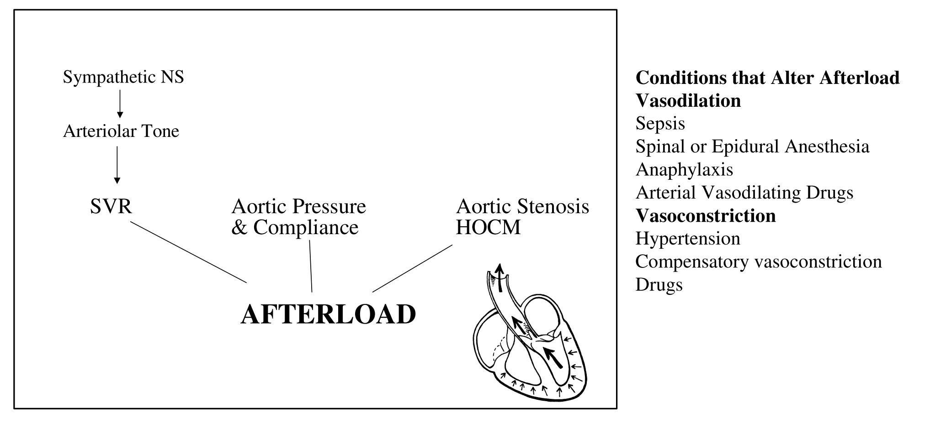
Afterload

Slide 20
CONTRACTILITY (ionotropism)
Intrinsic ability of cardiac muscle to develop force at a given muscle length (inotropism).
Is related to the intracellular Ca2+ concentration.
Can be estimated by the ejection fraction (stroke volume/end-diastolic volume), which is normally 0.55 (55%).
Increased dp/dt (change in pressure vs. change in time) = rate of pressure development during isovolumetric contraction. Contractility affects the rate at which the ventricular muscle develops active tension, which is expressed as pressure in the ventricle during isovolumetric contraction.

Slide 21
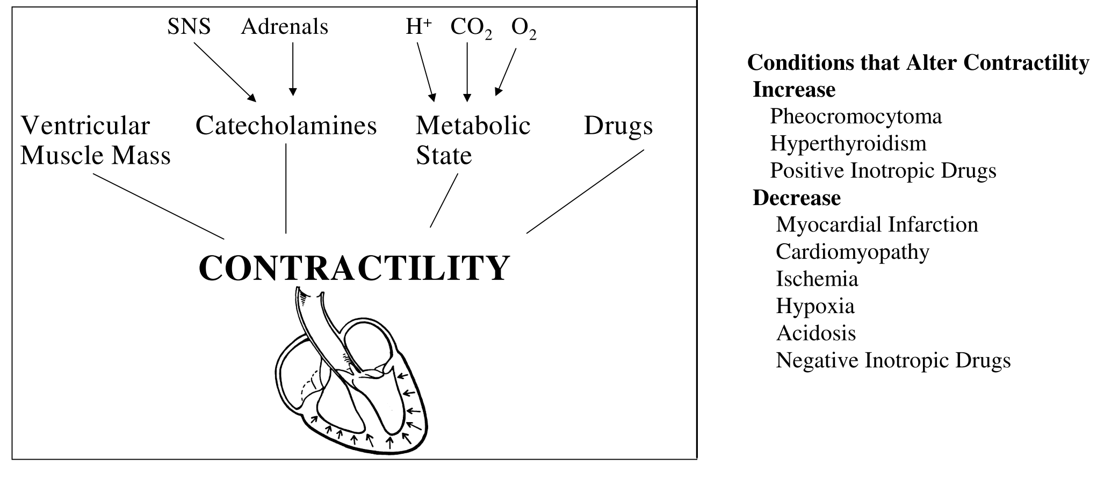
What changes the Contractility ?

Slide 22
Modulation of contractility SNS

Slide 23
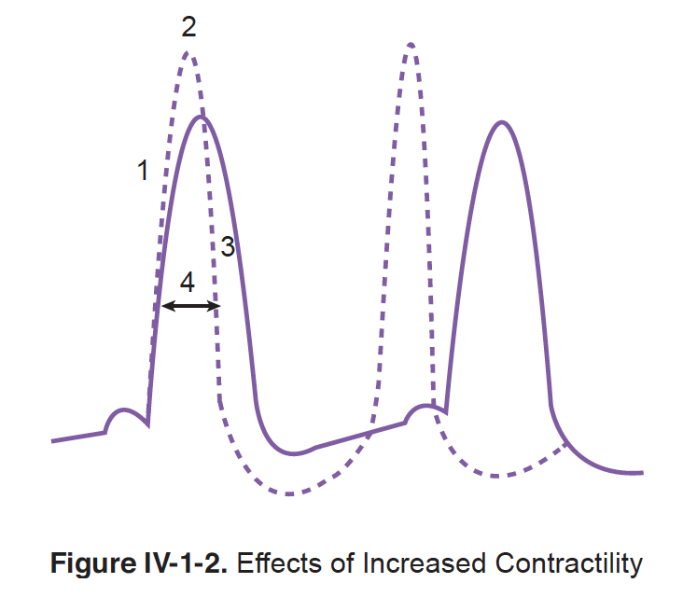
Effect of increasing contractility

Slide 24
Heterometric and homeometric autoregulation of contractility

Slide 25
IMPORTANT!

Slide 26
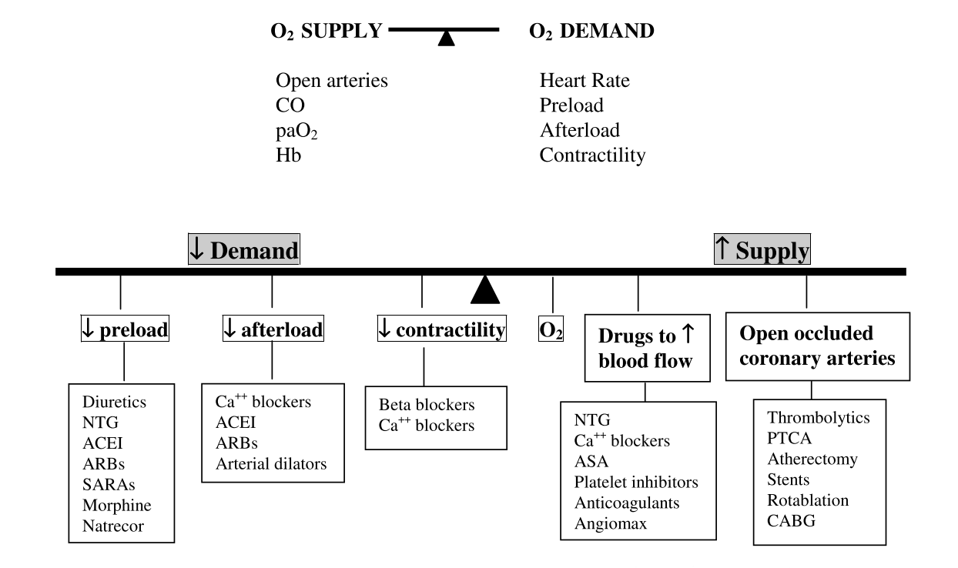
Why are we learning all of these!

Slide 27
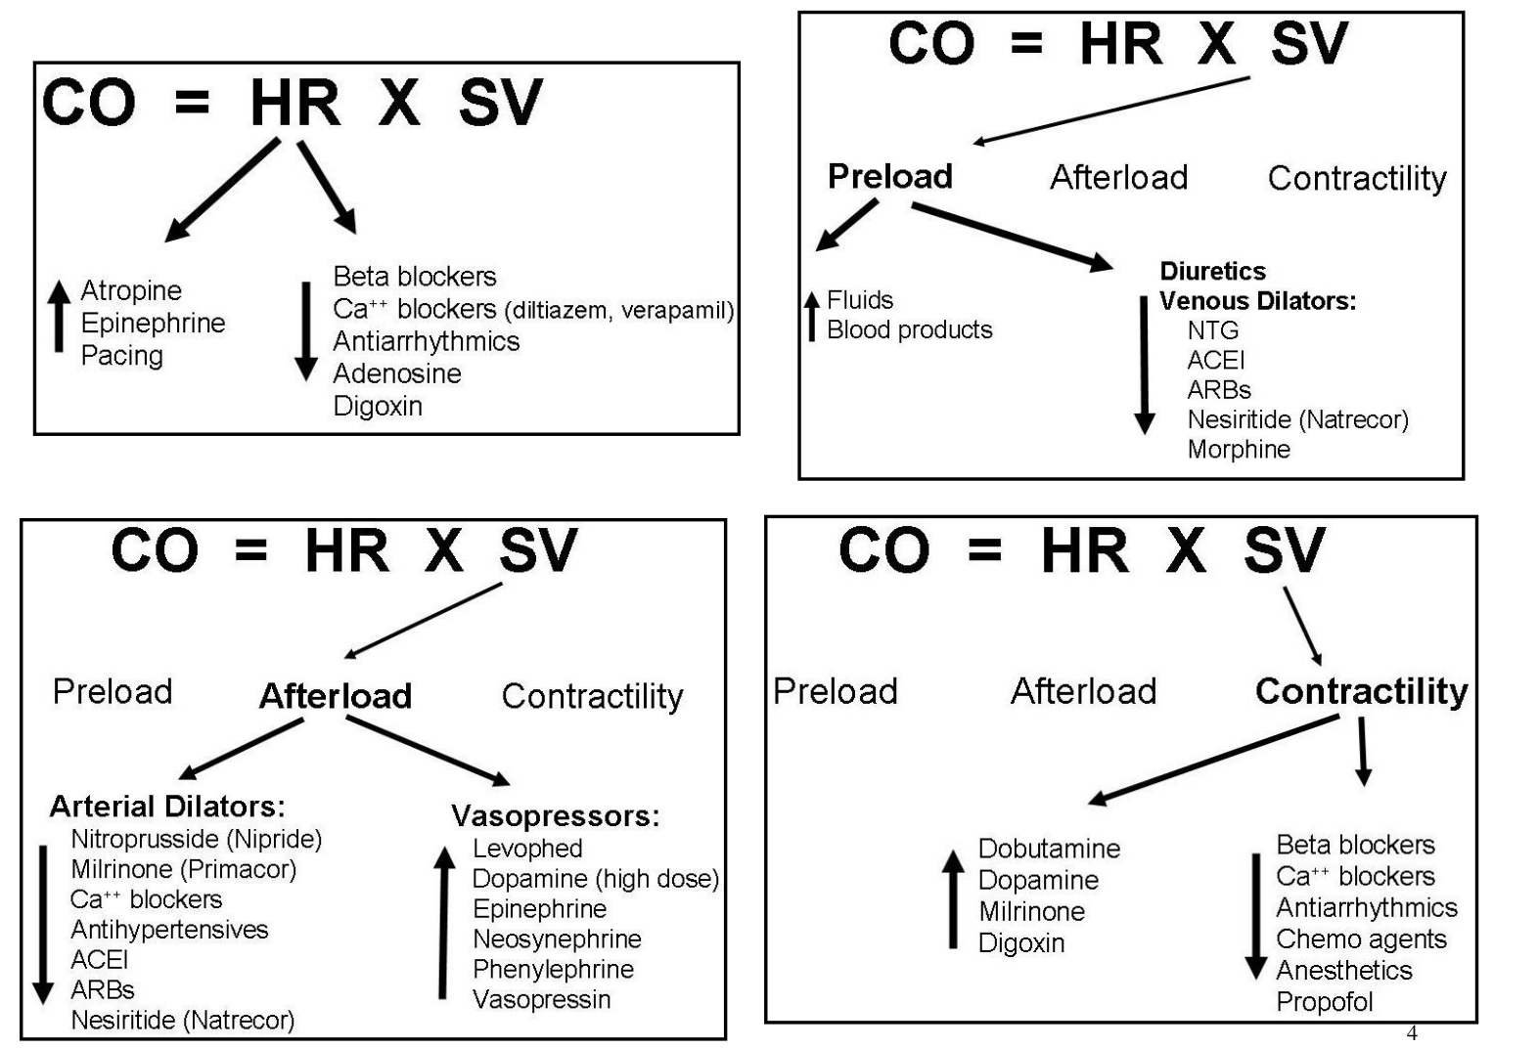
Pharmacological approach

Slide 28
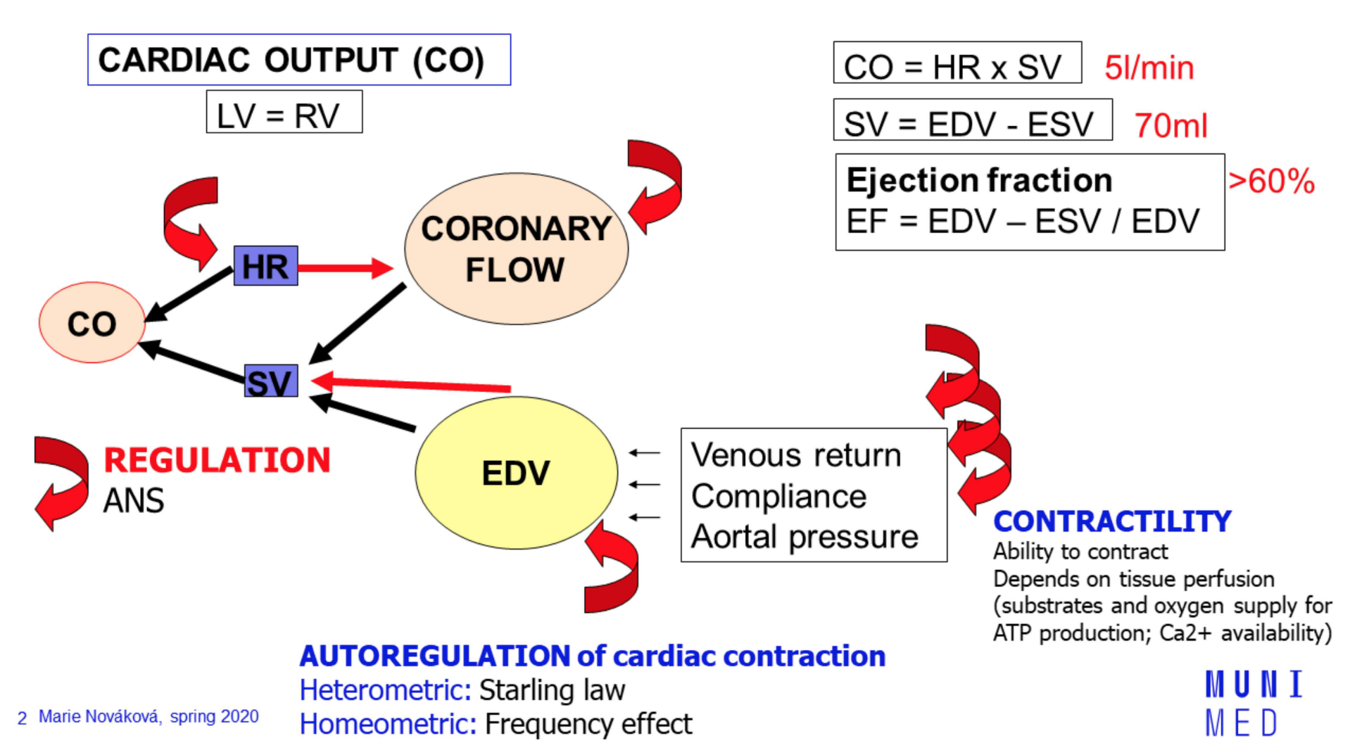
Cardiac Output as the measure of performance (courtesy of Prof. Marie Novakova)

Slide 29
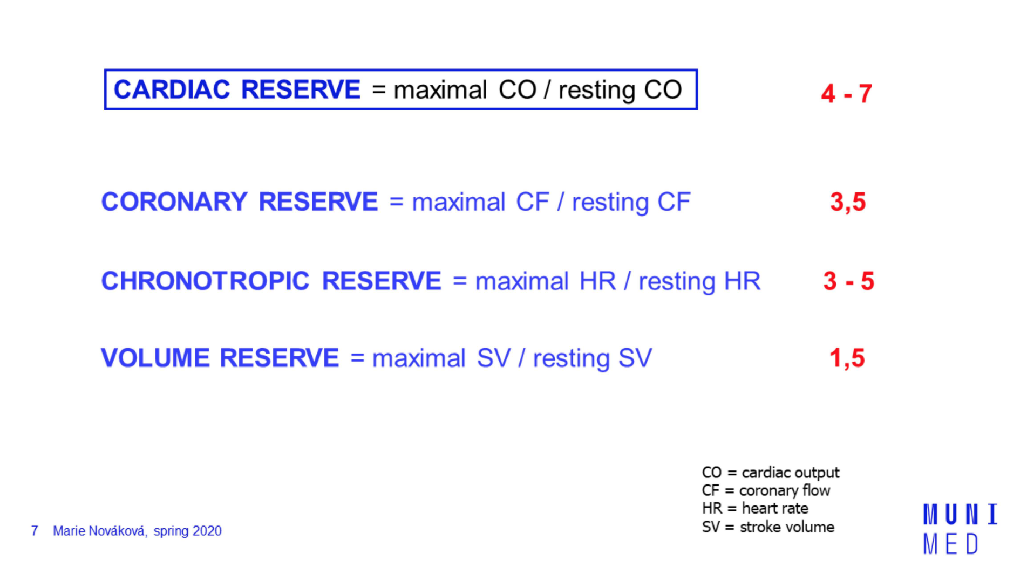
Cardiac Reserve (courtesy of Prof. Marie Novakova)

Slide 30
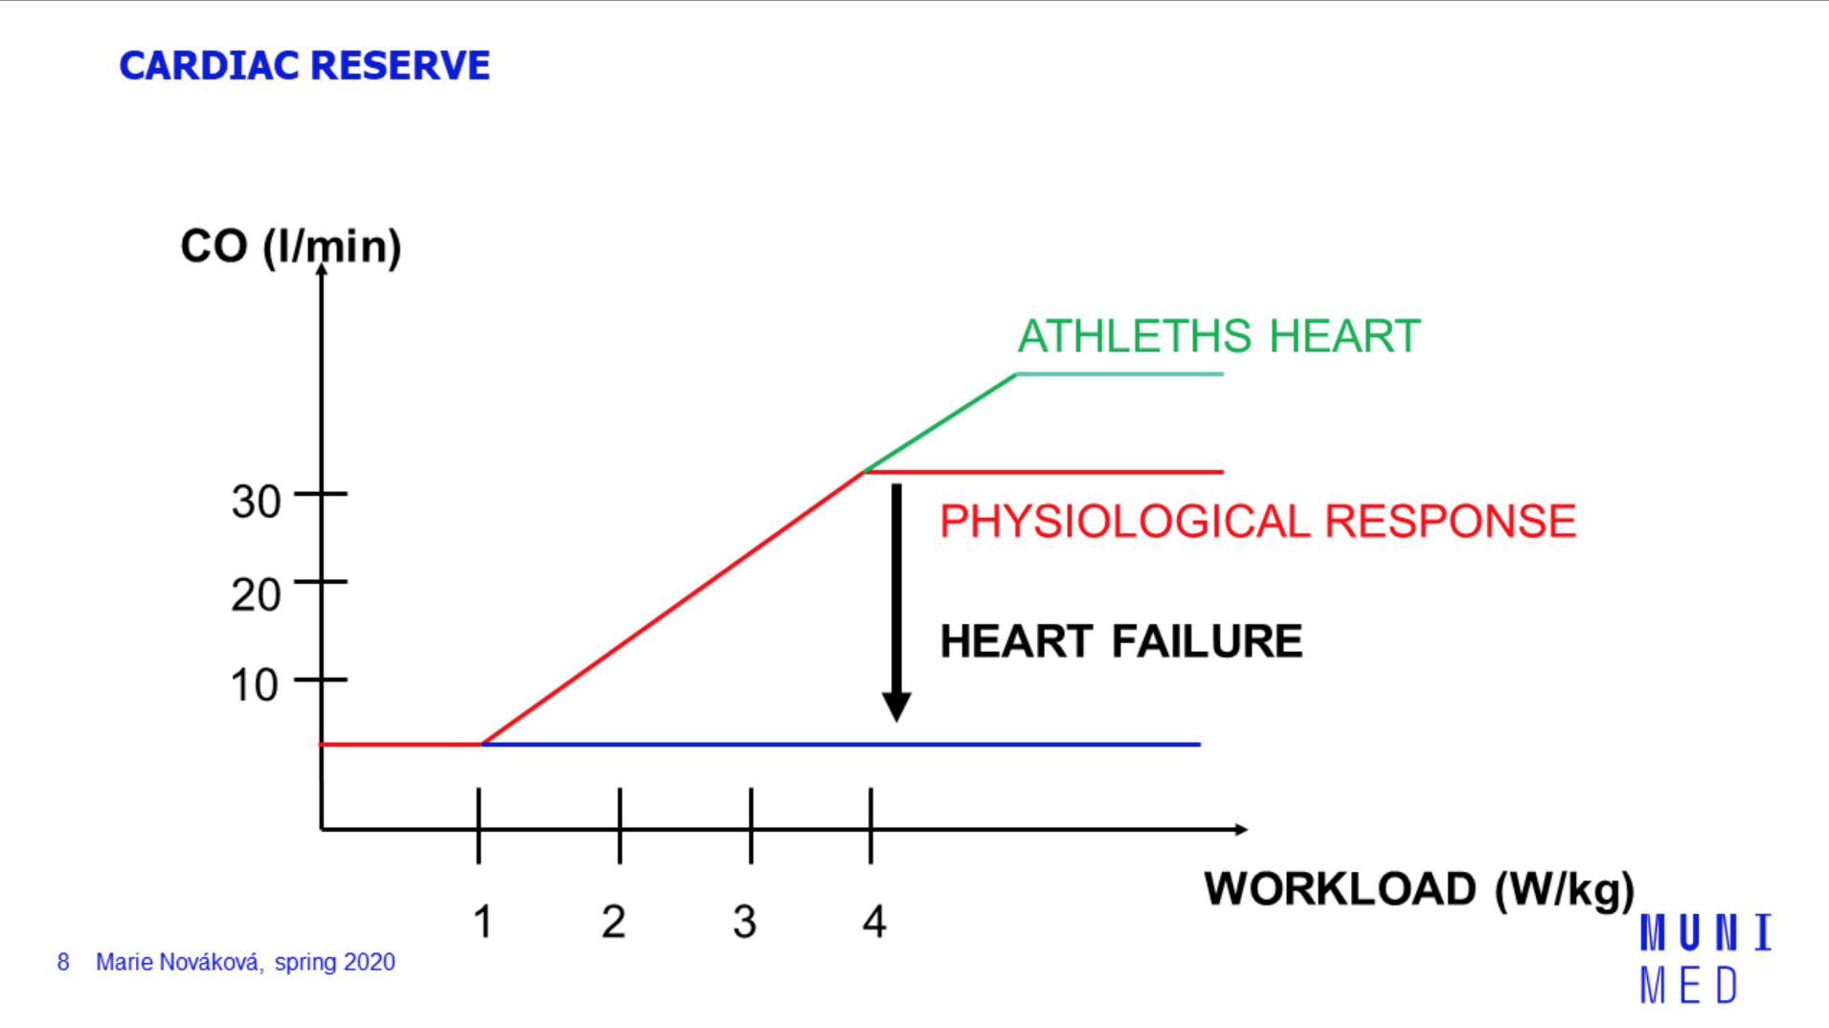
Cardiac Reserve

Slide 31
CARDIAC OXYGEN (O2) CONSUMPTION
Is directly related to the amount of tension developed by the ventricles.
Increased by:
- Increased afterload (increased aortic pressure).
- Increased size of the heart (Laplace's law states that tension is proportional to the radius of …….a sphere).
- Increased contractility.
- Increased heart rate.

Slide 32
MEASUREMENT OF CARDIAC OUTPUT BY THE FICK PRINCIPLE
The Fick principle for measuring cardiac output is expressed by the following equation:
The equation is solved as follows:
1. O2 consumption for the whole body is measured.
2. Pulmonary vein [O2] is measured in systemic arterial blood.
3. Pulmonary artery [O2] is measured in systemic mixed venous blood.

Slide 33
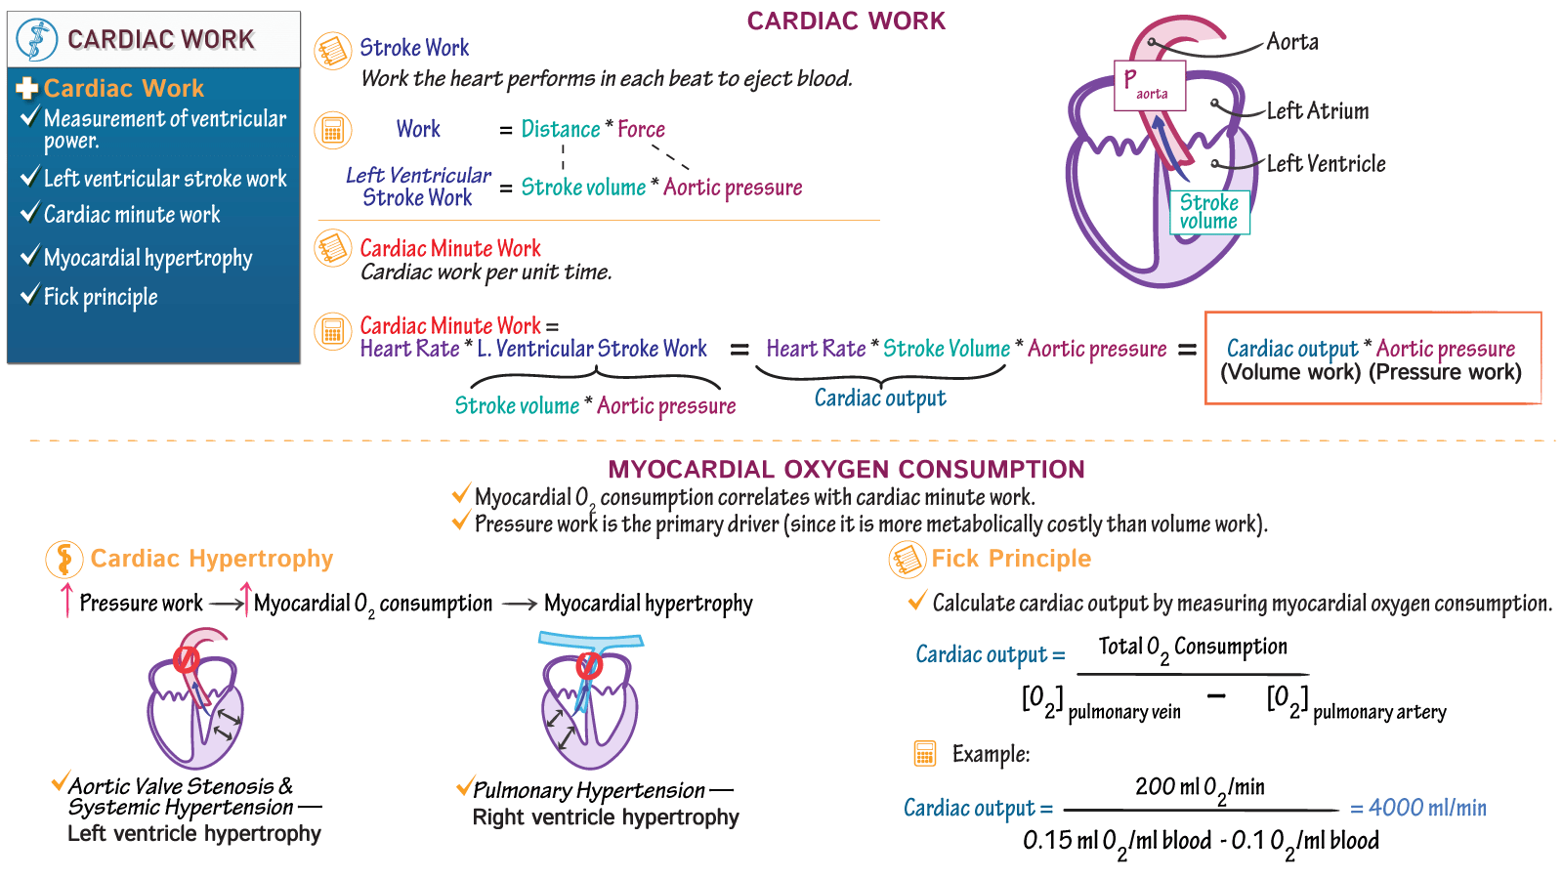

Slide 34
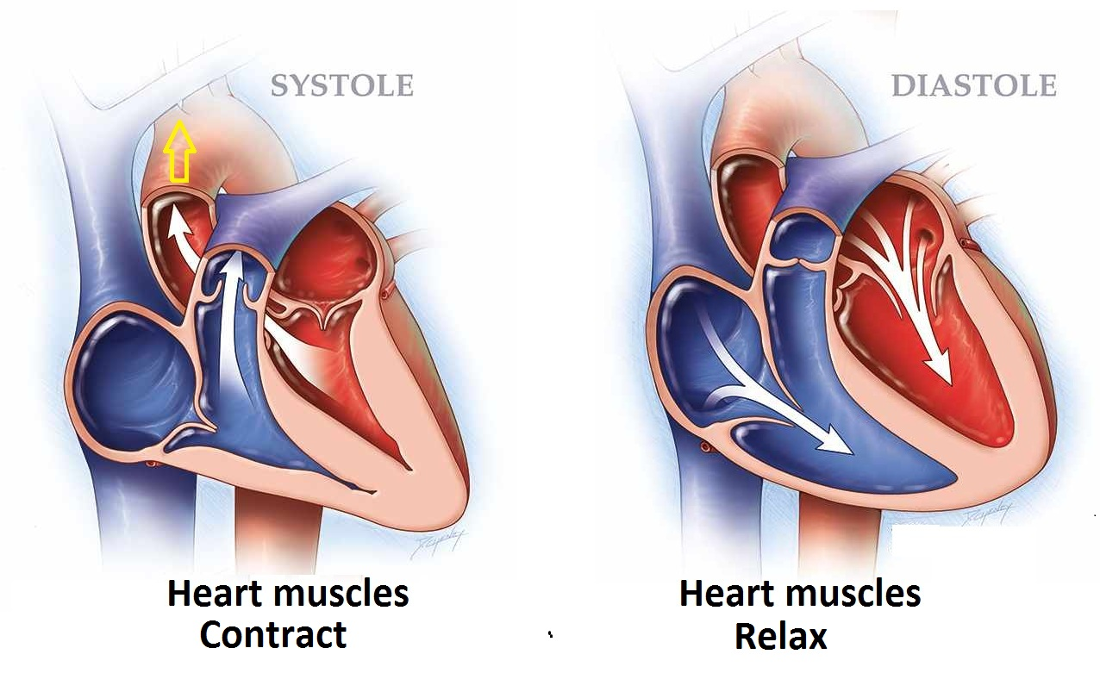
3. CARDIAC CYCLE.

Slide 35
Cardiac cycle
Made of 2 phases :
1) SYSTOLE
A. Cardiac contraction(isovolumic contration)
B. Ejection of the blood out of heart (systolic ejection)
2) DIASTOLE
A. Cardiac Relaxation (isovolumic relaxation)
B. Filling of the heart with blood (Ventricular filling)

Slide 36
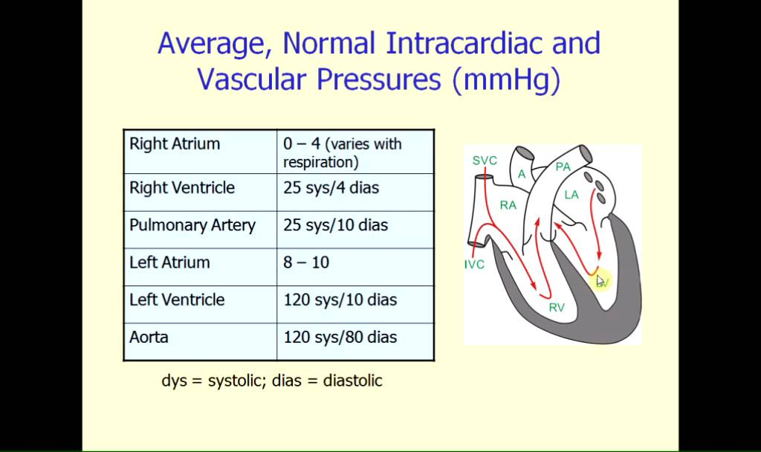
Intracardiac pressures

Slide 37
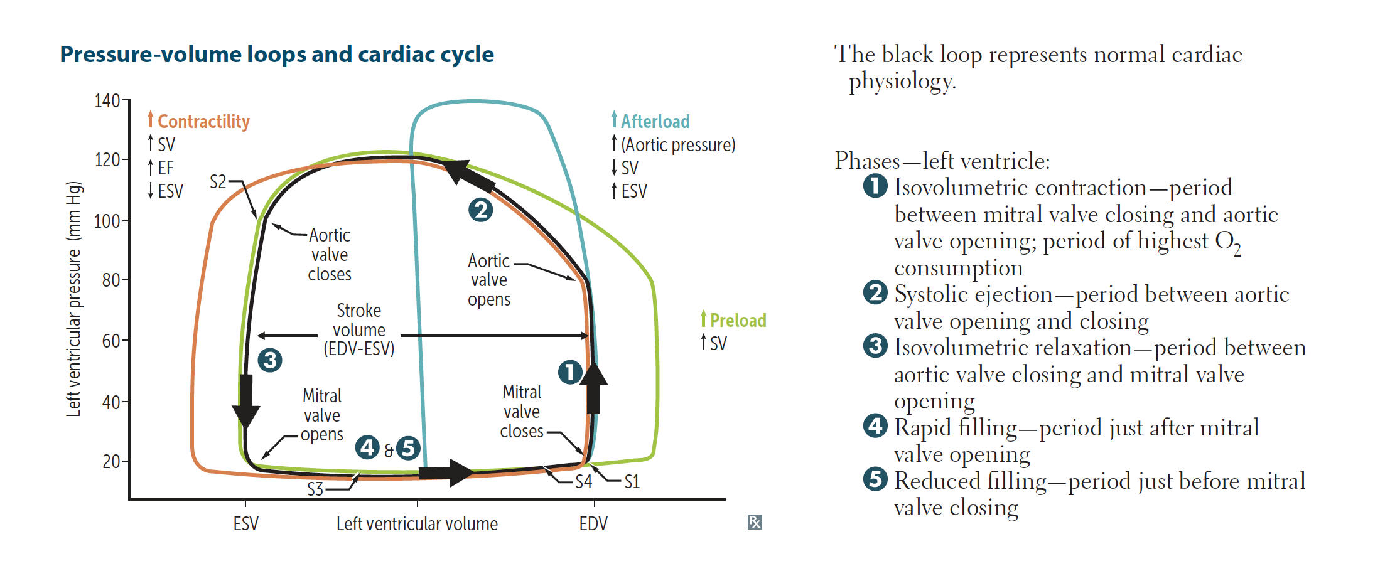
LV Pressure-Volume loop

Slide 38
AUSCULTATION OF HEART

Slide 39
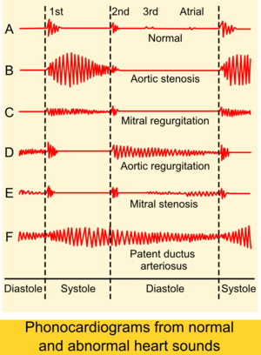
phonocardiography

Slide 40
Physiological heart sounds

Slide 41
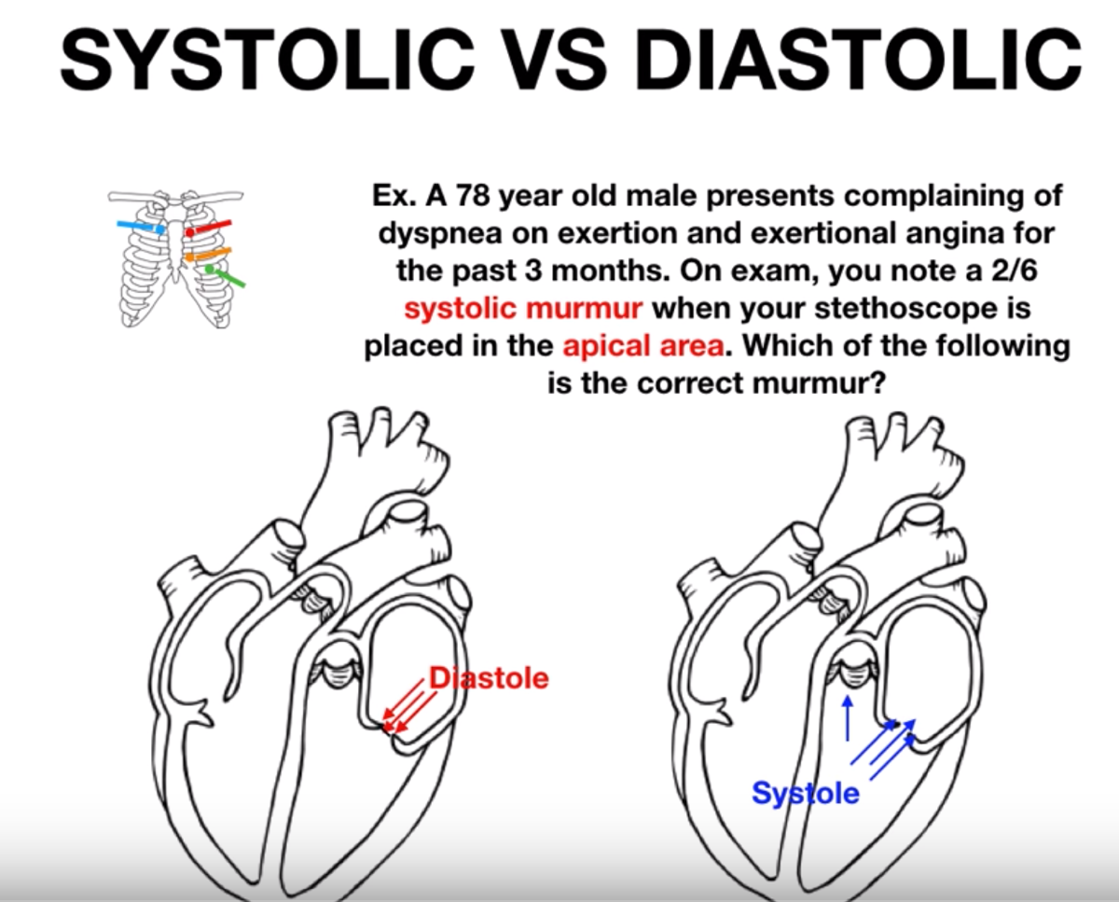
Question ?

Slide 42
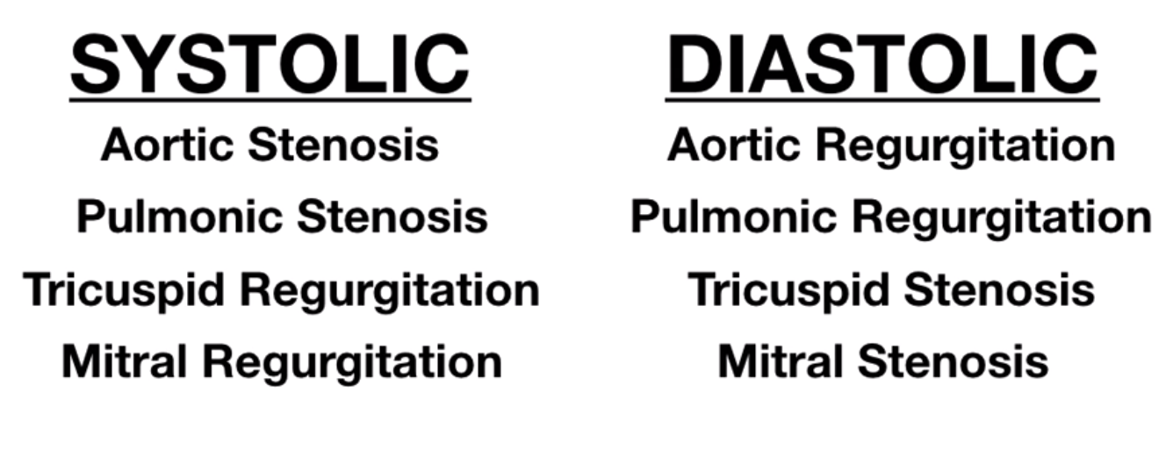
murmurs

Slide 43
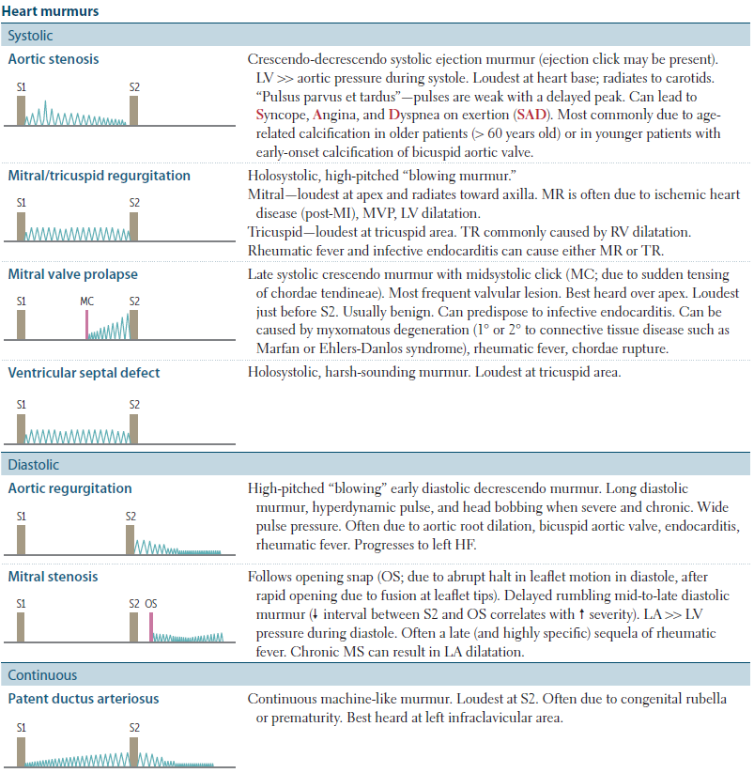

Slide 44
4. POLYGRAPHY

Slide 45
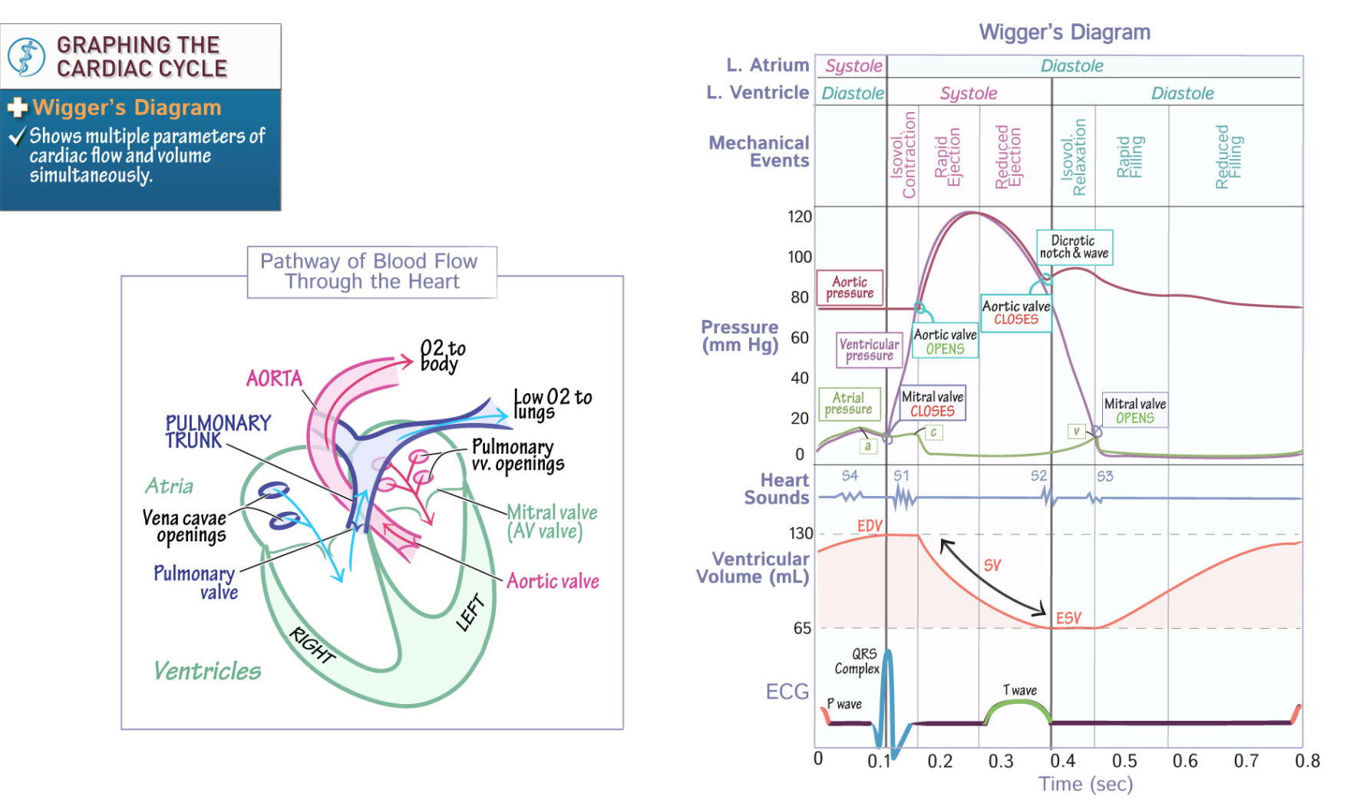

Slide 46
THANKS FOR YOUR ATTENTION!

