Slide 1


Case report – rectal cancer
T.Rohan
Department of Radiology and Nuclear Medicine University Hospital Brno and Faculty of Medicine Masaryk University

Slide 2
Male, 72 years
Admitted to surgery department for staging and treatment of recenttly diagnosed rectal cancer.
Positive fecal occult blood test. On following colonoscopy rectal cancer in the distance 8 cm from anus, histologically confirmed adenocarcinoma.
No subjective complaints.
Objectively palpable resistance during digital rectal examination.

Slide 3
Rectal cancer staging
Locoregional staging (extent of the tumor, regional lymph nodes):
MRI of the rectum, rectoscopy with endoluminal ultrasound
Staging of distant metastases:
CT of abdomen and thorax, alternative is PET/CT or PET/MRI of the trunk
PET/MRI of the trunk and rectum allows to perform locoregional staging and detection of distant metastases during one procedure.
During staging of rectal cancer on PET/MRI, in adition to standard sequences, dedicated sequences focused on rectum are performed.

Slide 4
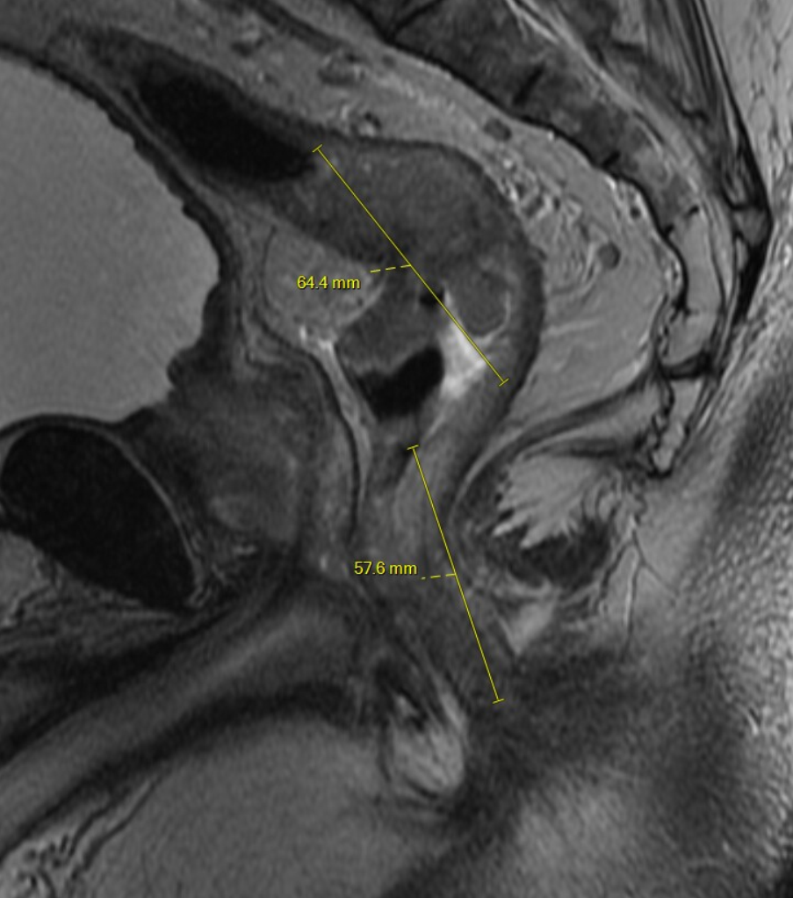
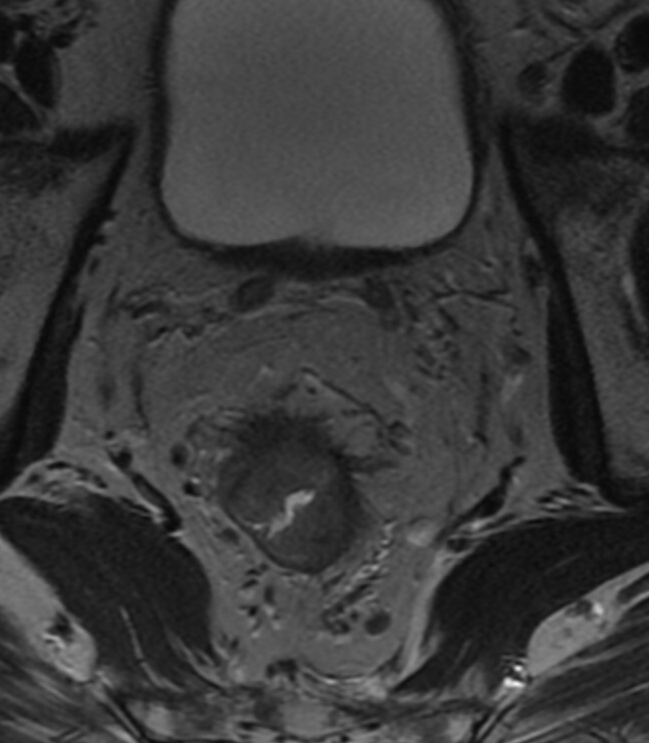
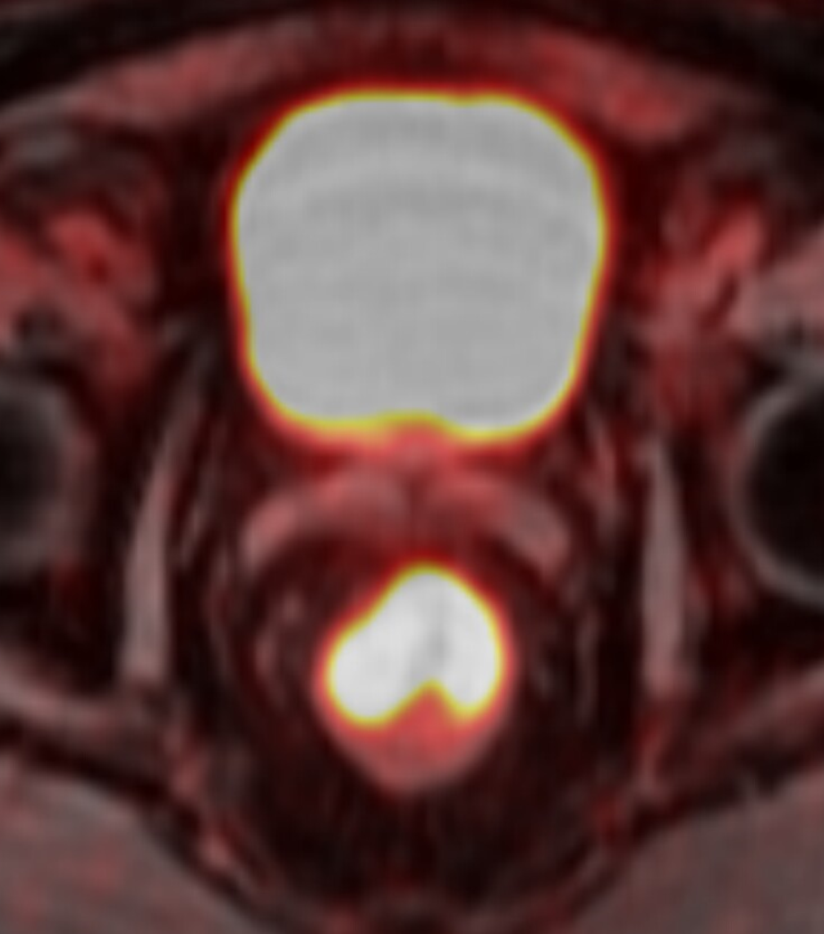
MRI of the rectum - summary
In the distance of 5 cm from anus is a rectal cancer causing circular thickening of rectal wall in the length of 8 cm. Tumor grows into surrounding fat, but it is not infiltrating mesorectal fascia or prostate. On diffuse weighted images is visible restricted diffusion corresponding to increased accumulation of fluordeoxyglucose.
Conclusion: Rectal cancer T3b N0 M0.
T2 axial plane – distance from anus, extent of the tumor
T2 coronal plane – circular thickening of the wall with spiculations iradiating into surounding fat, small lymph nodes in perirectal fat (circles).
PET/MRI fusion – radiopharmaceutical (18-FDG) is accumulated in rectal cancer and urinary bladder (excreted via urine).

Slide 5
Follow-up
Presentation on tumor board.
Tumor board recommends neoadjuvant chemoradiotherapy (in total aplicated 45Gy focused on the pelvis and 5.4Gy on the rectum, concomitantly capecitabine, no complicationss)
Initial plan was to perform restaging on PET/MRI, but the patient missed the appointment and PET/MRI was not ordered in time.
PET (PET/MR) should be performed at least 8 weaks since the last radiotherapy because of possible false positive findings in irradiated area.
Because of mentioned consequences restaging was performed via MRI of the rectum (locoregional staging) and abdominal CT (distant metastases).

Slide 6
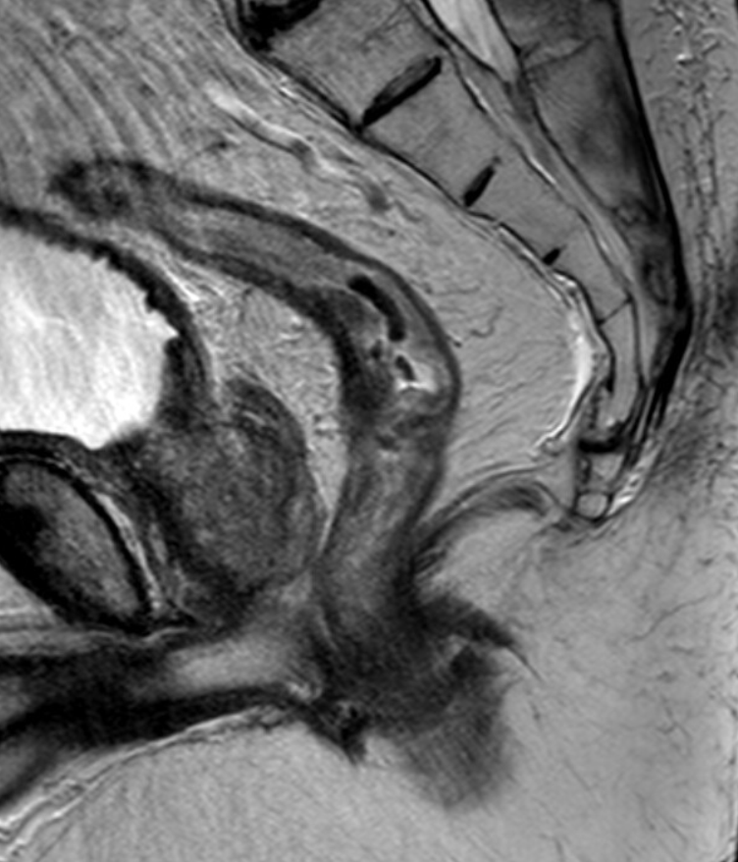
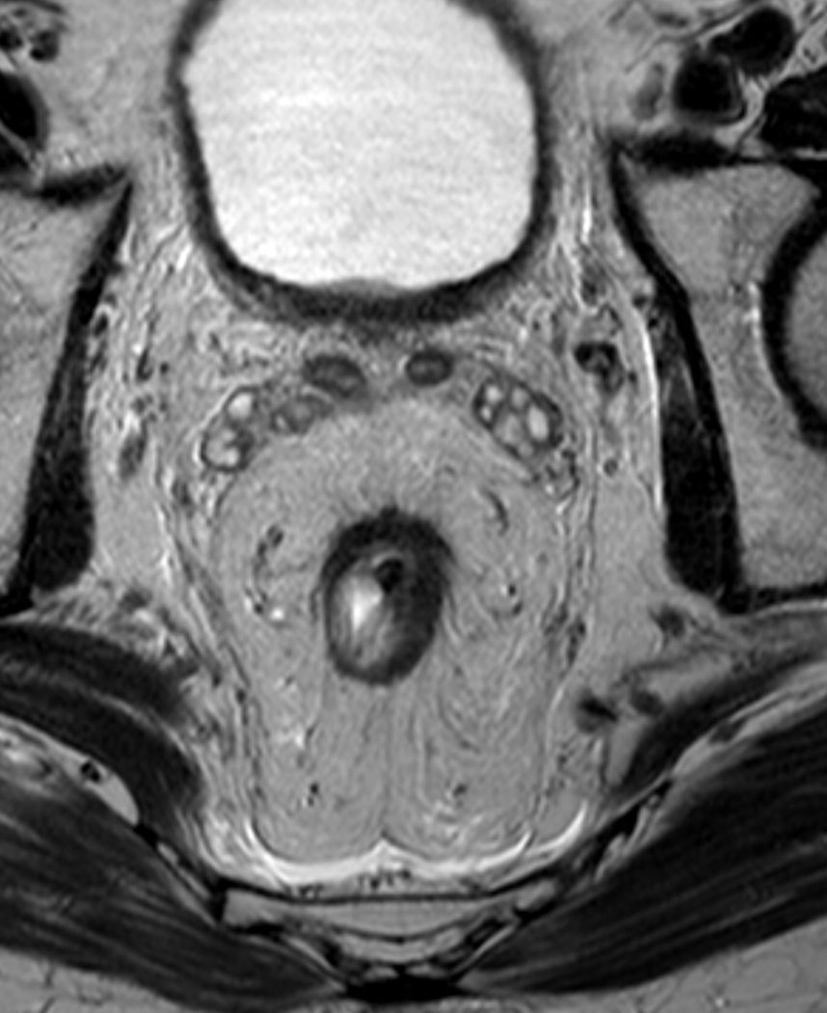
MRI of the rectum - restaging
7 cm from the anus is rectal tumor causing semicircular thickening of the wall in the length of 5 cm, wall thickening is in partial regression (today up to 10 mm, on the previous examination up to 17 mm). Tumor grows 1-2 mm into surrounding fat on the ventral part of the rectum, it is not in contact with mesorectal fascia or prostate.
Conclusion: Rectal cancer ycT3a N0 M0 – partial regression of the tumor.
T2 axial plane – distance from anus, extent of the tumor
T2 coronal plane – less conspicuous circular thickening of the wall with small spiculation into surrounding fat, no lymph nodes in perirectal fat.
PET/MRI fusion – radiopharmaceutical (18-FDG) is accumulated in rectal cancer and urinary bladder (excreted via urine).

Slide 7
No distant metastases on abdominal CT.
Surgical resection – transanal total mesorectal excision with coloanal anastomosis.
(Histologically moderately differentiated (G2) intestinal typee adenocarcinoma infiltrating muscular layer (ypT2). No signs of angioinvasion no metastasis in lymph nodes - LN 0/11 (ypN0). Proximal, distal and circular resection line without signs of the tumor. ypT2ypN0M0)
Resection was followed with adjuvant chemotherapy.
Further follow-up on PET/MRI.

Slide 8
Summary
Locoregional staging of rectal cancer rekta is performed on MRI.
PET/MRI allows to perform locoregional staging and detection of distant metastases of rectal cancer during one procedure.
MRI of the rectum is suitable method for restaging after neoadjuvant therapy.
PET (PET/MR) should be performed at least 8 weaks since the last radiotherapy because of possible false positive findings in irradiated area.

