Slide 1
Case reports
Five cases – diagnose, differential diagnose?
2. Select a case of your choice
Status localis?
Questions important for anamnesis
Further examination?
Therapy?
Prognosis?

Slide 2
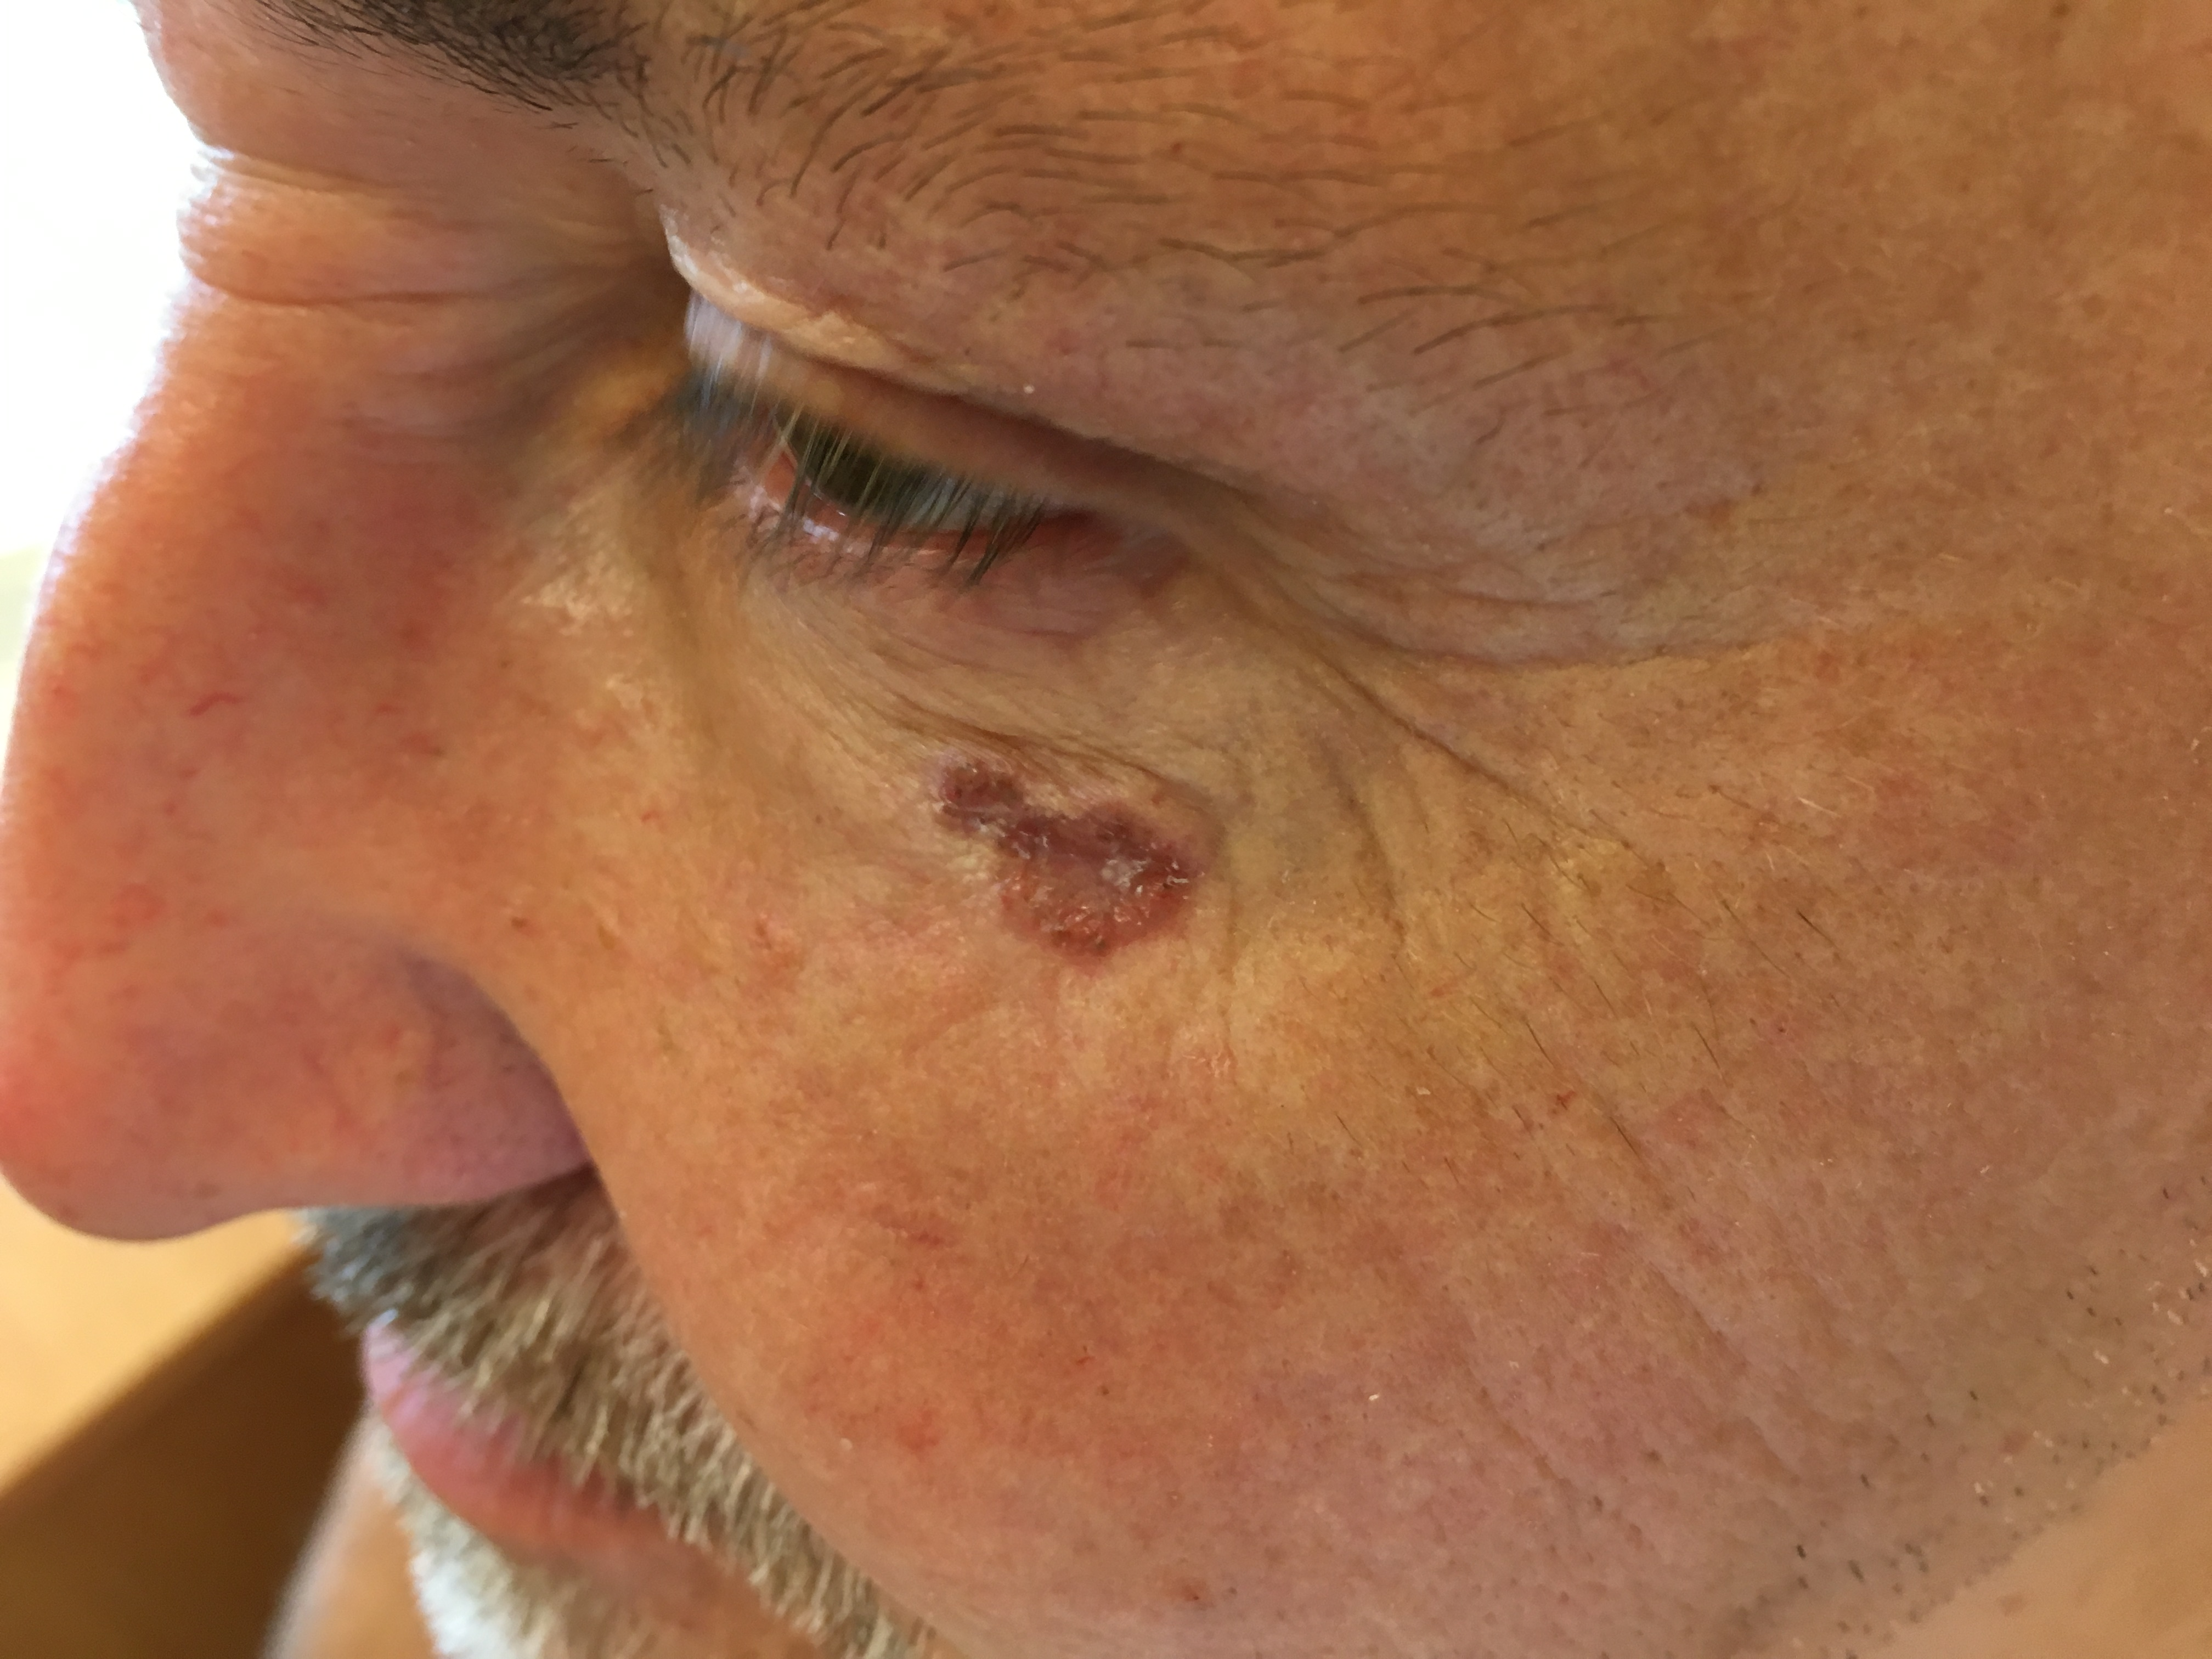
Patient 1
65 years old, male, otherwise healthy, comes for Melanoma screening.
Suspicious leasion under left eye (approx 6 months).

Slide 3
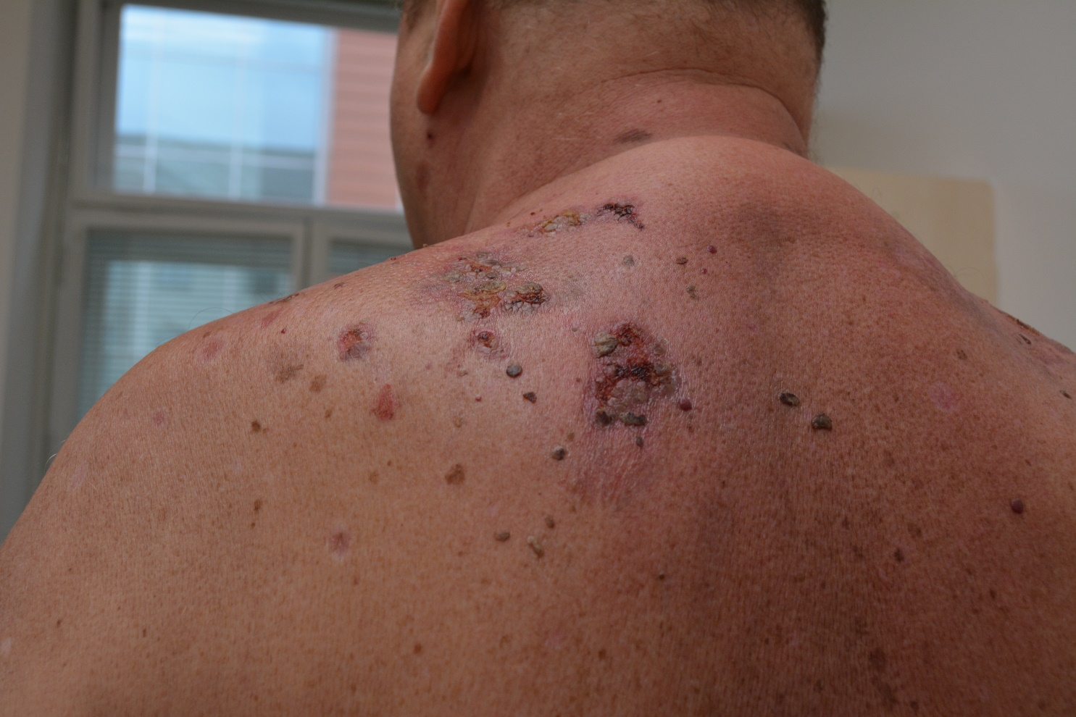
Patient 2
40 y.o., male
Hypertension, heavy smoker
Allergies unknown
Drug treatment: Prestarium neo
Mother being treated for thyreopathy, father died to colorectal ca
10 months treated for stomatitis aftosa
Th: penicilin, after treatment weeping leasions occured within the thoracal area

Slide 4
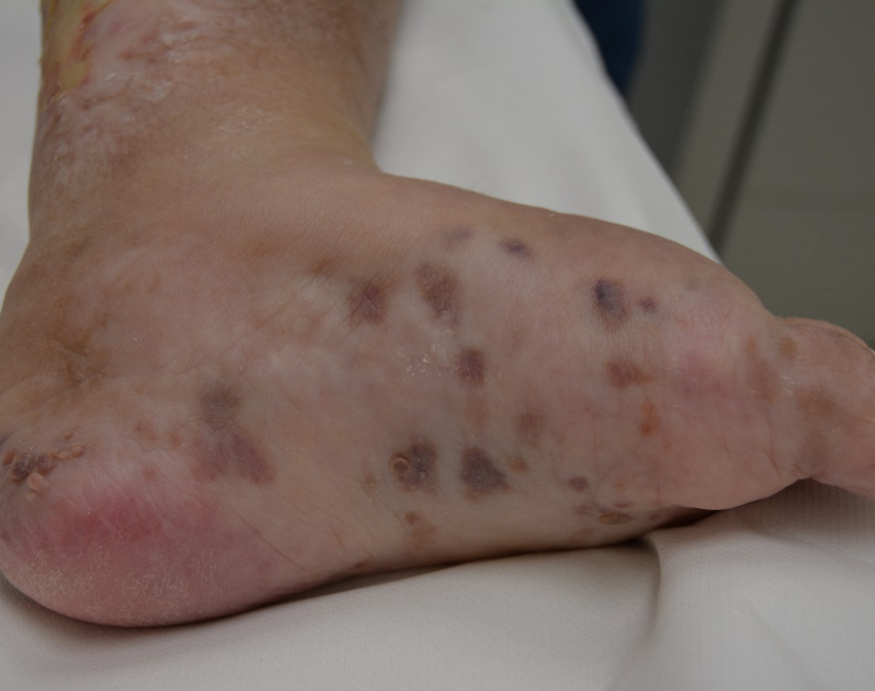
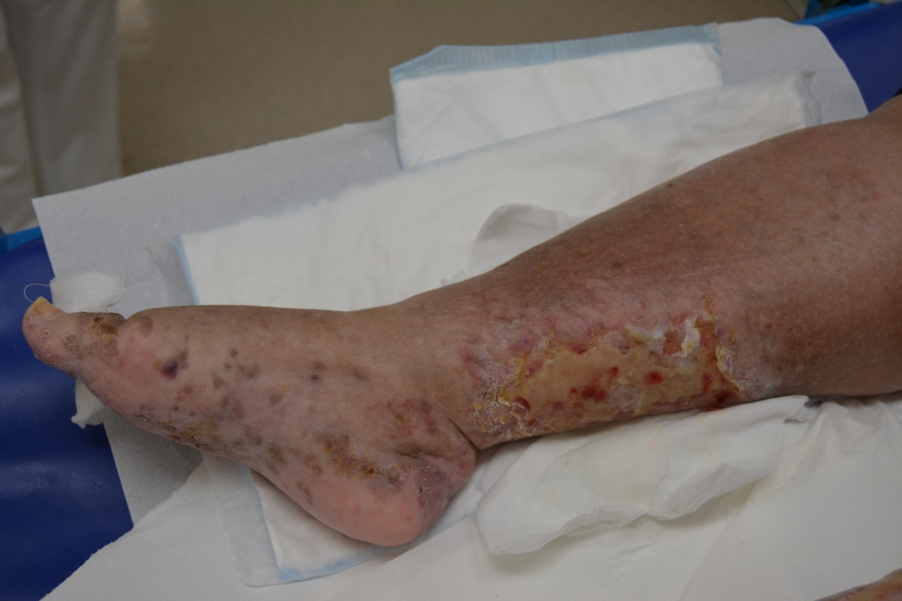
Patient 3
65 y.o., female
Have been treated for over 15 yrs for rheumatic arthritis and fibromyaliga
osteoporosis
Th: predniosn 20mg/ die
Manifest leasions in progress on the lower libs for 2 years now.
Ulcus on the lower limbs after radiotherapy.

Slide 5
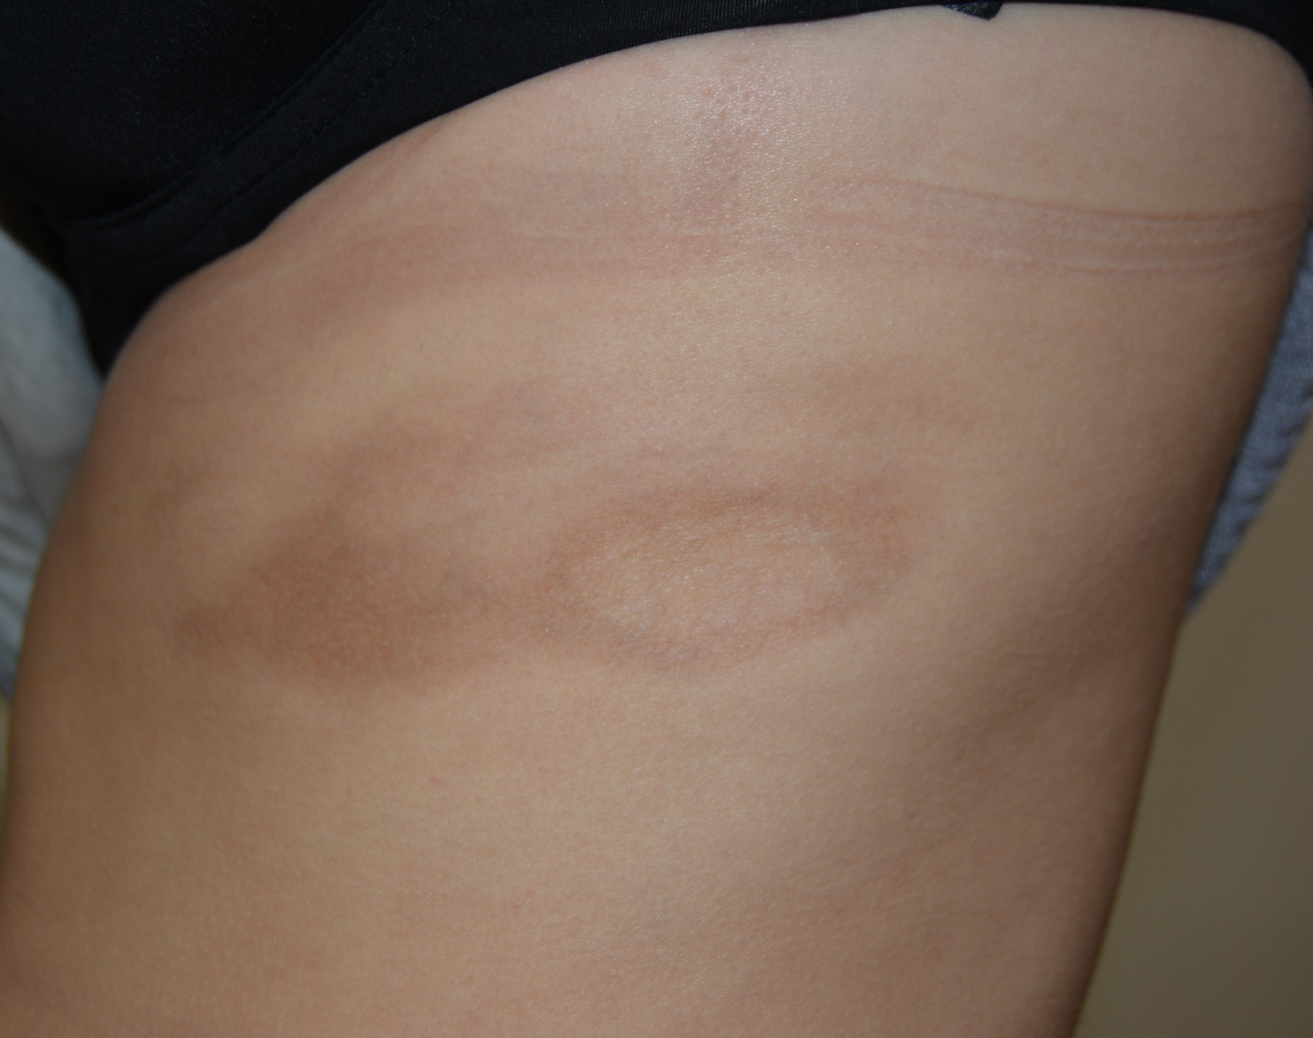
Patient 4
42 y.o., female
Treated for thyreopathy
Mother: rheumatic arthritis
Th: oral hormonal contraception
Comes for finding a painless pale spot on the side of the thoracal area. The spot appears to be firm in the center more than around the edges. A simmilar spot is found in the lower back area.

Slide 6
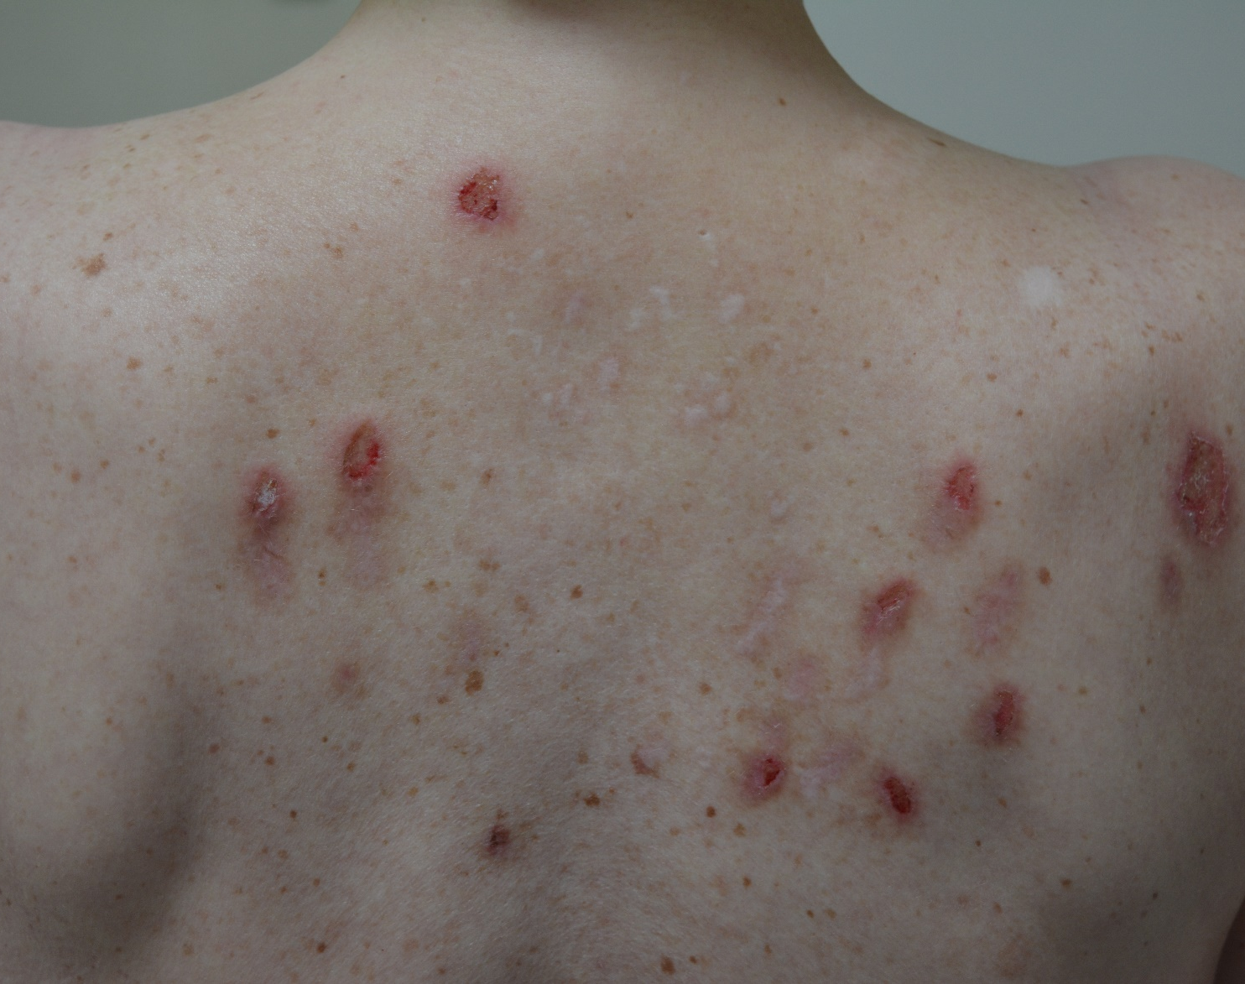
Patient 5
38 y.o., femalie
Treated for Chlamydia pneumoniae (1 year ago), very tired since then, unable to work.
Allergies: fish, milk, nuts
Th: cetirizin
Comes for itchy skin, since 6 months ago there are several painful nodules appearing on her back and in the scalp. The nodules tend to open up after few days and release unsually looking liquid with „very strange white chunks“.
There are more appearing, Th not succesful so far.

