Slide 1
ELECTROOCULOGRAPHY
Method of assesment of the eye movements employing the measurement of potential difference between cornea and retina
This potential generates an electric dipole oriented in parallel with the optical axis of the eye
The main goal of eye movements: to maintain and stabilize the object of interest at the point of sharpest vision (yellow spot)

Slide 2
Type of eye movements
Sustaining (miniature) – as fixation - Looking into our eyes do not stray far away in space, but they are automatically fixed on a point in space (its visual field)
Smooth pursuit movements - assist the macular stabilization of the observed object
Saccadic movements – assist the transfering the view to a new object
Nystagmus – rhythmic eye-bulb movements, 2 components: slow deviation to one side and fast twitch to the opposite side (slow is vestibular, fast from brainstem structures)
Vestibulo-ocular reflex – stabilization of the retinal image during sudden , non-uniform movements of the head
Optokinetic nystagmus – regular eye movement stabilizing the view during slights movement of the head or when the object changes its position with respect to motionless head

Slide 3
Eye Movement
Function of Eye Movement | Type of Eye Movement
"Holding" (slow) | Smooth Pursuit Optokinetic Nystagmus (slow phase) Vestibular Nystagmus | Convergence Divergence Accommodative Vergence
"Catching" (fast) | Saccades Optokinetic Nystagmus (quick phase)
"Sustaining" (miniature) | Microsaccades | Tremor Drift
voluntary eye movement; involuntary eye movement
Notes:
Six Neuronal Control Systems Keep the Fovea on Target
Hermann Helmholtz and other nineteenth century psychophysicists who studied vision were also interested in eye movement. They appreciated that an analysis of these movements was essential for understanding visual perception but they did not realize that there is more than one kind of eye movement. However, in 1890 Edwin Landott discovered that, when we read, the eyes do not move smoothly along a line of text but make little jerky movements— saccades—each followed by a short pause. By 1902 Raymond Dodge was able to outline five separate movement systems that put the fovea on a target and keep it there. Each of these movement systems shares the same effector pathway—the three bilateral groups of oculomotor neurons in the brain stem.
These five systems include three that keep the fovea on a visual target in the environment and two that stabilize the eye during head movement. Saccadic eye movements shift the fovea rapidly to a visual target in the periphery. Smooth pursuit movements keep the image of a moving target on the fovea. Vergence movements move the eyes in opposite directions so that the image is positioned on both foveae. Vestibulo-ocular movements hold images still on the retina during brief head movements and are driven by signals from the vestibular system. Optokinetic movements hold images during sustained head rotation and are driven by visual stimuli.
All eye movements but vergence movements are conjugate: Each eye moves the same amount in the same direction. Vergence movements are disconjugate: The eyes move in different directions and sometimes by different amounts. Finally, there are times that the eye must stay still in the orbit so that it can examine a stationary object. Thus, a sixth system, the fixation system, holds the eye still during intent gaze. This requires active suppression of eye movement. The vestibular and optokinetic systems are discussed in Chapters 40 and 41. We discuss the remaining four here.
One main reason that we make eye movements is to solve a problem of information overload. A large field of vision
allows an animal to survey the environment for food and to avoid predators, thus increasing its survival rate.
Similarly, a high visual acuity also increases survival rates by allowing an animal to aim at a target more accurately,
leading to higher killing rates and more food. However, there are simply not enough neurons in the brain to support a
visual system that has high resolution over the entire field of vision. Faced with the competing evolutionary demands
for high visual acuity and a large field of vision, an effective strategy is needed so that the brain will not be
overwhelmed by a large amount of visual input. Some animals, such as rabbits, give up high resolution in favor of a
larger field of vision (rabbits can see nearly 360Â°), whereas others, such as hawks, restrict their field of vision in
return for a high visual acuity (hawks have vision as good as 20/2, about 10 times better than humans). In humans,
rather than using one strategy over the other, the retina develops a very high spatial resolution in the center (i.e.,
the fovea), and a much lower resolution in the periphery. Although this â€oefoveal compromiseâ€ strategy solves
the problem of information overload, one result is that unless the image of an object of interest happens to fall on
the fovea, the image is relegated to the low-resolution retinal periphery.
The evolution of a mechanism to move the eyes is therefore necessary to complement this foveal compromise
strategy by ensuring that an object of interest is maintained or brought to the fovea. To maintain the image of an
object on the fovea, the vestibulo-ocular (VOR) and optokinetic systems generate eye movements to compensate for
head motions. Likewise, the saccadic, smooth pursuit, and vergence systems generate eye movements to bring the
image of an object of interest on the fovea. These different eye movements have different characteristics and
involve different parts of the brain. In this chapter, the fixation system is discussed; the VOR and optokinetic
systems, saccades, smooth pursuit, and vergence systems are discussed in subsequent chapters.
Introduction to the Six Eye Movement Systems
The six eye movement systems can be functionally divided into those that hold images of a target steady on the
retina and those that direct the fovea onto an object of interest. The former category includes (1) the fixation
system, which holds the image of a stationary object on the fovea when the head is immobile; (2) the vestibular
system (or the vestibulo-ocular reflex), which holds the image of a target steady on the retina during brief head
movements; and (3) the optokinetic system, which holds the image of a target steady on the retina during sustained
head movements.
The latter category, systems that direct the fovea onto an object of interest, includes (1) the saccadic system, which
brings the image of an object of interest rapidly onto the fovea; (2) the smooth pursuit system, which holds the
image of a small, moving target on the fovea; and (3) the vergence system, which moves the eyes in an opposite
direction (i.e., convergence or divergence) so that images of a single object are held simultaneously on both foveae.
Clinically, to localize a lesion, it is important to assess whether one or more eye movement systems are affected. For
example, a discrete lesion in the paramedian pontine reticular formation affects ipsilesional horizontal saccades
only, whereas a lesion in the abducens nucleus affects all ipsilesional horizontal eye movements, including saccades,
smooth pursuit, and the VOR (see sections 9.3.1 and 9.3.2).
Hold images steady on the retina
Fixation: holds the image of a stationary object on the fovea when the head is immobile
Vestibular (VOR): holds image steady on the retina during brief head movements
Optokinetic: holds image steady on the retina during sustained head movements
Direct the fovea to an object of interest
Saccades: bring the image of an object of interest rapidly onto the fovea
Smooth pursuit: holds the image of a small moving target on the fovea
Vergence: moves the eyes in an opposite direction (i.e., convergence or divergence) so that images of a single object
are held simultaneously on both foveae

Slide 4
The Vestibular
The vestibulo-ocular and optokinetic reflexes are the earliest eye movements to appear phylogenetically
The vestibulo-ocular reflex (VOR) stabilizes retinal images during head motion by counter-rotating the eyes at the same speed as the head but in the opposite direction
Notes:
The Vestibular and Optokinetic Systems
The vestibulo-ocular and optokinetic reflexes are the earliest eye movements to appear phylogenetically. The vestibulo-ocular reflex (VOR)
stabilizes retinal images during head motion by counter-rotating the eyes at the same speed as the head but in the opposite direction.
Information about head motion passes from the vestibular sensors in the inner ear to the VOR circuitry within the brainstem, which computes
an appropriate eye velocity command. The eyes, confined in their bony orbits, normally do not change position, and their motion relative to
the head is restricted to a change in orientation. However, the head can both change position and orientation relative to space. Thus, the
function of the VOR is to generate eye orientation that best compensates for changes in position and orientation of the head. Because the
drive for this reflex is vestibular rather than visual, it operates even in darkness.
To appreciate the benefits of having our eyes under vestibular and not just visual control, hold a page of text in front of you, and oscillate it
back and forth horizontally at a rate of about two cycles per second. You will find that the text is blurred. However, if you hold the page still
and instead oscillate your head at the same rate, you will be able to read the text clearly. This is because when the page moves, only visual
information is available. Visual information normally takes about 100 msec to travel from the visual cortices, through a series of brain
structures, to the ocular motoneurons that move the eyes. This delay is simply too long for the eyes to keep up with the oscillating page.
However, when the head moves, both vestibular and visual information are available. Vestibular information takes only about 7-15 msec to
travel from the vestibular sensors, through the brainstem, to the ocular motoneurons. With this short latency, the eyes can easily
compensate for the rapid oscillation of the head. Thus, damages to the vestibular system often cause oscillopsia, an illusion of motion in the
stationary environment, especially during head movements. Indeed, as described by a physician who lost his vestibular function from
streptomycin ototoxicity; without a VOR, every movement, including his own carotid pulse, jarred his vision (LIVING without a balancing
mechanism, New England Journal of Medicine, 1952).
Optokinetic eye movements stabilize the eyes during tracking of a large moving visual scene, which causes an illusionary sensation of self rotation
(circularvection) in the opposite direction. Optokinetic eye movements must be distinguished from smooth pursuit movements
(discussed in chapter 5), which are used to keep the image of a small moving target on the fovea. If you sit inside a rotating drum painted on
the inside with stripes or spots such that the entire visual field is perceived as rotating en bloc, your eyes will track the field rotation with a
nystagmus pattern of slow phases in the direction of drum rotation and quick phases in the opposite direction. This response is called
optokinetic nystagmus (OKN), and the neural system responsible for it is the optokinetic reflex (OKR). In nature, almost the only situation in
which a large visual scene moves en bloc is when the animal itself is moving and its VOR is not compensating perfectly. Therefore, it is
believed that the OKR serves as a visual backup for the VOR to generate compensatory eye movements. That the brain normally interprets en
bloc motion of the visual field as evidence for self-motion is shown by the compelling motion illusions we experience while watching IMAX
movies, or when the train beside the one you are on begins to move out of the station.
Clinically, damage to the vestibular sensors on one side, say, the left side, upsets the balance between vestibular signals generated from
both sides. This leads to an illusory sensation of self-rotation (vertigo) to the right. In addition, because the brain mistakenly believes that the head is rotating to the right, it rotates the eyes slowly to the left to compensate. As the eyes reach their leftward orbital limits, they quickly snap back rightward toward the straight-ahead positions and then resume their leftward drift. This repetitive combination of slow phases that alternate with corrective quick phases is called nystagmus. Usually, the nystagmus and vertigo only last for a few days. This is because the abnormal vestibular
sensation contradicts information from all other senses, including vision, sense of limb position, and sense of touch. Thus, with time, the
brain makes an unconscious self-diagnosis by localizing the lesion to the left vestibular sensors and adapts by reestablishing the balance
between the right and left inner ears. These adaptive and repair functions are performed by the cerebellum.
In this chapter, the characteristics of the VOR, as well as the anatomy, physiology, and functional organization of the vestibular sensors (the
semicircular canals and the otoliths) are described. The role of the cerebellum in VOR adaptation and the concept of velocity storage, which
explains disorders such as periodic alternating nystagmus, are discussed next. The optokinetic system, which serves as a visual backup for the
VOR, is then discussed. Finally, some tests of vestibular functions that could be performed at bedside are described.

Slide 5
Characteristics of the VOR
The VOR stabilizes retinal images during brief head movements by counter-rotating the eyes at the same speed as the head but in the
opposite direction
Notes:
3.1 The Vestibulo-Ocular Reflex
The VOR stabilizes retinal images during brief head movements by counter-rotating the eyes at the same speed as the head but in the
opposite direction..
Characteristics of the VOR
Vestibulo-ocular reflex gain is defined as the ratio of the velocity of smooth eye movements in one direction to the velocity of head
movements in the opposite direction. Vestibulo-ocular reflex gain varies with frequency of head motion, and it must approximate -1.0 to
prevent retinal images from slipping. At frequencies that correspond to most natural head rotations (0.5-5 Hz), horizontal and vertical VOR
gains approximate -0.9 in dark. In light, the gains are close to -1.0 due to visual enhancement, which is mediated by the optokinetic, smooth
pursuit, or the fixation systems. If the gain is too much above or below its ideal value of unity, a target image remains off the fovea, although
it may be transiently stable on the retina. The motion of the eyes and head must also be 180Â° out of phase. This normal phase difference is
designated zero, by convention. If there is a phase lead of the eyes before the head or a phase lag behind it, the target image is never
stationary on the retina. An abnormal gain or phase of the VOR causes visual blur and oscillopsia.
During dynamic head roll (i.e., tilting of the head alternately between the right and left shoulder), compensatory eye movements are
generated by torsional VOR, which is mediated predominantly by the vertical semicircular canals (i.e., the anterior and posterior canals). The
dynamic torsional VOR has a lower gain than horizontal or vertical VOR, typically ranging from -0.4 to -0.7, depending on the frequency of
head roll. In contrast, static head roll evokes compensatory changes in torsional eye position, which are mediated by the otolith-ocular reflex
from inputs of the utricles. Static torsional VOR (also known as ocular counter-roll) has a lower gain than its dynamic counterpart, ranging
from -0.1 to -0.24, depending on target distance and target features.
Peripheral and central vestibular lesions cause static and dynamic imbalance of the VOR. Static imbalance of canal inputs or connections
leads to spontaneous nystagmus, whereas dynamic imbalance affects the gain and phase of the VOR.
Function: The VOR stabilizes retinal image during brief head movement by generating eye movements that are equal in amplitude and
opposite in direction to head movements
Quantified by: VOR gain and phase
Normal values
1. Horizontal and vertical VOR
􀂄 In dark, VOR gain approximates -0.9, and phase shift approximates zero.
􀂄 In light, VOR gain approximates -1.0 (i.e., visual enhancement), and phase shift approximates zero.
2. Torsional VOR
􀂄 Dynamic torsional VOR gain ranges from -0.4 to -0.7.
􀂄 Static torsional VOR gain (ocular counter-roll) ranges from -0.1 to -0.24.
Vestibular Reflexes Stabilize the Eyes and the Body When the Head Moves
The vestibular nerve transmits information about head acceleration to the vestibular nuclei in the medulla, which then distribute it to higher centers. This central network of vestibular connections is responsible for the various reflexes that the body uses to compensate for head movement and the perception of motion in space. These reflexes include the vestibulo-ocular reflexes that keep the eyes still when the head moves and the vestibulospinal reflexes that enable the skeletomotor system to compensate for head movement.
The Vestibulo-Ocular Reflexes Compensate for Head Movement
We perceive stable images on the retina better than moving ones. When the head moves the eyes are kept still by the vestibulo-ocular reflexes of the eye muscles. If a person were to shake her head while reading this paragraph she would still be able to read it because of the vestibulo-ocular reflexes. If she moved the book at the same speed, however, she would no longer be able to read it because vision would be the only cue the brain had to stabilize the image of the moving book on the retina. Visual processing is much slower and less efficient than vestibular processing for image stabilization.
The vestibular apparatus signals how fast the head is rotating, and the oculomotor system uses this information to stabilize the eyes in order to keep visual images
P.809
motionless on the retina (Chapter 39). Loss of this reflex is devastating. A physician who lost his vestibular hair cells because of a toxic reaction to streptomycin wrote a dramatic account of this loss. Immediately after the onset of streptomycin toxicity he could not read in bed without steadying his head to keep it motionless. Even after partial recovery he still could not read street signs or recognize friends while walking in the street; he had to stop to see clearly.
Three different vestibulo-ocular reflexes arise from the three major components of the labyrinth:
The rotational vestibulo-ocular reflex compensates for head rotation and receives its input predominantly from the semicircular canals.
The translational vestibulo-ocular reflex compensates for linear head movement.
The ocular counter-rolling response compensates for head tilt in the vertical
The second and third reflexes receive their input predominantly from the otolith organs and thus are sometimes called the otolith reflexes. Although most head movement is a complex combination of rotation and translation, the reflexes have properties that enable the components to be analyzed independently.
Vestibular Nystagmus Resets Eye Position During Sustained Rotation of the Head
Of the three vestibulo-ocular reflexes the rotational reflex is the simplest. When the semicircular canals sense head rotation in one direction, the eyes slowly rotate in the opposite direction. As a result the eyes remain still and vision is clear. One would think that sustained rotation in any direction would drive the eyes to the edge of the orbit and keep them there. This does not occur because the eyes make a rapid resetting movement back across the center of the gaze (Figure 40-8). The combination of slow and quick phases of eye movement results in a repetitive pattern, nystagmus (Greek, “nod”), so called because a nod has a slow phase as the head drops and a quick phase as the head snaps back to an erect position. The vestibular signal drives the slow phase of nystagmus and brain stem circuits generate the quick phase.

Slide 6
Summary of Central Control of Pursuit Eye Movement
Notes:
Functions and Characteristics of Smooth Pursuit
Functions
1. Stabilizes the image of a small moving target on the fovea
2. Cancels the VOR during combined eye-head tracking (i.e., VOR cancellation). During smooth tracking of a target that moves in the same
direction as the head, smooth pursuit cancels VOR; otherwise, the VOR would move the eyes opposite the direction of intended gaze.
3. Cancels optokinetic nystagmus during tracking of a small, moving target against a detailed stationary background. For example, during
smooth tracking of a bird flying against a background of leaves, the optokinetic system will try to hold the gaze on the stationary
background, but it is overridden by pursuit.
Characteristics
1. Velocity: 0.1-70Â°/sec (top athletes may show pursuit as high as 130Â°/sec)
2. Latency (initiation time): 100-130msec (i.e., much longer than VOR [about 15 msec], but shorter than saccades [about 200msec])
3. Gain: eye velocity/target velocity = 1.0 (ideal)
4. Two phases of smooth pursuit:
Open loop phase (pursuit initiation): during the latency period
􀂄 Guided by target motion (i.e., retinal slip velocity)
􀂄 Initial acceleration (first 20-40 msec) is very stereotypic and does not depend on initial target velocity.
􀂄 After this, there is a variable component in which pursuit acceleration depends on the initial target velocity.
5. Closed loop phase (pursuit maintenance or steady state): after the latency period
􀂄 During open loop phase, retinal slip is reduced to a fraction of target speed.
􀂄 To maintain pursuit, the brain adds an extraretinal feedback of eye velocity (i.e., an efference copy) to retinal slip velocity to
compute the target velocity.
6. Predictive character of smooth pursuit
􀂄 If target motion is unpredictable, pursuit shows a phase lag behind the target (about one latency period), as when tracking a flying
insect.
􀂄 If target motion is predictable, pursuit will track with no phase lag such that the object is perfectly centered on the fovea, as when
tracking a child on a swing.
7. Stimuli for smooth pursuit
􀂄 Target velocity (i.e., retinal slip velocity; a velocity error) is the primary stimulus
􀂄 Position of target (a position error)
􀂄 Motor command to the eye (efference copy)
􀂄 Proprioception (afferent input) e.g., tracking one's outstretched finger in the dark; also uses knowledge of motor command to the limb
􀂄 Perception of motion (requires high-level integration of many motion cues; e.g., stroboscopic motion in which one infers motion of an
object from a series of flashes, even though no actual motion occurs)
Putative Smooth Pursuit Pathways
Putative Pathway for Horizontal Pursuit
The smooth pursuit pathway in primates originates in the M (large) ganglion cells in the retina. Signals from these cells are relayed through
the magnocellular layers of the lateral geniculate nucleus to the striate cortex (area V1), from there to areas V2 and V3, and then to MT
(middle temporal, area V5). Signals from MT are relayed to MST (medial superior temporal, area V5a) and to the visual motor area in the
frontal (the smooth pursuit subregion of the frontal eye field and supplemental eye field) and posterior parietal cortex (lateral intraparietal
area). In V1, the information about motion is transformed by neurons that respond to particular directions of motion. These signals are
further elaborated in MT, where the firing pattern of the population of neurons encodes the speed and direction of motion. Information
about motion from MT is then extracted in MST. Both MT and MST, as well as the frontal eye field, project directly to the dorsolateral
pontine nuclei (DLPN) in the ipsilateral basal pons. The DLPN, in turn, projects to the contralateral flocculus/ventral paraflocculus and the
dorsal vermis in the cerebellum. The flocculus and fastigial nucleus project to the medial vestibular nucleus (MVN) in the brainstem, which
then projects to the contralateral abducens nucleus. The abducens nucleus innervates the lateral rectus on the same side and, via the
abducens internuclear neurons, innervates the contralateral medial rectus. This constitutes a double decussation of the horizontal pursuit
pathway. The first decussation is the pontocerebellar projections from the DLPN, through the contralateral middle cerebellar peduncle, to
the contralateral flocculus/ventral paraflocculus and the dorsal vermis. The second decussation is from second-order vestibular neurons in
the MVN to the contralateral abducens nucleus. In addition, the nucleus of the optic tract (NOT) receives projections from MT and MST and
projects to the DLPN. The NOT participates in horizontal pursuit only. Unilateral or bilateral lesions of NOT do not affect vertical pursuit.
Putative Pathway for Vertical Pursuit
Vertical pursuit follows the same pathway as for horizontal, except that it involves (1) the rostral nucleus reticularis tegmenti pontis in the
basal pons (instead of the DLPN), which receives input from MT, MST and the pursuit subregion of the frontal eye field and projects to the
contralateral cerebellum, (2) the y-group (instead of the MVN), which projects to the oculomotor and trochlear nuclei, as well as the
interstitial nucleus of Cajal (INC), and (3) the dentate nucleus in the cerebellum.
Omnipause neurons in the nucleus raphe interpositus, which inhibit excitatory burst neurons for saccades during fixation and stop firing
during saccades, also exert inhibitory control over pursuit. The nucleus prepsitus hypoglossi-MVN complex and INC perform integration, in the
mathematical sense, for conjugate horizontal and vertical pursuit, respectively, by transforming eye velocity signals to eye position signals.
The smooth pursuit and optokinetic systems share similar neural pathways and are often activated simultaneously (see section 3.14).
Vertical pursuit follows the same pathway as for horizontal, except that it involves (1) the rostral nucleus reticularis tegmenti pontis in the
basal pons (instead of the DLPN), which receives input from MT, MST and the pursuit subregion of the frontal eye field and projects to the
contralateral cerebellum, (2) the y-group (instead of the MVN), which projects to the oculomotor and trochlear nuclei, as well as the INC,
and (3) the dentate nucleus in the cerebellum.

Slide 7
VERTIGO and NYSTAGMUS
Vertigo (dizzines)– subjective loss of stability in space, rotation of surrounding space or rotation of body in space
- connected with objective symptoms – disturbances of equilibrium and nystagmus – by stimulation of the labyrinths
semicircular canals are stimulated by:
  post-rotational
  Caloric (application of external auditorial tube either with cold=27 C or warm=47 C water)
  Galvanic (stimulation with electric current)

Slide 8
nystagmus
rhythmic eye-bulb movements, 2 components: slow deviation to one side and fast twitch to the opposite side
(slow is vestibular, fast from brainstem structures)
Nystagmus at rest – vestibular system is affected by some pathological proces or cerebellum

Slide 9
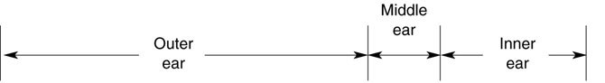
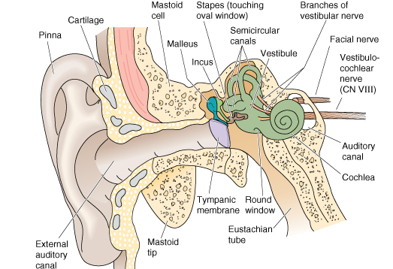
Vestibular System: Structure

Slide 10
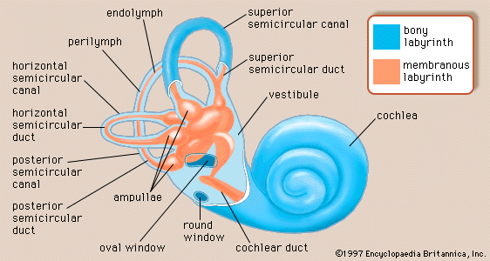
Vestibular System: Structure
utricle
Otolith organs
saccule
Notes:
canals are surrounded by perilymph and contain endolymph
the ionic composition of the endolymph is high in K+ and low in Na+
canals connect with utricle which is linked to saccule
utricle oriented horizontally; saccule oriented vertically
lateral canals located in a plane tilted about 25° above horizontal when head is level
posterior canal is rotated about 55° posterior to sagittal plane
anterior canal is rotated about 40° anterior to sagittal plane
The utricle and saccule are specialized primarily to respond to linear accelerations of the head and static head position, whereas the semicircular canals are specialized for responding to rotational accelerations of the head.

Slide 11
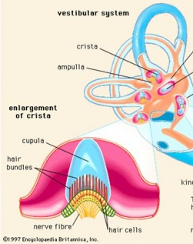
Semicircular canals: structure
Semicircular canals
each semicircular canal contains an ampulla
  Contains hair cells embedded in sensory epithelium called crista ampullaris
  Cilia of hair cells project into gelatinous cap called cupula
Enlargement of ampulla
Crista ampullaris
Notes:
specialized for responding to rotational accelerations of the head
canals are surrounded by perilymph and contain endolymph
the ionic composition of the endolymph is high in K+ and low in Na+
canals connect with utricle which is linked to saccule
utricle oriented horizontally; saccule oriented vertically
lateral canals located in a plane tilted about 25° above horizontal when head is level
posterior canal is rotated about 55° posterior to sagittal plane
anterior canal is rotated about 40° anterior to sagittal plane
The utricle and saccule are specialized primarily to respond to linear accelerations of the head and static head position, whereas the semicircular canals are specialized for responding to rotational accelerations of the head.

Slide 12
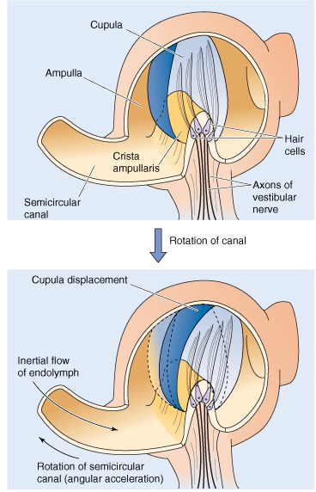
Semicircular canals: function
Specialized for responding to rotational acceleration of the head
  Head rotation results in intertial movement of endolymph in opposite direction
  Bends cupula which bends hair cells
    Same mechanical/electrical coupling as in auditory hair cells
B&B Figure 13-18
Notes:
the ampulla is an expanded region which contains sense organs made of hair cells that respond to rotational motion
hair cells innervated by afferent fibers of vestibular nerve are embedded in crista ampullaris
hair cell is made up of columns of stereocilia which are graded in height and single kinocilium (tall cilium)
stereocilia are embedded in cupula (gelatinous structure) which extends to the upper wall of ampulla

Slide 13
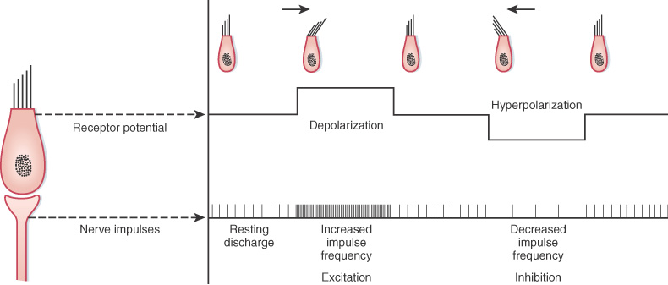
Semicircular canals: sensory transduction
Steriocilia maintain directionality on both sides of the head
  Bending towards kinocilium → opens mechanically gated cation channels → K⁺ influx → depolarization
  Bending away from kinocilium → closes channels that are open during resting state → hyperpolarization
B&L Figure 8-26
Notes:
stereocilia bending in the opposite direction creates a hyperpolarization by closing those channels that are constantly open, even in the resting state, thus further obstructing K⁺ flow down the electrochemical gradient.

Slide 14
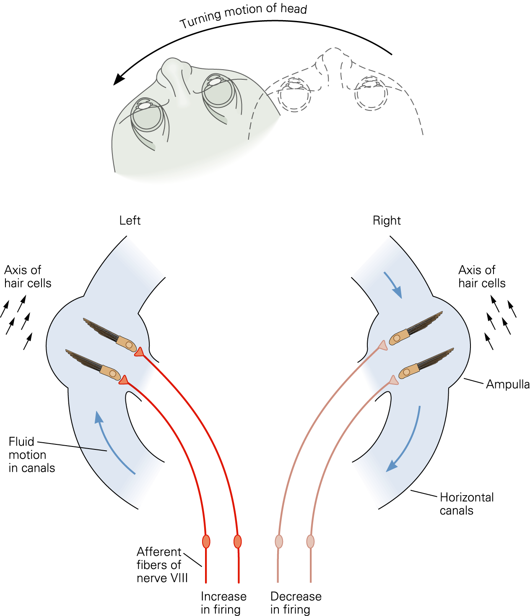
Semicircular canals: sensory transduction
Paired canals work together to signal head movement
  With turning of the head, hair cells on one side of the body send excitatory signals to the brain while hair cells on the opposite side are inhibited
Kandel Figure 40-7
Notes:
This view of the horizontal semicircular
canals from above shows how the
paired canals work together to signal head
movement. Because of inertia, rotation of the
head in a counterclockwise direction causes endolymph
to move clockwise with respect to the
canals. This reflects the stereocilia in the left
canal in the excitatory direction, thereby exciting
the afferent fibers on this side. In the right
canal the hair cells are hyperpolarized and afferent
firing there decreases.

Slide 15
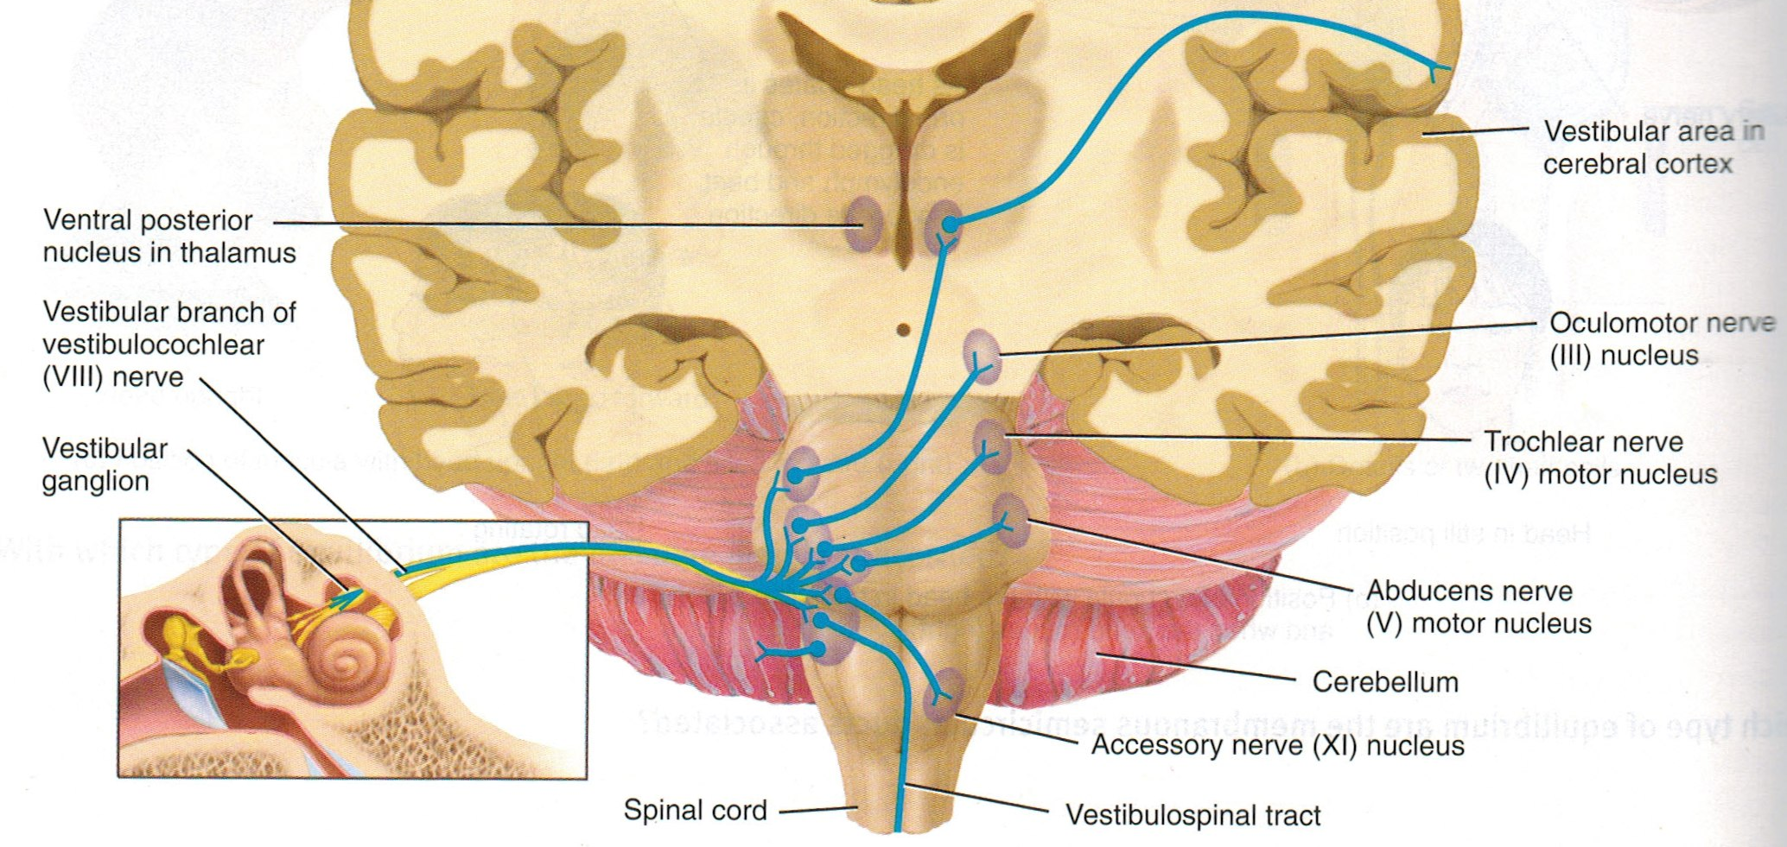
Vestibular Pathways
vestibular afferents synapse on vestibular nuclei located in medulla & pons
  Nuclei integrate information from vestibular, visual, and somatic receptors and send collaterals to
    1.cerebellum
      Sends corrective adjustments to motor cortex: maintenance of balance and posture
Notes:
lateral & medial vestibular nuclei give rides to lateral and medial vestibulospinal tracts (influence activity of postural muscles)
vestibular nuclei also project to the cerebellum, reticular formation, and thalamus
superior and medial vestibular nuclei project through medial longitudinal fasiculus to the oculomotor nuclei and are involved in the control of reflex eye movements (e.g. vestibulo-ocular reflex)

Slide 16
Vestibular Pathways
    2.nuclei of cranial nerves
      Control coupled movements of the eyes, maintain focus and visual field
    3.nuclei of accessory nerves
      Control head movement and assist with equilibrium
Notes:
lateral & medial vestibular nuclei give rides to lateral and medial vestibulospinal tracts (influence activity of postural muscles)
vestibular nuclei also project to the cerebellum, reticular formation, and thalamus
superior and medial vestibular nuclei project through medial longitudinal fasiculus to the oculomotor nuclei and are involved in the control of reflex eye movements (e.g. vestibulo-ocular reflex)

Slide 17
Vestibular Pathways
Areas 1,2,3
    4.ventral posterior nucleus of thalamus and vestibular area in cerebral cortex (part of primary somatosensory cortex)
      Conscious awareness of the position and movement of head
Notes:
Areas 1, 2 3 are part of the primary somatosensory cortex

Slide 18
Vestibular Reflexes
Vestibulospinal Reflexes
Senses falling/tipping
  contracts limb muscles for postural support
Vestibulocollic Reflexes
  acts on the neck musculature to stabilize the head if body moves
Vestibulo-ocular Reflexes
stabilizes visual image during head movement
  causes eyes to move simultaneously in the opposite direction and in equal magnitude to head movement

Slide 19
Summary of Central Control of Saccades
Notes:
Cerebral and Cerebellar Control of Saccades
Cerebral Control of Saccades
The saccade subregion of the frontal eye field (FEFsac), the supplementary eye field, and the dorsolateral prefrontal cortex, as well as the
parietal eye field (PEF) and area 7a in the parietal cortex, participate in the control of saccades. These areas initiate saccades by sending
trigger signals to the omnipause neurons in the pons, and they encode saccade amplitude and direction. The PEF initiates visually guided
(reflexive) saccades and projects to the ipsilateral superior colliculus and to the FEF.
The FEFsac initiates volitional and visually guided (reflexive) saccades and projects to the superior colliculus (SC) directly and via the PEF.
The FEFsac also projects to the caudate nucleus, which sends inhibitory projections to the nucleus substantia nigra pars reticulata (SNpr) in
the basal ganglia. The SNpr, in turn, sends inhibitory projections to the superior colliculus. The SNpr tonically discharges during fixation, and
when it pauses, it disinhibits the SC, which discharges before and during voluntary and visually evoked saccades. Thus, the FEFsac has a
powerful two-pronged effect on the SC: one direct and the other through the basal ganglia (i.e., the caudate and SNpr). The FEFsac and SC
project directly to the PPRF and riMLF in the brainstem. Each FEFsac and SC generates contralateral horizontal saccades, whereas vertical
and torsional saccades are generated by simultaneous activation of both frontal eye fields or both superior colliculi.
Together, the FEFsac and SC form an obligatory route for saccadic commands originating in the cerebrum. A lesion of both the FEFsac and SC,
but not either alone, causes defective saccade generation. A lesion of either the FEFsac or the SC alone causes subtle abnormalities: mildly
hypometric and delayed (increased latency) saccades.
Cerebellar Control of Saccades
The cerebellum regulates the size of saccades (dorsal oculomotor vermis and the fastigial nucleus) and participates in the repair of saccade
inaccuracy (flocculus and paraflocculus). The dorsal â€oeoculomotorâ€ vermis (lobules VI and VII) receives saccadic input from, among
other structures, the nucleus reticularis tegmenti pontis and discharges before saccades. The nucleus reticularis tegmenti pontis in turn sends
inhibitory projections to an ellipsoidal region in the caudal fastigial nucleus, the fastigial oculomotor region, which is important in the control
of saccade accuracy and consistency. Projections of the fastigial nucleus decussate within the cerebellum to reach the brainstem, where they
terminate onto burst neurons, omnipause neurons, and the rostral pole of the superior colliculus. The flocculus and paraflocculus are
important for the adaptation of the pulse and pulse-step mismatch for saccades.
A lesion of the dorsal vermis results in dysmetric and slow saccades (i.e., hypometric ipsilesional saccades and mild hypermetric
contralesional saccades). A lesion of the fastigial nucleus also leads to dysmetric and slow saccades, but saccades are hypermetric toward
the side of the lesion (i.e., ipsipulsion; hypermetric ipsilesional and hypometric contralesional saccades) because projections of the fastigial
nucleus decussate within the cerebellum to reach the brainstem. A lesion of the flocculus and paraflocculus results in postsaccadic drift
because adaptation to pulse-step mismatch of saccades is lost.

