Slide 1
Endocrine System
AMIR SAMADIAN M.D.
DEPARTMENT OF PHYSIOLOGY

Slide 2
Forms of cell to cell communication!

Slide 3
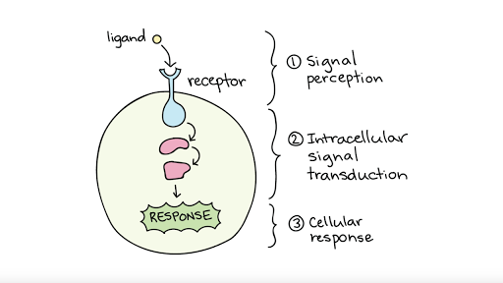
Endocrine system
Works with Nervous system to maintain homeostasis
Glands 🡪 produce specific signaling molecules (Hormones)
Hormones will be released into the blood
Bind to their specific receptor on target tissue 🡪 Physiological response !

Slide 4
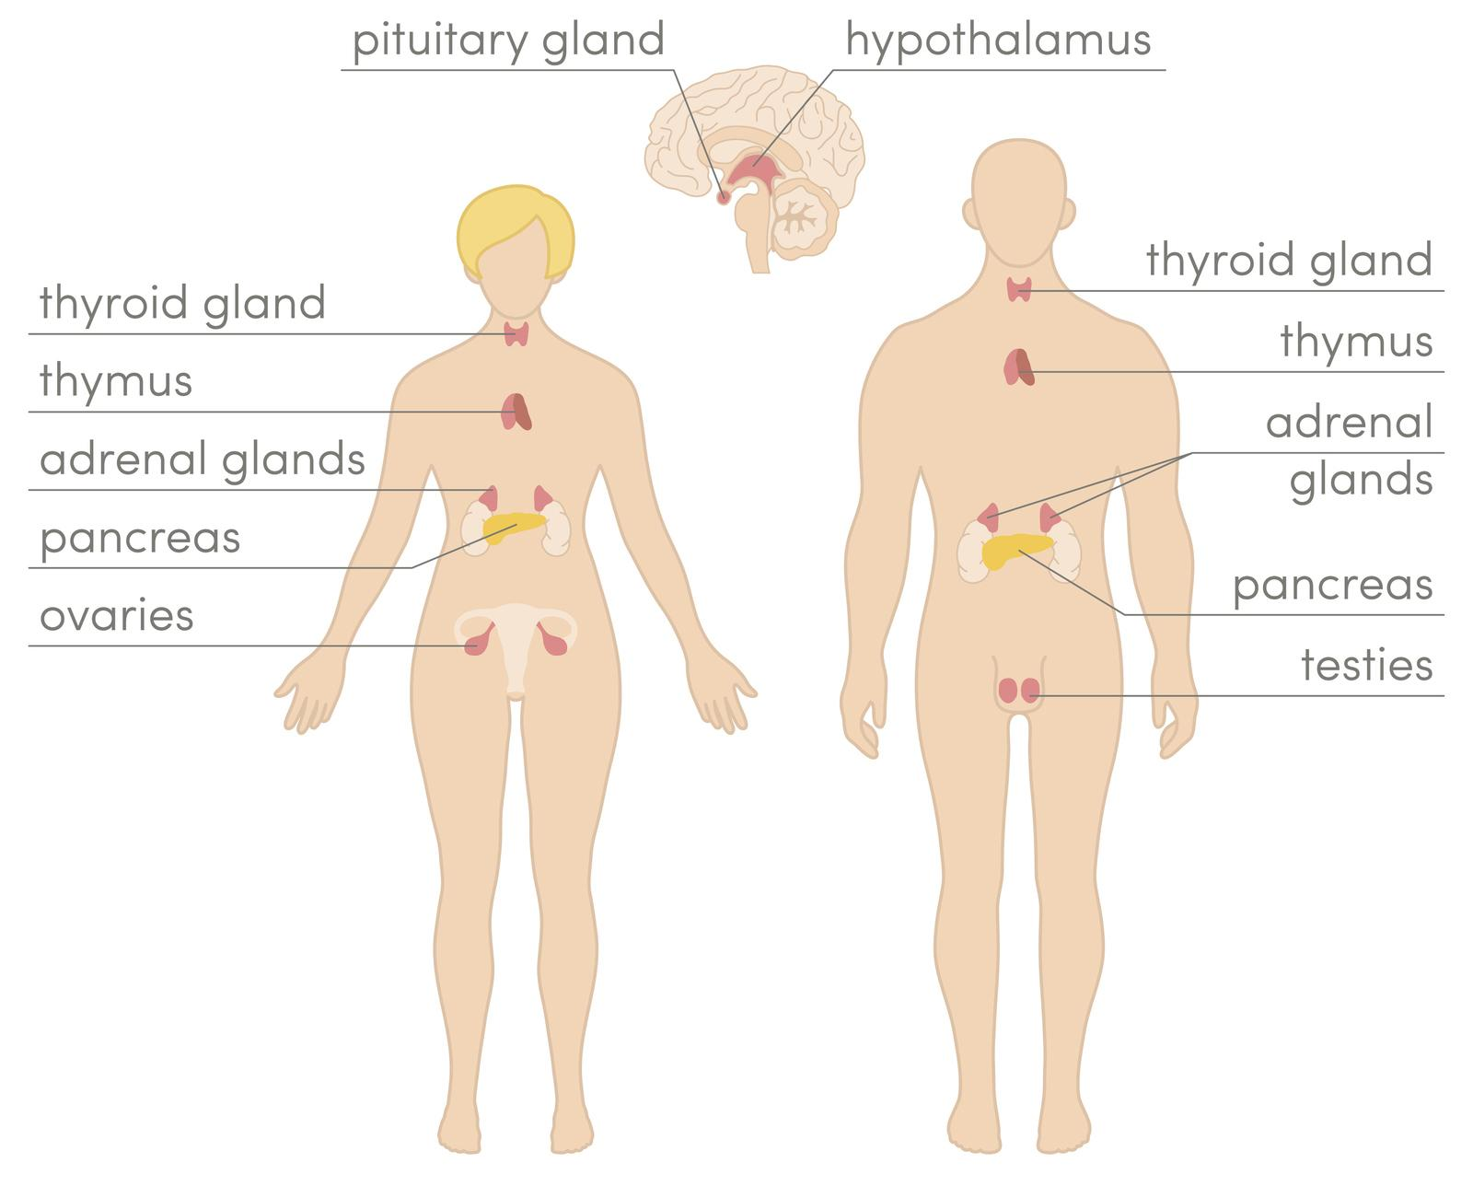
Hormones overview

Slide 5
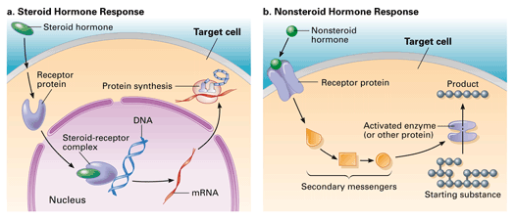
Hormones can be Hydrophilic or lipophilic
Water soluble hormones (Peptides and protein) can not pass membrane 🡪 bind to peripheral receptors on the surface of the cell , eg : G-protein-coupled receptors or Tyrosin kinases
Lipid soluble hormones ( Steroids, Thyroid-hormones ) can pass cell membrane 🡪 act on cytoplasmic or nuclear receptor to alter gene expression

Slide 7
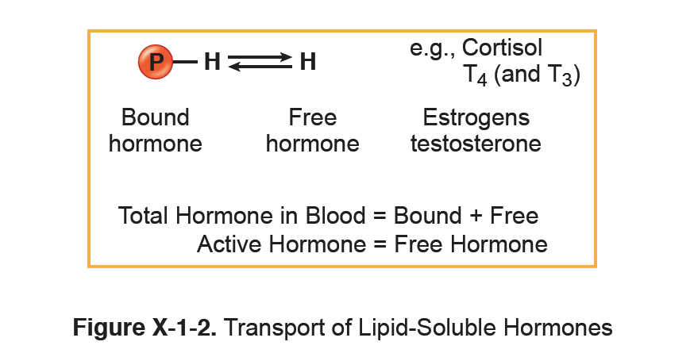
Protein bound and free circulating hormone

Slide 8
Factors determining the magnitude of response in target cell
Concentration of circulation hormone
( Dose – response relation ) : higher the dose 🡪 higher the response
Number of receptors and their affinity for the hormone

Slide 9
Regulation of hormone secretion

Slide 10
Negative vs positive feedback

Slide 11
Regulation of reception

Slide 12
Cell response : receptors up/down regulation

Slide 13
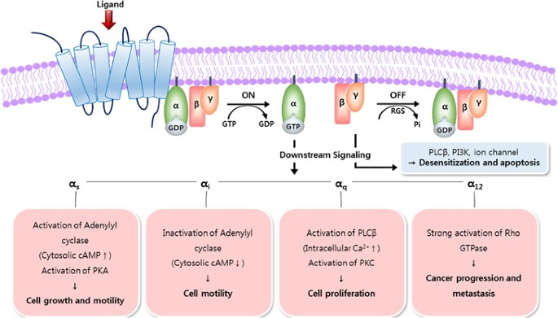
Gs/i 🡪 cAMP 🡪 Protein kinase A

Slide 14
Gq 🡪 PL C 🡪 DAG & IP3🡪 PK C

Slide 15
Steroid hormone cell response mechanism

Slide 16
Mechanism of signal transduction (summary)

Slide 17
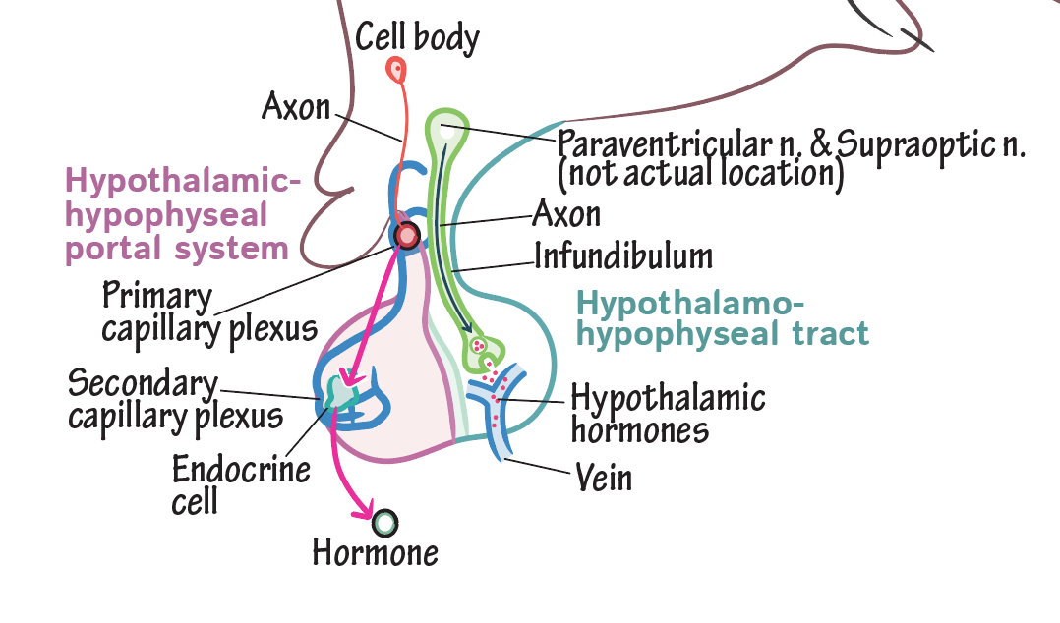
Hypothalamo-Hypophysial Axis

Slide 18
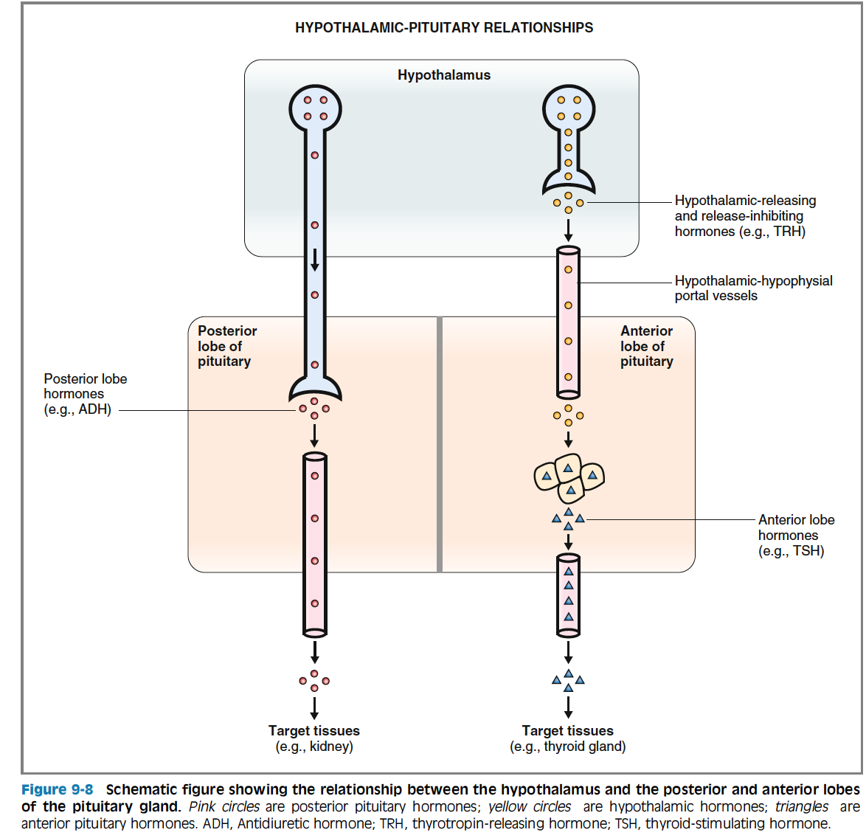

Slide 19
Hypothalamo pitutary hormons

Slide 20
Pitutary in a nutshell

Slide 21
Vascular endothelial cell function

Slide 22
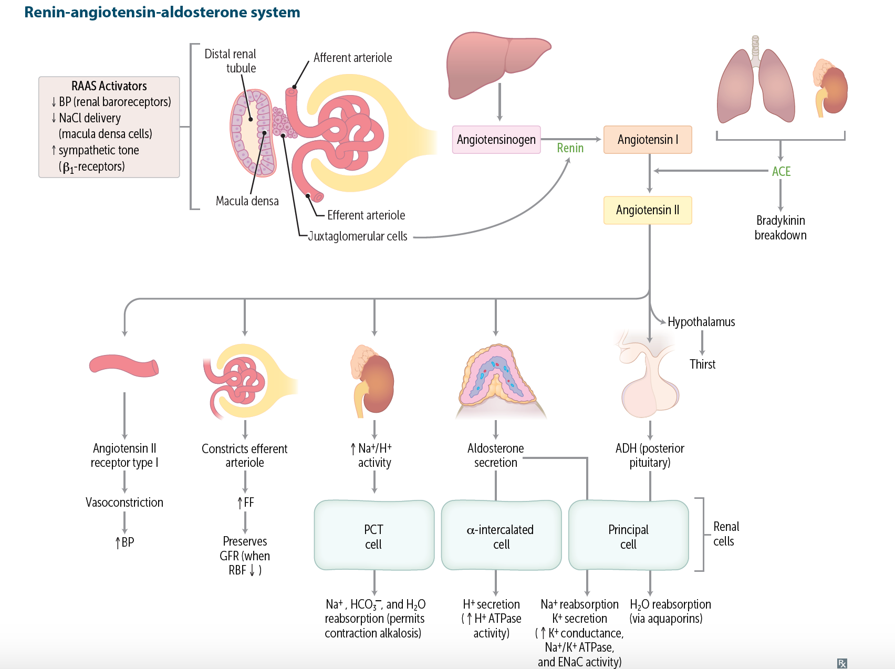
RAAS and AG II
Is activated to preserve Volume and maintain the Blood pressure
This is done by :
Vasoconstictrion 🡪 increase TPR
Increasing Na+ resorbtion 🡪 increase Preload 🡪 increase in CO
Both of which increase MAP

Slide 23
Natriuretic peptides (opposing RAAS)
Cardiovascular and Renal Actions of Natriuretic Peptides
Natriuresis
Diuresis
Improve glomerular filtration rate & filtration fraction
Inhibit renin release
↓ circulating angiotensin II
↓ circulating aldosterone
Systemic vasodilation
Arterial hypotension
Reduced venous pressure
Reduced pulmonary capillary wedge pressure

Slide 24
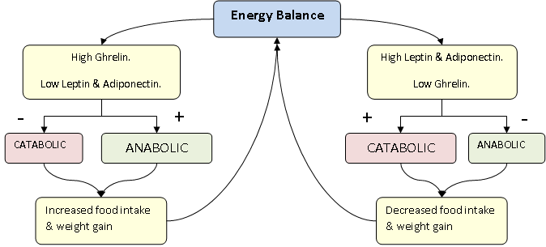

Slide 25
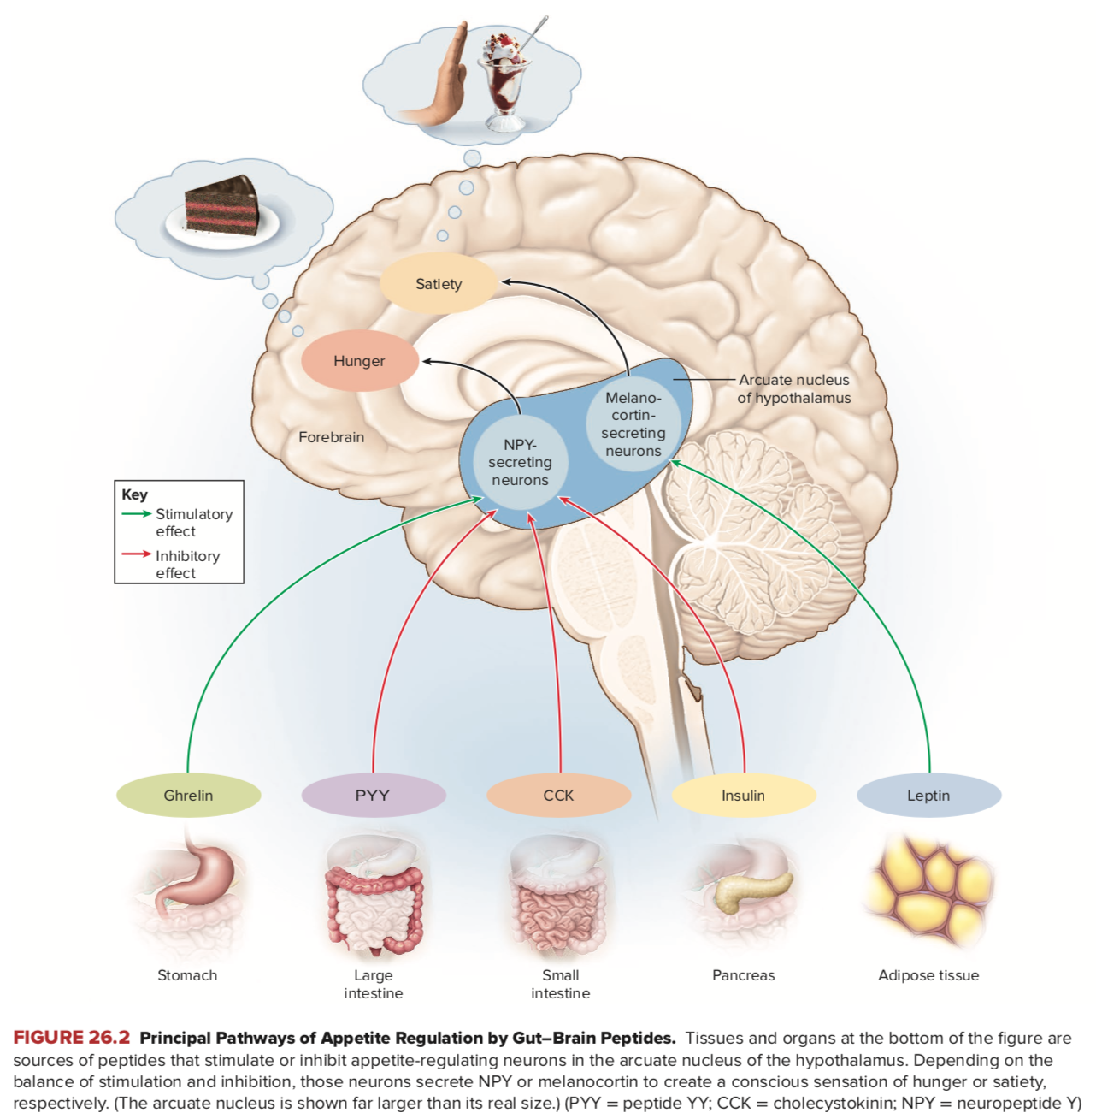

Slide 26
Increase in white adipose tissue and changes in related hormones

Slide 27
Pathophysiology of Obesity (Increase in WAT mass )
Increase in AGE → increase in BP (HTN)
Increase in PAI-1 → inhibiting fibrinolytic system 🡪 Clotting 🡪 Risk of CVD
TNF-a & IL-1 → disruption of insulin signaling 🡪 insulin resistance
Excess leptin → leptin resistance 🡪 obesity and insulin resistance 🡪 type 2 DM
Decrease in adiponectin → decrease Gluc uptake & Pro-inflammatory condition in endothelial cells → risk of type 2 diabetes & CVD respectively.
excess resistin → decrease insulin mediated Glu uptake 🡪 type 2 DM

Slide 28
Leptin as a marker of long-term energy storage and acute changes in energy intake (keeps you thin)
Factors promoting leptin secretion
Excess energy stored as fat (obesity)
Overfeeding
Glucose
Insulin
Glucocorticoids
Estrogens
Inflammatory cytokines, including Tumor Necrosis Factor-α and Interleukin-6 (acute effect)
Factors inhibiting leptin secretion
Low energy states with decreased fat stores (leanness)
Fasting
Catecholamines and adrenergic agonists
Thyroid hormones
Androgens
Peroxisome Proliferator-activated Receptor-γ (PPARγ) agonists^{c}
Inflammatory cytokines, including Tumor Necrosis Factor-α (prolonged effect)

Slide 29
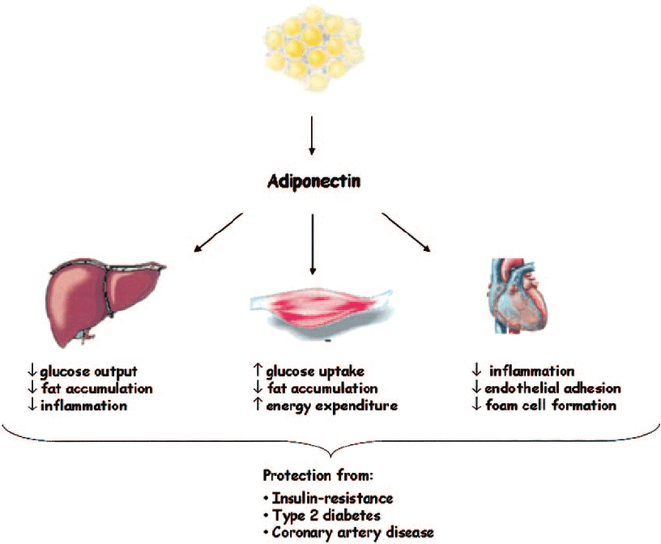
Adiponectin
Plasma adiponectin concentration has inverse correlation with body fat mass ie, the less WAT you have 🡪 higher is your adiponectin plasma level
High levels of Adiponectin is beneficial and protective against Type 2 DM and CVD

Slide 30
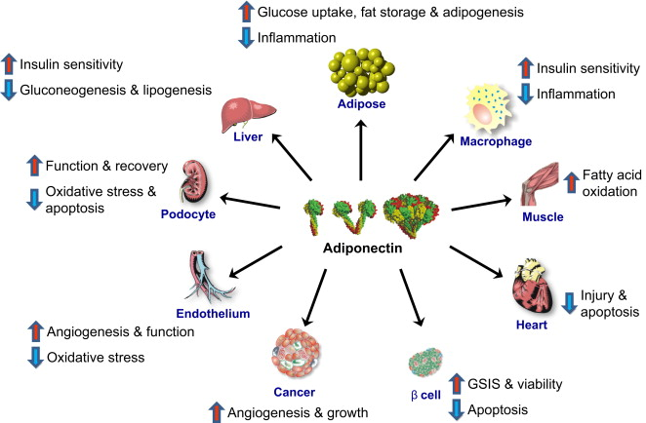

Slide 31
