Slide 2
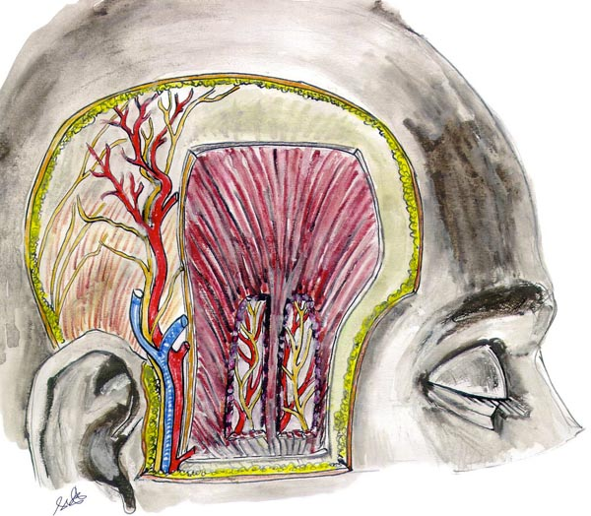
Temporal region
linea temporalis sup., arcus zygomaticus
skin
n. auricularis magnus
m. temporoparietalis (n.VII.)
a., v. temporalis spf. (v. retromandibularis
n. auriculotemporalis
fascia temporalis
m. temporalis
a.,v., n. temporalis prof.

Slide 3
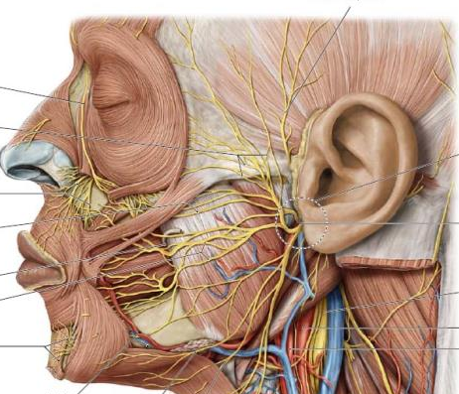
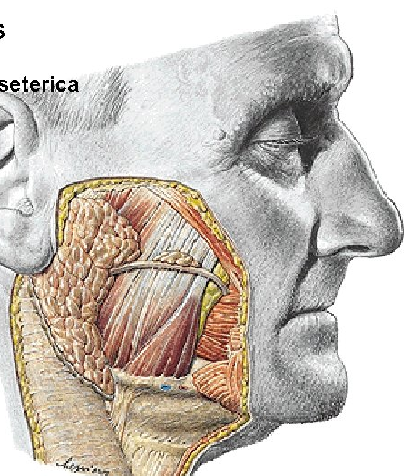
Regio parotideomasseterica
Superior - arcus zygomaticus
Ventral - m. masseter
Caudal - mandible
Posterior – line through tragus
glandula parotis
fascia parotideomasseterica
ductus parotideus
plexus parotideus n. VII.
pars spf. et prof. gl. parotis
a. temporalis spf.
a. transversa faciei
v. temporalis spf., v.
retromandibularis
n. auriculotemporalis

Slide 4
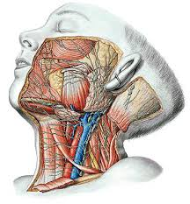
Retromandibular region
n.VII.
r. stylohyoideus
(m. stylohyoideus)
r. digastricus
(venter post. m. digastrici)
n. auricularis post.
a. auricularis post.
(a. carotis ext.)

Slide 5
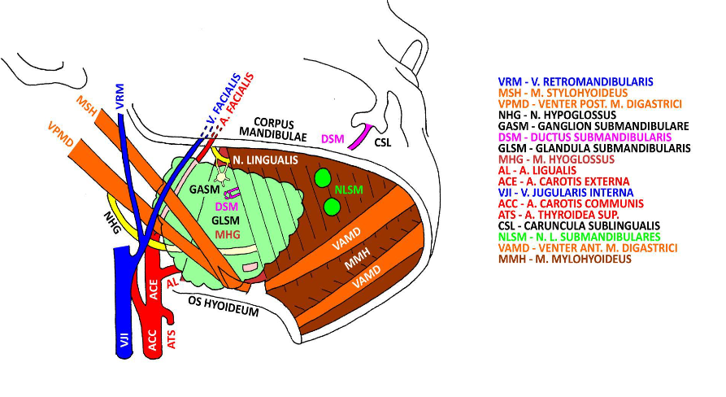
Trigonum submandibulare

Slide 6
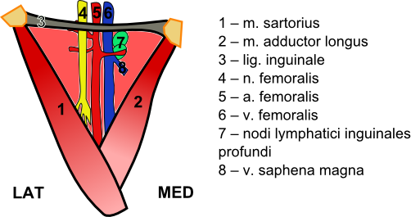
Trigonum femorale

Slide 7
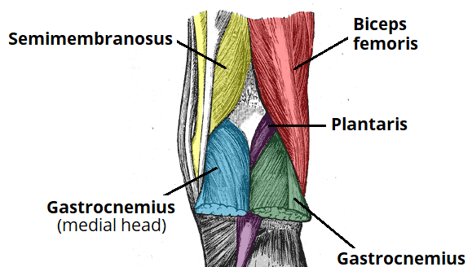
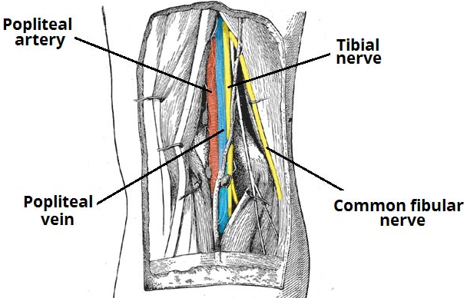
Fossa poplitea

Slide 8
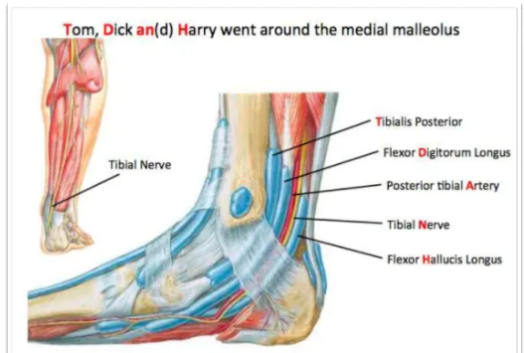
Medial Ankle

Slide 9
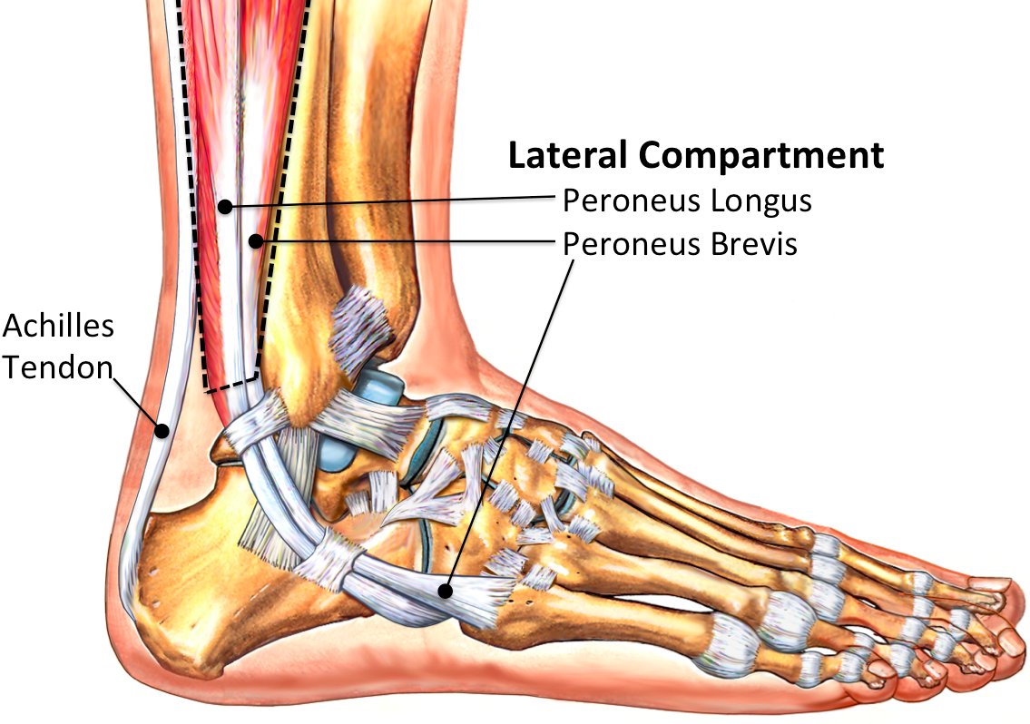
Lateral Ankle

Slide 10
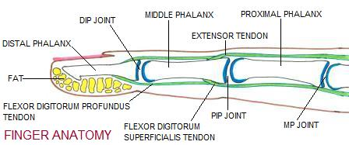
Fingers/Toes
dorsal side – skin: thin and movable on dorsal side (with hairs and nails), above the joints transverse flexion creases
dorsal digital nerves and vessles on the sides
the tendons of the extensors below subcutaneus tissue, attached to the dorsal aponeurosis
palmar side – skin: → thick and not movable on palmar/plantar side (with tactile ridges)
subcutaneous fat pads
connective tissue attaches the skin to the fibrous sheaths of flexor tendons and to the periosteum
lymphatic plexus on ventral side in the subcutaneus tissue
proper palmar digital nerves and vessels → subcutaneously on the sides
tendons of superficial and deep flexor covered by fibrous and synovial sheaths → separated from common flexor sheat (except 1th finger -> flex.poll.long. thenar space in between the 2 heads of the short flexor with its own synovial sheath)

Slide 11
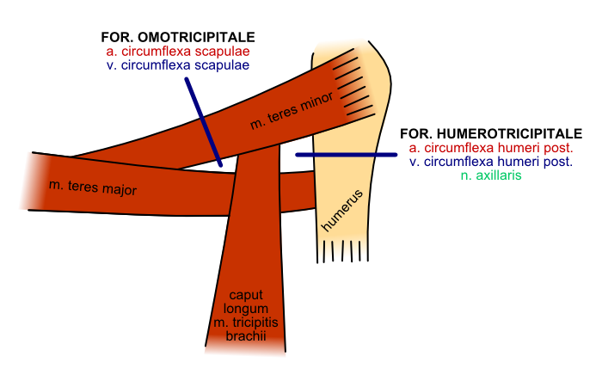
Foramen omotricipitale and humerotricipitale

Slide 12
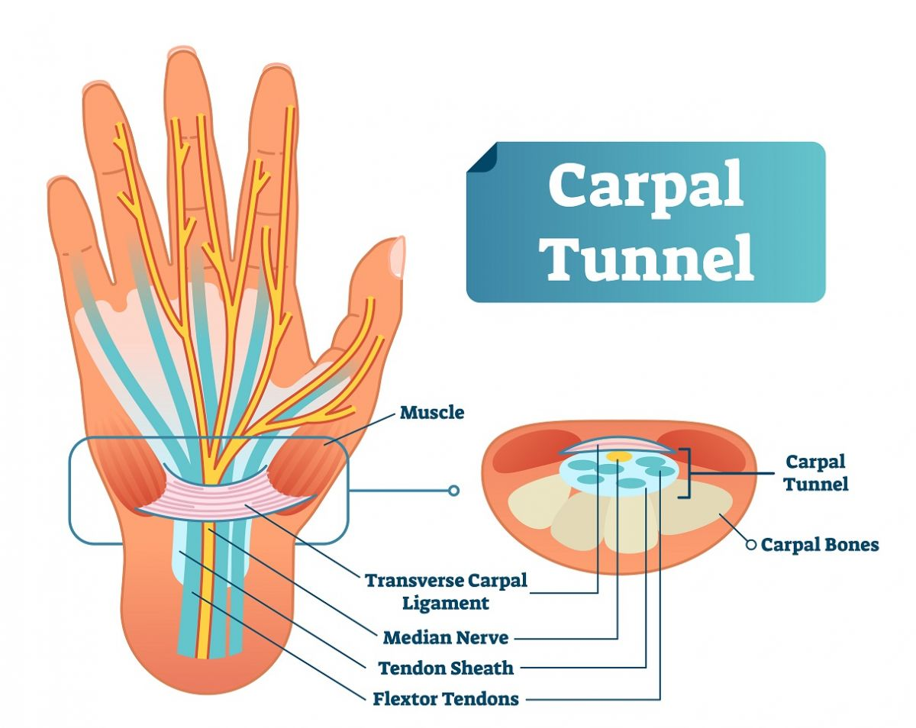
Carpal tunel

Slide 13
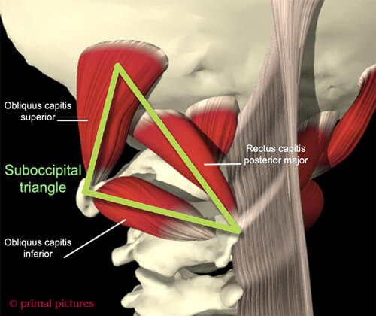
Suboccipital triangle

