Slide 1
Systemic Pathology
CARDIOVASCULAR
system

Slide 2
ATHEROSCLEROSIS
disease of large and medium-sizes arteries with lipid deposition into intima
active inflammatory process
endogennous risk factors, mostly noninfluenceables :
  age, MxF (estrogen?), familiar factors (f. hypercholesterolemia), hereditary homocysteinemia
exogennous risk factors:
  hyperlipidemia (LDL) ←← hypothyreoidism, nephrotic sy;
  hypertension, diabetes mellitus, life style smoking (nicotine, CO), sedentary life, food + obesity; ↑CRP, ↑ phosphate level (food, metabolic dysregulation)

Slide 3
Atherosclerosis - pathogenesis
Endothelial injury
  - mechanic (↑BP, turbulence)
  - endotoxins, immune complexes, exogennous toxins (cig. smoke), ↑ cholesterol
  ↑ expression of cell adhesion molecules, ↑ permeability, ↑ thrombogenicity
Lipoprotein insudation (LDL) – oxidation in intima
Inflammation
  - blood monocytes (→foam cells), T-cells, platelets, smooth muscle cells
Repair - proliferation of myointimal cells
  - synthesis of collagen, elastin, proteoglycans → fibrotic plaque, + lipid accumulation - atheromatous plaque
  stable plaque under repeated inflammation turns into unstable plaque – fibrous cap + endothelium rupture - thrombus

Slide 4
Atherosclerosis - pathogenesis

Slide 5
atherosclerosis – cell interactions in an atheromatous plaque

Slide 6
Atherosclerosis
fatty streak
fibrotic plaque
atheromatous plaque
complicated atheromatous plaque (ulceration, calcification, thrombosis)

Slide 7
Atherosclerosis
SEQUELS: arterial occlusion in situ
chronic (→ hypoxia, atrophy)
acute (→ ischemia, infarction, encephalomalatia)
embolism (thrombus, plaque material)
weakening of arterial wall (aneurysm), risk of rupture
bleeding (from plaque, fissured wall)
calcification (hypertensive factor)

Slide 8
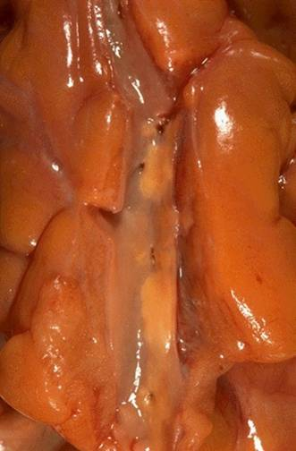
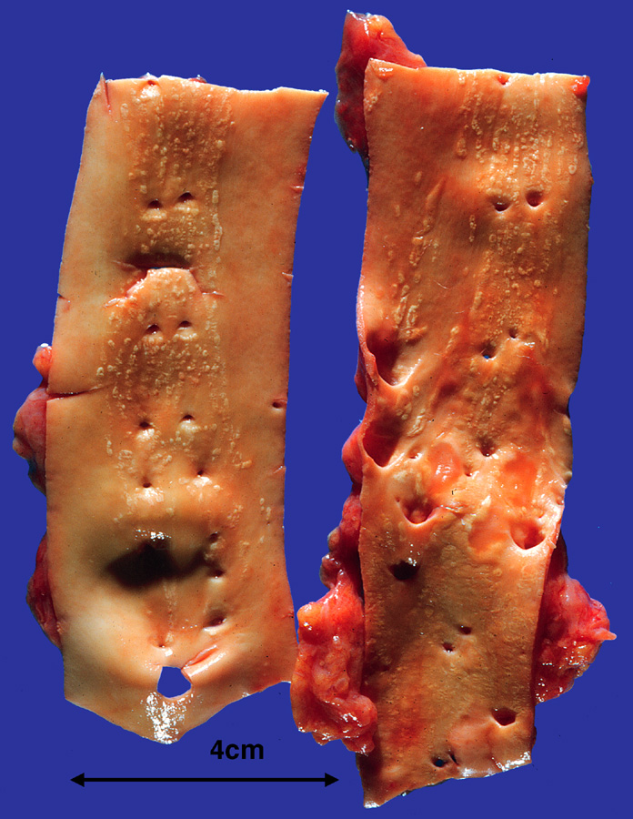
Atherosclerosis– fatty streak

Slide 9
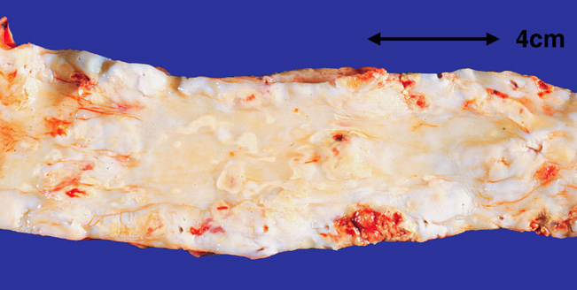
Atherosclerosis – fibrous and atheromatous plaques

Slide 10
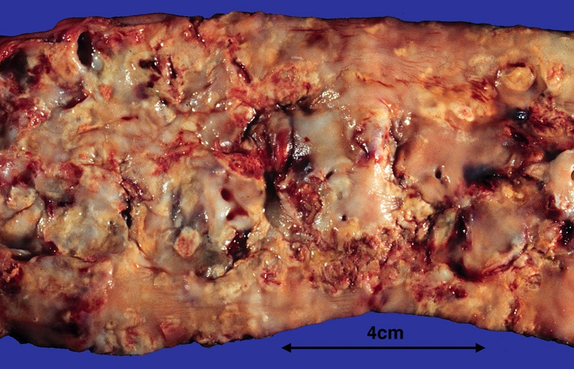
Atherosclerosis– plaque ulceration, mural thrombosis

Slide 11
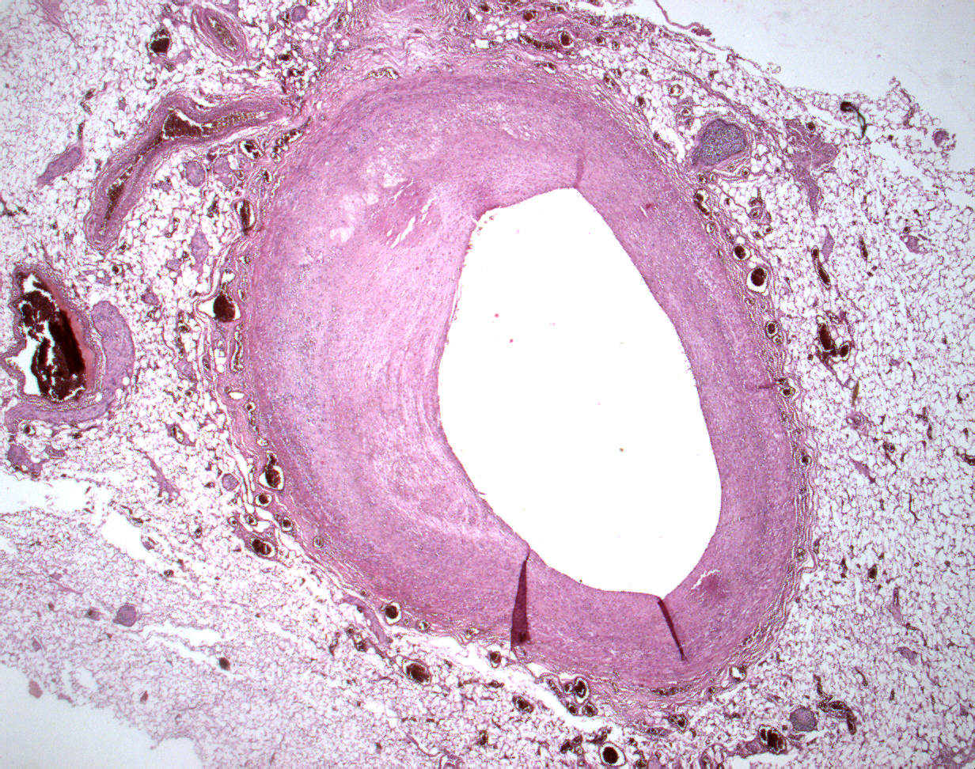
Atherosclerosis– coronary artery
2
1
4
3
1 lumen narrowing
2 intimal atheromatous plaque
3 undamaged wall
4 epicardial fat tissue

Slide 12
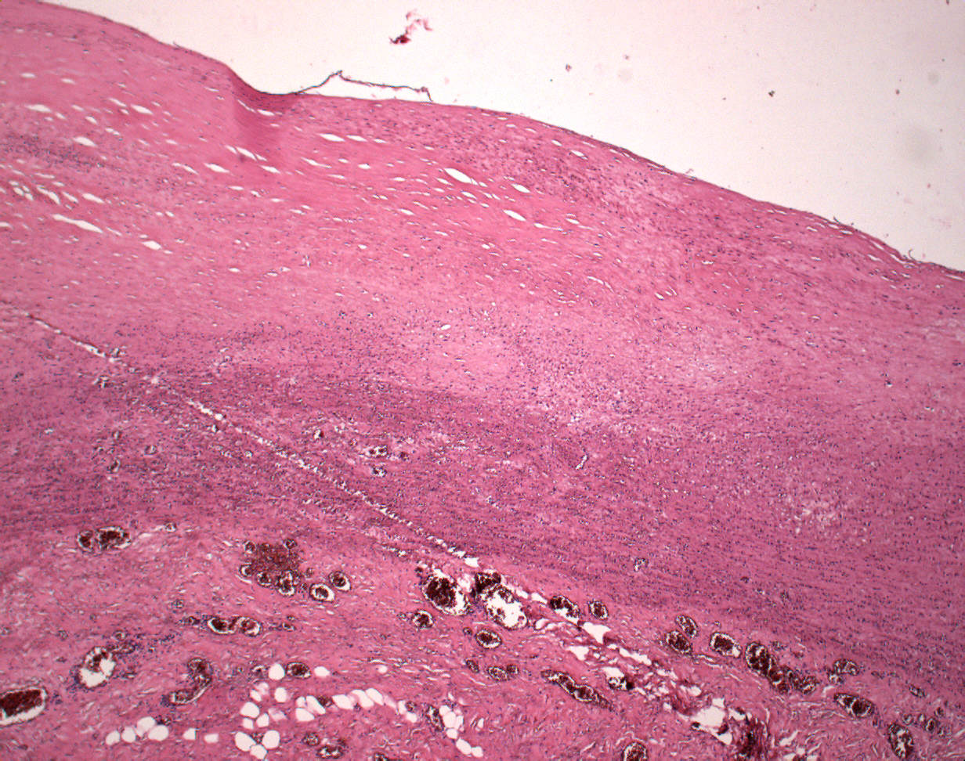
Atherosclerosis – fibrous plaque
2
1
1
3
4
1 fibrous plaque in intima
2 vessel lumen
3 media
4 adventitia

Slide 13
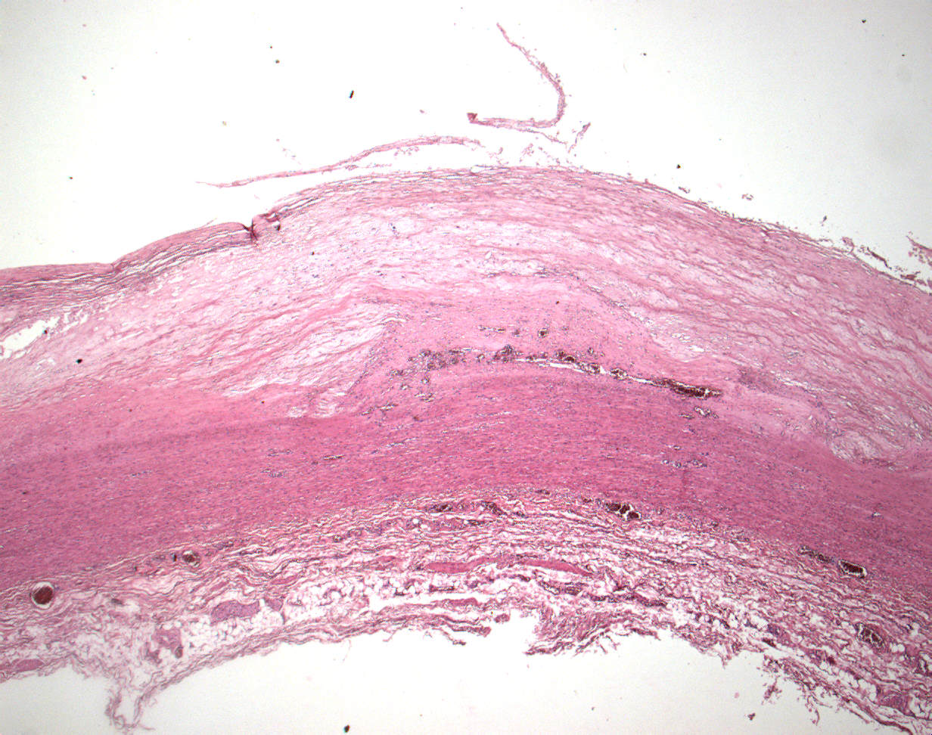
Atherosclerosis – atheromatous plaque
2
1
1
5
3
1 atheromatous plaque in intima
2 vessel lumen
3 media
4 adventitia
5 intimal neovascularization
4

Slide 14
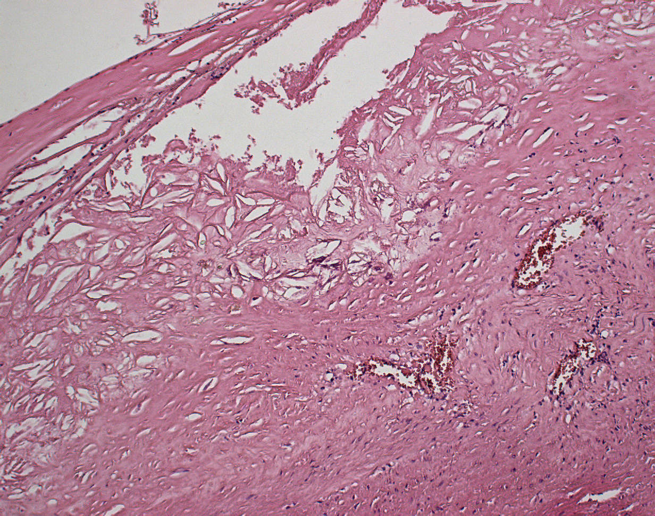
Atherosclerosis – atheromatous plaque, intimal neovascularization
1
4
4
3
1 vessel lumen
2 media
3 vascularization
4 cholesterol crystals
2

Slide 15
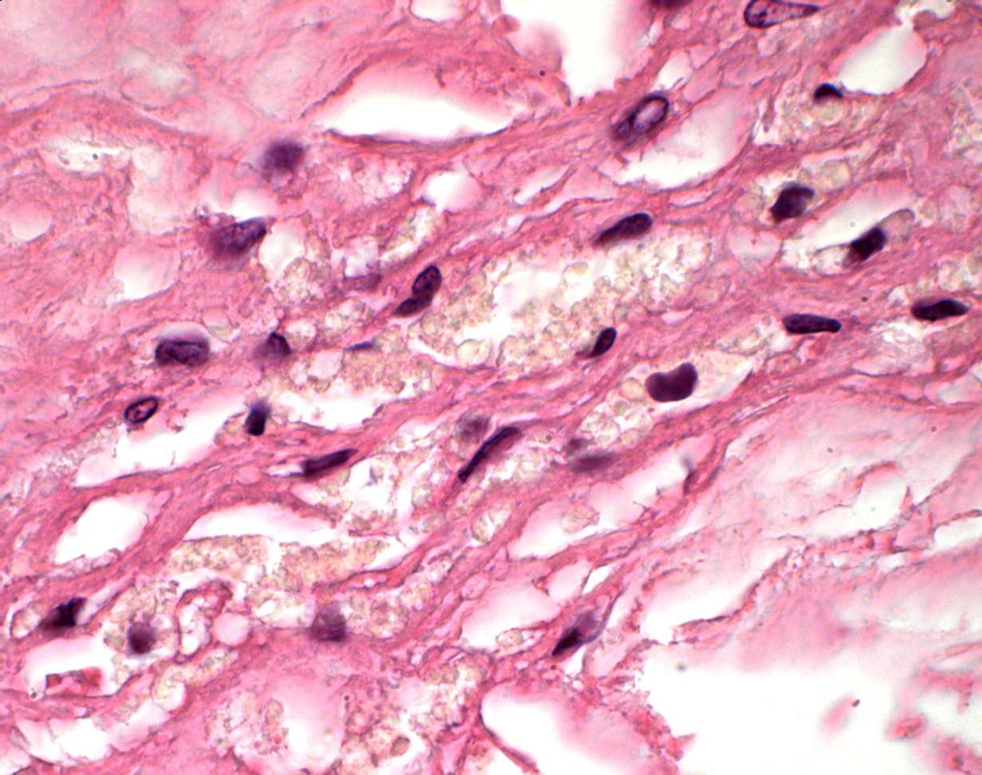
Atherosclerosis – foam cells in atheromatous plaque
2
1
2
1 nuclei of foam cells
2 lipids in cytoplasm

Slide 16
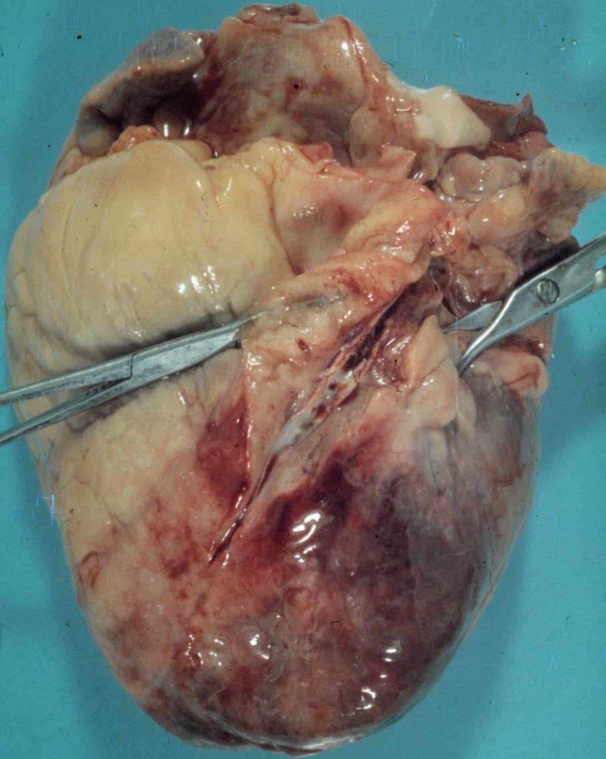
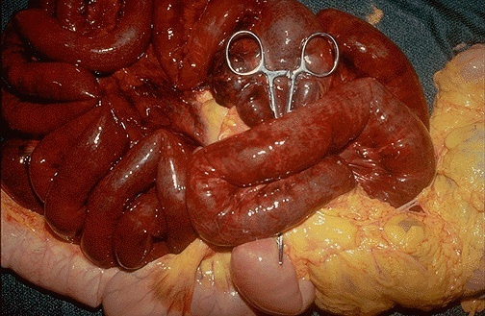
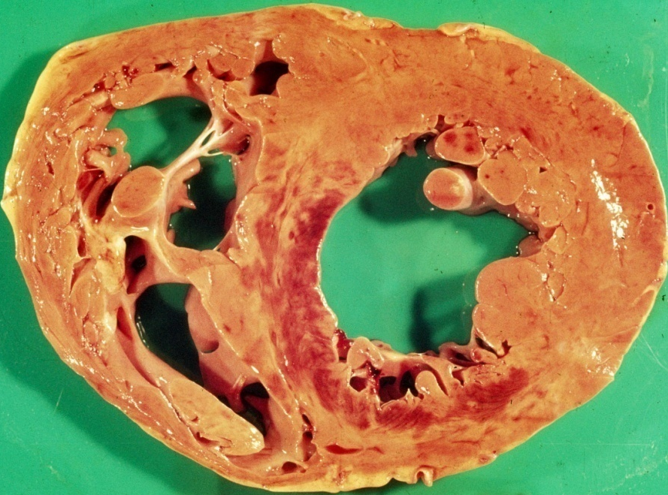
Atherosclerosis – complications thrombosis/thrombembolia
1
3
2
4
1 abdominální aorta
2 trombóza a. mesenterica
3 truncus coeliacus
4 trombóza koronární a.

Slide 17
Aneurysm
localized, blood-filled balloon-like bulge in the wall of a blood vessel.
  the circle of Willis in the brain, thoracic and abdominal aortic aneurysm
atherosclerotic aneurysm x syphilitic
etiology:
  hereditary defects in the structure, atherosclerosis, inflammation, perifocal disease process, accidents …
false aneurysm
serpentine aneurysm, arteriovenous aneurysm

Slide 18
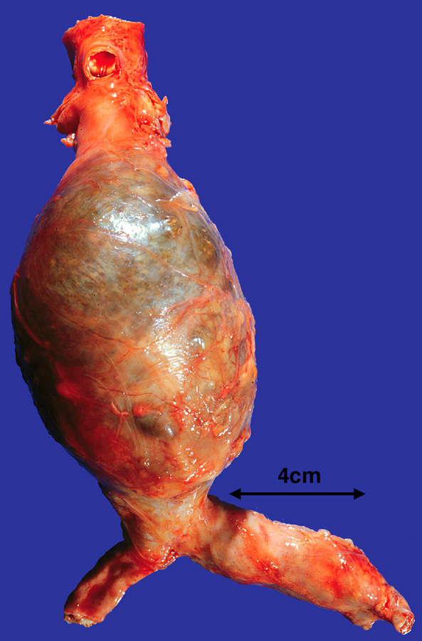
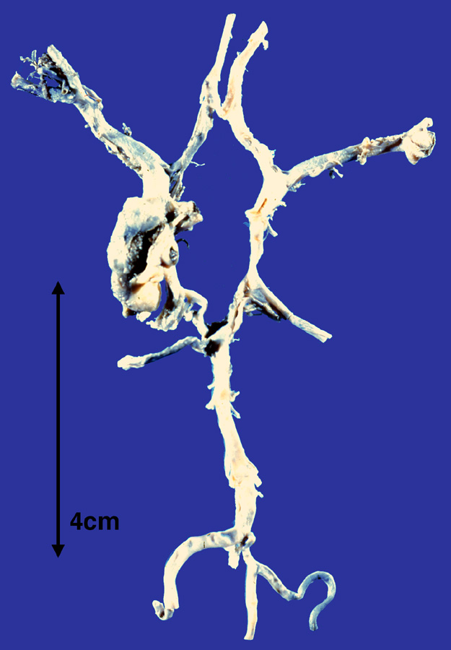
Atherosclerosis – complications– aneurysm
3
1
4
7
5
2
6
3 a. cerebri anterior
4 a. cerebri media
5 a. cerebri posterior
6 a. basilaris
7 aneurysm
1 abdominal aorta
2 aneurysm

Slide 19
Aortic dissection
tear in aortic intima - intramural bleeding through media, false lumen, possible „double-barreled“ aorta
typic in ascending aorta, 1–8 cm above aortic valve
ante– and retrograde spread to the aortic root
common thrombosis in false lumen
risk of external rupture (➔ hemoperikardium), progression at the aortic branches (➔variable organ‘s ischemia), heart failure
predisposition – hypertension, Marfan sy, cystic medial necrosis, …

Slide 20
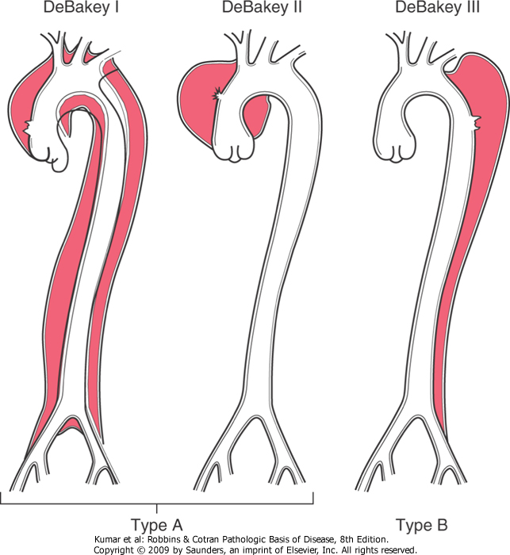
Aortic dissection

Slide 21
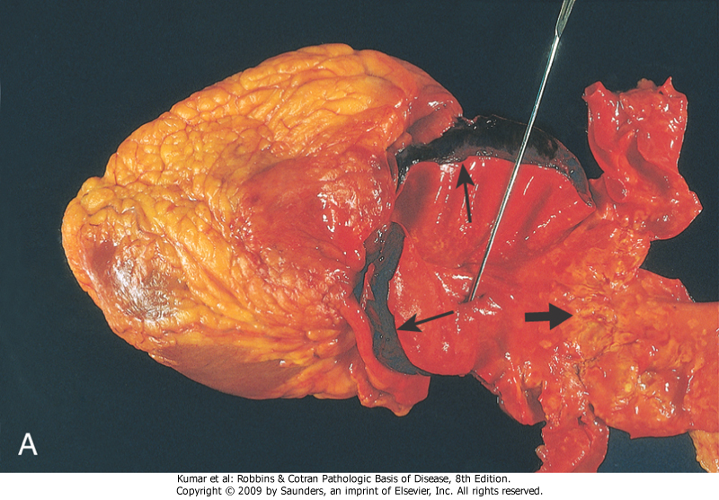
Aortic dissection

Slide 22
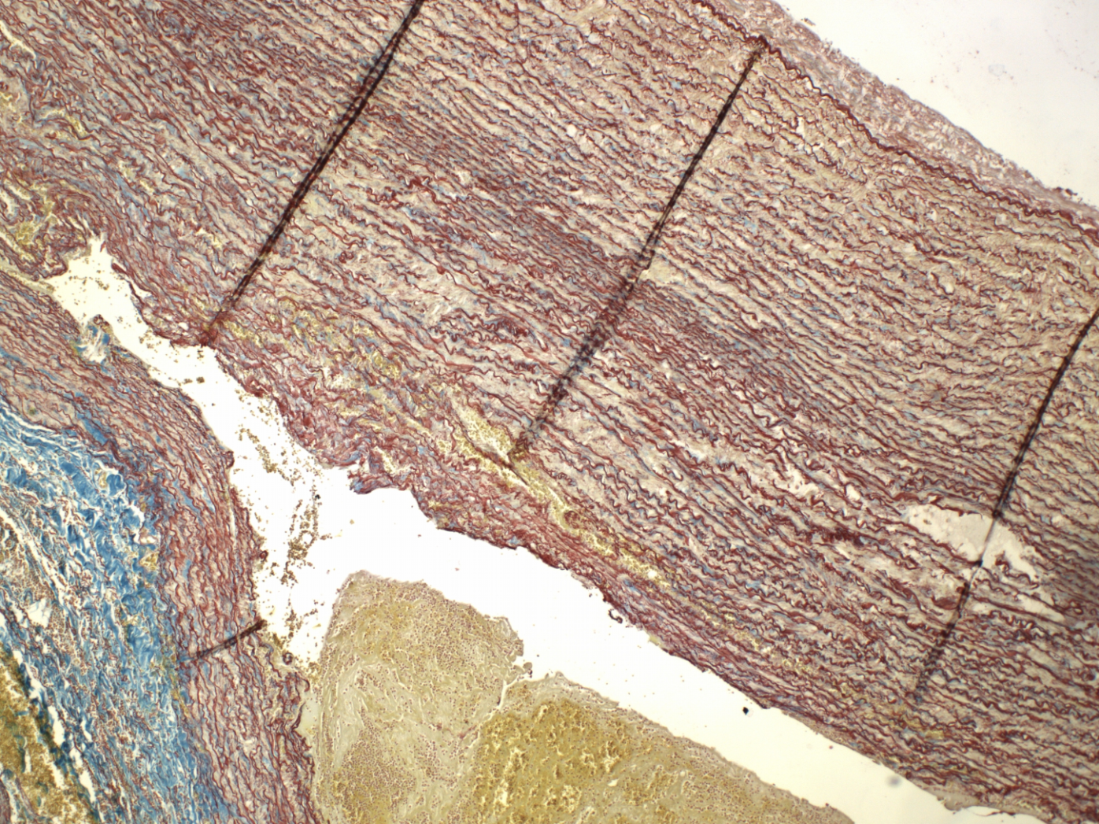
Aortic dissection

Slide 23
Arteriosclerosis
in muscular arteries
smooth muscle hypertrophy
intimal fibrosis
collagenisation of elastic membrane
hyalinisation (hyaline a.)
age and/or hypertension related changes
→ nephrosclerosis, cerebral ischemia, …

Slide 24
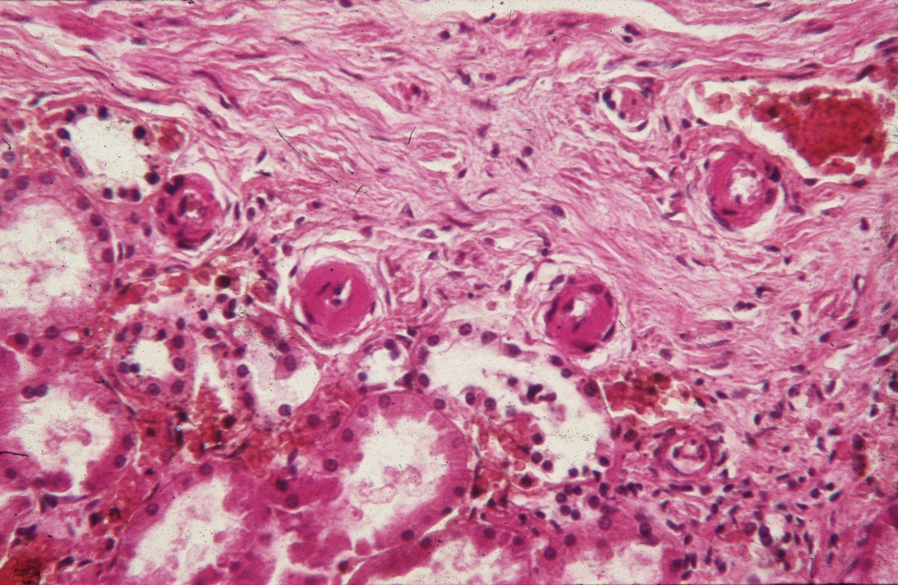
Hyaline arteriolosclerosis

Slide 25
VASCULITIS
Vessel wall inflammation
signs: local (ischaemia, necrosis – infarction, ulceration); systemic
Classification according cause: infectious x non-infectious (commonly immune-mediated, ANCA+/ANCA-)
Affected organs : all organs with vessels
Type (size) of vessel involved: Large-vessel
Medium-vessel
Small-vessel

Slide 26
Vasculitis
ANCA⁺ vasculitis (dangerous, even fatal within a few years, if not recognised)
  Wegener granulomatosis
  Churg-Strauss syndrome
  microscopic polyangiitis
ANCA⁻ vaskulitis:
  polyarteritis nodosa
  Kawasaki disease
  giant-cell arteriitis (Horton, temporal))
  Takayasu arteriitis
  thrombangiitis obliterans (Bürger disease)
  leukocytoclastic (allergic) vasculitis – cca 30%

Slide 27
Etiology
immune-mediated/associated process
infection
  ie. streptococcus, …
  direct cause of infective v., or trigger factor of pathological immune processes
other

Slide 28
Possible clinical signs of systemic vasculitis
ORL: - repeated respiratory tract inflammation
- exudate rich in plasma cells + eosinophils
Kidney: - glomerulonephritis
Lung: - variable presentation of lung diseases + hemoptysis
Skin: - ulceration, necrosis, petechiae-purpura
GIT: - ischemic ulcerations (sharply demarcated, without HP, minimal inflammation)
Chronic debilitating disease – clinical signs of tumor!!

Slide 29
Patient presentation
    fever, nausea, myalgia, arthralgia
    skin purpura
    signs of nephritis
    abdominal pain
    general malaise (~ severe influenza, long duration, resistant to usual therapy)
    sinusoid course (relapse --- remission --- relapse--)

Slide 30
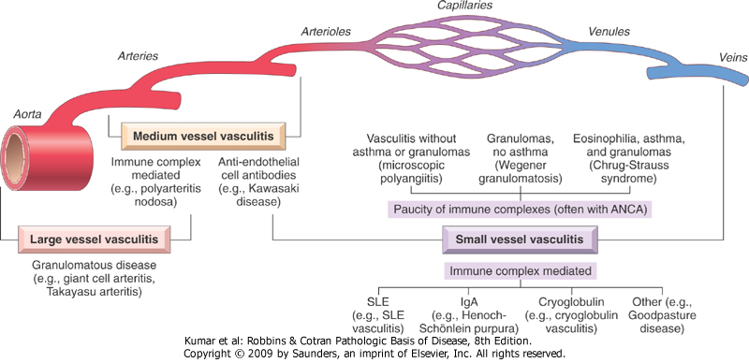
Microskop. polyangiits
Wegener
Churg-Strauss. sy
PAN
Kawasaki
ANCA
Giant-cell a., Takayasu

Slide 31
ANCA+ vasculitis
incidence ????
  ≤20/1mil. inhabitants
  age 65+ - 53/1mil. inhabitants
prognosis:
  untreated ANCA⁺ vasculitis ≥80% fatal in 2 yrs
  treated ANCA⁺ vasculitis : ≥80% survives 5 yrs
  renal failure in elders >70 yrs - in 40% due to ANCA⁺ vasculitis

Slide 32
granulomatosis with polyangiitis
(Wegener granulomatosis)
clinically as pneumonitis, persistent X-ray with bilat. nodular infiltrates, chronic sinusitis with mucosal ulcerations of nasopharynx (sometimes destructive axial structures), ARI / CHRI (focal necrosis, sickle cell GLN)

Slide 33
granulomatosis with polyangiitis
(Wegener granulomatosis)
persistent pneumonitis (95%) – nodular infiltrates
chronic sinusitis (90%) – ulcerations, event. Destructive
renal disease (80%) – glomerulonephritis
other features: rashes, muscle pains, articular involvement, mono-/polyneuritis

Slide 34
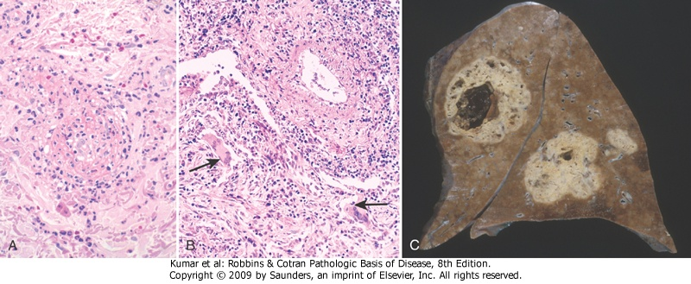
Small vessel vasculitis with giant-cell granulomatous reaction

Slide 35
ANCA+ VASCULITIS: microscopic polyangiitis
ANCA in approx. 70% (remaining by immune complexes or antibodies)
= necrotizing vasculitis arterioles, capillaries, venules (synonyms: leukocytoclastic v., hypersensitive v., allergic v.)
: SKIN, kidney, lung, GIT, brain…
highly variable etiopathogenesis (part of systemic connective tissue diseases; alergic response to exogennous antigens – bacteria, viruses, drugs)
micro:
  fibrinoid necrosis of vessel wall with neutrophils and chromatin fragments from neutrophil‘s nuclei - leukocytoclastic)
  all lesions in the same stage of evolution (X polyarteritis nodosa)

Slide 36
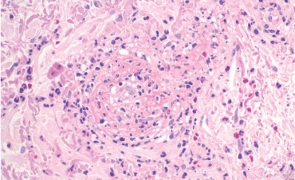
leukocytoclastic vasculitis
nuclear fragments from neutrophils in a small vessel wall

Slide 37
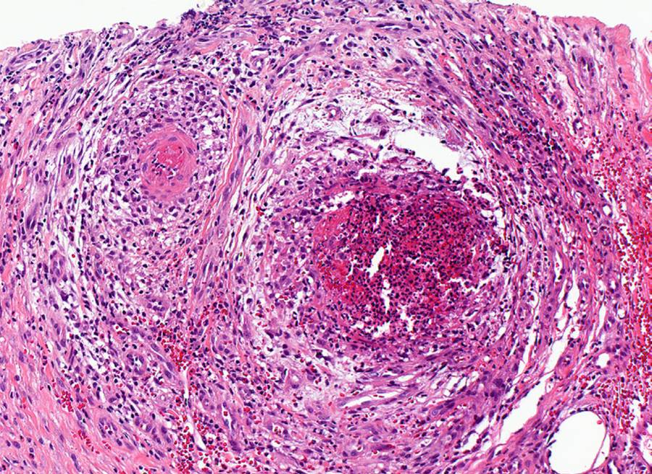
polyarteritis nodosa
3
3
1
2
2
1
3
1 thrombosed vessel lumen
2 fibrin deposition
3 mixed inflammatory infiltrate

Slide 38
leukocytoclastic vasculitis
nuclear fragments from neutrophils in a small vessel wall

Slide 39
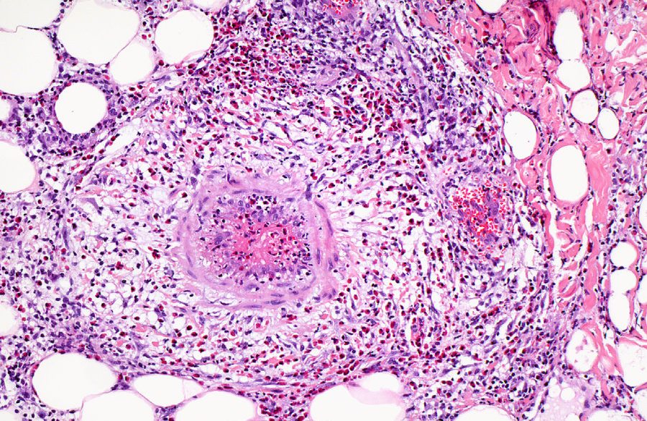
polyarteritis nodosa
3
1
2
3
1 thrombosed vessel lumen
2 fibrin deposition
3 mixed inflammatory infiltrate

Slide 40
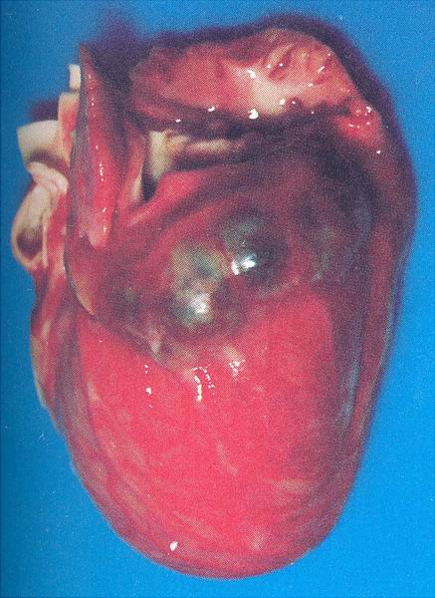
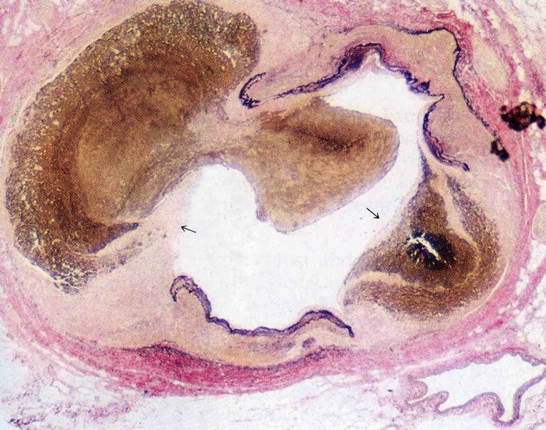
Kawasaki disease
coronary artery with lamina elastica interna defects (arrows) and thrombotized aneurysms
Coronary aneurysms in a child‘ heart

Slide 41
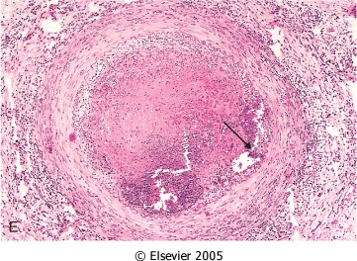
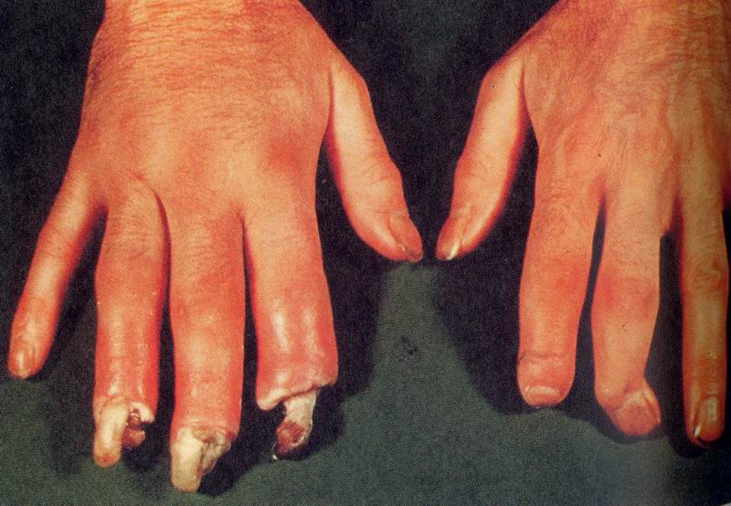
Thrombangiitis obliterans
(Bürger disease)
Obliterative thrombosis with granuloma with central microabscess (arrow)
acral necroses

Slide 42
infectious vasculitis
rare
cause:
  direct transfer of infection from surrounding tissues
  infected emboli during pyemia
bacterial (commonly in sepsis):
  Staph., Strep., Neisseria
  G- rods
  aortitis luetica
  mycobacteria
  bacillary angiomatosis = opportunistic infections (eg AIDS)
fungal (Aspergillus, Mucor)
viral (hepatitis B, C; HIV, CMV, SARS-CoV-2)
parasitic (Schistosoma, amoebiasis)

Slide 43
Infectious vasculitis
direct invasion of vascular wall by inf. pathogen
primary angioinvasive microorganism
Fungi: Aspergillus, Mucor - thrombosis→ ischemic necrosis
secondary vasculitis - localized vasculitis in focal infection
  purulent – meningitis
  pneumonia
  abscess, fasciitis – pyogenic bacteria
  granulomatous
    obliterative endarteritis – TBtertiary syphilis, l
    Lepra
  lymphocytic vasculitis – rickettsia (spotted fever, Q fever etc.)
  recurrent herpes, CMV
  necrotizing vasculitis – anthrax

Slide 44
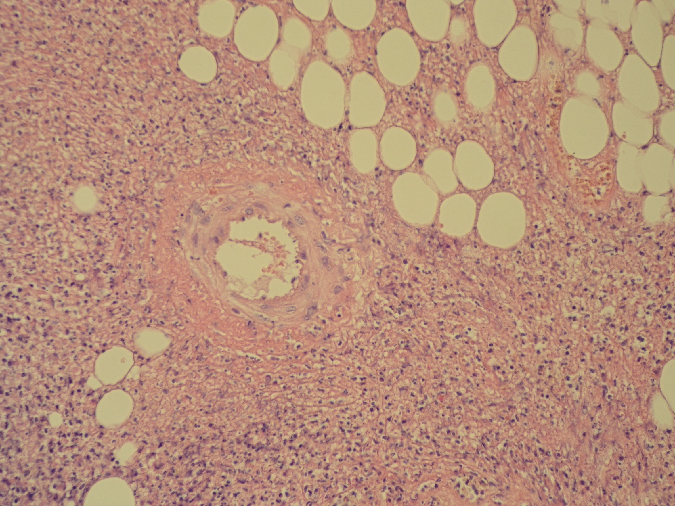

Slide 45
Vasculopathy, thrombosis in COVID-19
microangiopathy
  endotheliitis
  diffuse microthrombosis (platelets + fibrin), lungs in ARDS, kidney, heart, liver
  capillary congestion
  angiogenesis
coagulopathy /hypercoagulability w. thrombosis, thrombembolisation
  endothelial damage, circulating prothrombotic factors, blood stasis
  deep venous thrombosis
  infarctions inc. stroke

Slide 46
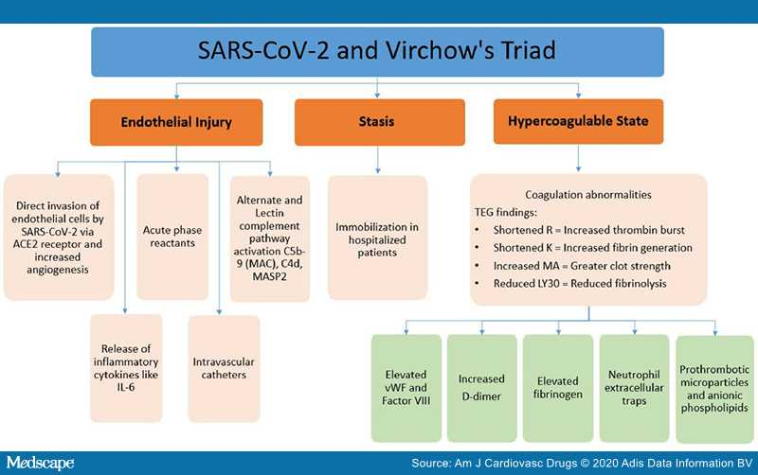

Slide 47
Cardiac pathology

Slide 48

Morphology
pericardial sac – cca 30ml clear yellowish fluid
male = 300 – 350 g,
  - hypertrophy > 400g
myocardium:
➔ RV 3 – 4 mm
➔ LV 12 – 15 mm
foramen ovale
  - closed x opened ➔ paradoxical embolia

Slide 49
Congenital cardiovascular disease

Slide 50
Congenital heart defects
approx. 2,5 % of live newborns
in children mostly ventricular septal defect
in adults mostly atrial septal defect
prenatal diagnostics
possible signs
  dyspnoe, possible cyanosis, polycythemia
  growth retardation
  repeated infections (lungs, valves)
  possible paradoxical embolization

Slide 51
Morphological classification
abnormal heart position
abnormal connection between ventricles and arteries (transposition)
septal defects
valvular defects
dct. arteriosus persistens
combination of multiple defects

Slide 52
Pathological shunts
atrial septal defect
ventricular septal defect
patent ductus arteriosus
Initially left-to right shunts, i.e. non-cyanotic, later (in heart defects) right ventricular hypertrophy – reverse shunt, cyanotic defect

Slide 53
Ventricular septal defect

Slide 54
Ventricular septal defect

Slide 55
Atrial septal defect

Slide 56
Congenital stenosis
coarctation of the aorta – congenital constriction
valvular stenosis
Hypertrophy, hypertension and dilatation ahead of stenotic part. Collateral circulation, if posssible.

Slide 57
Coarctation of the aorta
Aortic constricton
with patent dct. arteriosus (pre- or postductal)
with closed dct. arteriosus
Congestive heart failure,
bacterial endocarditis, intracerebral haemorrhage

Slide 58
Complex congenital heart disease
Fallot‘s tetralogy
transposition of the great arteries
Combination of malformations, i. e. hypoplasia, shunting or incorrect connection, stenosis, etc.

Slide 59
Fallot‘s tetralogy
ventricular septal defect with dilatated overriding aorta,
stenosis of the pulmonary valve,
right ventricular hypertrophy

Slide 60
Pericardial pathology
1) Pericardial effusion
- transudate in congestive heart failura or hypoproteinemia, slow (up to 500ml – pericardial dilatation)
2) haemopericardium
– wall rupturein MI or aortic root dissection ➔ fatal cardiac tamponade
diastolic filling restriction

Slide 61
Pericardial pathology
3) Inflammatory exudate in pericarditis:
  a) non-infectious
– pericarditis epistenocardiaca, uremic, post-operative, SLE, Dressler sy (post-MI autoimmune)
b) infectious
  – haematogenous, direct spread, lymphogennous; variable agents

Slide 62
Acute fibrinous pericarditis
Gross: yellow-greyish superficial coating – granular layer, villi - cor villosum, hirsutum;
Micro: mesh of thin eosinophilic strands, commonly + inflammatory infiltrate
Healing: may be complicated. Fibrinolysis x organisation by granulation tisssue → adhesions, dystrophic calcification.

Slide 63
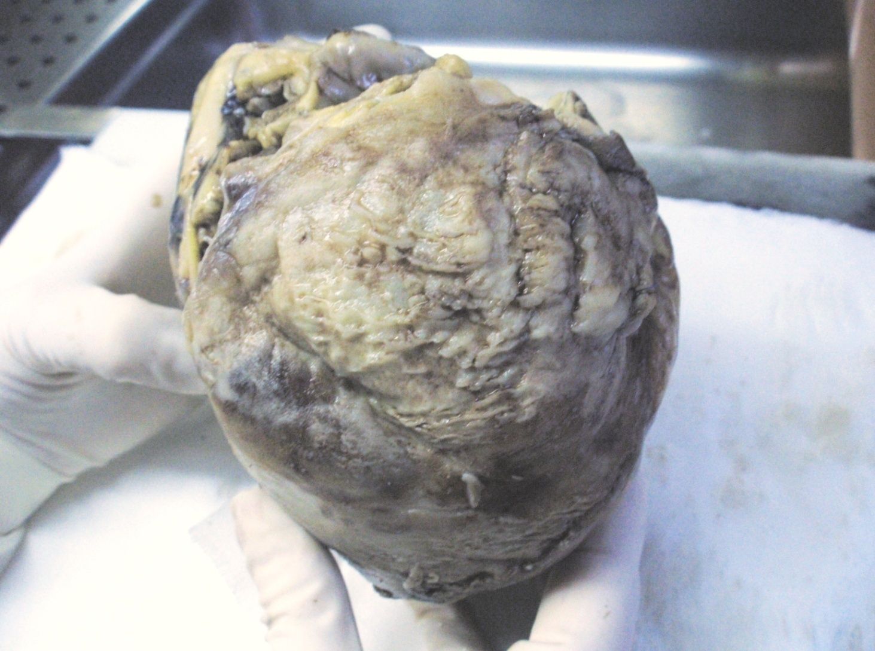
Acute fibrinous pericarditis

Slide 64
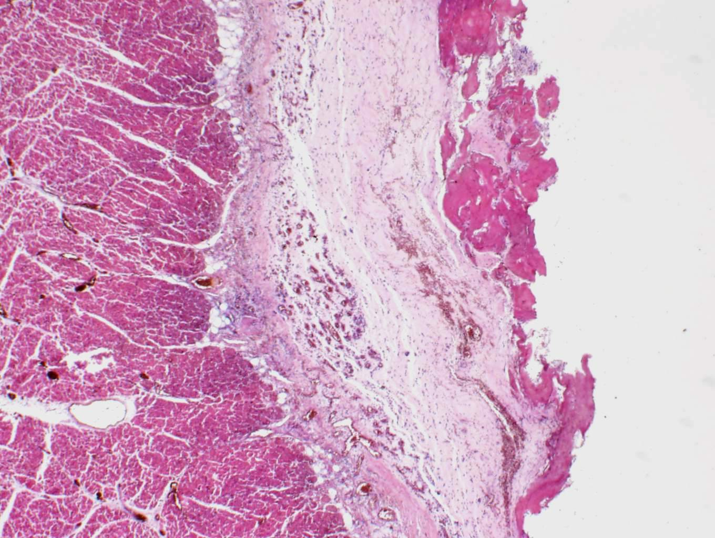
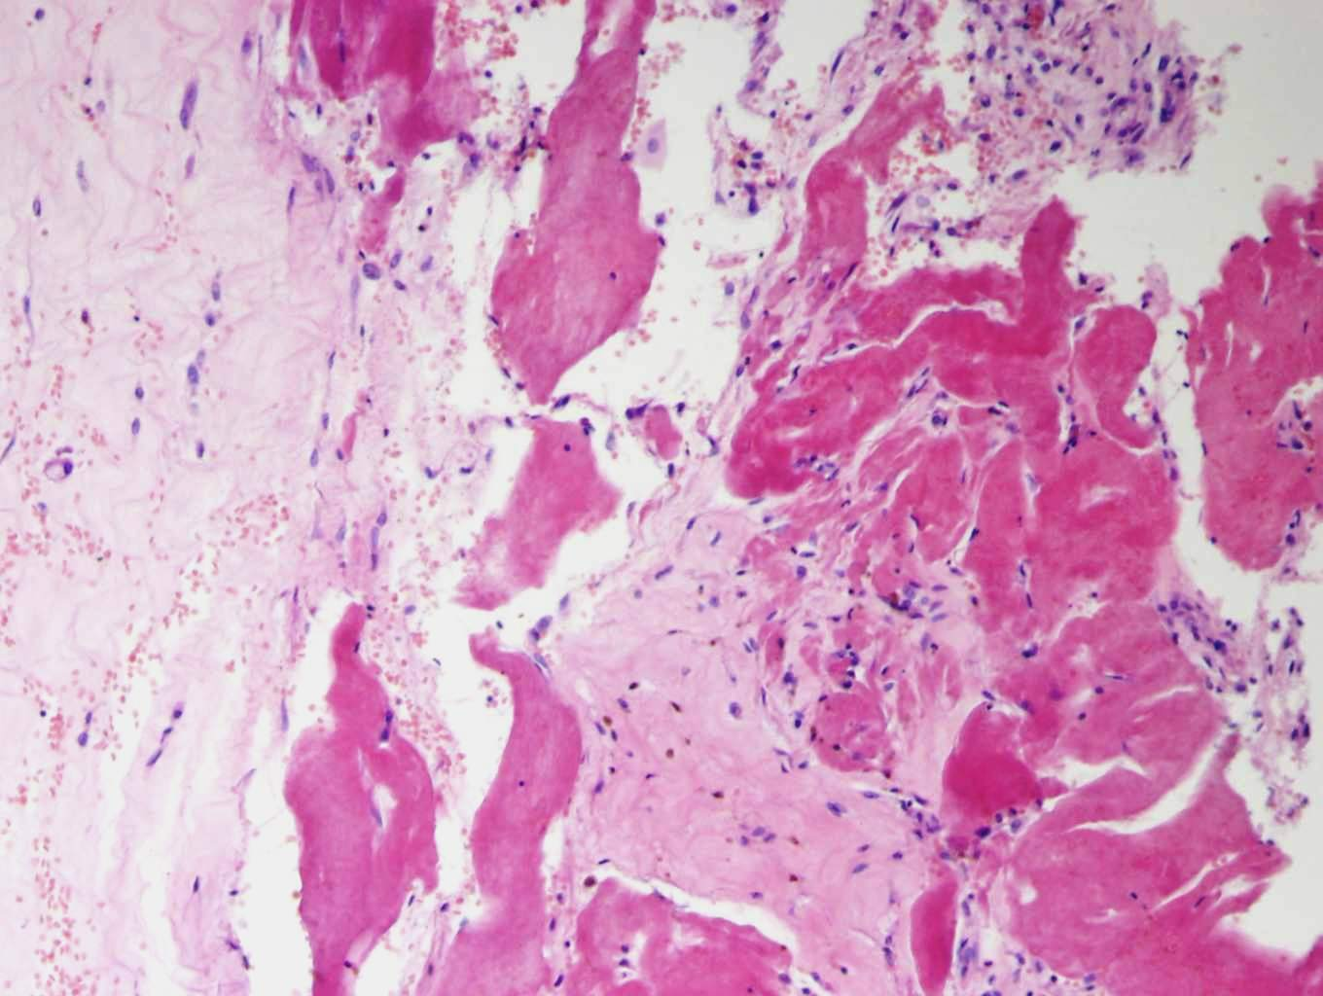
fibrinous pericarditis
1
1
1
1 fibrinous exudate

Slide 65
Hypertension
systemic
pulmonary
portal

Slide 66
Systemic hypertension
Primary (essential) h.
  multifactorial
  genetics incl. abnormal trensmembrane Na/K transport in renal tubules
  inborn defects incl. low birthweight, decreased nephron number
  acquired risk factors
Secondary h. (renal, endocrine hyperfunction, aortic coarctation, drug induced)
Endothelial + vessel wall lesions
  hyalinne – circular hyperplastic arteriolosclerosis
  fibrinoid necrosis + thrombosis in malignant hypertension
  arteries w. intimal and smooth muscle hyperplasia

Slide 67
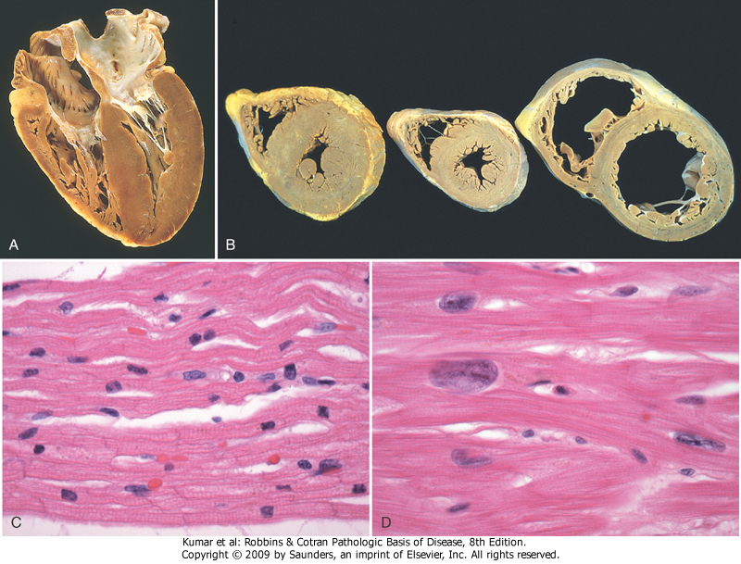
Systemic hypertension and heart
90–95% essential , risk factor for AS
work overload ➔ LV adaptation to ↑ peripheral resistance = cor hypertonicum (concentric LV hypertrophy) ➔ limited compensatory mechanisms ➔ cor hypertonicum decompensatum (dilatation of hypertrophic LV)
➔ heart insufficiency ↑ relative coronary incompetence

Slide 68
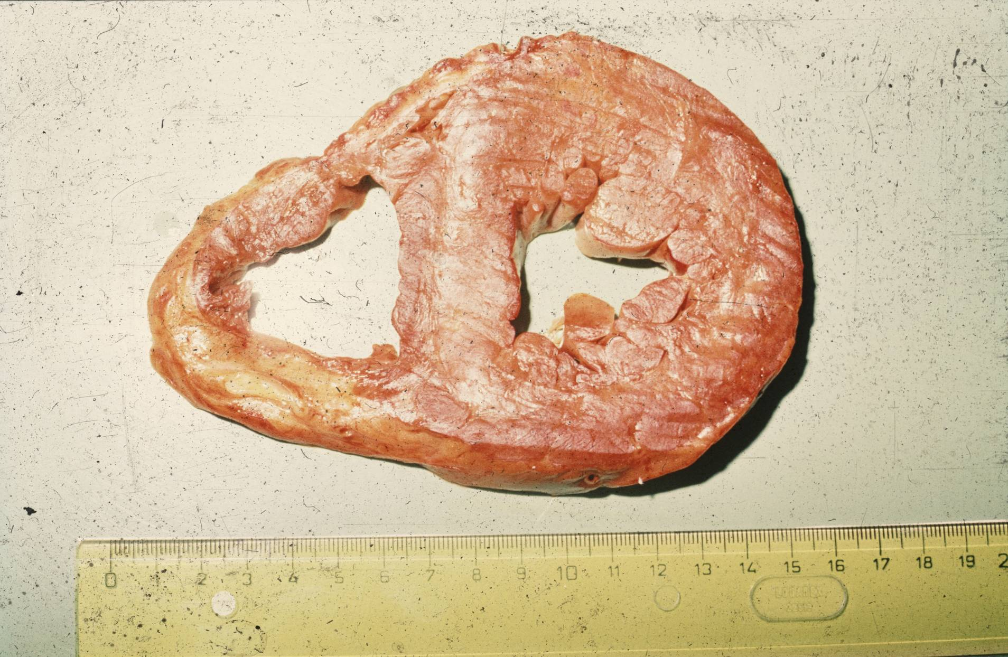
Cor hypertonicum

Slide 69
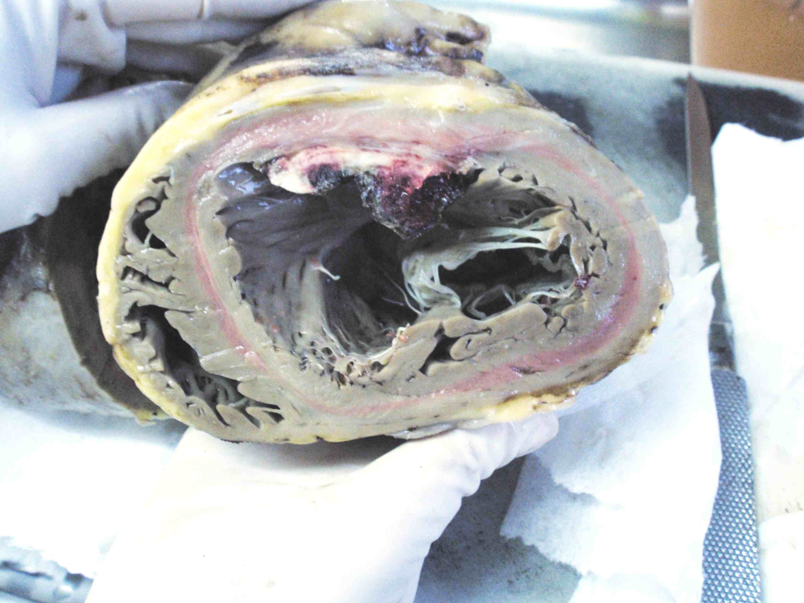
LV hypertrophy

Slide 70
Heart failure
heart unable to pump blood at a rate sufficient for metabolic demands of the tissues
systolic dysfunction - ↓ myocardial contractile function (ischemic injury, pressure or volume overload – valvular disease, hypertension, cardiomyopathy
diastolic dysfunction - inability to dilatate sufficiently (massive LV hypertrophy, myofibrosis, amyloidosis)
cardial – extracardial pathologic changes

Slide 71
Heart failure
failure of normal pumping action of the heart
failure of forward and backward ➔ to cardiogenic shock
manifestations of the heart and heart out

Slide 72
Cardial changes
disproportion between heart function and peripheral vascular resistance
differ according rapidity of development:
– sudden ➔ acute dilatation
– chronic ➔ adaptation ➔ ➔ ➔
myocardial hypertrophy (↑ nutritional demands) +/- ventricular dilatation (enhanced contractility – Frank-Starling mechanism), + activation of neurohumoral systems (norepinephrin, renin-angiotensin sy, atrial natriuretic peptide

Slide 73
Extracardial changes
venoous congestion – e.g. liver (-> hepar moschatum)
induration – fibroproduction (liver, spleen, kidney)
oedema –
cyanosis – visible on acral parts

Slide 74
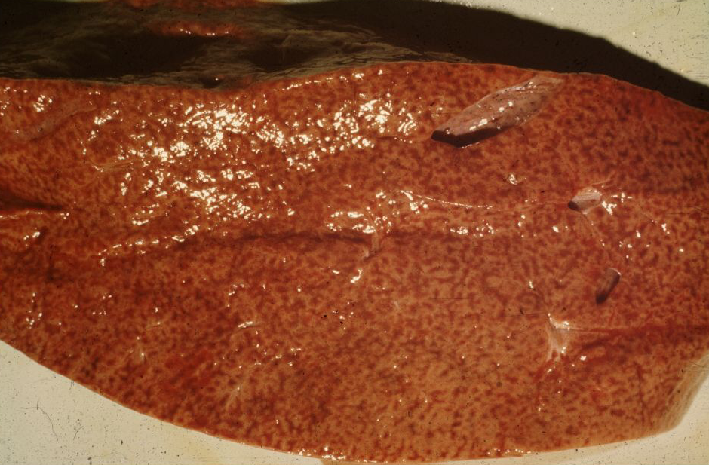
Chronic venous congestion
(nutmeg liver - hepar moschatum)

Slide 75
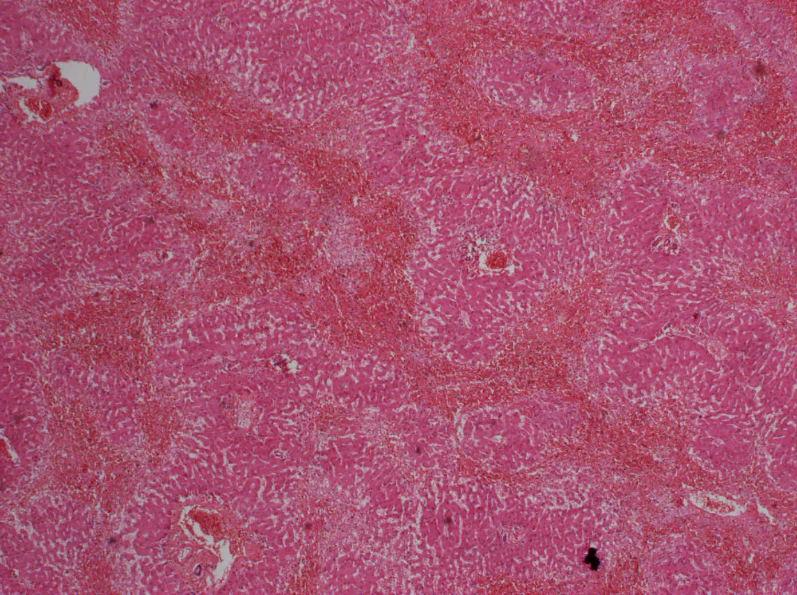
Hepatic venous congestion
2
1
1
2
1
1 Portal spaces
2 Congestive lines (severe congestion with hepatocyte necrosis)
--- pseudolobule: confluent remnants of 3 lobules, centrally portal space

Slide 76
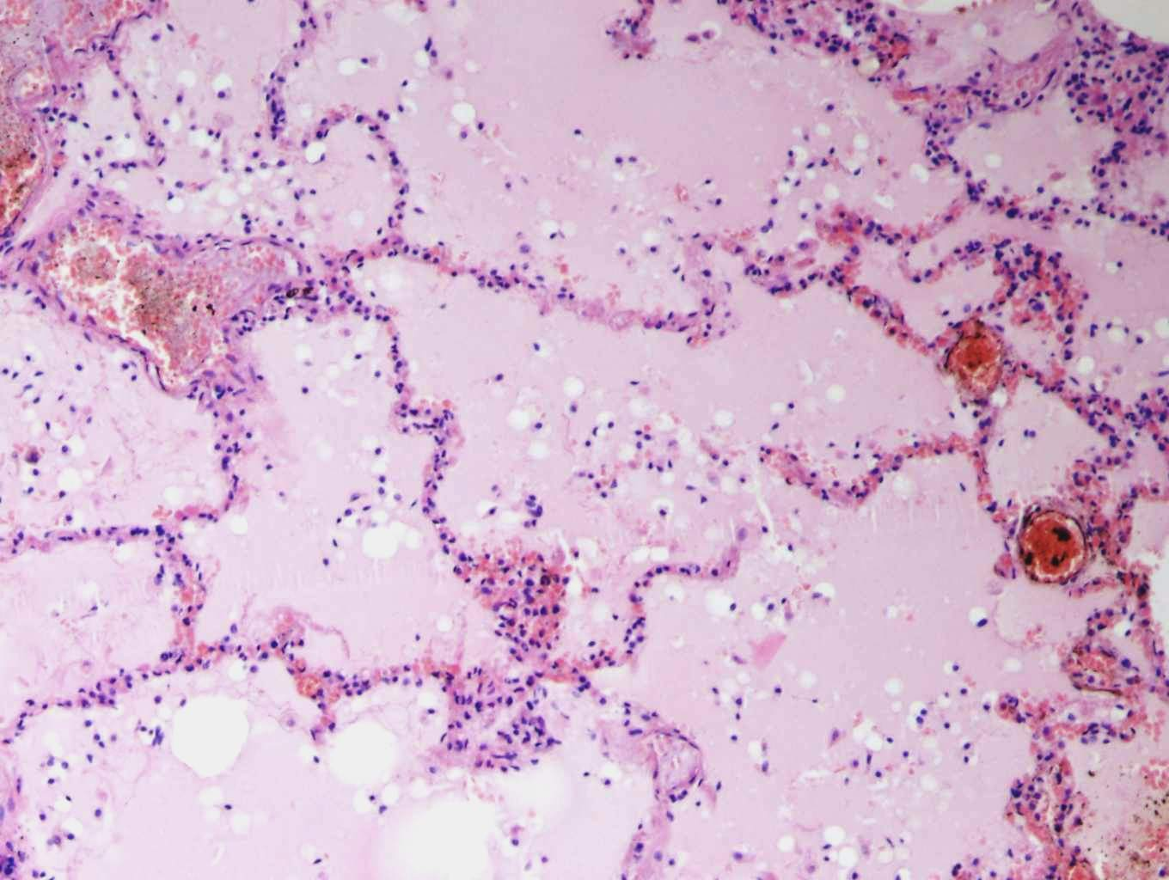
Pulmonary oedema
1
1
3
1 oedematic fluid
2 widening of septa
3 capillary dilatation
2

Slide 77
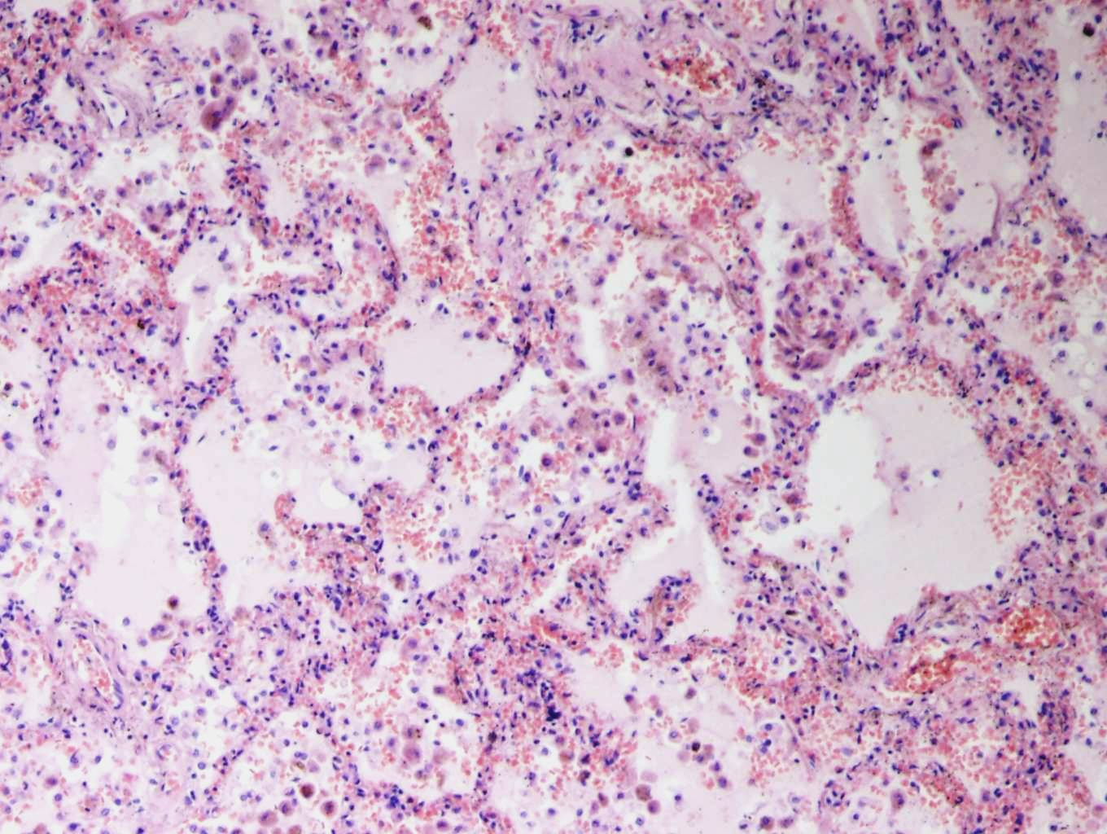
Chronic pulmonary venous congestion
1
1
1 oedematic fluid
➔ hyperemic septa
 siderophages

Slide 78
Ischemic heart disease (IHD)
group of pathophysiologically related syndromes resulting from myocardial ischemia (hypoxia or anoxia, ↓ nutrients, ↓ removal of metabolites)
imbalance between the demand and supply by coronary arteries.
important factor – coronary AS
forms:
  angina pectoris
  myocardial infarction (MI)
  chronic IHD with heart failure
  sudden cardiac death

Slide 79
Ischemic heart disease (IHD)
Morphology of myocardial ischemia:
  myofibrosis
  myomalatia (= partial necrosis – cardiomyocytes only)
  myocardial infarction: transmural/subendocardial (complete coagulative necrosis incl. interstitium)

Slide 80
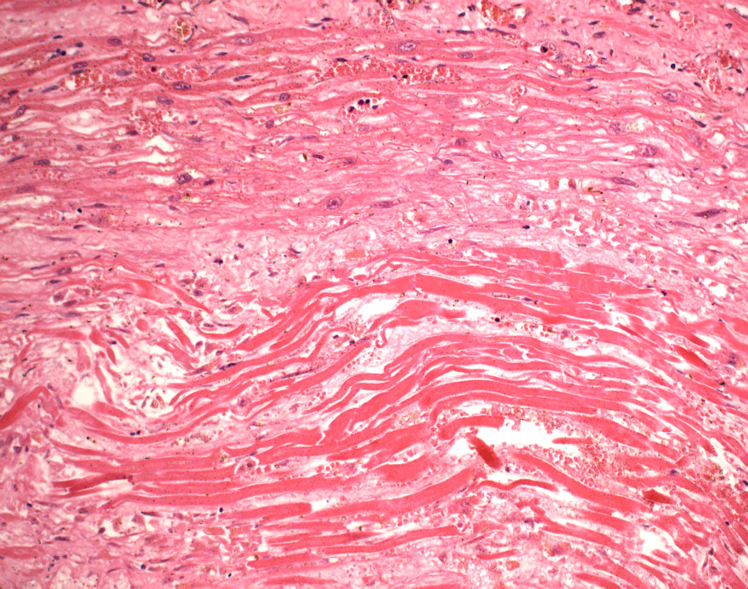
Myomalatia
2
3
1
1
1 myomalatia
2 normal cardiomyocytes
3 myofibrosis

Slide 81
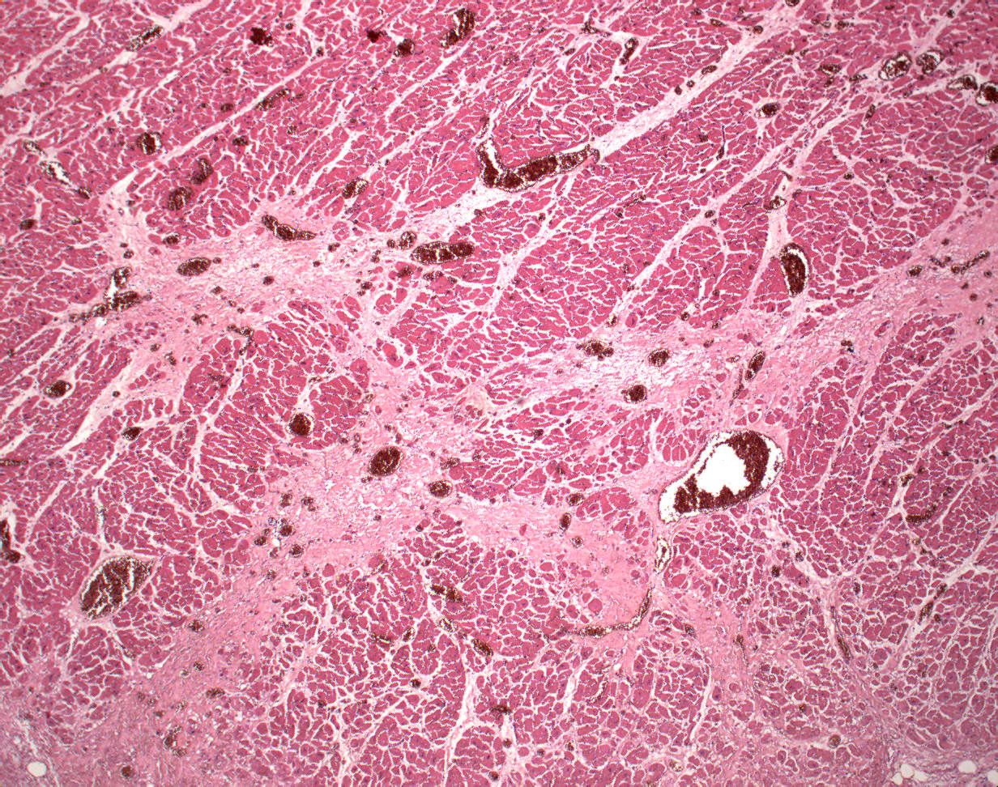
Myofibrosis
3
1
2
1 cardiomyocytes
2 myofibrosis
3 vessels

Slide 82
Pathogenesis of IHD
AS of coronary aa.
– commonly at a. branching
– fixed obstruction by plaque (fibrous, atheromatic)
– acute plaque change (rupture, erosion, haemorrhage, thrombosis)
– 75% stenosis – ischemia during ↑ workload – stable angina pectoris
– 90% stenosis –ischemia even at rest – ustable angina - preinfarction
2) non-atherosclerotic
– coronary emboli – endocarditis, atrial fibrillation, mural thr., paradoxical e.
– coronary vasospasm
– aortic dissection
– coronary vasculitis
– congenital coronary aa. defects
–hematologic disorders, amyloidosis, shock, etc.

Slide 83
Angina pectoris (AP)
transient myocardial ischemia ➔ chest pain !!!
1. stable (typical)
– due to increased workload, duration ≤ 15 min, relieved by rest or nitroglycerin
– no myocardial necrosis
–subendocardial LV myocardium
2. unstable
– increasing frequency / duration of pain attack, even at rest
– plaque disruption + mural thrombosis, possible vasospasm
– preinfarction angina
3. variant (Prinzmetal) angina
– mostly unrelated to physical activity, coronary vasospasm - vasodilatative therapy

Slide 84
Myocardial infarction
ischaemic coagulative necrosis
causes:
  usually coronary thrombosis
  complicated atheromatic plaque
  event. embolism
  spasm
  inflammation
  rarely systemic causes.
gross
  evolution; first signs (red, softer) after 12 hrs
  2-3 days established infarction (yellowish, haemorrhagic rim)
  weeks – formation of firm white fibrotic scar

Slide 85
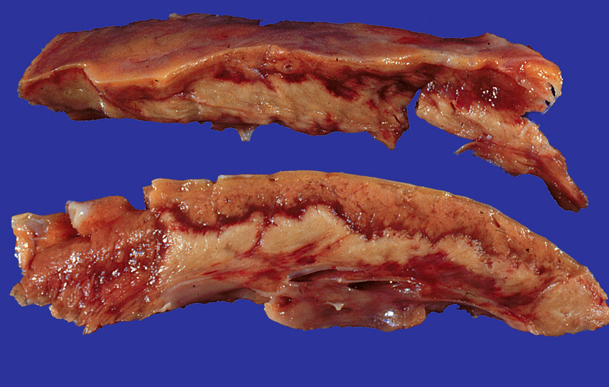
Myocardial infarction
4
2
1
3
2
1
1 subendocardial coagulative necrosis 2 hyperemic rim 3 normal myocardium 4 epicardium

Slide 86
Myocardial infarction
micro:
  necrotic cells more red
  loss of nuclei and striation
  neutrofils
  later macrophages in stroma
  reparation by granulation tissue -> scar

Slide 87
Myocardial infarction
micro:
12-24 hr: edema, hypereosinophilia of necrotic cells, pyknosis
1-3 days: neutrophils, loss of nuclei
3-7 days: macrophages at the border, desintegration of myofibers
1-2 weeks: repair by granulation tissue
cca 2 months: scar

Slide 88
Microscopic changes in developed MI
3
5
2
4
1 coagulative necrosis
2 myomalatia
3 hyperemic rim
4 neutrophils
5 regressive changes
1

Slide 89
Myocardial infarction
transmural (QIM, STEMI) - + ST elevation on ECG
– ≥ ¾ of wall thickness, breadth >25 mm
– complete coronary artery obstruction
emergency angioplasty/stenting
non-transmural (subendocardial, Non-STEMI)
– internal ¼ až ½ of LV wall
– collateral blood flow, incomplete obstruction, shorter ischemia
- stenosis + systemic hemodynamic problem (hypotension, ...)

Slide 90
Myocardial infarction
Type 1: spontaneous MI
  unstable AS plaque + thrombosis
Type 2: ischemic dysbalance
  demand and supply dysbalance
    hypotension, anaemia, sepsis, surgery
Type 3: heart death due to MI
Type 4: MI associated w. stenting
Type 5: MI associated w. ao-coronary bypass
Incidental MI
Reinfarction up to in 28 days
Recurrent MI after 28 days

Slide 91
MI complications
sudden death (arrythmia)
cardiogenic shock (contractile dysfunction)
pericarditis epistenocardiaca
  -> sero-fibrinous inflammation
mural thrombosis
  -> embolism into systemic circulation (-> brain, kidney, intestine, spleen infarction)
ventricular aneurysm
  -> acute – risk of rupture, trhrombosis; chronic – LV insufficiency
cardiac rupture
  -> free wall, septum, : tamponade / acute heart failure
papillary muscle rupture
  -> valvular incompetence → acute heart failure

Slide 92
MI complications
persistent pain – extension of infarct
Dressler‘s syndrome – autoimmune; chest pain, fever, effusion during weeks – months
progressive late heart failure - IHD

Slide 93
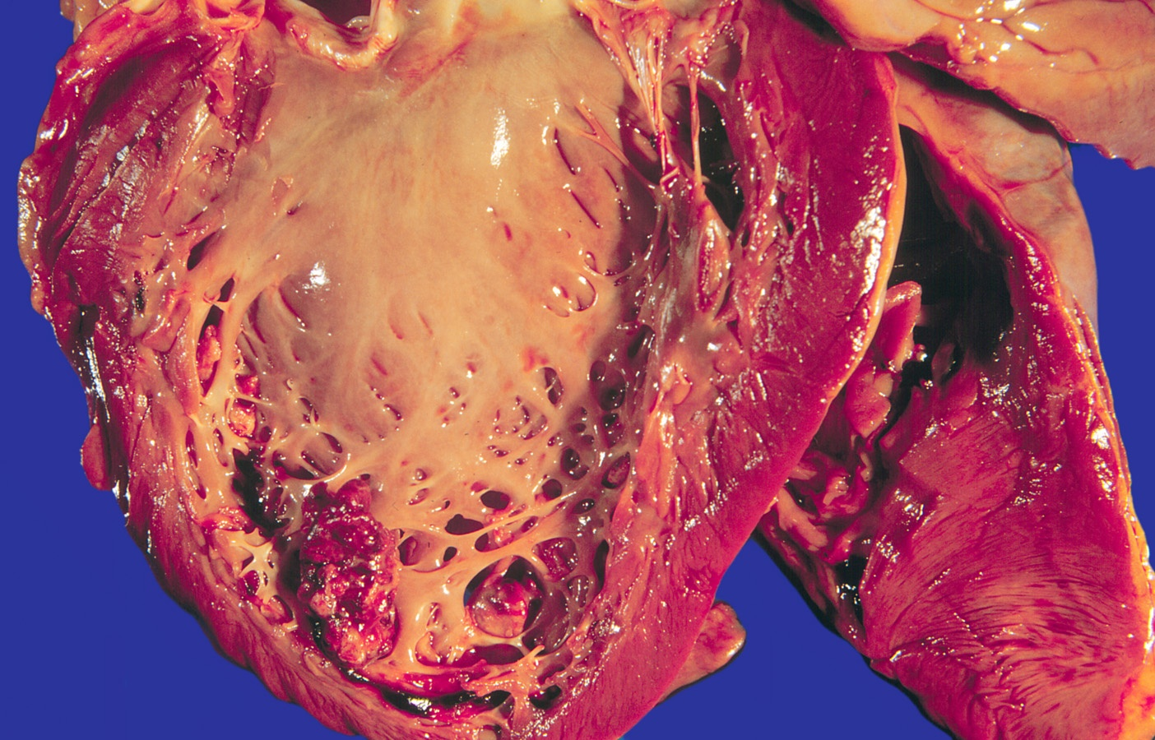
MI – mural thrombosis

Slide 94
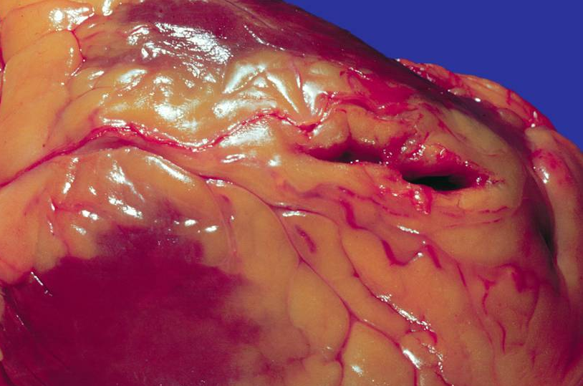
Mi – rupture

Slide 95
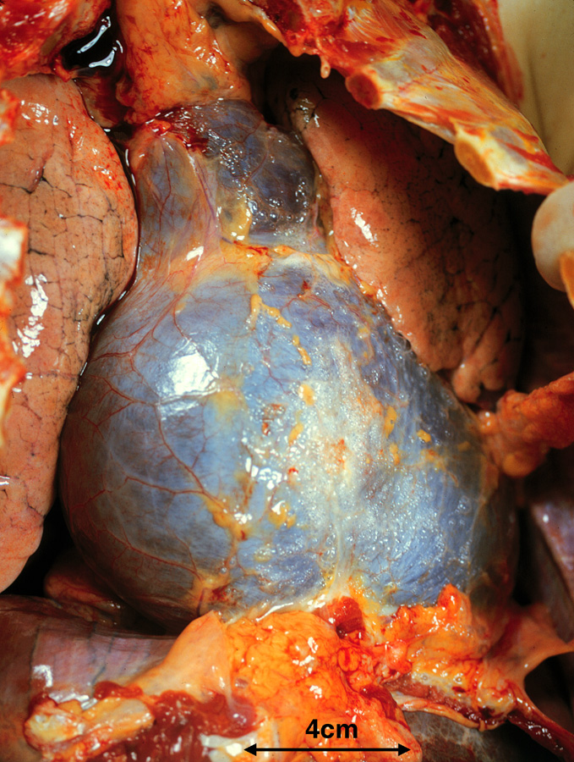
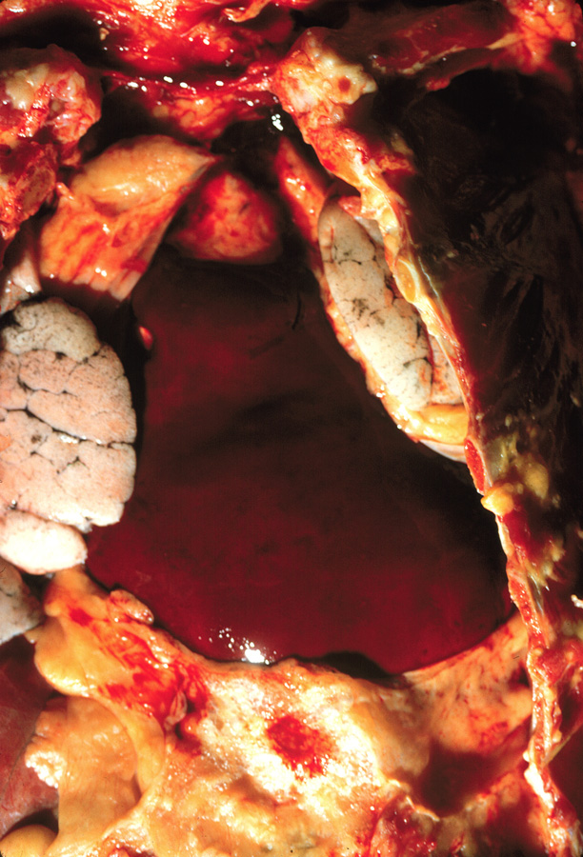
MI – rupture, tamponade
4
1
1
4
1
2
3
1 lung 2 pericardial sac 3 blood coagulum 4 thoracic wall

Slide 96
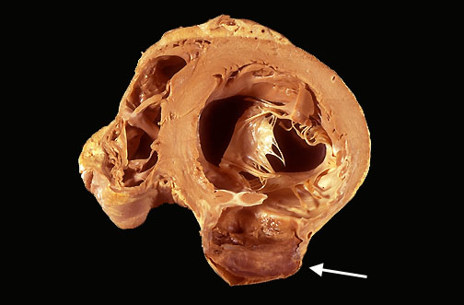
MI – LV aneurysm
2
4
3
1 aneurysm w. thrombosis
2 RV
3 LV
4 mitral valve
1

Slide 97
Chronic ischemic heart disease (IHD)
angina pectoris or MI in anamnesis
progressive heart failure due to ischemic myocardial damage ➔ LV failure ➔ congestive RV failure
heart hypertrophy + dilatattion, myofibrosis and/or post-MI scars
multiple coronary arteries with significant AS stenosis
imminent risk of MI, sudden cardiac death due to arrythmia, heart failure

Slide 98
Sudden cardiac death
= unexpected death from cardiac causes, without preexisting symptoms or within 1 hr of the onset of symptoms
most commonly due to lethal arrythmia (ventricular fibrillation, asystole)
sudden collapse without signs of acute MI
other causes:
  dissecting/ruptured aortic aneurysm
  pulmonaty thrombembolism
  massive intracerebral haemorrhage
  heritable conditions incl. anatomic, electriical – channelopathies

Slide 99
Myocarditis
myocardial inflammatory damage without ischemia
gross:
  cardiac dilatation, flabby, mottled myocardium
micro:
  inflammatory infiltrate (acccording etiology) + cardiomyocyte regressive changes incl. necrosis
etiology:
  viruses, ricketsia, chlamydia, bacteria (diphtheria, sepsis), fungi, protozoa (toxoplasmosis), helminths (trichinosis)
  immune-mediated (drug hypersesitivity, postviral, rheumatic fever, rejection)
  ionising radiation
  unknown (giant-cell myocarditis

Slide 100
Viral myocarditis
Coxsackie, parvovirus B19, influenza, EBV, CMV, HIV
inflammatory infiltrate: T-cells mostly
after acute attack commonly autoimune-mediated cardiomyocytes destruction
and fibrosis → dilated cardiomyopathy

Slide 101
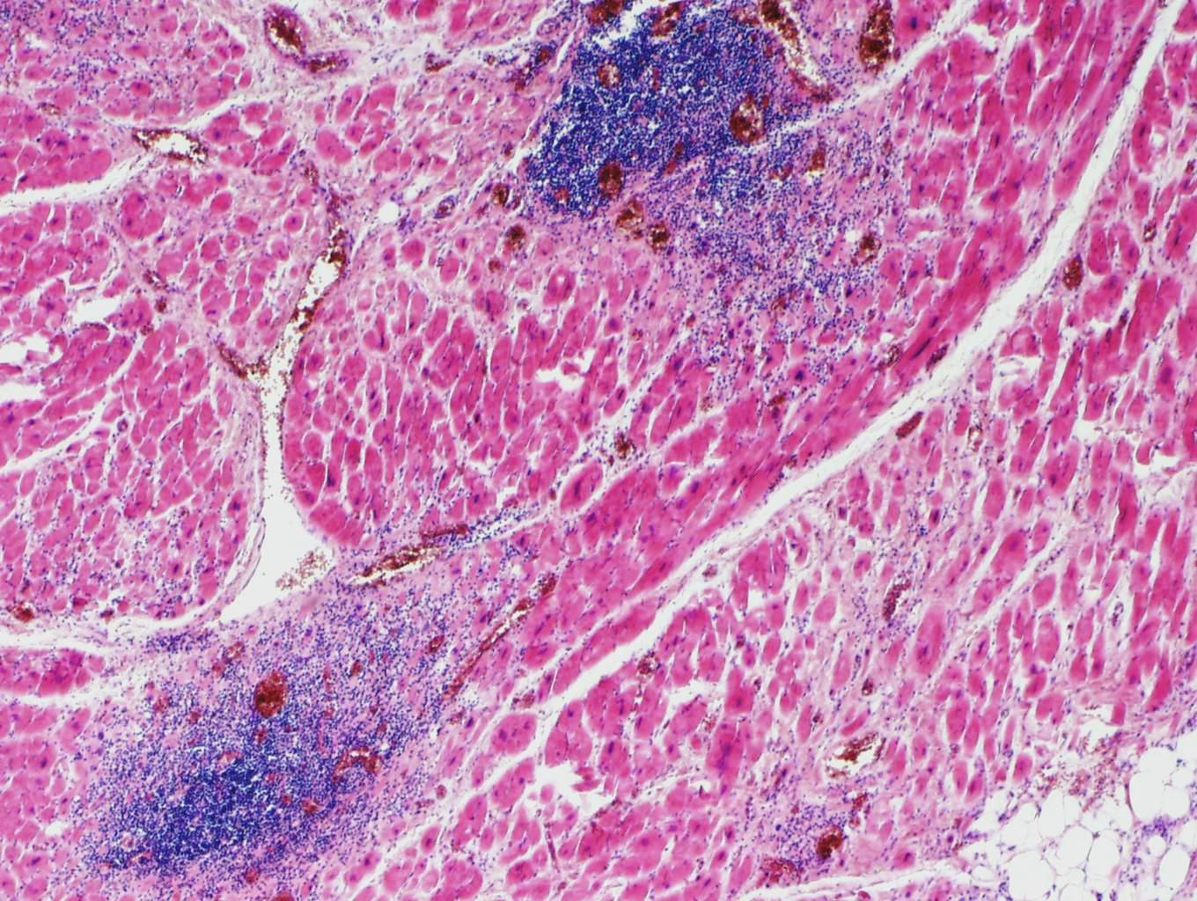
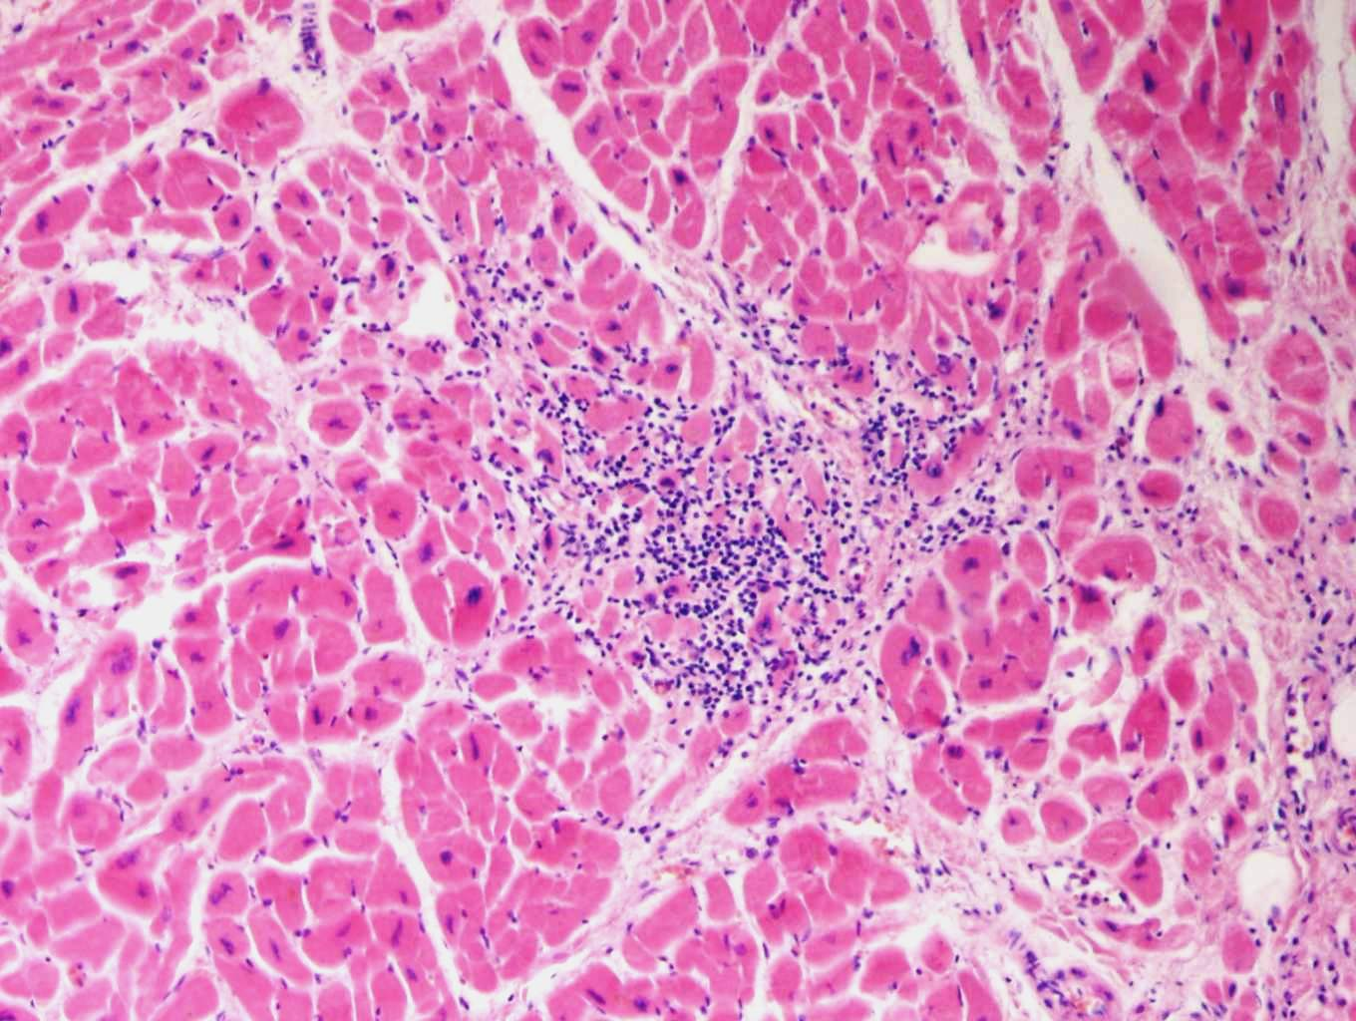
Viral myocarditis
2
1
1
2
2
1 cardiomyocytes
2 lymphocytic infiltrate in interstitium

Slide 102
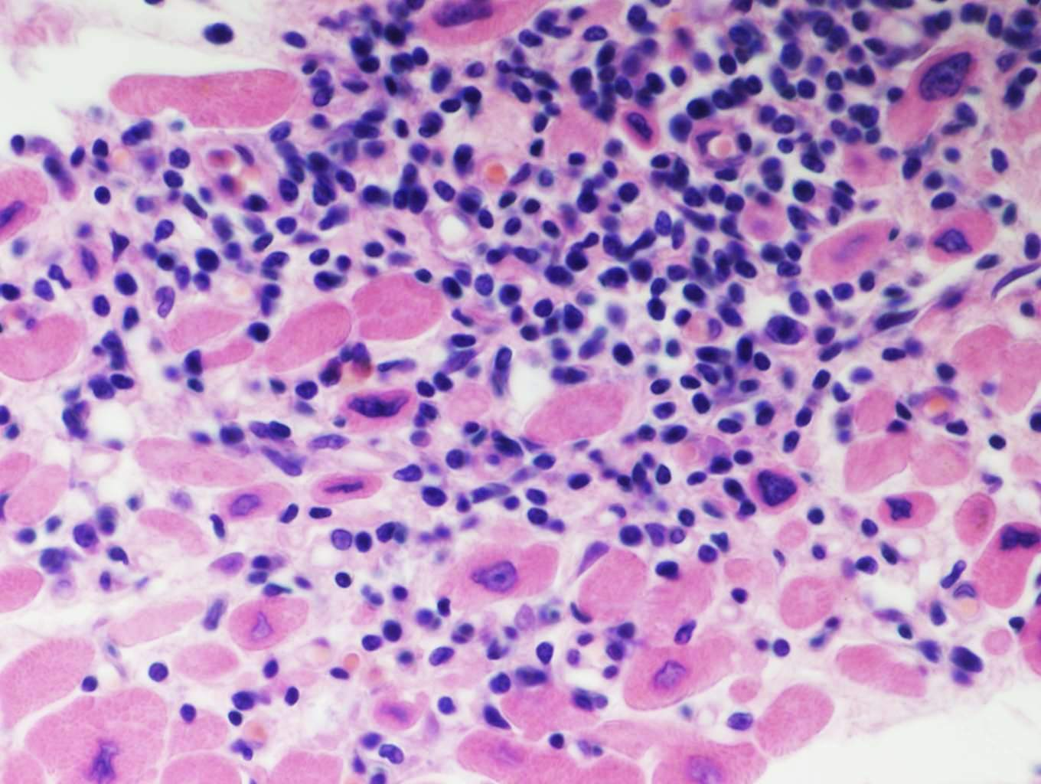
Viral myocarditis
1
2
2
1
1 cardiomyocytes
2 lymphocytic infiltrate in interstitium

Slide 103
Heart and COVID-19
patients w.preexisting cardiovascular lesions in increased risk of worse course (approx. ½ in hostpitals)
general common cardiovascular lesions
  10-20 %, raised troponin, arrythmia in acute stage
  cardiomyopathy in „Long COVID syndrome“ 30-90 d. afrer dg., abnormities on MRI, atypical stenocardias, dyspnoea
etiology
  hypoxia + ischemia due to lung lesions (pneumonia, ARDS)
  lymphocytic myocarditis
  microvasculopathy + thrombosis
in children and teens possible pert of COVID-associated multisystem inflammatory syndrome in children (MIS-C)

Slide 104
MIS-C
Kawasaki-like disease
delayed signs, some weeks after infection (commonly 3-4)
fever, inflammatory signs in lab tests, lesion up to failure in min. 2 organ systens (heart in 80 %, renal, GIT, lung, neurological, ...), association w. SARS-CoV-2
commonly acute heart failure, shock, peri-myocarditis
rare (cca 10 %) coronary aneurysms
micro: myocarditis w. oedema, mixed infl. reaction w. neutrophils, macrophages, lymphocytes, eosinophils), possible cardiomyocyte necrosis
most patients survive, rapid recovery

Slide 105


MIS-C
male, age 19
EMB

Slide 106

Eosinophilic myocarditis

Slide 107

Septic myocarditis
1
3
2
3
1
3
1
1 cardiomyocytes
2 bacterial colony
3 neutrophils

Slide 108
Cardiomyopathies
= heart disease due to myocardial abnormality, with heart dysfunction
diagnosis after exclusion of IHD, valvular disease, congenital d. or hypertension
heterogenous group of disorders:
  dilated (DCM)
    – dilatation + hypertrophy,↓ LV contraction, possible mural thrombosis; 20–50% genetic (AD); alkoholic, peripartum, myocarditis...
  hypertrophic (HCM)
    – massive LV hypertrophy, 100% genetic, diastolic dysfunction, histologic „disarray“
  restrictive cardiomyopathy
    – diastolic dysfunction, ↓ of compliance - ↓ filling, myocardial stiffness
  specific CM
    – Duchenne muscle dystrophy, toxic (drugs), endocrine d., metabolic d. (hemochromatosis, amyloidosis, glykogenosis,…)

Slide 109

Dilated cardiomyopathy

Slide 110

Cardiomyopathy

Slide 111
Myocardial amyloidosis
local x systemic (mostly AL amyloidosis)
senile amyloidosis
  atrial + ventricles; amyloid protein = prealbumin (transthyretin)
isolated atrial amyloidosis
  amyloid protein = atrial natriuretic peptide
gross: consistency normal - firm (rubbery)
micro: variable amyloid deposits v interstitium and vessels, Congo red + polarization

Slide 112

Myocardial amyloidosis

Slide 113

Myocardial amyloidosis

Slide 114

Myocardial amyloidosis

Slide 115

Myocardial amyloidosis - IMF

Slide 116
Endocardial / valvular diseases
endocarditis
  infectious or immune-mediated endocardial inflammation
degenerative diseases
  calcific aortic (rarely mitral) stenosis, mitral valve prolapse, annular and marginal sclerosis
endocrine diseases
  carcinoid syndrome
nonbacterial thrombotic endocarditis (in debilitated patients)

Slide 117

Mitral valve prolapse

Slide 118
Aortic valve calcification

Slide 119
Rheumatic fever, rheumatic heart disease
acute non-purulent, imunne-mediated systemic poststreptococcall inflammation (cross-reactive antibodies)
acute stage: PANCARDITIS
  fibrinous pericarditis + myocarditis with Aschoff bodies (foci of fibrinoid necrosis + inflammatory reaction + verrucous endocarditis (small depositions of fibrin along the closure lines of Ao a Mi valves)
  acute endocarditis commonly recurrent
chronic stage:
  diffuse fiubrous thickening + distortion, commisural fusion → dystrophic calcifikacation - stenosis + incompetence)

Slide 120
rheumatic heart disease
Verrucous endocarditis
Aschoff body
Commisural fusion

Slide 121
Infective endocarditis
commonly by highly virulent microorganisms
  Strep. pyogenenes, Strep. pneumoniae, Staph. aureus, … ev. fungi
subacute IE – less virulent microorganisms
  viridans streptococci
predisposition:
  deformed valve, bioprosthesis, postcatethrization, i.v. drug addicts
bacteremia - endocardial damage by bacteria - trombosis = infective vegetation

Slide 122
Infective endocarditis
gross: friable red-brown mass 0,5-2 cm on leaflets or chordae tendinae, valvular damage incl. ulceration
micro:
  fibrin + bacterial colonies + neutrophils (+ granulation tissue)
  Inflammation/ necrosis of the valve tissue
complications:
  acute: valvular damage, myocarditis + abscess, pyemia,thrombembolism
  chronic valvular disease

Slide 123

Infective endocarditis–
valve destruction
2
1
4
1 vegetation
2 endocardium
3 papillary muscle
4 myocardium
3

Slide 124
Infective endocarditis
Mi vegetations
Ao valve destruction
IE repair (Mi fenestration without vegetations)
purulent inflammation

Slide 125

Infective endocarditis - vegetations
3
1
1
2
1
1 bacterial colonies
2 trombus
3 red + white blood cells

Slide 126

Infective endocarditis - vegetations
3
2
1
2
3
1 bacterial colonies
2 trombus
3 inflammatory infiltrate
1

Slide 127
Non-bacterial thrombotic endocarditis
sterile vegetations due to hypercoagulative state ⇒ concurrent venous thrombosis and lung embolization
in generalized malignancies, chronic nephropathy with uremia, COPD etc.
mostly on mitral valve (normal)
micro: verrucous vegetations (single or multiple), 1-5 mm, bland thrombi
possible source of emboli

Slide 128

Non-bacterial thrombotic endocarditis
2
4
4
1
4
5
1 mi valve
2 endocardium
3 papillary muscle
4 trombi
5 myocardium
3

Slide 129
Carcinoid syndrome
endocardial fibrous plaquelike thockenings – RA, RV

Slide 130
Cardiovascular tumors

Slide 131


Capilary hemangioma
1
2
3
1 - capillaries
2 - endothelium
3 – red blood cells

Slide 132
Cavernous hemangioma
gross:
  red -blue focus (nodular)
  possible large size (-15 cm)
  liver, spleen, skin; commonly multiple
micro:
  large blood-filled vascular spaces divided by fibrous septa

Slide 133

Cavernous hemangioma
2
1
2
1 septa
2 vascular spaces

Slide 134
Kaposi sarcoma
classic form
  chronic
  in mediterranean or jewish origin
  usually (90%) confined to skin
endemic
  south-african children
  lymphadenopatic
  aggressive
immunosuppression (transplant) associated
  – internal organs in 50%
AIDS associated

Slide 135
Kaposi sarcoma
HHV-8
hyperproliferation of endothelial cells
prevention of apoptosis
gross:
  red to purple patches
  raised plaques
  nodules
micro:
  irregular blood spaces
  plump atypical endothelial cells
  perivascular aggregates of spindle cells

Slide 136
Kaposi sarcoma

Slide 137

Kaposi sarcoma

Slide 138
Kaposi sarcoma
fusicellular proliferation, hyaline globules, hemosiderin

Slide 139
Heart tumors
primary tumors rare, mostly benign myxomas
malignant mesenchymal (sarcomas)
  leiomyo - , rhabdomyo - , hemangio - , fibrosarcoma
secondary tumors
  100 x more common than primary
  metastases + infiltrates : lung, breast carcinomas, malignant melanoma, malignant lymphomas and leukemias
  direct spread (lung ca, mesothelioma, renal ca)
  pericarditis carcinomatosa – hemorrhagic effusion

Slide 140
Benign tumors
Myxoma
  mostly in the left atrium (fossa ovalis on septum)
  4 – 6 cm, usually single
  sessile x pedunculated, papillary x villous, soft – gelatinous, regressive changes (haemorrhage, fibrosis)
  micro: polygonal (stellate / globular) cells in myxoid matrix (acid mucopolysaccharides)
other: hemangioma, lipoma, rhabdomyoma…

Slide 141

LV myxoma

Slide 142
LV myxoma

Slide 143

Myxoma (100x)
1
3
1
2
2
1 stellate cells
2 myxoid matrix
3 hemosiderin deposits

Slide 144

Myxoma (400x)
1
2
1
2
1 stellate cells
2 myxoid matrix

Slide 145

Pericardial angiosarcoma
biopsy

Slide 146

Pericardial angiosarcoma

Slide 147
Angiosarcoma
RV angiosarcoma
CD31

Slide 148

Angiosarcoma
1
1
1- mitoses

Slide 149
Small vessel vasculitis with giant-cell granulomatous reaction

Slide 150


