Slide 1

Introduction to the respiratory system pathophysiology
Structural and functional properties of airways and lungs
defence mechanisms of airways and lungs
Respiration as a process ensuring a gas exchange
ventilation & diffusion & perfusion
Diffusion – principles and determinants
alveolar-capillary membrane
„oxygen cascade“
Lung circulation – principles and determinants
Ventilation – pulmonary mechanics
volumes and capacities
static and dynamic airflow resistance
dynamic collapse
obstruction vs. restriction

Slide 2
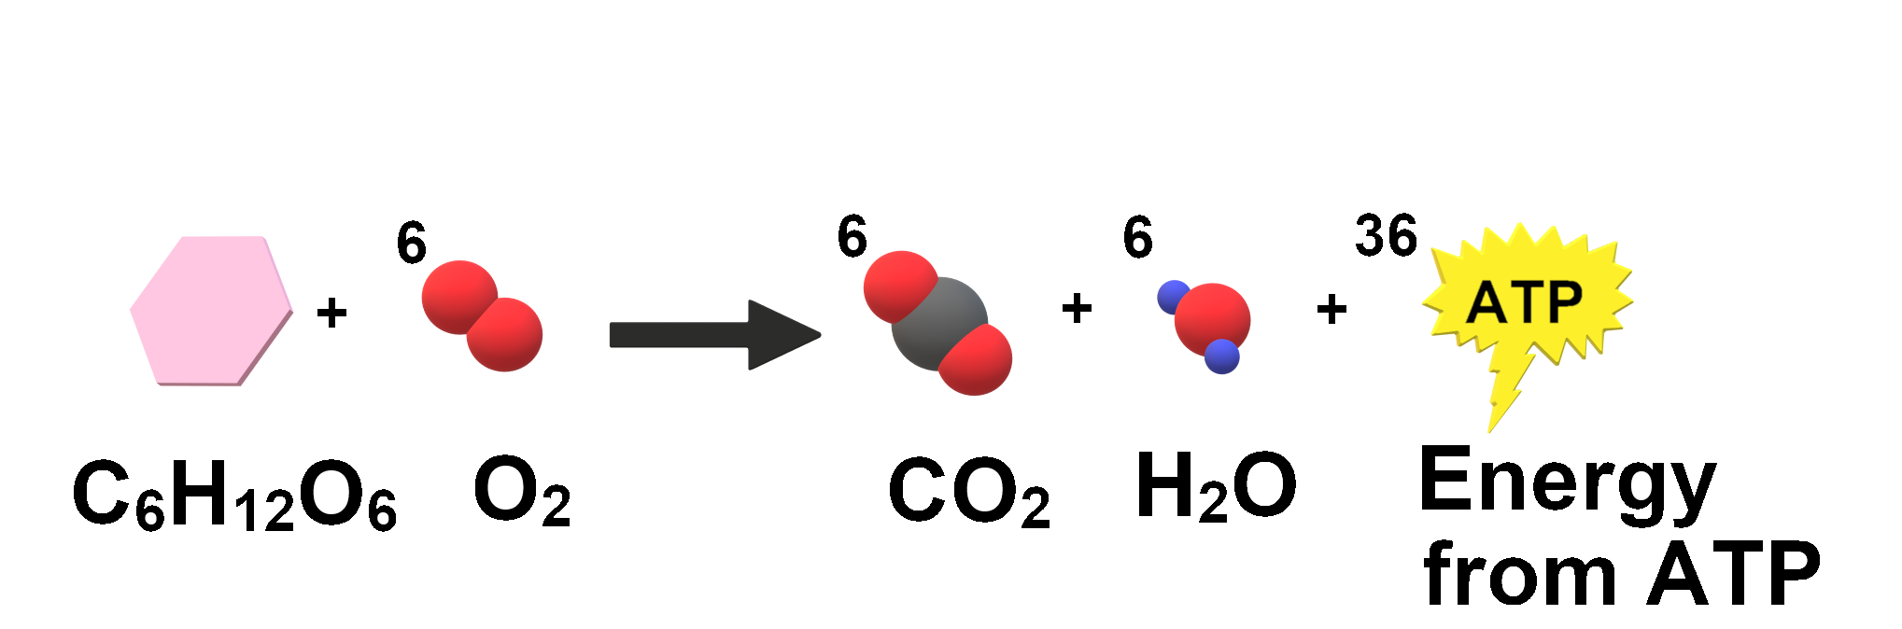
Warming up questions
(1) WHY do we breathe???
(2) HOW do we breathe???
  principles of the quiet breathing
(3) WHEN do we breathe???
  all the time/non-stop, the death = „until the last breath“

Slide 3
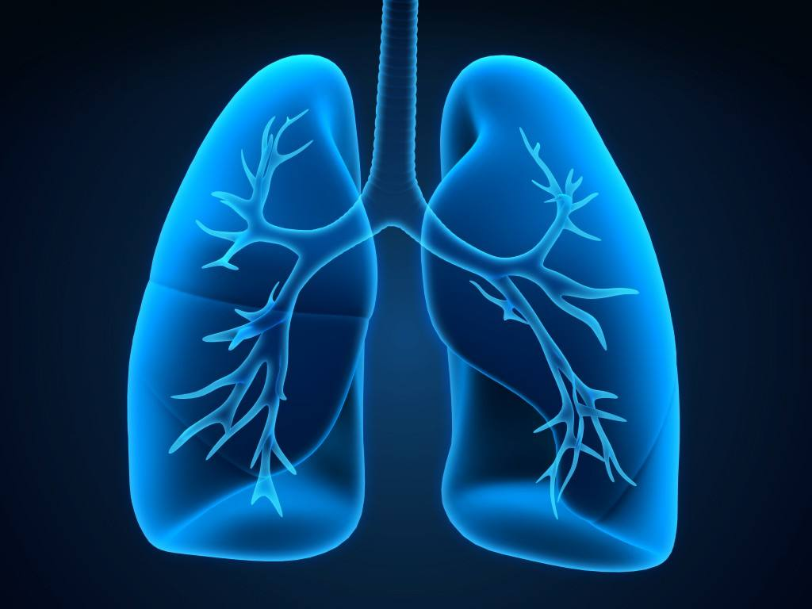
structural-functional Considerations important for PP of respiration & particular disorders

Slide 4
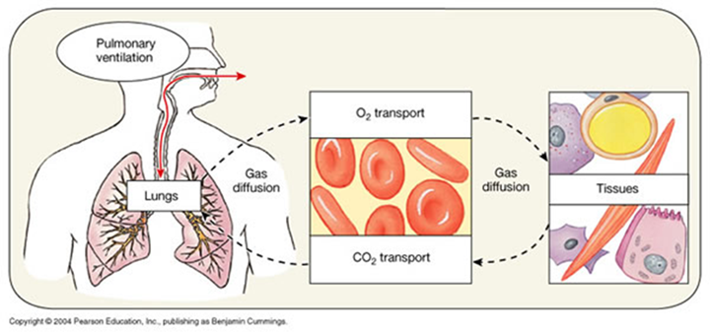
Respiration and gas exchange in the lungs
death from lung disease is almost always due to an inability to overcome the altered mechanical properties of the lung or chest wall, or both
ventilation = mechanical process
  breathing in narrower meaning
diffusion = chemical process
  through alveolo-cappilary barrier
perfusion = circulatory process
  circulation of blood in lungs

Slide 5
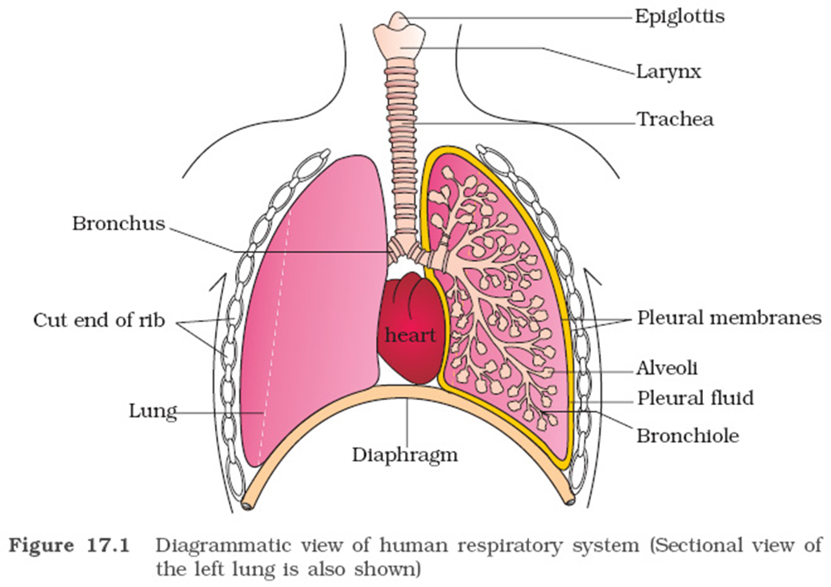

Slide 6
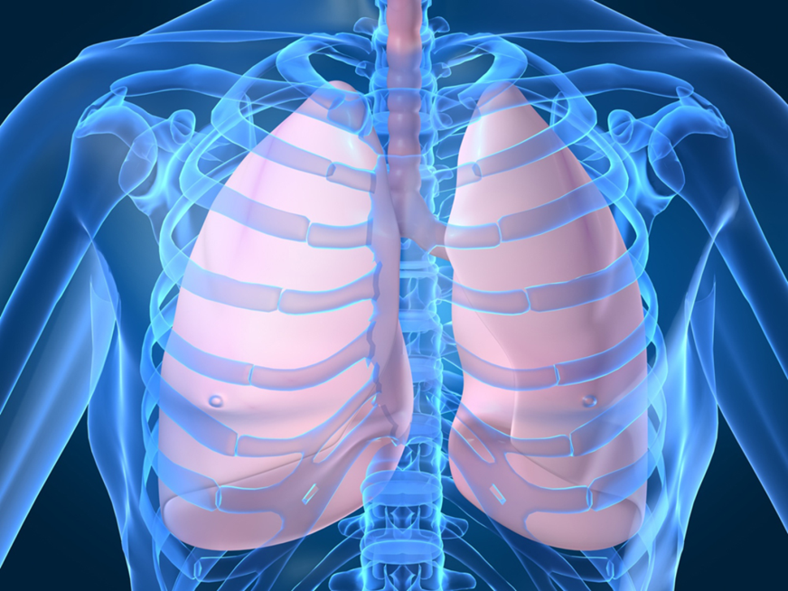
The delicate structure-function coupling of lungs
The main role of the respiratory system is GAS EXCHANGE, i.e. extraction of oxygen from the external environment and disposal of waste gases, principally carbon dioxide
  at the end of deep breath 80% of lung volume is air, 10% blood and 10% tissue
    lung tissue spreads over an enormous area !
The lungs have to provide
  a large surface area accessible to the environment (∼tennis court area) for gas exchange
  alveoli walls have to present minimal resistance to gas diffusion
Close contact with the external environment means lungs can be damaged by dusts, gases and infective agents
  host defense is therefore a key priority for the lung and is achieved by a combination of structural and immunological means

Slide 7
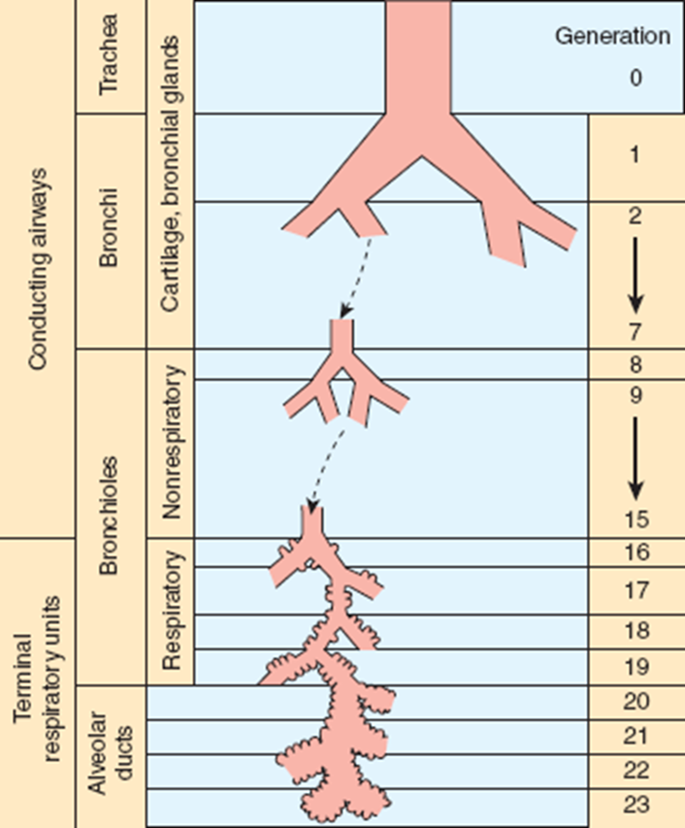
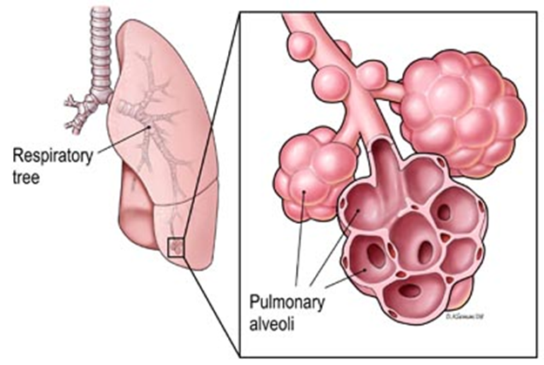
Structure of airways
There are about 23 (18-30) divisions (2²³ i.e. approx. 8 millions of sacs) between the trachea and the alveoli
  the first seven divisions, the bronchi have:
    walls consisting of cartilage and smooth muscle
    epithelial lining with cilia and goblet cells
    submucosal mucus-secreting glands
    endocrine cells - Kulchitsky or APUD (amine precursor and uptake decarboxylation) containing 5-hydroxytryptamine
  the next 16-18 divisions the bronchioles have:
    no cartilage
    muscular layer progressively becomes thinner
    a single layer of ciliated cells but very few goblet cells
    granulated Clara cells that produce a surfactant-like substance

Slide 8
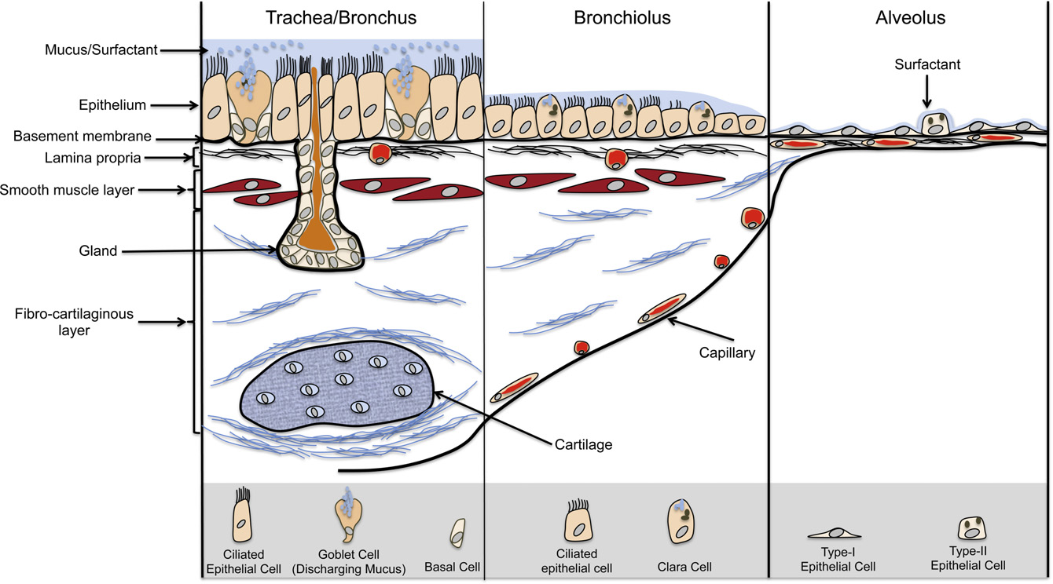
Wall structure of conducting airways and respiratory region

Slide 9
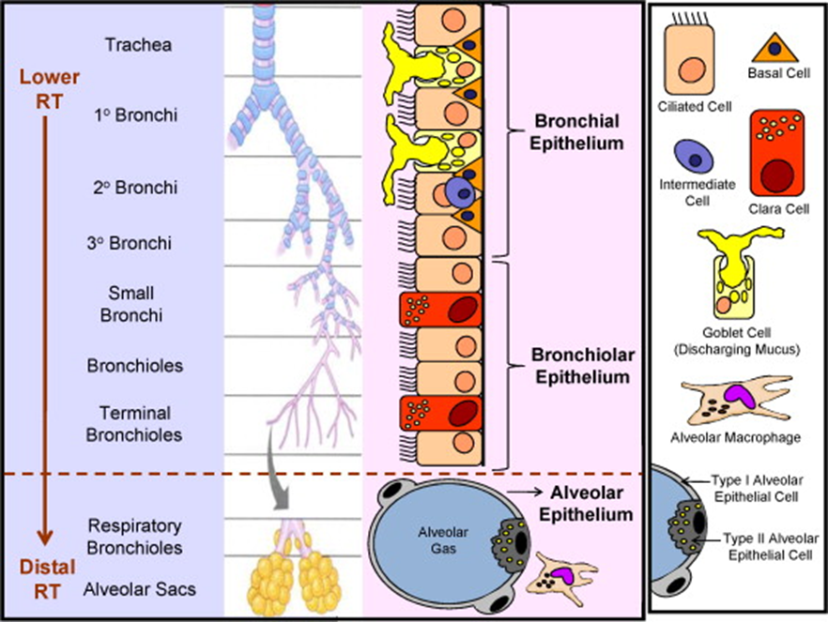
Lung defense – multiple mechanisms (details later)

Slide 10
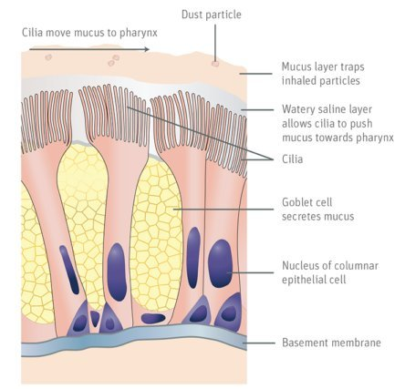
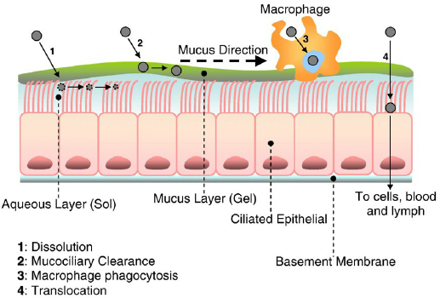
Mucocilliary escalator

Slide 11
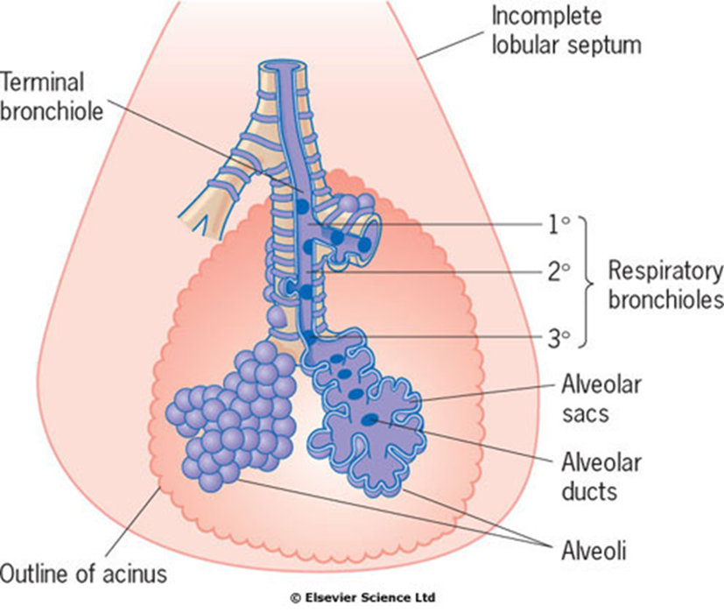
Functional classification of airways
Conducting airways (= anatomical dead space)
    nose (mouth)
    larynx
    trachea
    main bronchi & bronchioles
  gas conduction, humidification & warming, defense
Acinar airways (= respiratory space)
    respiratory bronchioles
    alveolar ducts & sacs
    alveoli
  gas exchange
The concept of acinus
  the functional 3-D unit - part of parenchyma - in which all airways have alveoli attached to their wall and thus participating in gas exchange

Slide 12
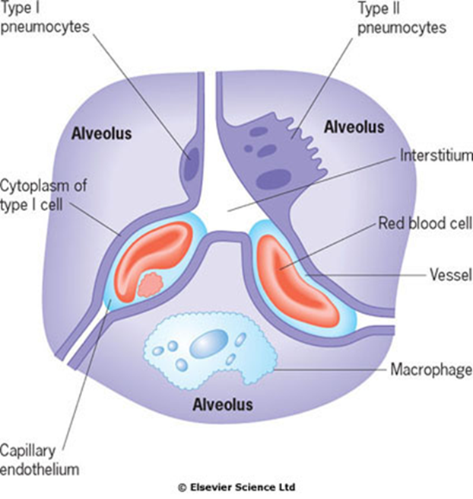
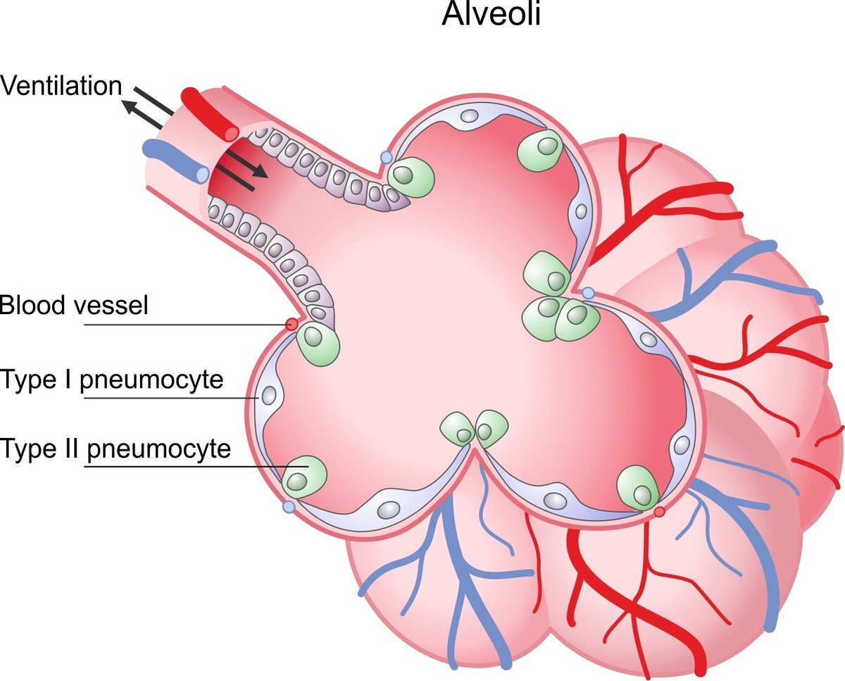
Alveoli
There are approximately 300-400 million alveoli in each lung with the total surface area is 40-80m²
Cell types of the epithelial lining
  type I pneumocytes
    an extremely thin cytoplasm, and thus provide only a thin barrier to gas exchange, derived from type II pneumocytes
    connected to each other by tight junctions that limit the fluid movements in and out of the alveoli
    easily damageable, but cannot divide!
  type II pneumocytes
    slightly more numerous than type I cells but cover less of the epithelial lining
    the source of type I cells and surfactant
  macrophages

Slide 13
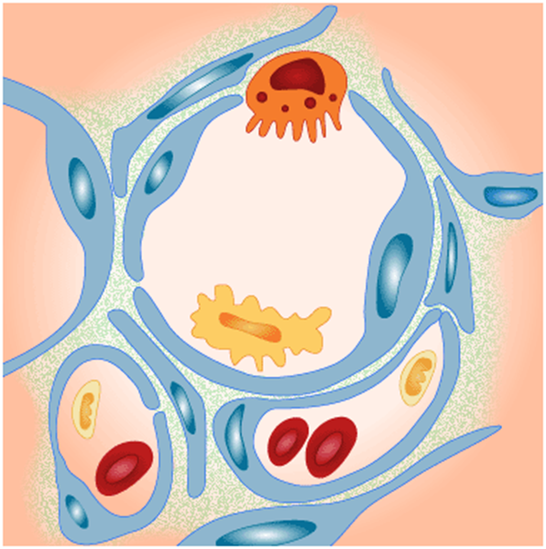
Alveolo - capillary barrier
Alveolar epithelia
  type I
  type II
Capillary endothelium
  non-fenestrated
Intersticium
  cells (very few!)
    fibroblasts
    contractile cells
    immune cells (intersticial macrophages, mast cells, …)
  ECM
    elastin and collagen fibrils

Slide 14
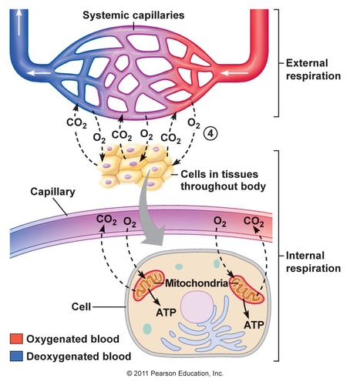
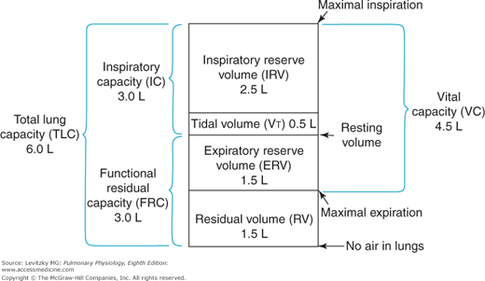
Gas exchange in lungs
main function of respiratory system – gas exchange between blood and outside environment – is governed by temporally changing requirements of organism for O₂
  maintained in optimum by regulation of intensity of ventilation (see control of ventilation further)
requirements defined mainly by consumption of ATP and its replenishing by mitochondria
  oxidative phosphorylation
  other O₂ consuming processes
driving force for O₂ exchange (and reciprocally for CO₂) is the gradual decrease of its partial pressure, i.e. concentration gradient between inhaled air, blood and tissues:
  partial pressure = the pressure that the gas would have if it alone occupied the same volume at the same temperature
solubility of the gas matters
  very high for CO₂ = there are no biological barriers in the body to block CO₂ diffusion
tidal volume exchange by each resting breathing cycle ads only 0.5L to FRC = meaning a composition of the alveolar air is more or less constant

Slide 15
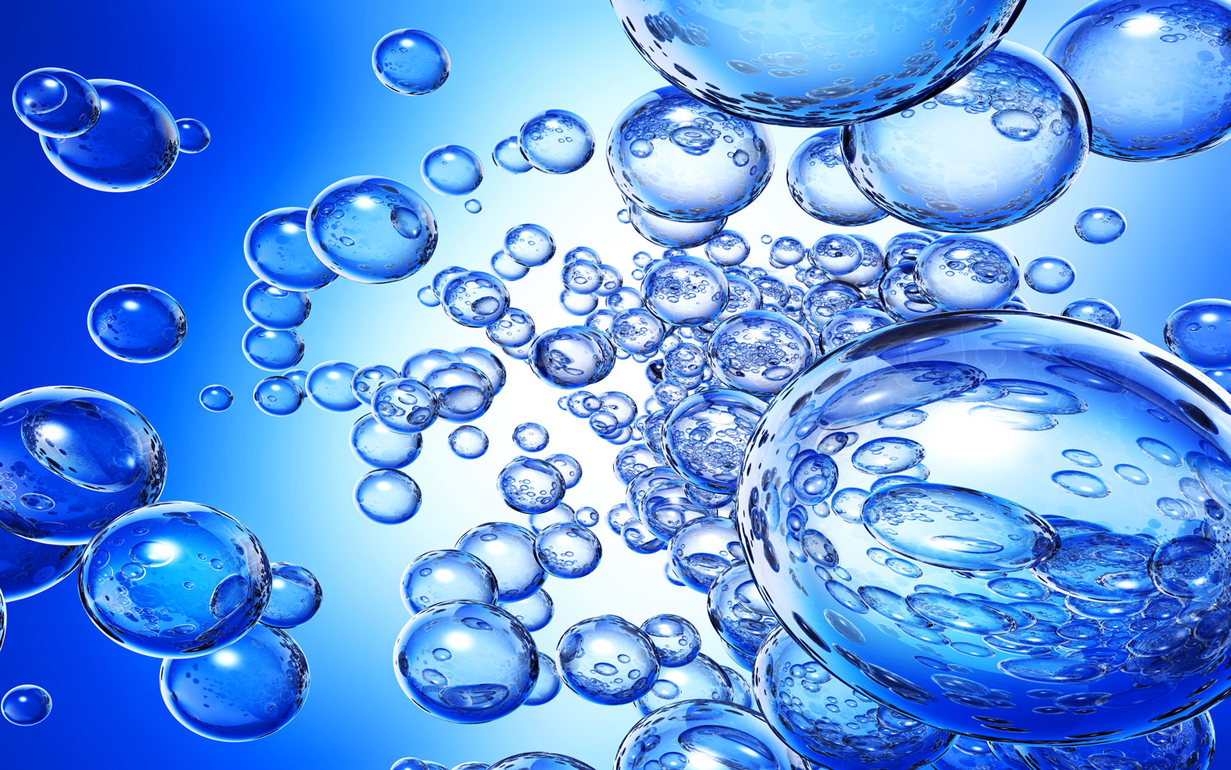
Oxygen cascade in the body

Slide 16
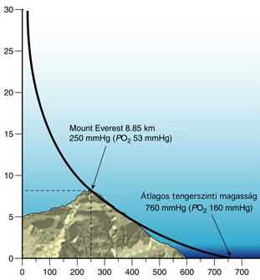
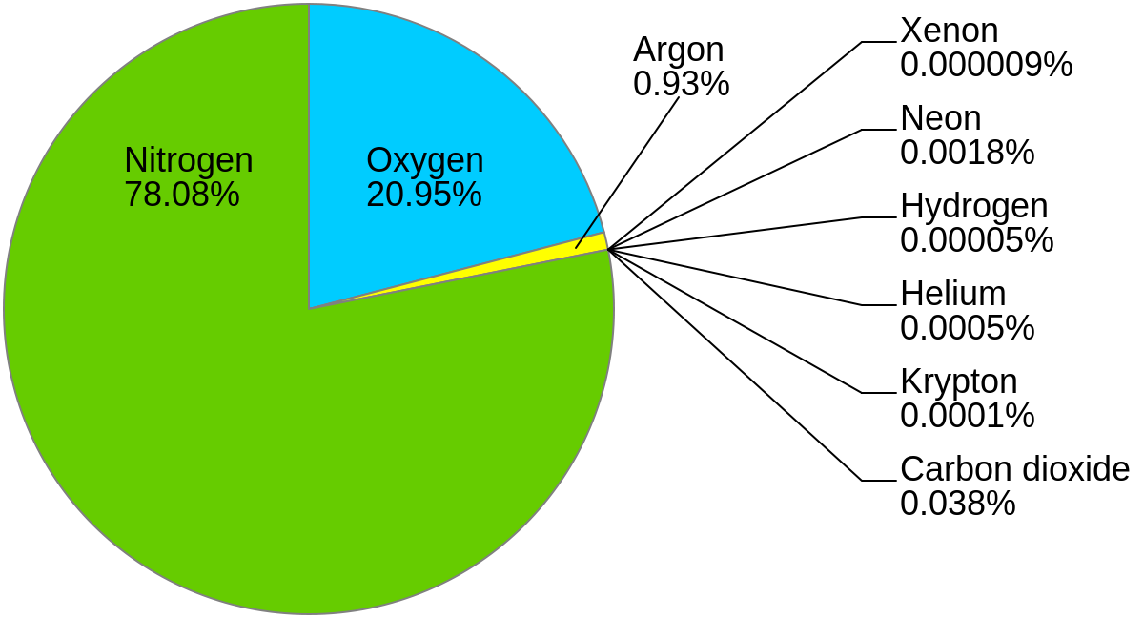
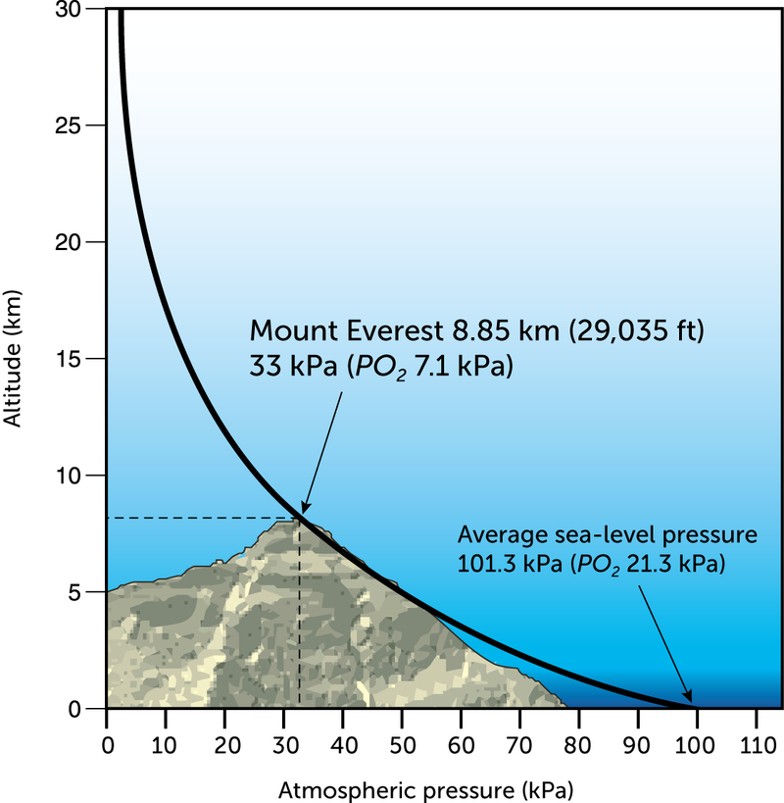
What are we breathing?

Slide 17
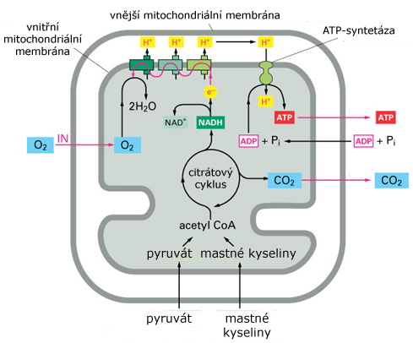
Oxygen in the body
there are no significant O₂ stores in the body
    available oxygen lasts for ∼ 5min
  therefore breathing has to be continuous process
  disruption means
    life-threatening emergency (<5min)
      reversible vision loss in ∼7s, unconsciousness in ∼10s
    clinical death (∼5-7min), event. brain death
    death of the whole organism (>10min)
85-90% used in aerobic metabolism coupled with ATP production
  maintenance of ion gradients
  muscle contraction
  chemical synthetic reactions
remaining processes are less sensitive to ↓PaO₂
  hydroxylation of steroids
  detoxification of xenobiotics in liver
  synthesis of NO (→ vasodilation)
  degradation of haem by hemoxygenase

Slide 18
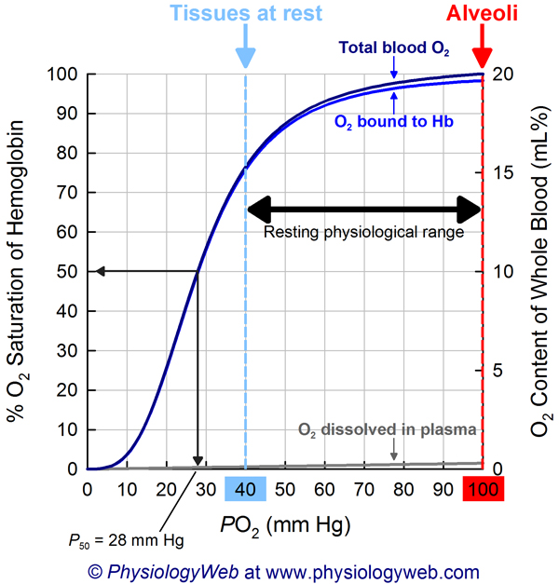
Transport of oxygen in the blood
CO₂ can be considered to be in simple solution in the plasma, the volume carried being proportional to its partial pressure (physically dissolved)
O₂ is carried in chemical combination with hemoglobin in the red blood cells, and the relationship between the volume carried and the partial pressure (physically dissolved fraction) is not linear
  in physiological PaO₂ (90mmHg/12kPa) and normal hemoglobin there is nearly 100% Hb saturation
    if PaO2 > 10kPa/60 mmHg, saturation do not significantly decreases
      advantage when being in high altitude
      saturation measured by pulsion oxymetry
O₂ diffuses to tissues according to demands of mitochondria
  for adequate production of ATP in mitochondria O₂ in tissues have to be > 0.13kPa/1mmHg = critical oxygen tension
organism needs oxygen:
  ∼ 250 mL/min → 350 L/day in rest
  much more (10x) during exercise
total O₂ in the blood
  total [O₂] = 1.39 × [Hb] × % saturation / 100 + 0.003 × PO₂ = 20.5 ml/dl

Slide 19
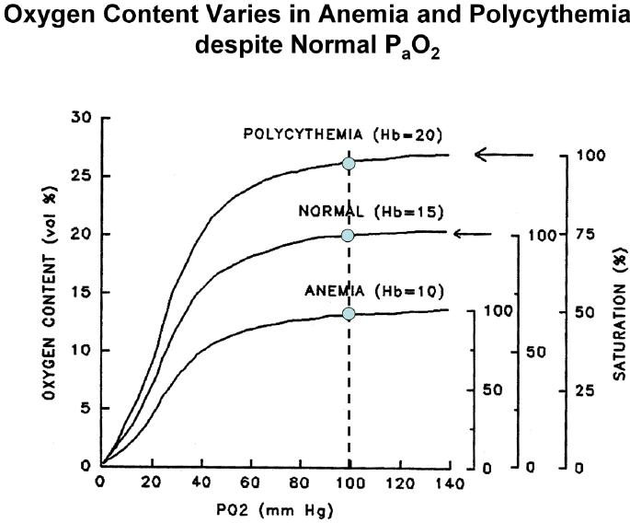
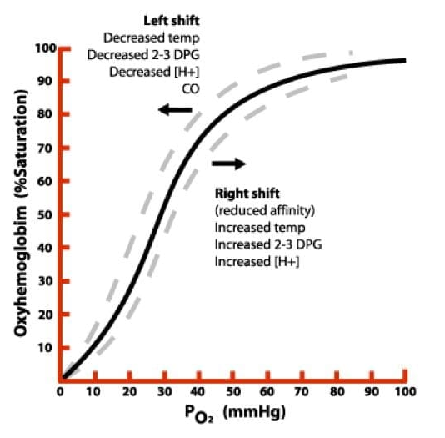
Shifting of Hb dissociation curve and the effect of [Hb]

Slide 20
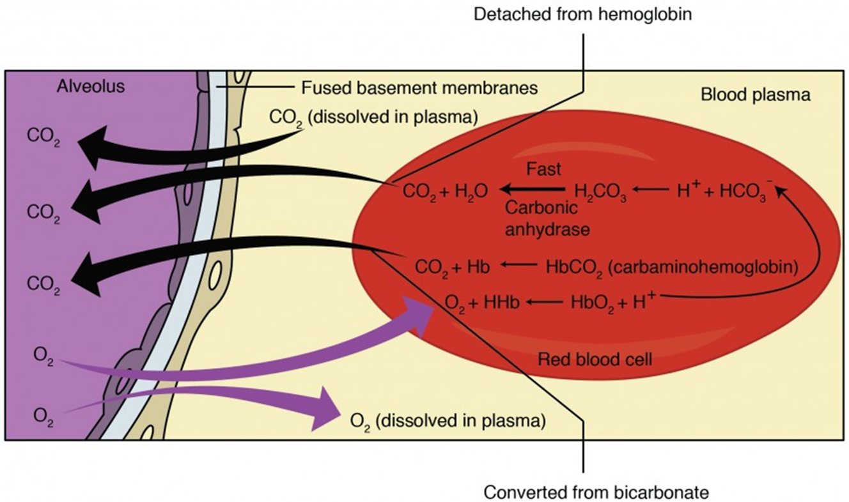
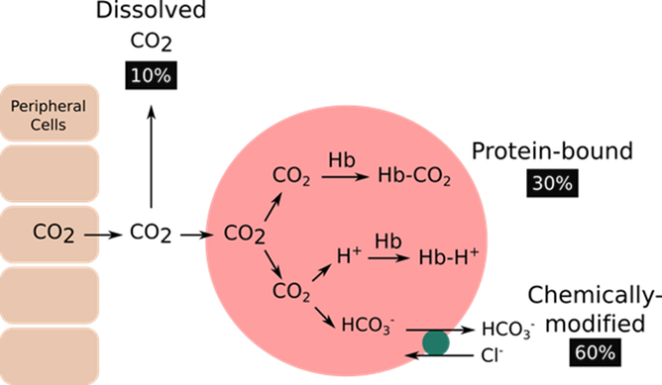
Transport of CO₂ in the blood
CO₂ can be considered to be in simple solution in the plasma, the volume carried being proportional to its partial pressure (physically dissolved)
solubility of carbon dioxide is much higher (20×) than that of oxygen, therefore physically dissolved CO₂ is much more important than for O2

Slide 21
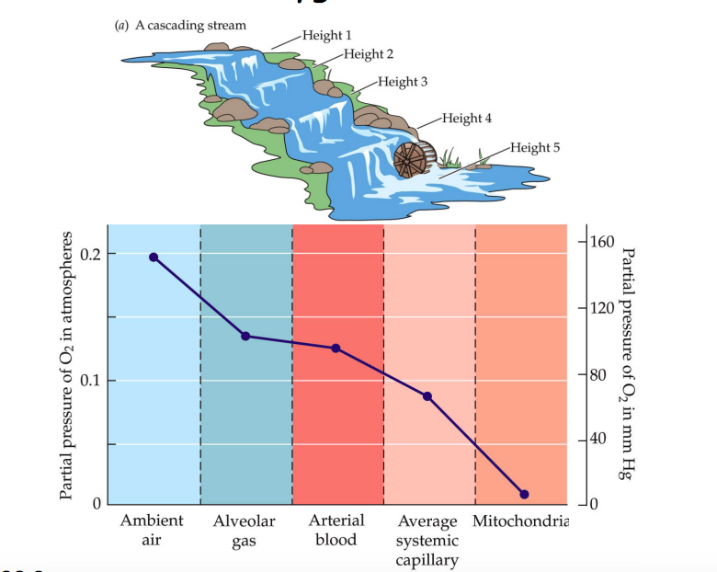
Oxygen cascade – progressive drop of oxygen content
reasons for normal gradual decrease of PO₂ between air and blood:
  „competition“ with CO₂ in alveoli
    up to the atmospheric pressure
      see alveolar gas equation
  less that 100% diffusion across alveolo-capillary membrane
    irregularity of its thickness and change in the rate of lung perfusion
      diffusion & perfusion limitation
    lower solubility of O₂ compared to CO₂
  physiological right-left shunt
    mixing of oxygenated and deoxygenated blood
      nutritional supply of large airways by aa. bronchiales and their drainage to v. pulmonalis
      drainage of vv. coronarie and thebesian veins into left atrium and other chambers
  phyiological ventilation-perfusion inequality
  physiologically a small fraction of abnormal Hb
    Met-Hb
    COHb
  various oxygen extraction by tissues
pathological aggravation in any if these steps contributing to drop of oxygen tension can cause hypoxia
  hypoxic (= hypoxemia)
  anaemic
  circulatory
  histotoxic

Slide 22
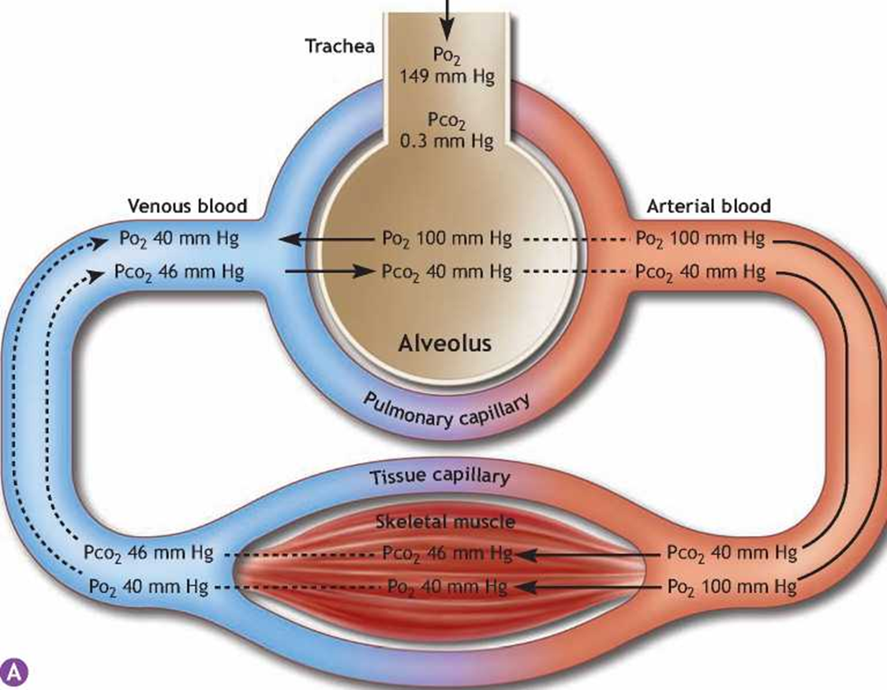
Quantitatively
(1) inhaled atmospheric air
  21% O₂, 0.03% CO₂, 78% N₂, water gases 0.6% and the rest other gases (argon, helium, ..)
    atm. pressure 760 mmHg (101 kPa)
    PO₂: 0.21 x 760 = 160 mmHg
    analogically PCO₂ = 0.3mmHg
(2) alveolar air (mixture of inhaled and exhaled air)
  P_{A}O₂ = 100mmHg (13.3kPa), P_{A}CO₂ = 40 mmHg (5.3kPa), P_{water vapour} = 47 mmHg
    P_{A}O₂ in alveolus slightly lower than atmospheric due to higher CO₂ content in alveolus (diffusion from blood)
(3) arterial blood
  PaO₂ = 90mmHg (12kPa), PaCO₂ = 45 mmHg
    diffusion of oxygen not 100% and there is also physiological shunt
(4) venous blood
  PvO₂ = 30 - 50mmHg
 | air (P) | alveolar (P_{A}) | arterial (Pa) | venous (Pv)
O₂ | 21kPa/150mmHg | 13.3 kPa/100mmHg | 12kPa/90mmHg | 5.3kPa/40mmHg
CO₂ | 0.03kPa/0.3mmHg | 5.3kPa/40mmHg | 5.3kPa/40mmHg | 6.0kPa/45mmHg

Slide 23
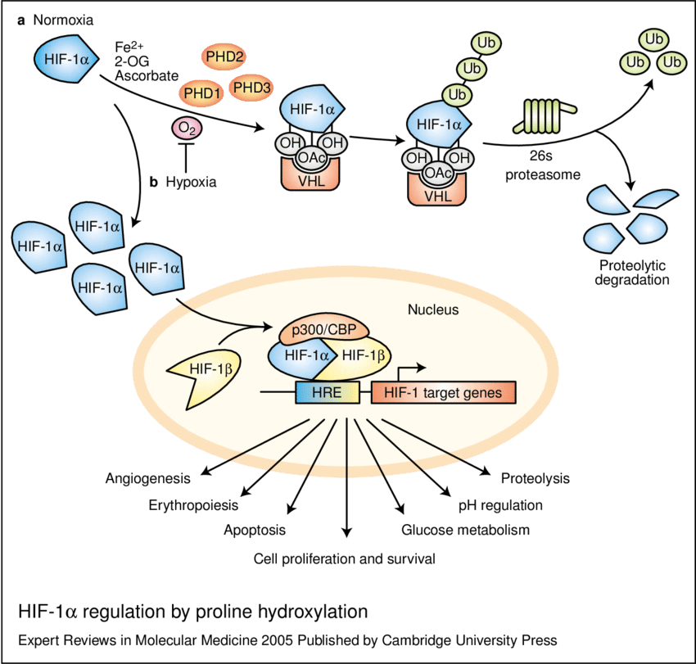
Hypoxia and its consequences
HIF-1α regulation by proline hydroxylation
  (a) In normoxia, hypoxia-inducible factor (HIF)-1α is hydroxylated by proline hydroxylases (PHD1, 2 and 3) in the presence of O₂, Fe²⁺, 2-oxoglutarate (2-OG) and ascorbate.
    Hydroxylated HIF-1α (OH) is recognised by pVHL (the product of the von Hippel-Lindau tumour suppressor gene), which, together with a multisubunit ubiquitin ligase complex, tags HIF-1α with polyubiquitin; this allows recognition by the proteasome and subsequent degradation.
    Acetylation of HIF-1α (OAc) also promotes pVHL binding.
  (b) In response to hypoxia, proline hydroxylation is inhibited and VHL is no longer able to bind and target HIF-1α for proteasomal degradation, which leads to HIF-1α accumulation and translocation to the nucleus.
    There, HIF-1α dimerises with HIF-1β, binds to hypoxia-response elements (HREs) within the promoters of target genes and recruits transcriptional co-activators such as p300/CBP for full transcriptional activity.
    A range of cell functions are regulated by the target genes, as indicated.
  Abbreviation: CBP, CREBbinding protein; Ub, ubiquitin.

Slide 24
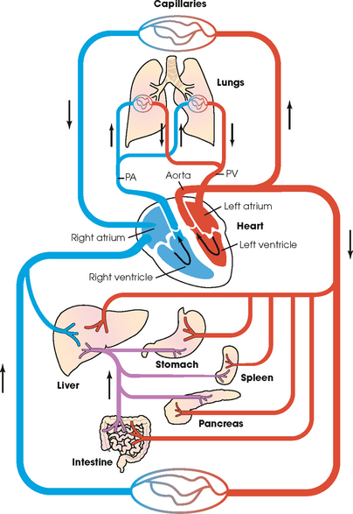
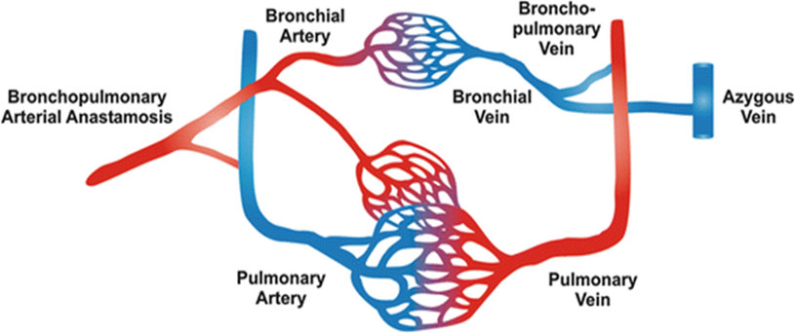
Pulmonary vs. systemic circulation
Plíce jsou jediným orgánem, kterým prochází veškerá krev!!!
  v objemu, který se rovná srdečnímu výdeji (cardiac output, CO)
Tlak je generován pravou komorou (right ventricle, RV)
  pří zvýšení CO (např. fyzická aktivita) musí být plicní cirkulace schopna pojmout objem bez významného zvýšení práce RV
    distenze a „recruitment“ v klidu uzavřených kapilár
  tj. vzhledem k jiným tlak a objemovým poměrům a délce je i morfologie plicní cév jiná
    méně hladké svaloviny, větší roztažnost tlakem a zvýšeným průtokem
    ale svalovina malých plicních arterií je důležitá – viz hypoxická vazokonstrikce
Plicní vaskulární rezistence (PVR) kolísá mezi nádechem a nádechem, tedy s objemem plic (viz dále)
Plíce mají dvojí krevní zásobení
  deoxygenovaná krev z RV cestou plicní arterie (PA)
  systémové (nutriční) zásobení dýchacích cest (po úroveň resp. bronchiolů) bronchiální cirkulací
    odstup z descendentní aorty
    bronchiální vény z malé části drénují do pulmonální vény a podílí se tak na fyziologickém zkratu
4 hlavní plicní vény ústí do levé síně (LA)

Slide 25
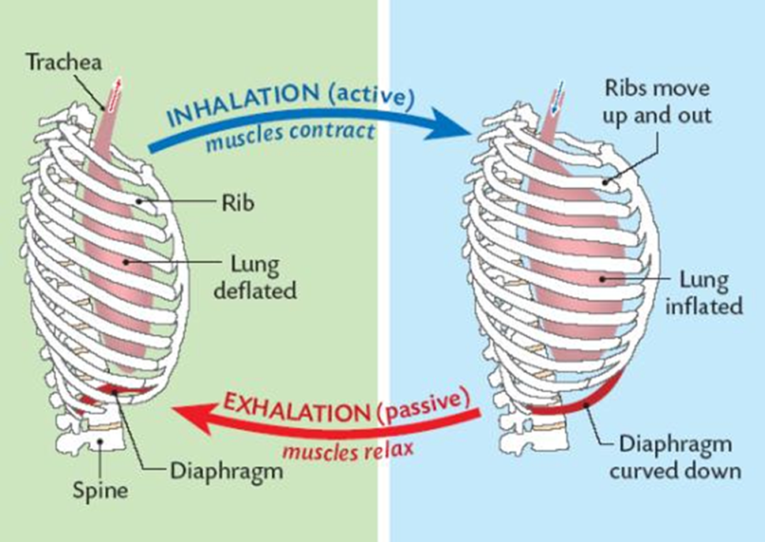
Summary
The physiological structure of the lungs and airways ensures that
  the work consumed for mechanical breathing is minimal
  the airways and the lungs are able to effectively defend themselves against inhaled pathogens and particles
  the area available to a gas exchange is huge, and the diffusion barrier minimal
  in order to get enough O₂ into peripheral tissues, the exchange of gases in the lungs has to be as effective as possible
  maintaining the concentration gradients necessary to keep the passive diffusion going is the principal driving force of ventilation
  pulmonary circulation is adapted to maximize gas diffusion through the alveolar-capillary membrane

Slide 26

(1) Principles of Ventilation and its abnormalities

Slide 27
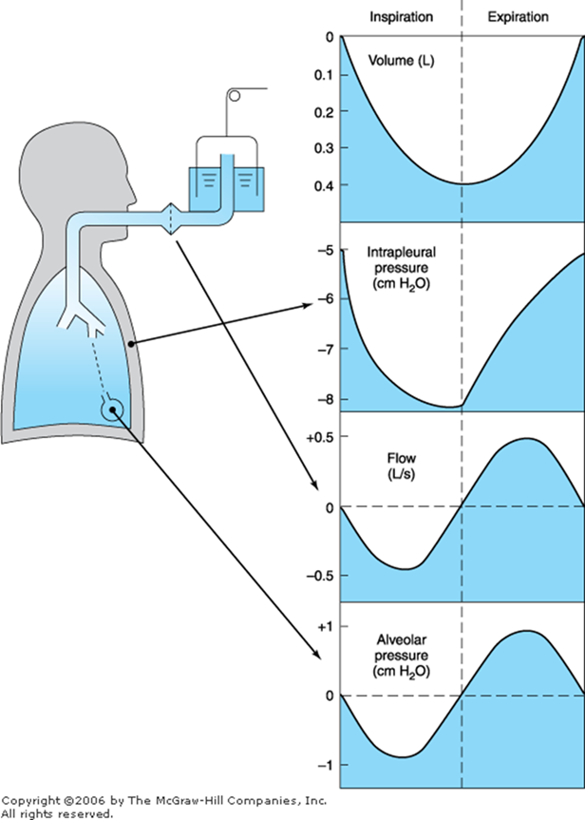
Mechanics of ventilation – breathing cycle
pressures and pressure gradients
  pressure on the body surface(P_{bs}),
    usually equal to atmospheric (P_{ao})
  alveolar pressure (P_{alv})
  „elastic“ pressure (P_{e}l)
    generated by lung parenchyma and surface tension
  pressure in pleural cavity (P_{pl})
  trans-pulmonary pressure (P_{L})
    pressure difference between alveolus and pleural cavity
    P_{L} = P_{alv} - P_{pl}
  trans-thoracic pressure (P_{rs})
    pressure difference between alveolus and body surface
    determines actual phase of ventilation, i.e. inspirium or expirium
    P_{rs} = P_{alv} - P_{bs}

Slide 28
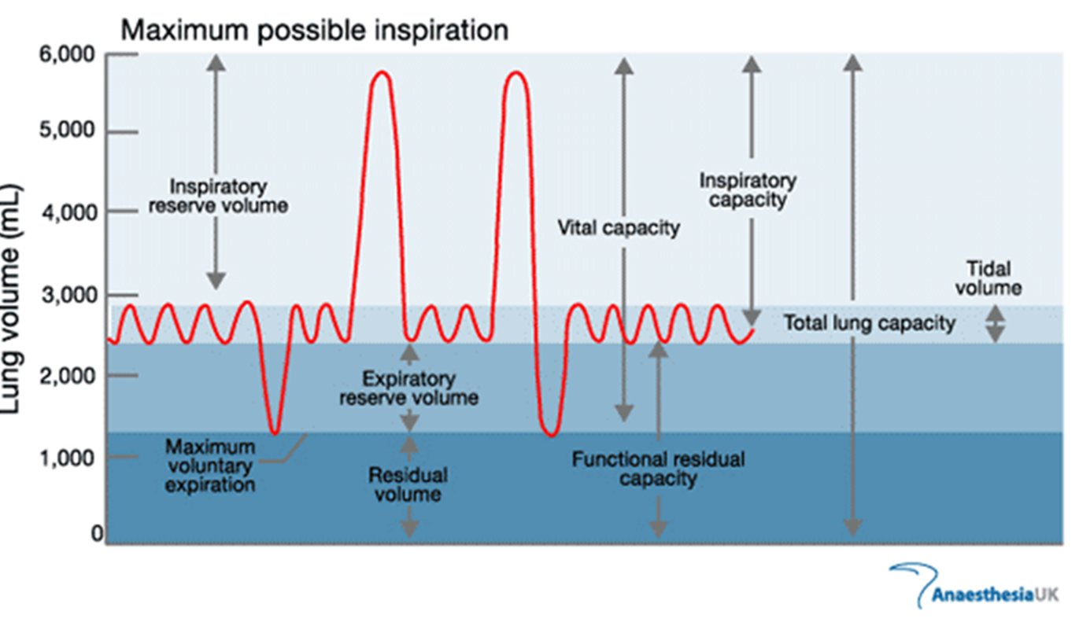
Lung volumes and capacities (tj. ≥ 2 volumes)
The ratio of RV to TLC (RV/TLC ratio) in normal individuals is usually less than 0.25
abnormal = increased RV/TLC ratio in different types of pulmonary disease
  obstructive diseases
    ↑ RV
  restrictive diseases
    ↓ TLC

Slide 29
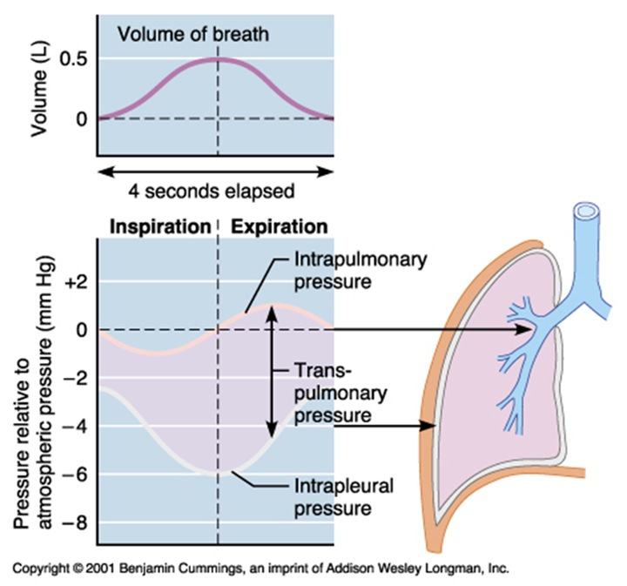
Ventilation (breathing) as a mechanical process
Inspiration
  an active process that results from the descent of the diaphragm and movement of the ribs upwards and outwards under the influence of the intercostal muscles
    in resting healthy individuals, contraction of the diaphragm is responsible for most inspiration
  respiratory muscles are similar to other skeletal muscles but are less prone to fatigue
    weakness may play a part in respiratory failure resulting from neurological and muscle disorders and possibly with severe chronic airflow limitation
  inspiration against increased resistance may require the use of the accessory muscles of ventilation
    sternocleidomastoid and scalene muscles
Expiration
  follows passively as a result of gradual lessening of contraction of the intercostal muscles, allowing the lungs to collapse under the influence of their own elastic forces (elastic recoil)
  forced expiration is also accomplished with the aid of accessory muscles
    abdominal wall

Slide 30
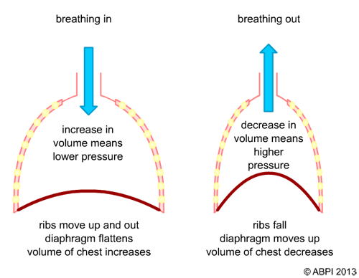
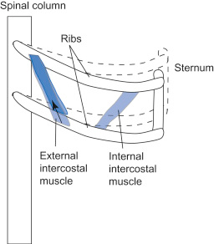
Muscles performing inspiration
Notes:
b

Slide 31
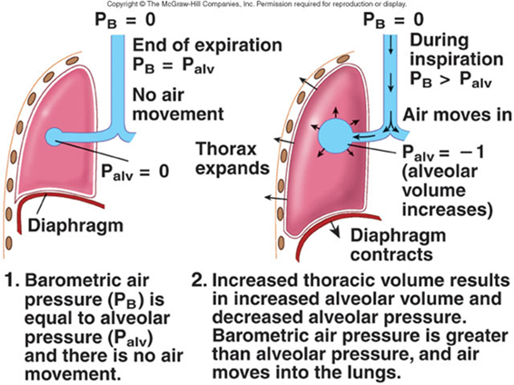
Ventilation
pressure necessary to distend lungs has to overcome two kinds of resistances
  (1) STATIC = elastic recoil
    in the respiratory part of airways and lung parenchyma
  (2) DYNAMIC = airway resistance
    in the convection part of airways
energy requirements for respiratory muscles to overcome these resistances are normally quite low
  2-5 % of a total O₂ consumption
but increases dramatically when resistance increases (up to 30%)

Slide 32
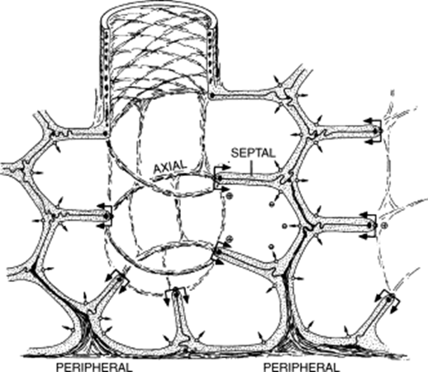
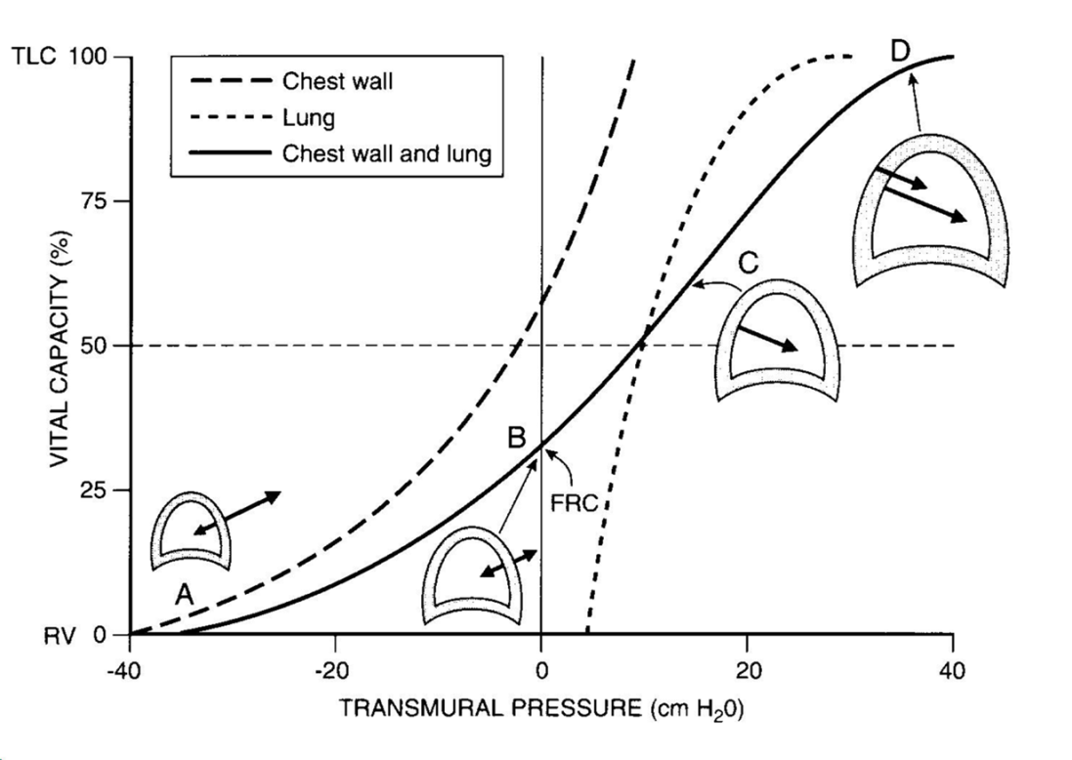
(ad 1) Elastic properties of the lung
the system of airway elastic fibres
lungs have an inherent elastic property that causes them to tend to collapse generating a negative pressure within the pleural space
  the strength of this retractive force relates to the volume of the lung
    for example, at higher lung volumes the lung is stretched more, and a greater negative intrapleural pressure is generated
  at the end of a quiet expiration, the retractive force exerted by the lungs is balanced by the tendency of the thoracic wall to spring outwards
    at this point, respiratory muscles are resting and the volume of the lung is known as the functional residual capacity (FRC)

Slide 33
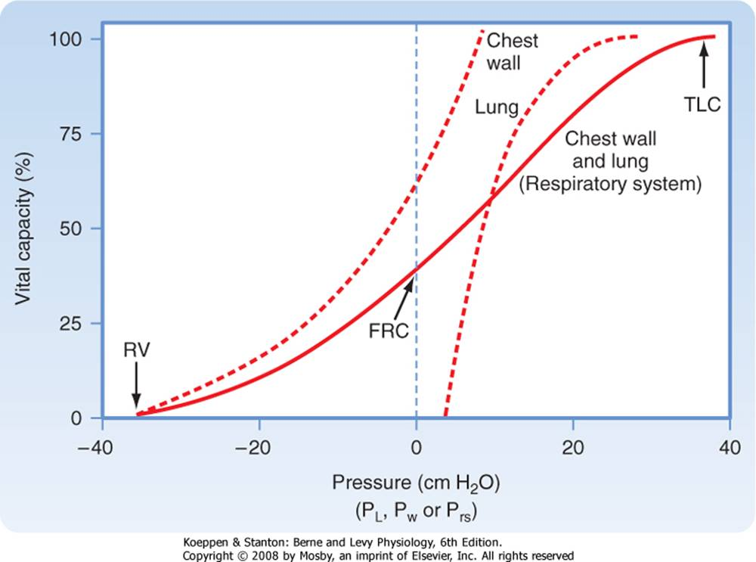
The transmural pressure across the respiratory system at FRC is zero. At TLC, both lung pressure and chest wall pressure are positive, and they both require positive transmural distending pressure. The resting volume of the chest wall is the volume at which the transmural pressure for the chest wall is zero, and it is approximately 60% of TLC. At volumes greater than 60% of TLC, the chest wall is recoiling inward and positive transmural pressure is needed, whereas at volumes below 60% of TLC, the chest wall tends to recoil outward

Slide 34
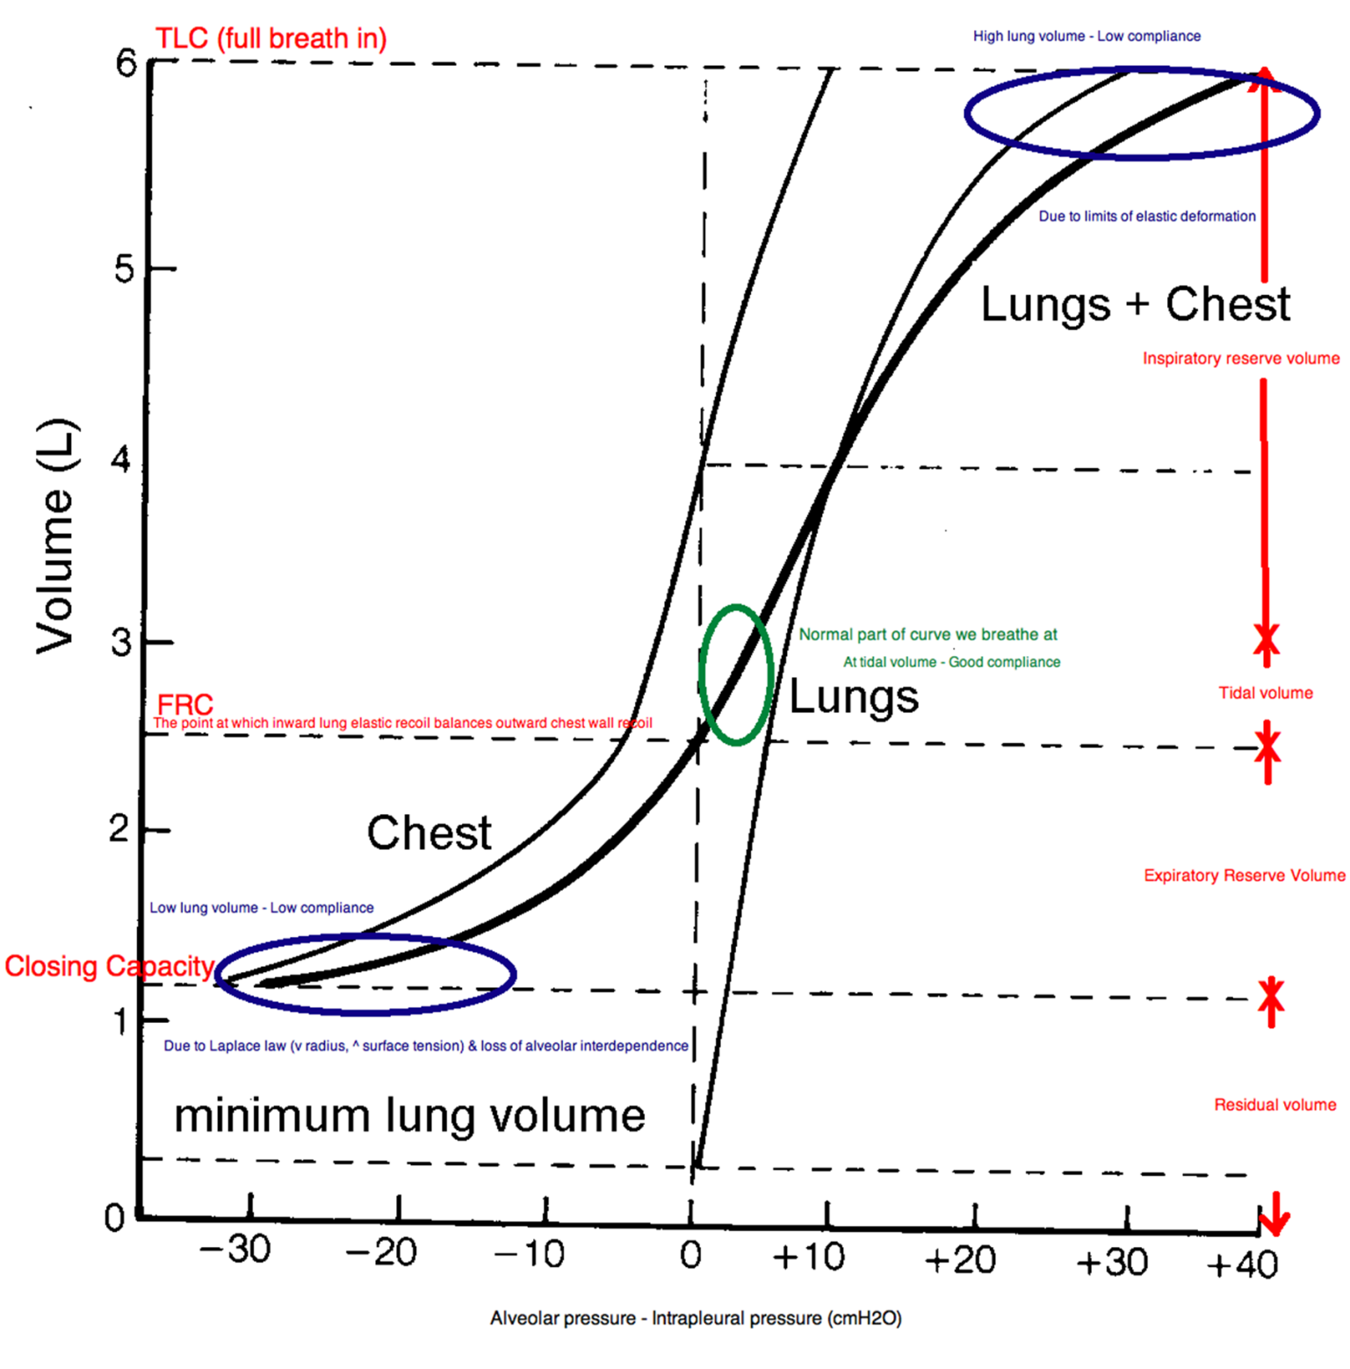

Slide 35
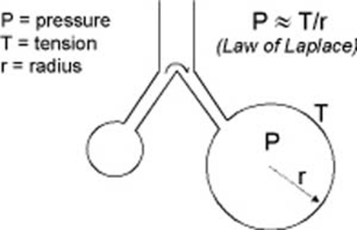
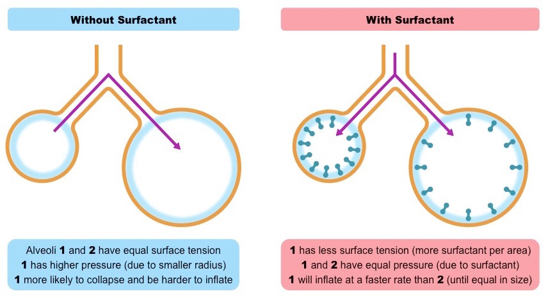
Elastic recoil is determined by two kinds of forces
lung compliance (“distensibility”)
  a measure of the relationship between this retractive force and lung volume (pressure-volume relationship)
  defined as the change in lung volume brought about by unit change in transpulmonary (intrapleural) pressure (L/kPa)
surface tension produced by the layer of fluid that lines the alveoli
  determined by the cohesive (binding together) forces between molecules of the same type
    on the inner surface of the alveoli there is a fluid that can resist lung expansion
    there would be a lot of surface tension because there is an air-water interface in every alveolus
    if surface tension remained constant, decreasing r during expiration would increase P and smaller alveolus would empty into large one
  this collapsing tendency is offset by pulmonary surfactant which significantly lowers surface tension

Slide 36
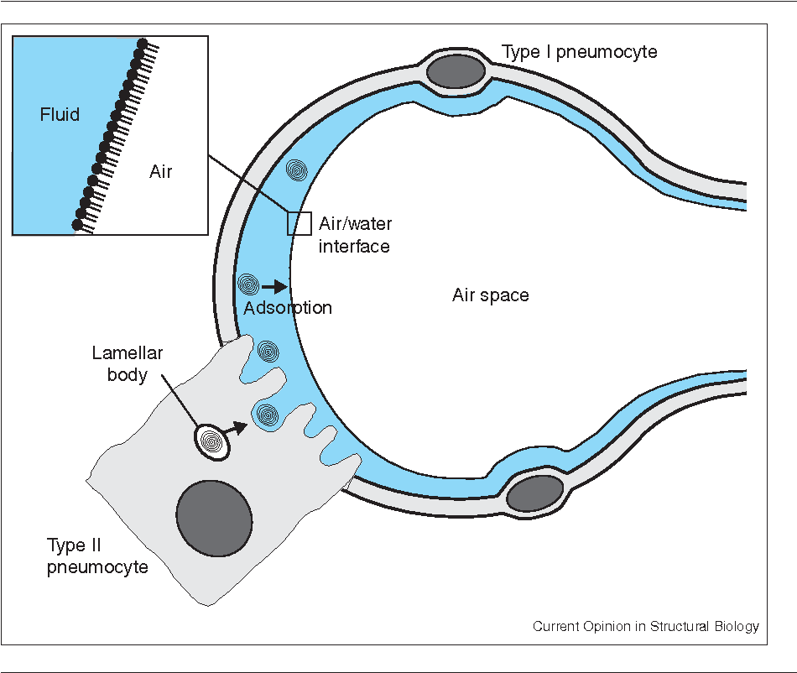
Pulmonary surfactant
Complex mixture of lipids and proteins at the alveolar cell surface (liquid – gas interface) reducing surface tension
  superficial layer made of phospholipids (dipalmitoyl lecithin)
  deeper layer (hypophase) made of proteins (SP-A, -B, -C, -D)
Surfactant maintains lung volume at the end of expiration
Continually and very rapidly recycles
  influenced by many hormones incl. glucocorticoids
    lung maturation in pre-term newborns

Slide 37
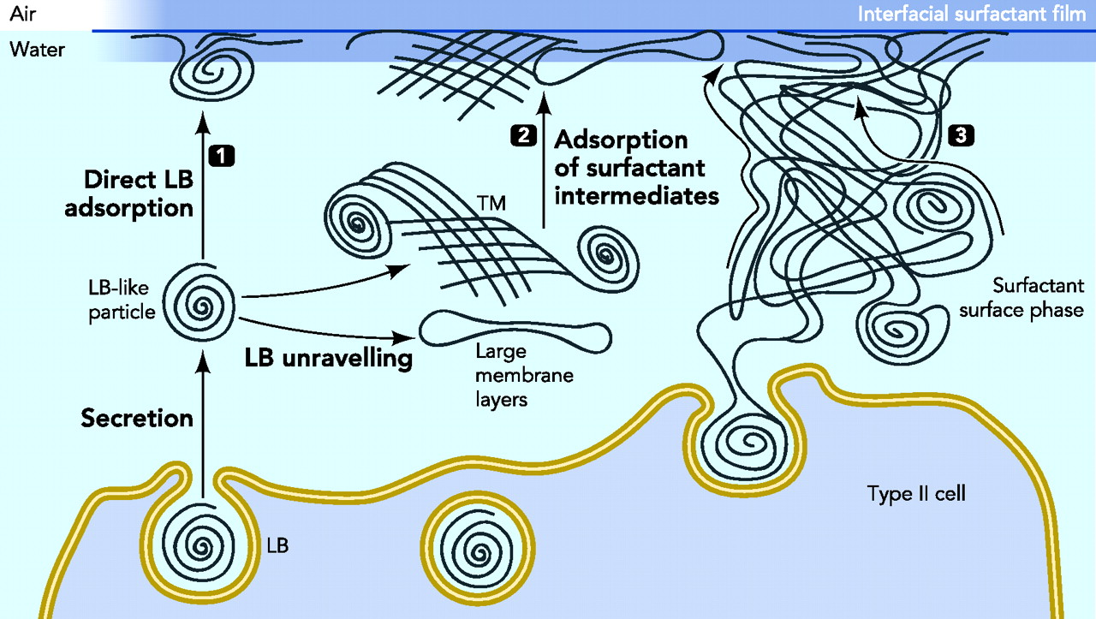
Pulmonary surfactant adsorption to the interface and surface film formation. Processes that may contribute to transport of surface active surfactant species to the interface include 1) direct cooperative transfer of surfactant from secreted lamellar body-like particles touching the interface, 2) unravelling of secreted lamellar bodies to form intermediate structures such as tubular myelin (TM) or large surfactant layers that have the potential to move and transfer large amounts of material to the interface, and 3) rapid movement of surface active species through a continuous network of surfactant membranes, a so-called surface phase, connecting secreting cells with the interface.
©2010 by American Physiological Society
Perez-Gil J , Weaver T E Physiology 2010;25:132-141
Notes:
Pulmonary surfactant adsorption to the interface and surface film formation Processes that may contribute to transport of surface active surfactant species to the interface include 1) direct cooperative transfer of surfactant from secreted lamellar body-like particles touching the interface, 2) unraveling of secreted lamellar bodies to form intermediate structures such as tubular myelin (TM) or large surfactant layers that have the potential to move and transfer large amounts of material to the interface, and 3) rapid movement of surface active species through a continuous network of surfactant membranes, a so-called surface phase, connecting secreting cells with the interface.

Slide 38
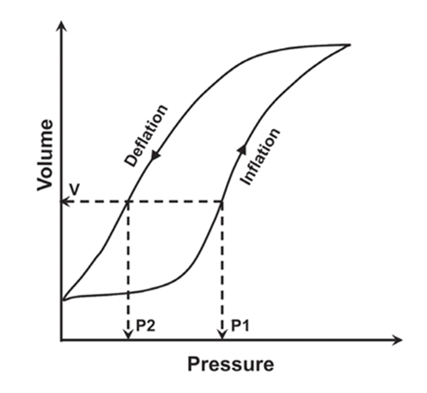
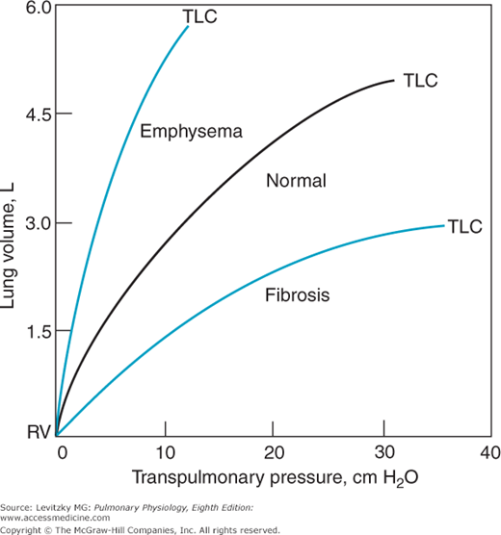
Abnormalities of elastic properties
change of lung compliance (TLC, FRC, RV)
  ↑ pulmonary emphysema, aging (↑TLC, ↑FRC, ↑RV)
  ↓ interstital disease (↓TLC, ↓FRC, ↓RV)
    e.g. pulmonary fibrosis or bronchopneumonia
lack of surfactant (↓TLC, ↓FRC, ↓RV)
  infant or adult respiratory distress syndromes (IRDS or ARDS, resp.), i.e. tendency of lung to collapse
  alveolar lung edema (damages/dilutes surfactant)
diseases that affect the movement of the thoracic cage and diaphragm
  marked obesity
  diseases of the thoracic spine
    ankylosing spondylitis and kyphoscoliosis
  neuropathies
    e.g. the Guillain-Barré syndrome)
  injury to the phrenic nerves (spine C3-C5)
  myasthenia gravis

Slide 39
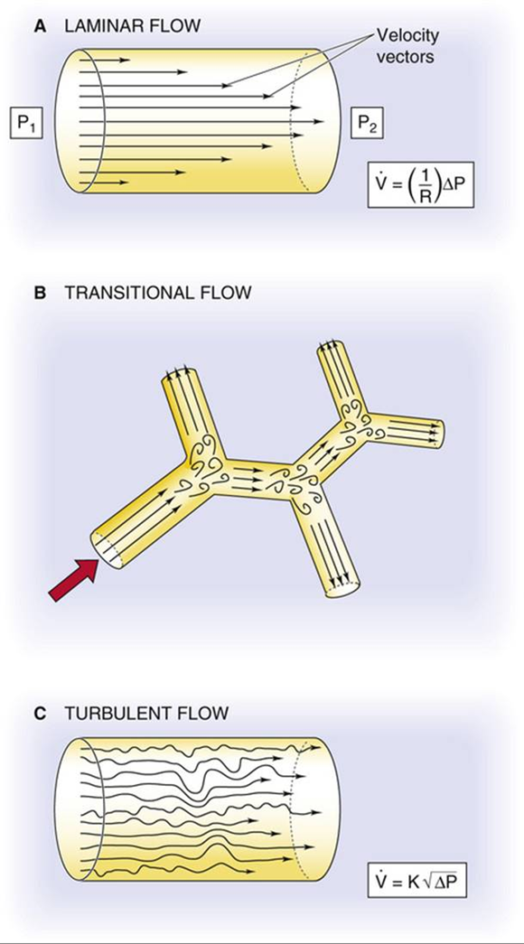

(ad 2) Airway (dynamic) resistance
Poiseuille’s law for pressure states that pressure is
  directly proportional to flow, tube length, and viscosity
  and it is inversely proportional to tube radius
Overcoming increased resistance requires forced expiration

Slide 40


Airflow velocity and pattern

Slide 41




Airflow – where is the highest resistance?

Slide 42



Airflow resistance
From the trachea to the periphery, the airways become smaller in size (although greater in number)
  the cross-sectional area available for airflow increases as the total number of airways increases
  the flow of air is greatest in the trachea and slows progressively towards the periphery (as the velocity of airflow depends on the ratio of flow to cross-sectional area)
    in the terminal airways, gas flow occurs solely by diffusion
The resistance to airflow is very low (0.1-0.2 kPa/L in a normal tracheobronchial tree), steadily increasing from the small to the large airways
Airway tone is under the control of the autonomic nervous system
  bronchomotor tone is maintained by vagal efferent nerves
  many adrenoceptors on the surface of bronchial muscles respond to circulating catecholamines
    sympathetic nerves do not directly innervate them!
Airway resistance is also related to lung volumes
  because airways are ‘tethered’ by alveoli (i.e. pulled open by radial traction)
  visible on bronchoscopy
  patients with obstruction benefit from breathing in high lung volumes

Slide 43


Airflow resistance – effect of changed airway diameter
theoretical amplifying effect of luminal mucus on airflow resistance in asthma
  (a) According to Poiseuille’s law, resistance to flow (R) is proportional to the reciprocal of the radius (r) raised to the fourth power.
  (b) Without luminal mucus, bronchoconstriction to reduce the airway radius by half increases airflow resistance 16-fold.
  (c) A small increase in mucus thickness (t_{M}), which reduces the radius of the airway by only one-tenth, has a negligible effect on airflow in the unconstricted airway (compare with panel a).
  (d) With bronchoconstriction, the same amount of luminal mucus markedly amplifies the airflow resistance of this airway

Slide 44


Work of breathing

Slide 45

Airflow pattern
Movement of air through the airways results from a difference between the pressure in the alveoli and the atmospheric pressure
  alveolar pressure (P_{ALV}) is equal to the elastic recoil pressure (P_{EL}) of the lung plus the pleural pressure (P_{PL})
  positive P_{ALV} occurs in expiration and a negative pressure occurs in inspiration
During quiet breathing the sub-atmospheric pleural pressure throughout the breathing cycle slightly distends the airways
  during vigorous expiratory efforts (e.g. cough) the central airways are compressed by positive pleural pressures exceeding 10 kPa
  the airways do not close completely because the driving pressure for expiratory flow (alveolar pressure) is also increased
When there is no airflow (i.e. during a pause in breathing) the tendency of the lungs to collapse (the positive P_{EL}) is exactly balanced by an equivalent negative P_{PL}
The relationship between maximal flow rates on expiration and inspiration is demonstrated by the maximal flow-volume (MFV) loops

Slide 46


Flow-volume loop: peak inspiratory and expiratory flow rates are dependent on effort, whereas expiratory flow rates later in expiration are independent of effort.

Slide 47

Why is expiratory flow limited?
In forced expiration, the driving pressure raises both the P_{ALV} and the P_{PL}
  between the alveolus and the mouth, a point will occur (C) where the airway pressure will equal the intrapleural pressure, and airway compression will occur
    equal pressure point
  however, this equal pressure point and event. compression of the airway is not fixed during the entire expiration (as the lung volume decreases)
  initially, it does not existsince in the absence of lung disease, the equal pressure point occurs in airways that contain cartilage, and thus they resist collapse
  later, the equal pressure point moves closer to the alveoli causing transient occlusion of the airway
    this, however, results in an increase in pressure behind it (i.e. upstream) and this raises the intra-airway pressure so that the airways open and flow is restored
  the airways thus tend to vibrate at this point of 'dynamic airway compression'

Slide 48


Dynamic airway compression/collapse
In forced expiration, the driving pressure raises both the P_{ALV} and the P_{PL}
  between the alveolus and the mouth, a point will occur (C) where the airway pressure will equal the intrapleural pressure, and airway compression will occur
    equal pressure point
  however, this compression of the airway is temporary, as the transient occlusion of the airway results in an increase in pressure behind it (i.e. upstream) and this raises the intra-airway pressure so that the airways open and flow is restored
    the airways thus tend to vibrate at this point of 'dynamic compression'

Slide 49


Slide 50

Dynamic compression in various situations
The respiratory system is represented as a piston with a single alveolus and the collapsible part of the airways within the piston
    C, compression point; PALV, alveolar pressure; PEL, elastic recoil pressure; PPL, pleural pressure.
  (a) at rest at functional residual capacity
  (b) forced expiration in normal subjects
  (c) forced expiration in a patient with COPD

Slide 51

Various mechanisms of airway obstruction
Narrowing of the airway lumen may be due to:
  a) mucus, cells or other material within the lumen
  b) thickening of the airway wall that encroaches on the lumen (hypertrophy)
  c) shortening of smooth muscle around the lumen (bronchoconstriction)
  d) collapse of the airway wall into the lumen (emphysema)

Slide 52

Thanks for your attention!

