Slide 1
Secondary hypertension
Experimentally induced renal ischemia

Slide 2
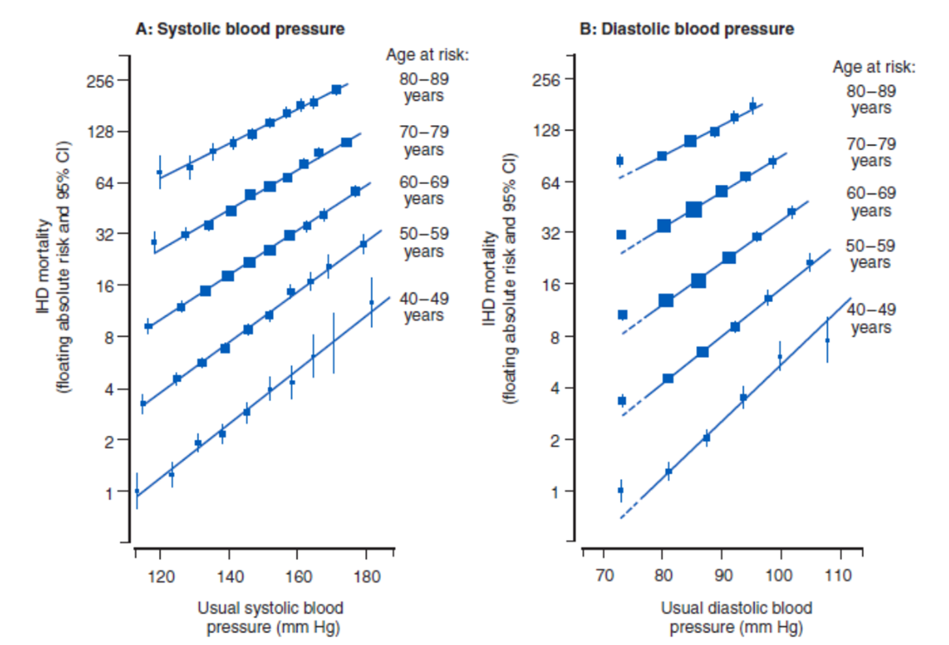
Blood pressure and ischemic heart disease mortality

Slide 3
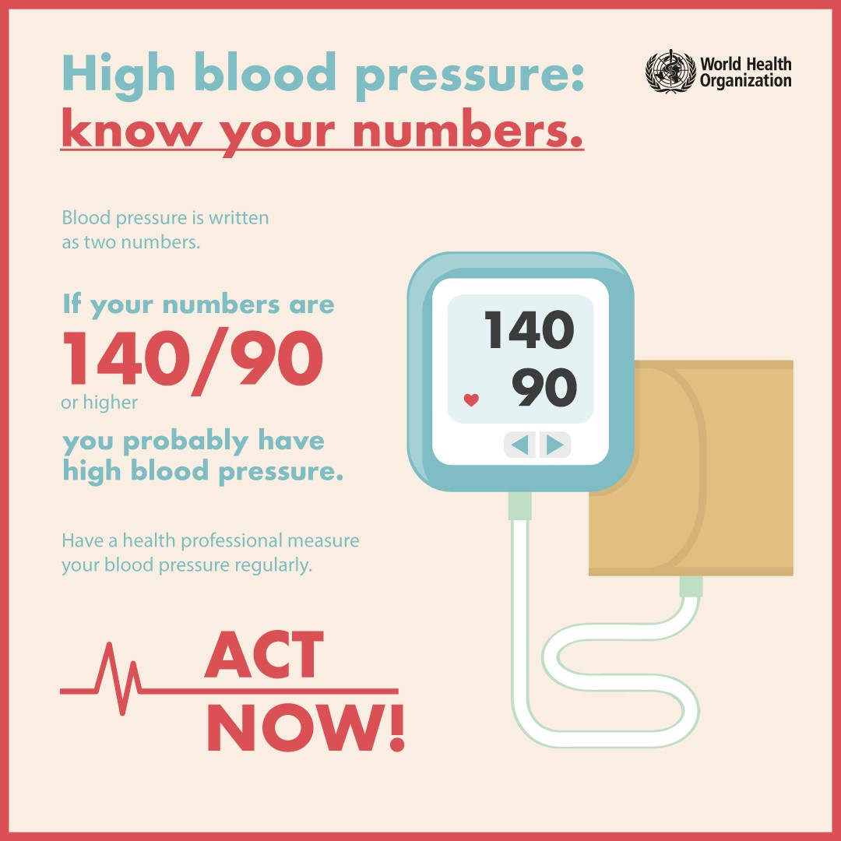
Conceptual definition of hypertension
blood pressure > 140/90 mm Hg
arbitrary definition reflecting CV-related morbidity and mortality
  quantitative relationship between blood pressure and mortality
  artificial dichotomy between normo- and hypertension
the level at which the benefits of action exceed those of inaction
  benefit of action – decreased risk of CV disease
  risk of action – side effect of therapy
    hypokalemia in diuretics-treated patients
    elevation of triglycerides and glucose in β-blockers users
  risk of inaction - increased risk of CV disease
benefit of drug treatment have been definitely established in randomized placebo-controlled trials

Slide 4
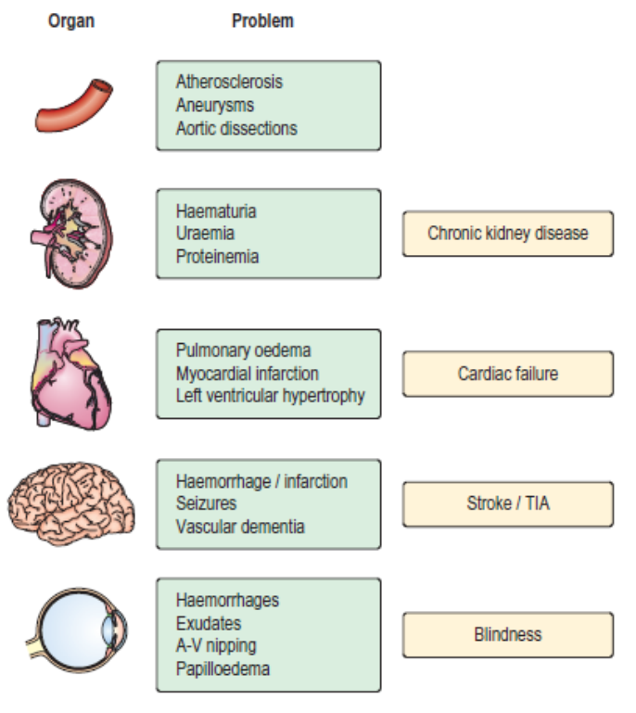
Hypertension and target organ damage
types
  primary and secondary
hypertension
  major risk factor for premature cardiovascular disease
  leading cause of death worldwide
  incidence continues to grow
asymptomatic nature
treatment remains most commonly empiric
  often 3 or more pharmacologic agents with complementary mechanisms
hypertension causes
  54 % of stroke
  47 % of ischemic heart disease
    of all modifiable risk factors, hypertension is exceeded only by smoking

Slide 5
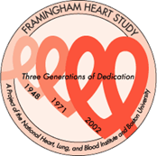
Framingham study
since 29.9.1948, Framingham, Boston, MA
identification of major cardiovascular risk factors
  blood pressure, cholesterol, triglycerides, HDL, smoking, obesity, diabetes, physical inactivity, age, gender (male) a psychosocial factors
Initial cohort
  5209 people, 30-62 years, detailed examination every 2 years
II. cohort (since 1971)
  5,124 adult offspring
III. cohort
  3,500 children (grandchildren of original participants)
late clinical manifestations of long-term uncontrolled hypertension
  myocardial infarction, stroke
  heart failure
  kidney failure
  retinopathy

Slide 6
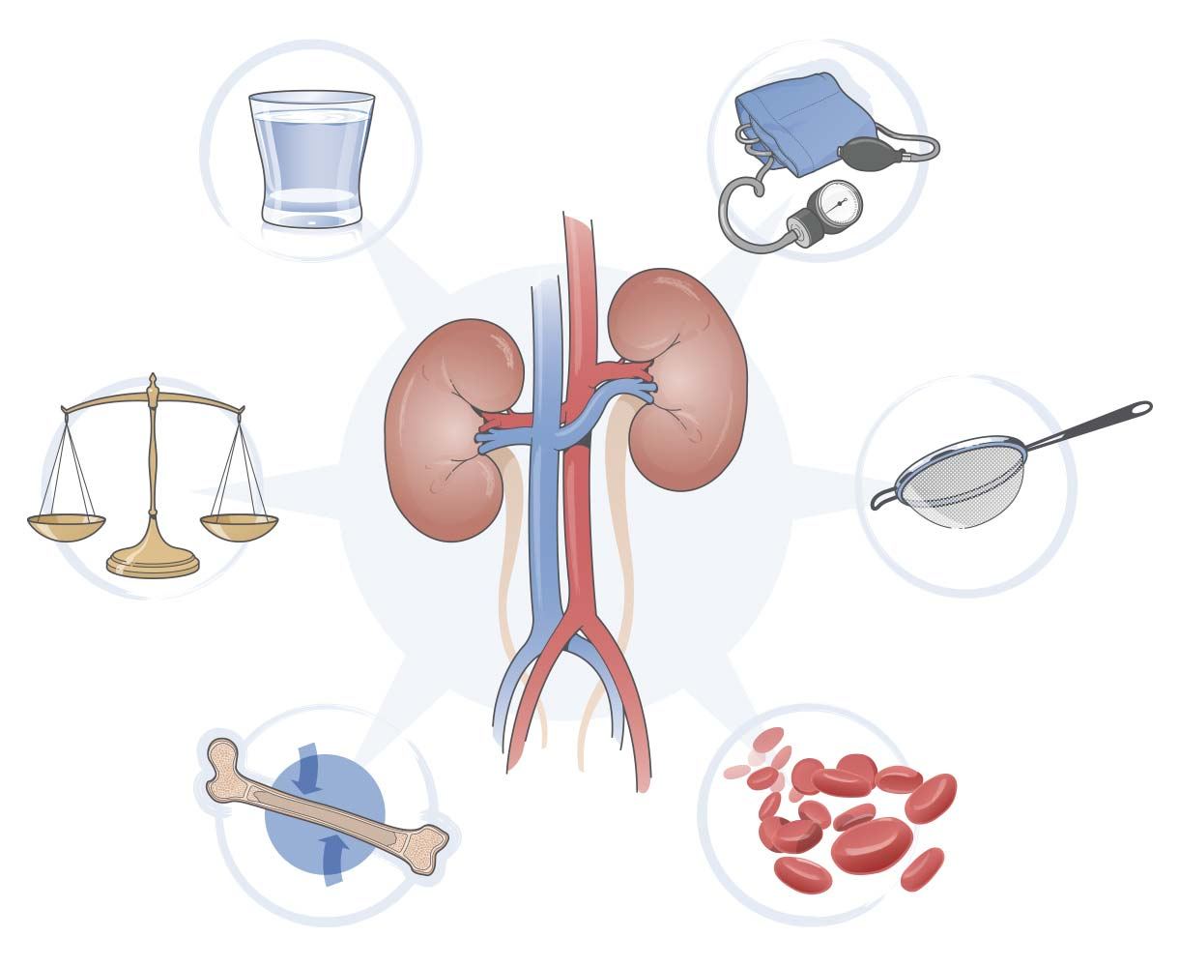
Kidney function
regulation of
  extracelllular fluid volume and blood pressure
  osmolarity
  acid-base balance
  ion balance
  excretion of wastes
  production of hormones
kidney perfusion
  20 – 25 % of minute heart volume
    1200 ml/min, 90 % goes to cortex
    markedly more than would correspond to kidney weight
  reasons for high perfusion
    high energy need of tubular cells
    production of primary filtrate in glomeruli
      20 % of perfusion
      150-180 l/day – 90 % reabsorption
      glomerular filtration rate (GFR)
        100-120 ml/min

Slide 7
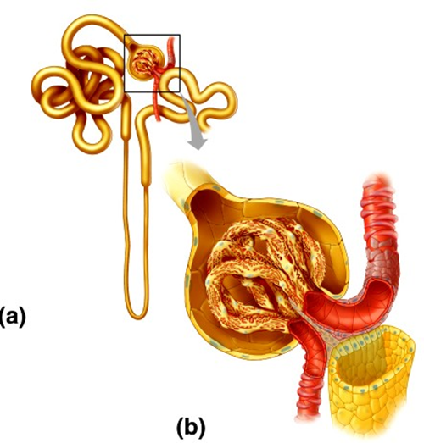
Juxtaglomerular apparatus
juxtaglomerular (JG) cells
  specialised muscle cells
  advanced endoplasmic reticulum and Golgi apparatus
  production of renin
  blood pressure receptor
macula densa
  close to JG cells
  senzitive to NaCl
mesangial cells
  specialized pericytes
  contraction
juxtaglomerular apparatus
  sympathetic innervation

Slide 8
Renin-angiotensin-aldosterone system
plasma/systemic RAS
tissue RAS
  kidneys, adrenal gland
intermediate
  lungs, heart, vessels, liver
renin – protease released by JG cells
factors controlling renin release
  drop in blood pressure
  decrease in the amount of NaCl delivered to the kidney
  β-adrenergic stimuli
  angiotensin II
  low potassium
aldosterone
  binding to cytosolic mineralocorticoid receptors (MR) in the renal collecting duct cells
  sodium channels in the membrane and subsequent reabsorption of Na
    volume re-expanding
  MR expressed also outside the kidney
    impairment of vascular health by multiple extrarenal mechanisms

Slide 9
Effects of angiotensin II
cardiovascular tissues
brain
  stimulation of thirst
  release of ADH
angiotensin II receptors
  AT₁
    responsible for the majority of Ang II action
    smooth muscle, endothelial cells, adrenal cortex
  AT₂
    opposes the effect of AT1 (at least in rodent models), the role in humans is not explained
    widely distributed in the fetus
    in adults expressed in
      adrenal medulla, endothelium, brain regions

Slide 10
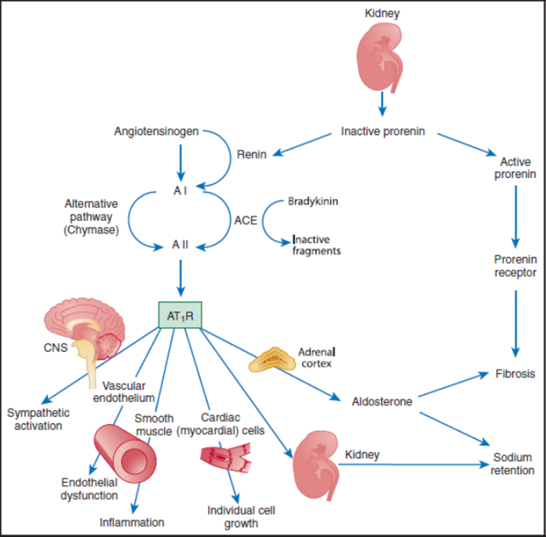
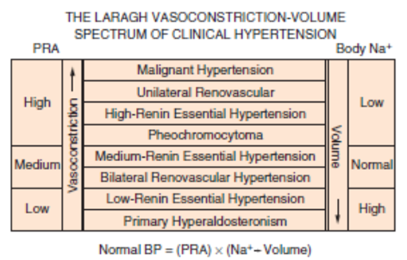
RAAS overview

Slide 11
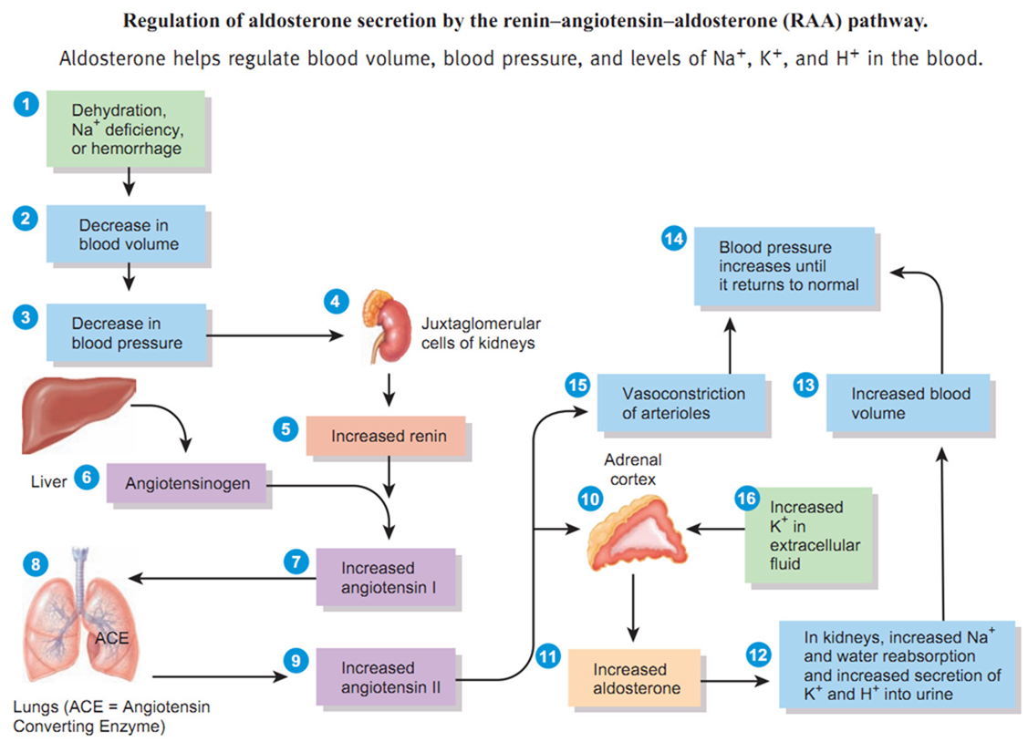
RAAS overview

Slide 12
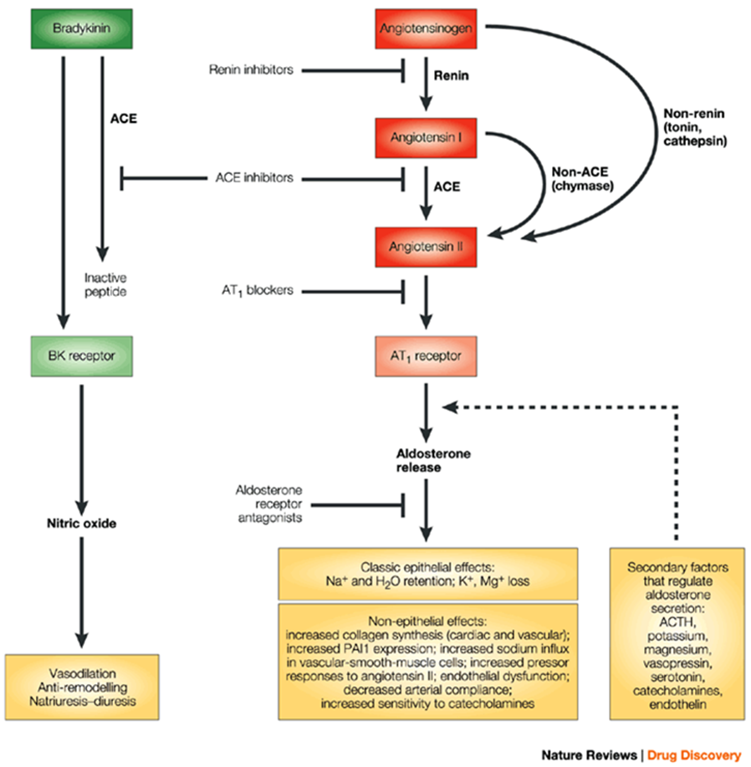
RAAS manipulation

Slide 13
Major forms of secondary hypertension
renal disorders
  parenchymal
  renovascular
endocrine disorders
  Cushing syndrome
  primary aldosteronism
vascular disorders
  coarctation of the aorta
pregnancy
exogenic cause
  medication
  contraception
  drugs
    cocaine, amphetamine
  licorice

Slide 14
Screening for secondary hypertension
secondary forms are rare and screening for them expensive and laborious
  it is not cost effective to search for secondary causes of hypertension in every patient
testing requires clinical suspicion and knowledge of limitations of different tests
general principles
  new onset hypertension if <30 or >50 years of age
  hypertension refractory to treatment (>3-4 medications)
  specific clinical/lab features typical for secondary HT
    hypokalemia, differential BP in arms, episodic hypertension…

Slide 15
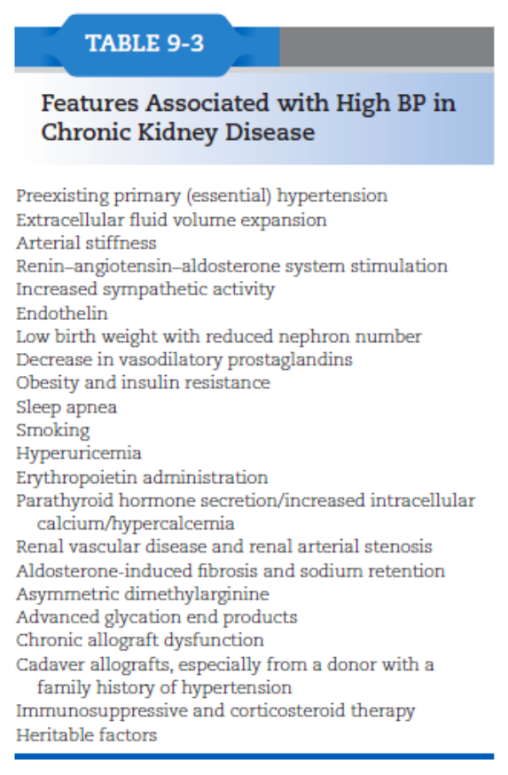
Renal parenchymal disease
2 – 5 % cases of hypertension
mechanisms
  common pathway
    impaired renal autoregulation
    high perfusion pressure
    damage of the glomerular cells
  stiffness of the arteries
    ↑ SBP, ↓ DBP, ↑ pulse pressure
  retention of water and electrolytes due to significant decrease of glomerular fitration

Slide 16
Renovascular hypertension
1-2 % cases of hypertension
  atherosclerosis
    70 – 90 % of cases
      in older adults
  fibromuscular dysplasia
    more common in women
    non-inflammatory vascular disease
    affects more commonly young women
      often in the 3rd decade
mostly partial obstruction of one main renal artery
  decreased RBF, activation of RAAS
suspiction of renal artery stenosis
  hypertension in previously normotensive person
    < 30 or > 50 years
  severe or resistant hypertension
  smoking
  accelerated hypertension in previously controlled person
  worsening renal function after RAS inhibition
reduction in renal perfusion by 50 %
  immediate and persistent increase of renin secretion from ischemic kidney
renovascular vs. primary hypertension
  hypokalemia
  no family history of hypertension
  duration < 1 year
administration of ACE inhibitors may cause a decline in renal function
diagnostic tests
  assessment of renal function, RAAS
  imaging studies
treatment
  blood pressure control
  renal function stabilization
  angioplasty

Slide 17
Renovascular hypertension
atherosclerosis
  90 % of RVH
  affects mainly proximal third of the main renal artery
  seen mostly in older men
  bilateral in 30 %
fibromuscular dysplasia
  10 % of RVH
  noninflammatory vascular disease
  involving mainly distal 2/3 and branches of renal arteries
  rarely bilateral
    predilection in the right renal artery
  appears most commonly in younger women

Slide 18
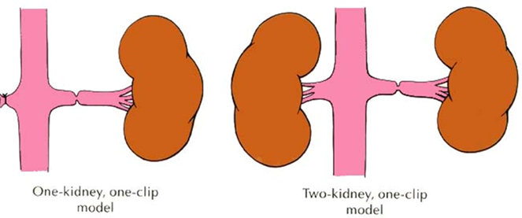
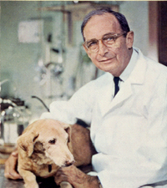
Goldblatt‘s experimental hypertension
2 kidneys/1 clip (2K1C)
  hypertension + preserved regulation of extracellular volume
1 kidney/1 clip (1K1C)
  hypertension + disorder of extracelllular volume regulation

Slide 19
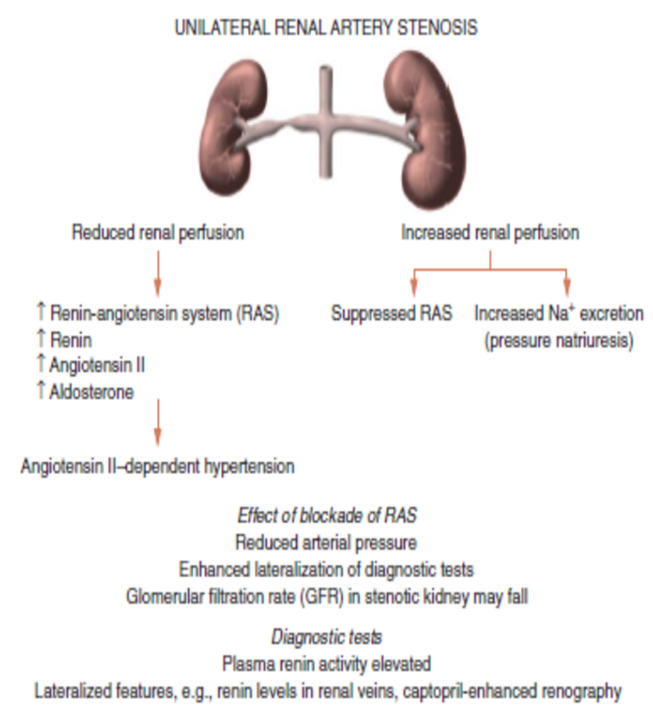
2K1C hypertension
unilateral stenosis may be present with an intact contralateral renal artery
counterregulatory processes in the contralateral kidney
  sodium excretion in response to increased blood pressure

Slide 20
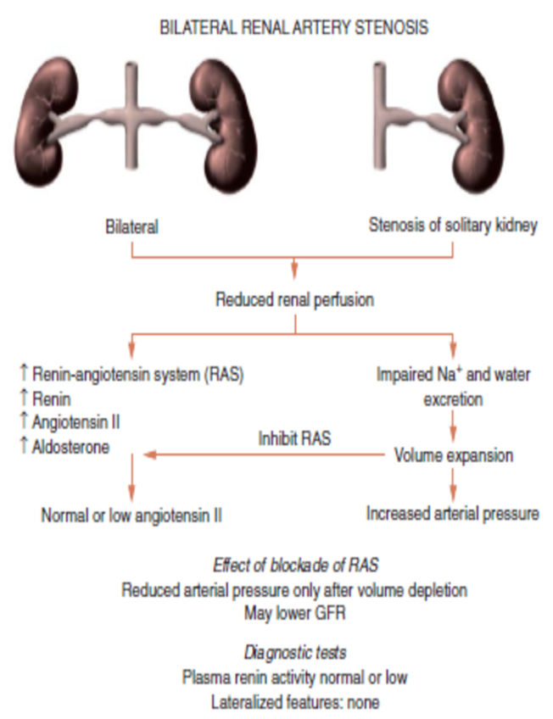
1K1C hypertension
bilateral stenosis and 1K1C lead to more severe hypertension

Slide 21
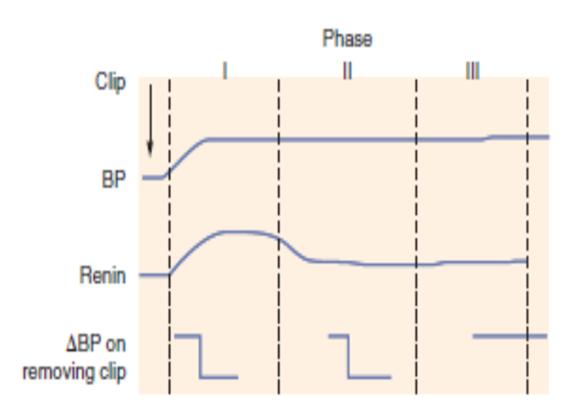
Phases of experimental hypertension
early phase
  renal ischemia, activation of RAAS
  elevated renin, hypertension
second phase
  blood pressure responds to clip removal
third phase
  no reduction of blood pressure after clip removal
  microvascular injury of contralateral kidney
  oxidative stress?

Slide 22
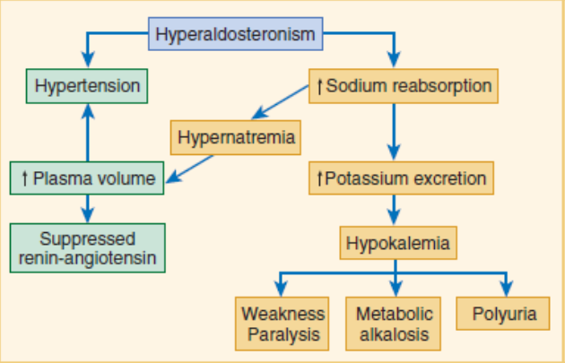
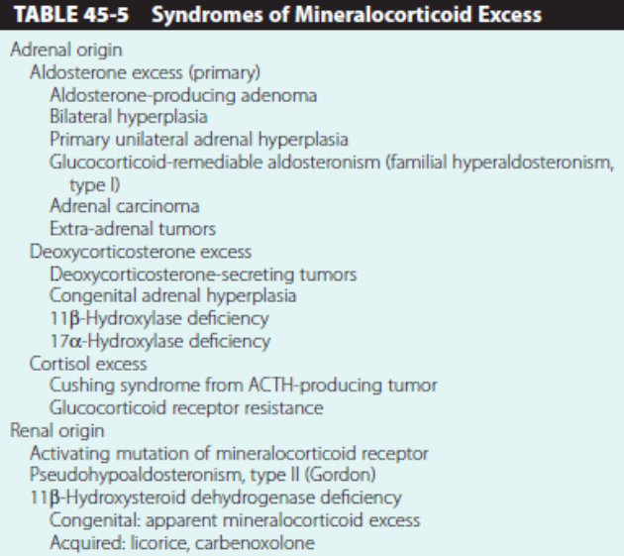
Mineralocorticoid-induced hypertension

Slide 23
Hyperaldosteronism
group of conditions characterized by chronic excess aldosterone secretion
primary
  autonomous overproduction of aldosterone
  supression of RAAS, decreased plasma renin
  3 types
    bilateral idiopathic hyperaldosteronism
      the most common cause of primary hyperaldosteronism (60 % of cases)
    adrenocortical neoplasm
      Conn syndrome – solitary aldosterone-secreting adenoma
    glucocorticoid-remediable hyperaldosteronim
      uncommon, familial
      ectopic aldosterone synthase activity in the cortisol producting zona fasciculata of adrenal cortex
      under the regulation of ACTH
        glucocorticoid supression
secondary hyperaldosteronism
  aldosterone release occurs in response to activation of RAAS
    increased plasma renin
  conditions
    decreased renal perfusion
    hypovolemia
    pregnancy
      estrogen-induced increases in plasma renin substrate

Slide 24
Hyperaldosteronism
clinical consequences
  hypertension
    one of the most comman causes of secondary hypertension
      in 20 % of patients with treatment-resistant hypertension
  hypokalemia
  profibrotic effect of aldosterone
    more CV events in patients with primary aldosteronism than in patients with primary hypertension
diagnosis
  hypokalemia, low plasma renin
  high plasma aldosterone/renin
  decreased excretion of potassium

Slide 25
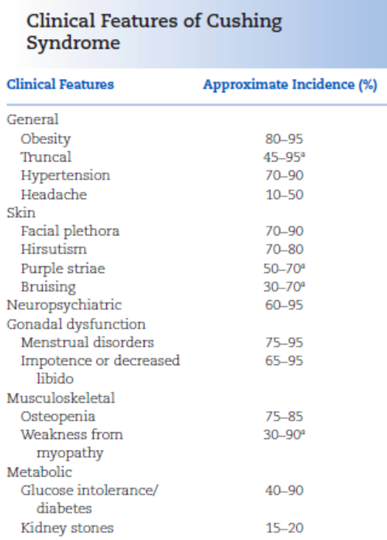
Hypercortisolism (Cushing syndrome)
conditions that produce elevated glucocorticoids levels
  exogenous
    administration of steroids is the most common cause of hypercorticolism
  endogenous
    ACTH dependent and independent
      most often secondary to an ACTH-producing pituitary microadenoma (=Cushing disease)
Cushing syndrome
  serious disease
  hypertension in ∼ 75 %
  often difficult to treat
    incompletely controlled
  4-fold excess of mortality

Slide 26
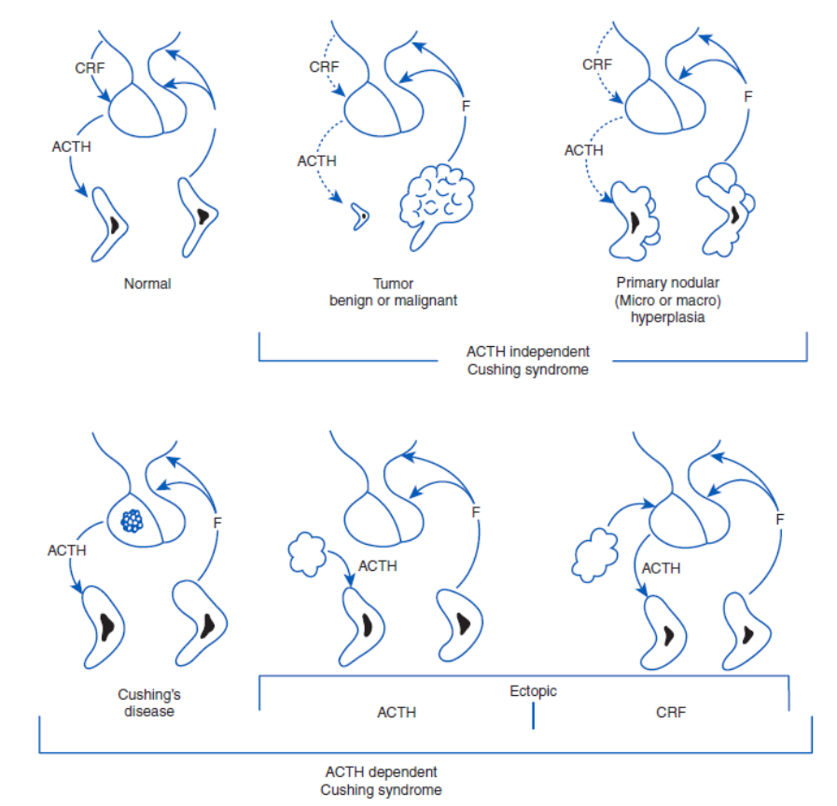
Causes of endogenous Cushing syndrome

Slide 27
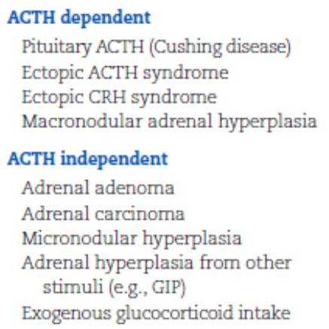
Classification and mechanisms of hypertension
mechanisms of hypertension
  Na retaining action of cortisol
    ↑ cortisol overwhelms 11β-HSD2
    cortisol acts on mineralocorticoid receptor (MR)
  direct action on smooth muscle cells
  ↑ production of mineralocorticoids
  ↓ activity of eNOS
  ↑ angiotensinogen

Slide 28
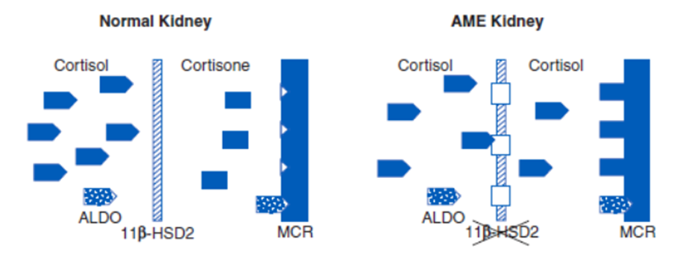
Increased access of cortisol to MR
11β-Hydroxysteroid Dehydrogenase
  11β-HSD1
    regeneration of active glucocorticoids, amplification of their action
    widely expressed in liver, adipose tissue, muscle, pancreas
  11β-HSD2
    inactivates cortisol and corticosterone to the inert cortisone
      protect mineralocorticoid receptor from occupation by cortisol
    highly expressed in the distal neuron
deficiencies of 11β-HSD2
  enzyme deficiency
    autosomal recessive
    apparent mineralocorticid excess (AME)
  enzyme inhibition
    glycerrhizic acid
    confectionery licorice
      50 g/daily for 2 weeks - ↑BP
    treatment
      competitive blockade of MR with spironolactone

Slide 29
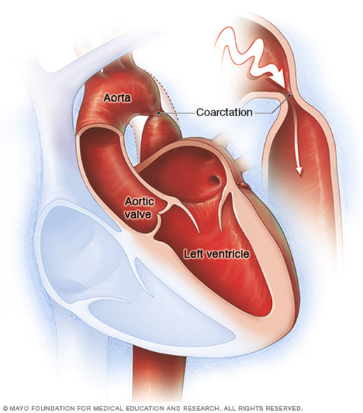
Coarctation of aorta
distal to the origin of subclavial arteries
signs
  hypertension in the arms
  weak or absent femoral pulses
  BP on lower extremities is normal or low
reduced blood flow to the lower part of the body
  kidneys – RAAS activation
  increased stroke volume
probably also generalized vasoconstrictor mechanism
diagnosis
  pressure diference > 20 mm Hg
treatment
  surgical
  angioplasty

Slide 30
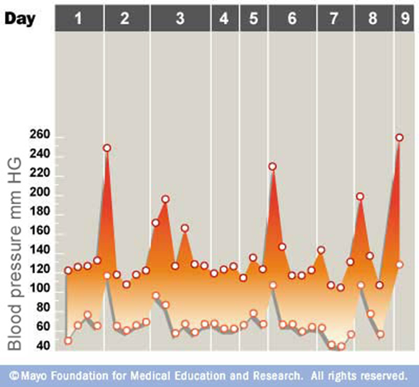
Pheochromocytoma
tumor of chromaffin tissue
  adrenal medulla
  sympathetic ganglia
0.1 – 0.5 % of people with hypertension
can cause serious hypertensive crisis
production of epinephrine and norepinephrine
  paroxysmal or continuous
  episodes of headache, sweating, palpitations
  weakness, fatigue, weight loss
  marked BP variability
diagnostic test
  urinary catecholamines
  localization of tumor
treatment
  surgery
  blockade of catecholamines action or synthesis
50 % have paroxysmal episodes of hypertension
other 50 % have sustaines hypertension
some may be normotensive

Slide 31
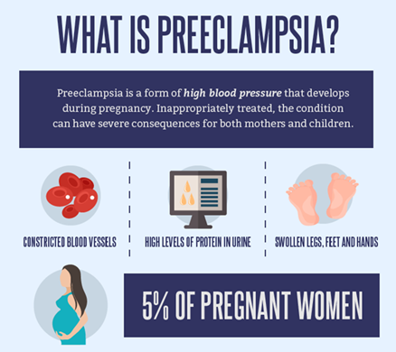
Hypertension in pregnancy
5-10 % of all pregnancies
blood pressure changes during pregnancy
  decrease during the first semester
  lowest in the second trimester
  rise during the third trimester
changes of cardiac output (CO) and peripheral vascular resistence (PR)
  large increase of CO in early pregnancy
    high throughout pregnancy
  decreased PR
pregnancy is normally accompanied by
  increased renin, ang I and II, estrogen, progesterone and aldosterone
women with preeclampsia
  new-onset hypertension with proteinuria
    develops after 20 weeks of pregnancy
  sensitive to the RAAS
  also responsive to other vasoconstrictors
  insulin resistence may predispose to hypertension

Slide 32
Oral contraceptive drugs and hypertension
the most common cause of secondary hypertension in young women
mechanism
  volume expansion
    estrogens and progesterons cause sodium retention

Slide 33
Malignant hypertension
acute and life-threatening condition associated with a sudden increase in BP
  usually in younger people
    black men, kidney damage
  diastolic > 120 mm Hg
organ dysfunction
  hypertensive encephalopathy
    cerebral vasoconstriction
      homeostatic response
    brain edema
  damage of kidney vessels
    ↑ creatinine, urea
    metabolic acidosis, hypocalcemie, proteinuria
prolonged exposure to high BP
  arterioles injury
  intravascular coagulation and RBC fragmentation
  renal damage
    ↑ creatinine
    proteinuria

Slide 34
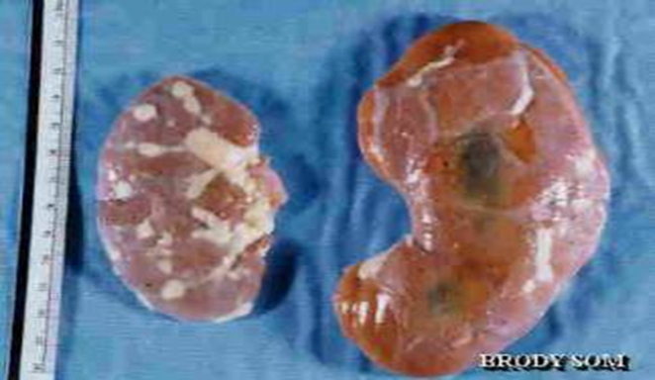
Practical part
weight of
  animal
  kidneys
  heart
suture
microscopic detection of renin

Slide 35
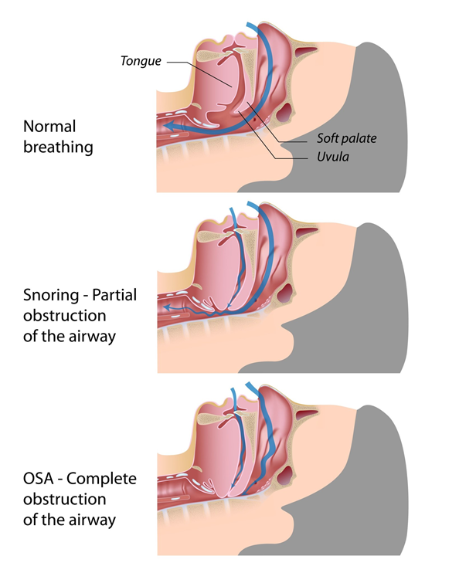
Sleep apnea syndrome
prevalent in middle-aged and older adults
mechanisms
  obesity
  craniofacial changes
  alteration in upper airway muscle function
consequences
  intermittent hypoxia and hypercapnia
  recurrent arousals and increase in respiratory efforts
  secondary sympathetic activation, oxidative stress and systemic inflammation
  daytime sleepiness

