Slide 1
ECHOcardiography

Slide 2
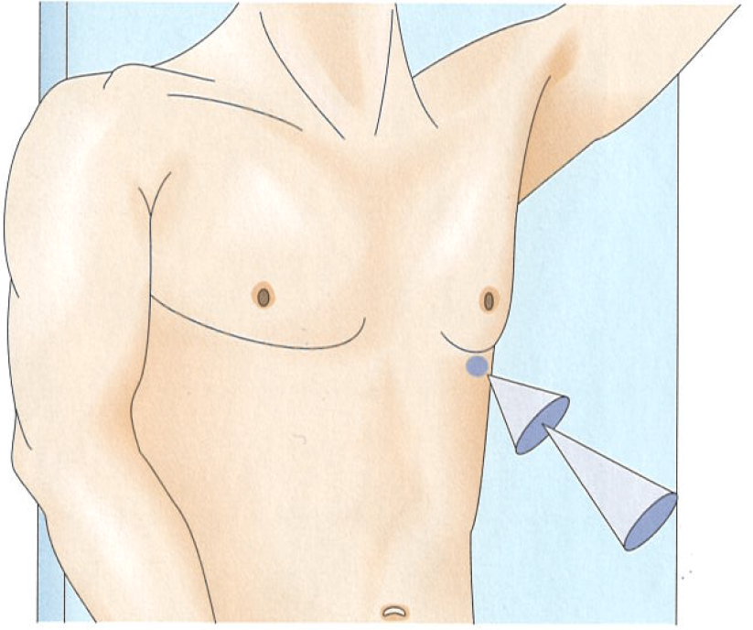
ECHO „windows“ and views. Apical window.
Short – axis view
  2 – chambre view
  3 – chambre view
Long – axis view
  4 – chamber view
  5 – chambre view

Slide 3
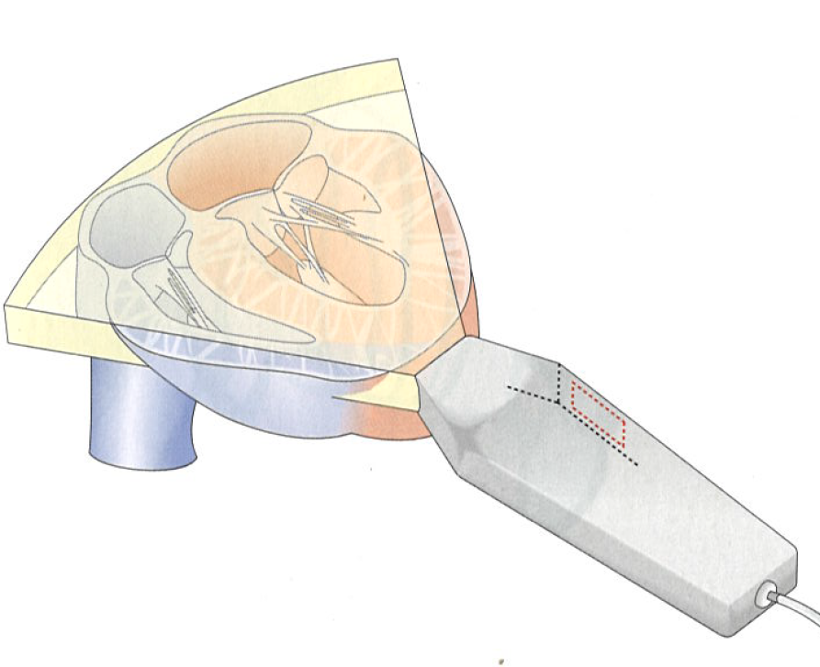
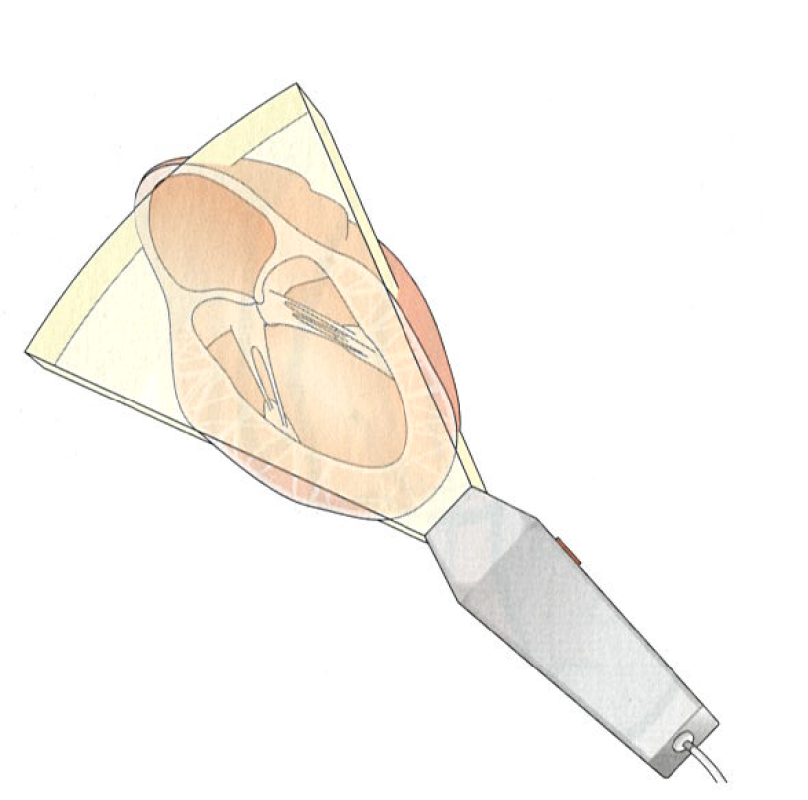
ECHO „windows“ and views. Apical window.
Long – axis view
Short – axis viewview

Slide 4

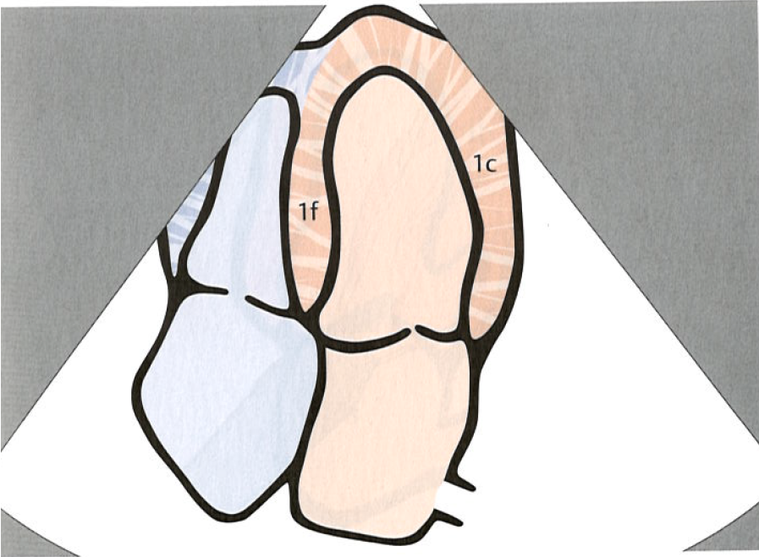
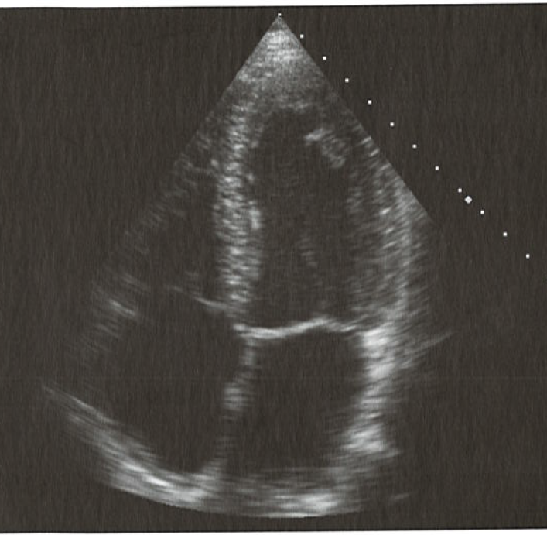
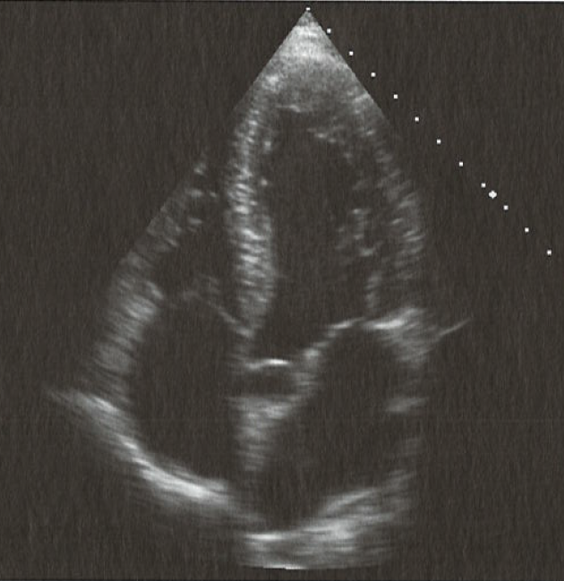
ECHO „windows“ and views. Apical window.
Long – axis view
Evaluation of the systolic and diastolic function of the heart

Slide 5

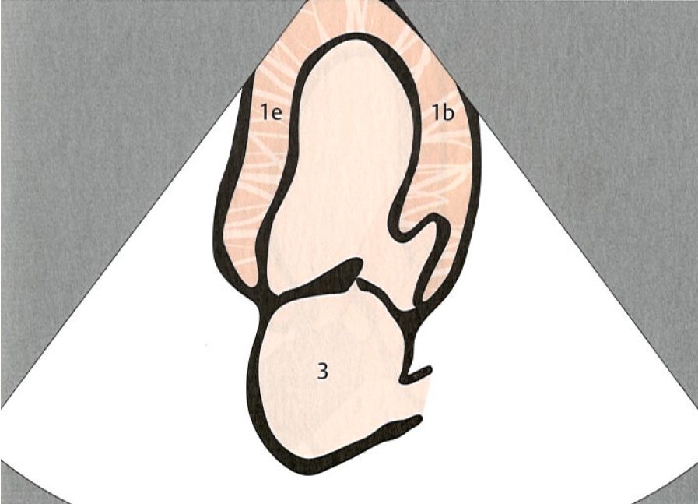
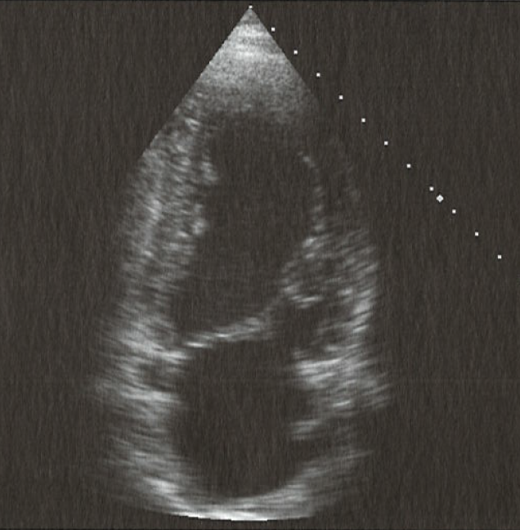
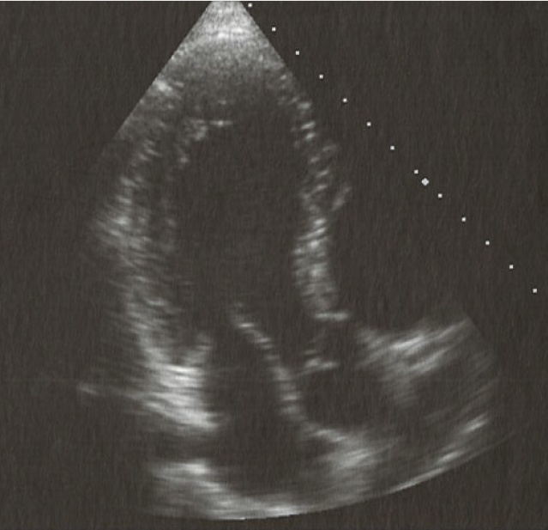
ECHO „windows“ and views. Apical window.
Short – axis view
1b – left ventricular anterior wall
1e – left ventricular posterior wall
3 – left atrium

Slide 6
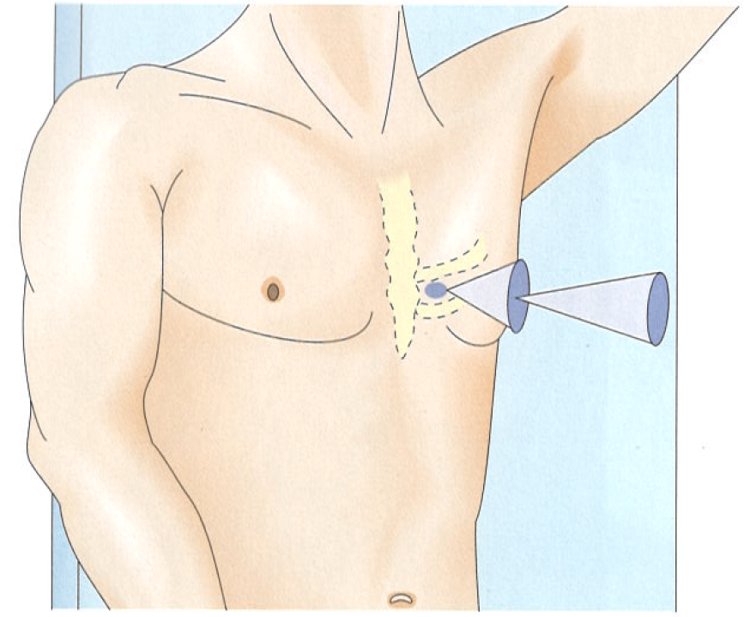
ECHO „windows“ and views. Parasternal window.
Short – axis view
Long – axis view

Slide 7
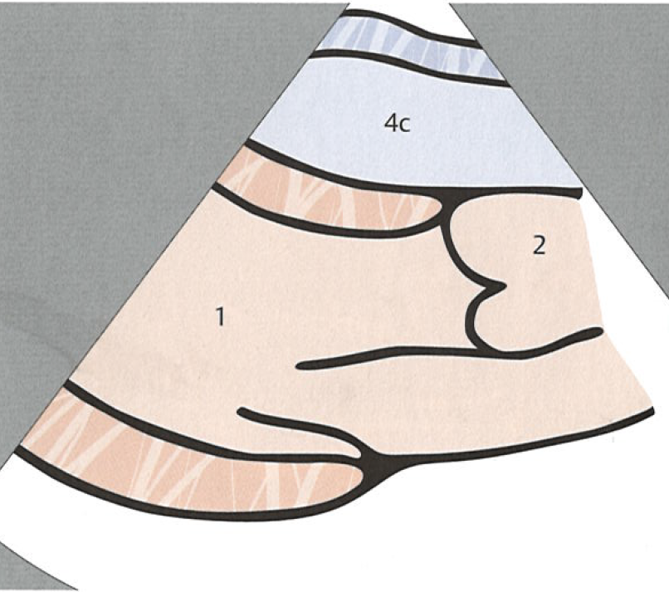
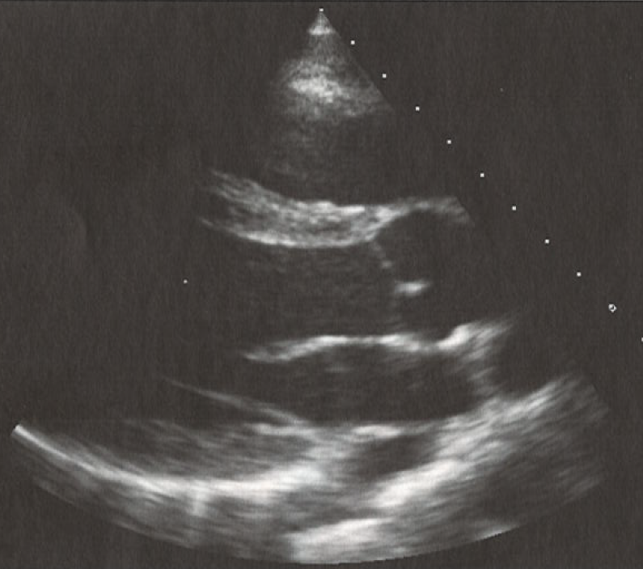
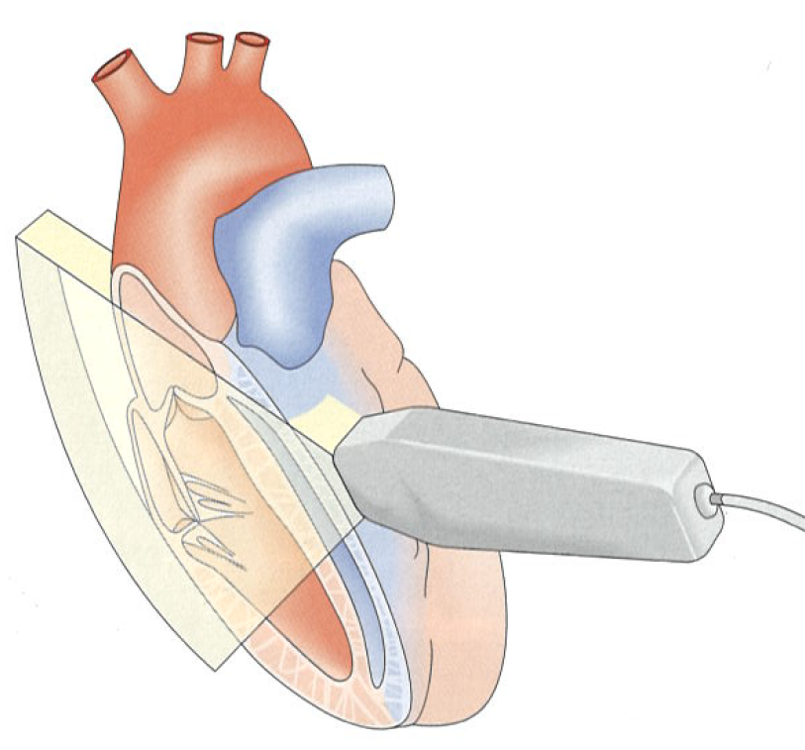
ECHO „windows“ and views. Parasternal window.
Long – axis view
1 – left ventricle
2 – aorta
4c – right ventricle
Estimation of the size of the heart

Slide 8
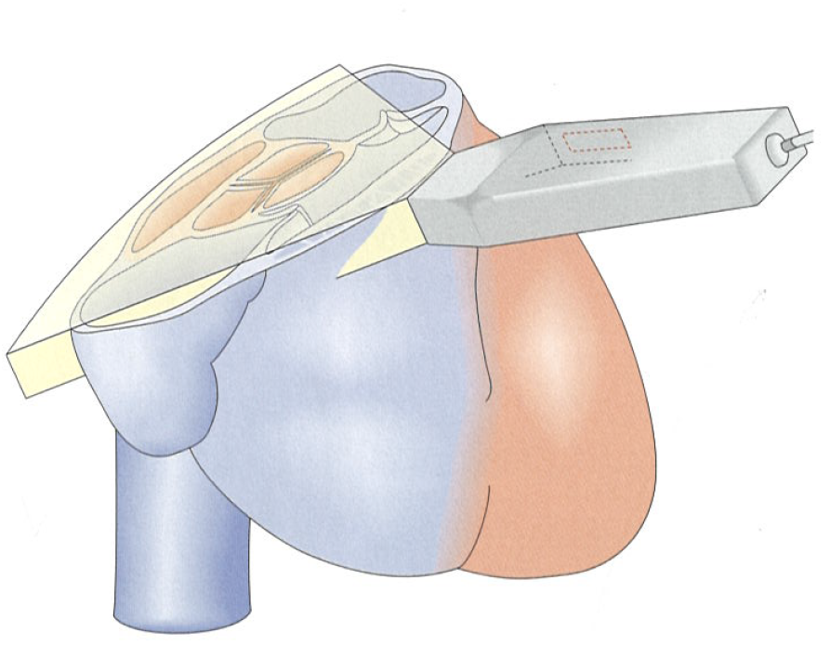
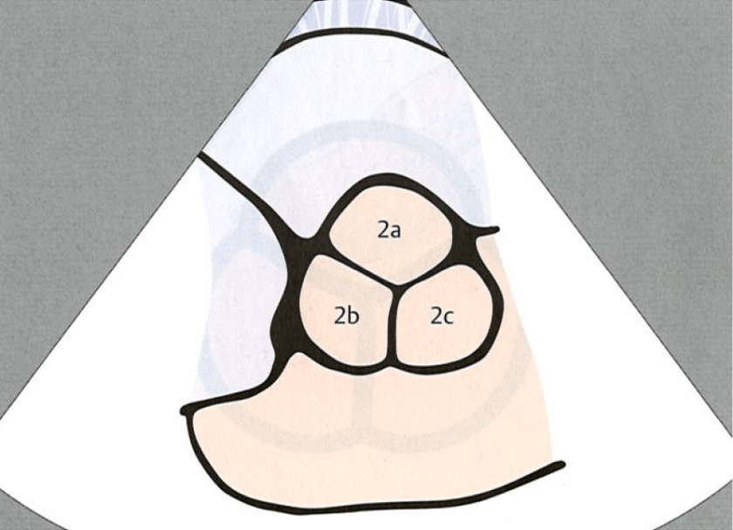
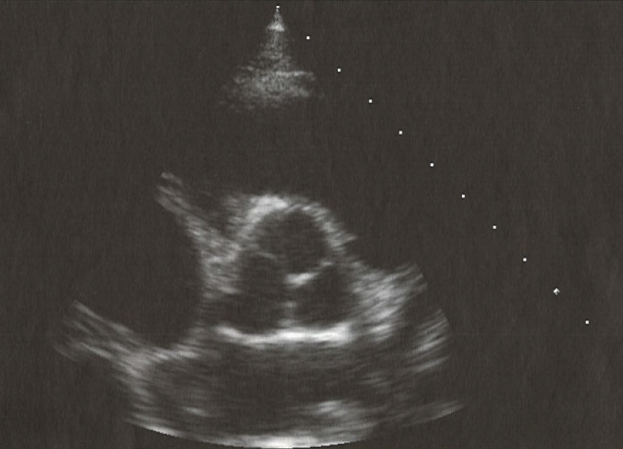
ECHO „windows“ and views. Parasternal window.
Short – axis view (Aortic valve)
2c - left posterior (origin of left coronary)
2b - anterior (origin of the right coronary)
2a - right posterior

Slide 9
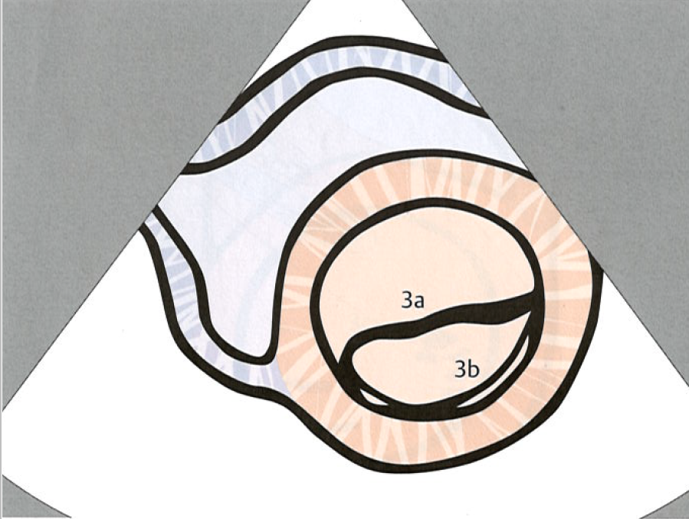
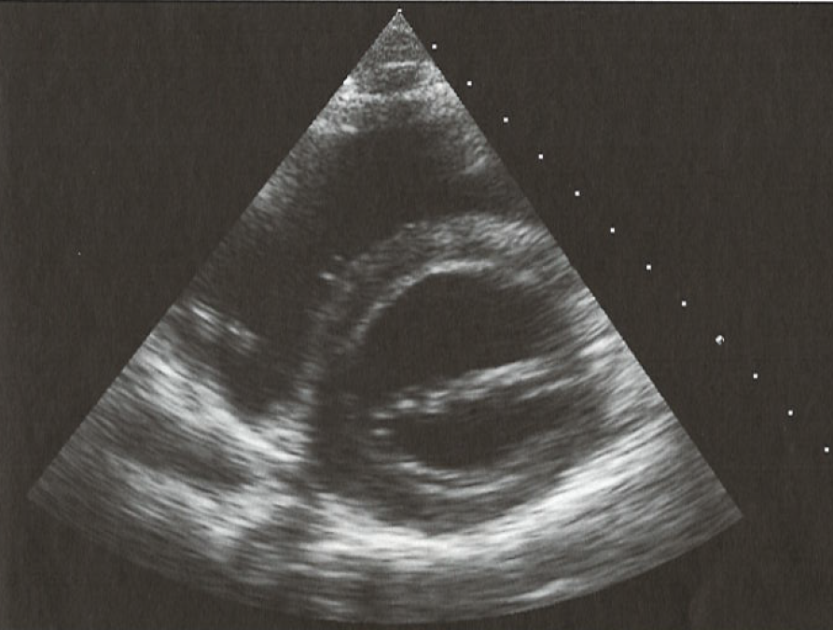
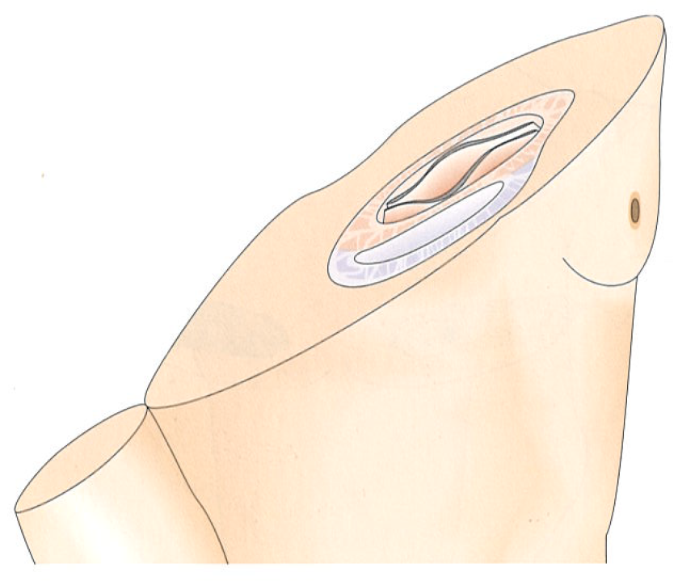
ECHO „windows“ and views. Parasternal window.
Short – axis view (Mitral valve)
anteromedial leaflet
posterolateral leaflet

Slide 10
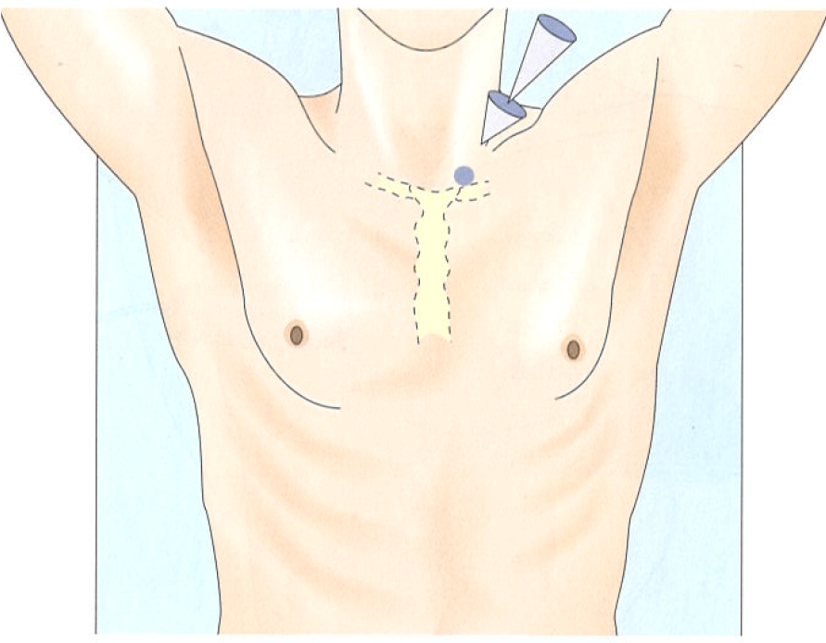
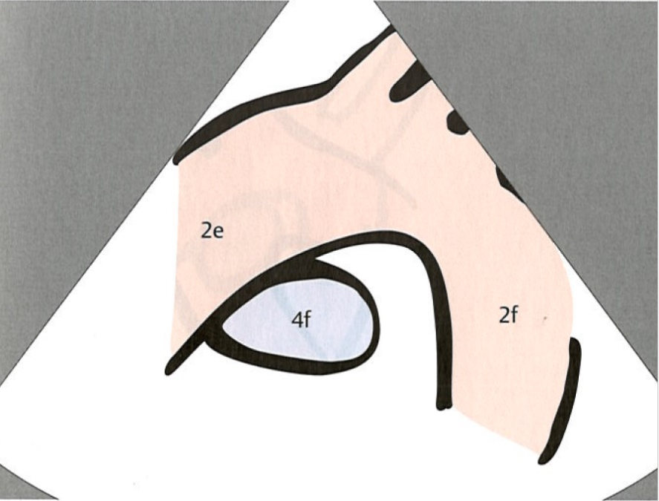
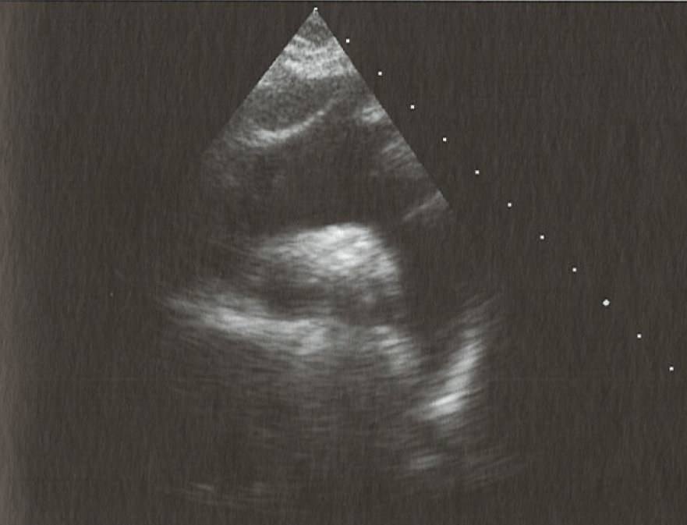
ECHO „windows“ and views. Suprasternal window.
2e – ascendent aorta
2f descendent aorta

Slide 11
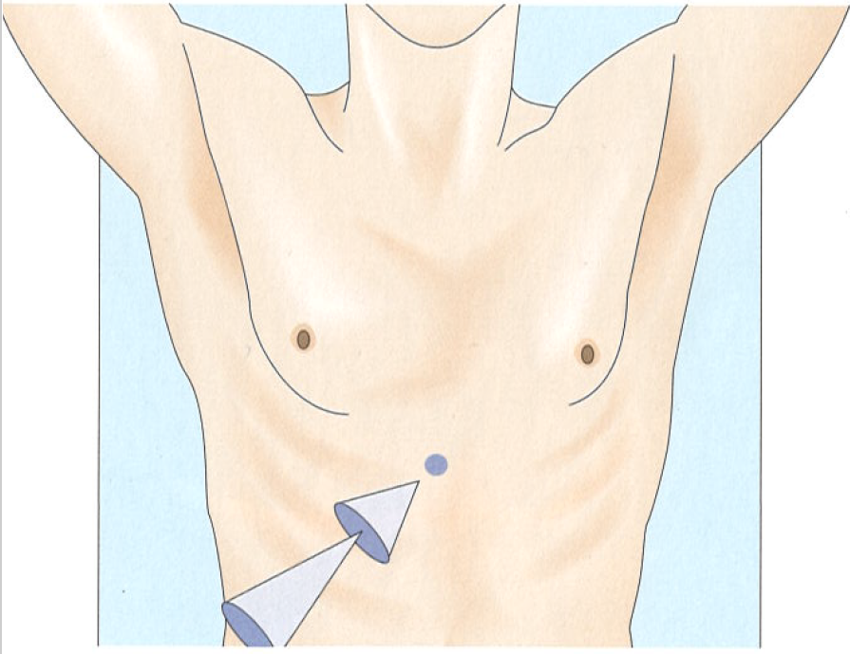
ECHO „windows“ and views. Subcostal window.

Slide 12
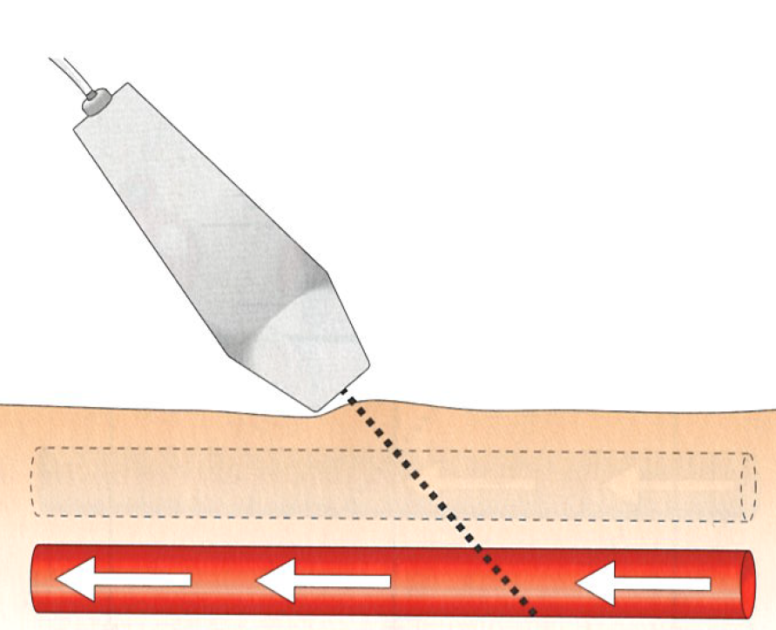
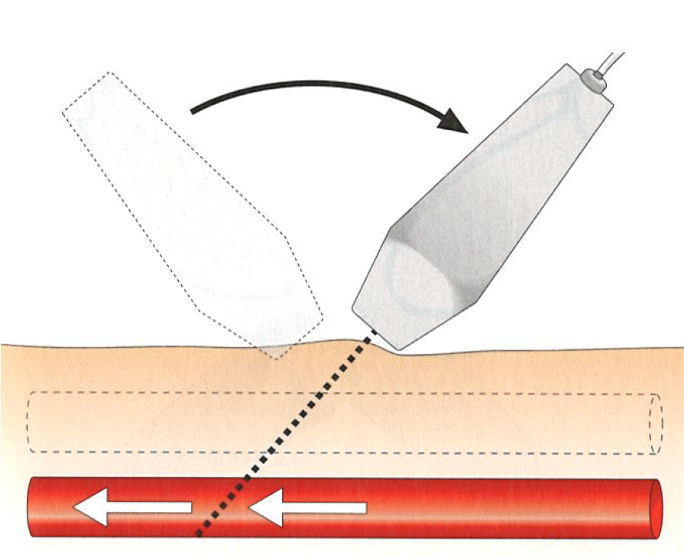


Probe position and slope

Slide 13
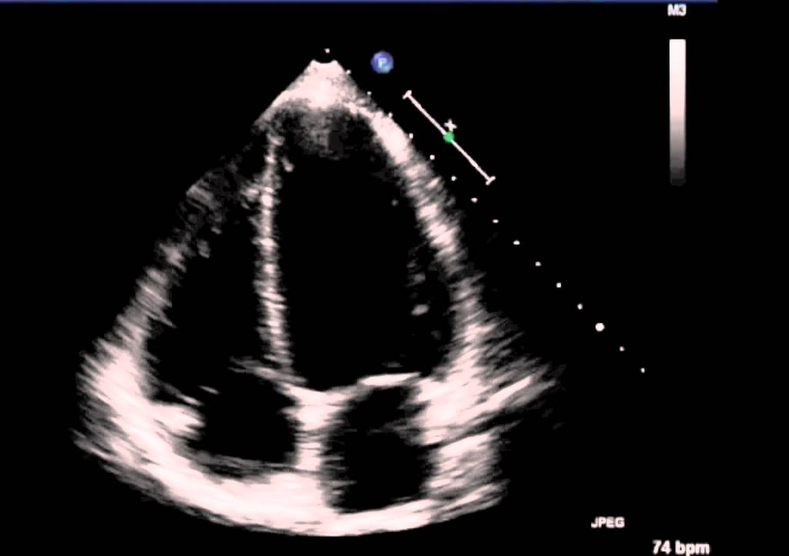
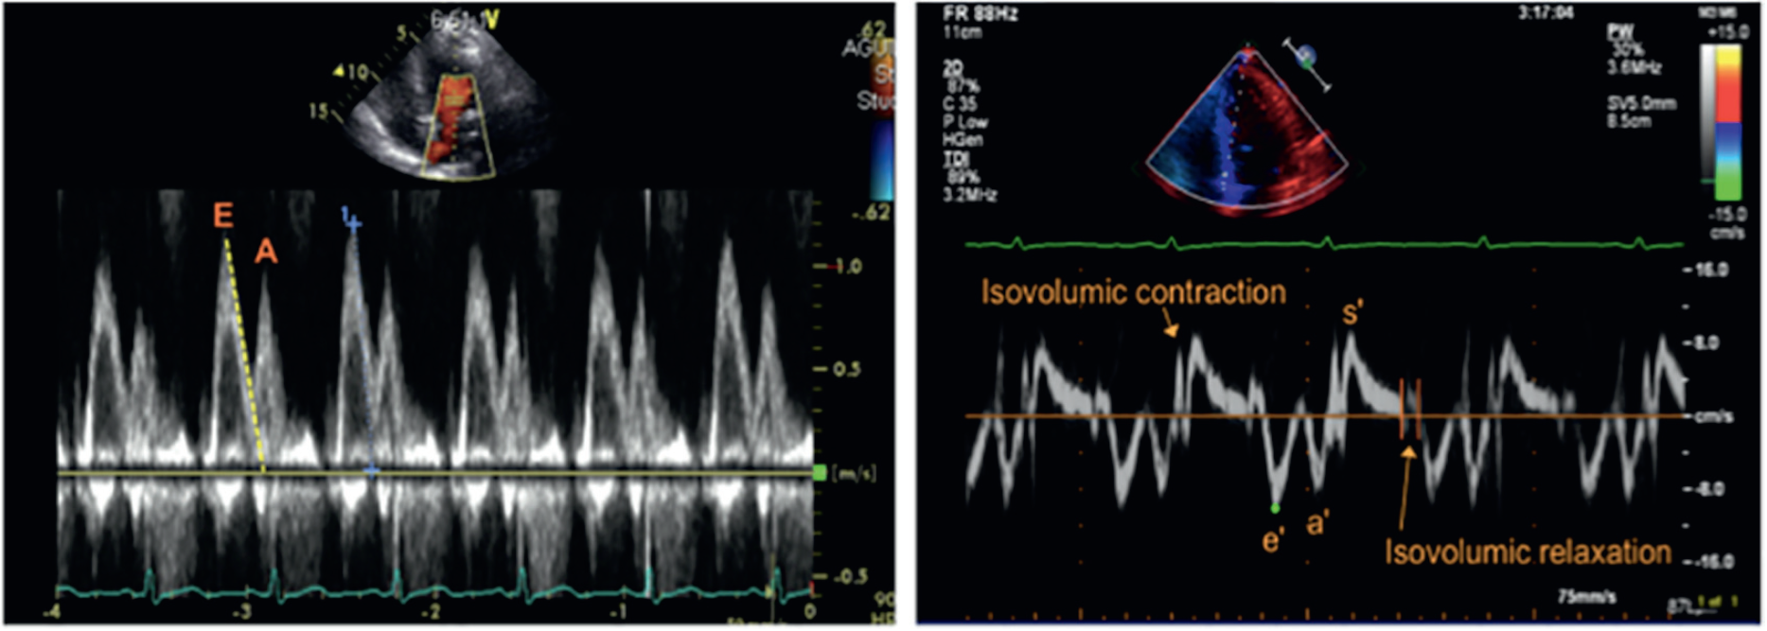
ECHO. Record.

