Slide 1
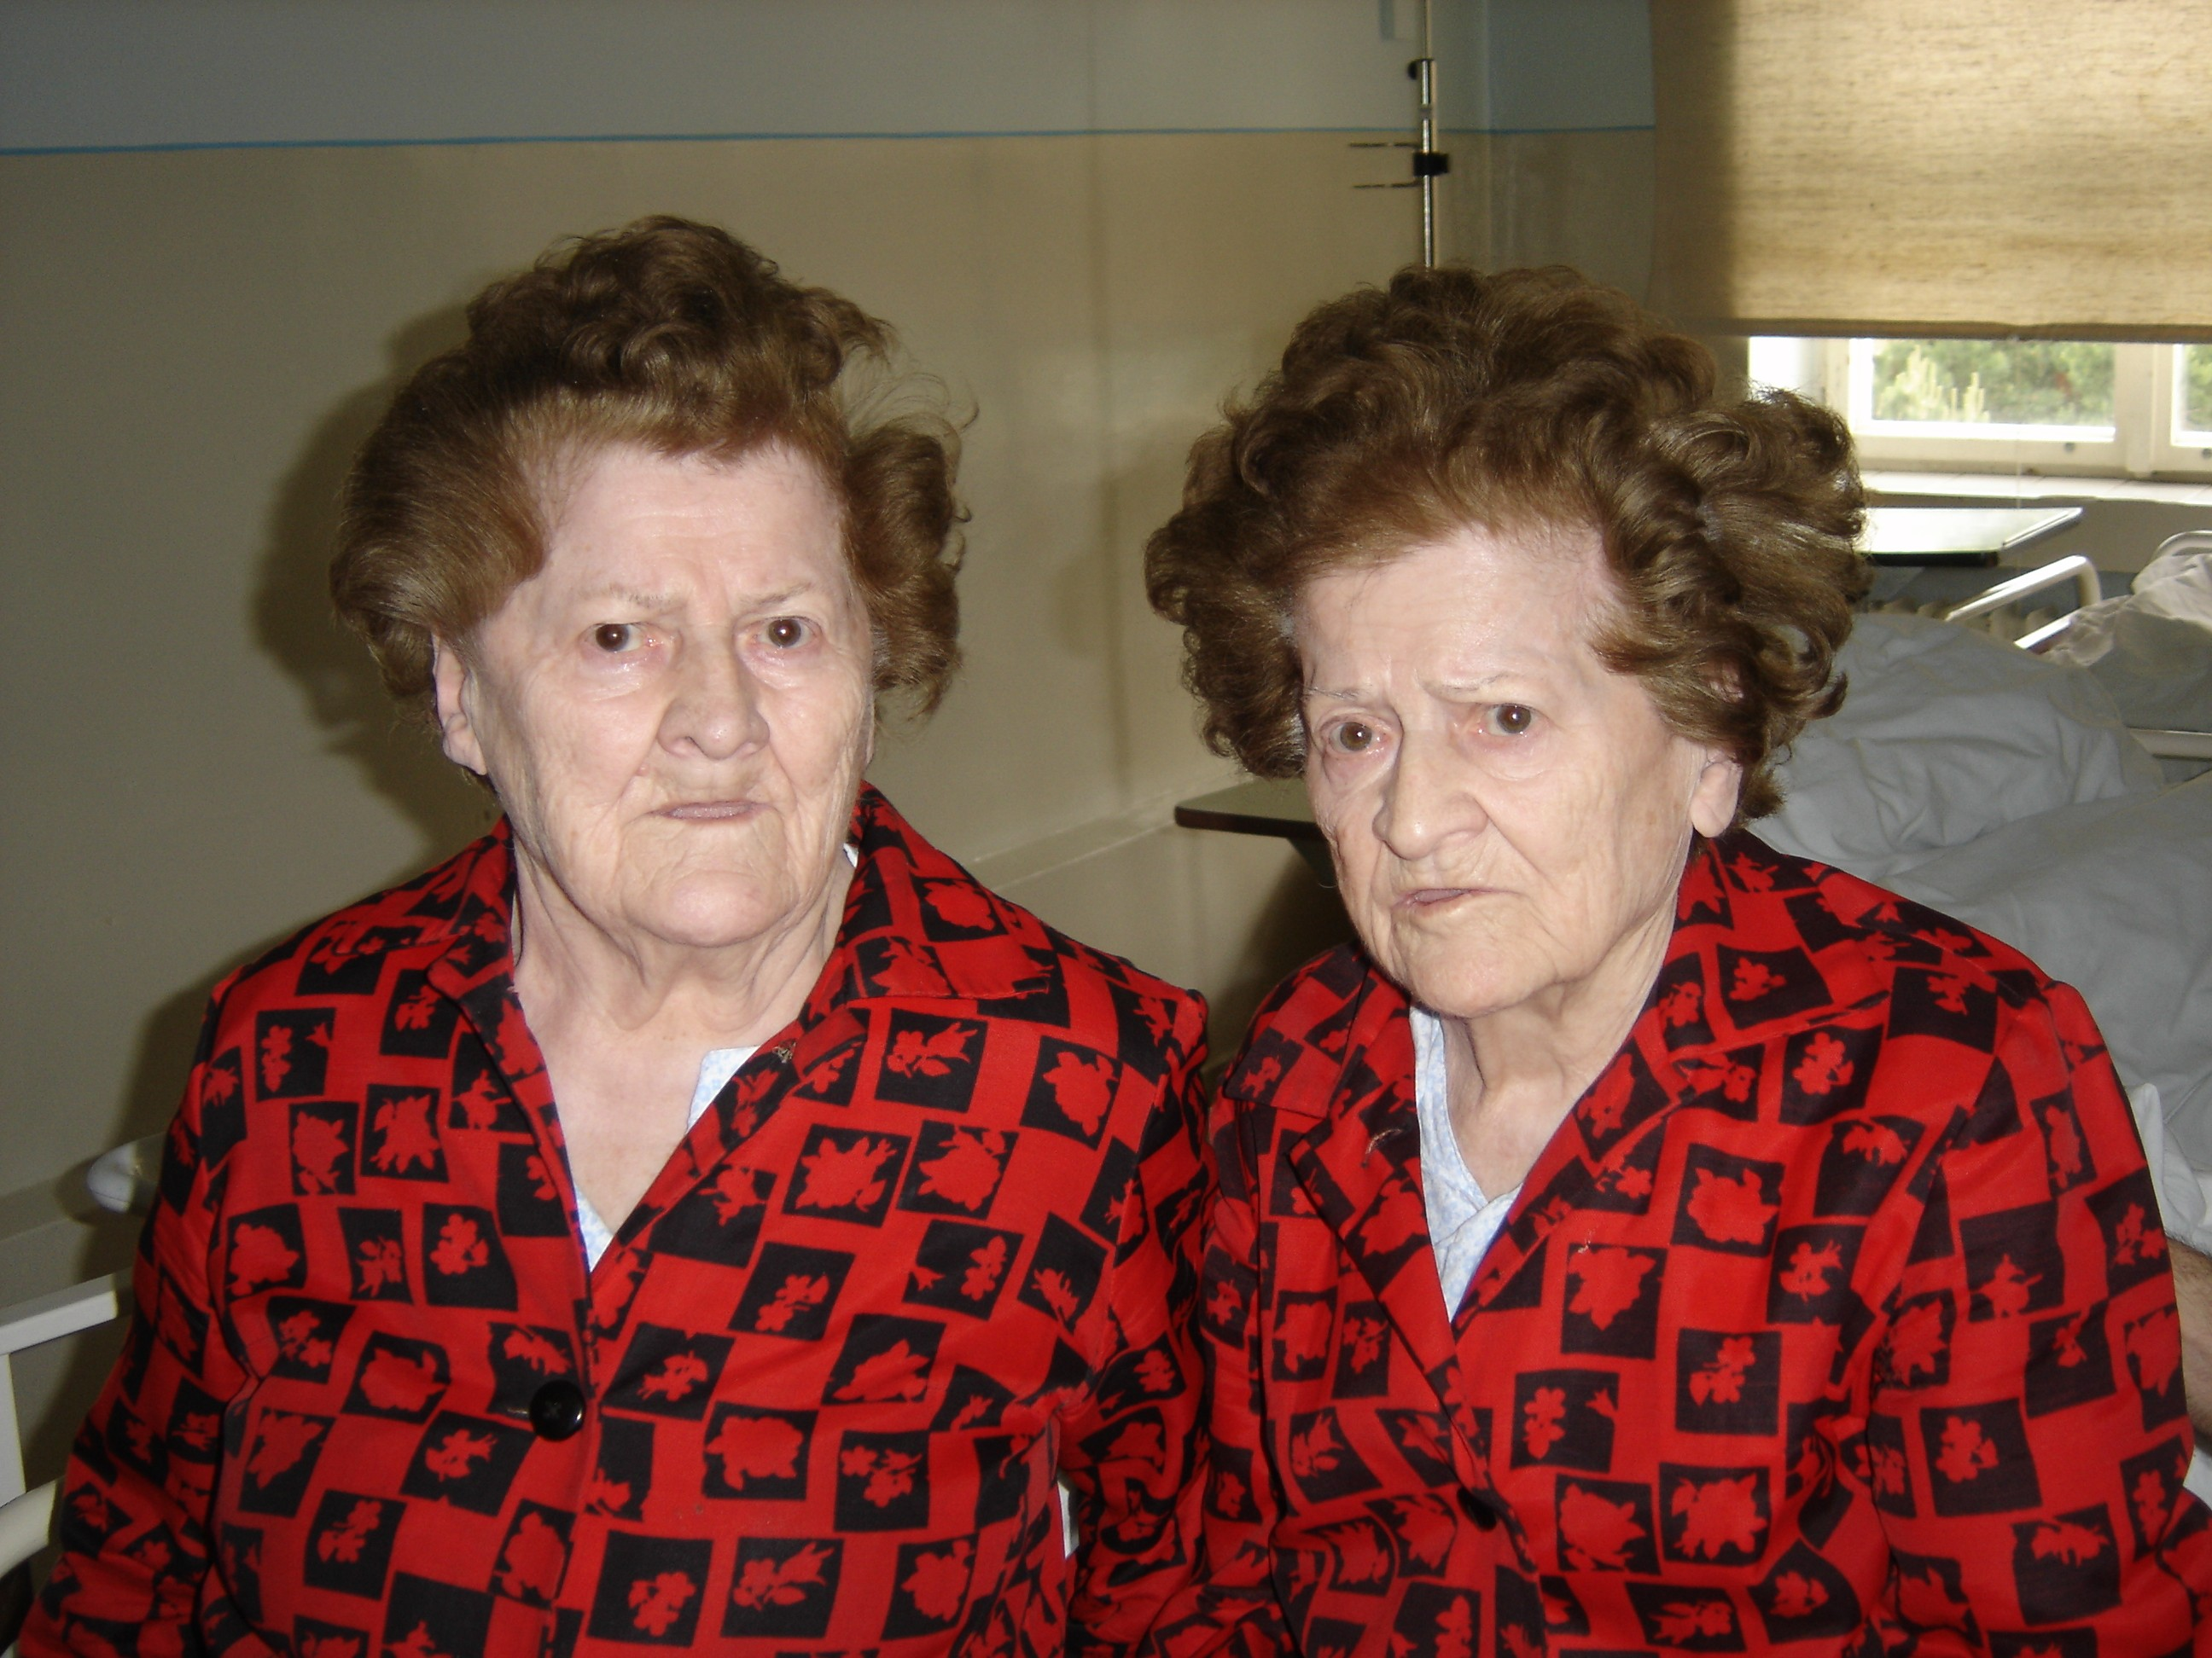
The basic principles of gerontology
The modern strategy of health support
and increasing of independence of seniors
Brno, October-November 2017

Slide 2
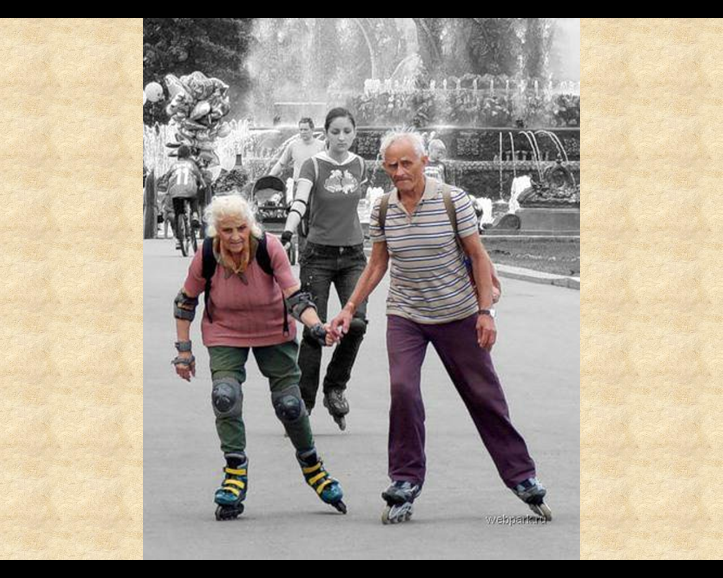
Gerontology
the body of knowledge on ageing, about the problems of aging people and life in old age

Slide 3
Gerontology subspecialties I
experimental gerontology – causes and ways of ageing, actually at the cellular and molecular level, neuropsychology of ageing
social gerontology – relationship between aging people and society, needs of elderly, demography, sociology, economy, law, urbanistics, architecture etc
clinical gerontology - geriatrics

Slide 4
Gerontology subspecialties II
geriatrics - summarizes and generalizes across all disciplines main topics of senior´s health and fuctional status, specific needs, specificities of appearance, symptoms, therapy, prevention and social context of diseases of old age

Slide 5
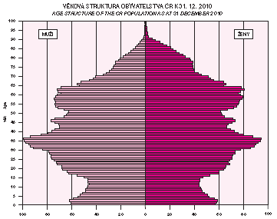
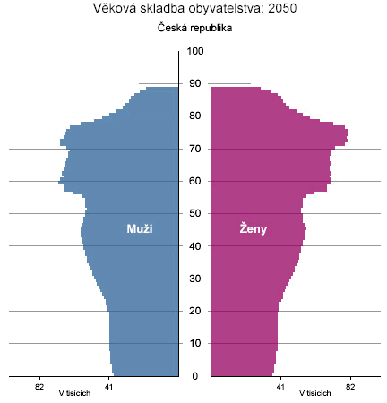
Expected changes of the population age-structure 2010-2050
*1960
*1975
*1990
*1960
*1975
*1990

Slide 6
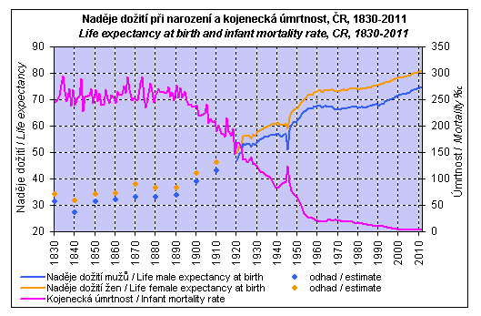
Life expectancy and infant mortality rate

Slide 7
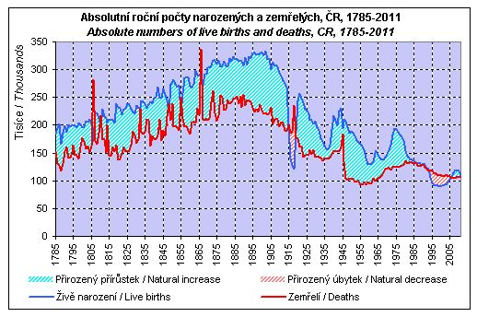
Absolute numbers of live births and deaths 1785-2011

Slide 8
Specific features of diseases in elderly
Risk of false diagnosis

Slide 9
Oligosymptomatology
expression of less typical symptoms peritonitis without defence musculaire
pneumonia without fever
cystitis with polakisuria, but without pain
tachyfibrilation only in hypothyreosis

Slide 10
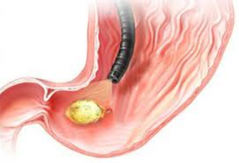
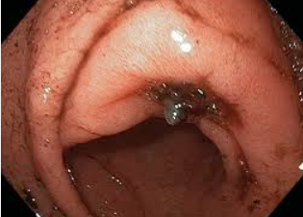
Microsymptomatology
uroinfection without fever
uncomplete inflammation symptomatology
myocardial infarction without typical stenocardia, but with chest tightness only
florid ulcer disease with dyspepsia, but without typical pain
inflammation leucocytosis absent

Slide 11
„Another organ cries“
current disease burden most frail organs
cardiac failure because of pneumonia
confusion caused by sepsis, urosepsis
stenocardia more expressed in anemia
TIA in anemia, cardiac failure, myocardial infarction

Slide 12
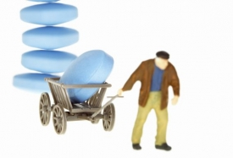
Polymorbidity
the number of chronic diseases increases with age
80% of patients above 80 years suffer from more than one chronic disease
diseases influence each other – more frequently negatively
polypragmasia, compliance, interaction
long term recovery
risk of imobilization

Slide 13

Glacier like symptom
apparent symptomatology is the little part of reality only
dyspnea in myocardial infarction only
confusion in cardiac failure
confusion in acute abdomen
dementia progression caused by chronic pain

Slide 14
Interdisciplinary problems
geriatric giants „4 I“
instability
cognitive disturbances
imobilization
incontinentia, skin integrity disorders

Slide 15
Specificities and pecularities of pharmacotherapy in elderly
Problem topics
Farmacokinetics
Compliance

Slide 16
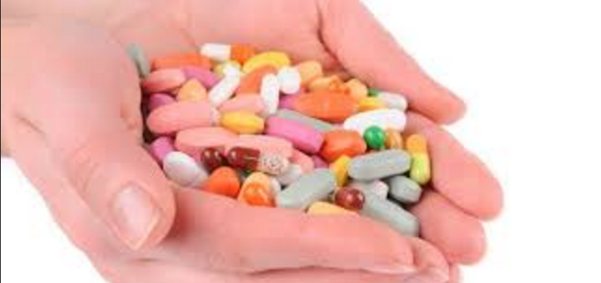
Problem topics
pharmacokinetics, pharmacodynamics
compliance
polymorbidity
polypragmasia
medications market
the patient's wishes
treatment coordination
„external“ influences

Slide 17
Farmakokinetics I
decrease of gastric acidity
decrease of gastric motility
reduced GIT blood flow
slower resorption

Slide 18
Farmacokinetics II
decreased distribution volume for hydrosolubile substantions
increased distribution volume for liposolubile substantions
decreased liver and kidney function
decreased albumin concentration

Slide 19
Compliance and its changes in elderly I
reciprocal association between compliance and number of medications used – 5 medications take exactly 33-44%, - 10 medications 10-20% only
influence of relatives and caregivers
dependence on specialised supervision

Slide 20
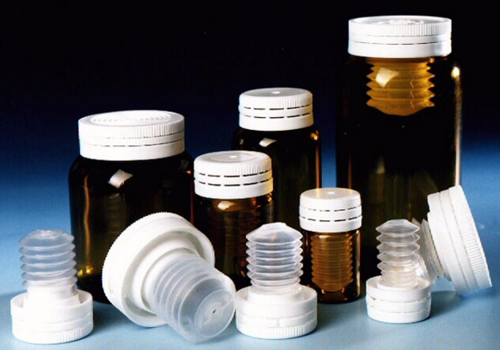
Compliance and its changes in elderly II
medicaton price influence
user´s comfort
medication shape and color
content of package leaflet

Slide 21
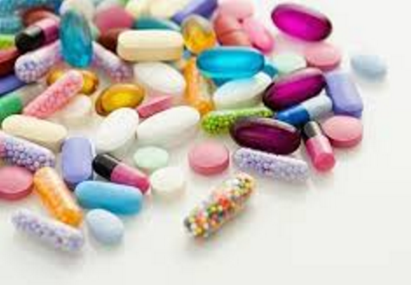
Polypragmasia? Polypharmacotherapy?
tackle fundamental problems
improve the quality of life
profylactic medications
number of medications limitation?
respecting of guidelines
unwanted symptoms induced by therapy express 24-28% patients, 90% of symptoms are predictable

Slide 22
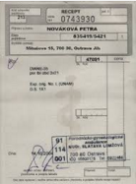
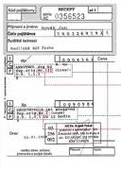
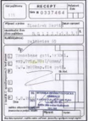
Therapy coordination problems
„gate keeping“x confidence in the knowledge of GP
„travelling“ around out-patient clinics
addition of recommended treatments
lack of communication between GPs and specialists
financial limitations of GPs and specialists
doubled generics

Slide 23
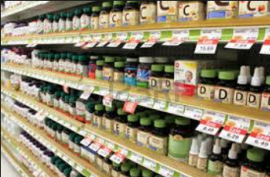
Medication at the market
many market names of the same generic substance
the elderly patient remembers the medication according to shape and colour
the influence of advertisement
the influence of friends or neighbors „me too“

Slide 24
Seniors and medications consumption
age group 60-75 years creates 15% of population
consums 33% prescription medications
consums 40% OTC medications

Slide 25
Creating the medication schedule
one coordinator
specialist´s recommendations
substantial medications
or to know or to consult

Slide 26
Ten rules for elderly prescription I
1. Define substantial problems to treat
2. Define treatment targets
3. Consider alternative methods including education and non pharmacologicla methods
4. Consider all risks and risk medications already taken
5. Optimal dosage “start low go slow”

Slide 27
Ten rules for elderly prescription II
6. Select the simpliest schedule
7. Consider the risk of cumulation in retarded medications
8. Prepare the table containing redommended medications and ask the patient about understanding
9. Ask the use of OTC or other substances
10. Consider the possibility to stop the taking of some medication

Slide 28
Non-pharmacological therapy
positive alternative to polypragmasia
regime measures – sleeping rhytm, to use the bed for sleeping only, regular day and week rhytm
reduction of harmful habits
change of eating habits – regular warm dishes, care for oral cavity and teeths

Slide 29
Comprehensive geriatric assessment

Slide 30
Comprehensive geriatric assessment (CGA)
personality
somatic health
functional status
psychical health
social context

Slide 31
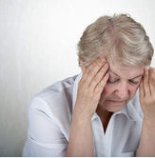
Personality
life situations
priorities and decisions – treat/not to treat, reanimate/not to reanimate, decisions in dementia
subjective quality of life

Slide 32
Somatic health
diseases – main diseases, other diaseases
functional burden of diseases
syndromological dg (imobilization, incontinentia …), hypotermie apod.)

Slide 33
Functional efficiency
stability and walking
performance and independence
physical condition
nutrition

Slide 34

Mental health
cognitive and fatic disorders and deliria – active screening and evaluation
affective disorders (depression) – active screening and evaluation
mental balance, maladaptation, the influence of psychosocial stressors

Slide 35
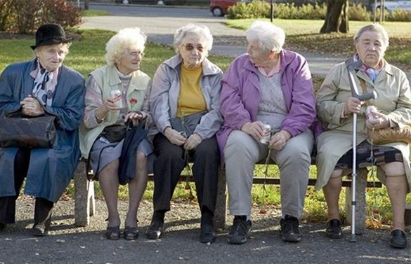
Social context
social roles and relationships (social network)
operation demands and safety of the home environment
social needs supplied or claimed služby

Slide 36
Evaluation of stability and walking disorders
basic neurological assessment
getting up from lying to a sitting position and from sitting position to standing
spontaneous standing
maneuvers in standing – Romberg, pull test, push test
spontaneous walking – 10m – base width, lenght of the step, fluidity of movement, start and stop, rotation, obstacles
maneuvers in walking – on heels, on tiptoes, with closed eyes, backwords, tandem walking

Slide 37

Possible pathologies
walking of width base with unstable destination
polyneuropathic walking – uncertainty, weakness of lower extremities
cerebellar walking – like ebrietas
choreatic walking
short step, stiffness
unability to start the step

Slide 38
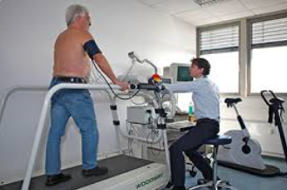
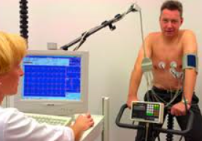
Evaluation of physical performance
anamnestic – comparison with contemporaries, with standards - ADL, IADL
stress tests – speed evaluation, observation of EKG, blood pressure, heart rate
selection of tests – izometric, izotonic, treadmill

Slide 39
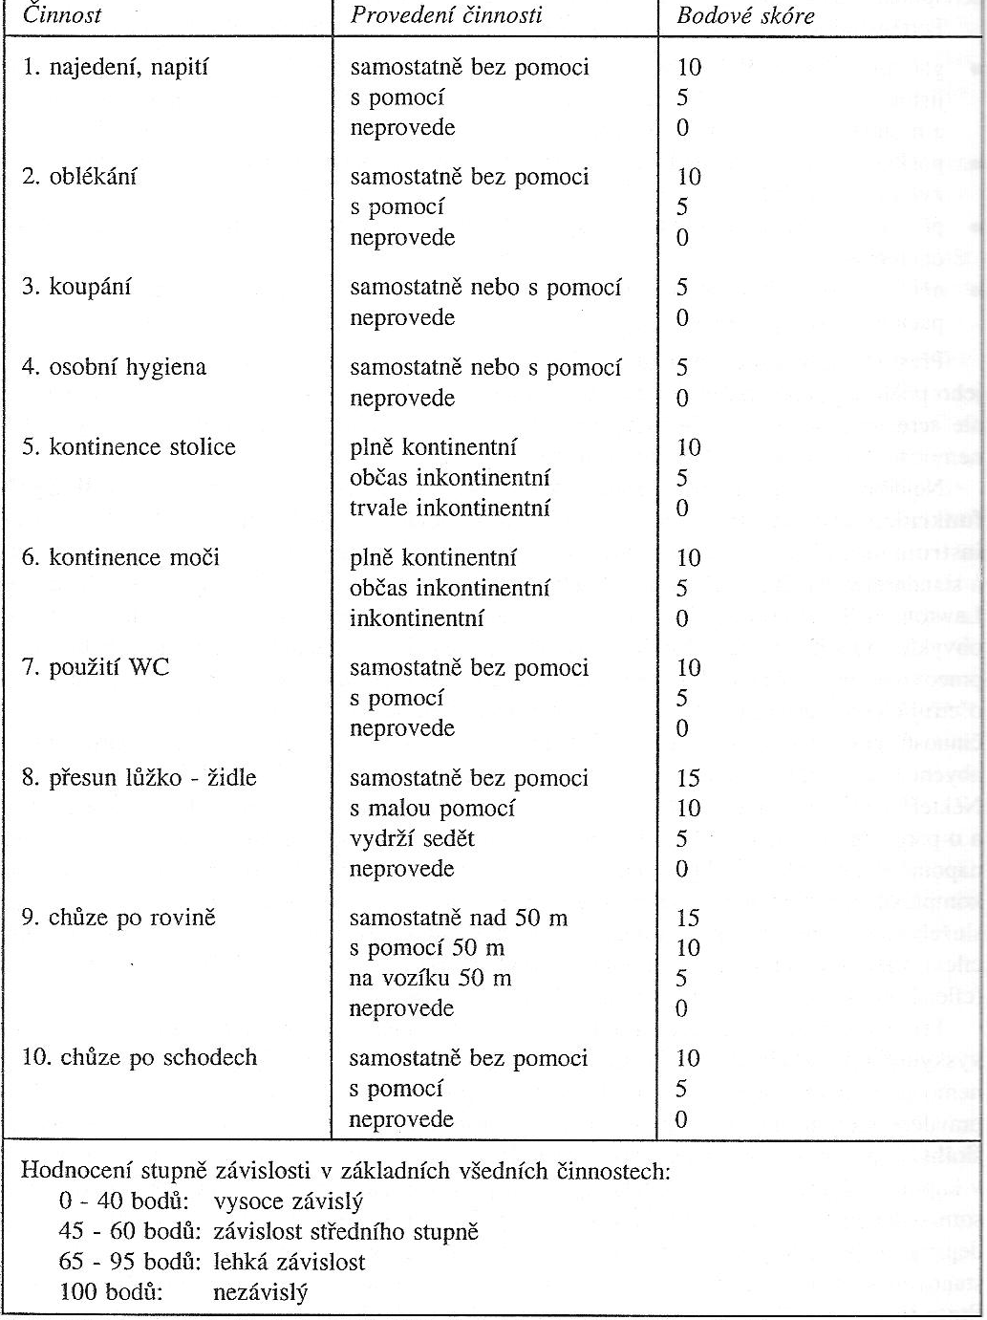
ADL

Slide 40
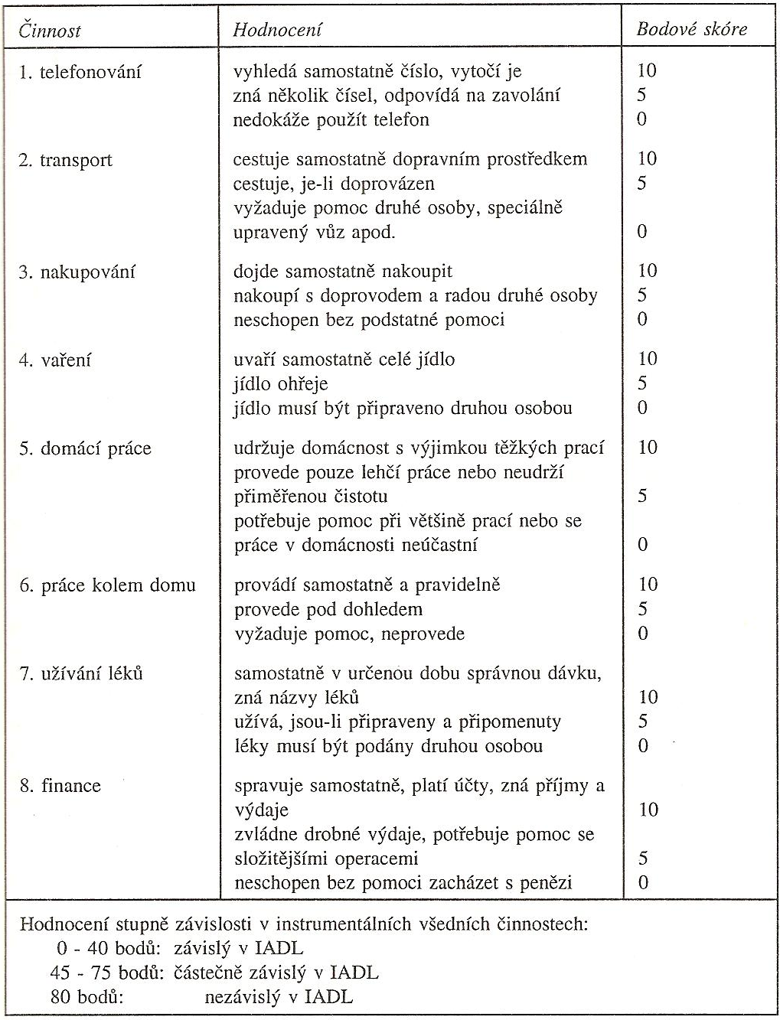
IADL

Slide 41
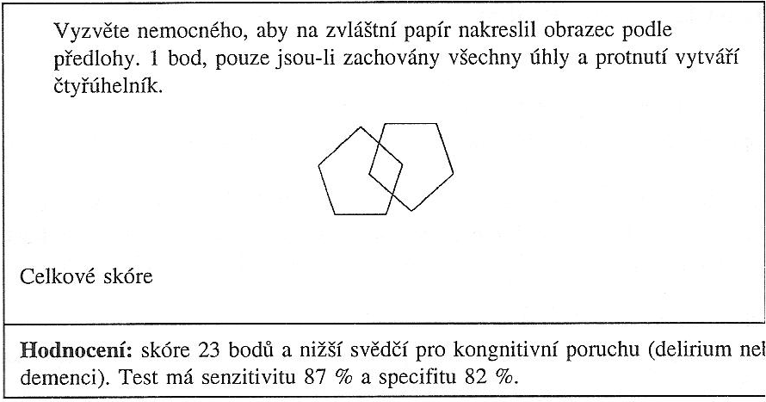
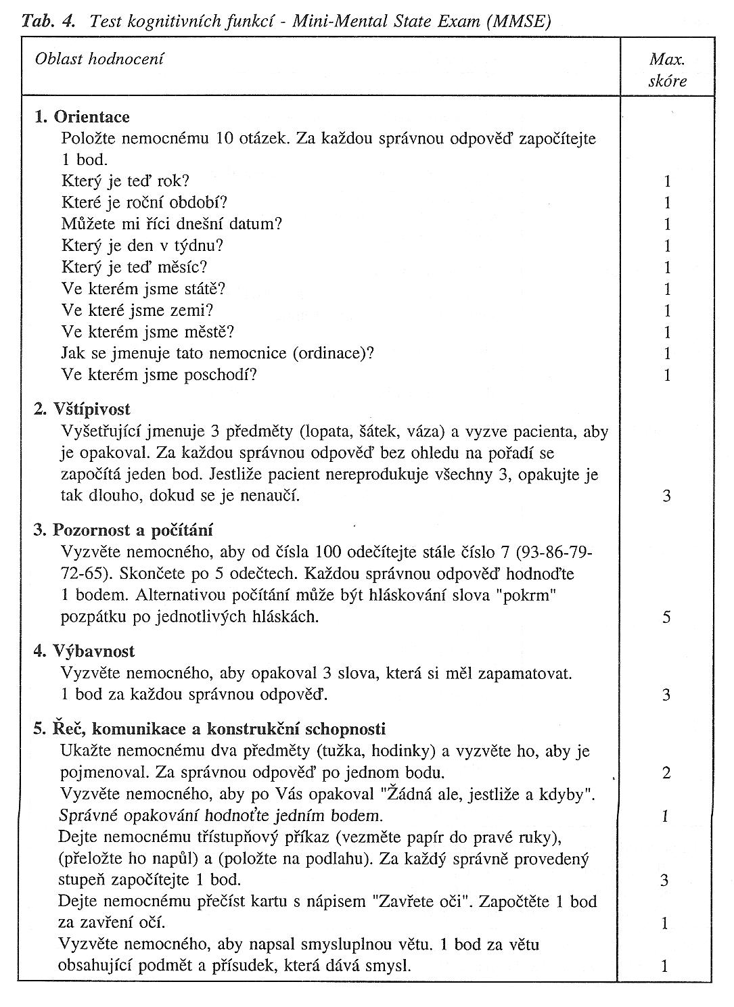
Cognitive performance evaluation
MMSE
Mini Mental State Examination 30-27-23-18-13
clock test
test connecting numbers and letters

Slide 42
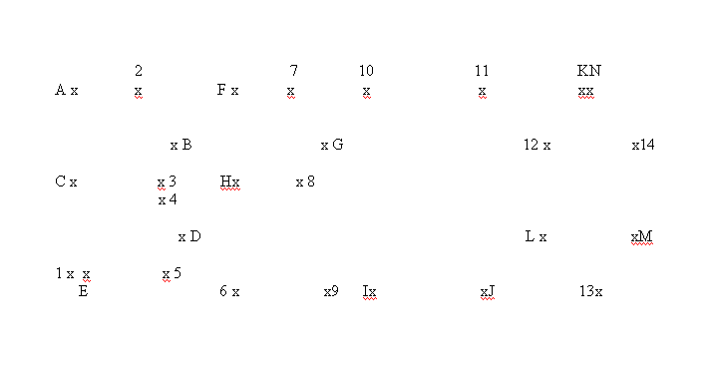
Connecting numbers and letters

Slide 43
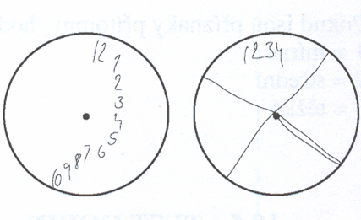
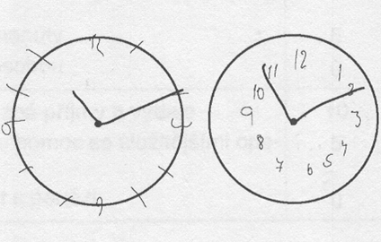
Clock test

Slide 44
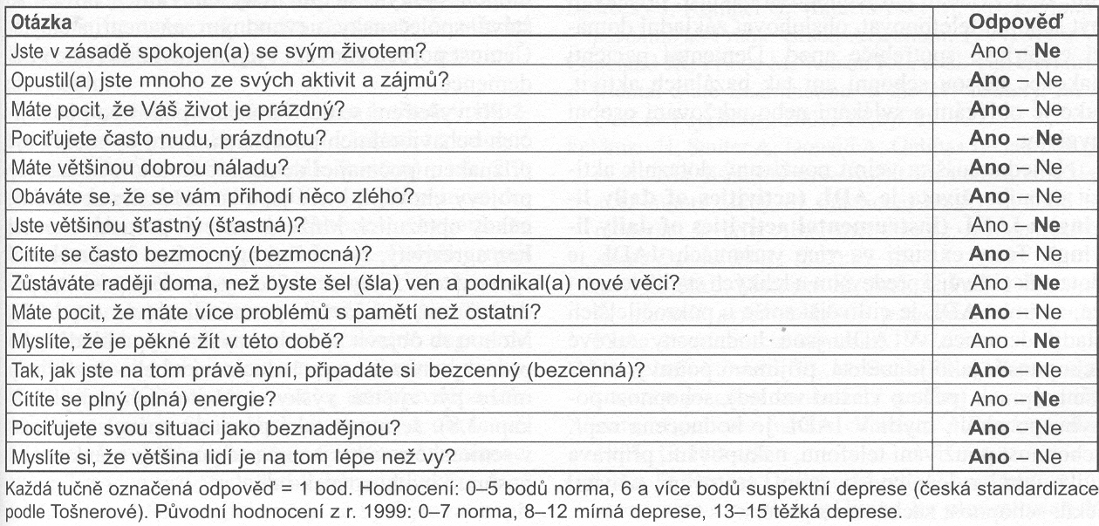
Depression evaluation – geriatric depression scale GDS
Škála deprese
podle Sheikha-Yesavage

Slide 45
MNA I
Poslední 3 měsíce ztráta chuti k jídlu, obtíže GIT, problémy se žvýkáním a polykáním 0 = těžké poruchy 1 = mírné 2 = bez potíží
Ztráta tělesné hmotnosti v posledním měsíci 0 = více než 3 kg 1 = neví 2 = v rozmezí 1-3kg 3 = stabilní hmotnost
Pohyblivost 0 = upoután na lůžko 1 = pohyb v okolí lůžka, po místnosti 3 = vychází ven
Psychický stres v posledních 3 měsících 0 = ano 2 = ne
Neuropsychické problémy 0 = těžká demence, deprese 1 = mírná demence 2 = žádné problémy
Index tělesné hmotnosti BMI 0 = < 19 1 = 19 – 21 2 = 21 – 23 3 = > 23
maximum – 14 bodů
norma - 12 bodů
riziko malnutrice - < 11 bodů

Slide 46
MNA II
Žije v domácnosti 0 = ne 1 = ano
Užívá více než 3 léky denně 0 = ne 1 = ano
Dekubity 0 = ano 1 = ne
Počet hlavních jídel denně 0 = 1 jídlo 1 = 2 jídla 2 = 3 jídla
Příjem proteinů 1x a vícekrát denně mléčné výrobky ano ne 2x a vícekrát denně vejce a luštěniny ano ne maso, ryby denně ano ne 0 = 0-1x ano 0,5 = 2x ano 1 = 3x ano
Ovoce a zelenina denně 0 = ne 1 = ano
Příjem tekutin 0 = méně než 3 šálky 0,5 = 3-5 šálků 1 = 5 a více šálků

Slide 47
MNA III
Způsob příjmu potravy 0 = s dopomocí 1 = samostatně s obtížemi 2 = samostatně bez problémů
Vlastní hodnocení stavu výživy 0 = podvyživený 1 = nehodnotí 2 = nemá nutriční problémy
Hodnocení vlastního zdravotního stavu ve srovnání s vrstevníky 0 = nedobrý 0,5 = neví 1 = stejně dobrý 2 = lepší
Střední obvod paže 0 = <21cm 0,5 = 21-22cm 1 = > 22cm
Obvod lýtka 0 = < 31 cm 1 = 31 cm a více
Zhodnocení – max. 14 bodů
Celkové hodnocení z obou částí tabulky – 30 bodů - maximum 17-23,5 bodů – riziko malnutrice < 17 bodů - malnutrice

Slide 48

Thank you for your attention

