Slide 1
Case report I
Chest pain
Monika Bratova

Slide 2
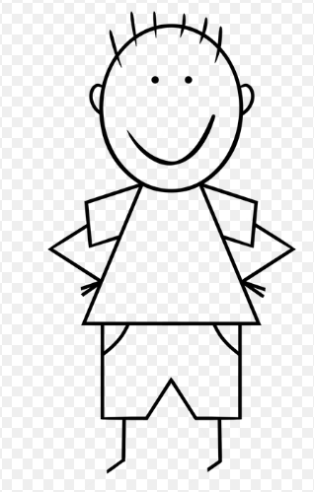
A young man, 35-year old, a long-time smoker, with no heath problems in the past, working as a storeman, grown up in a children´s home
Symptoms:
Admission due to acute left-sided chest pain. It started during a corporeal strain. He had no fever and cough.
Asthenic habitus, without neurological problems, a regular heart beat, without a heart murmur, alveolar breathing on the right side, , silent breathing above the left lung, abdomen without any resistance, down extremities without edema

Slide 3
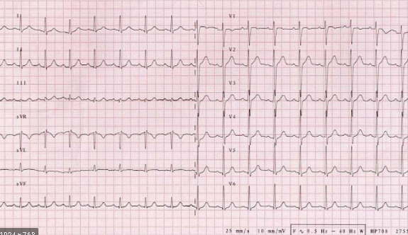
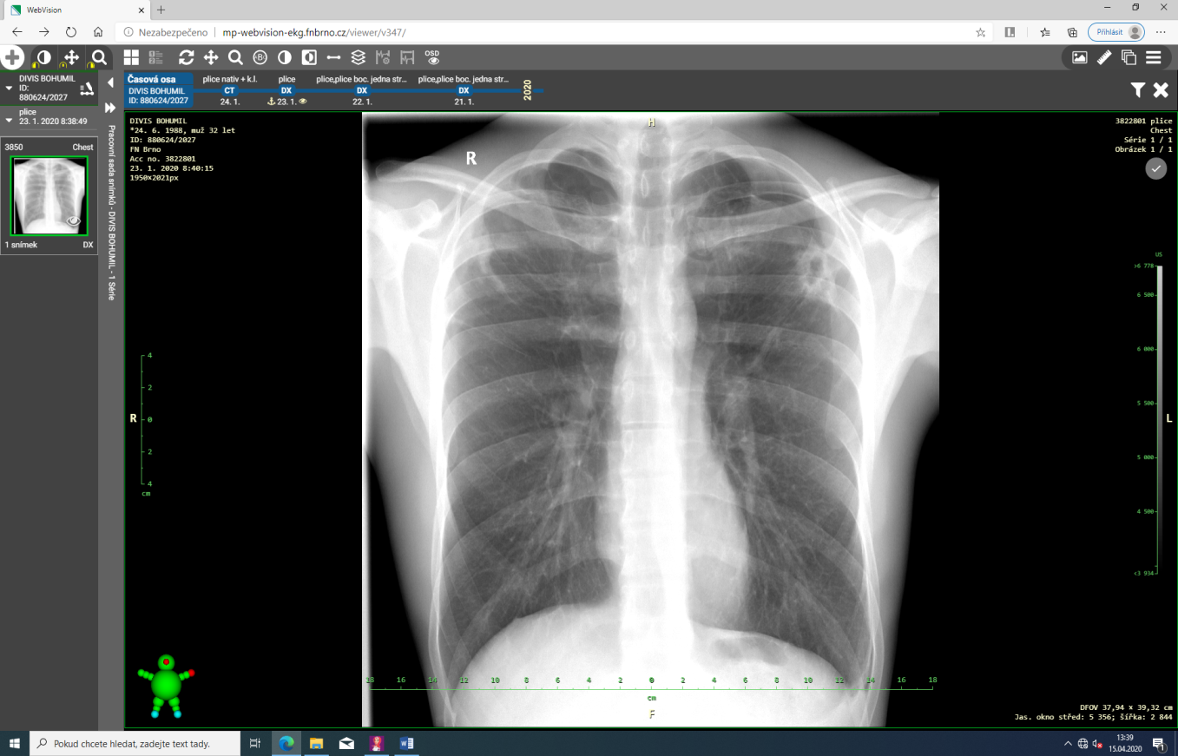
Saturation O2 98%
Which basic examination should be done?
Physiologic ECG
Blood account | Biochemistry
Leucocytes 10,2 | Urea 2,0
Erytrocytes 4,5 | Kreatinine 78
Hemoglobin 140 | Kalium 3,6
Trombocytes 250 | CRP 30,5

Slide 4

A left-sided borderline pneumothorax in apex up to 2 cm, a cavity in the left upper lobe, pleural changes in the right upper lobe
A secondary pneumothorax

Slide 5
A lung cancer:
PLUS – the X-ray finding, a history of smoking
CONTRA – young age, a bilateral finding
Tuberculosis:
PLUS – localization in the upper lobes, night sweatting, a social situation
CONTRA – no contact with TB in a patient´s history
What is a possible cause of the X-ray finding?
Vasculitis with lung demonstration:
PLUS – the X-ray finding,
CONTRA – the localization in the upper lobes, an absence of other symptoms (e.g. otolaryngological)
Aspergilosis:
PLUS – the X-ray finding of a cavity
PROTI – no immunosupresive status

Slide 6
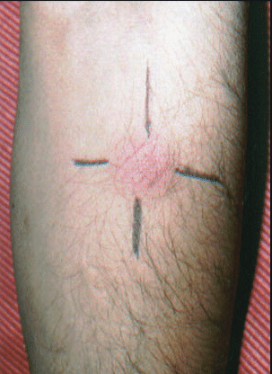
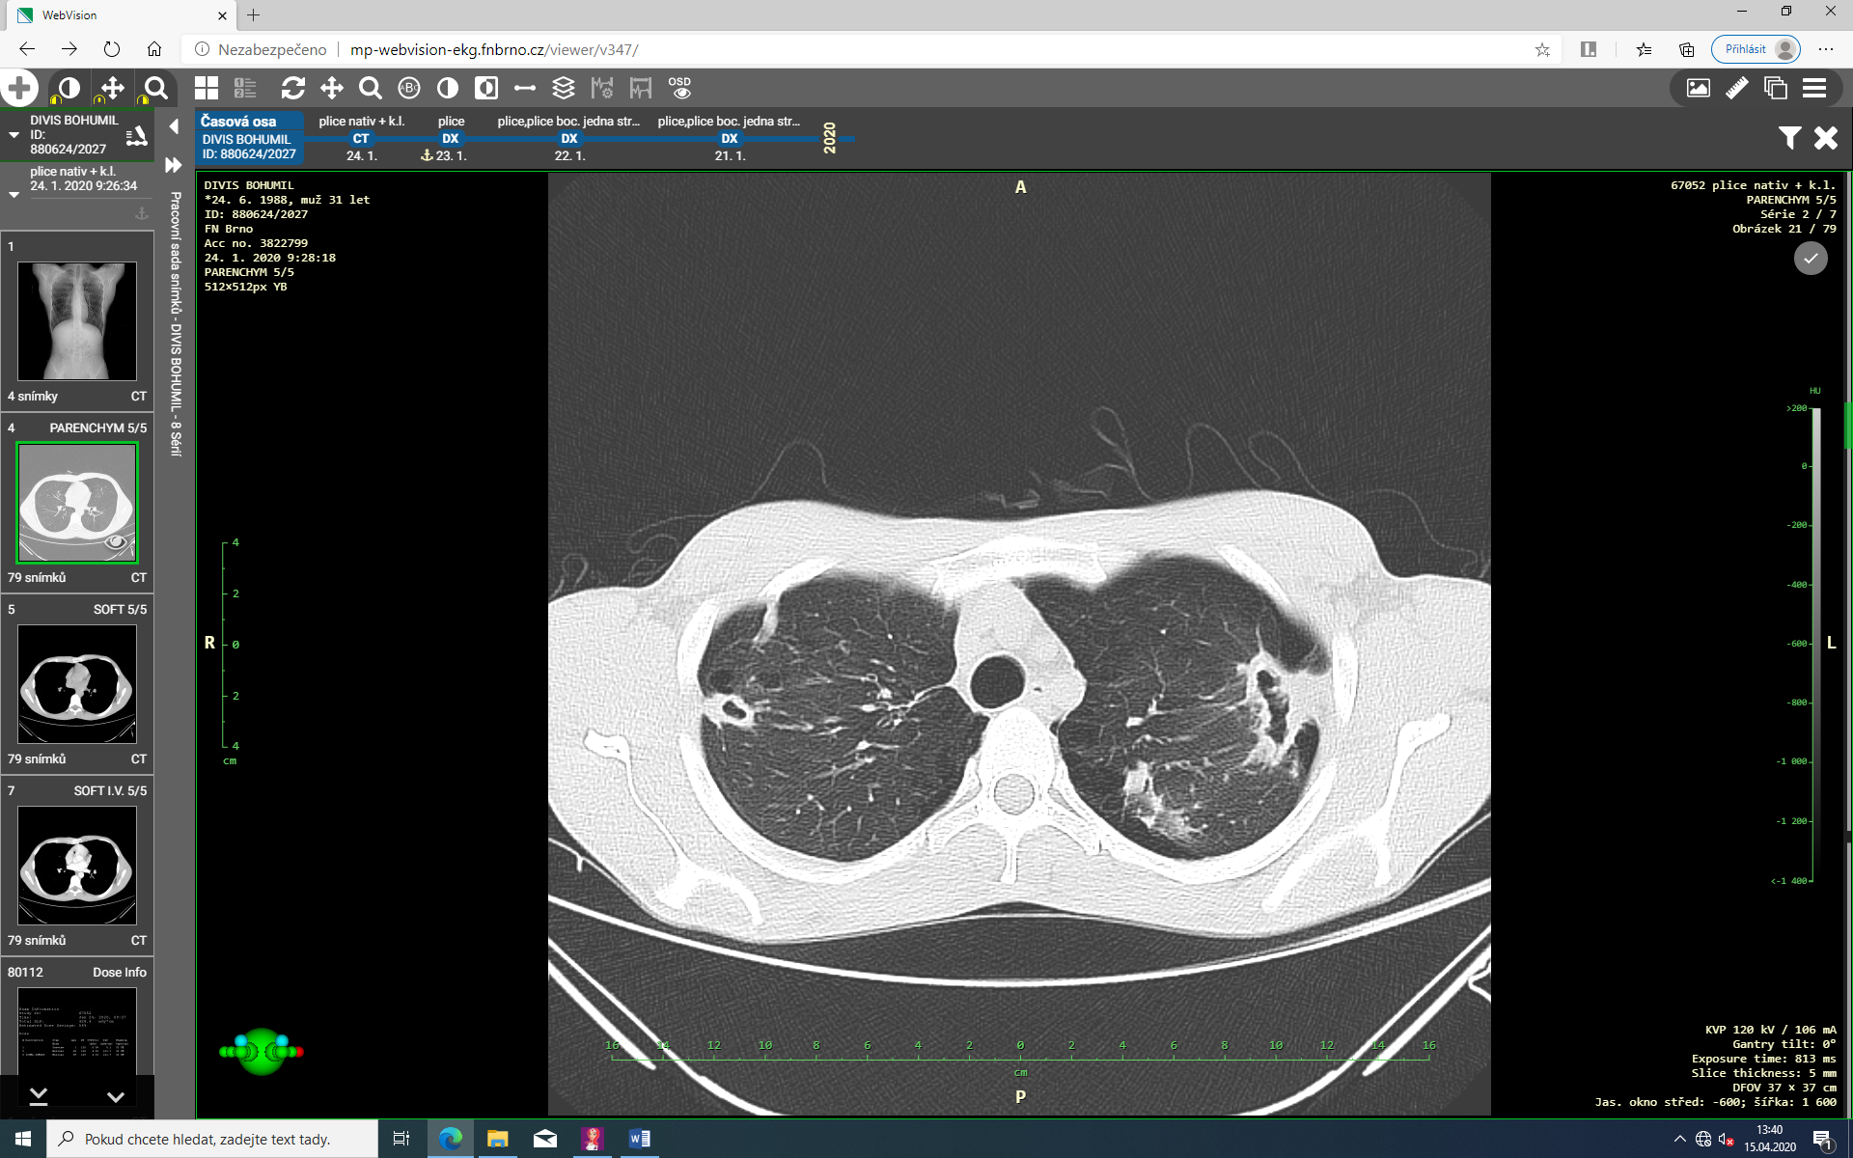
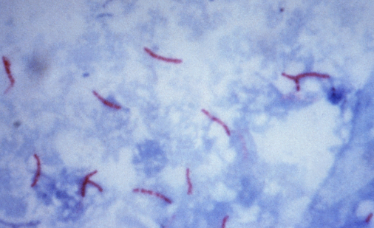
Autoantibodies (ANA, ANCA, ENA) negative, glucane negative
Mantoux II +15mm
CT scan: Cavities in both upper lobes, calcifications, pachypleural changes, no lympadenopathy, a left-sided pneumothorax.
Which further examination should be done?
A pozitive microscopy of sputum for M.tuberculosis

Slide 7
Conclusion
Diagnosis of tuberculosis
The antituberculose drug treament was started (RMP, PZA, INH, EMB), a hospital care for 6 months is needed
Contacts of patient were found and examined to exclude TB
Conservative treatment of the pneumothorax was indicated

