Slide 1
Case report II
Dyspnea
Monika Bratova

Slide 2
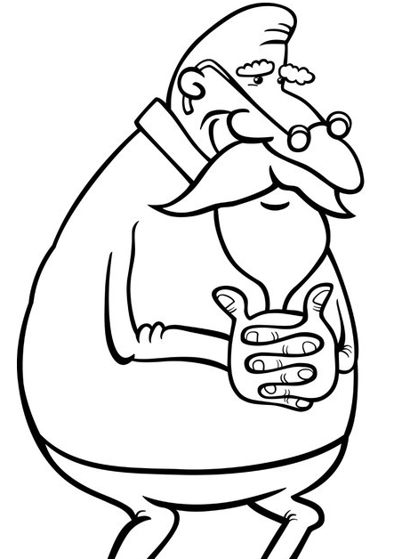
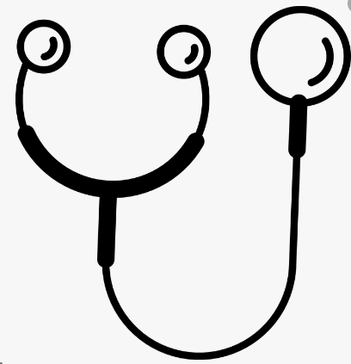
Man, 80-year old, a former smoker, with chronic heart failure, hypertension and chronic renal failure in the patients history, senior, a managing director in the past, a breader of budgerigars
Resting dyspnoeic, without neurological problems, a regular heart beat, a systolic heart murmur 2/6, breathing - crepitus bilaterally, abdomen without any resistance, down extremities with edema around ankels
Symptoms:
Addmision due to progressive dyspnea and dry cough. He has no fever or chest pain. Downh extremities are a bit tumid around ankles.

Slide 3
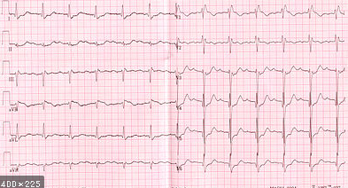
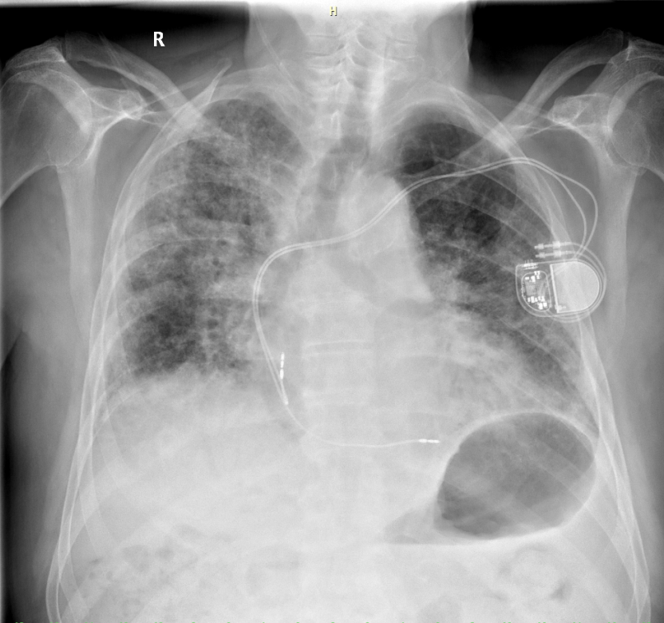
Saturation O2 80%
Which basic examination should be done?
Right bundle branch block
Blood account | Biochemistry
Leucocytes 8,5 | Urea 9,8
Erytrocytes 5,5 | Kreatinine 100
Hemoglobin 160 | Kalium 4,2
Trombocytes 220 | CRP 10
D dimer 0,45 | proBNP 600

Slide 4
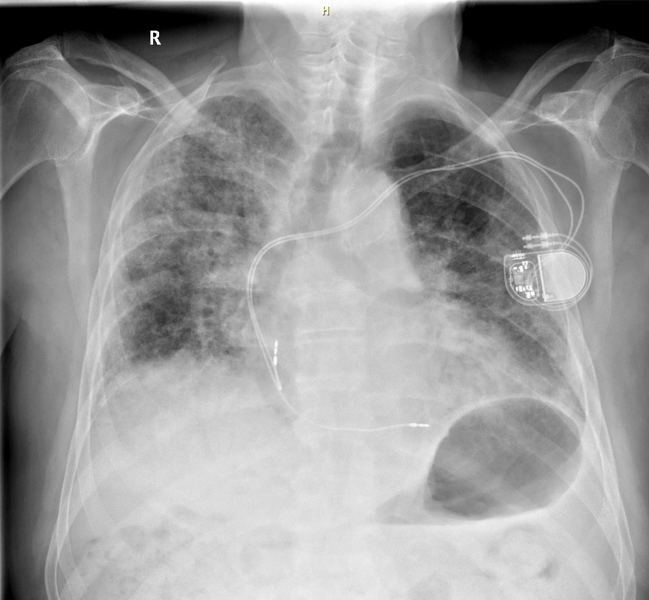
The infiltration of lungs bilaterally, a right lung is more affected, an enlargement
of the heart, a pacemaker on the left side, elektrodes in situ

Slide 5
Progression of a chronic heart failure:
PLUS – a chronic heart failure in the patients history, the X-ray finding
CONTRA – proBNP in an intermediate zone, minimal edema of down extremities, an atypical auscultation finding
Pneumonia:
PLUS – the X-ray finding, typical symptoms for pneumonia (a dyspnea, a cough)
CONTRA – a progressive course , negative CRP, no fever
What is a possible cause of the X-ray finding?
Intersticial fibrosis:
PLUS – the X-ray finding, a progressive dyspnea, the typical auscultation finding, dry cough, a breeding of budgerigars (in dif.ddg. exogenic alLergic alveolitis)
CONTRA – without any lung problems so far
Metastatic process:
PLUS – the X-ray finding, a bilateral distribution
CONTRA – without any oncological disease in the patient´s history,
no other symptoms of an oncological disease (anorexia, a weight lost)

Slide 6
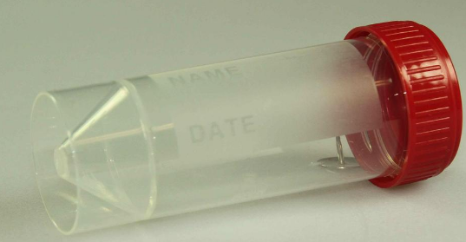
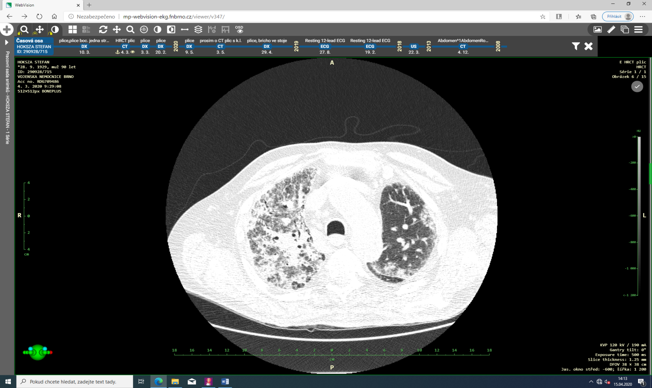
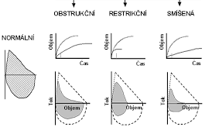
A panel of basic tumor markers and autoantibodies negative
CT scan: Intersticial changes typical of lung fibrosis, in peribronchial distribution, mainly on the right side, ground glass opacities, bronchiectasis, without honey combing. In dif.ddg. NSIP (non-specific intesticial fibrosis).
A negative cultivation of sputum
Which further examination should be done?

Slide 7
Conclusion
Diagnosis of the intersticial lung fibrosis
There was a partial effect of intravenous kortikosteroids
A specific anti-fibrotics are not indicated due to an advanced lung process and another type of lung fibrosis than UIP (usual intersticial fibrosis)
We managed domiciliary long-term oxygen treatment because of a severe hypoxemia

