Slide 1
Dyspnea
case reports
MUDr. Ondřej Venclíček
Department of Pulmonary Diseases and Tuberculosis - Institutions shared with the Faculty Hospital Brno - Adult Age Medicine - Faculty of Medicine

Slide 2
Three patients who suffer from shortness of breath have met in the waiting room:
Go through all three patients using the inserted hyperlinks. It is possible to return from each screen to the previous one.
Mr. P.
Mr. D.
Mrs. H.
Conclusion

Slide 3
Mr. P., born 1949
Anamnesis
Physical exam
Laboratory findings
Imaging
Functional examination of the lungs
Diagnosis
Therapy
Back to the waiting room

Slide 4
Anamnesis
Patient brought by ambulance for shortness of breath, fever and hemoptysis
recurrent thrombophlebitis of lower extremities - warfarin since 2010, hypertension, hypercholesterolemia, susp. Chronic obstructive pulmonary disease - not yet treated
Works as electrician
Treated with tenaxum (antihypertensive medication), torvacard (statin), warfarin
without allergies
Smoker – 20 cigarettes per day from 1965 to 2012 (47 packyears)
Back to Mr. P.

Slide 5
Physical exam
Lucid, oriented, cooperating, neurologically normal, febrile, regular heart action, dyspnea even with minimal exertion (during speech). Objectified hemoptysis - a tablespoon of fresh blood coughed into a handkerchief. Quiet breathing with discrete spastic auscultation finding bilaterally. Abdomen without pathological finding, extremities without swelling, without signs of inflammation, plantar sign negative, Homans sign negative
O2 Saturation 84%, blood pressure 130/80mmHg, puls 75‘ reg., body temperature 38°C, weight 85kg, height 179cm.
Back to Mr. P.

Slide 6
Laboratory findings
CRP 100, leukocytes 14 tis., hemoglobin 189, hematocrit 0,46
CRP and leukocytes are markers of inflammation that our patient seems to have. But why is hemoglobin so high? It is a consequence of adaptation to chronic hypoxemia - a secondary polyglobulia in COPD patient.
Back to Mr. P.

Slide 7
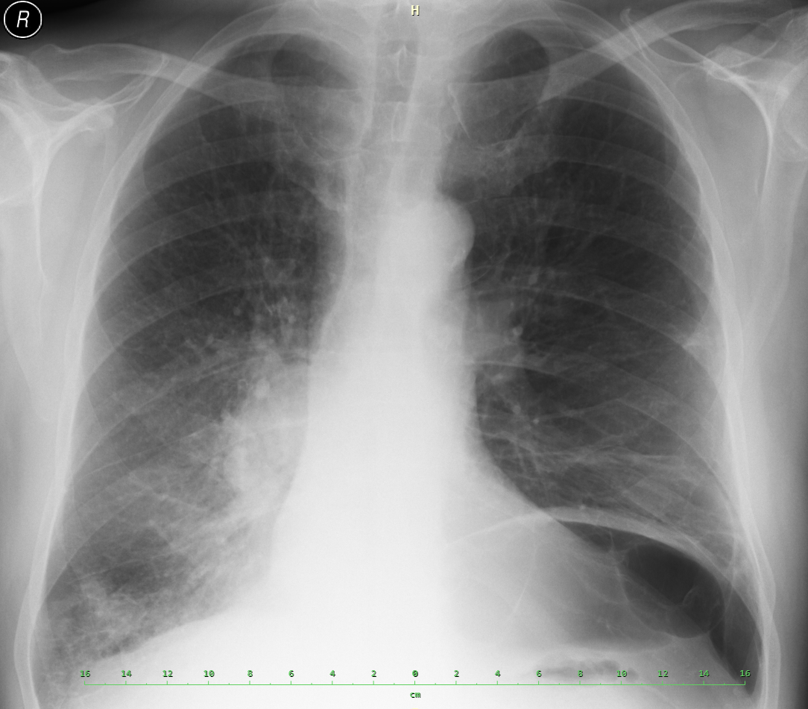
What do we actually see on the chest skiagram?
There are signs of emphysema
The skiagram shows tumor
The skiagram shows tumor, emphysema, and inflammatory infiltration
Back to Mr. P.

Slide 8
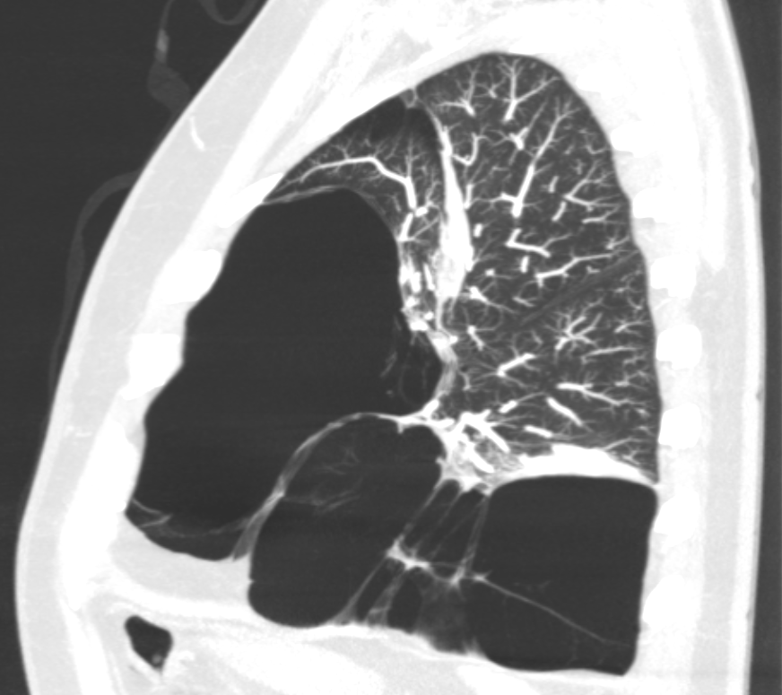
There really are signs of emphysema present. The emphysematous bulla is marked blue. Actual extent of the bulla was shown by CT of the chest.
Back to imaging

Slide 9
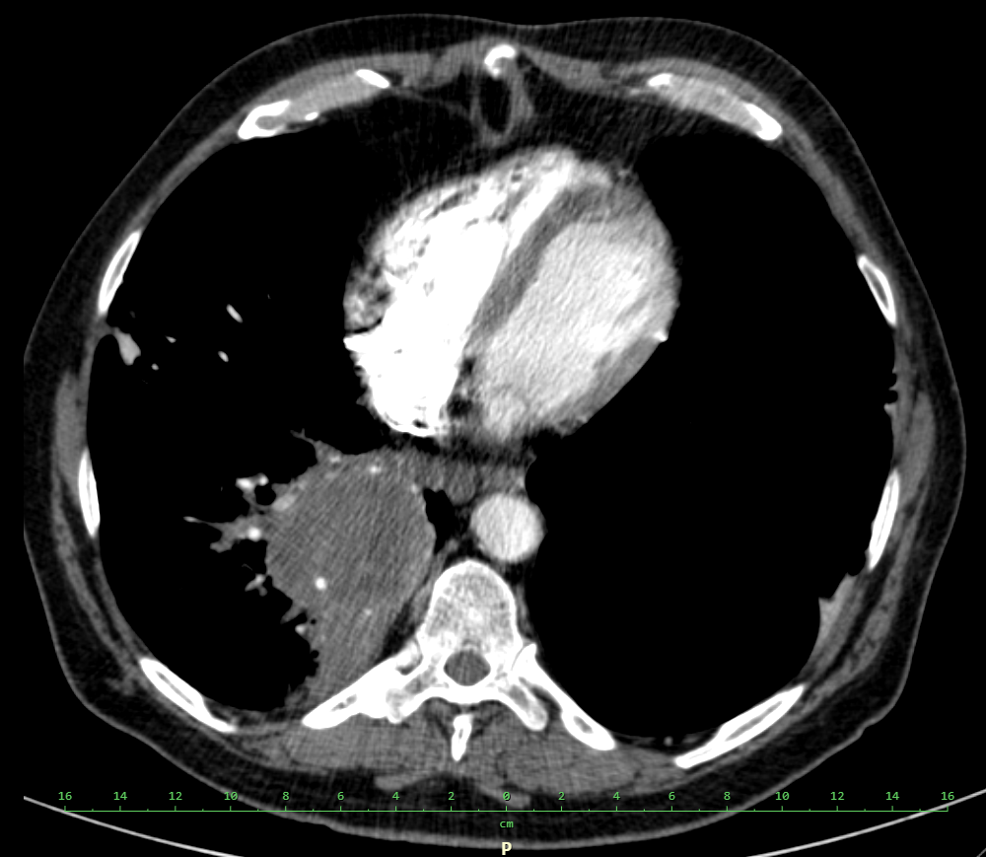
The picture also shows infiltration of tumor etiology. It is better seen on a CT of the chest, which was done later.
Back to imaging

Slide 10
The skiagram of Mr. P.'s chest is rich in findings.
In correlation with other examinations and findings, we can say in retrospect that these were the following pathologies:
tumor
inflamation
Emphysematous bulla
Back to imaging

Slide 11
Functional examination of the lungs
Since the patient suffers from dyspnea, it would be useful to know more about how the lungs manage their function. Therefore, we will perform:
Complete functional examination of the lungs (spirometry, plethysmography, diffusion, arterial blood gases)
examination of arterial blood gases only
Back to Mr. P.

Slide 12
Complete functional examination
The patient was unable to undergo complete functional examination of the lungs (spirometry, plethysmography, diffusion) due to severe dyspnea, and with regard to hemoptysis it would not be appropriate to perform examinations requiring forced breathing maneuvers - hemoptysis could worsen with fatal consequences.
Back to functional examination

Slide 13
Examination of blood gasses
In this case, we were satisfied with the examination of arterial blood gases: pH: 7.391, pCO2: 6.82, pO2: 6.0, HCO3: 31.1, SO2: 79.4% - hypercapnic-hypoxemic respiratory insufficiency, thanks to compensatory mechanisms so far without respiratory acidosis. Finding compatible with a diagnosis of chronic obstructive pulmonary disease.
Back to functional examination

Slide 14
Diagnosis
From the performed examinations, we found out that the cause of Mr. P.'s problems is the exacerbation of untreated chronic obstructive pulmonary disease (COPD), which arose on the basis of ongoing pneumonia, which developed in the tumor-affected lung.
In this case, hemoptysis is a symptom of lung cancer, hemostatics were used with good effect in medication, and we also know that we will treat exacerbations of COPD and pneumonia. Staging chest CT revealed a locally advanced, inoperable tumor, without distant metastases (T4N2M0, clinical stage IIIB). What do we do to obtain a morphological diagnosis of a tumor?
A. send the patient for bronchoscopy
B. send the patient for resection of the affected lung
C. take oncomarkers
Back to Mr. P.

Slide 15
Bronchoscopy
In this case, the right option. The least invasive procedure that provided the diagnosis. Direct and indirect signs of tumor in the right joint bronchus have been described bronchoscopically. From a sample taken from pathological endobronchial tissue it was possible to establish a morphological diagnosis - squamous carcinoma.
Note: in 2011 only chemotherapy was available within the pharmacotherapy of squamous cell carcinoma, today (in 2020) the obtained tissue would be further examined for markers that predict a probability of immunotherapy treatment succes.
Back to diagnosis

Slide 16
Surgical option
We always try to obtain the diagnosis with the least invasive procedure, in this case bronchoscopy.
Note: Due to the fact that according to CT of the chest it is an inoperable tumor, curative surgical treatment is not possible in this case. Even if the finding was operable in terms of local progression and metastatic impairment, our patient has such a compromised ventilation reserve due to COPD with emphysema, that he would not withstand resection of any part of lung tissue.
Back to diagnosis

Slide 17
Oncomarkers
Oncomarkers are not specific enough to give us a clear diagnosis, but they are suitable for monitoring the development of the disease. Therefore, it is advisable to take them at the beginning of lung cancer treatment to determine the baseline values. When monitoring lung tumors, we use CEA and CYFRA in non-small cell lung cancer (NSCLC) and proGRP in small cell lung cancer (SCLC).
Back to diagnosis

Slide 18
Therapy
Treatment of pneumonia with a broad-spectrum antibiotic (amoxicillin-clavulonate) and complex bronchodilator treatment of exacerbation of COPD (inhaled parasympatholytic, inhaled ß-sympathomimetic, corticoids, aminophylline), hemostatic therapy of hemoptysis were started immediately.
Mr. P. successfully went through the therapy of pneumonia and exacerbation of COPD and got into a condition in which he was able to undergo bronchoscopy and oncological treatment. Performance status was evaluated as 1 after the cessation of acute problems.
After obtaining a morphological diagnosis, chemotherapy of squamous cell carcinoma consisting of vinorelbine + platinum derivative was planned.
However, the night before the planned administration of chemotherapy, despite the hemostatik therapy, there was a recurrence of hemoptysis and the patient died because of terminal hemoptoe.
Back to the waiting room

Slide 19
Mr. D., born 1963
Anamnesis
Physical and laboratory examination
Imaging
Functional examination of the lungs
Diagnosis and therapy
Back to the waiting room

Slide 20
Anamnesis
the patient comes for shortness of breath and cough, lasting several weeks, the problems are slowly escalating.
Reccurent thrombophlebitis of both lower extremities
Uses Clexane 0.8ml s.c. 1-0-1 at 12 o'clock, Lioton gel for the right lower limb once a day
Former smoker, previously up to 10cig / day about 8 years
Without allergies
Works in a foundry
Back to Mr. D.

Slide 21
Physical and laboratory examination
Lucid, oriented, cooperating, neurologically normal, cardiac action regular, afebrile, dyspnea even with mild exertion, breathing on the left side weakened in the whole range, abdomen without pathology, extremities without swelling, without signs of inflammation, Homans and plantar signs negative.
O2 saturation 97%, blood pressure 110/60mmHg, puls 105 ‘reg., body temperature 36.0°C, weight 93kg, height 191cm.
Hemoglobin 118, Leukocytes 12 000, CRP 40
Back to Mr. D.

Slide 22
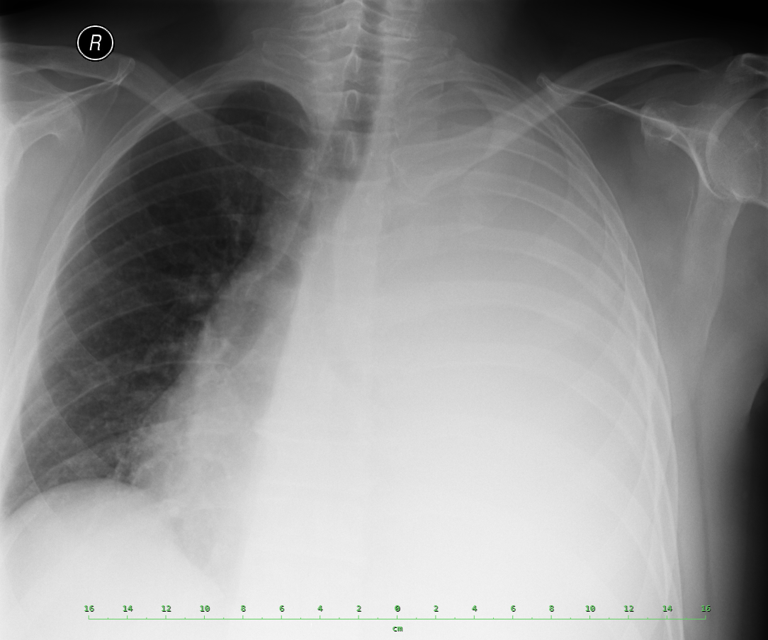
What are we looking at? Intentionally, in addition to the correct option, there is one common student tip:
Pneumothorax
Pleural effusion
Back to Mr. D.

Slide 23
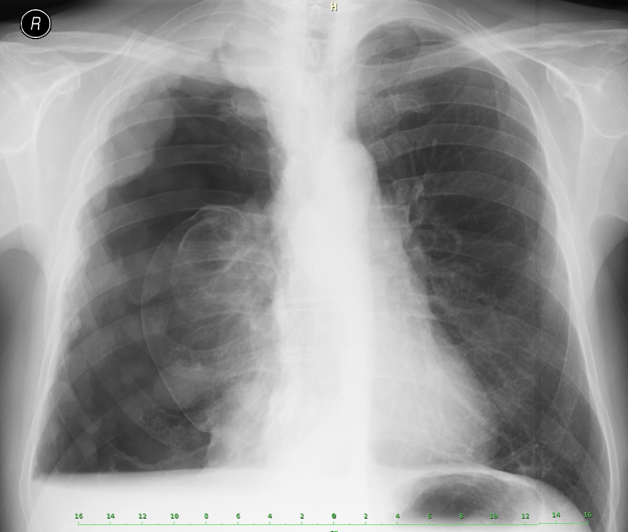
It is not pneumothorax, the air is black on the X-ray. Typical pneumothorax looks like this (here in a picture of a patient with malignant mesothelioma):
Tumor mass
Colapsed lung
Completely flat level of small pleural effusion = presence of air in the pleural cavity
Air in pleural cavity, no presence of lung tissue
Back to imaging

Slide 24
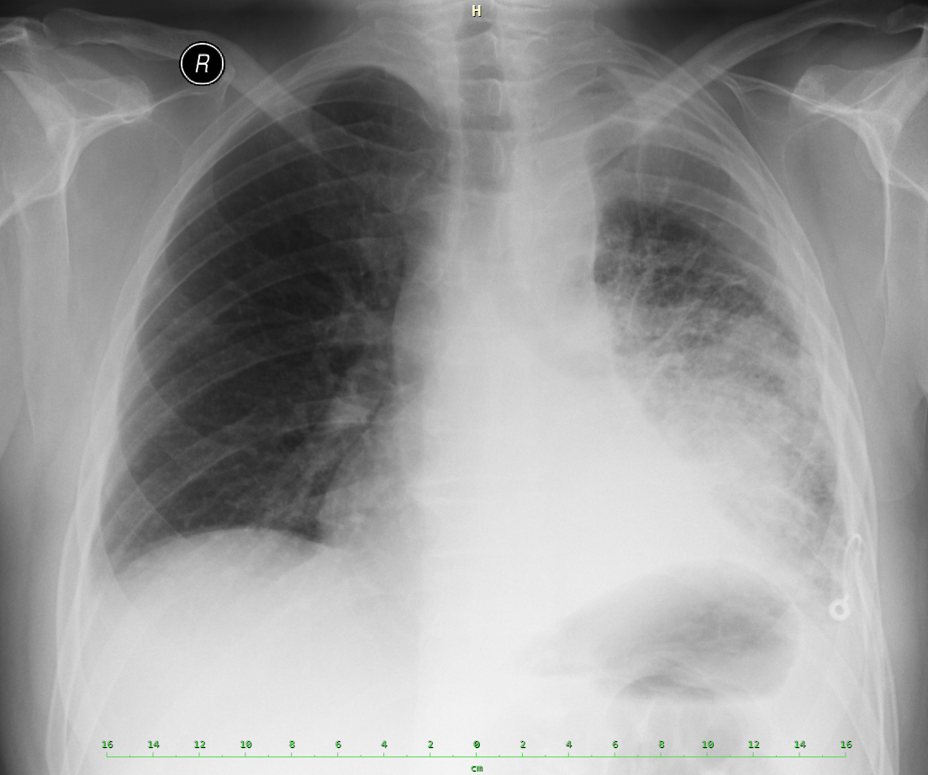
The original image shows a massive pleural effusion, which pushes the mediastinal structures to the healthy side with its volume. This image shows the condition after chest drainage:
Shift of the mediastinum back to its right position
Tumor mass
Chest drainage tube
Back to imaging

Slide 25
Functional examination
At the beginning, the patient was unable to undergo a functional examination due to severe dyspnea, so we were satisfied with the examination of blood gases, which was without respiratory insufficiency. Subsequently, the patient underwent lung function tests. The result was moderate restrictive ventilation disorder - a picture of the "absence" of a functional lung parenchyma due to the presence of extensive tumor infiltration.
Back to Mr. D.

Slide 26
Diagnosis and therapy
After the evacuation of the effusion, a tumor mass hidden in the fluid appeared on the skiagram of the chest.
According to staging CT of the chest, the clinical stage was IV, T2N2M1a - metastatic involvement of the pleura with cytologically confirmed malignant pleural effusion. Bronchoscopic examination succeeded in obtaining a morphological diagnosis - adenocarcinoma, according to molecular genetic examination without the presence of driving mutations EGFR or ALK – the patient was started on chemotherapy in combination pemetrexed + platinum derivative.
After II. cycle of chemotherapy (about 6 weeks of treatment), the progression of the disease was noted and the patient was started on erlotinib – I. generation inhibitor of EGFR tyrosine kinase activity. However, erlotinib treatment did not have a significant effect either, and after three months it was discontinued for further disease progression, and only symptomatic treatment continued. The patient died 4 weeks after stopping erlotinib treatment with evidence of terminal cancer progression.
Back to the waiting room

Slide 27
Mrs. H., born 1953
Anamnesis
Physical and laboratory examination
Imaging
Functional examination of the lungs
Diagnosis and therapy
Back to the waiting room

Slide 28
Anamnesis
Patient comes for exertional dyspnea lasting several weeks, except for shortness of breath without problems, does not cough, without temperatures.
varicose veins of lower extremities, hypertension, gallstones, carpal tunnel surgery, depressive syndrome
Uses Lorista H, Citalec
Smoker - 15 cig/day from early youth
Without allergies
Administrative worker
Back to Mrs. H.

Slide 29
Physical and laboratory examination
Lucid, oriented, cooperating, neurologically normal, cardiac action regular, afebrile, shortness of breath when walking, breathing on the left side weakend in the whole range, abdomen without pathology, extremities without swelling, no signs of inflammation, varices calm, Homans and plantar signs negative.
O2 saturation 94%, blood pressure 120/80mmHg, puls 72 ‘reg., body temperature 36.6 ° C, weight 80kg, height 162cm.
Laboratory examination without serious pathologies
Back to Mrs. H.

Slide 30
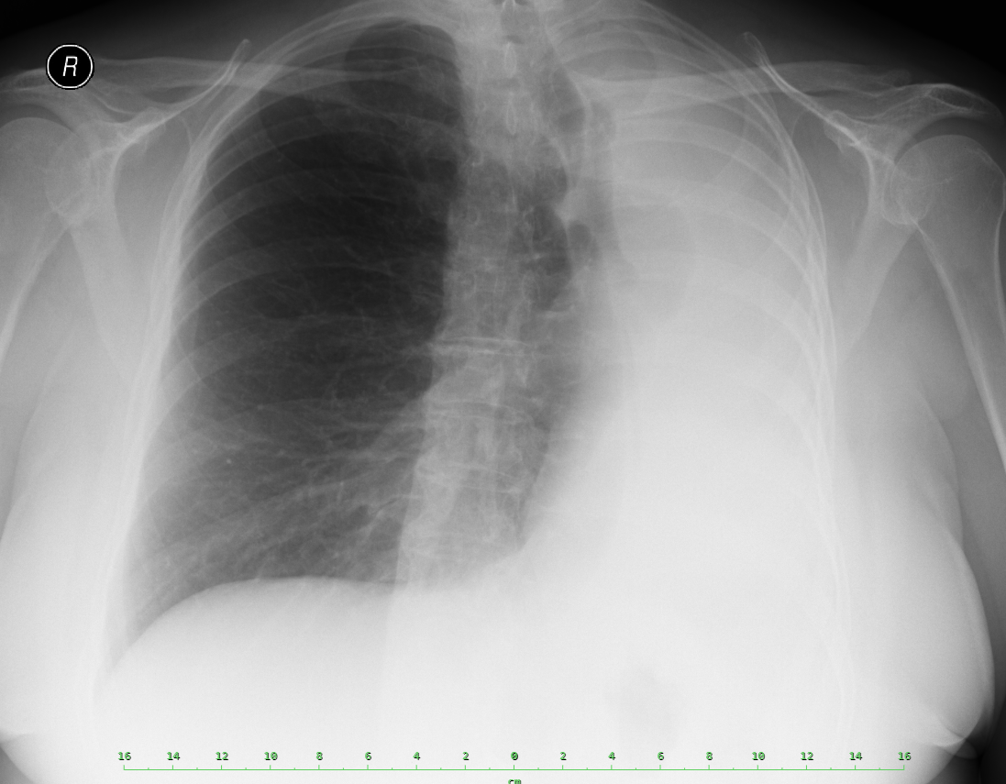
What pathology is found on the chest skiagram?
Pleural effusion
Atelectasis
Back to Mrs. H.

Slide 31
A typical example of a large effusion is Mr. D., in whom the pressure of the fluid overpressed the mediastinal structures to the healthy side. In Mrs. H., however, we observe the opposite phenomenon - the shift of mediastinal structures to the side of pathology. It is therefore not a effusion in this case.
Back to imaging

Slide 32
It is atelectasis. Due to endobronchial pathology, the air supply to the left lung was closed, which thus became airless, then the unaffected side developed compensatively and the mediastinum shifted to the pathological side.
Back to imaging

Slide 33
Functional examination of the lungs
Examination of arterial blood gases: pH 7.41, pCO2 5.5, pO2 9.6, HCO3 25.9 - without respiratory insufficiency
Functional examination of the lungs, similarly to the case of Mr. D., showed a restrictive ventilation disorder.
Back to Mrs. H.

Slide 34
Diagnosis and therapy
Mrs. H. underwent bronchoskopy and was diagnosed with small cell lung cancer. According to staging chest CT clinical stage IV - T4N2M1b - with metastasis of the left adrenal gland.
The endobronchial finding, which caused atelectasis of the left lung, was found in the left main bronchus and was suitable for laser treatment. The patient therefore underwent palliative endobronchial procedure with the intention of clearing the left main bronchus. During the procedure, however, only a part of the tumor mass was removed and the desired effect was not achieved.
After endobronial procedure, the patient underwent 4 cycles of chemotherapy consisting of platinum derivative + etoposide. The clinical effect of the treatment was good and the patient's quality of life was satisfactory. Cancer progression and death occurred 5 months after treatment. The overall condition of the patient at the time of progression allowed only symptomatic treatment.
Back to the waiting room

Slide 35
Conclusion
The common denominator of all the cases you went through was the presence of lung cancer. However, the causes of dyspnea were various - in the first case exacerbation of COPD, in the second effusion and in the third atelectasis. The skiagram of the chest was absolutely essential for the diagnosis in all cases - a simple and accessible examination.
All three patients were smokers. Mr. D. and Mr. P. suffered from recurrent lower limb thrombosis. This diagnosis occures more common in cancer patients - cancer is a procoagulant condition.
In patients with COPD and lung cancer, differential diagnosis of dyspnea may be difficult - it may be tumor progression, exacerbation of COPD, infectious complication, a combination of the situations named above, or a completely different cause, for example pulmonary embolism.

