Slide 1
Lung cancer
MUDr. Monika Bratová
Department of Respiratory Diseases and TB University Hospital Brno
Masaryk University, Faculty of Medicine

Slide 2
Introduction
Lung cancer = bronchogenis carcinoma - include tumors of lung and brochi
In 1912 all cases of lung cancer worldwide were documentated, it was 374 cases x in 2018 according to WHO there are 2 093 876 new cases of lung cancer in the world
Smoking is still a main risk factor

Slide 3
Demography in CR (2016)
The highest incidence and mortality from oncological diagnosis in men and women in the Czech Republic
Incidence 6 782 cases (♂4478, ♀2304)
While incidence in men decreased, in women it is still increasing (!)

Slide 4
Demografic data 2014
Lung cancer is most common in 7th decenium, the bigger increase of incidence was in 2014 around 55 years
A lot of cases are diagnosed in the locally advanced and metastatic stages (IIIB a IV), 5-year survival is 10%
Some areas of our country have higher incidence because of mining expecially

Slide 5
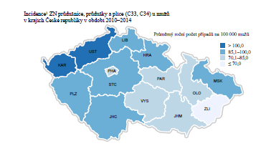
Distribution in the Czech republic

Slide 6
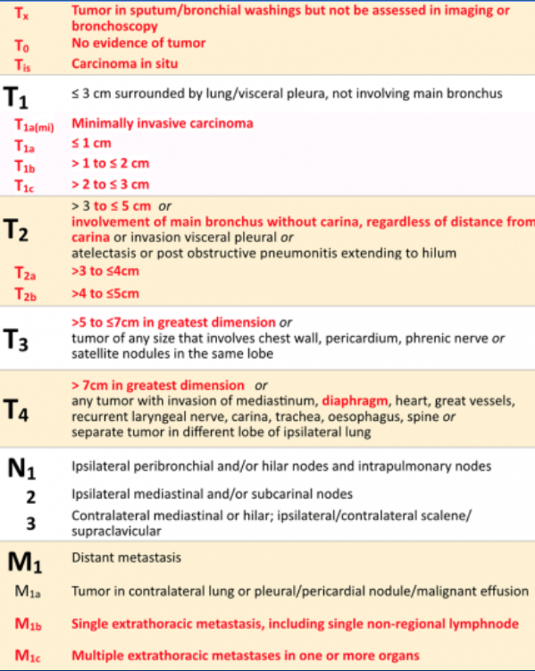
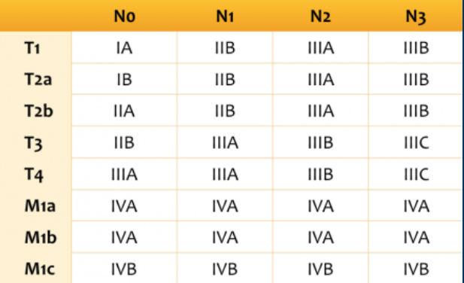
Th TNM Classification

Slide 7
CLassification
The most useful classification of lung cancer reflects its biological properties is into:
Non-small cell lung cancer (NSCLC)
Small cell lung cancer (SCLC)

Slide 8
NSCLC
80% of all lung cancers
TNM classification
Histological types – squamous cell carcinoma, adenocarcinoma, large cell carcinoma
Some types of carcinomas can be mixed (squamous/adeno, NSCSL/SCLC)
Biological features: slow growth, lower sensitivity to chemo and radiotherapy

Slide 9
SCLC
20% of all lung cancers
Stage – limited disease or extensive disease (ED)
No further histological subclassification
Biological features: rapid growth, huge tendency to metastatise early (ussually bones and brain), paneoplastic signs, sensitivity to chemo and radiotherapy
Ussualy central tumours, can cause vena cava superior syndrome

Slide 10
Lung cancer - Pacients history
The most important is well done history and physical examination of a patient!
History:
family history, other oncological disesases, smoking, professional risks, cough, hemoptysis, chest pain, dyspnoe, dysfagia, recurent pneumonias

Slide 11
Lung cancer – Physical examination
We can observe:
Cyanosis, ikterus
Edema of extremities, vena cava syndrome
Dyspnoe, stridor
Peripheral lymfadenopathy
Rarely Claude-Bernard-Horner syndrome
Any kind of paraneoplastic syndrome
Physiological breathing, weakened or non-audible, wheezes, dull percussion

Slide 12
Diagnosis
Postero-anterior and lateral chest X-rays
CT scan of lung and abdomen
Bronchoscopy and its modifications
Transparietal punction biopsy
Thoracoscopy (VATS or mediastinoscopy)
Cytological examination of pleural fluid
MR of a brain (SCLC), scintigraphy of bones (SCLC)
Final diagnosis is allways based on histological or cytological findings

Slide 13
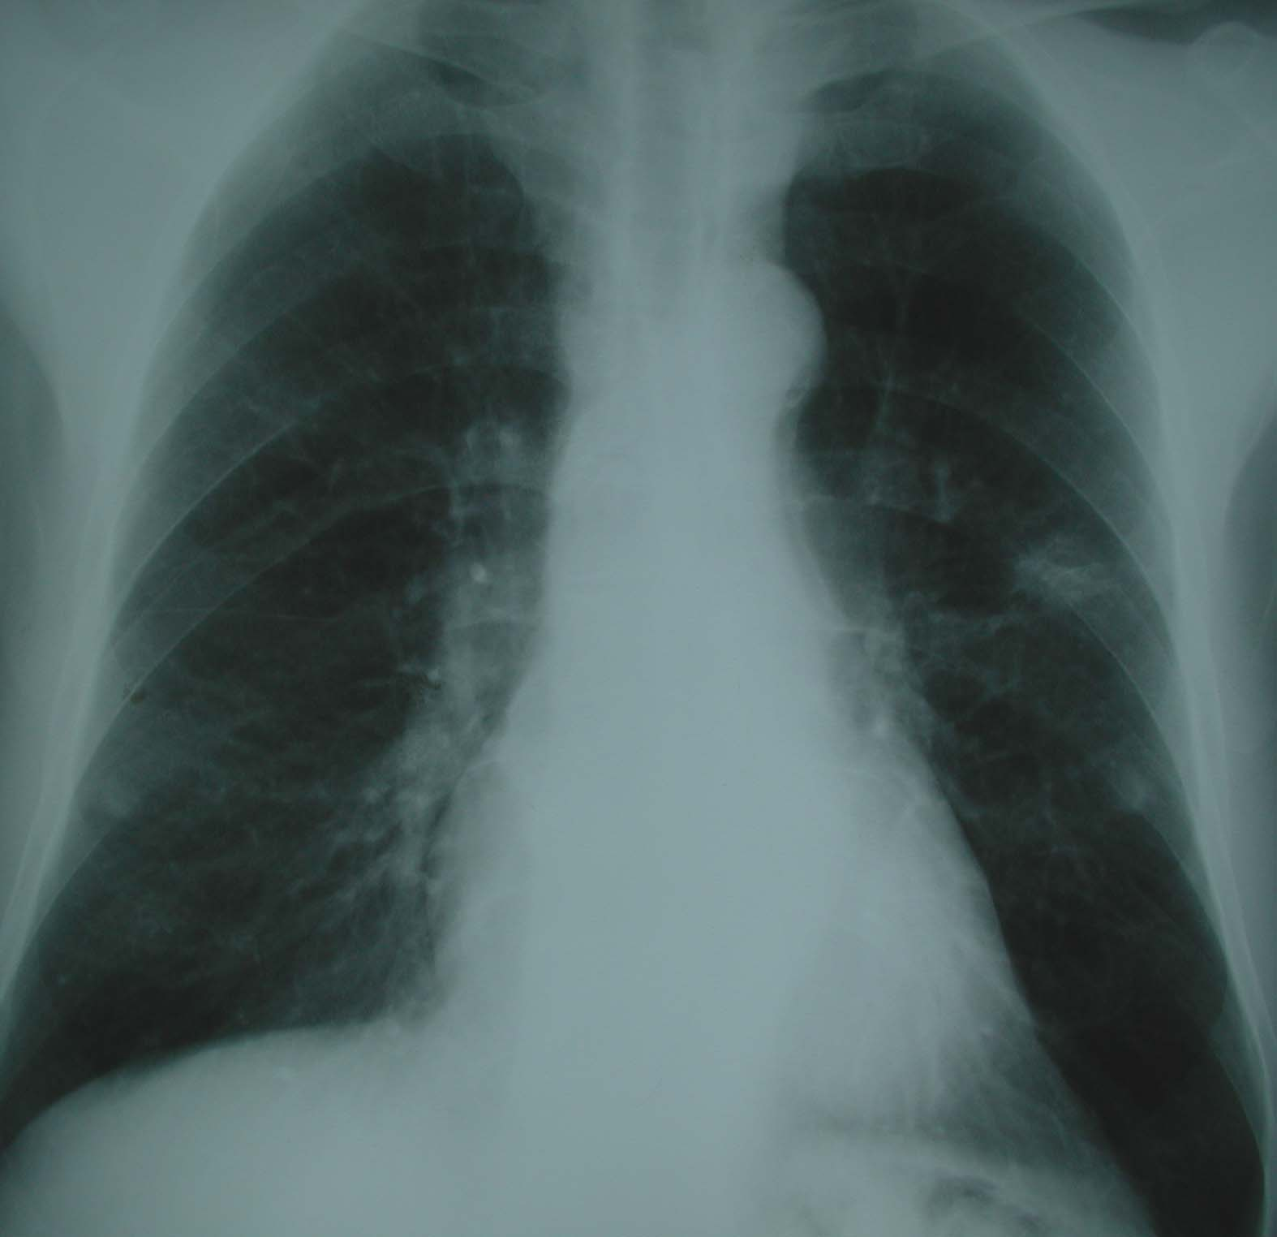
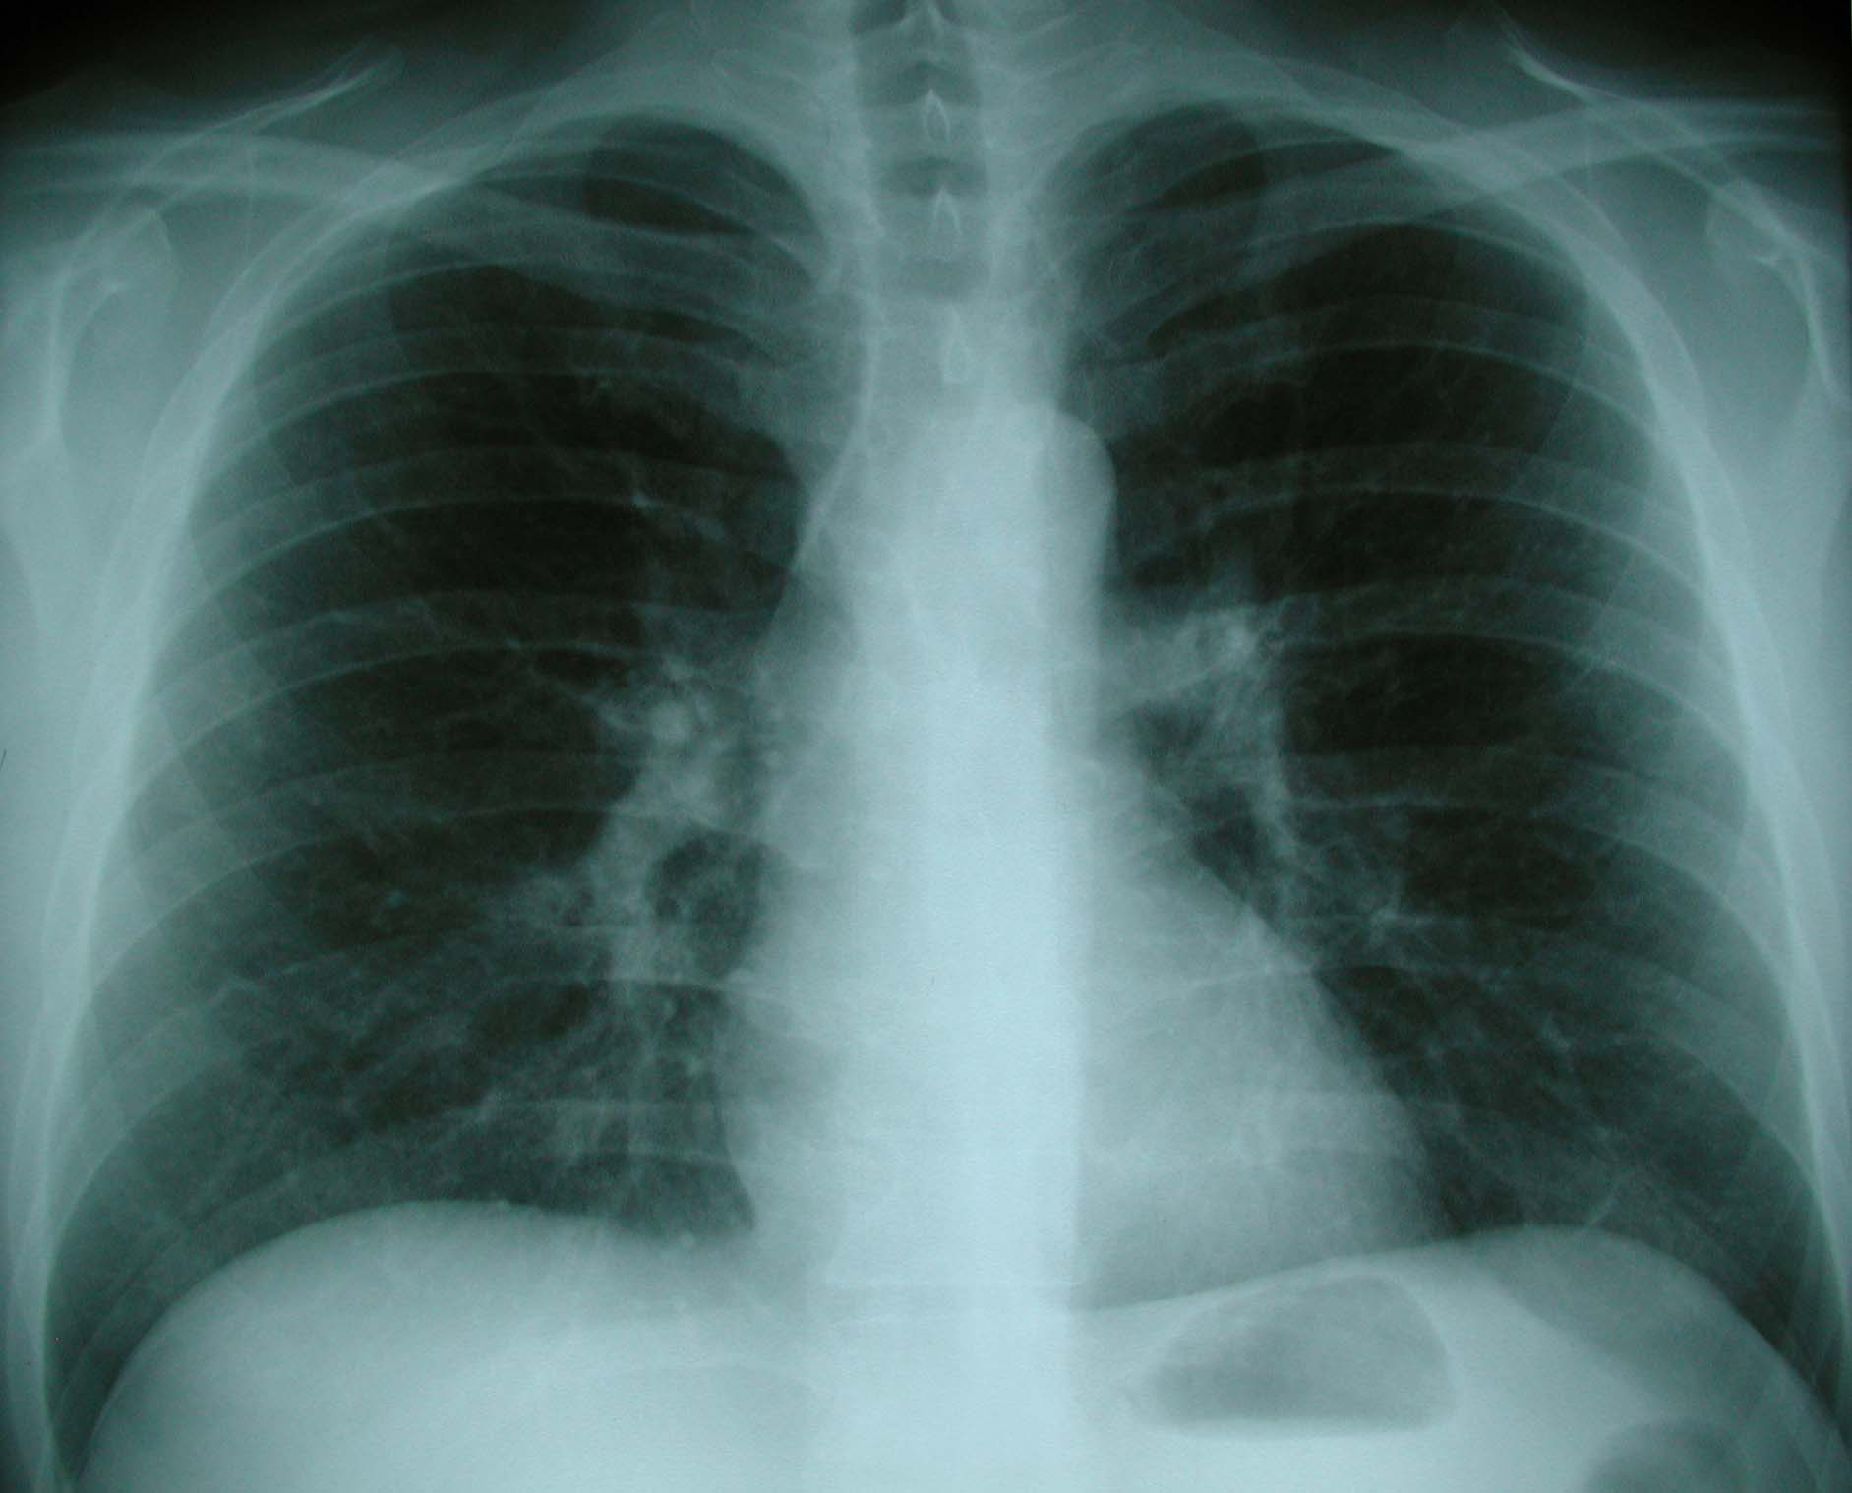
X-rays

Slide 14
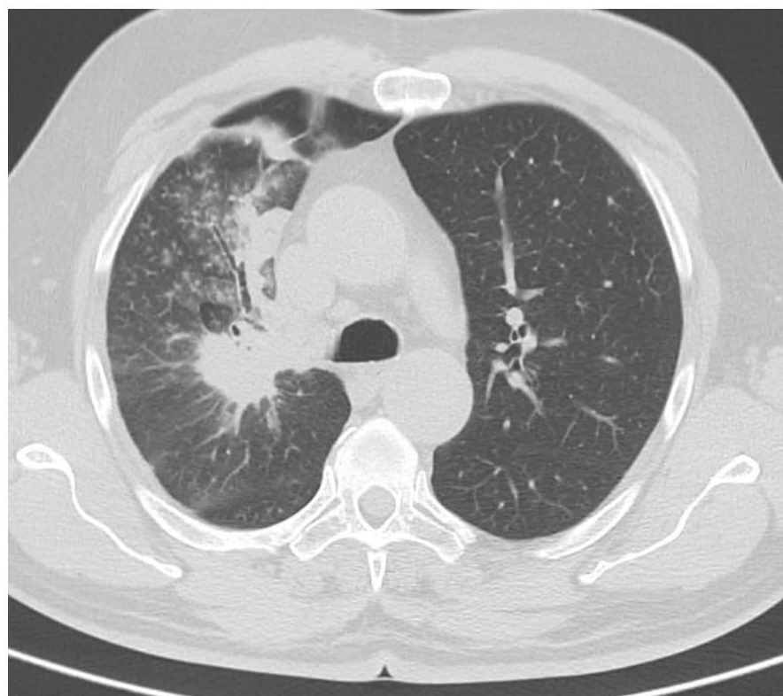
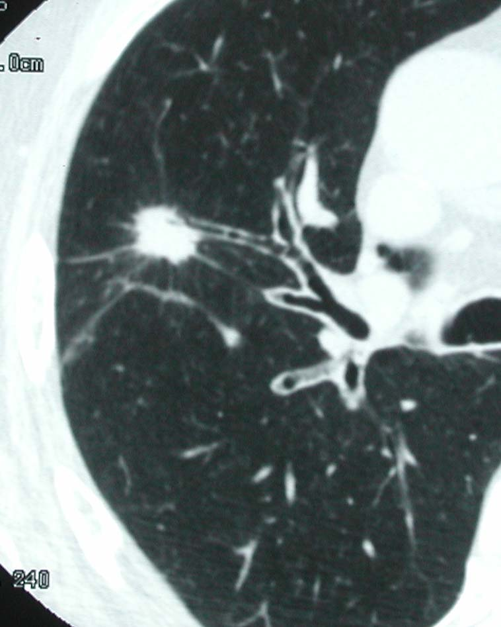
CT scans

Slide 15
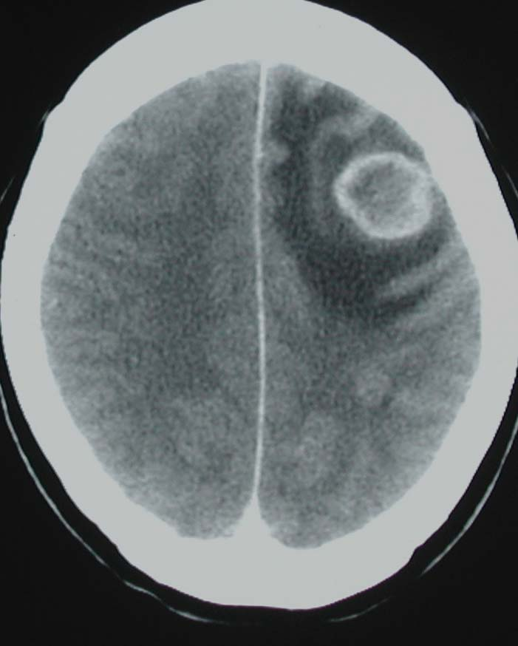
MRI of the brain

Slide 16
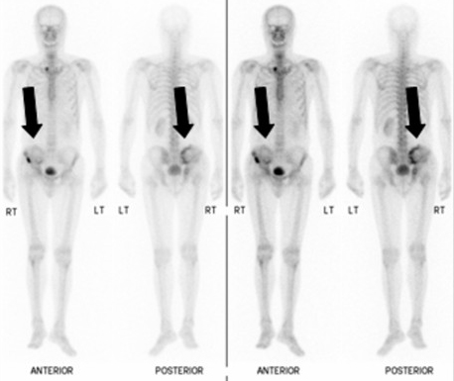
Scintigraphy of bones

Slide 17
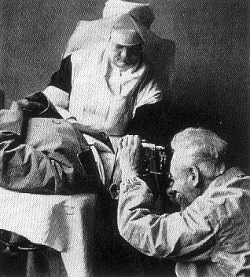
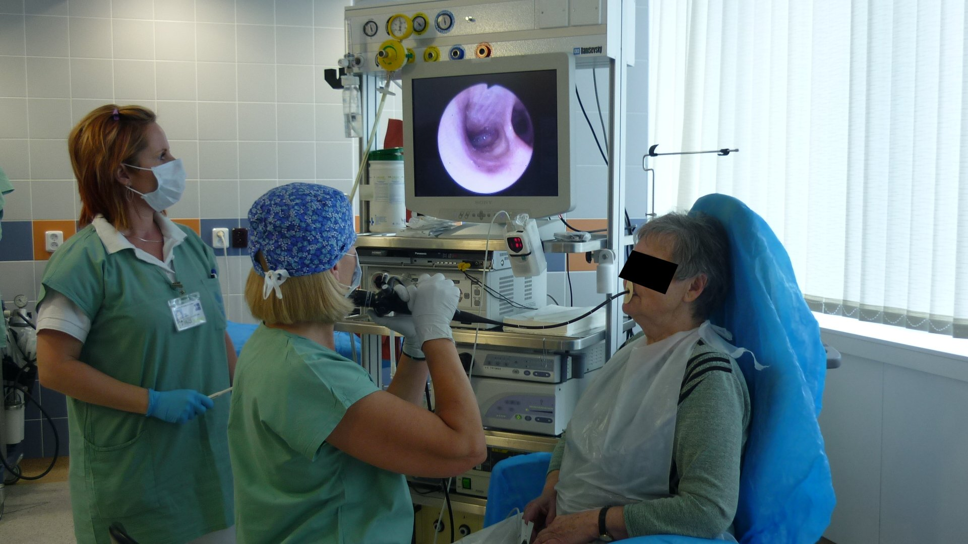
Bronchoscopy before and today

Slide 18
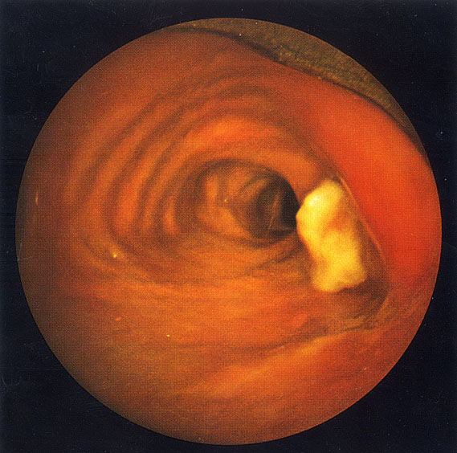
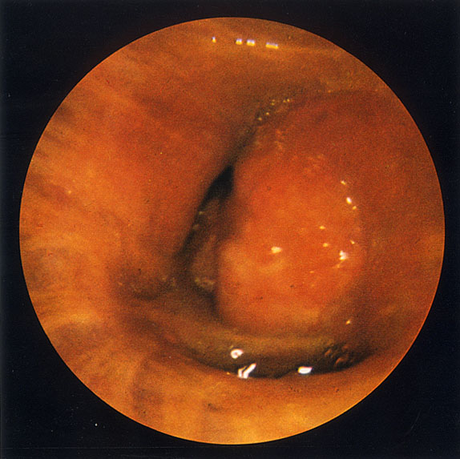
Endobronchial finding

Slide 19
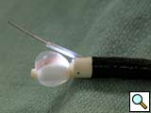
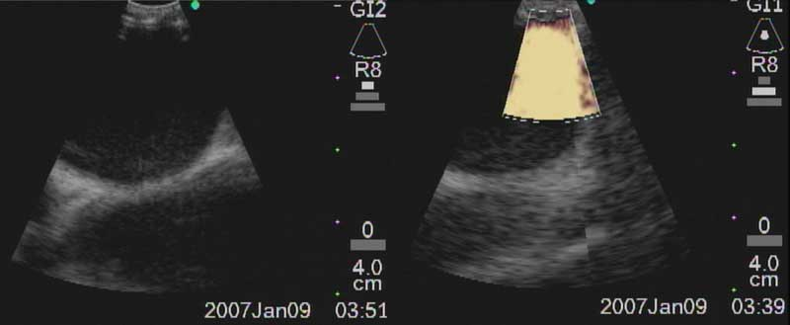
EBUS

Slide 20
Tumor markers
Are importatnt in a monitoring of the disease not for the diagnosis
NSCLC:
CEA (cancer embryonal antigen)
CYFRA 21-1 (fragment of cytokeratine 21)
SCC Ag (squamos cell antigen)
SCLC:
NSE (neuron specific enolase),
Pro GRP (pro-gastrine realising peptide)

Slide 21
Oncological treatment
According to the clinical stage of the disese (and performance status of the patient):
Curative for I-IIIA (operation or curative radiotherapy)
Palliative for IIIB-IV (chemo or radiotherapy)
Supportive for anyone (management of the symptoms)

Slide 22
Treatment of NSCLC
Adjuvant chemotherapy - following a radical surgery (stage IB, IIA, IIB, IIIA)
Neo-adjuvant chemotherapy before surgery
(IIIA, IIIB)
Chemotherapy + radiotherapy concurrently or following (IIIB)
Chemotherapy alone (IIIB, IV)

Slide 23
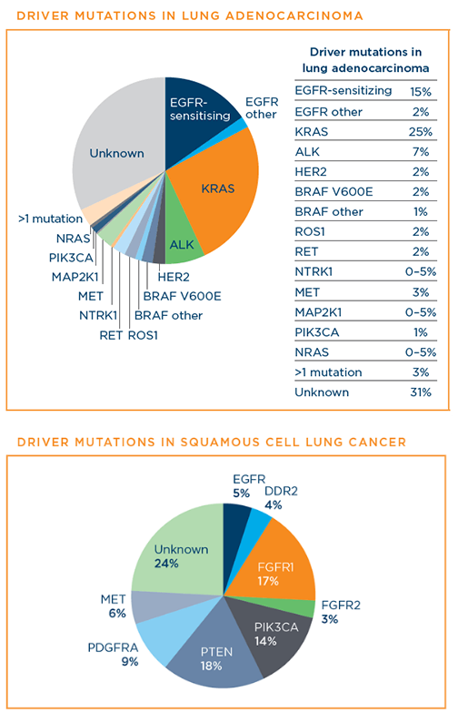
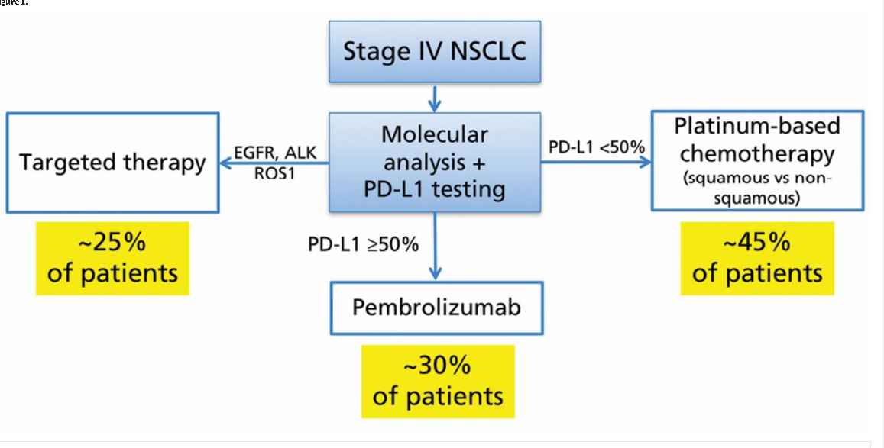
Mutation analysis of NSCLC

Slide 24
Treatment of NSCLC
Adenoca without driver mutation:
pemetrexed (Alimta®) + cisplatine
Bevacizumab (VEGFR inhibitor) + chemo
Adenoca EGFR +:
TKI´s (gefitinib, erlotinib, afatinib, osimertinib)
Adenoca ALK+:
ALK inhibitors (crizotinib, alectinib)
Adenoca PD-L1 more than 50%:
Imunotherapy (pembrolizumab, nivolumab in the further lines)
Squamous carcinoma:
Standard chemo

Slide 25
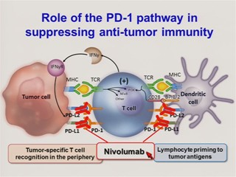
Immunotherapy
New type of treatment in last 5 years
Attack a blocage of PD-1 receptor at T-cells by PD-L1 ligand at the surfice of tumor cells
Indication: NSCLC stage IV according to expression of PD-L1
Contraindication: autoimunity, high dose of steroids
Various side effects, so called pseudoprogression

Slide 26
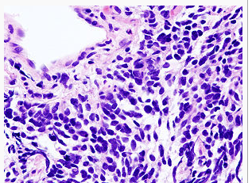
SCLC - Treatment
The same from 1970´s
Limited disease: chemo+ radiotherapy of the chest
Extensive disease: standard chemotherapy (platine+etoposid, hycamtin in the second line)
Imunotherapy for SCLC in progress (?)

Slide 27
Bad prognostic farctors
Stage of disease
Performance status
Weight loss
Paraneoblastic signs
Comorbidities
Sociodemographic characteristics

Slide 28
Palliative treatment
Opioid´s, antitusics and others
Palliative radiotherapy of bone, brain metastasis or malignant lymphadenopathy
Management of malignant pleural effusion (pleural punctions, drenage, pleurodesis, tunelized catheter, pleuroscopy)
Treatment of symptomatic tumour obstruction (endobronchial treatment, laser therapy, stents)

Slide 29
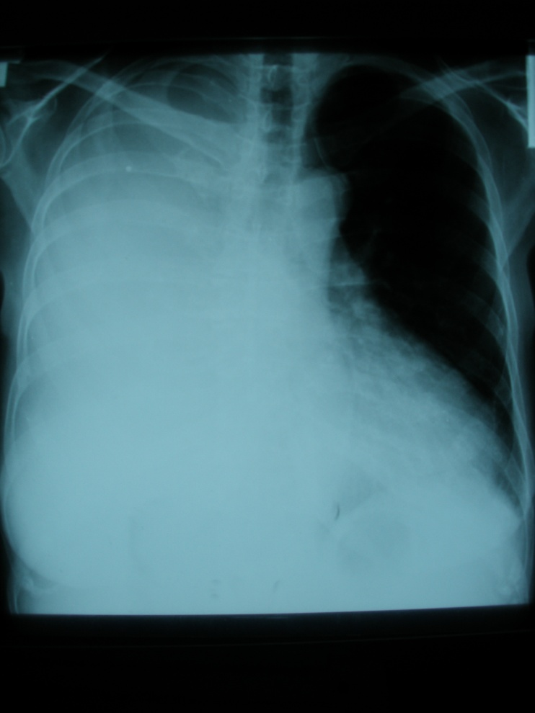
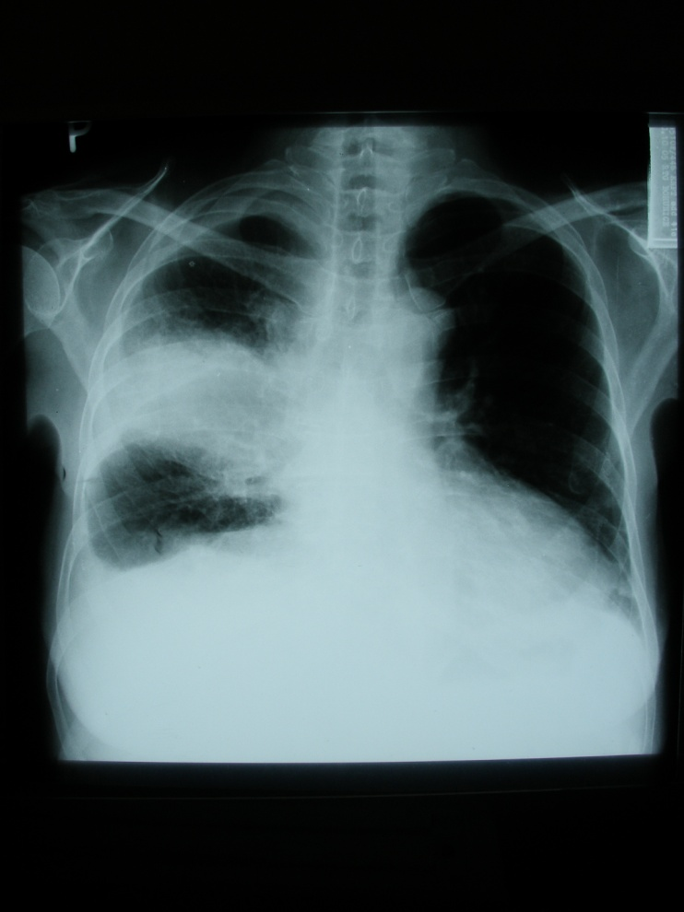
Laser therapy

Slide 30
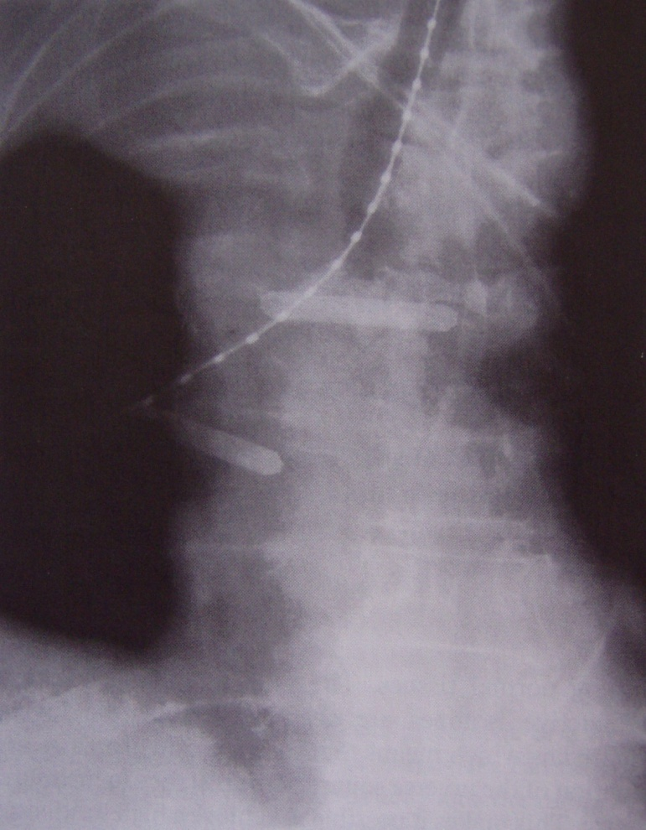
Brachytherapy

Slide 31
Future?
New biological drugs – TKI´s (dacotinib), ALK inhibitors (brigatinib)
Immunotherapy – atezolizumab for NSCLC and SCLC ?
Cyber-knife of brain metastasis, protontherapy
Improvement of palliative care (hospices, mobile hopsice care)

Slide 32
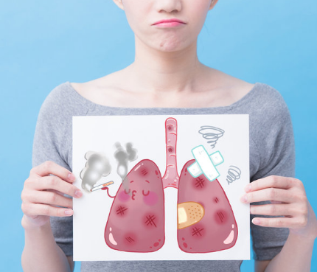
Thank you for your attention

