Slide 1
Pneumonia and pleural effusions
K. Brat

Slide 2
Pneumonia
Different epidemilogical types of pneumonia require different treatment orptions and procedures
CAP (Community-Acquired Pneumonia)
HAP (Hospital-Acquired Pneumonia)
VAP (Ventilator-Associated Pneumonia)
HCAP (Health Care-Associated Pneumonia)

Slide 3
CAP
Correct diagnosis
Risk stratification: ambulatory treatment / hospital admission / intensive care
Optimal antibiotic treatment (choice and duration)
Prevention of CAP
80% of pneumonia cases treated ambulatory way – mortality <1%
20% of cases treatet in hospitals – mortality ca 14%

Slide 4
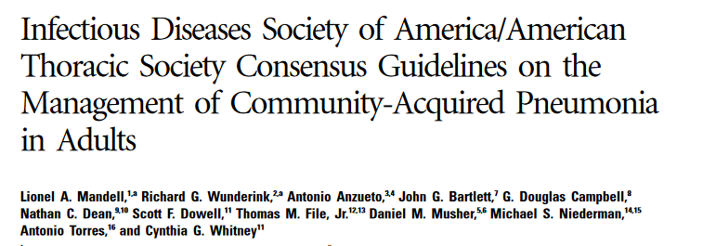
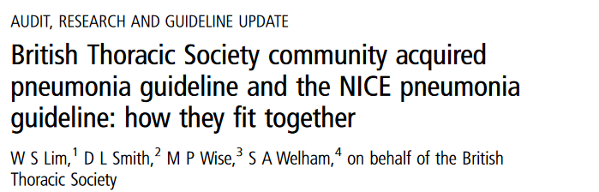

Slide 5
Diagnosis of CAP
Clinical signs, lab (CRP + leukocytes), CXR
In severe CAP (PSI class IV-V) also microbiology: sputum, legionella and pneumococcal antigen in urine, blood culture, serology Mycoplasma/Chlamydophila

Slide 6
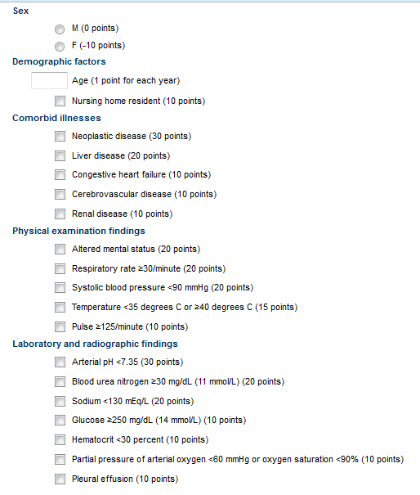
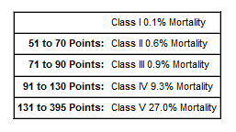
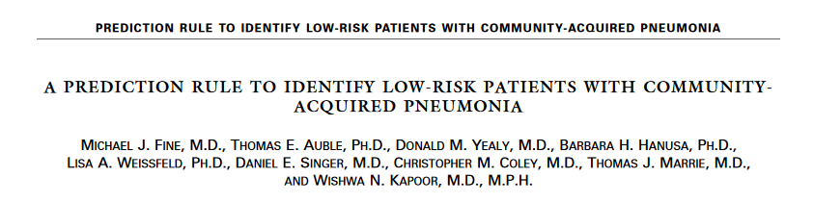

Pneumonia Severity Index (PSI)
>14.000 pts, confirmed by further studies

Slide 7
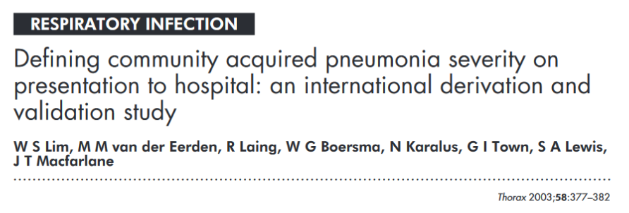
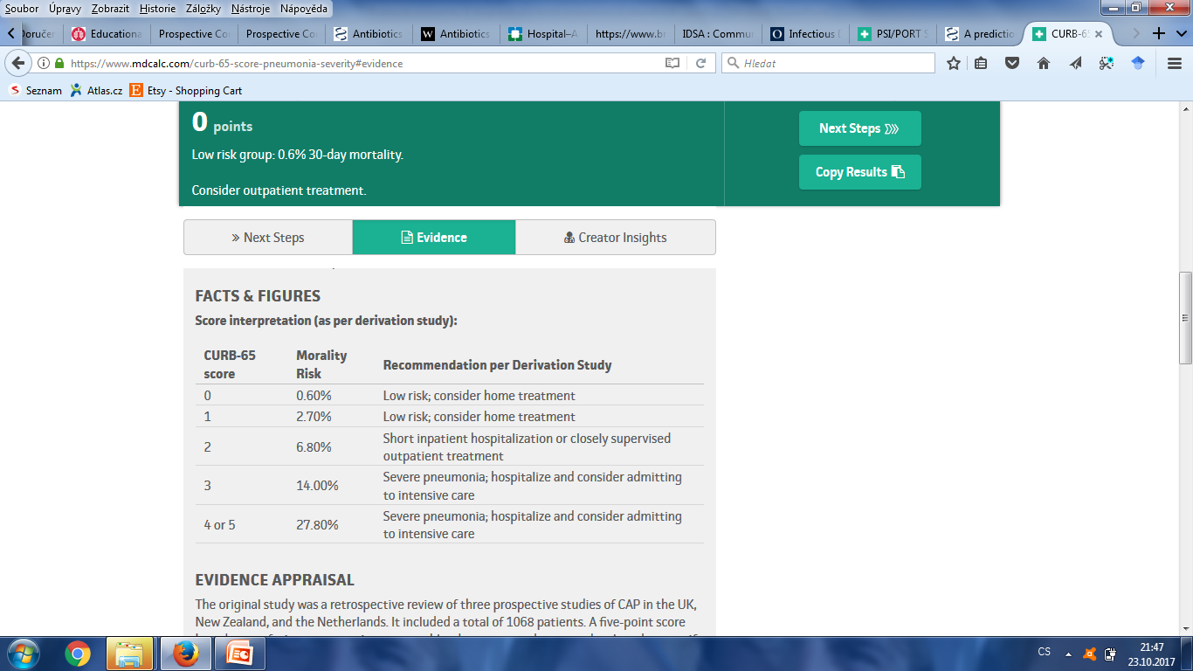

CURB-65

Slide 8
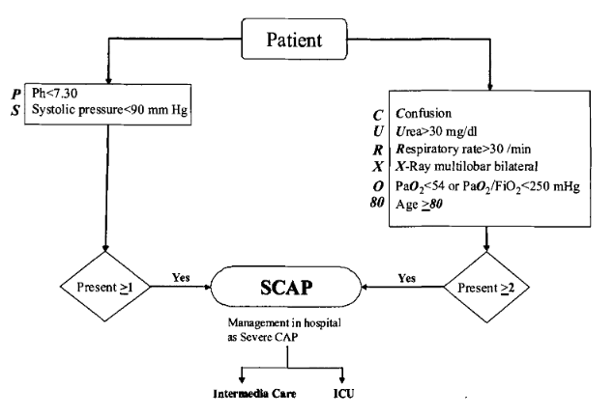
SCAP – next generation risk stratification tool

Slide 9
Antibiotic treatment of CAP
Low-risk patients:
1) amoxicillin
2) clarithromycine or doxycycline
Moderate-risk patients (standard department) – start the treatment ASAP
1) amoxicilline oral
2) amox + clarithro iv
3) moxifloxacin
High-risk patients (ICU) - start the treatment immediately:
1) amoxicillin/clavulanic acid + clarithromycine
2) cefuroxim + klaritromycin
I.v. antibiotics unless body temperature below 37°C for 24hrs.
Duration: low-risk pts 7 days, moderate-risk 7-10 days, high-risk may be extended up to 14-21 days

Slide 10
Prevention of CAP… vaccination
Str.pneumoniae – patients >65 yr
Influenza – patients >65, health care professionals, pts >50 let + severe CV or renal comorbidities or diabetes

Slide 11
Treatment of HAP
HAP is the 2nd most frequent type of nosocomial infection
Empirical antibiotics: cefotaxime / moxifloxacine / ertapenem
Pseudomonas?... tazocin / meropenem / imipenem / ceftazidime + amikacin / ciprofloxacine
MRSA?...tazocin / meropenem / cefotaxime + linezolide, vancomycin

Slide 12
Pleural effusion
Epidemiology - Czech Rep. (5 most frequent causes):
Acute heart failure (45-65%)
Parapneumonic effusion/empyema (22-30%)
Malignant/paramalignant effusion (17-24%)
Effusion secondary to pulmonary embolism (cca 5-8%)
Hemothorax (5-10%)
Other (ca 15%)
(Marel et al. Chest 104: 1486-9)

Slide 13
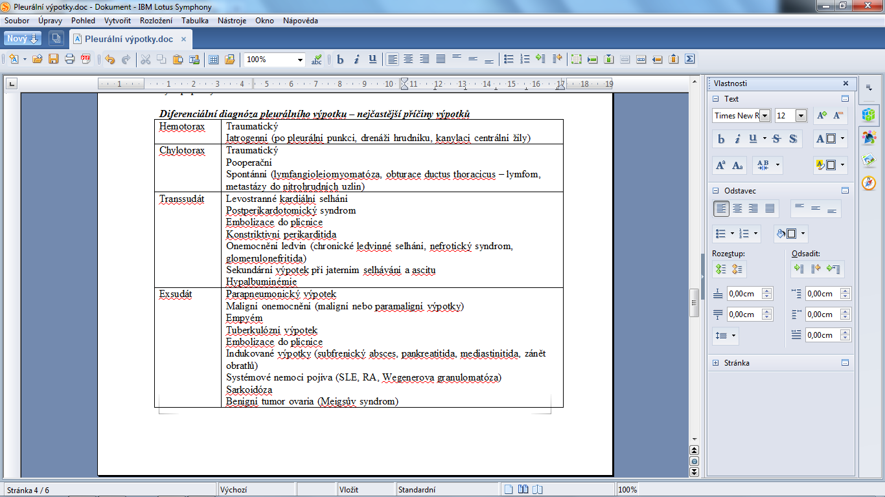
Differential diagnosis of pleural effusions

Slide 14
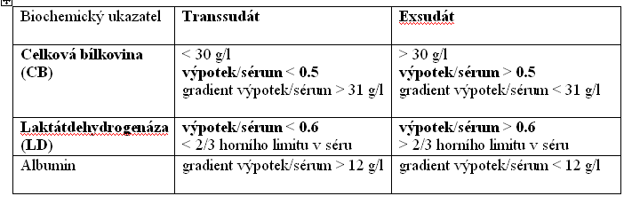
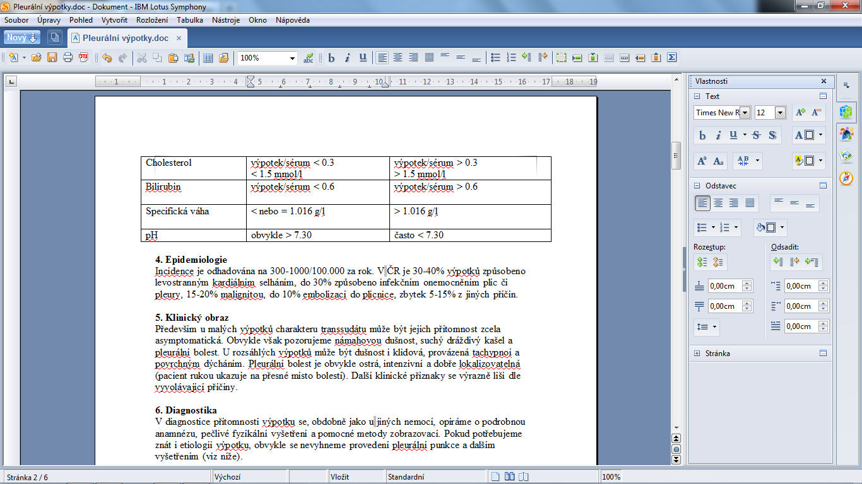
Biochemic examination of effusions – Light`s criteria
Major criteria
Minor criteria

Slide 15
Parapneumonic effusions (infectious pleurisy)
30-40% of pts with pneumonia develop pleural effusion
Ca 15% of parapneumonic effusions are complicated (i.e. pH<7.20)

Slide 16
Complicated parapneumonic effusions / empyema
The incidence doubled in last 20 years
Morbidity: mean hospitalization duration 14 days
Surgery inavoidable in up to 35% pts
1-year mortality 20% (no change during last 20 years)
The most valuable predictor of poor outcome is pH<7.20 (effusion)

Slide 17
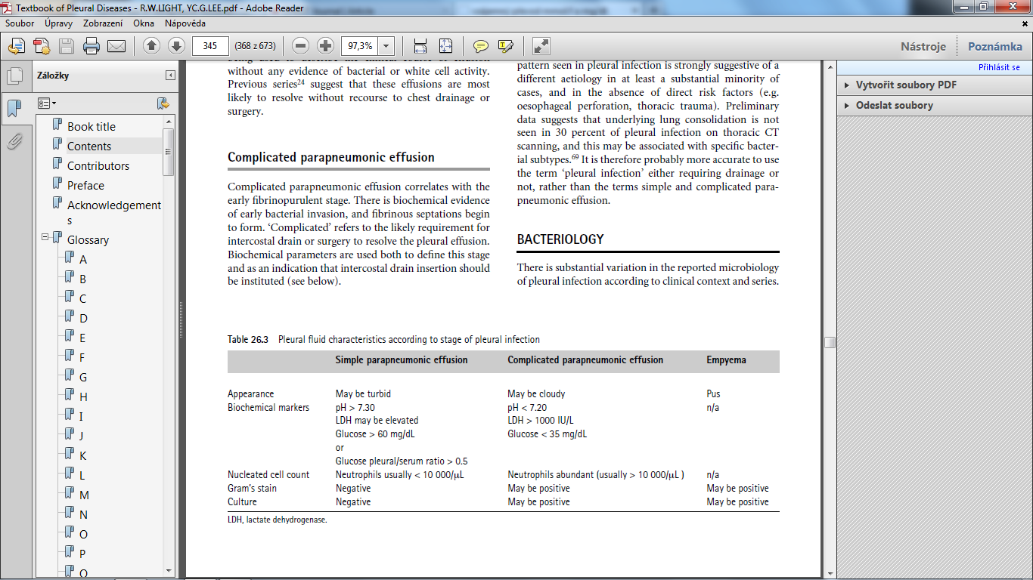
Classification of parapneumonic effusions

Slide 18
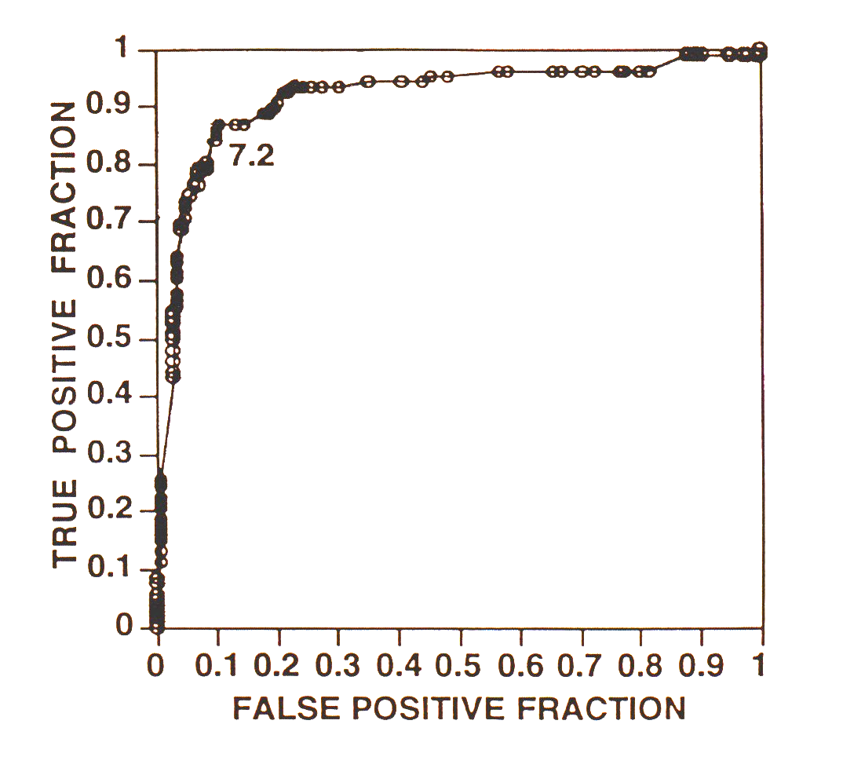
pH of infectious effusion – main decision-making parameter (for the introduction of invasive procedures)
AJRCCM; 152: 1700-08

Slide 19
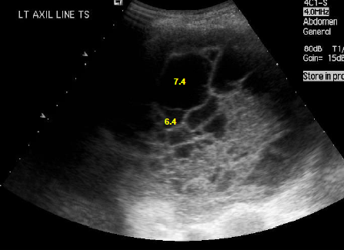
Presence of septation can modify lab results
pH of effusion modified also by:
Time delay (…lab)
Air in syringe
Traces of local anesthetics
Proteus-infection

Slide 20
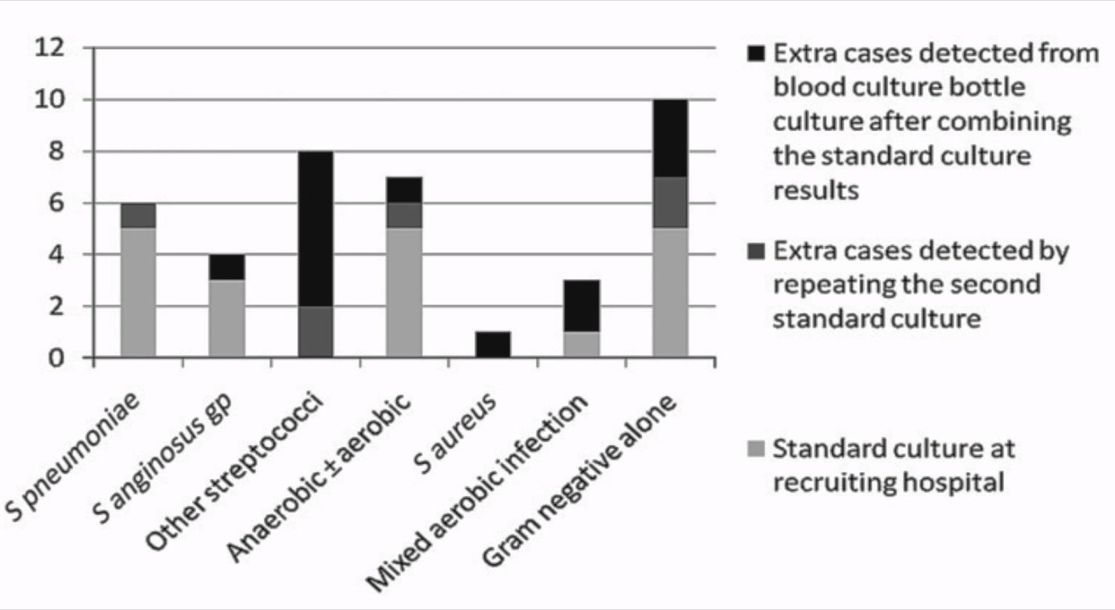
Microbiology
Agent caught only in ca 50% of infectious pleurisy cases (incl. empyema!)
Inoculation on blood culture (aerobic a anaerobic type) increases pathogen detection by 20%
Menzies et al, Thorax 2011; 66:658

Slide 21
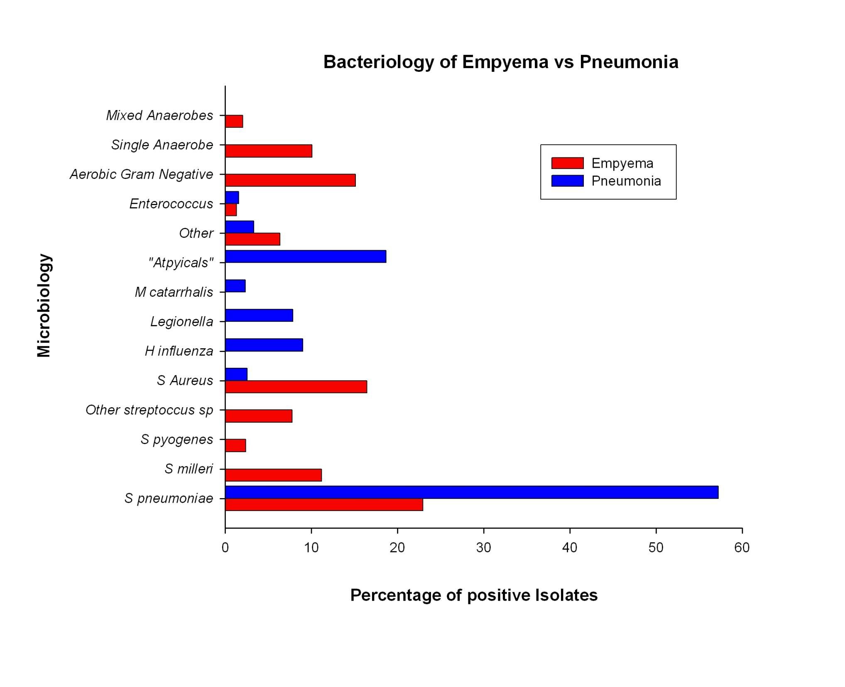
Is empyema just a “pneumonia gone bad?”

Slide 22
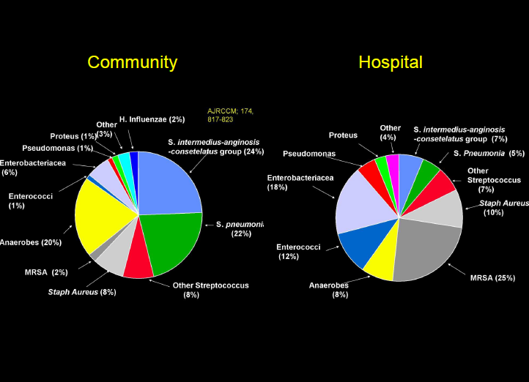

Slide 23
Antibiotic treatment of infectious pleurisy
Wrightson et al, Chest 2015 1:148(3)
Target on streptococci, S.aureus, G- bacilli, anaerobes
Anaerobes are less frequent
Mycoplasma and Legionella do not induce pleural effusions, i.e. no need for antibiotics targeted on „atypicals“

Slide 24
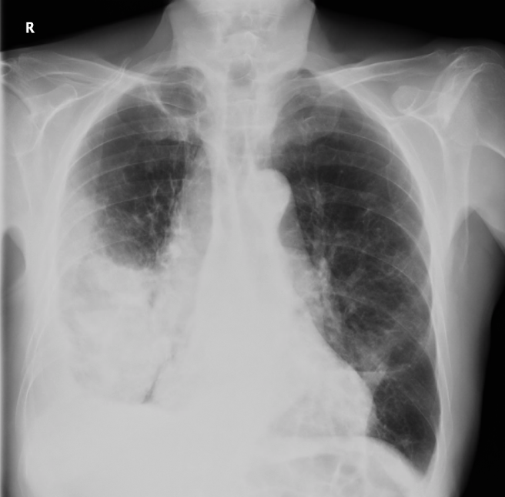
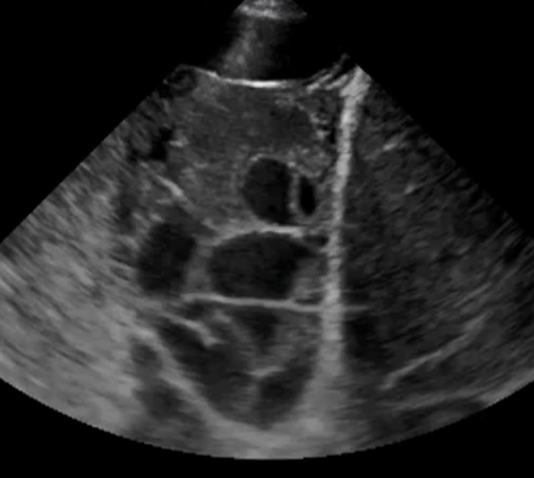
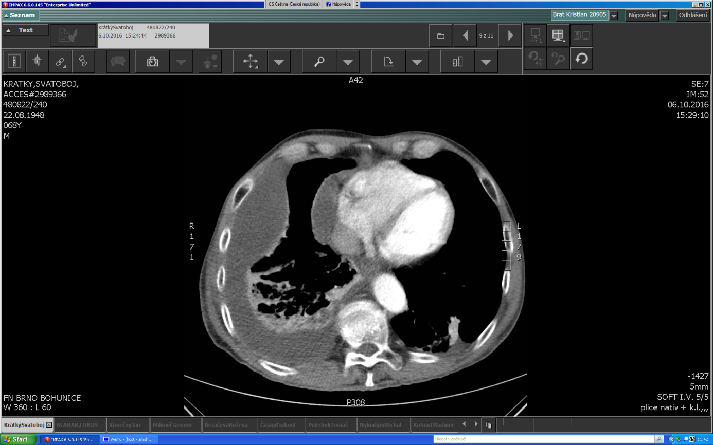
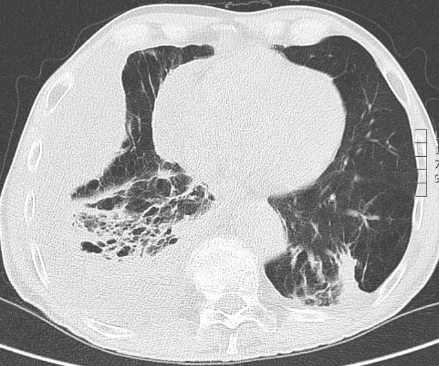
CXR / CT / chest ultrasound – effusion volumetry and septation
AP CXR „finds“ more than 200ml effusion / septation usually missed
Side CXR – accurate from 50ml…
CT scan / tens of mililiters… / septation of long duration – fibrous septae
Chest ultrasound – accurate from tens of ml / loculation found from early stage septation … and without irradiation!

Slide 25
Prediction of poor outcome in infectious pleurisy
Ultrasound proven loculation (Chen et al, 2001 J Ultrasound Med 19:837-43):
Longer hospital stay
More frequent use of intrapleural fibrinolytics
Higher rate of surgical intervention
RAPID score

Slide 26
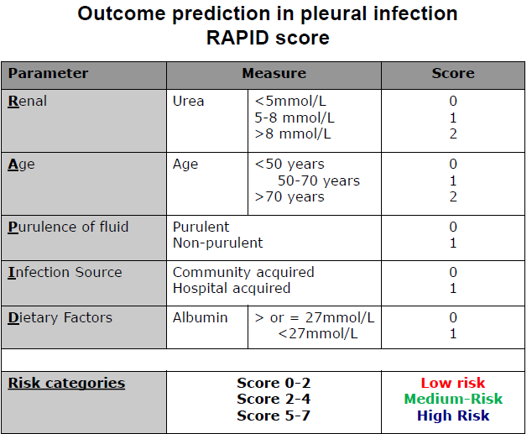
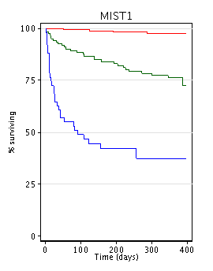
RAPID score - MIST 1 a 2 studies
Chest 2015; 145(4): 848

Slide 27
Intrapleural treatment
MIST1 study: intrapleural streptokinase not effective (NEJM; 352: 865-874)
MIST2 study: t-PA (alteplase) + DNase increase drainage of pleural fluid, decrease the duration of hospital treatment and the rate of surgery (NEJM; 365: 518-526), but… high costs
Irrigation by 3x daily 250ml of saline increase drainage of pleural fluid and decrease the need for surgery (Hooper et al, ERJ 2015)… low cost treatment
10/2017 MIST3 initiated: 3 cohorts are randomized> early VATS vs t-PA + DNase vs conservative therapy

Slide 28
Further remarks
The diameter of pleural catheter (chest tube) has no effect on treatment outcomes (Chest 2009
Purulency of the effusion (macroscopic feature) has no prognostic value (treatment success depends on pH<7.20 and the presence of loculation)
(medical) thoracoscopy – a rising star… 91% success rate in complicated infectious pleurisy treatment (Brutsche et al, Chest 2005;128:5)
No study stated when is the ideal timing of surgery (if needed)

Slide 29
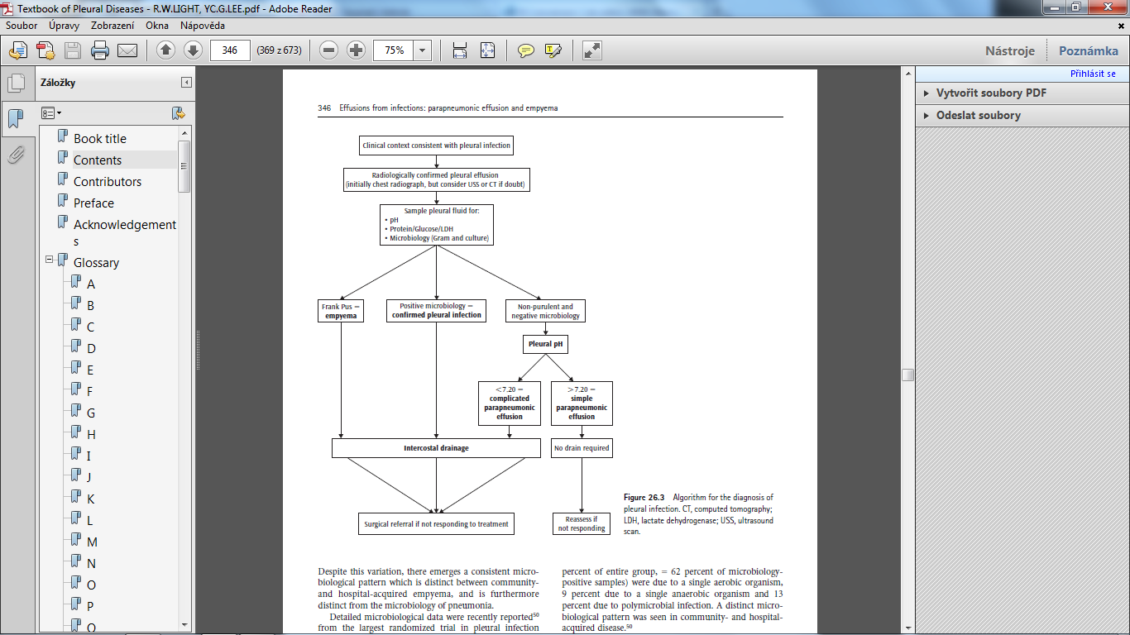
Parapneumonic effusion – main points of care
Antibiotics – empiric or microbiology-guided
Thoracentesis – effusions exceeding 300-400ml
Chest tube insertion – effusion >500ml and pH<7.2
Intrapleural antiseptic agents (iodpovidone, H₂O₂)– each effusion with pH<7.2
Intrapleural fibrinolytics?
Surgery – prevent fibrothorax!
Take care of nutrition
Respiratory physiotherapy
Other (oxygen, analgesics...)

Slide 30
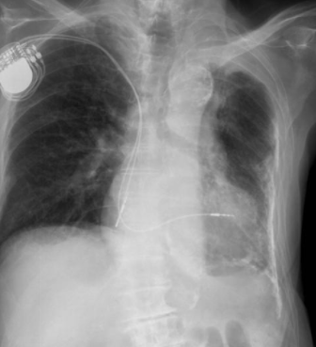
What comes after treatment failure…?
…fibrothorax and its characteristics: pulmonary restriction, respiratory failure, decreased mucociliary clearance, locus minoris resistentiae
…or „trapped lung“, i.e. inexpandible lung covered by fibrocortex and effusion

Slide 31
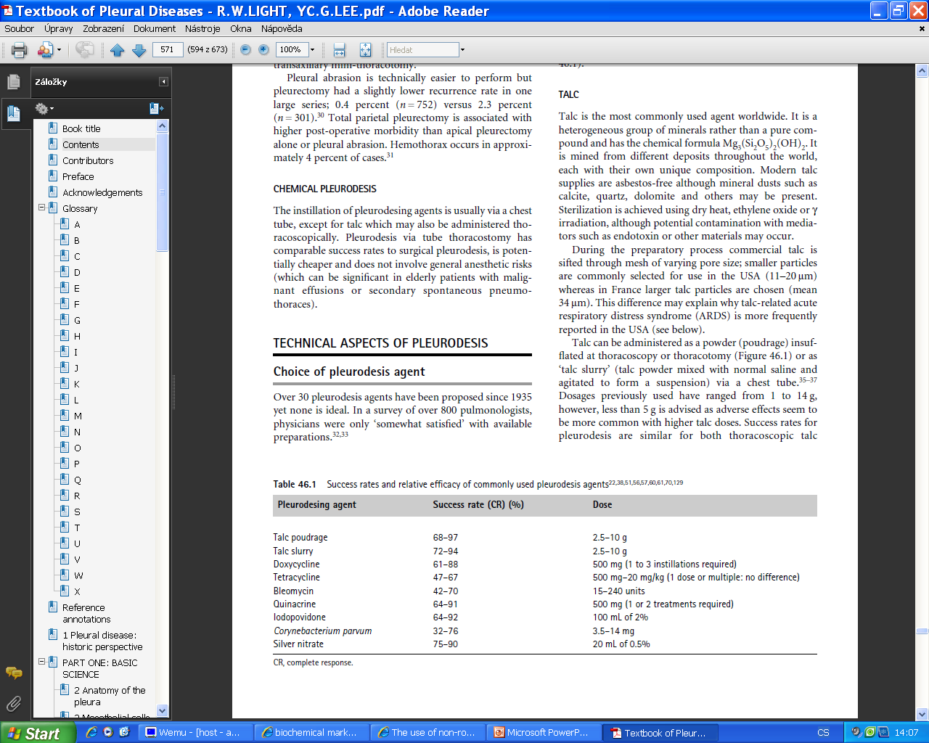
Case management - malignant/paramalignant effusion
Diagnosis:
- malignant cells present in cytology
- or malignancy present in pleural space
- biochemistry: may be both transudate or exsudate
- often need for surgery to obtain histology… (thoracoscopy, VATS)
Treatment:
- oncological (CHT, RT, biologicals)
- thoracentesis
- thoracic drainage
- pleurodesis – using chemical agents (talc, bleomycine, doxycycline)
- pleurodesis - surgical (VATS)
- Indwelling pleural catheter

Slide 32
Case management - hemothorax
Diagnosis:
- check recent injury in patient history
- may be severe thoracic bleeding with anemic shock!
- if hemothorax suspected, perform thoracentesis immediately!
- hematocrit effusion/periph.blood > 0.5 or hematocrit in effusion > 0.15
Treatment:
- thoracic drainage ASAP, use large calibers of chest tube (28-32F)!
- initial treatment: conservative, but watch for continuous bleeding
- if bleeding exceeds 200ml/hr for more than 2 hours, call the surgeon - urgent thoracoscopy is needed!

Slide 33
Case management – TB pleurisy
Cytology: lymphocytes predominant
Cultivation positive only in 20-50%
Histology: caseificating granulomas in 79% (pleural biopsy) up to 100% (thoracoscopy)
PCR Myco TB: sensitivity 60-90%, specificity 80-100%
ADA, ADA-2: sensitivity 75-100%, specificity 80-95%
Patients with untreated TB pleurisy develop pulmonary TB within 5 yrs in 65% of cases
DOTS-short course - 2 months HRZE + 4 months HR
No evidence for steroids use
Complete removal of effusion not neccessary

Slide 34
Case management - chylothorax
Diagnosis
- milky effusion
- biochemistry: triacylglyceroles > 1.2 mmol/l or ratio effusion/serum >1.5
- perform CT scans
Frequent in malignancy (lymphoma, metastases to mediastinal lymph nodes)
Treatment:
- thoracic drainage + parenteral nutrition 14 days
- surgery (ligation of ductus thoracicus)

