Slide 1

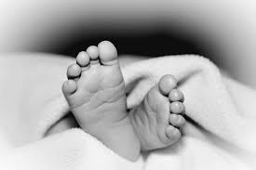

Adult Congenital Heart Disease
Lenka Kubkova
Masaryk University and University Hospital in Brno, 2020

Slide 2
Purpose of the Lecture
to remember you and explain:
basics from blood circulation and hemodynaemics
basics from anatomy and pathophysiology of the most frequent CHDs - CHD = Congenital Heart Disease
to demonstrate:
how does adult patient with CHD look like
what are his symptoms
how can we investigate and treat him
what could be different between „normal“ cardiology patient and that one with CHD

Slide 3
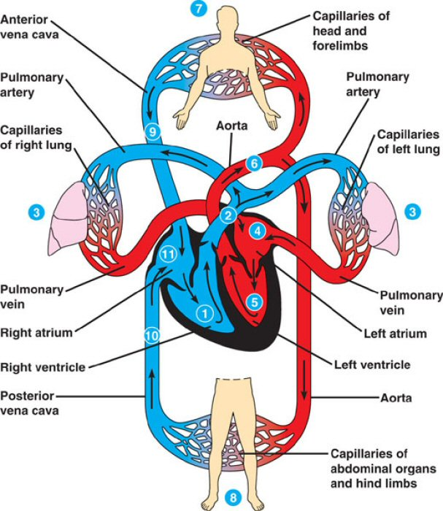
Systemic and Pulmonary Circulation

Slide 4
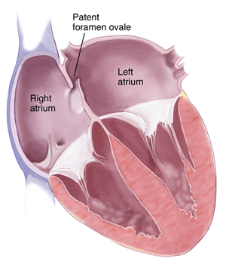
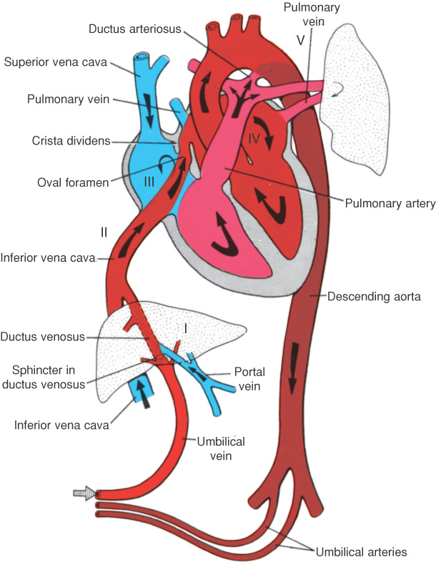
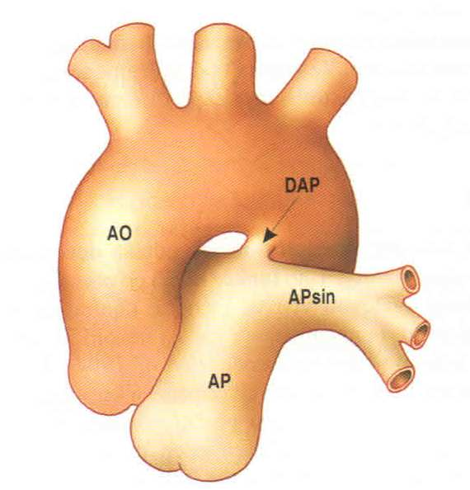
Fetal Circulation

Slide 5
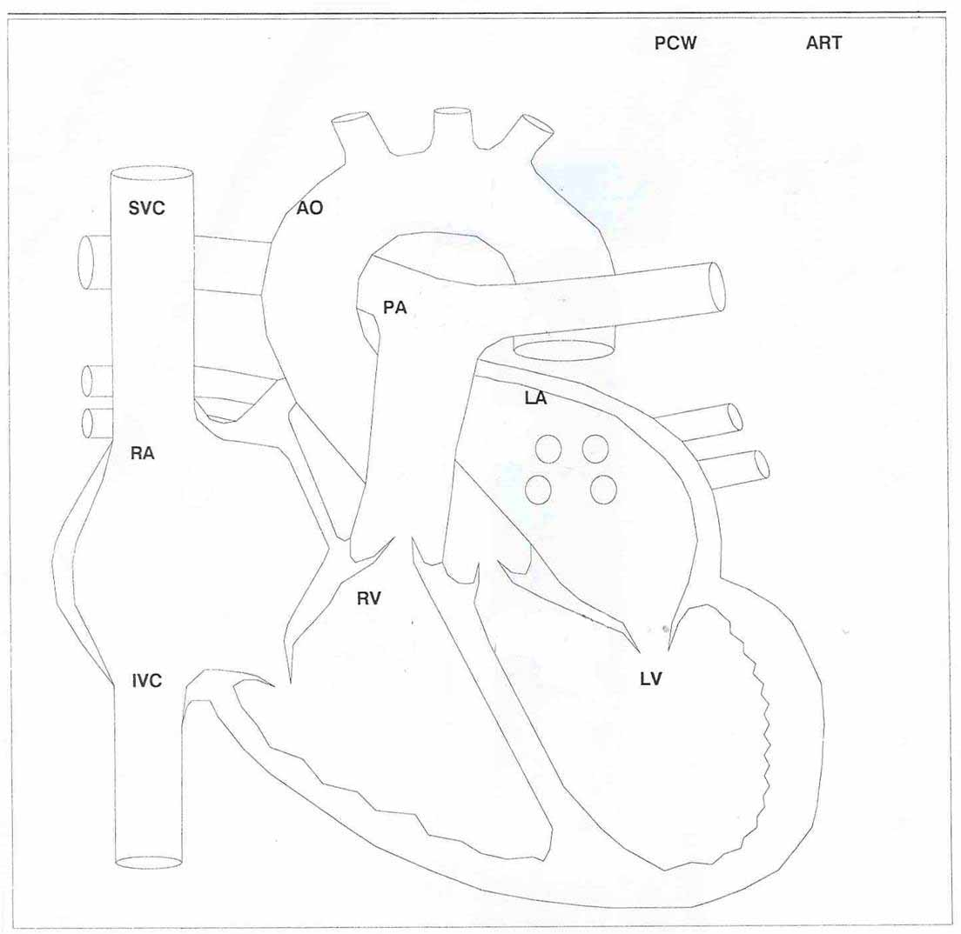
Normal Blood Pressures
* mmHg
120/80
30/8
8/0
12/4
30/8
120/12

Slide 6
Basic Terminology in CHD
situs solitus
situs viscerum inversus
situs ambiguus
= syndrome of visceral heterotaxis
dextroisomerism (Ivermark sy)
levoisomerism
concordance / discordance
restrictive / non-restrictive defect
erythrocytosis

Slide 7
Definition of Congenital Heart Disease
Congenital Heart Disease (CHD)
= morfological disorder of heart / great vessels that has been present since birth

Slide 8
Nomenclature and Classification
complexed and complicated (heterogenity)
classification according to:
anatomy (most common; description of CHD)
physiology
outcome for the patients
35% of all CHD are critical disorders requiring immediate intervention

Slide 9
Most frequent CHD - Review
CHD type | % adult CHD | % children CHD
Atrial septal defect | 25-30 | 9
Ventricular septal defect | 21 | 42
Aortic coarctation | 10 | 5
Tetralogy of Fallot | 10 | 3
Pulmonary stenosis | 6-10 | 6
Patent arterial duct | 5 | 5
Transposition of great arteries | 5 | 5
Atrioventricular septal defect | 4 | 4
Ebstein´s anomaly of TV | 2 | 0,4
Pulmonary atresia | 1 | 2
Tricuspid atresia | 0,7 | 0,8
*Aortic stenosis | 2-4% com.pop. | 8

Slide 10
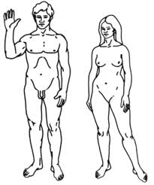
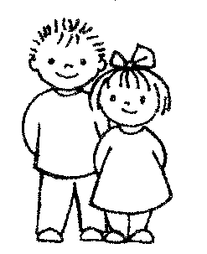
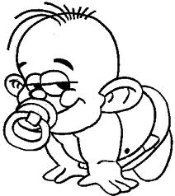
Most frequent CHD
adults
ASD II 25-30%
VSD 21%
children
VSD 42%
ASD II 9%

Slide 11
Lifetime of Diagnosis of CHD
some defects need not be presented / detected in early life
(Portion of all CHD)
60% in babies < 1 year old
30% in children
10% in adults

Slide 12
Epidemiology of CHD
live birth incidence approx. 6-10 cases per 1000
(1 in every 145 babies born)
advances in diagnosis and management of pts. with CHD over the latter part of the 20th century
80-85% of all children with CHD survive to adulthood
prevalence in adult population 280 per 100 000
(CR: 10 000 children and 25 000 adults with CHD)
there are now more adults than children with CHD

Slide 13
Findings in Patients with CHD
physical appearence (syndromes, clubbed fingers, scars)
cyanosis
murmurs
hypoxemia
hypertension
pulmonary hypertension
erythrocytosis (hyperviscosity, sideropenia)
hyperuricemia, gout
ecg changes, chest X-ray changes...

Slide 14

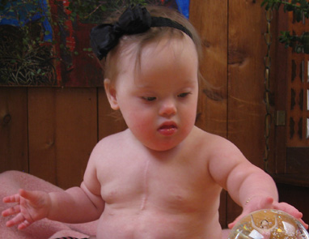
Scars after Cardiothoracic Surgery

Slide 15
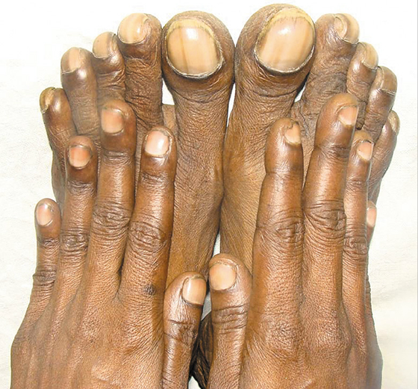
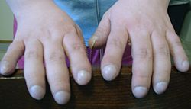
Clubbed Fingers

Slide 16
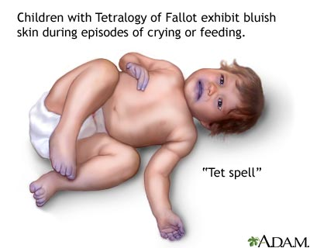
Cyanosis

Slide 17

Hypertension (Systemic Arterial)
BP ≥ 140/90
both arms measurement
BP difference between arms and legs

Slide 18
Pulmonary Hypertension
increased blood pressure
in pulmonary circulation
syst. > 35 mmHg
mean > 25 mmHg
change of shunt direction to R-L
congestion
RV hypertrophy
RV dilatation
RV failure

Slide 19
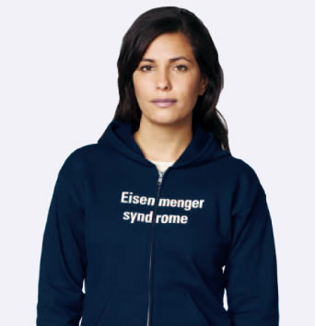
Eisenmenger Syndrome
Pulmonary Hypertension
R-L shunts
hypoxemia, cyanosis

Slide 20
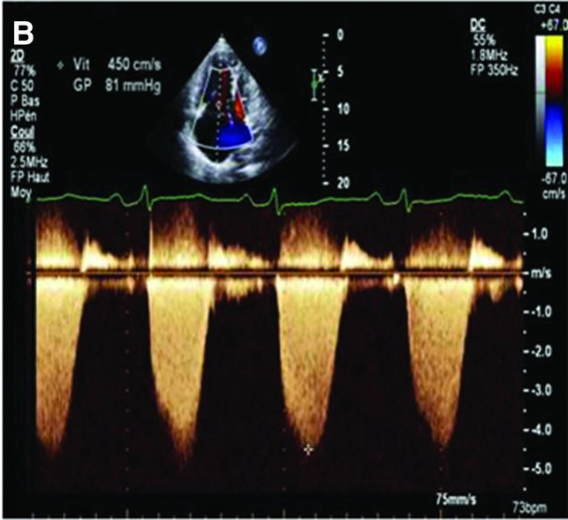
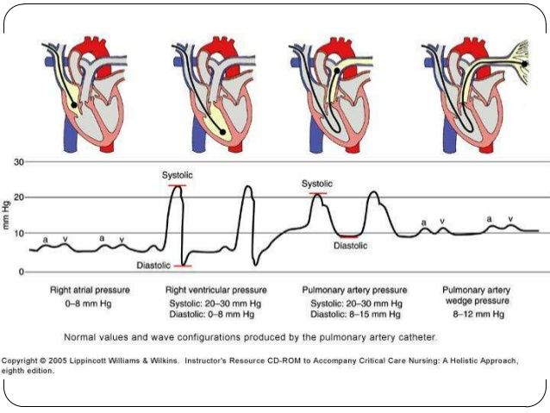
Pulmonary Hypertension
ECHO
CATHETER

Slide 21
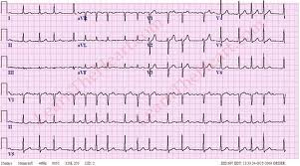
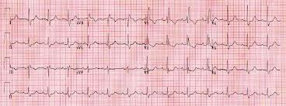
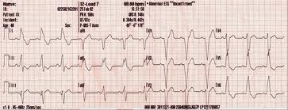
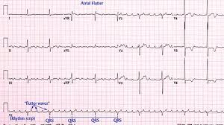
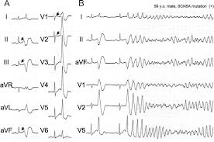
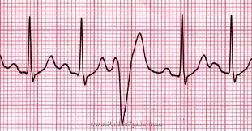
Arrhytmias in Patients with CHD

Slide 22
Etiology of CHD
non-genetic
illness in the mother (rubella, diabetes, lupus)
mother drug ingestion (anti-epileptic, alcohol, lithium)
genetic
isolated heart / GV disorder
disorder associated with genetic syndrome
*The crucial period for fetal cardiac development occurs btw. weeks 6 and 12.

Slide 23
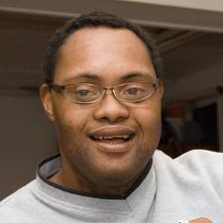
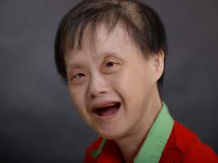
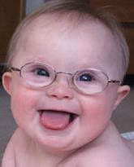
Down syndrome (Trisomy 21)
atrioventricular septal defects
tetralogy of Fallot

Slide 24
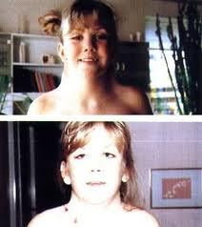
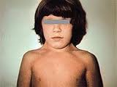
Turner syndrome
coarctation, bicuspid aortic valve

Slide 25
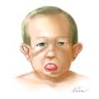
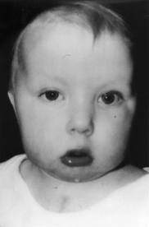
DiGeorge syndrome (CATCH 22)
tetralogy of Fallot, right sided aortic arch,
pulmonary atresia, aortic-to-pulmonary collaterals

Slide 26
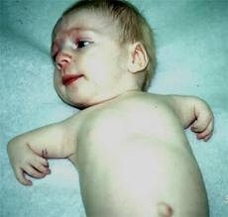

Holt-Oram syndrome
septation defects (ASD, VSD)

Slide 27

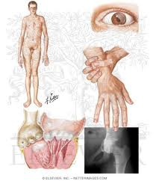
Marfan Syndrome
aortic dilation, aneurysm, dissection; heart valve disorders

Slide 28
CHD Anatomy and Pathophysiology
Septation Defects (ASD, VSD)
Patent Arterial Duct
Aortic Coarctation
Tetralogy of Fallot
Transposition of Great Arteries

Slide 29
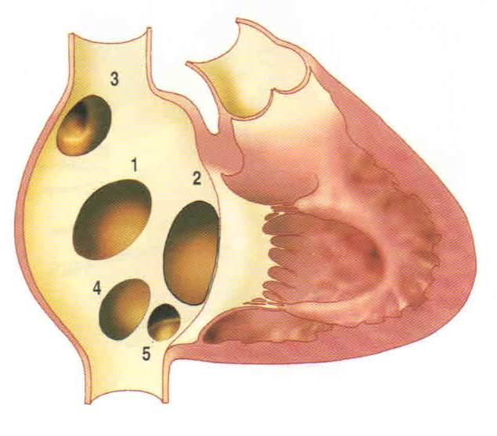
Atrial Septal Defect (ASD)
1 – Secundum type
2 – Primum type
3 – Sinus venosus superior type
4 – Sinus venosus inferior type
5 – Coronary sinus type

Slide 30
ASD Pathophysiology
left to right IA shunt
volume overload
of right atrium
and ventricle
pulmonary hypercirculation
RV dilatation
PH, bidirectional shunt

Slide 31
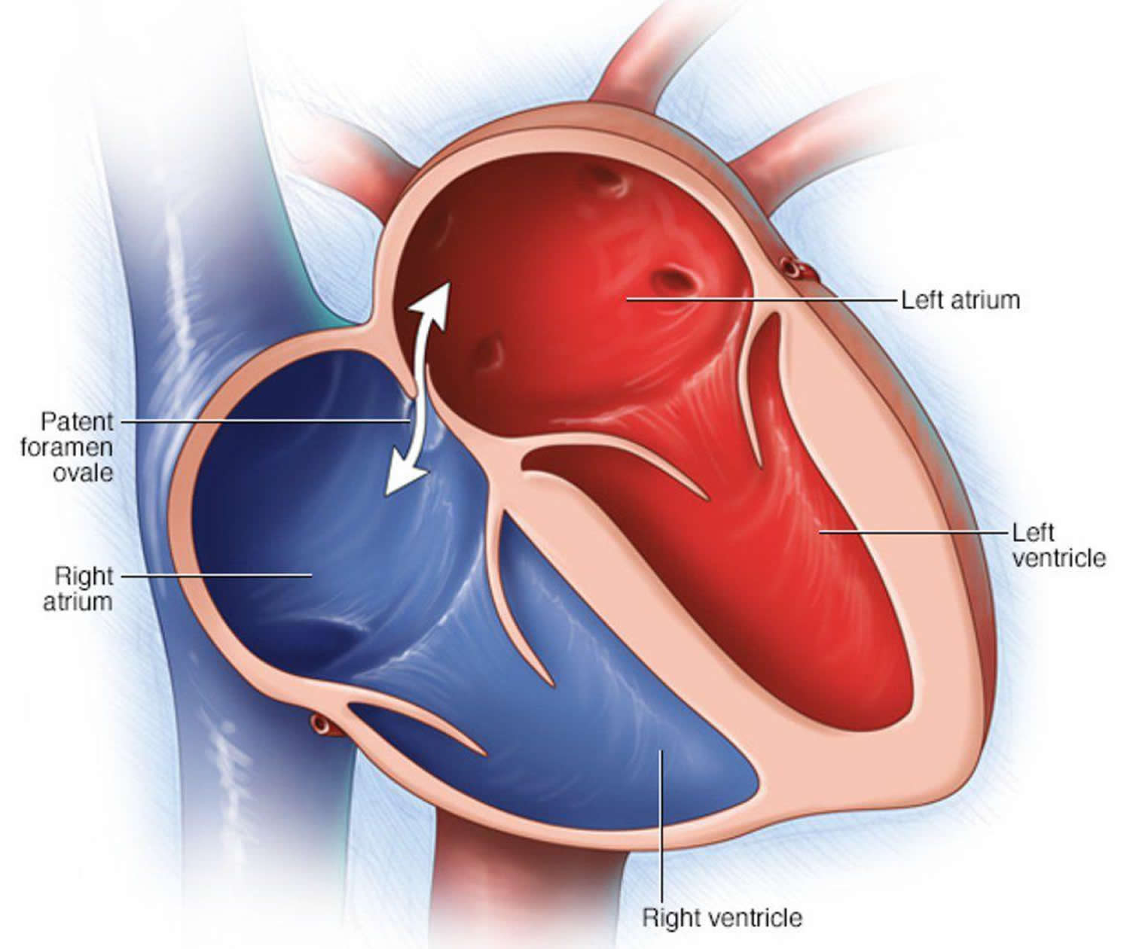
Patent Foramen Ovale (PFO)
25-30% of general population
not considered as CHD

Slide 32
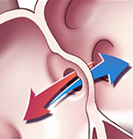
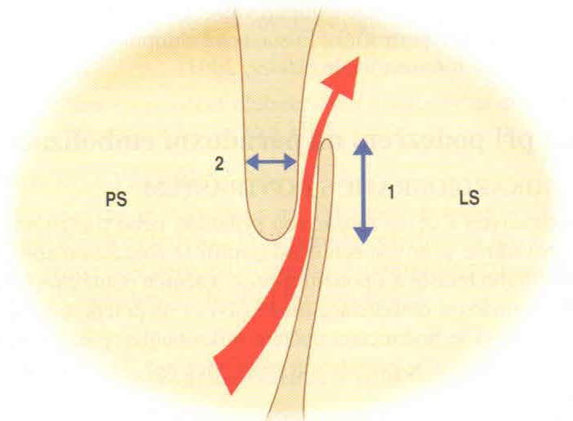
ASD x PFO
CHD
CHD
paradoxical embolism risk

Slide 33
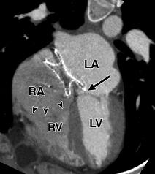
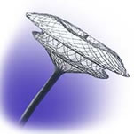
Amplatzer Ocluder - PFO/ASD II Closure

Slide 34
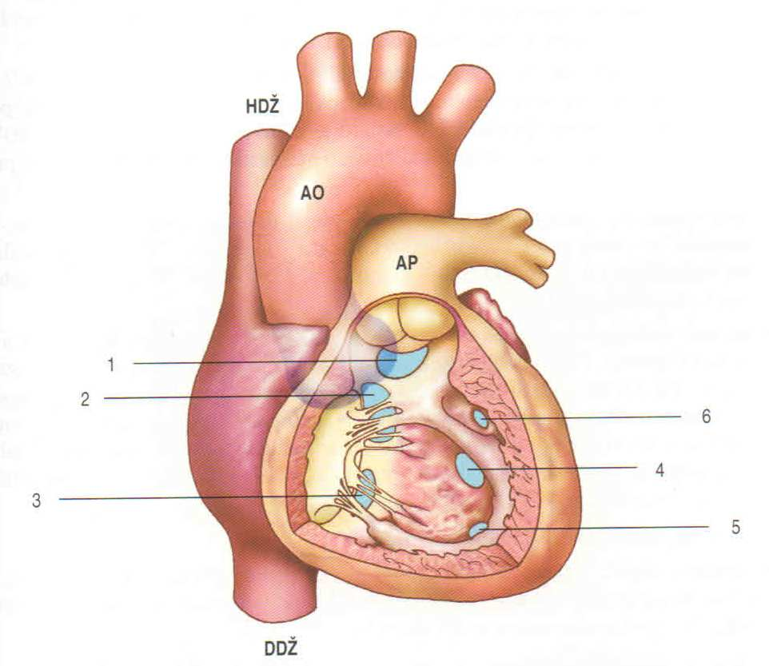
Ventricular Septal Defect (VSD)
1 - Outflow
(Subaortic)
2 - Perimembraneous
3 - Inflow
4 - Muscular

Slide 35
VSD Pathophysiology
left to right IV shunt
pulmonary hypercirculation
volume overload
of left atrium and
left ventricle
PH
RV hypertrophy
right to left shunt
Eisenmenger syndrome

Slide 36
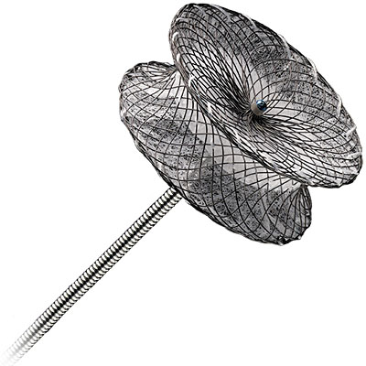
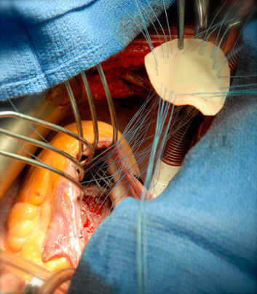
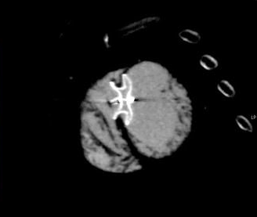
VSD Closure

Slide 37
Patent Ductus Arteriosus (PDA)
L-R shunt PH RV hypertrophy R-L shunt Eisenmenger sy

Slide 38
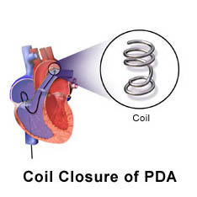
PDA Closure

Slide 39
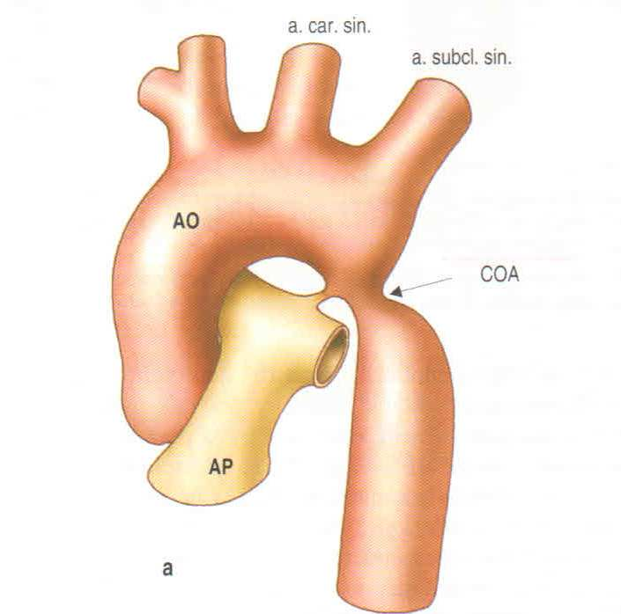
Coarctation of the Aorta
hypertension
in precoarctation area
LV hypertrophy
LV dysfunction
ascend. Ao dilatation
aortic dissection/rupture
*85% assoc. with bicuspid Ao

Slide 40
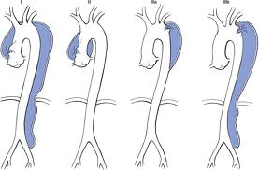
Aortic Dissection

Slide 41
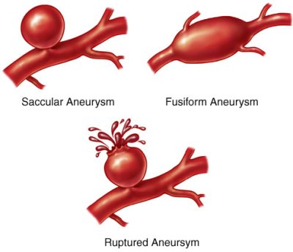
Aortic Aneurysm

Slide 42
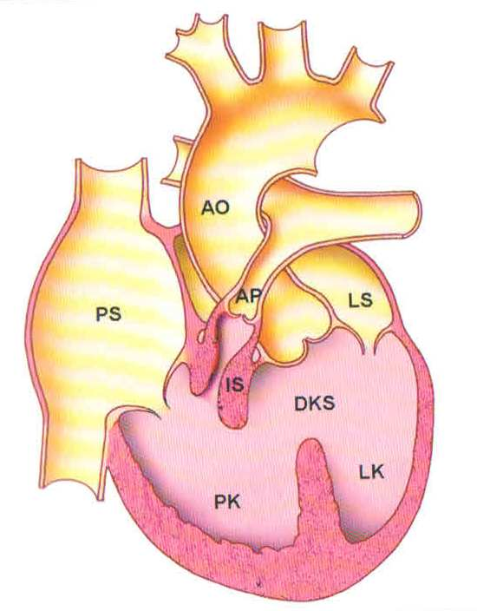
Tetralogy of Fallot (TOF)
ventricular septal defect
overriding aorta
pulmonary stenosis
RV hypertrophy
(atrial septal defect /PFO)
(Pentalogy of Fallot)

Slide 43
TOF Pathophysiology
Pu stenosis
RV hypertrophy
R-L shunt
cyanosis / „pink Fallot“
hypoxemia
RV failure

Slide 44
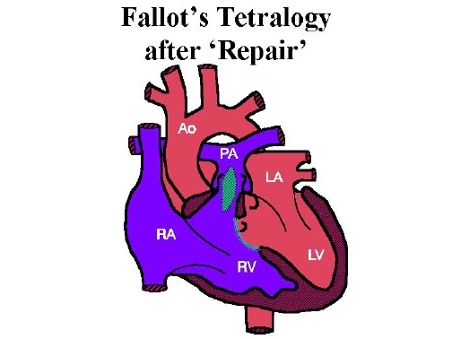
PA patch
VS patch
„normal“ circulation

Slide 45
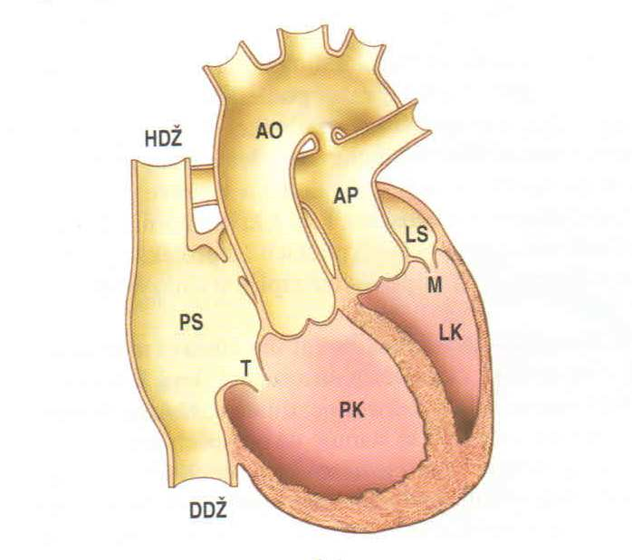
Transposition of the Great Arteries (TGA)
2 isolated circulations
oxygenated blood in isolated pulmonary circulation
deoxygenated blood in isolated systemic circulation
impossible to survive without correction
d-TGA

Slide 46
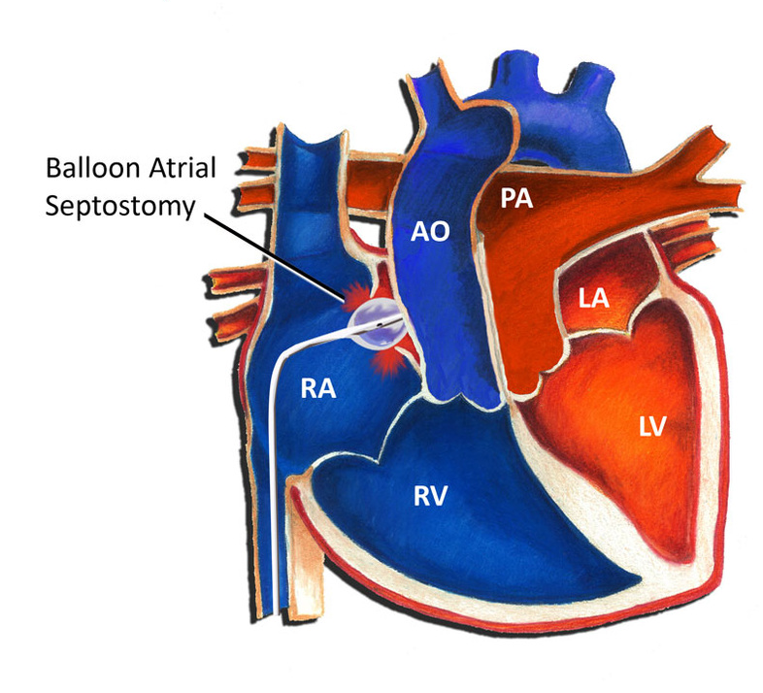
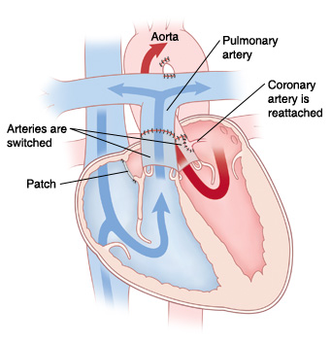
TGA Repair
palliative septostomy
arterial switch

Slide 47

Congenitally Corrected TGA (CCTGA)
„normal“ circulation
RV in systemic circulation
RV dysfunction/failure

Slide 48


Ebstein´s Anomaly of the Tricuspid Valve

Slide 49


Pulmonary Stenosis
valvar
infundibular

Slide 50


Surgical Repair of CHD
corrective
(patch...)
palliative
(connections...)

Slide 51

Fontan Circulation

Slide 52
CHD non-included Congenital Disorders
Bicuspid Aortic Valve 1-2% common population
Patent Foramen Ovale (PFO) 25-30% common population
Persistent Left Upper Vena Cava 0,5%
Cardiomyopathies

Slide 53

Bicuspid Aortic Valve (BAO)

Slide 54

Patent Foramen Ovale (PFO)

Slide 55

Persistent Left Upper Vena Cava

Slide 56
Adult Patient with CHD
symptoms
investigation
difference between patient with CHD and „normal“ cardiology patient
treatment and follow up

Slide 57
Symptoms in CHD (most common)
dyspnea
palpitations
syncope
chest pain
hemoptysis
symptoms of hyperviscosity syndrome
low stress tolerance
fatigue, exhaustion

Slide 58

Hyperviscosity Syndrome
chronic hypoxemia
erythrocytosis
stiff blood
headache, vertigo, bleeding, visual disturbances, seizure, chest pain, dyspnea, difficulty walking, coma

Slide 59
Investigation in Patients with CHD
history, physical exam
ECG, BP, blood oxygen saturation
blood tests
urine tests
chest X-ray
echocardiography
CT scan, MRI
stress testing (spiroergometry, 6-MWT)
QOL questionnaire

Slide 60
Problems associated with CHD in Adults
rezidual findings
non-detected disorders in early life
late indication to operation
arrhythmias
infective endocarditis
anticoagulation
pregnancy and labour in women with CHD
social and work problems
depression

Slide 61
Treatment and Follow-up
surgical repair of disorder
reoperation
anticoagulation therapy/bleeding complications
infective endocarditis prophylaxis/treatment
pharmacology treatment of arrhytmias, PH, HF
non-pharmacology treatment: PM, ICD, CRT
oxygen therapy
heart/lung transplant
psychotherapy

Slide 62
What can the patient with CHD die of?
heart failure
malignant arrhytmias
aortic aneurysm rupture / dissection
infective endocarditis
cardioembolism (stroke)

Slide 63



...but we are here to help every patient with CHD living a full life!

Slide 64

If You have any questions to discuss or need consultation regarding cardiology topics, do not hesitate to contact me by e-mail:
lienka@mail.muni.cz
(ID 39899)

