Slide 1
Handling chemical substances
http://www.rect.muni.cz/nso/
sekce Chemické látky – For foreigners

Slide 2
Hazard classes
Physical hazard | Health hazard | Environmental hazard
explosives gases under pressure flammable substances etc. | acute toxicity skin corrosion skin irritation eye damage carcinogens mutagens etc. | acute / chronic aquatic toxicity

Slide 3
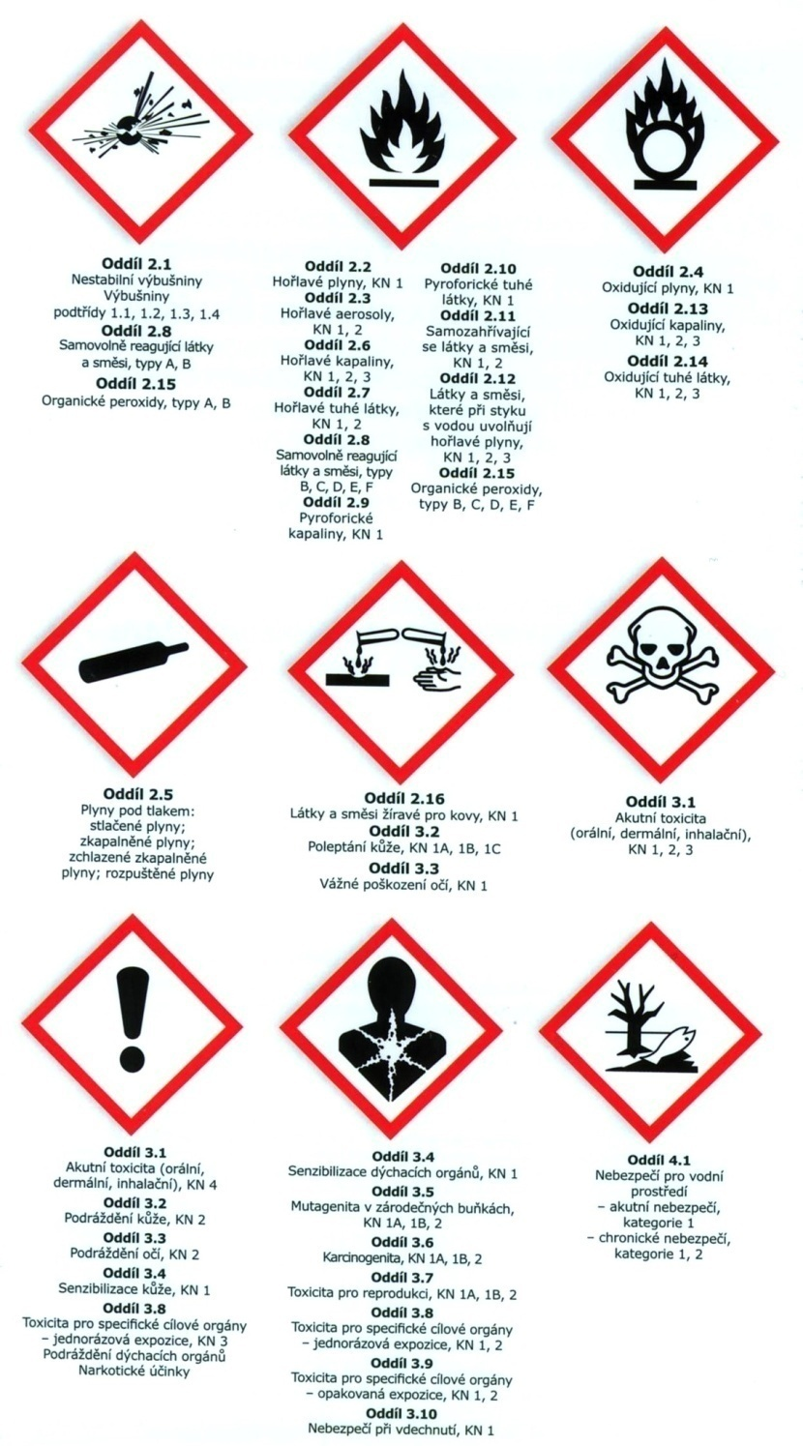
Pictograms for hazard classes

Slide 4
In handling chemical substances, it is the responsibility of everyone to observe:
hazard symbols
hazard statements
precautionary statements
protect human health
protect the environment

Slide 5
Hazard statements - They are intended to form a set of standardized phrases about the hazards of chemical substances
https://en.wikipedia.org/wiki/GHS_hazard_statements
Precautionary statements - They are intended to form a set of standardized phrases giving advice about the correct handling of chemical substances
https://en.wikipedia.org/wiki/GHS_precautionary_statements

Slide 6
Signal word
"Danger" or "Warning"
are used to emphasize hazards and indicate the relative level of severity of the hazard, assigned to a hazard class.
Some lower level hazard categories do not use signal words.

Slide 7
Safety data sheet (SDS)
it is intended to provide workers with procedures for handling that substance in a safe manner,
includes information such as physical data (melting point, boiling point, flash point, etc.), toxicity, health effects, first aid, reactivity, storage, disposal, protective equipment, and spill-handling procedures.
SDS formats can vary from source to source within a country depending on national requirements.

Slide 8
Final test
Test is available in IS.
Limit to pass the test: 13/15.
There is unlimited number of test repetitions.

