Slide 1
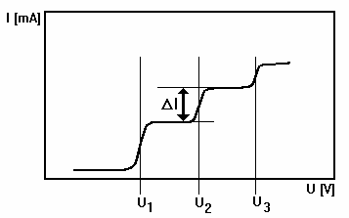
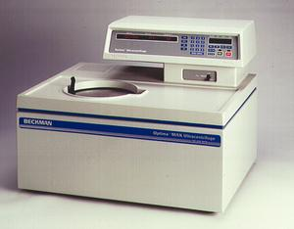
Lectures on Medical Biophysics
Devices for electrochemical analysis
Auxiliary laboratory devices

Slide 2
Lecture outline
This lecture deals with devices used in electrochemical analysis of body fluids and auxiliary devices which can be often encountered in biomedical laboratories as well as surgical theatres, offices etc.
Devices for electrochemical analysis:
  Galvanic cell, electrodes and potentiometry
  Conductometer (coulometer)
  Voltametric and polarographic systems
Auxiliary devices:
  Centrifuges
  Shakers and stirrers
  Homogenisers and disintegrators
  Vacuum pumps
  Washing machines and cleaners
  Thermostatic devices
  Air conditioning

Slide 3
Galvanic cell
Galvanic cell: a device that changes chemical to electrical energy.
Formed by metallic electrodes immersed in an electrolyte containing ions of the same metal. The electrolytes are connected by a semipermeable membrane which allows passage of ions but prevents mixing of electrolytes.
Electrons are released in reaction M_{i} → M_{i}⁺ + e⁻ and consumed in reaction M_{j}⁺ + e⁻ → M _{o} on the second electrode.
After connecting the electrodes the electrons move to places with lack of them. Thus, on one electrode, more ions are released into solution. On the other electrode, some ions are deposited as metal atoms.
In a disconnected galvanic cell a thermodynamic equilibrium appears: certain amount of ions pass (dissolve) as ions into the solution, and free electrons remain on the metal. This results in an electric voltage which electrostatically hinders further passage of ions into the electrolyte. This voltage depends on the kind of metal, i.e. its ability to release ions in a given medium. The resulting voltage is given by the difference of voltages on individual electrodes. The individual electrode voltages cannot be measured because we always need two electrodes at least for the measurement.
The galvanic cell is the principle of potentiometric devices used for the determination of ionic composition of electrolytes including body fluids.

Slide 4
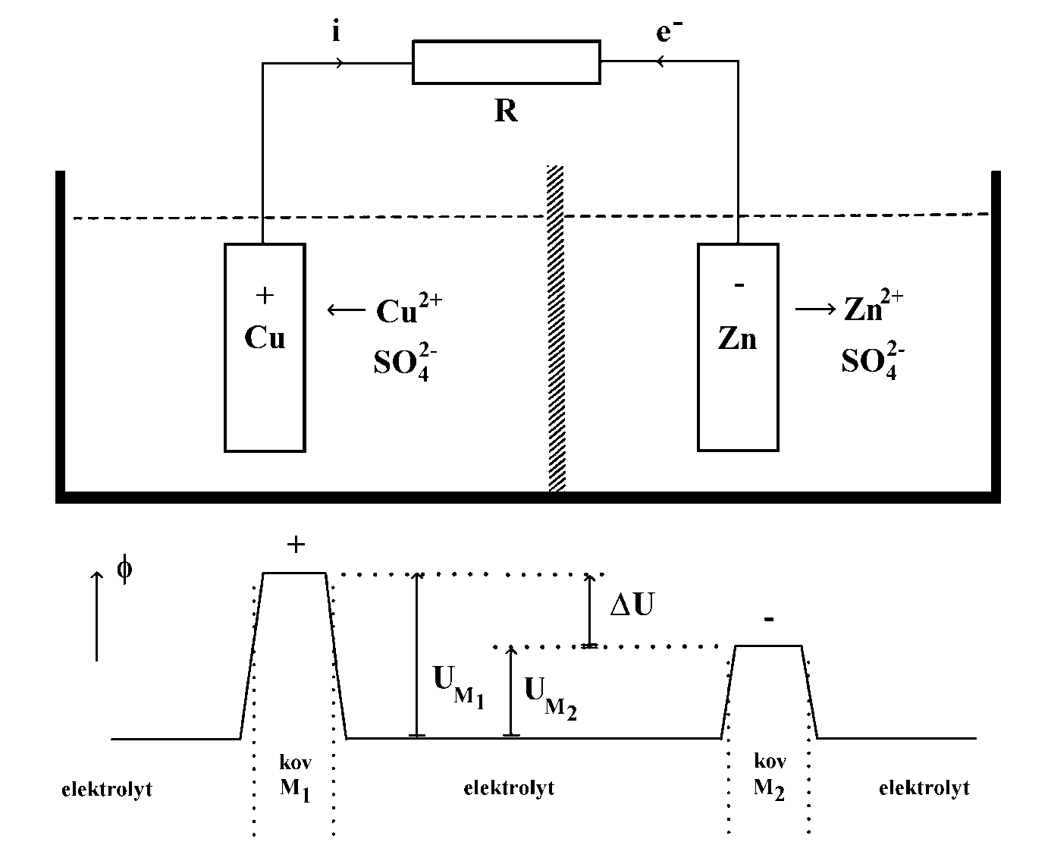
Origin of electric voltage U in the galvanic cell (called Daniell cell in this case). R – working resistor, i – conventional direction of current, e⁻ - direction of electron flow. Down: Changing electric potential Φ in the cell.
Galvanic cell
kov = metall
electrolyte
electrolyte
electrolyte

Slide 5
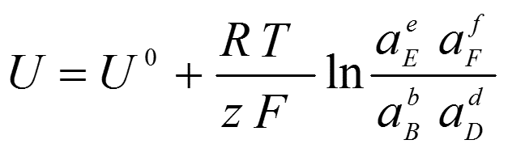
Voltage of Galvanic Cell
The equation, which expresses the voltage of a galvanic cell, is called the Nernst equation. If B, D, E, F are individual components of the reaction mixture, b, d, e, f are stoichiometric coefficients of the reaction and U° the standard EMF (voltage) of the cell then:
When the reagents are in standard state (a = 1), then U = U°.

Slide 6
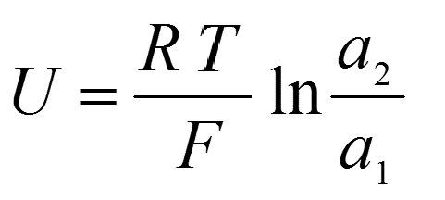
Concentration cell
The concentration cell is formed by two electrodes made of the same metal which are immersed in solution of respective ions of different activity (concentration) a₁ and a₂. Considering the Nernst equation, the standard voltage U° is equal to zero and the second term is simplified (the activities of metals are identical). Then:

Slide 7
Electrochemical methods - electrodes
Electrodes are conductors in contact with an electrolyte. It would be better to speak about half-cells, because they are “halves” of galvanic cells. We already know that certain (equilibrium) voltage arises on them.
Electrodes of the 1st kind: exchange of ions and electrons between the solution and the electrode takes place. They can be cationic (metallic or gaseous hydrogen electrode) with equilibrium between neutral atoms and cations released into solution. Anionic electrodes are possible too. A typical electrode of the 1st kind is the copper electrode immersed in a solution of Cu²⁺ ions.
Electrodes of 2nd kind consist of three parts. The metal is covered by a layer of its poorly soluble salt or hydroxide, and immersed into an electrolyte containing the same anion as the salt or hydroxide. Example: calomel electrode (Hg/Hg₂Cl₂/KCl) and silver chloride electrode (Ag / AgCl / KCl).

Slide 8
Electrodes
Oxidoreduction electrodes are formed by a noble metal conductor (gold or platinum), immersed in a solution containing reduced as well as oxidised form of a substance.
Ion-selective electrodes are formed by membranes permeable to given ions, and their potential depends on the activity of these ions present in solution. The most important ion selective electrode is the glass electrode, specific for H₃O⁺ ions.
Enzyme electrodes are a special kind of ion-selective electrodes. They contain enzyme splitting substrate the concentration of which should be determined. The reaction product must be of ionic character, to be determined by the respective ion selective electrode.
Ion selective and enzyme electrodes are important for biosensor technologies.

Slide 9
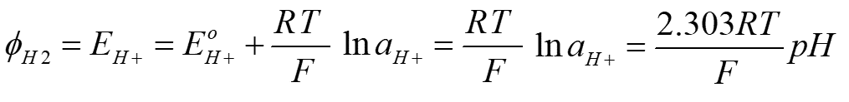
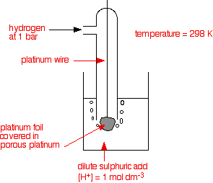
Hydrogen electrode
The standard hydrogen electrode is considered as the standard electrode, with a potential conventionally equal to zero. The potential of any other electrode is defined as the voltage of the galvanic cell formed by the electrode and the standard hydrogen electrode. It is made of platinum covered by platinum black, immersed in a solution of hydrogen ions, and saturated by gaseous hydrogen (bubbling around the electrode and absorbed by the platinum black). The potential of the hydrogen electrode depends on the activity (concentration) of hydrogen ions and equals zero at unit activity of these ions. However, this electrode is not utilised to measure pH in practice because of its difficult preparation. We can write:
where pH = -loga_{H+}
http://www.chemguide.co.uk/physical/redoxeqia/introduction.html

Slide 10
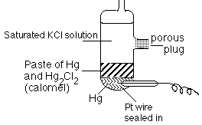
Calomel electrode
The calomel electrode is together with the silver chloride electrode the most important electrode of the 2nd kind. It is used as reference electrode in the determination of potentials of other electrodes. It is made of mercury covered by the calomel layer (Hg₂Cl₂) and KCl solution. The potential of this electrode is given by the equilibrium concentration of Cl⁻ anions in the electrode reaction:
Hg₂Cl₂(s) + 2 e⁻ = 2 Hg(l) + 2 Cl⁻
This equilibrium is also influenced by concentration of KCl. Saturated calomel electrode is usually prepared – solution of KCl is saturated. It is easy to prepare and its potential is reproducible and very stable.
http://www.resonancepub.com/electrochem.htm

Slide 11
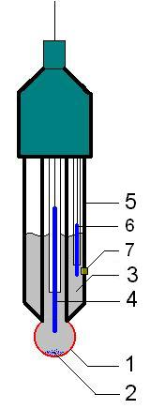
Glass electrode
The glass electrode is an ion selective electrode used in the determination of pH. Its main part is a silver chloride electrode (4) placed in medium of known pH, e.g. in solution of NaCl (2). This solution is separated from a solution with unknown pH by a thin glass membrane (1). It forms a concentration cell the potential of which is given by the activities (concentrations) of hydrogen ions on either side of the membrane, and is partly influenced by alkaline ions present both in the glass and measured solution. For the surface potential of the glass membrane we can write:
E = Eº - 0,059 pH [V],
where Eº is a characteristic electrode constant. The voltage on the glass electrode is measured by electronic voltmeters which display directly the pH values. These instruments are called pH-meters. As a reference electrode (6), the silver chloride or calomel electrode surrounded by 0.1 M HCl solution is usually used. Both electrodes often form an integral immersion body (5). (7) is a porous junction to the measured solution. Modified pH-electrodes can be used directly for pH measurement in blood, gastric juice etc. Microelectrodes can be used directly for pH measurement inside cells.
http://commons.wikimedia.org/wiki/Image:Glass_electrode_scheme.jpg

Slide 12
Potentiometry Devices
Electrochemical devices generally denoted as potentiometry devices, are used for the determination of ion concentrations based on measurement of potential of the respective electrodes.
The most important potentiometric measurement is the measurement of pH.
Except of pH-metry, we can often encounter potentiometric determination of potassium, sodium or calcium ions.
The measuring system always consists of a measuring electrode, reference electrode, and a sensitive voltmeter.

Slide 13
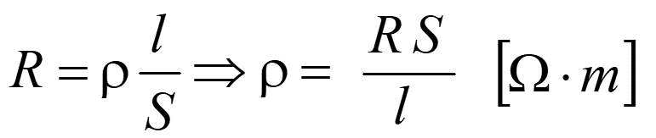
Conductometry (coulometry)
Conductometry (coulometry) is measurement of conductance or conductivity of electrolytes. Electric resistance of a conductor is given by:
where ρ is resistivity, l – length of the conductor, and A its cross-section area. The reciprocal value of resistance is called the conductance, G = 1/R [Ω⁻¹ = siemens, S]. The conductivity γ is the reciprocal of the resistivity (γ = 1/ρ). C is the resistance constant of the conductometric vessel.
The quantities l and A are difficult to measure in most cases. In practice, the resistance constant C is determined from experimentally measured resistance or conductance of an electrolyte with known conductivity.

Slide 14
Conductometry (coulometry)
We can also write:
G = γ/C, γ = GC and C = γR
The conductivity of electrolytes depends on concentration of ions and their mobility, which is of practical importance. To compare conductivities of individual electrolytes, it is suitable to relate the conductivity to unit concentration. The quantity called molar conductivity Λ (lambda) is defined:
Λ = γ/c,
where c is the concentration of the electrolyte.

Slide 15

Conductometers (coulometers)
Conductometers can consist of a common instrument for resistance measurement in a circuit of low-voltage alternating current with a frequency of e.g. 1kHz. The direct current cannot be used, because it causes polarization of electrodes and electrolysis of the solution. The pair of measuring electrodes is made of platinum. The instrument scale is calibrated directly in units of conductance.
Conductometry is used to check purity of distilled water, to check for the quality of potable water, for the measurement of water content in food or soil, etc. Chemists use this method in conductometric titration (see practical exercises).

Slide 16
Polarography and voltametry
Polarography and voltametry are electrochemical analytical methods, which utilise electrolytic processes on polarizable electrodes. Principle of polarography was discovered by Jaroslav Heyrovský (1890-1967) in 1922 (Nobel award for chemistry in 1959).

Slide 17
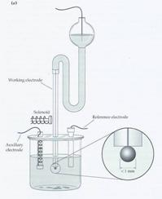
Polarography
Polarography is based on the measurement of the dependence of electric current on the voltage across the mercury dropping electrode (cathode). This voltage usually does not exceed -2 V. Drops of mercury are formed in short regular intervals at the end of the immersed capillary and fall to the bottom of measuring vessel. This means that the mercury surface is renewed after each drop fall.
On the mercury surface, cations are reduced and deposited at the characteristic so-called half-wave potentials which can be read in polarographic curves (polarograms). Reduction of individual cations manifests itself near ‘half-wave’ potentials, as increase in electric current, which is proportional to the concentration of given ions in solution.
Classical setup of polarography
http://www.chem.ntnu.edu.tw/changijy/secondyear/teachingcontent.files/image054.jpg

Slide 18
Example of a polarogram. U₁, U₂, U₃ are so called half/wave potentials of different cations present on the solution. ΔI is the height of the polarographic half-wave proportional to the concentration of the respective cation.
Polarography

Slide 19
Modifications of polarography (optional)
The sensitivity of polarography was increased by several modifications (the detection limit ranges from tens to hundreds of nM concentrations of ions). We can measure using the hanging mercury drop electrode (not falling) so that the analysed ions are collected on the electrode surface during linearly increasing voltage.
A modern version of polarography is the differential pulse polarography. The voltage increases linearly but small voltage pulses (e.g. 50 mV) are superimposed.
In oscillographic polarography, alternating voltage is applied. The electrode process is then given not only by faradic currents (the exchange of electrons between the electrode and the ions) but also by capacity currents (the electrode surface behaves like a capacitor). The surface capacity depends on the way of deposition of adsorbed substances. So we can study also the substances which cause no faradic currents, such as nucleic acids and their components. This kind of polarography is sometimes called tensametry.

Slide 20
Voltametry
In general, voltametry is the measurement of the dependence of electric current on the voltage across the electrodes placed in an electrolyte. The measuring electrodes are made of various inert conductors (platinum, gold, graphite). The platinum electrodes can rotate.
The main advantage of mentioned electrode materials is the possibility to use them as anodes. (The mercury electrode cannot be used, because it would dissolve in the electrolyte.) It means that we can follow not only reduction processes but also oxidation. Voltametry can be also done as oscillographic or differential pulse voltametry.
In both polarography and voltametry, we use the calomel electrode as a reference electrode. It is connected to the measured electrolyte by means of a salt bridge (gel containing ions to ensure good electric conductivity).

Slide 21
Auxiliary laboratory devices
In modern laboratories oriented towards biomedical research or analyses of samples for diagnostic purposes, we can encounter many auxiliary devices. Except for the analytical ultracentrifuge, they do not serve for measurements but we cannot do it without their help. These auxiliary devices can be very expensive, and they need qualified operators. Some of these devices are explained in other lectures, in practicals (balances, thermometers) or chemistry lessons.

Slide 22
Centrifuges
The centrifuge works using the sedimentation principle, where the centripetal acceleration is used to separate substances of greater and lesser density. To accelerate sedimentation, we use centrifuges or ultracentrifuges.
In the laboratories, we encounter table-top centrifuges which reach 10³ – 10⁵ rpm. Low-speed centrifuges are used to accelerate sedimentation of bigger particles (e.g. cells). The particles sediment to the bottom of glass or plastic cuvettes. It is then possible to change the medium (supernatant) to resuspend the particles – they are washed in this way.
The rotor space of the centrifuge can be cooled to avoid degradation of biological materials.
Fractionation of a mixture of dispersed particles to individual components.
Example: analysis of blood plasma or cerebrospinal fluid.

Slide 23
Ultra-Centrifuges
High-speed centrifuges (ultracentrifuges reaching 10⁵ rpm or more) serve for the separation of biomacromolecules. They can be equipped with an optical system for observation of the movement of individual macromolecular fractions.
The cuvettes with samples must be precisely balanced otherwise the unbalanced rotor starts vibrate which can lead to the violent destruction of the whole device. The rotors of ultracentrifuges are made of very strong materials (e.g. titanium alloys) considering the high stresses which they have to withstand.

Slide 24
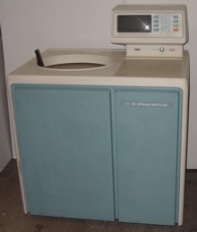
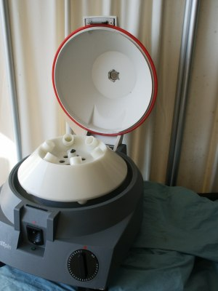
Centrifuges
This ultracentrifuge can achieve 100,000 rpm with centrifugation „forces“ of up to 802,400 g.
A small table-top centrifuge with open lid of the rotor space. Six positions for cuvettes (centrifugation tubes) can be seen.

Slide 25
Centrifuges - Sedimentation
Sedimentation velocity depends on the difference of particle and medium densities, on particle size and shape. Three forces act on the sedimenting particle:
1) Buoyant force according the Archimedes principle:
F = ρVa = ρVrω²
where ρ (rho) is the particle density, V particle volume, a centrifugal acceleration, r radius of rotation, ω (omega) angular velocity.

Slide 26
Centrifuges - sedimentation
2) Centrifugal force:
F = mrω²
where m is particle mass.
3) Frictional force in the liquid (Stokes formula)
F = 6πrηv
where r is radius of the particle, η (eta) dynamic viscosity, v velocity of the particle moving in the liquid.

Slide 27


Centrifuges - sedimentation
The sedimentation of the particles is characterised by the sedimentation coefficient s [s] (centrifugal velocity per unit acceleration):
v = dr/dt - therefore we can write:

Slide 28
Centrifuges - sedimentation
After separation of variables and integration we obtain equation:
ln r = sω²t + const.
s can be obtained from the slope of the graph of lnr vs. t. This graph (line) can be obtained by measurement of the particle position r at different time t during sedimentation.
The sedimentation coefficient of small protein molecules is about 10⁻¹³ s. ⇒ unit of sedimentation coefficient:
svedberg S ( = 1·10⁻¹³ s).
Visualisation of sedimenting particles (proteins, DNA etc.): measurement of UV light absorption, index of refraction, fluorescence etc.

Slide 29
Centrifuges – sedimentation analysis
Separation of different particles is due to different sedimentation velocity of the various types of particles (fractions). Two methods:
1) Pure solvent is overlaid by thin layer of analysed particle suspension. After certain centrifugation time, the positions of the individual fractions in the tube are determined - zonal sedimentation.
2) Sedimentation within a solution with a density gradient. At first, a solution with a density gradient of a suitably dissolved compound is prepared (often CsCl) by intense centrifugation. Thereafter the sedimenting fraction stops its movement in position, where the buoyant force equals to the centrifugal force.

Slide 30
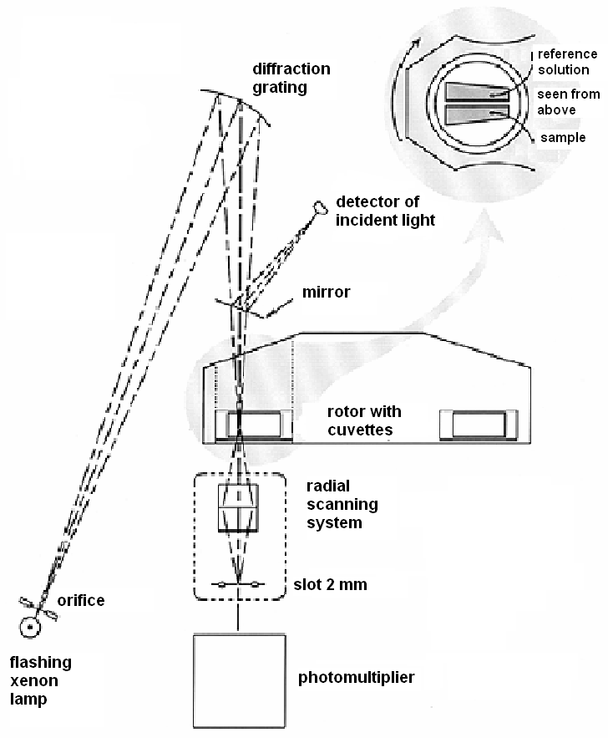
Analytical ultracentrifuge scheme according: http://www.embl-heidelberg.de/ExternalInfo/geerlof/draft_frames/flowchart/Characterization/AUC/auc.html#Why Analytical Ultracentrifugation

Slide 31
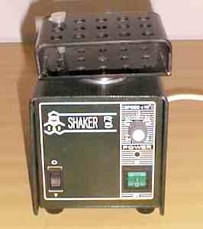
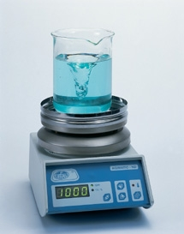
Shakers and stirrers
Shakers are used to accelerate chemical reactions, to dissolve poorly dissolvable substances, to prevent sedimentation etc. They are equipped with holders or plates with holes to fasten flasks or test tubes. The vessels perform swinging or rotational movements. Some shakers have housings, which allow keeping of constant temperature.
The stirrers serve for similar purposes.It is advantageous to combine heaters and magnetic stirrers. A magnet rotates below the heater or a rotating magnetic field is produced, to put in rotation a plastic or glass-sealed iron rod on the bottom of a beaker.

Slide 32
Homogenisers and disintegrators
Tissue samples must often be homogenised before analysis - use homogenisers and ultrasonic disintegrators.
Rotation homogeniser is made of ground glass – a glass cylinder revolves swiftly in a test tube, the diameter of which is only slightly bigger than the diameter of the cylinder. The sample under pressure is pushed into the space between the cylinder and tube wall, where the grinding occurs.
In some modern devices, the sample is pushed through a jet under very high pressure (up to hundreds of MPa), reaching velocities up to 500 m/s. Big internal friction and adiabatic compression causes temperature increase – cooling is necessary.

Slide 33
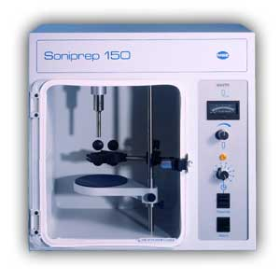
Homogenisers and disintegrators
Ultrasonic disintegrator works with low-frequency ultrasound (~ tens kHz) produced by a magnetostrictive transducer – core of a solenoid energised by alternating current, is put in oscillation. The core is connected to a titanium tip (horn), which is immersed into the homogenised fluid. Ultrasonic oscillation and cavitation destroy almost any material. These disintegrators are very effective but they require cooling. Sensitive biological molecules can be also damaged by free radicals arising during cavitation. The homogenised sample is in this case called the sonicate.

Slide 34
Air pumps / vacuum pumps
In the laboratory we frequently need very low pressure or vacuum. Some devices have built-in vacuum pumps (e.g. electron microscopes, particle accelerators etc.). Sometimes we need only underpressure to suck liquids away from vessels which cannot be turned bottom-up.
The simplest device of this kind is the water air pump, which is based on the principle of lowering hydrostatic pressure in a liquid streaming from a narrowed tube (see Bernoulli equation). These pumps can lower the air pressure to about 1% of normal value. Disadvantage: big consumption of water.
Much more lower pressure can be achieved by oil air pumps. Almost perfect vacuum can be reached by diffusion vacuum pumps.

Slide 35

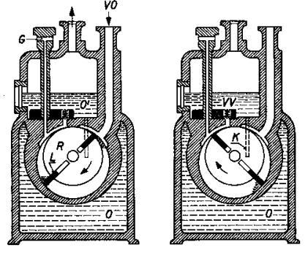
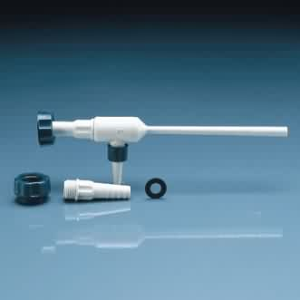
Air pumps / vacuum pumps
The principle and design of the water air pump
Oil air pump

Slide 36
Laboratory washing machines and cleaners
Laboratory glass is washed in automatic washing machines which are more sophisticated versions of household dishwashers. Their inner space is fitted to the shapes and sizes of laboratory glass, and the final rinsing is done by distilled or deionised water, the source of which must be connected to the machine. Special detergents must be also used.
In case of poorly removable impurities, we can use devices called ultrasonic cleaners or ultrasonic baths. We can use them for cleaning of dental tools, or optician’s workshops. Low-frequency high-power ultrasound is emitted into a special cleaning bath. The impurities are destroyed and removed by ultrasonic oscillations and cavitation. Similar sources of ultrasound are used also in chemistry to speed up chemical reactions (sonocatalysis).

Slide 37
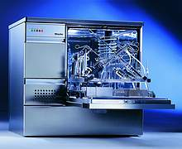
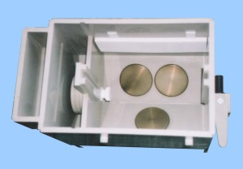
Laboratory washing machines and cleaners
automatic washing machines
ultrasonic bath seen from above (circular plates are sources of ultrasound)

Slide 38
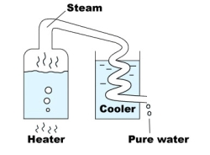
Distilling apparatuses and deionizers
When preparing solutions, growing media, rinsing laboratory glass, filling thermostated water baths etc. we need big amounts of distilled, redistilled and deionised water. It is produced by distilling apparatuses and deionizers.
Classical distilling apparatus consist of a tank with tap water, in which is an electric heating body with power of several kW. Formed steam comes into cooler, condenses there and flows into a reservoir. Then it can flow into second distillation cycle. So we produce twice distilled (redistilled) water. The distilled or redistilled water can also be made free of dissolved gases, e.g. by boiling under low pressure.
An analogy of the distilling apparatus is the deionizer, which removes ions and some other impurities from water by means of ion exchangers (see chemistry). The exchanger can be regenerated for repeated use. The quality of deionised water is fully comparable with or even better than the quality of distilled water.

Slide 39
Sterilisers and autoclaves
Today many sterile laboratory vessels and other aids are disposable (plastics test tubes, Petri dishes, cultivation flasks, tips for automatic pipettes) but we need sometimes to sterilise other things, including solutions, which cannot be bought in sterile form.
Besides application of ionising radiation or chemical agents, we can sterilise by means of increased temperature. One-hour action of air at a temperature of 200 °C guarantees full sterilization. This principle is used in electrical hot-air sterilisers. Faster sterilisation of glass or some solutions can be achieved in autoclaves (high pressure vessels, analogy of pressure cookers), in which overheated water vapour with pressure two-times higher than the atmospheric pressure acts on the sterilised items.

Slide 40
Thermostatic Devices
Many experiments or laboratory tests have to be done under constant temperature. It is easier to keep temperature higher than the surrounding than keeping it lower, because we need only a controlled heater. For keeping lower temperature, we need both a cooler and a heater.
A thermostated water bath consists of a pump, heater, temperature sensor and water tank. Water is pumped around the heater. The temperature sensor (thermistor, thermocouple) produces a signal when a pre-set temperature is achieved.
No thermostat can stabilise the temperature absolutely. In standard thermostates, the temperature of circulating water oscillates in range of tenths of degree.
These devices are used to maintain constant temperature in cultivation boxes, sterilisers etc. Some cultivation boxes are equipped with an apparatus able to keep constant also concentration of CO₂ (e.g. 5%), which is necessary for growing of cells originating from the human organism.

Slide 41
Refrigerators and freezers
Aside from common refrigerators and freezers, in which the temperature does not decrease below -20 °C, we can encounter also laboratory deep-freezers with temperatures from -60 to -80 °C. Such low temperatures are necessary for long-term storage of sensitive biological materials, including frozen cells and tissues. Before placement in the deep-freezer, these materials are quickly frozen mostly by liquid nitrogen.
Due to high price and value of the stored materials, the deep-freezers are equipped with alarms which start to sound when the internal freezer temperature exceeds certain temperature, e.g. during failure of electricity.

Slide 42
Air conditioning and humidifiers
The air conditioning of the labs has two purposes. At first, it ensures necessary comfort for the staff, namely in summer, when the room temperature is increased not only by hot weather, but also by heat produced by the devices working in the lab. Secondly, it serves for keeping constant laboratory conditions. The air conditioning is of considerable importance in rooms where ventilation is not possible (e.g., labs with biological hazard).
Central air conditioning is less advantageous (the lab can be easily contaminated from outside or vice-versa). Best is to have local air conditioning with filtering of the circulating air.
The air conditioning should control not only room temperature but also relative air humidity.
Air humidifiers (evaporating, spraying, ultrasonic) need regular service (cleaning, disinfection), because they may become sources of dangerous infections. Similar problems may appear in central air conditioning (e.g., so-called legionnaires disease, deadly lung infection).

Slide 43
Author:
Vojtěch Mornstein
Content collaboration and language revision:
Carmel J. Caruana
Last revision October 2921, soundtrack addition November 2020

