Slide 1
Antifungals (antimycotics)
MUDr. Alena Máchalová, Ph.D.

Slide 2
Antimycotics
Chemotherapeutics for the treatment od infections caused by pathogenic fungi:
↑ incidence: immunodefficiency, DM, radiotherapy, chemotherapy, HIV, transplantations
Mycotic infections:
superficial (local) - skin and mucous membranes
systemic infections - individuals with weakened immunity (therapy with ATB, CHT, cytostatics,...)

Slide 3
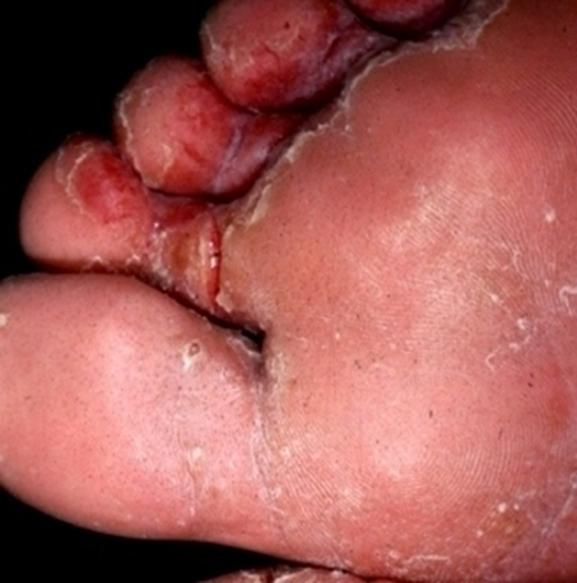
Superficial mycoses
Dermatomycoses
trychophyton
epidermophyton
microsporum
dermatophyton (tinea)
Superficial candidiasis
Skin, nails and mucosae (oral cavity, vagina),
infections caused by Candida yeasts (most often Candida albicans).

Slide 4
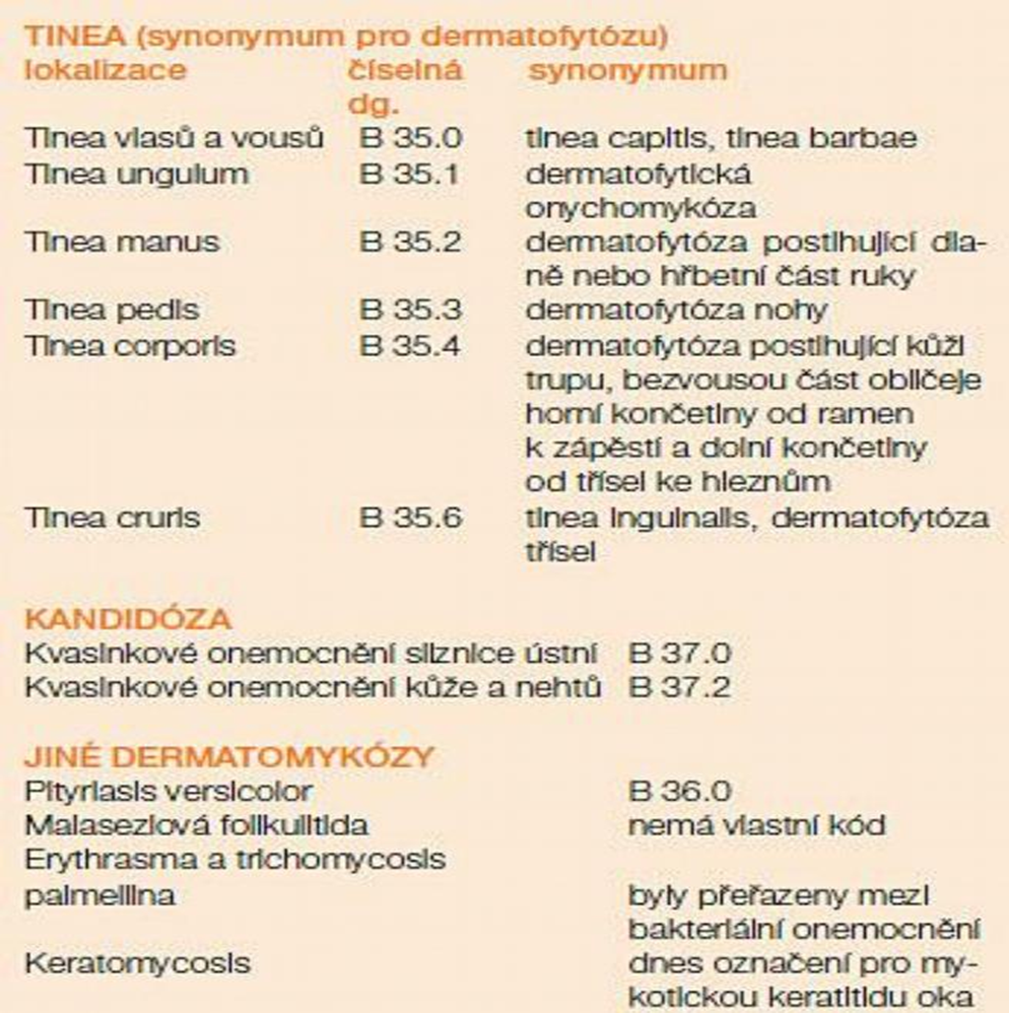

Slide 5
Fungal Infections of the Skin
Dermatophytes
 | Tinea corporis (ringworm), includes tinea gladiatorum and tinea faciei
 | Tinea capitis (ringworm of the scalp)
 | Tinea cruris (jock itch)
 | Tinea pedis (athlete's foot)
 | Tinea unguium (onychomycosis)
 | Tinea manuum (commonly presents with “one-hand, two-feet” involvement)
 | Tinea barbae (beard infection in male adolescents and adults)
 | Tinea incognito (altered appearance of dermatophyte infection caused by topical steroids)
Candida (yeast) and mold, which may cause onychomycosis or coexist in a dystrophic nail
Pityriasis versicolor (formerly tinea versicolor) caused by Malassezia species
Uncommon fungal skin infections that involve other organs (e.g., blastomycosis, sporotrichosis)

Slide 6
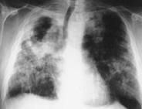
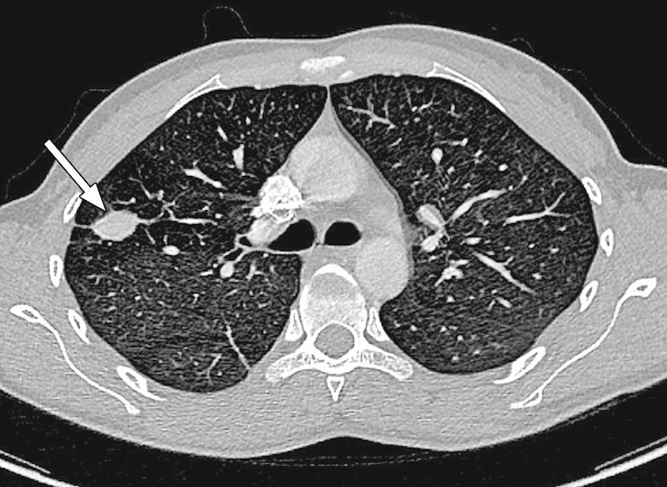
Systemic mycoses
Lung aspergilosis
Pneumocystis pneumonia (P.carini)
Legionella pneumonia
Cryptocococal meningitis and endocarditis
Rhinocerebral mucomycose
Systemic candidiasis

Slide 7
Risk factors for invasive candidiasis
Iatrogenic factors Factors of the patient
> 3 antibiotics chronic neutropenia
> 4 days at ICU immunosuppression
> 2 days on ventilator DM
central venous catheter colonization by candida
parenteral nutrition elderly person
abdominal surgery

Slide 8
The most common agents of mycotic infections
Yeasts
Candida species
C.albicans 50-80%
C.tropicalis
C.krusei
C.glabrata
C.parapsilosis
C.lusitaniae
Moulds
Aspergillus sp.
A.fumigatus 80-90 %
A.flavus 10-15 %
A.terreus 2-5 %
A.niger

Slide 9
The treatment of fungal infections
curing deep tissue mycosis is difficult; patient may die even if given modern effective antifungals
treatment may last up to 4-6 weeks
surgical resection of the most affected focus may be required

Slide 10
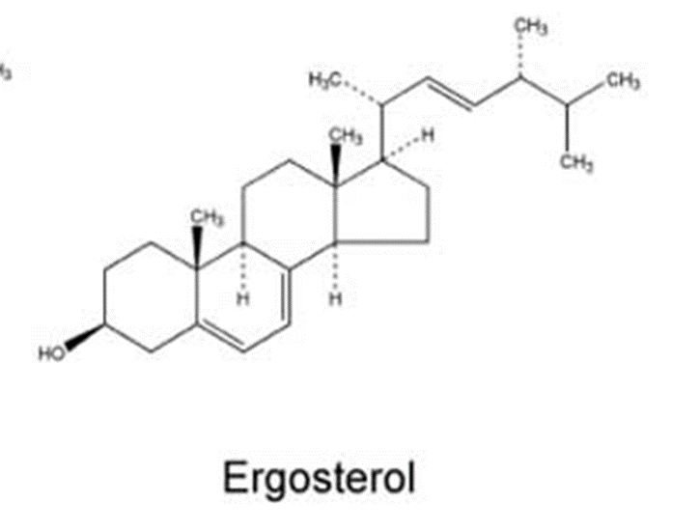
Mechanism of action of antifungals
Specific - interfering at a defined place of micromycet metabolism
Nonspecific - they usually work also on bacteria and can be considered antifugical antiseptics
Blockage of synthesis fungal lipid (ergosterol) in cell membranes

Slide 11
ANTIMYCOTICS
squalene
oxidosqualene
lanosterol
Ergosterol
1-3 glukan
ALLYLAMINES
HYDROXYPYRIDONE
DERRIVATIVE
squalenepoxidase
ENZYME ACTIVITY
REDOX STABILITY
GENETIC INFORMATION
AZOLES
Syntesis of cell wall components
IMPAIRMENT OF MYCOTIC CELLT METABOLISM
lanosterol-14α -demethylase
POLYENES
Ciclopirox
ECHINOCANDINS

Slide 12
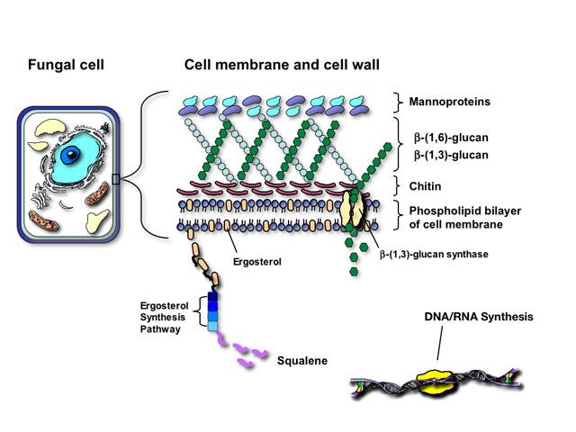
Mechanism of action of antifungals
Inhibition
Inhibition
Inhibition

Slide 13
Classification of antifungals according to the mechanism of action
Antifungals - classification by site of action
Wall/membrane
Intracellular
Others
Ergosterol inhibitors
Echinokandins - beta glucan synthesis inhibitors kaspofungin
Azoles - lanosterol 14 alpha-demethylase inhibitors
Polyenes - ergosterol binding
Allylamines – inhibitors of squalen monooxidaase terbinafin
Antimetabolites pyrimidine analogues
Mitosis inhibitors
Eg. ciklopirox
Imidazoles
Triazoles
Thiazoles
Flucytosin
Griseofulvin

Slide 14
Classification of antifungals
Polyenes | systemic | amphotericin B
 | local | nystatin, natamycin
Antimetabolites | systemic | flucytosine
Azoles | systemic | fluconazole, itrakonazole vorikonazole posakonazole
 | local | clotrimazole, ekonazole, oxikonazole, terkonazole,…
Echinocandines | systemic | caspofungin, anidulafungin
others | systemic | Alylamines - terbinafin, griseofulvin
 | local | ciclopiroxolamin, tolnaftate

Slide 15
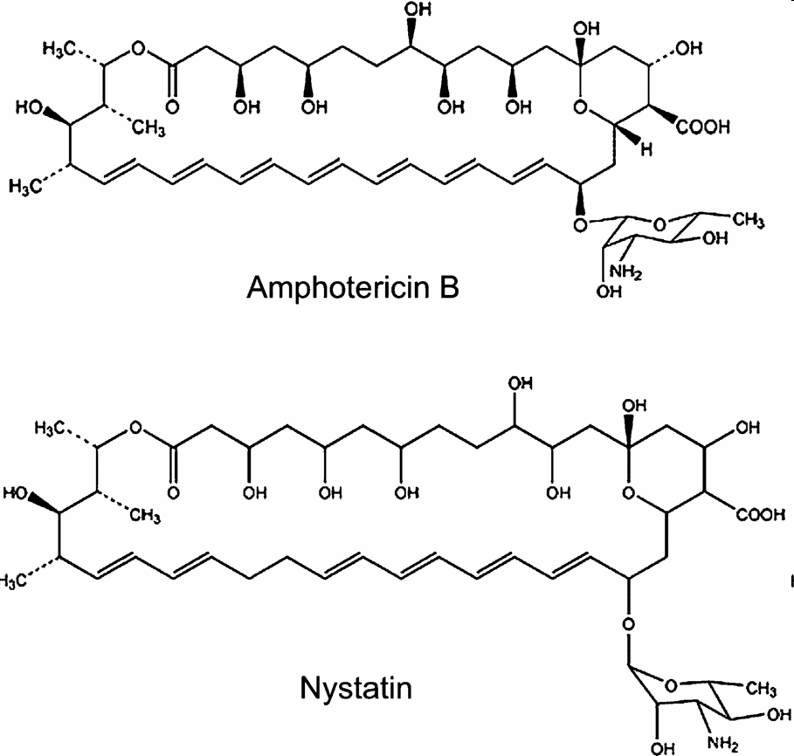
Polyenes
Nystatin
Natamycin
Amphotericin B

Slide 16
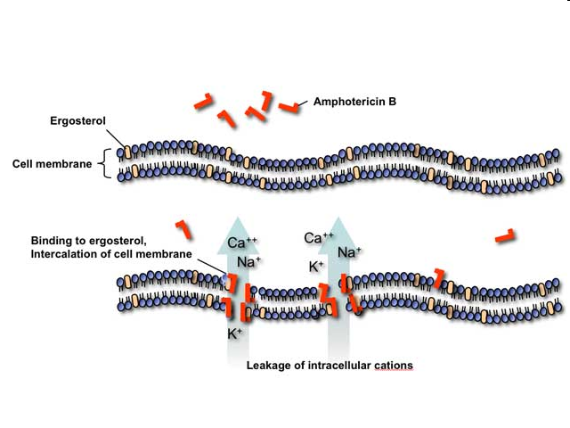
Systemic polyenes
Amphotericin B
broadest spectrum, lowest resistance
toxic, most of patients percieve some grade of toxicity/AE
drug of choice in aspergiloses
MoA: binding to ergosterol in cell wall
I: severe mycotic infections (life theratening), „prophylactic“ use in oncologic treatment, after trasplantations…

Slide 17
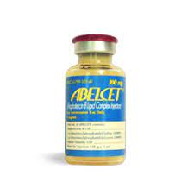
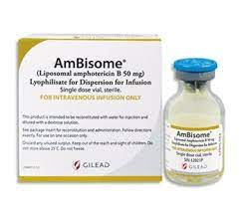
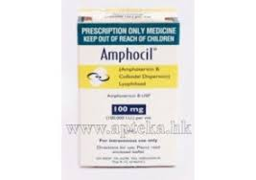
Amphotericin B
PK:
poor GIT bioabailability, administered i.v.- lipidic complex (ABLC)
difficult distribution to tissues (HEB)
binding to proteins (95%) and cholesterol
T1/2 15 days!
Toxicity
Acute manifestations:
fever, chills, rigor, nausea, vomiting,
tachycardia, hypotension, bronchospasm
headache, muscle pain, joint pain,
allergies,
thrombophlebitis
Chronic manifestations:
nephrotoxicity (total dose) followed by electrolyte imbalance,
neuropathy
normocytic normochromic anemia (therapy: erythropoietin)
trombocytopenia
Prevention of toxicity:
Liposomes - ↓nefrotoxicity
3 prep:
Amfotericin B lipid complex (Abelcet)
Liposomální Amfotericin B (Ambisom)
Koloid dispersion of amphotericin B (Amphocil)
Premedication:
Hydratation
Paracetamol
Antihistamines
Cortikosteroids

Slide 18
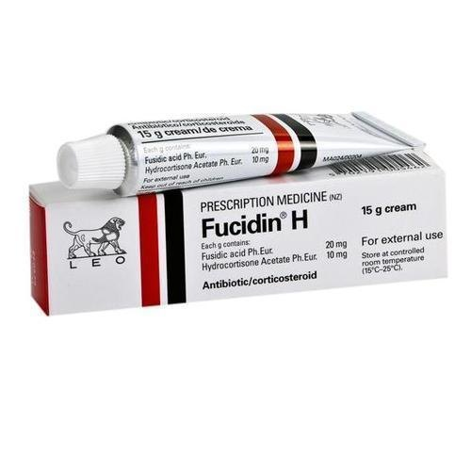
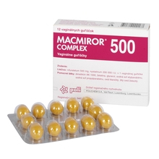
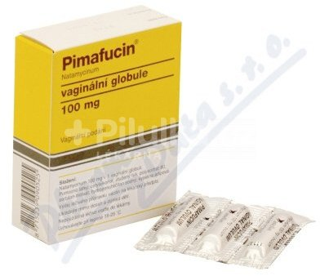
Topical polyenes
Nystatin (fungicidin):
I: superficial mycoses, yeasts, the most often used antifungal drug in oral medicine
Fungicidin, Macmiror
Natamycine:
I: Candida, Trichomonas vaginalis, anguli infectiosi, vulvitis, onychomycoses
Pimafucin, Pimafucort
18

Slide 19
Antimetabolites
Flucytosin

Slide 20
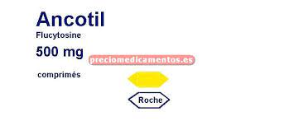
Antimetabolites
Flucytosine (5-fluorocytosine)
Systemic effects, narrow spectrum – candida, cryptococcus
Good penetration into tissues (HEB, placenta, breast milk) – genotoxic, teratogenous
MoA: inhibition of nucleic acid synthesis
fungistatic
Monotherapy is rarely used - Synergism with amphotericin B and azoles
AE: granulocytopenia, GIT intolerance
genotoxic, teratogenous

Slide 21
Azoles
Systemic Local
Imidazoles
Triazoles
Clotrimazole
Ekonazole
Oxiconazole
Fenticonazole
Tioconazole
Ketokonazole
Mikonazole
Fluconazole
Posaconazole
Itraconazole
Voriconazole
Systemic candidoses
Systemic candidoses
Systemic aspergilloses
Dermacologics and gynecologics, are not absorbed
AE: irritation,
contact allergies

Slide 22
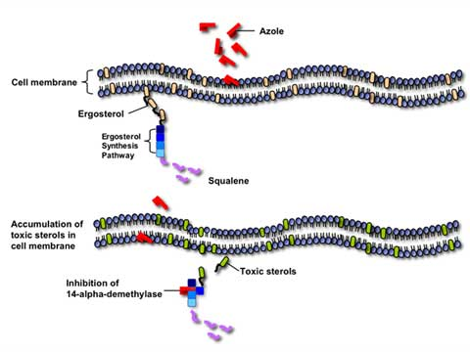
Azoles
MoA:
inhibition of C-14-α-demethylase (CYP450)
CYP and Pgp inhibition !!! - interactions + AE

Slide 23
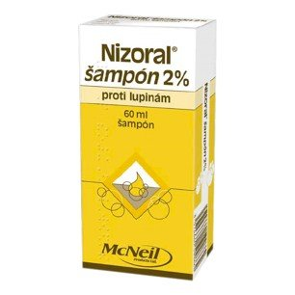
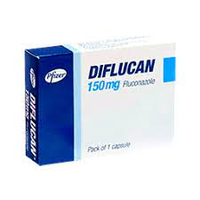
Azoles
Ketoconazole
accumulation in the skin (5 days after discontinuation)
p.o., skin, hair and nail infections (dermatophytes and yeasts)
for the treatment of endogenous Cushing's syndrome
Flukonazol
p.o. i.v.,
the only hydrophilic – excretion in urine
the highest therapeutic index, the least AE (GIT, allergies, headaches), DDI
Great clinical experience, very often used also in children

Slide 24
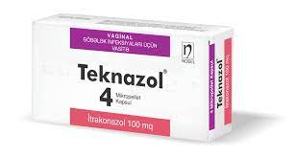
Azoles
Itraconazole
p.o., variable absorption, 1st pass effect, β-cyclodextrin
i.v.
high antifungal specificity incl. Aspergillus),
does not penetrate into the CNS
AE: increased liver enzymes, skin reactions

Slide 25
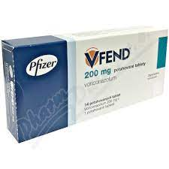
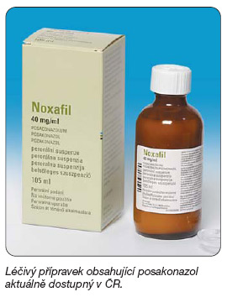
Azoles
Voriconazole
- Better effect in invasive aspergillosis than amphoterecin B
- p.o. and i.v., almost complete F (95-96%)
- High fungicidal aktivity– candida, aspergillus - invasive life-threatening infections (aspergillosis, mucormycosis) candidoses rezistant to fluconazole
Posaconazole
- second-line drug
- prohylaxis of candidiasis in risk patients, aspergillosis resistant to AmB or itraconazole, or in intolerance of 1st line drugs

Slide 26
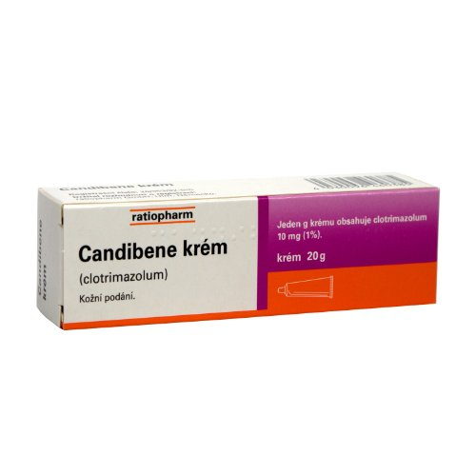
Topical (local) azoles
Clotrimazole (depot in stratum corneum)
Econazole (also efficient against some bacterias)
Oxiconazole, Fenticonazole, Tioconazole
Dermacologics and gynecologics, are not absorbed
AE: irritation, contact allergies

Slide 27
Allylamines
Terbinafine
terbinafin

Slide 28
ANTIMYCOTICS
squalene
oxidosqualene
lanosterol
Ergosterol
1-3 glukan
ALLYLAMINES
HYDROXYPYRIDONE
DERRIVATIVE
squalenepoxidase
ENZYME ACTIVITY
REDOX STABILITY
GENETIC INFORMATION
AZOLES
Syntesis of cell wall components
IMPAIRMENT OF MYCOTIC CELLT METABOLISM
lanosterol-14α -demethylase
POLYENES
Ciclopirox
ECHINOCANDINS

Slide 29
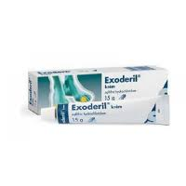
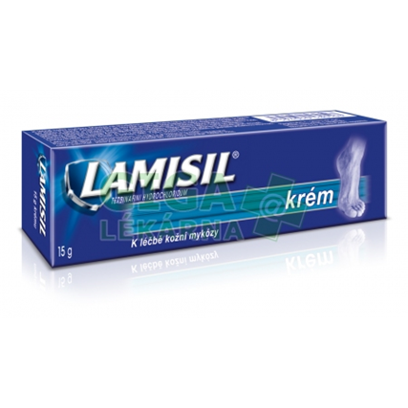
Allylamines
Terbinafine
MoA: block of squalenepoxidase
acummulation in the adipose tissue and skin
fungicidal activity up to 3 w after discont.
synergistic effect with ketoconazole
AE: dyspepsia, loss of apetite
I: tinea, candidiasis, onychomycosis

Slide 30
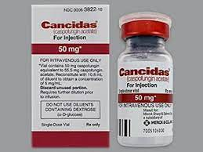
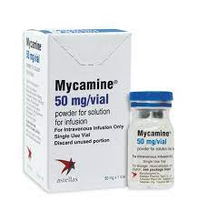
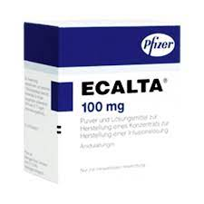
Echinocandins
= lipopeptides
Caspofungin (Cancidas)
Invazivní kandidóza, aspergilóza
Micafungin (Mycamine)
Invazivní kandidóza
Anidulafungin (Ecalta)
Invazivní kandidóza

Slide 31
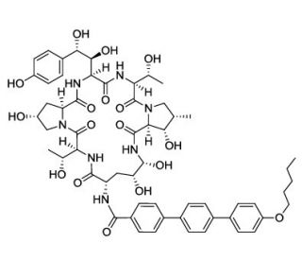
Echinocandins
MoA: inhibition of glucan synthesis
(cell wall component of many fungi and yeasts)
parenteral administration
synergism when combined with azoles or polyenes
not metabolized via CYP
I: alternative therapies for severe invasive mycoses (aspergillosis, invasive candidiasis)
1st choice in hemodynamic instable patient with severe infection
AE: minimal toxicity, flebitis, GIT AE, hypokalemia
Notes:
cílové místo působení echinokandinů není přítomno v buňce savců - minimální toxicita
Echinocandins comprise a ring of six amino acids linked to a lipophilic side-chain. All drugs in this group are synthetic modifications of echinocandin B, which is found naturally in Aspergillus nidulans.
Caspofungin active in vitro against a wide variety of fungi, and it has proved effective in the treatment of candidiasis and forms of invasive aspergillosis that are refractory to amphotericin. Oral absorption is poor, and it is given intravenously, once daily.
Anidulafungin is used mainly for invasive candidiasis; again it is given intravenously. The principal side effects of both drugs include nausea, vomiting and diarrhoea, and skin rash. The relatively new micafungin is also mainly used for treating invasive candidiasis. It shares many of the side effects of the group but may also cause serious hepatotoxicity

Slide 32
Other antifungal drugs
Ciklopirox(-olamin)
Tolnaftate
(Griseofungin)

Slide 33
Ciclopirox-olamine
topical fungicidal antimycotic agent
+ G+/G- bacteria, mycoplasms, trichomonades
MoA: chelates Fe³⁺ (➨ metaloproteins function abruption)
➨ i. cytochrome – blocks energy metabolism of the mycotic cell
➨ inh. catalase, peroxidase – block antioxidative protection
Cytoplasmatic membrane – block of transporters
- deplete essent. AA (Leu), nucleotides, ..
antioxidant - scavenger ROS (OH•)
inhibitor AA ➨ inh. synthesis a LT in human PMN cells
antiinflammatory activity in vivo
Notes:
birch tar –betulae
beech tar – fagi pix

Slide 34
Tolnaftate
OTC drug for the treatment of tinea pedis, tinea cruris, dermatophytosis
Fungicid
MoA similar to terbinafine
Notes:
birch tar –betulae
beech tar – fagi pix

Slide 35
Griseofulvin
obsolent
Narrow spectrum, fungistatic
MA: interaction with microtubules – mitotic poison
administered orally
acummulation in stratum corneum, hair, nails
I: dermatomycoses
AE: GIT irritation, alergy, leucopenia, hepatotoxicity, nerologic disorders
CYP inducer
Notes:
dermatophyte infections of the skin, hair, and nails not adequately treated by topical therapy
isolated from cultures of Penicillium griseofulvum. It interferes with mitosis by binding to fungal microtubules. It can be used to treat dermatophyte infections of skin or nails when local administration is ineffective, but treatment needs to be prolonged. It has largely been superseded by other drugs.
The plasma half-life is 24 h, but it is retained in the skin for much longer. It potently induces cytochrome P450 enzymes and causes several clinically important drug interactions

Slide 36
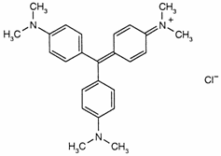
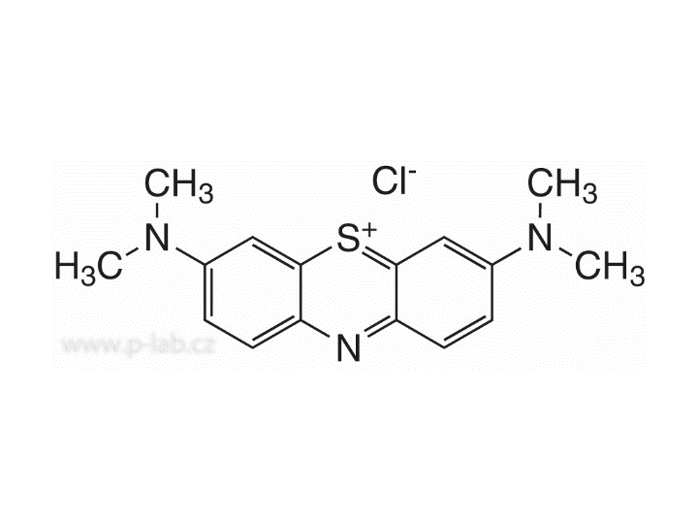
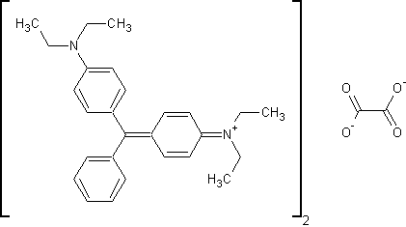
ANTIMYCOTICS
Nonspecific antifungals
1) Acids and derivatives: Ac. salicylicum
Ac. boricum
Ac. undecylenicum
Ac. benzoicum
2) Phenols: resorcinol, hexachlorophene
3) Organic dyes:
crystal gentian - (Methylrosanilinii chloridum)
methylene blue - (Methylthioninii chloridum)
brilliant green - (Viride nitens)

Slide 37
ANTIMYCOTICS
Nonspecific anfufungals
4) Aldehydes: formaldehyde, glutaraldehyde
5) Halogens and derivatives: iodine, iodine-povidon, iodine-glycerol
chlorine
6) Oxidizing agents: KMnO4 , H2O2 (1-3%)
7) Tars: Lithanthracis pix
Betulae pix
Fagi pix…
Notes:
birch tar –betulae
beech tar – fagi pix

