Slide 1
Department of Gynecology and Obstetrics
Brno University Hospital and
Masaryk University, Faculty of Medicine
head: doc. MUDr. Vít Weinberger, Ph.D
Menopause and HRT
Meixnerová I., Tvarožek S.
Obstetrics and Gynecology - lectures
2020

Slide 2
Menopause and HRT
Key words
Perimenopause (climacteric)
Menopause
Premenopause
Postmenopause
Induced menopause
Senium
Hormonal replacement therapy

Slide 3
Menopause and HRT
Definition
Perimenopause (Climacteric)
the period of transition between the fertile age of a woman and the onset of senium
physiologically between 45 and 60 years
Premature ovarian failure (insufficiency) – before 40 years
Menopause
last menstrual bleeding
defined retrospectively 12 months after the last menstrual bleeding
Typically occurs between 49 and 51 years of age

Slide 4
Menopause and HRT
Definition
Premenopause
period of time within 12 months before menopause
menstrual cycle (MC) is still preserved
ovarian function is progressively decreasing
symptoms of menopausal syndrome are already appearing
MC can be irregular, decreasing number of ovarian cycles
Decrease in progesterone levels, relative predominance of estrogen

Slide 5
Menopause and HRT
Definition
Postmenopause
begins 12 months after the last menstrual bleeding
minimal estrogen production – hypergonadotropic hypoestrism
estrogens of extragenital origin (adipose tissue)
constantly elevated FSH level (40 IU/l and more)
LH-FSH ratio <1; elevated LH ( 3-7x ) and FSH level ( 4-10x )
high levels for 2-5 let, then gradual decrease in gonatropin level
with the end of postmenopause starts the senium – decline of secondary sex characteristics reduction of steroid production in adrenal glands after age of 60

Slide 6
Menopause and HRT
Anatomic changes
caused by estrogen deficiency, depletion of ovarian follicles
termination of ovarian function, atrophy
endometrium - premenopausal hyperproliferation
or glandular cystic hyperplasia
- postmenopausal atrophy
vagina - loss of elasticity, shortening, thinning of the mucosa, disappearance of lactobacilli,
atrophy of the uterus, vulva, ligaments and pelvic floor muscles,
skin (dry, wrinkled), hirsutism, breast atrophy, change body weight
pelvic floor – pelvic organ descensus and prolaps

Slide 7
Menopause and HRT
Climacteric syndrome
Symptoms associated with climacterium
Climacteric (menopausal) syndrome
vegetative
organic
metabolic

Slide 8
Menopause and HRT
Climacteric syndrome vegetative
vasomotor symptoms
hot flashes
night sweats
palpitation
changes in psychic
mood changes, depression, anxiety, mournfulness, exhaustion
memory impairment, loneliness, irritability,
loss of libido, headache, sleep problems, loss of energy

Slide 9
Menopause and HRT
Climacteric syndrome organic
estrogen deficiency
estrogen receptors are present in the vagina, urethra, bladder trigon and pelvic floor muscles, in the skin
atrophic vulvovaginitis, dyspareunia, pruritus, chronic vaginitis
stress incontinence, urge incontinence
atrophic senile urethritis, hypoestrogenic cystopathy
thinning of the epidermis, faster skin aging, loss of elasticity
decreasing estradiol level causes a decrease in SHBG - an increase in free testosterone levels (hirsutism)

Slide 10
Menopause and HRT
Climacteric syndrome metabolic
osteoporosis loss of bone mass, disorder of bone architecture,
tendency to fractures – compression fractures of the vertebrae, femoral neck and wrist
atherosclerosis
estrogens have a cardioprotective effect (prevents HDL degradation by inhibiting hepatic lipase)
estrogen deficiency - decrease in HDL, increase in LDL, triglycerides
and plasma cholesterol
cardiovascular disease, ischemic heart disease

Slide 11
Menopause and HRT
Osteoporosis
loss of bone density, bone microarchitecture impairment, Increased susceptibility to fractures
in the CR 7 % of population, almost 35% in postmenopausal women
postmenopausal osteoporosis - caused by estrogen deficiency
from the age of 30 begins a loss of bone mass of 0.1 - 1% per year
in early postmenopause 1/3 of women: loss of bone density of up to 7% per year - fast loosers
significant estrogen deficiency in fertile age - after ovariectomy, loss of bone density up to 7% per year
clinically: bone fracture, bone and joints pain

Slide 12
Menopause and HRT
Osteoporosis – risk factors
age, premature menopause, ovariectomy, GnRH analogues
anorexia, malabsorption, low weight
immobility, smoking, alcoholism
long-term use of corticoids
hyperparathyroidism (PTH increases bone resorption)
metabolic syndrome, diabetes, hepatopathy, nephropathy, chronic gastrointestinal inflammation
rheumatoid arthritis

Slide 13
Menopause and HRT
Osteoporosis - diagnostics
anamnesis - risk factors, family history, the age of menopause, fractures, drugs, diseases
Somatic examination – weigt, loss of height, ability to get up and walking
X-ray examination - side image of Th and LS spine densitometry
Densitometry – measuring of bone mineral density (bone loss)
Quantitative computed tomography (QCT)
Heel ultrasound bone scans – less accurate
Biochemical blood analysis, vitamin D level, markers of bone resorption (carboxy-terminal telopeptide CTx) and bone formation (alkaline phosphatase and osteocalcin)

Slide 14
Menopause and HRT
Densitometry
Principle: X-ray absorption in bone mass
Vertebrae L1 – 4, proximal femur including neck, distal forearm
Degree of decalcification is assessed according to deviation from the average values in healthy young people of the same sex – T-score
normal T-score -1,0 and higher
osteopenia T-score -1,0 to -2,5
osteoporosis T-score -2,5 and lower
Repeated measurements at intervals of 1-2 years on the same machine
Indicated in women at high risk of osteoporosis – long-term corticoid treatment, age over 65 years, thyreopathy

Slide 15
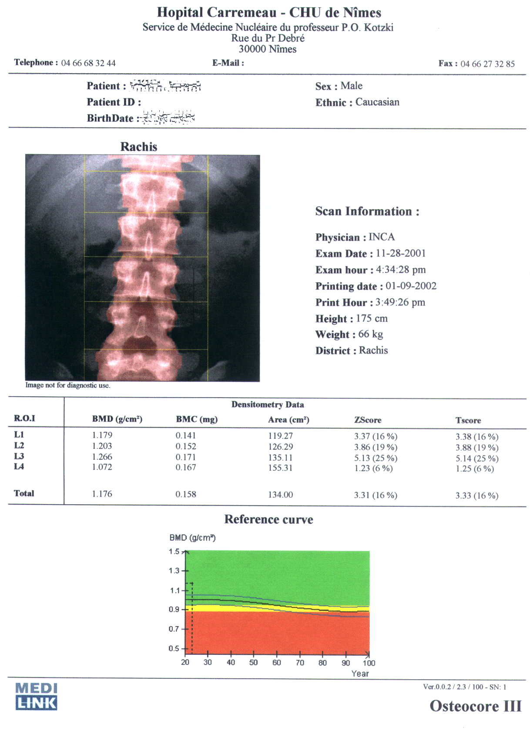
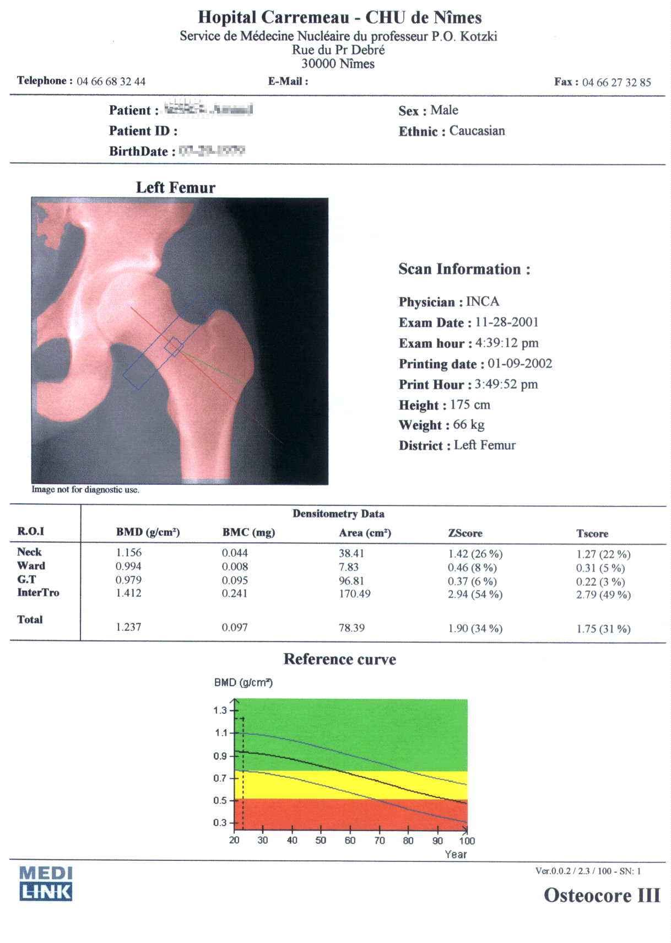
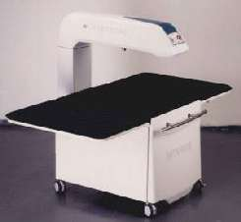
Menopause and HRT
Densitometry

Slide 16
Menopause and HRT
Osteoporosis - therapy
physical activity, nutrition (dairy products, fish), stop smoking
calcium - the recommended daily calcium intake in postmenopausal women is 1200mg (dairy products)
vitamin D - the target level of vitamin D is 50 -75 nmol/l, dose of 800 IU/day in combination with calcium reduces the risk of fracture
HRT – reduces bone loss, increases the risk of breast cancer

Slide 17
Menopause and HRT
Osteoporosis - therapy
Tibolon – STEARs (selective tissue estrogenic activity regulator), comparable effect to HRT, does not increase breast density, does not stimulate the endometrium to grow
Bisphosphonates - inhibition of osteoclastic resorption
Osteoanabolic treatment – a derivative of PTH hormone Teriparatide
Raloxifen – SERM (Selective estrogen receptor modulator), an estrogen receptor agonist in bone, does not affect the endometrium

Slide 18
Menopause and HRT
Pharmacotherapy in menopause
non-hormonal – phytoestrogens – soy (Estrovone), red clover (Fytofem), Alfalfa (Medicago sativa), cimicifuga (Fytofem), bee products (Sarapis)
- SSRIs - antidepressants
hormonal - ovarian hormone replacement
HRT - estrogens + progestins
ERT - estrogens
Tibolon – steroid analogue, does not affect endometrium, the drug of choice in patients with a history of endometriosis,
has a protective effect on bone mass (Livial, Ladybon)

Slide 19
Menopause and HRT
HRT indication
menopausal syndrome – vasomotor symptoms
– mental problems
estrogen deficiency syndrome – organic (urogenital atrophy) – metabolic (osteoporosis)
anticipated effects of long-term use– prevention of Alzheimer's and Parkinson's disease, prevention of senile macular degeneration, senile blindness, tooth loss and colon cancer (contrary to long-term use)

Slide 20
Menopause and HRT
HRT contraindication
breast cancer, estrogen dependent tumors
endometrial cancer, unclear uterine (vaginal) bleeding
active hepatopathy, severe liver disease
thromboembolic disease - pulmonary embolism, phlebothrombosis
arterial thromboembolism - myocardial infarction, angina pectoris

Slide 21
Menopause and HRT
Examination before HRT
Anamnesis
Gynecological examination, ultrasound
Gynecologic Cancer Prevention
Mammography
Blood pressure and weight check
Densitometry – in women with risk of osteoporosis

Slide 22
Menopause and HRT
HRT side effects
Brest tension and pain, fluid retention
nausea and headache, lower limb cramps
thromboembolic complication
uterine bleeding

Slide 23
Menopause and HRT
General principles of HRT
premenopause
Gestagen substitution, intrauterine hormonal system(IUS)
low-dose monophasic contraception
perimenopause
combined sequential estrogen - gestagen therapy
low-dose therapy, if not effective, increase the dose
Period maintenance – according to the patient 's wishes (up to 52 yo)
postmenopause
combined continuous estrogen - gestagen therapy

Slide 24
Menopause and HRT
General principles of HRT
In women with uterus – ALWAYS combined substitution with gestagens!
- long-term administration of estrogens without gestagens increases the risk of endometrial cancer
In women without uterus (after hysterectomy) only estrogen therapy
HRT should be discontinued 4-6 weeks before surgical procedure
early start - start of treatment no later than 5 years after menopause
duration of therapy 5-10 years
individual approach

Slide 25
Menopause and HRT
HRT
therapeutic regimes
cyclic – 3 weeks of application, one week break with withdrawal bleeding
sequential – continuous application of estrogen with the addition of progestin in the second half of the menstrual cycle
continuous – application without break
Application forms
oral, transdermal, percutaneous, intramuscular, intranasal, subcutaneous and local (vaginal)

Slide 26
Menopause and HRT
HRT drugs
estradiol valerate + levonorgestrel
Klimonorm EV 2mg + LNG 0,15mg cyclic (not available in CR)
estradiol valerate + medroxyprogesterone acetate
Divina EV 2mg + MPA 10mg cyclic (not available in CR)
Indivina EV 1mg + MPA 2,5mg, EV 2mg/ MPA 5mg continuous
estradiol valerate + cyproterone acetate
Climen 2mg/1mg cyclic, sequential
estradiol valerate + dienogest
Velbienne EV 1mg + dienogest 2mg continuous

Slide 27
Menopause and HRT
HRT drugs
estradiol benzoate + testosterone
Folivirin EB 5mg + T 50mg intramuscular every 4 – 6 weeks
estradiol hemihydrate
Estrofem 2mg, 1mg
Estrimax 2mg
Estrahexal skin patch 2mg, 4mg
Dermestril 25, 50 skin patch 2mg, 4mg
Oestrogel – gel
Vagifem – vaginal suppositories
Linoladiol – vaginal cream
Lenzetto – 1,53mg/dose, transdermal spray

Slide 28
Menopause and HRT
HRT drugs
estradiol hemihydrate + drospirenone
Angeliq E 1mg + drospirenone 2mg continuous
estradiol hemihydrate + norethisteronacetate
Activelle E 1mg + NETA 0,5mg continuous
Gynovel E 1mg + NETA 0,5mg continuous
Kliogest E 2mg + NETA 1mg continuous
Novofem E 1mg + NETA 1mg sequential continuous, withdrawal bleeding
Trisequens E 2mg 22 days/E 1mg 6 days + NETA 2mg 10 days
sequential continuous, withdrawal bleeding

Slide 29
Menopause and HRT
Preparáty HRT
estradiol hemihydrate + dydrogesterone
Femoston E 1mg, E 1mg + dydrogesteron 10mg sequential continuous
Femoston E 2mg, E 2mg + dydrogesteron 10mg sequential continuous
Femostin conti E 1mg + dydrogesteron 5mg continuous
Femoston conti mini E 0,5mg + 2,5mg dydrogesteron continuous
Estriol
Ovestin – 1mg/g vaginal suppositories, 1mg tbl., 0,5mg vag supp
Tibolon
Livial 2,5mg
Ladybon 2,5mg

Slide 30
Menopause and HRT
HRT risks
long-term use of HRT (over 10 years) increases the risk of breast cancer
by 10 - 30%
estrogens can be cancer promoters
increase of breast tissue density by up to 8% - decrease of mammography sensitivity
using unopposed estrogens in women with a uterus: the relative risk of endometrial cancer is 2.3-9.5%, the risk increases with the duration of drug administration
in compliance with the rules of therapy - the benefits outweigh the risks
individual approach

Slide 31
Menopause and HRT
Thank you
for
your
attention

Slide 32
Menopause and HRT
Questions
Menopause
starts 12 months after the last menstrual bleeding
is defined 12 months after the last menstrual bleeding
starts 12 months before the last menstrual bleeding
is a period of time with irregular menstrual cycles
Postmenopause is characterised by
hypergonadotropic hypoestrinism
hyporgonadotropic hyperestrinism
hypergonadotropic hyperestrinism
estrogen overproduction

Slide 33
Menopause and HRT
Questions
Menopause
starts 12 months after the last menstrual bleeding
is defined 12 months after the last menstrual bleeding
starts 12 months before the last menstrual bleeding
is a period of time with irregular menstrual cycles
Postmenopause is characterised by
hypergonadotropic hypoestrinism
hyporgonadotropic hyperestrinism
hypergonadotropic hyperestrinism
estrogen overproduction

Slide 34
Menopause and HRT
Questions
Menopause
starts 12 months after the last menstrual bleeding
is defined 12 months after the last menstrual bleeding
starts 12 months before the last menstrual bleeding
is a period of time with irregular menstrual cycles
Postmenopause is characterised by
hypergonadotropic hypoestrinism
hyporgonadotropic hyperestrinism
hypergonadotropic hyperestrinism
estrogen overproduction

Slide 35
Menopause and HRT
Questions
Climacteric (menopausal) syndrome is not characterised by
vasomotor disorders
estrogen deficiency
atrophic vulvovaginitis
estrogen overproduction
HRT is not contraindicated in case of
breast cancer
estrogen dependent tumors
osteoporosis
arterial thromboembolism

Slide 36
Menopause and HRT
Questions
Climacteric (menopausal) syndrome in not characterised by
vasomotor disorders
estrogen deficiency
atrophic vulvovaginitis
estrogen overproduction
HRT is not contraindicated in case of
breast cancer
estrogen dependent tumors
osteoporosis
arterial thromboembolism

Slide 37
Menopause and HRT
Questions
Climacteric (menopausal) syndrome in not characterised by
vasomotor disorders
estrogen deficiency
atrophic vulvovaginitis
estrogen overproduction
HRT is not contraindicated in case of
breast cancer
estrogen dependent tumors
osteoporosis
arterial thromboembolism

Slide 38
Menopause and HRT
Questions
Principles of HRT
in women with a uterus, we choose only estrogen therapy
in women without uterus, we choose only gestagen therapy
in women with a uterus, we choose combined estrogen-gestagen therapy
All answers are correct

Slide 39
Menopause and HRT
Questions
Principles of HRT
in women with a uterus, we choose only estrogen therapy
in women without uterus, we choose only gestagen therapy
in women with a uterus, we choose combined estrogen-gestagen therapy
All answers are correct

