Slide 1


Gynekologicko - porodnická klinika
Lékařské fakulty MU a FN Brno
head of the department:
doc. MUDr. Vít Weinberger, Ph.D
Labour and delivery
Eliška Gazárková
Obstetrics and Gynecolgy

Slide 2
Definition
Labour = process by which the fetus is delivered
Live birth - newborn has at least one signs of life regardless of pregnancy duration
Stillbirth - fetus born without signs of life and
  Weighting 500g and more
  If weight cannot be determined, born after finished 22. week of gestation
  If the duration of pregnancy cannot be determined, at least 25cm long

Slide 3
Labour date
estimated data of the labour according:
first fetal movement
date of the conception
ultrasound measurement
date of the last menstrual period
average pregnancy duration:
40 weeks ( 280 days ) from the last date of the menstrual period
38 weeks ( 266 days ) from the conception

Slide 4
Labour date
Premature labour
  24 – 36 gestational weeks
Term labour
  38 – 42 gestational week
Post term labour
  after 42 gestational week
until 24 gestational week = abortion

Slide 5
Overview
Vaginal / Caesarean section
Spontaneous / induced labour
Medicamental labour (spontaneous beggining)
Operative labour (VEX, forceps)

Slide 6
Overview
Onset of labour – uterine contractions become regular and cervical effacement and dilatation becomes progressive.
4 stages
3 factors affecting progression of labor (3 P)
  Power – uterine activity
  Passage – birth canal
  Passenger – position, presentation, size

Slide 7
Labour forces
Uterine activity
  Relaxed during pregnancy
  Mild irregular non-progressive contractions may occur - Braxton Hicks contractions
  (dolores praesagientes)
    may be falsly preceived as onset of labour
  During labour regular contractions and retraction of myometrium
  Frequency, length of contractions and time between contractions is monitored
Abdominal muscles
Gravitation

Slide 8
Labour forces - disorders
Hyperkinetic
Hyperactivity
Hypertonus
Hypokinetic
Primary hypoactivity
Secondary hypoactivity
Discoordination
Discoordinated contraction wave
Abdominal muscles
Neurodegenerative disorders (myasthenia gravis, spinal lesions)
Lowered defecation reflex (epidural analgesia)
Insufficient abdominal muscles

Slide 9
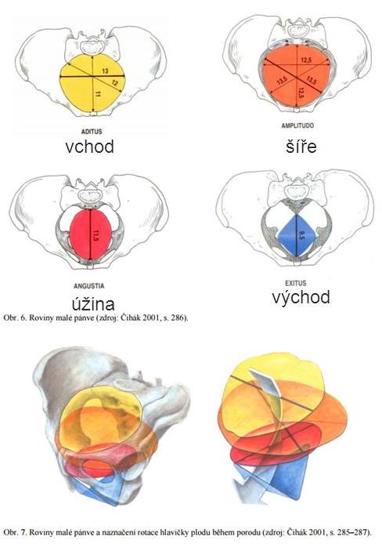
Birth canal
Bony pelvis
  Aditus pelvis
  Amplitudo pelvis
  Angustia pelvis
  Exitus pelvis
Soft tissue
  Lower uterine segment
  Vaginal walls
  Vulva
  Pelvic floor muscles
  Perineum

Slide 10
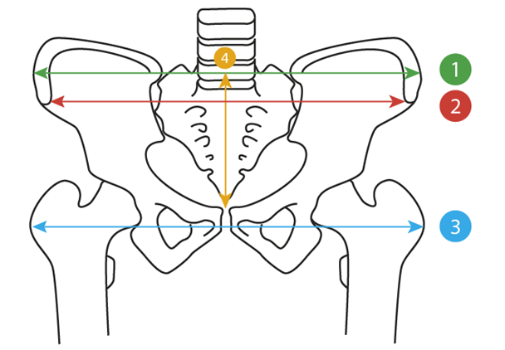
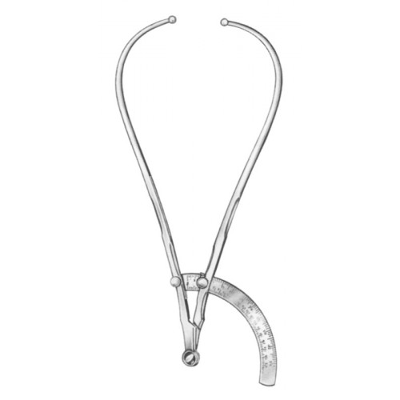
Birth canal
Pelvic diamteres
  Disatntia bicristalis
  Distatntia bispinalis
  Distantia bitrochanterica
  Conjugata externa
Pelvimetry

Slide 11
Birth canal - disorders
Pelvic deformity
Posttraumatic
Cephalopelvic disproportion
Disproportion in the size of fetus and the patients pelvis
Symphyseolysis
Postoperative
Rickets in past

Slide 12
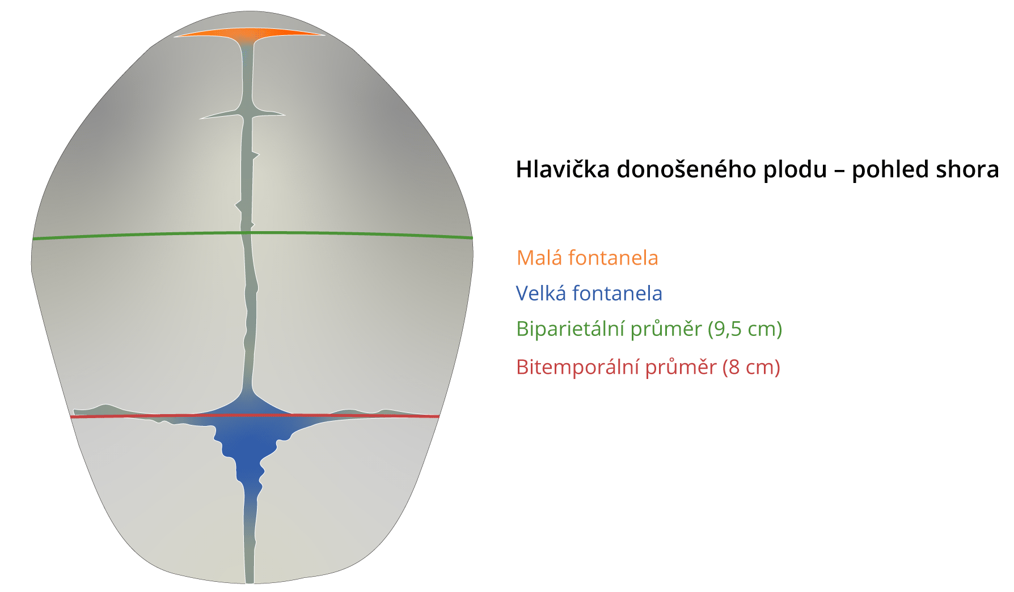
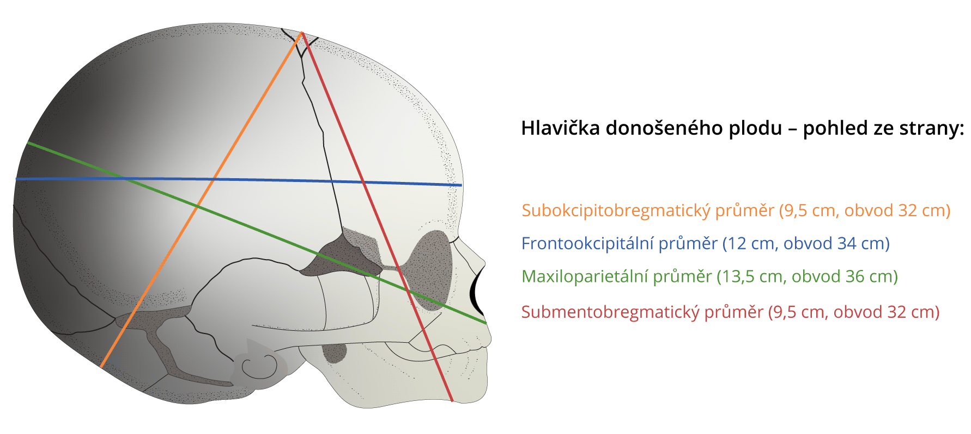
Fetus
The most freqent fetus presentation – cephalic.
Fetus head - ( size, shape ) – influence on conduct of labour, labour outcome
Skull: two frontal bones, two parietal bones, two temporal bones, one occipital bone
Joints: frontal, saggital, lambdoid, occipital
Fontanelle – big and small

Slide 13
I. Stage of labour
Preparatory stadium (dolores praesagientes, preparing of uterine muscles, going down uterus, cervical slimy secretion)
Onset: regular uterine contractions which cause progress in cervical effacement and dilatation
End of the I. stage: complete cervical dilatation
Latent phase and active phase (from 3 cm)
According to our standards no longer than 10 hours (regardless of the use of epidural)

Slide 14
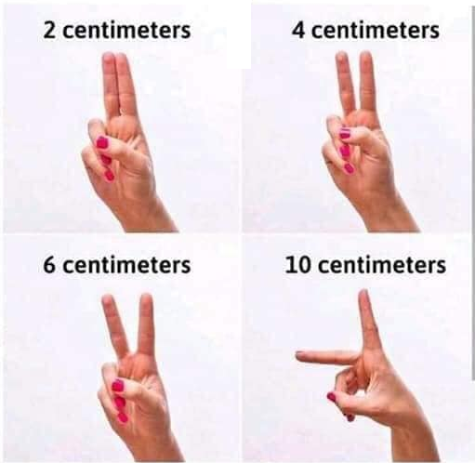
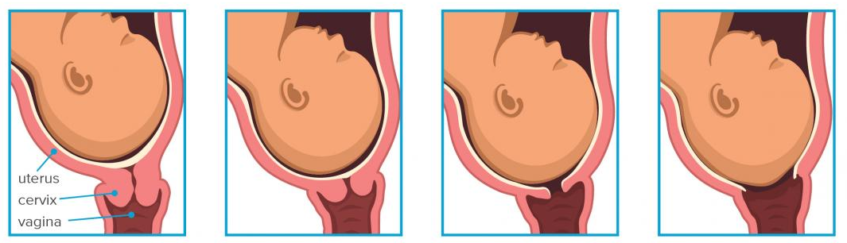
I. Stage of labour – monitoring
Fetal wellbeing – CTG, amniotic fluid color
Mothers wellbeing – blood pressure
Labour progression – dilatation of cervix

Slide 15
I. Stage of labour – disorders
Secondary arrest of labour – previously adequate progress
Primarily dysfunctional labour – slow from onset
Causes:
Uterine activity
(Power)
Inefficient uterine activity
Birth canal
(Passage)
Inadequate pelvis
Fetus
(Passenger)
Malposition
Most common
Malpresentation
Large baby

Slide 16
II. Stage of labour
Onset: complete cervical dilatation (end of the first stage)
End of the II. stage: delivery of the baby
Pasive – descent of the neonates head through birth canal
Active – active pushing efforts of the mother
According to our standards no longer than 60 minutes

Slide 17
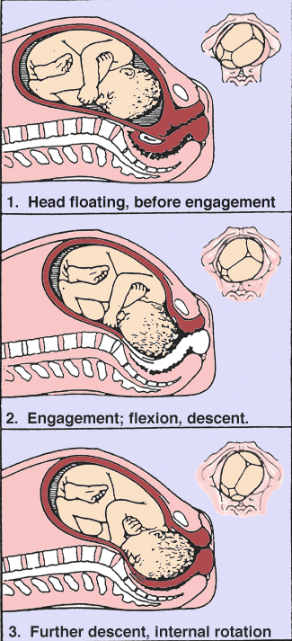
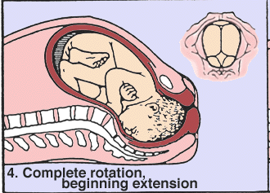
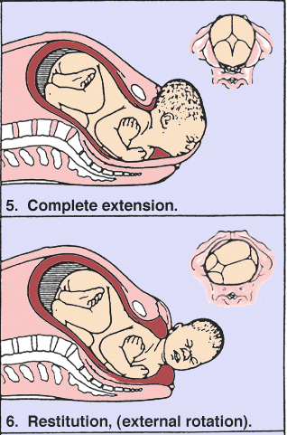
II. Stage of labour
Head delivery
  Flexion
  Progression
  Internal rotation
  Extension (around symphysis)
  External rotation

Slide 18
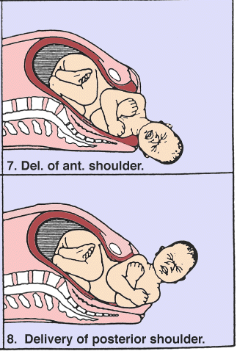
II. Stage of labour
Shoulders delivery
  Rotation of the anterior shoulder behind symphysis
  Delivery of the anterior shoulder
  Delivery of the posterior shoulder
Rest of the body
  Usually passively follows after delivery of the head and shoulders

Slide 19
II. Stage of labour – disorders
Progression
Uterine activity
Malpresentation
Birth canal
Shoulder dystocia
Anterior shoulder impacted against the symphysis
2. Internal manoeuvers
1. McRoberts manoeuvre + suprapubic pressure

Slide 20
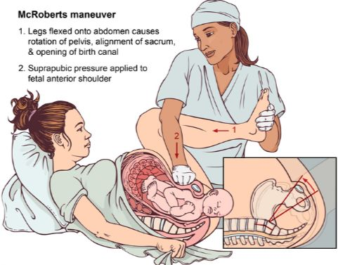
Shoulder dystocia

Slide 21
III. Stage of labour
expeling placenta and fetal membranes
From delivery of fetus until delivery of placenta
Should not take longer than 60 minutes
Active management – use of uterotonics

Slide 22
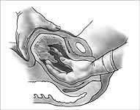
III. Stage of labour - disorders
Retention of placenta – manual extraction in general anesthesia

Slide 23
IV. Stage of labour
First two hours after delivery
Complications most commonly occur during this time

Slide 24
IV. Stage of labour – disorders
Postpartum bleeding (4 T)
  Tone – uterine hypotonia
  Trauma – birth canal trauma (vaginal wall, perineum, cervix, hematma)
  Tissue – retention of part of the placenta
  Thrombin – coagulopathy

Slide 25
Delivery room incoming
Anamnesis
Examination – external + internal = obstetric
  blood presure, pulse, body temperature
Nonstress test - cardiotocography
Ultrasound - position, estimated weight, (doppler sonography)

Slide 26
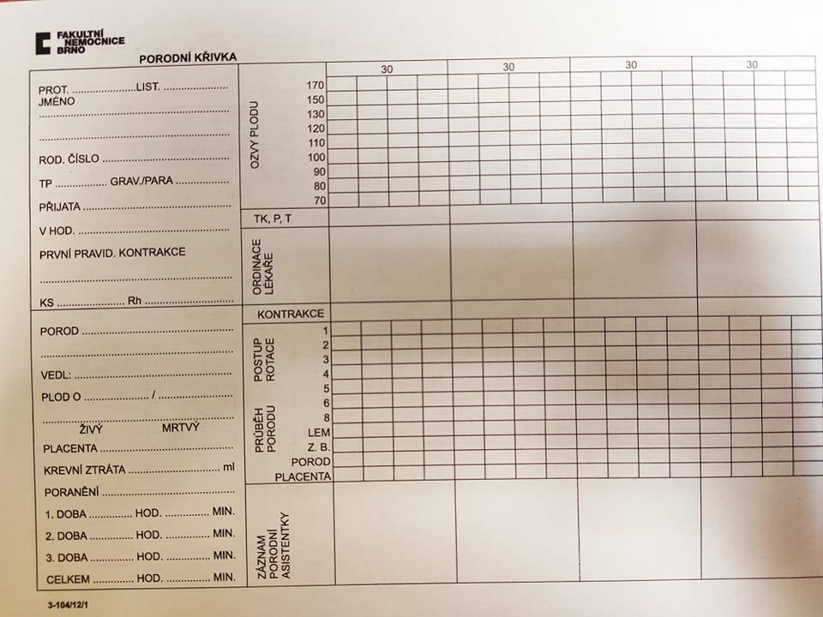
Delivery monitoring
Partogram

Slide 27
Delivery monitoring
Patient monitoring
  blood presure, pulse, body temperature, pain, psychical status
  uterine contractions – external examination and monitoring
  labour progression – internal examination
  bleeding and coagulability
Fetal monitoring
  Fetal heart rate - cardiotocography (external, internal )
  intrapartal fetal pulse oxymetry
  S – T analysis ( fetal EKG )
  Amnionic fluid quality
  ultrasound examination - presentation,

Slide 28
Induction and preinduction of labour
Indication:
  Obstetric (Prodloužené těhotenství, FGR, uteroplacentární insuficiencie, diabetes, … )
  Medical (Závažná hypertenze, renální onemocnění, …)
Methods:
  Mechanical:
    Hamilton manouver – separation of the membranes from the cervix leads to the local release
    of prostaglandins
    Cervical dilatators
  Pharmacological: Prostaglandins, Oxytocin
  Other methods (questionable effectivity but not harmful): sexual intercourse, herbal remedies (raspberry leaf tea), nipple stimulation

Slide 29
Thanks for your attention!

