Slide 1
Department of Gynecology and Obstetrics
Brno University Hospital and
Masaryk University, Faculty of Medicine
head: doc. MUDr. Vít Weinberger, Ph.D
Pelvic infection and STDs
Tvarožek S., Meixnerová I.
Obstetrics and Gynecology - lectures
2020

Slide 2
Pelvic infection and STDs
Risk factors
Age, parity
early sexual life, high risk: 15-39 yo.
Multiparous women 10x higher risk compare to nulligravid women
Promiscuity
IUS/IUD - 5-6x higher risk of inflamatory disease
Alcohol, drugs
Other
Iatrogenic factors (cervical dilatation, abrasion and curretage of the uterine cavity, hysteroscopy ...)

Slide 3
Pelvic infection and STDs
Gynecological inflammatory diseases
Localisation:
External female organs (vulvitis, colpitis)
Internal organs (cervicitis, metritis)
PID = pelvic inflammatory disease (oophoritis, salpingitis, pelveoperitonitis)
Etiology:
Viruses, bacterias, fungi (?) protozoa (?)

Slide 4
Pelvic infection and STDs
Vulvitis
Elderly women with skin damage (scratching, leakage of urine,
sweat – obese people, menstrual blood)
Reduced skin resistens (diabetes, hepatopathy, anemia)
can occur concomitantly with other vaginal inflammatory diseases
Etiology :
bacteria, fungi, viruses

Slide 5
Pelvic infection and STDs
Vulvitis
Symptoms:
Bacterial : well-defined border (folliculitis, furuncle, abscess) or wihout
sharply defined border (phlegmon), abrasions, skin defect with
secretion, crusts
Fungal (Yeast) : itchy, burning, white patches
Viral (specific symptoms) : condylomata accuminata, herpes simplex genitalis

Slide 6
Pelvic infection and STDs
Vulvitis
Diagnose:
Clinical symptoms, microbiological culture (bacterial inflammation)
Serological test (viruses)
Dermatologic examination
Therapy: depends on etiology
Antimycotics/local use of ATB/ATB systematic
Painkillers, antihistamines, corticosteroids
Surgical (abscess) incision/extirpation

Slide 7
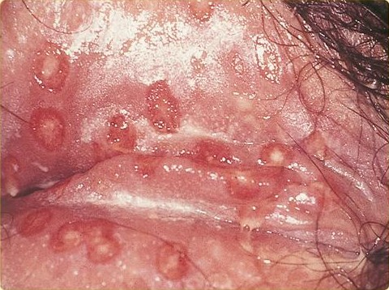
Pelvic infection and STDs
Herpes simplex
Etiology: DNA virus Herpesviridae (HSV1 a HSV2)
Latent infection – notably reside in neural ganglia, in case of stress or immunodeficiency can be reactivated
Transmitted by contact with infected person
Symptoms:
Prodrome – red skin, itching 1-2 days before the onset of disease
Painful blisters - papules, vesikles, pustules, crusts
Tingling or burning in the genital area
Therapy: Acyclovir 200mg tablet five times a day

Slide 8
Pelvic infection and STDs
Condylomata accuminata
(genital warts)
Etiology: DNA Papillomaviridae, HPV low risk 6, 11 , sexually transmitted
Symptoms and characteristics:
anogenital warts, located on vulva, perineum, perianal region, anus,
vaginal wall, cervix
itching, bleeding
spread through direct skin-to-skin contact (oral, genital, or anal sex)
virus affect only squamous cells of the skin
Therapy:
Topical agents: Podofylotoxin, Trichloroacetic acid, Imiquimod
Physical ablation: excision, electrocauterization, laser ablation
Prophylaxis: HPV vaccination (low 6, 11 and high risk 16, 18 – cervical ca.)

Slide 10
Pelvic infection and STDs
Vaginal infections
Diagnosis:
1. microscopic examination
vaginal wet mount – looking for: WBC, epithelia, bacteria, yeast cell, trichomonads, clue cells
2. Whiff test
several drops of a potassium hydroxide (KOH) solution are added to a sample of the vaginal discharge
a strong fishy odor from the mix means bacterial vaginosis is present
3. KOH slide
a sample of the vaginal discharge is placed on a slide and mixed with a KO
The KOH kills bacteria and cells from the vagina, leaving only yeast for a yeast infection

Slide 11
Pelvic infection and STDs
Vaginal infections
Diagnosis:
3 . Vaginal pH
normal vaginal pH: 3–4,5
pH 4,5–5,5 suggestive of bacterial vaginosis
pH higher than 5,5 may indicate bacterial vaginitis or trichomoniasis
in case of yeast infection is pH in normal range
In case of unclear diagnose or recurrent infection perform microbiological culture

Slide 12
Pelvic infection and STDs
Bacterial vaginosis
Definition:
overgrowth of bacteria naturally found in the vagina, or decrease in the abundance of lactobacilli in the vaginal microbiota
more common in women with IUD
Etiology:
facultative anaerobic Gardnerella vaginalis
overgrowth of other, predominantly anaerobic bacteria (Bacteroides, Mobiluncus (Vibrio), peptostreptococcus)

Slide 13
Pelvic infection and STDs
Bacterial vaginosis
Symptoms:
Thin, grey, white or green vaginal discharge
Foul-smelling "fishy" vaginal odor, mostly after sexual intercourse
Vaginal itching, burning
Sometimes no signs or symptoms
Diagnosis: Amsel criteria (2 out of 4 required for diagnosis)
Homogenous grey-white discharge
Increased pH 4,5–5,5
Clue cells in microscopy (squamous epithelial cell with bacteria adherent on their walls)
Positive Whiff test

Slide 14
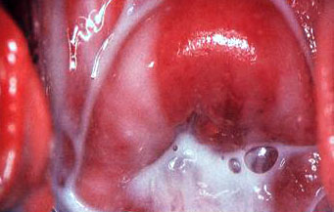
Pelvic infection and STDs
Bacterial vaginosis
Therapy:
In women with symptoms, I. trim. of pregnancy, before surgery
Metronidazol 500mg vag. 7 days, Clindamycin, Nifuratel (Macmiror)
Vaginal probiotics after ATB treatment as recurrence prophylaxis
treating the sexual partner is not necessary
Complication :
metritis, cystitis, PID
Risk factor for preterm birth

Slide 15
Pelvic infection and STDs
Bacterial colpitis (aerobic vaginitis)
Etiology : colistreptococcus, staphylococcus, enterococcus and E. coli
Symptoms:
Thick yellow vaginal discharge, dyspareunia, vaginal inflammation – red and swollen vaginal wall
Diagnosis:
clinical symptoms
microbiological culture
Therapy:
vaginal application: Clindamycin, Nifuratel

Slide 16
Pelvic infection and STDs
Candidiasis (yeast infection)
Eriology: Candida albicans, C. tropicalis, C. glabrata
Vagina naturally contains a balanced mix of yeast including Candida
In case of disrupted vaginal balance, in immunodeficient patients, increased estrogen levels (pregnant, COC, estrogen therapy)
Risk factors:
pregnancy (III. trimester)
Diabetes mellitus, increased sugar intake
ATB therapy, corticosteroids, estrogens
Impaired immune system
Synthetic underwear, promiscuity

Slide 17
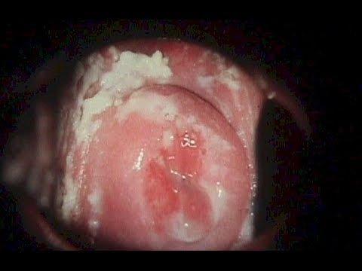
Pelvic infection and STDs
Candidiasis (yeast infection)
Symptoms:
itching, burning, especially during intercourse or while urinating
Thick, white, odour-free vaginal discharge with a cottage cheese appearance
redness and swelling of the vulva and vagina
Very often as a vulvovaginitis

Slide 18
Pelvic infection and STDs
Candidiasis (yeast infection)
Diagnosis:
Clinical symptoms
microscopic examination
microbiological culture
In recurrent infections – oGTT (DM exclusion)
Normal vaginal pH, negative whiff test
Therapy:
Azol antifungals – topical/vaginal (Clotrimazole) or systemic
therapy success rate is more than 90%

Slide 19
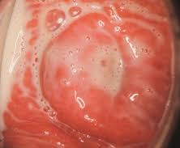
Pelvic infection and STDs
Trichomoniasis
Etiology : Trichomonas vaginalis
STD, treatment of all sexual partners is necessary
Symptoms:
50 % of women are without any clinical symptoms
frothy, greenish, foul-smelling vaginal discharge
vulval itching and soreness, Cervix may have a ‘strawberry’ appearance
Diagnosis:
Positive Whiff test
pH > 4,5
microscopy: flagellated moving protozoa (trichomonas vaginalis)

Slide 20
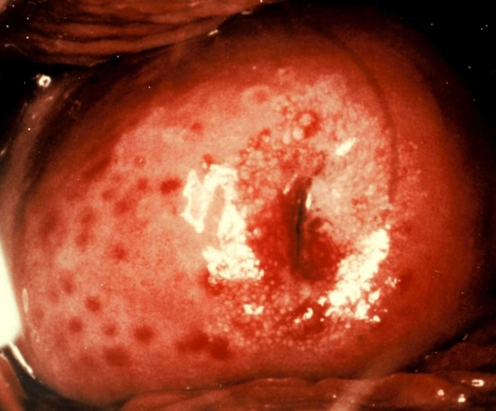
Pelvic infection and STDs
Trichomoniasis
Therapy:
systemic use of Metronidazole 500mg tbl twice a day for 7-10 days
Complications:
Preterm birth
Low birth weight
transmission of infection to the baby during
delivery

Slide 21
Pelvic infection and STDs
Cervicitis
Etiology:
Chlamydia trachomatis, mycoplasma, Neisseria gonorrhoea
Symptoms:
Asymptomatic in 30–50 % cases
large amounts of unusual vaginal discharge, dyspareunia, bleeding between periods, painful urination, lower abdomen pain
chronic cervicitis– dysmenorrhoea, dyspareunia, infertility
in men – urethritis, mostly asymptomatic – Asymptomatic carrier

Slide 22
Pelvic infection and STDs
Cervicitis
Diagnosis:
a pelvic examination
A specimen collection – microbiological culture from the cervix
Antibody detection – RIA, ELISA, PCR
Cervical cancer exclusion (colposcopy, cytology, biopsy)
Therapy:
Systemic targeted antibiotic therapy
Azithromycin 1000mg oral single dose (chlamydia)
Doxycyclin 200mg every twice a day for 7 day (chlamydia, Neisseria)

Slide 23
Pelvic infection and STDs
Endometritis (endomyometriris)
Etiology:
Ascendent infection - cervix
Surgical procedures (curettage, hysteroscopy, IUD insertion)
Neisseria, Chlamydia, rarely M. tuberculosis
Symptoms:
acute: lower abdomen pain, fever, abnormal vaginal bleeding or discharge
tender to bimanual palpation
chronic: hypermenorhoea, chronic lower abdomen pain

Slide 24
Pelvic infection and STDs
Endometritis (endomyometriris)
Diagnosis:
Symptoms
a pelvic examination
a specimen collection – microbiological culture from the cervix
The inflammatory markers: CRP, WBC)
Cervical cancer exclusion (colposcopy, cytology, biopsy)
Therapy:
intravenous administration of antibiotics (empiric→ targeted)
Symptomatic therapy: painkillers …

Slide 25
Pelvic infection and STDs
Pelvic inflammatory disease - PID
Inflammation of upper genital tract
fallopian tube or ovary (salpingitis, oophoritis)
Tubo-ovarian abscess (TOA)
Pelviperitonitis
Peritonitis
Etiology:
ascendent infection from uterus or spreading from appendix
TOA can develop from the lymphatic system with infection of the parametrium from an intrauterine device (IUD)

Slide 26
Pelvic infection and STDs
PID
Symptoms: very variable
acute – almost 40% asymptomatic, lower (bilateral) abdomen pain, vaginal discharge, abnormal uterine (vaginal) bleeding, fever sometimes with chills, nausea, vomiting, dyspareunia, frequent or difficult urination
chronic – dyspareunia, chronic lower abdomen pain, infertility, irregular menstrual cycle

Slide 27
Pelvic infection and STDs
PID
Etiology :
Ch. trachomatis, N.gonorrhoeae, E.coli, mycoplasma, ureaplasma, Staphylococcus, Streptococcus, bacteroides, peptostreptococcus
Risk factors:
Being sexually active women younger than 25 yo.
Multiple sexual partners
Previous STDs
Uterine instrumentation – curettage, hysteroscopy, IUD insertion (very small risk)

Slide 28
Pelvic infection and STDs
PID
Diagnosis:
Symptoms
a pelvic examination
a specimen collection – microbiological culture from the cervix
The inflammatory markers: CRP, WBC)
Cervical cancer exclusion (colposcopy, cytology, biopsy)
Ultrasound – sacto/pyosalpinx
Therapy:
intravenous administration of antibiotics (empyric→ targeted)
Symptomatic therapy: painkillers …
Laparoscopy – ovariectomy, salpingectomy, adnexectomy,…..

Slide 29
Pelvic infection and STDs
ATB therapy PID
Combination of broad-spectrum antibiotics – intravenous preferably
Aerobic bacteria ATB
doxycyclin – 100 mg twice a day oral
azithromycin – 500 mg a day
Amoxicillin+Clavulanic Acid (Augmentin) – 1,2 g every 8 h. iv.
Anaerobic bacteria ATB
metronidazole – 500 mg every 8 h. iv.

Slide 30
Pelvic infection and STDs
PID Complications
Acute:
Perihepatitis (4 - 28 %)
Rupture of TOA resulting in sepsis (life-threating) - mortality 6 - 15 % - immediate surgical intervention
Periappendicitis (2 - 10 %)

Slide 31
Pelvic infection and STDs
PID Complications
Chronic:
Chronic lower abdominal pain (5 %)
Infertility (14 - 38 %) – from blocked fallopian tubes
Ectopic pregnancy 10 - 30 %)
FITZ-HUGH-CURTIS sy. – perihepatic adhesion (Chlamydia, Neisseria)

Slide 32
Pelvic infection and STDs
Pelvic actinomycosis
Etiology: Actinomyces israeli
formation of painful abscesses and fibrosis in human body (lung, breast, pelvis...)
predominantly associated with the longstanding use of intrauterine device
Symptoms: abdominal pain, fever, vomitus, nausea, diarrhoea, obstipation
Therapy
IUD extraction, ATB therapy PNC, Doxycycline
laparotomy/LSC (abscess drainage, lavage) (in unsuccessful ATB treatment)

Slide 33
Pelvic infection and STDs
Thank you
for your attention

Slide 34
Pelvic infection and STDs
Questions
Which of the following is not the risk factor of pelvic infection?
Promiscuity
Alcohol
Late sexual life
Cervix dilatation
What two STDs cause PID when left untreated?
Syphilis and gonorrhoea
Genital herpes and genital warts
Chlamydia and genital warts
Gonorrhoea and chlamydia

Slide 35
Pelvic infection and STDs
Questions
Which of the following is not the risk factor of pelvic infection?
Promiscuity
Alcohol
Late sexual life
Cervix dilatation
What two STDs cause PID when left untreated?
Syphilis and gonorrhoea
Genital herpes and genital warts
Chlamydia and genital warts
Gonorrhoea and chlamydia

Slide 36
Pelvic infection and STDs
Questions
Which of the following is not the risk factor of pelvic infection?
Promiscuity
Alcohol
Late sexual life
Cervix dilatation
What two STDs cause PID when left untreated?
Syphilis and gonorrhoea
Genital herpes and genital warts
Chlamydia and genital warts
Gonorrhoea and chlamydia

Slide 37
Pelvic infection and STDs
Questions
A normal vaginal pH level is?
Between 3.8 and 4.5
Below or equal to 4.5
Above or equal to 4.5
Between 4.5 and 7
Whiff test?
may suggest either trichomoniasis or bacterial vaginosis
strong fishy odour is indicative of a negative test result
may suggest either trichomoniasis or bacterial colpitis
All of the above answers are correct

Slide 38
Pelvic infection and STDs
Questions
A normal vaginal pH level is?
Between 3.8 and 4.5
Below or equal to 4.5
Above or equal to 4.5
Between 4.5 and 7
Whiff test?
may suggest either trichomoniasis or bacterial vaginosis
strong fishy odour is indicative of a negative test result
may suggest either trichomoniasis or bacterial colpitis
All of the above answers are correct

Slide 39
Pelvic infection and STDs
Questions
A normal vaginal pH level is?
Between 3.8 and 4.5
Below or equal to 4.5
Above or equal to 4.5
Between 4.5 and 7
Whiff test?
may suggest either trichomoniasis or bacterial vaginosis
strong fishy odour is indicative of a negative test result
may suggest either trichomoniasis or bacterial colpitis
All of the above answers are correct

Slide 40
Pelvic infection and STDs
Questions
Symptoms of genital herpes are:
Tingling or burning in the genital area
Painful blisters in the genital area
Vaginal discharge
A and B
A,B and C
The cytomegalovirus (CMV) can‘t be spread by:
Kissing
Sharing an office with an infected person
Changing a child's wet diapers
Childbirth

Slide 41
Pelvic infection and STDs
Questions
Symptoms of genital herpes are:
Tingling or burning in the genital area
Painful blisters in the genital area
Vaginal discharge
A and B
A,B and C
The cytomegalovirus (CMV) can‘t be spread by:
Kissing
Sharing an office with an infected person
Changing a child's wet diapers
Childbirth

Slide 42
Pelvic infection and STDs
Questions
Symptoms of genital herpes are:
Tingling or burning in the genital area
Painful blisters in the genital area
Vaginal discharge
A and B
A,B and C
The cytomegalovirus (CMV) can‘t be spread by:
Kissing
Sharing an office with an infected person
Changing a child's wet diapers
Childbirth

Slide 43
Pelvic infection and STDs
Questions
Which of these is a health problem that can be caused by STIs in women?
Pelvic inflammatory disease (PID)
Ectopic pregnancy
Higher risk for cervical cancer
All of the above
What are symptoms of pelvic inflammatory disease?
Abdominal pain
Foul-smelling vaginal discharge
Painful sexual intercourse (dyspareunia)
Fever
All of the above

Slide 44
Pelvic infection and STDs
Questions
Which of these is a health problem that can be caused by STIs in women?
Pelvic inflammatory disease (PID)
Ectopic pregnancy
Higher risk for cervical cancer
All of the above
What are symptoms of pelvic inflammatory disease?
Abdominal pain
Foul-smelling vaginal discharge
Painful sexual intercourse (dyspareunia)
Fever
All of the above

Slide 45
Pelvic infection and STDs
Questions
Which of these is a health problem that can be caused by STIs in women?
Pelvic inflammatory disease (PID)
Ectopic pregnancy
Higher risk for cervical cancer
All of the above
What are symptoms of pelvic inflammatory disease?
Abdominal pain
Foul-smelling vaginal discharge
Painful sexual intercourse (dyspareunia)
Fever
All of the above

Slide 46
Pelvic infection and STDs
Questions
Which of the following HPV subtypes are linked to cervical cancer?
6, 18
16, 11
6, 11
16, 18
What are complications of pelvic inflammatory disease?
Endometriosis
Uterine fibroids
Infertility
Incontinence

Slide 47
Pelvic infection and STDs
Questions
Which of the following HPV subtypes are linked to cervical cancer?
6, 18
16, 11
6, 11
16, 18
What are complications of pelvic inflammatory disease?
Endometriosis
Uterine fibroids
Infertility
Incontinence

Slide 48
Pelvic infection and STDs
Questions
Which of the following HPV subtypes are linked to cervical cancer?
6, 18
16, 11
6, 11
16, 18
What are complications of pelvic inflammatory disease?
Endometriosis
Uterine fibroids
Infertility
Incontinence

