Slide 1

Department of Gynecology and Obstetrics
Brno University Hospital and
Masaryk University, Faculty of Medicine
head: doc. MUDr. Vít Weinberger, Ph.D
Infertility
Tvarožek S., Meixnerová I.
Obstetrics and Gynecology - lectures
2020

Slide 2
Infertility
Infertility
Fertility – biological ability to conceive within 6–9 months
Infertility – disability to concieve after 12 months of unprotected sex
15–20 % couples, rapidly growing incidence in last decades
evaluation should begin after 6 months of trying unsuccessfully to conceive

Slide 3
Infertility
Fertility – physiology
Ovulation
Oocyte migration
Sperm penetration
Fertilization
Embryo migration
Implantation in uterine cavity

Slide 4
Infertility
Infertility causes
Male factor (40%)
Abnormal sperm production or function
  undescent testicles, genetic defect, DM, infection, mumps
Sperm delivery problems
  premature ejaculation, cystic fibrosis, blockage of testicles, damage/injury
Damage related to cancer treatment
  radiation, chemotherapy
Immunological
  an autoimmunity to own sperm

Slide 5
Infertility
Infertility causes
Female factor (40%)
Uterine: polyps, shape abnormalities (septum...), fibroids
Tubal: blocking or damage (inflammation, endometriosis, adhesion)
Ovulatory: ovulation disorders, PCO, insufficiency,chemotherapy, hyperprolactinemia
Cervical: polyps, occlusion
Immunological: immunity to sperm, zona pellucida, ovary... Endometriosis: affect function of ovaries, uterus, fallopian tubes
Unexplained: not diagnoses by any known medical procedure

Slide 6
Infertility
Age and fertility
Female fertility after 35 years of age decreases 3 times in comparison to women under 25 years of age
Causes: ovarian dysfunction, endocrinologic factors, hypothalamic – pituitary factors, environmental changes

Slide 7
Infertility
Diagnosis
Always both partners
Pacient/family history
Sexual habits (intercourse frequency)
Laboratory tests (hormones)
Genetic testing
Semen analysis
Ovulation testing (LH, P, prolactin)

Slide 8
Infertility
Diagnosis
Ovarian reserve testing (AMH)
Ultrasound examination
Hysterosalpingography (SONO-HSG)
Hysteroscopy
Diagnostic laparoscopy (DGL)
  Chromopertubation – blue dye solution introduction
Other hormone testing (TSH, T3, T4, FSH...)
                BOLD – fallopian tube patency diagnosis

Slide 9
Infertility
Sperm analysis
Volume | ≥ 1.5 ml
Concentration | ≥ 15 millions/ml
Total sperm count | ≥ 40 millions
Motility/forward progression | ≥ 32 %
Morphology | ≥ 4 % normal and more
Approximate concentration of total sperm cells:
      1940 …………… 110 mil/ml
      1990 …………… 60 mil/ml

Slide 10
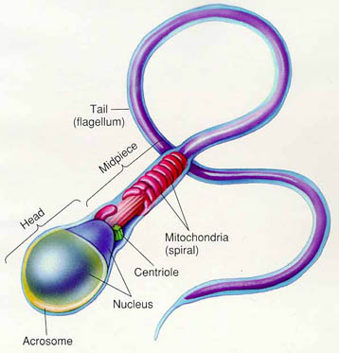
Sperm

Slide 11
Infertility
Semen deficiencies - nomenclature
Normozoospermia | normal result
Oligozoospermia | reduced concentration
Asthenozoospermia | reduced sperm motility
Teratozoospermia | abnormal morphology
Azoospermie | absence of spermatozoa (motile sperm cell)
Aspermia | complete lack of semen

Slide 12
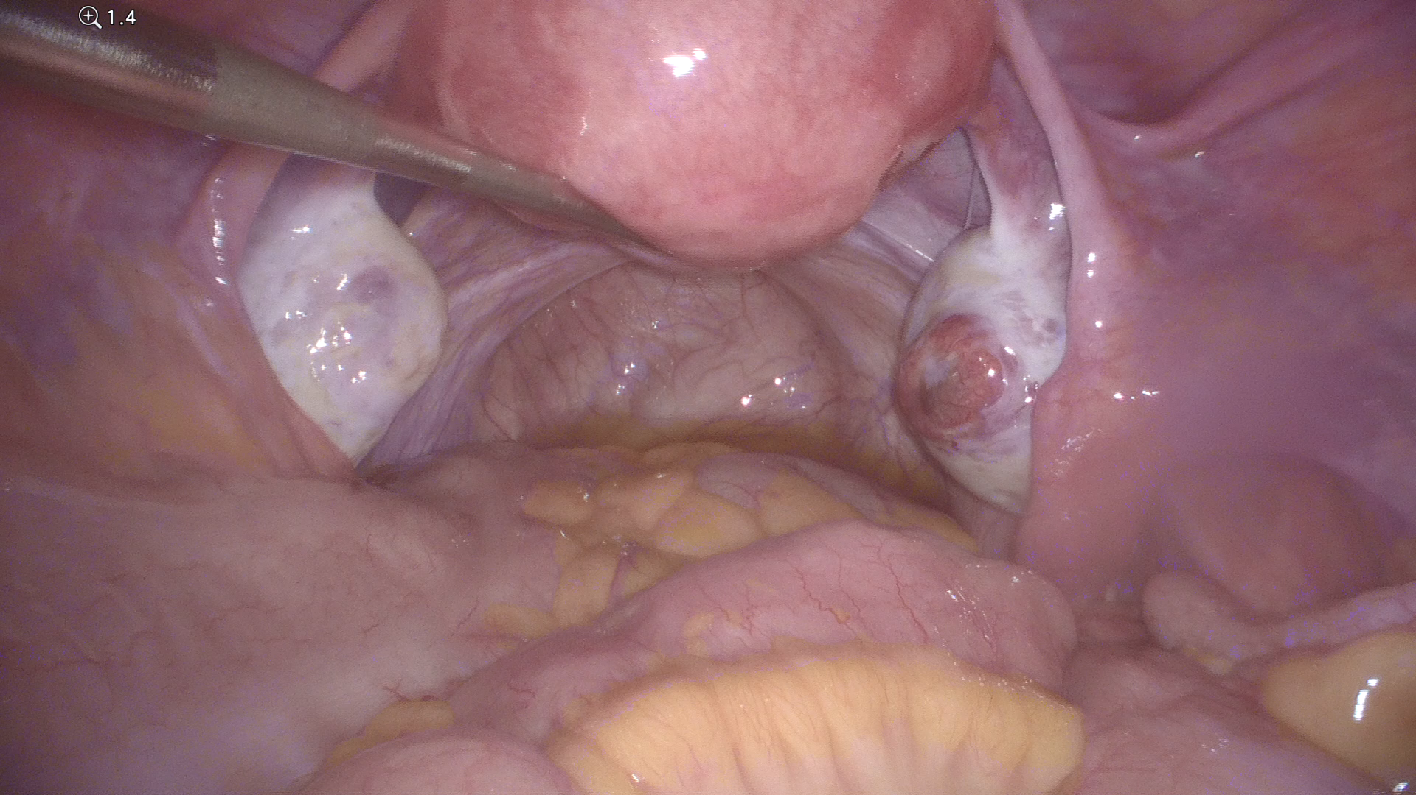
Chromopertubation

Slide 13
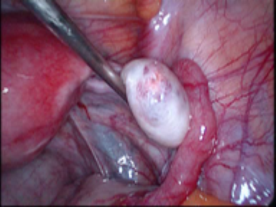
Normal ovary

Slide 14
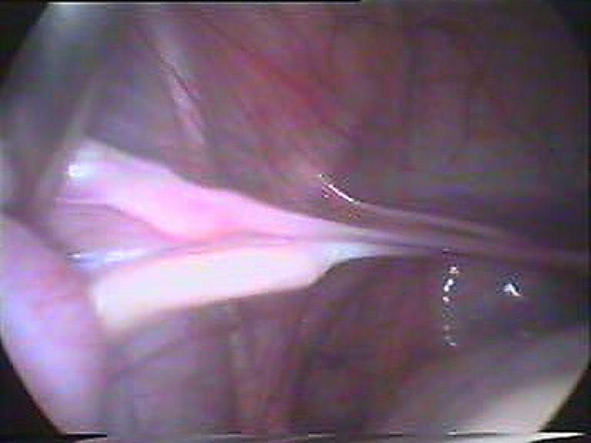
Streak ovary (Turner sy.)

Slide 15
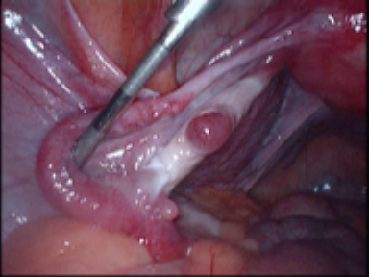
Ovary after chemotherapy

Slide 16
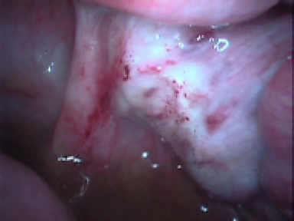
Ovary after ovarian cyst removal

Slide 17
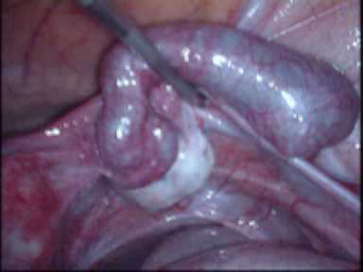
Sactosalpinx

Slide 18
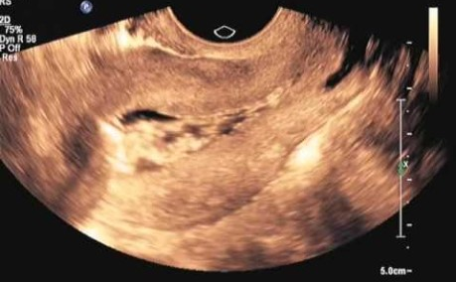
SONO HSG

Slide 19
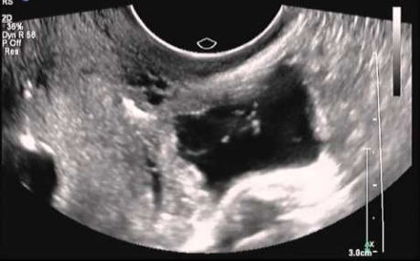
SONO HSG - fimbriae

Slide 20
Infertility
Assisted reproduction
medical procedures used primarily to address infertility
any procedure that involves the handling of eggs, sperm,
or both, outside the human body
includes artificial insemination, intrauterine insemination,
in vitro fertilization, and ovarian stimulation

Slide 21
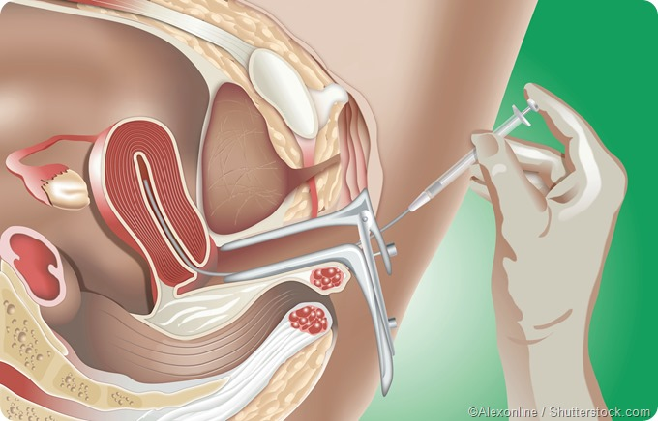
Infertility
Assisted reproduction methods
Ovulation induction (stimulation)
Artificial insemination (IUI) – introduction of sperm into uterus
In-vitro fertilisation (IVF)
Preimplantation genetic diagnosis (PGD)
Donor conception
Surrogacy

Slide 22
Infertility
In vitro fertilisation
A process of fertilisation outside the body (in vitro/glass)
Monitoring and stimulating a woman‘s ovulatory process
Retrieving oocytes from ovaries
Sperm and oocytes placed in a liquid culture to fertilise
Embryo culture – embryo is growing in an artificial medium
Embryo transfer/frozen embryo transfer (to a uterus)

Slide 23
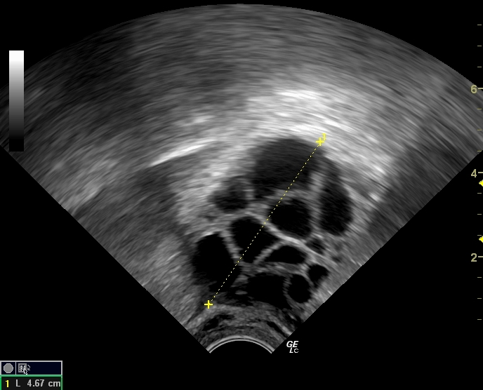
Infertility
Ovulation induction (stimulation)
Woman is not ovulating or not ovulating regularly
Taking a hormone medication to stimulate ovulation
Response to hormones is monitored with US
Timing of intercourse
At the beginning of every IVF cycle
Th: clomifen citrate, FSH, hCG.....
monitored by US folliculometry

Slide 24
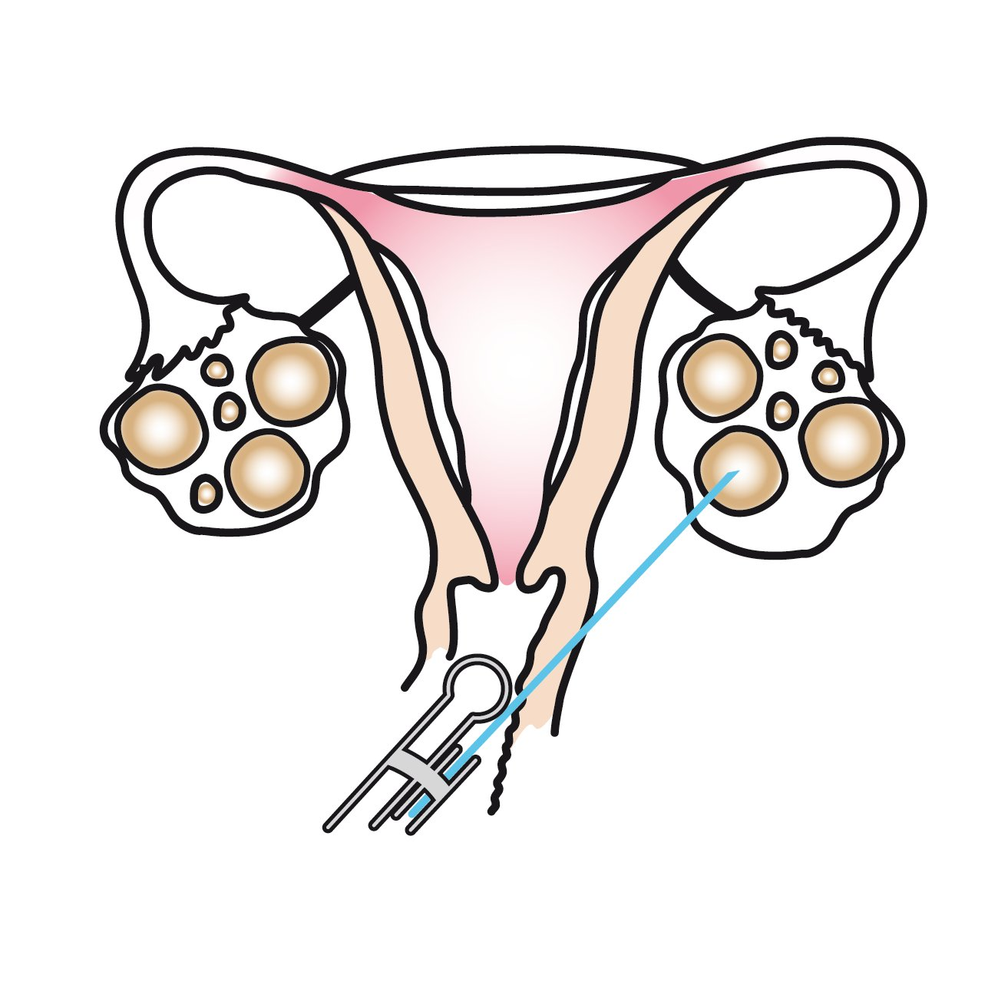
Infertility
Oocyte retrieval/egg collection
transvaginal oocyte retrieval
removing oocytes from the ovary
in order to enable fertilisation or
to egg freezing (cryopreservation)

Slide 25
Infertility
Sperm retrieval techniques
Microsurgical method of sperm extraction MESA, TESE
Obstructive azoospermia
microsurgical epididymal sperm aspiration – MESA
Non obstructive azoospermia
testicular sperm extraction – TESE

Slide 26
Infertility
Microsurgical epididymal sperm aspiration – MESA
in case of oclusion between epididymis and urethra
via 3 cm long scrotal incision, under general anesthesia
liquid is aspired from the ducts by pipette

Slide 27
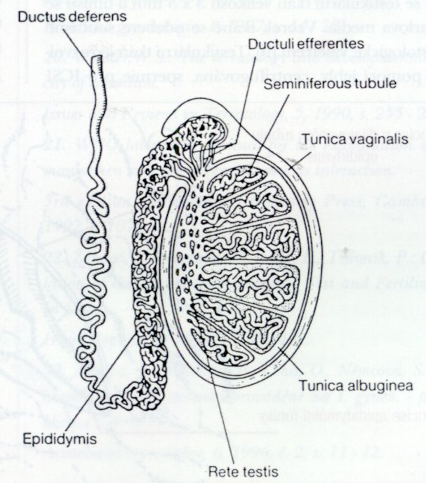
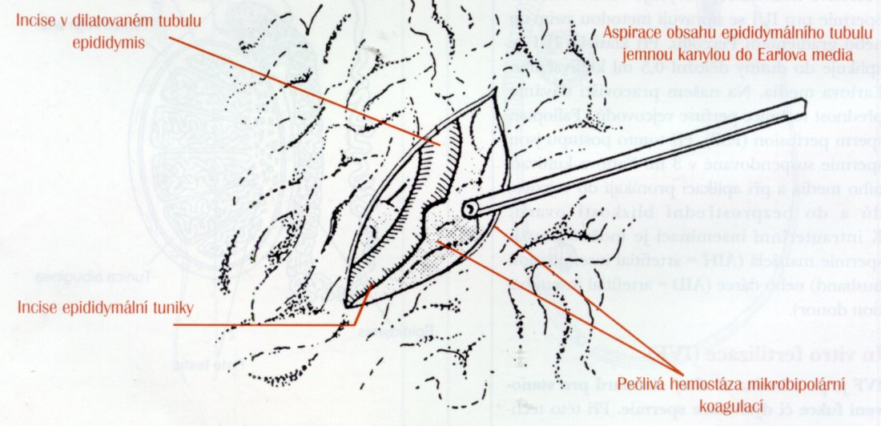
MESA

Slide 28
Infertility
Testicular sperm extraction – TESE
in case of no sperm was retrieved from MESA technique
It allows for extracting sperm cells (if they are present) from the ducts of the germinal epithelium
follows the previous MESA procedure
small incisions are made in the testicular sheets
a little of the testicular tissue is retrieved

Slide 29
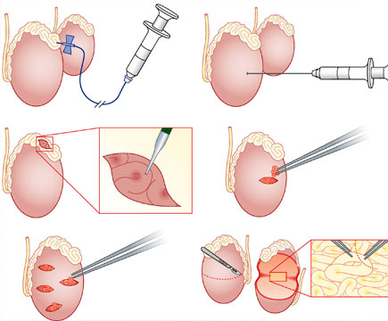
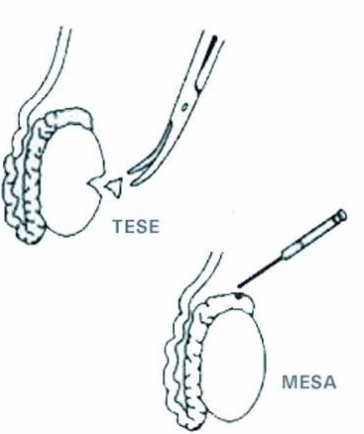
MESA/TESE

Slide 30
Infertility
In vitro fertilisation – advanced techniques
Intracytoplasmic sperm injection (ICSI)
  direct injection of a single sperm into each oocyte
Preselected Intracytoplasmic sperm injection (PICSI)
  transferring specially selected sperm
  Sperm exhibits positive binding to hyaluronan gel
  Hyaluronan is an important component of oocyt layer

Slide 31
Infertility
In vitro fertilisation – advanced techniques
Magnetic activated cell sorting (MACS)
  selecting damaged spermatozoas with higher number of fragmented DNA
Assisted Hatching (AH)
  Embryo is surrounded by a hard layer of cell – zona pellucida
  Creating small crack in the zona pelludica
  AH help an embryo implant in the uterus

Slide 32
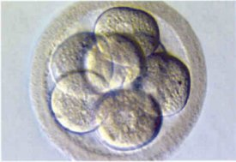
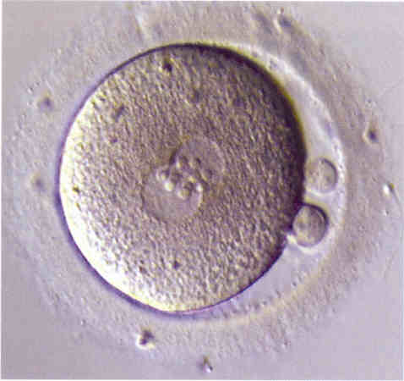
8-cell embryo after 72-hour-long cultivation
Zygote

Slide 33
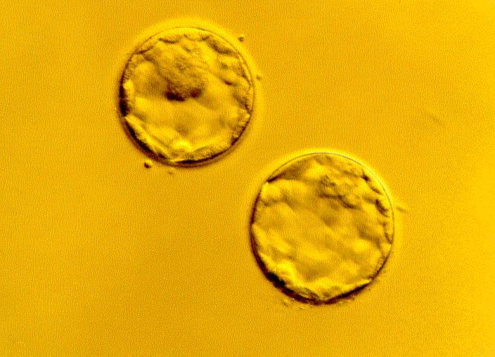
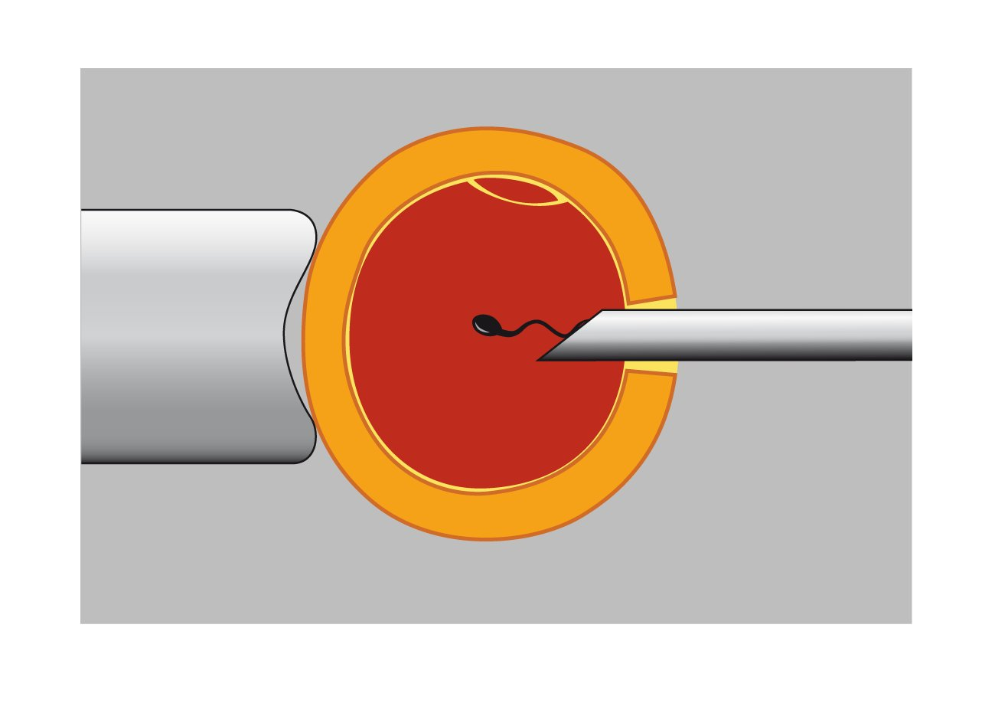
Blastocyst
ICSI

Slide 34
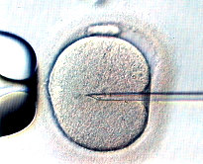
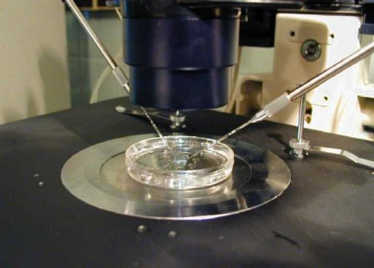
Micromanipulation pipettes
ICSI

Slide 35
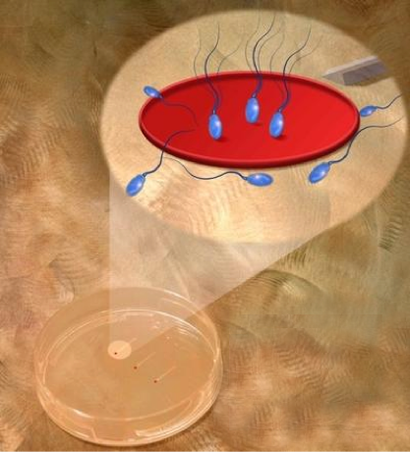
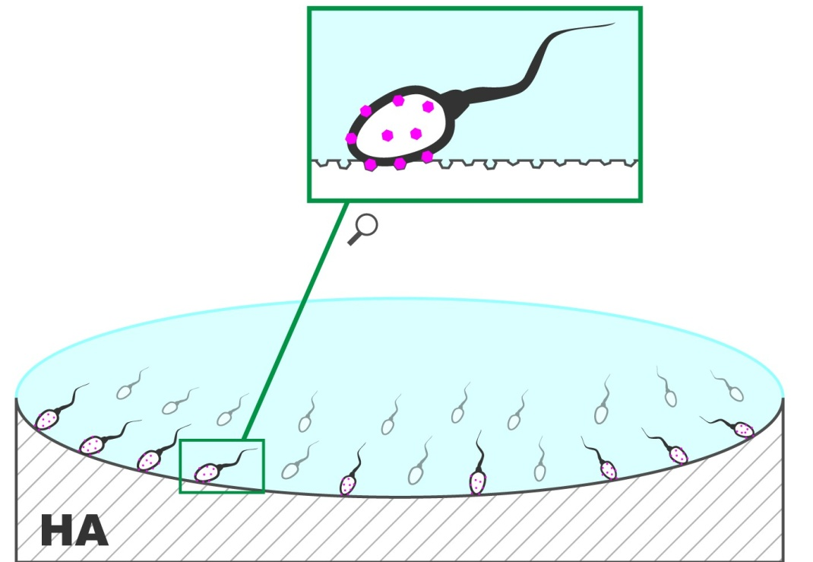
Sperm selection – hyaluronan acid binding for PICSI

Slide 36
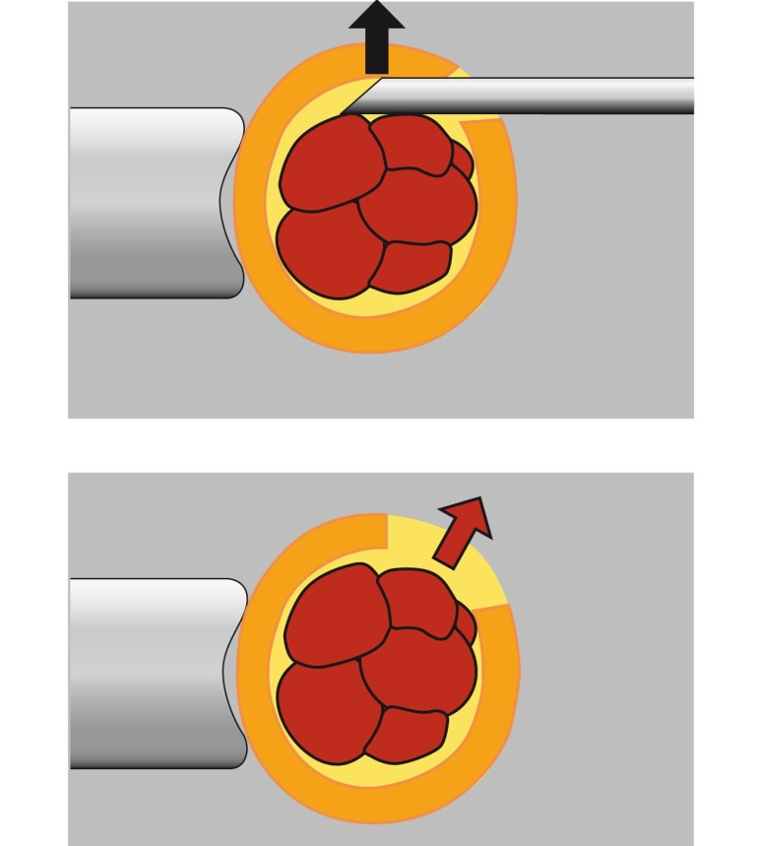
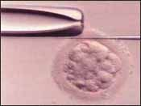
Assisted hatching (AH)

Slide 37
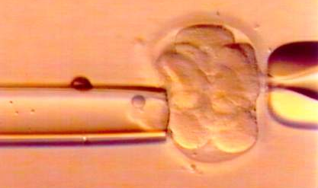
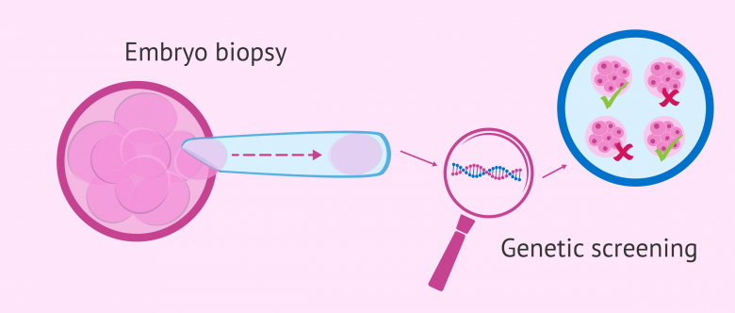
Pre-implantation diagnosis (PGD)
the genetic profiling of embryos prior to implantation
sampling on single cell taken from developing embryo
usually takes place on the 5th day of the embryo’s development

Slide 38
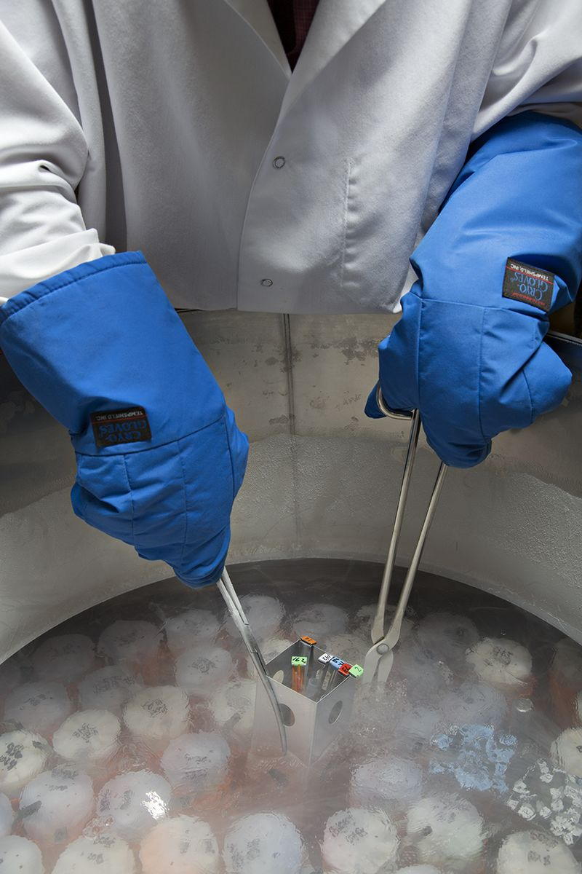
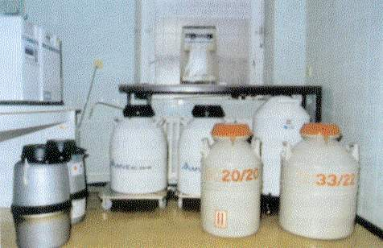
Cryoconservation (cryopreservation)
process of freezing and storing embryos
providing an additional chance for pregnancy
saving embryos before certain treatments

Slide 39
Donor conception
the eggs, sperm or embryos or both (double donation) from donors are used in order to conceive
can be used in IUI or IVF
donation is voluntary and anonymous
some donor characteristics may be known (skin hair and eye color) – try to find the best match

Slide 40
Surrogacy
arrangement, whereby a woman (the surrogate mother) agrees to bear a child for another person or person
indications: abnormal uterus, post hysterecromy, congenital malformation of uterus, history of multiple miscarriages, (same sex couple)

Slide 41
Infertility
Endometriosis
The presence of endometrial tissue in an abnormal anatomical location (out of uterus)
Endometrial tissue respond to menstrual cycle hormones, and bleed during the menstrual cycle
between 6 and 10 percent of women of reproductive age worldwide
Lot of theories of etiology (metaplastic, Sampson‘s retrograde menstruation theory, and many others)

Slide 42
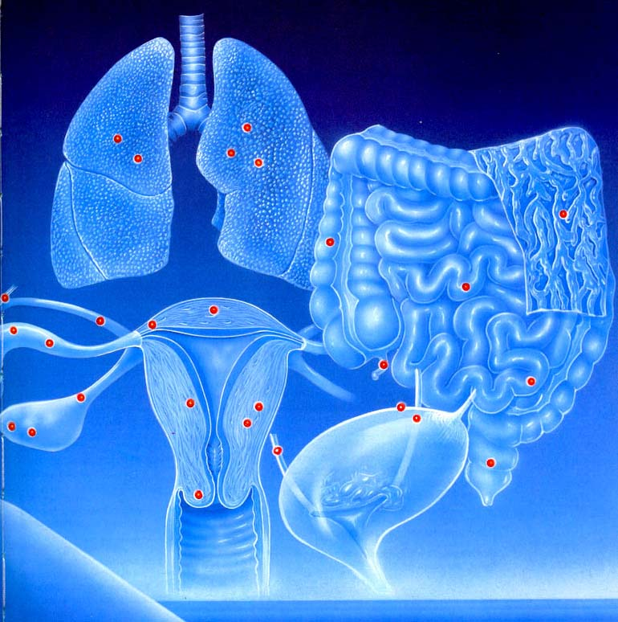
Infertility
Localisation of endometriosis
Sacrouterine ligg. | 63 %
Ovary | 56 %
C.Douglasi | 25 %
Vesica ur. | 20 %
Samps. Cyst | 20 %
Broad ligament | 8 %
Intestine | 6 %

Slide 43
Infertility
Risk factors
White race
Early menarche
Late menopause
Nulliparity
Obesity
Short menstrual cycle
Family history

Slide 44
Infertility
Symptoms
20-25% of women are asymptomatic
Pelvic pain/chronic pelvic pain
Dysmenorrhea
Dyspareunia
Dysuria
Mittelschmerz – associated with ovulation
Infertility
diarrhoea/constipation
Irregular/heavy period.....

Slide 45
Infertility
Diagnosis
Ultrasound examination / expert US examination
DGL
MRI
Biopsy/histopathology

Slide 46
Infertility
Therapy
depends on: symptoms, age, fertility, stage, former therapy
Hormonal therapy: COC, Progesterone, GnRH modulators
NSAID
Surgery – excision/resection endometrial endometriomas

Slide 47

Infertility
  Thank you
  for your
  attention

Slide 48
Pelvic infection and STDs
Questions
Normal sperm cell concentration is?
20 mil./ml
40 mil./ml
15 mil./ml.
35 mil./ml.
Ashenozoospermia means?
reduced concentration
reduced sperm motility
abnormal morphology
absence of spermatozoa (motile sperm)
complete lack of semen

Slide 49
Pelvic infection and STDs
Questions
Normal sperm cell concentration is?
20 mil./ml
40 mil./ml
15 mil./ml.
35 mil./ml.
Ashenozoospermia means?
reduced concentration
reduced sperm motility
abnormal morphology
absence of spermatozoa (motile sperm)
complete lack of semen

Slide 50
Pelvic infection and STDs
Questions
Normal sperm cell concentration is?
20 mil./ml
40 mil./ml
15 mil./ml.
35 mil./ml.
Ashenozoospermia means?
reduced concentration (Oligozoospermia)
reduced sperm motility
abnormal morphology (Teratozoospermia)
absence of spermatozoa (motile sperm) (Azoospermia)
complete lack of semen (Aspermia)

Slide 51
Pelvic infection and STDs
Questions
Which of the following does not belong to assisted reproduction methods?
Ovulation stimulation
In-vitro fertilisation
Surrogacy
Vasectomy
Infertility is ?
Failure to achieve a pregnancy after two years of regular unprotected intercourse
Failure to achieve a pregnancy after 6 months of regular unprotected intercourse
Failure to achieve a pregnancy after 9 months unprotected intercourse
Failure to achieve a pregnancy after one year of regular unprotected intercourse

Slide 52
Pelvic infection and STDs
Questions
Which of the following does not belong to assisted reproduction methods?
Ovulation stimulation
In-vitro fertilisation
Surrogacy
Vasectomy
Infertility is ?
Failure to achieve a pregnancy after two years of regular unprotected intercourse
Failure to achieve a pregnancy after 6 months of regular unprotected intercourse
Failure to achieve a pregnancy after 9 months unprotected intercourse
Failure to achieve a pregnancy after one year of regular unprotected intercourse

Slide 53
Pelvic infection and STDs
Questions
Which of the following does not belong to assisted reproduction methods?
Ovulation stimulation
In-vitro fertilisation
Surrogacy
Vasectomy
Infertility is ?
Failure to achieve a pregnancy after two years of regular unprotected intercourse
Failure to achieve a pregnancy after 6 months of regular unprotected intercourse
Failure to achieve a pregnancy after 9 months unprotected intercourse
Failure to achieve a pregnancy after one year of regular unprotected intercourse

Slide 54
Pelvic infection and STDs
Questions
Which of the following does not belong to infertility diagnostic methods?
Anti-Műllerian Hormon (AMH)
SONO-Hysterosalpingography
Curettage
Diagnostic laparoscopy
MESA is indicated for sperm retrieval in case of?
failure of TESA method
occlusion between epididymis and urethra
oligospermia
Occlusion between ovarium and uterus

Slide 55
Pelvic infection and STDs
Questions
Which of the following does not belong to infertility diagnostic methods?
Anti-Műllerian Hormon (AMH)
SONO-Hysterosalpingography
Curettage
Diagnostic laparoscopy
MESA is indicated for sperm retrieval in case of?
failure of TESA method
occlusion between epididymis and urethra
oligospermia
Occlusion between ovarium and uterus

Slide 56
Pelvic infection and STDs
Questions
Which of the following does not belong to infertility diagnostic methods?
Anti-Műllerian Hormon (AMH)
SONO-Hysterosalpingography
Curettage
Diagnostic laparoscopy
MESA is indicated for sperm retrieval in case of?
failure of TESA method
occlusion between epididymis and urethra
oligospermia
Occlusion between ovarium and uterus

Slide 57
Pelvic infection and STDs
Questions
Which is the most common symptom of endometriosis?
missed periods
rapid weight loss
chronic pelvic pain
vomiting
Which of the following is not a risk factor for Endometriosis?
long menstrual cycle
nulliparity
late menopause
early menarche

Slide 58
Pelvic infection and STDs
Questions
Which is the most common symptom of endometriosis?
missed periods
rapid weight loss
chronic pelvic pain
vomiting
Which of the following is not a risk factor for Endometriosis?
long menstrual cycle
nulliparity
late menopause
early menarche

Slide 59
Pelvic infection and STDs
Questions
Which is the most common symptom of endometriosis?
missed periods
rapid weight loss
chronic pelvic pain
vomiting
Which of the following is not a risk factor for Endometriosis?
long menstrual cycle
nulliparity
late menopause
early menarche

