Slide 1
Schizophrenia and other psychotic disorders
Michaela Mayerová

Slide 2

Psychosis, schizophrenia
Psychosis:
1. symptom, not illness
halucinations, delusions, thought disorder
2. „psychoses“ = psychotic disorders (for example: schizophrenia, toxic psychosis, delusional disorder, acute polymorfic psychotic disorder, …)
Schizophrenia:
- one of the psychoses, diagnosis

Slide 3
Definition of SCH
The schizophrenic disorders are characterized in general by fundamental and characteristic distortions of thinking and perception, and affects that are inappropriate or blunted. Clear consciousness and intellectual capacity are usually maintained although certain cognitive deficits may evolve in the course of time.
The most important psychopathological phenomena include
  thought echo
  thought insertion or withdrawal
  thought broadcasting
  delusional perception and delusions of control
  hallucinatory voices commenting or discussing the patient in the third person
  thought disorders
  negative symptoms

Slide 4
Schizophrenia IS NOT
Some laymen think that psychosis is „bifurcation“ of personality. That´s a false idea.
Patients with schizophrenia can have postpsychotic changes of personality, can hear contradictory voices and can be ambivalent (all will be explained). But they don´t „live two different lives with two different personalities“.

Slide 5
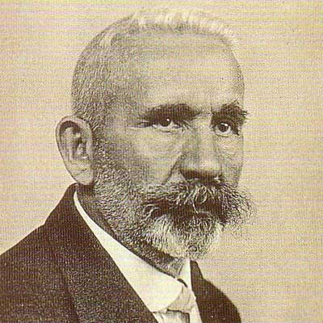
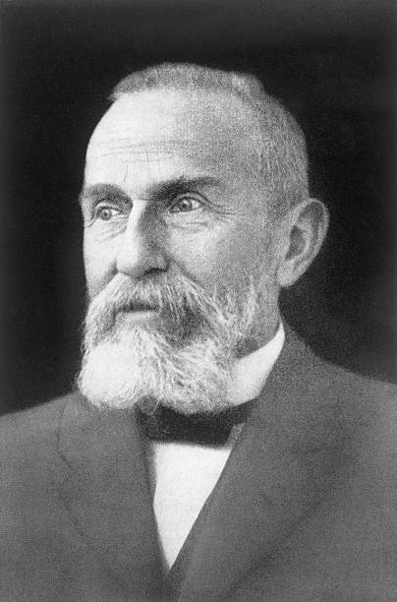
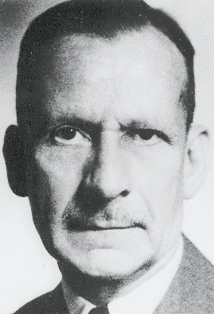
History
Emil Kraepelin: This illness develops relatively early in life, and its course is likely deteriorating and chronic; deterioration reminded dementia („Dementia praecox“), but was not followed by any organic changes of the brain, detectable at that time.
Eugen Bleuler: He renamed Kraepelin’s dementia praecox as schizophrenia (1911); he recognized the cognitive impairment in this illness, which he named as a „splitting“ of mind.
Kurt Schneider: He emphasized the role of psychotic symptoms, as hallucinations, delusions and gave them the privilege of „the first rank symptoms” even in the concept of the diagnosis of schizophrenia.

Slide 6
4 A (Bleuler) – „four“ A
Bleuler maintained, that for the diagnosis of schizophrenia are most important the following four fundamental symptoms:
  affective blunting
  disturbance of association (fragmented thinking)
  autism
  ambivalence (fragmented emotional response)
Bleuler thought, that they are „primary” for this diagnosis.
The other known symptoms, hallucinations, delusions, which are appearing in schizophrenia very often also, he used to call as a “secondary symptoms”, because they could be seen in any other psychotic disease, which are caused by quite different factors — from intoxication to infection or other disease entities.

Slide 7
Schizophrenia - general information
Is heterogenous disease – in symptoms, in course, in etiopatogenesis.
Can disrupt almost any mental function – thinking, perception, emotions, behavior, cognitive functions; personality, …
Usally begins in early adultery
Is sometimes called „cancer of psychiatry“
Many patients are invalidized, but 1/5 of patients have good prognosis

Slide 8


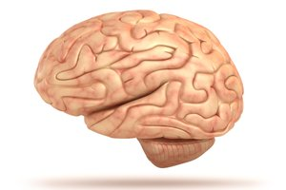
Symptoms
Positive – „plus“, an excess or distortion or normal function
Negative – „minus“, „lost“ functions
Cognitive
(Affective) – „secondary“, are not basic symptoms

Slide 9
Positive symptoms
Halucinations
Delusions
Formal thought disorder
Bizarre behaviour

Slide 10
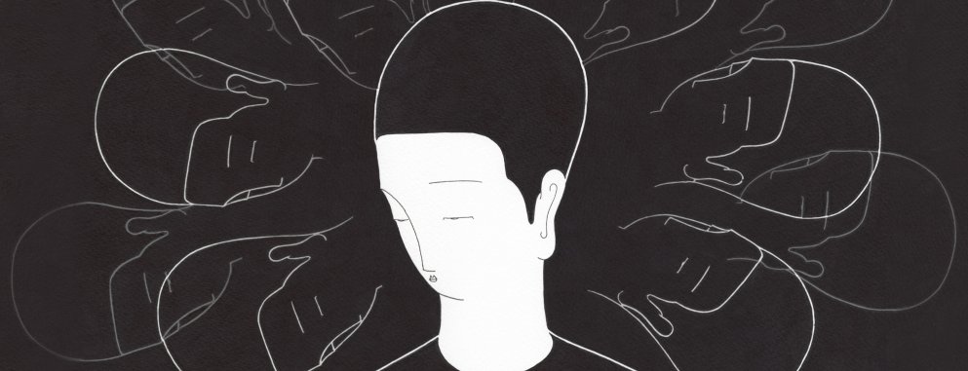
Halucinations
Disturbance of perception
Auditory:
„hearing voices“, usual more, words or sentences, usually unplesant;
commenting, imperative, giving advice; can be contradictory
Intrapsychical:
hearing own thoughts, thought broadcasting, thought insert, externalization, control
Tactile, olfactory – not so typical
Visual – not typical (typical for delirium, sometimes in toxic psychoses)

Slide 11

Delusions
Disturbance of thinking/thought
Delusion - a mistaken belief that is held with strong conviction
3 types:
Macromanic – immortality, grandeur, inventory, erotomania, …
Micromanic- nihilistic, autoaccusative, hypochondric, …
Paranoid – paranoid, persecutory, control, jealousy, dysmorfofobic, …

Slide 12
Formal thought disorder
Disorganized thinking (and speech, and behaviour)
Organized (logical) – tangencial - disorganized

Slide 13
Example of disorganized thinking
Female patient, 28 years olf, hospitalized for the first time. Wrote many pages of text, we didn´t asked for it. She told the blue color are her thoughts, the red color are the voices of her dead father. Part of the text:
„give the cats, other rooks, and the firemen back; sirens, which are on where something is on fire; don´t be afraid, alarm“
„You have tried to violate my friend, who is lying next to me, too, dissmiss and it..“

Slide 14
Negative symptoms
Alogie – relative absence of thoughts and speech
Affective flattening – little expressed emotion
Avoliation – apathy – lack of initiation and persistence
Anhedonia – asociality – lack of pleasure feeling
Attentional impairment

Slide 15
Cognitive symptoms
Impaired memory and attention
Difficulty thinking through complicated processes, making sense of information
Impaired ability to organize
Poor decision-making
Difficulty in interpreting social cues

Slide 16


Other symptoms
Sleep distorsion
Paralogia = pseudologia
Catatonia
Ambivalency (having simultaneous conflicting reactions, beliefs, or feelings towards some object)
Anosognosia (they don´t accept they are ill)
„Postpsychotic personality changes“ – they can become less active, more introversive, more hypochondrical, don´t have hobbies, feel stigmatized, are socially isolated, are not able to work, are not able to have close relationships

Slide 17
Symptoms
No symptom is patognomic.
One patient doesn´t necessarily have all groups of symptoms – positive, negative, cognitive.
Positive symptoms are better treatable then negative and cognitive.

Slide 18
The Criteria of Diagnosis (ICD-10)
For the diagnosis of schizophrenia is necessary
presence of one very clear symptom - from point a) to d)
or the presence of the symptoms from at least two groups - from point e) to h)
for one month or more:
the hearing of own thoughts, the feelings of thought withdrawal, thought insertion, or thought broadcasting
the delusions of control, outside manipulation and influence, or the feelings of passivity, which are connected with the movements of the body or extremities, specific thoughts, acting or feelings, delusional perception
hallucinated voices, which are commenting permanently the behavior of the patient or they talk about him between themselves, or the other types of hallucinatory voices, coming from different parts of body
permanent delusions of different kind, which are inappropriate and unacceptable in given culture

Slide 19
The Criteria of Diagnosis
the lasting hallucination of every form
blocks or intrusion of thoughts into the flow of thinking and resulting incoherence and irrelevance of speach, or neologisms
catatonic behavior
„the negative symptoms”, for instance the expressed apathy, poor speech, blunting and inappropriatness of emotional reactions
expressed and conspicuous qualitative changes in patient’s behavior, the loss of interests, hobbies, aimlesness, inactivity, the loss of relations to others and social withdrawal
-------------------------------------------------------------------------------------------------------
Diagnosis of acute schizophorm disorder (F23.2) – if the conditions for diagnosis of schizophrenia are fulfilled, but lasting less than one month
Diagnosis of schizoaffective disorder (F25) - if the schizophrenic and affective symptoms are developing together at the same time

Slide 20

Types of schizophrenia
F20 Schizophrenia
F20.0 Paranoid schizophrenia
F20.1 Hebephrenic schizophrenia
F20.2 Catatonic schizophrenia
F20.3 Undifferentiated schizophrenia
F20.4 Post-schizophrenic depression
F20.5 Residual schizophrenia
F20.6 Simple schizophrenia
F20.8 Other schizophrenia
F20.9 Schizophrenia, unspecified

Slide 21
F20.0 Paranoid Schizophrenia
is characterized mainly by delusions of persecution, feelings of passive or active control, feelings of intrusion, and sometimes by megalomanic tendencies also.
The delusions are not usually systemized too much, without tight logical connections and are often combined with hallucinations of different senses, mostly with hearing voices.

Slide 22
Example of patient with paranoid schizophrenia
40 years old male patient, hospitalized few times, anosognostic.
„I want to write the complaint to the Center for human laws. I am doing nothing wrong to anyone. But „they“ are constantly disturbing me, annoying me. They don´t believe I am able to marry someone. They stare at me, I feel their sights. They yell at me, they are under the windows - at home, in the hospital, everywhere. They yell at me that I am dumb and ugly. „They“ are bad people, especially young women. They think I am a fool. I help Kájínek to be acquited, I like him. (Kájínek is czech criminal, who had been jailed.) I suffer from Kájinkophobia for many years. I suffer from many diseases caused by bad young women.“
psychopatology: vocal halucinations, persecutive delusions, ambivalency (to Kájínek – likes him and suffers from Kájínkophobia in the same time)

Slide 23
F20.1 Hebephrenic Schizophrenia
is characterized by disorganized thinking with blunted and inappropriate emotions. The behavior is often bizarre. There could appear mannerisms, grimacing, inappropriate laugh and joking, pseudophilosophical brooding and sudden impulsive reactions without external stimulation. There is a tendency to social isolation.
It often begins in adolescency.
Usually the prognosis is poor because of the rapid development of "negative" symptoms, particularly flattening of affect and loss of volition.
Denoted also as disorganized schizophrenia .

Slide 24
F20.2 Catatonic Schizophrenia
is characterized mainly by motoric activity, which might be strongly increased (hypekinesis) or decreased (stupor), or automatic obedience and negativism.
  productive form — which shows catatonic excitement, extreme and often aggressive activity.
  (rare symptoms: echopraxia, echolalia, echomimia)
  stuporose form — characterized by general inhibition of patient’s behavior or at least by retardation and slowness, followed often by mutism, negativism, flexibilitas cerea or by stupor.
  TREATMENT: ECT, benzodiazepines, hypnotics, NOT antipsychotics (catatonia is hypodopaminergic situation)

Slide 25
movie
Please watch the movie „catatonic and other symptoms“

Slide 26
F20.3 Undifferentiated Schizophrenia
Psychotic conditions meeting the general diagnostic criteria for schizophrenia but not conforming to any of the subtypes in F20.0-F20.2 or exhibiting the features of more than one of them without a clear predominance of a particular set of diagnostic characteristics.
This subgroup represents also the former diagnosis of atypical schizophrenia.

Slide 27
F20.4 Postschizophrenic Depression
A depressive episode, which may be prolonged, arising in the aftermath of a schizophrenic illness. Some schizophrenic symptoms, either „positive“ or „negative“, must still be present but they no longer dominate the clinical picture.
These depressive states are associated with an increased risk of suicide.

Slide 28
F20.5 Residual Schizophrenia
A chronic stage in the development of schizophrenia with clear succession from the initial stage with one or more episodes characterized by general criteria of schizophrenia to the late stage with long-lasting negative symptoms and deterioration (not necessarily irreversible).

Slide 29
F20.6 Simple Schizophrenia
Simple schizophrenia is characterized by early and slowly developing initial stage with growing social isolation, withdrawal („introvertization“), small activity, passivity, avolition and dependence on the others.
The patients are indifferent, without any initiative and volition. There is not expressed the presence of hallucinations and delusions.

Slide 30
Incidence, onset
Schizophrenia occurs with regular frequency nearly everywhere in the world in 1 % of population.
Begins mainly in young age (mostly around 16 to 25 years).
Men usually earlier then women.
Women: second peak of incidence – year 37 or 38.
Onset after 40 is very unusual.
(Women – better prognosis, more „affective“ symptom, later onset then men, women are protected by estrogens.
The gender incidence is nearly the same - men 1,1 : women 1)

Slide 31

Schizophrenia in childhood
Typical symptoms:
Disorganization
Disturbance of behaviour
Abnormal postures, movements
Cognitive dysfunction
Anxiety
Social disturbance
Less typical, but possible symptoms:
Delusions, Hallucinations
Prognosis depends on the type of schizphrenia, age of onset – the sooner onset, the worse prognosis.
Onset of schizophrenia in childhood is rare.
The diagnostic criteria for children are the same as for adults.

Slide 32
Course of Illness
Course of schizophrenia:
  continuous without temporary improvement
  episodic with progressive or stable deficit
  episodic with complete or incomplete remission
Typical stages of schizophrenia:
  prodromal phase
  active phase
  residual phase

Slide 33
Suicidality, lenght of life
Approximately 5-6 % of SCH patients commite suicide.
Schizophrenia shorten life of approximately 15 years.

Slide 34

Etiology of Schizophrenia
The etiology and pathogenesis is multifactorial
Nowadayys we know more and more, but not enough
  internal factors – genetic, inborn, biochemical, immunological
  external factors – trauma, infection of CNS, stress

Slide 35

Genetics of Schizophrenia
Many psychiatric disorders are multifactorial (caused by the interaction of external and genetic factors) and from the genetic point of view very often polygenically determined.
Relative risk for schizophrenia is around:
  1% for normal population
  5.6% for parents
  10.1% for siblings
  12.8% for children

Slide 36
Dopamine Hypothesis
The most influential and plausible are the hypotheses, based on the supposed disorder of neurotransmission in the brain, derived mainly from
  the effects of antipsychotic drugs that have in common the ability to inhibit the dopaminergic system by blocking action of dopamine in the brain
  dopamine-releasing drugs (amphetamine, mescaline, diethyl amide of lysergic acid - LSD) that can induce state closely resembling paranoid schizophrenia
Classical dopamine hypothesis of schizophrenia: Psychotic symptoms are related to dopaminergic hyperactivity in the brain. Hyperactivity of dopaminergic systems during schizophrenia is result of increased sensitivity and density of dopamine D2 receptors.

Slide 37
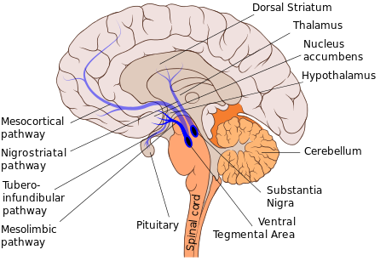
Positive symptoms – hyperdopaminergic state in mesolimbic pathway
Negative symptoms – hypodopaminergic state in mesocortical area

Slide 38
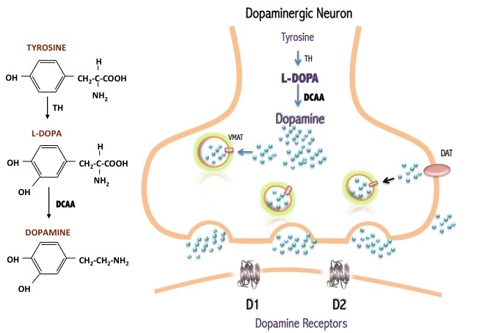
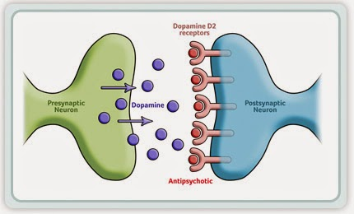

Slide 39
Contemporary Models
Dopamine hypothesis revisited: various neurotransmitter systems probably takes place in the etiology of schizophrenia (norepinephric, serotonergic, glutamatergic, some peptidergic systems); based on effects of atypical antipsychotics especially.
Contemporary models of schizophrenia conceptualize it as a neurocognitive disorder, with the various signs and symptoms reflecting the downstream effects of a more fundamental cognitive deficit:
  the symptoms of schizophrenia arise from “cognitive dysmetria” (Nancy C. Andreasen) (a dysfunction in cortical-subcortical-cerebellar circuitry)
  concept of schizophrenia as a neurodevelopmental disorder (Daniel R. Weinberger)

Slide 40
Neurodevelopmental Model
Neurodevelopmental model supposes in schizophrenia the presence of “silent lesion” in the brain, mostly in the parts, important for the development of integration (frontal, parietal and temporal), which is caused by different factors (genetic, inborn, infection, trauma...) during very early development of the brain in prenatal or early postnatal period of life.
It does not interfere too much with the basic brain functioning in early years, but expresses itself in the time, when the subject is stressed by demands of growing needs for integration, during formative years in adolescence and young adulthood.

Slide 41
Abnormities in brain structure
Nonspecific, usually not visible on basic MRI
cortical gray matter loss (i.e. superior temporal and inferior frontal regions)
disrupted neural connectivity

Slide 42
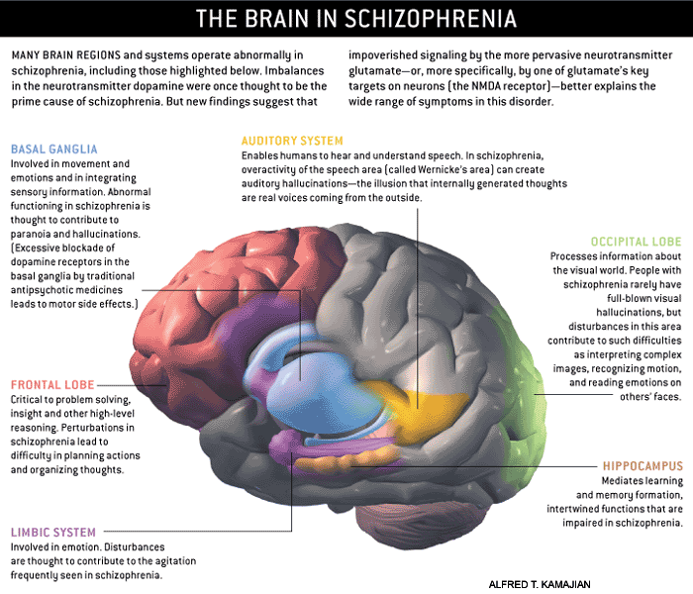

Slide 43
Treatment of schizophrenia
Antipsychotics
Individual psychotherapy
Family therapy
Social skill training
Supported employment etc
ECT or rTMS in the minority of patient
(ECT – usually pharmacoresistant patients with affective symptoms, rTMS – vocal hallucinations, negative symptoms)

Slide 44
Antipsychotics
First generation | Second generation
- Typical, traditional - Cause more extrapyramidal and probably cardial side effects Are effective to positive symptoms Are less prescribed We discovered and used earlier (late 60´s, 70´s) haloperidol, zuklopenthixol, melperone, chlopromazine, fluphenazine, chlorprothixen, levomepromazine, … | - Atypical, modern Cause less extrapyramidal symptoms Are effective to positive, probably to negative and cognitive symptoms Are more prescribed Usually are more expensive We discovered (except clozapine) later risperidone, paliperidone, olanzapine, quetiapine, clozapine, amisulpride, aripiprazol, cariprazine
Is not easy to characterise all the first generation according to all the second one, because there are big differences (in usage, sife effects, effectivity..) among concrete antipsychotics in both groups.

Slide 45
First episode
Usually they need hospitalization, only rarely can be treated outpatiently.
Antipsychotics are immediately used – in the form of acute intramuscular injections or in peroral form. (Examples of i.m. injections: olanzapine, haloperidol, zuklopenthixol)
We prefer monotherapy.
First choice can use almost any (except clozapine) antipsychotic from the first or second generation, but we prefer second generation. (for example risperidon, olanzapin, amisulprid)
We should consider side effects of the concrete medication, patient´s other diseases, …

Slide 46
First episode, other acute episode
We can observe antipsychotic effect in at least 2 to 3 weeks.
Sedative effect is obvious after few hours or days (usually we combine antipsychotics with anxiolytics in the beginning).
The hospitalization usually takes 6 weeks.
Sometimes the first antipsychotic is not effective, we shoud change it.
Clozapine can be used like third antipsychotic, not the first one, not the second one. (Because it can cause agranulocytosis.)

Slide 47

First episode, other acute episode
Some patients are converted to instramuscular long-lasting injections (LAI). The frequency of apllication is from 2 weeks to 1 month (depend on concrete medication).
Examples of LAI: paliperidon, olanzapin, aripiprazol, haloperidol, zuklopenthixol, fluphenazine
(Paliperidone exists in 3 months´form, it is usually used after 1 month form in outpatient care.)

Slide 48

How long should pharmacotherapy last?
After first episode – 2 years
After second episode – 5 years
After third and other episodes, in patients with chronic course, in patients with repetitive suicidal behaviour – longer, usually the whole life

Slide 49
Some practical notes
When the patient has symptoms of psychosis (not necessarily of schizophrenia, can be acute psychosis, concrete diagnosis is not so important), please don´t wait. Please handle psychiatric consult as soon as possible, the patient probably needs the hospitalization.
(Also think about other diagnostical alternatives - is he
intoxicated? Does he have any neurological symptoms?
When the patient is treated for schizophrenia, attends psychiatry outpatiently and is stabile, there is no need to handle psychiatric consult („consilium“) just because of the diagnosis of schizophrenia when he is hospitalized in other department (internal, surgical etc.). But when you are not sure about his condition, behaviour, medication, suicidal thoughts, than of course handle the psychiatric consult.

Slide 50
F21 Schizotypal disorder
eccentric behavior
deviations of thinking and affectivity, which are similar to that occurring in schizophrenia,
but without psychotic features and expressed symptoms of schizophrenia of any type.

Slide 51
F22.0 Delusional Disorder
A disorder characterized by the development of one delusion or of the group of similar related delusions, which are persisting unusually long, very often for the whole life.
Other psychopathological symptoms — intrusion of thoughts etc. are not present and are excluding this diagnosis.
It begins usually in the middle age.
Treated by usual antipsychotics.

Slide 52
F23 Acute and Transient Psychotic Disorders
The criteria should be the following features:
  acute beginning (to two weeks)
  quickly changing “polymorphic symptoms” – emotivity, psychotics symptoms
  typical schizophrenic symptoms are present or not
Complete recovery usually occurs within a few months, often within a few weeks or even days.
The disorder may or may not be associated with acute stress, defined as usually stressful events preceding the onset by one to two weeks.

Slide 53
F24 Induced Delusional Disorder
A delusional disorder shared by two or more people with close emotional links. Only one of the people suffers from a genuine psychotic disorder; the delusions are induced in the other(s) and usually disappear when the people are separated.

Slide 54
F25 Schizoaffective Disorders
Episodic disorders in which both affective and schizophrenic symptoms are prominent (during the same episode of the illness or at least during few days) but which do not justify a diagnosis of either schizophrenia or depressive or manic episodes.
Patients suffering from periodic schizoaffective disorders, especially with manic symptoms, have often good prognosis with full remissions without any remaining defects.
They are divided in different subgroups:
  F25.0 Schizoaffective disorder, manic type
  F25.1 Schizoaffective disorder, depressive type
  F25.2 Schizoaffective disorder, mixed type
  F25.8 Other schizoaffective disorders
  F25.9 Schizoaffective disorder, unspecified

Slide 55

„Toxic psychoses“
Usually caused by usage of marijuana or metamphetamine (the more frequent and longer use the higher probability)
Negative and cognitive symptoms are not typical, but positive are
Some patients can have visual hallucinations, which are not typical for schizophrenia
Sometimes there is not easy to distinquish whether the substance was the trigger or the cause of psychosis
Usually dissaper when the patient abstain
Antipsychotics are usually used in acute phase, in some patients also in subsequent treatment

Slide 56

Thank you for your attention
There are some passages from my colleguages´presentations and some passages which had been googled in this presentation.

