Slide 1

CT, MRI and Sonography in stomatology
J.Stulík – Department of radiology and nuclear medicine

Slide 2
Computed tomography (CT)
Classic CT
Dental Cone Beam CT

Slide 3
Classic CT
CT images are acquired while the x-ray tube i rotating 360dg. around the patient
The x-ray beam is collimated in axial orientation and divergent to encompass the patient‘s width in the other orientation.
The intensity of attenuated x-rays emerging from the patient is measured with an array of minute detectors

Slide 4
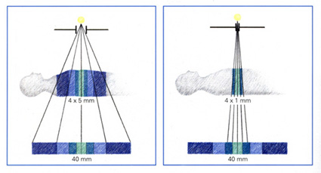
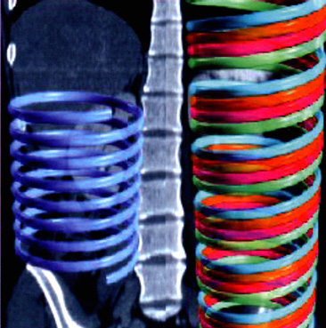
Multislice CT
Several rows of detectors each above another
MS- detector array segmented in z axis, as a mosaic.
–Allows for simultaneous acquisition of multiple images in scan plane with ONE rotation.

Slide 5
Classic CT indication
  Examination of facial soft tissue
  parotid gland disease
  diagnosing and staging tumors
  diagnosis and assess the extent of osteomyelitis (inflammation of the jaw bone)
  temporomandibular joint disorders
  impacted teeth
  complex traumatic injuries of facial skelet

Slide 6
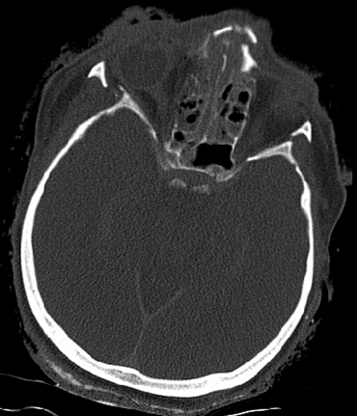
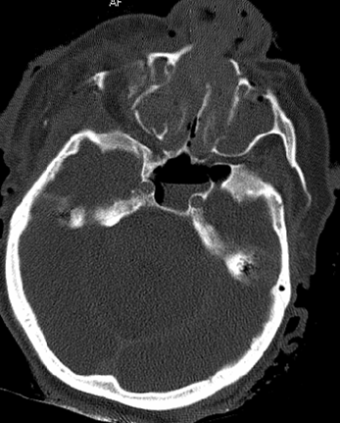
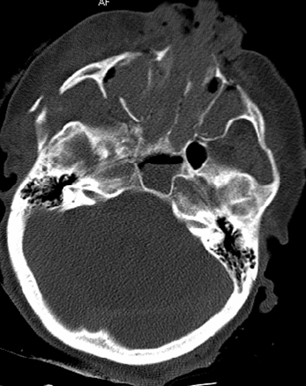
Complex fractures of facial skelet

Slide 7
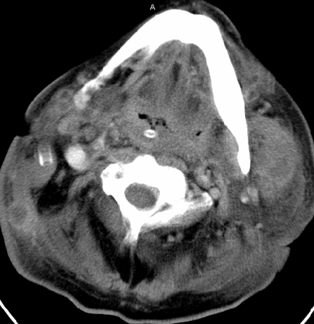
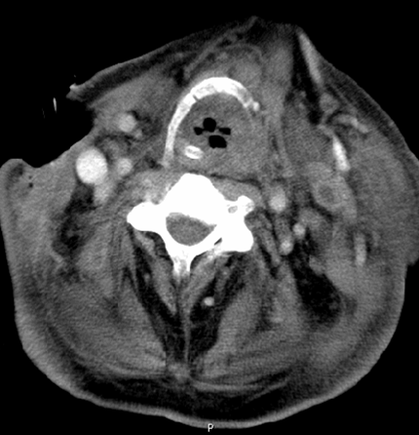
Absces

Slide 8
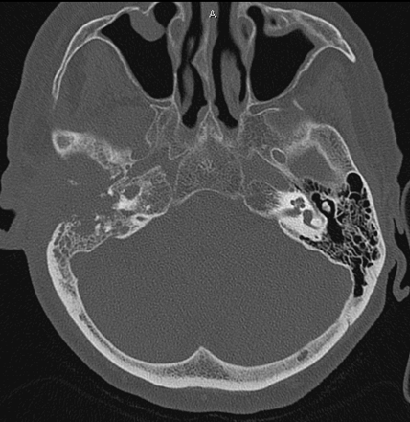
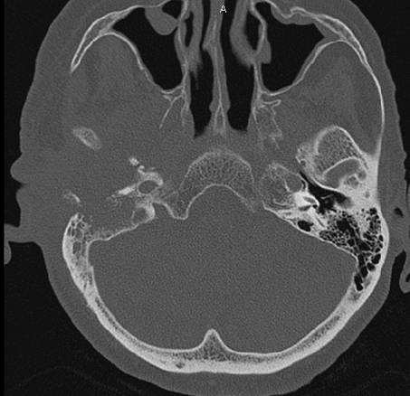
The extensive osteolysis of the temporal bone

Slide 9
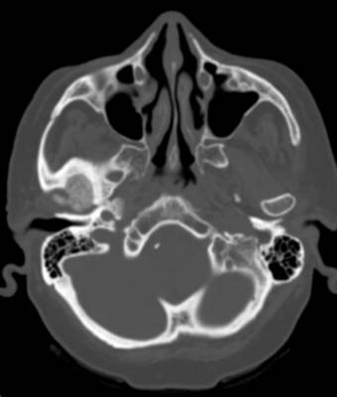
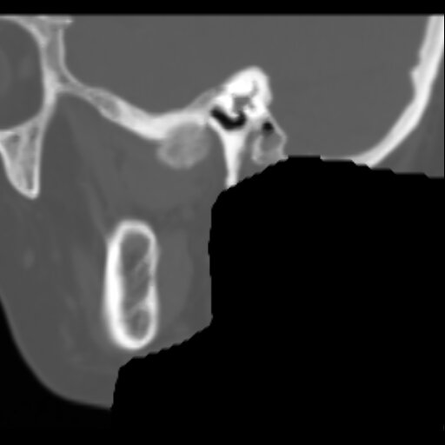
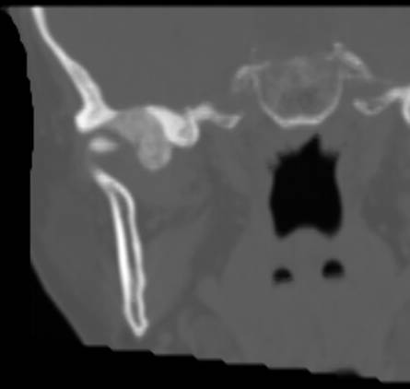
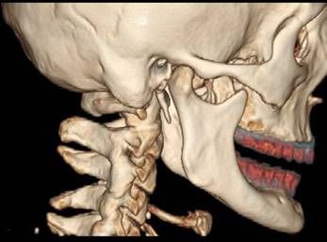
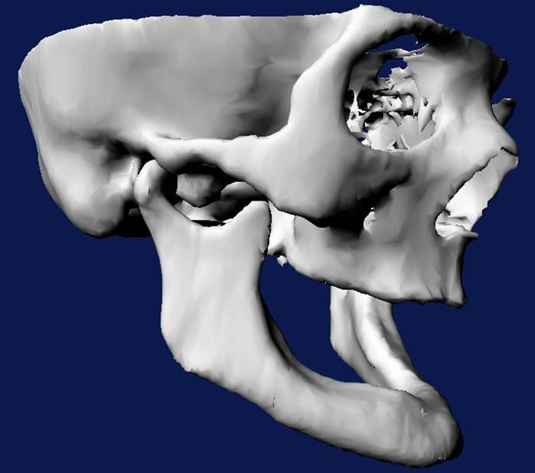
Postprocessing - reconstructions
Multiplanar rec. - MPR
Volume rendering technique - VRT
Shadow surface display - SSD

Slide 10
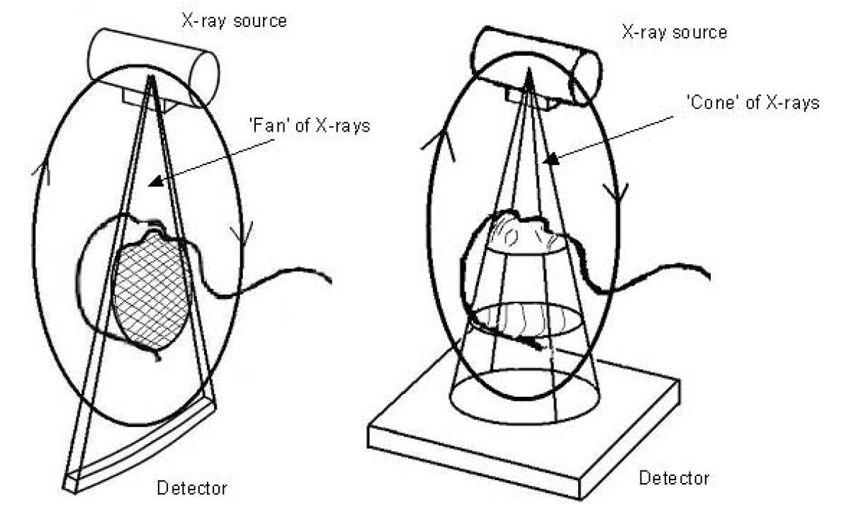
How CBCT Works
Dental Cone Beam CT
Similar to current CT technology
Uses cone shaped x-ray beam
2-D flat panel detector
Gives volumetric data

Slide 11
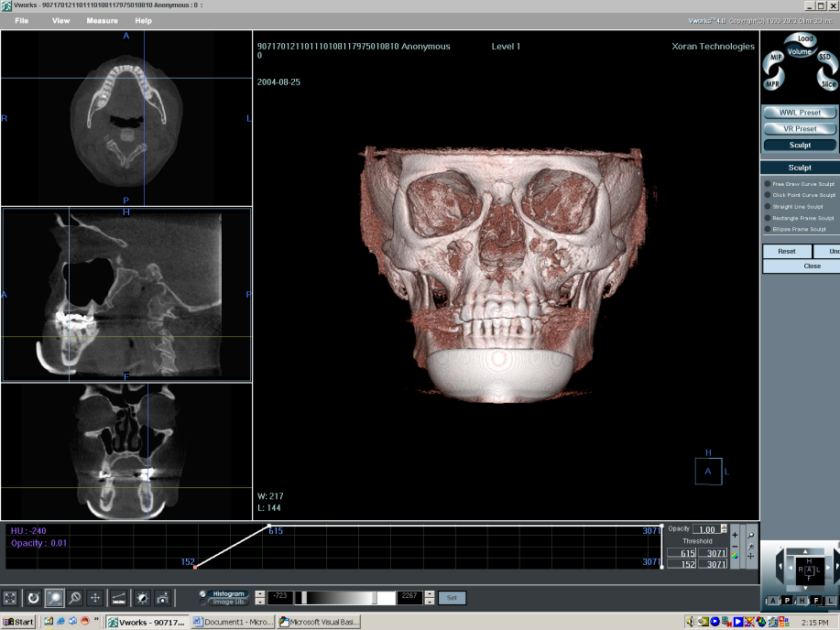
Advantages in Dental Imaging
Lower dose than helical CT
Compact design
Superior images to Panoramic
Low cost
Low heat load
Dose:
Panoramic: 6-20 µSv
CBCT: 20-70 µSv
Conventional CT: 314 µSv

Slide 12
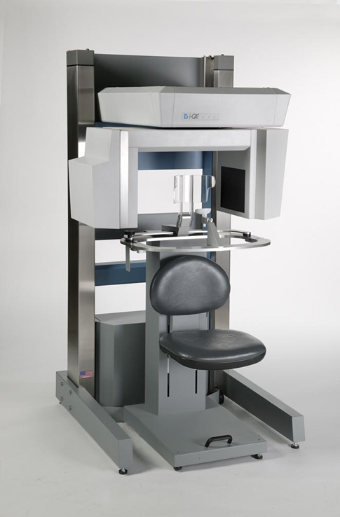
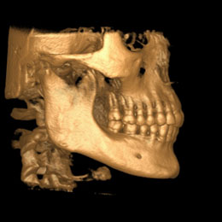
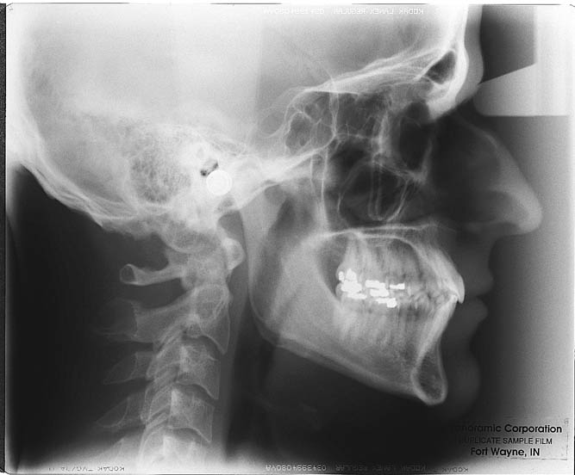
CBCT
Cephalometric CBCT image
Cephalometric Panoramic image
The i-Cat CBCT

Slide 13
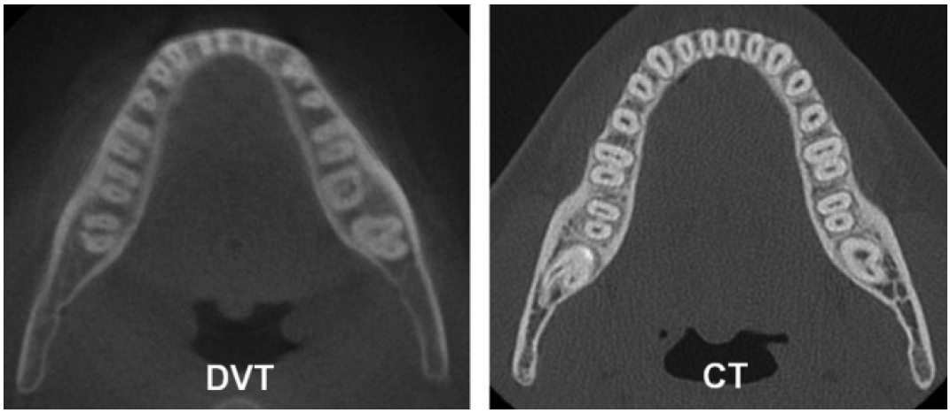
Shortcomings
Worse resolution in low contrast tissues
Long scan times = motion artifacts
Slightly Inferior quality to conventional CT
CBCT
Periodontal ligament spaces easily recognizable in the dental CT but not satisfactory in the CBCT

Slide 14
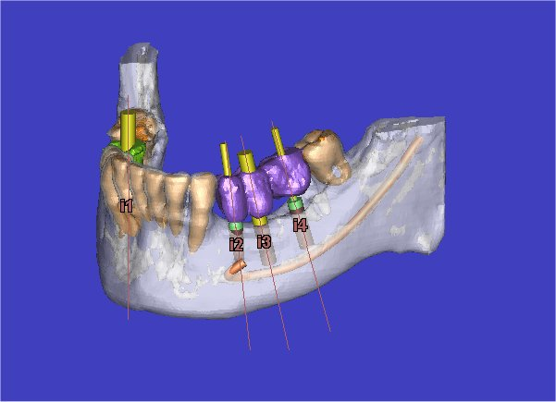
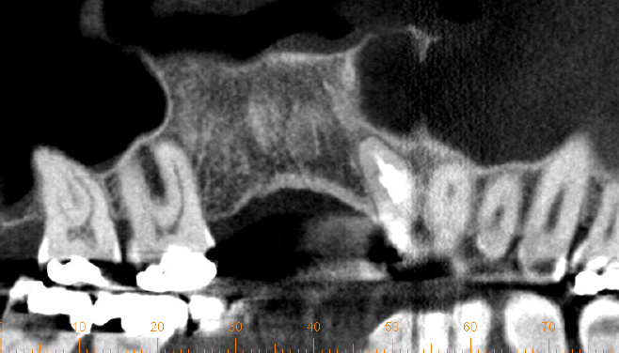
Applications of CBCT
Great for pre-planning for implant surgery
Virtual Surgery
Conventional CT diagnosis at 1/5 the dose
Tumor detection
Airway visualization

Slide 15
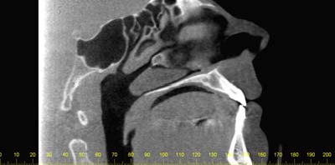
Conclusions
CBCT offers less dose than conventional CT
CBCT offers superior images and diagnosis to panoramic
More practical than a conventional CT

Slide 16
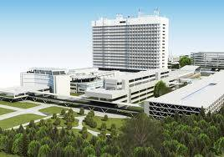
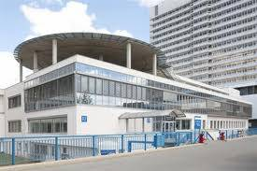
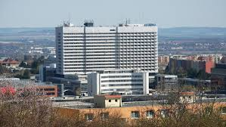
Sonography

Slide 17
Sound
Mechanical waves (energy transfer).
Sound use particles of enviroment for own transmision(so no sound in vacuum).
Infrasound 0-16 Hz
An audible sound 20 Hz-20 kHz
Ultrasound 20 kHz-10 GHz
Hypersound 10 GHz - ?

Slide 18
Sound
Wave propagation consists of cyclic compressions and decopressions of environmental particles
decompresion
compresion

Slide 19
Sound - Graphically expressed
Notes:
-During longitudinal wave demo point out particle motion
(http://members.xoom.com/Surendranath/LongWave.html)
(http://members.xoom.com/Surendranath/TranWave.html)

Slide 20
Zvuk
Vyšší frekvence = vyšší rozlišení, horší penetrace
Nižší frekvence = vyšší penetrace, horší rozlišení

Slide 21
Sound - Spread rate
Air 330 m/s
Water 1480 m/s
Liver 1550 m/s
Kidney 1560 m/s
Soft tissue 1540 m/s

Slide 22
Sound
The spread rate is determined only by the characteristics of the environment - in particular with density (stiffness)
density (stiffness) = Speed
The average sound velocity in the human body for ultrasound purposes is about 1540 m / s
Notes:
-use analogy of room full of people and passing a note to illustrate density
and stiffness
-takes longer to pass a note with a room full of people because more people
must handle it
-the less curious (more stiff) people are the faster the note will be passed

Slide 23
Basic principle of ultrasound image creation - reflections of ultrasound waves on the interface of two different environments with different acoustic impedance.
Reflections (echos) can be displayed in a 2D image, the reflected energy intensity is expressed on a gray scale (the strongest = lightest)
.

Slide 24
Puls ultrasound
The probe sends a wave and detects the amplitude of returning wave.
According to the return time, it calculates from which depth the signal was reflected.
Depending on the amplitude, it assigns the brightness to the point on the screen
The same is repeated several times in the lateral direction and together all lines of points makes final picture
.

Slide 25
Aplication of diagnostic ultrasound in stomatology
Detection of cortical fracture lines in maxillo-facial fractures
Position of mandibular condyls.
Detection of diseases of the salivary glands (inflammation, tumors, sialolithiasis, dilation of the outlets)
Detection of lymphadenopathy
navigational interventions (biopsy, puncture) at palpably inaccessible departments, TMJ ozonotherapy
Surface soft-tissue affection of the maxillo-facial region, differential diagnosis (significantly better resolution than CT)

Slide 26
Therapeutic UZ - Conservative Therapy
Therapeutic ultrasound - principle
The main mechanism of therapeutic effect is high-frequency micromassage of tissues together with heat inducing hyperaemia and physico-chemical changes in the environment.
Its application enhances membrane permeability, accelerates diffusion in tissues, has a suppressive effect on the transmission of nerve impulses, changes the pH of the tissues.
The result is an analgesic and spasmolytic effect, increased local blood circulation and consequently also metabolism
.

Slide 27
Therapeutic ultrasound - indication
Myofacial pain dysfunction sy
TMJ diseases
Sialolitotrypsis (extracorporeal shock wave - ESWL)
Algic syndromes, bone healing
It inhibits the release of inflammatory mediators from the cells
Accelerates healing
Increases the elasticity of collagen fibers
Reduces joint stiffness
Reduces muscle spasms, improves mobility
Prospective utility of therapeutic ultrasound in dentistry—Review with recent comprehensive update, Shalu Rai, Mandeep Kaur, Shailly Singh, Adv Biomed Res. 2012; 1: 47.

Slide 28
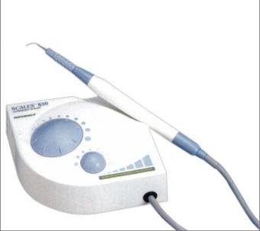
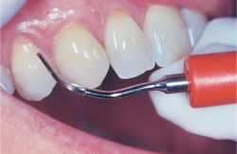
Therapeutic UZ - Conservative Therapy
Therapeutic ultrasound - Dental Descaler
Ultrasound dental descaler - tartar removal.
It is a device with a source of low-frequency ultrasonic waves (25-42 kHz), the end of which is equipped with a working extension. The tip of the extension vibrates and mechanically disturbs dental plaque.
However, in addition to the direct mechanical effect of the oscillating tip, effect of ultrasonic cavitation is also involved.

Slide 29
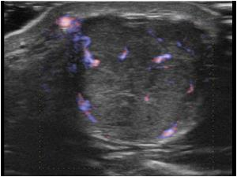
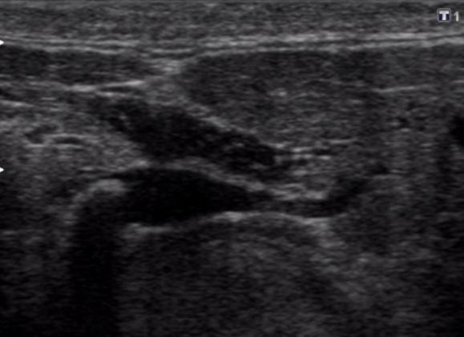
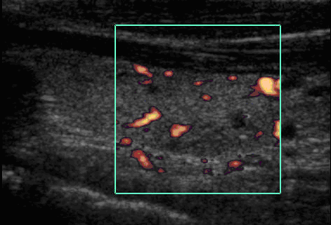
Ultrasound of salivary glands
Pleomorf adenoma
Sialolithiasis
Cysts

Slide 30
Advantages of ultrasound examinations
safe, cheap and affordable method
there are practically no contraindications
accessibility at the patient's bed
significant spatial resolution
Doppler option, flow display, blood circulation

Slide 31
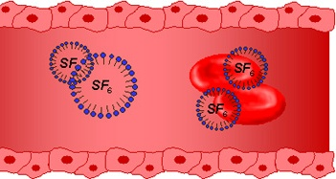
CEUS
ultrasound examination with i.v. application of special contrast media
microbubbles stabilized by phospholipid
100 million x higher soundwaves reflection of microbubbles than of blood.
nontoxic
no special patient preparation is
required
there are no allergic reactions
is excreted after about 10 minutes with lungs
only contraindication: AIM
Pure intravascular contrast agent

Slide 32
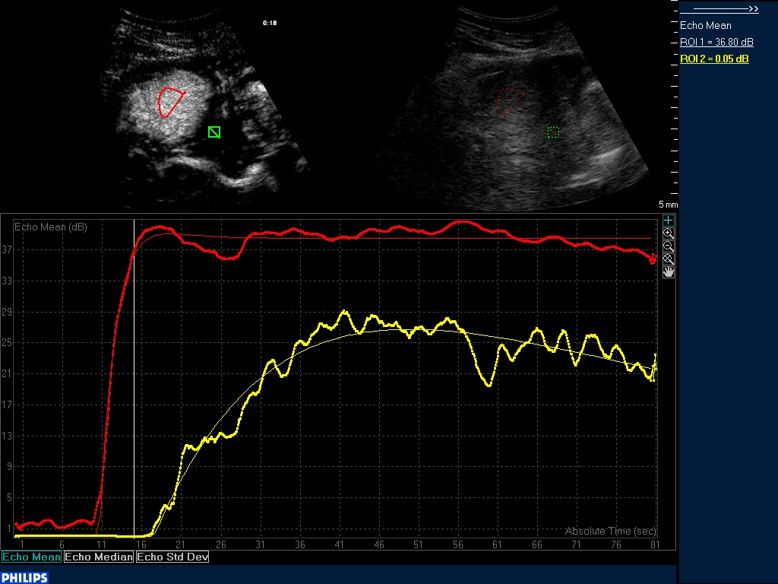
Possibility of quantification

Slide 33
Disadvantages, limitations of ultrasound
number of artifacts
subjective examination
limited investigability in non-cooperating patients

Slide 34
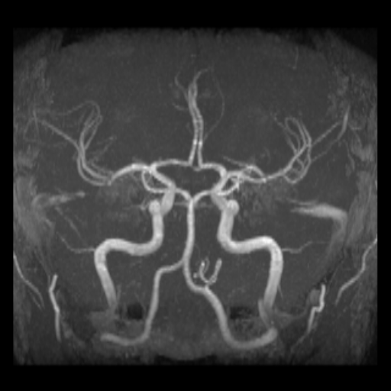
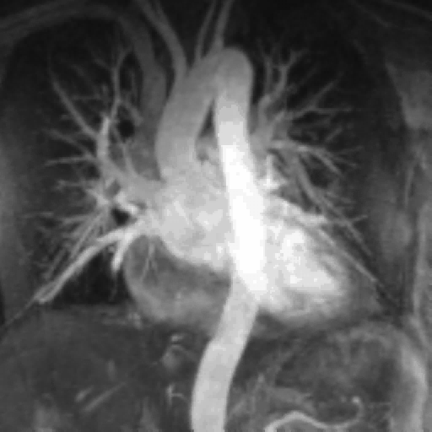
Magnetic resonance

Slide 35
Magnetic resonance
Hydrogen nuclei (1H) have a magnetic behavior
We use a strong magnetic field (0,2-2T)
radiofrequency pulses - a resonance of frequencies - transfer of energy - 1H raising from lower to higher energy states
signal from protons = from the pacient body - induction of a current in a receiver coil - computer reconstruction - resulting image

Slide 36
Disadvantages of MRI
Strong magnetic field! (whole patient is placed in)
duration of examination - untill 60 min.
limited examination space
the price = availability
limited examination field (brain + Csp., C+Th, Th+L)

Slide 37
Benefits of MRI
Noninvasive technique
unprecedented soft tissue contrast
arbitrary plane of cross-section
MR angiography, ERCP, PMG (without a contrast medium)
contrast media - Gd (minimal risk of allergic reaction)

Slide 38
Contraindications of MRI
ABSOLUTE
presence of magnetic metallic implants in otbit or intracranialy
Magnetic implante in other location shorter than 6 weeks after implantaion
pacemaker/ICD
RELATIVE
claustrophobia
non-cooperative patient
I. trimestr of pregnancy

Slide 39
MR principles
Nuclear magnetic resonance (NMR) is a non-invasive means of obtaining clinical images and of studying tissue metabolism in vivo. Bloch and Purcell independently discovered NMR in 1946. Six years later they were awarded the Nobel Prize for their achievements. Since then, the development of NMR spectrometers and NMR scanners has led to the opening up of whole new branches of physics, chemistry, biology and medicine.
Notes:
Achievements - úspěchy

Slide 40
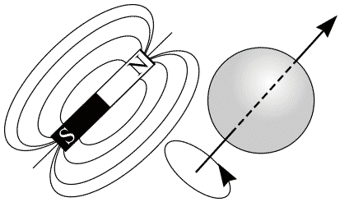
Nuclei with an odd number of protons and neutrons possess a property called spin. In quantum mechanics spin is represented by a magnetic spin quantum number. Spin can be visualised as a rotating motion of the nucleus about its own axis. As atomic nuclei are charged, the spinning motion causes a magnetic moment in the direction of the spin axis. This phenomenon is shown in figure. The strength of the magnetic moment is a property of the type of nucleus. Hydrogen nuclei (1H), as well as possessing the strongest magnetic moment, are in high abundance in biological material. Consequently hydrogen imaging is the most widely used MRI procedure.
A charged, spinning nucleus creates a magnetic moment which acts like a bar magnet (dipole).
Notes:
Odd - lichý
consequently - následkem (toho)

Slide 41
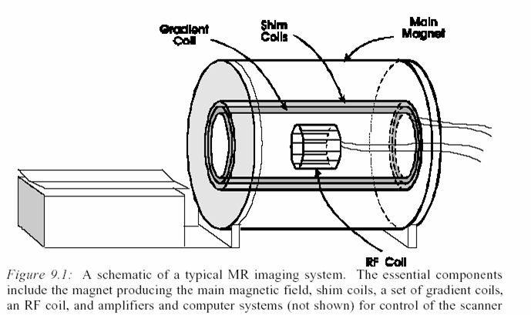
The first step in creating a magnetic resonance image is placing the subject in a strong magnetic field.
Notes:
shim - destička pro nastavení vůle
shim - kotouček pro nastavení vůle
shim - vymezovací podložka
shim - vyrovnávací podložka

Slide 42
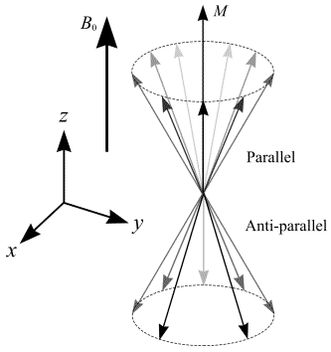
Presence of a strong magnetic field causes the nuclear spins of certain atoms within the body, namely those atoms that have a nuclear spin dipole moment, to orient themselves with orientations either parallel or antiparallel to the main magnetic field (Bo).

Slide 43
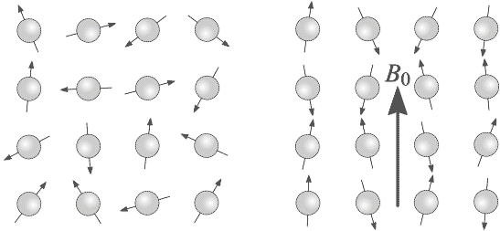
A collection of 1H nuclei (spinning protons) in the absence of an externally applied magnetic field. The magnetic moments have random orientations. (b) An external magnetic field B0 is applied which causes the nuclei to align themselves in one of two orientations with respect to B0 (denoted parallel and anti-parallel).
Notes:
align - seřadit
denoted - označený (mat.)

Slide 44
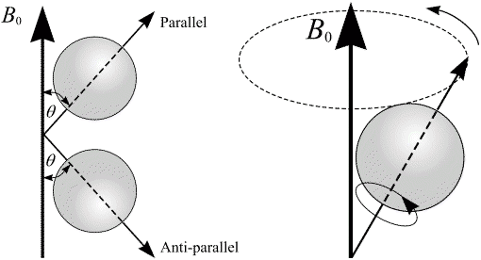
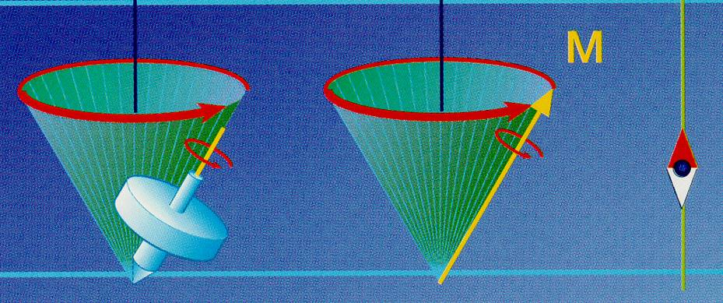
The spin axes are not exactly aligned with B0, they precess around B0 with a characteristic frequency
(a) In the presence of an externally applied magnetic field, B0, nuclei are constrained to adopt one of two orientations with respect to B0. As the nuclei possess spin, these orientations are not exactly at 0 and 180 degrees to B0. (b) A magnetic moment precessing around B0. Its path describes the surface of a cone.
Notes:
constrained - nucený

Slide 45
The nuclei precess about Bo with a frequency called the resonance or a Larmor frequency.
Because the parallel state is the state of lower energy, slightly more spins reside in the parallel configuration, creating a net magnetization represented by a vector M.
A collection of spins at any given instant in an external magnetic field, B0. A small net magnetisation, M, is detectable in the direction of B0.
Notes:
instant - chvíle
reside - spočívat v (o moci)
reside - sídlit
reside - zdržovat se (bydlit); kniž.

Slide 46
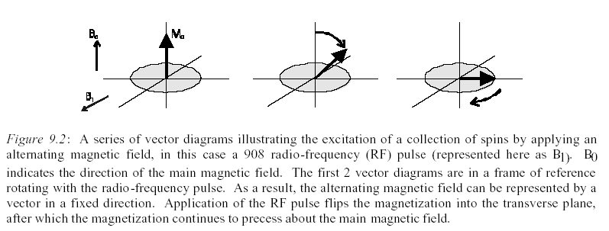
Magnetic resonance occurs when a radiofrequency pulse , applied at the Larmor frequency, excites the nuclear spins raising them from their lower to higher energy states. Classically this can be represented by a rotation of the net magnetization,
away from its rest of equilibrium state.
Notes:
frame - koncipovat
frame - konstrukce (nosná)
frame - konstruovat
frame - kostra (stavby, stroje, lodi apod.)

Slide 47
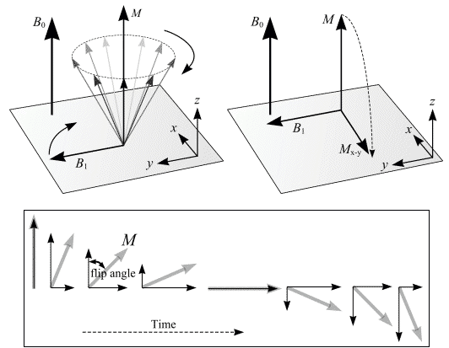
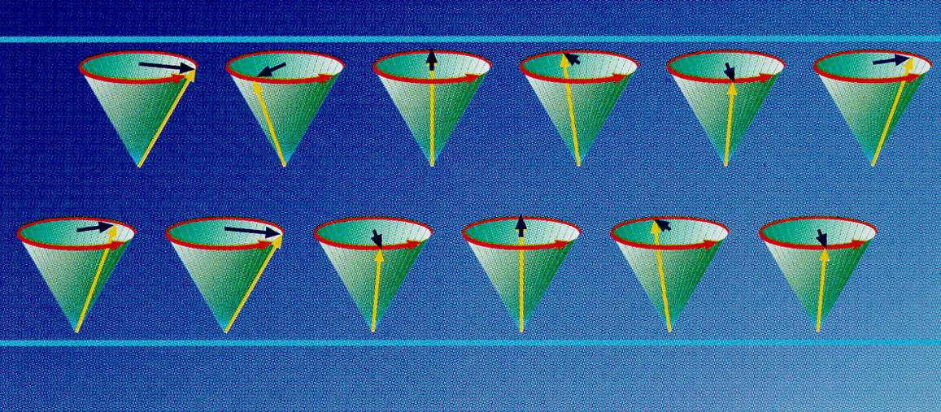
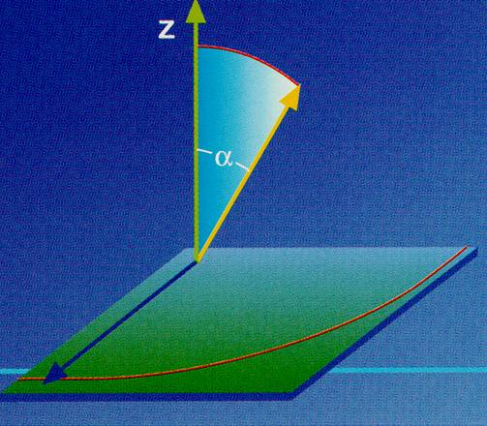
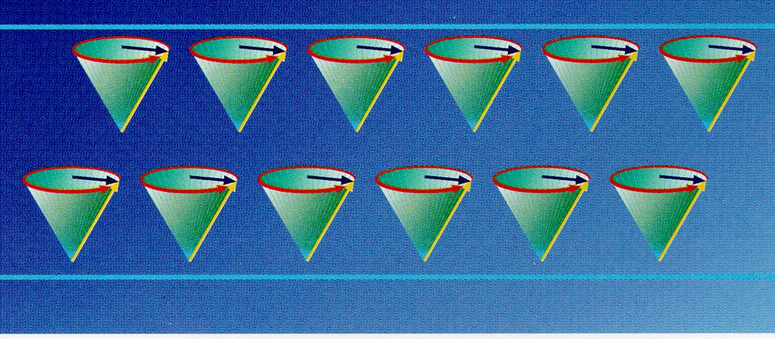
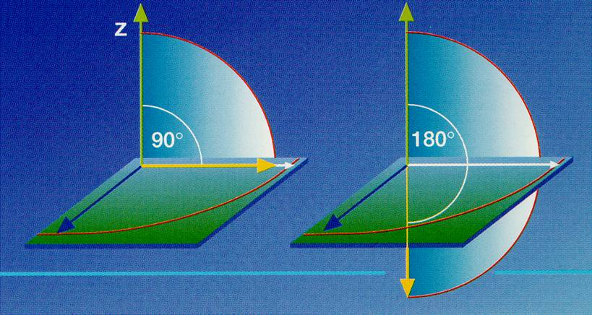
After a 90 degrees RF pulse, M lies in the x-y plane and rotates about the z-axis. The component of M in the x-y plane decays over time. An alternating current is induced in the receiver coil.

Slide 48
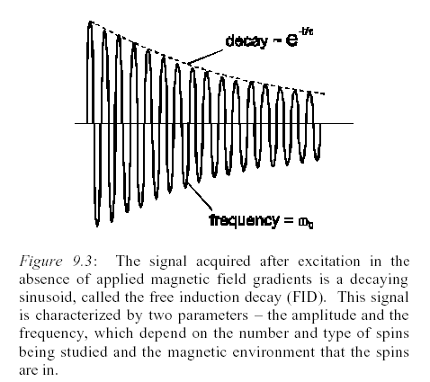
Once the magnetization is deflected, the RF field is switched of and the magnetization once again freely precesses about the direction of Bo.
This time dependent precession will induce a current in a receiver coil.
The resultant exponentially decaying voltage, referred to as the free induction decay (FID), constitutes the MR signal.
After a 90 degrees RF pulse, M lies in the x-y plane and rotates about the z-axis. The component of M in the x-y plane decays over time. An alternating current, shown in Figure (b), is induced in the receiver coil.
Notes:
deflect - odchýlit (se)
deflect - odklonit (se)

Slide 49
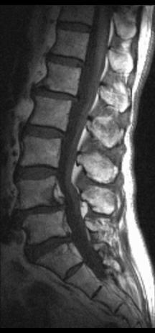
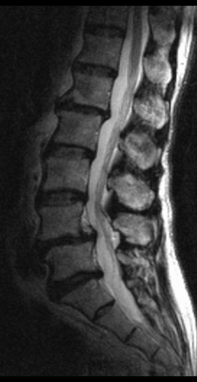
During the period of free precession the magnetization returns to its original equilibrium state by a process called relaxation which is characterized by two time constants, T1 and T2.
T1 and T2 depend on certain physical and chemical characteristics unique to tissue type, therefore contributing substantially to the capability of MRI to produce detailed images of the human body with unprecedented soft tissue contrast.
Notes:
therefore - proto (tedy)
therefore - pročež
contribute - přispívat
substantially - podstatně

Slide 50
Reconstruction of MR image
How do we make the voxels (volume elements)?
How do we know, from which part of the body cames the signal, how we make the final image?
Complex and complicated process, we need a physical and mathematical device
Notes:
Device - aparát, prostředek, deviza

Slide 51

Slice Selection
The first step is the selection of a slice, which is achieved by applying a magnetic field gradient along the z-axis (Gz) during a 90o rf pulse of a specific frequency bandwidth (period 1 of Figure 9.7). When the slice select gradient, Gz, is applied along the z-axis,the resonance frequencies of the protons become linearly related to position along the z-axis. Individual resonance frequencies correspond to individual planes of nuclei.
Notes:
bandwidth - vnímací schopnost; hovor. hanl.
bandwidth - šířka pásma

Slide 52



Slide 53

Frequency Encoding
After slice selection, the next task is to distinguish signal from different spatial locations within this slice. This is accomplished in the x-direction by applying a gradient (Gx), the frequency-encoding gradient, during the acquisition of the signal. (time period 3 in Figure 9.11).
The sequence of RF power and gradient ampitudes used to excite one slice and encode the positions of the spins within that slice into the signal. In this “frequency encoding,” the positions of the spins encoded by applying a magnetic field gradient in one of the directions in the excited slice during the acquisition.
Notes:
accomplished - dokonalý
accomplished - hotový

Slide 54

A series of steps illustrating the concept of frequency encoding to distinguish the signal
coming from two point sources of magnetization, e.g. small vials of water, in an object.(left) When no gradient is applied, both sources of magnetization resonate at the same frequency and the signal is a simple decaying sinusoid. When this signal is Fourier transformed, the signal is shown to contain only one frequency.(right)
When a gradient is applied, one of the sources of magnetization precesses at a higher frequency than the other. The resulting signal is an interference pattern of the two frequencies and is shown to contain by Fourier transformation to contain two distinct frequencies. Notice that the Fourier transformed signal is the projection of the amount of magnetization along the axis along which the gradient was applied.
That is, in this one dimensional case, the frequency content of the signal is the image.
Notes:
vial - ampulka (lahvička)
pattern - obrazec

Slide 55

A complete pulse sequence diagram for the spin echo sequence.
Spatial locations of the spins are encoded into the signal by applying three orthogonal gradients, techniques that are called slice selection, frequency encoding, and phase encoding. In period 1, a 90 degree pulse and a slice selection gradient excite one slice. In period 2, the initial frequency encoding gradient and the phase encoding gradient are applied. In period 3, a 180 degree pulse is applied, along with a slice selection pulse (such that only the spins in the same excited slice are “flipped,”) and in period 4 the frequency encoding gradient is applied and the signal is acquired. The sequence shown here is repeated numerous times (128, 256, 512, etc. depending on the desired resolution) each time with a different strength of the phase encoding gradient.

Slide 56
Although the signal obtained from one acquisition (slice selection, phase encoding and frequency encoding) contains information from all voxels in the imaging slice, the information gathered from one iteration of this sequence is not sufficient to reconstruct an image. Consequently, the sequence has to be repeated with different settings of the phase-encoding gradient Gy.
To construct a 256 x 256 pixels image a pulse sequence is repeated 256 times with only the phase encoding gradient changing.
A Fourier transformation allows phase information to be extracted so that a pixel (x, y) in the slice can be assigned the intensity of signal which has the correct phase and frequency corresponding to the appropriate volume element. The signal intensity is then converted to a grey scale to form an image.

Slide 57

MR and metallic dental materials
Different grade of artifacts according to the material used
It depends mainly on material susceptibility (pronounced in amalgam, titanium, less nickel-chromium or cobalt-chromium)
So if it can be removed, then take off before the examination

Slide 58

MR in stomatologi
The most common use is in temporomandibular joint diseases
  Pseudodynamic sequences are used
Ameloblastoma
Osteomyelitis
  Dif.dg. Cystic lesions
Range of hemangiomas, spread of tumors in general
Localization of the neurovascular bundle before planning potential sites for implants

Slide 59
Diseases of the temporomandibular joint
dysfunctional syndrome
inflammatory and degenerative changes
iatrogenic lesions (repeated injections of steroids)
M. Paget
Gout
Tumors
osteochondritis dissecans (avaskular necrosis)
Pigmented vilonodular synovitis
Ancylosis of TMJ
Hyperplasis of processus coronoideus

Slide 60


Intracapsular disease = discopathy
Discus artikularis – an important part of the temporomandibular joint
Disc – biconcav fibrocartilage structure dividing the joint into the upper and lower compartments
The correct position prevents damage to the mandible
The movement of the disc is limited by a strong rear ligament
Dorsal part - neurovascular structures = retrodiscular tissue (bilaminar zone)

Slide 61
Diskopathy
due to the pathological location of the articular disk or the adhesion of the disc
disc dislocation with reposition::the disk is dislocated at rest (most often anterior to the joint head), in the movement is repositioned, asymmetric opening, sound phenomena (most often in the sense of clicking), eventually. with the presence of pain. There is no limitation of opening mouth
disc dislocation without repositioning::
the disk is dislocated, but it does not reposition, the movement of the joint is so limited. In addition to limited opening, pain may be present, but no sound phenomena are present.
Adhesion of intraarticular disc:
the disk is at rest in the correct, physiological, position, however its mobility is limited. The reduction of the opening of the mouth is characteristic.

Slide 62

MRI pseudodynamicly

Slide 63






18 year old patient with DD with reposition

Slide 64




17 year old patient with DD without reposition

Slide 65
DWI – diffusion-weighted imaging
Diffusion - Random movement of water molecules in the tissue (Brown's motion)
The degree of diffusion often differs between individual tissues or between healthy and pathological tissues
The MR imaging of diffusion adds additional diagnostically valuable information.
Notes:
65

Slide 66
Diffusion imaging in different directions

Slide 67
DTI –diffusion tensor imaging
Method based on DWI principles
Anisotropy of diffusion in the white matter of the brain and spinal cord: the movement of water molecules proceeds more easily along the nerve fibers
The intensity of the DWI image signal depends on the direction of the additional magnetic gradient used
By repeated measurement with different diffusion directions we can detect the dominant direction of diffusion → the course of the nerve pathways
Notes:
67

Slide 68






DTI fibertracking: glioma gr. II
Tractus corticospinalis
Fasciculus arcuatus
Notes:
68

Slide 69







PCA: CSF circulation measurment
MR kontrola
Notes:
69

Slide 70


Funkční MR
It enables the resolution of active and inactive brain tissue regions by detecting changes in deoxyhemoglobin concentration occurring during activation
Measurement is performed repeatedly at rest and during activation - the patient performs some specific action

Slide 71

Possible applications fMRI
Neurosurgery - Preoperative mapping of the location of important centers
1)The figure on the left shows the situation before the operation: The speech center activity during the verbal test is located in the immediate vicinity of the tumor mediodorsally
2)In the figure on the right, a postoperative state is visible: The activity area during the speech center remains intact near the bed after tumor resection. No verbal function deficit was found in the patient after surgery.
www.fmri.org

Slide 72
Case – men *1979
Personal anamnesis: hypertension, smoker
Before two weeks purulent pouch in the oral cavity, self-emptying, since then but chills.
now a few days of headache
For headaches and prefrontal syndrome examined for CT

Slide 73

CT

Slide 74



MR
T2
T1
DWI
T1 + contrast

Slide 75
Dg.
Brain absces
He underwent neurosurgical evacuation
Thanks for your attention

