Slide 1
Cévní zásobení mozku
Petrášová Hana

Slide 2
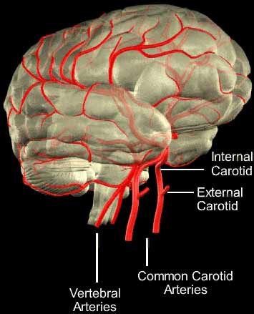
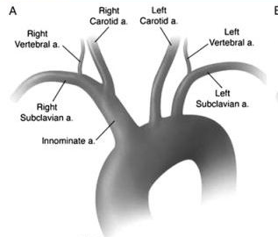
Magistrální mozkové tepny

Slide 3
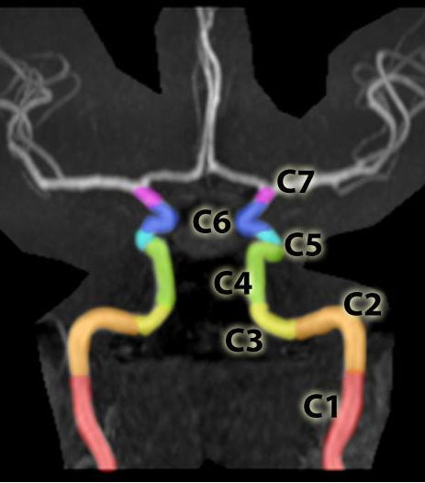
ACI
Cervical segment, or C1 - none
Petrous segment, or C2 - Caroticotympanic arteries, Artery of pterygoid canal
Lacerum segment, or C3 - none
Cavernous segment, or C4 - Tentorial basal branch, Tentorial marginal branch, Meningeal branch - helps supply blood to the meninges of the anterior cranial fossa, Clivus branches - tiny branches that supply the clivus, Inferior hypophyseal artery, Capsular branches - supplies wall of cavernous sinus, Branches to trigeminal ganglion - provide blood to trigeminal ganglion, Artery of the foramen rotundum, Branches to nerves
Clinoid segment, or C5 - none
Ophthalmic, or C6 - Ophthalmic artery, Superior hypophyseal artery
Communicating, or C7 - Posterior communicating artery, Anterior choroidal artery, Anterior cerebral artery, Middle cerebral artery

Slide 4
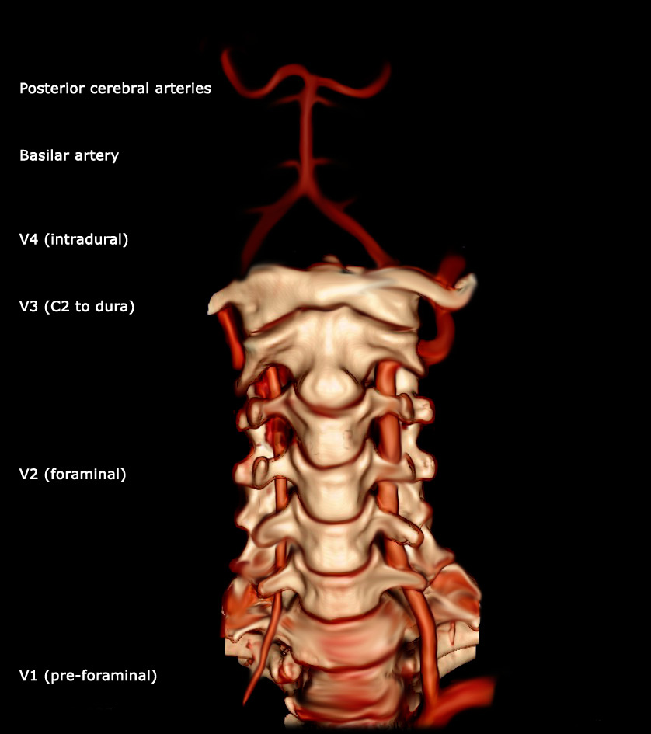
AV
First part- V1
Second part- V2 through the foramina in the transverse processes of the C6 to C2 vertebrae
Third part- V3 from the C2 foramen transversarium, entering the foramen transversarium of C1, behind the superior articular process of the atlas and enters the vertebral canal.
Fourth part- V4 intradural

Slide 5
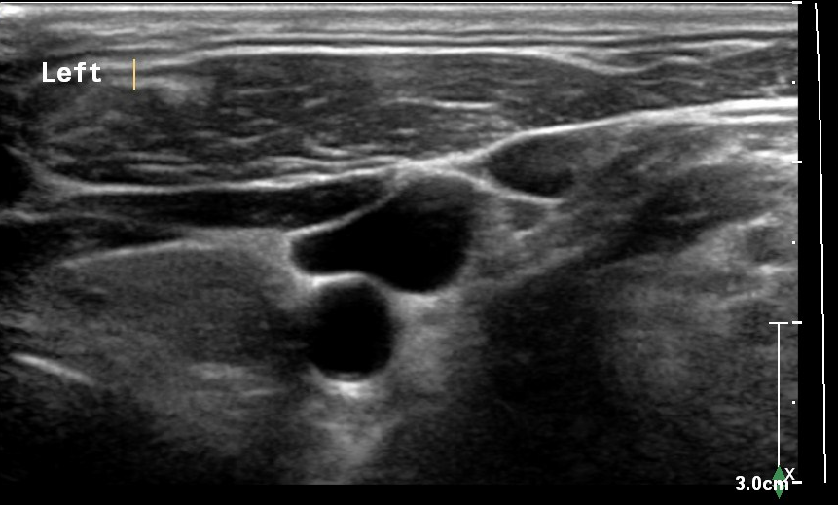
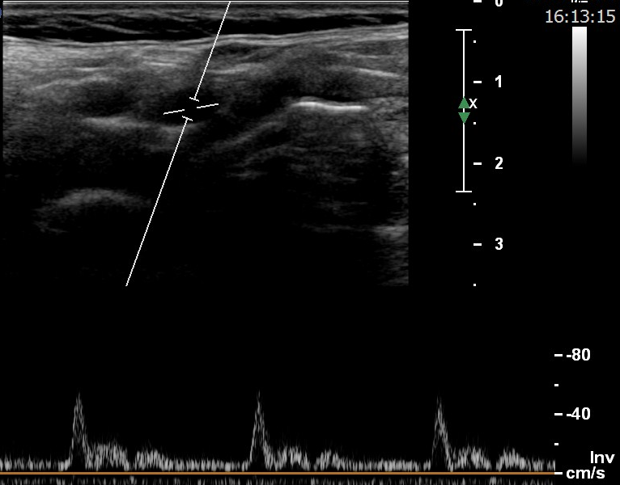
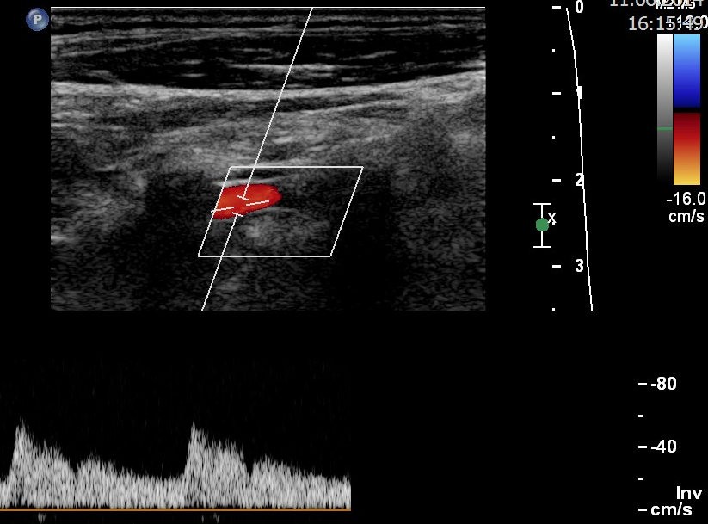
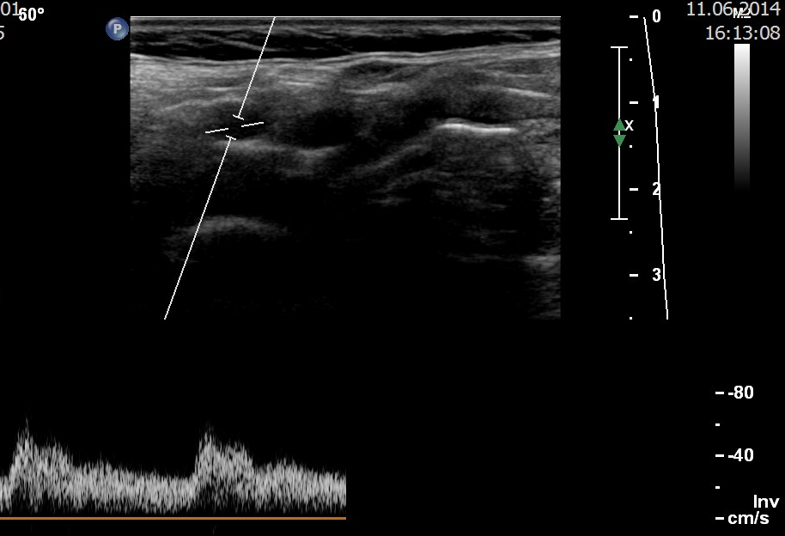
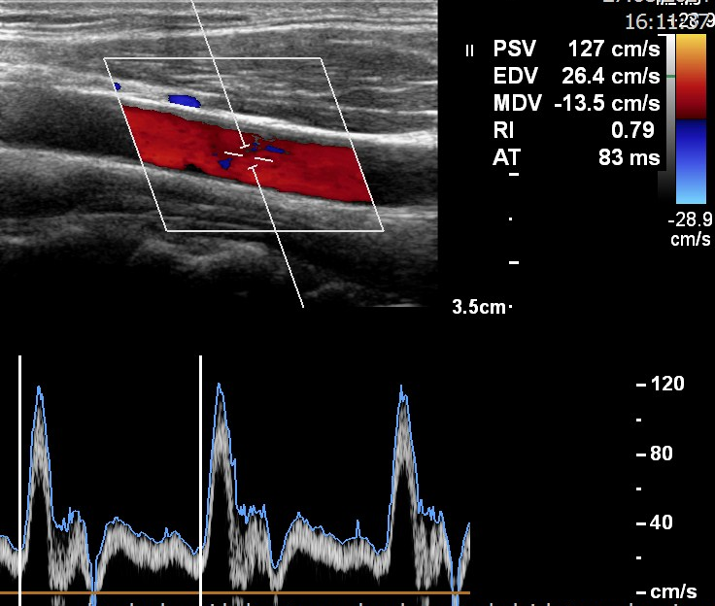

Slide 6
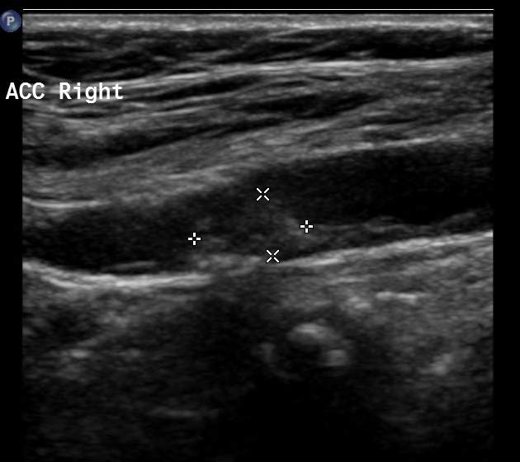
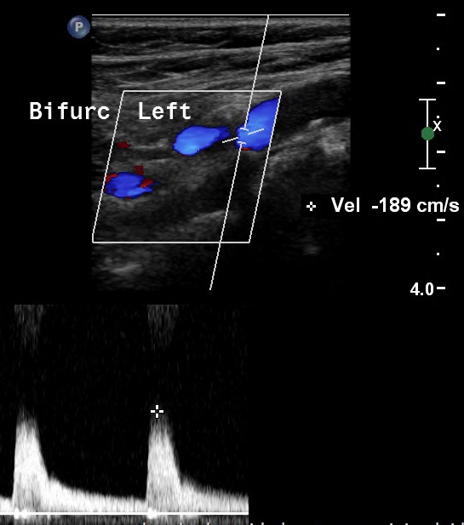
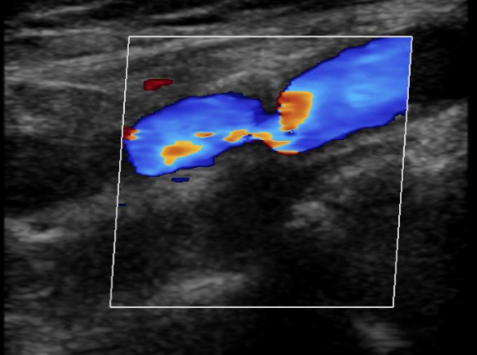

Slide 7
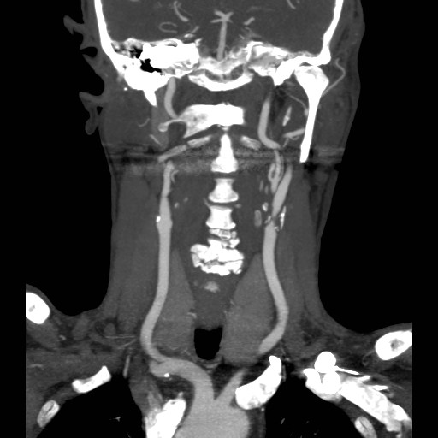
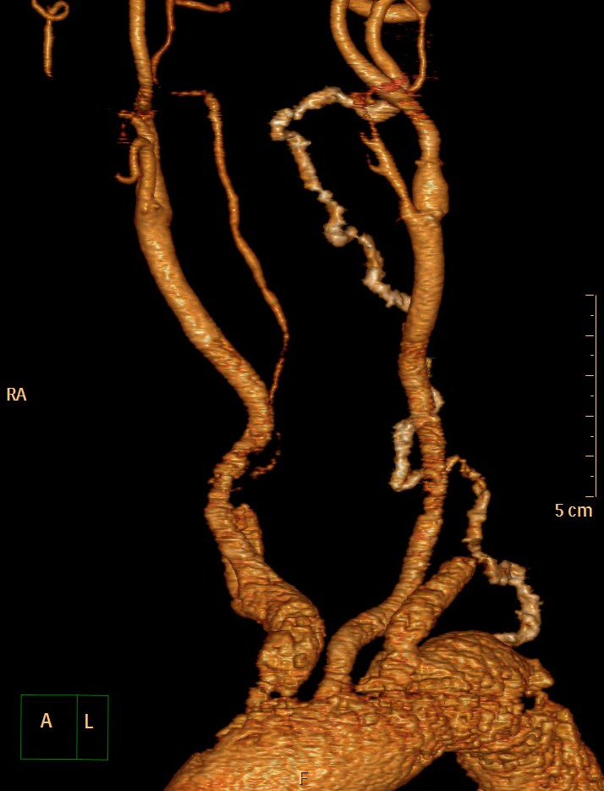
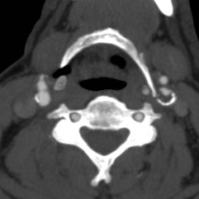
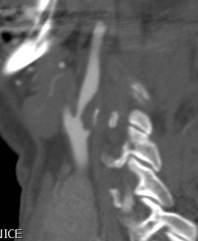

Slide 8
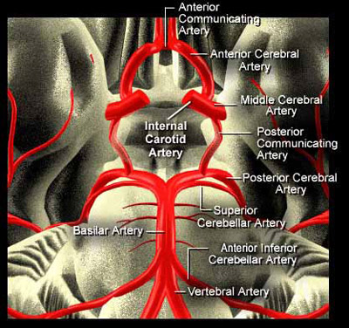
Willisův okruh

Slide 9
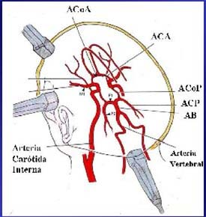
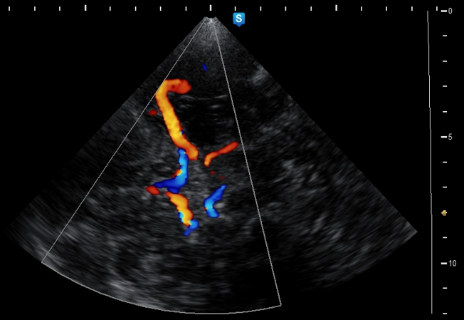
TCD

Slide 10
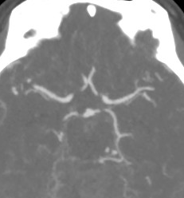
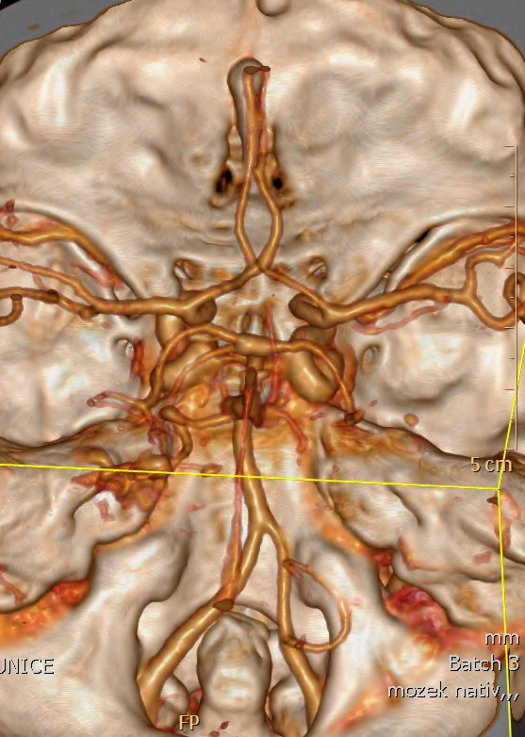
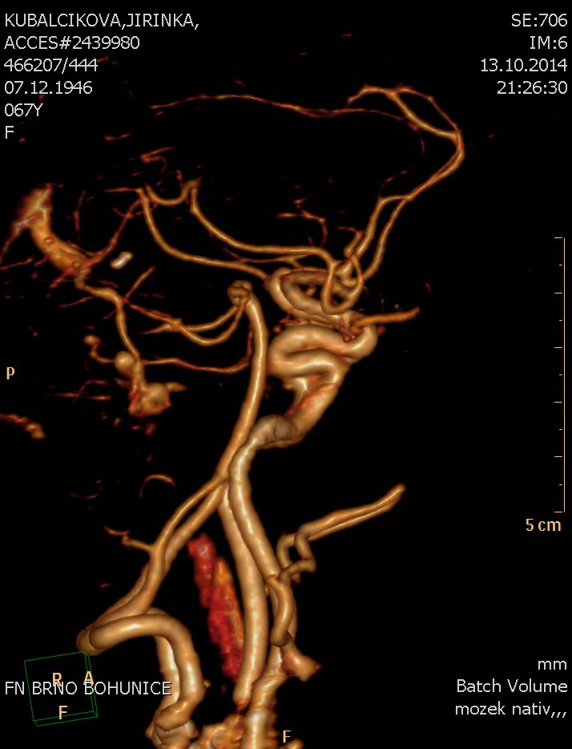
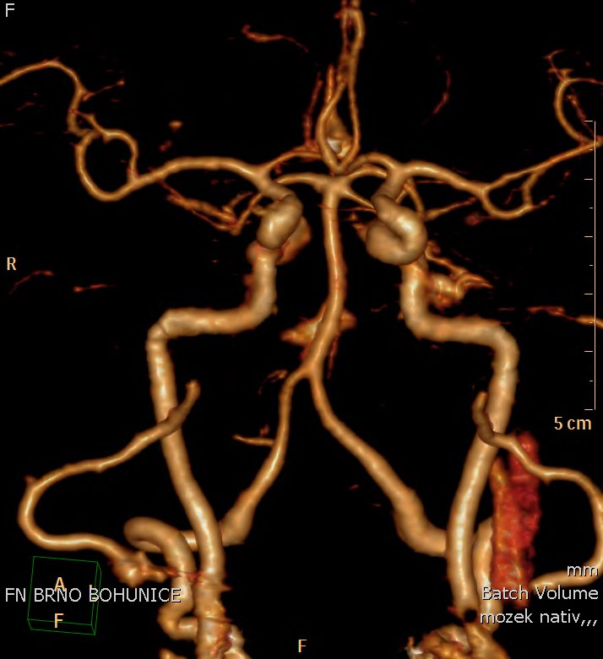
CTAG

Slide 11
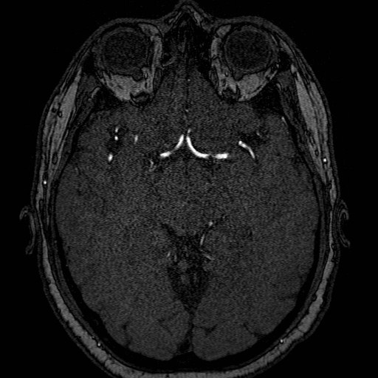
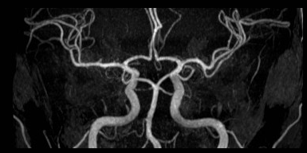
MRAG

Slide 12
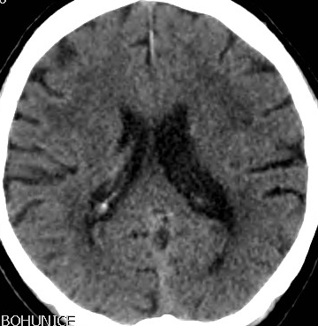
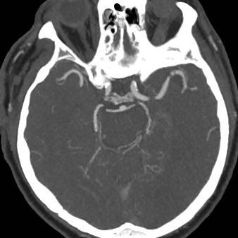
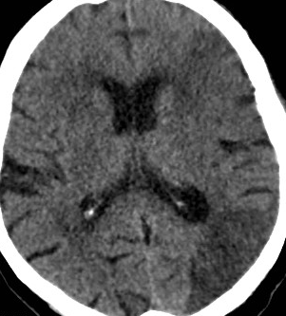

Slide 13
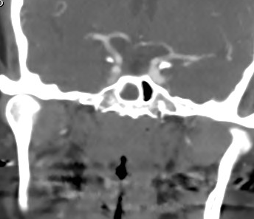
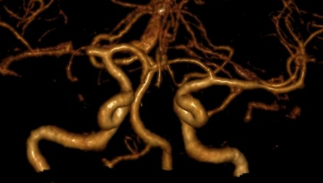
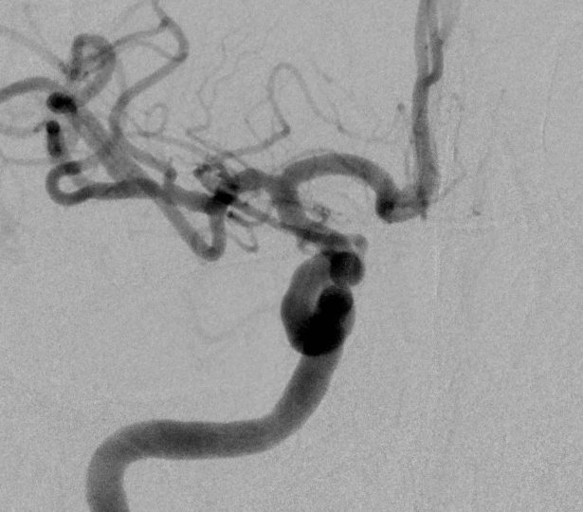
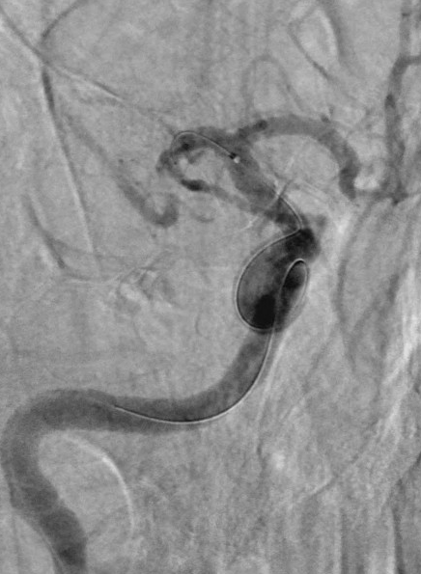
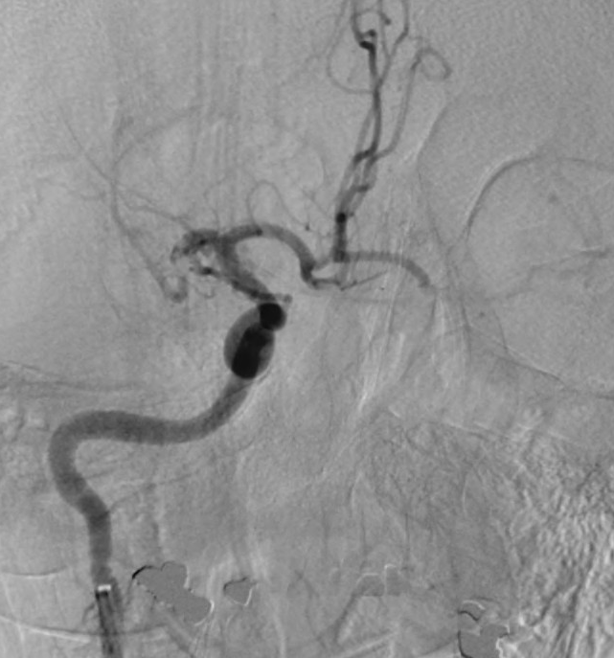
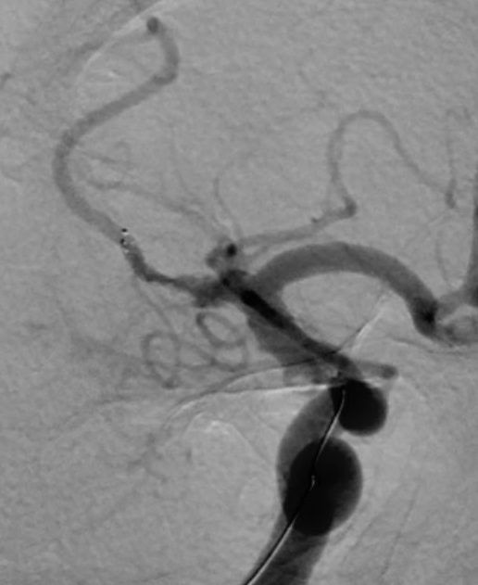

Slide 14
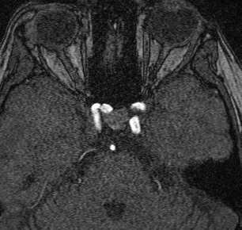
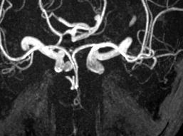
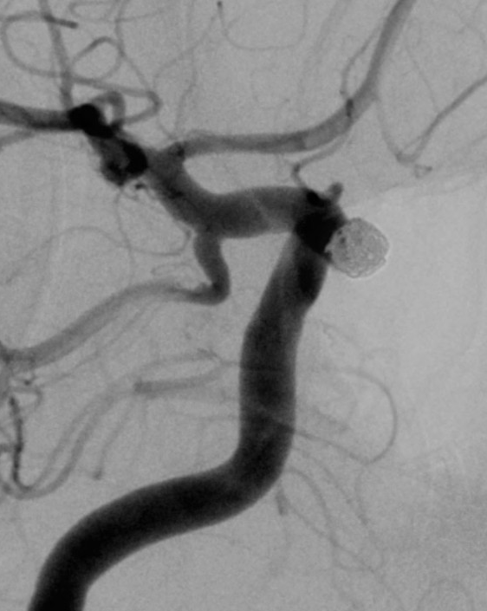
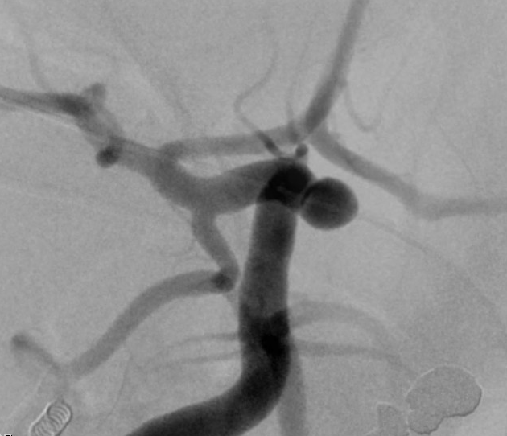

Slide 15
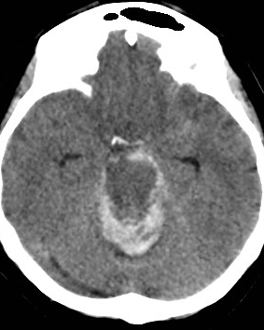
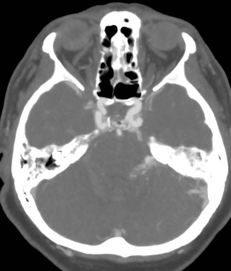
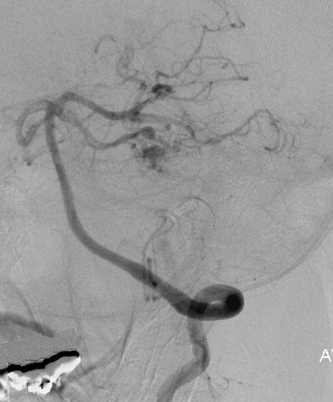

Slide 16
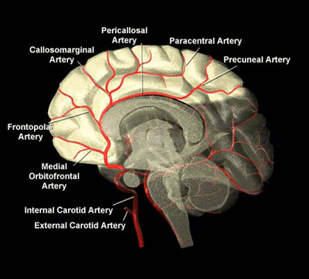
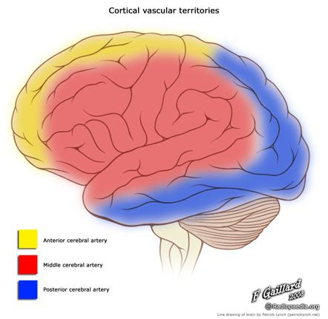
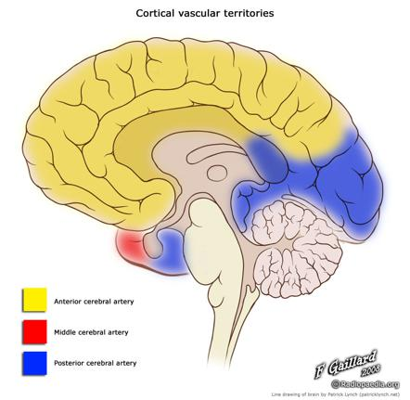
ACA
The ACA is divided into three segments:
A1: origin from the ICA to the anterior communicating artery (ACOM).
A2: from ACOM to the origin of the callosomarginal artery
A3: distal to the origin of the callosomarginal artery

Slide 17
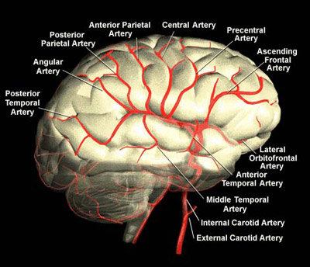
ACM
The MCA is divided into M1, M2, M3 and M4 segments:
M1: from the origin to bifurcation/trifurcation (the limen insulae); also known as horizontal segment
M2: from bi (tri) furcation to origin of cortical branches (circular sulcus of insula); also known as insular segment
M3: opercular branches (those within the sylvian fissure); also known as opercular segment
M4: branches emerging from the sylvian fissure onto the convex surface of the hemisphere; also known as cortical segment

Slide 18
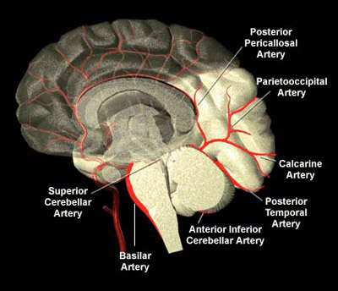
ACP
The PCA is divided into four segments named P1 to P4:
P1: from it origin at the termination of the basilar artery to posterior communicating artery (PCOM), within interpeduncular cistern.
P2: from the PCOM around the mid-brain, is within crural cistern and ambient cistern P3: quadrigeminal segment (segment with the quadrigeminal cistern)
P4: cortical segment (e.g., calcarine artery, within the calcarine fissure)

Slide 19
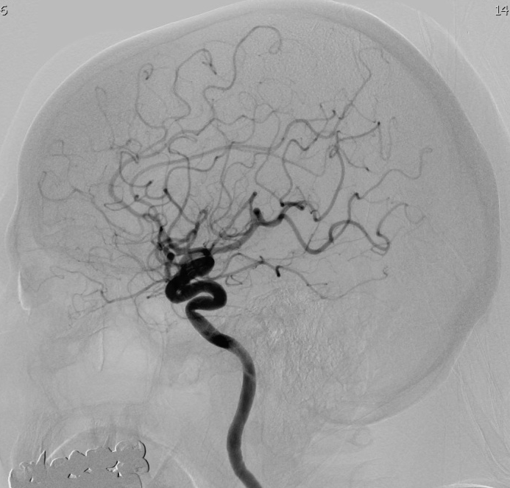
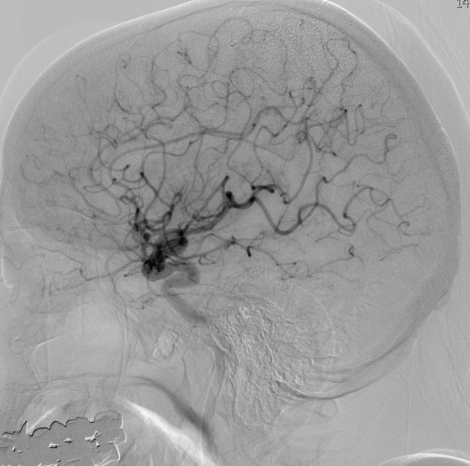
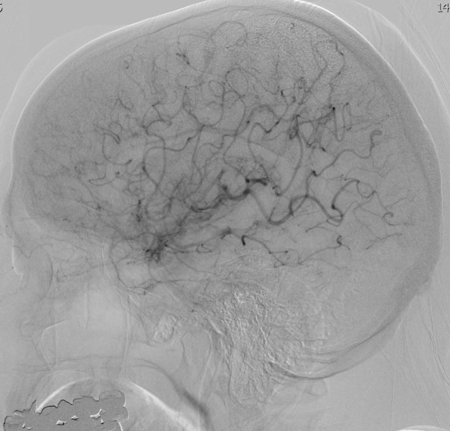
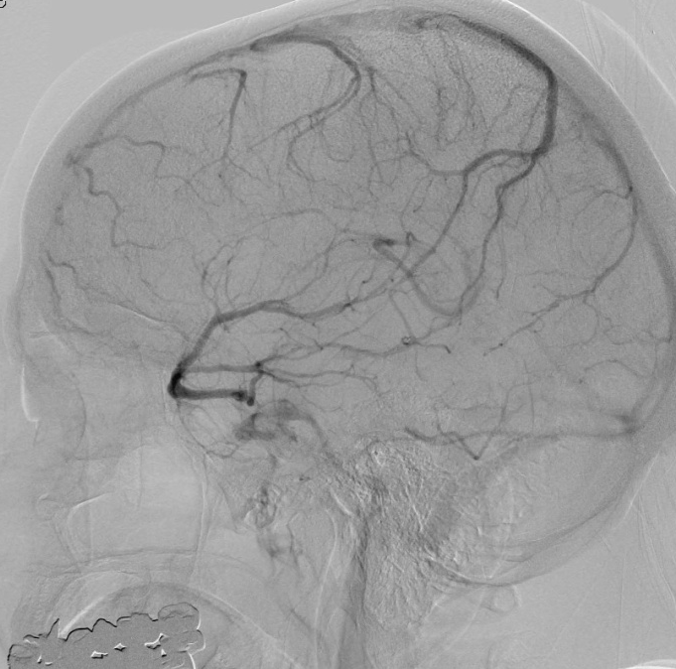

Slide 20




Teritoriální infarkt

Slide 21


Interteritoriální infarkt

Slide 22

Lakunární infakrt

Slide 23




Slide 24



Slide 25
http://www.strokecenter.org/professionals/brain-anatomy/blood-vessels-of-the-brain/
http://www.radiologyassistant.nl/en/p484b8328cb6b2/brain-ischemia-vascular-territories.html
http://radiopaedia.org/articles/middle-cerebral-artery

