Slide 1

AEROSOLS
IN DENTISTRY
Veronika Chuchmová
394229@mail.muni.cz
Department of Public Health, Faculty of Medicine, Masaryk University

Slide 2
Content
Basic information
Infectious aerosols in dental office
Aerosol in dental environment
Current information about aerosols and COVID-19

Slide 3
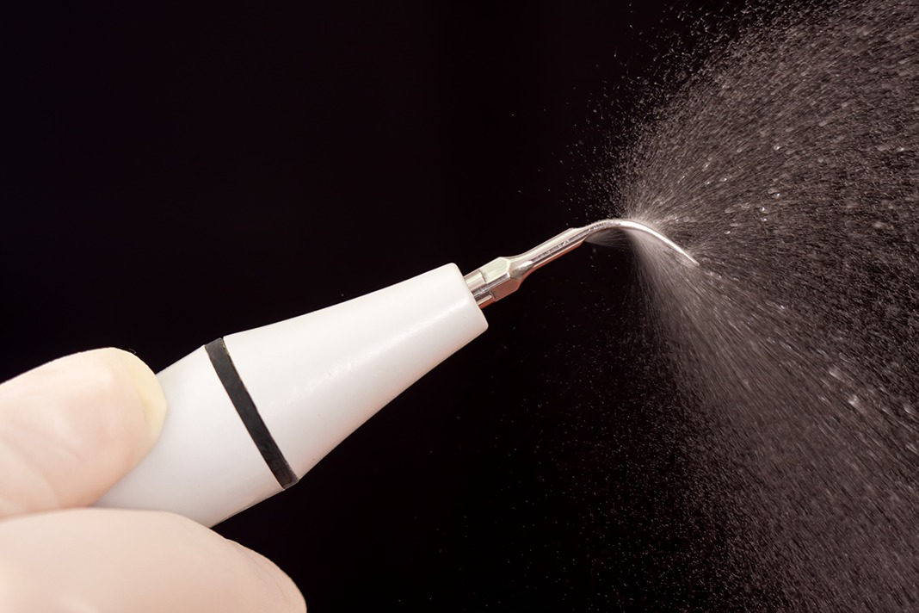
DEFINITION
Aerosols = liquid or solid particles suspended in the air by humans, animals, instruments, or machines.
Bio-aerosols = aerosols consisting of particles of any kind of organism.

Slide 4
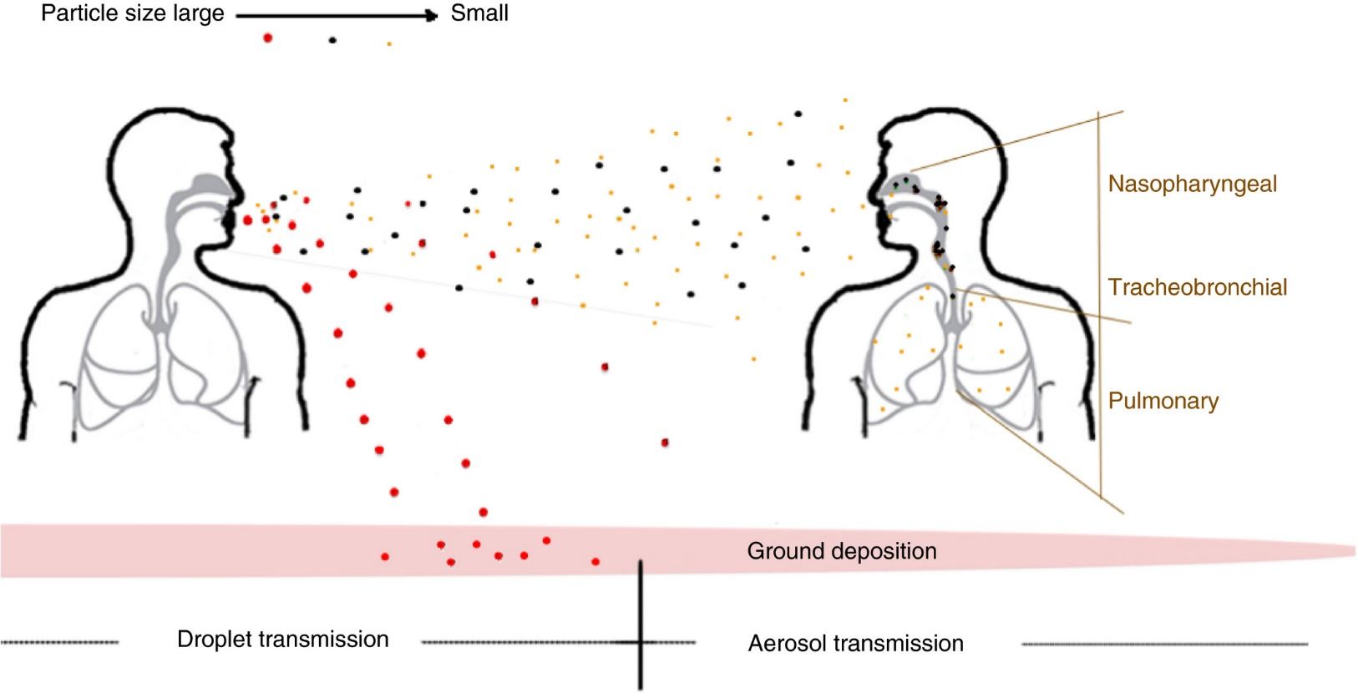
DEFINITION
Aerosol - particles less than 5 μm in diameter
Splatter - particles larger than 5 μm in diameter

Slide 5
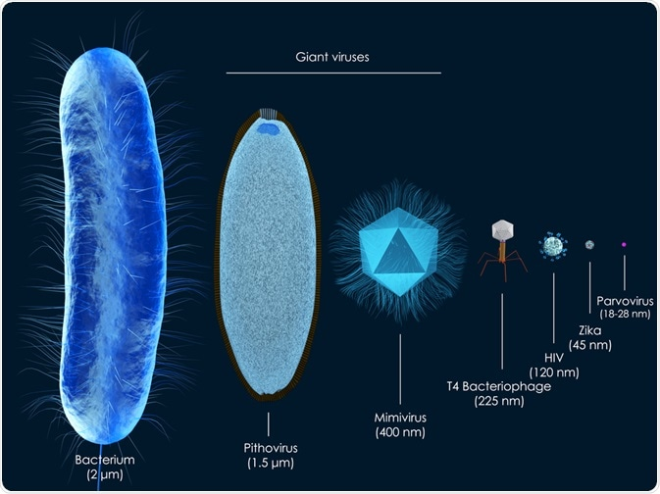
SIZE COMPARISON
Aerosol particles: < 5 μm
Mycobacterium tuberculosis: 2 µm
Staphylococcus epidermidis: 1,5 µm
Coronaviridae: 100-150 nm
Influenza viruses: 80-120 nm

Slide 6



DISEASES KNOWN TO BE SPREAD BY DROPLETS OR AEROSOLS
Tuberculosis, Influenza, Legionnaires' Disease, Severe Acute Respiratory Syndrome, Measles, Pneumonic Plague,
diseases caused by herpetic viruses (Varicella Zoster Virus) and rhinovirus.

Slide 7
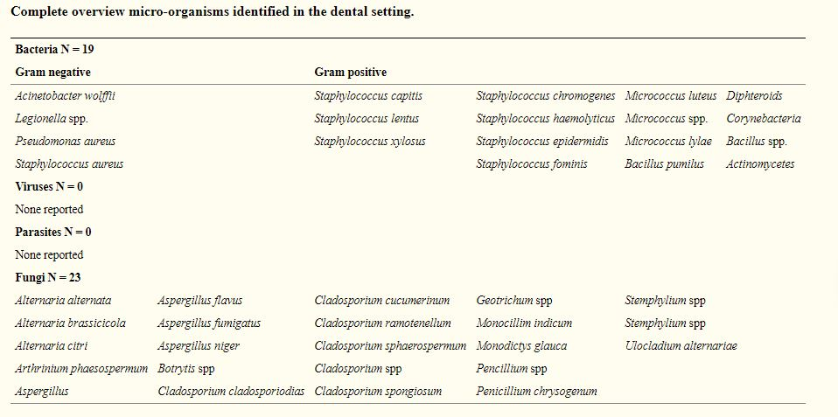
INFECTIOUS AEROSOLS IN DENTAL OFFICE

Slide 8
INFECTIOUS AEROSOLS IN DENTAL OFFICE
To minimise the likelihood of airborne disease transmission via droplets or aerosols, the dental team adopts the following (SARS, 2004):
Reduction of droplet/aerosol generation
Use of rubber dam isolation
Use of pre-procedure mouthwash ( 0.12% chlorhexidine mouth rinse or povidone iodine)
Dilution and efficient removal of contaminated ambient air (High volume evacuation, ventilation)
Disinfect air/aerosol generated (Ultraviolet germicidal irradiation etc.)
Adoption of contact precautions (Thorough hand washing, Personal protective equipment )

Slide 9
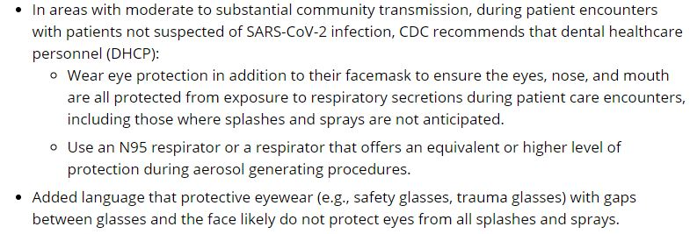
COVID-19: Guidance for Dental Settings
CDC: Summary of Recent Changes

Slide 10
COVID-19: RELEVANT INFORMATION
WHO
https://www.who.int
CDC
https://www.cdc.gov/coronavirus/2019-ncov/index.html
Science
https://www.sciencemag.org/collections/coronavirus?intcmp=sci_cov
Actual information from Ministry of Health of the Czech Republic
https://onemocneni-aktualne.mzcr.cz/covid-19?utm_source=general&utm_medium=widget&utm_campaign=covid-19

Slide 11
Conclusion
Aerosols in dental offices
To date (October 28) there are no relevant studies in COVID-19 and aerosol
The current guidelines are extrapolated from influenza and previous outbreaks of SARS-1 and on expert opinion
At this moment there are few researching groups around the world which focused on aerosol in dental offices (one in Czech Republic)

