Slide 1
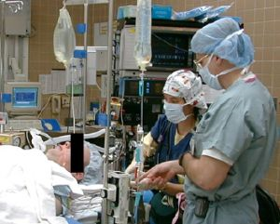
Anaesthesia and
Pain Management
Lukáš Dadák
aVLAL091

Slide 2
Goal
understand basic concepts of general and regional anaesthesia
learn basic skills of airway management
learn anatomy of regional anaesthesia (SA, EPI)
Anaesthesia of children
.. and if you would like, more …

Slide 3
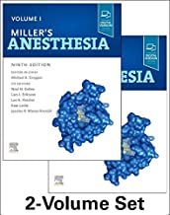
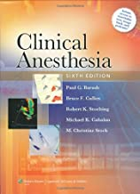
How to get credit??
Lectures
Literature : Larsen, Miller, Barash
Simulation (Airway management drill)
OR – voluntary intership – (COVID era not possible)
Oral Exam (December 2022 – February 2023)

Slide 4
Topics for oral exam
Anatomy of airways + physiology of breathing
Physiology of circulation (cardiac output)
Monitoring
Pharmacology
ASA I patient and GA, premedication;
Airway management
Rapid sequence of induction = technique, indications
Difficult ventilation / intubation
Malignant hyperthermia
Acute, chronic pain
Anatomy of spinal column – SA, EPI

Slide 5
History
Opium (Egypt, Syria)
Hippokrates 400 BC ease pain
1555 Andreas Vesalius - arteficial ventilation through tube between vocal cords, ventricular fibrilation (animals)
1546 Valerius Cordus - ether – oleum vitreolum dulce
1547 Paracelsus - analgetic effect of ether
1646 Severino - cryoanaesthesia – Napoleon's wars – Larey
1773 N2O Joseph Priestley (1733-1804)
1774 oxygen
1779 Humphry Davy - Anaesthetic effect of N2O

Slide 6
Surgery before modern Anaesthesia
Surgical procedures were carried out prior to the introduction of Anaesthetics.
The key to success was the speed of the procedure, with successful amputations lasting 30 seconds. Strong assistants and restraints were frequently required. Alternatively, decreased cerebral perfusion via bilateral carotid compression was used to decrease sensation during the procedure. Importantly, surgical procedures were associated with significant risk of death and, at a minimum, severe pain. The development of Anaesthesia was heralded as one of the great advances of modern medicine, in that it allowed surgery to advance.

Slide 7
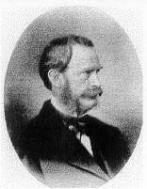
Beginning of GA
October 16th 1846 ether general Anaesthesia Boston dentist William Thomas Green Morton to Gilbert Abbott (tumor of mandibule)
  February 6th 1847 Prague - first Czech ether Anaesthesia - Celestýn Opitz
1895 direct laryngoscopy Alfred Kirstein in Berlin.
  1920 direct laryngoskopy to clinical praxis Magill and Rowbotham

Slide 8
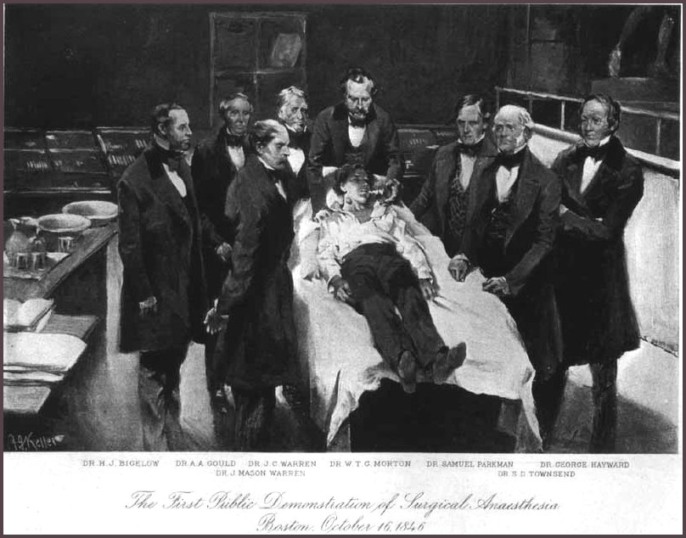
Ether

Slide 9
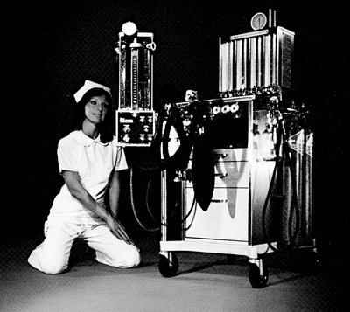
After ether
1847 – chloroform – obstetrics Anaesthesia
1884 – cocaine – eye, mucosa
1885-99 – cocaine “spinaly”
1950's – halothan
1960's – enflurane, isoflurane
1994 – sevoflurane
2006 – sugammadex

Slide 10
Ideal Anaesthetic Drug
temporary disable function of neurons
no influence on breathing, circulation
safe
cheap
non-toxic
Does not exist.

Slide 11
Anaesthesiology
is a jung discipline (176y) dealing with
the preoperative, intraoperative and postoperative evaluation and treatment of patients who are rendered unconscious and/or insensible to pain and emotional stress during surgical, obstetrical, therapeutic and diagnostic medical procedures;
the protection of life functions and vital organs (brain, heart, lungs, kidneys, liver, endocrine, skin integrity, nerve) under the stress of surgical and other medical procedures;

Slide 12
Anaesthesiology
Monitoring and maintenance of normal physiology during the perioperative period;
Diagnosis and treatment of acute, chronic and cancer-related pain;
Clinical management of CPR;
Evaluation of respiratory function and application of respiratory therapy;
Management of critically ill patients;
Conduct of clinical research;
Teaching personnel involved in perioperative care
GUIDELINES FOR PATIENT CARE IN AnaesthESIOLOGY, ASA 1967

Slide 13
General Anaesthesia - Definition
arteficial reversible intoxication,
controled coma
drug-induced loss of consciousness, felling, pain
„No reaction“ to stimuli
allow therapy (surgery, electroshock)
allow diagnostic method (CT, MRI)

Slide 14
General Anaesthesia
No memory
No pain
No force
Hypnotics,
volatile
anaesthetics
Analgetics:
opioids
N2O
Muscle
relaxants
Notes:
Anesteziologické systémy
otevřené např.Schimlbuschova maska
polootevřené Kuhn, Mapleson
polouzavřené okruh
uzavřené

Slide 15
General Anaesthesia
Hypnotics,
volatile
anaesthetics
Analgetics:
opioids
N2O
Muscle
relaxants
Notes:
Anesteziologické systémy
otevřené např.Schimlbuschova maska
polootevřené Kuhn, Mapleson
polouzavřené okruh
uzavřené

Slide 16
General Anaesthesia
No memory
No pain
No force
No respiratory drive
Hypnotics,
volatile
anaesthetics
Arteficial Ventilation
Analgetics:
opioids
N2O
Muscle
relaxants
Notes:
Anesteziologické systémy
otevřené např.Schimlbuschova maska
polootevřené Kuhn, Mapleson
polouzavřené okruh
uzavřené

Slide 17
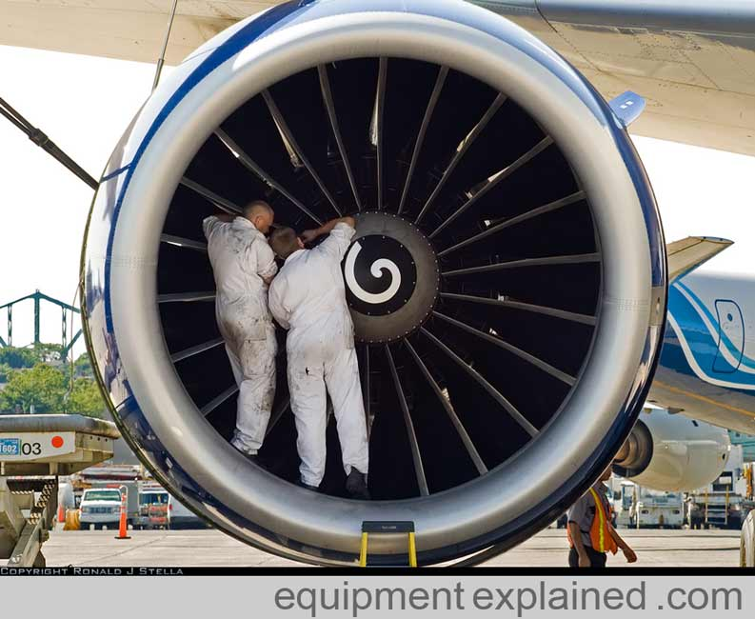
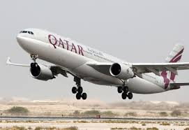


Patient and Course of Anaesthesia
preoperative anaesth. visit, informed consent, optimalization
premedication (evening/morning)
OR:
monitoring
venous line
induction (+ airway protection)
maintenance
recovery (extubation)
treatment of postoperative pain
record of GA

Slide 18
Preoperative examination
history (GA, RA, complications)
physical examination (ABC… neck, back)
laboratory: CBC, ions, urea, creatinin, glucose, (AST, ALT, GMT) bilirubin, AB0.
ECG (older 45y).
Xray of chest (older 60y).
function exam
  cardiological, lung, nephro, hemato …

Slide 19
Why to do PreOP exam?
decrease RISKs
what is the benefit of surgery
Airway examimation
GA / regional?
premedication

Slide 20
Preoperative tests
as a component of the preanesthesia evaluation, may be indicated to:
1) discovery a disease / disorder
which may affect perioperative Anaesthetic care,
2) verification of an already known disease, disorder, medical or alternative therapy which may affect perioperative Anaesthetic care,
3) formulation of specific Anaesth. plans
Will I change something if the resust is ...?

Slide 21
Airway
History of Airway Management
  any difficulty, teeth?
  TS scar [narrower trachea]
!!! Tell the truth about troubles in Anaesthesia !!!

Slide 22
Airway
Examination:
  mouth opening(3 fingers)
  free teeth, carious teeth
  gotic palatum
  Mallanpati
  (big tongue, small mouth)
  hypoplastic mandibula
  anteposition of larynx = mandibula-os hyoideum <3 fing.
  fletion, extension of head = neck motion

Slide 23
Difficul airway
Obesity - body weight > 110kg
Mouth opening - inter-incisor distance < 4cm in an adult
Ability to prognath - a large overbite, or the inability to shift the lower incisors in front of the upper incisors
Thyromental distance - The distance from the thyroid cartilage to the mentum (tip of the chin) should be > 6.5-7 cm.
Mentum-Hyoid distance - Similar to thyromental distance, and should be at least 3-4 finger-breadths.

Slide 24
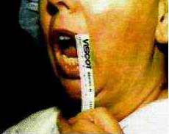
Inter Incisors Distance
3 fingers = cm

Slide 25
Mouth opening
Should be adequate (3 cm or more) to easily
allow a laryngoscope plus endotracheal tube (ETT).
Patients with temporomandibular joint (TMJ) disease or trismus may not be able to open widely, and may require fiberoptic intubation by the nasal route

Slide 26
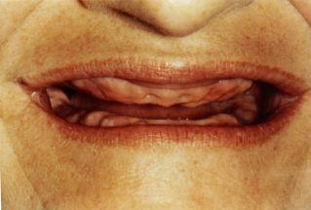
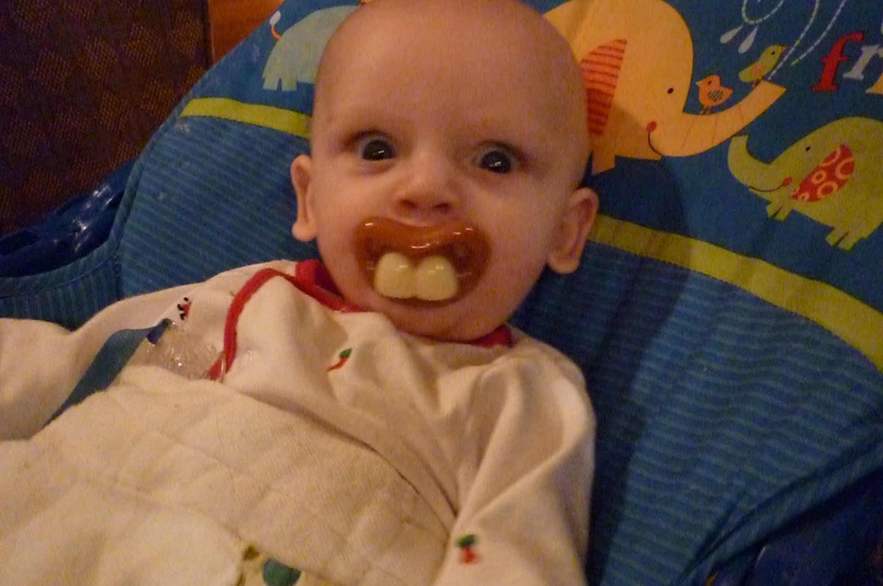
Teeth
Edentulous patients are always easier to intubate, but are often more difficult to ventilate with a face mask.
Patients with teeth in poor condition or with very prominent teeth may be more difficult to intubate.

Slide 27
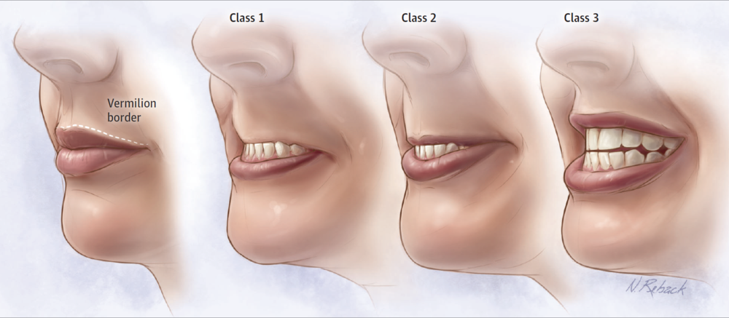
The Upper Lip Bite test

Slide 28
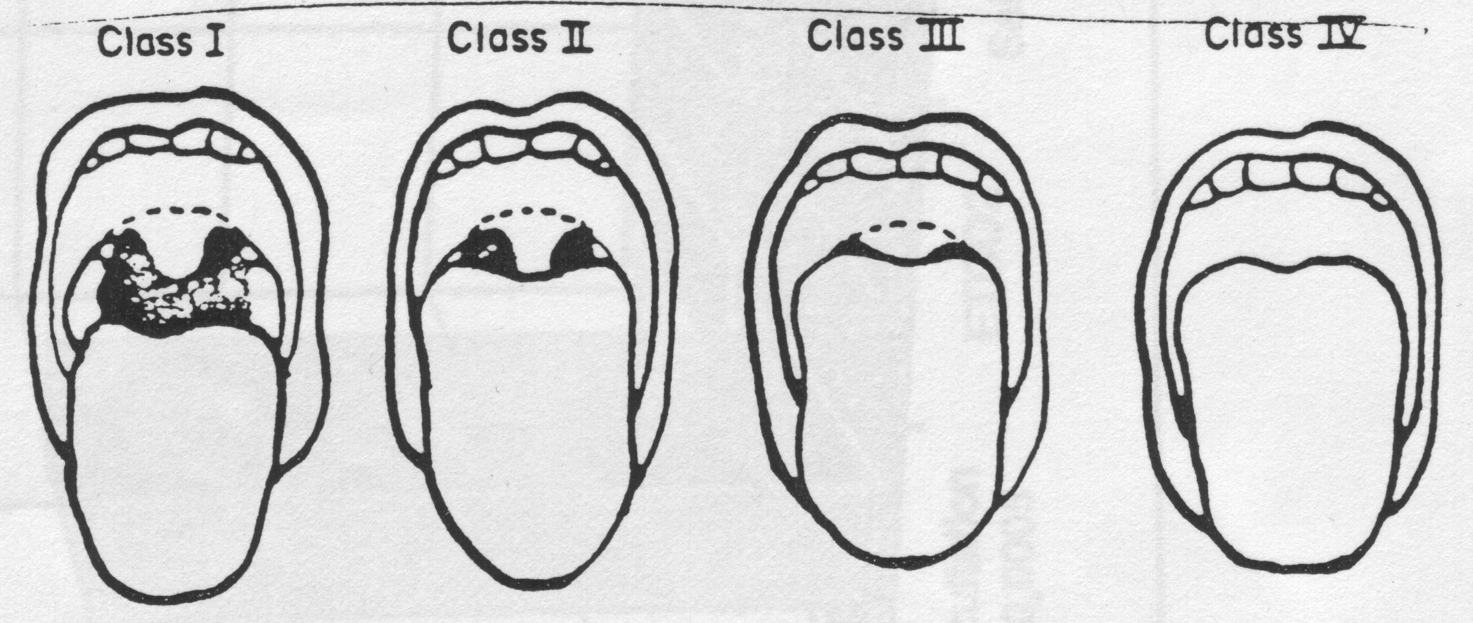
Mallampati
OTI easy 95% OTI difficult 50%

Slide 29
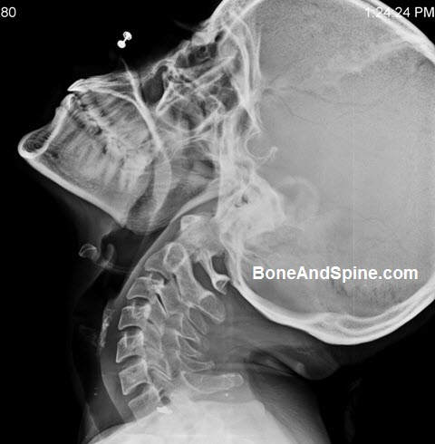
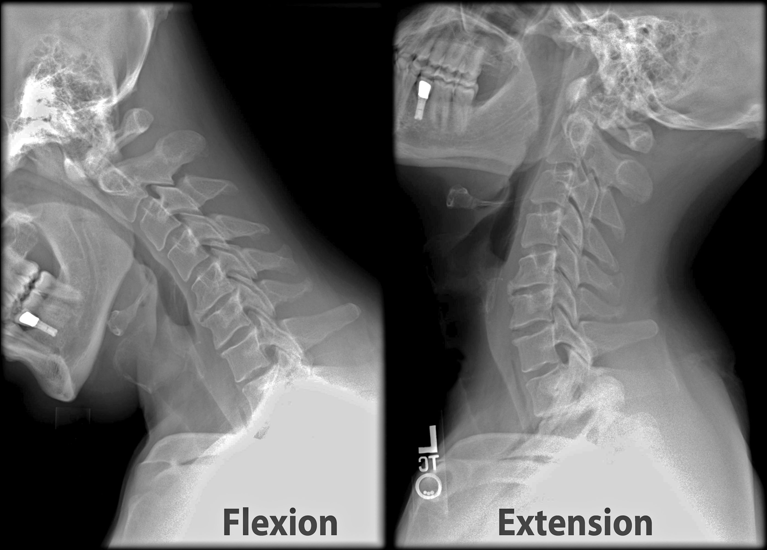
Cervical mobility
Head in neutral position.
Use index 2 index fingers:
  on chin and nape
Extension of neck
Read the position of fingers
Result:
Normal bend
slightly limited = fingers horizontal
significantly reduced bend

Slide 30
Thyromental distance
Distance from the mentum of the mandible to the thyroid, with neck fully extended.
If distance is less than 6 cm there is less space for the tongue to be displaced with laryngoscopy

Slide 31
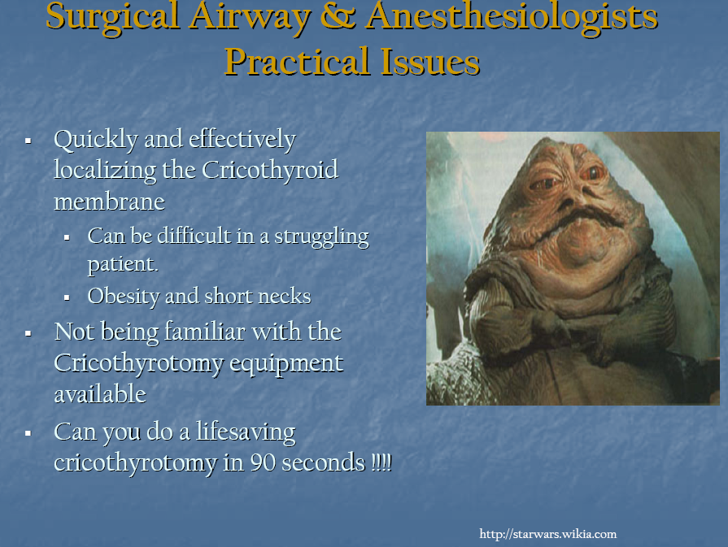
Easy patient?
No prediction is accurate.
MP I, normal C spine movements, 3-3-2 ... DAM

Slide 32
Predicted difficult airway
epiglotitis
abscesus (submandibular, retropharyngeal)
tetanus
trauma of the neck, mouth
tumor of the larynx, faryngx
temporomandibular joint disease
obesity

Slide 33
Respiratory risk
X-ray
spirometry
blood gases
COPD
Astma
chronic bronchitis
acute inflamation of lunx
(pneumonia 3 weeks postponement)

Slide 34
Cardiovaskular risks
ECG (load)
ECHO, (coronarography)
hypertension (cardiac work, failure)
ischemia (AP, IM, rhythm)
cor pulmonale
valvular abnormalities (Ao stenosis)
Prophylaxis:
Beta blockers, ? antihypertensive drugs

Slide 35
… other risks
Diabetes mellitus
Hepatic
    porphyry
    failure, cirhosis
Renal
CNS
  epilepsy
  mm. (Myastenia gr., )

Slide 36
ASA Physical Status = risk
I Healthy patient 0,06%
II Mild systemic disease, no functional limitations hypertension, smoker, mild asthma 0,47%
III Severe systemic disease- definite functional limitation coronary disease, COPD, DM, CHF, renal failure 4,39%
IV Severe systemic disease that is a constant threat to life unstable angina, burn with septic shock 23,48%
V Moribund patient not expected to survive 24 hours with or without operation
patient with extensive bowel infarction, polytrauma 50,8%

Slide 37
Mortality of Anaesthesia (ASA I)
0,008-0,009% primary connected with A
0,01-0,02% partially connected with A
0,6% 6 day mortality after operation
3 times danger than flying [1: 775 000]

Slide 38
Risk of Anaesthesia - mortality
Trend to improve safety => low tolerance to complications of Anaesthesia
Mortality and Anaesthesia:
1952 1 : 2 000 (Beecher, 1954)
1982 1 : 10 000 (NCEPOD 1987)
2001 1 : 50 000 – 220 000 (Brown, 2002)
Risk of death in aviation 1: 755 000 (1997)

Slide 39
Death and Anaesthesia
hypoxia /
intubation of oesophagus
aspiration / regurgitation of gastric fluid to lung
circulatory instability (ischaemia)
overdose
anaphylaxy, interaction of drugs
!!! Death was preventable (30-60%) !!!
Notes:
Importantly, 64 percent of the deaths were inevitable, a finding suggesting that only one-third were preventable.
http://web.squ.edu.om/med-Lib/MED_CD/E_CDs/anesthesia/site/content/v03/030008r00.HTM

Slide 40
Complications of GA
!!! No risk = no Anaesthesia !!!
difficult intubation, ventilation … asfyxia
aspiration of stomach fluid … pneumonia
overdose Anaesthetic … cardiovascular, respiratory colaps
malfunction of the monitor, ventilator
organ failure (MI, COPD, hepatitis, ...)
malignant hyperthermia
allergic reaction / shock
Notes:
Postoperative Nausea and Vomiting

Slide 42
Premedication
goal: cooperating patient
anxiolysis
easer induction of A.
lower consumption of drugs
easer recovery

Slide 43
Premedication
usually p.os - evening + morning
sedation/anxiolysis (benzodiazepines)
analgesia only if pain (paracetamol, opioids)
reduce airway secretions + heart rate control + hemodynamic stability
prevent bronchospasm
prevent and/or minimize the impact of aspiration
decrease post-op nausea/vomiting

Slide 44
Premedication of adults
Evening:
alprazolam 0.5 mg p.os 22 h
(or diazepam 10 mg p.os)
Morning:
alprazolam 0.5 mg p.os 6 h
paracetamol 1g p.os

Slide 45
PreOP starving
24 h no smoking
6-8 h no eating
4h breast milk
2 h last clear liquid

Slide 46
Risk of Aspiration
Severe obesity
Symptoms of gastroesophageal reflux
Advanced pregnancy
Severe ascites
Opioid administration or other condition resulting in delayed gastric emptying
History of gastroparesis or other motility disorder
Bowel ileus or bowel obstruction
((Metoclopramid, sodium citrate with citric acid))
→ RSI Rapid Sequence of Induction

Slide 47
Operating Room

Slide 48
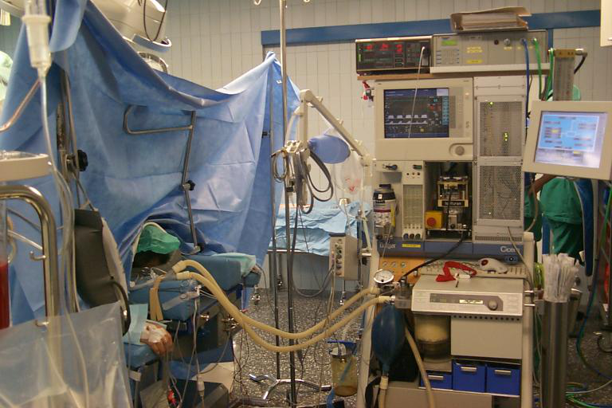

Slide 49
Conversation before GA or RA
identity and procedure site
tooth (artificial, free)
empty stomach - last food, fluid
weight
allergy
complication of CA in his/family history
check-up questionnaire
agreement with Anaesthesia

Slide 50
Induction of Anaesthesia
1 – 3 drugs i.v. =
lethal dose
the most effective way
=> no self-controle, unable call for help, suppress of vital autoregulating mechanisms
unmask compensated disturbances
(hypovolemia, relative respiratory insuf, ...)

Slide 51
Induction
30 - 60s from fully conscious to vitally dependent on Anaesthetist
Moment with big influence on the rest of the life.
P.S. Did you ever sign “Informed Consend“

Slide 52
Airways
Indication for intubation:
full stomach (Rapid Sequence of Induction)
artificial ventilation after procedure
Laryngeal mask
Face mask
Orotracheal intubation, nasotracheal intubation with direct laryngoscopy
Tracheotomy
Cricothyreotomy
Notes:
INTUBATION - Always consider why you are exposing the patient to the risk, albeit small, of intubation-
a.) protection from gastric aspiration and secretions
b.)access and maintenance-in difficult airway and difficult surgical positions/procedures
c.) provide positive pressure ventilation- can be done for shorter periods with a mask or LMA
d.) oxygenation- to provide a controlled concentration of oxygen up to 100%, also provides for complete scavenging
e.) secretions- facilitates removal of secretions via suctioning

Slide 53
In the End of Anaesthesia
No bleeding, no revision, end of procedure:
Stable ABCD: extubation, pain, temperature control, PostAnest.CareUnit
Unstable: analgosedation + arteficial ventilation - transport to ICU

Slide 54
Extubation
pay now or pay later - if in doubt, leave it in.
always awake if - difficult mask airway or intubation, full stomach, surgical considerations, sux contraindicated
awake means awake - if in doubt, leave it in

Slide 55
Postoperative care
ICU or standard department
monitoring according to the type of OP + health
control laboratory
treatment of acute pain
infusion therapy, blood loss

Slide 57
OR checklist
Test A.Machine = does it inflate O2
[before Anaesthesia]
Identity
Procedure, side
Allergy
Documentation (fill in, Informed Consend)
i.v. access
Monitoring

Slide 58
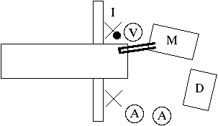
ORoom
„Dobry den“
fellowship Anaesthetist ~ A.nurse
confidence, respect
hygiene – wash your hands before every case, use of gloves
Notes:
Figure 1. Operating room layout showing how space can be controlled by positioning the Anaesthesia personnel (A), machine (M), and drug cart (D). The infusion (I) is in view and a visitor (V) can be provided with a good view while remaining outside the "controlled space."

Slide 59
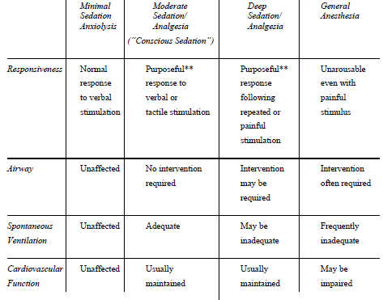
Continuum of depth of sedation
ASA 2004/2009

Slide 60
Phraseology
analgesia = elimination of pain
sedation = elimination of stress, impatience, fear
  Minimal Sedation (Anxiolysis) is a drug-induced state during which patients respond normally to verbal commands. Although cognitive function and physical coordination may be impaired, airway reflexes, and ventilatory and cardiovascular functions are unaffected.
  Moderate Sedation/Analgesia (“Conscious Sedation”) is a drug-induced depression of consciousness during which patients respond purposefully to verbal commands, either alone or accompanied by light tactile stimulation.

Slide 61
Phraseology
  Deep Sedation/Analgesia is a drug-induced depression of consciousness during which patients cannot be easily aroused but respond following repeated or painful stimulation. The ability to independently maintain ventilatory function may be impaired. Patients may require assistance in maintaining a patent airway, and spontaneous ventilation may be inadequate.
  General Anaesthesia is … loss of consciousness during which patients are not arousable, even by painful stimulation.
  inability to maintain ventilatory function = often require assistance in maintaining a patent airway, and positive pressure ventilation may be required.

Slide 62
Anaesthesia
General
inhalation
TIVA
Regional
  central block (subarachnoid, epidural)
  periferal blocks (brachial, nervous)
  local Anaesthesia (eye – cornea + conjunctiva, infiltration)
Combined = GA + EPI-line

