Slide 1

PHARMACOLOGY OF ANAESTHETICS
Katarina Zadrazilova
Kamil Hudacek
Faculty of medicine, Masaryk University
University Hospital Brno

Slide 2
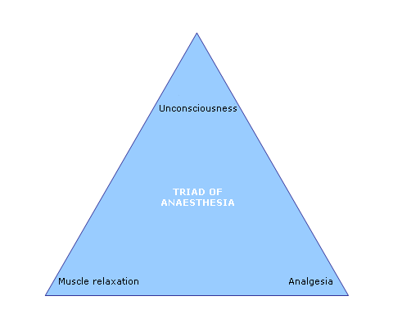
AIMS OF ANAESTHESIA

Slide 3
Triad of anaesthesia
Analgesics IV/regional anaesthesia or analgesia
Anaesthetic agents to produce unconsciousness
Neuromuscular blocking agents for muscle relaxation
Why unconscious patient require analgesia ?

Slide 4
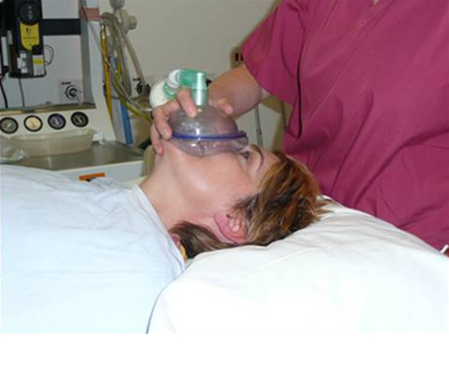
Overview
Intravenous and inhalational anaesthetics
Analgesics – simple, opioids
Muscle relaxants
Decurarization

Slide 5
INTRAVENOUS ANAESTETICS

Slide 6

Stages of anaesthetics
Induction – putting asleep
Maintenance – keeping the patient asleep
Reversal – waking up the patient

Slide 7
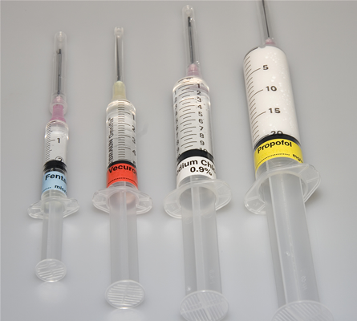
Intravenous anaesthetics
Onset of anaesthesia within one arm – brain circulation time – 30 sec
Effect site brain
  Propofol
  Thiopentale
  Etomidate
  Ketamine
  BZD

Slide 8
General anaesthetic-how do they work
TASK – EXPLAIN
  Loss of conscious awareness
  Loss of response to noxious stimuli
  Reversibility
Anatomical site of action
  Brain : thalamus, cortex
  Spinal cord

Slide 9
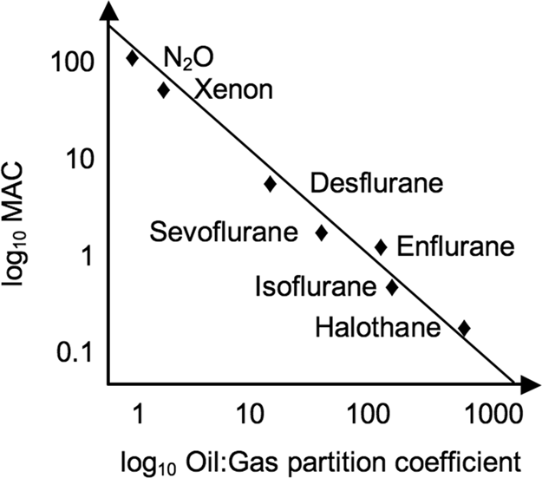
Molecular theories
GA – how do they work
\\credit:
Cambridge University Press
Meyer-Overton hypothesis
Linear correlation between the lipid solubility and potency

Slide 10
Molecular theories
GA – how do they work
Critical volume hypothesis
  Disruption of the function of ionic channels
Perturbation theory
  Disruption of annular lipids assoc. with ionic channels
Receptors
  Inhibitory – GABA _{A}, glycin enhance
  Excitatory - nAch, NMDA inhibit

Slide 11
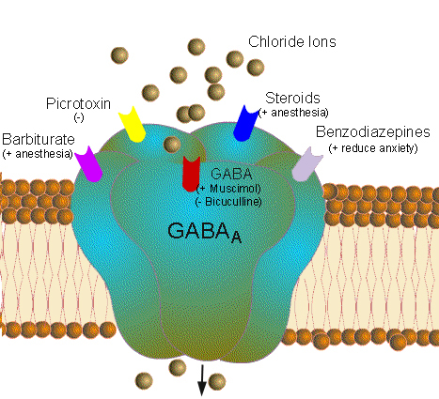
GABA_{A} receptor
GA – how do they work
- ionotropic receptor

Slide 12
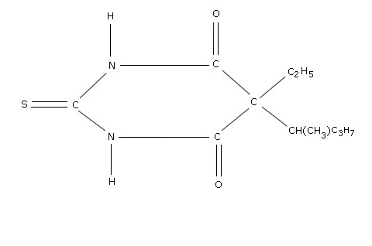
Thiopentale
Intravenous anaesthetics
Barbiturate
Dose 3-7 mg/kg
Effects : hypnosis, atiepileptic, antanalgesic
Side effects
  CVS: myocardiac depression, ↓CO
  Reduction in MV, apnea

Slide 13
Thiopentale
Intravenous anaesthetics
Problems with use
  Extremely painfull and limbtreatening when given intra-arterially
  Hypersensitivity reactions 1: 15 000
Contraindications
  Porphyria

Slide 14
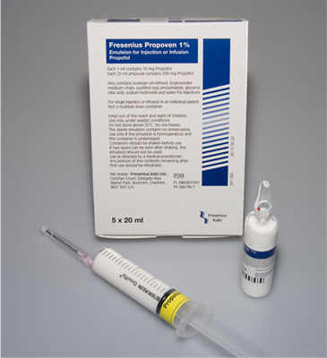
Propofol
Phenolic derivative
Dose 1- 2.5 mg/kg
Effects : hypnosis
Side effects
  CVS: myocardiac depression, ↓SVR, ↓CO
  Respiratory depression
  Hypersensitivity 1 : 100 000

Slide 15

Propofol
Other effects
  Pain on induction
  Nausea and vomiting less likely
  Better for LMA placement then thiopentale
Relative contraindications
  Children under 3

Slide 16
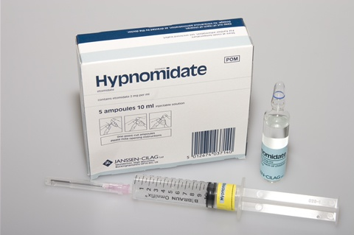
Etomidate
Ester
Dose 0.3 mg/kg
Effects : hypnosis
Side effects
  CVS: very little effect on HR, CO, SVR
  Minimal respiratory depression

Slide 17
Etomidate
Intravenous anaesthetics
Problems with use
  Pain on injection
  Nausea and vomiting
  Adrenocortical suppression
  Hypersensitivity reaction 1: 75 000
Relative Contraindications
  Porphyria

Slide 18
Ketamine
Phencyclidine derivative
CV effects - ↑ HR, BP, CO, O2 consumption
RS - ↑ RR, preserved laryngeal reflexes
CNS – dissociative anaesthesia, analgesia, amnesia
Use – analgesic in Emerg. Med

Slide 19
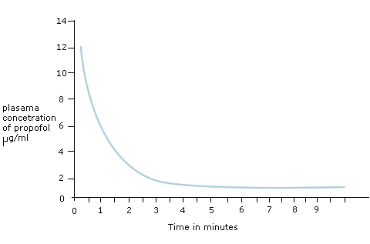
Pharmakokinetics
Intravenous anaesthetics
Recovery from propofol single bolus 5-10 min

Slide 20
Choice of induction agent
Intravenous anaesthetics
1. Are any agents absolutely contraindicated ?
  Hypersensitivity, porphyria
2. Are there any patient related factors ?
  CVS status
  Epilepsy
3. Are there any drug related factors ?
  Egg allergy

Slide 21
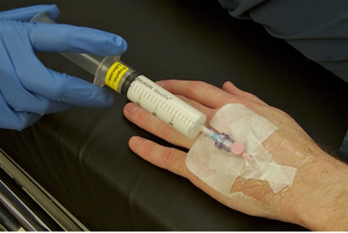
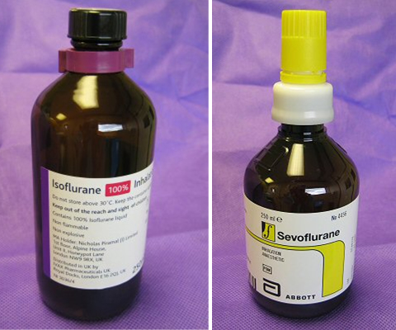
Induction + maintenance
Intravenous anaesthetics
- TIVA (=Total Intravenous Anesthesia)

Slide 22
SUMMARY – IV anaesthetics
Mechanism of action – via receptors
Used for anaesthesia and sedation
Used for induction
  thiopentale, propofol, etomidate
Propofol used for maintenance as well
Most of them cause CV and respiratory depression

Slide 23
INHALATIONAL ANAESTETICS
= volatile anesthetics

Slide 24
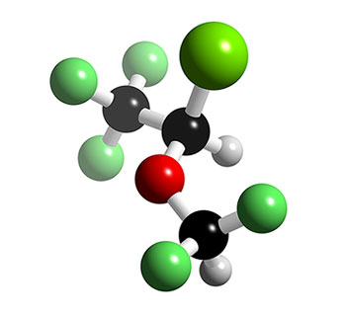
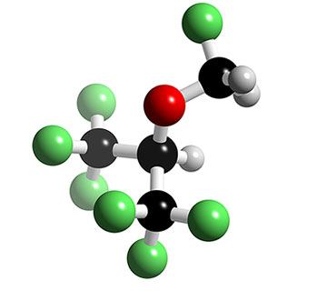
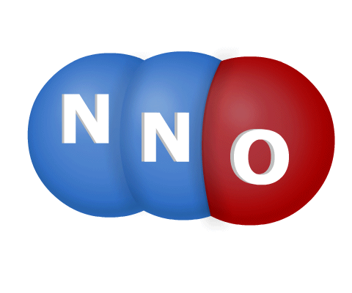
Anaesthetic gases
Inhalational anaesthetics
Isoflurane
Sevoflurane
Halothane
Enflurane
Desflurane
N₂O – nitrous oxide

Slide 25
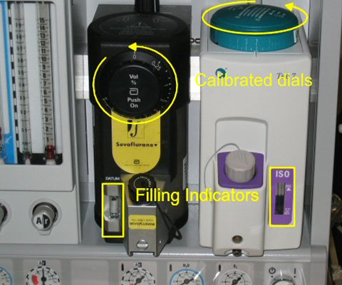
Anaesthetic gases
Inhalational anaesthetics
Any agent that exists as a liquid at room temperature is a vapour
Any agent that cannot be liquefied at room temperature is a gas
  Anaesthetic ‘gases’ are
  administered via
  vaporizers

Slide 26
Potency
Inhalational anaesthetics
MAC – that concentration required to prevent 50 % of patients moving when subjected to standart midline incision
Sevoflurane MAC 1.8 %
Isoflurane MAC 1.17 %

Slide 27
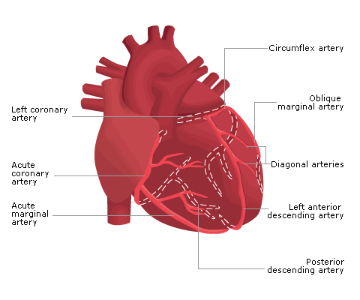
Respiratory and cardiovascular effects
Inhalational anaesthetics
All volatile anaesthetics cause ↓ MV and ↑RR
Isoflurane is irritant vapour
↓ SVR, blood pressure falls, ↑ HR
Isoflurane - ? Coronary steel

Slide 28
Metabolism and toxicity
Inhalational anaesthetics
Isoflurane (0.2 %)and Sevoflurane(3.5%) are metabolized by liver
F⁻ ions are produced - ? Renal impairment
Iso and Sevo trigger malignant hyperthermia
N2O
  Megaloblastic anaemia
  Teratogenic
  PONV

Slide 29
SUMMARY – inhalational anaesthetics
Mechanism of action – via receptors
Used for induction (sevoflurane)
And maintenance of anaesthesia
Commonly used : Sevoflurane, Isoflurane
Dose dependent CV and respiratory depression
All, but N2O trigger malignant hyperthermia

Slide 30
NEUROMUSCULAR BLOCKING AGENTS
= NMBAs

Slide 31
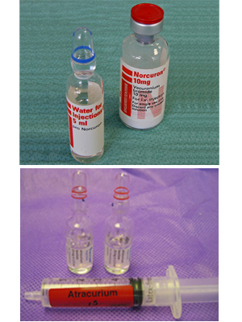
Neuromuscular blocking agents
Exclusively used in anaesthesia and intensive care
Two classes
  Depolarizing
    succinylcholine
  Non depolarizing
    Vecuronium, rocuronium - aminosteroid
    Atracurium, cisatracurium - benzylisoquinolinium

Slide 32
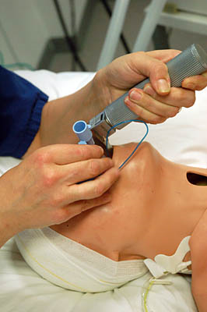
Use of NMBAs
Neuromuscular blocking agents
Tracheal intubation
Surgery where muscle relaxation
is essential
Mechanical ventilation

Slide 33
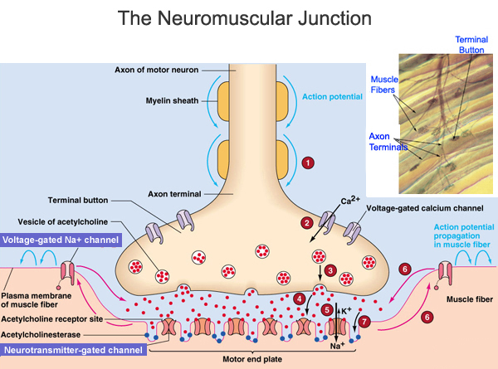
Neuromuscular junction
Neuromuscular blocking agents

Slide 34
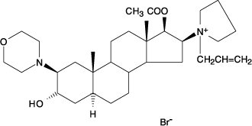
Mechanism of action
Neuromuscular blocking agents
Depolarizing
  structurally related to Ach (=acetylcholine)
  first activating muscle fibres, then preventing further response
  short acting drugs
Non depolarizing
  compete with Ach at nicotinic receptor at the neuromuscular junction
  middle and long acting drugs

Slide 35
Choice for tracheal intubation
Neuromuscular blocking agents
Elective surgery | Emergency surgery
Standart induction | Rapid sequence induction
Non depolarizing agent | Succinylcholine or rocuronium
Intubating doses
Succinylcholine | 1 – 2 mg/kg AcBW
Rocuronium | 0.6 - 1 mg/kg IBW
Atracurium | 0.5 mg/kg IBW

Slide 36
To maintain paralysis
Neuromuscular blocking agents
Non depolarizing muscle relaxants
Succinylcholine | No
Rocuronium | maintenance dose: 0.1 – 0.2 mg/kg
Atracurium | maintenance dose: 0.1 – 0.2 mg/kg

Slide 37

Succinylcholine pharmacokinetics
Neuromuscular blocking agents
Duration of action : 3 – 6 min (full recovery over 10 min)
Metabolism – plasma cholinesterase
  Cave: suxamethonium apnea

Slide 38
Succinylcholine - adverse effects
Neuromuscular blocking agents
Bradycardia
Muscle pain – ‘sux’ pain
Transient raised pressure in eye, stomach and cranium
Raise in potassium !!

Slide 39
Succinylcholine - contraindications
Neuromuscular blocking agents
Patient related contraindications
  Malignant hyperpyrexia
  Anaphylaxis to SCh
  Succinycholine apnea / Pseudocholinesterase deficiency
  Clinical contraindications
  Denervation injury / long term immobilized patient
  Patient with burns
  Penetrating eye injury

Slide 40
Non depolarizing muscle relaxants
Neuromuscular blocking agents
Choice of NMBs
  Personal preference
  Atracurium or cisatracurium better in renal or hepatic failure
  Avoid atracurium in asthmatic patients – cisatracurium is drug of choice
  Rocuronium (or vecuronium) could be reversed (by antidotum sugammadex)

Slide 41
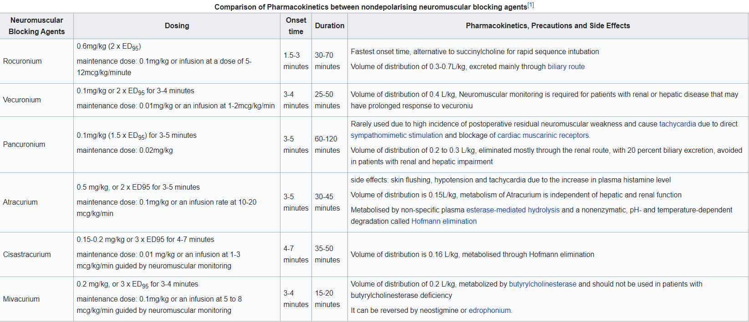
Brull, Sorin; Naguib, Mohamed. "Clinical use of neuromuscular blocking agents in anesthesia". UpToDate. Retrieved 20 April 2020.

Slide 42
Reversal
Neuromuscular blocking agents
Acetylcholine esterase inhibitor – neostigmine
  Increases concentration of Ach at NMJ
Neostigmine acts at all sites where acetylcholine esterase is present including heart
What effect this might have and how this can be overcome?

Slide 43
Neostigmine
Neuromuscular blocking agents
Dose of neostigmine – 0.05 mg/kg
In > 50 kg man 2.5 mg
Given with atropine 0.5 mg

Slide 44
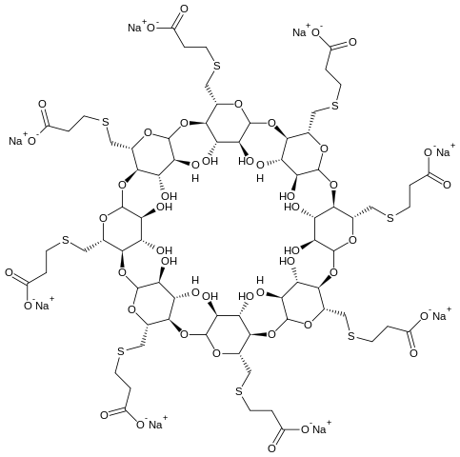
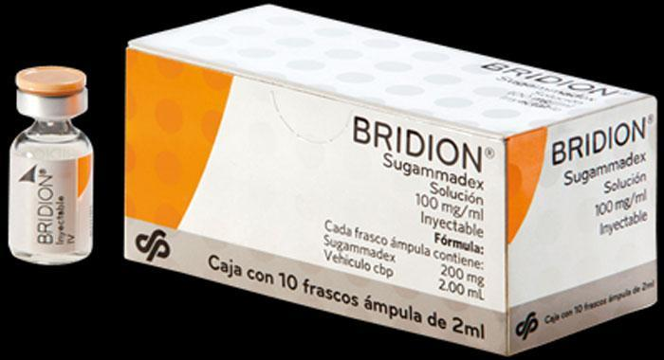
Sugammadex (Bridion)
medication for the reversal of neuromuscular blockade induced by rocuronium and vecuronium
the first selective relaxant binding agent (SRBA)
dose depends on time of use
  (16 - 4 - 2 mg kg⁻¹)
expensive

Slide 45
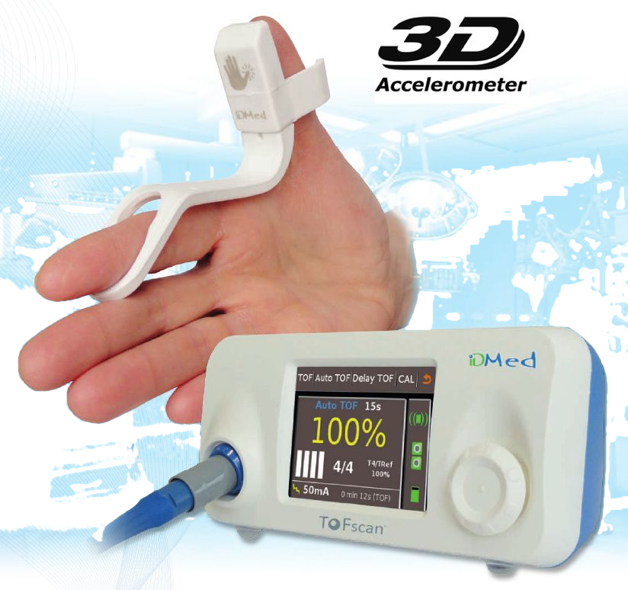
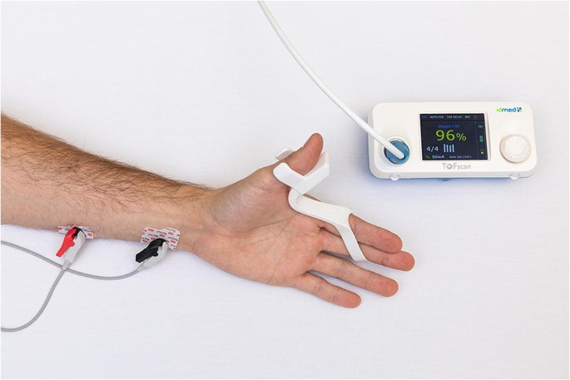
Peripheral nerve stimulator
Neuromuscular blocking agents
Check the depth of neuromuscular blockade
  TOF, PTC ..
Determine that neuromuscular blockade is reversible
Check that blockade has been reversed fully (TOFr ≤ 0.9)

Slide 46
SUMMARY – muscle relaxants
Mechanism of action – via acetylcholine receptor
Used to facilitate tracheal intubation, mechanical ventilation and surgery
Depolarizing – Succinylcholine
  Lots of side effects
Non depolarizing – Rocuronium, Atracurium, ..
  Minimal CV and respiratory effects

Slide 47
ANALGESICS

Slide 48
Analgesics
paracetamol (=acetaminophen), metamizole
Nonsteroidal anti-inflammatory drugs = NSAIDs
  (aspirin, ibuprofen, naproxen, indomethacin, diclofenac, meloxicam,..)
Opioids
Local anaesthetics
Antidepressants
Anti-epileptics
Ketamine
Clonidine

Slide 49
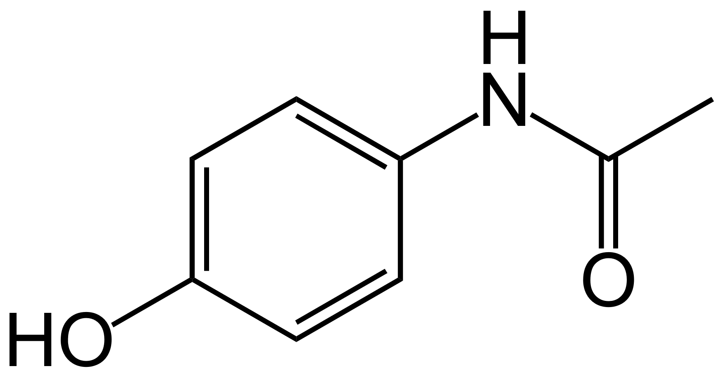
Paracetamol = acetaminophen
1877
classified as a mild analgesic
does not have significant anti-inflammatory activity
for severe pain, such as cancer pain and pain after surgery, in combination with opioid pain medication
is generally safe at recommended doses
max daily dose for an adult is 4 grams - overdose results in a lengthy, painful illness, acute liver failure and death
safe during pregnancy and when breastfeeding

Slide 50
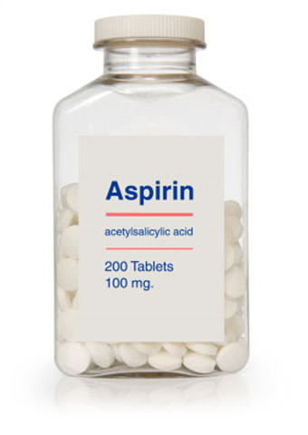
NSAIDs - effects
reduces pain
decreases fever
prevents blood clots
decreases inflammation
  in higher doses

Slide 51
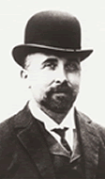
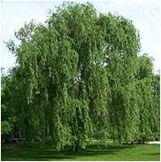
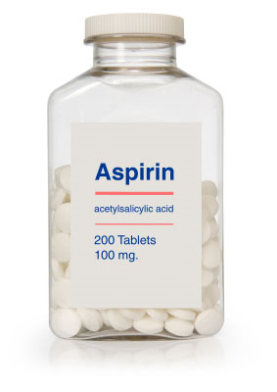
Simple analgesics
1853
Antipyretic agents found in willow tree and led to development of acetylsalicylic acid
Charles Frédéric Gerhardt
Bayer company had named it "Aspirin"

Slide 52
Acetylsalicylic acid (ASA) = Aspirin
Simple analgesics
Anti-inflamatory agent in joint disease
Cardiovascular - unstable angina
Antiplatelet drug - prevention of stroke / aMI
Radiation induced diarrhoea
Alzheimer’s disease

Slide 53
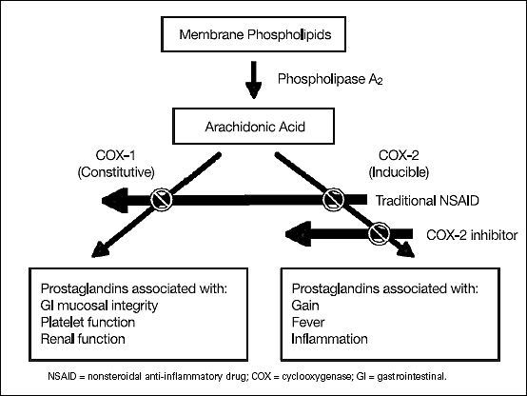
NSAIDs – mechanism of action
Simple analgesics
Inhibition of cyclo-oxygenase enzymes (COX-1, COX-2)

Slide 54
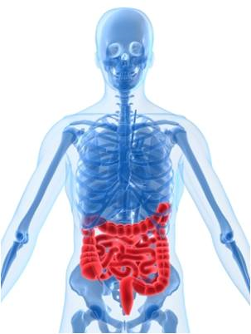
NSAIDs – side effects
Gastric irritation
Renal dysfunction – analgesic nefropathy
Antiplatelet function
Hepatotoxicity
NSAID sensitive asthma
CAVE: drug interaction – warfarin, lithium

Slide 55
Simple analgesics
 | Aspirin | Paracetamol
Chemistry | Acetic acid | Paraaminophenol
Mechanism of action | Inhibition of COX 1 | ? COX 3 inhib
Metabolism | Estrases in gut wall, liver | Liver
Toxicity | Hepatic/renal inpairment | GI upset
 | GI upset | Trombocytopenia
 | Rayes syndrome in kids | Liver necrosis
Dose | 300 – 900 mg every 6 h | 1 g every 6 h
Route of administration | orally | PO/PR/IV

Slide 56
Other NSAIDs
Ibuprofen – the lowest risk of GI upset
Indomethacin, Diclofenac – mainly antiinflamatory effect
Aspirin and NSAIDs are not contraindicated for regional anesthesia

Slide 57
SUMMARY – simple analgesics
Paracetamol
NSAIDs
MOA – inhibition of COX
Renal, gastric, hepatic side effects
Can trigger NSAID sensitive asthma

Slide 58

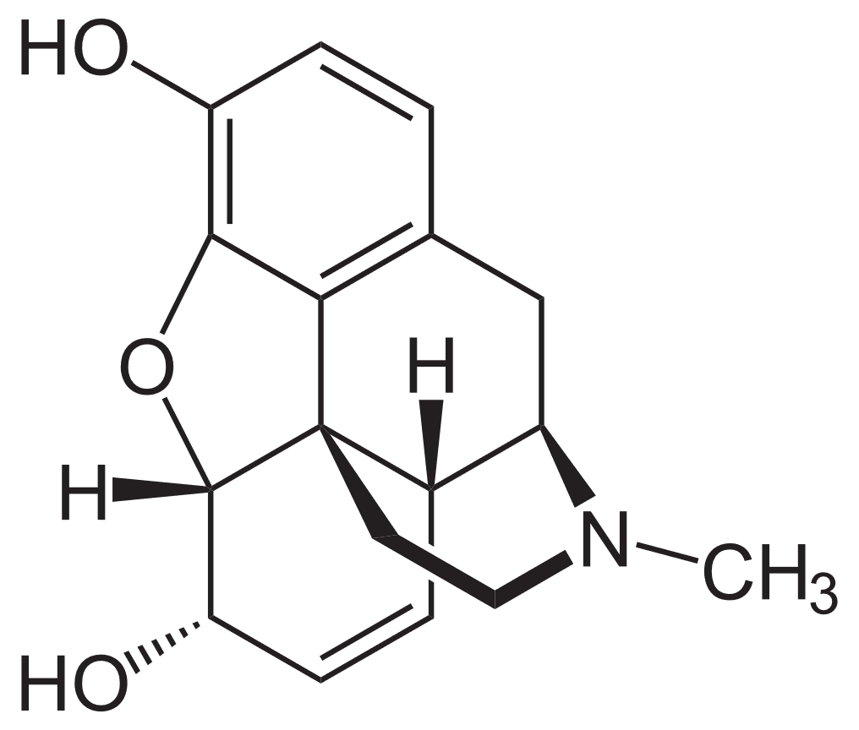
Opiods
MORPHEUS Morphine
- GREAK GOD OF DREAMS

Slide 59

Definitions
Opiods
Opiate - naturally occuring substance with morphine-like properties; mean a substance derived from opium
Opioid - all substances, both natural and synthetic, that bind to opioid receptors in the brain (including antagonists)
Narcotic - from greek word ‘numb’
Opium is dried latex obtained from the seed capsules of the opium poppy Papaver somniferum.

Slide 60
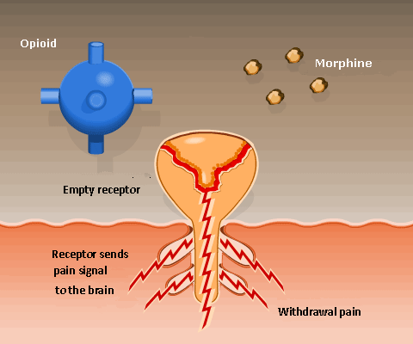
Opioids – mechanism of action
Via opioid receptors - in the central and peripheral nervous system and the gastrointestinal tract
  μ - receptor
  κ - receptor
  δ - receptor

Slide 61
Uses and routes of administration
Opiods
Analgesics
Anti-tussive
Anti-diarrhoea
Intravenously
Intramuscularly
Oral, Buccal, Rectal
Transdermal - Patches
Epidural / Intrathecal

Slide 62
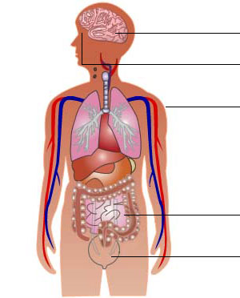
Opioids - effects
Brain:
  Analgesia, sedation
  Respiratory depression / arrest
  Euphoria and dysphoria
  Addiction, tolerance
  Nausea and vomiting
Eyes
  Miosis
Cardiovascular system
  Hypotension, bradycardia

Slide 63
Opioids - effects
Respiratory system
  Anti-tussive effect
GI tract
  Spastic immobility
Skin
  Pruritus – histamine release
Bladder
  Urinary retention

Slide 64
Commonly used opioids
Opiods
 | Dose | Elimination ½ life | Metabolism | Comment
Sufentanyl | 0.1 μg/kg | 50 min | liver | Faster onset then fentanyl
Fentanyl | 1-2 μg/kg | 190 min | liver | Neurosurgery, patches
Alfentanyl | 5 – 25 μg/kg | 100 min | liver | Faster onset then sufentanyl
Remifentanyl | 0.05 – 2 μg/kg | 10 min | Plasma and tissue esterases | Infusion only, very short context sensit. ½ life

Slide 65
Naloxone
Opiods
Pure opioid anatagonist at μ, δ and κ - receptors
Used in opioid overdose as an antidote
Dose : 1- 4 μg/kg
Duration of action 30 – 40 min
! Often shorter then duration of action of opioid, need for repeated doses

Slide 66
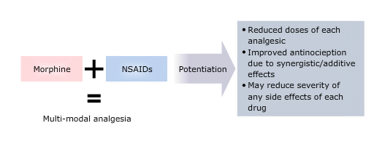
Multimodal analgesia

Slide 67
SUMMARY – opioids
Morphine, Fentanyl, Sufentanyl, Alfentanyl
MOA – via opioid receptors
Used for analgesia, anti–tussive, anti–diarrhoea
Side effects : respir. depression, tolerance, constipation, nausea + vomiting
Opioid overdose reversal – Naloxone
Multimodal analgesia – simple analgesics + opioids

Slide 68
SUMMARY
Triad of anaesthesia
  Analgesia
  Anaesthesia
  Muscle relaxation
  Choice depends on
  Patient factors
  Type of surgery
  Whether the surgery is elective or emergency

Slide 69

Questions ?

