Slide 1
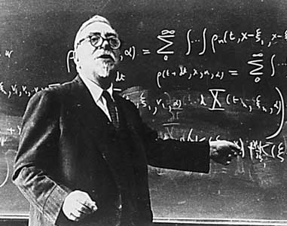
Lectures on Medical Biophysics
Norbert Wiener 26.11.1894 - 18.03.1964
Biocybernetics

Slide 2
Lecture outline
Cybernetics
Cybernetic systems
Feedback
Principles of information theory
Information system
Information processes in living organism
Control and regulation
Principles of modelling

Slide 3
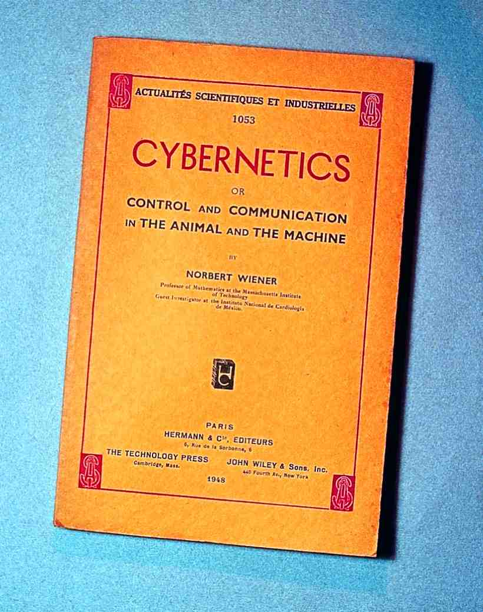
Norbert Wiener
N. Wiener: (1948)

Slide 4
Definitions
Cybernetics is the science dealing with general features and laws regulating information flow, information processing and control processes in organised systems (technical, biological or social character).
System - a set of elements, between which certain relations exist
Modelling – the main method in cybernetics:
  Simplified expression of objective reality.
  It should be understood as a set of relations between elements
  Choice of model must reflect the specific goal
  For an accurate modelling of a system, it is necessary to know its structure and function
Applied cybernetics involves the modelling of systems in specific regions of human activity, e.g. technical cybernetics, biocybernetics and social cybernetics. These models can be:
  Mathematical - mathematical modelling of systems
  Experimental - building actual miniature models or computer based models (simulation)

Slide 5
Cybernetics and informatics
The cybernetics can be assumed a broad theoretical background of informatics and some other branches of science or knowledge (economy, management, sociology etc.)

Slide 6
Biomedical Cybernetics
Main goal: analysis and modelling of regulatory and control systems of living organisms under physiological and pathological conditions (pathological processes are seen as a distortion of the normal regulatory mechanisms present in the organism)
Medical cybernetics also involves:
  Support of medical decisions in diagnostics and therapy planning
  Healthcare management = healthcare cybernetics

Slide 7
Living Systems Are Cybernetic Systems
Fundamental property of living systems: multiple interaction with surroundings
ambient variables which act on the system = input
variables by which the system acts on surroundings = output
Input variables for describing the system must be chosen to be independent.
The output ones depend on the input variables and the inner parameters of the given system.
Example: the ear

Slide 8
Analysis and synthesis of a system
System analysis - we know structure - we have to determine its behaviour
System synthesis - the structure is to be determined - behaviour is known
Black box - system of unknown structure and behaviour. Identification of the system is done on the basis of relations between input and output data.

Slide 9
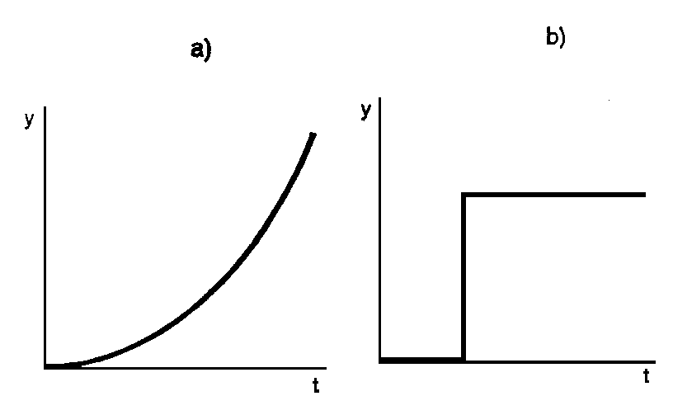
Transfer Function
TRANSFER function - Dependence of the values of an output parameter on values of an input parameter
We can distinguish:
- linear systems (straight line, an ideal case)
- non-linear
linearization of a non-linear system - an approximation by a straight line
Time-course of the output parameter change determines the behaviour of the system - continuous or discontinuous

Slide 10
Transfer Function
Basic forms of transfer:
  Amplification or attenuation of the input parameters
  Their time-delay
  Performing simple logic operations
  Selective permeability
  Generation of specific time-courses etc. (also deformation of input parameters)
All these forms are encountered in biological systems
The transfer function need not to be constant. Dynamic systems are capable of adaptation and learning.

Slide 11
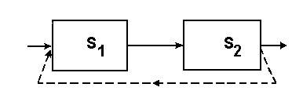
Feedback
Feedback: changes in a system output parameter leads to changes an input parameter of the same system
In positive feedback an increase / decrease of the output parameter from its normal value leads to an increase / decrease in the input parameter - the change of the input parameter in this way increases in an uncontrolled manner - positive feedback is therefore unsuitable for controlling dynamic systems.
In negative feedback an increase / decrease of the output parameter from its normal value leads to a decrease / increase (i.e., vice-versa) in the input parameter - the change of the input parameter is in this way minimised hence allowing regulation. Homeostasis in the body is based on negative feedback.

Slide 12
Principles of information theory
Stochastic (accidental) event
Information: any statement about events and processes inside the system and in its surrounding. Information expresses a relation between systems and/or elements of a system.
Stochastic (accidental) event: an event which can or need not occur under given conditions
Frequency (rate) of the event occurrence F_{A}:
F_{A} = n/N
n - number of the events occurred
N - total number of „experiments“

Slide 13
Probability and information entropy
Probability P(A) - mean value of the event frequency
Probability values can vary from 1 to 0 (1 > P(A) > 0)
Impossible and regular (unavoidable) event
Let’s have an experiment which outcomes can reach values A₁...A_{n} of equal probability P(A):
The degree of uncertainty (given by the number of individual uncertainties) grows with increasing n. It is denoted as information entropy.
Let’s have n mutually excluding events with P(A₁), P(A₂)...P(A_{n}). Uncertainty degree N_{i} of one possible outcome is:
N_{i} = -P(A_{i})log₂P(A_{i})
Information entropy of the whole experiment = the sum of individual uncertainties:
H = Σ-P(A_{i})log₂P(A_{i})

Slide 14
Probability and information entropy
Intuition: the uncertainty can be removed by the delivery of respective amount of information
Therefore, the last term is also a quantitative expression of the amount (capacity) of information.
Information increases the system ordering.
P(A) large = small amount of information
An experiment gives two alternative outcomes of the same P(A) = 0.5 ⇒
H = - (0.5log₂0.5 + 0.5log₂0.5) = 1
1 bit (binary digit)

Slide 15
Information system
Five parts:
  information source
  transmitter (coding)
  information channel (noise)
  receiver (decoding)
  user
Signal = the substance or energy carrier of the information
Information channel = medium in which the signal propagates
Symbols = dimensionless parameters qualitatively representing the given event
Position - spatial and temporal arrangement of symbols due to coding process
The elementary signal carries 1 bit-information
Max. amount of information which can be delivered by the information channel in unit time = capacity of the information channel

Slide 16
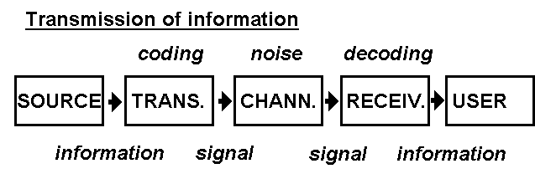
Redundancy
Noise = influences reducing original amount of information transmitted
Excess information (redundant information) can be used to reduce the effects of noise
Redundancy R is given by the formula: R = 1 - H/H_{MAX}, where H is the really transmitted amount of information and H_{MAX} is capacity of the information channel.
Language redundancy is relatively high (about 70 %), in scientific writings - relatively low

Slide 17
Information processes in living organism
The human organism is able to process an information flow of about 35 bit/s under optimal conditions in average.
Transmission and processing of information in living organism: hormonal and nervous
Three levels:
  basic biochemical reactions (control of protein synthesis - hormonal)
  autonomous systems (e.g., regulation of the heart activity - hormonal and nervous)
  central nervous system

Slide 18
Examples of information processes in a living organism: eye
Information processing in the vision analyser.
In the yellow spot there are about 10⁷ receptors, each can resolve 120 levels of light intensity, i.e. 7 bits of information. The eye can distinguish 10 images/s so that the capacity of the vision analyser is about 7·10⁸ bit/s at the level of the yellow spot.
The optical nerve consists of about 10⁶ fibres. Each can pass about 300 action potentials/s, so that the nerve capacity is about 3.10⁸ bit/s (compare with a standard TV-channel capacity 10⁷ bit/s)

Slide 19
Examples of information processes in living organism: DNA
DNA: DNA contains 4 bases (A, G, C, T). Any nucleotide contains only one base. Therefore, the information carried by one nucleotide is 2 bits. The DNA of one human sperm contains 10⁹ nucleotides, i.e. information of 2·10⁹ bits.
Protein: 20 different AA - information carried by one of them is about 4 bits. Let the protein molecule contain ≈ 10³ AA-units, so that its inf. capacity is ≈ 4·10³ bits. The quotient of the total information content of DNA molecule, and the information carried by one protein molecule determines the number of protein molecules able of synthesis: 5·10⁵.
Condition: 1 protein = 1 enzyme, 1 enzyme is coded by 1 gene ⇒ the chromosomal DNA of human sperm contains about 5·10⁵ genes*.
*The real numer is much smaller, of course. See biology.

Slide 20
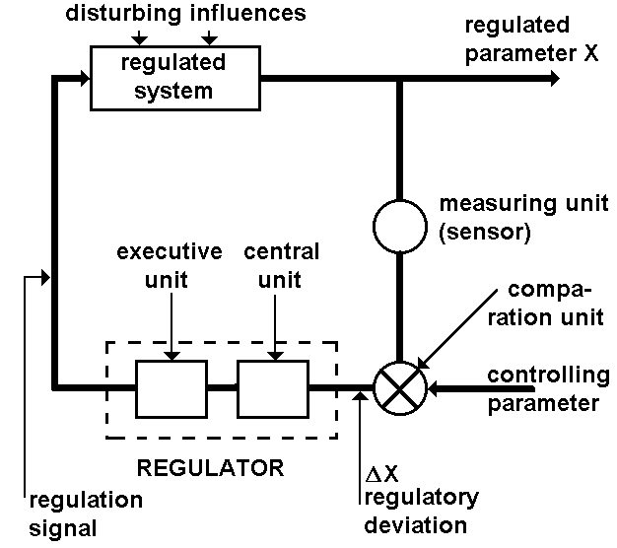
CONTROL AND REGULATION
Control: changes of the system behaviour are evoked by the information transmitted from the controlling part of the system.
According to the complexity of the control process:
systems controlled - without feedback
systems regulated - with feedback
Regulation - process minimising the differences between real values of regulated parameters, and the values required
Features of the automatic regulation:
1. Direct communication (inf. channel) between the controlling and controlled unit
2. Feedback (negative, short or long) between the controlling and controlled unit
3. Automatic transformation of the information received via the feedback channel into the control commands

Slide 21
Forms of control in living organisms:
Direct control - control commands are transmitted directly from the controlling to the controlled unit.
Control with autonomous response. The control commands are only a triggering mechanism for switching over the system states (humoral control - e.g. by hormones).
Differentiated control - it involves both the previous forms. It is performed by the controlling system with a complex feedback net (CNS)

Slide 22
Automata
Technical devices utilising the control principles able to work independently in certain extent - automatic machines:
Without feedback - they perform only a program controlled action, they cannot modify or adapt their activity.
With feedback - they are able of autoregulation, they maintain their function in certain limits.
Able of certain logical operations, automatic adaptation and learning. When communicating with surroundings and being able of manipulation, they are called robots.
In medicine, the automatic machines are used in laboratory analysis of biochemical and haematological parameters or in monitoring and analysis basic vital functions.

Slide 23
Principles of modelling
Theoretical cognitional process which goal is to recognise properties of certain original on the basis of its representation. The way of re-presentation is given by the purpose of the model.
Each model is a simplification of reality.
Main principle of modelling is the abstraction of identification. We take into account only identical properties of the objects. A model sufficiently representing the properties of the original object can be a source of information about that object and its interactions.
Analogy - structural or functional similarity of objects, processes and phenomena (events). Structural analogy is based on partial or total structural identity of two systems.
Functional analogy (more important) - identity in functional properties of two systems - the character of both systems can be quite different (e.g. functional analogy of natural and artificial kidney).
Isomorphism is a special case of analogy - the systems in question are of the same mathematical description

Slide 24
Types of models
Formal: real (physical, chemical) and abstract (mathematical).
According to the presence of accidental features, these can be divided into stochastic and deterministic.
According to the way of origin: induction models (from empirically obtained information) and deductive ones (on the basis of supposed relations)
According to the purpose: descriptive (serving for description of properties of the original) and explanatory (serving for verification of hypotheses)
The choice of modelled hypotheses must be representative - the non-modelled properties must not disable to draw general conclusions.

Slide 25
Process of model construction and utilisation
Observation of certain phenomenon
Its experimental verification and, if possible, its quantification
Designing the model
Its comparison with experimental results
Simulation = specific kind of modelling. Principle: The original system is re-placed by the simulation model. Regressive verification of knowledge obtained by means of the simulation model in the original system is done. The simulation is often performed using computers.
Mathematical modelling of biological and physiological processes (stimulated, e.g., by development of radionuclide methods - substance distribution and kinetics in organism is studied).

Slide 26
Author:
Vojtěch Mornstein
Content collaboration and language revision:
Ivo Hrazdira, Carmel J. Caruana
Last revision: November 2021

