Slide 1
XXVII. Examination of reflexes in man
Physiology - practices
Department of Physiology, Faculty of Medicine, LF MU

Slide 2
Reflexes
Reflex: is an involuntary response of an organism triggered by stimulation of receptors – the main functional unit of the nervous system based on negative feedback
Reflex arch: consists of 1. receptor, 2. afferent pathway, 3. centre (brain or spinal cord), 4. efferent pathway and 5. effectors organ.
Particular reflexes have anatomically strictly defined reflex arches, e.g. pathway and centre.
According to the character of a reflex response to a certain stimulus, we can topically diagnose and point out the place of nervous system disablement.
Function: correction of changes or protection against damage.

Slide 3
Examination of Reflexes
When examining reflexes the following items are considered:
  Elicitability of a reflex – if we can elicit the reflex
  Quantitative changes in the response – the strength or symmetry of the response
  Qualitative changes – if the response is as expected or different
Proprioceptor reflexes (stretch reflexes)
  Most reflexes are elicited by fast, springy tapping of the corresponding receptor area with a percussion hammer.
  The tapping of the hammer should be adequately strong, fast, and precise, but not painful.
  Muscles involved in the muscle response must be sufficiently relaxed.
Facilitating manoeuver consisting of a voluntary contraction of antagonistic muscles should be used if the reflex can not be elicited even in a correct procedure, e.g. Jendrassik’s manoeuvre (the patient flexes both sets of fingers into a hook-like form and tries to put them apart)
Sometimes it is necessary to distract the subject’s attention by asking him to perform
a simple calculation (repeated subtraction of a number).

Slide 4
Classification of reflexes
conditioned (acquired)
extracentral
axonal,
ganglionic
e.g.: red
dermographism
unconditioned (congenital)
genesis
Centre
 | number of synapses
central
spinal
e.g.: stretch reflex (patellary, bicipital
Afferent pathway
brain
Efferent pathway
e.g.: vestibulo-ocular, pupillary reflex
Receptor
monosynaptic, polysynaptic
Effector
interoreceptors
exteroreceptors
somatic
e.g.: stretch, flexor reflex
proprio- receptors
combined
viscero- receptors
senses
skin
autonomic
e.g.: stretch reflex (patellar, bicipital), inverse stretch reflex
e.g.: cough reflex
e.g.:
flexor reflex
e.g.: vestibulo-ocular, pupillary
e.g.: baroreflex, chemoreflex, emetic reflex, gastroileal reflex
e.g.: baroreflex,
chemoreflex

Slide 5
Reflexes in practicals
Proprioceptive reflexes (myotatic, stretch):
  jaw thrust reflex (masseter), nasopalpebral
  biceps, styloradial, triceps
  patellar (knee jerk), ankle jerk (Achilles‘ tendon reflex), medioplantar
Exteroceptive reflexes (cutaneous and mucous):
  corneal and conjuctival, palatal
  epigastric, mesogastric, hypogastric
  plantar
Sensory reflexes:
  pupillary reponse to light (direct or indirect), to convergence, to pain
  twinkle reflex

Slide 6
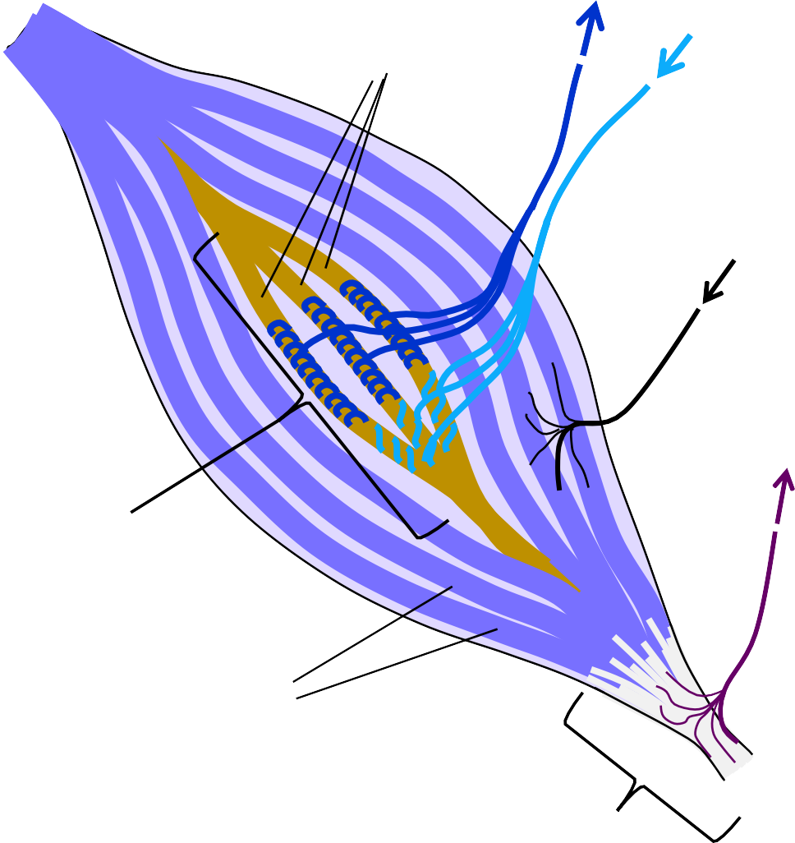
Proprioreceptors in the muscle
afferent neural fibre I_{a}
intrafusal fibres
efferent fibre of γ-motoneuron
- innervates contractile part
of muscle spindle
Apart from muscle spindles and Golgi tendon organs, proprioceptors in joints registering the position of a joint also exist
efferent neural fibre of
α-motoneuron
afferent fibre I_{b}, II
muscle spindle
muscle length reception
extrafusal fibres
(muscle fibres)
Golgi tendon organ regulation of tension in muscle

Slide 7
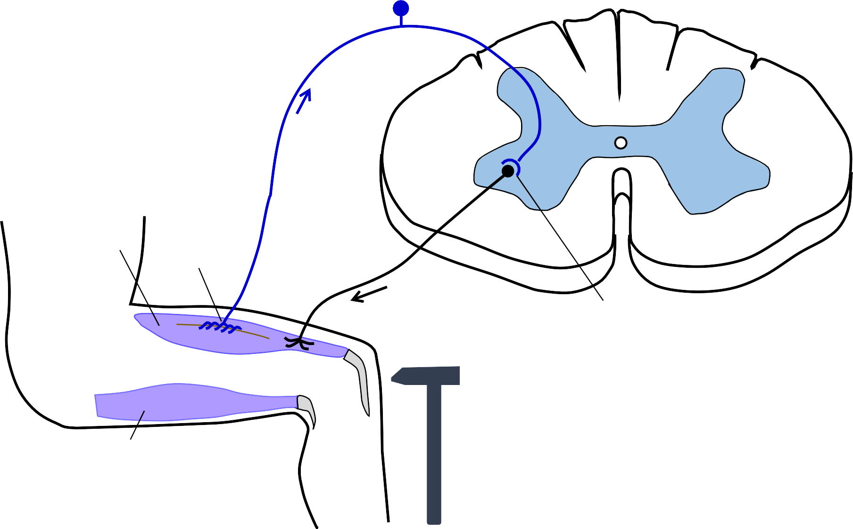
Stretch reflex – reflex arch (myotatic reflex: monosynaptic, proprioceptive)
Receptor: Muscle spindle
Main function: Unwanted extension causes contraction of the muscle (containing muscle spindle). Reflex serves as a correction to unwanted prolongation of muscles - maintaining of erect posture, defying gravity (closing of the mouth)
body of neuron I_{a}
spinal cord
neural fibre I_{a}
muscle spindle
Elicitation: By percussion of the tendon of a muscle with a reflex hammer, passive and involuntary prolongation of the muscle occurs. The muscle spindle is triggered and a reflexive muscle contraction is started.
extensor
neural fibre of
α-motoneuron
synapse
percussion hammer
flexor

Slide 8
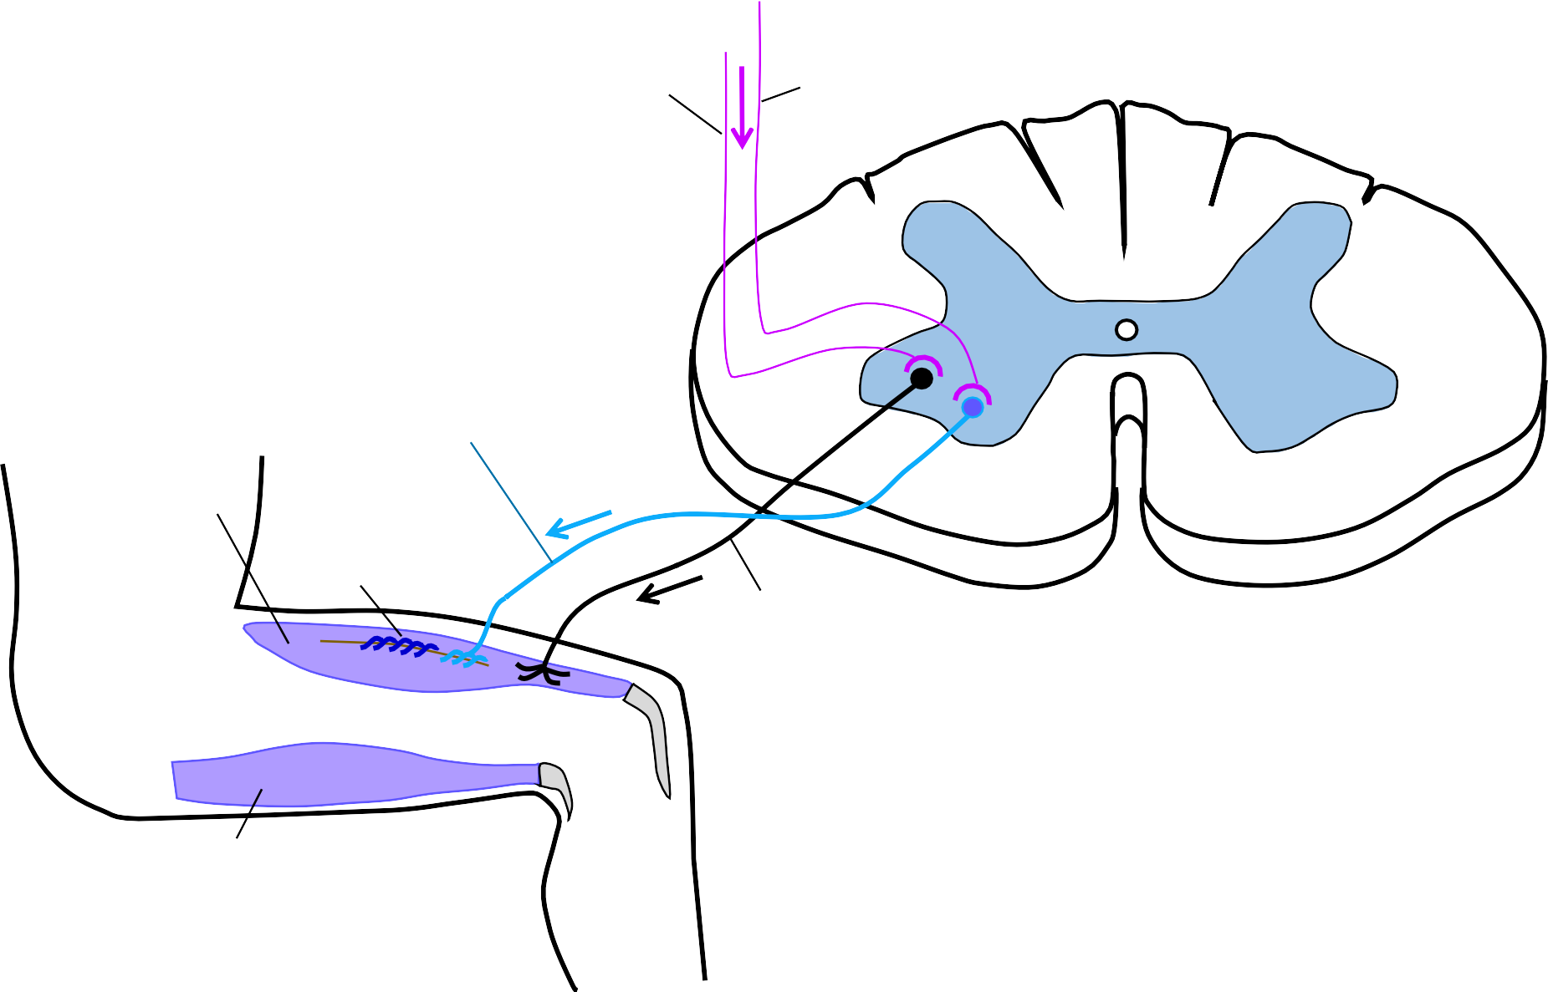
Stretch reflex – correction of muscle spindle sensitivity
The activity of γ- motoneurons regulates muscle spindle sensitivity via contraction of intrafusal fibres. Shortening of muscle spindle fibres leads to higher sensitivity to a stimulus.
extrapyramidal pathways
pyramidal pathways
spinal cord
γ-motoneuron
extensor
muscle spindle
α-motoneuron
The desired change of muscle length activates simultaneously γ-motoneurons and α- motoneurons. Intrafusal and extrafusal fibres extend simultaneously and the sensitivity of the muscle spindle does not change.
flexor

Slide 9
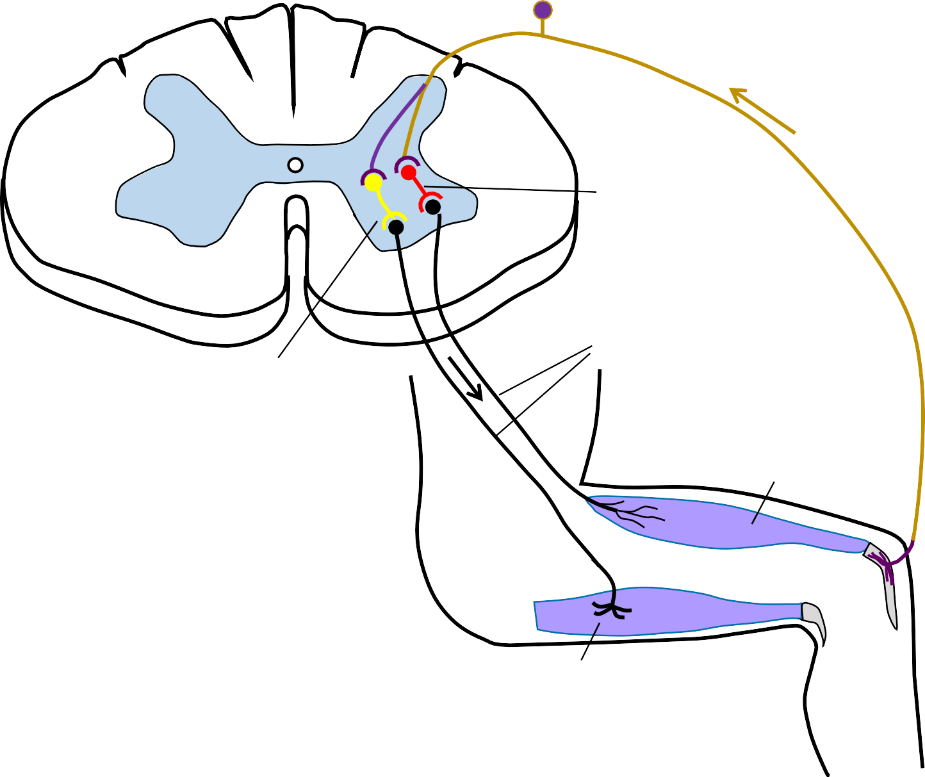
Golgi tendom reflex, inverse stretch reflex (bisynaptic, proprioceptive)
Receptor: Golgi tendon organ
-
inhibitory interneuron
+
neural fibres I_{b}, II
α-motoneuron
spinal cord
excitatory interneuron
extensor
Function: An increase of tension in a tendon causes the relaxation of a muscle (containing a Golgi receptor) and contraction of an antagonist muscle.
This reflex serves as a protection from muscle and tendon damage.
Golgi tendon organ
flexor

Slide 10
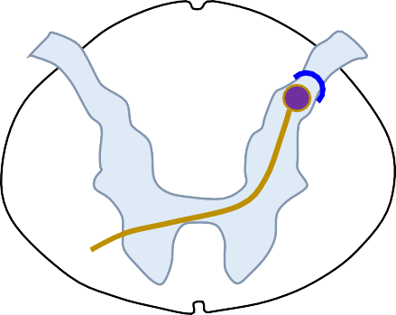
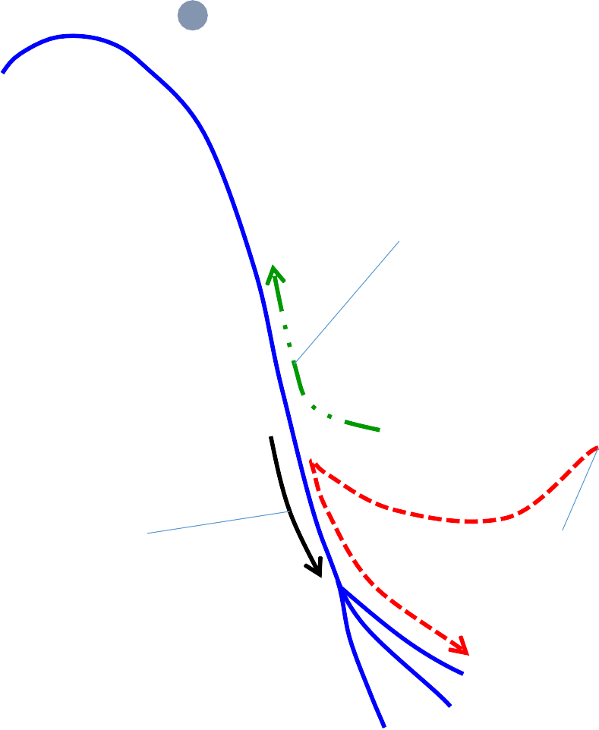
Axon reflex (extracentral)
body of sensoric
neuron
spinal
cord
The impulses generated in the sensory nerve are transmitted anti-directionally (upstream) to other branches of the sensory fibre
When irritating the skin receptors, the pulse is converted to nearby arterioles innervated by the same fibre
orthodrome conduction
skin nerve endings
antidrome
axon reflex arch
Substance P from the nerve endings dilates the arteriol and increases the vascular permeability (red dermographismus)
  In addition, histamine released from mast cells also dilates the vessels and increases their permeability
arteriolar nerve endings

Slide 11
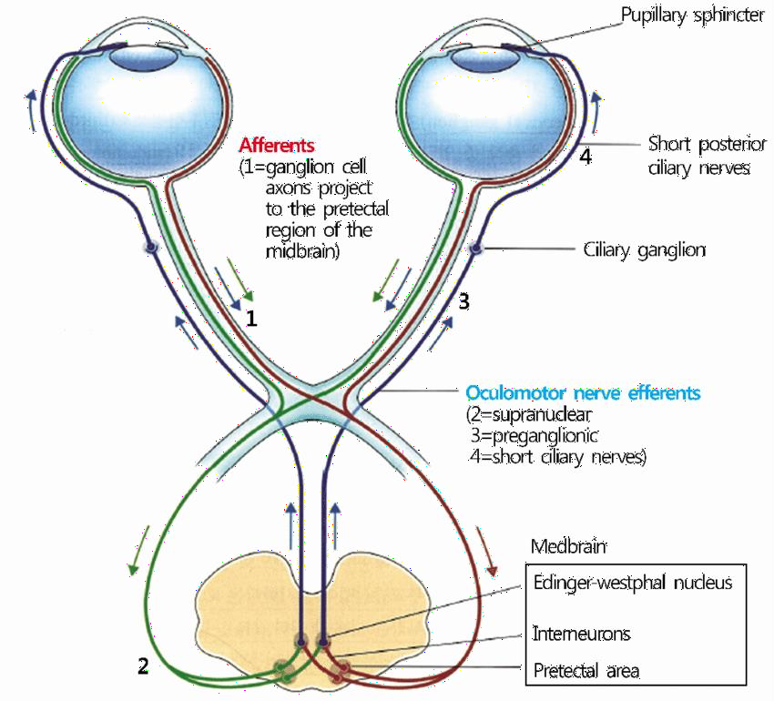
Pupillary responses
https://www.researchgate.net/figure/Schematic-drawing-of-the-pupillary-light-reflex-pathway- By-way-of-the-optic-tract-the_fig1_318593544
Constriction of pupils in reaction to light
  symmetrical constriction of both pupils
  miosis – constriction of pupils, parasympathetic activity
  mydriasis – dilatation of pupils, sympathetic activity
  centre of reflex: brainstem (diencephalon)

Slide 12
XXVIII. Recording of Achilles’ tendon reflex
Physiology - practices
Department of Physiology, Faculty of Medicine, LF MU

Slide 13
Recording of Achilles’ tendon reflex
Aim:
To learn how to register electrical and mechanical responses of
Achilles’ tendon reflex.
After measuring particular values get an idea about the time sequence of electrophysiological processes of reflex response, which start with stimulation of appropriate receptors and ends up in muscle relaxation.
Achilles' tendon reflex – monosynaptic, proprioceptive, somatic, stretch, unconditioned, spinal, monosegmental

Slide 14
Achilles tendon reflex (or ankle jerk) as a proprioceptive reflex is elicited by tapping the tendon of the soleus muscle with a reflex hammer. The rapid stretch of muscle activates the muscle spindles and evokes an increased discharge of action potentials from the spindles.
The volley of action potentials in the primary sensors Ia fibres monosynaptically excites the alpha motoneurons (mainly in the S1 segment) which in turn activate the soleus muscle, where the reflex begins.
Contraction of muscle is preceded by membrane depolarisation of activated muscle fibres which generate the so called compound muscle action potential (CMAP). This potential may be recorded using surface electrodes (electromyographically). Two parameters of electromyogram (EMG) are of interest: the duration of the signal and the interval of its delay, the latency period.

Slide 15
Methods
The mechanical response of the muscle, contraction and relaxation, may be recorded with a joint goniometer fixed on the calf and the foot. The muscle contraction changes the angle formed by the attached boxes, thereby the deflexion of the fibres and eventually the amount of light converted to an electric signal. The first derivative of the signal yields the velocity of contraction and relaxation.
Electrodes are placed on the calf and an electromyographic curve is obtained.
The measurement of Achilles tendon reflex was formerly used to assess indirectly the thyroid function. Prolongation of the mechanical response (specifically the time when the velocity of muscle relaxation reaches its maximal value) is symptomatic of thyroid hypofunction, whereas it is shortened in hyperthyroidism

Slide 16
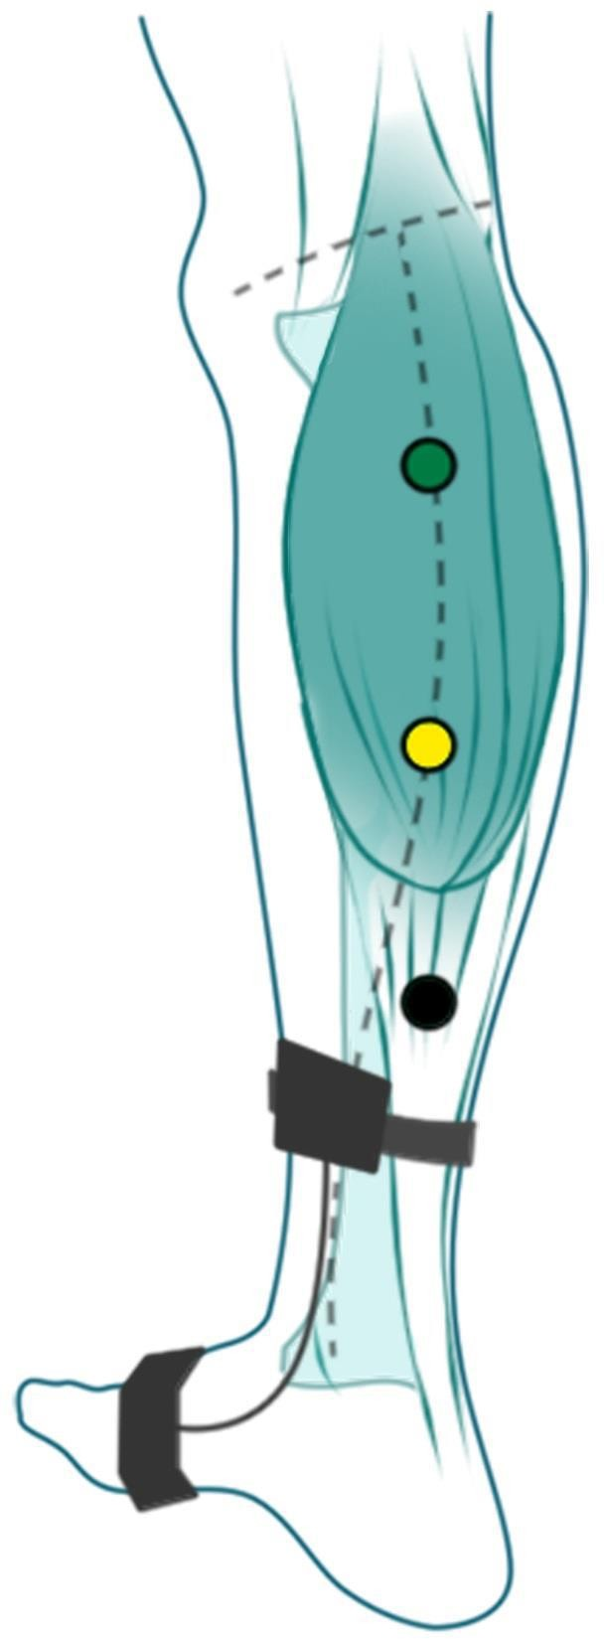
Position of goniometer and electrodes on the right leg
ground electrode (green)
active electrode (yellow)
reference electrode (black)
PC
goniometer
(a box with a cable located on the medial side of the calf)

Slide 17
Polygraphic record of the Achilles tendon reflex
movement
EML
end of contraction,
start relaxation
Δt₄
time of maximal relaxation velocity = time duration of reflex
velocity
of muscle contraction and
relaxation
Δt
5
Physiological values:
Δt₁ : 32 ± 3 ms
Δt₃ : 120 ± 20 ms
Δt₅ : 320 ± 50 ms
Δt₃
CAMP
time of maximal
contraction velocity
Δt
1
CAMP (Δt - Δt ): 14,9 ± 2,5 ms
electromyography
2 1
Δt₂
0
time

Slide 18
Example of how to process the protocol:
Write results from 5 records in the table
In conclusion:
Compare acquired values to physiological values
High Δt5 values may point to reduced thyroid function and vice versa
record | 1 | 2 | 3 | 4 | 5 | mean | phys. values (ms)
Δt₁ |  |  |  |  |  |  | 32 ± 3
Δt₂
Δt₃ |  |  |  |  |  |  | 120 ± 20
Δt₄
Δt₅ |  |  |  |  |  |  | 320 ± 50
CAMP |  |  |  |  |  |  | 14,9 ± 2,5

Slide 19
Interesting links
Stretch reflexes
  https://www.youtube.com/watch?v=0sqCIzuotWo
Babinski and plantar reflex:
  https://www.youtube.com/watch?v=HnX4bH1WRHQ
  https://www.youtube.com/watch?v=iV_a2WSbdM8
Reflexes used in brain dead examination:
  https://www.youtube.com/watch?v=Nty6bICZlyA
From 8:40 min
  https://www.youtube.com/watch?v=qiZBGFWvv4E&t=524s
Vestibuloocular reflex
  https://www.youtube.com/watch?v=j_R0LcPnZ_w
Pupillary reflex
  https://www.youtube.com/watch?v=aM0ipmW3ikc

