Slide 1
(XXIX.) Erect posture examination using stabilometry
Physiology - practices
Dep. of Physiology, Fac. of Medicine, MU, 2016 © Michal Pásek

Slide 2
Control of erect posture by the central nervous system is manifested by permanent corrections of deviations of the body from the vertical axis, which results in changes of gravity-opposing muscle tone.
spinal cord
muscle tone
(to keep upright posture)
brainstem (motor centers)
proprioreceptors
tactile receptors
cerebellum
vision
motor cortex
vestibular system
Simplified scheme of regulation of stability

Slide 3
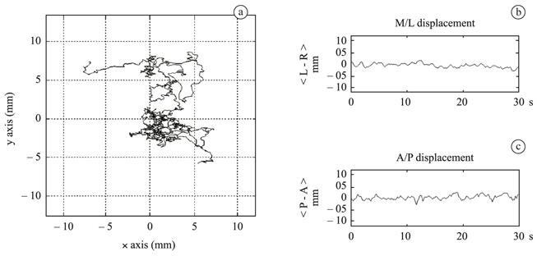
Deviation of the body from the vertical axis and following changes in muscle tone are manifested by changes in the moments of supporting forces that are registered by the stabilometer.
L-R displacement
[mm]
axis Y [mm]
P-A displacement
[mm]
axis X [mm]
COP displacement in the statokineziogram (a) and stabilogram (b, c)
COP (centre of pressure) is an imaginary point on the ground, where the resultant ground reaction force (opposing the resultant gravity force) is located.

Slide 4
Parameters of stabilometric test
Mean COP X, Y (mm): the mean value of X coordinates and mean value of Y coordinates of all points of statokinesigram. It depends not only on the position of the subject on the stabilometer plate but also on the inclination of his/her body.
Mean distance from the centre (mm): the average deviation of COP position from the mean COP X, Y in left-right (X) and front-back (Y) directions. It is proportional to the size of the area determined by COP trajectory.
Mean velocity (mm/s): represents the average speed achieved by moving COP. It characterizes the extent of muscular effort in maintaining erect posture.
X, Y-axis movement (mm): the total length of the path that the COP followed in the left-right (X) and front-back (Y) directions. It provides information about the prevailing direction
of the movement.

Slide 5
Stabilometric tests
Romberg’s test I: Subject’s feet are 10 cm from each other, eyes open, and the head is straight ahead.
Romberg’s test II: The experimental subject puts his/her feet together, keeps his/her eyes open and his/her head straight ahead.
Romberg’s test III: The subject closes his/her eyes and keeps his/her feet together and his/her head straight ahead.
Stimulation of the Achilles tendons with vibrators: The examined subject keeps his/her eyes closed, feet together and his/her head straight ahead. The vibrators are switched on during the examination.
Attenuation of tactile afferentation from feet: The subject steps on the stabilometer equipped with a soft pad, puts his/her feet together, and after a short adaptation closes his/her eyes.

Slide 6
(XLI.) Estimation of Reaction Time Using Computer
Physiology II - practices
Dep. of Physiology, Fac. of Medicine, MU, 2016 © Michal Pásek

Slide 7
Reaction time is the time between the application of a stimulus (light, acoustic, tactile, etc.) and the moment of appropriate reaction by the experimental subject.
Reaction time depends on:
  modality and intensity of the stimulus,
  the complexity of the task (different reactions to different stimuli),
  motivation, attention, fatigue and experience of the subject.
stimulus
sensory organ (detection)
CNS
(processing)
muscle system (reaction)
reaction time

Slide 8
Reaction time testing
Visual and acoustic stimuli: The test consists of a repeated random presentation of visual (asterisk in the centre of the screen) and acoustic (simple sound of 1 kHz) stimuli. The examined person responds to every stimulus by pressing ENTER on the keyboard.
Visual stimuli: The reaction to the repeated random presentation of visual stimuli.
Acoustic stimuli: The reaction to the repeated random presentation of acoustic stimuli.

Slide 9
Reaction time testing
Go/NoGo centre: The test consists of repeated random presentation of two different visual stimuli (asterisk and symbol of dollar). Every stimulus is presented in the centre of the screen. The examined person responds to every asterisk by pressing ENTER on the keyboard. The symbol of dollar should be ignored.
Go/NoGo periphery: The test consists of repeated random presentation of two different visual stimuli (asterisk and symbol of dollar). Each stimulus is presented anywhere on the screen. The examined person responds to every asterisk by pressing ENTER on the keyboard. The symbol of dollar should be ignored.

Slide 10
Reaction time testing in practicals in this form write your results in the protocol
Fill the results to the table:
Test |  | Arithmetic mean value | Standard deviation value | Number of mistakes
Visual and acoustic stimuli | Visual
 | Acoustic
Visual stimuli
Acoustic stimuli
Go/NoGo centre
Go/NoGo periphery

Slide 11
Reaction time – discussion write the answers to these considerations in the protocol as a conclusion
Notice and explain the difference between reaction time values in the case of visual and acoustic stimuli.
Discuss the diverse reaction time values and number of mistakes in different parts of the testing.
What other factors influence reaction time values in humans? What can cause faster or slower reaction time?

Slide 12
Source of figures
Slide 2 – Physiology and neuroscience practicals, Masaryk University 2011

