Slide 1
XVII. Pneumography XX. Pneumotachography
Physiology I – practice
Autumn, weeks 10-12

Slide 2
Pneumography
= a method for registration of respiratory movements
Respiratory muscles
Main inspiratory muscles: diaphragm and external intercostal muscles
Accessory inspiratory muscles: sternocleidomastoid musculus and a group of scalene muscles
Expiratory muscles: internal intercostal muscles and anterior abdominal wall muscles
Inspiration – active process (contraction of respiratory muscles)
Expiration – a passive process at rest (elasticity of the lungs pulls the chest wall back to the expiratory position), and forced exhalation is an active process (use of expiratory muscles)

Slide 3
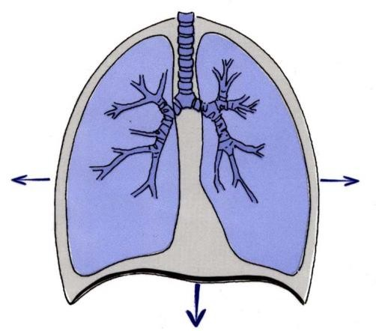
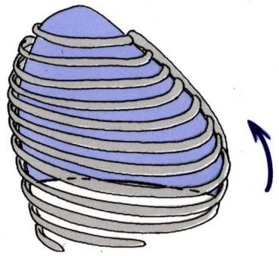
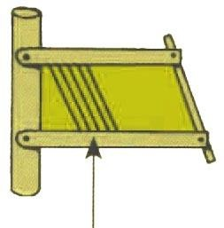
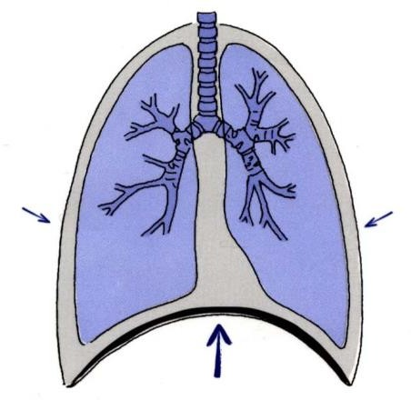
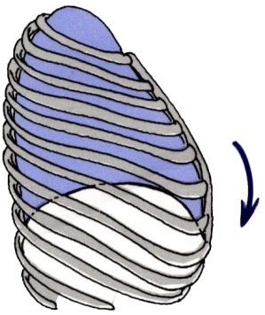
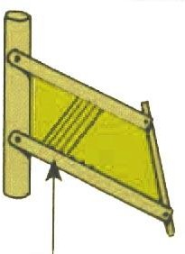
Pneumography
inspiration
expiration

Slide 4
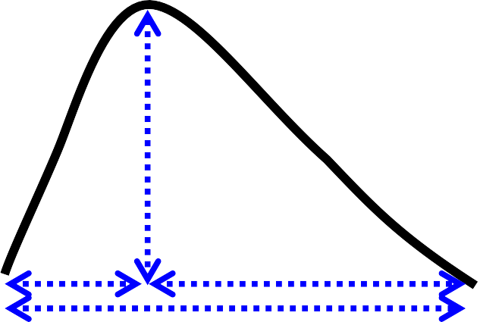
Chemical regulation of ventilation
Ventilation = tidal volume * respiratory rate
The volume of air ventilated over time (l/min)
Respiratory rate in pneumography – determined by the duration of the whole respiratory cycle (breathing interval, BI), duration of inspiration (T_{i}) and expiration (T_{e})
Depth of breathing in pneumography – amplitude of breathing movements (Amp)
Chemical control of ventilation leads to a change in depth and frequency of breathing based on chemoreceptor information
Chemoreceptors
Central – cells in the medulla oblongata near the respiratory centre
Peripheral – carotid and aortic
Amp
Ti
Te
BI

Slide 5
Central chemoreceptors
Located near the respiratory centre in the medulla oblongata
CO₂ passes the blood-brain barrier into the cerebrospinal and intercellular fluids of the brain
CO₂ + H₂O → CHO₃⁻ + H⁺
Increased concentration of H₊ in cerebrospinal fluid stimulates chemoreceptors → increased ventilation

Slide 6
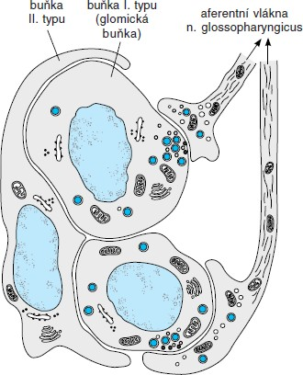
Peripheral chemoreceptors
They contain two types of cells
Type I: located beside nerve fibres
Type II: glia (each one surrounds 4-6 type I cells)
Registration of pO₂ levels dissolved in the blood plasma over time
Stimulation by a decrease in pO₂ or by a decrease in blood flow
Peripheral receptors also register pCO₂ and pH
Type II cell
Type I cell (glomus)
Afferent fibres of n. IX

Slide 7
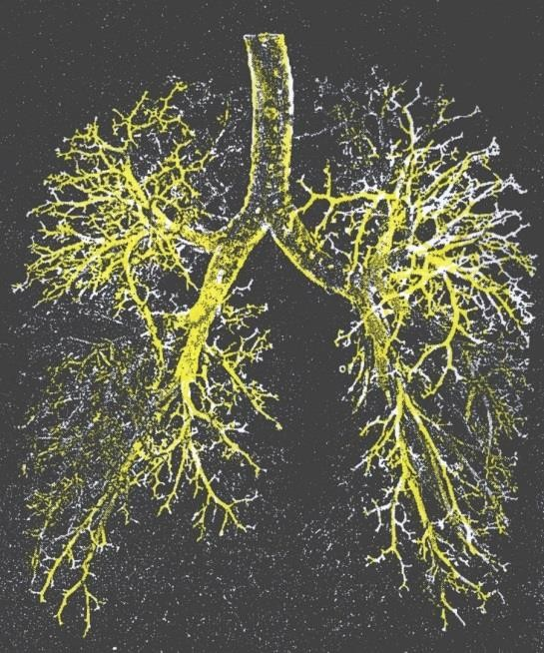
Dead space
Air volume in the conductive airway area where no gas exchange with blood occurs
Anatomical DS: volume of the respiratory system outside the alveoli (150-200 mL)
Functional (physiological) DS: the volume of air that does not participate in gas exchange with the blood – includes non-perfused alveoli
In healthy individuals, both dead spaces are the same

Slide 8
Partial pressures of gases (mmHg)
in different parts of the respiratory and circulatory systems

Slide 9
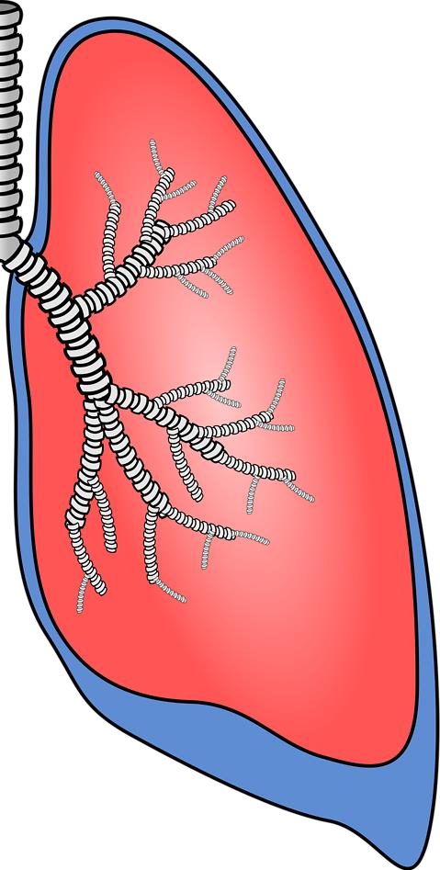
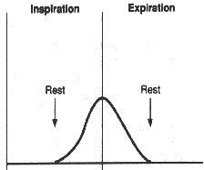
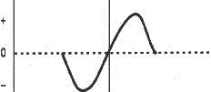
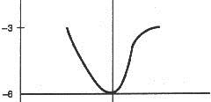
Pressures in lungs
http://worldartsme.com/images/happy-lungs-clipart-1.jpg
The volume of inhaled air
nádech výdech
Visceral pleura
Parietal pleura
Intraalveolar (pulmonary) pressure
Atmospheric pressure
(now 0)
Intrapleural pressure (always negative)
Pleural cavity – between parietal and visceral pleura
Pleural
fluid

Slide 10
Lung compliance C
Volume change from relaxation volume (L)
$C=\frac{∆V}{∆C}$
the slope of the curve on the graph
The value of C is the highest at rest
The value of C depends on
Own tissue elasticity (ensured by elastin and collagen fibres)
Surface tension forces (surface tension forces in the alveoli: liquid-air interface, surfactant)
Forced inspiration curve
Relaxation pressure curve
3
2
Forced expiration curve
Vital capacity
1
Position at rest
(relaxation volume)
0
-1
-80 -40 0 40
Pulmonary pressure (mmHg)
(0 = atmospheric pressure)
80 120 160

Slide 11
Statistical evaluation – in general
 |  | Reality
 |  | H₀ | H_{A}
Results | H₀ | OK | β
 | H_{A} | α | OK
Mann-Whitney test
Nonparametric sequential test, it compares samples A and B
Null hypothesis H₀: sample A do not differ from sample B
Alternative hypothesis H_{A}: sample A is bigger or smaller than sample B
Statistical significance of α (usually α = 0.05 or 0.01)
The probability of error, in other words, that we reject H₀ based on the selection, but in reality H₀ is true
Test results:
The test is not significant = confirmation of H₀: we did not confirm the difference between A and B
The test is significant with significance α = rejection of H₀: we confirmed that there is a difference between A and B

Slide 12
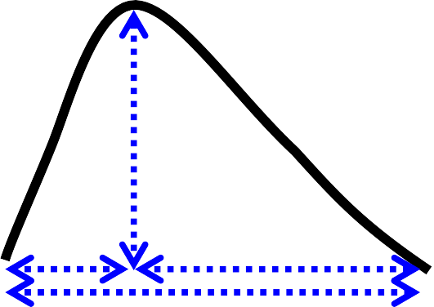
Statistical evaluation – an example
Amp
Ti
Te
Sample A: Amp at rest, sample B: Amp after exercise
Null hypothesis H₀: Amp at rest will be the same as Amp after the exercise
Alternative hypothesis H_{A}: Amp at rest is bigger or lower than Amp after exercise
We compare T1 ́-T1 with the table values for α while the number of elements n = 6. Possible results:
T1 ́-T1 < 13 → we do not reject H₀ at the significance level of α = 0.01, i.e. we have not shown that Amp at rest differed from Amp after exercise
T1 ́-T1 > 13 → we reject H₀ at the significance level of α = 0.05, i.e. we have shown that Amp at rest differs from Amp after exercise (logically it should be higher after exercise)
T1 ́-T1 > 16 → we reject H₀ at the significance level of α = 0.01, i.e. we have shown that Amp at rest differs from Amp after exercise (logically it should be higher after exercise)
BI

Slide 13
Pneumotachography

Slide 14
Pneumotachography
Pneumotachography is a method enabling the estimation of airway resistance. It measures the pressure difference between two ends of a tube through which the examined person breathes.
An increased value of airway resistance indicates obstruction of the airways.

Slide 15
Poiseuille-Hagen law
$$P_{A}$$
$$r$$
$$P_{B}$$
Volume flow ($Q$) in rigid tube equals directly to the pressure gradient between the beginning and end of the tube ($∆P=P_{A}−P_{B}$) and to the fourth power of its radius ($r$), and indirectly to its length ($l$) and viscosity of the fluid ($η$)
$$Q=\frac{π∙∆P∙r^{4}}{8∙l∙η}=\frac{∆P}{R}$$
$R$ is tube resistance against gas flow
The pressure required to pass a given volume of liquid/gas through the tube
Valid only in laminar flow

Slide 16
Airway resistance
Airway resistence (R_{d}) results from inner friction between flowing gas and the airway wall.
$$R_{d}=\frac{∆P}{Q}=\frac{8∙l∙η}{π∙r_{d}^{4}}$$
A small change in the radius of the airways (r_{d}) causes a substantially bigger change in the airway resistance to airflow (R_{d}).
Narrowing (obstruction) of the airways occurs when the chest is compressed, the mucous membrane is swollen, vocal cords are swollen, smooth muscles of the airways are constricted when a foreign body is inhaled, asthma attack or other allergic reaction
Bronchioles are the main contributors to resistance: a large proportion of smooth muscle and no cartilaginous reinforcement, they contain receptors for various agents (histamine – bronchioloconstriction, adrenaline – bronchiolodilatation)

Slide 17
Principle of pneumotachography
The airflow in the pneumotachograph is the same as the airflow in the airways:
$$\frac{P_{p}−P_{atm}}{R_{p}}=Q=\frac{P_{alv}−P_{p}}{R_{d}}$$
Substitution:
$$∆P_{p}=P_{p}−P_{atm}$$
$$∆P_{alv}=P_{alv}−P_{atm}$$
$$R_{d}=R_{p}∙\left[\frac{∆P_{alv}}{∆P_{p}}−1\right]$$
Pneumotachograph resistence: $R_{p}=0.043 kPa∙s/L$
$∆P_{p}$ and $∆P_{alv}$ are measured
(Note: The values are in mV, not kPa, which does not matter because they are in ratio. Do not write minus for expiratory values.)
$$P_{p}$$
$$P_{atm}$$
$$Q$$
$$R_{p}$$
valve
pneumotachograph tube
$$Q$$
trachea
$$R_{d}$$
lung
$$P_{alv}$$

Slide 18
$$R_{d}=R_{p}∙\left[\frac{∆P_{alv}}{∆P_{p}}−1\right]$$
Calculation of $R_{d}$
During inspiration with a normal mouthpiece
During expiration with the normal mouthpiece
During inspiration with a narrowed mouthpiece
During expiration with the narrowed mouthpiece
Physiological values:
$0.1−0.2 kPa∙s/L$
A narrowed mouthpiece increases $R_{d}$ several times
U [V]
Pneumotachographic curve
^{ΔP}alv
M
ΔP_{p}
0
ΔP_{p}
t [s]
marker
^{ΔP}alv
Valve closing at the start of inspirium/expirium
U [V]
Pneumographic curve
inspirium
expirium

