Slide 1
Autonomic nervous system

Slide 2
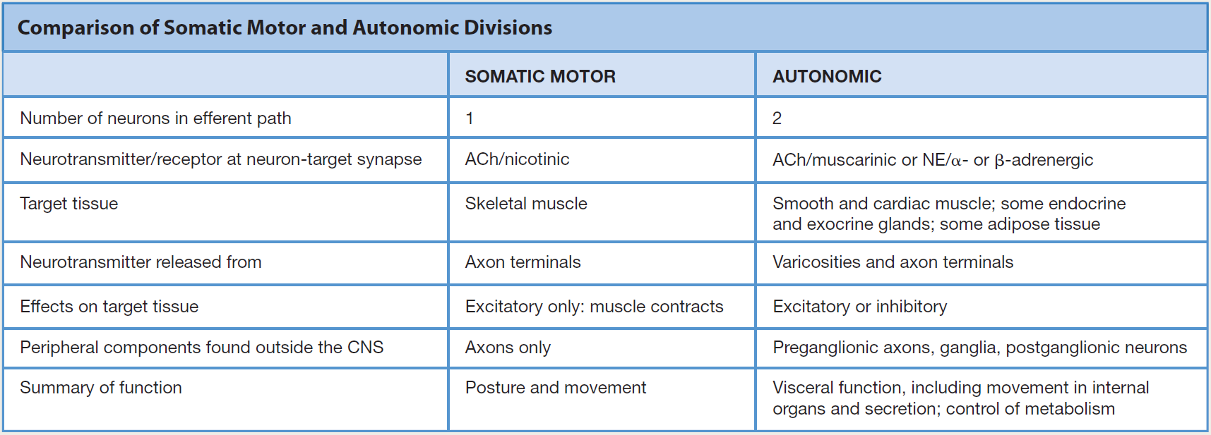
ANS vs. somatic NS

Slide 3
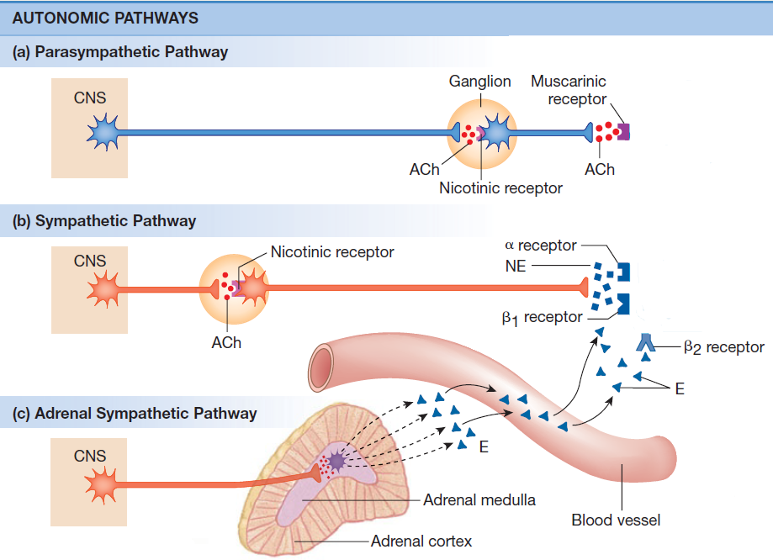
Autonomic nervous system

Slide 4
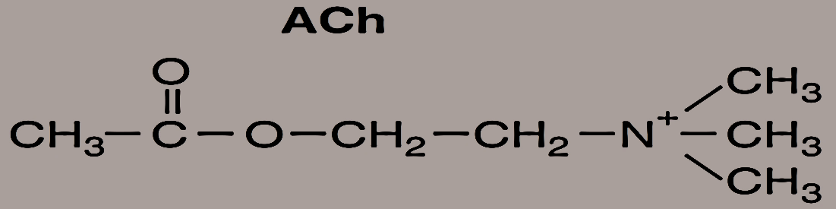
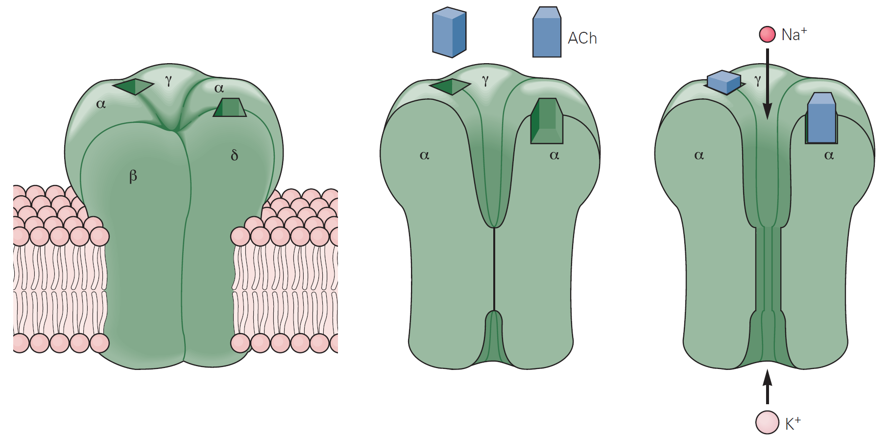
Autonomic nervous system
Preganglionic fibers
SNS, PNS
Nikotinic receptor
  N_{N} type and N_{M} type
  Excitatory receptors

Slide 5
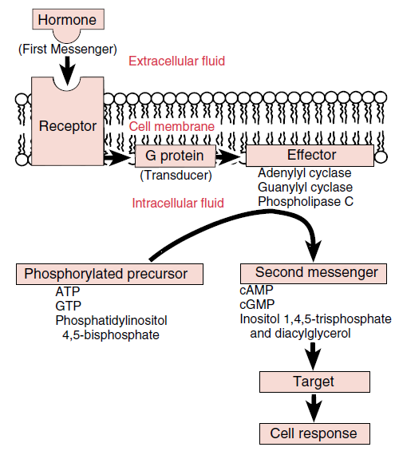
Second messenger systems

Slide 6
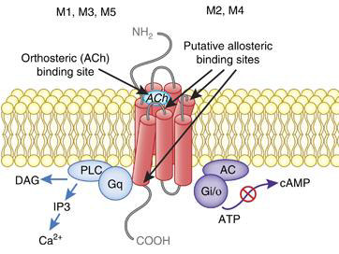
Autonomic nervous system
Postganglionic fibers
PNS
Muscarinic receptor
  G-protein coupled
  Excitatory receptors (M₁, M₃, M₅)
  Inhibitory receptors (M₂, M₄)

Slide 7
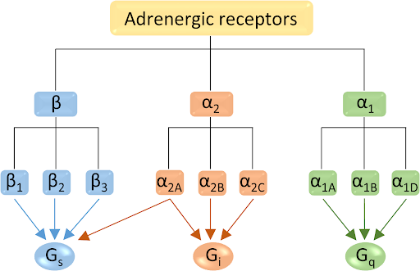
Autonomic nervous system
Postganglionic fibers
SNS
Adrenergic receptor
  G-protein coupled

Slide 8
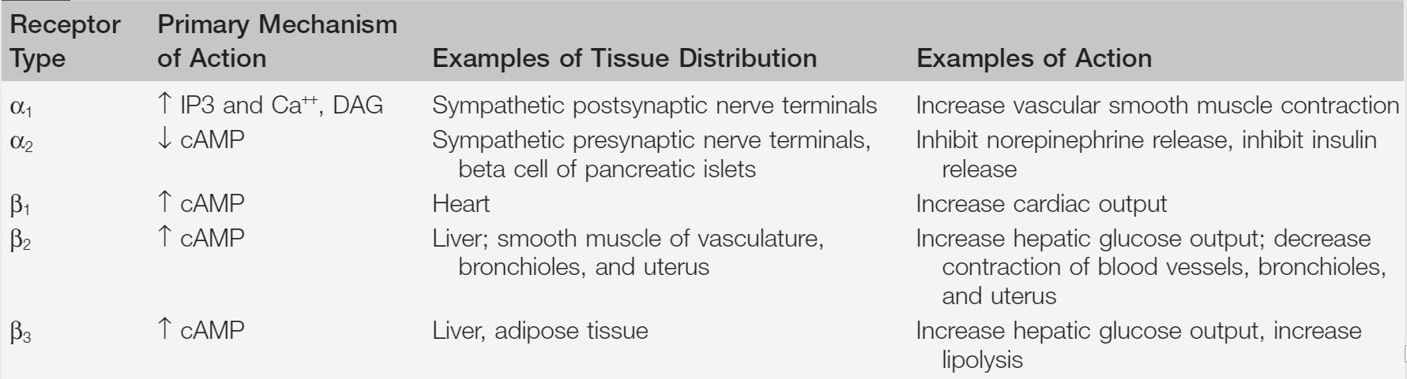
Autonomic nervous system
Adrenergic receptor
G-protein coupled
Type α –Excitatory receptors
Type β – Inhibitory receptors

Slide 9
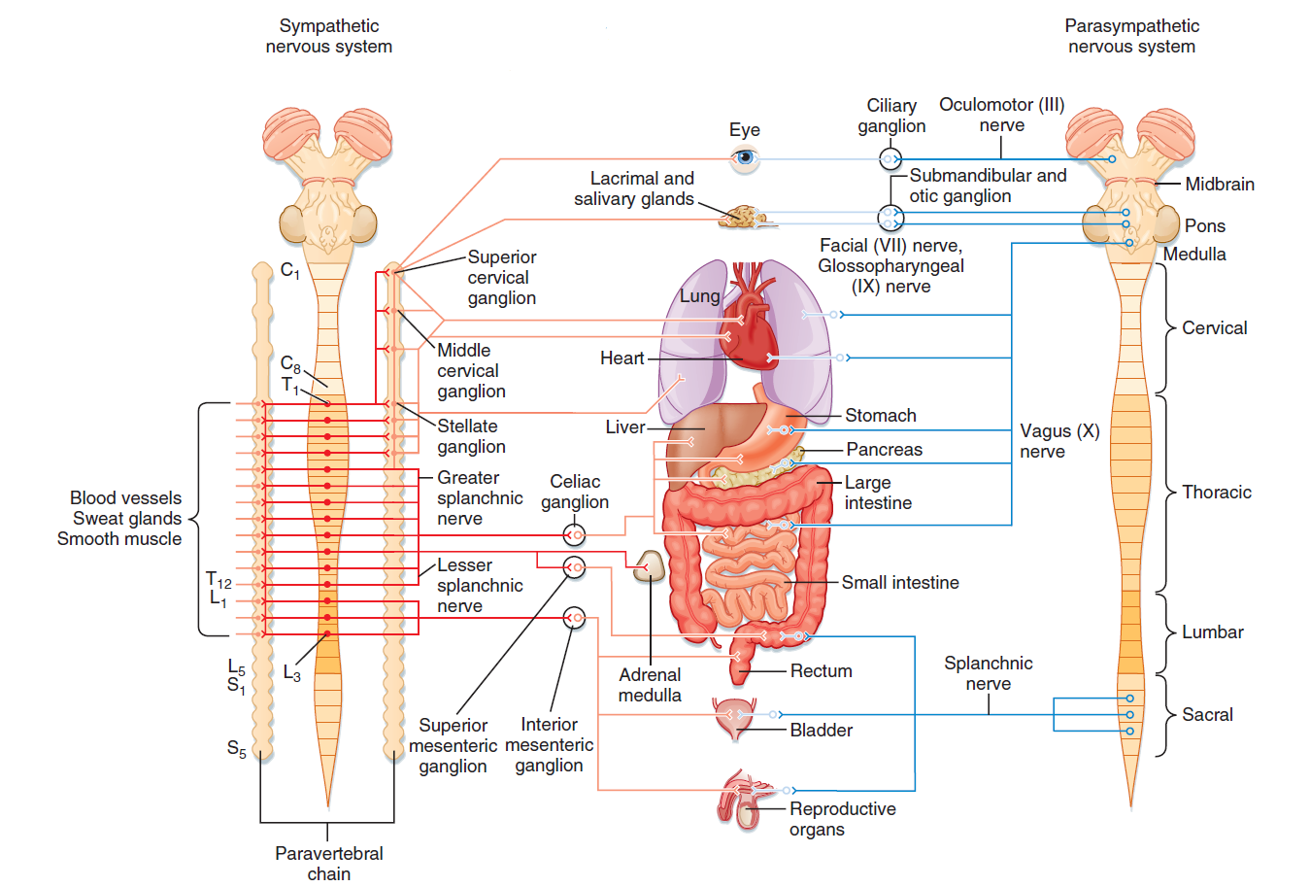
Autonomic nervous system
FIGHT OR FLIGHT
REST OR DIGEST

Slide 10
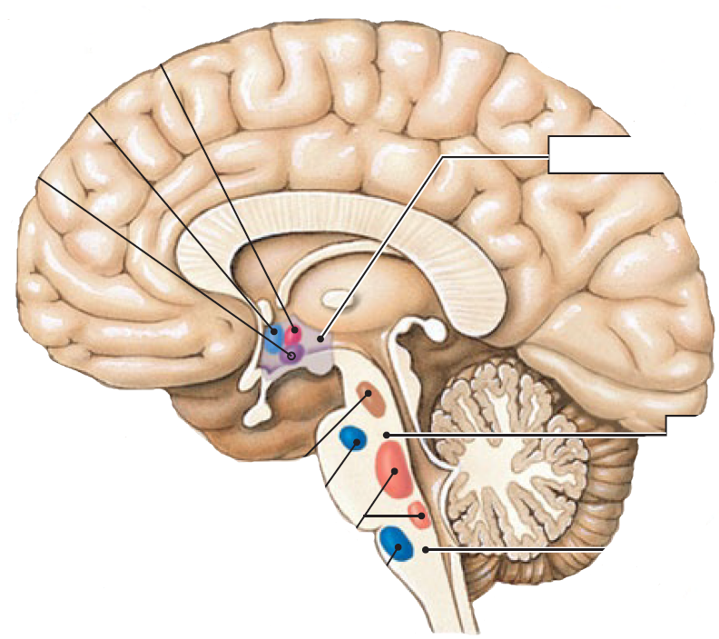
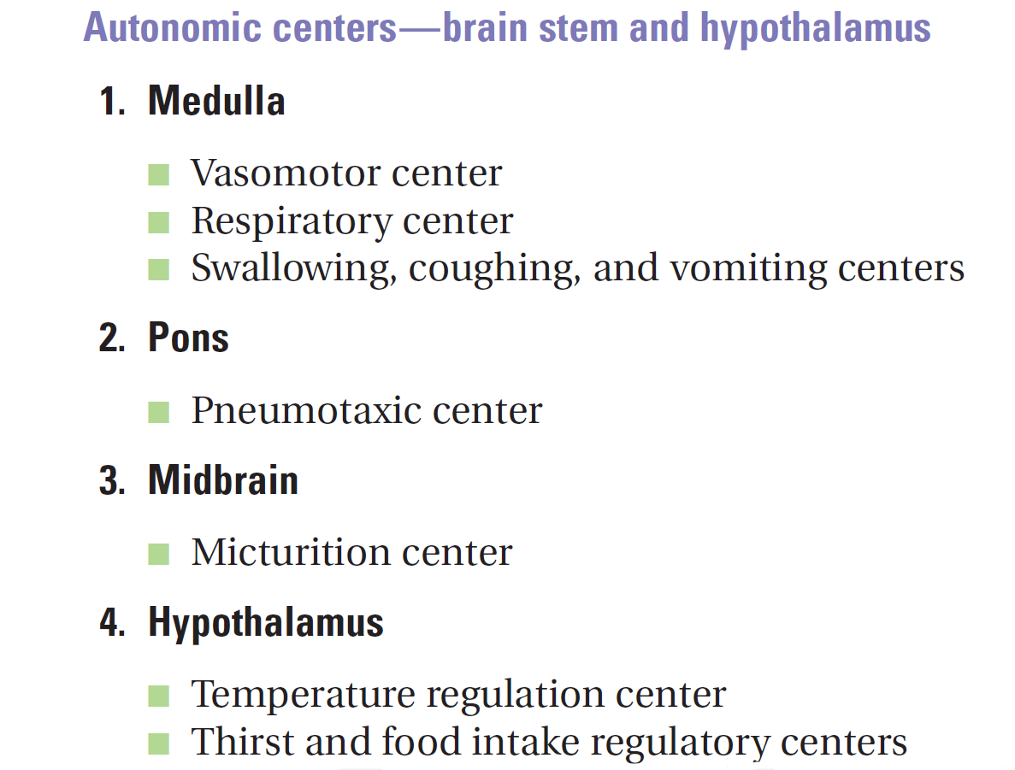

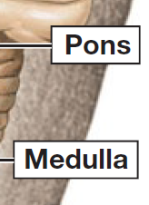
Brain control of ANS
Temperature control
Water balance
Eating
behavior
Urinary bladder
control
Secondary
respiratory center
Respiratory center
Blood pressure
control

Slide 11
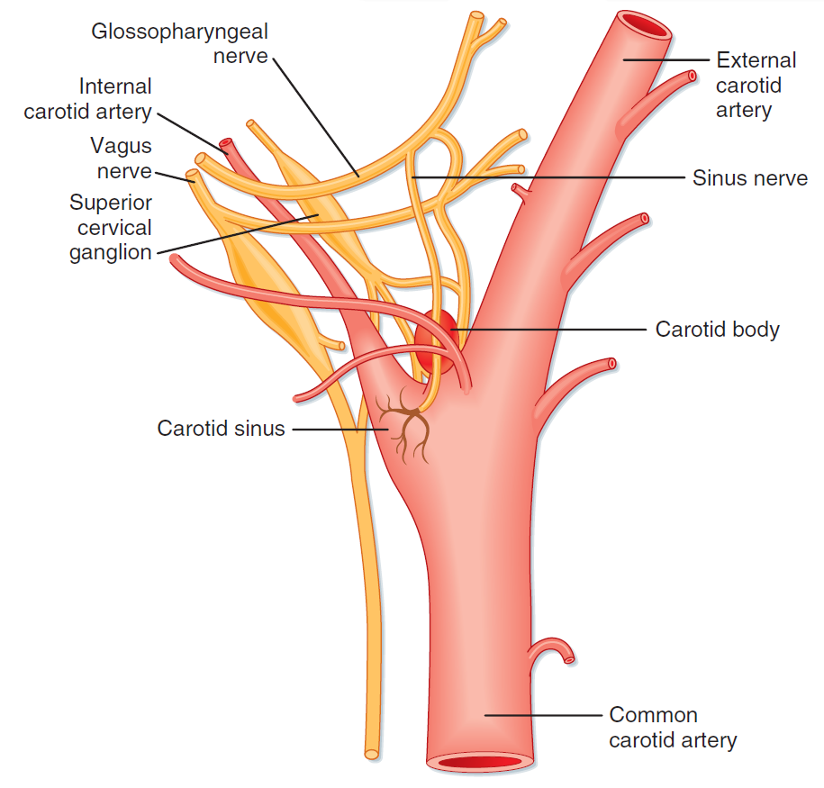
Baroreceptor vs. Chemoreceptor

Slide 12
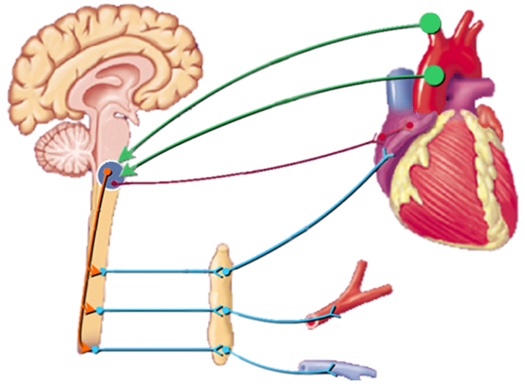
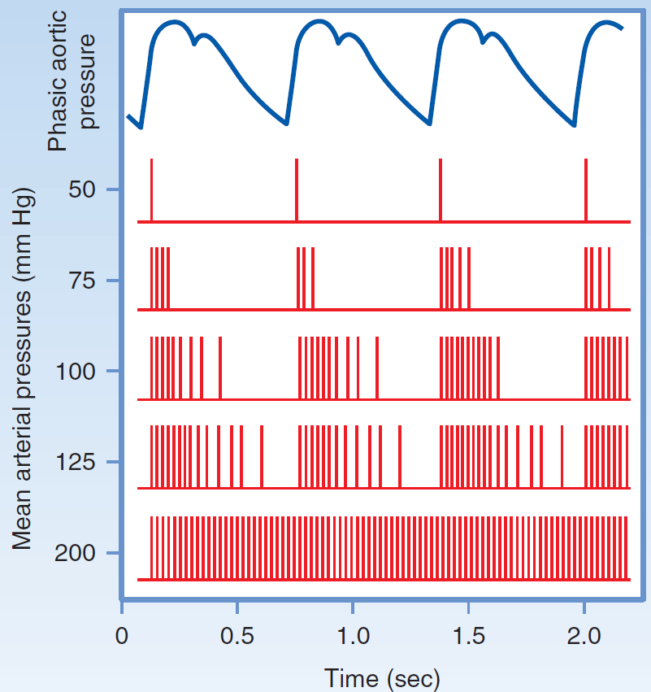
Baroreflex I
HR
Aferent pathway
Parasympathetic pathway
Sympathetic pathway
R
Inotropic
Chronotropic
Dromotropic
Batmotropic
effect
BP=HR x SV x R

Slide 13
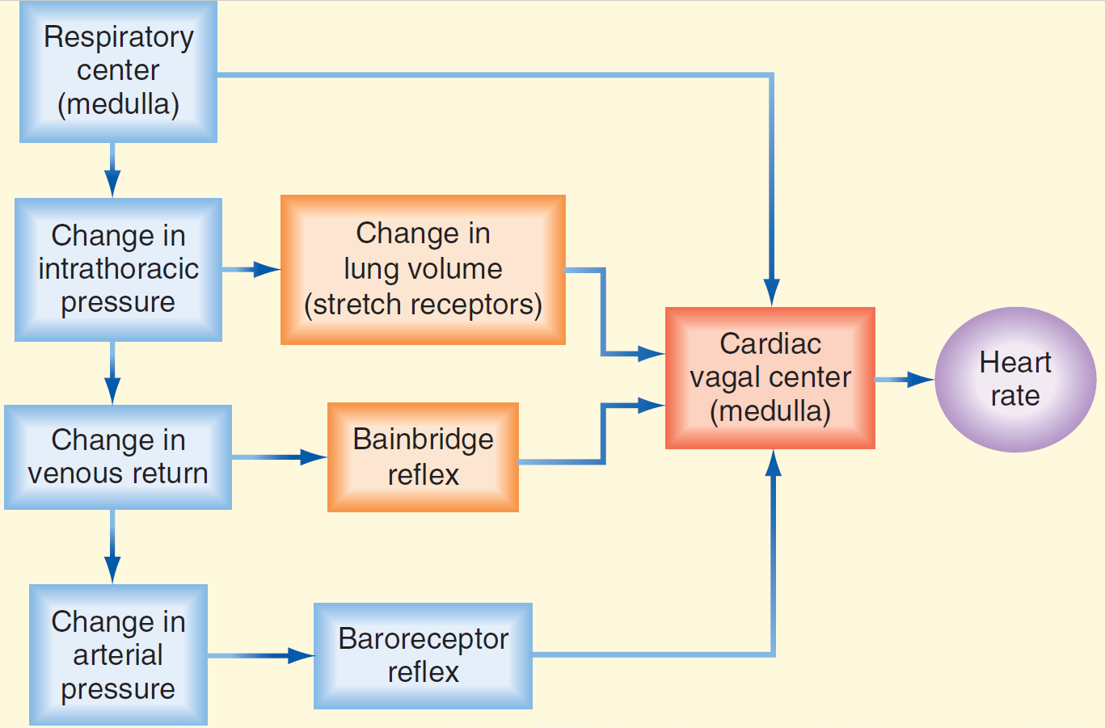
Sinus respiratory arrhythmia

Slide 14
Something more…
Oculocardial reflex
  Pressure on the eye bulbes decreases heart rate (activation of the vagus)
  It is used to suppress or stop tachycardia
Low pressure baroreflex
  greater expansion of the left ventricle stimulates baroreceptors –vagus→medulla - inhibition of SNS – vasodilation, bradycardia – decrease of BP
Diving reflex
  Cold water on the face causes respiratory arrest, peripheral vasoconstriction and bradycardia
Coronary chemoreflex (Bezoldov-Hirtov-Jarisch reflex)
  Substances applied to the left coronary artery (veratridine, capsaicin, some contrast agents, substances produced by ischemic tissue) induce apnea and then hyperpnea, hypotension, bradycardia (vagal afferentation)

Slide 15
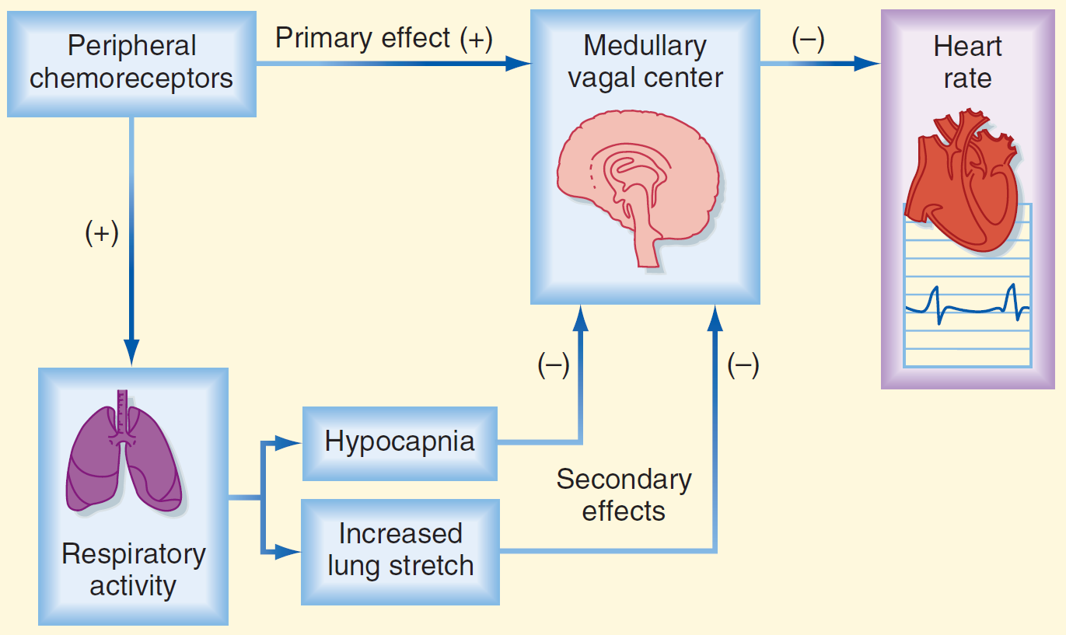
Chemoreflex

Slide 16
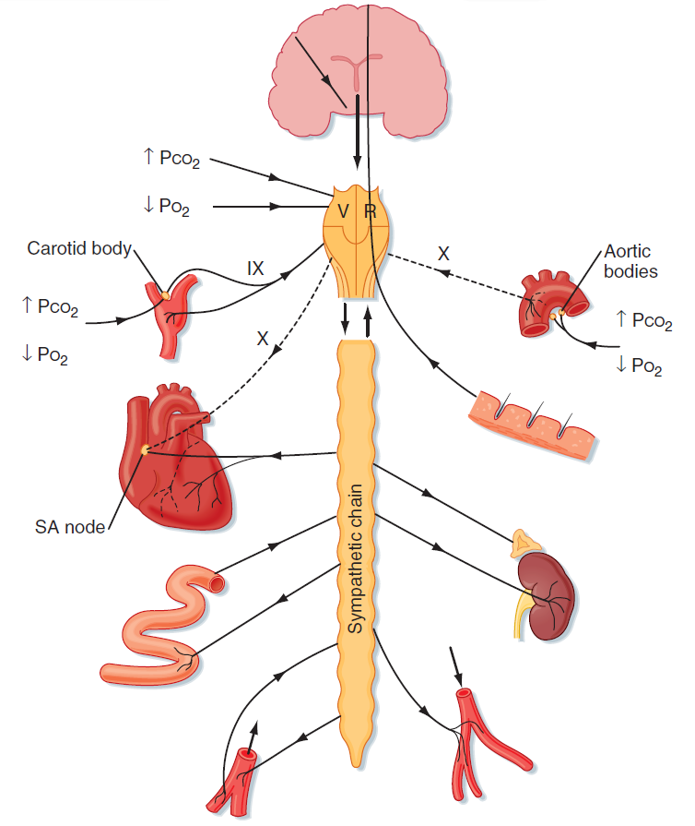
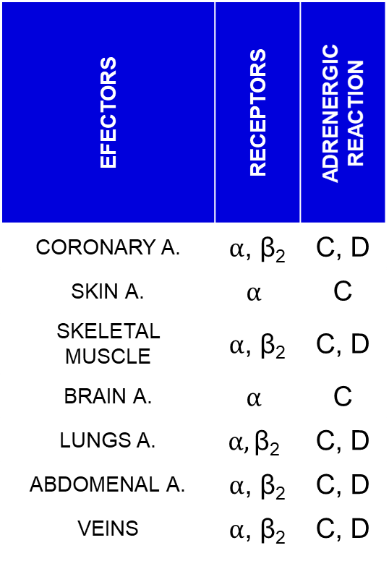
ANS and blood vessels
EFECTORS | RECEPTORS | ADRENERGIC REACTION
CORONARY A. | $α$, β₂ | C, D
SKIN A. | $$α$$ | C
SKELETAL MUSCLE | $α$, β₂ | C, D
BRAIN A. | $$α$$ | C
LUNGS A. | $$α,\text{β}\text{2}$$ | C, D
ABDOMENAL A. | $α$, β₂ | C, D
VEINS | $α$, β₂ | C, D

Slide 17
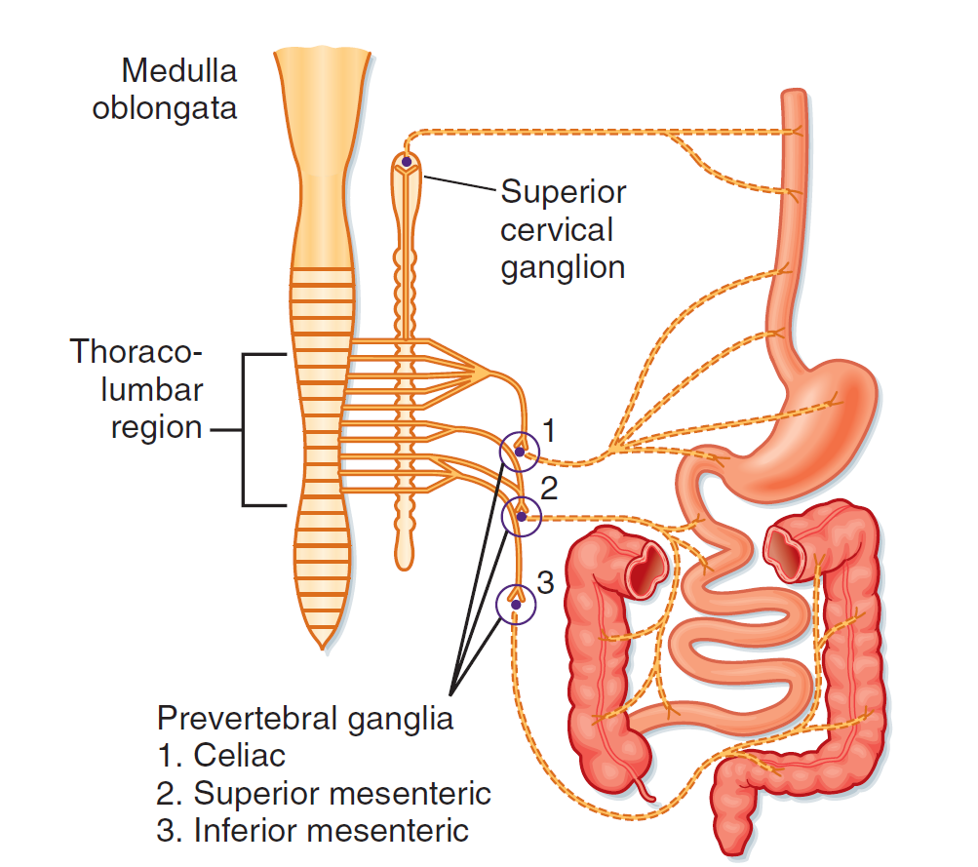
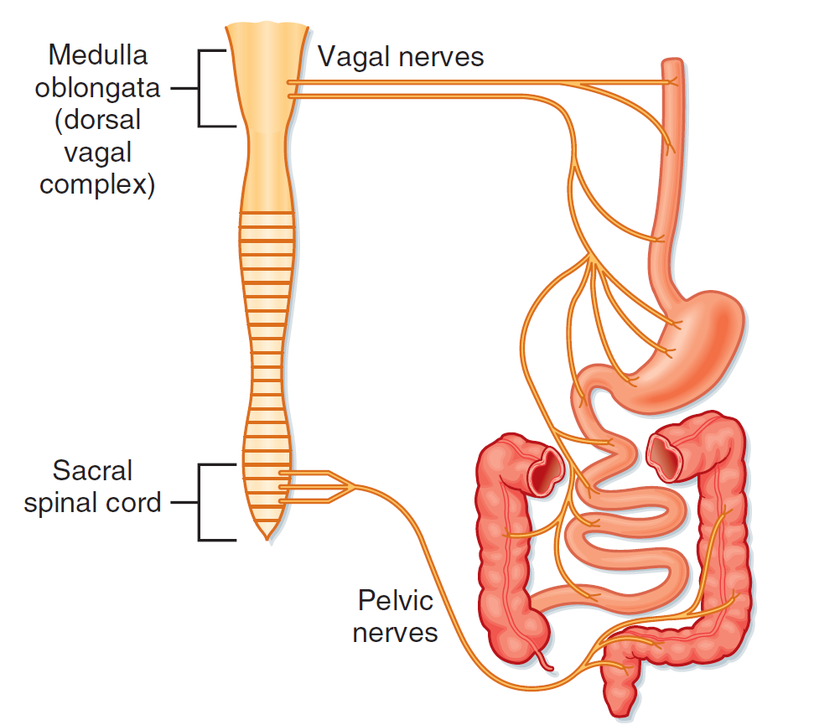
GIT and ANS
SNS
PNS

Slide 18
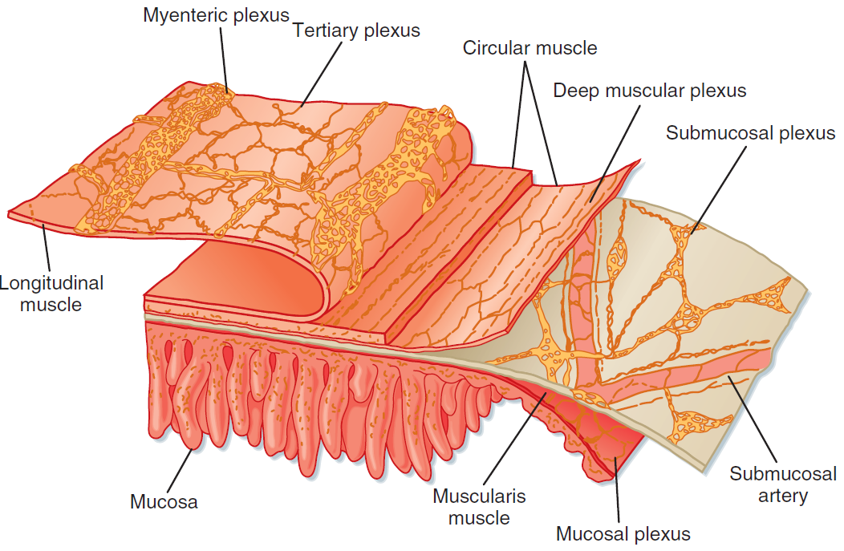
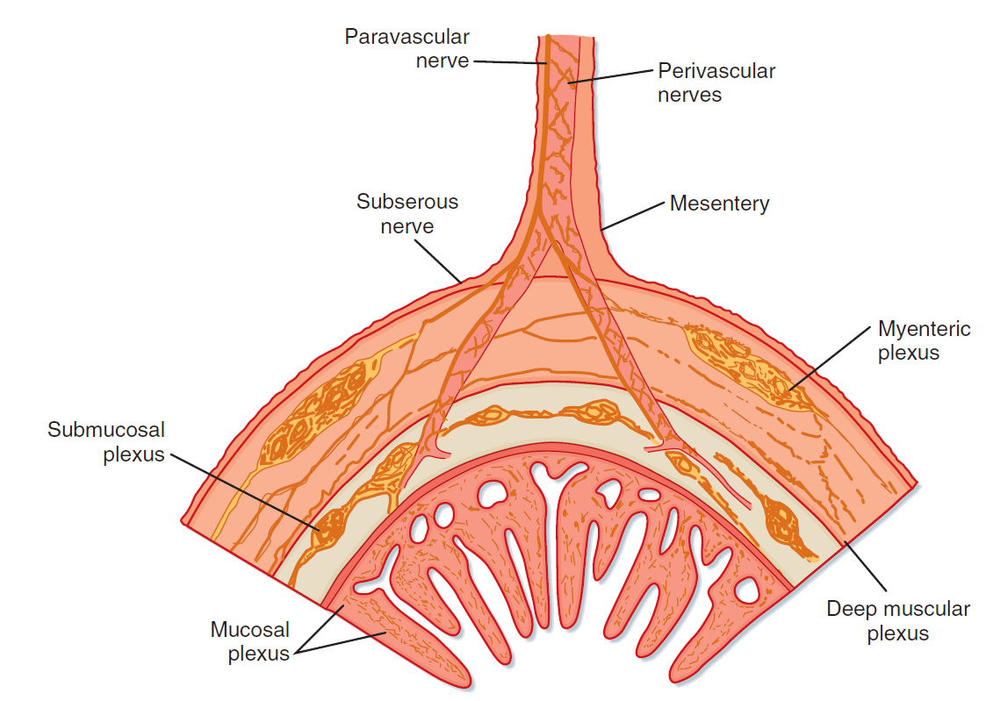
GIT - Enteric Nervous System

Slide 19
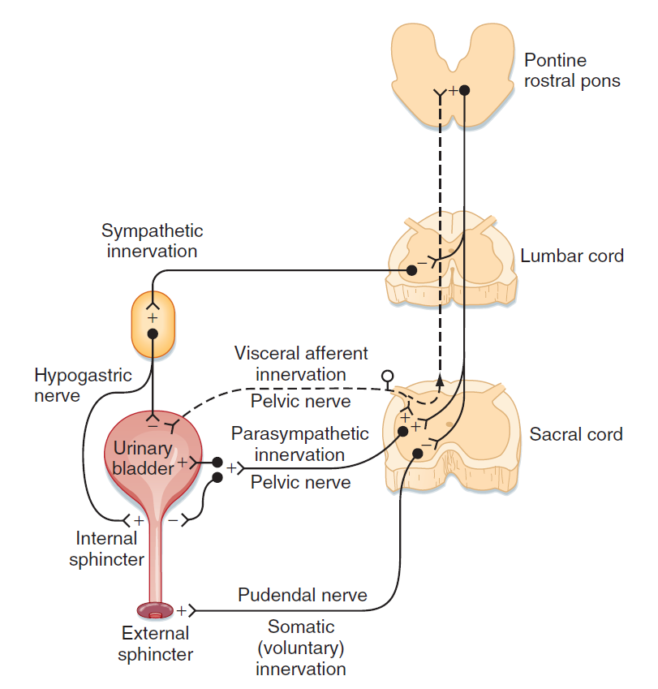
ANS and urinary bladder
SNS
DETRUSOR | RELAXATION
SPHINCTER | CONTRACTION
PSN
DETRUSOR | CONTRACTION
SPHINCTER | RELAXATION

Slide 20
Neurogenic bladder
NAME | COMMENTS
Uninhibited bladder | Lesion: above the pontine micturition center Signs: reduced awareness of bladder fullness, incontinence may occur
Upper motor neuron bladder (Detrusor-sphincter dyssynergia) | Lesion: between the pontine micturition center and sacral cord Signs: detrusor is usually spastic, simultaneous detrusor and urinary sphincter contractions increase pressures in the bladder, can lead to vesicoureteral reflux that and renal damage
Mixed type A bladder | Lesion: sacral cord lesion at the detrusor nucleus with sparring of the pudendal nucleus Signs: the detrusor muscle is flaccid, bladder is large, external urinary sphincter is spastic, incontinence uncommon
Mixed type B bladder | Lesion: sacral cord lesion at the pudendal nucleus with sparring of the detrusor nucleus Signs: the bladder is spastic and the external urinary sphincter is flaccid, incontinence is common
Lower motor neuron bladder | Lesion: sacral cord or sacral root while the thoracic sympathetic outflow to the lower urinary tract is preserved Signs: bladder is large and hypotonic, incontinence uncommon

Slide 21
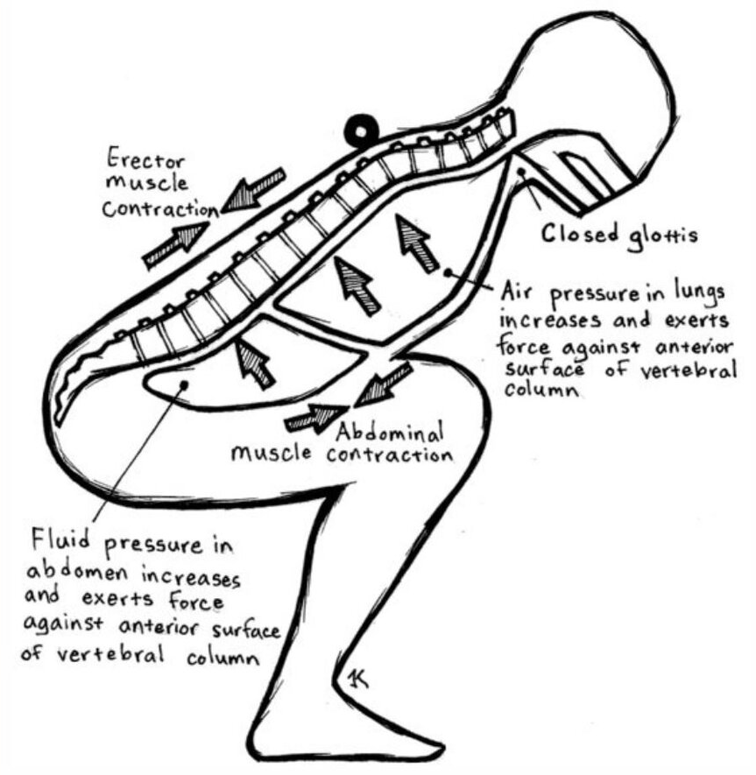
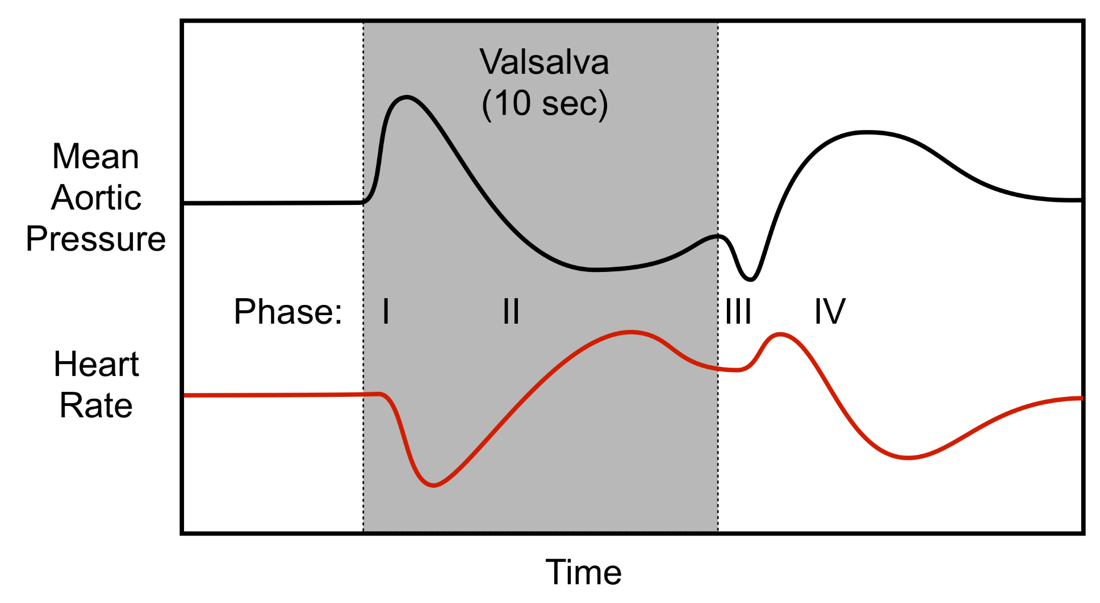
Valsalva maneuver

Slide 22
A 36-year-old female began to have problems at the age of 18 years after she developed a severe case of mononucleosis. She began to experience palpitations, sweating, irritable bowel syndrome, and was diagnosed with anxiety. Her symptoms continued throughout subsequent years, and she continued to feel light-headed upon standing as well as noticing excessive palpitations. She had a few syncopal events, but she generally has enough warning to sit down and protect herself.
She cannot exercise much because of her very poor stamina. She has no other autonomic symptoms except for the irritable bowel, which is diarrhea predominant. She has a history of migraines, which have been fairly well controlled. She reports her sleep quality is quite good, but still she is exhausted at the end of the working day and oftentimes needs a nap before dinner.
The examination was normal.
Hematologic, endocrine, routine chemistry, and neuroimmunology panel were normal except for lower vitamin D levels. Plasma catecholamines were normal as were the 24-hour urinary sodium output and urine volume.
The echocardiogram was normal.
Autonomic reflex screen: marked tachycardia on tilt, but was otherwise normal.
Exercise study: normal hemodynamic profile but profound deconditionin

Slide 23
Thank you for your attention

