Slide 1



Emerging Coronavirus
Diseases
MUDr. Roman Stebel, Ph.D.
Klinika infekčních chorob LF MU a FN Brno

Slide 2
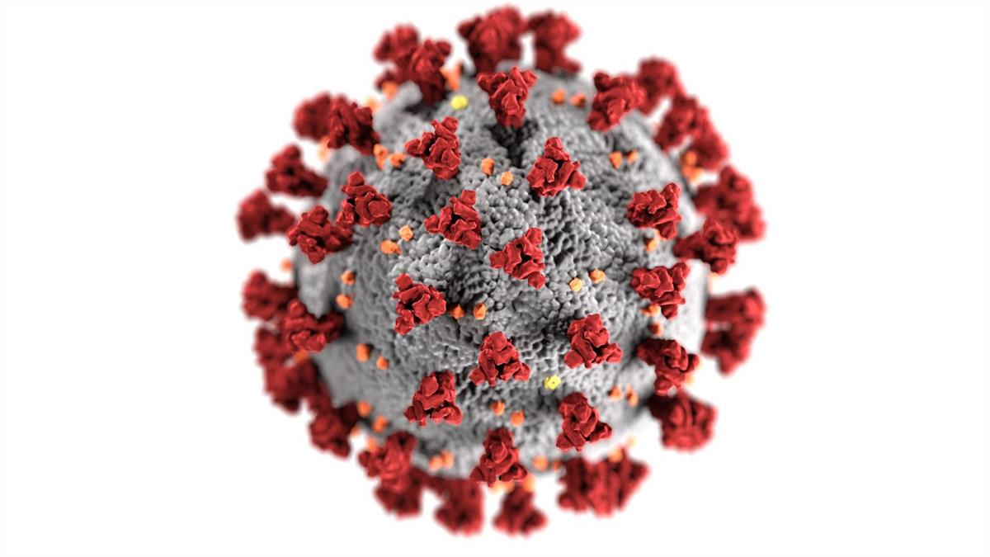
Principal points of the presentation
Coronavirus family generally
Severe Acute Respiratory Syndrome (SARS-CoV-1)
Middle East Respiratory Syndrome (MERS-CoV)
COVID-19 (SARS-CoV-2)
  etiopathogenesis
  clinical manifestations
  diagnostics
  treatment options
  prevention and control

Slide 3
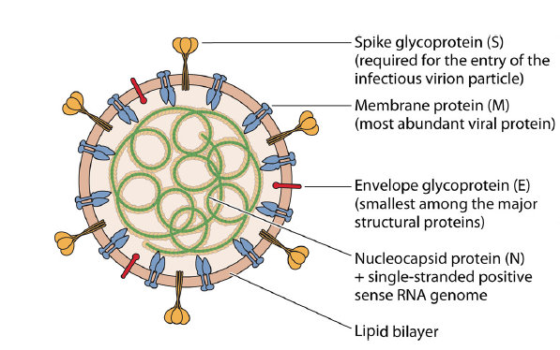
Coronaviridae
→ family of enveloped, single-strand, nonsegmented RNA viruses
→ circulate among mammals and birds, animal coronaviruses can rarely spread to humans and subsequently spread between people
2 humans serogroups (229E and OC43)
→ cause usually mild to moderate respiratory illnesses (1/3 of „common colds“)
→ able to survive in dry air for up to 3 hours, killed by exposure to UV light
→ mutate easily, each mutation triggers off an epidemic of respiratory disease
→ bats are considered as natural hosts of these viruses
Virus structure
Envelope (lipid bilayer), S – spike protein,
M – membrane protein, E – envelope protein,
N – nucleocapsid with RNA
→ “coronavirus” refers to the protein molecules
surrounding the virus, making it look like
a crown (lat. „corona“)

Slide 4
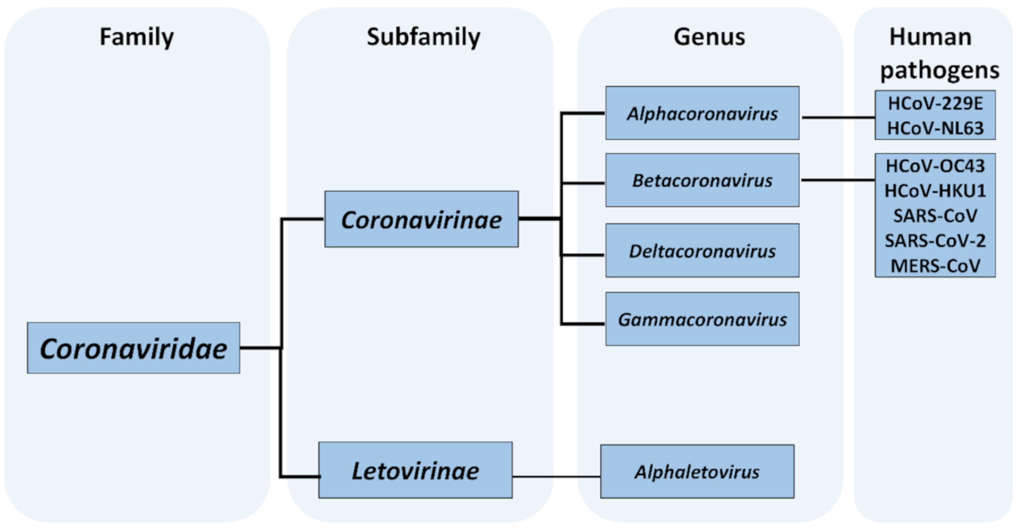
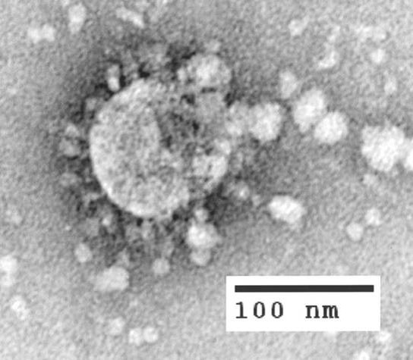
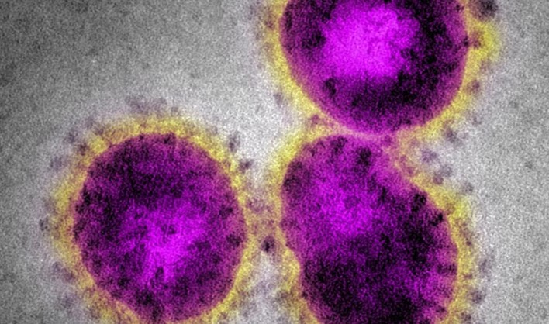
Classification and Taxonomy of CoV

Slide 5
Severe Acute Respiratory Syndrome
→ respiratory disease caused by SARS-associated coronavirus (SARSr-CoV or SARS-CoV-1)
→ first identified at the end of February 2003 during an outbreak in China and spread (2003 – 2004) to 4 other countries (Hong Kong, Taiwan, Canada, Singapore)
→ first severe and readily transmissible new infection to emerge in the 21st century and showed a clear capacity to spread along the routes of international air travel
→ characteristic clinical symptoms include fever above 38 °C, muscle pain, lethargy, cough, sore throat, complications were direct viral or secondary bacterial pneumonia
→ in June 2003, the incidence was 8 422 cases with a case fatality rate of 11 %
→ measurement of body temperature at international airports, often using thermal imagers and subsequent targeted testing, was considered a key factor in stopping the spread of SARS-CoV-1
→ chinese scientists traced the virus through the intermediary of Asian palm civets to cave-dwelling bats in Yunnan (province in the southwest China)

Slide 6
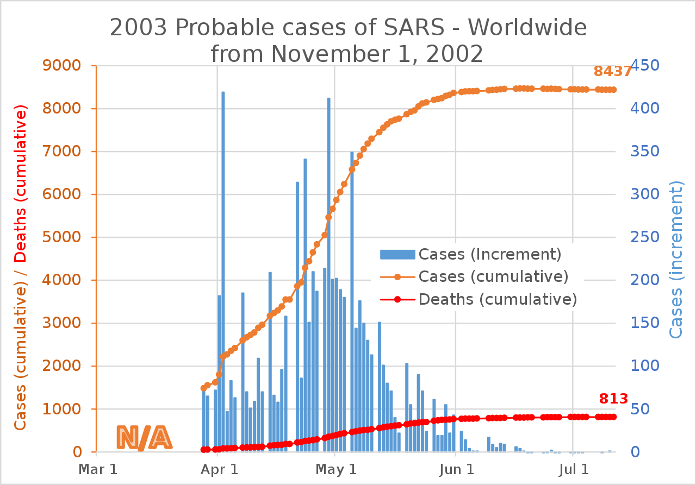
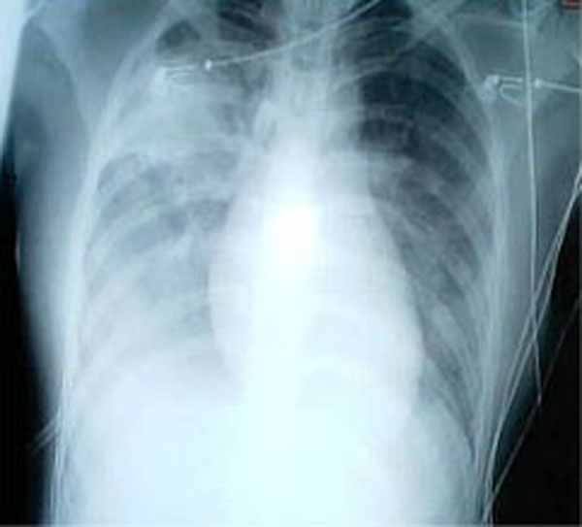
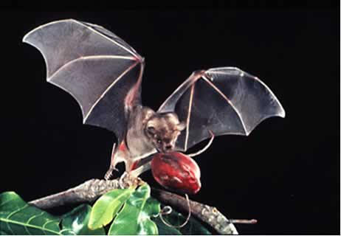
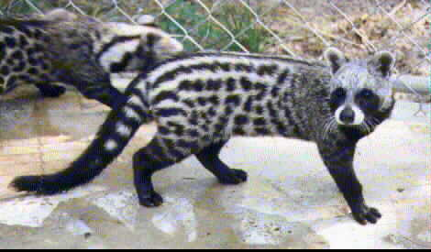
Severe Acute Respiratory Syndrome

Slide 7
Middle East Respiratory Syndrome
→ viral respiratory infection caused by the MERS-coronavirus (MERS-CoV)
→ first identified case occurred in June 2012 in Jeddah, Saudi Arabia, generally most cases have occurred in the Arabian Peninsula
→ next outbreaks have occurred in South Korea (2015) and also in Saudi Arabia (2018)
→ most MERS patients developed severe respiratory illness with symptoms of fever, cough and shortness of breath, severe complications followed, such as pneumonia and kidney failure, 72% of patients required arteficial ventilation, 35 % of patients with MERS have died (ARDS + renal failure)
→ relatively high lethality and targeted anti-epidemic measures taken in the Middle East have prevented the global spread of infection, but we will certainly encounter local outbreaks of MERS in the future as well
→ MERS-CoV may have originated in bats later transmitted via dromedaries (Arabian camels) to human

Slide 8
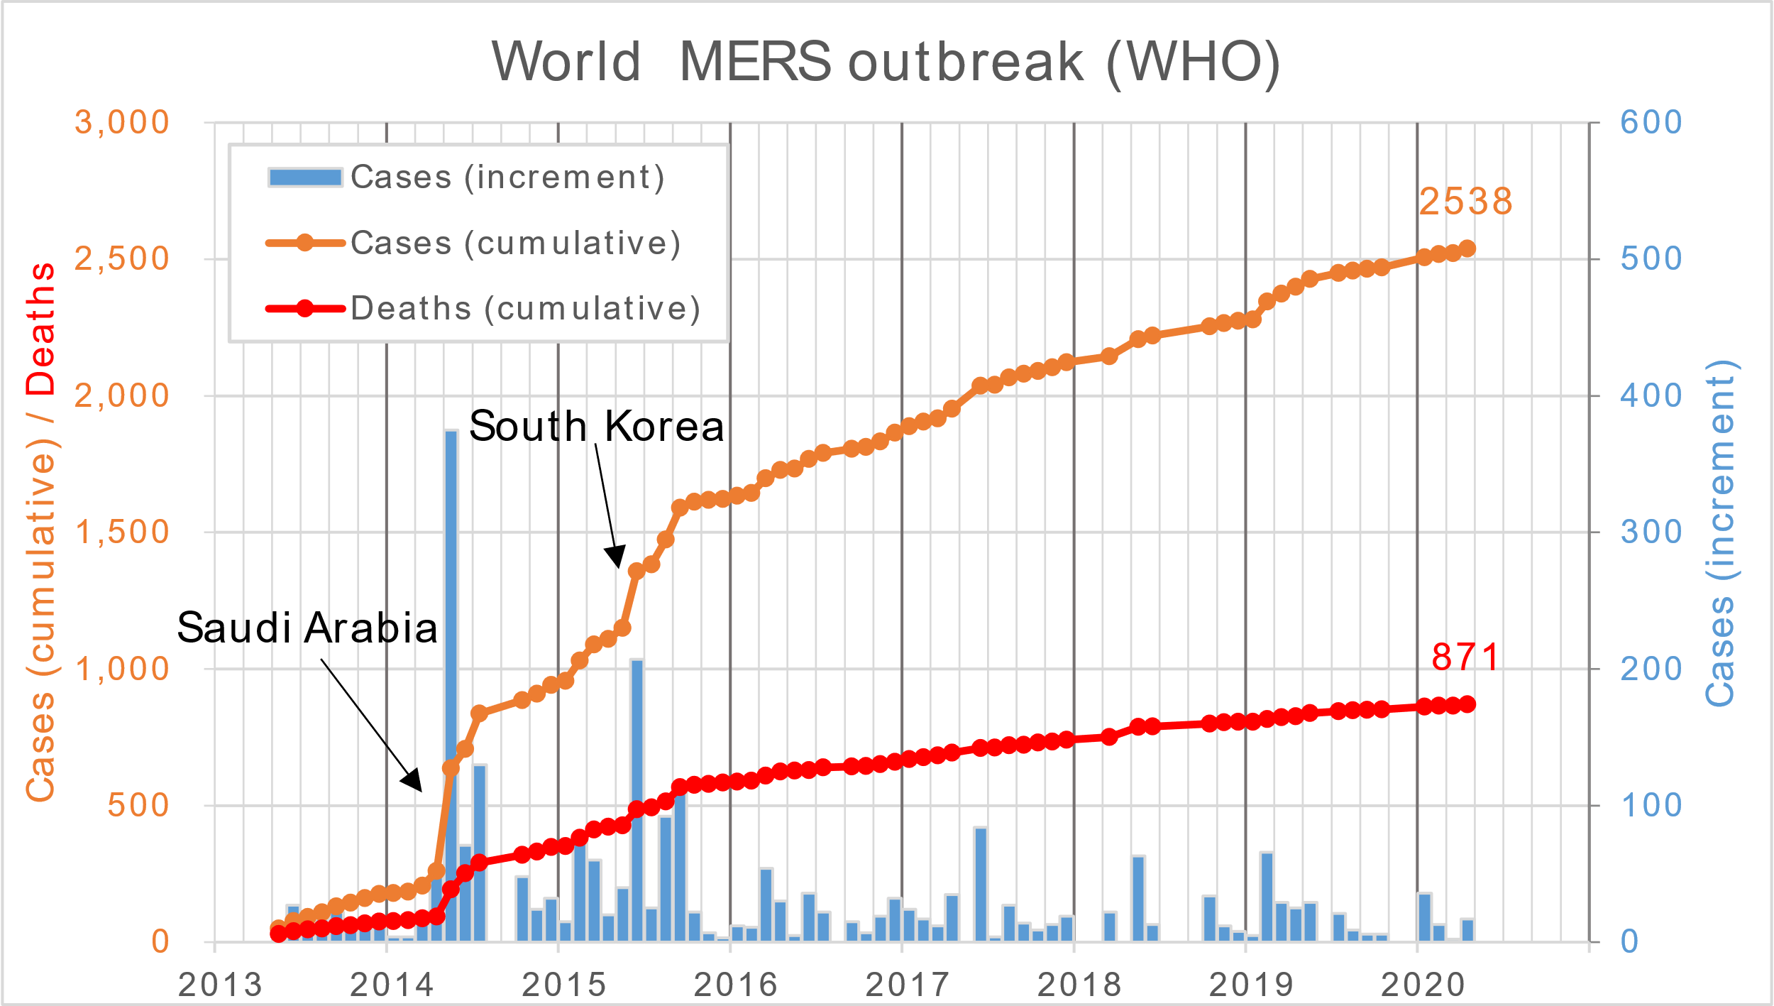

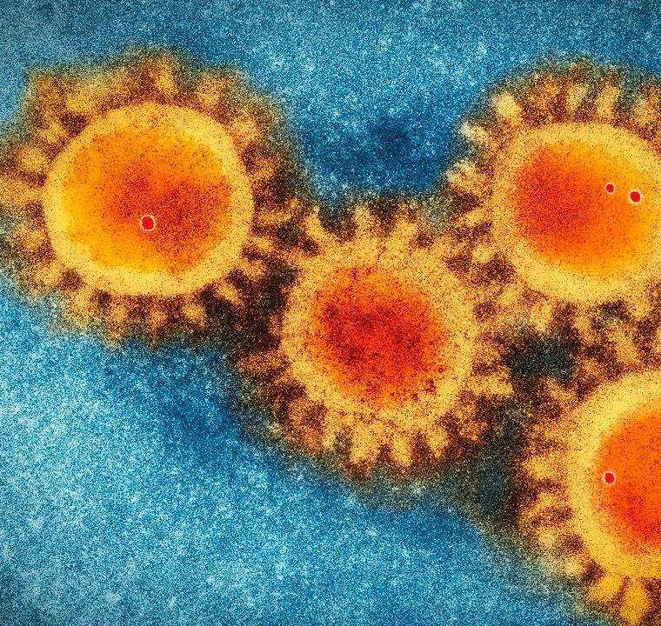
Middle East Respiratory Syndrome

Slide 9
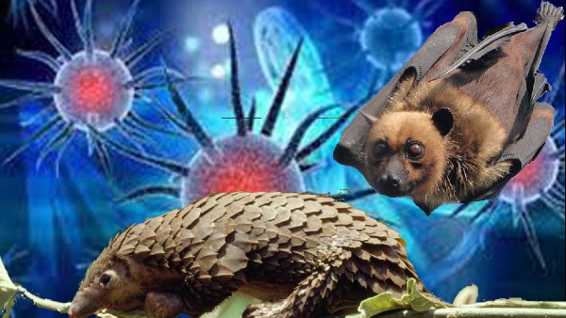
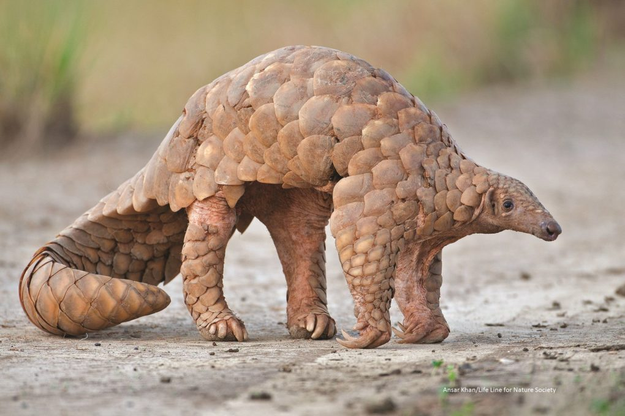
COVID-19 - Introduction
→ at the end of 2019, a novel coronavirus (2019-nCoV) was identified as the cause of a cluster of pneumonia cases in Wuhan, a city in the Hubei, province of China
→ not previously identified virus in humans, natural host suspected to be bats, as intermediate hosts were considered Pangolins, first cases in China linked with an animal market
→ novel coronavirus rapidly spread, resulting in an epidemic throughout China, followed by a global pandemic (WHO declared a global pandemic on March 11, 2020)
→ in February 2020 WHO designated the disease COVID-19, the virus that causes COVID-19 is designated severe acute respiratory syndrome coronavirus 2 (SARS-CoV-2)

Slide 10
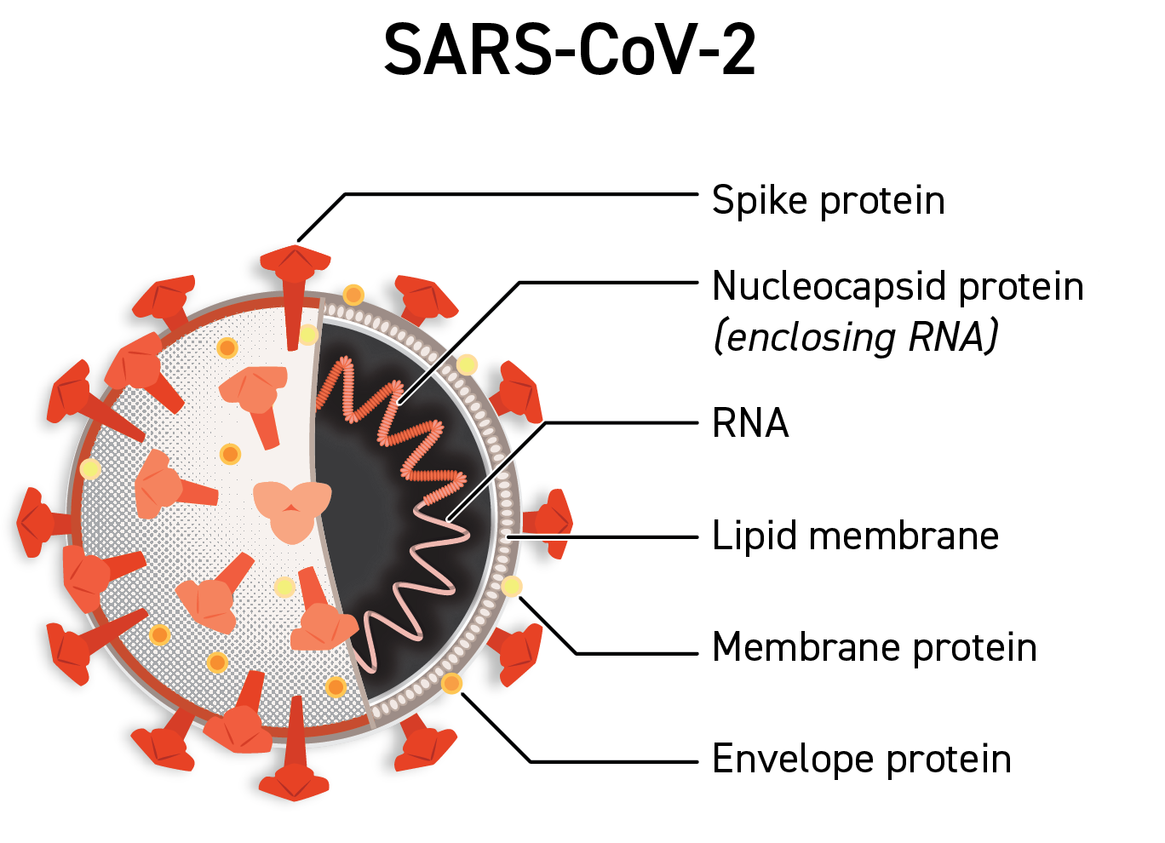
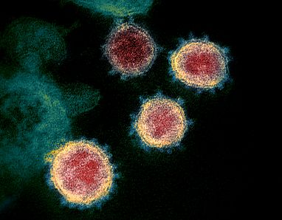
COVID-19 - Virology
→ SARS-CoV-2 is a betacoronavirus in the same subgenus (Sarbecovirus) as the severe acute respiratory syndrome (SARS) virus (as well as several bat coronaviruses)
→ the host receptor for SARS-CoV-2 cell entry is the same as for SARS-CoV-1, the angiotensin-converting enzyme 2 (ACE2)
→ the structural proteins of SARS-CoV-2 include membrane glycoprotein (M), envelope protein (E), nucleocapsid protein (N), and the spike protein (S), the M protein of SARS-CoV-2 is 98,6% similar to the M protein of bat coronavirus, maintains 98,2% homology with pangolins coronavirus, and has 90% homology with the M protein of SARS-CoV-1; whereas, the similarity is only 38% with the M protein of MERS-CoV

Slide 11
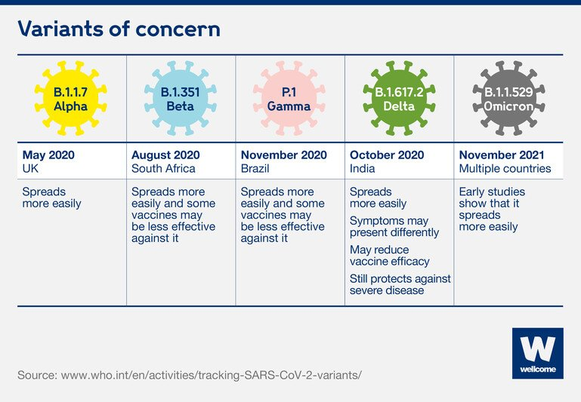
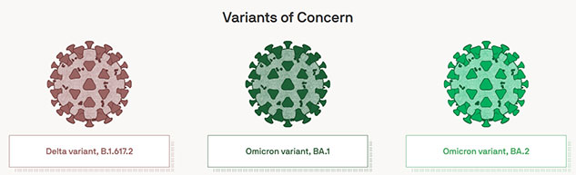
COVID-19 - Virology

Slide 12
COVID-19 - Pathophysiology
→ SARS-CoV-2 binds to ACE2 through the receptor-binding gene region of its spike protein, density of ACE2 receptors in each tissue correlates with the severity of the inflammation and tissue demage
→ virus can affect the upper respiratory tract (sinuses, nose, throat) and the lower respiratory tract (windpipe and lungs), lungs are the organs most affected (ACE2 receptors are most abundant in type II alveolar cells)
→ SARS-CoV-2 also affects gastrointestinal organs (ACE2 is abundantly expressed in the glandular cells of gastric, duodenal and rectal epithelium)
→ virus can cause acute myocardial injury (perimyocarditis in 12% of infected people admitted to the hospital in Wuhan), ACE2 receptors are highly expressed in the heart and in vascular endothelium
→ blood vessel dysfunction and clot formation (high D-dimer levels) are thought to play a significant role in mortality, incidences of clots leading to pulmonary embolisms, and ischaemic events within the brain have been noted as complications leading to death

Slide 13
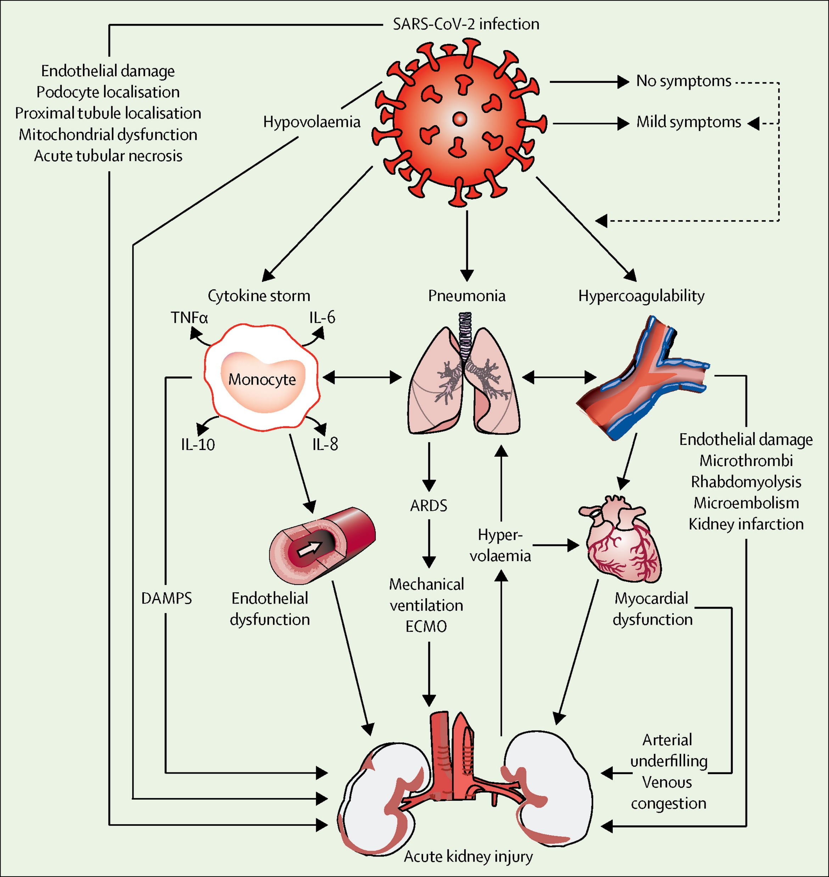
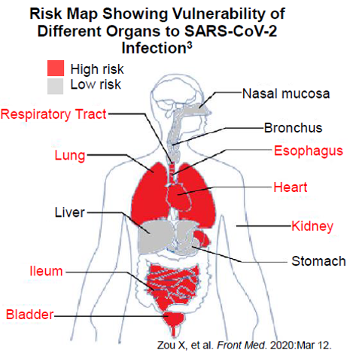
COVID-19 - Pathophysiology

Slide 14
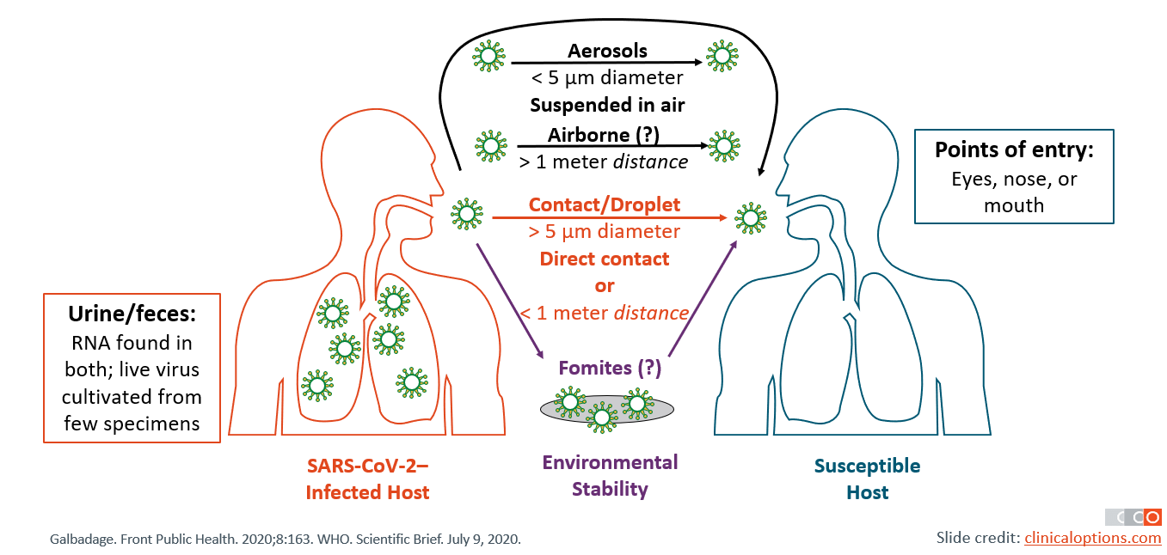
COVID-19 - Routes of Transmission

Slide 15
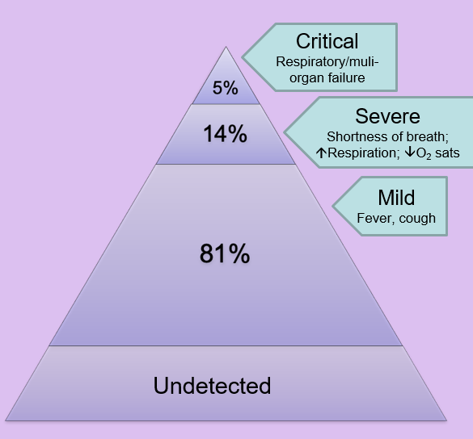
COVID-19 – Clinical Manifestations
→ symptoms of COVID-19 are variable, ranging from mild „flu-like“ symptoms to severe life-threatening illness with acute respiratory failure or MODS/MOF
The typical symptoms are:
→ Fever or Subfebrile > 37.3 °C (83-99%)
→ Dry cough (59-82%)
→ Fatigue, collapse states (44-70%)
→ Anorexia (40-84%)
→ Shortness of breath, dyspnoea (31-40%)
→ Digestive symptoms (diarrhea) can be in up to 50%
→ Runny nose, sore throat, loss of smell and taste
Symptoms last 5 - 6 days
Severe illness (complications) starts usually after day 5-8:
→ Intersticial bilateral pneumonia
→ Acute hypoxemic respiratory failure
→ Perimyocarditis, acute heart failure
→ Pulmonary embolism („in situ“)
→ Kidney failure, disseminated intravascular coagulation, secondary bacterial infection...

Slide 16
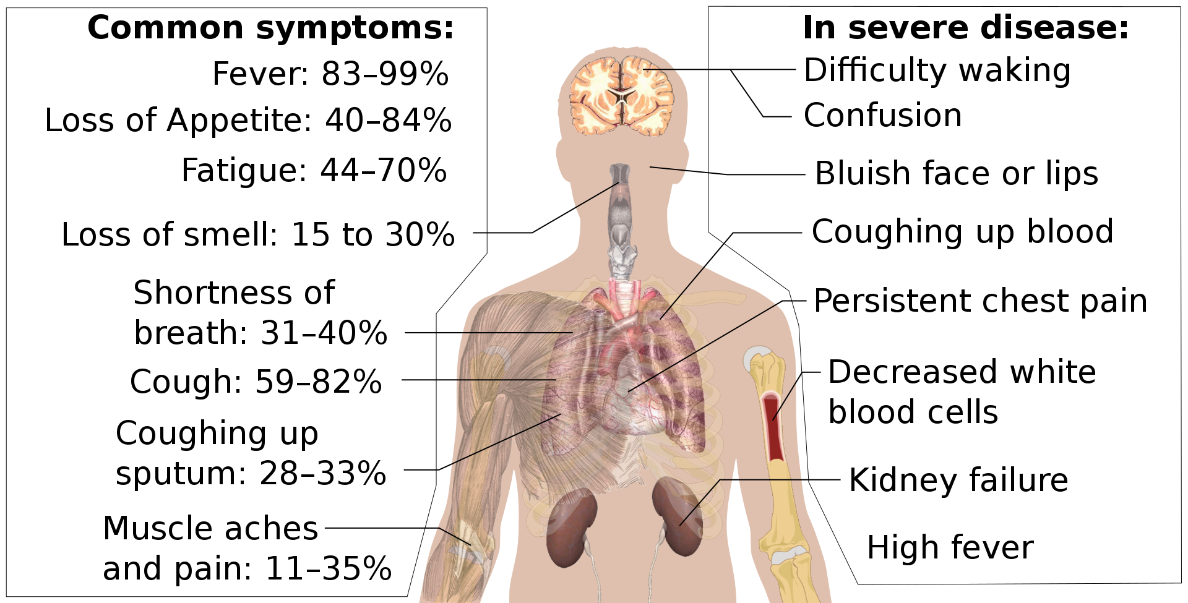
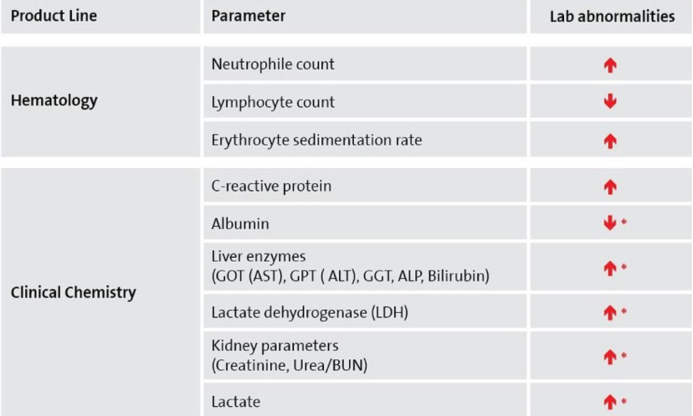
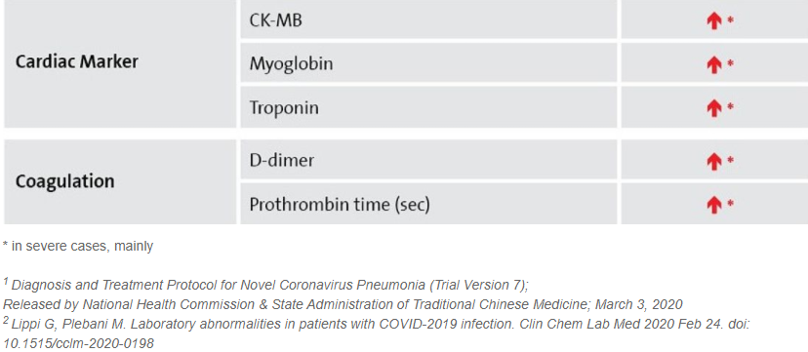
COVID-19 – Clinical Manifestations

Slide 17
COVID-19 – Risk Factors
Risk factors for more severe illness:
→ Age 65 and older
→ People who reside in nursing homes or long-term care facilities
People of all ages with underlying medical conditions:
→ Chronic lung disease (asthma bronchiale, COPD)
→ Serious heart conditions
→ Immunocompromise and onkological patiens
→ Severe obesity (BMI > 35)
→ Diabetes mellitus
→ Severe kidney disease
→ Chronic liver disease
Outcomes of COVID-19 patients in USA:
Adults > 65 represented:
→ 31% of COVID-19 cases
→ 45% of hospitalizations
→ 53% of ICU admissions
→ 80% of deaths

Slide 18
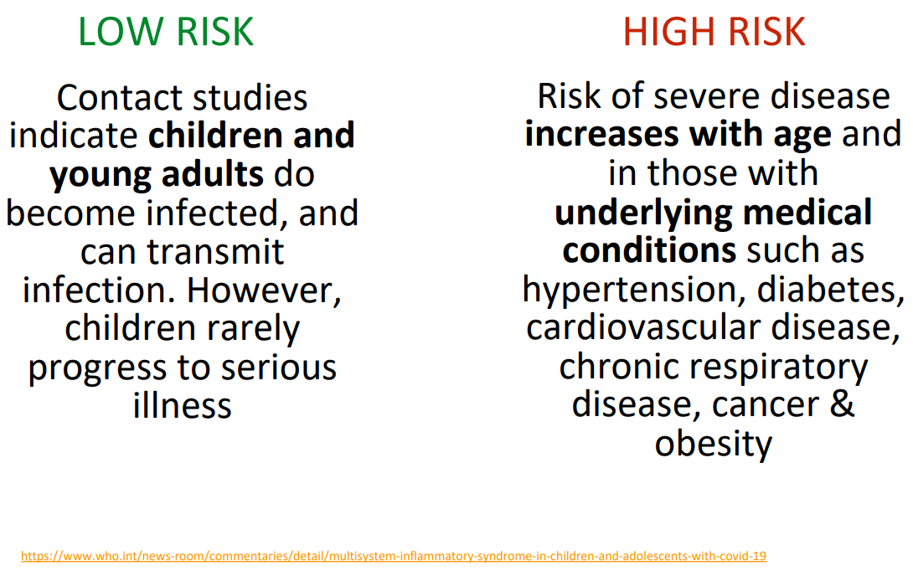
COVID-19 – Risk Groups

Slide 19
COVID-19 – Diagnostics
→ COVID-19 can be diagnosed on the basis of typical clinical symptoms (fever, dry cough, shortness of breath, diarrea, loss of smell and taste) and confirmed using polymerase chain reaction (RT-PCR) with the detection of viral in RNA in collected biological
→ test is typically done on respiratory samples obtained by a nasopharyngeal swab, however, a nasal swab, saliva or sputum sample may also be used
→ serologic tests detect antibodies (IgG, IgM, IgA) to SARS-CoV-2 in the blood and can help identify patients who previously had COVID-19 as well as patients with current infection who have had symptoms for three to four weeks
→ antigen detection tests detect viral antigens (nucleocapsid or spike protein), their advantage is speed and low price (can be performed at the point of care), the disadvantage is lower sensitivity
→ negative antigen test result (in a symptomatic patient) should be always confirmed by PCR test

Slide 20
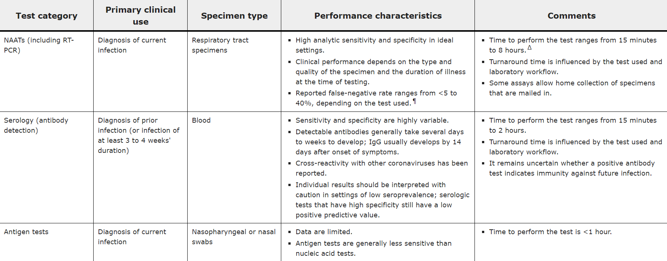
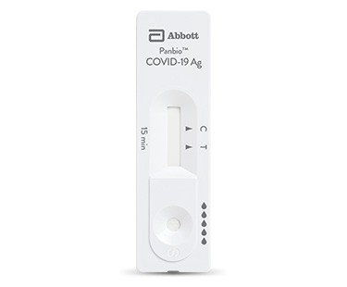
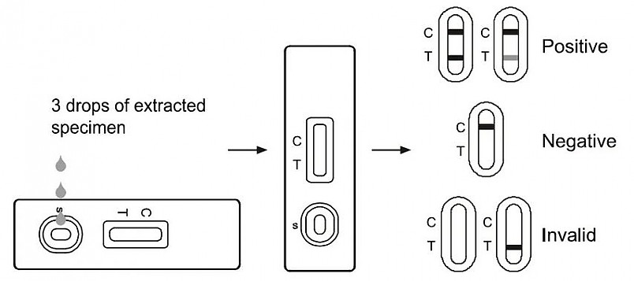
COVID-19 – Diagnostics

Slide 21
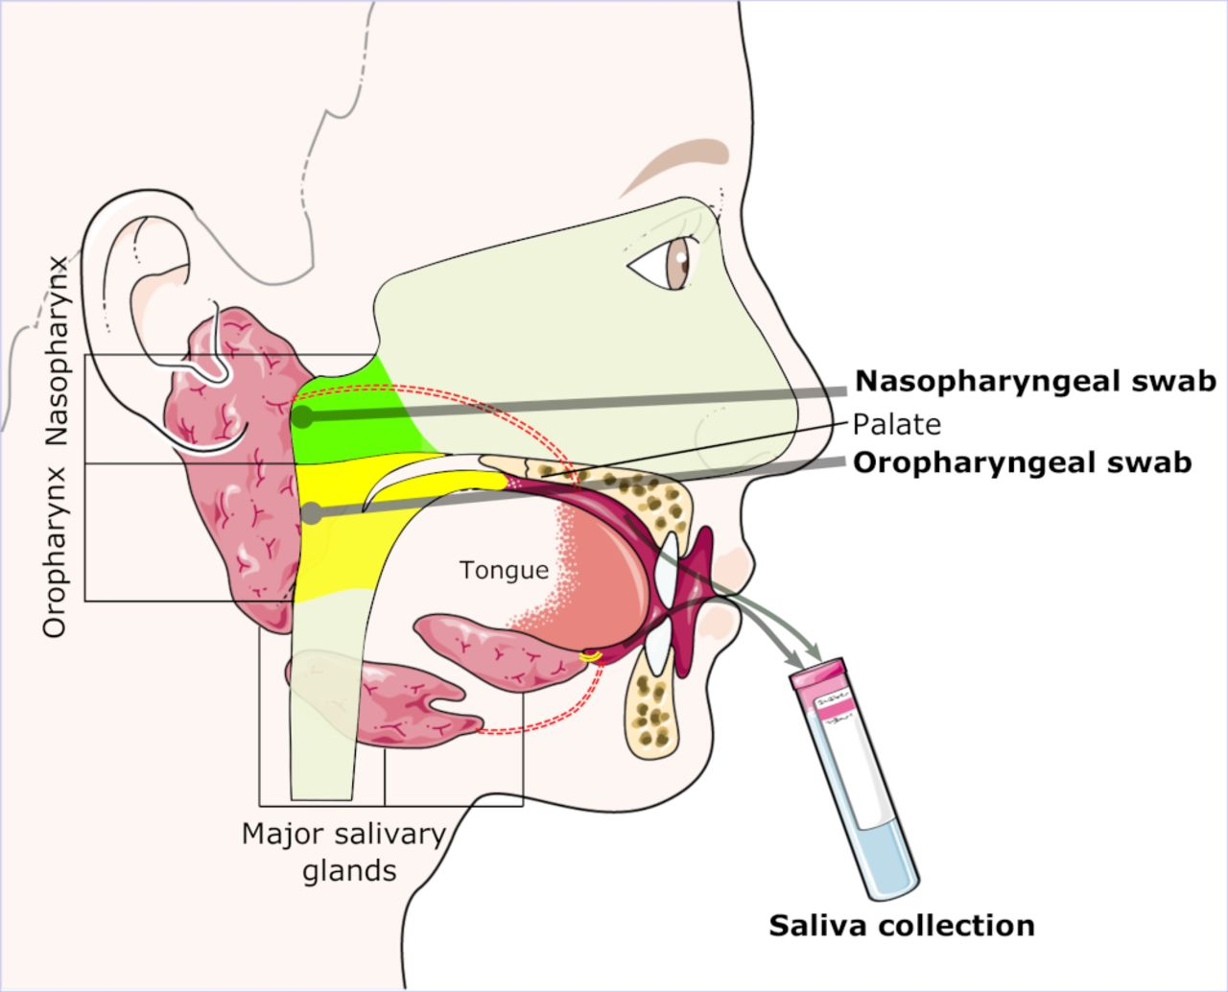
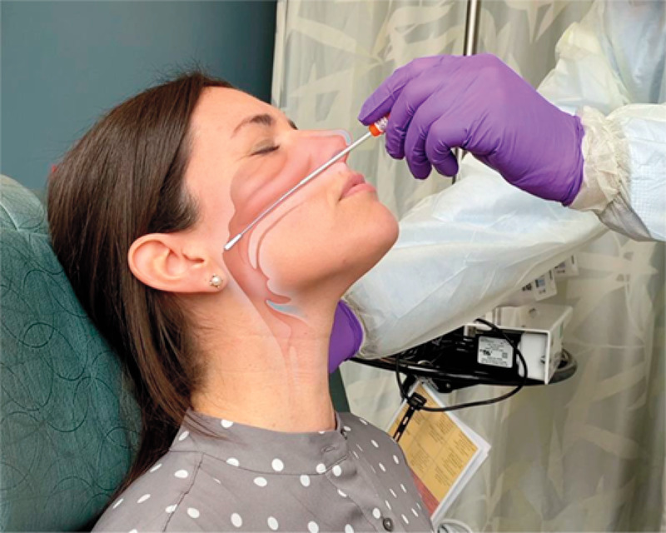
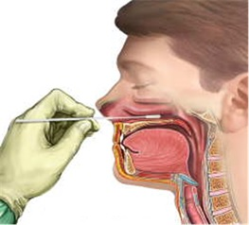
COVID-19 – Diagnostics
Is crucial to know how to collect the sample (nasophyryngeal swab) properly!

Slide 22
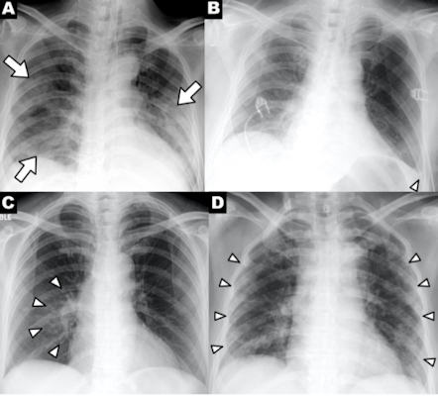
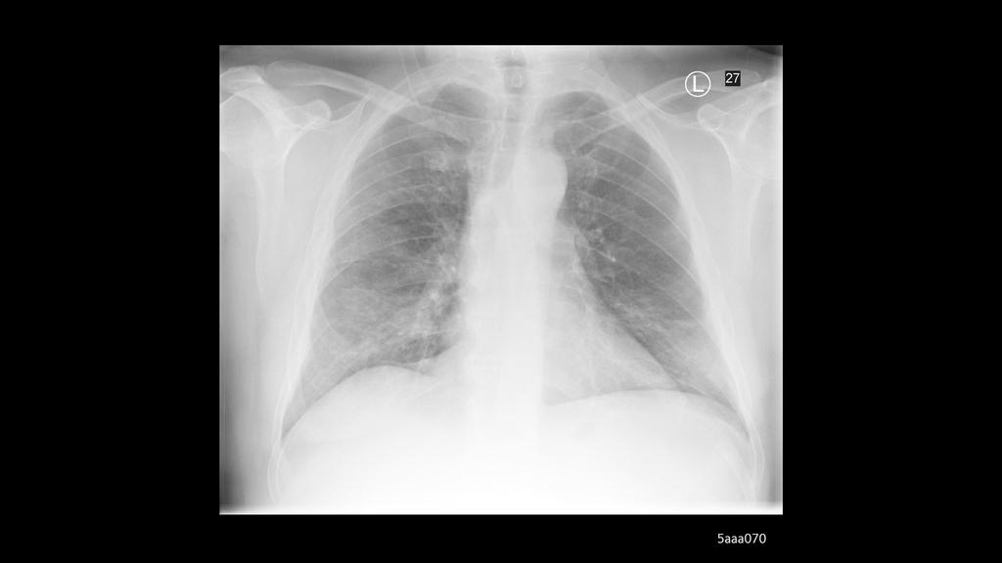
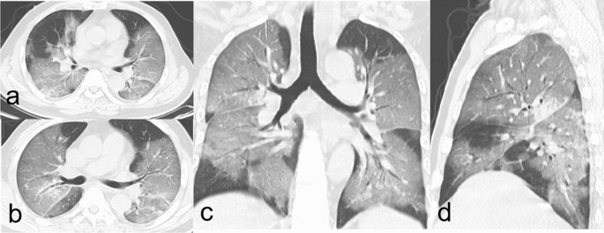
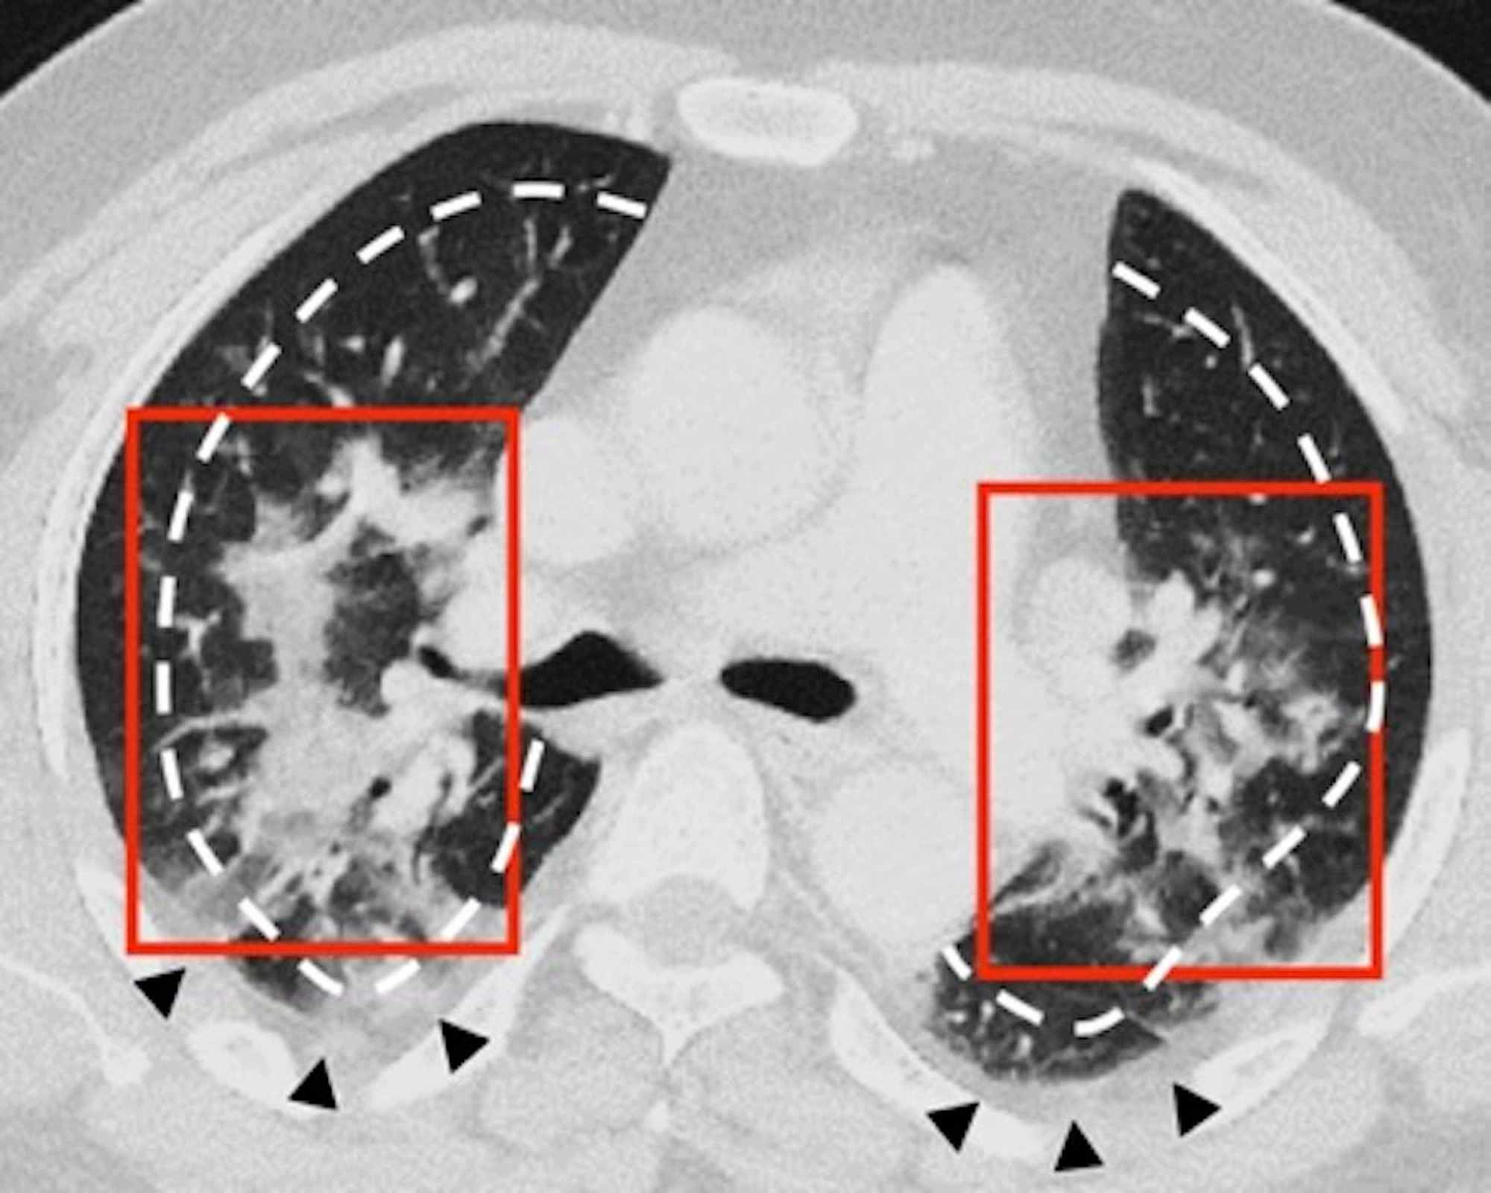
COVID-19 – Imaging Modalities

Slide 23
COVID-19 – Treatment Options
→ the management of COVID-19 includes especially supportive and symptomatic care, the possibilities of targeted therapy are limited, they are still in the research stage
→ treatment in mild forms of COVID-19 takes place in most cases in home isolation, in case of development of dyspnea or other complications, hospitalization is necessary
Non-specific therapy includes:
→ close monitoring for symptomatic patients with risk factors for severe disease (blood pressure, pulse, blood oxygen saturation level, GCS, qSOFA…)
→ empiric antibiotics (ceftriaxone, cotrimoxazole, meropenem) are administered if bacterial pneumonia strongly suspected (CRP > 100, positive prokalcitonin)
→ symptomatic care (antipyretics, fluid therapy, NSAIDs, antitussives and mucolytics)
→ supportive care (vitamins, probiotics, nutrition, rehabilitation, prone position)
→ prophylaxis of thromboembolic disease (LMWH) in all hospitalized patients + ASA
→ oxygen support: low-dose oxygen (nasal cannula, simple face mask, non-rebreather masks), high-flow nasal oxygen therapy (HFNO, Airvo), non-invasive ventilation, orotracheal intubation and artificial lung ventilation, ECMO

Slide 24
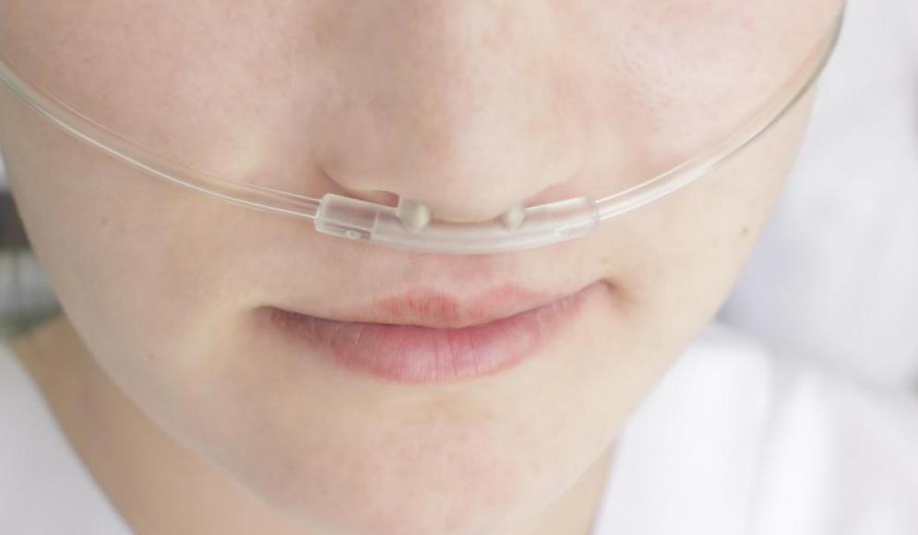
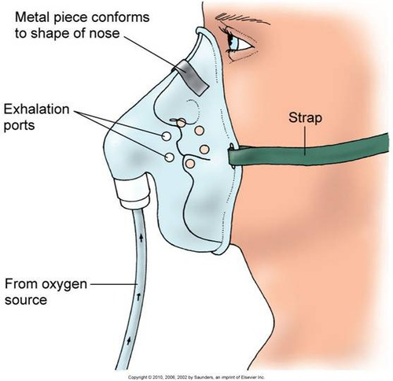
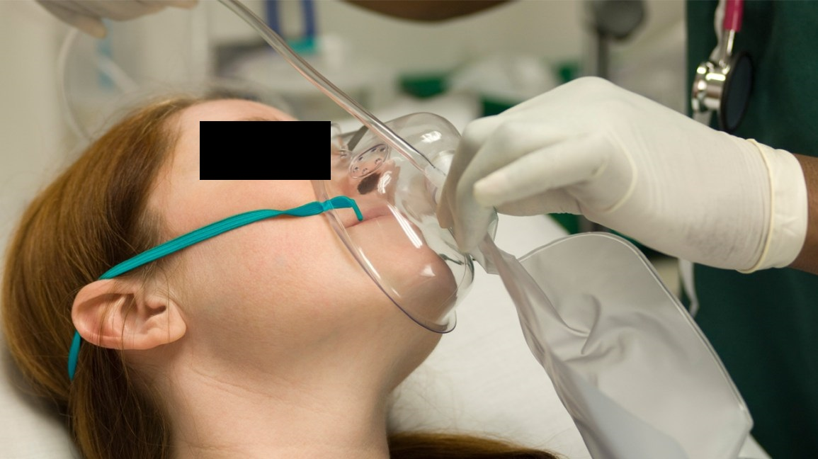
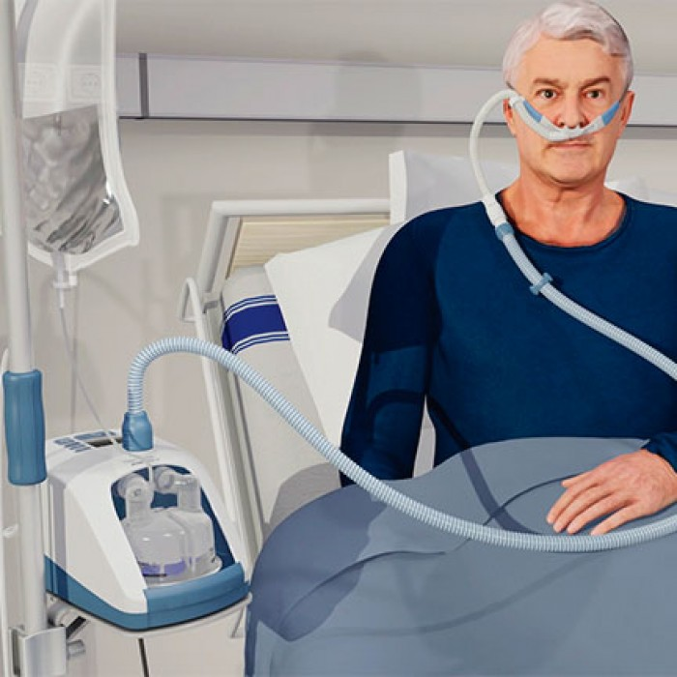
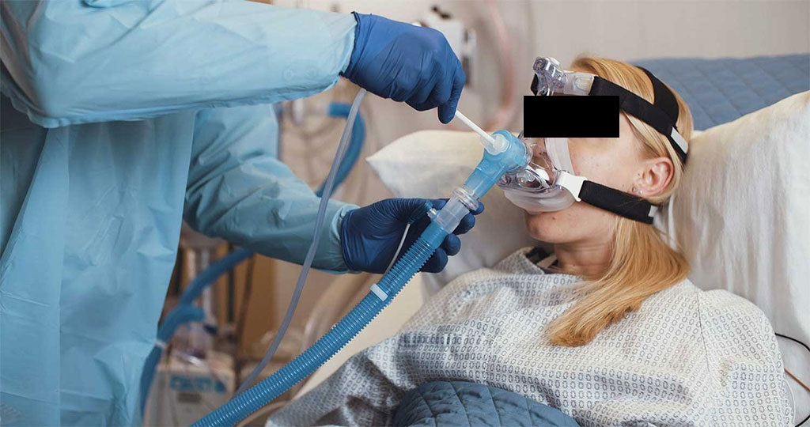
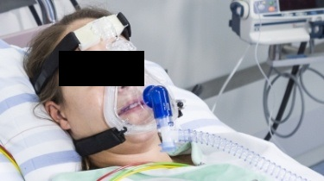
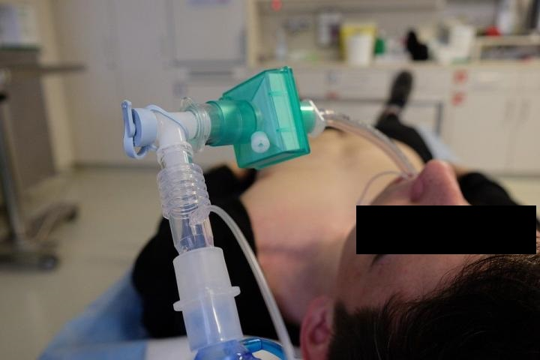
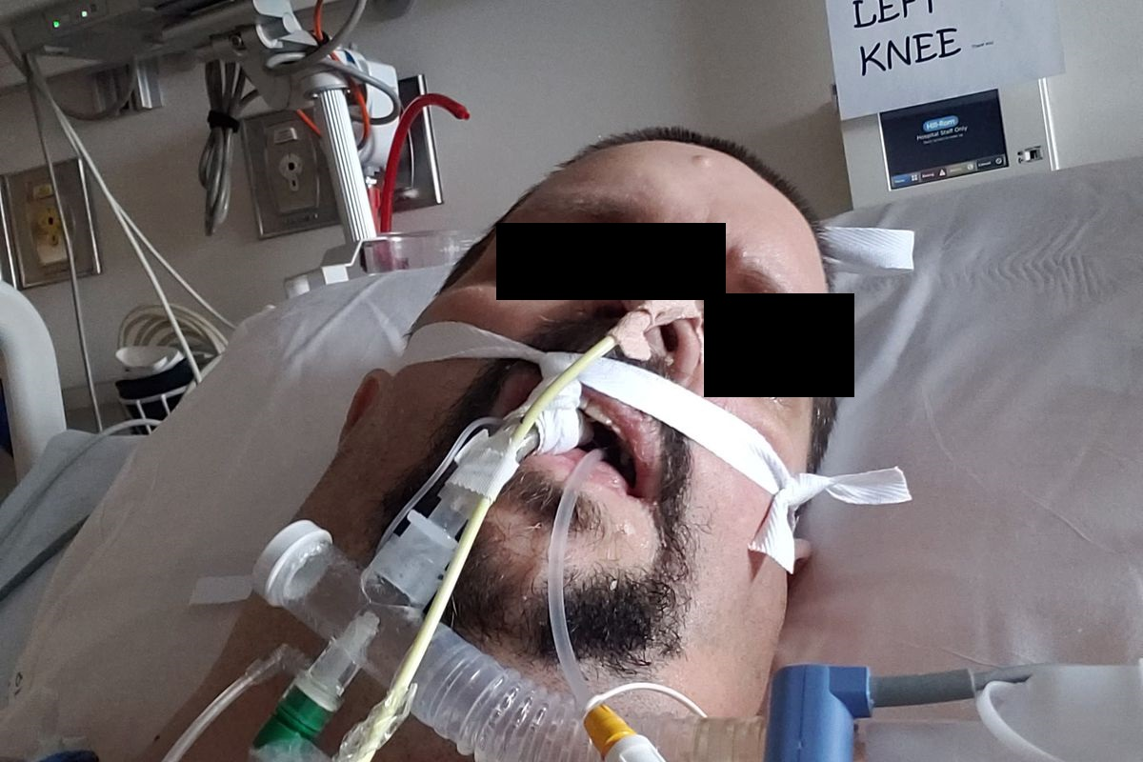
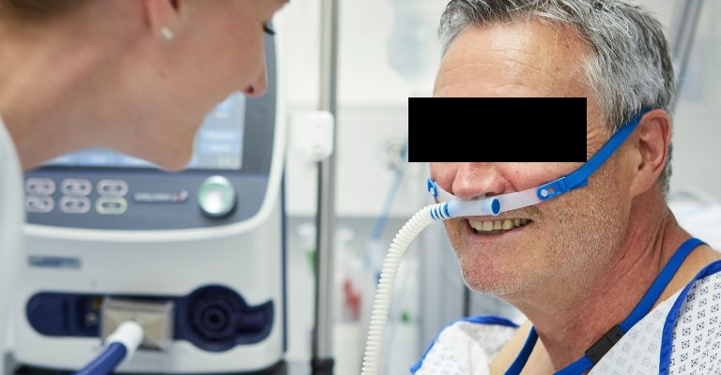
COVID-19 – Oxygen Therapy

Slide 25
COVID-19 – Specific Therapy
Glucocorticoids (dexamethasone)
→ data from randomized trials support the role of glucocorticoids for severe COVID-19, in a meta-analysis of seven trials that included 1703 critically ill patients glucocorticoids reduced 28-day mortality compared with standard care or placebo (32 % versus 40 %) and were not associated with an increased risk of severe adverse events
Proposed mechanism of action:
→ the sickest patients with COVID-19 suffer a hyperinflammatory state (cytokine storm)
→ immune suppression should help such patients, by contrast, immune suppression during the early phase of the viral infection might allow increased viral replication and aggravate the disease!
→ inhaled glucocorticoids – in trials evaluating inhaled glucocorticoids, there was some benefit in the treatment of mild, early, COVID-19, although no mortality reduction was demonstrated
→ dexamethasone (or e.g. methylprednisolone) is recommended for severely ill patients with COVID-19 who are on supplemental oxygen or ventilatory support

Slide 26
COVID-19 – Specific Therapy
Remdesivir (GS-5734, Veklury®)
→ a novel nucleotide analogue, inhibitor of the viral RNA-dependent RNA polymerase with in vitro inhibitory activity against SARS-CoV-2 (and SARS-CoV-1, MERS-CoV...)
→ remdesivir in ACTT-1 study (2020) resulted in a faster time to recovery, defined as discharge from the hospital or continued hospitalization without need for supplemental oxygen or ongoing medical care (median 10 versus 15 days), remdesivir reduced time to recovery whether patients were randomized within or after 10 days of symptom onset, however, in subgroup analysis, the reduced time to recovery was only statistically significant among patients who were on low-flow oxygen at baseline
→ in the EU, remdesivir is indicated for the treatment of COVID‑19 in adults and adolescents with intersticial pneumonia requiring supplemental oxygenotherapy, we prioritize remdesivir for those requiring low-flow oxygen because it may also reduce mortality in this population
→ suggested adult dose is 200 mg intravenously on day 1 followed by 100 mg daily for 5 days total

Slide 27
COVID-19 – Specific Therapy
Monoclonal antibodies
1) Monoclonal antibodies anti-SARS CoV-2:
→ developed to neutralize SARS-CoV-2 by targeting the SARS-CoV-2 proteins (e.g. spike protein) and preventing viral cell entry
→ bamlanivimab/etesevimab (Eli Lilly), casirivimab/imdevimab (Regeneron), sotrovimab
→ therapy and also postexposure prophylaxis in patients who are at high risk for progression to severe COVID-19
2) Inflammatory pathways inhibitors:
→ elevated inflammatory markers and elevated pro-inflammatory cytokines (e.g. IL-6) are associated with critical COVID-19 → blocking the inflammatory pathway has been hypothesized to prevent disease progression (cytokine storm)
→ these include the IL-6 receptor blockers tocilizumab and sarilumab, the direct IL-6 inhibitor siltuximab, JAK (Janus kinase 1 and 2) inhibitor baricitinib
Approaches that target the virus itself are more likely to work early in the course of infection, whereas approaches that modulate the immune response may have more impact later in the disease course.

Slide 28
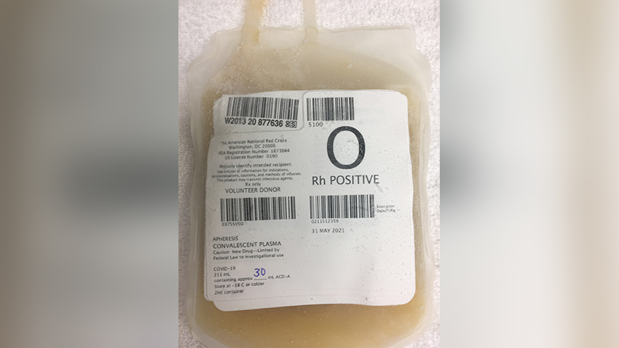
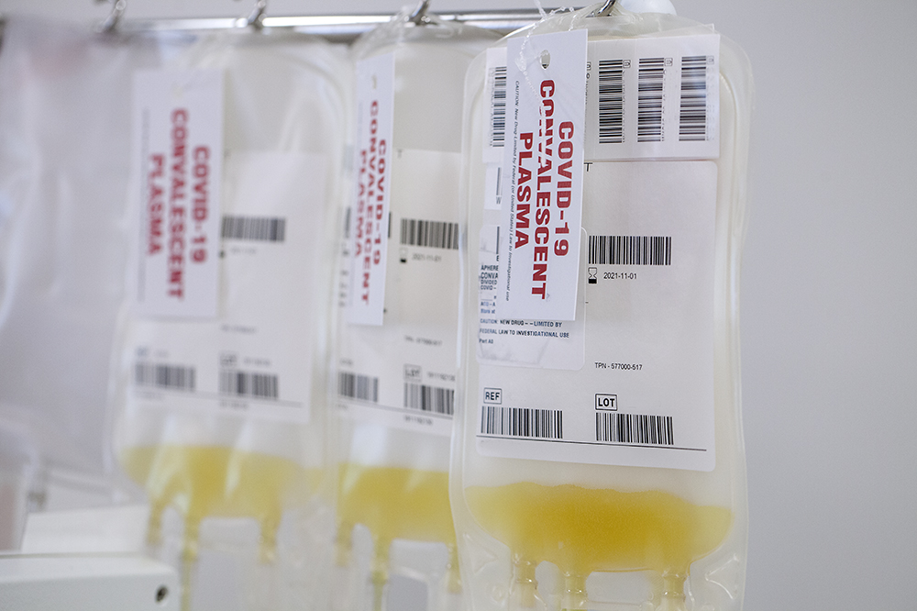
COVID-19 – Specific Therapy
Convalescent plasma
→ plasma obtained from individuals who have recovered from COVID-19 can provide passive antibody-based immunity, neutralizing antibodies are thought to be the main active component
→ plasma that contains high neutralizing antibody titers is hypothesized to have clinical benefit when given early in the course of disease (first 3 - 5 days), and it may be of particular interest for individuals with deficits in antibody production
Favipiravir
→ RNA polymerase inhibitor that is available in Asian countries for treatment of influenza, is being evaluated in clinical trials for treatment of COVID-19 in the United States and elsewhere, favipiravir may hasten SARS-CoV-2 RNA clearance, although data are limited

Slide 29
COVID-19 – Specific Therapy
Molnupiravir (Lagevrio)
→ potent ribonucleoside analog that inhibits the replication of SARS-CoV-2
→ exerts its antiviral action through introduction of copying errors during viral RNA replication
→ I: treatment of mild-to-moderate COVID-19 in adults who are at high risk for progression to severe COVID-19; CI: pregnancy, breastfeeding, people under 18
Tixagevimab/cilgavimab (Evusheld)
→ long-acting monoclonal antibody combination
→ I: pre-exposure prophylaxis of COVID-19 in adults and adolescents with moderate to severe immune compromise who may not mount an adequate immune response to COVID-19 vaccination
→ duration of protection is estimated to be at least 6 months
Nirmatrelvir/ritonavir (Paxlovid)
→ potent orally active 3C-like protease inhibitor
→ a number of drug interactions (ritonavir induces CYP1A2 and inhibits CYP 3A4 and 2D6)

Slide 30
COVID-19 – Prevention and Control
→ in locations where community transmission is widespread, preventive strategies for all individuals in a health care setting are warranted to reduce potential exposures!
Personal preventive measures:
→ diligent hand washing, particularly after touching surfaces in public, use of hand sanitizer that contains at least 60% alcohol
→ social/physical distancing (CDC recommends a minimum distance of two meters)
→ respiratory hygiene (covering the cough or sneeze)
→ avoiding touching the face (in particular eyes, nose, and mouth)
→ cleaning and disinfecting objects and surfaces that are frequently touched
→ adequate ventilation of indoor spaces
→ optimize of health of individuals (quit smoking, minimize alcohol, healthy diet, get adequate sleep, regular physical activity...)
Wearing masks in the community:
- a surgical mask or respirators (FFP2)
- in public spaces, inside buildings, in public transport or when around individuals outside of their household

Slide 31
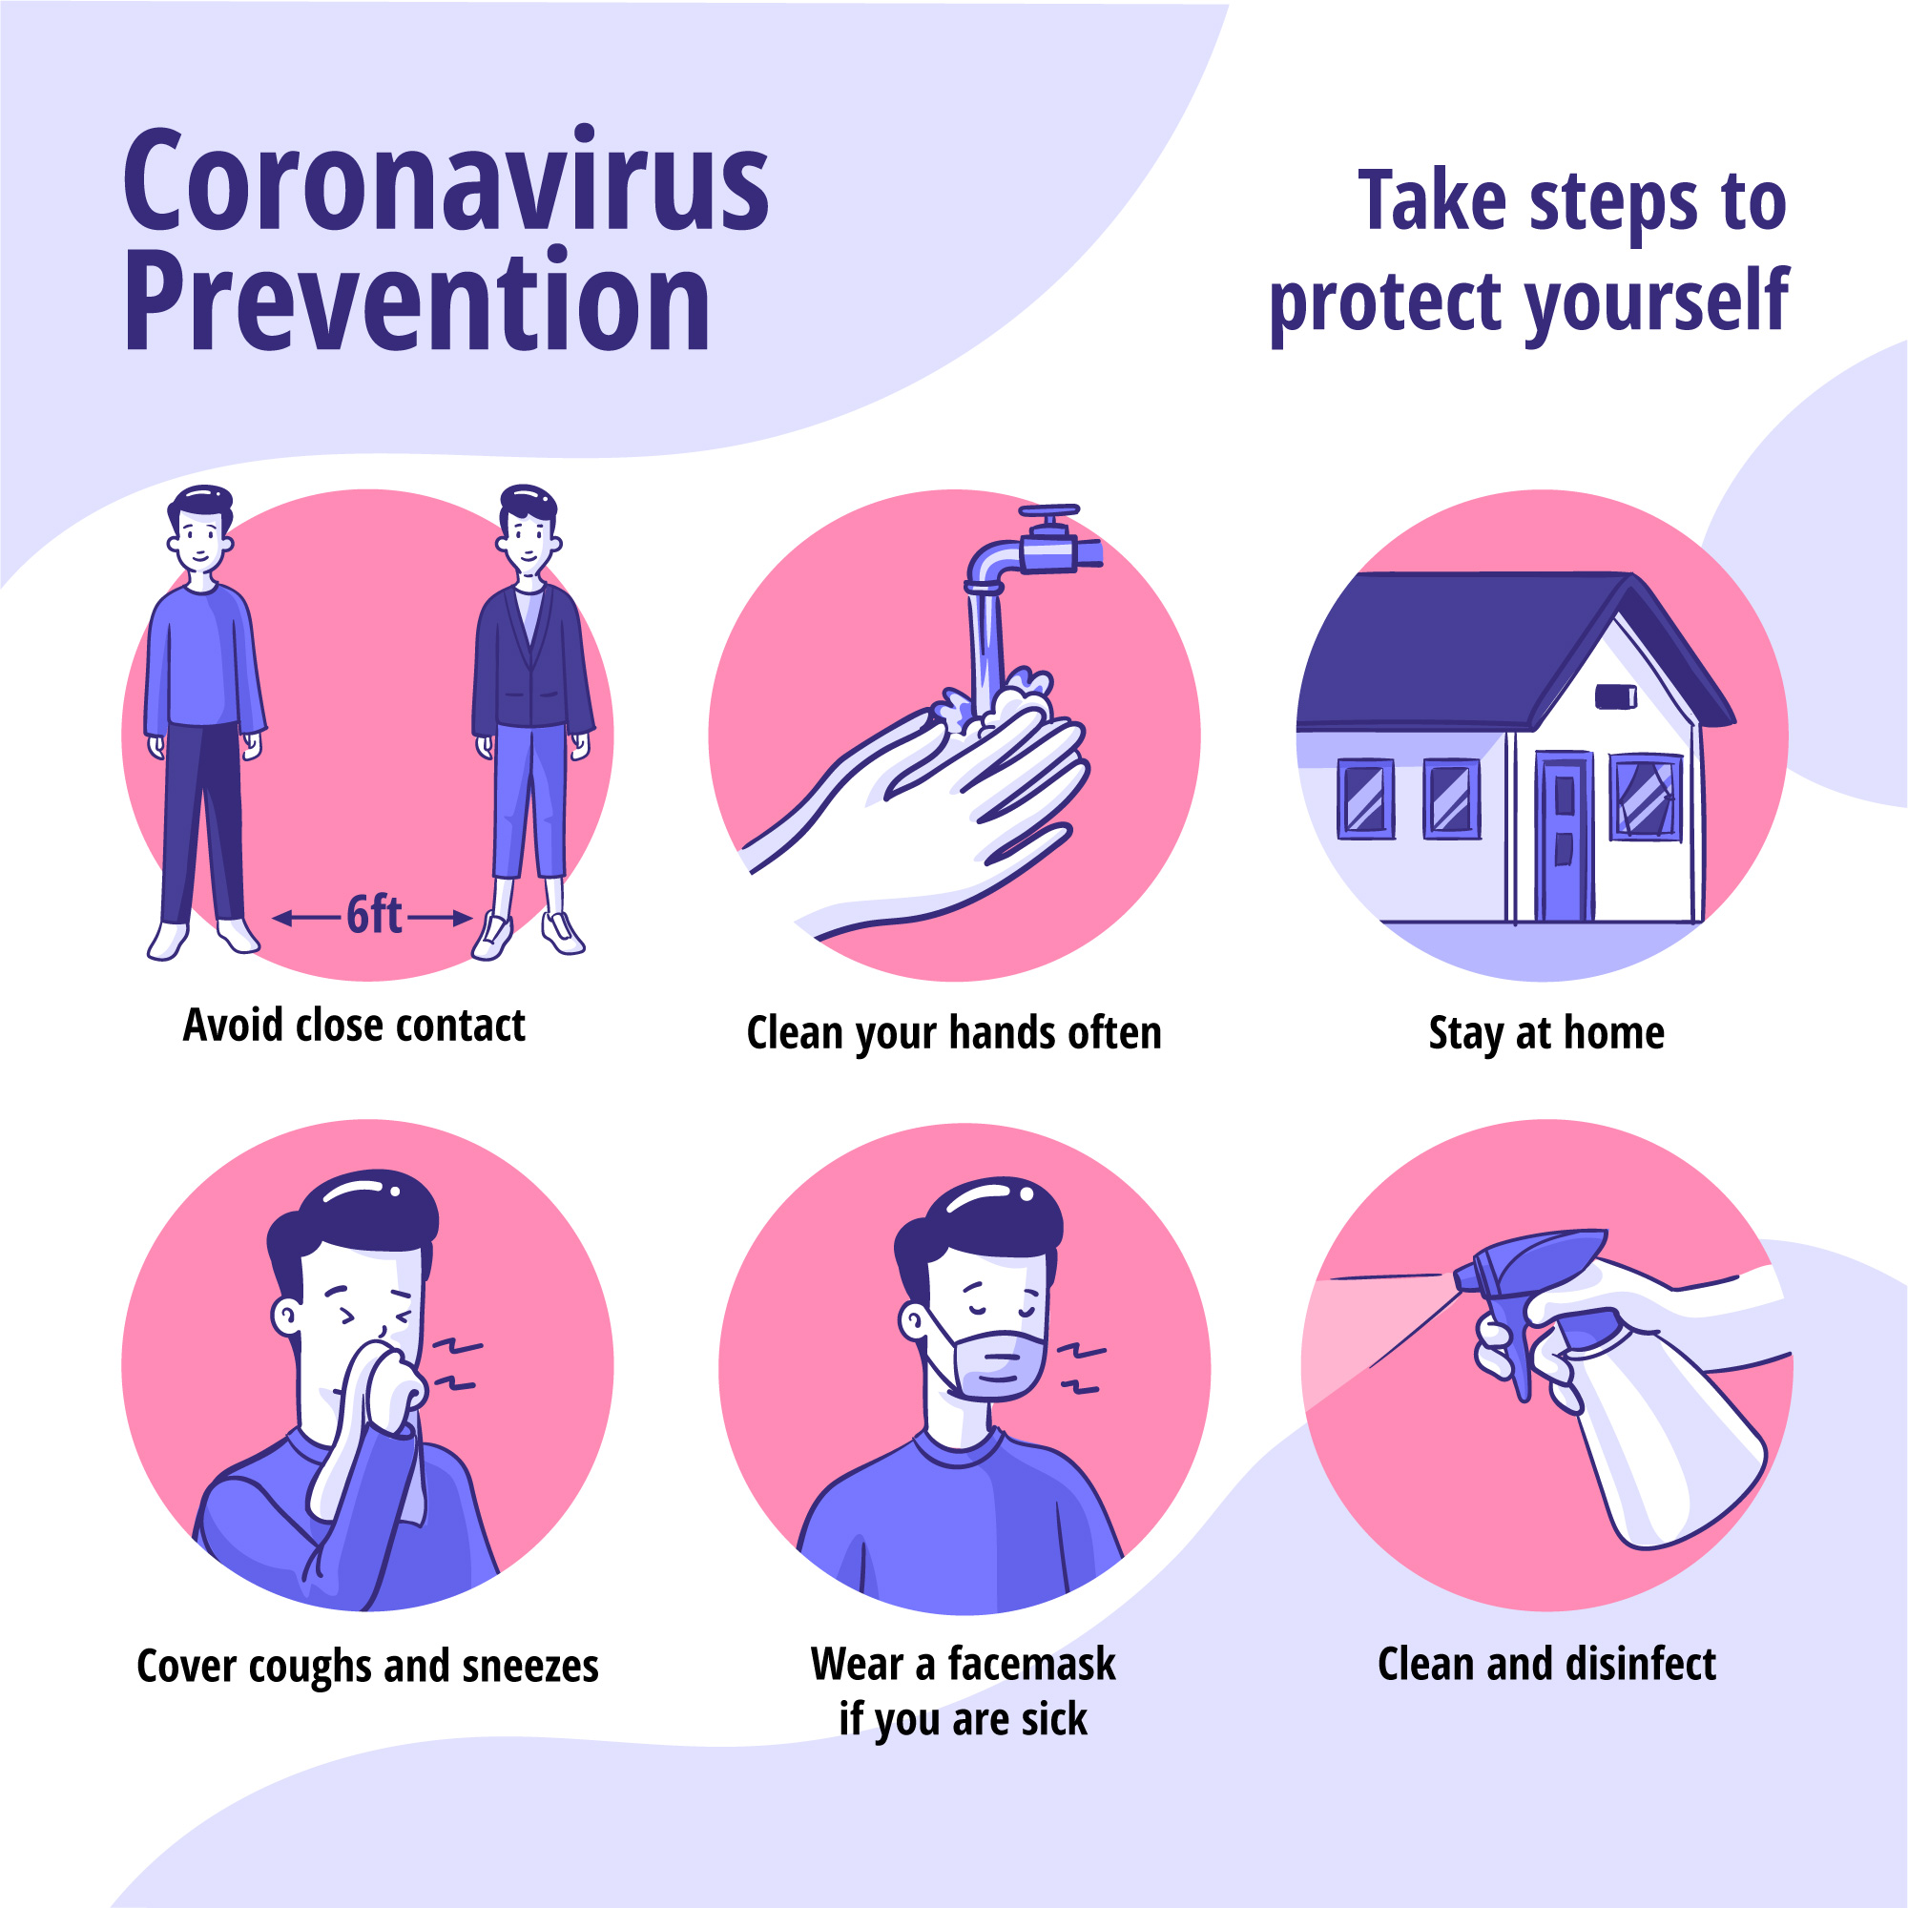
COVID-19 – Prevention and Control

Slide 32
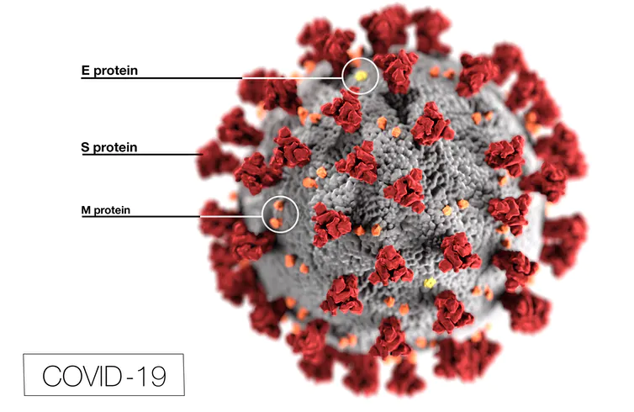
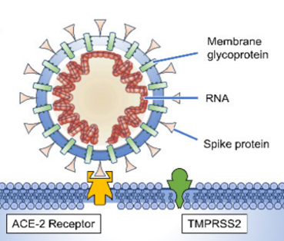

COVID-19 – Vaccines
Passive immunization - administration of ready-made virus neutralizing antibodies (immunoglobulins) to the human body ​
Notes:
Protilátky (pasivní imunizace)

Slide 33


COVID-19 – Vaccines
Passive immunization - administration of ready-made virus neutralizing antibodies (immunoglobulins) to the human body ​
+ convalescent plasma
Notes:
Protilátky (pasivní imunizace)

Slide 34



COVID-19 – Vaccines
Antigen
imunogeneze
VLP
Proteins, peptides
Whole virus
inactivated
attenuated
Antibodies produced by the organism itself ​
Notes:
Protilátky (pasivní imunizace)

Slide 35


COVID-19 – Vaccines
Antigen
imunogeneze
VLP
Proteins, peptides
Whole virus
inactivated
attenuated
Antibodies produced by the organism itself ​
Notes:
Protilátky (pasivní imunizace)

Slide 36
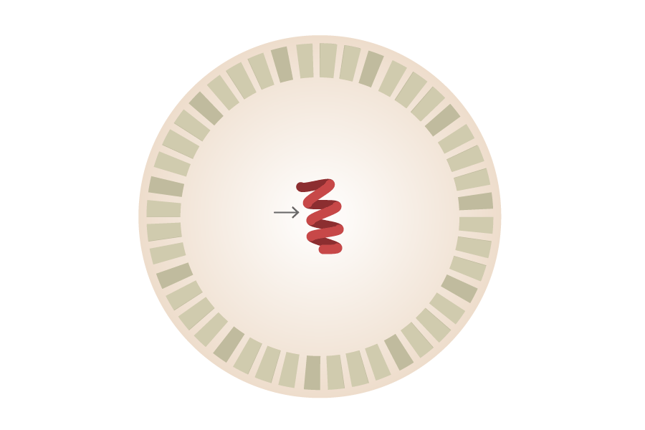
COVID-19 – Vaccines
mRNA
translace
Antigen
imunogeneze
VLP
Proteins, peptides
Whole virus
inactivated
attenuated
Antibodies produced by the organism itself ​
Notes:
Protilátky (pasivní imunizace)

Slide 37




COVID-19 – Vaccines
mRNA
translace
Antigen
imunogeneze
VLP
Proteins, peptides
Whole virus
inactivated
attenuated
Antibodies produced by the organism itself ​
Notes:
Protilátky (pasivní imunizace)

Slide 38


COVID-19 – Vaccines
DNA
Vektor
transkripce
mRNA
translace
Antigen
imunogeneze
VLP
Proteins, peptides
Whole virus
inactivated
attenuated
Antibodies produced by the organism itself ​
Notes:
Protilátky (pasivní imunizace)

Slide 39


COVID-19 – Vaccines
DNA
Vektor
transkripce
mRNA
translace
Antigen
imunogeneze
VLP
Proteins, peptides
Whole virus
inactivated
attenuated
Antibodies produced by the organism itself ​
Notes:
Protilátky (pasivní imunizace)

Slide 40

COVID-19 – Vaccines
Polack FP, Thomas SJ, Kitchin N, et al. Safety and Efficacy of the BNT162b2 mRNA Covid-19 Vaccine. NEJM, 2020; 383:2603-2615.
DOI: 10.1056/NEJMoa2034577

Slide 41

COVID-19 – Vaccines
Comirnaty 1:100 000 (21 cases)
Polack FP, Thomas SJ, Kitchin N, et al. Safety and Efficacy of the BNT162b2 mRNA Covid-19 Vaccine. NEJM, 2020; 383:2603-2615.
DOI: 10.1056/NEJMoa2034577

Slide 42





Slide 43





Slide 44

stebel.roman@fnbrno.cz

Slide 45
Resources
→ https://www.uptodate.com/contents/coronavirus-disease-2019
→ https://clinicaloptions.com/c19
→ https://www.cdc.gov/coronavirus/2019-ncov/index.html
→ https://www.who.int/emergencies/diseases/novel-coronavirus-2019
Beigel JH, Tomashek KM, Dodd LE, et al. Remdesivir for the Treatment of Covid-19 — Final Report. N Engl J Med. 2020;383(19):1813-1826. doi:10.1056/NEJMoa2007764
Hemmati F, Saedi S, Hemmati-Dinarvand M, Zarei M, Seghatoleslam A. Mysterious Virus: A Review on Behavior and Treatment Approaches of the Novel Coronavirus, 2019-nCoV. Archives of Medical Research. 2020;51(5):375-383. doi:10.1016/j.arcmed.2020.04.022
Qin Y-Y, Zhou Y-H, Lu Y-Q, et al. Effectiveness of glucocorticoid therapy in patients with severe coronavirus disease 2019: protocol of a randomized controlled trial. Chinese Medical Journal. 2020;133(9):1080-1086. doi:10.1097/CM9.0000000000000791
Armour C, McGlinchey E, Butter S, McAloney-Kocaman K, McPherson KE. The COVID-19 Psychological Wellbeing Study: Understanding the Longitudinal Psychosocial Impact of the COVID-19 Pandemic in the UK; a Methodological Overview Paper. J Psychopathol Behav Assess. November 4, 2020. doi:10.1007/s10862-020-09841-4

