Slide 1
Glaucoma

Slide 2
Outline
Healthy eye
What is glaucoma
Anatomy of glaucoma
Types of glaucoma
Glaucoma risk factors
Examination in glaucoma
Treatment of glaucoma

Slide 3
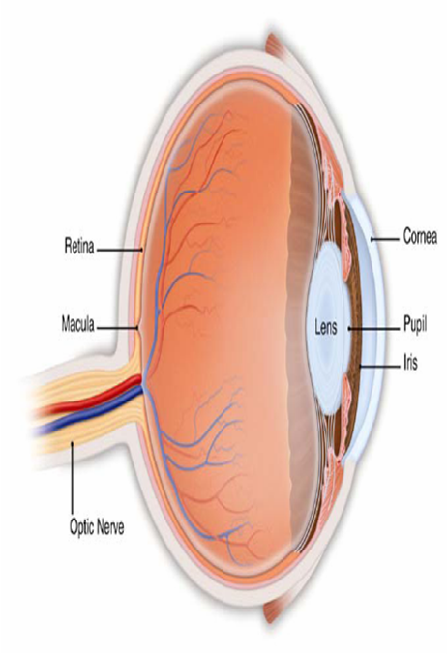
The healthy eye
Light rays enter the eye
the cornea, pupil and lens.
These light rays are focused
directly onto the retina, the
light-sensitive tissue lining
the back of the eye.
The retina converts light
rays into impulses; sent
through the optic nerve to
your brain, where they are
recognized as images.

Slide 4
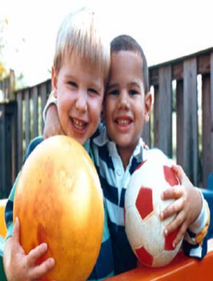
What is glaucoma?
• Disease of the optic nerve.
• When damage to the optic nerve
fibers occurs, blind spots
develop; blind spots usually go
undetected until optic nerve is
significantly damaged.
• One of leading cause of blindness
in the world (especially in older
people)
• Early detection and treatment are
keys to prevent vision loss
from glaucoma.
Normal vision
Vision as it might be
affected by glaucoma

Slide 5
Glaucoma - definition
  Glaucoma is a multifactorial (there are more causes), irreversible and still progressive (without treatment) damage of the optic nerve, that is typical by acquired loss of ganglion retinal cells (=neurons) and by atrophy of optic nerve
  The newest theory describes glaucoma as illness of the brain, not only as disease of optic nerve (=neuropathy)

Slide 6
Types of glaucoma
Two main categories of glaucoma:
• Open-angle glaucoma: the most
common form of glaucoma.
(chronic glaucoma)
• Closed-angle glaucoma: a less common
and more urgent form of glaucoma.
(acute glaucoma)

Slide 7
Glaucoma risk factors
Risk factors for glaucoma include:
• Age
• Family history
• Elevated eye pressure (IOP)
• Nearsightedness or farsightedness /myopia or hyperopia/
• African, Hispanic or Asian ancestry
• Diabetes
• Previous eye injury
• Thin cornea

Slide 8
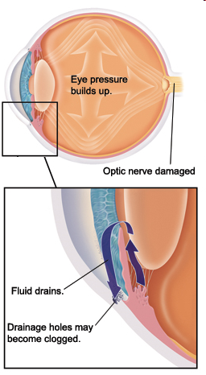
Anatomy of glaucoma
• In glaucoma, aqueous humor
does not flow through the
trabecular meshwork properly.
• Over time, eye pressure
increases, damaging the optic
nerve fibers.

Slide 9
Anatomy of glaucoma
• Clear liquid called aqueous
humor circulates inside the
front portion of the eye.
• To maintain a healthy level of
pressure within the eye, a
small amount of aqueous
humor is produced constantly,
while an equal amount flows
out of the eye through a
microscopic drainage system
- the trabecular meshwork.

Slide 10
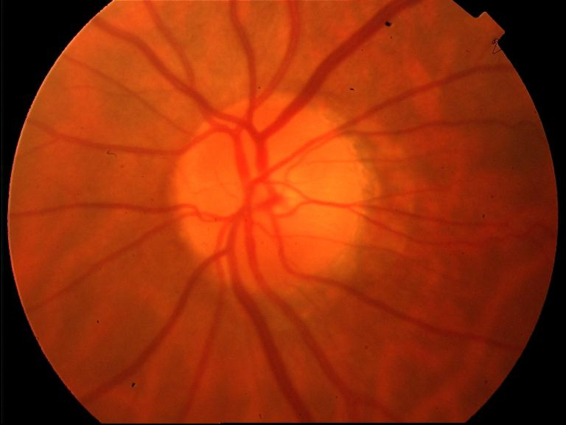
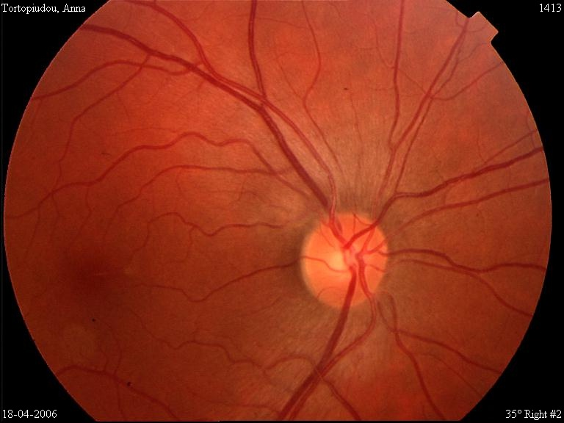
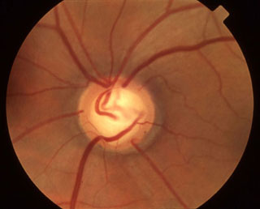
Healthy optic nerve heads
Glaucoma damage of ONH

Slide 11
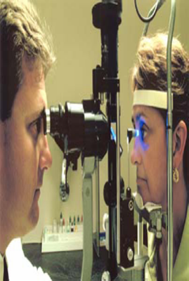
What happens during an exam
• Tonometry measures eye
pressure (IOP).
• High tonometry reading is
often one of the first signs of
glaucoma.
Tonometry examination

Slide 12
Non-contact tonometer
IOP measured by air-flow
Advantage:
no local (conjunctival) anesthesia
no transfer of infection
Disadvantage:
less accurate (sensitive to corneal thickness)

Slide 13
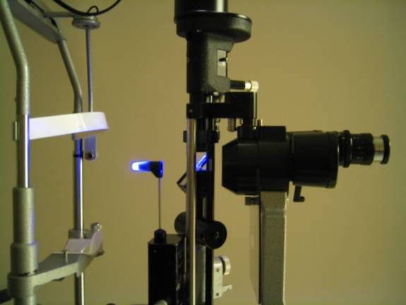

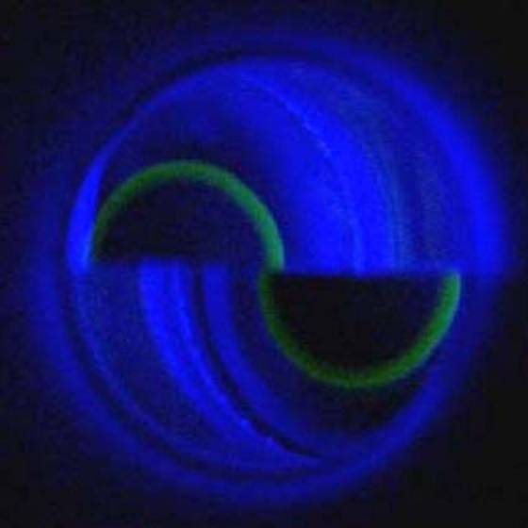
Goldmann´s applanation tonometry
(the most precise method, benoxi, fluorescein, 2 curves must touch in the middle)

Slide 14
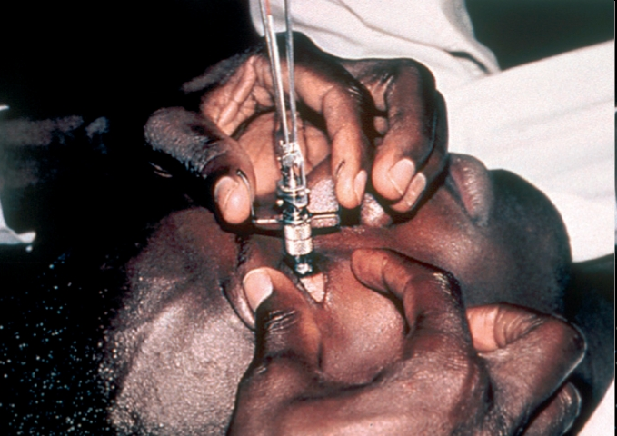
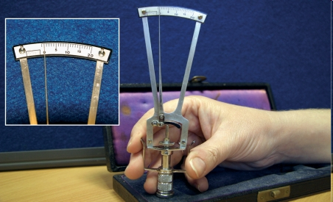
Schiöetz tonometry

Slide 15
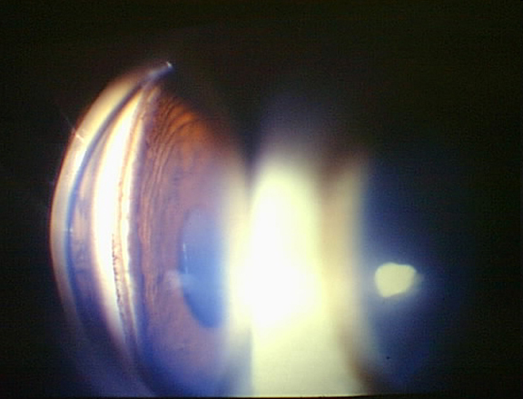
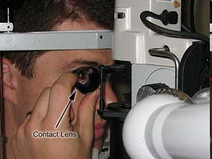
Gonioscopy
local anesthesia required
contact lens with a mirror
examination of angle between cornea and iris
(place of aqueous humor outflow)

Slide 16
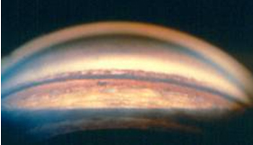
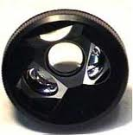
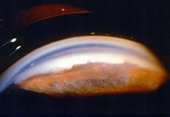
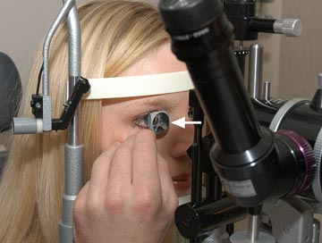
Gonioscopy

Slide 17
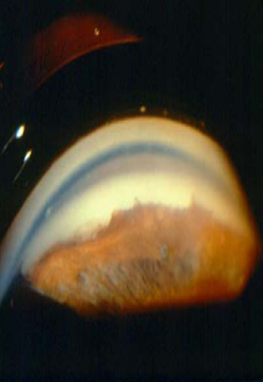
What happens during an exam
• Gonioscopy inspects
drainage angle of aqueous
humor (anterior chamber angle)
• Allows ophthalmologist to
determine type of glaucoma
(open- or closed-angle).
Gonioscopic image of the eye

Slide 18
Detecting glaucoma
• Regular eye examinations by
your ophthalmologist are the
best way to detect glaucoma.
• Glaucoma screening that
checks only eye pressure is
not sufficient to detect
glaucoma.
Ophthalmoscope examination

Slide 19
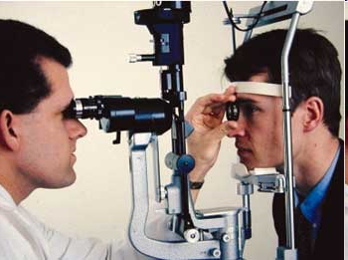
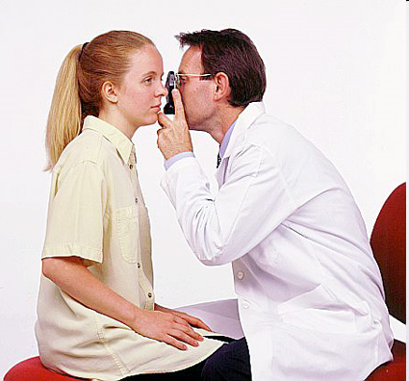
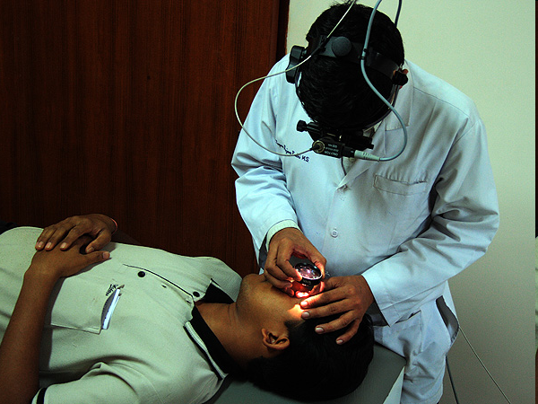
Ophthalmoscopy - examination of ONH, mydriasis (dilatation of pupil) required
Biomicroscopy on a slit lamp
Direct ophthalmoscopy
Indirect ophthalmoscopy

Slide 20
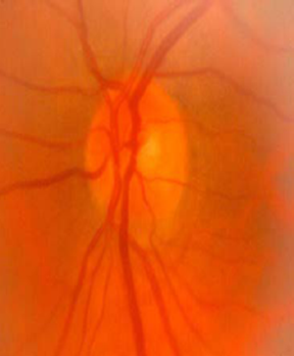
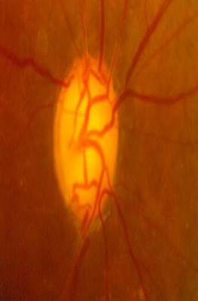
What happens during an exam
• Optic nerve exam, in which ophthalmologist dilates your
pupils to detect optic nerve damage.
• Subtle changes of optic nerve reveal early signs of
glaucoma (previous slides)
Normal optic nerve
Optic nerve damaged by glaucoma

Slide 21
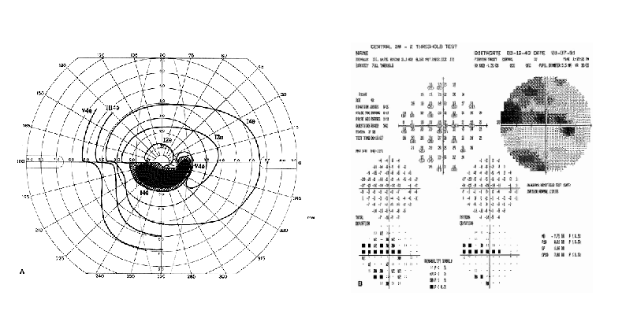
Perimetry – visual field examination
Kinetic perimetry
older method
quantitative evaluation of VF
(provides detection just of
absolute scotomas)
Static (computer) perimetry
more modern method
quantitative and qualitative
evaluation of VF
(provides detection of absolute
and also relative scotomas)

Slide 22
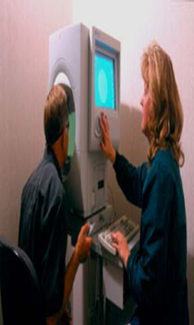
What happens during an exam
• Visual field exam (perimetry), testing for
blank spots in peripheral vision
• Scotomas – absolute or relative (decreased sensitivity).
Visual field exam

Slide 23
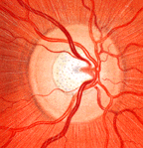
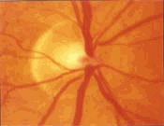
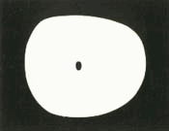
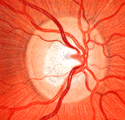
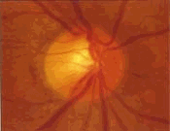

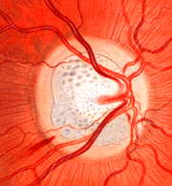
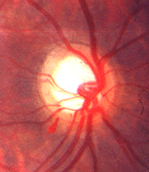

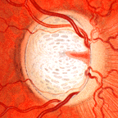
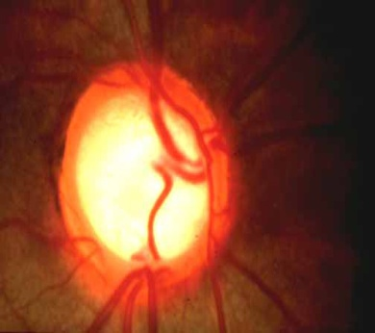
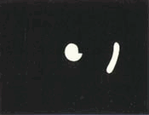

Slide 24


Slide 25
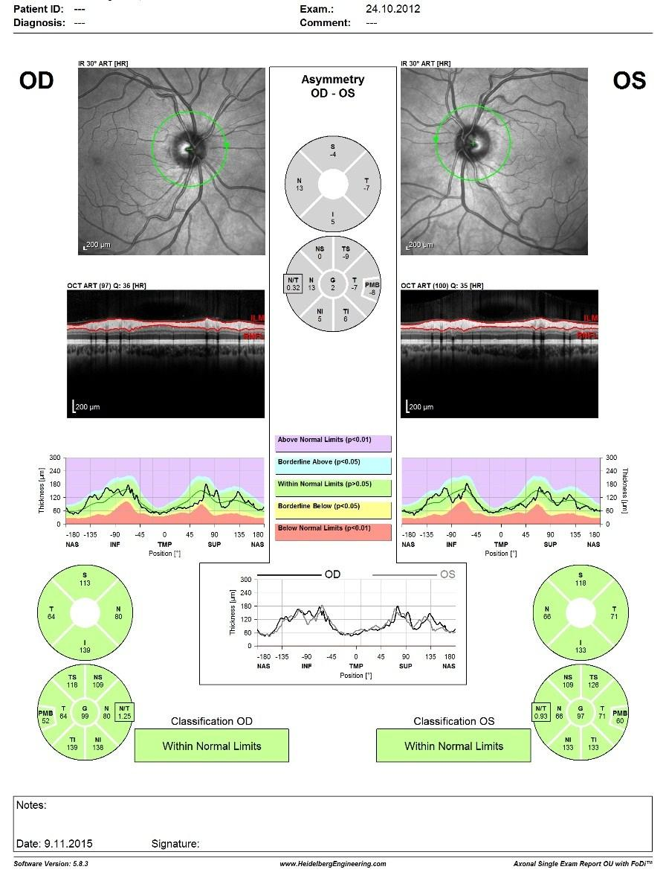
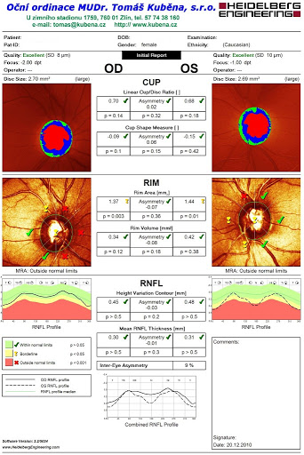
OCT RNFL
HRT

Slide 26
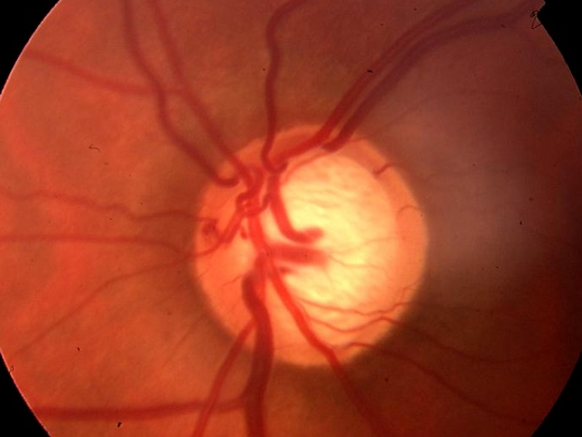
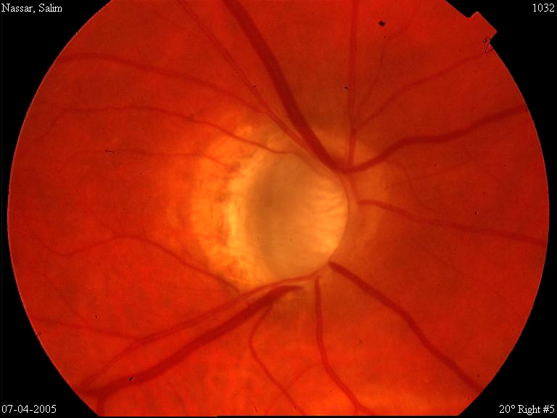
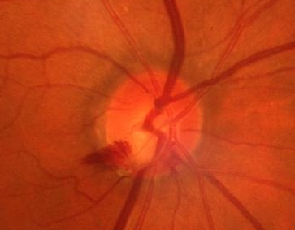
Glaucoma damage
Anatomical loss of tissue
Glaucoma atrophy of ONH – partial or total loss of nerve fibers, that create optic nerve
Signs of glaucoma atrophy of ONH:
Excavation of papilla of ONH
Nasalization (nasal shift of vessels)
Peripapillary choroidal atrophy
Disc hemorrheage

Slide 27
Open angle glaucoma
• Trabecular meshwork becomes
less efficient at draining aqueous
humor.
• Intraocular pressure (IOP) increases,
which leads to damage of the optic
nerve.
• Damage of the optic nerve occurs at
different eye pressure among
different patients.
• Typically, glaucoma has no
symptoms in its early stages
Open-angle glaucoma

Slide 28
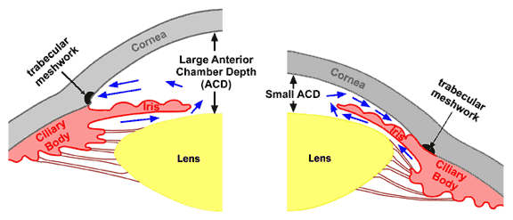
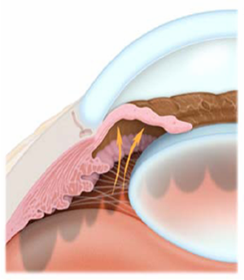
Closed angle glaucoma
• often in hypermetropic eyes
• The drainage angle of trabecular
meshwork becomes blocked by
the iris.
• IOP increases very fast (very high IOP,
painful)
• Symptoms include severe eye or brow
pain, redness of the eye, decreased or
blurred vision
• Must be treated as a medical Emergency
- see your ophthalmologist immediately.

Slide 29
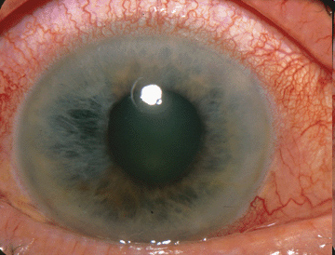
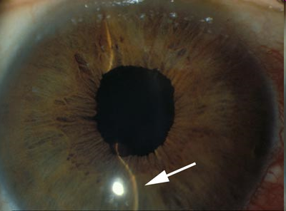
Signs of acute (narrow-angle) glaucoma
Red eye, pain of eye, corneal edema (semitransparent cornea), pain around the eye,
headache, (sometimes nausea, vomitting), shallow anterior chamber, plegia of pupil
(mid-dilated), very high IOP

Slide 30
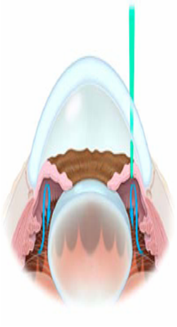
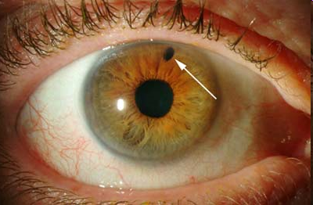
Treating glaucoma
Narrow-angle glaucoma (laser treatment)
• Laser iridotomy: creates a small hole in the iris to improve
flow of aqueous humor into drainage angle.
Laser iridotomy

Slide 31
Treating glaucoma
• Treatment of glaucoma depends on:
Specific type of glaucoma
Severity of glaucoma
How glaucoma responds to treatment

Slide 32
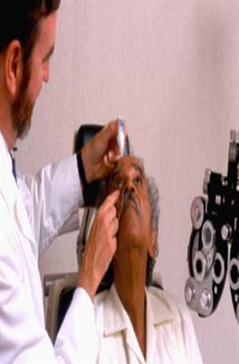
Treating glaucoma
• Medication (see below)
• Eyedrops are the most
common treatment
Eyedrop application for
Open angle glaucoma

Slide 33
Antiglaucomatics
Beta-blockers
Work by decreasing aqueous production in the eye and now are often prescribed as an adjunct to or in combination with prostaglandins.
Medical history of patient is important. Beta-blockers have the potential to reduce heart rate and may cause adverse side effects in individuals with certain heart problems, lung problems (such as emphysema), diabetes, depression or other conditions.

Slide 34
Antiglaucomatics
Carbonic anhydrase inhibitors
Decreasing rate of aqueous humor production. They are usually used in combination with other anti-glaucoma eye drops and not alone. This classification of drug is also used in oral form (pills).
Common side effects: include burning, a bitter taste, eyelid reactions and eye redness (ocular injection).
The systemic (pill) form: Diluran (=acetazolamide): systemic side effects include fatigue, depression, loss of appetite, weight loss, loss of libido, kidney stones, metallic taste and tingling in fingers and toes (peripheral neuropathies). Not suitable for longterm therapy.

Slide 35
Antiglaucomatics
Prostaglandins
Often the best user compliance because they are required only once daily.
Better outflow of fluids, thus reducing buildup of eye pressure.
Possible side effects include stinging and burning, eye color change, and lengthening and curling of the eyelashes.

Slide 36
Antiglaucomatisc
Parasympathomimetics
Work by increasing the outflow of aqueous humor from the eye. Frequently used to control IOP in narrow-angle glaucoma. These eye drops cause the pupil to constrict, which assists in opening the narrowed or blocked angle where drainage occurs.
Common side effects include brow ache, pupil constriction, burning, and reduced night vision.

Slide 37
Antiglaucomatics
Alpha-adrenergic agonists
Decrease rate of aqueous humor production and can be used alone or in combination with other anti-glaucoma eye drops
Common side effects associated with this classification of eye drop include ocular injection, upper lid elevation, dilated pupils and itching.

Slide 38
Antiglaucomatics
Combination glaucoma drugs
Many individuals with glaucoma require more than one type of medication to control IOP. Pharmaceutical companies have produced "combination" eye drops that can include two different anti-glaucoma medicines in the same bottle.
Combined medications have the additive effect of reducing IOP

Slide 39
Antiglaucomatics
Hyperosmotic agents
For people with a severely high IOP that must be reduced immediately before permanent, irreversible damage occurs to the optic nerve. Hyperosmotic agents reduce IOP by lowering fluid volume in the eye.
Usually given only on a one-time, emergency basis, these drugs include mannitol i.v. (20%, 100ml), (event. oral glycerin and isosorbide orally)

Slide 40
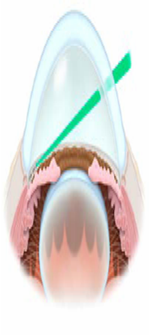
Treating glaucoma
Open angle glaucoma (laser treatment)
• Laser trabeculoplasty: stimulates the trabecular
meshwork (drainage angle) to function more efficiently (temporary effect).
Laser trabeculoplasty

Slide 41
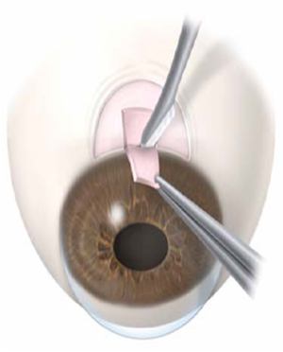
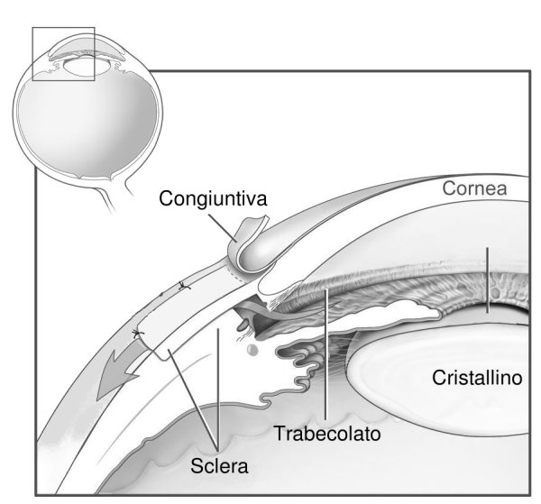
Treating glaucoma
Glaucoma surgery (all types
of glaucomas)
• Trabeculectomy is a filtering surgery where a new drainage channel is created into the anterior chamber from underneath a partial thickness scleral flap to allow for aqueous flow out of the eye. The aqueous flows into the subconjunctival space, usually leading to an elevation of the conjunctiva, referred to as a filtering bleb
• Goal is to stabilize disease
and prevent further
damage/vision loss.
• Does not reverse damage to
the optic nerve.
• Performed for treatment of glaucoma inadequately controlled by maximally tolerated medical therapy.
Trabeculectomy

Slide 42




Trabeculectomy – filtrating blebs

Slide 43



Aqueous shunts
For managing complicated glaucoma
When trabeculectomy has failed
A silicone tube leads aqueous humor
from anterior chamber or vitreous cavity
to an extraocular fluid reservoir under
conjunctiva

Slide 44




Slide 45



PEX glaukom
Glaucoma pseudoexfoliativum

Slide 46



Pigmentary glaucoma

Slide 47


Sekundární glaukomy, neovaskulární a při přední luxaci nitrooční čočky
Neovascular glaucoma

Slide 48
Glaucoma is controllable
• Glaucoma is a silent dissease (usually)
• Glaucoma is a blinding disease
• Vision loss from glaucoma usually can be prevented if detected
and treated early.
• If you are prescribed eyedrops for glaucoma, you must take them
regularly.
• If you are at risk for glaucoma, visit your ophthalmologist
regularly.

Slide 49










Thank you for your attention !

