Slide 1
Shoulder
Pazourek, L., Rozkydal, Z.

Slide 2
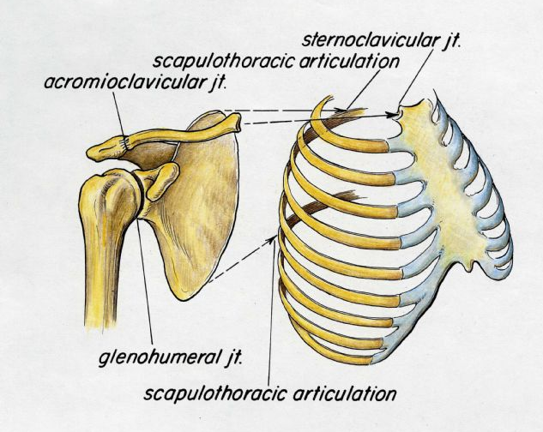
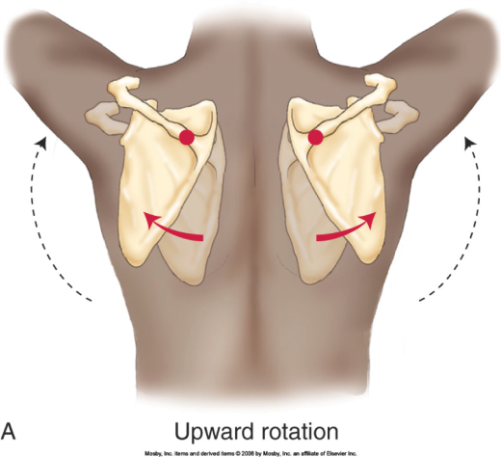
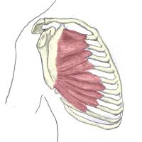
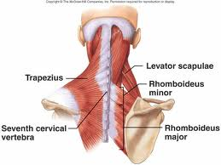
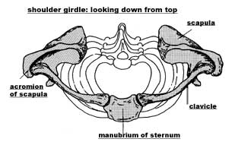
5 joints
  Glenohumeral
  Acromioclavicular (AC)
  Sternoclavicular (SC)
  Thoracoscapular
  Bursal joint
+ connection to Th and C spine

Slide 3
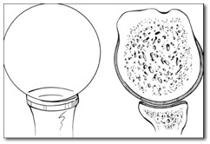
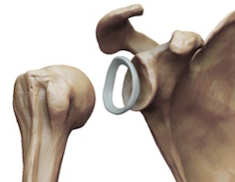
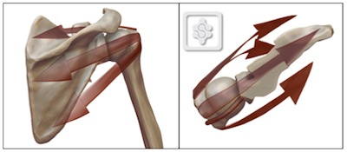
Stability of GH joint
Biggest ROM
small glenoid
Soft tissue stability
  Static: labrum glenoidale, capsule, glenohumeral ligaments
  Dynamic: muscles of rotator cuff
  deltoid muscle
Patology:
  Most frequent dislocation
  Instability- often

Slide 4
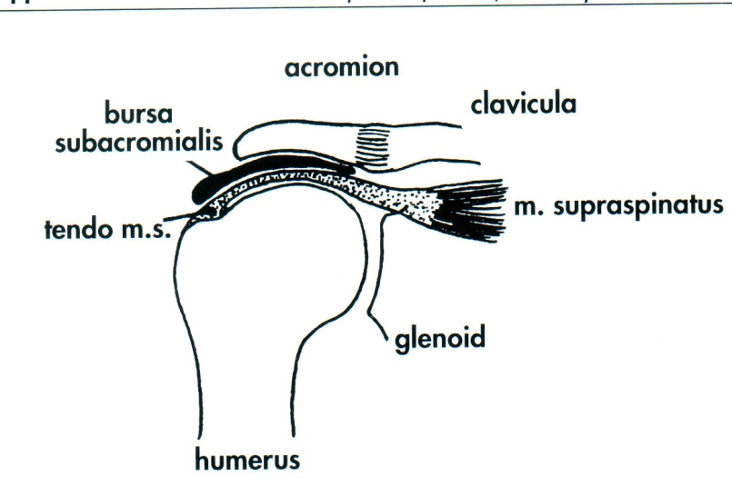
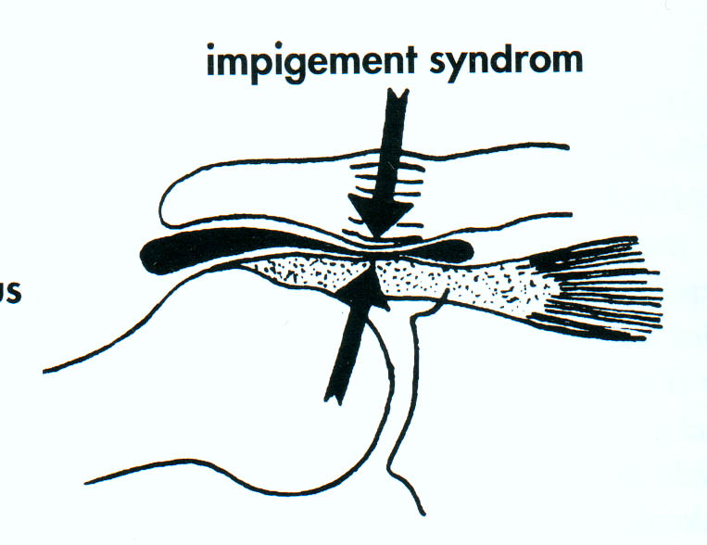
Subacromial joint
Impingement syndrom
Subacromial bursa

Slide 5
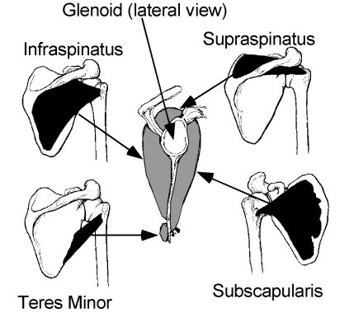
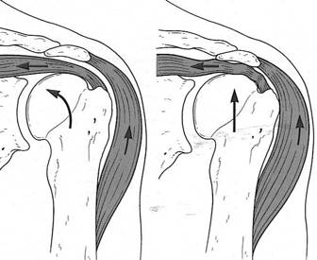
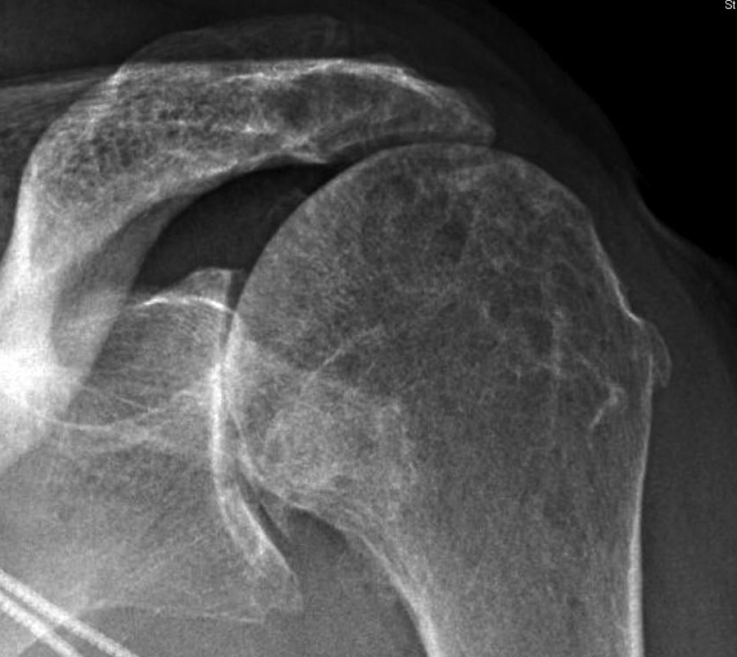
Rotator cuff
m.subscapularis, m.supraspinatus, m.infraspinatus, m.teres minor
  Movement in GH joint
  Depression of the humeral head
  Dynamic stabilisation

Slide 6
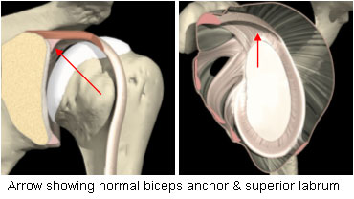
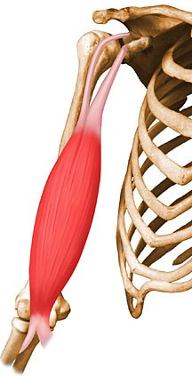
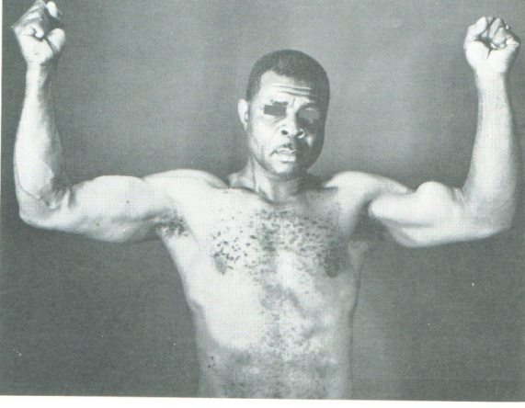
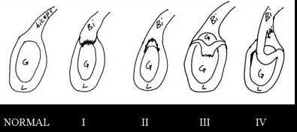
Long head of biceps LCMBB
intraarticular
Insertion to upper portion of labrum
Pathology:
tenosynovialitis
Rupture
SLAP

Slide 7
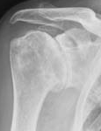
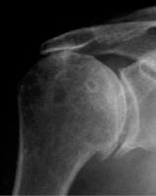
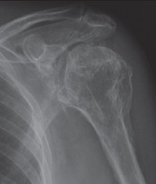
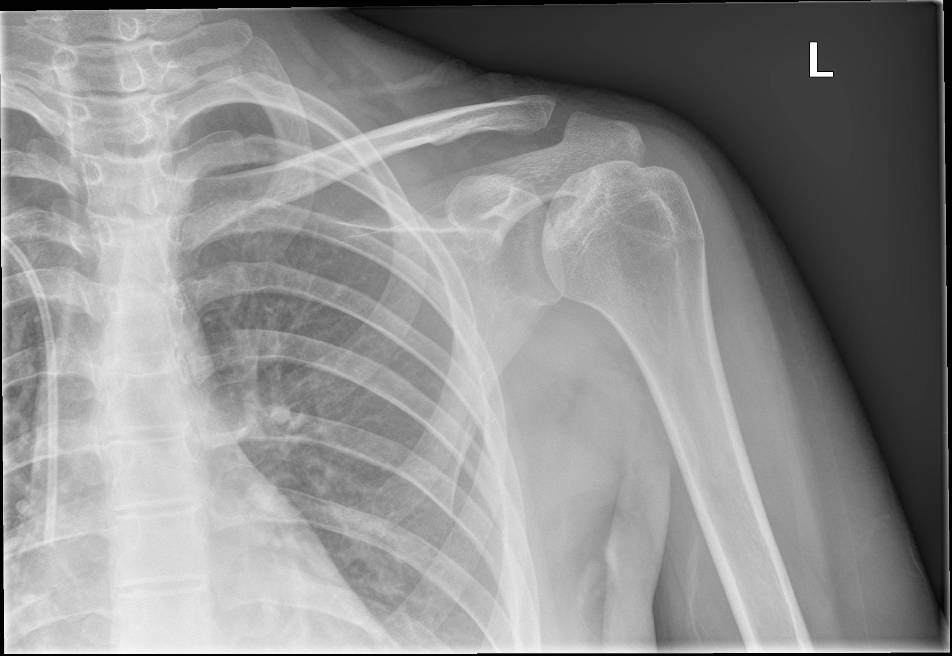
GH joint
Primary O.A. less frequent
  Posttraumatic
  R.A.
  Rotator artropathy
  Necrosis of humeral head

Slide 8
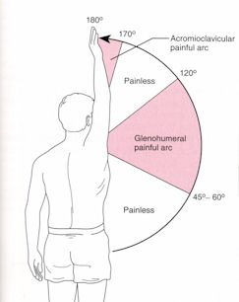
Analysis of pain
impingement syndrom –painful arc
Pain in full elevation– AC joint
Pain in abduction 20-30 degree- supraspinatus
Pain in rest or during night – pyogenic arthritis, O.A., R.A. acute rpt of
RC, acute tendinitis
Pain iradiating to the shoulder

Slide 9
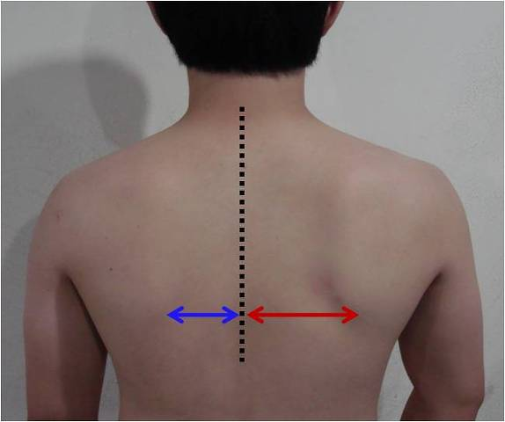
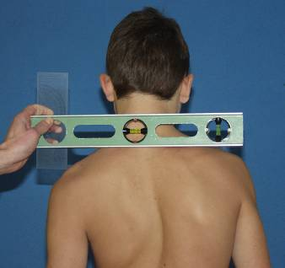
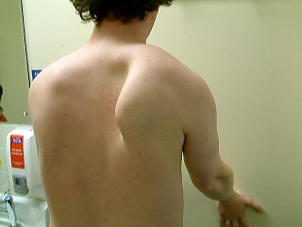
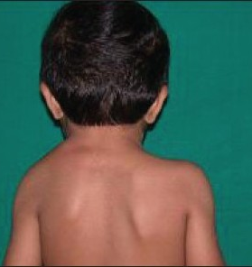
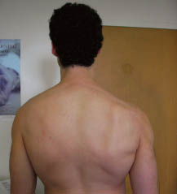
Clinical examination
  Deformity of the spine
    Muscle dysbalance
    scapula alta -Sprengel
      Palsy of n. thoracicus longus (m.serrarus anterior)
      Palsy of n. accesorius (m.trapezius)

Slide 10
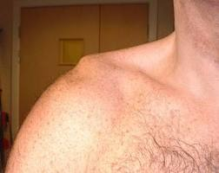

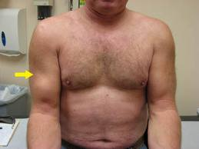
Clinical examination
Muscles
Antalgic position
Swelling
Skin

Slide 11
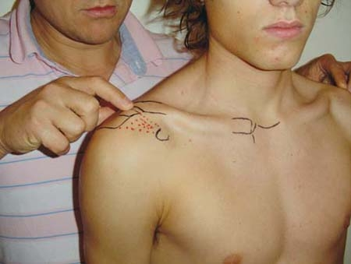
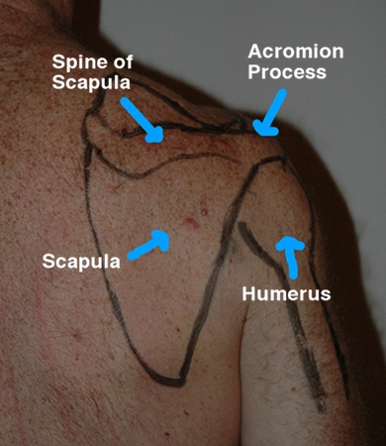
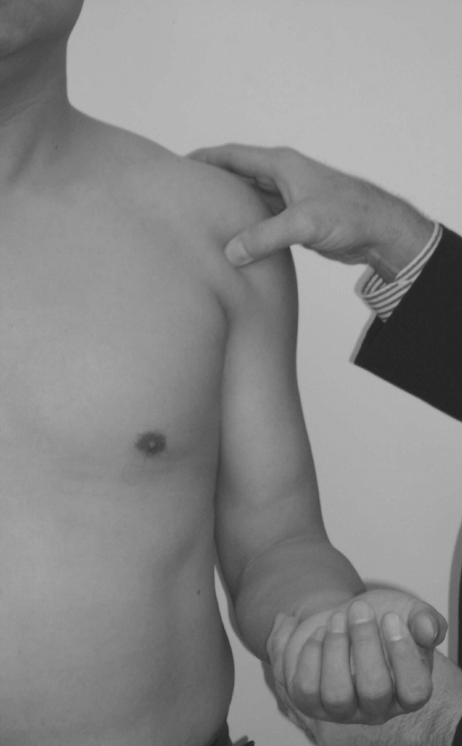
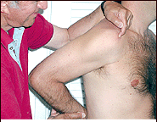
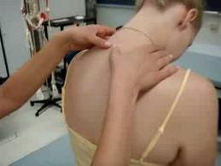
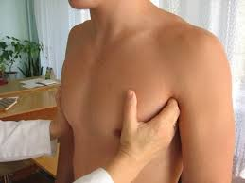
Clinical examination- tenderness

Slide 12
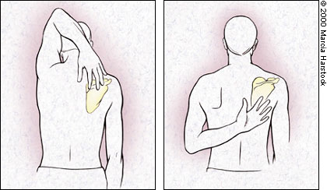
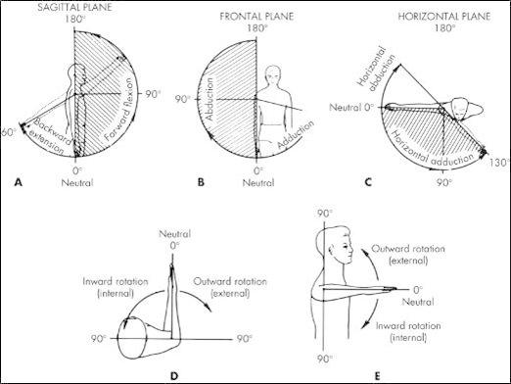
ROM
SFTR

Slide 13
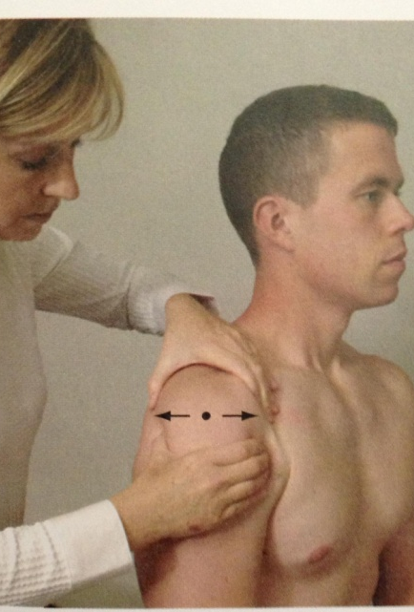
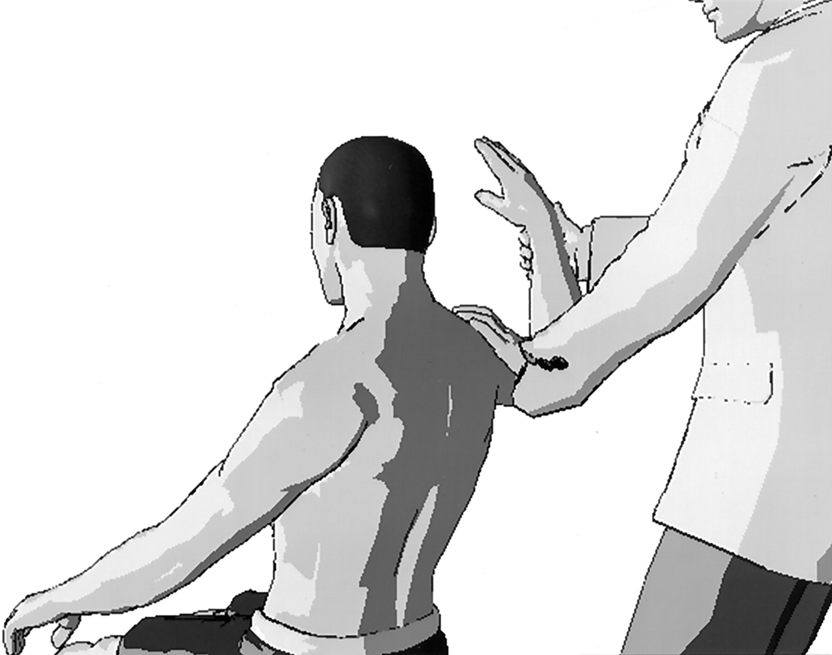
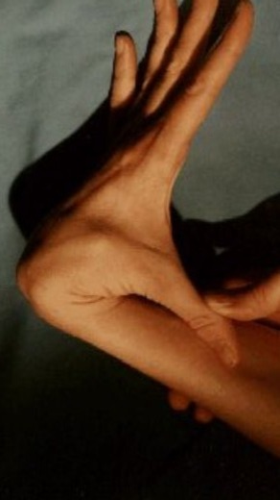

Clinical examination – stability
Posttraumatic instability
(typicky unidirekcionální, přední)
  přední zásuvka
  Apperhension test
  Jobeho relokační test
  event. zadní zásuvka, zadní Apperhension test (u zadní instability)
Habitual instability
  příznaky mesenchymální laxicity
  sulcus sign
  známky multidirekcionální instability

Slide 14
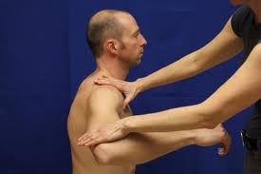
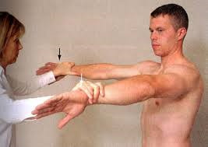
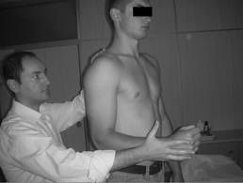
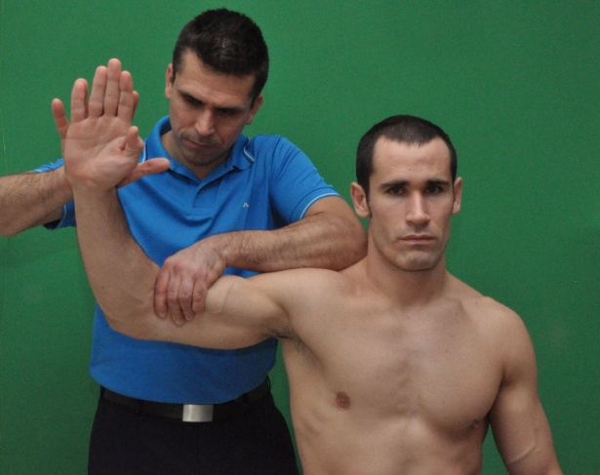
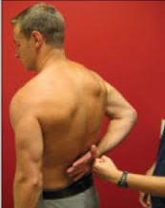
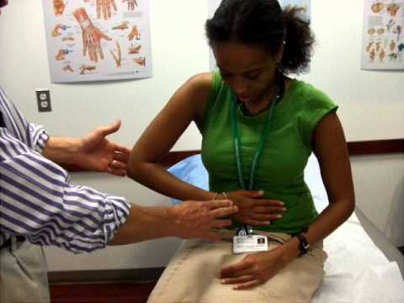
Rotator cuff tests
Resistance tests
m.supraspinatus:
  Abduction
  Jobe test
  drop arm test
M. infraspinatus, teres minor
  External rotation
m.subscapularis
  Inner rotation
  Gerber test
  Napoleon sign (press belly test)

Slide 15
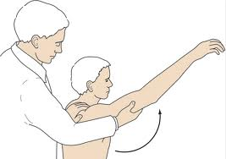
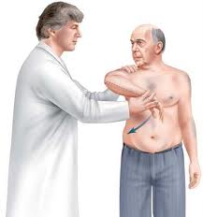
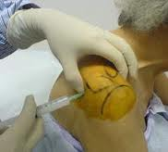
Impingement syndrom
Painfuil arc (60 – 120 degree)
crepitation
impingement sign Neer
impingement sign Hawkins and Kennedy
Neer infiltration test

Slide 16
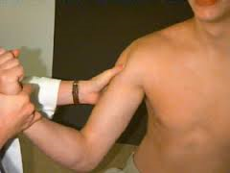


Tests for CLMBB
Tenderness
Speed test
Yergasson test
Distalisation of muscle belly

Slide 17



Tests for AC joint
tenderness
painful full elevation
Dislocation of clavicle

Slide 18




Imaging
Ultrasonography
X-ray
CT
MRI
Others

Slide 19

Ultrasonography
USG

Slide 20


USG
  impingement syndrom
  SA bursa
  RC
  Changes in

Slide 21




X ray
  ap
  axial
    inferoposterior
    transthoracal
  Y projection

Slide 22






Xray
X ray

Slide 23






X ray
    instability (Hill Sachs defect
    Subacromial space

Slide 24



CT
CT

Slide 25



MRI
Soft tissue

Slide 26
Painful shoulder
Tenosynovitis of tendon of long head of biceps
Rupture of tendon of long head of biceps
Subacromial bursitis
Supraspinatus tendinitis
Rotator cuff rupture
Impimgement syndrom
Frozen shoulder syndrom
Osteoarthritis of glenohumeral joint
Disorders of acromioclavicular joint
Inflammations
Tumors
Referred pain from cervical spine

Slide 27

Tenosynovitis of long head of biceps
Tenderness
Resisted flexion and supination
of the elbow
Therapy:
Corticosteroids locally
Rest, sling
NSAID

Slide 28

Rupture of long head of biceps
Therapy:
Rest, sling
NSAID
Surgery – up to 40 years
Conservative- over 40 years
Surgery:
key hole fixation to the humerus
Suture to the short head
of biceps

Slide 29

Rupture of long head of biceps
Tenderness
Distalisation of
muscle belly
Diminished strength

Slide 30


Subacromialis bursitis
Inflammation
White fluid
Severe, burning pain
Restricted movements
Tenderness
Calcifications

Slide 31

Subacromial bursitis
Conservative treatment:
Rest, sling
Lavage with 2 needles
Corticosteroids locally
NSAID
Physiotherapy
Surgery:
Removal of bursa

Slide 32



Bursitis subacromialis
Therapy
Conservative
Surgery

Slide 33

Supraspinatus tendinitis
Tenderness over greater
tuberosity
Limited movements
Therapy:
Rest, NSAID
Corticosteroids
Physiotherapy

Slide 34


Rotator cuff
Rotator cuff:
m. supraspinatus
m. infraspinatus
m. teres minor
m. subscapularis
Function:
First 30 ° of abduction
Pressure of the humeral head
into glenoid cavity
Depressor of the humeral
head

Slide 35

Anatomy of the shoulder

Slide 36

Anatomy of the shoulder

Slide 37

Rupture of rotator cuff
Partial rupture:
Severe pain
Painful arc
Painful abduction
Keeps the arm in position
of adjusted abduction
Ultrasonography
Management: conservative

Slide 38



RC
Tendinopathy
Degenerative rupture
Rotator arthropathy

Slide 39





RC
Suture of RC
reverse total joint arthroplasty

Slide 40
Rupture of rotator cuff
Complete rupture:
No active abduction
Lifting of the shoulder
Managemet:
suture: ASC, open surgery
- attachment to greater
tuberosity

Slide 41

Impingement syndrom
Greater tuberosity impinges
to distal surface
of acromion and
coracoacromial ligament
Narrowing of subacromial
space

Slide 42

Impingement syndrom
Causes
acromion spur
Change of acromion
Distal osteophytes of AC
Prominence of tuberculum maius

Slide 43

Impingement syndrom
Stages:
Swelling, hemorhage of
supraspinatus
2. Fibrosis, tendinitis,
bursitis
degenerative changes of cuff
3. Rupture od rotator cuff
and long biceps tendon

Slide 44

Impingement syndrom
Symptoms:
Painful arc
Impingement sign
Impingement test
Jobe test
X-ray:
Narrowed subacromial space
Y view- outlet view
Arthrography
Ultrasonography

Slide 45

Impingement syndrom
Therapy:
stage: conservative
Rest, NSAID,
Physiotherapy,
Local corticosteroids
2. stage: the same
+ bursectomy, ASAD
3. stage: ASAD
Subacromial decompression

Slide 46

Frozen shoulder- capsulitis adhesiva
Progressive limitation
of movements
Pain
No motivation for movement
Shrinkage of capsule
Adhesions in distal recesus
Tightening of soft tissue
Muscle spasm
Low capacity of joint space

Slide 47

The cause
All conditions limiting
joint movements:
Impingement syndrom
Arthrosis of AC joint
Posttraumatic conditions
Inflammations
Thoralic outlet syndrom
Tumors of the lungs
Disorders of pleura
Cardiac disorders

Slide 48
Frozen shoulder
Management:
Long lasting period
Heat
Passive movements
Positioning
Active movements
Physioterapy
NSAID
Local corticosteroids
ASC- decompression
Redressement force
Removal of adhesions

Slide 49


Long head of biceps
Tenosynovialitis
in SLAP lesion
subluxation
parcial or total rupture
Th.:
conservative
ASC debridement
Tenotomy, tenodesis

Slide 50




SLAP lesion
= superior labrum anterior, posterior
Causes
  Subluxation, dislocation
  Microtraumatisation
  throwing shoulder
Snyder classification

Slide 51



Instability of GH joint
  Acute, chronic posttraumatic
  Multidirectional, unidirectional
  Habitual
  Posterior, anterior
  Neglected
History

Slide 52

Glenohumeral osteoarthritis
- omarthrosis
Therapy:
Conservative
Total shoulder replacement

Slide 53


Osteoarthritis
Secondary
Postraumatic
In R.A.
Rotaror arthropathy
Primary
Therapy
  Conservative
  surgery
    Resurfacing
    Head prosthesis
    Total joint
    Reverse total joint

Slide 54





Slide 55


Rotator arthropathy
Reverse total shoulder artroplasty

Slide 56
Infection and tumors
Pyogenic arthritis
Tumors
  OSA, CHoSA, Ewing- sa
  Metastases
  Benign tumors
  Myeloma

Slide 57

Disorders of acromioclavicular joint
Synovitis
O.A.
Sprain
Subluxation
Dislocations

Slide 58
Refered pain to the shoulder
Cervical spine
Thoracic outlet syndrom
Cardiac diseases
Lung and pleura disorders
Herpes zoster neuralgia

