Slide 1
Obstructive sleep apnea
(OSA)
P.Turčáni, Department of Respiratory Diseases and TB, University Hospital Brno, 2020

Slide 2
Definition
Is characterised by recurrent episodes of partial or complete upper airway collapse during sleep. The collapse is highlighted be reduction in, or complete cessation of, airflow despite ongoing inspiratory efforts
OSA effects productivity, cognition, coordination, quality of life and cardiovascular health

Slide 3
Epidemiology
The prevalence of OSA increases from young adulthood through the sixth to seventh decade, then appears to plateau
The prevalence of an AHI > 5 event/hour in general population has previously been estimated to be 24 % in a male and 9% in female population. When symptoms of sleepiness were also taken into account, the prevalence decreased to 4% in males and 2% in females
A minimum prevalence of childhood OSAS is estimated to be 2-3% and the prevalence of habitual snoring may be as high as 20%

Slide 4
Pathophysiology
OSA is characterized by obstructive apneas, hypopneas, and/or respiratory effort-related arousals caused by repetitive collapse of the upper airway during sleep
The occlusion or narrowing of the upper airway during sleep has been attributed to several factors: abnormal anatomy of upper airway (maxillary or/and mandibular hypoplasia, adenotonsillar hypertrophy,.. ), pharyngeal muscle factors (impaired strenght and endurance of pharyngeal dilators,..), pharyngeal compliance, sensory function (impaired pharyngeal dilatator reflexes,..), ventilatory control system factors (unsatble ventilatory control,..), sex factors (male influences,..)weight, lung volume dependence of upper airway cross-sectional area.

Slide 5
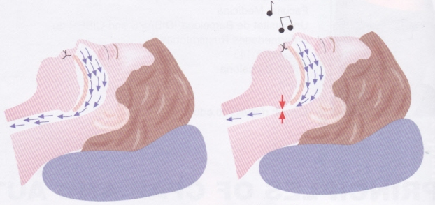
Notes:
5

Slide 6
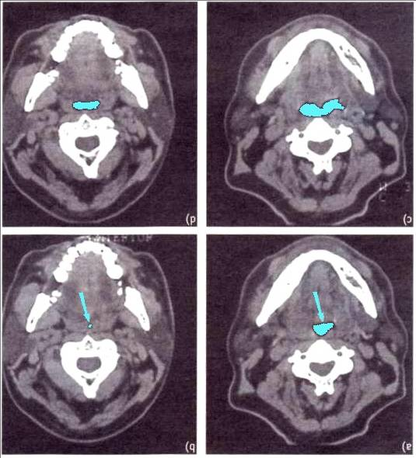


Slide 7
Symptoms
Most frequent (>60 %): loud snoring, difficulty staying asleep, restless sleep, unrefreshing sleep, nocturia, neuropsychiatric symptoms, sleep partner noticed repeated apneas or loud snoring
Common (10 % - 60 %): sudden awakenings to restart breathing, sexual dysfunction, night sweats, morning headaches
Infrequently (<10 %): enuresis, night cought, sleeplessness, gastroesophageal reflux

Slide 8
Risk factors and associated conditions
obesity
large neck circumference
retrognathia, micrognathia
nasal congestion
narrow pharynx, enlarged tonsils
elongated or enlarged uvula
elongated soft palate
older age, male gender
smoking
family history of snoring or OSA

Slide 9
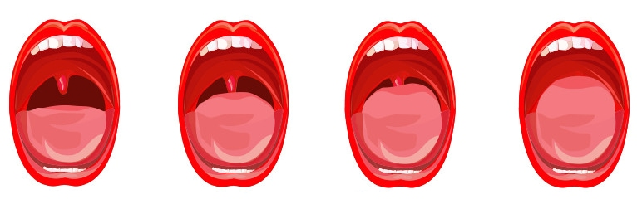
The Mallampati Classification
I. II. III. IV.
The Mallampati classification is commonly used to quantify airway
narrowing, with classes 3 and 4 considered positive for airway narrowing.
The Mallampati classification correlates with OSA severity

Slide 10
Adverse outcomes associated with OSA
Systemic hypertension
Congestive heart failure
Coronary artery disease and myocardial infarction
Arrhythmias
Pulmonary hypertension
Stroke
Depression
Sexual dysfunction
Type 2 diabetes mellitus
Drowsy driving and motor vehicle crashes

Slide 11
Diagnostic strategy
The diagnosis of OSA is based upon the presence or absence of related symptoms, as well as the frequency of respiratory events during sleep (ie, apneas, hypopneas, and respiratory effort-related arousals [RERAs])

Slide 12
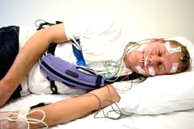
Testing for OSA, Polysomnography
Is the accepted standard
The sleep EEG recording is the core part of polysomnography
Includes the recording of sleep signals, respiratory effort, muscle movement and cardiovascular signals

Slide 13
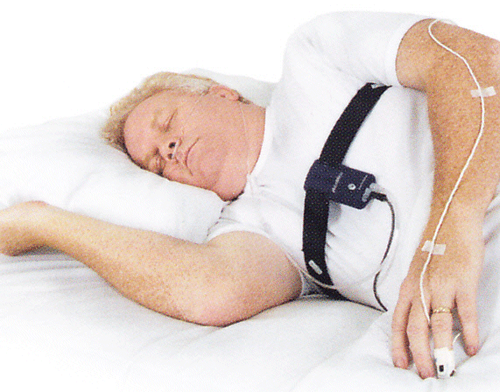
Testing for OSA, Polygraphy
staff-monitored in the laboratory
with recording of at least cardiorespiratory parameters and body posture

Slide 14
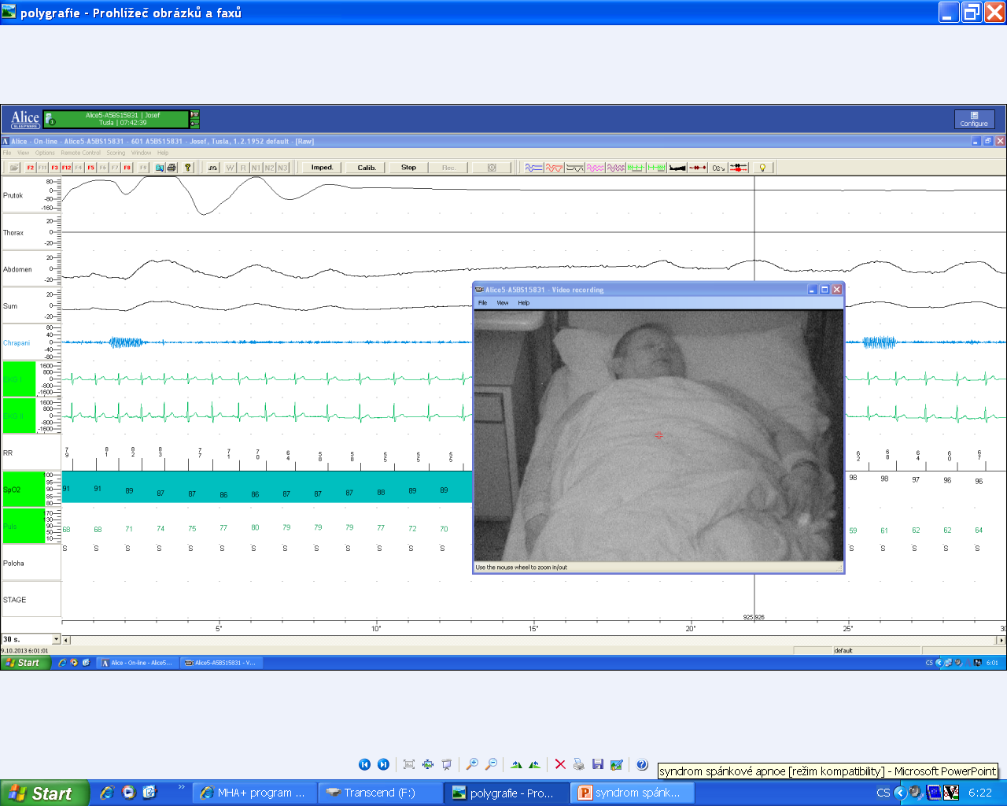
Polygraphy, an example of signals recorded in a sleep lab.

Slide 15
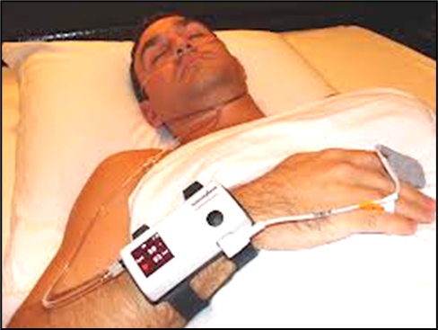
Testing for OSA, Screening
recording of oxygen saturation and one further parameter (flow mainly)
attended or unattended
not suitable for the exclusion or confirmation of mild OSA

Slide 16
The most important results of diagnostic testing for OSA
AHI (apnoe/hypopnoe index) – defined as the number of apneas and hypopneas per hour of sleep
ODI (oxygen desaturation index) – is the number of times per hour of sleep that the blood's oxygen level drop by a certain degree from baseline
T90 – the rate of sleep-time spent below 90% oxygen saturation

Slide 17
Classification, stages of severity
< Normal
5-15 AHI Mild OSA
15-30 AHI Moderate OSA
> 30 AHI Severe OSA

Slide 18
Epworth Sleepnies Scale
is valuable tool to define the functional impact of the sleep-related breathing events in patients with OSAS
was constructed with intention to describe the probability of falling asleep in 8 specific situations
is applied mostly because of simplicity and practicability in routine

Slide 19
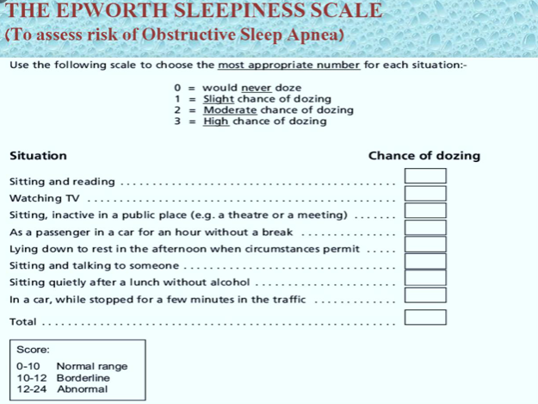
Epworth Sleepnies Scale

Slide 20
Differential diagnosis
primary snoring
COPD, asthma
gastroesophageal reflux
obesity hypoventilation
psychiatric illnesses
a variety of diseases with excessive daytime sleepiness

Slide 21
Treatment
Weight loss and lifestyle changes
Treatment of comorbidities
The first-line therapy for treatment of OSA is positive airway pressure (PAP). PAP significantly reduced snoring and daytime sleepiness and improved health-related quality of life and mood. Treatment with PAP is cost-effective, decreases morbidity and mortality due to cardiovascular diseases, and reduces the risk of drowsiness-related traffic accidents
Alternatives to PAP for the treatment of OSA include a variety of soft tissue and/or maxillary-mandibular surgical interventions
Mandibular advancing dental devices are a third-line treatment option for some OSA patients intolerant of PAP who are not candidates for surgery

Slide 22
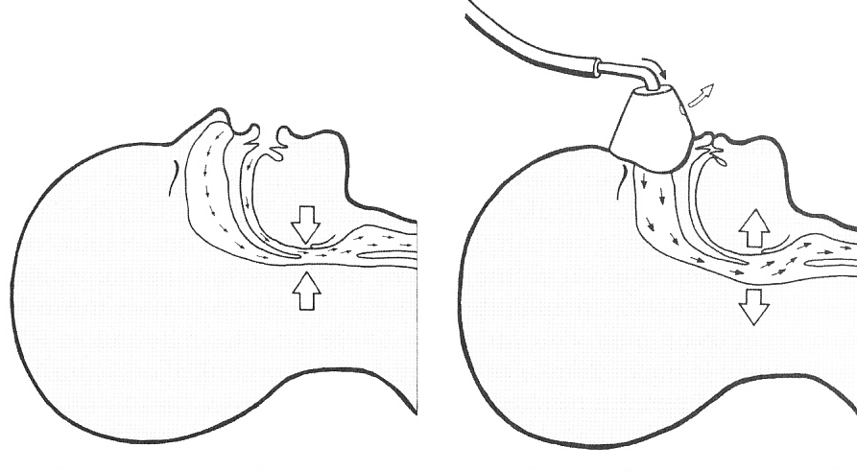
Mechanism of action : CPAP provides „pneumatic stent“ for the pharyngeal airway

Slide 23
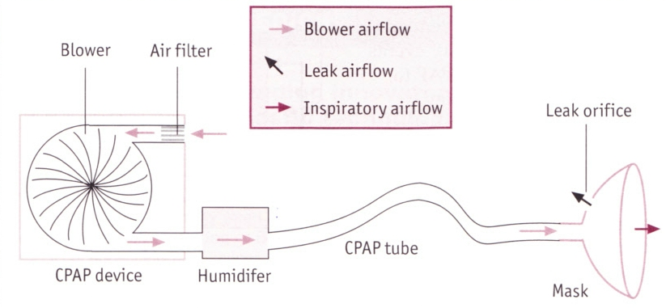
Principle of CPAP machine
Notes:
23

Slide 24
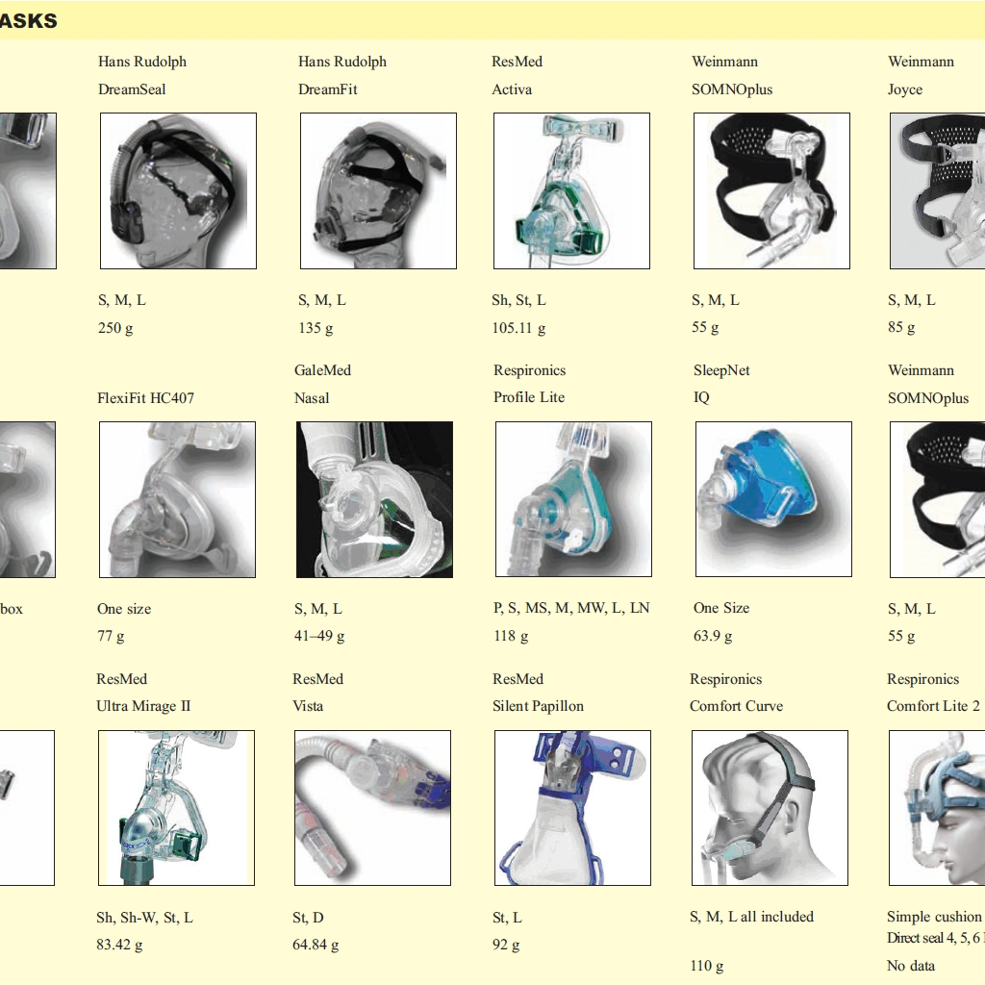
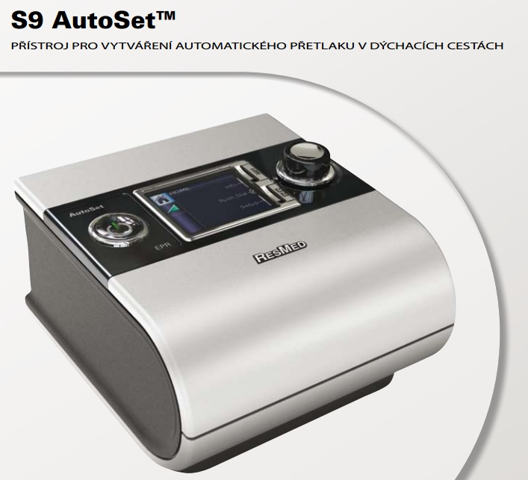
Physicans can use different types of masks and devices
Notes:
24

Slide 25
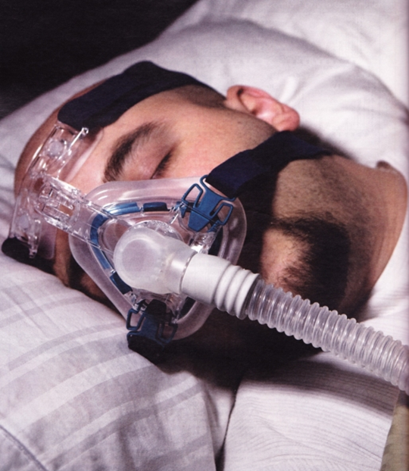
Thank you for your attention

