Slide 1
CYSTIC FIBROSIS
NELA ŠŤASTNÁ

Slide 2
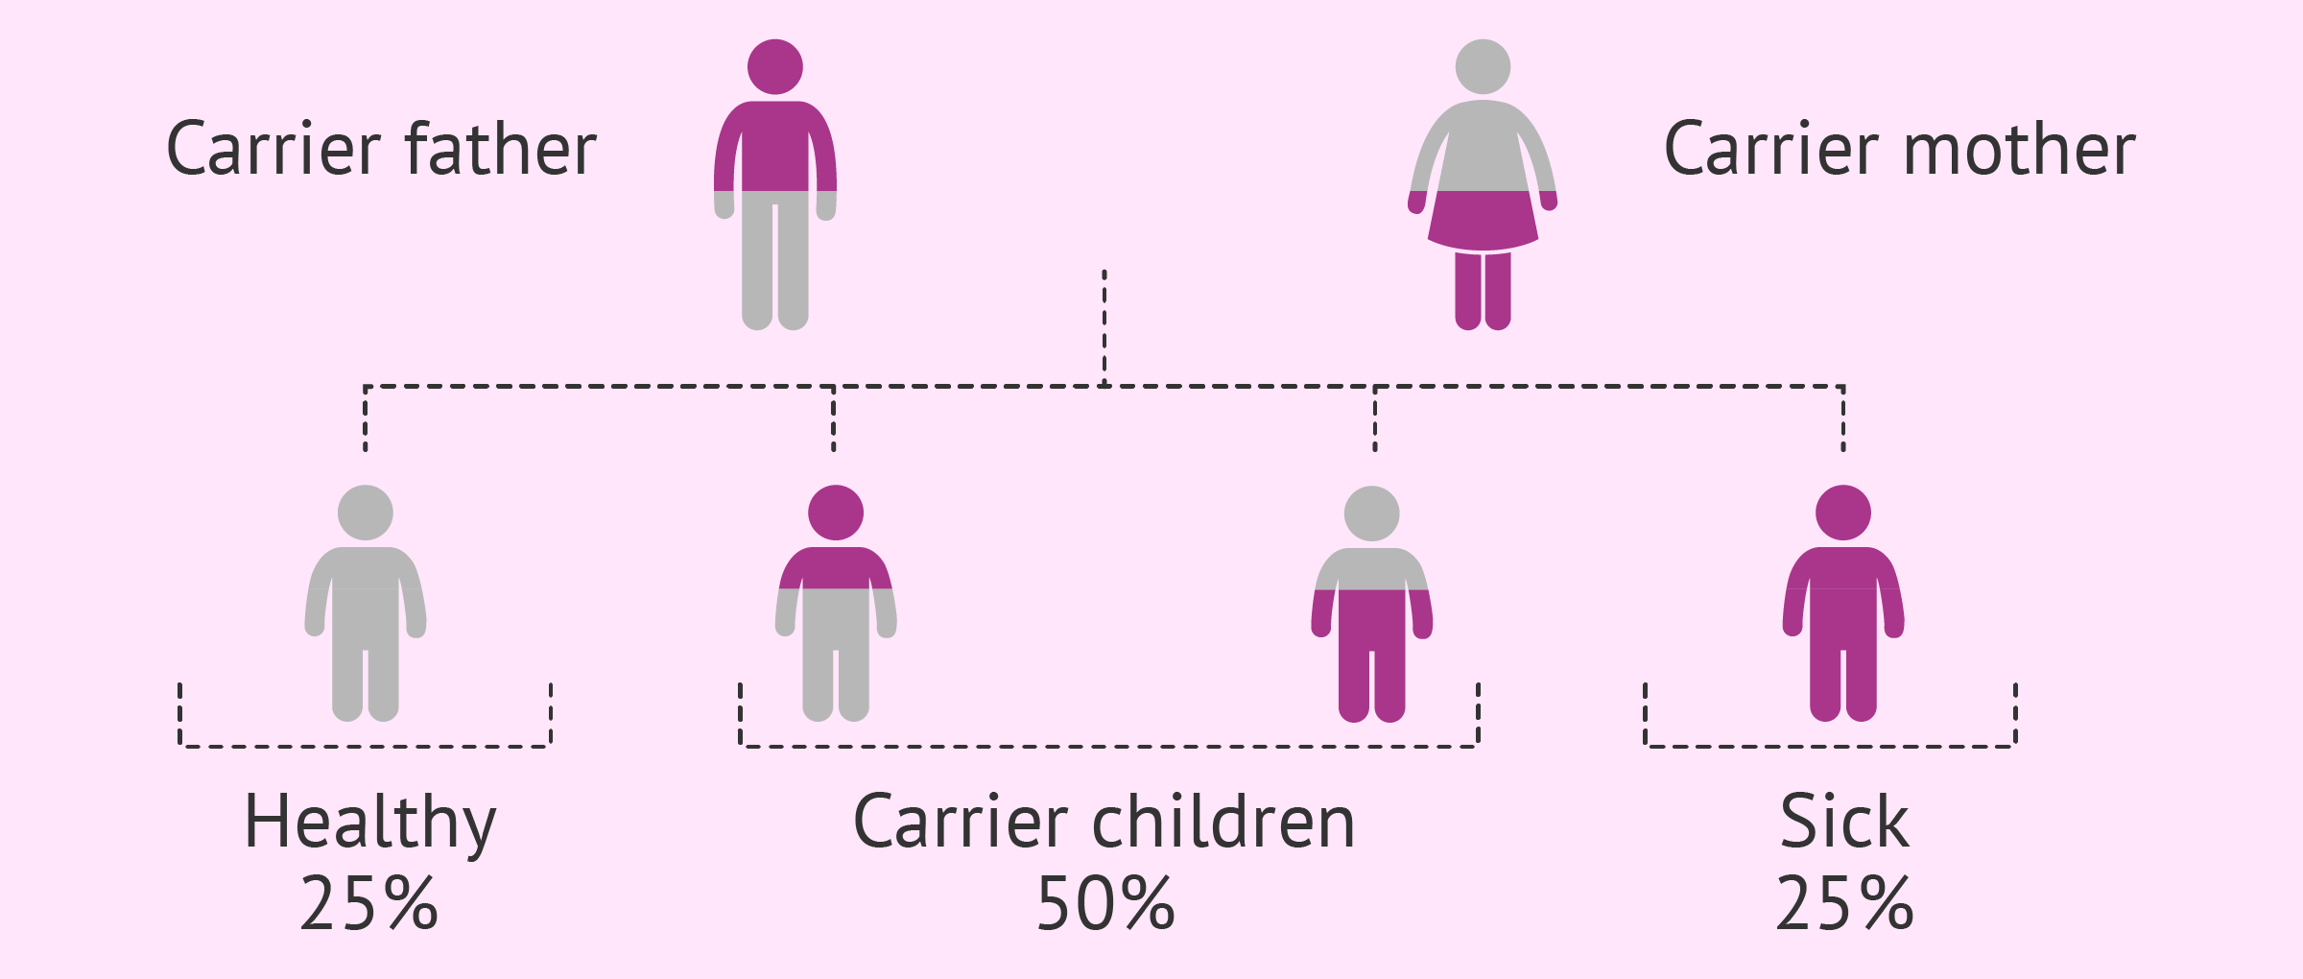
DEFINITION
Most frequent congenital metabolic disease
Autosomal recessive inheritance – only a person with 2 clinically significant mutations becomes ill
Progressive lung disease, pancreatic insuficiency, high concentration of electrolytes in sweat, azoospermia, affects liver, intestines
Described in 1938, gene discovered in 1989, name refers to pancreatic fibrotic and cystic conversion

Slide 3
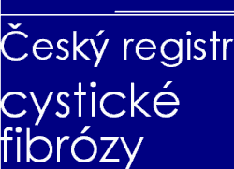
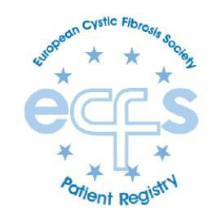
EPIDEMIOLOGY
1:2500 – 4500 Caucasian newborns
35 newborns with CF per year in Czech Republic
Every 25th person CFTR mutation carrier

Slide 4
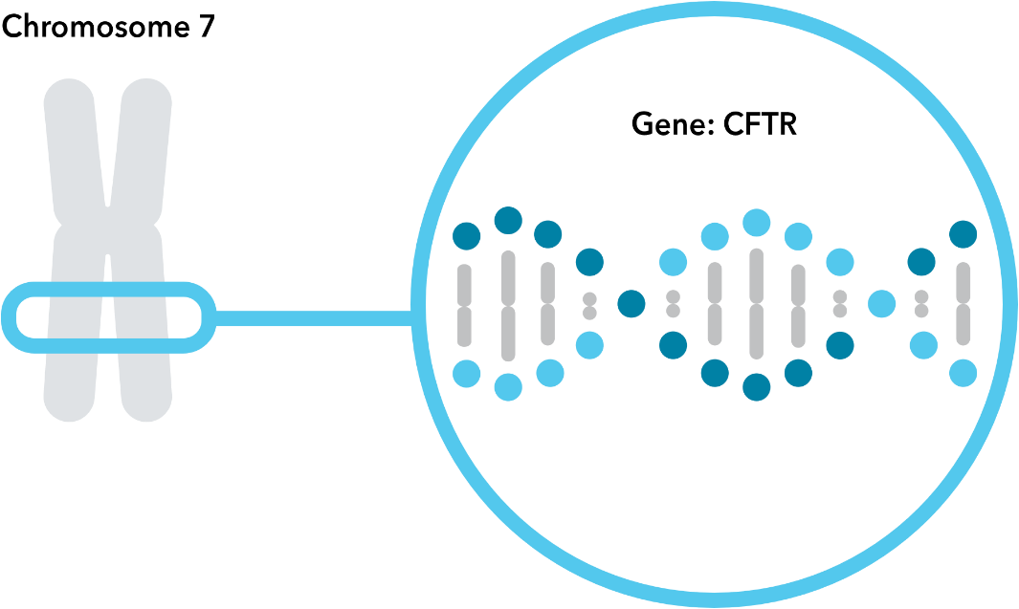
GENETICS
CFTR gene codes CFTR protein (ion transmembrane conductance regulator)
> 2000 mutations known – most of them are rare or don‘t cause manifest disease
30 mutations cause manifest CF
Most frequent mutation F508del
Relationship of the genotype and the phenotype:
Severe mutations – classic signs of CF
Mild mutations – atypical forms – sufficient pancreatic function, borderline limits of the sweat test, late onset and mild respiratory manifestation, normal liver function

Slide 5
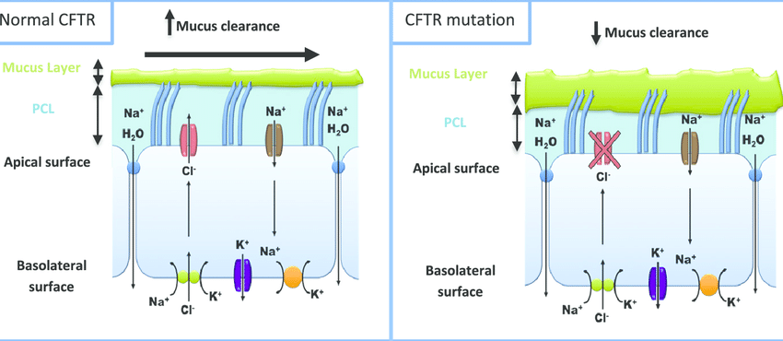
PATHOPHYSIOLOGY
Gene product – chloride chanel on the epithelial cell‘s membrane
Impermeability to chloride ions:
1. thickening of the mucus secretions – mucociliary clearance disorder – mucus retention – bacterial colonisation (biofilm) – neutrophil infection – bronchiectasis, obstructive ventilation disorder, respiratory insuficiency, blockage the ducts carrying digestive enzymes - demage of the pancreas and liver, reduced fertility
2. chlorides and sodium cannot be resorbed in the sweat glands

Slide 6
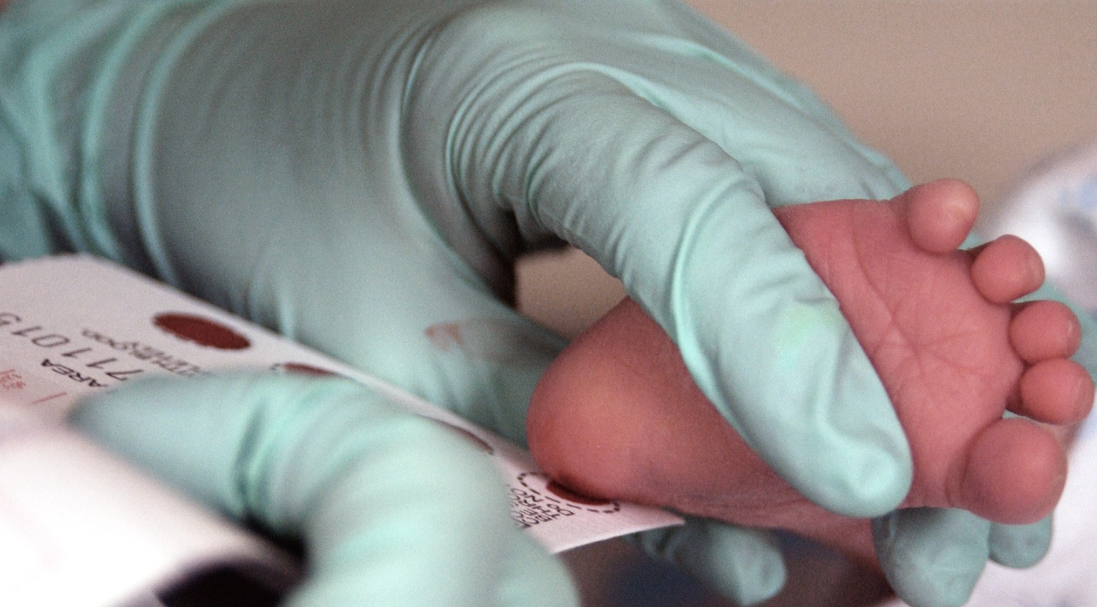
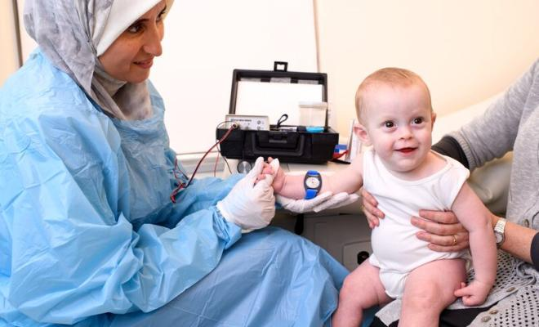
DIAGNOSTICS
Typical clinical signs and/or
Family history and/or
Newborn screening – blood tests for rare diseases and genetics, kiss your baby test
+
Positive sweat test and/or
2 classical CFTR gene mutations

Slide 7
ALGORITHM
CLINICS / NEWBORN SCREENING / FAMILY HISTORY
SWEAT TEST
LOW
MIDDLE
HIGH
CF non-suspected
CF Dg.
GENETICS
GENETICS
2 MUTATIONS
Atypical CF / CFTR - RD
1 – 0 MUTATIONS
CFTR-RD / healthy carier / false positive SwCl

Slide 8
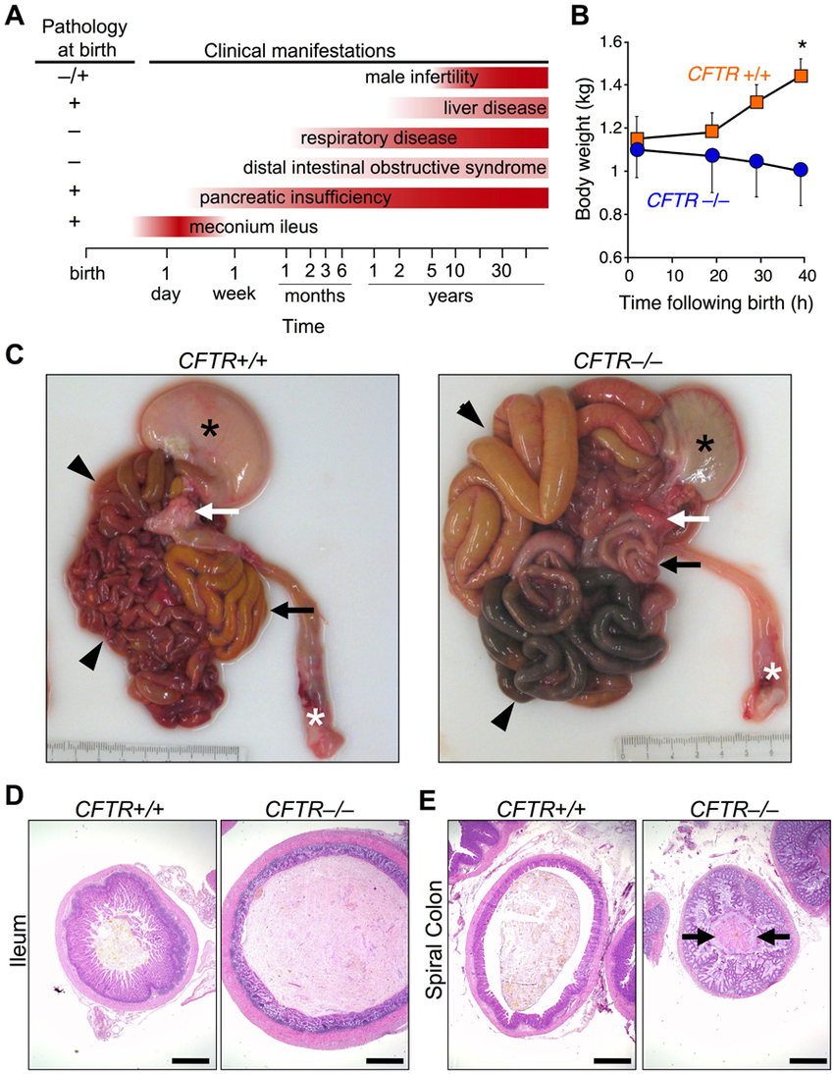
CLINICAL SYMPTOMS
Newborns – meconium ileus, lower birth weight, long newborn jaundice
Older babies and kids – respiratory + gastrointestinal manifestation, salt loss syndrome (acute hyponatremic dehydratation with shock, chronic metabolic alkalosis), poor growth and weight gain
Adolescents + adults – infertility / azoospermia, bronchiectasis, Pseudomonas aeruginosa cultivation, pancreatic insufficiency, mental health problems, osteoporosis

Slide 9
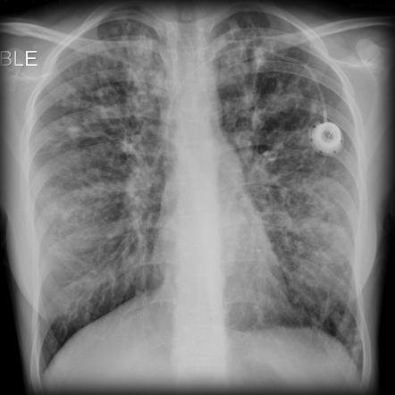
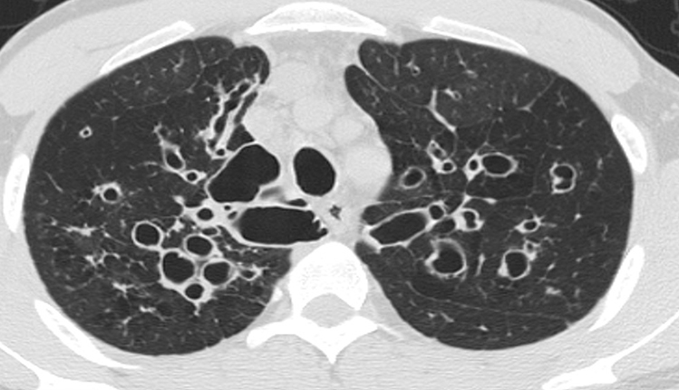
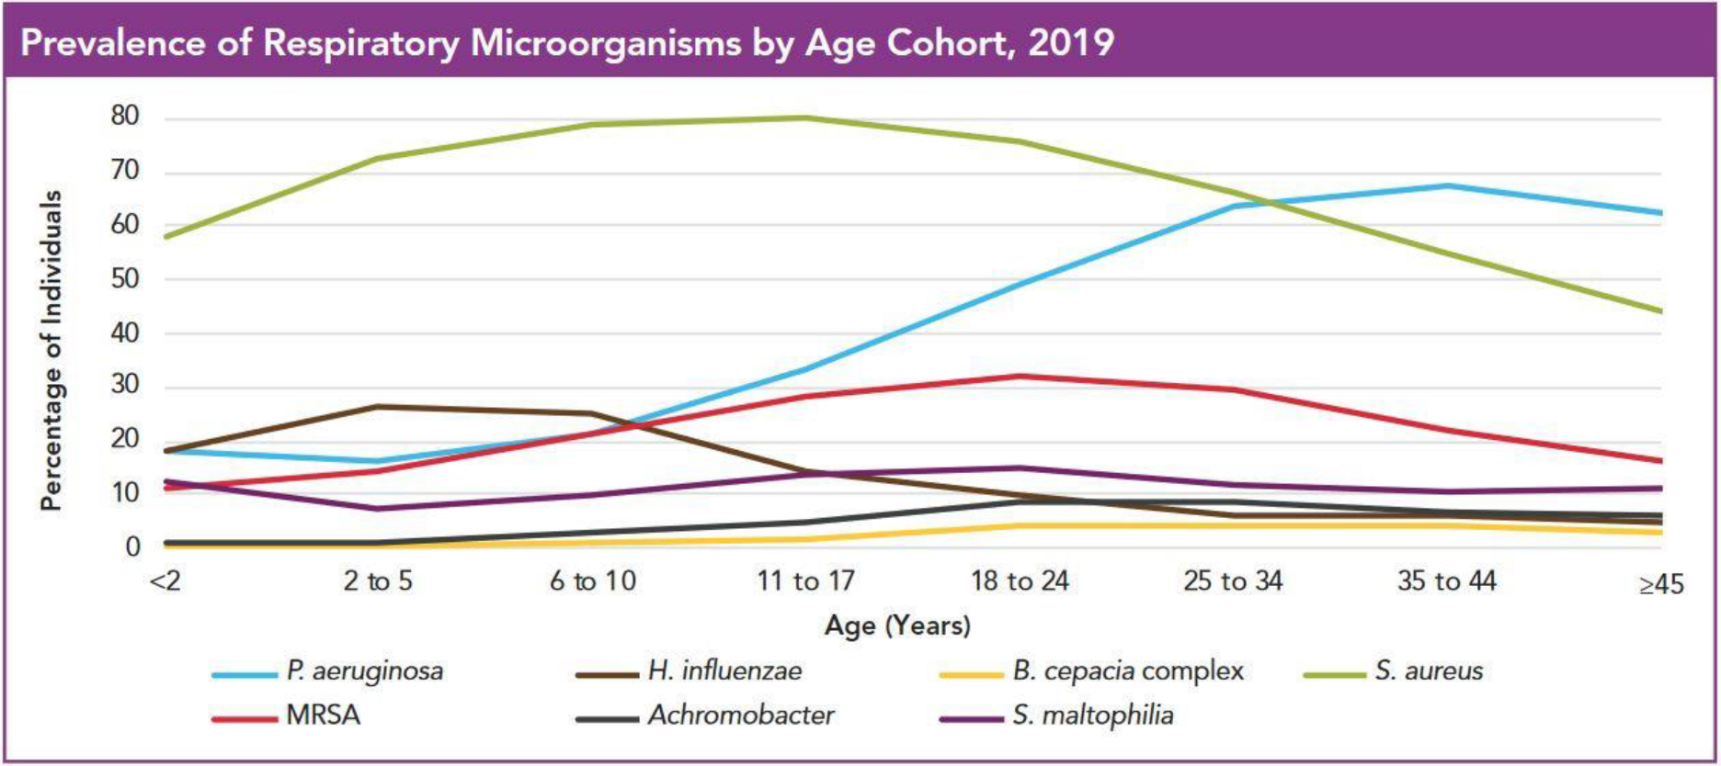
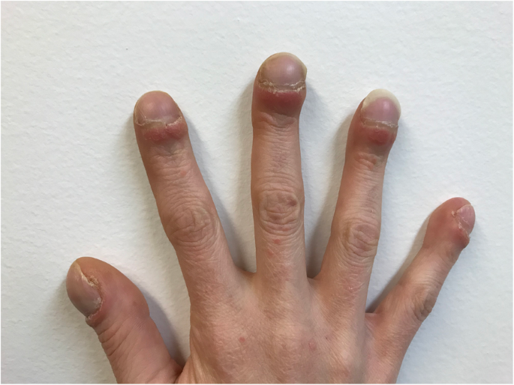
RESPIRATORY SYMTOMS
Persistant pathogen colonisation – Staphylococcus aureus, Haemophillus influenzae, Pseudomonas aeruginosa, Burkholderia cepacia, MOTT
Chronic respiratory infection – cough, sputum production, X-ray changes, obstructive ventilatory disorder, clubbing fingers
Chronic sinusitis – nasal polyps, pansinusitis
Complications:
Bronchiectasis, allergic bronchopulmonary aspergillosis, atypical mycobacteriosis, atelectasis, pneumothorax, hemoptysis, pulmonary hypertension, cor pulmonale, hypoxemia, respiratory failure

Slide 10
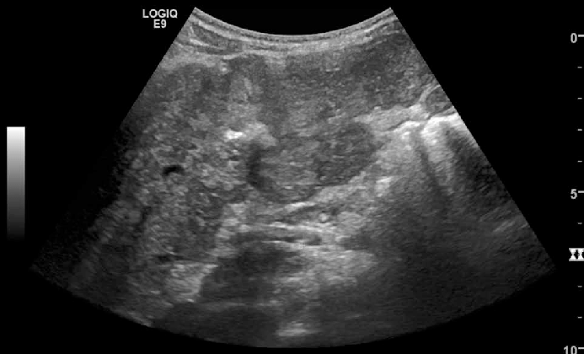
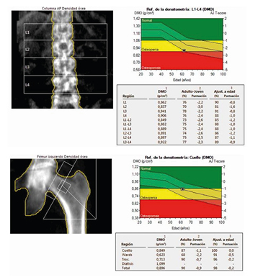
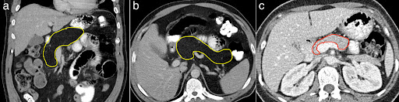
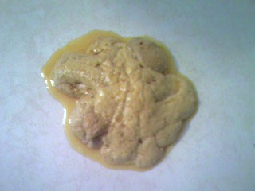
GASTROINTESTINAL SIGNS
Intestinal disease – distal intestinal obstruction syndrome, rectal prolapse
Pancreatic disease – exocrine insufficiency, steatorhea, relaps of pancreatitis
Chronic hepatobiliary disease – cirrhosis
Malabsorbtion, malnutrition, hypoprotein odema
Avitaminosis – ADEK, blood clotting disorder
Complications:
Gastroesophageal reflux, oesophagitis, gastroduodenal ulcerations, fibrotic colonopathy, portal hypertension, distal bile duct stenosis, cholelithiasis, gallstones, CFRDM, metabolic bone disease

Slide 11
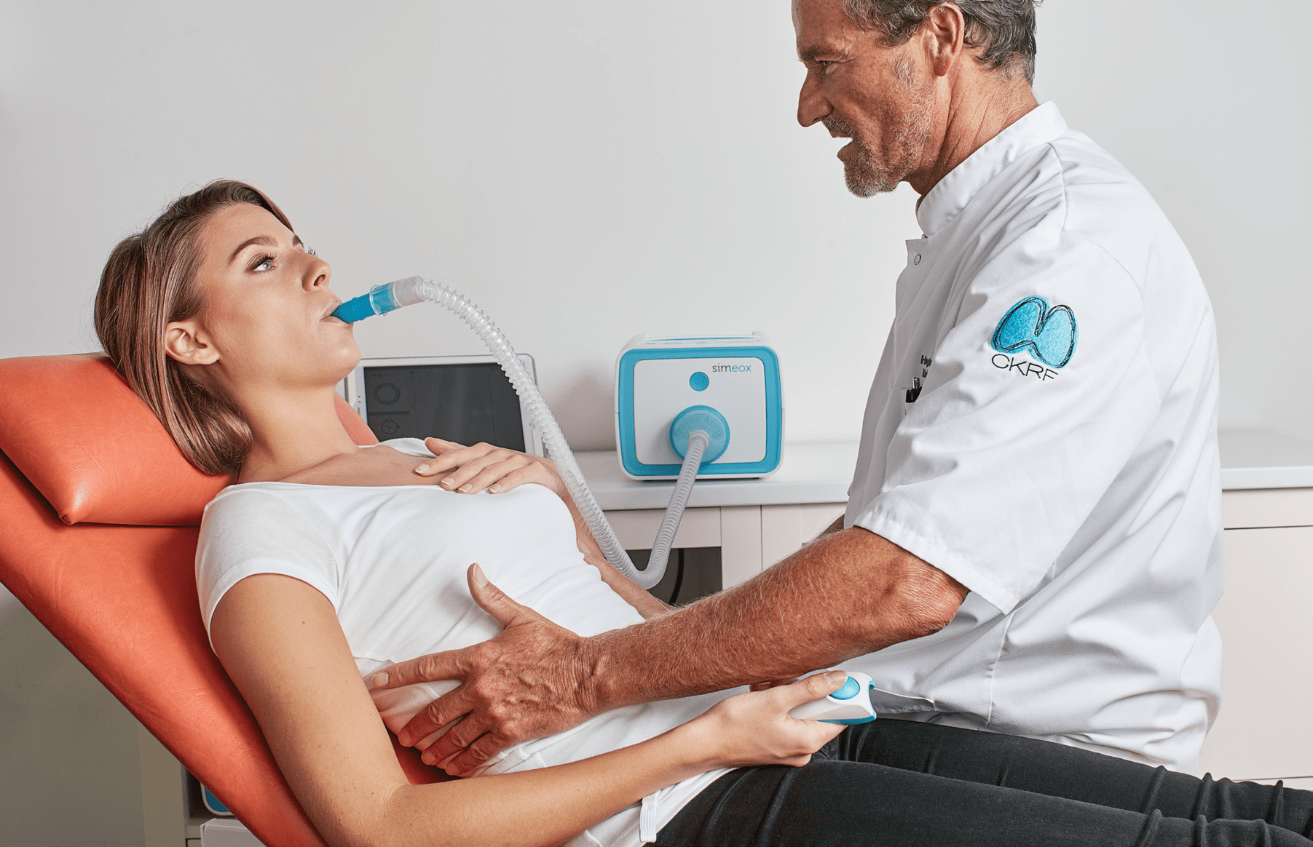
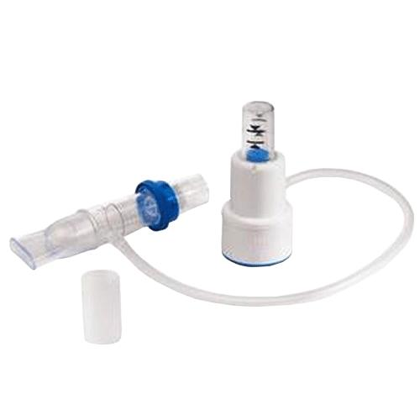
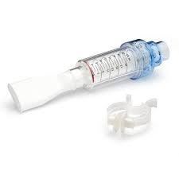
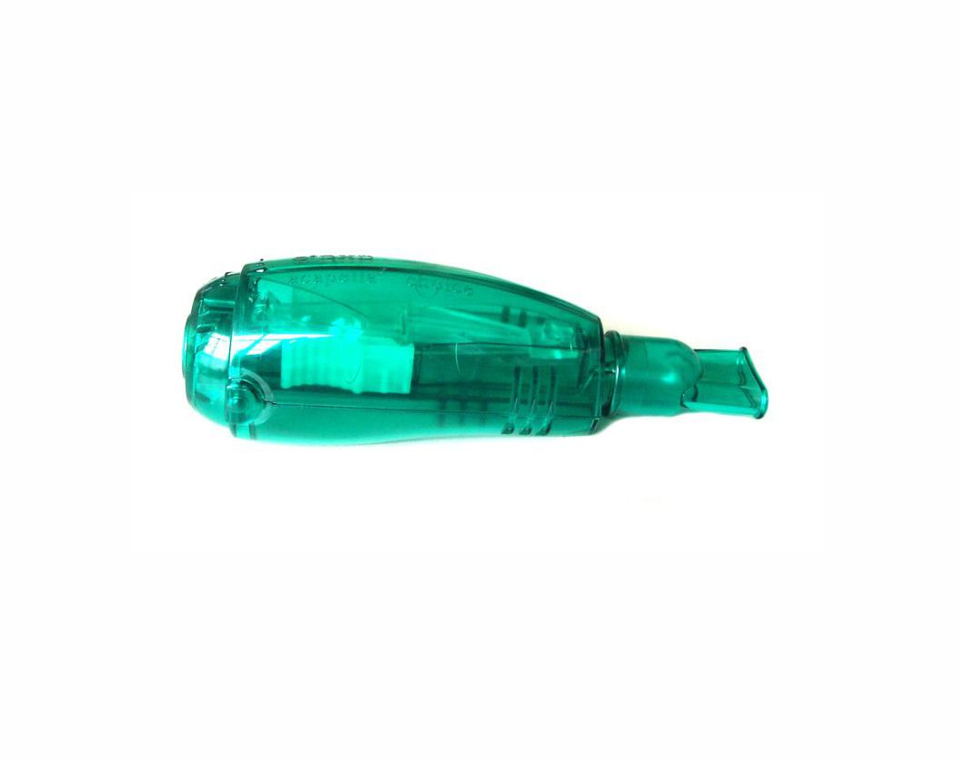
TREATMENT
At specialist multidisciplinary centers
1. Proactive treatment of airway infection
2. Good nutrition - supplementation
3. Pulmonary rehabilitation
4. Causal therapy
5. Psychological support, complications solution
6. Epidemiological and hygine restrictions

Slide 12
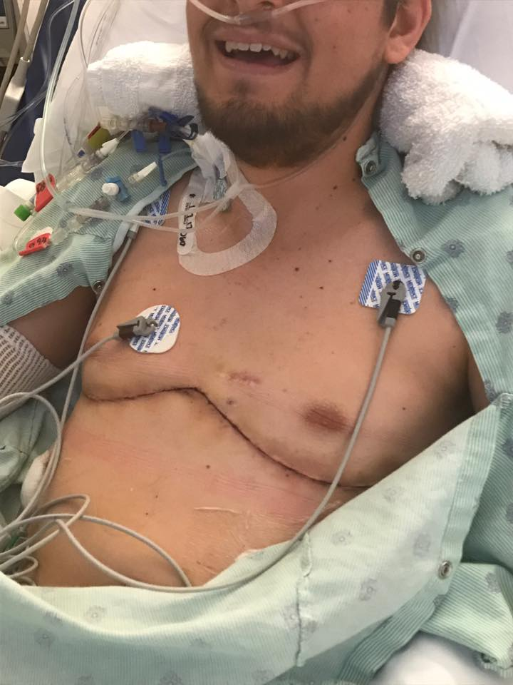
TREATMENT – RESPIRATORY DISEASES
Airway clearance – mucolytics – dornase alfa, hypertonic saline
Pulmonary infection – ATB according to sensitivity, never empirical, high dosage, long duration (2-3 weeks), cure every exacerbation, ATB combination
Ps. aeruginosa - ciprofloxacin + tobramycin / colistin inhalation, amikacin /gentamycin + ceftazidim / meropenem
B. cepacia – meropenem + amikacin + cotrimoxazole + chloramfenicole
Home oxygen therapy
Surgical removal of the infected part of the lung
Lung transplatation – WL: FEV1< 30% or rapid FEV1 decrease, frequent exacerbations, recurrent PNO, recurrent hemoptysis uncontroled by bronchial artery embolization. Performance indication : oxygen dependent respiratory failure, hypercapnia, pulmonary hypertension

Slide 13
TREATMENT – GASTROINTESTINAL DISEASE
Exocrine pancreatic insufficiency – lipase substitution
CF related DM – insulin injections / pump, diet never reccomended
Hepatic cirrhosis - ursodeoxycholic acid, taurin
Metabolic bone disease – prevention = exercise, vitamine D, calcium, bisfosfonate
Malnutrition – increased caloric intake (150-200% of the standard), sipping, nasogastric probe, gastrostomy (PEG), parenteral nutrition
Vitamine and mineral substitution – Ca, Mg, Zn, Se, Fe, fat soluble vitamines
Pancreatic or liver transplantation

Slide 14

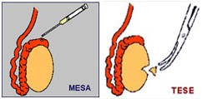
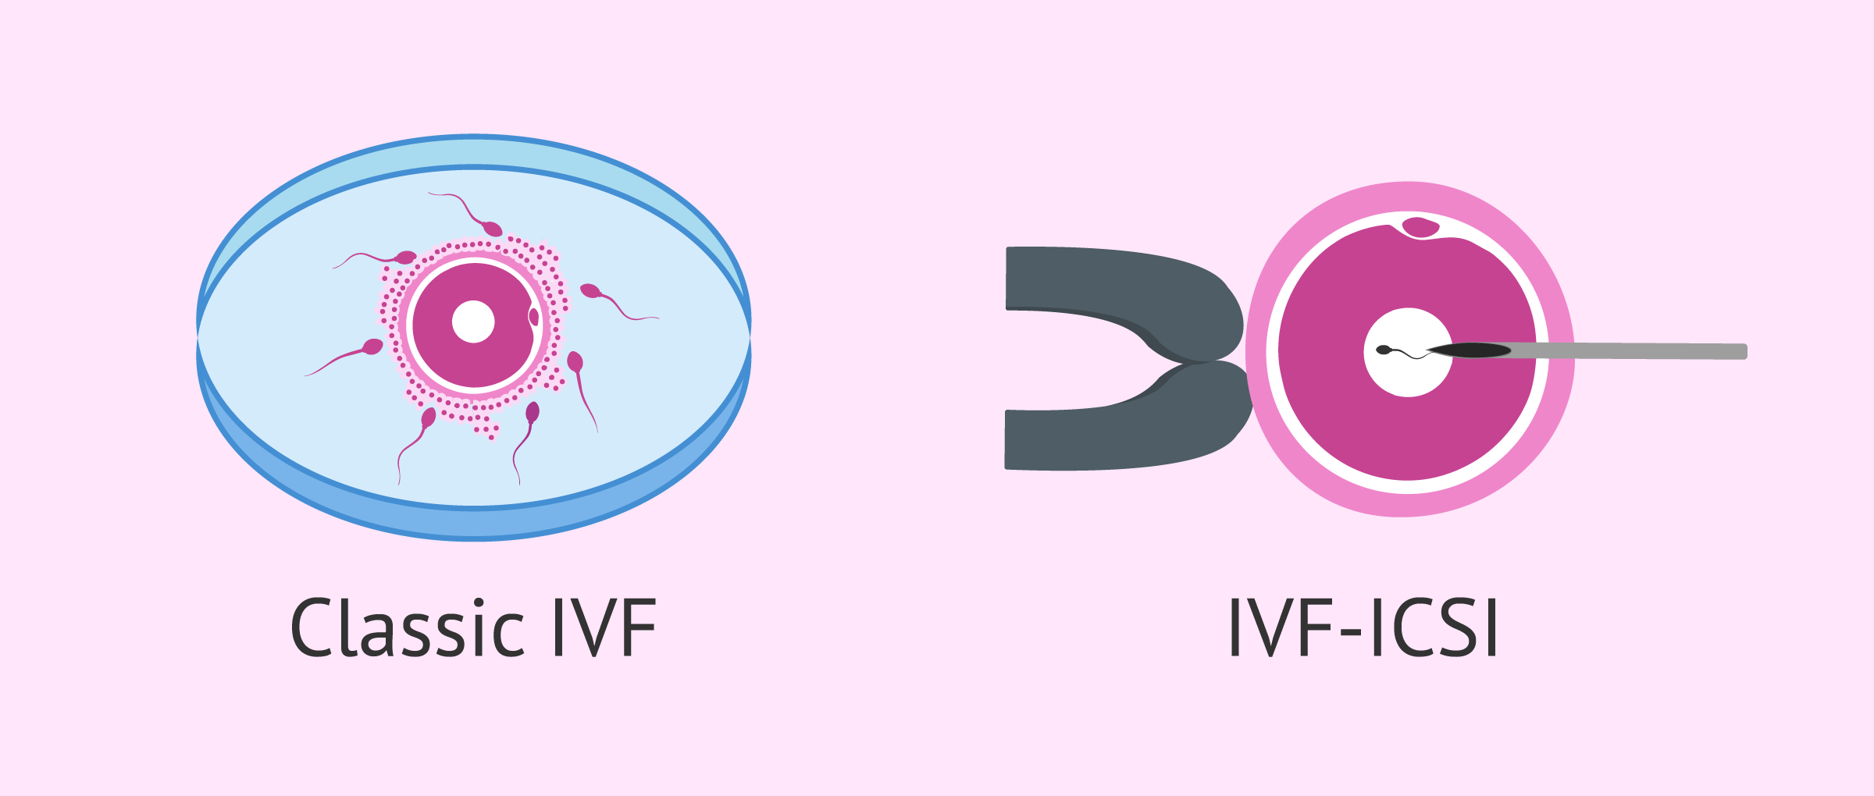

REPRODUCTION
In 98% infertility (CBAVD) - genetics examination of the partner
Micro epididymal sperm aspiration (MESA) /Testicular sperm extraction (TESE) – spontaneus IVF / intracytoplasmic sperm injection (ISCI) – embryo transfer
Absolute gravidity contraindications: pulmonary hypertension, cor pulmonale, hypercapnia, resting hypoxemia
Relative contraindications: FEV1 < 50%, rapid pulmonary function decrease, Burkholderia colonisation, recurent pulmonary infections with IV ATB treatment, malnutrion, CFRDM
Third party reproduction

Slide 15
HYGIENE, EPIDEMIOLOGICAL AND OTHER RESTRICTIONS
Prevention of salt loss by the sweat, avoid physical exercise, sauna and hot dry conditions and dust environment, regular change of clothes because salty sweat irritates skin
Prevention of respiratory infection by avoiding crowded places, contact with humid subjects, stagnant water, nor its aerosol (toilet flushing only with closed toilet board), wash hands regularly, have their own bathroom – must be daily cleaned by chlorine preparations, cannot grow plants and water them, cannot wash dishes, avoid to molds on the wall and moldy things
Strictly isolate patients to prevent the transmission of infections to each other

Slide 16
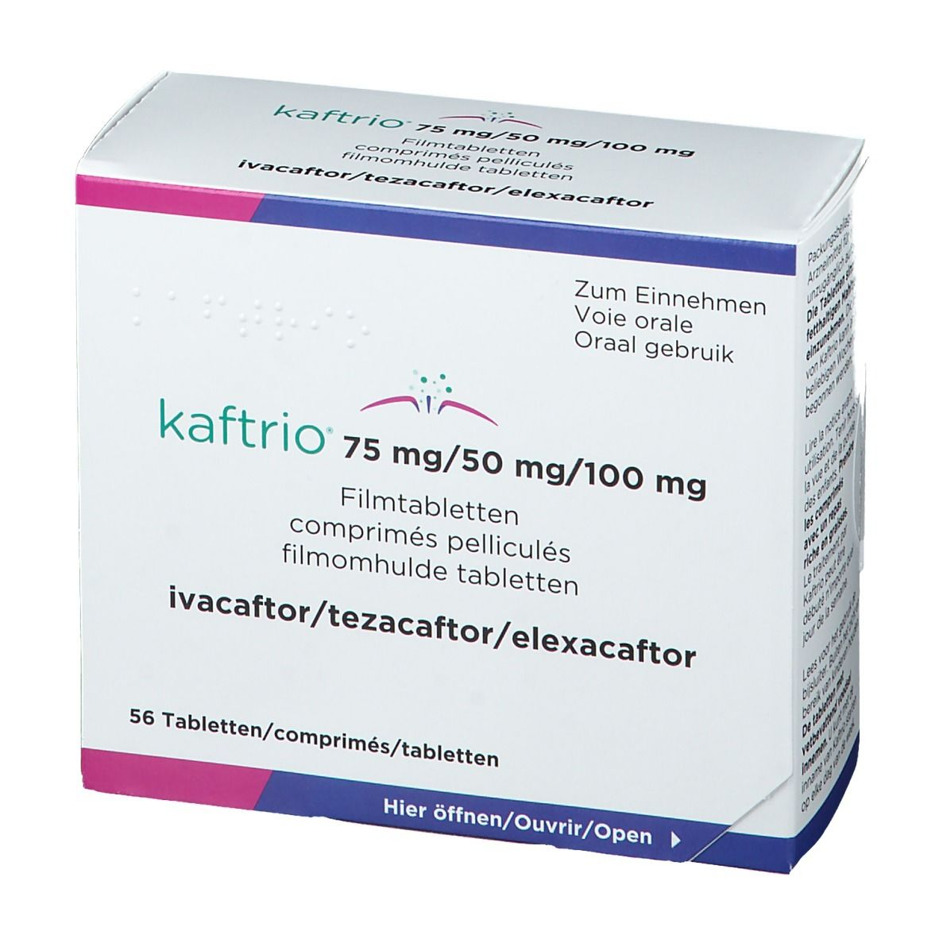
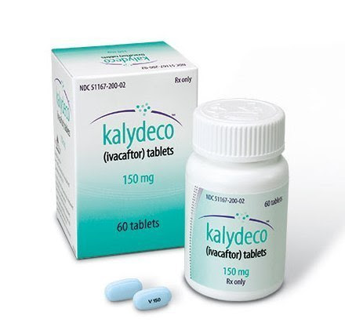
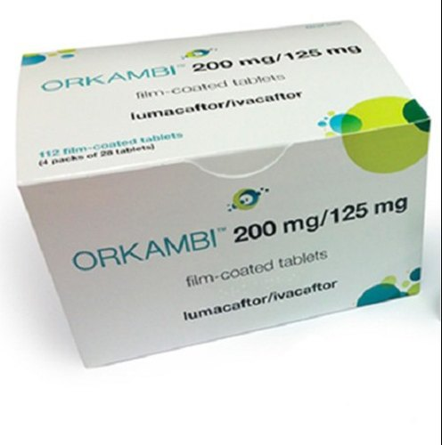
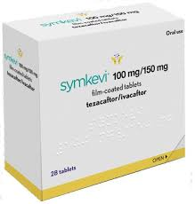
CAUSAL TREATMENT
Orphan drugs – rare diaseses (prevalence < 5/10 000 newborns)
Disease modifying drug:
Defective CFTR protein aktivator – increase capacity of ion channels for transport chloride ions – ivacaftor (Kalydeko)
Defective CFTR protein corrector – binds and stabilizes the channel in the membrane of the epithelial cell – lumacaftor (LUMA/IVA – Orkambi), tezakaftor (TEZA/IVA – Symkevi), elexacaftor (ELEXA/IVA/TEZA – Kaftrio)

Slide 17
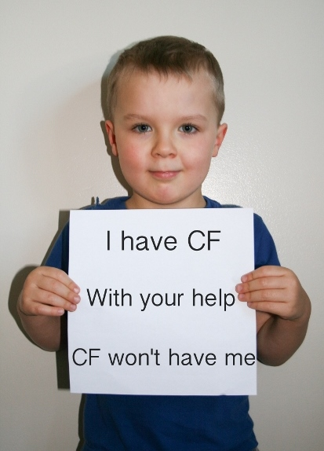
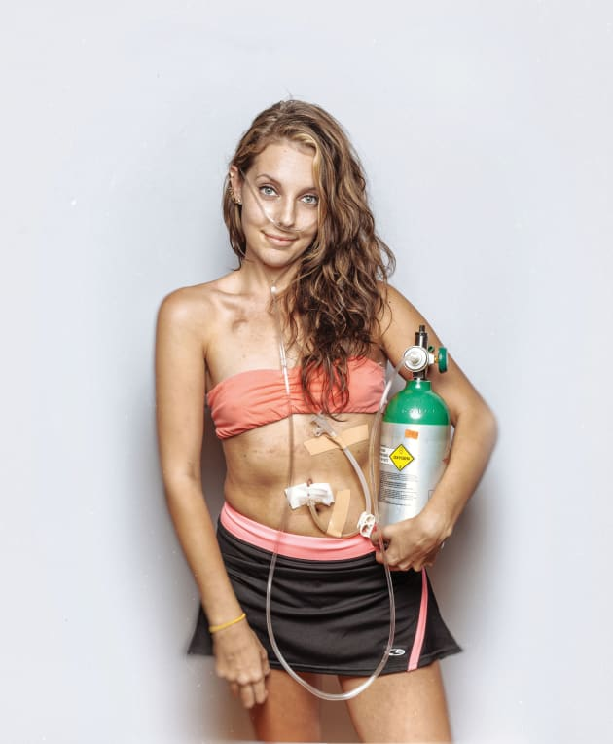


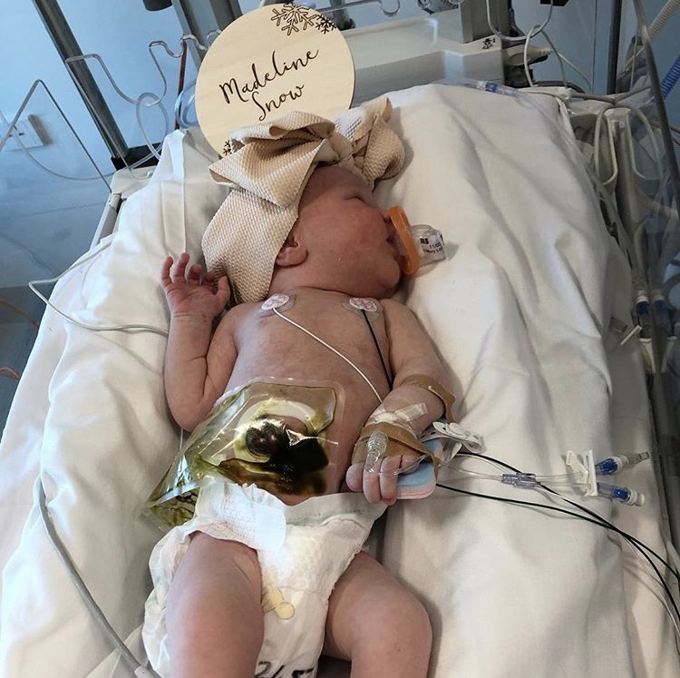
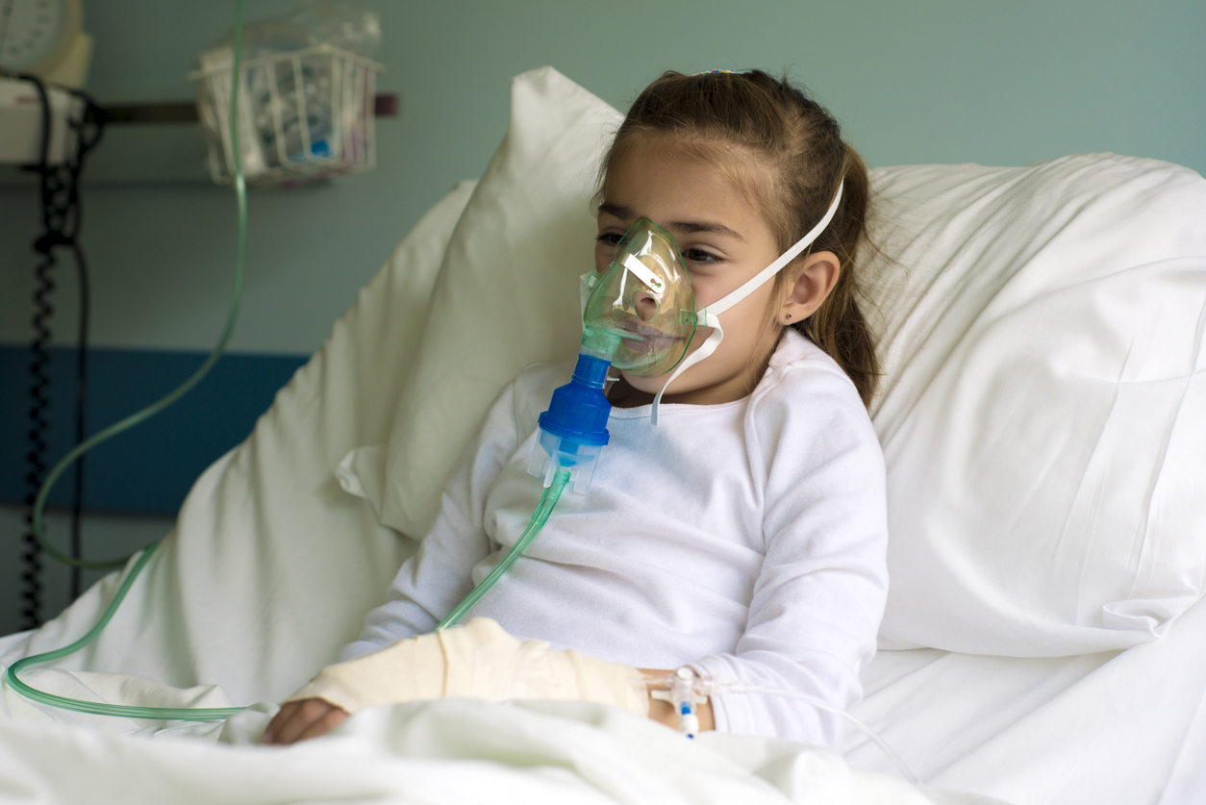
PROGNOSIS
Median age of survival 44 years
Quality of life expectations in causal treatment
Cardiorespiratory complications and acute infections cause death in 80%
9 years median survival posttransplant

Slide 18





THANK YOU

