Slide 1
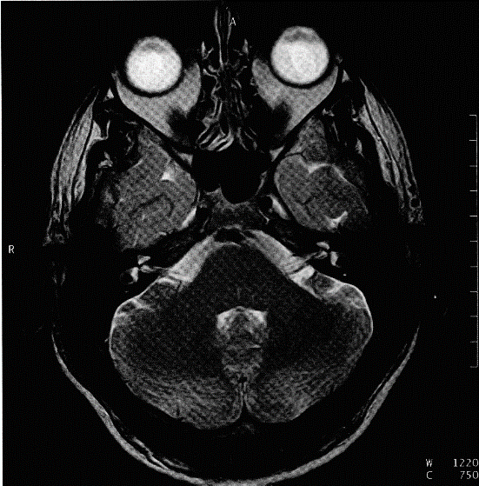
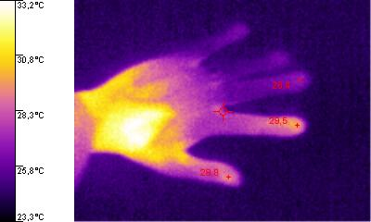
Lectures on Medical Biophysics
Magnetic resonance imaging (MRI)
Infrared imaging (thermography)

Slide 2
Magnetic resonance imaging
Infrared imaging
The common feature of these imaging methods is the use of non-ionising radiation and the absence of genetic damage.
Magnetic resonance imaging (MRI) is one of the most advanced imaging methods which gives both morphological and physiological (functional) information. The first MR image (cross-section of chest) was obtained by R. Damadian in 1977.
Infrared imaging is a functional imaging method giving pictorial information on body surface temperature and thus level of metabolism. It is absolutely safe for the patient as the images are produced by IR radiation given out by the patient himself. First infrared cameras appeared in late 60‘ of 20th century.

Slide 3
MRI

Slide 4
Spin
Spin is a specific property of sub-atomic particles (electrons, protons etc) like electric charge and mass
Spin has some strange properties!
  electrons, protons and neutrons all have the same spin i.e., 1/2
  pairs of particles of a single type (e.g., 2 electrons or 2 protons or 2 neutrons) can have a total spin of zero!
  particles having non-zero total spin act like small magnets (we say they have a ‘magnetic moment’) and their energy is affected if placed in a magnetic field

Slide 5
Total Nuclear Spin (I)
In MRI we are interested in the spin of NUCLEI
In medicine, we use the magnetic properties of mainly light nuclides like hydrogen ¹H, phosphorus ³¹P, carbon ¹³C, fluorine ¹⁹F or sodium ²³Na to get anatomical or physiological information.

Slide 6
MRI Theory
The magnetic moment μ of a nucleus is proportional to its angular momentum S (μ = γS, γ is the gyromagnetic ratio) which depends on the total nuclear spin I.
In the absence of an external magnetic field, the magnetic moments of nuclei have all possible (random) directions with the result that:
  The vector sum of the nuclear magnetic moments in a unit volume of a substance, i.e. the magnetisation vector, is equal to zero
  The energy of all nuclei is the same

Slide 7
H Nuclei in a Uniform Magnetic Field B
When hydrogen nuclei are placed in an homogeneous strong magnetic field with magnetic flux density B:
  Their individual magnetic moments will precess with an axis parallel to the direction of B and orientate themselves either in the same direction or in the opposite direction to B.
  Therefore they have only two possible energies (a higher and a lower energy state).
  The angular frequency of rotation of this precession (i.e., number of revolutions per second) - is called the Larmor angular frequency ω and is given by :
= γ B
γ = gyromagnetic ratio
The hydrogen nuclei in the body precess at about 42.6 MHz if B = 1T

Slide 8
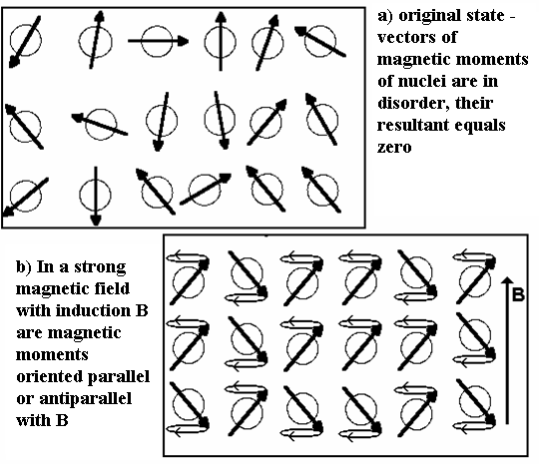
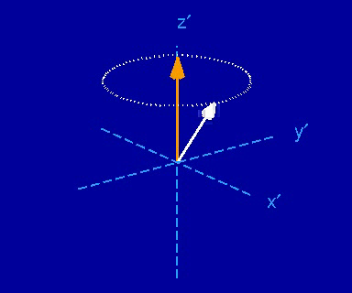

Slide 9
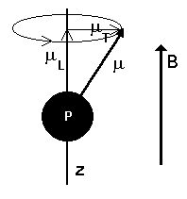
Magnetisation Vector
P - hydrogen nucleus (proton), B - magnetic flux density, z - axis identical with axis of precession (parallel with B), μ - magnetic moment of nucleus, μ_{L} - component of the magnetic moment of nucleus in z axis (vector sum of these projections in unit volume of a substance is the longitudinal magnetisation vector), μ_{T} – projection of μ in xy plane (vector sum of these projections in unit volume is the transverse magnetisation vector).

Slide 10
Measuring H(ydrogen) Density in Tissues
For H nuclei in the lower energy state to move to the higher energy state RF pulses of frequency equal to the Larmor frequency must be transmitted towards the patient using a transmitter coil (hence the ‘resonance’ in MRI). When this occurs the nuclei are also forced to precess in phase.
Longitudinal magnetisation vector becomes oriented in opposite direction
Transverse magnetisation vector appears and rotates in plane xy.
The return to the ground state (relaxation) is accompanied by the emission of a quantum of electromagnetic energy, which is when detected by an antenna (receiver coil) - the nuclear magnetic resonance (NMR) signal. The signal is relatively strong since the nuclei are precessing in phase. The amplitude of the pulse is proportional to the H density in the tissues (often known as ‘spin density’) .

Slide 11
Relaxation times
We have two relaxation times:
T₁ – longitudinal (spin – lattice) - time necessary for return of the “population” of nuclei to the ground state. In biological media: 150 - 2000 ms.
Longitudinal magnetisation vector returns to original direction during this time.
T₂ – transversal (spin – spin) - 2x - 10x shorter than T₁. After this time interval the precession movement of individual nuclei is not in phase again.
Transverse magnetisation vector disappears after this time.

Slide 12
MRI - Magnetic Resonance Imaging
To recognize signals from the different parts of the patient magnetic field gradients („gradual change“) are used e.g., a gradient of B along the z-axis allows us to identify signals coming from different slices of patient perpendicular to the z-axis.
The final image is produced using similar types of image generation processes as in CT.
We can visualise differences in local hydrogen density or differences in relaxation times.

Slide 13
Technical aspects
Up to values B = 0.3 T we can use giant permanent magnets (cheap but low contrast resolution).
Electromagnets are stronger but need a lot of electric energy.
Best contrast resolution but also the highest operational costs is obtained with magnets having superconducting coils, which can produce fields of up to B = 10 T today, but must be cooled by liquid helium. Typical values of B used in practice are 1 – 3 T.
Gradients (about several mT·m⁻¹) of magnetic field are formed by additional coils.

Slide 14
MR Contrast and MR Spectroscopy
Some paramagnetic atoms can amplify the signal. That is why e.g., gadolinium is used as a contrast agent for MRI. Gadolinium is chemically bound to certain pharmaceuticals e.g., DTPA - diethylen-triamin-penta-acetic acid.
The exact value of the Larmor frequency changes slightly (shifts) according to the position of the hydrogen in the molecules. For example, different shifts of H in groups =CH- or -CH₂- are well measurable. This allows us to identify such groups using in-vivo MR - spectroscopy is a powerful tool with application in functional MRI (analysis of ATP content etc.).
MRI devices are usually adjusted to the resonance of hydrogen atoms present in water molecules.

Slide 15
Safety aspects
The magnet can impair function of other medical devices. Hence MRI is strongly contraindicated in patients with some electronic devices inside their bodies (pacemakers, cochlear implants etc.)
Iron objects are strongly attracted to the “gantry” – they can damage the device and cause injuries. MRI is strongly contraindicated in patients with any iron bodies inside (implants, bullets, splinters of grenades etc.)
MRI is not recommended in the first trimester of pregnancy.
Some minor problems can be caused by any metals inside the body or on the body surface (heating, prickling sensations). For example: jewellery, some mascaras, old tattoos, tooth fillings, dental crowns and frameworks, implants etc.)
Some patients are anxious or unquiet inside the device gantry, because of strong noise during the examination. Claustrophobia is also common.

Slide 16
Important Advice
magnetic memories (e.g., credit cards) can be destroyed if taken into an MRI room!!!!

Slide 17
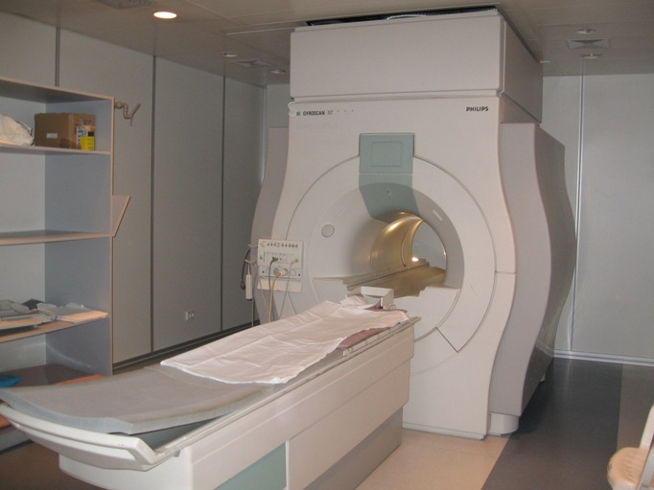
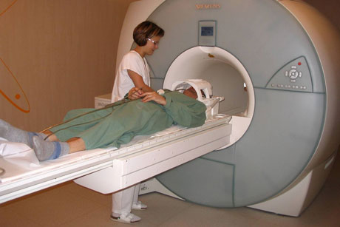
MRI Devices

Slide 18
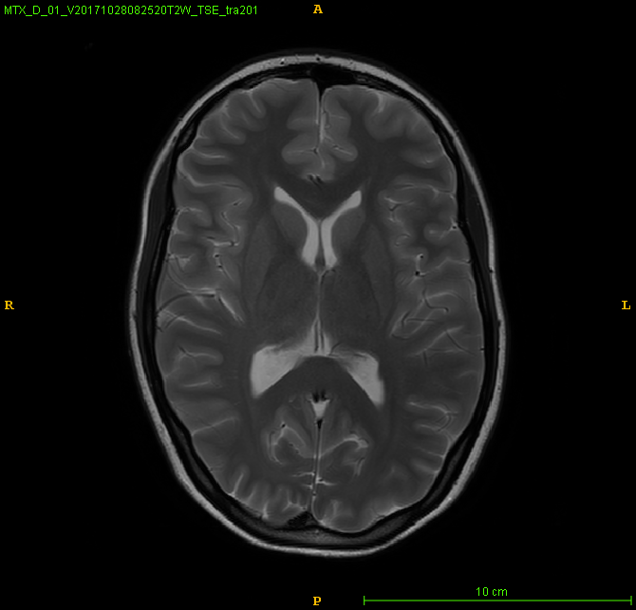
Transversal image of the brain

Slide 19
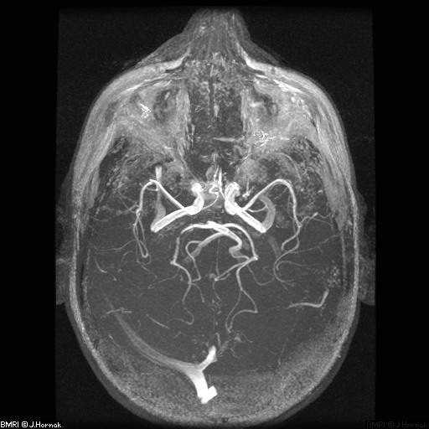
MR - Angiogram
http://www.cis.rit.edu/htbooks/mri/inside.htm

Slide 20
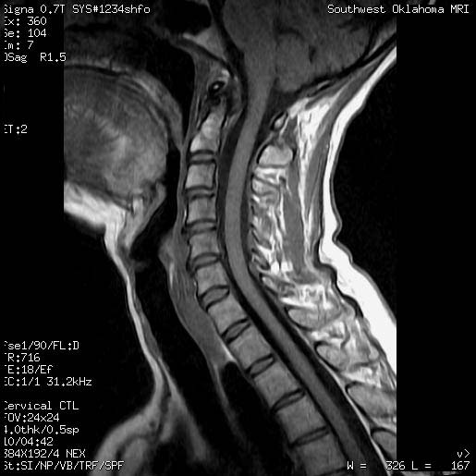
Sagittal section of cervical spine

Slide 21
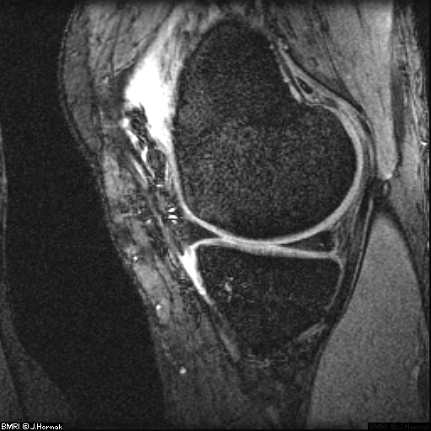
Sagittal section of knee

Slide 22
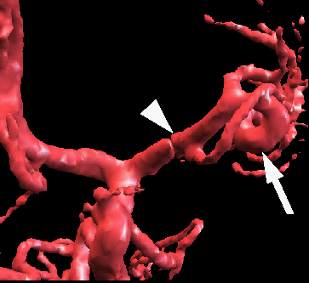
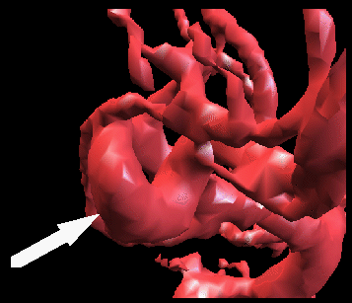
3D model of curvature of left A. cerebri media (arrow) and M1 segment of the same artery (wedge)
B) other view on this model shows also curvature of A. cerebri media (arrow shows a well visible aneurysm)
These are not plastic models but the result of real MRI image processing!
http://splweb.bwh.harvard.edu:8000/pages/papers/shin/ns/ns.html#Outcome:

Slide 23
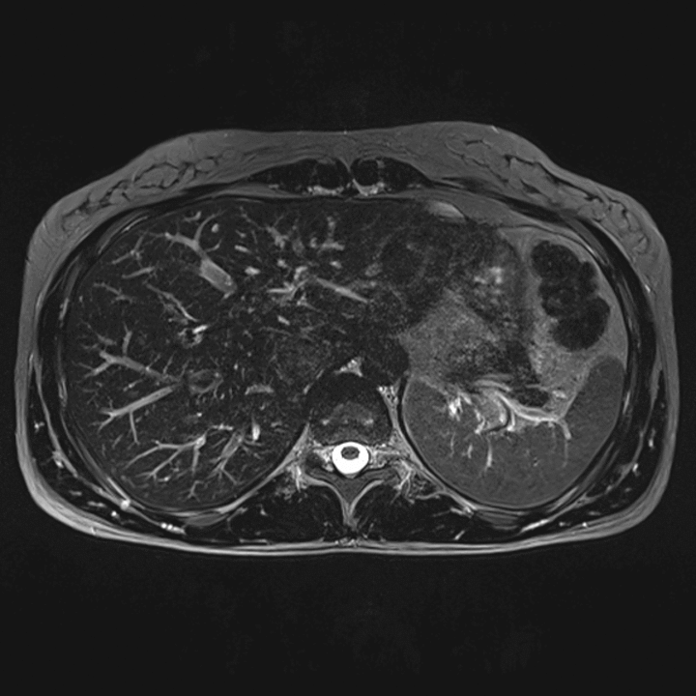
Continuous browsing of transversal images of a body section, „gif“ (examination of pancreatic duct)
https://www.healthcare.siemens.com.au/magnetic-resonance-imaging/options-and-upgrades/clinical-applications/syngo-space

Slide 24
Thermography

Slide 25
What is infrared imaging and infrared radiation?
The contact-less thermographic method is based on the measurement of infrared radiation (IR) emitted by the surface of the body.
Digital sensor technology is used for image recording.
Wavelength 780 nm - 1 mm
IR visualised first by Holst in 1934
Discovered by astronomer Herschel in 1800
The wavelength used in thermography 0.7 - 14 μm

Slide 26
Principle of image recording
A digital camera with an IR-sensitive pixel sensor array (microbolometer).
Microbolometer is a grid of vanadium oxide or amorphous silicon heat sensors atop a corresponding grid of silicon. IR radiation from a specific range of wavelengths strikes the vanadium oxide and changes its electrical resistance. This resistance change is a measure of the temperature. Temperatures can be represented graphically. The microbolometer grid is commonly found in many sizes e.g., 244 x 193 (Meditherm), 160×120 array (Fluke).

Slide 27
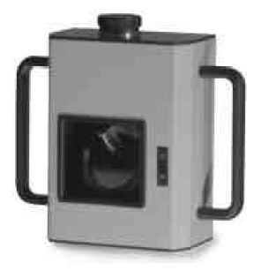

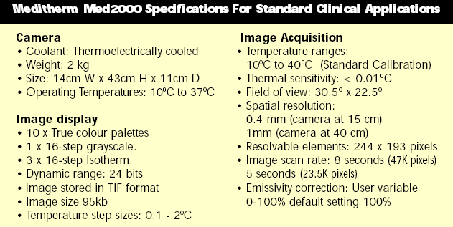

Slide 28
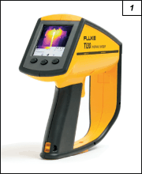
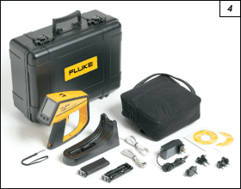

The first IR camera of Department of Biophysics
Fluke Ti30
Accessories

Slide 29
IR imaging in medicine – advantages and disadvantages
High temperature and spatial resolution
Temperature distribution is displayed in the form of isothermal lines - isotherms
Possibility to display temperature profiles
Fast measurement
Surface temperature distribution differs even in healthy people
We have always to compare temperature of symmetrical body parts
In contrast to original expectation, it is not possible to use IR imaging as a screening method for malignancies, e.g. breast tumours, because of its low specificity.

Slide 30
Clinical Importance of Thermography
The method informs us about the extent and dynamics of any pathological process which is accompanied by increased temperature.
Indications
  Diseases of peripheral blood vessels
  Diseases of thyroid
  Diseases of lymphatic system
  Joint inflammations
  Demarcation of burns and frostbites
  Assessment ob blood supply after reconstruction surgery...
Imaging conditions:
Temperature of darkened room 20 °C
Acclimatisation time about 20 min.
Examined body area must be uncovered during acclimatisation.
It is not allowed to smoke, drink alcoholic beverages, exercise or take drugs causing vasodilatation or vasoconstriction before examination.

Slide 31
Clinical Thermograms

Slide 32
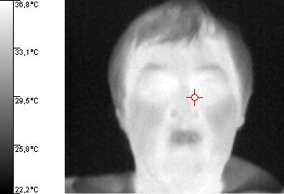
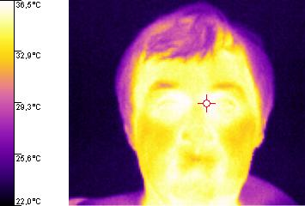
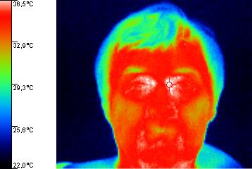
Different palettes of colours (Fluke)

Slide 33
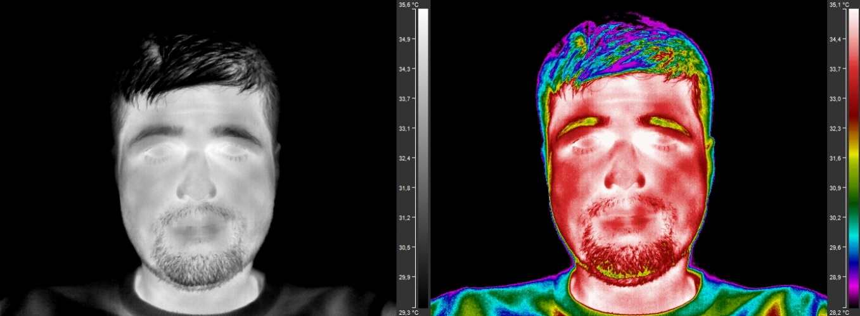
Human face (better quality camera)

Slide 34
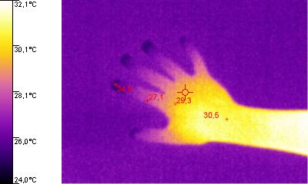
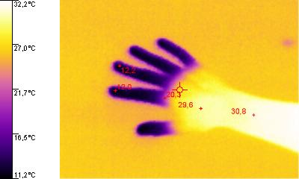
Thermogram of fingers before and after cold test (Fluke)

Slide 35
Finger inflammation after a small injury
(FLUKE Ti30)

Slide 36
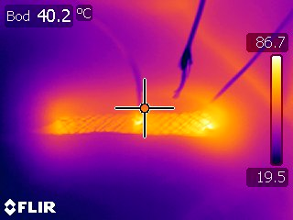
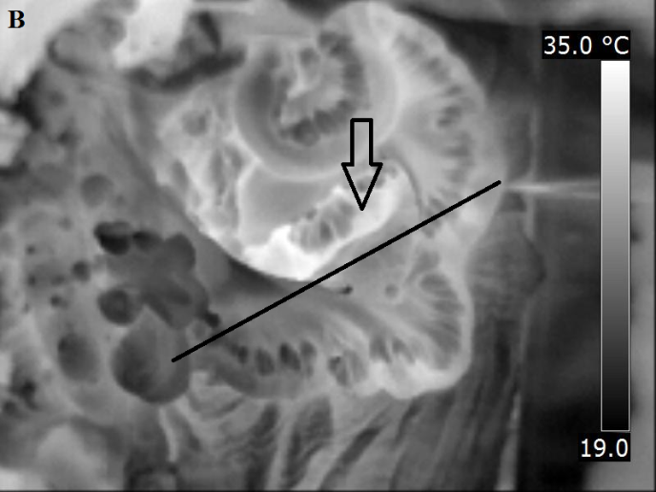
Thermography in surgery
Stent heating by means of a radiofrequency ablation device (an experiment)
Identification of an intestinal segment for resection (an experiment)

Slide 37
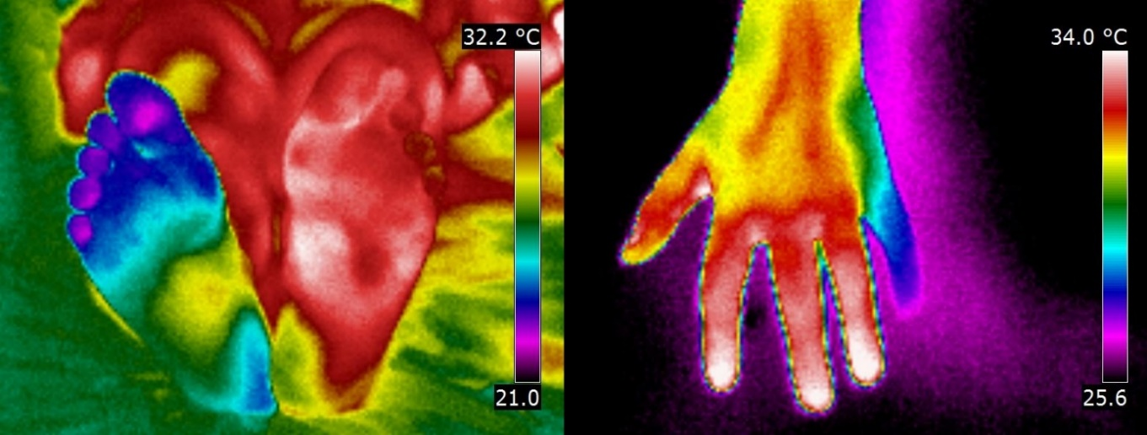
Themography of ischaemia
Left: an acute case of ischaemia in a patient with ischaemic lower limb disease.
Right: left hand with paresis of n. ulnaris demonstrated by lowered skin temperature.

Slide 38
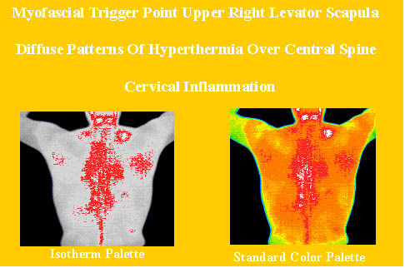
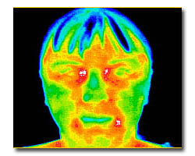
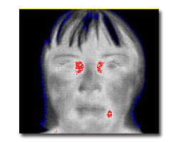
Pictures:www.mhs5000.com/software.htm.

Slide 39
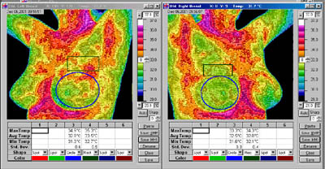
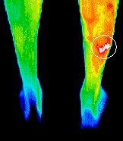
www.mhs5000.com/software.htm
Stress fracture on football player
X-ray showed no abnormality, thermography correlated well with the patients report of pain and provided justification for the more invasive test of scintigraphy which clearly showed a stress fracture in the exact location indicated by the thermogram.
www.dititexas.com/page6.html

Slide 40
Use of the IR Camera for Safety Studies

Slide 41
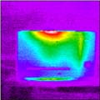
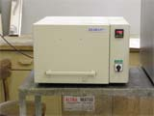
Oven leaking heat – checking heat devices

Slide 42
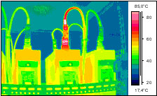
Overheated cable

Slide 43
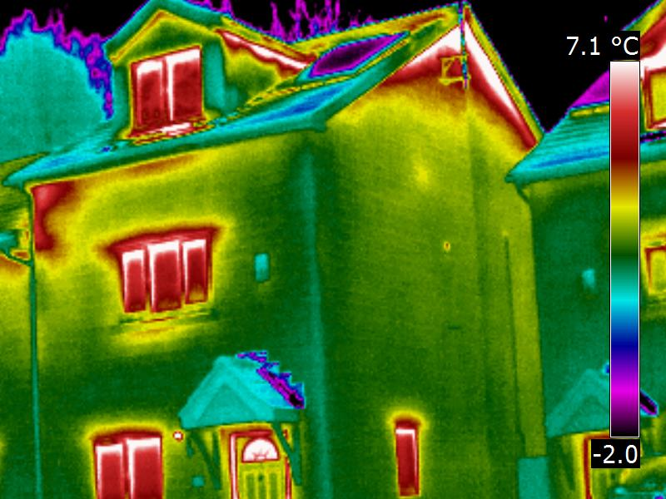
Thermography in construction engineering – house leaking heat

Slide 44
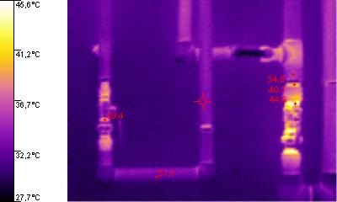
Low quality insulation of a warm water piping in area of joints (Fluke)

Slide 45
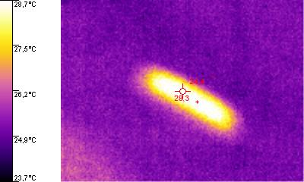
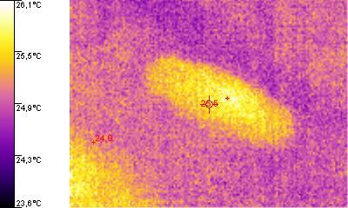
Ultrasonographic probe (Fluke)
Probe „frozen“
26,5 °C
Probe in operation
28,3 °C

Slide 46
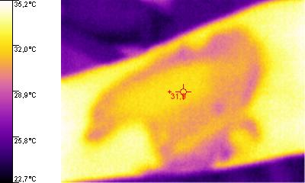
Thermal spot left by ultrasonographic probe on the forearm + cooling effect of the coupling gel (Fluke)

Slide 47
Language revision:
Carmel J. Caruana
Presentation design:
Lucie Mornsteinová
Authors:
Vojtěch Mornstein Carmel J. Caruana,
Ivo Hrazdira
Last revision October 21, soundtrack added October 20
Last revision October 21, soundtrack added October 20

