Slide 1
Morfology
MUDr. Anna Žáková
I. DVK FNUSA a LF MU v Brně

Slide 2
1) Types of skin lesions
A lesion is any single area of altered skin
Primary - macule, papule, nodule, wheal, vesicle, bulla, pustule
Secondary – scale, crust, fissure, erosion, excoriation
Other –plaque, cyst
A rash is a widespread eruption of lesions
Exanthema - generalized, symetric
Enanthema – mucous membranes
Notes:
Decision- rozhodnutí

Slide 3
a) Primary Lesions
Are the initial manifestation of the disease, unaffected by the course of the disease or manipulation by the patient.

Slide 4
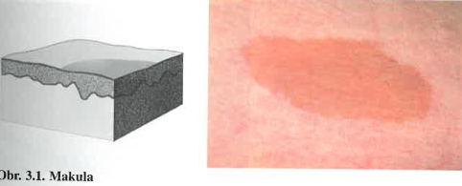
Primary Lesions
MACULE
= is a flat lesion, identified only by color change and not palpable
- Large macules- are sometimes called patches
- Example: it can be caused by leakage of blood, changes in the blood flow, hemosiderin, melanin

Slide 5
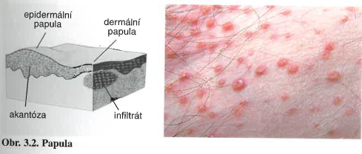
Primary Lesions
PAPULE
= A raised lesion, usually defined as less than 1 cm in diameter, a papule may consist of a thickened epidermis, dermis or combination of them
- Larger similar lesions are nodules, they are occupying subcutaneous space
- Example: psoriasis vulgaris , pityriasis rubra pilaris
Notes:
Raised- vyrostlý
Thickened – fiknd - zesílený
psoriasis vulgaris – červená se šupinou na povrchu
pityriasis rubra pilaris- červená vázaná na vlasové folikuly

Slide 6
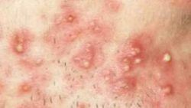
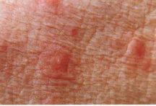
Papulopustule – papule with pustule on the top (acne vulgaris)
Papulovesicule – papule with central vesicule (prurigo acuta)
Notes:
Prurigo acuta- akutní svědivé onem. Malých dětí (2-7 let), vznik v letních a podzimních měsících, charakter alergické reakce
- etiologie- kombinace I. A IV. Typu alergické reakce, vznik nejčastěji následkem štípnutí hmyzem

Slide 7
Primary Lesions
PLAQUE
= a flat-topped lesions larger than 1 cm in diameter

Slide 8
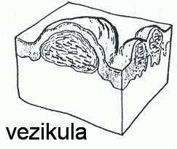
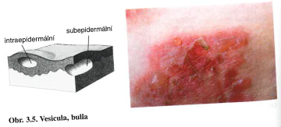
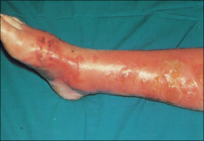
Primary Lesions
VESICLE
= a fluid-filled lesion less than 1 cm, herpes simplex, herpes zoster
BLISTER
= a fluid-filled lesion larger than 1 cm
The site of fluid may be within the epidermis or subepidermal
It is either clear or hemorhagic
Notes:
Either- bud
Vezikula- může být intraepidermální (např. ekzém, herpes simplex)
- nebo subepidermální (pemfigoid)
8

Slide 9
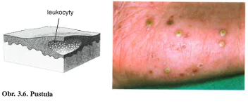
Primary Lesions
PUSTULE
= a pus-filled vesicle
-it can be primary (psoriasis pustulosa), or secundary, when a vesicle becomes cloudy (impetigo)

Slide 10
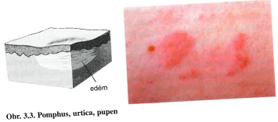
Primary Lesions
HIVE
= also known as urtica or wheal, this elevated lesion is caused by leakage of fluid from a vessel, it is ussually pruritic and transient, disappears < 24 hours
- Example: urticaria
Notes:
HIVE- (hajv)

Slide 11
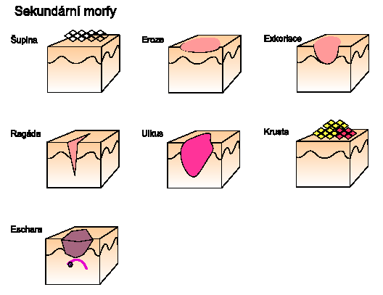
b) Secondary Lesions
Are showing changes during next development of the disease, it is caused by degeneration or reparation of the skin, or by influence of external factors

Slide 12
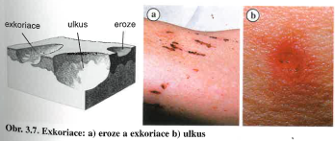
EROSION
A superficial loss of epidermis, caused by ruptured intraepidermal blister or slight trauma
EXCORIATION
A defect in the epidermis, and often the dermis, induced by scratching or manipulation
- It is bleeding, it heals with crust without scar
ULCER
A defect in the epidermis and dermis with impaired healing, caused by trauma, impaired vascular supply, tumors, and infections
- It heals with scar
Notes:
Impaired healing- zhoršeným hojením
Eroze i exkoriace- se hojí bez jizvy, někdy depigmentací

Slide 13
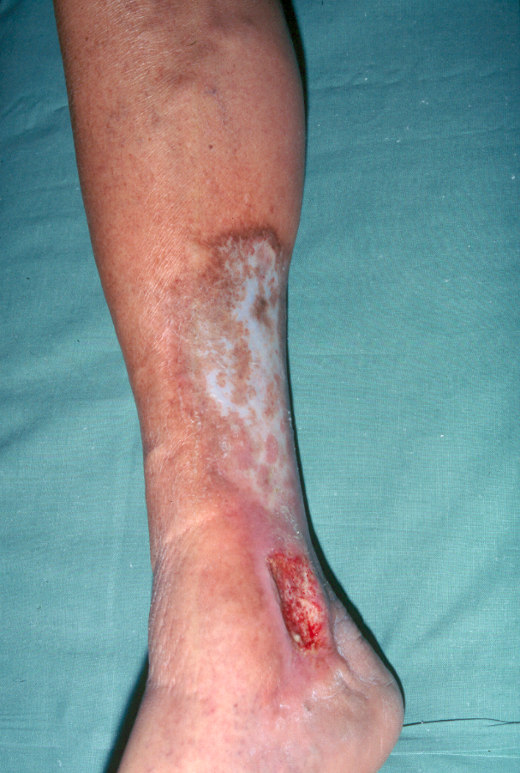
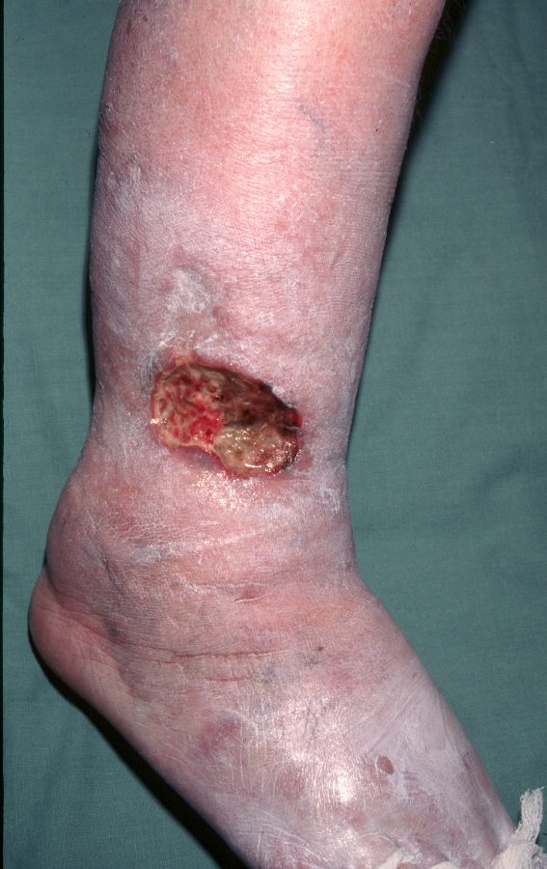
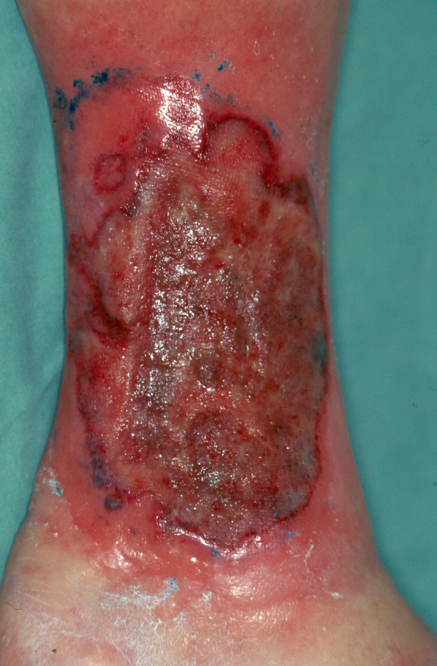

Slide 14
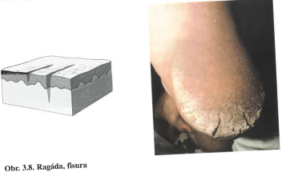
FISSURE
A crack or split in the epidermis and dermis
- Fissures around circular orifices are known as rhagades
Notes:
Fišr (praskliny), orifices- otvory
Fisury- např. hluboké praskliny ústí análního otvoru, radiálně uspořádané

Slide 15
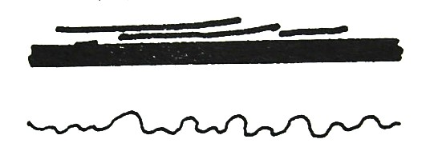
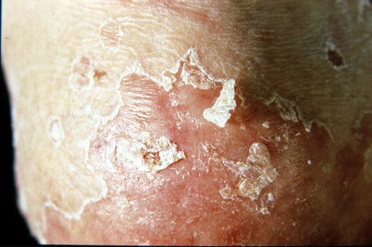
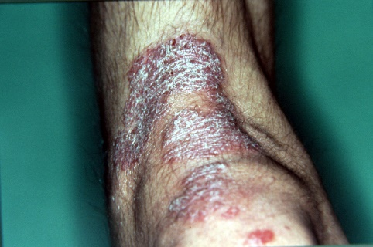
SCALE
An abnormal accumulation of corneocytes, secondary to excassive epidermal turnover (psoriasis) or delayed shedding
Types include:
- Psoriasiform - silvery
- Pityriasiform - fine
- Rupiar – thick, coarse
- Collarette – prominent at the periphery
Notes:
Delayed- zpožděný, shedding- olupování

Slide 16
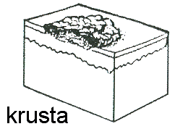
CRUST
- A surface coating consisting of dried serum, pus, or blood, sometimes with scale.
ATROPHY
Thinning of the skin because of loss of dermis, epidermal atrophy is a microscopic finding

Slide 17
SCLEROSIS
Dermal scar-like induration, such as in morphea or systematic sclerosis
SCAR
The site of repair of a dermal defect, scars may be:
hypertrophic- thickened
flat
atrophic (depressed)

Slide 18
LICHENIFICATION
A distinctive response to inflammation, leading to pronounced skin markings. Rubbing produces epidermal thickening with many small smooth papules, as in lichen simplex chronicus or atopic dermatitis

Slide 19
Description of lesion
Localisation
Arrangement
Size
Shape (circular, geografical)
Surface (flat, depressed)
Borders (sharpened / unsharpened)
Color (brown-red, yellow, white)
Consistency
Notes:
Kromě správné diagnostiky jednotlivých eflorescencí je třeba při popisu objektivních změn uvést jejich:
Lokalizaci
Konfiguraci
Velikost
Tvar (kruhovitý, ledvinovitý, mapovitý)
Povrch (hladký, svraštělý, vkleslý)
Ohraničení (ostré/ neostré)
Barvu (hnědočervená, žlutavá, bělavá)
Konzistenci u hmatných projevů

Slide 20
Location and Distribution
It is important to notice:
Lesions are single or multiple
It could create groups with typical arrangement
Distribution is random or patterned, symmetric or asymmetric
Localized – on certain place
Disseminated - scattered in several places
Generalized - lesions everywhere
Erythroderma - continuous skin involvement

Slide 21
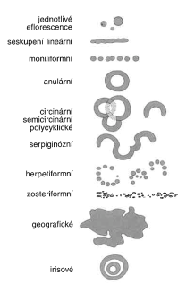
2) Arrangement of lesions
= can make a group of shapes
Linear ( in the line)
Anular (circular), circinár (to the ring), semicircinální
(into semicircle)
Herpetiform (grouped vesicles, as in herpes simplex)
Zosteriform (group of lines)
Geographical - psoriasis

Slide 22
Notes:
Tinea corporis- circinární (do kroužku), semicircinální (do polokruhu)

Slide 23
Texture
Some skin lesions have visible or palpable texture that suggests a diagnosis.
Verrucous lesions have an irregular, pebbly, or rough surface. Examples include warts and seborrheic keratoses.
Lichenification is thickening of the skin with accentuation of normal skin markings; it results from repeated scratching or rubbing.
Induration, or deep thickening of the skin, can result from edema, inflammation, or infiltration, including by cancer. Indurated skin has a hard, resistant feeling. Induration is characteristic of panniculitis, some skin infections, and cutaneous metastatic cancer
Notes:
Diseminované = rozeseté
Generalizované- pokud se projevy (morfy) vyskytují všude
Erytrodermie = souvislé (difúzní) postižení celého kožního povrchu

Slide 24
3) Localization of skin diseases
= describe where the lessions are placed
- Predilections = typical localization of each disease
Intertriginous
Embolization
Seborhoic
Solar
Notes:
(intertridžinrs),

Slide 25
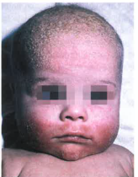
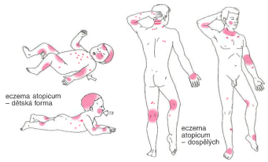
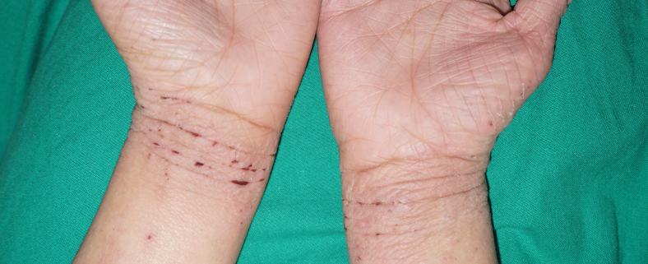
Predilections of atopic dermatitis
Notes:
Infants- (2nd-6th month after birth) - cheeks, forehead, gradually to the whole head, body, arms and legs
Children's form - (preschool, school children) - elbow, knee holes, neck, wrists, backs of hands
Adult form - the same places as children's

Slide 26
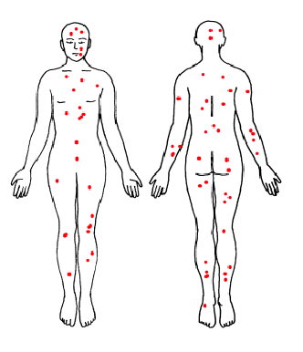
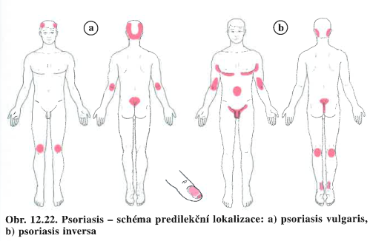
Predilections of Psoriasis
Acute – gutate form
Chronical
Notes:
Chronical form – over large joints – knees, elbows, sacral area, in hair, on nails
Psoriasis inversa – cubitas, popliteas, intergluteal, under the braest

Slide 27
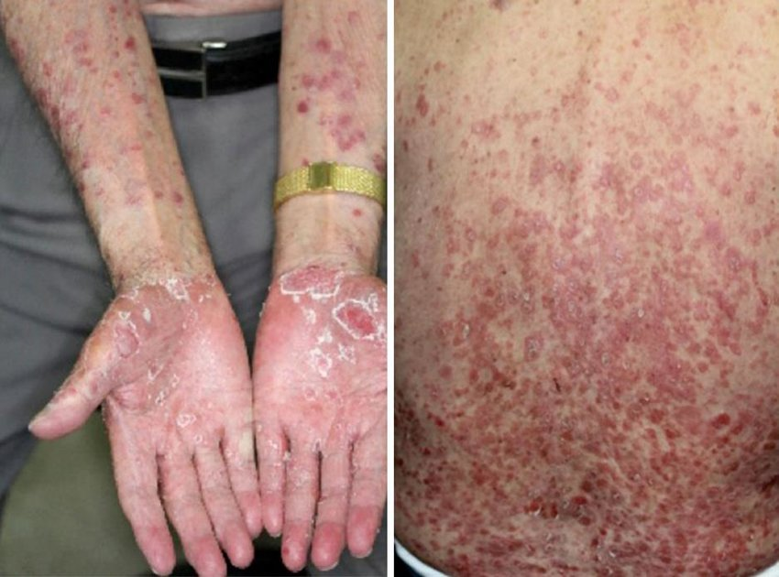
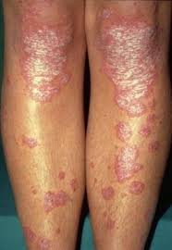
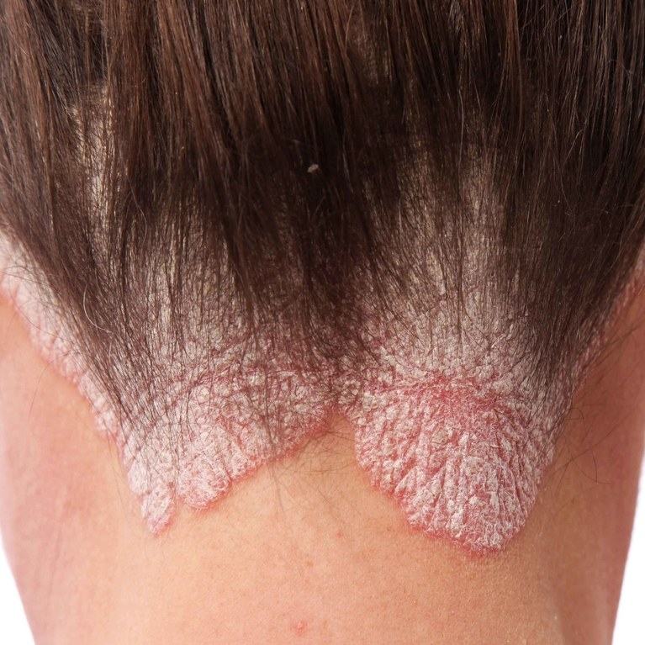
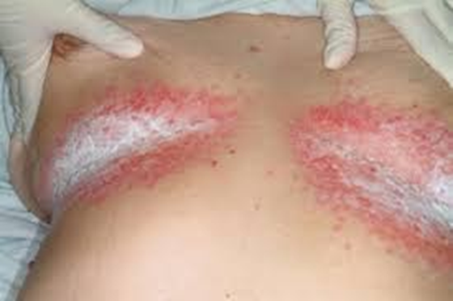
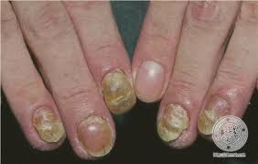
Acute – gutate form
Chronical - psoriasis vulgaris, psoriasis inversa

Slide 28
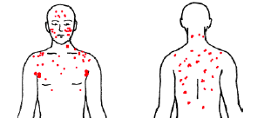
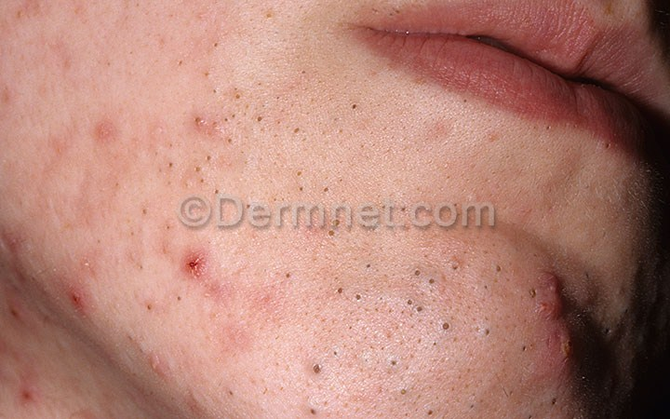
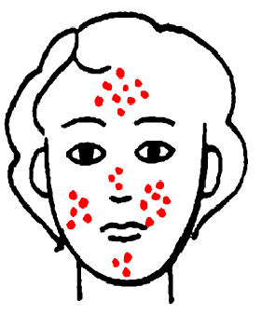
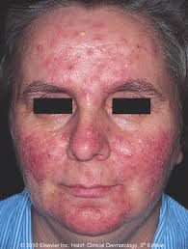
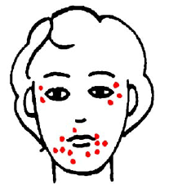
Predilections of Acne, or rosacea
Notes:
Akne – the places with many subaceous glands – central part of the face, between scapule bone, above the sternum, around the genital - seboriická dermatittis, akné
Rosacea – forehead, cheeks

Slide 29
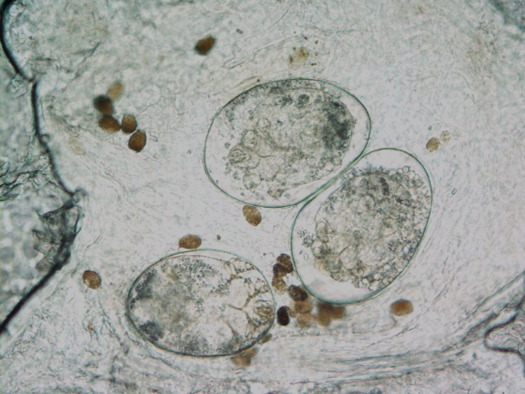
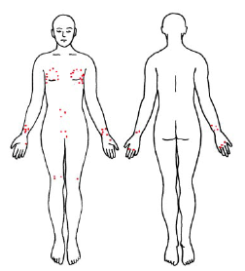
Predilections of scabies
Notes:
Interdigital place, volar side of the wrist, axillas, areolas, navel – pupek, genital, arches of the feet – papules in pairs

Slide 30
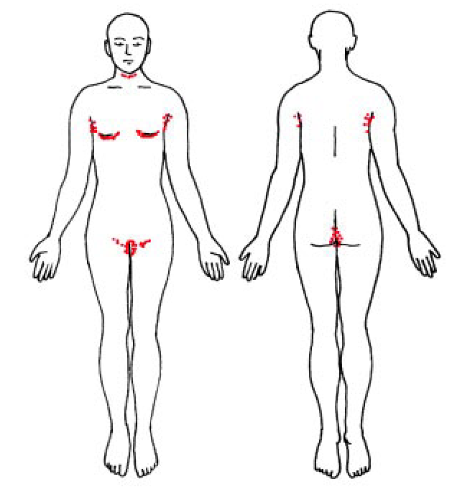
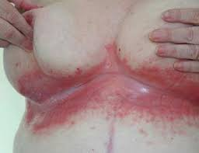
Intertriginous localization
Notes:
- In the places with the number of sweat glands and at the site of skin folds – inguinas, under breast, axilas – very easy there can be intertrigo, psoriasis inversa

Slide 31
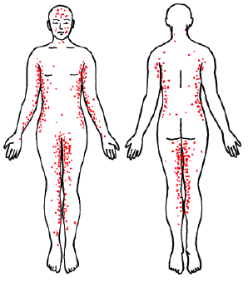
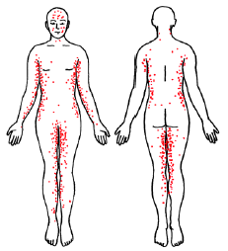
Embolic localization- drug exantemas
Notes:
affected by blood spread – symetricaly lateral part of the trunk, inner part of arms a legs – drug eruptions

Slide 32
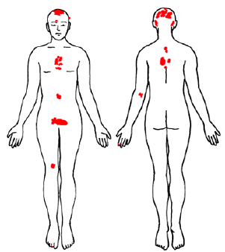
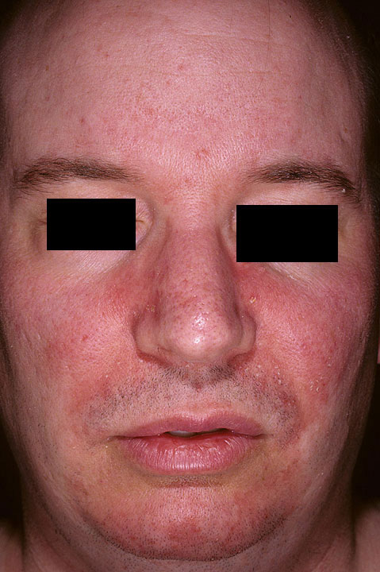
Seborhoic localization
Notes:
the places with many subaceous glands – central part of the face, between scapule bone, above the sternum, around the genital - seboriická dermatittis, akné

Slide 33
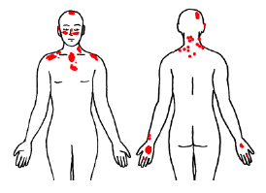
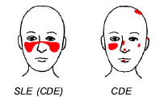
Solar localization
Notes:
Sun exposed body parts – face, neck, cleavage – dekolt, back of hands – skin tumors

Slide 34
What is what?

Slide 35
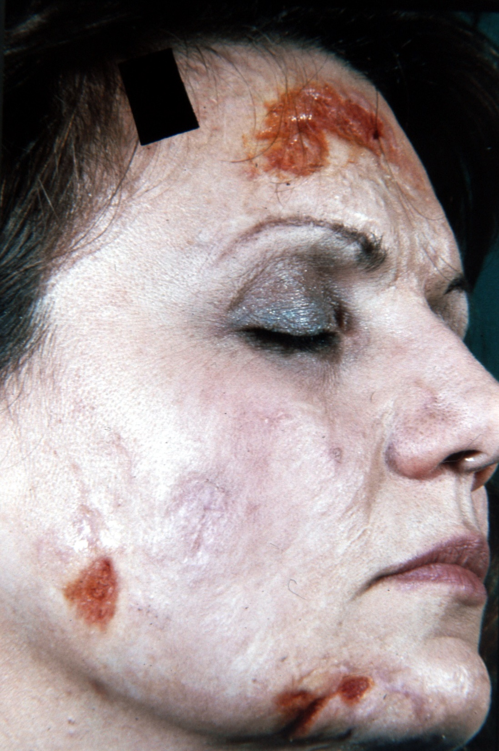
Notes:
Ulcus- vřed- sekundární morfy

Slide 36
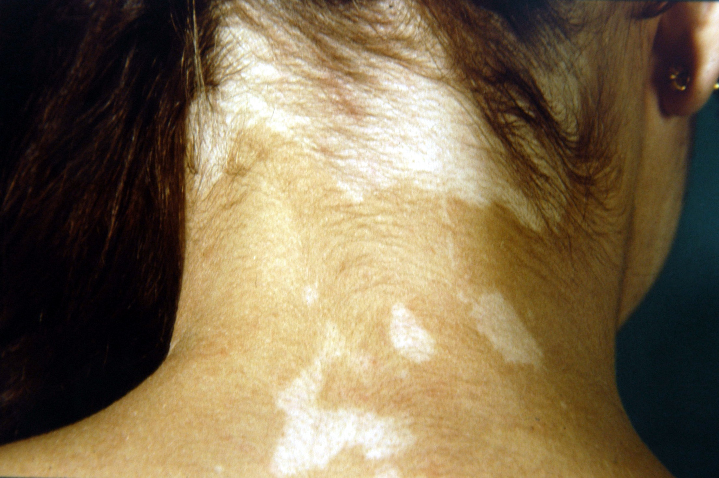
Notes:
Vitiligo- makula – primární morfa

Slide 37
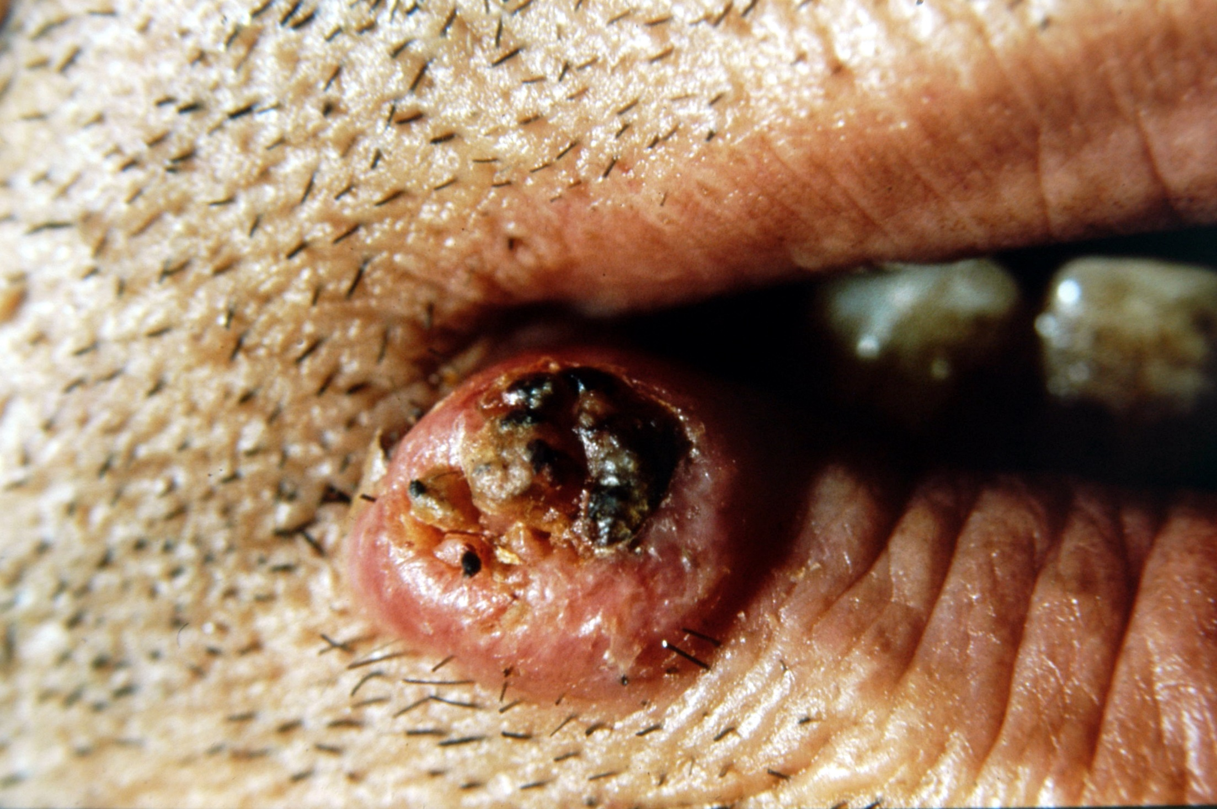
Notes:
Bazaliom- nádory- typicky- nodulus- primární morfy

Slide 38
Notes:
Skvama- šupina- sekundární morfy

Slide 39
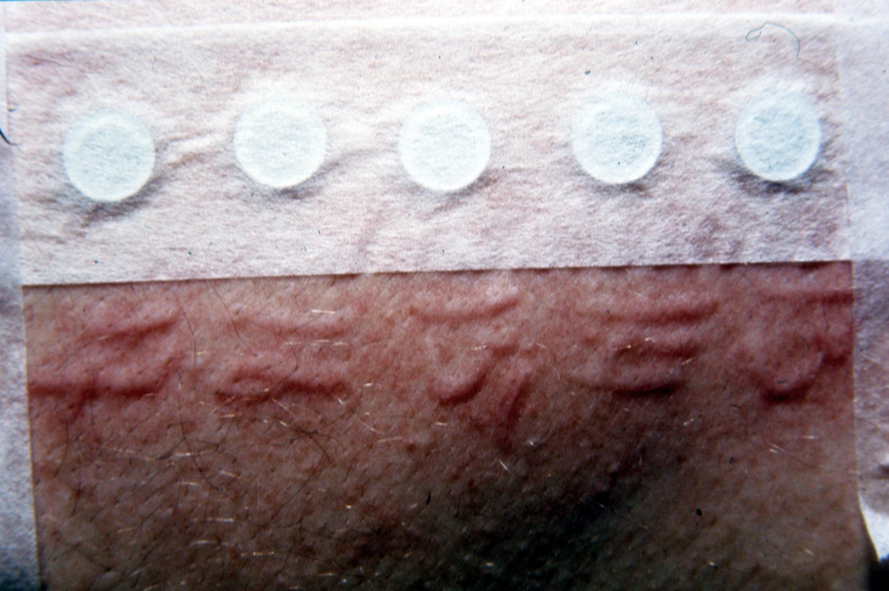
Notes:
Urtica- epikutánní testy- primární morfy

Slide 40
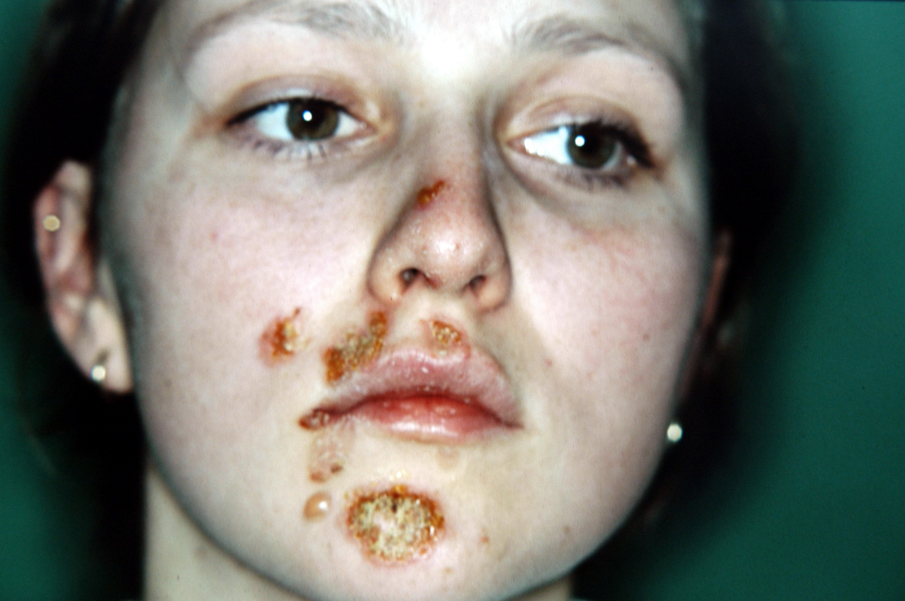
Notes:
Krusta- sekundární morfy- tkáňový mok

Slide 42
Notes:
Erysipelas bullosum- bula- primární morfy

Slide 43
Notes:
Ragády, fisury- sekundární morfy

Slide 44
Notes:
Gutátní psoriáza- papula- primární morfa

Slide 45
Notes:
Kaposiho sarkom- nodulus- nádor- primární morfy

Slide 46
Notes:
Ulcus- sekundární morfa

Slide 47
Notes:
Pustuly- primární morfy

Slide 48
Notes:
Nodulus- tuber- primární morfy

Slide 49
Notes:
Krusta- strup- sekundární morfy- krev

Slide 50
Notes:
(acne vulgaris) - Papulopustula – papula s pustulou na vrcholku- primární morfy

Slide 51
Thank you for your attention

