Slide 1
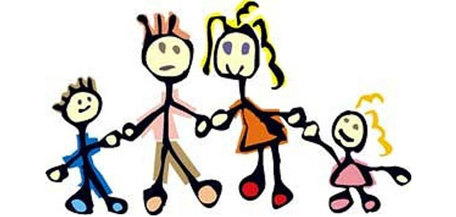
Child and adolescent psychiatry
Pavel Theiner, MD, PhD
Department of Psychiatry
Masaryk University

Slide 2
Child and adolescent psychiatry
An independent speciality in medicine, only partially overlapping with the psychiatry of adults
Deals with mental and behavioral disorders of the youth, usually 2-18 years old

Slide 3
Child and adolescent psychiatry basic theses
Paediatric medicine = developmetal medicine
Mental development is striking in childhood
There are many pathways to healthy mind of the adult
There are also developmental milestones that must be achieved
Considering pathology = mastering healthy development

Slide 4
Paediatric medicine = developmetal medicine
From a newborn baby to an 18 yo adolescent
Several important phases
  Newborn
  Infant
  Toddler
  Pre-school
  Schoolar
  Puberty
  Adolescence

Slide 5
Mental development is striking in childhood
Brain development is exraordinary in childhood
Motoric development
Speech development
Emotional development
Development of thinking

Slide 6
There are many pathways to healthy mind of the adult
Not sure, what is fundamental for healthy mind development
Many pathogenic factors are however known
The concept of vulnerability and resilience

Slide 7
There are also developmental milestones that must be achieved
In all kinds of development there are milestones and deadlines to help differ, what is physiological (albeit delayed) and what is pathological
https://www.cdc.gov/ncbddd/actearly/milestones/index.html

Slide 8
Considering pathology = mastering healthy development
To consider if a behavioral, emotional or thoughts-content symptom is pathological, one must master the healthy development.
Ex.:
  Physiological periods of anger, anxiety, perfectionism
  No developmental period of depression

Slide 9
Assessment of a child
History taken from adults, ideally parents
History must include thorough information about mental and somatic development
Interview with a child (at least a part of it without a parent)
  playing, using toys, drawing…

Slide 10
The comprehensive evaluation of a child
Description of present problems and symptoms
Information about health, illness and treatment (both physical and psychiatric), including current medications
Parent and family health and psychiatric histories
Information about the child's development
Information about school and friends
Information about family relationships
If needed, laboratory studies such as blood tests, x-rays, or special assessments (for example, psychological, educational, speech and language evaluation)

Slide 11
Mental problems in children
Disorders with onset in childhood, variable course and sometimes persistence into adulthood
Same disorders as in adults, with lower incidence in children and often with atypical signs and symptoms
Hyperkinetic disorders/ADHD, child autism, tics, Tourette sy, conduct disorders, emotional disorders in childhood, specific developmental disorders of speech, learning disorders and mental retardations
Schizophrenia, depression, anxiety disorders, bipolar disorder, obsessive-compulsive disorder, eating disorders, suicidal behaviour,
adjustment disorders

Slide 12
Mental problems in children
Developmental problems (disorders)
  specific (one domaine of development affected)
  pervasive (complete development affected)
Emotional and behavioral problems
Disorders typical in adulthood with childhood onset

Slide 13
Neurodevelopmental disorders
Intellectual Disabilities
Communications disorders
Autism Spectrum Disorder
ADHD
Specific Learning Disorder
Motor Disorder
Neurodevelopmental disorders in DSM-5

Slide 14
Intellectual disability
(mental retardation)
MILD (IQ 50-69)
MODERATE ( IQ35-49)
SEVERE (IQ 21-34)
PROFOUND (IQ less than 20)

Slide 15
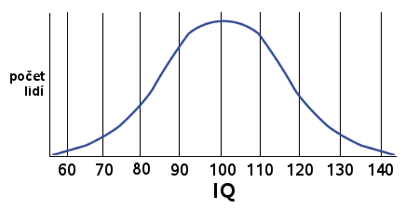
IQ in population
Below 69 = ment. retardation – 5 %
70–89 = under average – 20 %
90–109 = average – 50 %
110–129 = above average – 20 %
130–139 = signif above av - 3 %
Above 140 = genius
IQ calculation
mental age
calendar age
100 = average IQ.
× 100 = ?
Gaussian distribution

Slide 16
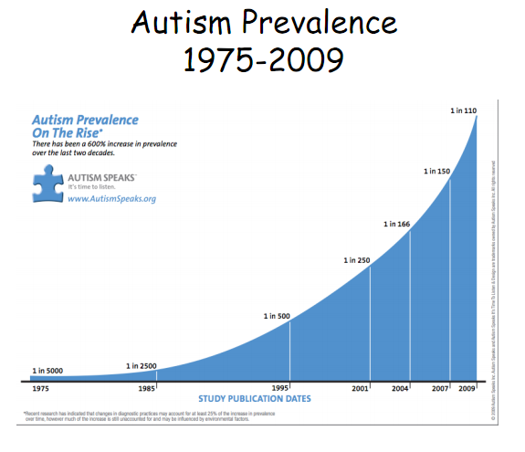
CHILD AUTISM (Kanner, 1943)
SOCIAL A EMOTIONAL WITHDRAWAL
„Extreme loneliness“
Symptoms present before 36th month of age.
Impairment :
social interaction
communication and playing
limited, stereotyped habits, aversion to change
„Softer“ diagnostic criteria?
Increased father age?
Better diagnostics and knowledge?
Other factors?
1975 1985 1995 2001 2904 2007 2009

Slide 17
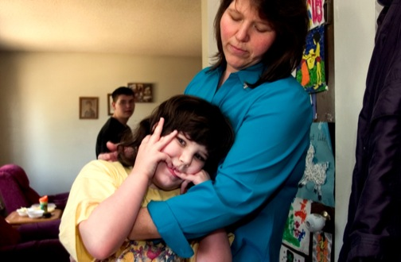
Child autism
Symptoms in early childhood
lack of interest for contact with others
· decreased face fixation
· lack of interest in communication (monologues)
· often strange intonation, echolalias, grammatical mistakes
· emotional distance or inappropriate emotions
· stereotypes adherence (wishing the things to be always same)
· anxiety and panic reactions in new situations
· stereotyped, non-constructive playing
· interest in non-living (non soft) objects
· inappropriate exploration and manipulation (sniffing, licking)
· bizarr stereotyped movements (arm shaking, wrist twisting…)
Autistic regress visible in 30-39% patients around 2. year of age (loss of speech and regresive changes in behaviour)

Slide 18

Autism in older children and adolescents
Lack of empathy and spontaneity,
behaviour „mechanic“, indifferent to feelings of
other people, peple less attractive than objects.
• Eye contact limited, no interest in communication
Speech stereotyped, pedantic, without intonation and
emotion, echolalias, answers irrespective to context.
Lack of fantasy and imagination – stereotyped behaviour
and restricted interests (fanatical preoccupation with traffic
signs, numbers, timetables, birthdates, dinosauruses…)
Intelligence : normal (but hardly useful), mental retardation (commonly), sometimes isolated, accented skills (mathematics, music, painting…)

Slide 19
Videos
https://www.youtube.com/watch?v=3w1c4sF4ZTg
https://www.youtube.com/watch?v=YtvP5A5OHpU

Slide 20
ASPERGER SYNDROM
(1944 - Hans Asperger, Austrian psychiatrist)
Social abnormities less pronounced that in autism. Strogn ego-centrism, introversion, normal IQ and speech skills (sometimes even hypertrophic speech), often clumsiness.
lack of empathy, poor recpect to social conventions
emotional withdrawal
problems in social contact
strange intonation and expression (detailed, „small adult“)
poor social skills, pedantic truthfulness, inapproproate,
shocking remarks, poor understanding of jokes and hyporboles
samotimes special talents and almost obsessive interests (computers, encyclopedias, collections, chess...)
PREVALENCE: boys prevail ( 8 : 1 )

Slide 21
Video
https://www.youtube.com/watch?v=Wi1MW6CTJbc

Slide 22
Hyperkinetic disorder/ ADHD
ICD 10
DSM 5
Hyperkinetic
disorder
Attention Deficit
Hyperactivity
Disorder - ADHD
Attention
deficit
Hyperactivity
Impulsivity
SUBTYPES
SUBTYPES
Attention deficit with hyperactivity
Hyperkinetic
conduct disorder
Inattentive
Hyperactive/impulsive
Combined
Prevalence : 3 - 7 %
Prevails in boys

Slide 23
Mental Disorders by prevalence (2011)
(and estimated number of persons affected in millions)
OCD 0,7 2,9 mil
Eating disorder 0,9 1,5 mil
Cannabis dependence 1,0 1,4 mil
Psychotic disorder 1,2 5,0 mil
Personality disorder 1,3 4,3 mil
PTSD 2,0 7,7 mil
Conduct disorder 3,0 2,1 mil
Alcohol dependence 3,4 14,6 mil
Somatoform dis. 4,9 20,4 mil
ADHD/hyperkin. dis. 5,0 3,3 mil
Dementia 5,4 6,3 m il
Unipolar depression 6,9 6,3 mil
Insomnia 7,0 29,1 mil
Anxiety disorders 14,0 61,5 mil
Výskyt ve státech Evropské Unie (EU-27) plus Švýcarsko,
Island a Norsko
H.U. Wittchen et al. European Neuropsychopharmacology (2011) 21, 655–679

Slide 24
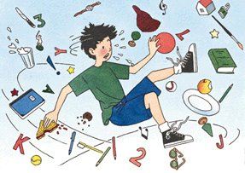
Core ADHD symptoms
Attention deficit
Hyperactivity
1.inattentive during tasks or games
2. skips details, makes mistakes
3. doesn´t follow instructions
4. disorganized
5.absent-minded
6. fails in making plans
7.inpatient, hates effortful tasks
8. loses things
9. forgets tasks, needs prompts
1. Can´t stay calm
2. Makes useless moves
3. Stands up and runs in classroom
4. Noisy all the time
5. Always on-the-go
6. talkative
Impulsivity
7. Answers before a question is finished
8. Can´t stay in queues
9. Interrupts others

Slide 25
Etiopathogenesis of ADHD
Significantly genetic disorder with variant genes for:
Neurotransmitters
Neurodevelopmental factors
Dysfunction of neurotransmitters important for
cognitive functions – dopamine, norepinephrine.
Impairments in inhibition of activity, time planning, sequencing
Notes:
Most research evidence suggests deficiencies in the availability of dopamine and norepinephrine among children with ADHD relative to comparison children, although epinephrine and serotonin have also been implicated.

Slide 26
Pharmacotherapy in ADHD :
Increase in catecholamine levels
Stimulants :
Methylphenidate
reuptake DA, NE re-uptake inhibitor, also increases release from presynaptic neuron
in PFC –improves cogn. deficits
Nonstimulating treatment:
Atomoxetine
Selective NE re-uptake inhibitor
- increases NE levels in PFC.
Also increases DA levels in PFC but not in BG nor ncl. accumbens
The efficacy of drug treatment for ADHD is high, probably the best in all psychiatric disorders.

Slide 27
TIC DISORDERS
Tics :
Sudden, irregularly repeated moves/jerks or sounds,
stereotyped and purposeless
Types : motor, vocal (sounds, words, utterances)
Frequent location: mimic muscles (eyelids, nose, mouth, neck)
Tics are anticipated by urge
Partially voluntarily controlled which is an important sign to consider in differential diagnosis against extrapyramidal disorders
If they are suppressed for longer time, the inner tension increases and then tics reappear usually in higher frequency and intensity for a short period of time („rebound” phenomenon).

Slide 28
TOURETTE SYDROME
( Gilles de la Tourette, 1885)
The most serious tic disorder
Onset between age 7-11, improves in early adulthood.
Complex motor tics in combination with vocal tics (simultaneously)
- motor tics: complex, similar to rituals
- vocal ticsy : sounds, words, echolalias, koprolalia
TS often comorbid with OCD and ADHD
https://www.youtube.com/watch?v=7_dBRDvkbTU

Slide 29
Therapy of tics
Mild forms:
  Psychotherapy the first choice
  Medication if PT fails or tics are persistent and disruptive
Tourette: Antipsychotics (antidopaminergic effect)
atypical AP (tiaprid, risperidon, aripiprazol), sometimes haloperidol (typical AP, very potent but lot of AE)

Slide 30
Conduct disorders
a repetitive and persistent pattern of behavior by a child or teenager in which the basic rights of others or major age-appropriate societal norms or rules are violated.
  Agression towards humans and/or animals (bullying,
  fights, threats, sexual offence)
  Property loss or damage
  (setting fires, voluntary property destruction)
  Deceitfulness or theft (lying, burglary)
  serious violations of rules time and time again
  (escapes, truancy before age 13.)

Slide 31
Conduct disorders
SOCIALIZED - the child/teenager is able to socialize, has friends and friendly relationships. The delicts are commited either alone or in a gang
NON-SOCIALIZED – decreased ability for socializing, few friends, ususally alone (poorer prognosis)

Slide 32
Conduct disorders
Oppositional defiant disorder (ODD)
Younger children up to 10, age-inappropriate oppositional behaviour, angry/irritable mood, poor respect towards authorities. Aggresive or antisocial behaviour not present!

Slide 33
Conduct disorders
If CD comorbid with ADHD the prognosis is poorer
If symptoms of CD persist into adulthood, then personality disorder is classified, often antisocial PD

Slide 34
Emotional disorders
Separation anxiety disorder
Elective mutism
Phobias
Mixed conduct and emotional disorders
Stress reactions
Post-traumatic stress disorder (PTSD)
Adjustment disorders

Slide 35
Emotional disorders with childhood onset
Separation anxiety disorder
Strong and age-inappropriate anxiety if separated from parent(s)/home or even imagining such a situation
Irrational concerns (kidnap, losing, beeing killed...)
Fear of: leaving home
  staying home alone
  sleeping alone
  going to preschool/school
Frequent and significant somatic symptoms
(headeaches, abdominal pains, nausea and vomiting)
Typically worsens on Sunday evening or Monday morning
Pronounced affects during separation

Slide 36
Fobic anxiety disorders in childhood
abnormal and specific fears of specific objects and situations
more pronounced than appropriate in a particular age
(e.g. Zoophobia is frequent in preschoolers)
Animals general zoophobia
Insects entomophobia
Cats ailurophobia
Dogs cynophobia
Snakes ophidophobia
Spiders arachnophobia
Dark nyktophobia
Blood hematophobia
Dirt mysophobia
Heights acrophobia
Closed places claustrophobia
Strangers xenophobia
Fire pyrophobia
Thunder brontophobia

Slide 37
Elective mutism
A period of mutism (not speaking) in specific social situations despite the normal development of speech and lack of problems when speaking with family members
Prevalence 0,3-0,8/1000 children, more girls
Psychological traits like shyness
Good prognosis with therapy, although social phobia as a possible outcome
https://www.youtube.com/watch?v=WXcgNPpFjBM

Slide 38
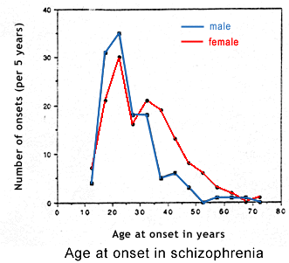
Early-onset schizophrenia
Symptoms in children:
Impairment of interpersonal relations, emotional changes, social withdrawal, bizarr, anxious behaviour, rituals, unjustified fears or flattened emotivity, delusional fantasies, abnormal speech, abnormal motor symptoms
Older children: verbal and sometimes visual hallucinations (animals, monsters…)
Symptoms are influenced by cognitive development and only after 11 years of age are similar to those in adults
Age of onset
before 10 – 1%
before 15 5%
before 17 20%
before 25 50%
before 30 80%

Slide 39
Prognosis of COS and therapy
Early childhood:
Poor progosis
Mental development is impaired
Chronical course
Often pharmacoresistant
Later childhood
Insure prognosis
Adolescence:
Better prognosis
Atypical antipsychotics
    Risperidon
    Paliperidone
    Aripiprazol
    Olanzapin
    Quetiapin
    Clozapin
    Ziprasidon
https://www.youtube.com/watch?v=BIligWBtJus

Slide 40
DEPRESSION in children
In early childhood the diagnosis is difficult.
CHILDREN: depressive mood not necessarily predominates, more anxiety symptoms, anhedonia, unexplicable somatic symptoms, irritability, changes in behaviour and conduct, impaired school performance, reduction of interests and social contacts
ADOLESCENTS: more sleep disorders, changes in appetite, suicidal thoughts and attempts, impaired performance, inattention, tiredness, reduction of interests and social contacts, being bored, irritated
Quite often delusions and hallucinations.

Slide 41
Depression - treatment
Milder depression- psychotherapy
Severe depression – SSRI antidepressants + psychotherapy
Antidepressants are less effective than in adults

Slide 42
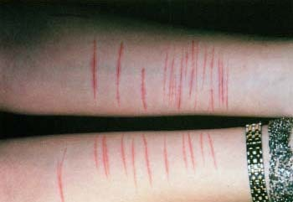
Self-harm
Deliberate, often repeated self-injury – no wish of dying.
Superficial cutting, burning with cigarettes – used to diminish inner tension, mental suffering during strong emotions or feelings of inner emptiness. Physical pain reduces the mental one.
Often habitual coping strategy (maladaptive) in youth with non-harmonic personality development, eating disorders, anxiety disorders and many other
The treatment is focused on primary cause, relationships, better coping strategies

Slide 43
Suicidal attepmts
Infrequent until 10 years, increase in adolescence and adulthood.
In CZ approx. 40 completed suicides in adolescents per year
Boys – less attempts but more often completed
(use of more dangerous and letal means)
Girls - more attempts, more often incompleted (intoxications)
Parasuicides (demonstrative s.)- in children are considered serious. Children understand the definitiveness of death by 9 years
In adolescence a suicidal attempt is the most common reason for acute psychiatric help and suicide is the second most frequent reason of death.

Slide 44
Suicidal behaviour - causes
Family and school problems
- Family discomfort
- Abuse and neglect
death of a parent or divorce
homesickness (college)
- school results, failures
Personal and relational:
- poor acceptance from others
- romantic failures
- low self-esteem
- self-accusation
- increased impulsivity

Slide 45
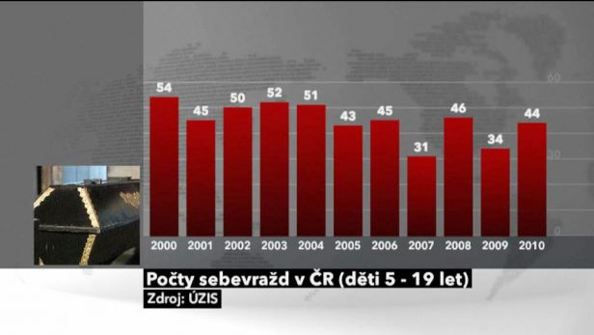
Child and adolescent suicidality in CZ
Year up to 15 15-19
1996 9 71
1997 6 66
1998 8 52
1999 3 58
2000 12 42
2001 6 39
2002 6 44
2003 9 43
2004 8 43
2005 6 37
2006 3 55
Data from Institute of Health Information and Statistics of the Czech Republic.

Slide 46
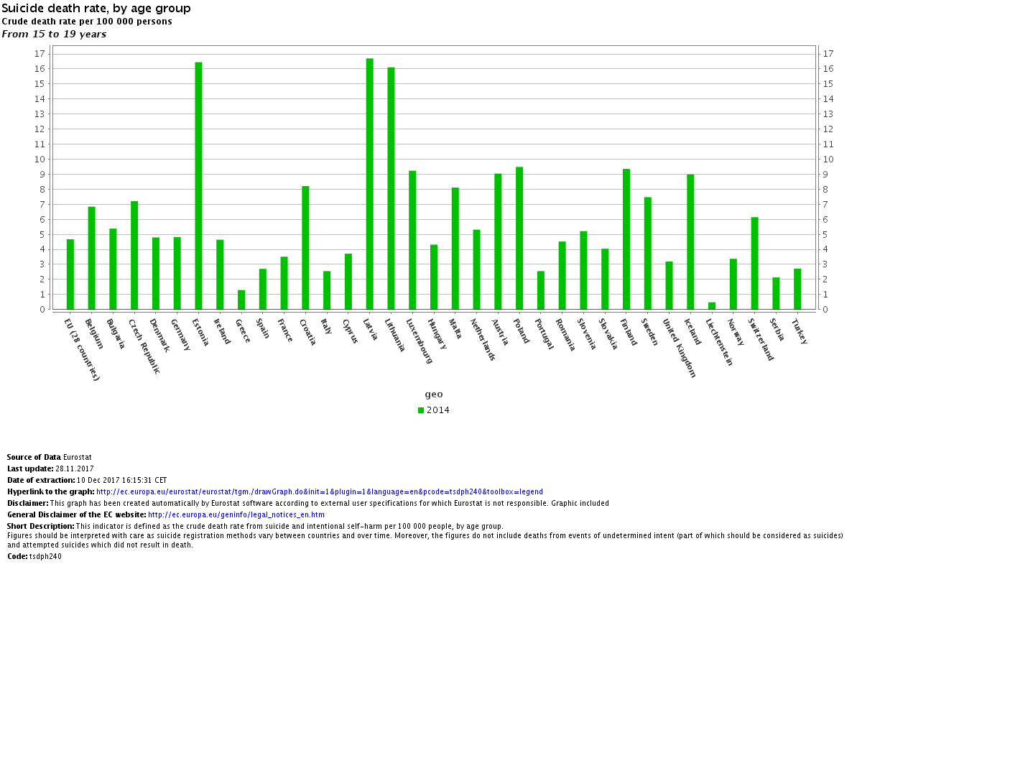
Eurostat, 2014, suicidal rates 15-19yo

Slide 47
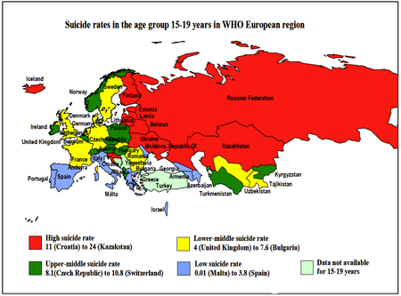

Slide 48
Other common disorders
Eating disorders!
Enuresis (bed-wetting)
Encopresis
Child abuse and neglect (sydrome) CAN

Slide 49
Thanks for your attention
If you cannot pay attention due to ADHD, thanks anyway

