Slide 1
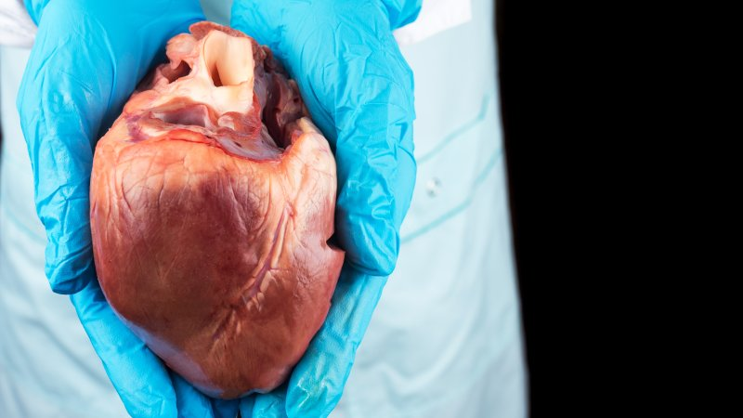
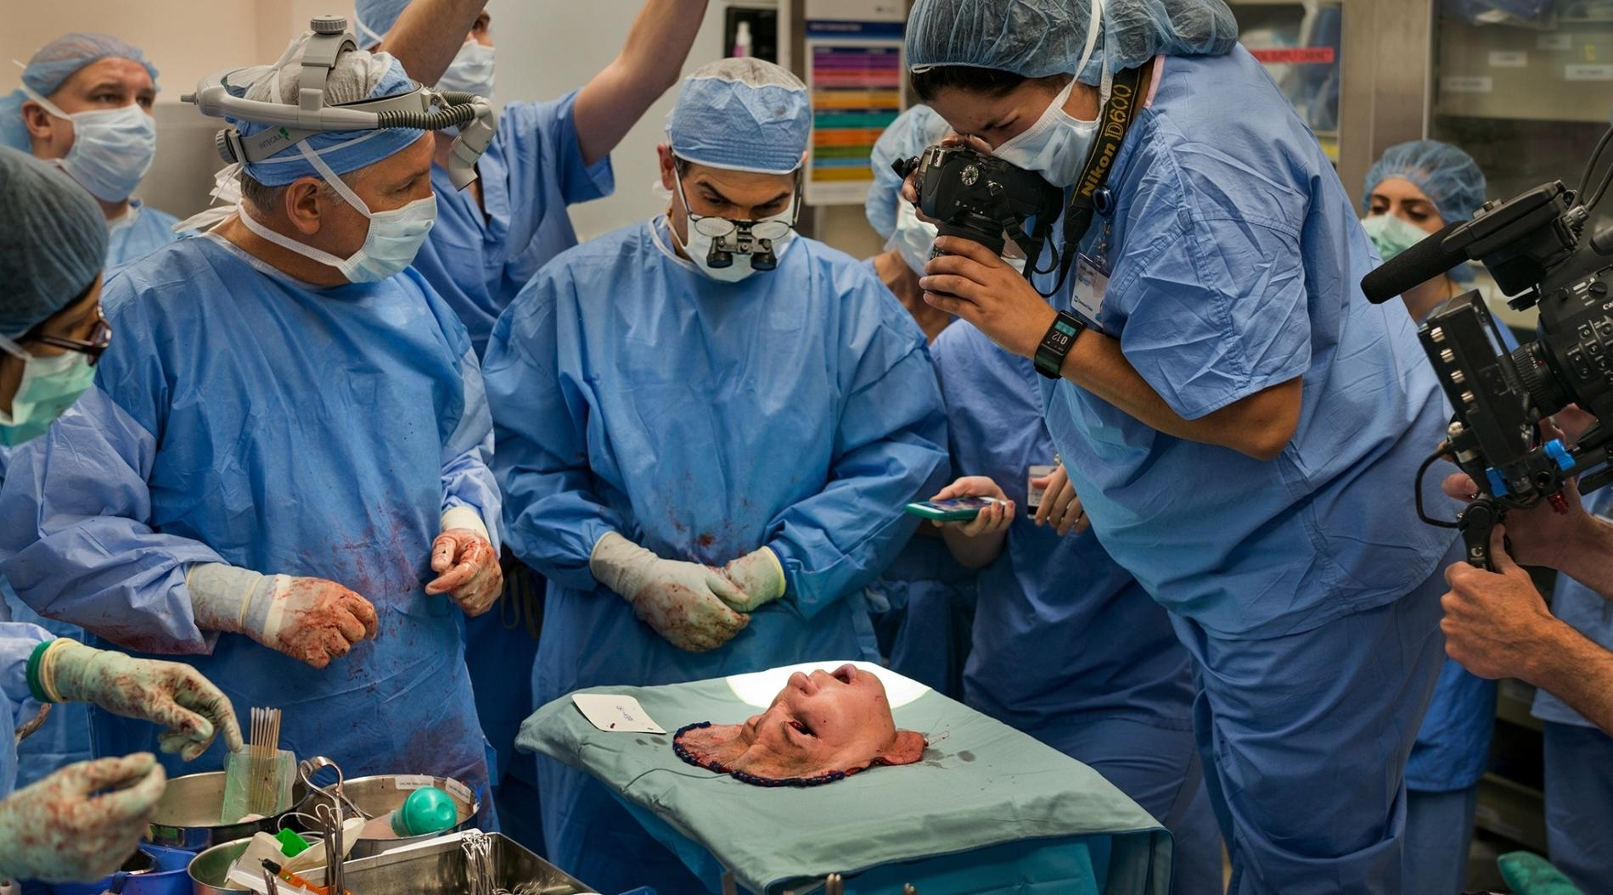
TRANSPLANT SURGERY
Department of Trauma Surgery
University Hospital Brno

Slide 2
DEFINITION :
An organ transplant is a surgical operation in
which a failure or damaged organ in human body is
removed and replaced with a functioning one. The
donated organ may be from a deceased donor, a living
donor or an animal.
 Organs that can be transplanted are the heart, kidneys,
liver, lungs, pancreas, intestine and thymus.
 Tissues include bones, tendons, cornea, skin, heart valves,
nerves and veins.
 Worldwide, the kidneys are the most commonly
transplanted organs, followed by the liver and then the
heart.

Slide 3
Types of transplants
Autograft
Allograft
Isograft
Xenograft
Split transplant
Domino transplant

Slide 4
Autograft is a transplant of tissue from one to oneself. Sometimes this is done with surplus tissue,
or tissue that can regenerate, or tissues more desperately needed elsewhere (examples include skin
grafts, for CABG, etc.) sometimes this is done to remove the tissue and then treat it or the person
before returning it.
Alograft is transplant of an organ or tissue between two genetically non identical
members of the same species. Most human tissue and organ transplants are allografts.
Isograft - a sub set of allografts in which organs or tissues are transplanted from a donor to a
genetically Identical recipient(such as an identical twin). Isografts are differentiated from other
types of transplants because while they are anatomically identical to allografts, they do not trigger
an immune response.

Slide 5
Xenograft - A transplant of organs or tissue from one species to another. Xenograft is often an
extremely dangerous type of transplant because of increased risk of noncompatibility, rejection,
and disease carried in the tissue. Examples include porcine heart valves, which are quite common
and successful. The latter’s research study directed for potential human use if successful.
Split transplants - sometimes, a deceased-donor organ, usually a liver, may be divided between
two recipients, especially an adult and a child. This is not usually a preferred option because the
transplantation of a whole organ is more successful.
Domino translplants - This operation is usually performed for cystic fibrosis as both lungs need to be
replaced and it is a technically easier operation to replace the heart and lungs. As the recipient’s native
heart is usually healthy, this can then itself be transplanted into someone needing a heart transplant

Slide 6
Major organs and tissues transplated
CHEST:
Heart (deceased-donor only)
Lung (deceased-donor and living-donor)
Heart/Lung (deceased-donor and domino transplant)
ABDOMEN:
Kidney (deceased-donor and living-donor)
Liver (deceased-donor and living-donor)
Pancreas (deceased-donor only)
Intestine (deceased-donor and living-donor)
Stomach (deceased-donor only)
Testis (deceased-donor and living-donor)

Slide 7
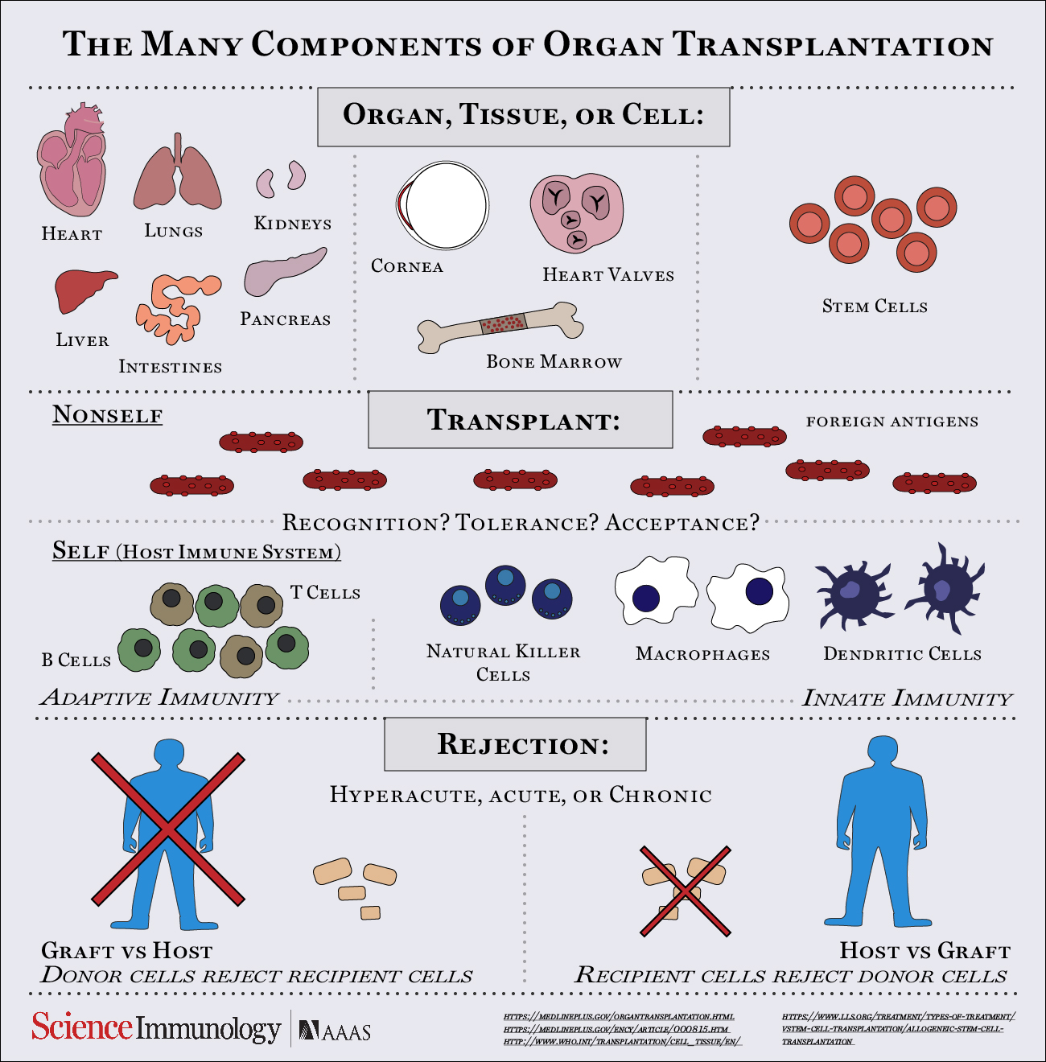

Slide 8
Tissues, cells and fluids
Hand (deceased-donor only)
Cornea (deceased-donor only)
Skin (deceased-donor, living-donor and autograft)
Islets of langerhans (deceased-donor and livingdonor)
Bone marrow (living-donor and autograft)
Heart valves (deceased-donor, living-donor and
xenograft)
Bone (deceased-donor, living-donor and autograft)

Slide 9
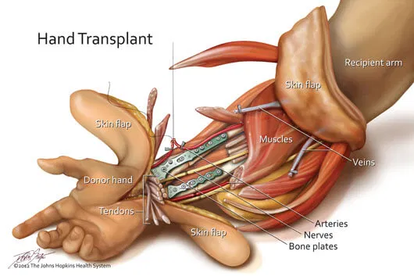
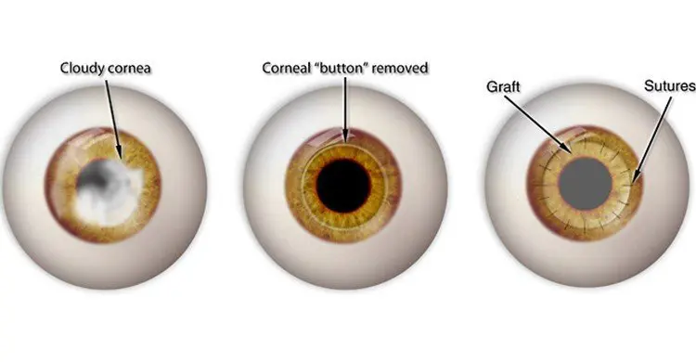
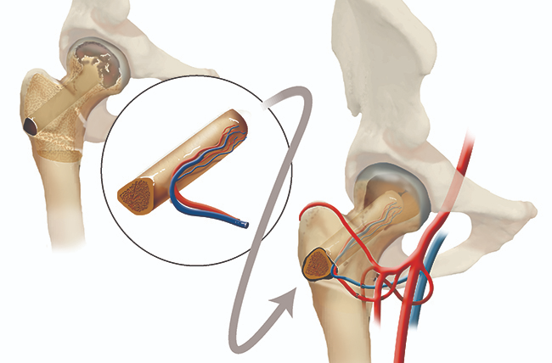
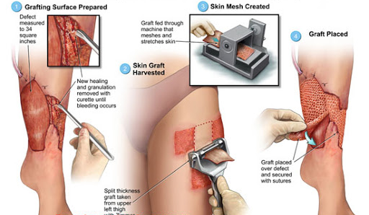

Slide 10
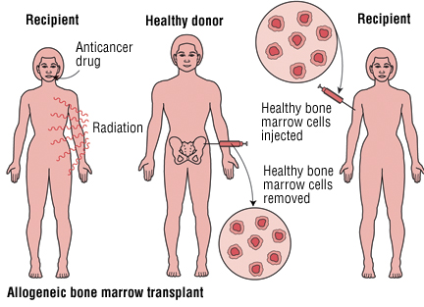
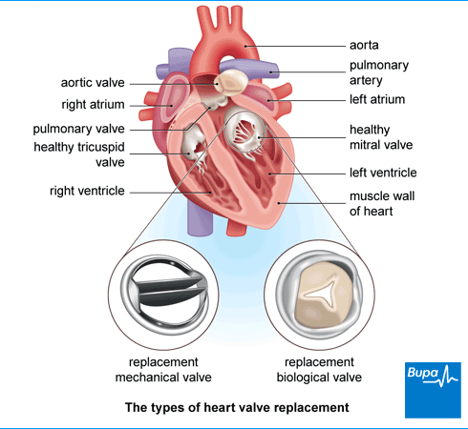
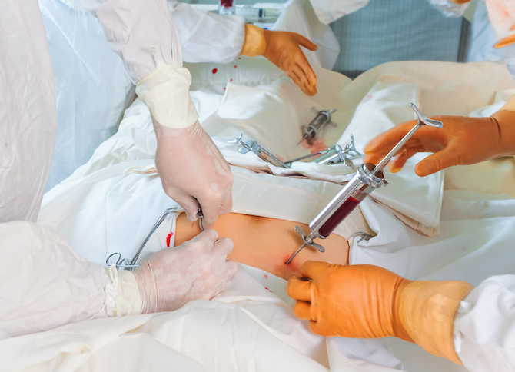

Slide 11
Transplant antigens
Human leucocytes antigen(HLA)
a group of highly polymorphic cell surface
molecules
They act as antigen recognition unit on T lymphocytes
and are the major trigger for graft rejection
Types; class1 –A,B,C present in all
nucleated cells, class2 – HLADR,
DP,DQ present only on APC
Class 2- HLA-DR are most important in
rejection
CD8+ and CD4+ recognize class 1 and 2
receptors respectively
bbinyunus2002

Slide 12
MHC
Major histocompatibility complex. They are clusters of genes on the short arm of chromosome 6 expressed on the cell surface as HLA i.e. genes that encode HLA.
ABO
These blood group antigen are expressed not only on red blood cells but by most cell types as well. Incompatibility leads to hyperacute rejection.

Slide 13
GRAFT REJECTION
Rejection of transplanted organs is a bigger challenge than the technical expertise required to perform the surgery. It results mainly from HLA and ABO incompatibility.
Hyperacute
Acute
Chronic

Slide 14
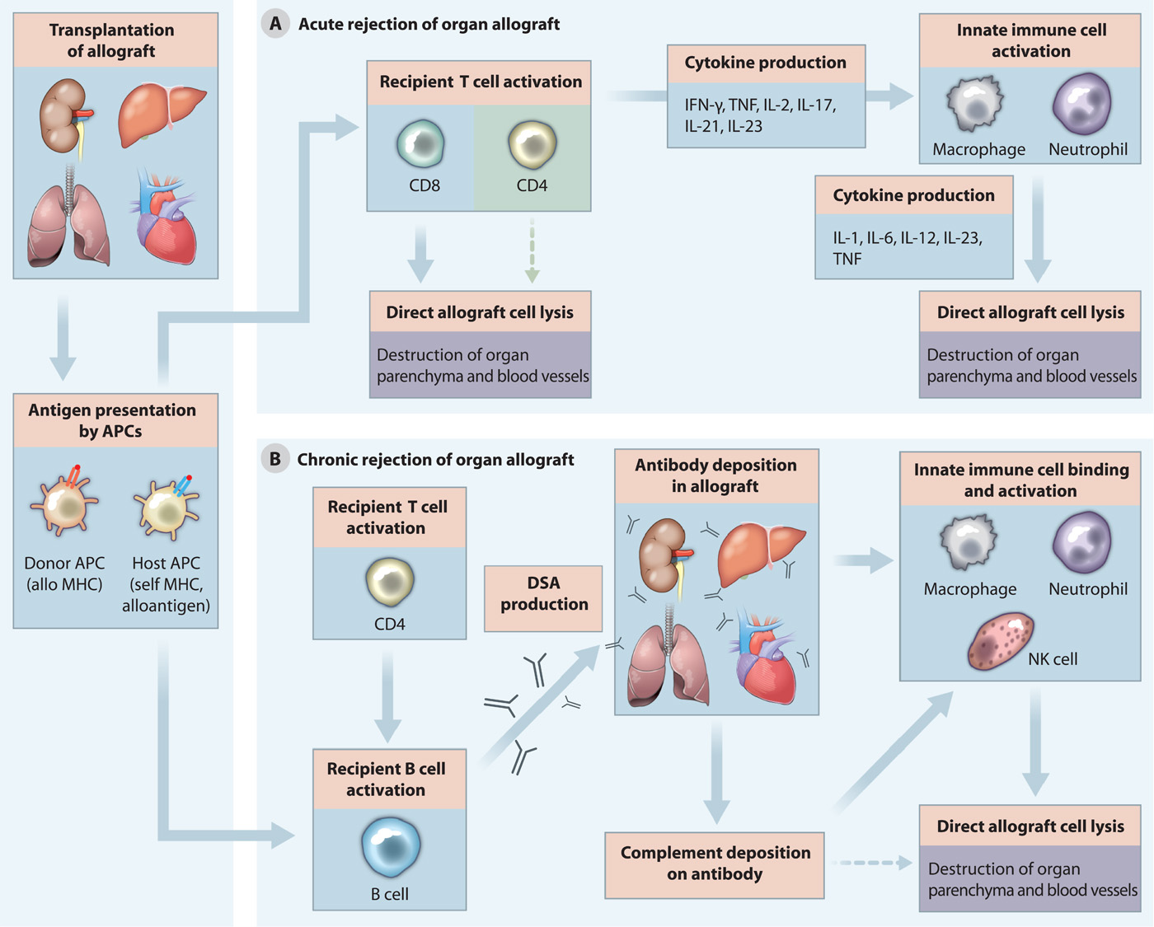

Slide 15
Hyperacute rejection
Immediate graft destruction due to AB or preformed anti- HLA antibodies.
Characterized by intravenous thrombosis and interstitial hemorrhage.Risk factors are previous failed transplant and blood transfusions
Kidney transplant is vulnerable to hyperacute rejection
Acute rejection
Usually occurs during the first 6month
May be cell mediated (T-cell), antibody mediated or both
Characterized by cellular infiltration of the graft(cytotoxic, B- cells, NK cells and
macrophages)

Slide 16
Chronic rejection
It occurs after 6month
Most common cause of graft failure
Antibodies play important role
Non- immunological factors contribute to
the pathogenesis
Characterized by myointimal proliferation in graft arteries leading to
ischemia and fibrosis

Slide 17
PATIENT SELECTION AND EVALUATION
RECIPIENT
Patient who met the indication for transplant –
ORGAN FAILURE
Clinical evaluation; history and physical
examination to rule out other diseases and comorbidities
Immunological evaluation
Serology; HIV, Hepatitis, CMV, VDRL
Tissue typing & cross matching
Blood group
Infection screening – septic work-up, mantoux
Others ; FBC, clotting profile, FBS, ECG, U/Ecr,
tumour markers, stool microscopy

Slide 18
Patient selection
DONOR
Cadaveric
Individuals with severe brain injury resulting in brain death-Brain death is defined as “complete irreversible cessation of all brain functions”
Other criteria;
Normothermic patient.
No respiratory effort by the patient.
The heart is still beating.
No depressant drugs intake should be
there while evaluating the patient.
Individual should not have any sepsis,
cancer (except brain tumour).
Not a HIV or hepatitis individual.

Slide 19
Living donor
a living donor should be healthy
Living unrelated donor or
Living related donor
Improved graft survival
Less recipient morbidity
Early function and easier to manage
Avoidance long waiting time for transplant
Less aggressive immunosuppressive regimen

Slide 20
Contra-indications for living donor
Mental disease
Disease organ
Morbidity and mortality risk
ABO incompatibility
Crossmatching incompatibility
Transmissible disease

Slide 21
Evaluation -to assess for suitability
CLINCAL - history of risk factors for infection,
malignancy in the past 5 years. Presence of
co-morbidities
ABO typing.
Serology tests.
Infection and malignant screening
CT-Angiogram
Intravenous urography.
HLA typing.

Slide 22
FACTORS DETERMING ORGAN FUNCTION AFTER TRANSPLANT
DONOR CHARACTERISTICS
■ Extremes of age
■ Presence of pre-existing disease in the transplanted
organ
■ Haemodynamic and metabolic instability
PROCUREMENT-RELATED FACTORS
■ Warm ischaemic time
■ Type of preservation solution
■ Cold ischaemic time
RECIPIENT-RELATED FACTORS
■ Technical factors relating to implantation
■ Haemodynamic and metabolic stability
■ Immunological factors
■ Presence of drugs that impair transplant function

Slide 23
COUNSELING
May involve professional counselors/ psychotherapist
Aimed at preventing / minimizing possible complication
Need for adherance to post-op maintenance medications
Regular follow-up thorough evaluation
Life style modification; smoking, alcohol, sedentary life style, junks, excessive salt ingestion.

Slide 24
DECEASE DONOR
Some Factors influencing refusal to consent by relatives;
non-acceptance of brain death.
Superstitions relating to being reborn with a missing organ
A delay in funeral
Lack of consensus within family members
Fear of social criticism
Dissatisfaction with the hospital staff
Religious believes
LIVING DONOR
Education
Willingly not for any financial reason or under duress
Most undergo extensive screening – medical phycological
Involve family
Surgery and anaesthetic complications complications outline to patients

Slide 25
RECIPIENT
Nature of disease and the need for transplant
Outcome and complications
Need for compliance to immunosuppressive therapy
Other available options

Slide 26
OPTIMIZATION OF RECIPIENT
Correction of derangements, getting patient ready for
surgery
Correction of anaemia
Uremia
Dehydration
Treatment of infection
Treatment of malaria
Deworming of patient
Central line
Urethral catheter
Loading dose immunosuppression 12hr pre-op
Prophylactic antibiotics

Slide 27
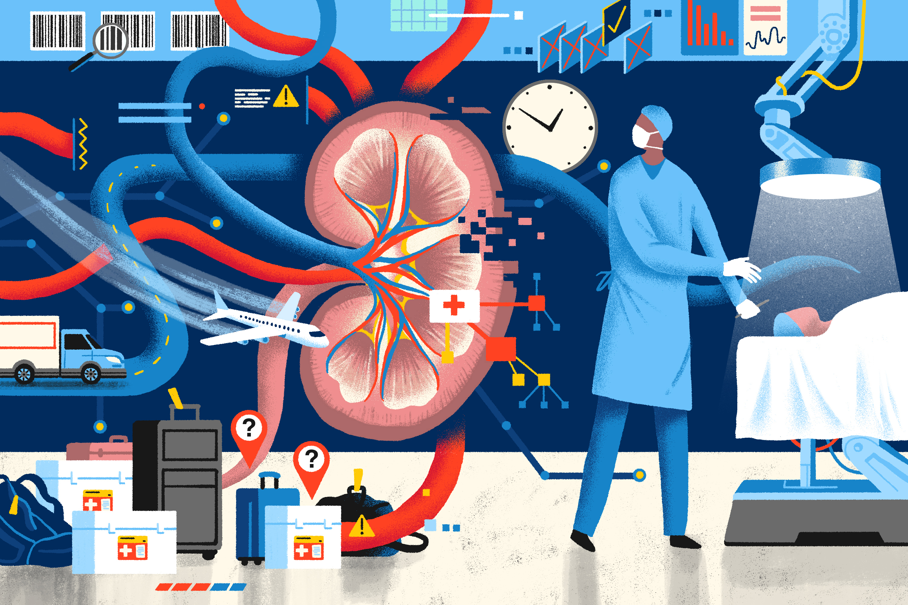

Slide 28
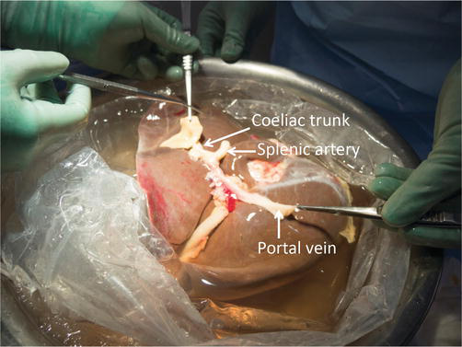
PRINCIPLES
INTRA-OPERATIVE
Organ procurement and preservation
Living donors
a. Strict asepsis and hemostasis
b. Adequate exposure
c. Control of the vessels above and below
the organs to be removed is done- cross clamping
d. Removal of the organ

Slide 29
e. Preservation
After removal, th organ is flushed with chilled organ preservation solution e.g. – University of Wisconsin (UW), Euriocolins, Celsior, Citrate/Marshall solutions

Slide 30
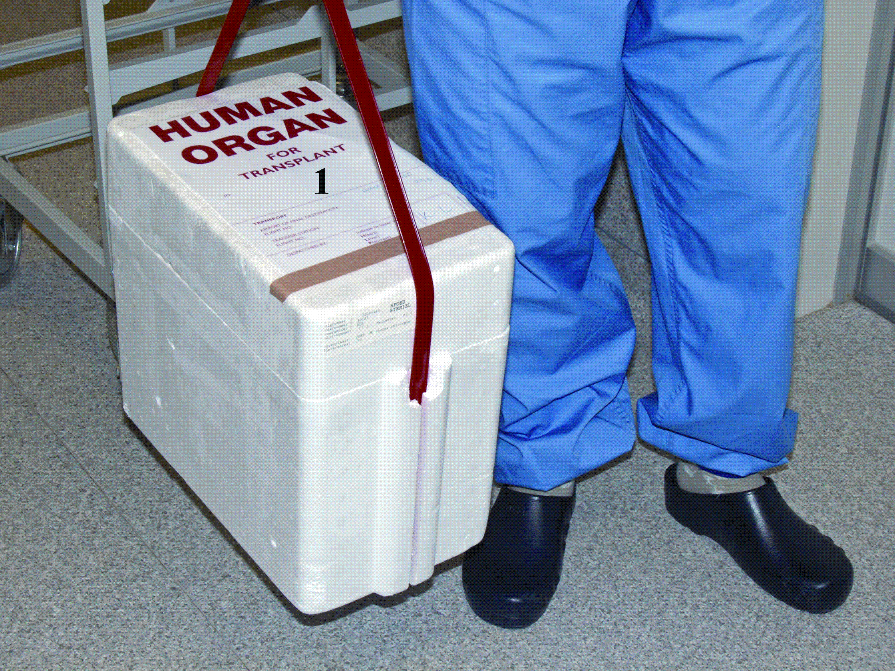
g. Organ packing

Slide 31
h. Transplantation/vascular
reconstruction
Warm ischemic time ; time an organ
remains at body temperature between which
the blood supply is cut off before cold
perfusion. (within 30min)
Cold ischemic time ; the time between the
chilling of the organ, after blood supply has
been cut off and the time it is warmed by
reconnection

Slide 32
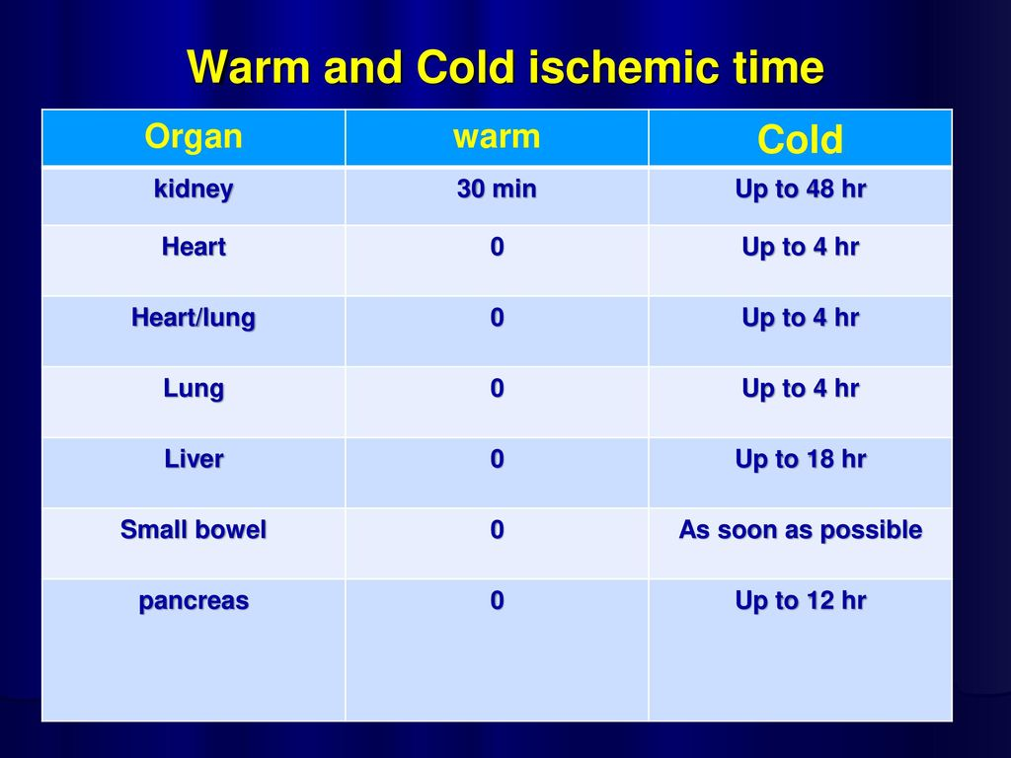

Slide 33
PRINCIPLES
Post-operative
Post-operative assessment
Clinical –vital signs; fever, tarchychadia, hypertension, pain at
site of transplant, pedal oedema (compession of external iliac
vein), decrease urine volume- features of hyperacute rejection
Investigations
U/Ecr
USS- increase in size, pelvicalyceal dilation
Biopsy; mononuclear infiltrates, fibrinoid necrosis, interstitial haemorrhage.
Others
O Maintenance immunosuppression
O DVT prophylaxis
O Treatment of infection
O Regular follow up

Slide 34
IMMUNOSUPPRESSION
The principles are the same for type of
organ transplant; maximize graft
protection and minimize side effect.
The agents used to prevent rejection act
predominantly on T cells.
The need for immunosuppression is
highest in the first 3 month but indefinite
treatment is needed
It increase the risk of infection and
malignancy.

Slide 35
COMPLICATIONS OF IMMUNOSUPPRESSION
INFECTIONS
high risk of opportunistic infections
Bacterial; common during first month after
transplantation / before recovery from surgery
Community acquired infections
Wound infection
UTI (catheter related)
Tuberculosis

Slide 36
Viral ; highest in the first six month
▪ CMV infection; may presents as
pnuemonia, gastrointestinal disease,
hepatitis, retinitis, encephalitis
▪ Herpes simplex virus (HSV) ;
mucocuteneous lesions sometimes around
the genitalia
▪ BK-virus; graft dysfunction
▪ Herpes zoster infection; chicken pox
O Fungal ; pneumocystic jiroveci(carinii),
candidiasis, aspergillosis
O Parasitic; strongiloides, leimaniasis,
toxoplasmosis

Slide 37
MALIGNANCY
▪ Post transplant lymphoprolipherative
disease (PTLPD); seen 1-3% of kidney
transplant with 50% mortality
▪ Squamous cell ca of the skin
▪ Basal cell ca and malignant melanoma are
higher in transplant patient than the genral
population
▪ 50% of transplant patient would develop skin
malignancy in 20years
▪ Kaposi sarcoma; 300 fold increased risk

Slide 38
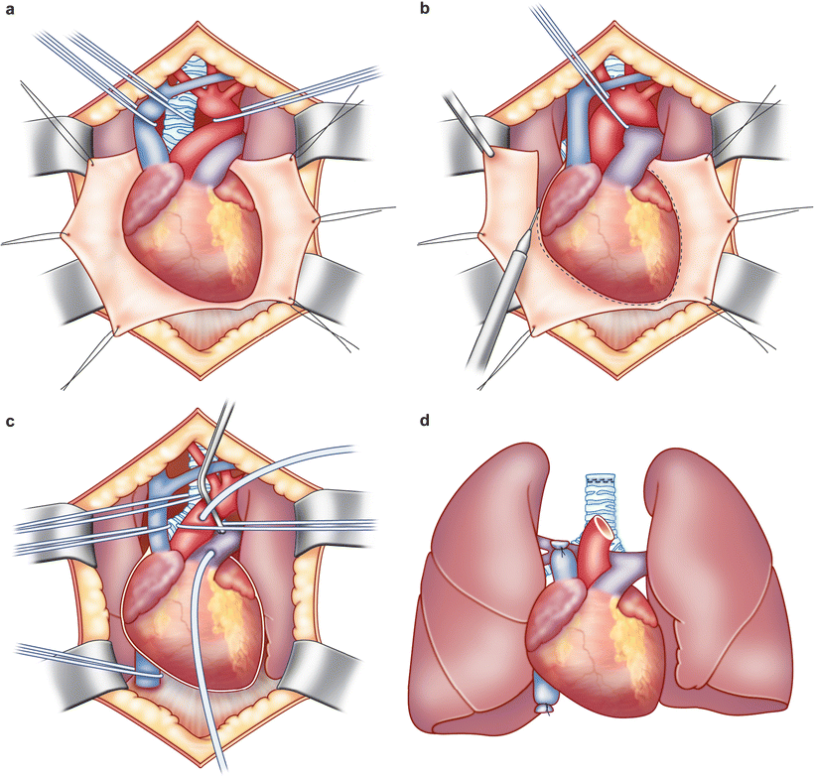
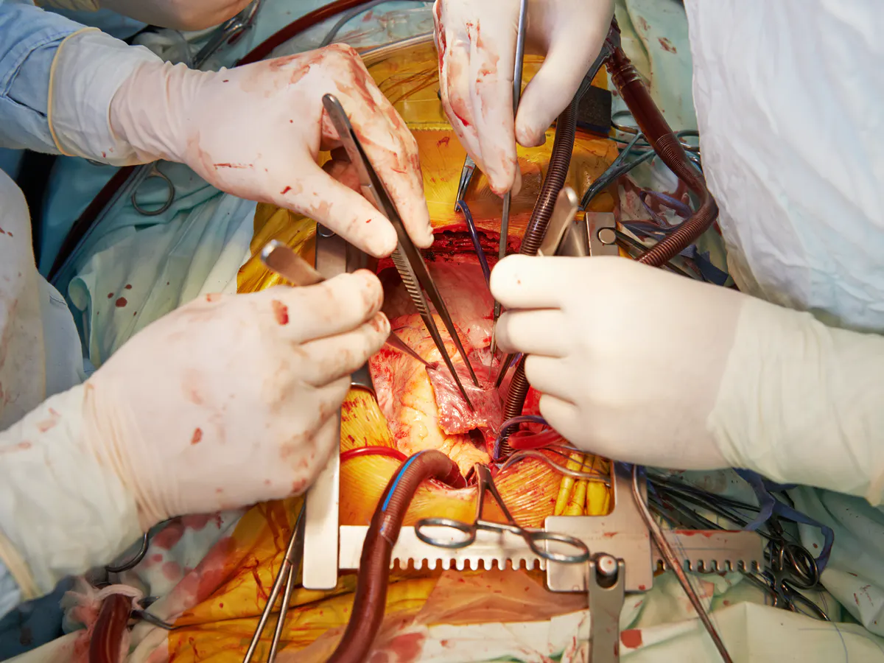
Heart transplantation
A heart transplant is an operation in which a diseased, failing heart is replaced with a healthier donor heart. Heart transplant is a treatment that's usually reserved for people whose condition hasn't improved enough with medications or other surgeries.

Slide 39
Heart transplants are performed when other treatments for heart problems haven't worked, leading to heart failure. In adults, heart failure can be caused by:
A weakening of the heart muscle (cardiomyopathy)
Coronary artery disease
Heart valve disease
A heart problem you're born with (congenital heart defect)
Dangerous recurring abnormal heart rhythms (ventricular arrhythmias) not controlled by other treatments
Failure of a previous heart transplant
In children, heart failure is most often caused by either a congenital heart defect or cardiomyopathy.

Slide 40
Another organ transplant may be performed at the same time as a heart transplant (multiorgan transplant) in people with certain conditions at select medical centers.
Multiorgan transplants include:
Heart-kidney transplant. This procedure may be an option for some people with kidney failure in addition to heart failure.
Heart-liver transplant. This procedure may be an option for people with certain liver and heart conditions.
Heart-lung transplant. Rarely, doctors may suggest this procedure for some people with severe lung and heart diseases if the conditions cannot be treated with only a heart transplant or a lung transplant.

Slide 41
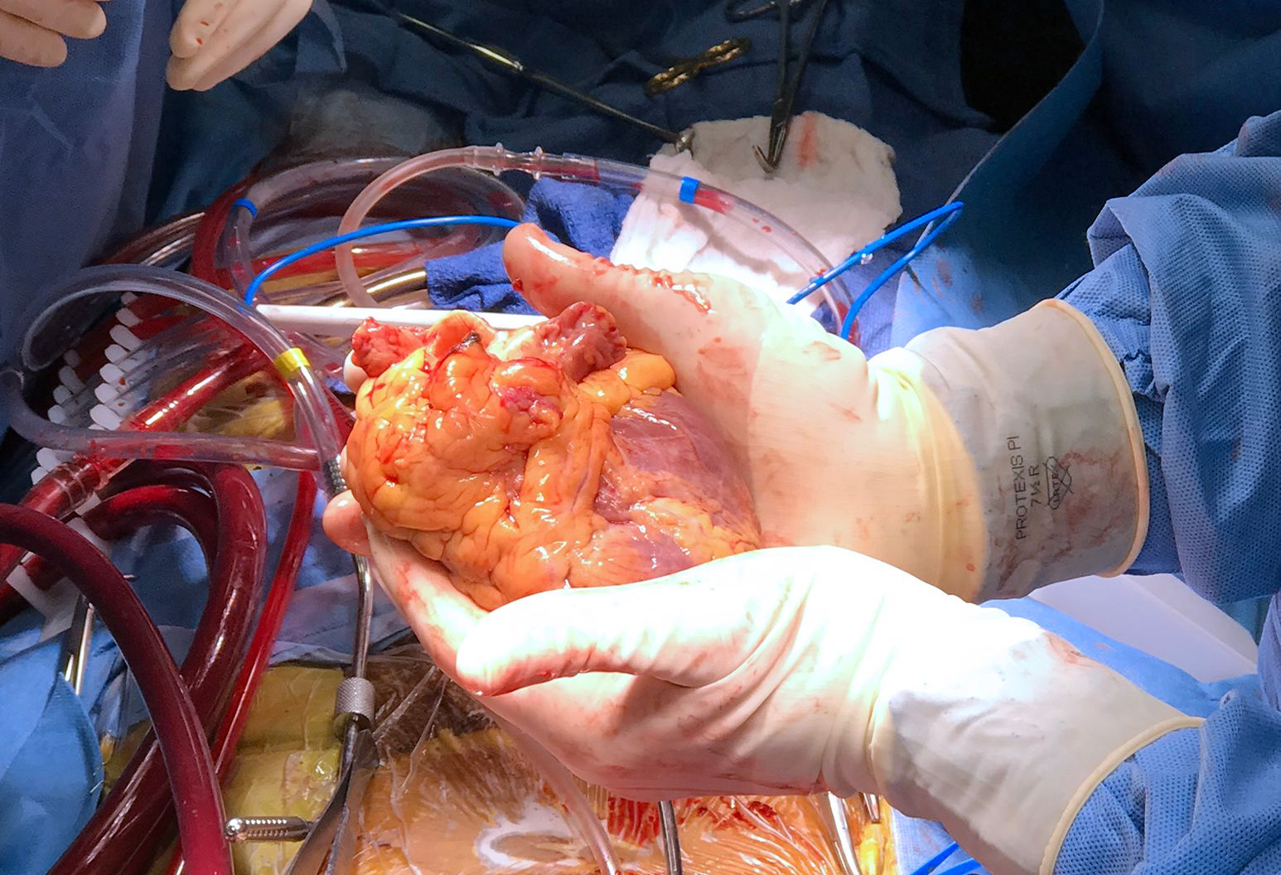
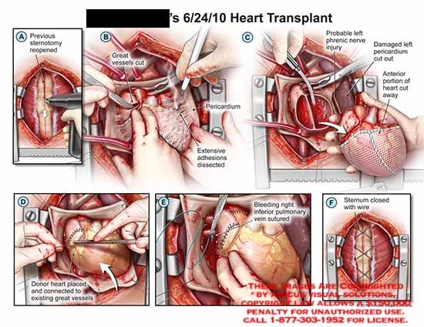

Slide 42
Absolute contraindications:
Advanced kidney, lung, or liver disease
Active cancer if it is likely to impact the survival of the patient
Life-threatening diseases unrelated to the cause of heart failure, including acute infection or systemic disease such as systemic lupus erythematosus, sarcoidosis or amyloidosis
Vascular disease of the neck and leg arteries.
High pulmonary vascular resistance – over 5 or 6 Wood units.
Relative contraindications:
Insulin-dependent diabetes with severe organ dysfunction
Recent thromboembolism such as stroke
Severe obesity
Age over 65 years (some variation between centers) – older patients are usually evaluated on an individual basis.
Active substance abuse, such as alcohol, recreational drugs or tobacco smoking (which increases the chance of lung disease)

Slide 43
Ventricular assist devices
For some people who cannot have a heart transplant, another option may be a ventricular assist device (VAD). A ventricular assist device is a mechanical pump implanted in your chest that helps pump blood from the lower chambers of your heart (ventricles) to the rest of your body.
VADs are commonly used as temporary treatments for people waiting for heart transplants. These devices are increasingly being used as long-term treatments for people who have heart failure but are not eligible for heart transplants. If a VAD doesn't help your heart, doctors may sometimes consider a total artificial heart — a device that replaces the ventricles of your heart — as an alternative short-term treatment while you're waiting for a heart transplant

Slide 44
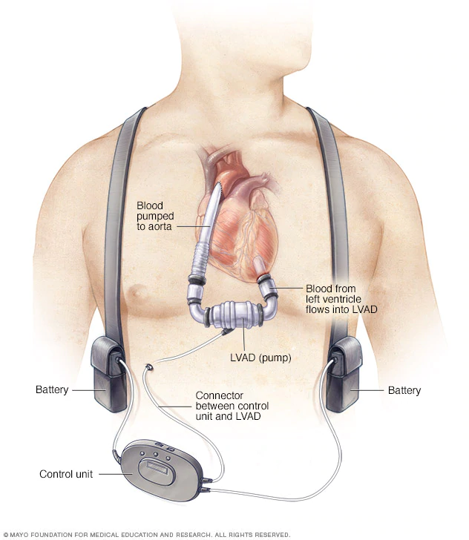

Slide 45
Risks
Besides the risks of having open-heart surgery, which include bleeding, infection and blood clots, risks of a heart transplant include:
Rejection of the donor heart. One of the most significant risks after a heart transplant is body rejecting the donor heart.
Primary graft failure. With this condition, the most frequent cause of death in the first few months after transplant, the donor heart doesn't function.
Problems with arteries. After transplant, it's possible that the walls of the arteries in heart could thicken and harden, leading to cardiac allograft vasculopathy. This can make blood circulation through your heart difficult and can cause a heart attack, heart failure, heart arrhythmias or sudden cardiac death.
Medication side effects. The immunosuppressants taken for the rest of your life can cause serious kidney damage and other problems.
Cancer. Immunosuppressants can also increase the risk of developing cancer. Taking these medications can put patient at a greater risk of skin and lip tumors and non-Hodgkin's lymphoma, among others.
Infection. Immunosuppressants decrease ability to fight infection. Many people who have heart transplants have an infection that requires them to be admitted to the hospital in the first year after their transplant.

Slide 46
KIDNEY TRANSPLANT
A kidney transplant is a surgical procedure to place a healthy kidney from a living or deceased donor into a person whose kidneys no longer function properly
O Indications
O End-stage renal disease
Causes
O glomerulonephritis;
O diabetic nephropathy;
O hypertensive nephrosclerosis;
O renal vascular disease;
O polycystic disease;
O pyelonephritis;
O obstructive uropathy;
O systemic lupus erythematosus;
O analgesic nephropathy;
O metabolic disease (oxalosis, amyloid).

Slide 47
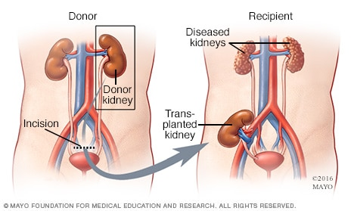
A kidney transplant is often the treatment of choice for kidney failure, compared with a lifetime on dialysis. A kidney transplant can treat chronic kidney disease or end-stage renal disease to help you feel better and live longer.
Compared with dialysis, kidney transplant is associated with:
Better quality of life
Lower risk of death
Fewer dietary restrictions
Lower treatment cost

Slide 48
Donor Nephrectomy
O Open or laparoscopic
O Open donor nephrectomy is the gold standard
O Open donor nephrectomy is via the 12th rib
incision, and in fat patient 10th rib or hypogastrium
O Extraperitoneal : avoid devascularizing ureter,
sharp dissection, avoid diathermy near vessels
O Renal vasculature dissect flush to IVC/Aorta
O Ligate lumbar veins posteriorly ± gonadal vein

Slide 49
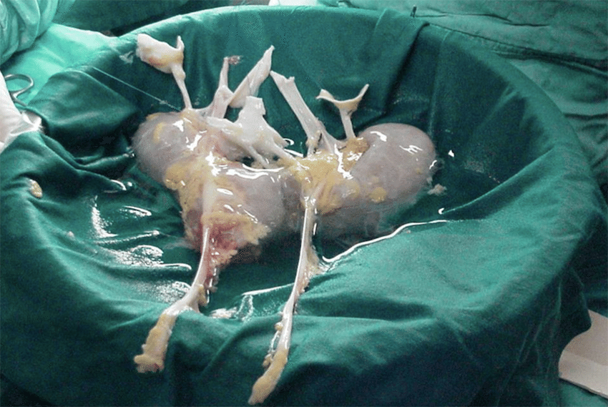
Donor Kidney Bench Surgery
O The kidney is perfused with ice-cold
preservative
O Iced saline is mashed into a slush and
kidney immersed
O Extra veins ligated, accessory artery(ies)
anastamosed together
O Kidney now ready for transplanting

Slide 50
THE TRANSPLANT
O Right donor kidney to left recipient site
and vice versa
O Gibson’s incision; Curvilinear incision 2
cm above the inguinal ligament, from
midline to just above the anterior Sup.
Iliac Spine
O End to side venous anastamosis 5/0
prolene
O End to end arterial anastamosis 5/0
Prolene
O Implant ureter to bladder

Slide 51
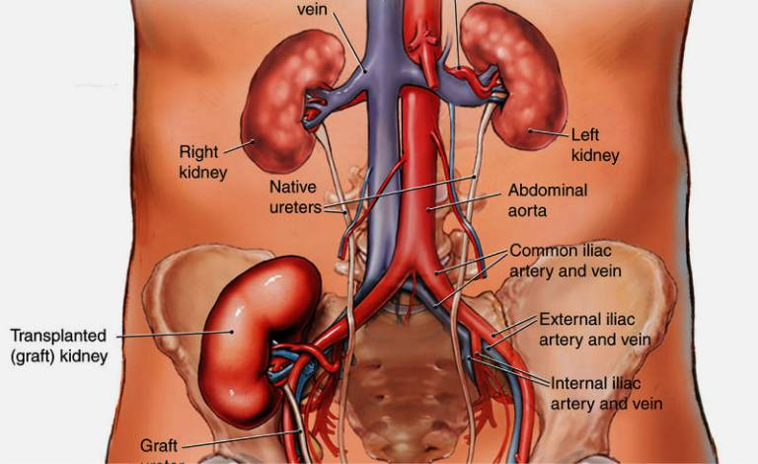
COMPLICATIONS
O TECHNICAL
O Vascular hemorrhage; Vascular thrombosis 10-
20%, within 2-3 days→ technical, 2/12→rejection,
most are lost: ↓urine output, ↑creat
O Urological ; infection, fistula, obstruction
O Wound infection
O RENAL
O Acute tubula necrosis
O Cortical necrosis
O Lymphocele
O Graft rupture
O Recurrent glomerulo-nephritis

Slide 52
Outcome
O Patient survival after deceased donor
renal transplantation is >90% at 1 year
and > 80% at 5 years.
O Graft survival is around90% at 1 year and
75% at 5 years. Graft survival after a
second transplant is only marginally worse
than after a first graft.
O After living-related kidney transplantation,
overall graft survival is around 95% at 1
year and 85% at 5 years.

Slide 53
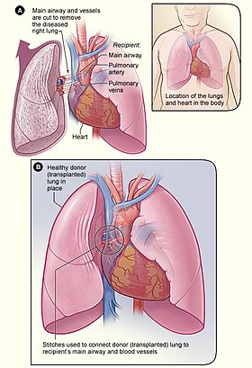
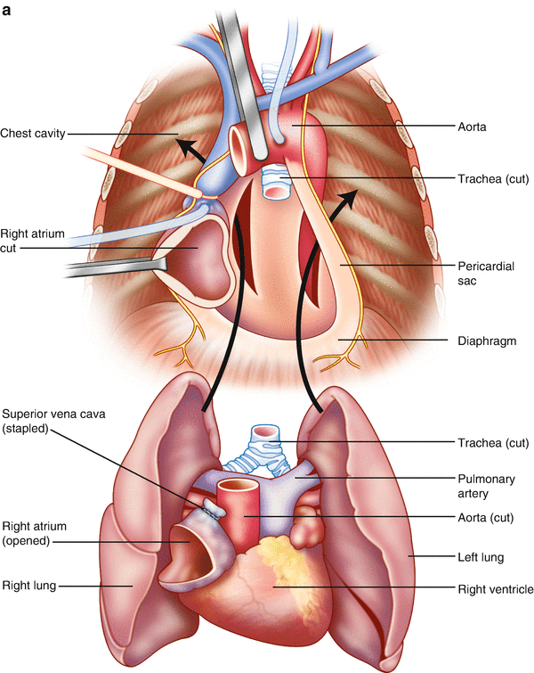
Lung Transplatation
Lung transplantation, or pulmonary transplantation, is a surgical procedure in which a patient's diseased lungs are partially or totally replaced by lungs which come from a donor. Donor lungs can be retrieved from a living donor or a deceased donor. A living donor can only donate one lung lobe. With some lung diseases, a recipient may only need to receive a single lung. With other lung diseases such as cystic fibrosis, it is imperative that a recipient receive two lungs. While lung transplants carry certain associated risks, they can also extend life expectancy and enhance the quality of life for end-stage pulmonary patients.

Slide 54
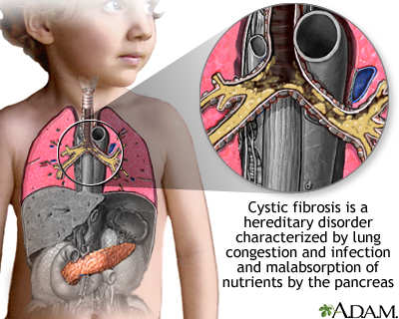
Unhealthy or damaged lungs can make it difficult for your body to get the oxygen it needs to survive. A variety of diseases and conditions can damage your lungs and hinder their ability to function effectively. Some of the more common causes include:
Chronic obstructive pulmonary disease (COPD), including emphysema
Scarring of the lungs (pulmonary fibrosis)
High blood pressure in the lungs (pulmonary hypertension)
Cystic fibrosis

Slide 55
Types of lung transplant
Lobe
A lobe transplant is a surgery in which part of a living or deceased donor's lung is removed and used to replace the recipient's diseased lung. In living donation, this procedure requires the donation of lobes from two different people, replacing a lung on each side of the recipient. Donors who have been properly screened should be able to maintain a normal quality of life despite the reduction in lung volume. In deceased lobar transplantation, one donor can provide both lobes.
Single-lung
Many patients can be helped by the transplantation of a single healthy lung. The donated lung typically comes from a donor who has been pronounced brain-dead.
Double-lung
Certain patients may require both lungs to be replaced. This is especially the case for people with cystic fibrosis, due to the bacterial colonization commonly found within such patients' lungs; if only one lung were transplanted, bacteria in the native lung could potentially infect the newly transplanted organ.
Heart–lung

Slide 56
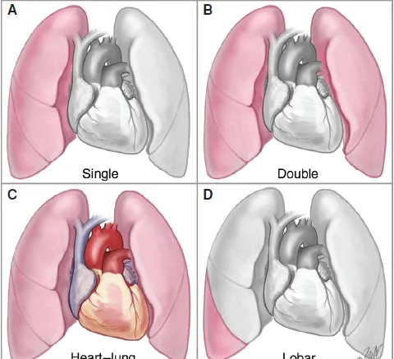

Slide 57
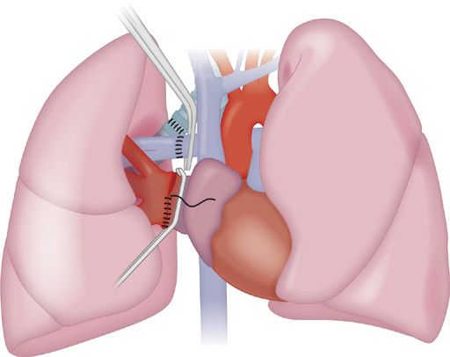

Slide 58
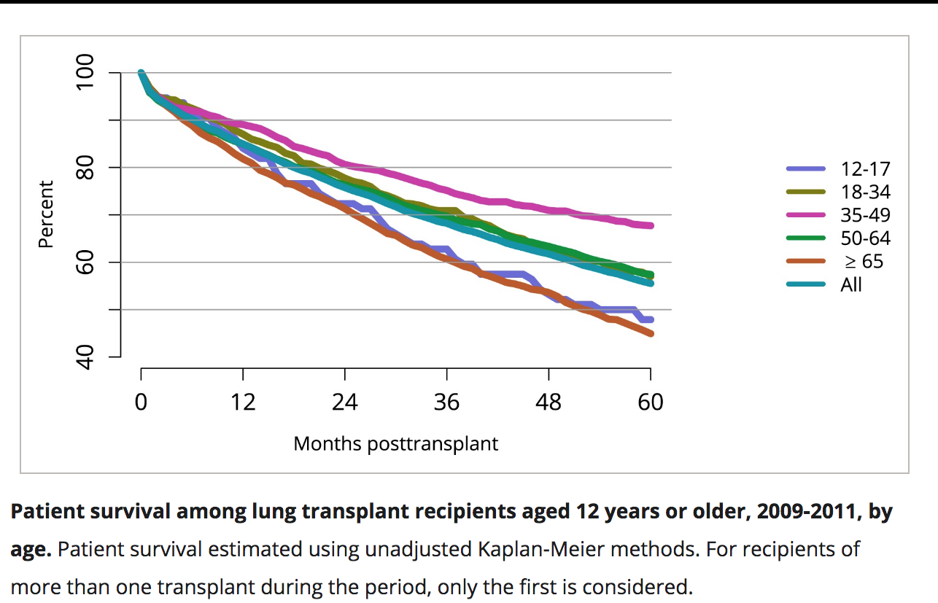
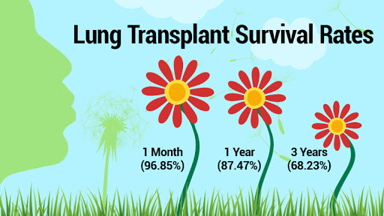

Slide 59
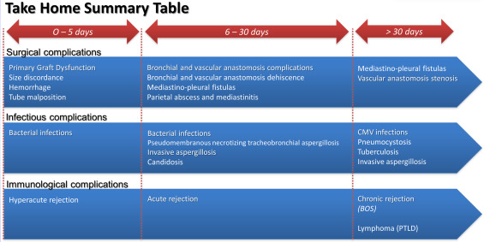
Complications

Slide 60
Liver Transplantation
Liver transplantation or hepatic transplantation is the replacement of a diseased liver with the healthy liver from another person (allograft).
Liver transplantation is a treatment option for end-stage liver disease and acute liver failure, although availability of donor organs is a major limitation.
The most common technique is orthotopic transplantation, in which the native liver is removed and replaced by the donor organ in the same anatomic position as the original liver.
The surgical procedure is complex, requiring careful harvest of the donor organ and meticulous implantation into the recipient. Liver transplantation is highly regulated, and only performed at designated transplant medical centers by highly trained transplant physicians and supporting medical team.

Slide 61
Indications
Liver transplant is a treatment option for people with liver failure whose condition can't be controlled with other treatments and for some people with liver cancer.
It is more often used to treat chronic liver failure. Chronic liver failure occurs slowly over months and years.
Chronic liver failure may be caused by a variety of conditions. The most common cause of chronic liver failure is scarring of the liver (cirrhosis). Cirrhosis is the most frequently reason for a liver transplant.
Major causes of cirrhosis leading to liver failure and liver transplant include:
Hepatitis B and C.
Alcoholic liver disease, which causes damage to the liver due to excessive alcohol consumption.
Nonalcoholic fatty liver disease, a condition in which fat builds up in the liver, causing inflammation or liver cell damage.
Genetic diseases affecting the liver, including hemochromatosis, which causes excessive iron buildup in the liver, and Wilson's disease, which causes excessive copper buildup in the liver.
Diseases that affect the bile ducts (the tubes that carry bile away from the liver), such as primary biliary cirrhosis, primary sclerosing cholangitis and biliary atresia. Biliary atresia is the most common reason for liver transplant among children.

Slide 62
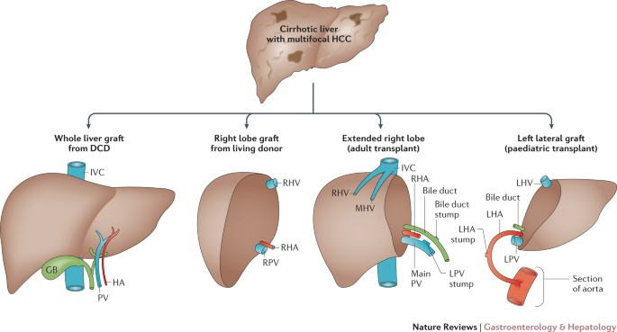
Contraindications
someone with advanced liver cancer, with known/likely spread beyond the liver
active alcohol/substance abuse
severe heart/lung disease
existing high cholesterol levels in the patient
dyslipidemia

Slide 63
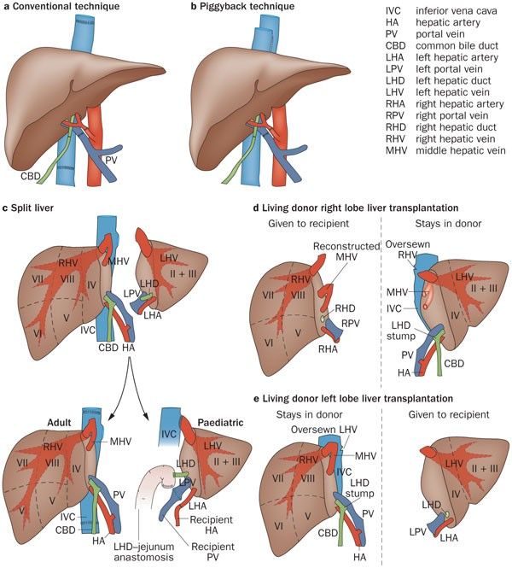
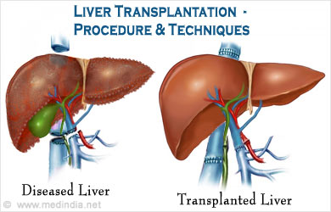

Slide 64
RISKS/COMPLICATIONS
Graft rejection
After a liver transplantation, immune-mediated rejection (also known as rejection) of the allograft may happen at any time. Rejection may present with lab findings: elevated AST, ALT, GGT; abnormal liver function values such as prothrombin time, ammonia level, bilirubin level, albumin concentration; and abnormal blood glucose. Physical findings may include encephalopathy, jaundice, bruising and bleeding tendency. Other nonspecific presentation may include malaise, anorexia, muscle ache, low fever, slight increase in white blood count and graft-site tenderness.
Biliary complications
Biliary complications include biliary stenosis, biliary leak, and ischemic cholangiopathy. The risk of ischemic cholangiopathy increases with longer durations of cold ischemia time, which is the time that the organ does not receive blood flow (after death/removal until graft placement).[2]
Vascular complications
Vascular complications include thrombosis, stenosis, pseudoaneurysm, and rupture of the hepatic artery.[1] Venous complications occur less often compared with arterial complications, and include thrombosis or stenosis of the portal vein, hepatic vein, or vena cava.

Slide 65
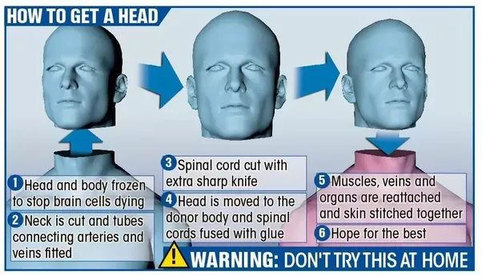
Thanks for your attentation

