Slide 1
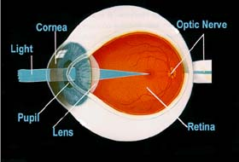
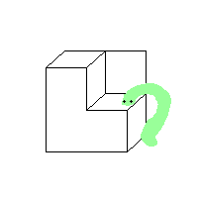
Přednášky z lékařské biofyziky
Biofyzika vnímání světelných podnětů

Slide 2
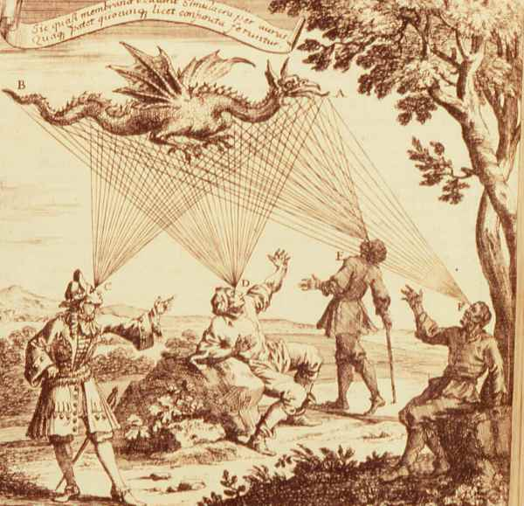
Obsah přednášky
Základní vlastnosti světla
(přehled předpokládaných středoškolských znalostí)
Anatomie oka
Optické vlastnosti oka
Sítnice – biologický detektor světla
Barevné vidění

Slide 3
Základní vlastnosti světla
Viditelné elektromagnetické záření:
λ = 380 – 760 nm
Kratší vlnové délky – Ultrafialové světlo (UV)
Delší vlnové délky – Infračervené světlo (IR)
Viditelné světlo – (VIS)
Prostředí, kterým se světlo šíří, se nazývá optické prostředí.
V homogenním prostředí se světlo šíří přímočaře, kolmo k vlnoplochám, čáry směru šíření se označují jako světelné paprsky.
Rychlost světla (ve vakuu, přesně)
c = 299 792 458 m·s⁻¹ ≈ 300 000 000 m·s⁻¹

Slide 4
Zdroje viditelného (VIS) světla
Přirozené
Umělé
Přirozené: Slunce
Slunce je zdrojem energie pro život a nelze si představit život bez něj.
Umělé: žárovky, fluorescenční zdroje, laser…

Slide 5
Polychromatické a monochromatické světlo, koherence
Polychromatické či bílé světlo je světlem o různých vlnových délkách.
Monochromatické světlo je světlem o jediné vlnové délce.
Dle svého „fázového“ charakteru může být světlo
Koherentní - Koherentní světlo jsou světelné vlny jsoucí vzájemně „ve fázi“, tj. mají stejnou fázi v téže vzdálenosti od zdroje. Světlo emitované laserem je koherentní.
Nekoherentní - Světelné vlny nejsou vzájemně „ve fázi“. Světlo žárovek nebo Slunce je nekoherentní.

Slide 6
Odraz a lom světla
Odraz – zákon odrazu: Úhel odrazu α’ je roven úhlu dopadu. Odražený paprsek se šíří v rovině dopadu.
Lom: Když světlo prochází z jednoho prostředí do druhého, jeho svazek mění směr na rozhraní mezi dvěma prostředími. Tato vlastnost optického prostředí je popsána indexem lomu
n = c/v [ bezrozměrová veličina]
n – index lomu prostředí
c – rychlost světla ve vakuu
v – rychlost světla v prostředí
index lomu vakua je 1

Slide 7
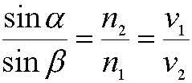
Snellův zákon (zákon lomu) α – úhel dopadu (v prostředí 1) β – úhel lomu (v prostředí 2)
(úhly měříme od kolmice!) n₁, n₂ – indexy lomu v₁, v₂, – rychlosti světla v daných prostředích n je velký: velká optická hustota) n je malý: malá optická hustota n₁ > n₂ – dochází k lomu od kolmice n₁ < n₂ – dochází k lomu ke kolmici
Odraz a lom světla

Slide 8
Obecné principy optického zobrazení
Skutečný obraz (lze promítnout): sbíhavost paprsků
Neskutečný obraz (nelze promítnout): rozbíhavost paprsků
Optická osa – osa centrovaného systému optických rozhraní
Ohnisko - bod, v němž se protínají paprsky dopadající na čočku (zakřivené zrcadlo) rovnoběžně s optickou osou. Rozlišujeme přední (předmětové) ohnisko a zadní (obrazové) ohnisko
Ohnisková vzdálenost f [m] je vzdálenost ohniska od středu čočky nebo zrcadla
Poloměry křivosti jsou kladné (záporné), pokud je příslušná čočka nebo povrch zrcadla konvexní (konkávní).
Optická mohutnost (síla čočky): převrácená hodnota ohniskové vzdálenosti
φ = D = S = 1/f [m⁻¹ = dpt = D (dioptrie)]
Spojné čočky: f a φ jsou kladné
Rozptylné čočky: f a φ jsou záporné

Slide 9
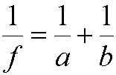
Rovnice čočky
Paprsky rovnoběžné s optickou osou se lámou do obrazového ohniska (u spojné čočky), nebo tak, že se zdají vycházet z předmětového ohniska (u rozptylky). Směr paprsků procházejících středem čočky se nemění. Rovnice čočky:
a – vzdálenost předmětu od středu čočky [m]
b – vzdálenost obrazu od středu čočky [m]
Znaménková konvence:
a je kladné před čočkou, záporné za čočkou;
b je záporné před čočkou (obraz je neskutečný), kladné za čočkou (obraz je skutečný)

Slide 10
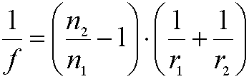
Rovnice „brusičů čoček“
f – ohnisková vzdálenost [m]
n₂ – index lomu čočky
n₁ – index lomu okolního prostředí
r₁, r₂ – poloměry křivosti čočky

Slide 11
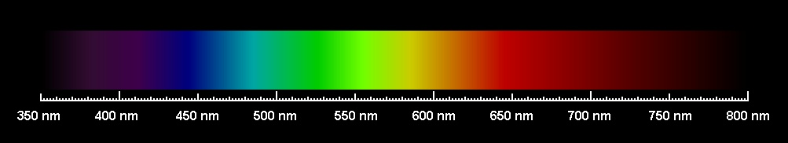
Lidské oko je citlivé na světlo od vlnové délky zhruba 380 nm (fialové) do asi 760 nm (červené). Náš zrakový analyzátor vnímá tento rozsah vlnových délek jako spojité duhové spektrum. Nazýváme je viditelné spektrum. Viz obrázek.
Viditelné spektrum

Slide 12
Anatomie oka

Slide 13
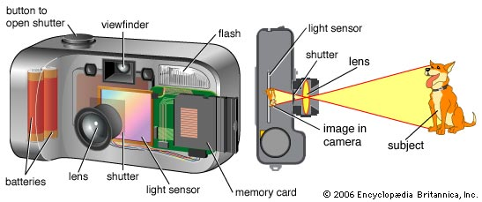
Jak pracuje lidské oko?
Jednotlivé části oka pracují podobným způsobem jako části (digitálního) fotografického přístroje. Každá část je důležitá pro zřetelné vidění.
shutter = závěrka, mechanická část filmových fotografických přístrojů
https://kids.britannica.com/kids/assembly/view/87818
Fotografickýpřístroj
Lidské oko
Notes:
How Does The Human Eye Work?
The individual components of the eye work in a manner similar to a camera. Each part plays
a vital role in providing clear vision. So think of the eye as a camera with the cornea, behaving
much like a lens cover. As the eye's main focusing element, the cornea takes widely diverging
rays of light and bends them through the pupil, the dark, round opening in the center of the
colored iris. The iris and pupil act like the aperture of a camera.
Next in line is the lens which acts like the lens in a camera, helping to focus light to the back
of the eye. Note that the lens is the part which becomes cloudy and is removed during cataract
surgery to be replaced by an artificial implant nowadays.
The Camera
The Human Eye
The very back of the eye is lined with a layer called the retina which acts very much like the
film of the camera. The retina is a membrane containing photoreceptor nerve cells that lines
the inside back wall of the eye. The photoreceptor nerve cells of the retina change the light
rays into electrical impulses and send them through the optic nerve to the brain where an
image is perceived. The center 10% of the retina is called the macula. This is responsible for
your sharp vision, your reading vision. The peripheral retina is responsible for the peripheral
vision. As with the camera, if the "film" is bad in the eye (i.e. the retina), no matter how good
the rest of the eye is, you will not get a good picture.
The human eye is remarkable. It accommodates to changing lighting conditions and focuses
light rays originating from various distances from the eye. When all of the components of the
eye function properly, light is converted to impulses and conveyed to the brain where an
image is perceived.
Glossary of Eye Terms:
Anterior Chamber
The cavity in the front part of the eye between the lens and cornea is called the Anterior
Chamber. It is filled with Aqueous, a water-like fluid. This fluid is produced by the ciliary
body and drains back into the blood circulation through channels in the chamber angle. It is
turned over every100 minutes.
Chamber Angle
Located at the junction of the cornea, iris, and sclera, the anterior chamber angle extends 360
degrees at the perimeter of the iris. Channels here allow aqueous fluid to drain back into the
blood circulation from the eye. May be obstructed in glaucoma.
Ciliary Body
A structure located behind the iris (rarely visible) which produces aqueous fluid that fills the
front part of the eye and thus maintains the eye pressure. It also allows focusing of the lens.
Conjunctiva
A thin lining over the sclera, or white part of the eye. This also lines the inside of the eyelids.
Cell in the conjunctiva produce mucous, which helps to lubricate the eye.
Cornea
The transparent, outer "window" and primary focusing element of the eye. The outer layer of
the cornea is known as epithelium. Its main job is to protect the eye. The epithelium is made
up of transparent cells that have the ability to regenerate quickly. The inner layer of the cornea
is also made up of transparent tissue, which allows light to pass.
Hyaloid Canal
A narrow channel that runs from the optic disc to the back surface of the lens. It serves an
embryologic function prior to birth but none afterwards.
Iris
Inside the anterior chamber is the iris. This is the part of the eye which is responsible for one's
eye color. It acts like the diaphragm of a camera, dilating and constricting the pupil to allow
more or less light into the eye.
Pupil
The dark opening in the center of the colored iris that controls how much light enters the eye.
The colored iris functions like the iris of a camera, opening and closing, to control the amount
of light entering through the pupil.
Lens
The part of the eye immediately behind the iris that performs delicate focusing of light rays
upon the retina. In persons under 40, the lens is soft and pliable, allowing for fine focusing
from a wide variety of distances. For individuals over 40, the lens begins to become less
pliable, making focusing upon objects near to the eye more difficult. This is known as
presbyopia.
Macula
The part of the retina which is most sensitive, and is responsible for the central (or reading)
vision. It is located near the optic nerve directly at the back of the eye (on the inside). This
area is also responsible for color vision.
Optic Disc
The position in the back of the eye where the nerve (along with an artery and vein) enters the
eye corresponds to the "blind spot" since there are no rods or cones in these location.
Normally, a person does not notice this blind spot since rapid movements of the eye and
processing in the brain compensate for this absent information. This is the area that the
ophthalmologist studies when evaluating a patient for glaucoma, a condition where the optic
nerve becomes damaged often due to high pressure within the eye. As it looks like a cup
when viewed with an ophthalmoscope, it is sometimes referred to as the Optic Cup.
Optic Nerve
The optic nerve is the structure which takes the information from the retina as electrical signals
and delivers it to the brain where this information is interpreted as a visual image. The optic
nerve consists of a bundle of about one million nerve fibers.
Retina
The membrane lining the back of the eye that contains photoreceptor cells. These
photoreceptor nerve cells react to the presence and intensity of light by sending an impulse to
the brain via the optic nerve. In the brain, the multitude of nerve impulses received from the
photoreceptor cells in the retina are assimilated into an image.
Sclera
The white, tough wall of the eye. Few diseases affect this layer. It is covered by the episclera
(a fibrous layer between the conjunctiva and sclera ) and conjunctiva, and eye muscles are
connected to this.
Vitreous
Next in our voyage through the eye is the vitreous. This is a jelly-like substance that fills the
body of the eye. It is normally clear. In early life, it is firmly attached to the retina behind it.
With age, the vitreous becomes more water-like and may detach from the retina. Often, little
clumps or strands of the jelly form and cast shadows which are perceived as "floaters". While
frequently benign, sometimes floaters can be a sign of a more serious condition such as a
retinal tear or detachment and should be investigated with a thorough ophthalmologic
examination.
How Does The Human Eye Work?
The individual components of the eye work in a manner similar to a camera. Each part plays
a vital role in providing clear vision. So think of the eye as a camera with the cornea, behaving
much like a lens cover. As the eye's main focusing element, the cornea takes widely diverging
rays of light and bends them through the pupil, the dark, round opening in the center of the
colored iris. The iris and pupil act like the aperture of a camera.
Next in line is the lens which acts like the lens in a camera, helping to focus light to the back
of the eye. Note that the lens is the part which becomes cloudy and is removed during cataract
surgery to be replaced by an artificial implant nowadays.
The Camera
The Human Eye
The very back of the eye is lined with a layer called the retina which acts very much like the
film of the camera. The retina is a membrane containing photoreceptor nerve cells that lines
the inside back wall of the eye. The photoreceptor nerve cells of the retina change the light
rays into electrical impulses and send them through the optic nerve to the brain where an
image is perceived. The center 10% of the retina is called the macula. This is responsible for
your sharp vision, your reading vision. The peripheral retina is responsible for the peripheral
vision. As with the camera, if the "film" is bad in the eye (i.e. the retina), no matter how good
the rest of the eye is, you will not get a good picture.
The human eye is remarkable. It accommodates to changing lighting conditions and focuses
light rays originating from various distances from the eye. When all of the components of the
eye function properly, light is converted to impulses and conveyed to the brain where an
image is perceived.
Glossary of Eye Terms:
Anterior Chamber
The cavity in the front part of the eye between the lens and cornea is called the Anterior
Chamber. It is filled with Aqueous, a water-like fluid. This fluid is produced by the ciliary
body and drains back into the blood circulation through channels in the chamber angle. It is
turned over every100 minutes.
Chamber Angle
Located at the junction of the cornea, iris, and sclera, the anterior chamber angle extends 360
degrees at the perimeter of the iris. Channels here allow aqueous fluid to drain back into the
blood circulation from the eye. May be obstructed in glaucoma.
Ciliary Body
A structure located behind the iris (rarely visible) which produces aqueous fluid that fills the
front part of the eye and thus maintains the eye pressure. It also allows focusing of the lens.
Conjunctiva
A thin lining over the sclera, or white part of the eye. This also lines the inside of the eyelids.
Cell in the conjunctiva produce mucous, which helps to lubricate the eye.
Cornea
The transparent, outer "window" and primary focusing element of the eye. The outer layer of
the cornea is known as epithelium. Its main job is to protect the eye. The epithelium is made
up of transparent cells that have the ability to regenerate quickly. The inner layer of the cornea
is also made up of transparent tissue, which allows light to pass.
Hyaloid Canal
A narrow channel that runs from the optic disc to the back surface of the lens. It serves an
embryologic function prior to birth but none afterwards.
Iris
Inside the anterior chamber is the iris. This is the part of the eye which is responsible for one's
eye color. It acts like the diaphragm of a camera, dilating and constricting the pupil to allow
more or less light into the eye.
Pupil
The dark opening in the center of the colored iris that controls how much light enters the eye.
The colored iris functions like the iris of a camera, opening and closing, to control the amount
of light entering through the pupil.
Lens
The part of the eye immediately behind the iris that performs delicate focusing of light rays
upon the retina. In persons under 40, the lens is soft and pliable, allowing for fine focusing
from a wide variety of distances. For individuals over 40, the lens begins to become less
pliable, making focusing upon objects near to the eye more difficult. This is known as
presbyopia.
Macula
The part of the retina which is most sensitive, and is responsible for the central (or reading)
vision. It is located near the optic nerve directly at the back of the eye (on the inside). This
area is also responsible for color vision.
Optic Disc
The position in the back of the eye where the nerve (along with an artery and vein) enters the
eye corresponds to the "blind spot" since there are no rods or cones in these location.
Normally, a person does not notice this blind spot since rapid movements of the eye and
processing in the brain compensate for this absent information. This is the area that the
ophthalmologist studies when evaluating a patient for glaucoma, a condition where the optic
nerve becomes damaged often due to high pressure within the eye. As it looks like a cup
when viewed with an ophthalmoscope, it is sometimes referred to as the Optic Cup.
Optic Nerve
The optic nerve is the structure which takes the information from the retina as electrical signals
and delivers it to the brain where this information is interpreted as a visual image. The optic
nerve consists of a bundle of about one million nerve fibers.
Retina
The membrane lining the back of the eye that contains photoreceptor cells. These
photoreceptor nerve cells react to the presence and intensity of light by sending an impulse to
the brain via the optic nerve. In the brain, the multitude of nerve impulses received from the
photoreceptor cells in the retina are assimilated into an image.
Sclera
The white, tough wall of the eye. Few diseases affect this layer. It is covered by the episclera
(a fibrous layer between the conjunctiva and sclera ) and conjunctiva, and eye muscles are
connected to this.
Vitreous
Next in our voyage through the eye is the vitreous. This is a jelly-like substance that fills the
body of the eye. It is normally clear. In early life, it is firmly attached to the retina behind it.
With age, the vitreous becomes more water-like and may detach from the retina. Often, little
clumps or strands of the jelly form and cast shadows which are perceived as "floaters". While
frequently benign, sometimes floaters can be a sign of a more serious condition such as a
retinal tear or detachment and should be investigated with a thorough ophthalmologic
examination.
How Does The Human Eye Work?
The individual components of the eye work in a manner similar to a camera. Each part plays
a vital role in providing clear vision. So think of the eye as a camera with the cornea, behaving
much like a lens cover. As the eye's main focusing element, the cornea takes widely diverging
rays of light and bends them through the pupil, the dark, round opening in the center of the
colored iris. The iris and pupil act like the aperture of a camera.
Next in line is the lens which acts like the lens in a camera, helping to focus light to the back
of the eye. Note that the lens is the part which becomes cloudy and is removed during cataract
surgery to be replaced by an artificial implant nowadays.
The Camera
The Human Eye
The very back of the eye is lined with a layer called the retina which acts very much like the
film of the camera. The retina is a membrane containing photoreceptor nerve cells that lines
the inside back wall of the eye. The photoreceptor nerve cells of the retina change the light
rays into electrical impulses and send them through the optic nerve to the brain where an
image is perceived. The center 10% of the retina is called the macula. This is responsible for
your sharp vision, your reading vision. The peripheral retina is responsible for the peripheral
vision. As with the camera, if the "film" is bad in the eye (i.e. the retina), no matter how good
the rest of the eye is, you will not get a good picture.
The human eye is remarkable. It accommodates to changing lighting conditions and focuses
light rays originating from various distances from the eye. When all of the components of the
eye function properly, light is converted to impulses and conveyed to the brain where an
image is perceived.
Glossary of Eye Terms:
Anterior Chamber
The cavity in the front part of the eye between the lens and cornea is called the Anterior
Chamber. It is filled with Aqueous, a water-like fluid. This fluid is produced by the ciliary
body and drains back into the blood circulation through channels in the chamber angle. It is
turned over every100 minutes.
Chamber Angle
Located at the junction of the cornea, iris, and sclera, the anterior chamber angle extends 360
degrees at the perimeter of the iris. Channels here allow aqueous fluid to drain back into the
blood circulation from the eye. May be obstructed in glaucoma.
Ciliary Body
A structure located behind the iris (rarely visible) which produces aqueous fluid that fills the
front part of the eye and thus maintains the eye pressure. It also allows focusing of the lens.
Conjunctiva
A thin lining over the sclera, or white part of the eye. This also lines the inside of the eyelids.
Cell in the conjunctiva produce mucous, which helps to lubricate the eye.
Cornea
The transparent, outer "window" and primary focusing element of the eye. The outer layer of
the cornea is known as epithelium. Its main job is to protect the eye. The epithelium is made
up of transparent cells that have the ability to regenerate quickly. The inner layer of the cornea
is also made up of transparent tissue, which allows light to pass.
Hyaloid Canal
A narrow channel that runs from the optic disc to the back surface of the lens. It serves an
embryologic function prior to birth but none afterwards.
Iris
Inside the anterior chamber is the iris. This is the part of the eye which is responsible for one's
eye color. It acts like the diaphragm of a camera, dilating and constricting the pupil to allow
more or less light into the eye.
Pupil
The dark opening in the center of the colored iris that controls how much light enters the eye.
The colored iris functions like the iris of a camera, opening and closing, to control the amount
of light entering through the pupil.
Lens
The part of the eye immediately behind the iris that performs delicate focusing of light rays
upon the retina. In persons under 40, the lens is soft and pliable, allowing for fine focusing
from a wide variety of distances. For individuals over 40, the lens begins to become less
pliable, making focusing upon objects near to the eye more difficult. This is known as
presbyopia.
Macula
The part of the retina which is most sensitive, and is responsible for the central (or reading)
vision. It is located near the optic nerve directly at the back of the eye (on the inside). This
area is also responsible for color vision.
Optic Disc
The position in the back of the eye where the nerve (along with an artery and vein) enters the
eye corresponds to the "blind spot" since there are no rods or cones in these location.
Normally, a person does not notice this blind spot since rapid movements of the eye and
processing in the brain compensate for this absent information. This is the area that the
ophthalmologist studies when evaluating a patient for glaucoma, a condition where the optic
nerve becomes damaged often due to high pressure within the eye. As it looks like a cup
when viewed with an ophthalmoscope, it is sometimes referred to as the Optic Cup.
Optic Nerve
The optic nerve is the structure which takes the information from the retina as electrical signals
and delivers it to the brain where this information is interpreted as a visual image. The optic
nerve consists of a bundle of about one million nerve fibers.
Retina
The membrane lining the back of the eye that contains photoreceptor cells. These
photoreceptor nerve cells react to the presence and intensity of light by sending an impulse to
the brain via the optic nerve. In the brain, the multitude of nerve impulses received from the
photoreceptor cells in the retina are assimilated into an image.
Sclera
The white, tough wall of the eye. Few diseases affect this layer. It is covered by the episclera
(a fibrous layer between the conjunctiva and sclera ) and conjunctiva, and eye muscles are
connected to this.
Vitreous
Next in our voyage through the eye is the vitreous. This is a jelly-like substance that fills the
body of the eye. It is normally clear. In early life, it is firmly attached to the retina behind it.
With age, the vitreous becomes more water-like and may detach from the retina. Often, little
clumps or strands of the jelly form and cast shadows which are perceived as "floaters". While
frequently benign, sometimes floaters can be a sign of a more serious condition such as a
retinal tear or detachment and should be investigated with a thorough ophthalmologic
examination.

Slide 14
Zrakový analyzátor má 3 části:
oko - z biofyzikálního hlediska nejlépe prozkoumaná část, v níž optickou a fotochemickou cestou vzniká primární obraz vnějšího světa,
optické dráhy - systém nervových buněk, tvořících kanál, jímž se informace zachycená a zpracovaná okem dostává do mozku,
zrakové centrum - oblast mozkové kůry, v níž si obraz vnějšího světa uvědomujeme

Slide 15
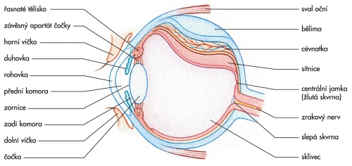
Anatomie oka
http://leccos.com/index.php/clanky/oko-1

Slide 16
Anatomie oka
Tuhá nejzevnější vrstva oka se nazývá bělima (sclera), udržuje tvar oka.
Přední asi šestina této vrstvy se nazývá rohovka (cornea). Veškeré světlo musí při vstupu do oka nejdříve projít přes rohovku. K bělimě je připojeno 6 okohybných svalů.
Cévnatka (chorioidea, hlavní část živnatky - uvey) je druhou vrstvou oka. Obsahuje cévy, které zásobují krví struktury oka. Přední část cévnatky přechází do dvou struktur:
Řasnaté těleso (corpus ciliare) – obsahuje svaly a je spojeno s čočkou. Kontrakce a relaxace těchto svalů způsobují změny zakřivení čočky při zaostřování (akomodaci).

Slide 17
Anatomie oka
Duhovka (iris) – barevná část oka. Barva duhovky je dána barvou vazivové tkáně a pigmentovými buňkami. Méně pigmentu způsobuje, že oči jsou modré, více pigmentu způsobuje hnědé zbarvení. Duhovka je přizpůsobivá blána s otvorem uporostřed, nazývajícím se zornice (pupilla).
Uvnitř oka se nacházejí dva kapalinou vyplněné oddíly oddělené čočkou. Větší zadní oddíl obsahuje čirou gelovitou látku zvanou sklivec (corpus vitreum).
Menší přední oddíl obsahuje čirou vodnatou tekutinu zvanou komorová voda (humor aquosus).
Tato část oka je rozdělena na dva oddíly zvané přední a zadní komora (před duhovkou a za duhovkou). Komorová voda je produkována řasnatým tělesem.

Slide 18
Anatomie oka
Duhovka má dva svaly:
M. dilator pupillae zmenšuje duhovku a tím zvětšuje zornici a množství světla vstupujícího do oka;
M. sphincter pupillae duhovku zvětšuje a zmenšuje zornici stejně jako množství světla vstupujícího do oka.
Průměr zornice se mění od 2 do 8 mm.
To znamená, že množství světla vstupujícího do oka se může změnit 30-násobně.

Slide 19
Anatomie oka
Průhledná čočka (lens crystallina) je umístěna těsně za duhovkou. Je to čirá dvojvypuklá struktura s průměrem přibližně 10 mm. Je udržována v oploštěném stavu tahem vláken závěsného aparátu. Čočka může měnit svůj tvar, protože je připojena ke svalům řasnatého tělesa, které působí proti tahu závěsných vláken.
Jestliže jsou ciliární svaly
relaxované, zakřivení čočky se zmenšuje, dochází k oploštění čočky;
kontrahované, zakřivení čočky se zvětšuje, čočka je vypuklejší (což je její přirozený stav).
Tyto změny umožňují oku přizpůsobit optický systém oka pro pozorování vzdálených i blízkých předmětů.
Čočka je složena ze 4 vrstev, ve směru od povrchu ke středu to jsou: kapsula, subkapsulární epitel, kůra a jádro.

Slide 20
Nitrooční tlak
(důsledek dynamické rovnováhy mezi tvorbou a odtokem komorové vody)
Fyziologická hodnota (individuálně variabilní):
2,66 kPa (20 mmHg)
Odchylky větší než cca 10 % jsou známkou vážnější oční poruchy, např. hrozícího zeleného zákalu (glaukomu).

Slide 21
Optické vlastnosti oka

Slide 22

Model Gullstrandův
(Alvar Gullstrand 1852 - 1930, švédský oftalmolog, Nob. cena za medicínu v r. 1911)
Vychází z představy oka jako centrované optické soustavy se schopností automatického zaostřování, nebere však ohled na určité rozdíly v zakřivení přední a zadní plochy rohovky ani na rozdíly v indexu lomu jádra a okraje čočky.

Slide 23
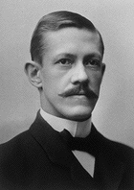
Základní parametry Gullstrandova modelu oka
Indexy lomu:
rohovka............................. 1,376
komorová voda................. 1,336
čočka ................................ 1,413
sklivec………………………1,336
Optické mohutnosti:
rohovka .............................. 42,7 D
čočka uvnitř oka ............... 21,7 D
oko jako celek ................... 60,5 D
Poloměr křivosti:
rohovka ................................... 7,8 mm
přední plocha čočky ............ 10,0 mm
zadní plocha čočky ............. -6,0 mm
Poloha ohnisek
(měří se od vrcholu rohovky):
ohnisko předmětové ............. -14,99 mm
ohnisko obrazové ................... 23,90 mm
poloha sítnice .......................... 23,90 mm
Allvar Gullstrand
1852 – 1930
Nobelova cena - 1911

Slide 24
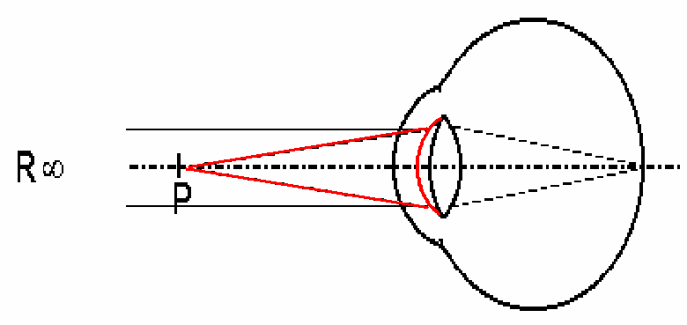
Akomodace
Schopnost oční čočky měnit svoji optickou mohutnost v závislosti na vzdálenosti pozorovaného objektu. Děje se tak především zvětšením zakřivení přední plochy čočky.
J. E Purkyně
Bod daleký - punctum remotum (R)
Bod blízký - punctum proximum (P)

Slide 25
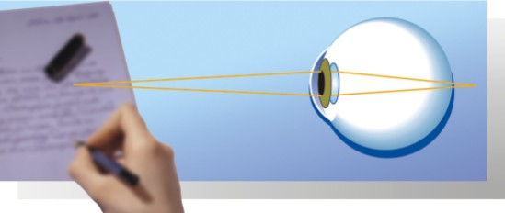
Akomodační šíře, presbyopie
Rozdíl reciprokých hodnot vzdáleností obou bodů od oka, vyjádřený v dioptriích (rozdíl tzv. vergencí těchto bodů), se označuje jako akomodační šíře.
U emetropického oka je vergence vzdáleného bodu nulová (1/∞ = 0), akomodační šíře je dána vergencí blízkého bodu.
Presbyopie (starozrakost,vetchozrakost)
Jedinec již není schopen vidět ostře předměty v konvenční vzdálenosti 0,25 m nebo bližší. Je způsobena zmenšením pružnosti čočky a ochabováním ciliárních svalů po překročení 40 let.

Slide 26
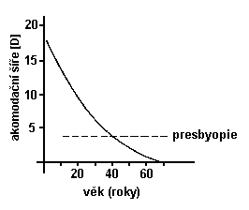
Úbytek akomodační schopnosti s věkem

Slide 27
Sítnice – biologický detektor světla

Slide 28
Sítnice – biologický detektor světla
Sítnice – část oka citlivá na světlo. Obsahuje tyčinky odpovědné za vidění při slabém osvětlení a čípky zodpovědné za vidění barev a detailů. Jakmile na tyto dva typy buněk dopadne světlo, dojde k sérii složitých biochemických reakcí.
Vnější segment tyčinek je dlouhý a tenký, zatímco vnější segmenty čípků mají spíše kuželovitý tvar.
V centrální části sítnice se nachází macula lutea (žlutá skvrna). Uprostřed makuly se nachází oblast zvaná fovea centralis. Zde se nacházejí pouze čípky a jejich vysoká hustota umožňuje rozlišování detailů.

Slide 29
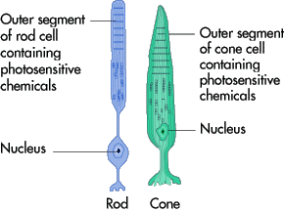
Tyčinky a čípky
Vnější segment tyčinky nebo čípku obsahuje fotosenzitivní látky. V tyčinkách je touto látkou rodopsin. Světlem aktivovaný rodopsin začne vytvářet elektrické impulsy, které jsou dále vedeny optickým nervem.
Analogické látky v čípcích jsou označovány jako barevné pigmenty nebo jodopsin.
Sítnice obsahuje asi 100 milionů tyčinek, které rozlišují intenzitu světla, a asi 7 milionů čípků, které umožňují barevné vidění.

Slide 30
Rodopsin
Jakmile světlo dopadne na fotosensitivní molekulu rodopsinu, nastane fotochemická reakce. Rodopsin je komplex tvořený bílkovinou zvanou scot(opsin) a 11-cis-retinalem, jehož prekursorem je vitamin A (⇒ nedostatek vitaminu A způsobuje problémy s viděním).
Jestliže je rodopsin vystaven světlu, dochází k jeho rozpadu, a to v důsledku změny 11-cis-retinalu na all-trans-retinal. K této reakci dojde během několika triliontin sekundy (10⁻¹⁸). 11-cis-retinal je „zprohýbaný“, zatímco all-trans-retinal má přímou molekulu, což jej činí chemicky nestabilním.
Za vznik elektrického podráždění odpovídá metarhodopsin II (aktivovaný rodopsin). Následuje schéma celého procesu včetně obnovy rodopsinu.

Slide 31
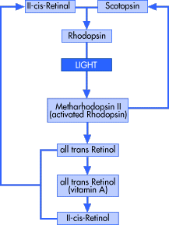
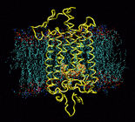
Biochemie rodopsinu
Představa uspořádání rodopsinu jako transmembránové bílkoviny.

Slide 32
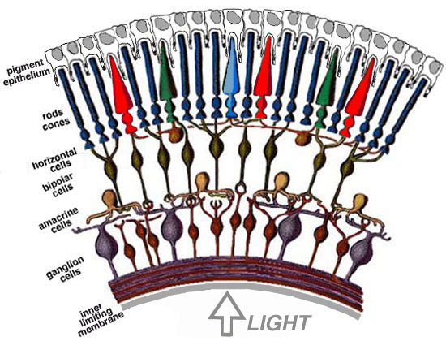
Struktura sítnice

Slide 33
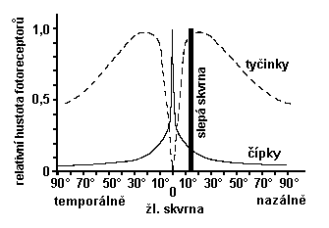
Slepá a žlutá skvrna
Od žluté skvrny k periferii čípků ubývá. Maximální hustota tyčinek je v kruhu asi 20º od žluté skvrny (úhel je měřen od zadního vrcholu čočky).
Nervová vlákna vedoucí podráždění z fotoreceptorů se sbíhají nazálně od žluté skvrny, kde tvoří papilu zrakového nervu. Toto místo neobsahuje žádné fotoreceptory a nazývá se slepá skvrna.

Slide 34

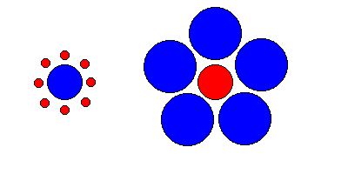
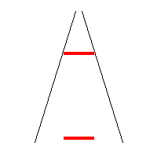
Zrakové klamy ukazují na úlohu zrakové části mozkové kůry při zpracování zrakové informace

Slide 35
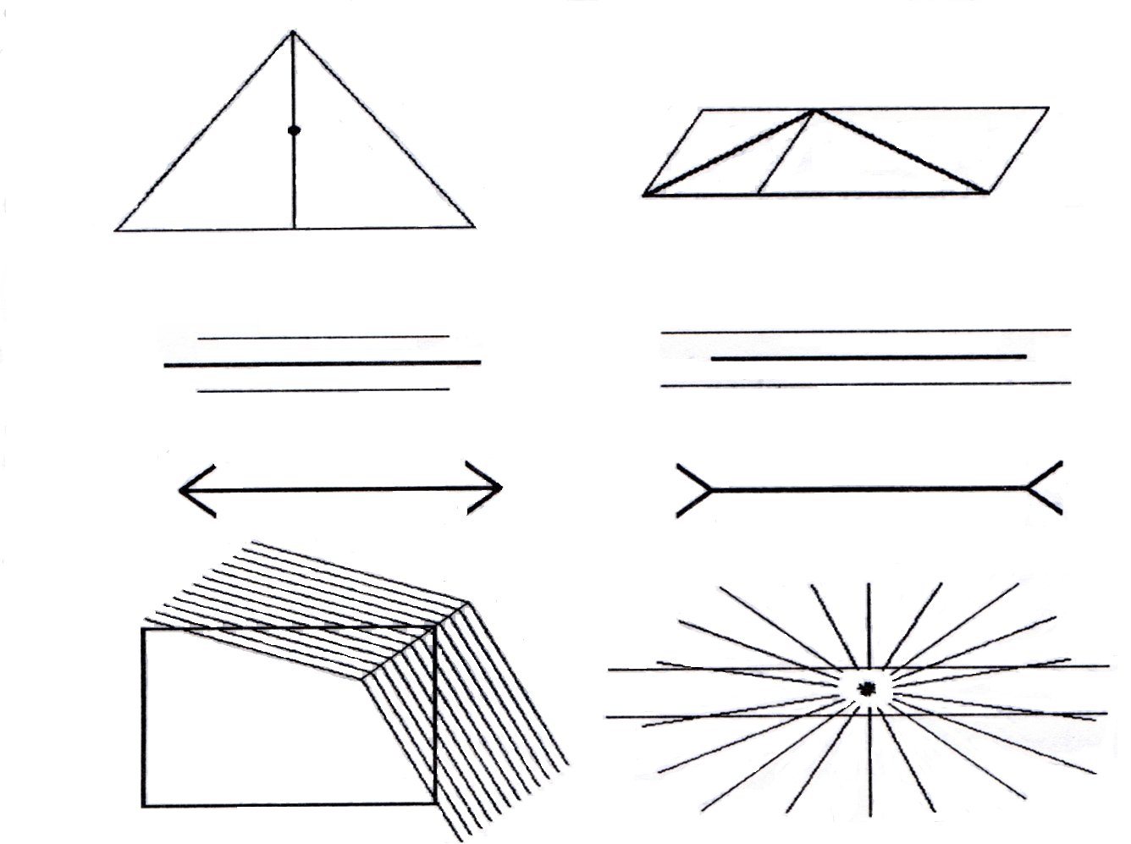
Zrakové klamy pokračování

Slide 36
Elektrické projevy sítnice
Elektrická aktivita sítnice je v úzkém vztahu k fotochemickým reakcím, probíhajícím ve fotoreceptorech při dopadu světla. Rozlišujeme:
        raný receptorový potenciál
        pozdní receptorový potenciál
Elektroretinografie (ERG), snímání pomocí dvou unipolárních svodů, amplituda signálu je 100 - 400 μV.
Podrobnější popis ERG je v jiných přednáškách

Slide 37
Barevné vidění

Slide 38
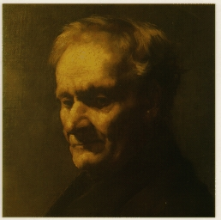
Barevné vidění
Barvy dělíme na:
základní a
doplňkové, tj takové, které vzájemným smísením dají počitek neutrální šedé a bílé barvy.
Každá vnímaná barva je charakterizována barevným tónem, světlostí a sytostí.
barevný tón je určen vlnovou délkou světla,
světlost intenzitou (jasem) světla.
sytost barevností počitku.
J. E. Purkyně (1787 – 1869)
změna poměrné světelnosti barev při adaptaci oka na tmu – PURKYŇŮV JEV

Slide 39
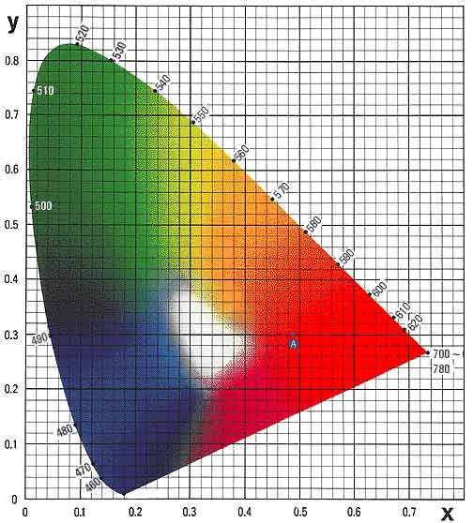
Barevný trojúhelník CIE
x – červená b. 650 nm,
y – zelená b. 530 nm
z – modrá b. 460 nm
x + y + z = 1

Slide 40
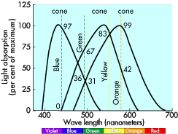
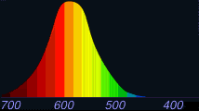
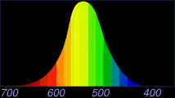
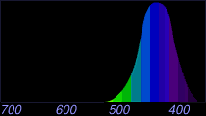
Barevné vidění – spektrální citlivost
Čípky citlivé na červenou barvu
Čípky citlivé na zelenou barvu
Čípky citlivé na modrou barvu

Slide 41
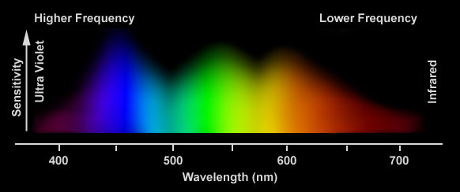
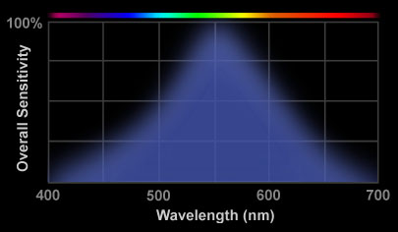
Citlivost oka na vlnovou délku
Čípky „sumárně“

Slide 42
Barvocit
Schopnost správného vnímání barev lidským okem.
Mechanismus vnímání barev není sice ještě jednoznačně rozřešen, všeobecně je však přijímána tzv. trichromatická teorie, spojená se jmény Helmholtze, Lomonosova a Younga.
Jednotliví autoři se liší jen v charakteristice tří základních barev. Helmholtz za ně považoval červenou, zelenou a fialovou, Lomonosov a Young červenou, žlutou a modrou.
Monochromáti - vnější svět vnímají pouze v odstínech šedi
Dichromáti – částečná ztráta barvocitu, v sítnici chybí mechanismus pro vnímání jedné ze základních tří barev
Trichromáti – jedinci s normálním barvocitem

Slide 43
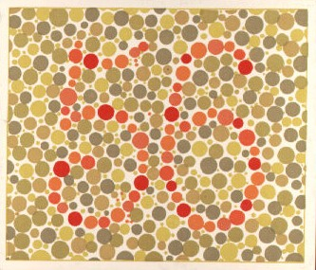
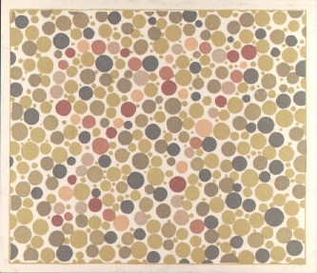
Vyšetřování barvocitu
Pseudoizochromatické tabulky různých autorů (Stillingovy, Velhagenovy, Ischiharovy, Rabkinovy). Číslice nebo písmena jsou sestavena z okrouhlých barevných políček v záměnné barvě. Dichromát daného typu písmeno či číslici nerozezná.
Vyšetření anomaloskopické. Nagelův anomaloskop je modifikovaný spektrální fotometr, pomocí něhož se barvocit určuje ze vztahu vyšetřovaného k vidění červené a zelené barvy.

Slide 44
Meze lidského zraku
zraková ostrost - testuje se pomocí Snellenových optotypů (viz praktika a navazující přednáška) - dána úhlem jedné obloukové minuty
limit citlivosti fotoreceptoru: 2-3 fotony během několika milisekund
kritická frekvence splývání světelných impulsů:
5 - 60 Hz v závislosti na jasu
omezení vlnovými délkami světla: 380 - 760 nm
mez stereoskopického vidění: úhel stereoskopické paralaxy menší než dvacet úhlových vteřin

Slide 45
Autoři
Vojtěch Mornstein, Lenka Forýtková
Obsahová spolupráce:
Ivo Hrazdira, Carmel J. Caruana
Poslední revize a ozvučení: březen 2021

