Slide 1
Lymphoproliferative disorders

Slide 2
What´s essential to remember – Take home message
For students and non-hematologists:
Clinical manifestation – when the disorder is to be suspected
Diagnostic algoritm – how the correct diagnosis is the best to be made
Basic overview of disorders – main groups of diseases and basic information about treatment modalities
For hematology specialists:
Recent optimal treatment algoritms

Slide 3
CANCER TYPES INCIDENCE CZECH REPUBLIC 2016 (men; ÚZIS)
3.8%

Slide 4
CANCER TYPES INCIDENCE IN CZECH REPUBLIC 2016 (women; ÚZIS)
3,5%

Slide 5
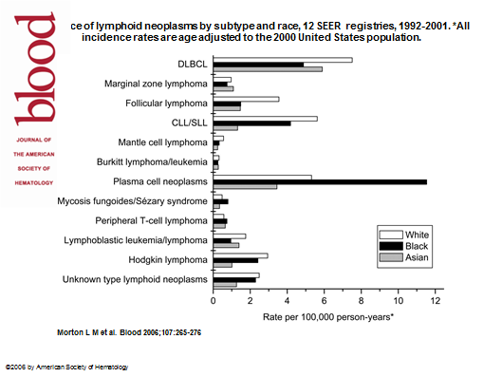

Slide 6
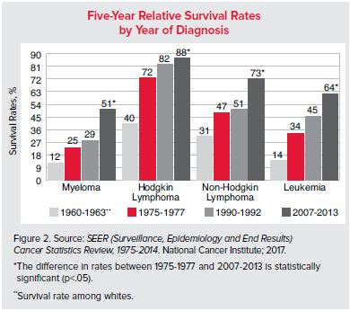
PROGNOSIS AND SURVIVAL OF PATIENTS WITH HEMATOLOGICAL MALIGNANCIES
-world data

Slide 7
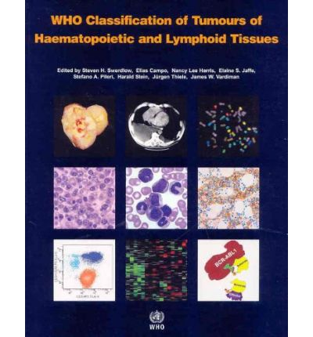
Basic overview of hematological malignancies
Based on WHO classification 2018
Hematological malignancies come:
from lymphoid cell-line
from myeloid cell-line
from histiocytic cell-line
from monocytoid-
macrofagocytic system

Slide 8
LYMPHOMA CLASSIFICATION historical overview
Rappaport (1970)
Kiel (1974)
Working Formulation (1980)
REAL (Revised European American Clasification
of Lymphoid Neoplasms)
WHO (5-th revision) 2018

Slide 9
Symptoms accompanying malignant lymphoproliferative diseases
We can recognise
Systemic (General) symptoms
Symptoms of local expansion
  Nodal
  Extranodal

Slide 10
GENERAL SYMPTOMS
WEIGHT LOSS
(≥10% during 3 months; GIT disorders, chronic inflamatory
diseases…)
SUBFEVER/FEVER
(lasting > 3 weeks, dif dg infections, other tumors or
autoimunity disorders)
ITCHING (usually without skin lesions)
NIGHT SWEAT (need to change clothes)
FATIGUE (pathological tiredness)

Slide 11
SYMPTOMS OF LOCAL EXPANSION
Peripheral (palpable) lymphadenopathy: „lumps“
Mediastinal lymphadenopathy: irritative dry cough, feeling of pressure, vena cava superior syndrom
Abdominal lymphadenopathy: stomach and intestinal dyspepsia, hydronephrosis due to uretheral compression.
Splenomegaly: enlarged spleen compressing stomach, feeling of fullness after small meal
Bone marrow infiltration: (pan)cytopenia
Osteolytic destruction of bones: pain (backbone), fractures

Slide 12
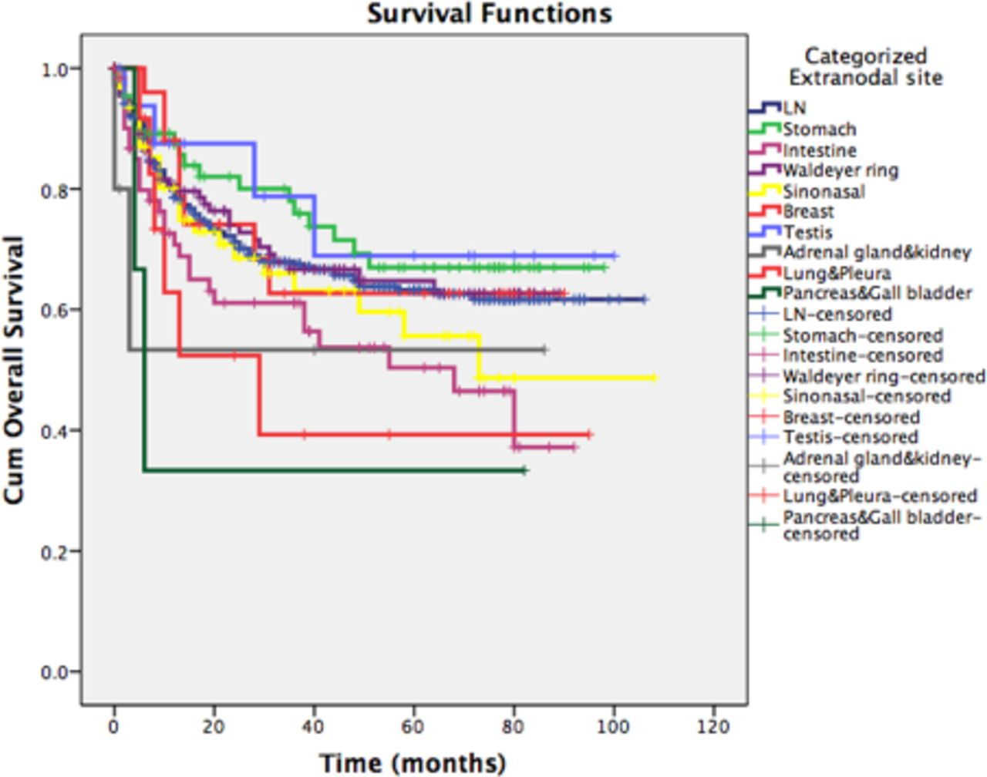
EXTRANODAL LOCAL SYMPTOMS
Extranodal involvement in systemic lymphoma
Primary extranodal lymphomas (~ 30% NHL!)

Slide 13
Diagnostic algoritm
Periferal
lymphadenopathy
Non-specific (general) symptoms
Clinical examination (lumps)
Infection must
be excluded
EBV, HIV, toxoplasma
Lymph node biopsy and histological examination
Native sample is prefered
Imaging examination:
Ultrasonogrphy- peripheral lymph node, abdomen
CT mediastinum + retroperitoneum
PET
MR

Slide 14
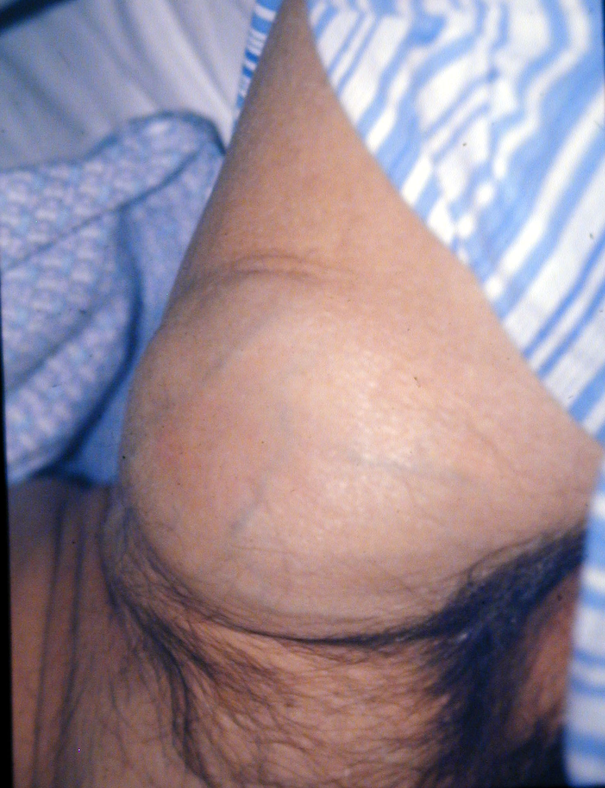

Slide 15
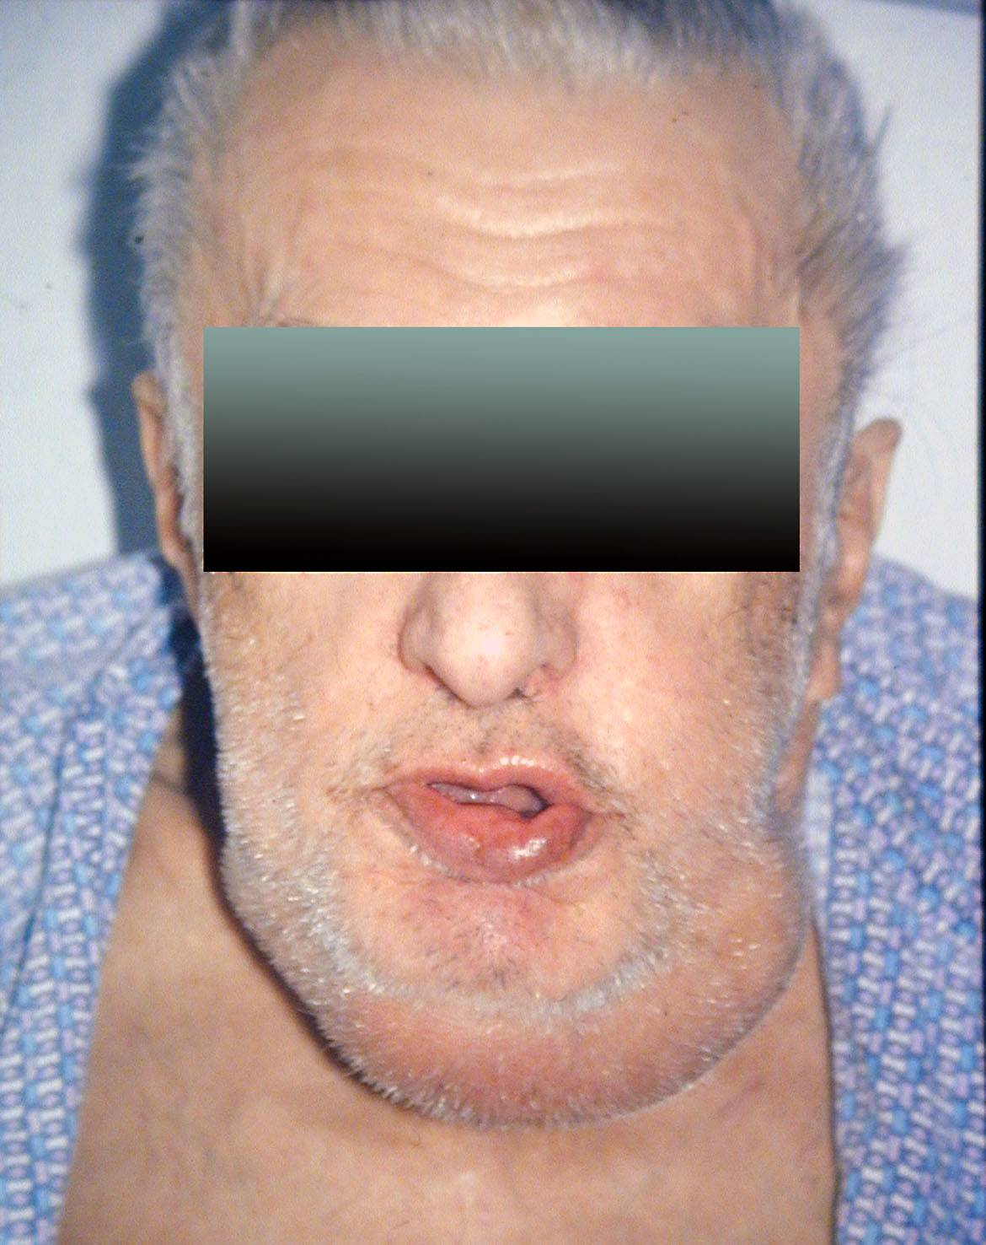

Slide 16
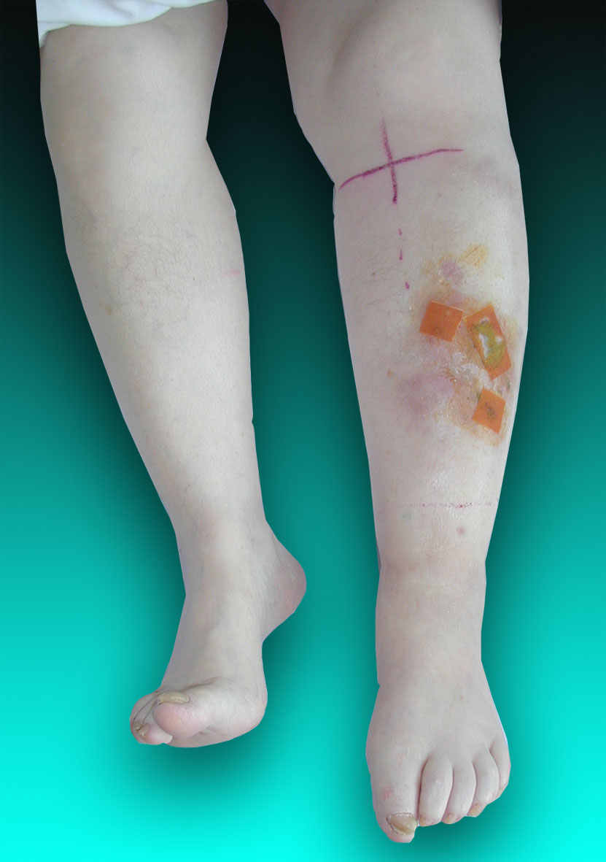

Slide 17
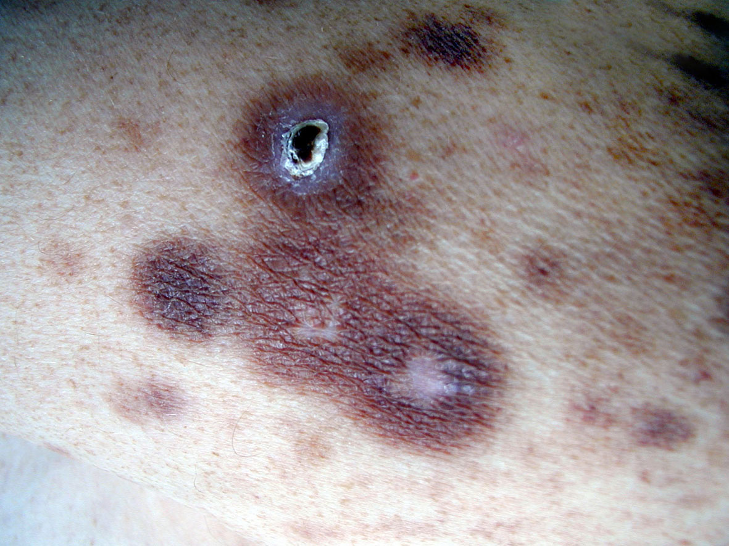

Slide 18
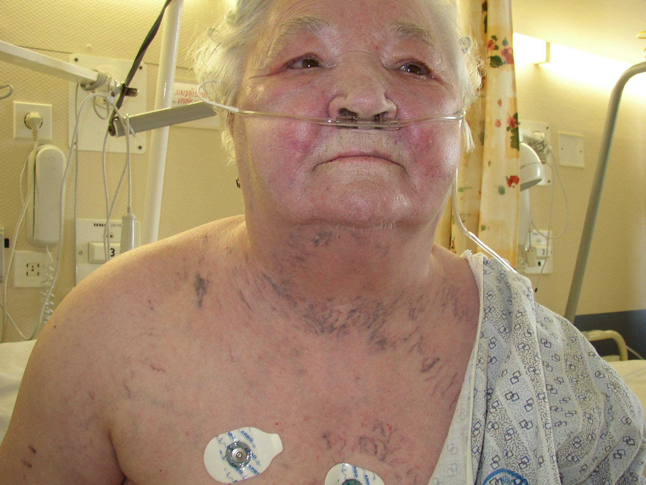
Vena cava superior syndrom
Swelling of face, enlarged volume of neck
Visible collateral veins between vena cava superior and inferior

Slide 19
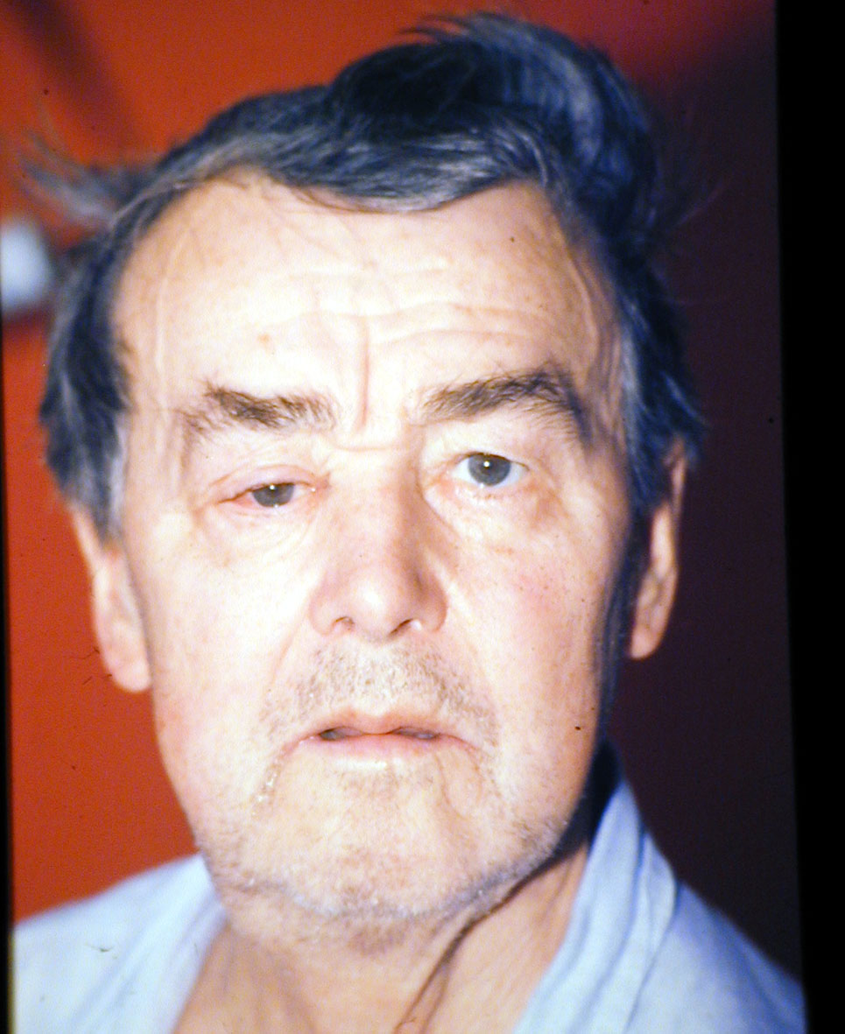

Slide 20
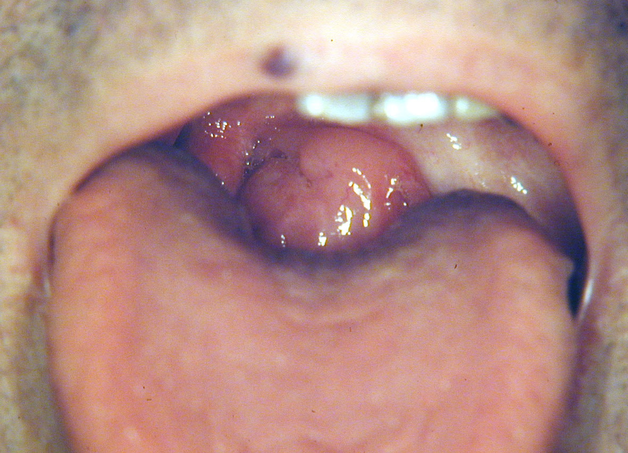

Slide 21
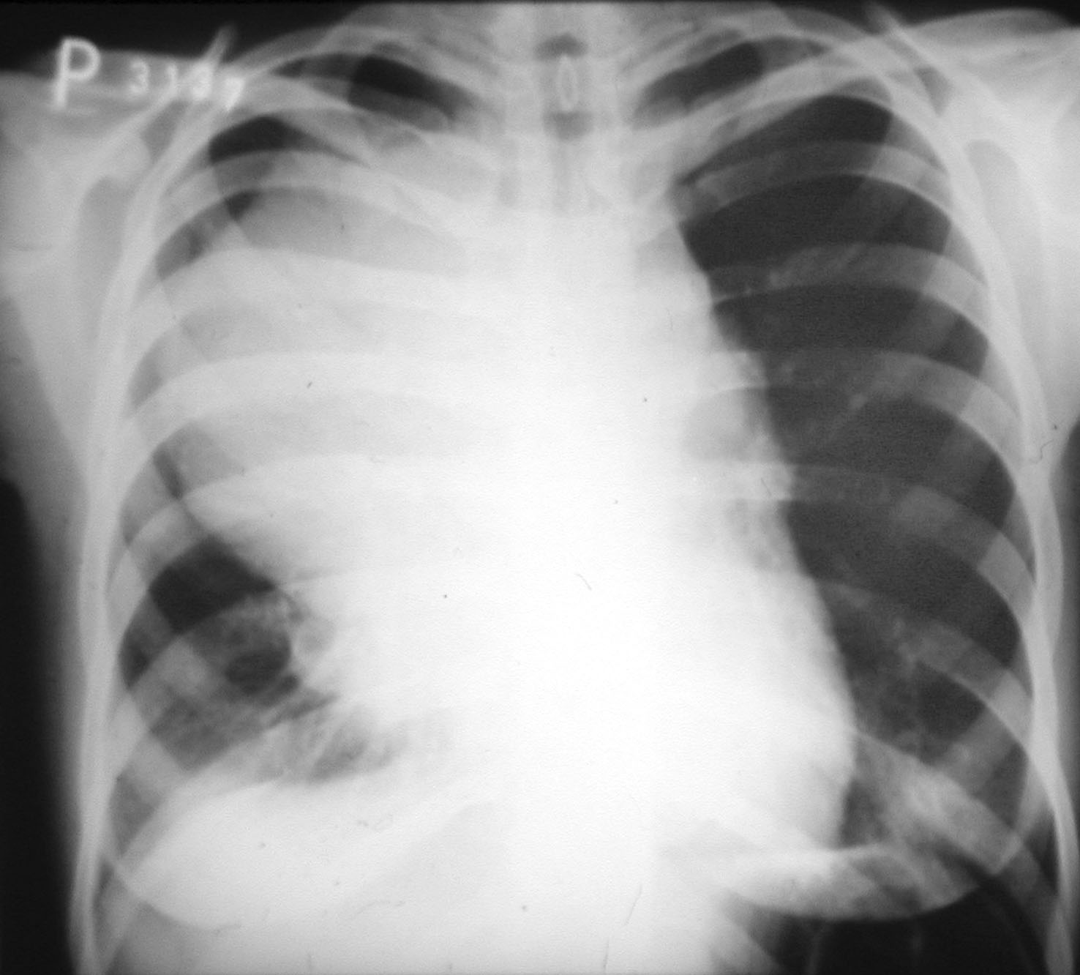

Slide 22
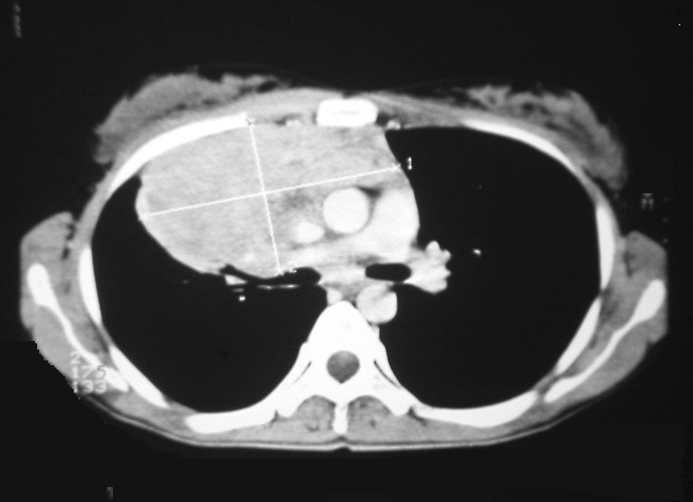

Slide 23
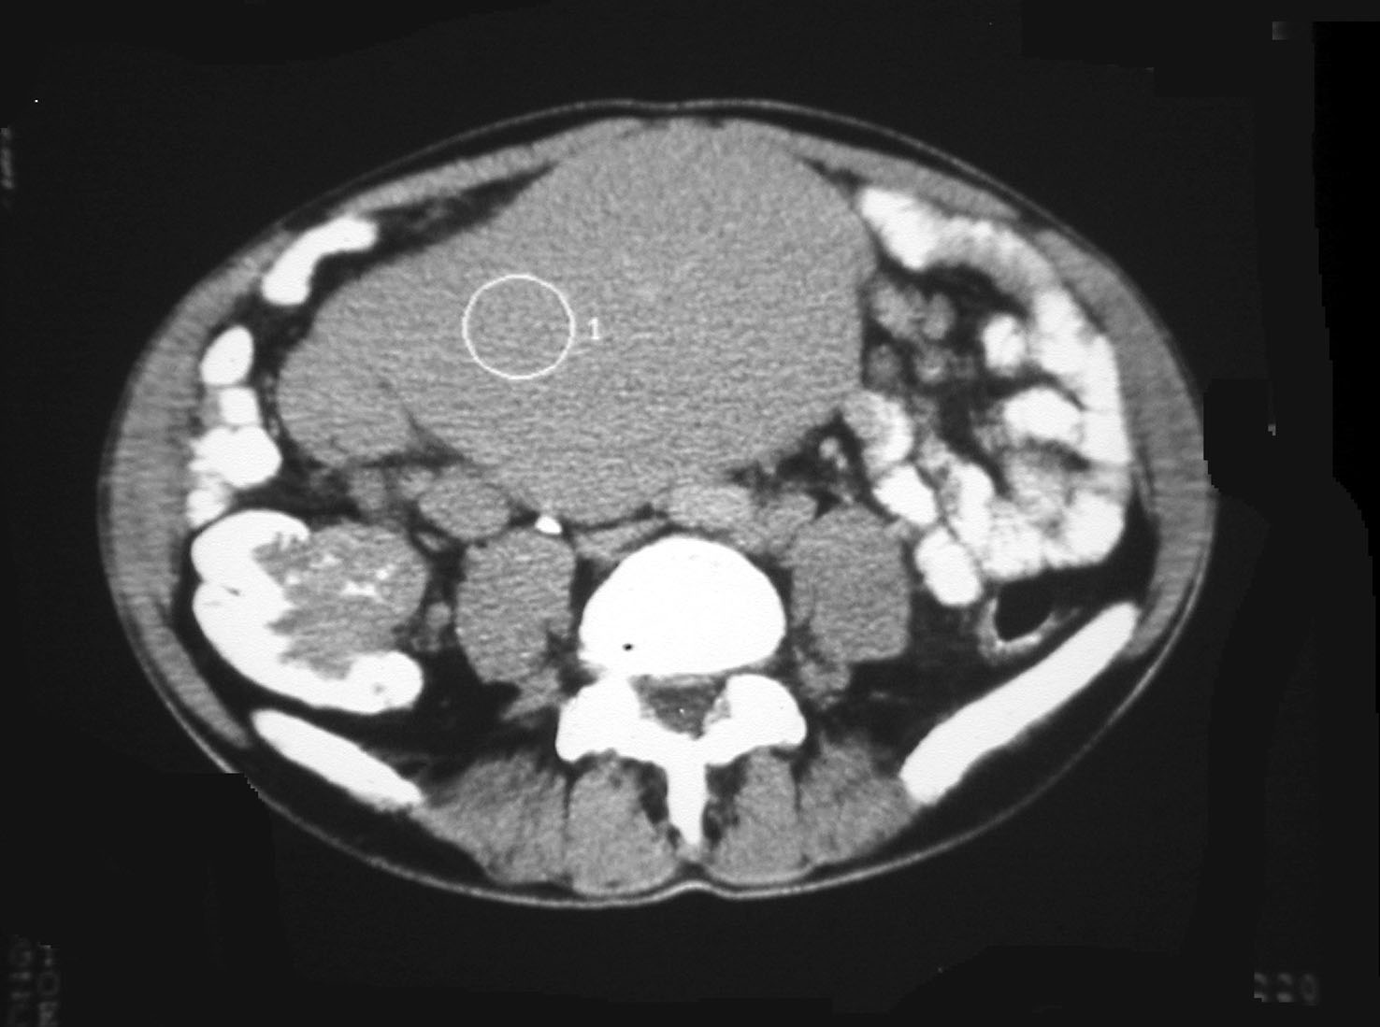

Slide 24
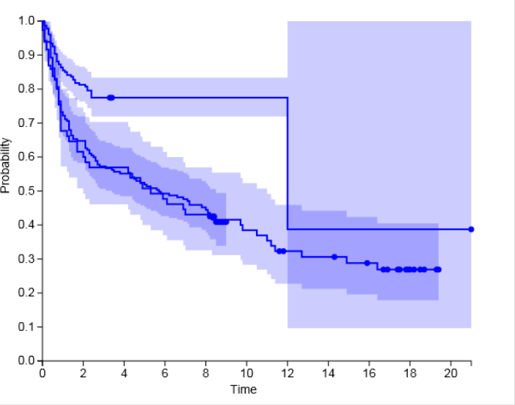
OVERALL SURVIVAL OF NHL PATIENTS (NIHIL; CLSG)
NHL dg 2015
NHL dg 2009
NHL dg 1999

Slide 25
PROGNOSIS OF THE PATIENT
WITH LYMPHOMA IS BASED ON:
Histology
Performance status according to ECOG/WHO
Laboratory examination
Physical examination, imaging (CT, MRI, US±PET)
Bone marrow examination (trephine biopsy)
Extent of disease = clinical stage

Slide 26
STAGING -
ANN ARBOR CLASSIFICATON
(modified)^{1,2,3}
Stage I | Involvement of 1 lymph nodes (LU) group or 1 extralymfatic organ (EN) (IE)
Stage II | Involvement 2 or more LN regions on the same side of diaphragma or LOCALISED involvement of 1 EN organ (IIE) including lymph node involvement of 1 or more groups LN on the same side of diaphragma
Stage III | Involvement of LN or lymphatic organs (spleen, Waldayer circle) on both side of diaphragma, which can be accompanied with LOCALISED involvement of 1 EN organ (IIIE)
Stage IV | Difuse or diseminated involvement of 1 or more EN organs or tissues with or without LN involvement
¹Carbone PP, Kaplan HS, Musshoff K, et al. Report of the Committee on Hodgkin’s Disease Staging Classification. Cancer
Res 1971; 31(11):1860-61.
²Rosenberg SA. Report of the committee on the staging of Hodgkin’s disease. Cancer Res 1966; 26: 1310.
³Lister TA, Crowther D, Sutcliffe SB, et al. Report of a commitee convened to discuss the evaluation and staging of
patients with Hodgkin’s disease: Cotswolds Meeting. J Clin Oncol 1989; 7(11):1630-36.

Slide 27
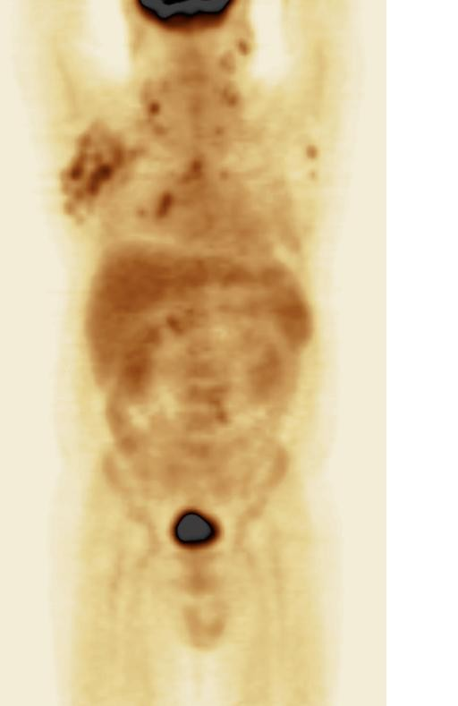
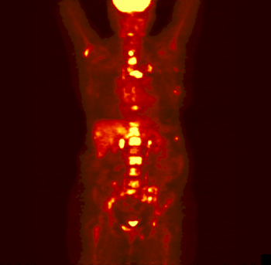
FDG-PET (¹⁸Fluordeoxyglucose -positrone emission tomography)

Slide 28

FDG-PET – what can we really see???
PET image/scan
REALITY

Slide 29
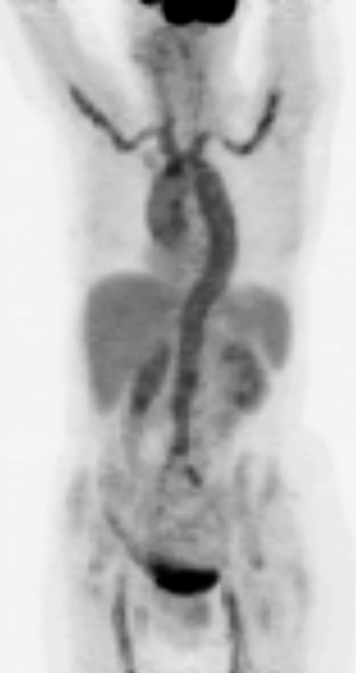
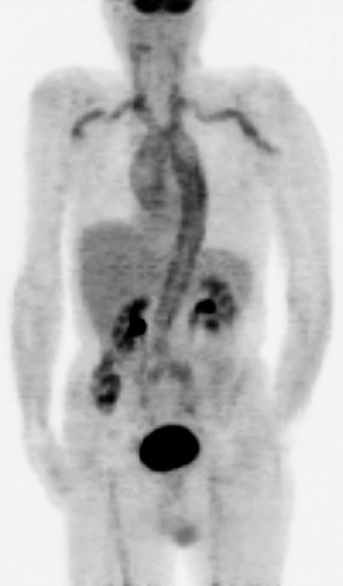
PET is sensitive but not specific for tumor!
Fever of unknown origin – vasculitis proven by FDG-PET

Slide 30
WHY IS IMPORTANT TO KNOW STAGE
OF THE LYMPHOMA?
Limited stage I and II
Advanced stage III a IV
vs.
TREATMENT STRATEGY (I+II vs III+IV stage) IS
SIGNIFICANTLY DIFFERENT
IN ALL LYMPHOMA SUBTYPES!

Slide 31
BASIC INFORMATION ABOUT HISTOLOGICAL CATEGORIES

Slide 32
LYMPHOPROLIFERATIONS = malignancies from lymphoid tissue
LYMPHOMAS
  Morbus Hodgkin (Hodgkin´s lymphogranuloma) ~30%
    Classical (~95%)
    Nodular lymphocyte predominant
  NonHodgkin´s lymphomas (NHL) ~70%
    B-NHL (~90%)
    T-NHL (~10%)
LYMPHATIC LEUKEMIAS
  B-line: B-CLL, Hairy cell, prolymphocytic leukemia
  T-line: T-prolymphocytic leukemia, T-LGL, adult T-cell leukemia
MULTIPLE MYELOMA

Slide 33
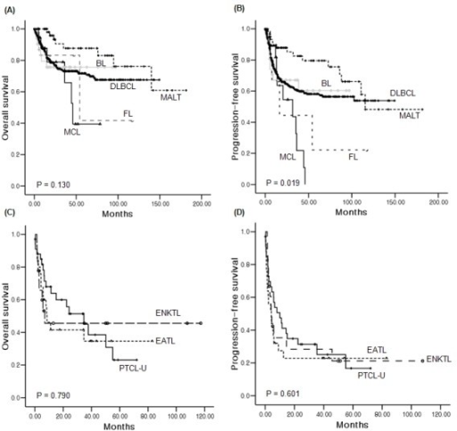
Survival according lymphoma subtype
MCL – mantle cell lymphoma
BL – Burkitt lymphoma
DLBCL- diffuse large B-cell lymphoma
FL –follicular lymphoma
MALT- mucosa associated lymphoma tissue lymphoma
ENKTL –extranodal NK/T lymphoma
EATL- enteropathy associated lymphoma
PTCL U –peripheral T-cell lymphoma (unspecified)

Slide 34
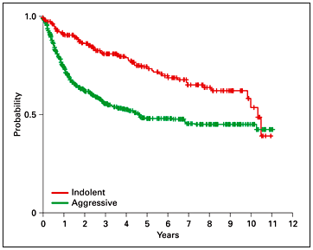
Malignant lymphoproliferative diseases
about 50 units (recent WHO 2008 classification)
from practical point of view two subgroups:
Low agressive (indolent) – slow growth, remission possible but usually incurable = start of treatment if symptoms are present
Agressive, high aggressive - rapid progression, BUT several categories potentially curable, start of treatment the earliest possible

Slide 35
LOW GRADE LYMPHOPROLIFERATIONS
B - line
T- line
Lymphoplasmacytic lymphoma
Hairy-cell leukemia
Chronic lymphatic leukemia (CLL) Small lymphocytic lymphoma (SLL/CLL)
Follicular lymphoma
Marginal zone lymphomas
T-cell large granular lymphocytic leukemia (LGL)
NK chronic lymphoproliferation
Mycosis fungoides/ Sézary syndrom
T- cell lymphatic leukemia/lymphoma
Primary cutaneous T-cell lymphoma (CD30+)

Slide 36
LOW GRADE LYMPHOMAS
– basic characteristicsand principles
Overall survival even without treatment in years
to 10 ys
Radiotherapy indicated and with curative effect in
limited extent (stage I or II)
Advanced stages (III/IV) are generally incurable,
chemotherapy-based (CHT) indicated and induces
remission, BUT relapses are the rule
Curative therapy has to be started immediatelly
Non-curative treatment (CHT) initiated in symptomatic
patients only

Slide 37
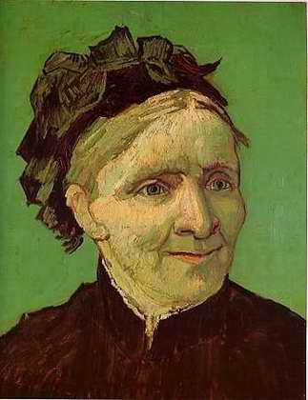
FOLLICULAR LYMPHOMA clinical behavior
Slow growing (sometimes vanishing) painless lymphadenopathy with relapsing course after treatment, spontaneous remissions are not exception, with or without general symptoms
Global median overall survival >18 years (Horning, JCO 2008),
BUT 20% dies during 2 years since diagnosis established
FL is considered incurable with exception of localised (limited stages I/II) which is relevant for 10-15% patients only
Cause of death – treatment toxicity and transformation (~25-60%) to more aggressive NHL

Slide 38
Follicular Lymphoma –
Principles of Therapy
PRIMARY THERAPY (first line)
Localised FL (stage I+II): IF RT 24Gy
Advanced FL (stage III+IV):
  /large tumor/: antiCD20+ chemotherapy + antiCD20 maintenance (2ys)
  /low tumor/: watch and wait
THERAPY OF RELAPSE
Chemotherapy ± antiCD20 maintenance
High-dose chemotherapy + autologous stem cell support
Allogeneic bone marrow transplantation
Radioimmunotherapy
Radiotherapy even very low dose (~4Gy!!!)

Slide 39
Anti-CD20 antibody therapies have changed the course of FL
100
CHOP + antibody*
80
ProMACE
60
Overall survival (%)
40
CHOP
20
p < 0.001
0
0
2
4
6
8
10
Time (years)
ProMACE: prednisone, methotrexate, doxorubicin, cyclophosphamide, etoposide
* SWOG 9911: CHOP + ¹³¹I-tositumomab;
SWOG 9800: CHOP + MabThera
OS = overall survival
1. Fisher RI, et al. J Clin Oncol 2005; 23:8447–8452.

Slide 40
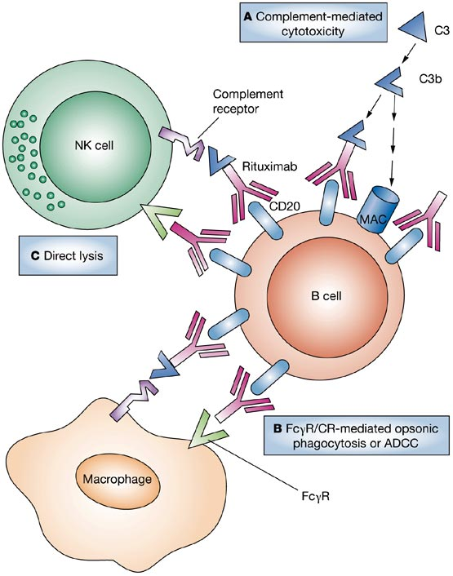
Anti CD20 monoclonal antibody
Rituximab – Mabthera®, Rituxan®
Chimeric humanized IgG1 type
CD20 receptor present on surface
of nearly all B-lymphoid cells
including malignant lymphocytes
Approved for clinical practice (FDA) in 1997
R is standard component of
treatment of CD20+lymphoma
Favourable efficacy/toxicity ratio
Mechanism of action
  CDC (complement dependent cytolysis)
  ADCC (antibody dependent cytotoxicity)
  Apoptosis induction
  Direct antiproliferative effect

Slide 41
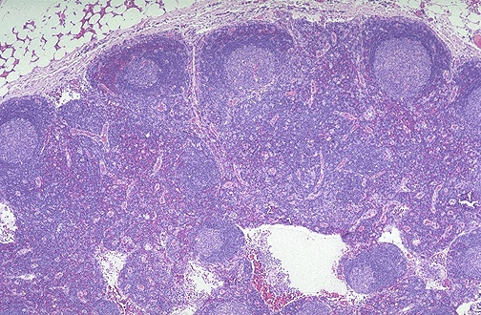
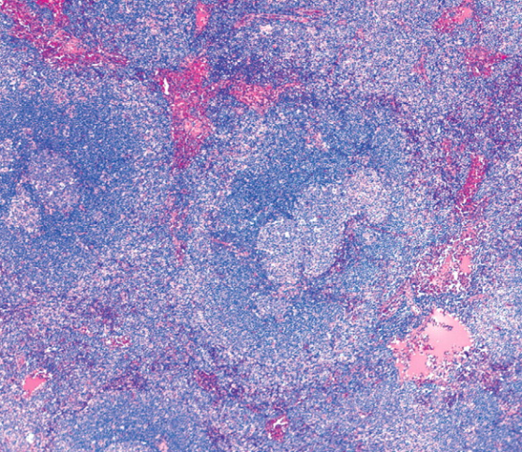
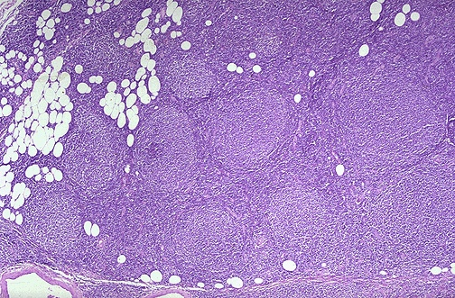
MARGINAL ZONE LYMPHOMAS (MZL)
Nodal – very similar to FL or SLL
Splenic with/without vilous lymphocytes
  Splenomegaly leading symptom
  Treatment options: splenectomy
        rituximab monotherapy
Extranodal (MALT)
LYMPHADENITIS MZL FOLLICULAR LYMPHOMA

Slide 42
MARGINAL ZONE LYMPHOMAS (MZL)
MALT – Mucosa associated lymphatic tissuse lymphoma
Etiology: antigen stimulation (H.pylori, Borellia, Chlamydia, HCV…)
Dominating MALT-lymphomas of stomach
Symptoms: „gastric ulceration“ (reccurent or non-healing)

Slide 43
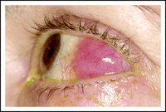
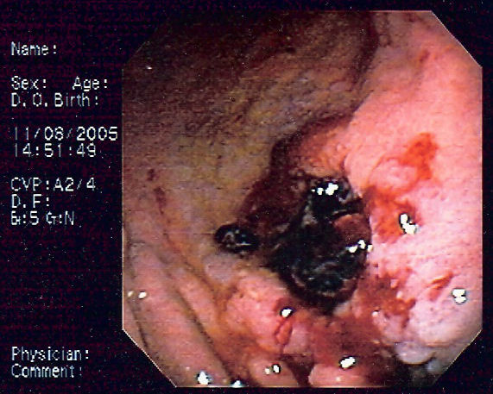
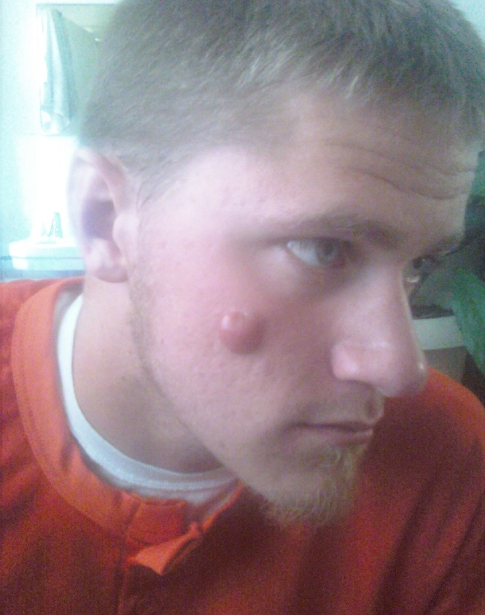
MALT- lymphomas (examples)
CAVE: gastric MALT or DLBCL
are second most frequent tumor
of stomach BUT with excelent curability!!!

Slide 44
MALT- lymphomas treatment principles
Limited stage (I and II)
Antibiotics, curative radiotherapy (30Gy)
Generalized stage (III and IV)
treatment like in FL (RCOP/RCHOP)
IN STAGING IS SPECIFIC:
Multiple biopsy of mucosa (even normally looking)
Helicobacter pylori must be ALWAYS examined

Slide 45
AGGRESSIVE LYMPHOMAS
B line
T line
Prolymphocytic B-cell leukemia
Multiple myeloma
Mantle cell lymphoma
Follicular lymphoma (grade III),
Diffuse large B-cell lymphoma
Primary mediastinal large B-cell lymphoma
Burkitt lymphoma
Prolymphocytic T-cell leukemia
Peripheral T-cell lymphoma
Angioimunoblastic lymphoma
Angiocentric lymphoma
Intestinal T-cell lymphoma
Anaplastic large T-cell lymphoma
Hepatosplenic γδ lymphoma
Panicullitis like T-cell lymphoma
Some units are curative
Rapid progression with short history
Treatment indicated immediatelly

Slide 46
DIFFUSE LARGE B-CELL LYMPHOMA
An aggressive subtype of lymphoma that typically originates in lymphoid tissues
The largest subtype of NHL (~ 35%) with about 100,000 new cases per year worldwide
Clinically and biologically a heterogeneous disease with recent data documenting at least 2 distinct subtypes
Clinical course is characterized by aggressive, rapid progression and symptoms
50% long term cure with current standard therapy
46

Slide 47
DIFFUSE LARGE B-CELL LYMPHOMA
Several morphological variants: centroblastic, immunoblastic, anaplastic
Several subtypes according to WHO 2008
  DLBCL
  Primary mediastinal DLBCL
  Plasmablastic lymphoma
  EBV associated DLBCL in elderly
  Primary DLBCL of CNS
  T-cell histiocyte rich
  Primary cutaneous leg-type
  ALK+ anaplastický DLBCL
  DLBCL associated with chronic inflamation
  Intravascular DLBCL
  Primary effusion lymphoma
  HHV8 associated DLBCL
47

Slide 48
Borderline DLBCL
provisional entitty to avoid contamination of „clasical
cases of DLBCL or BL
high-grade B-lymphoma between BL and DLBCL
double hit lymphoma (bcl2+ cmyc)
childhood DLBCLwith cmyc
BL lacking cmyc
Gray zone lymphoma
mediastinal lymphoma
two morfological and immunophenotype feature
B-cell transcriptional programme (BOB1, PAX5, OCT2)
activation programme: CD30+ CD15

Slide 49
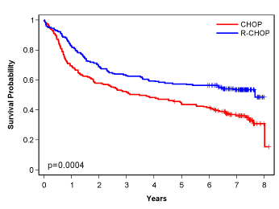
DLBCL – the global standard care
CHOP (Cyclophosphamide, Doxorubicin, Vincristine, Prednisolone) was developed empirically over ~ 30 years ago
Doxorubicin & Cyclophosphamide are considered to be essential drugs in high grade lymphomas
R-CHOP is current global standard treatment with significant improvement in PFS and overall survival
100
80
60
40
20
0
CHOP
MACOP-B
ProMACE-CytaBOM
m-BACOD
Overall survival (%)
0 5 10 15
Patients over 60 (LNH98-5) 2002
49
Notes:
49
49

Slide 50
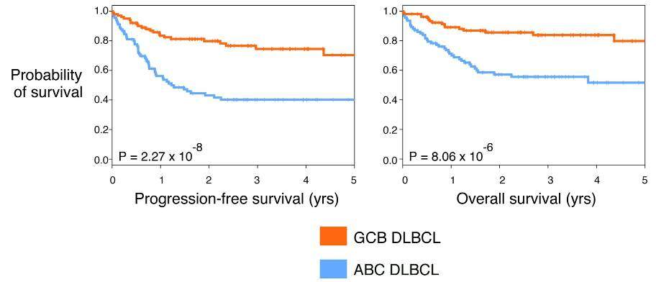
DLBCL – molecular classification
DLBCL
~50%
~10%
~40%
1. Alizadeh et al, Nature 2000
2. Davis et al, Exp Med 2001
3. Rosenwald et al, NEJM 2002
4. Hans et al, Blood 2004
5. Ngo et al, Nature 2006
6. Lenz et al, J Clin Oncol 2007
GCB
Type 3
non-GCB (ABC)
Lenz et al, 2008
50
Notes:
50
50

Slide 51
DLBCL – pathogenesis
GC-DLBCL (germinal center) phenotype
  Bcl2, c-myc
  Rare mutation in BCR subunits
nonGC (ABC=activated B-cell) phenotype
  CARD11, BCL10, MALT1, NF-кB
  mutation in BCR receptor subunits (CD79a/CD79b)
51
Notes:
51
51

Slide 52
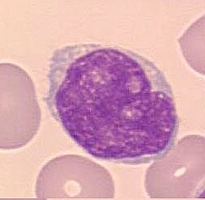
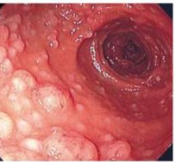
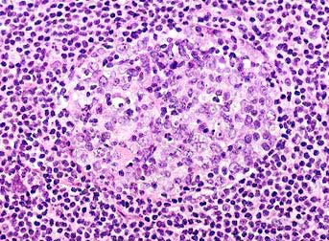
MANTLE CELL LYMPHOMA
mantle cell lymphoma = lymphoma from „mantle cells“ of lymphatic follicle, CD20+
Defined as a nosological unit since1992
6-8 % of all Nonhodgkins´s lymphomas
Typically in older men
Frequent extranodal involvement (>80%cases)
  Blood, bone marrow
  Gut (multiple lymphomatpus polyposis)
CD5+10-19+20+23-79b+sIgDM+sλ+
Diagnosis of MCL can be made by flow from blood and/or bone marrow!

Slide 53

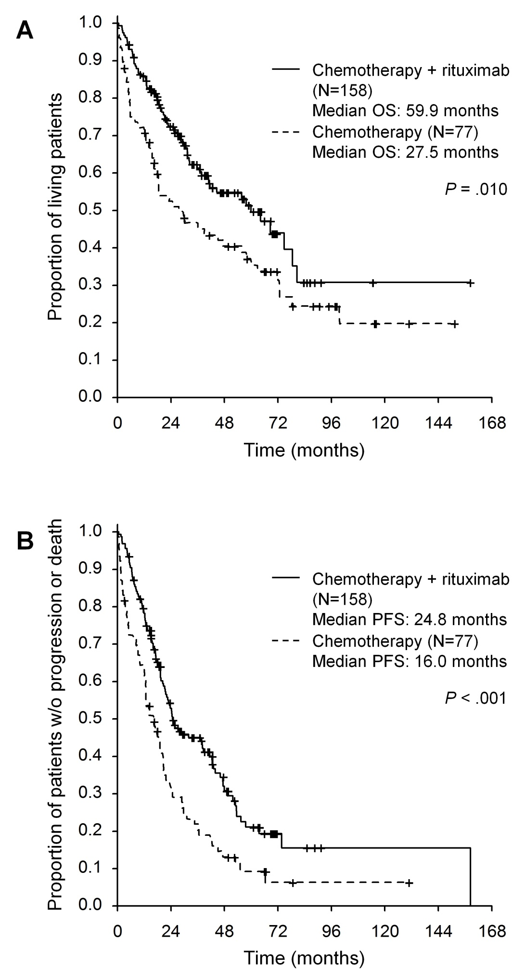
Prognosis of MCL
(Czech Lymphoma Database)
Prognosis is poor
New drugs are needed
Chemotherapy has
limited efficacy
Targeted therapy
Molecular pathogenesis
t(11;14) is hallmark
cyclinD1 overexpression

Slide 54
Gene instability/
Chromatin interaction/
enzymes modified histones
Degradation
P
p27
Cyklin D1
Cyklin D1
Cyklin E
DNA damage
CDK4/6
CDK2
ATM
E2F
P
ATM mutation
P
RB1
P
RB1
p53
E2F
transition from G1 to S phase of cell cycle

Slide 55
MCL- treatment
intensive chemotherapy is recommended
R-MaxiCHOP/high dose Arac/ high dose BEAM
transplantation therapy is indicated in younger
patients
majority of MCL patients not able to receive
intensive treament
new „smart“ drugs (biological agens) focused on
BCR signaling are efficace
Ibrutinib, bortezomib, temsirolimus +/- rituximab

Slide 56
B-CELL RECEPTOR (BCR) SIGNALING
CAL101; idelalisib

Slide 57
BCR signaling
Active BCR signaling
Antigen driven
BCR immobile clusters
activation of downstream pathways NF-кB, PI3, MAPkinase
NF-кB activated by BTK
ABC-DLBCL (BTK inhibitor)
Tonic BCR signaling
- antigen independent, necessary for B-cell survival
BCR freely mobile
namely PI3 pathway
Burkitt lymphoma

Slide 58
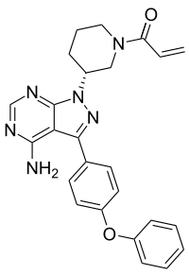
IBRUTINIB
Ireversibil inhibitor of Bruton´s tyrosinkinase (BTK)
Inhibition of autophosphorylation and phosphorylation by physiological substrate, blocage of phosforylation of PLCγ, ERK (extracelluar signal-regulated kinase),PI3K, NF-κB…
Proliferation inhibition, triggering of apoptosis
Increase resistance to microenvironment signals

Slide 59
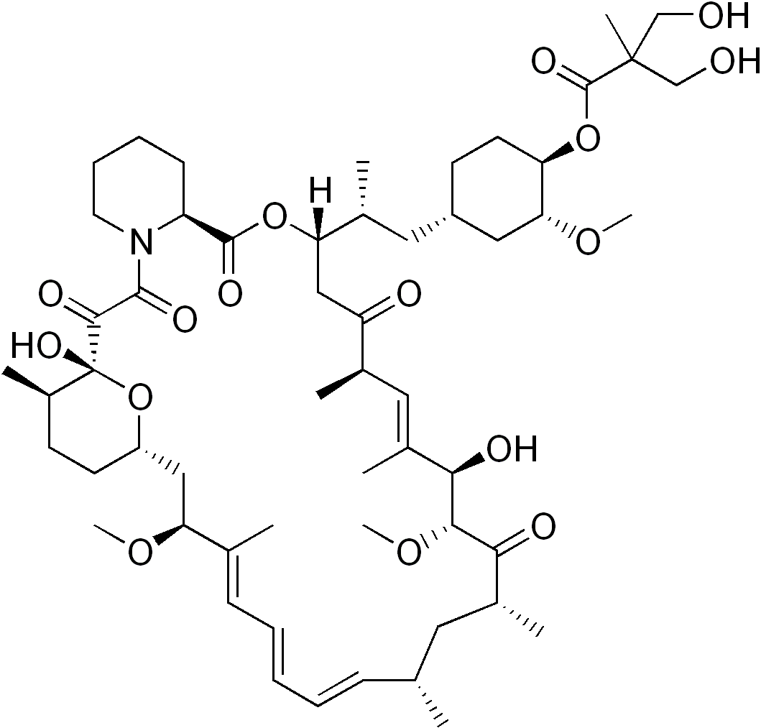
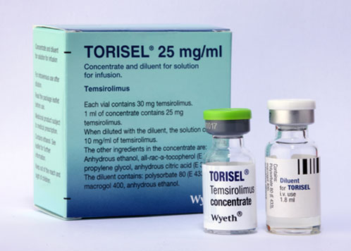
TEMSIROLIMUS
(Torisel®)
Selective inhibitor mTOR –
protein kinase (mamalian target of rapamycin)
Inhibition mTOR→ cell cycle arrest in G1 and angiogenesis (VEGF)
PI3Kinase/Akt/mTOR pathway
  konst. active in MCL

Slide 60
BURKITT LYMPHOMA
Very rapidly growing; aggressive; high-grade B-cell lymphoma
Rare disease in central Europe
  Endemic (Africa, young boys, jaw or facial mass, EBV associated)
  Sporadic (any age, abdominal mass)
  Epidemic (immunodeficiency associated)
Different behavior compared to DLBCL
Abdominal symptomatology (intususception, appendicitis-like)
BM and CNS involvement in 30% of cases
Tumor lysis syndrome (!)
CR 80%, long-term survival 50%

Slide 61
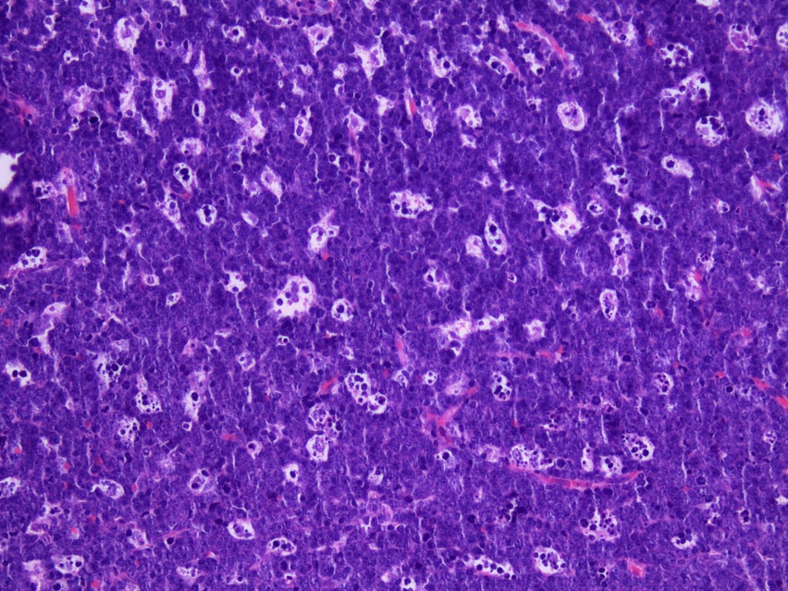
BURKITT LYMPHOMA
„Starry sky“ morphology (medium-sized lymphocytes)
WHO recognizes:
  Burkitt lymphoma with plasmacytoid differentiation
  Atypical Burkitt/Birkitt-like lymphoma
  Phenotype: CD10+, bcl6+, bcl2-, CD20+, sIgM+, Ki67≥95%
t(8;14) ~80% pts
c-myc translocation
Therapy: intensive chemotherapy
Magrath protocol: R-CODOX-M/R-IVAC
  (MTX+ CHOP; high dose AraC + IFO)

Slide 62
PRIMARY CNS LYMPHOMA
Rare type of aggresive lymphoma; about 4% of CNS tumours and about 4-6% of all extranodal lymphoma (1% of all lymphoma)
Localization: most common in hemispheras (38%), thalamus and basal gangliae (16%), c.calosum (14%)
Median age 60-65 ys
Belong to lymphomas with the worst prognosis
(5-year OS 30-50%)
Histologically: DLBCL in 95% cases

Slide 63
PRIMARY CNS LYMPHOMA
Symptoms: neurological deficits, epi-paroxysms, amention, lethargy
Diagnosis: MRI (typical pattern)+ stereotactic biopsy
Corticoids given in antiedematic setting can completely destroy tissue for histological evaluation!!!!
Treatment: cytostatics must have sufficient level in CSF
- high-dose MTX (3g/m2) and AraC (2g/m2) +
whole brain radiotherapy (24-36Gy)

Slide 64
T-CELL LYMPHOMAS
  Nodal
    PTCL –NOS peripheral T-cell lymphoma not otherwise specified (25%)
    ALCL anaplastic large cell lymphoma (12%)
    AITL angioimunoblastic lymphoma (19%)
  Extranodal (tissue tropism)
    Hepatosplenic γδ lymphoma (1.4%)
    Enteropathy associated T-lymphoma (EATL) (5%)
    Panniculitis-like T-cell lymphoma (0.9%)
  Leukemic
    Adult T-cell leukemia, LGL-leukemia, NK-cell leukemia, T-prolymphocytic leukemia

Slide 65
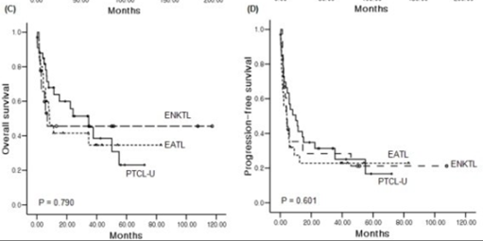
T-CELL LYMPHOMA -prognosis
Non-cutaneous T-lymphoma have very poor prognosis
  Heterogeneity of units
  Too smal populations for clinical trials
  Treatment used in B-cell lymphoma is unsuficient

Slide 66
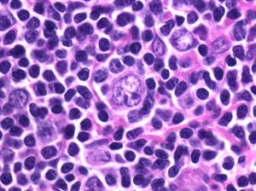
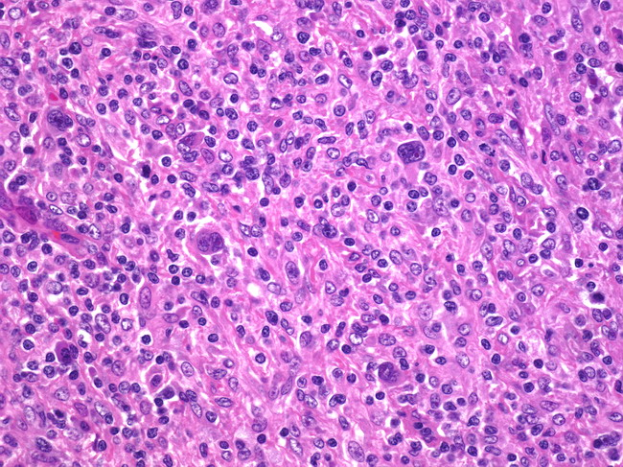
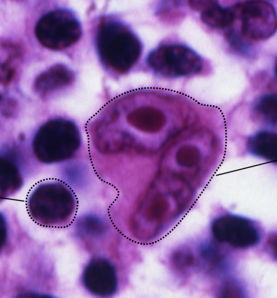
HODGKIN´S LYMPHOMAS
CLASSICAL M.H.
  CD30+, CD15+
  Reed-Sternberg cc.
  Nodular sclerosis
  Mixed cellularity
  Lymphocyte-rich
  Lymphocyte-depleted
NODULAR LYMPHOCYTE PREDOMINANT
  CD20+
  „popcorn“ cells

Slide 67
HODGKIN´S LYMPHOMAS
BASIC
Pathological Hodgkin´s cells (HRS) are derived from B-lymphocytes
Peaks of incidence around 20 and 60 ys
Hodgkin´s lymphomas account for 30% of all lymphomas
Highly curable disease
SYMPTOMS
Lymphadenopathy with/without systemic symptoms:
Fever
Weight loss
Itching
Alcohol-related pain (LN)

Slide 68
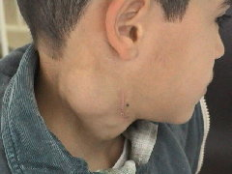
HODGKIN´S LYMPHOMAS – treatment strategy
Localised M.H.
2 x cycle of chemotherapy ABVD
+ IF RT 20Gy
Intermediate M.H.
2xABVD + 2x BEACOPP escalated
+ IF RT 30Gy
Advanced M.H.
6 cycles BEACOPP escalated

Slide 69
M.Hodgkin - Treatment results (DHG 2001)
Effect | COPP/ ABVD | BEACOP basal | BEACOP escalated
Complete remission | 84 % | 88 % | 96 %
Progression | 12 % | 8 % | 2%
3-ys symptom free survival | 72 % | 80 % | 92 %
3-ys Overall survival | 86 % | 91 % | 92 %

Slide 70
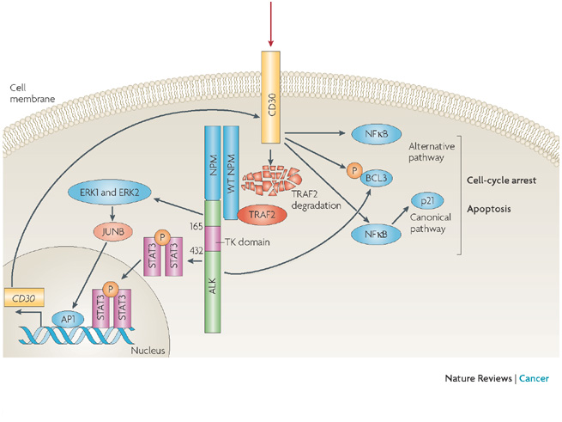
CD30 signal pathway
CD30 is expressed
  on RS-cells of M.Hodgkin, ALCL, and on primary cutaneous T-lymphomas
  Anti CD30 alone is not suficiently efficace!

Slide 71
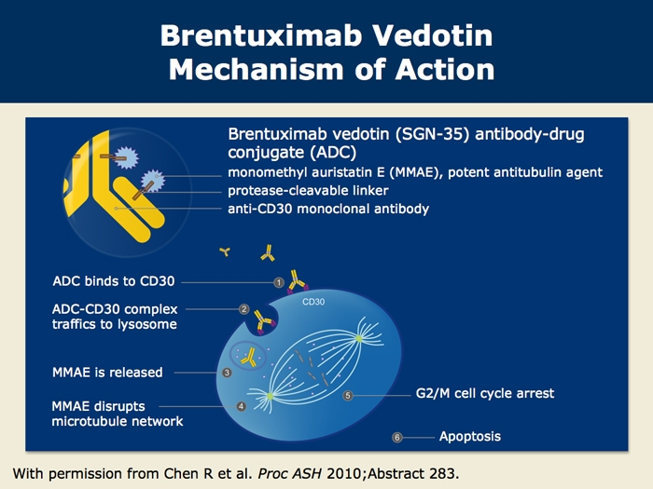

Slide 72
Long-term problems related to treatment of Hodgkin´s disease
Increased incidence of secondary malignancies
Damage of gonadal functions (sterility)
Long-term adverse events (toxicity) cardiomyopathy, lung fibrosis, myelodysplastic syndrome

Slide 73
MULTIPLE MYELOMA - SYMPTOMS
Clonal expansion of malignant plasmocyte-derived cells
- local infiltration of bone marrow and bones
- production of monoclonal Ig
Disease damaging (really multiple):
Bones (pains, fractures)
Kidneys (renal failure, nefrotic syndrome)
Peripheral nerves
Etc…..

Slide 74
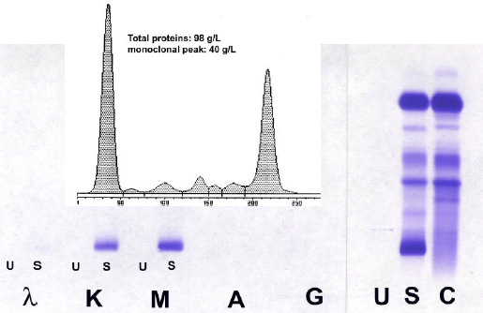
Immunofixation and electrophoresis with densitometry (quantification) of monoclonal immunoglobuline

Slide 75
Clinical symptoms of myeloma cells
Cytokins
inducing osteolysis
Monoclonal Ig:
total molecule
Light chains only!
Osteolytic lesions,
or
diffuse osteoporosis
or
both
Nephropathy
Neuropathy
neuropatic pains
hypo- i hypercoagulopathy
amyloidosis, cold aglutinins
Bone pains
Cytopenias
B and T immunosupression

Slide 76
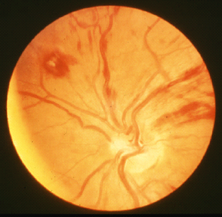
Fundus paraproteinemicus

Slide 77
MM criteria acc. Durie and Salmon, 1975
Big criteria | Small criteria
Plasmocytoma (histology) Plasmocytes in BM > 30 % 3) M-IgG > 35 g/l, IgA > 20 g/l or light chains in urine > 1g/24h | 10 – 30 % plasmocytes in BM M-Ig fewer than under point 3 Osteolytic lesions Decreased levels of normal Igs: IgM < 0,5 IgA < 1,0 a IgG < 6,0 g/l

Slide 78
MULTIPLE MYELOMA
Criteria IMWG 2003
Monoclonal plasmocytes >10 % biopsy proven plasmocytoma
Monoclonal Ig present in blood and urine
At least dysfunction of one organ
C – Calcium > 2,8 mmol/l
R - Renal insuficiency (creatinin >176,8 umol/l)
A – Anemia
B – Bone osteolysis

Slide 79
Characteristics of tumor pain
Intermitent pain usually back bone
Permanent pain
Episodic worsening of chronic permanent pain
Extremly strong pain during common daily activity:
turning over in bed
during walk
during cough

Slide 80
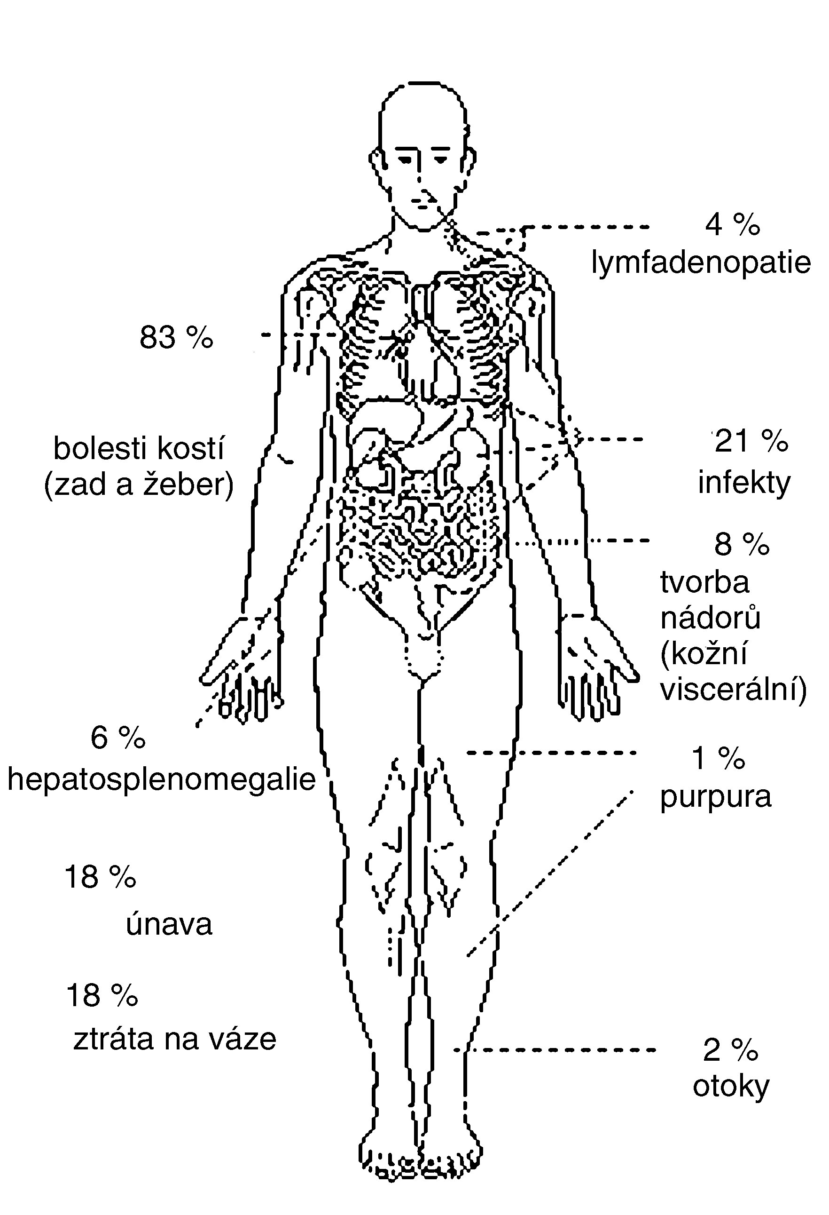
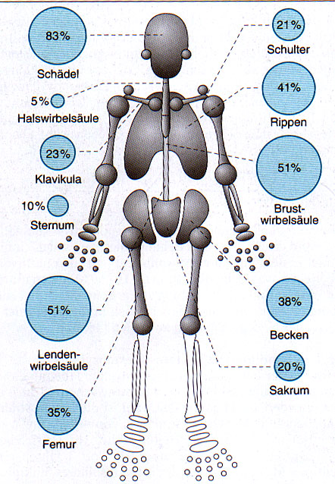
Symptoms of multiple myeloma

Slide 81


Slide 82


Slide 83



Slide 84


obr.3
obr.4
CT vyšetření:osteolytická ložiska sterna s okrajovou usurací kortikalis
MR vyšetření: patrna nádorová aktivita a infiltrace celého sterna

Slide 85
Diferencial diagnostics of back bone pain
Lumbago without any radicular iritation
Back bone pain with radicular iritation
Night back bone pains
Rapidly worsening pains
Osteoporosis and back bone pains
1 month of standard treatment
Laboratory and imaging examination

Slide 86


Patient v remission of multiple myeloma with rapidly worsening of back bone pain irradiating into both legs with muscle atrophy. What´s the cause?
X-ray of back bone with no susbstantial pathology explaining the troubles.

Slide 87

MRI: Extramedular expansion in L3 and Th8
Nelze

Slide 88


FDG-PET: is able to show bone and extrabone myeloma lesions

Slide 89

Can monoclonal Ig cause renal failure requiring hemodialysis?

Slide 90

Leg oedema in nephrotic syndrome

Slide 91
Multiple myeloma - therapy
Conventional chemotherapy – median 3– 4ys
High dose chemotherapy with autologous stem cell transplantation
  prolongs median +1,5 y
  increases priportion of patients surviving more than 5ys
  is a standard procedure for pacients in good condition younger than 65ys
New drugs used in clinical standard care: Thalidomid, bortezomib

Slide 92
Proteasome inhibition
Stabilisation:
  CDK inhibitors (p21, P27) ≈ decreasing of proliferation
  P53 ≈ apoptosis increasing
  Proapoptotic proteins (BAX, BID, BAK) ≈ apoptosis increasing
Increased inhibition of NFкB
≈ apoptosis increasing
≈ proliferation decrease
≈ angiogenesis decrease

Slide 93
E2
substrát
UB
substrát
E3
Poly - Ubi
substrát
bortezomib
Proteazom 26S
Beta řetězce

Slide 94
Multiple myeloma – supportive care
Bisfosfonates
Hemodialsis
Plazmapheresis
Antiinfective therapy, Ig substitution
Anaemia therapy
Radiotherapy
Analgetic therapy

Slide 95
Primary AL amyloidosis
Deposits of light chains generally or in selected organs according to „tropism“ of these proteins
Patients are diagnosed in very advanced stage of disease (heart failure)
Treatment can remove amyloid deposits, but time is needed (≈ 6 months at least)

Slide 96


Slide 97


Slide 98


Changes of tongue

Slide 99


